Slide 1
Chapter 04 Lecture Outline
See separate PowerPoint slides for all figures and tables pre-inserted into PowerPoint without notes.

Slide 2
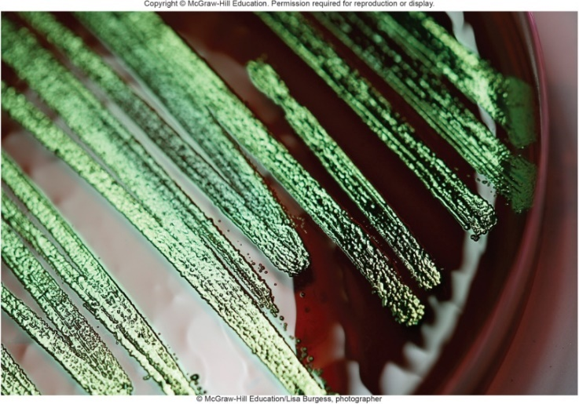
A Glimpse of History
German physician Robert Koch (1843 to 1910)
Studied disease-causing bacteria; Nobel Prize
Developed methods of cultivating bacteria
Worked on methods to allow single bacteria to grow and form colonies
Tried potatoes, but nutrients limiting for many bacteria
Solidifying liquid nutrient media with gelatin helped
Limitations: melting temperature, digestible
In 1882, Fannie Hess, wife of associate, suggested agar she used to harden jelly
© McGraw-Hill Education/Lisa Burgess, photographer

Slide 3
Introduction
Microorganisms found in severe conditions
Ocean depths, volcanic vents, polar regions all harbor thriving microbial species
Many scientists believe that if life exists on other planets, it may resemble these organisms
Each species grows under limited set of environmental conditions, including specific nutrients
Important to grow microbes in culture
Medical significance
Nutritional, industrial uses

Slide 4
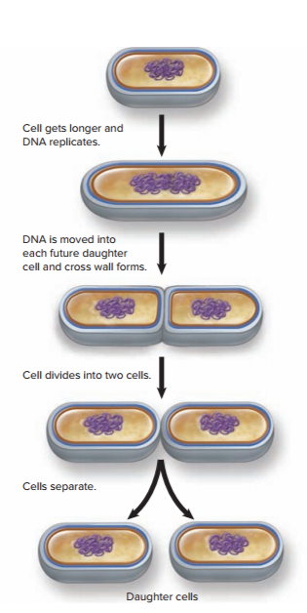
Principles of Microbial Growth - Figure 4.1
Prokaryotic cells divide by binary fission
One cell divides into two, two into four, 4→8, 8→16, etc…
Exponential growth: population doubles each division
Generation time is time it takes for the population to double
Varies among species
Environmental conditions
Microbial growth is defined as an increase in the number of cells in a population

Slide 5
Principles of Microbial Growth
Growth can be calculated
N_{t} = number of cells in population at time t
N₀ = initial number of cells
n = number of generations at that point
Example: pathogen in potato salad at picnic in sun
Assume 10 cells with 20 minute generation time
N₀ = 10 cells in original population
n = 12 (3 divisions per hour for 4 hours)
N_{t} = 10 × 4,096
N_{t} = 40,960 cells of pathogen in 4 hours
Notes:
5

Slide 6
Table 4.1 Example of Exponential Growth
Rapid generation time with optimal conditions can yield huge populations quickly

Slide 7
Microbial Growth in Nature
Microorganisms historically studied in laboratory
Changing, complex conditions in nature differ greatly from laboratory conditions
Profound effect on microbial growth, behavior
Cells adjust to changes in surroundings by sensing various chemicals
Produce materials appropriate for the situation

Slide 8
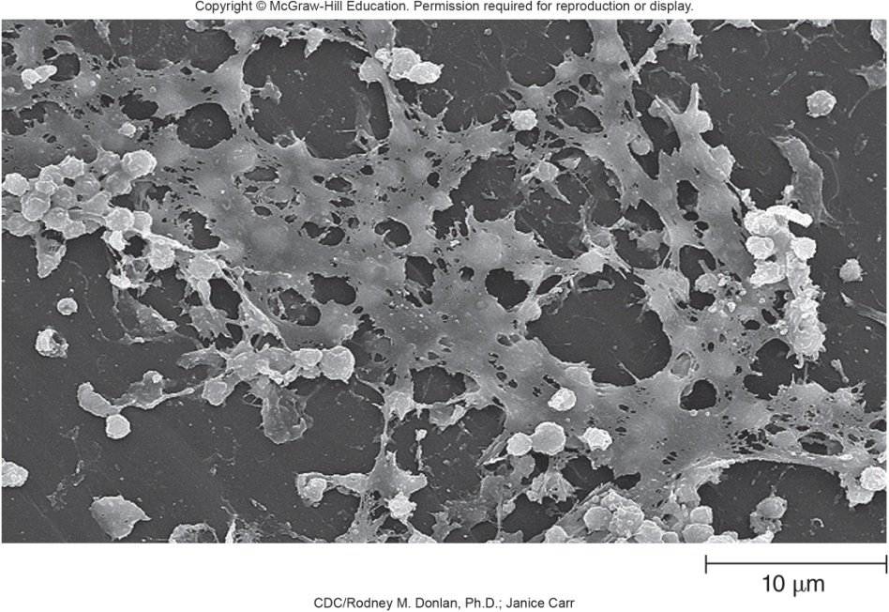
Microbial Growth in Nature - Figure 4.2
Most attach to surfaces and live in polymer-encased communities termed biofilms
Cause slipperiness of rocks in stream bed, slimy “gunk” in sink drains, scum in toilet bowls, dental plaque
CDC/Rodney M. Donlan, Ph.D.; Janice Carr
Notes:
8

Slide 9
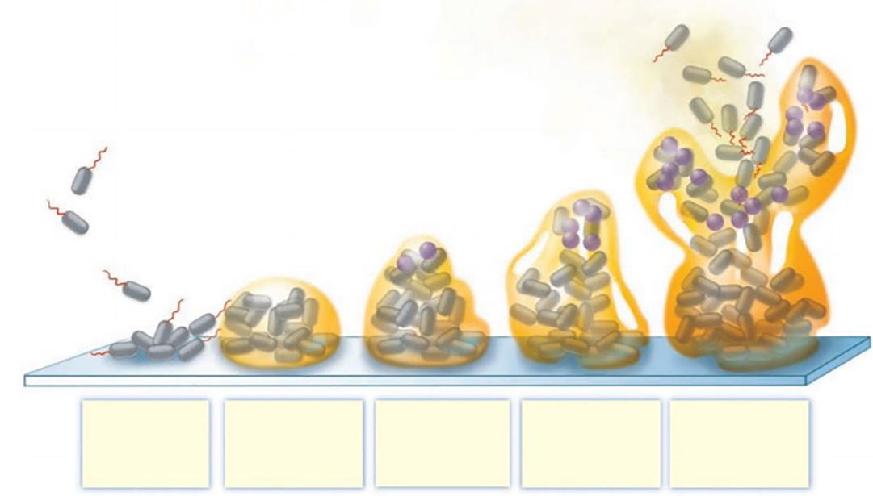
Biofilms - Figure 4.3
Biofilm formation and structure
Free cells adhere to surface and multiply
Release polymers to which unrelated cells may attach and grow
Extra polymeric substances (EPS) give slimy appearance
Nutrients and wastes pass through characteristic channels
Cells communicate with one another via chemical signals
Planktonic bacteria move to the surface and adhere.
Bacteria multiply and produce extracellular polymeric substances (EPS).
Other bacteria may attach to the EPS and grow.
Cells communicate and create channels in the EPS that allow nutrients and waste products to pass.
Some cells detach and then move to other surfaces to create additional biofilms.

Slide 10
Biofilms
Biofilms have important implications
Dental plaque leads to tooth decay, gum disease
Most infections seem to involve biofilms
Microbes within biofilms often resistant to immune system and antibiotics
Industrial concerns: accumulations in pipes, drains
May be hundreds of times more resistant to disinfectants
Biofilms can also be helpful
Bioremediation, wastewater treatment

Slide 11
Interactions of Mixed Microbial Communities
Microorganisms regularly grow in close association with many different species
Interactions can be cooperative
Can foster growth of species otherwise unable to survive
Strict anaerobes can grow in mouth if others consume O₂
Metabolic waste of one can serve as nutrient for other
Interactions often competitive
Some synthesize toxic compounds to inhibit competitors
Some Gram-negative bacteria use the needle-like structure called a type VI secretion system to inject toxic compounds directly into competing bacteria.

Slide 12
Microbial Growth in Laboratory Conditions
Pure culture: population of cells derived from a single cell; allows study of a single species
Organisms may behave differently than in nature
Only about 1% of microorganisms can be cultured
Pure culture obtained using aseptic technique
Minimizes accidental introduction of other organisms
Cells grown in or on culture medium
Contains nutrients dissolved in water
Can be liquid broth or solid gel

Slide 13
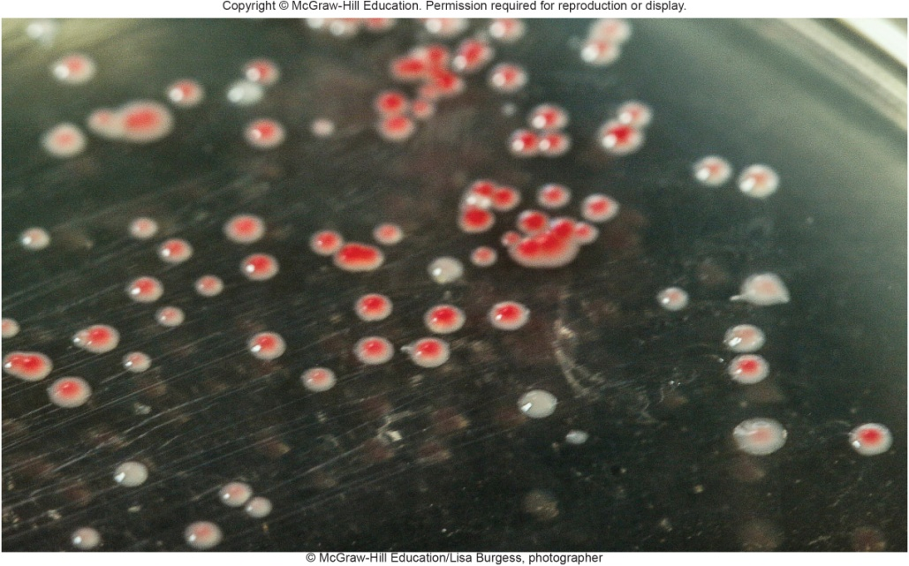
Obtaining a Pure Culture - Figure 4.4
Need culture medium, container, aseptic conditions, method to separate individual cells
With correct conditions, single cell will multiply to form a visible colony (approximately 1 million cells easily visible)
© McGraw-Hill Education/Lisa Burgess, photographer

Slide 14
Obtaining a Pure Culture (1)
Agar used to solidify medium
Few microbes can degrade
Not destroyed by high temperatures and can be sterilized
Liquefies above 95 degrees Celsius; solidifies below 45 degrees Celsius
Solid over temperature range for most microbial growth
Growth in Petri dish
Two-part covered container of glass or plastic
Allows air to enter, but excludes contaminants
Agar plate is Petri dish with agar nutrient medium
Notes:
14

Slide 15
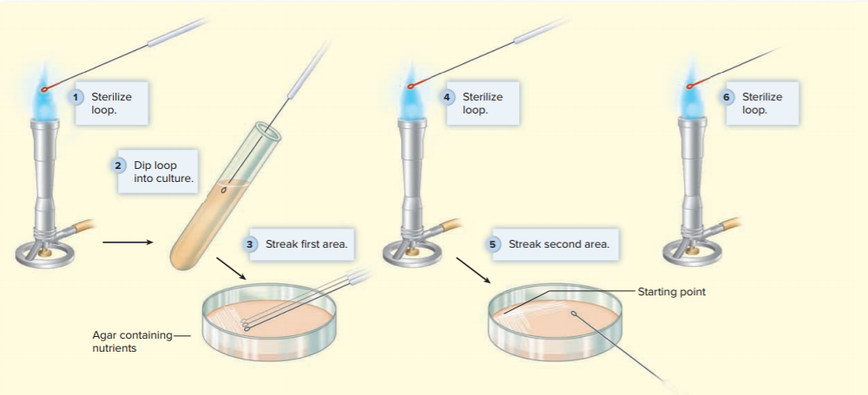
Obtaining a Pure Culture (2)
Streak-plate method
Simplest, most commonly used method for isolating
Reduces number of cells with each series of streaks
Jump to Obtaining a Pure Culture (2) Long Description

Slide 16
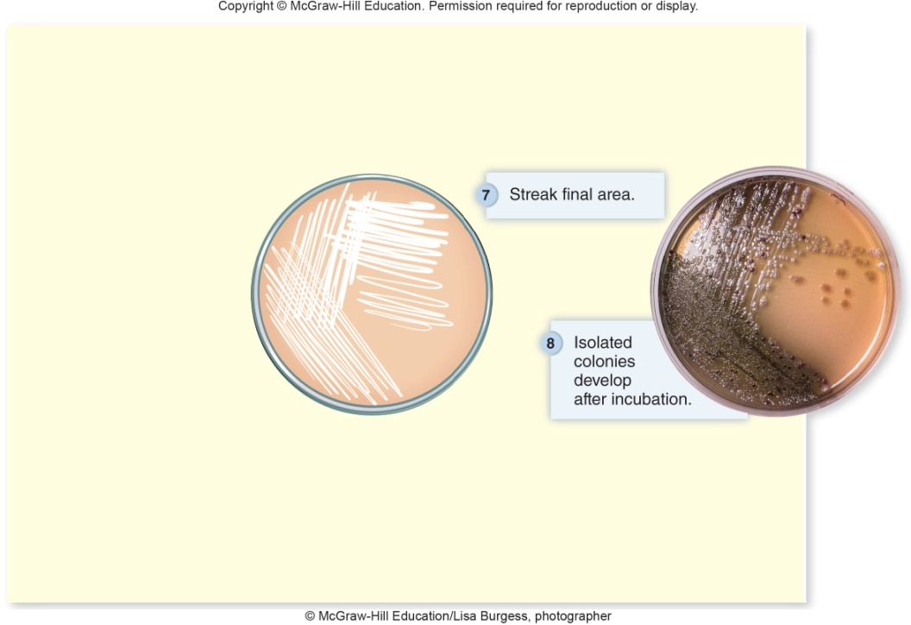
Obtaining a Pure Culture - Figure 4.5
Streak-plate method
Simplest, most commonly used method for isolating
Reduces number of cells with each series of streaks
Separated cells form distinct, isolated colonies
© McGraw-Hill Education/Lisa Burgess, photographer
Notes:
16

Slide 17
Maintaining Stock Cultures
A pure culture can be maintained as stock culture
Often stored in refrigerator as agar slant
Cells can be frozen at -70 degrees Celsius for long-term storage
Mixed with glycerol to prevent ice crystal formation
Can be freeze-dried

Slide 18
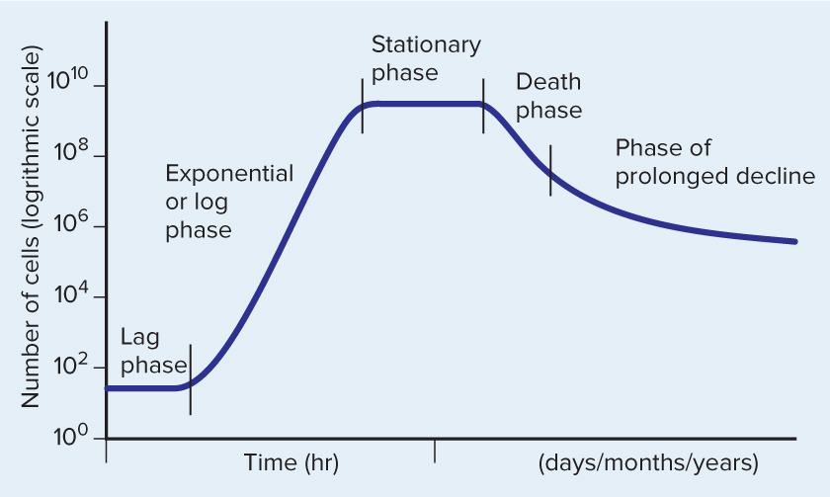
The Growth Curve - Figure 4.6
Closed system: culture in which nutrients are not added, nor are wastes removed
Includes microorganisms grown on agar plates or in tubes or flasks of broth
Also called batch cultures
Characteristic growth curve seen in closed broth culture
Jump to The Growth Curve - Figure 4.6 Long Description

Slide 19
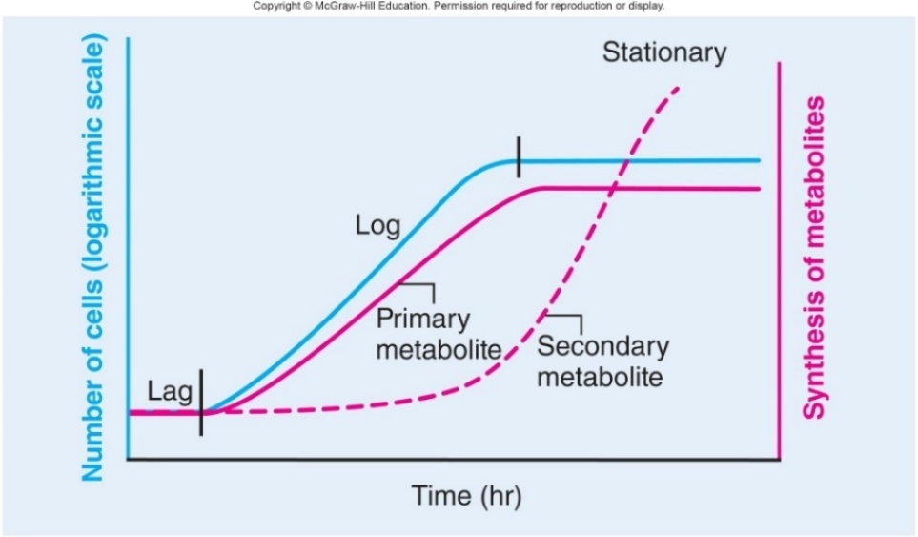
The Growth Curve - Figure 4.7
Lag phase
Number of cells does not increase
Cells begin synthesizing enzymes required for growth
Delay depends on conditions
Exponential (log) phase
Cells divide at constant rate
Generation time measured
Most sensitive to antibiotics
Produce primary metabolites such as amino acids
Secondary metabolites such as antibiotics are produced as nutrients are depleted and wastes accumulate

Slide 20
The Growth Curve
Stationary phase
Nutrient levels too low to sustain growth
Total numbers remain constant
Some die, releasing nutrients; others grow
Continue to produce secondary metabolites
Death phase
Total number of viable cells decreases
Cells die at constant rate
Exponential, but usually much slower than cell growth
Phase of prolonged decline
Some fraction may survive
Adapted to tolerate worsened conditions

Slide 21
Colony Growth
Growth of bacteria on solid medium and liquid broth is similar, but there are important differences.
Position of single cell in a colony determines its environment.
Edge of colony
Little competition for O₂, nutrients
Center of colony
Depleted O₂, nutrients
Accumulation of potentially toxic wastes
Cells at edges of colony may show exponential growth while those in the center are in the death phase

Slide 22
Continuous Culture
Open system: culture to which nutrients are continually added and waste products removed
A chemostat provides an open system that can maintain continuous growth
Nutrient content and speed of addition can be controlled to achieve constant growth rate and cell density
Produces relatively uniform population to study response to different conditions
Can maintain cells in log phase of growth to harvest commercially valuable products

Slide 23
Environmental Factors That Influence Microbial Growth
As a group, microorganisms inhabit nearly all environments
Some live in comfortable habitats favored by humans
Extremophiles live in harsh environments; most are archaea
Major factors that affect microbial growth
Temperature
Atmosphere
pH
Water availability

Slide 24
Table 4.2 Environmental Factors That Influence Microbial Growth (1)
Environmental Factor/Descriptive Terms | Characteristics
Temperature | Thermostability appears to be due to protein structure.
Psychrophile | Optimum temperature between -5 degrees Celsius and 15 degrees Celsius.
Psychrotroph | Optimum temperature between 15 degrees Celsius and 30 degrees Celsius, but grows well at refrigeration temperatures.
Mesophile | Optimum temperature between 25 degrees Celsius and 45 degrees Celsius.
Thermophile | Optimum temperature between 45 degrees Celsius and 70 degrees Celsius.
Hyperthermophile | Optimum temperature of 70 degrees Celsius or greater.
Oxygen (O₂) Availability | Oxygen (O₂) requirement/tolerance reflects the organism’s energy-harvesting mechanisms and its ability to inactivate reactive oxygen species.
Obligate aerobe | Requires O₂.
Facultative anaerobe | Grows best if O₂ is present, but can also grow without it.
Obligate anaerobe | Cannot grow in the presence of O₂.
Microaerophile | Requires small amounts of O₂, but higher concentrations are inhibitory
Aerotolerant anaerobe (obligate fermenter) | Indifferent to O₂.

Slide 25
Table 4.2 Environmental Factors That Influence Microbial Growth (2)
Environmental Factor/Descriptive Terms | Characteristics
pH | Prokaryotes that live in pH extremes maintain a near-neutral internal pH by pumping protons out of or into the cell.
Neutrophile | Multiplies in the range of pH 5 to 8.
Acidophile | Grows optimally at a pH below 5.5.
Alkalophile | Grows optimally at a pH above 8.5.
Water Availability | Prokaryotes that can grow in high-solute solutions maintain the availability of water in the cell by increasing their internal solute concentration.
Halotolerant | Can grow in relatively high-salt solutions, up to approximately 10% NaCl.
Halophile | Requires high levels of sodium chloride.

Slide 26
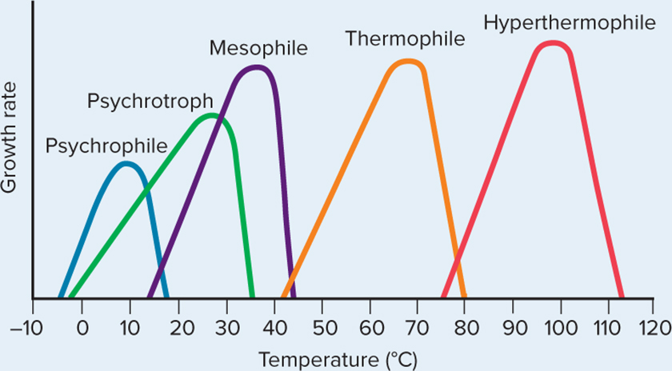
Temperature Requirements - Figure 4.8
Each species has well-defined temperature range
Optimum growth usually close to upper end of range
Psychrophiles: -5 degrees to 15 degrees Celsius
Found in Arctic and Antarctic regions
Psychrotrophs: 15 degrees to 30 degrees Celsius
Important in spoilage of refrigerated foods
Mesophiles: 25 degrees to 45 degrees Celsius
Pathogens 35 degrees to 40 degrees Celsius
Thermophiles: 45 degrees to 70 degrees Celsius
Common in hot springs and compost heaps
Hyperthermophiles: 70 degrees or greater
Usually archaea
Found in hydrothermal vents.

Slide 27
Temperature Requirements
Proteins of thermophiles resist denaturing
Thermostability comes from amino acid sequence
Number and position of bonds that determine structure
Temperature and food preservation
Refrigeration (approximately 4 degrees Celsius) slows spoilage by limiting growth of otherwise fast-growing mesophiles
Psychrophiles, psychrotrophs can still grow, but slowly
Freezing preserves food; not effective at killing microbes
Temperature and disease
Different parts of human body differ in temperature
M. leprae grows best in cooler regions so leprosy involves ears, hands, feet, fingers

Slide 28
Oxygen $\left(O_{2}\right)$ Requirements (1)
Measure in shake tube:
Boil nutrient agar to drive off O₂; cool to just above solidifying temperature; add microorganisms; gently swirl
Solidified agar slows gas diffusion
Top of tube is aerobic - O₂ is present
Bottom of tube is anaerobic - O₂ is absent
Position of growth indicates organism’s O₂ requirements
Obligate aerobes: require O₂
Facultative aerobes: use O₂, but don’t require it
Obligate anaerobes: cannot use O₂
Microaerophiles: require small amounts of O₂ only
Aerotolerant anaerobes: obligate fermenters (can grow in O₂, but they don’t use it)

Slide 29
Table 4.3 Oxygen $\left(O_{2}\right)$ Requirements
 | Obligate aerobe | Facultative anaerobe | Obligate anaerobe | Microaerophile | Aerotolerant anaerobe
Growth characteristics | Grows only when O₂ is available. | Grows best when O₂ is available, but also grows without it. | Cannot grow when O₂ is present. | Grows only if small amounts of O₂ are available. | Grows equally well with or without O₂.
Use of O₂ in energy-harvesting processes | Requires O₂ for respiration. | Uses O₂ for respiration, if available. | Does not use O₂. | Requires O₂ for respiration. | Does not use O₂.
Typical mechanisms to protect against reactive oxygen species | Produces superoxide dismutase and catalase. | Produces superoxide dismutase and catalase. | Does not produce superoxide dismutase or catalase. | Produces some superoxide dismutase and catalase. | Produces superoxide dismutase but not catalase.
Jump to Table 4.3 Oxygen $\left(O_{2}\right)$ Requirements Long Description
Notes:
29

Slide 30
Oxygen $\left(O_{2}\right)$ Requirements (2)
Reactive oxygen species (ROS): harmful by-products of using O₂ in aerobic respiration
Include superoxide
and hydrogen peroxide (H₂O₂)
Damaging to cellular components
Cells must have protective mechanisms; obligate anaerobes typically do not
Almost all organisms growing in presence of oxygen produce enzyme superoxide dismutase
Inactivates superoxide by converting it to O₂ and H₂O₂
Almost all also produce catalase
Converts H₂O₂ to O₂ and H₂O
Exception is aerotolerant anaerobes; makes for useful test

Slide 31
pH
Bacteria survive a range of pH; have optimum
Most maintain constant internal pH, typically near neutral
Pump out protons
if in acidic environment
Bring in protons
if in alkaline environment
Most microbes are neutrophiles
Range of pH 5 to 8; optimum near pH 7
Food can be preserved by increasing acidity
H. pylori grows in stomach; produces urease to split urea into CO₂ and ammonia to decrease acidity of surroundings
Acidophiles grow optimally at pH below 5.5
Picrophilus oshimae has optimum pH of less than 1!
Alkaliphiles grow optimally at pH above 8.5

Slide 32
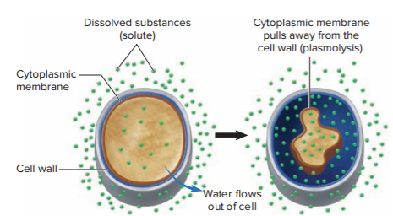
Water Availability - Figure 4.9
All microorganisms require water for growth
Dissolved salts, sugars make water unavailable to cell
If solute concentration is higher outside of cell, water diffuses out (osmosis)
Salt, sugar used to preserve food
Some microbes withstand or even require high salt
Halotolerant: withstand up to 10%
Staphylococcus on dry salty skin
Halophiles: require high
salt levels
Marine bacteria approximately 3%
Extreme halophiles
(Dead Sea, Utah’s salt flats)

Slide 33
Table 4.4 Nutritional Factors That Influence Microbial Growth
Nutrients required to synthesize cell components
Prokaryotes can use diverse sources to acquire various elements
Major elements: carbon, oxygen, hydrogen, nitrogen, sulfur, phosphorus, potassium, magnesium, calcium, and iron
Trace elements: cobalt, zinc, copper, molybdenum, manganese
Chemical | Function
Carbon, oxygen, and hydrogen | Component of amino acids, lipids, nucleic acids, and sugars
Nitrogen | Component of amino acids and nucleic acids
Sulfur | Component of some amino acids
Phosphorus | Component of nucleic acids, membrane lipids, and ATP
Potassium, magnesium, and calcium | Required for the functioning of certain enzymes; additional functions as well
Iron | Part of certain enzymes

Slide 34
Nutritional Factors That Influence Microbial Growth (1)
Carbon source distinguishes different groups
Heterotrophs use organic carbon
Autotrophs use inorganic carbon as CO₂
Carbon fixation converts inorganic carbon to organic form
Nitrogen required for amino acids, nucleic acids
Nitrogen fixation: converting N₂ gas to ammonia and then incorporating it into organic compounds
Many use ammonia (some convert nitrate to ammonia)
Phosphorus and iron are often limiting nutrients
Available at lowest concentration relative to need
Dictate maximum level of microbial growth

Slide 35
Nutritional Factors That Influence Microbial Growth (2)
Growth factors: organic molecules that an organism cannot synthesize; must be present in the environment
Growth factor requirements reflect biosynthetic capabilities
Most E. coli strains synthesize all cellular components from glucose; no growth factors needed
Neisseria species are fastidious; they require numerous growth factors, including vitamins and amino acids
Fastidious species can be used to measure the quantity of vitamins in food products

Slide 36
Nutritional Factors That Influence Microbial Growth (3)
Energy sources
Sunlight, chemical compounds
Phototrophs obtain energy from sunlight
Plants, algae, photosynthetic bacteria
Chemotrophs extract energy from chemicals
Mammalian cells, fungi, many types of prokaryotes extract energy from organic molecules
Sugars, amino acids, fatty acids are common sources
Some prokaryotes extract energy from inorganic chemicals
Hydrogen sulfide, hydrogen gas

Slide 37
Table 4.5 Energy and Carbon Sources Used by Different Groups of Microorganisms
Photoautotrophs: energy from sunlight; carbon from CO₂
Photoheterotrophs: energy from sunlight; carbon from organic compounds
Chemolithoautotrophs (also termed chemoautotrophs, chemolithotrophs): energy from inorganic compounds; carbon from CO₂
Chemoorganoheterotrophs (also termed chemoheterotrophs, chemoorganotrophs): energy and carbon from organic compounds
Type | Energy Source | Carbon Source
Photoautotroph | Sunlight | CO₂
Photoheterotroph | Sunlight | Organic compounds
Chemolithoautotroph | Inorganic chemicals (H₂, NH₂, NO₂⁻, Fe²⁺, H₂S) | CO₂
Chemoorganoheterotroph | Organic compounds (sugars, amino acids, etc.) | Organic compounds

Slide 38
Figure 4.6 Characteristics of Representative Media Used to Cultivate Bacteria
Medium | Characteristic
Blood agar | Complex medium used routinely in clinical labs. Differential because colonies of hemolytic organisms are surrounded by a zone of red blood cell clearing. Not selective.
Chocolate agar | Complex medium used to culture fastidious bacteria, particularly those found in clinical specimens. Not selective or differential.
Glucosesalts agar | Chemically defined medium. Used in laboratory experiments to study nutritional requirements of bacteria. Not selective or differential.
MacConkey agar | Complex medium used to isolate Gram-negative rods that typically reside in the intestine. Selective because bile salts and dyes inhibit Gram-positive organisms and Gram-negative cocci. Differential because the pH indicator turns pink-red when the sugar in the medium, lactose, is fermented.
Nutrient agar | Complex medium used for routine laboratory work. Supports the growth of a variety of nonfastidious bacteria. Not selective or differential.
ThayerMartin agar | Complex medium used to isolate Neisseria species, which are fastidious. Selective because it contains antibiotics that inhibit most organisms except Neisseria species. Not differential.
Complex media contain a variety of ingredients
Exact composition is highly variable
Chemically defined media composed of exact amounts of pure chemicals
Typically slower growth as cells must synthesize components

Slide 39
Table 4.7 Ingredients in Two Types of Media That Support the Growth of E. coli
E. coli can grow in complex media or chemically defined media
Nutrient Broth (Complex Medium) | Glucose-Salts Broth (Chemically Defined Medium)
Peptone | Glucose
Beef extract | Dipotassium phosphate
Water | Monopotassium phosphate Magnesium sulfate Ammonium sulfate Calcium chloride Iron sulfate Water

Slide 40
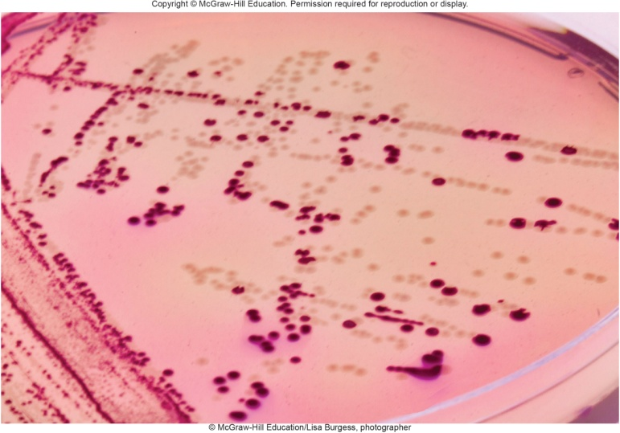
Special Types of Culture Media - Figure 4.12
Selective media inhibit growth of certain species in a mixed sample, while allowing growth of species of interest
MacConkey agar is selective for Gram-negative rods
Contains crystal violet that inhibits Gram-positive bacteria and bile salts that inhibit most non-intestinal bacteria
© McGraw-Hill Education/Lisa Burgess, photographer

Slide 41
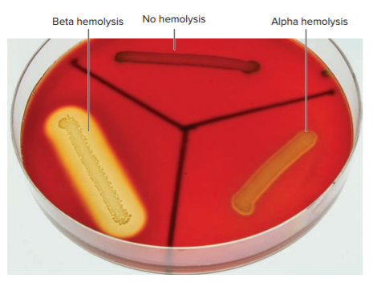
Special Types of Culture Media - Figure 4.11
Differential media contain substance that microbes change in identifiable way
Blood agar is differential
Beta hemolysis produces clear zone
Alpha hemolysis produces zone of greenish partial clearing
© McGraw-Hill Education/Lisa Burgess, photographer
Notes:
41

Slide 42
Special Types of Culture Media - Figure 4.10
Selective or differential media can be used to detect or isolate a species from a mixed population.
Routine medium (not selective or differential)
Selective medium
Differential medium
Selective and differential medium
Jump to Special Types of Culture Media - Figure 4.10 Long Description

Slide 43
Providing Appropriate Atmospheric Conditions
Aerobic
Most obligate aerobes and facultative anaerobes can be incubated in air (approximately 20% O₂)
Broth cultures shaken to provide maximum aeration
Many medically important bacteria (for example, Neisseria, Haemophilus) grow best with increased CO₂
Some are capnophiles, meaning require increased CO₂
One method is to incubate in candle jar
Microaerophilic
Require lower O₂ concentrations than achieved by candle jar
Can incubate in gas-tight container with chemical packet
Chemical reaction reduces O₂ to 5 to 15%

Slide 44
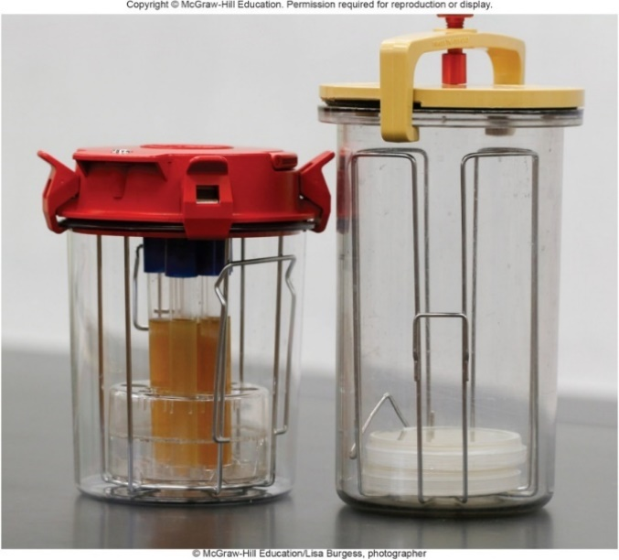
Providing Appropriate Atmospheric Conditions - Figures 4.13 and 4.14
Anaerobic: obligate anaerobes sensitive to O₂
Anaerobe containers useful if microbe can tolerate brief O₂ exposures; can also use semisolid culture medium containing reducing agent such as sodium thioglycolate)
Reduce O₂ to water
Anaerobic chamber provides more stringent approach
left: © McGraw-Hill Education/Lisa Burgess, photographer; right: © BSIP SA/Alamy

Slide 45
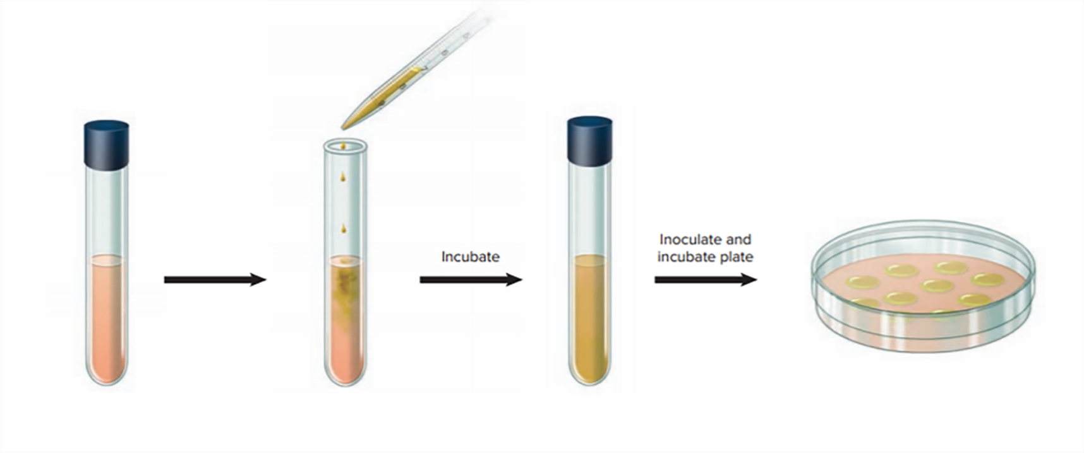
Enrichment Cultures - Figure 4.15
An enrichment culture is used to isolate organism present as only a small fraction of mixed population
Provide conditions promoting growth of particular species
Relative concentration of target organism increases
Medium contains nutrients that few species other than the one of interest can use.
Sample that contains a variety of species, including the one of interest, is added to the medium.
Species of interest multiplies, whereas others cannot.
Enriched sample is plated onto appropriate agar medium. A pure culture is obtained by selecting a single colony of the species of interest.

Slide 46
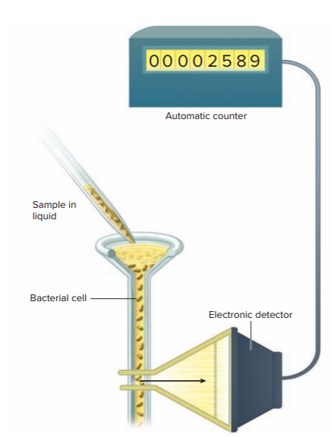
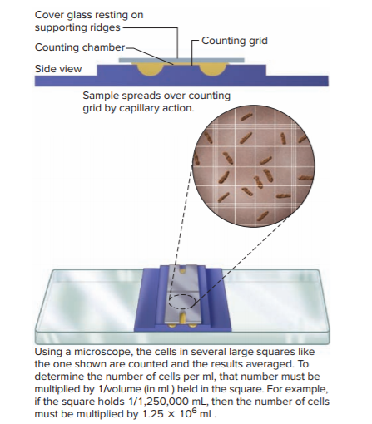
Methods to Detect and Measure Microbial Growth - Figures 4.16 and 4.17
Direct cell counts: total numbers (living plus dead)
Direct microscopic count
Cell-counting instruments (Coulter counter, flow cytometer)
Jump to Methods to Detect and Measure Microbial Growth - Figures 4.16 and 4.17 Long Description

Slide 47
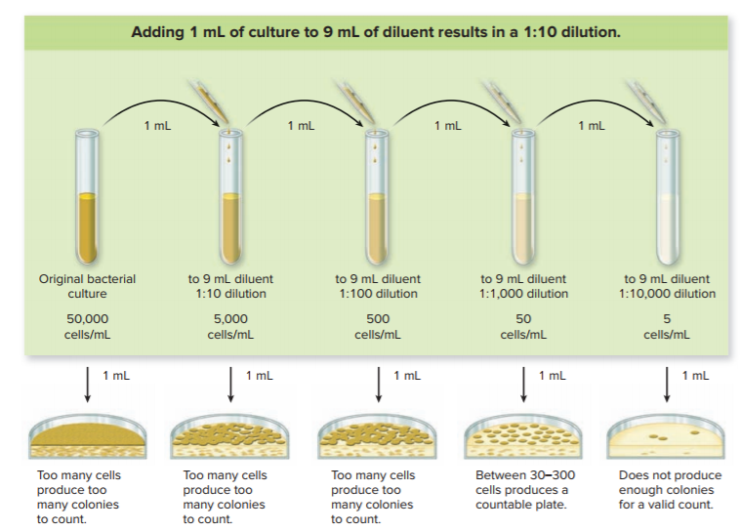
Methods to Detect and Measure Microbial Growth - Figure 4.18
Viable cell counts: cells capable of multiplying
Can use selective, differential media for particular species
Plate counts: single cell gives rise to colony
Number of colonies reflects how many cells were in sample
Plate dilution series to obtain 30 to 300 colonies
Jump to Methods to Detect and Measure Microbial Growth - Figure 4.18 Long Description

Slide 48
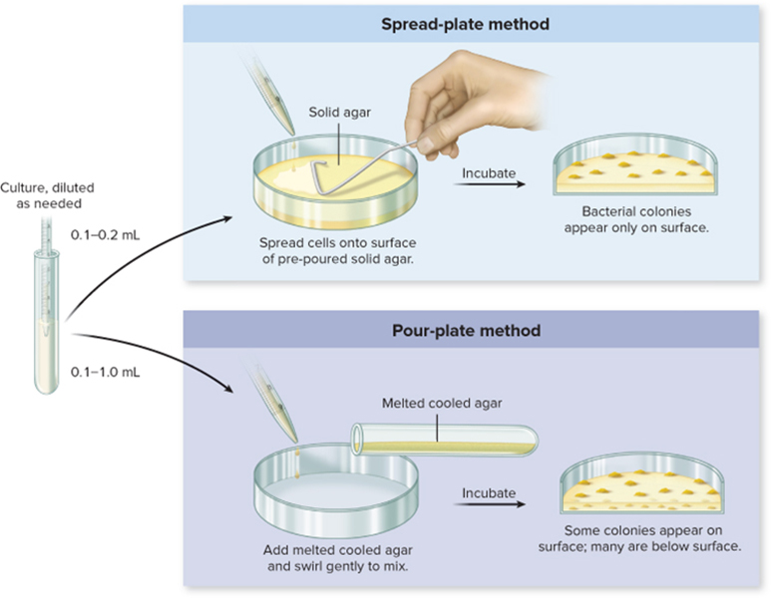
Methods to Detect and Measure Microbial Growth - Figure 4.19
Samples added to agar plate
Spread plate method
Pour plate methods
Plate counts determine colony-forming units (CFUs)
Cells often attach to one another and form a single colony
Jump to Methods to Detect and Measure Microbial Growth - Figure 4.19 Long Description

Slide 49
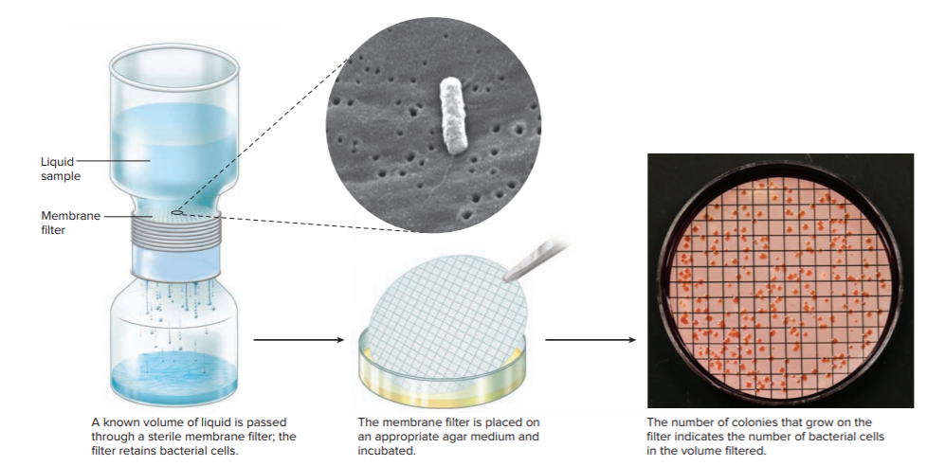
Methods to Detect and Measure Microbial Growth - Figure 4.20
Membrane filtration
Known volume passed through sterile filter
Captures and concentrates microbes by filtration
Filter is incubated on appropriate agar medium
left: Margaret Williams, PhD; Claressa Lucas, PhD; Tatiana Travis, BS/CDC; right: © McGraw-Hill Education/Lisa Burgess, photographer

Slide 50
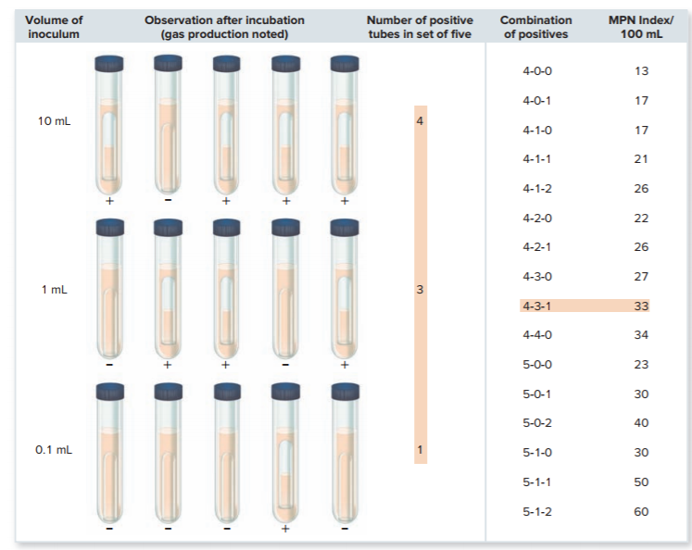
Methods to Detect and Measure Microbial Growth - Figure 4.21
Most Probable Number (MPN) Method
Estimates cell concentration using dilution series
Sets of tubes are incubated; results are recorded and compared to table to give statistical estimate of cell concentration
Jump to Methods to Detect and Measure Microbial Growth - Figure 4.21 Long Description

Slide 51
Methods to Detect and Measure Microbial Growth (1)
Measuring biomass: measure cell mass instead of number of cells
Turbidity of microbial suspension is proportional to concentration of cells
Measured with spectrophotometer
More cells present in sample means less light measured
Effective only with relatively high concentration of cells

Slide 52
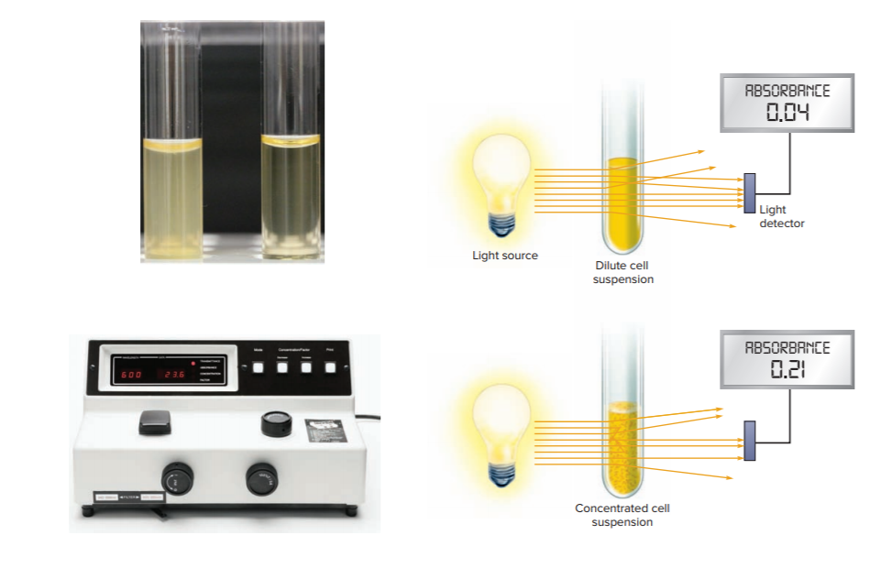
Methods to Detect and Measure Microbial Growth - Figure 4.22
Spectrophotometer
Standard tests correlate measured optical density to actual cell concentration
The cloudiness, or turbidity, of the liquid in the tube on the left is proportional to the concentration of cells.
A spectrophotometer is used to measure turbidity.
The percentage of light that reaches the detector of the spectrophotometer is inversely proportional to the optical density (absorbance).
Jump to Methods to Detect and Measure Microbial Growth - Figure 4.22 Long Description
a: © McGraw-Hill Education/Lisa Burgess, photographer; b: © Martin Shields/Science Source
Notes:
52

Slide 53
Methods to Detect and Measure Microbial Growth (2)
Measuring biomass
Total weight can be measured
Tedious and time-consuming
Typically only used for filamentous organisms that do not readily separate into individual cells for valid plate counts
Cells in liquid culture centrifuged; pellet is weighed
Dry weight can be determined by heating pellet in oven
Detecting cell products
pH indicators
Durham tubes (inverted tubes) to trap gas
CO₂ production

Slide 54
Table 4.8 Methods Used to Measure Microbial Growth
Method | Characteristics and Limitations
Direct Cell Counts | Used to determine total number of cells; counts include living and dead cells.
Direct microscopic count | Rapid, but at least 10⁷ cells / milliliter must be present to be effectively counted.
Cell-counting instruments | Coulter counters and flow cytometers count total cells in dilute solutions. Flow cytometers can also be used to count organisms to which fluorescent dyes or tags have been attached.
Viable Cell Counts | Used to determine the number of microorganisms capable of growing in a given set of conditions. Requires an incubation period of approximately 24 hours or longer. Selective and differential media can be used to determine the number of specific microbial species.
Plate count | Time-consuming but technically simple method that does not require sophisticated equipment. Generally used only if the sample has at least 10² cells / milliliter.
Membrane filtration | Used to count microorganisms in liquids that contain relatively few cells; the cells are caught on a paper-thin filter.
Most probable number | Estimates the likely concentration; it does not provide a precise count.
Measuring Biomass | Biomass can be correlated to cell number.
Turbidity | Very rapid method; used routinely. A one-time correlation with plate counts is required for turbidity to be used in determining cell number.
Total weight | Tedious and time-consuming; however, it is one of the best methods for measuring growth of filamentous microorganisms.
Detecting Cell Products | Used to detect growth, but not routinely used for quantitation. A pH indicator can detect acid production. Gases can be trapped in an inverted tube in the broth; a more sensitive method uses a fluorescent sensor that detects the slight decrease in pH that accompanies co² production.
Notes:
54

