Slide 1
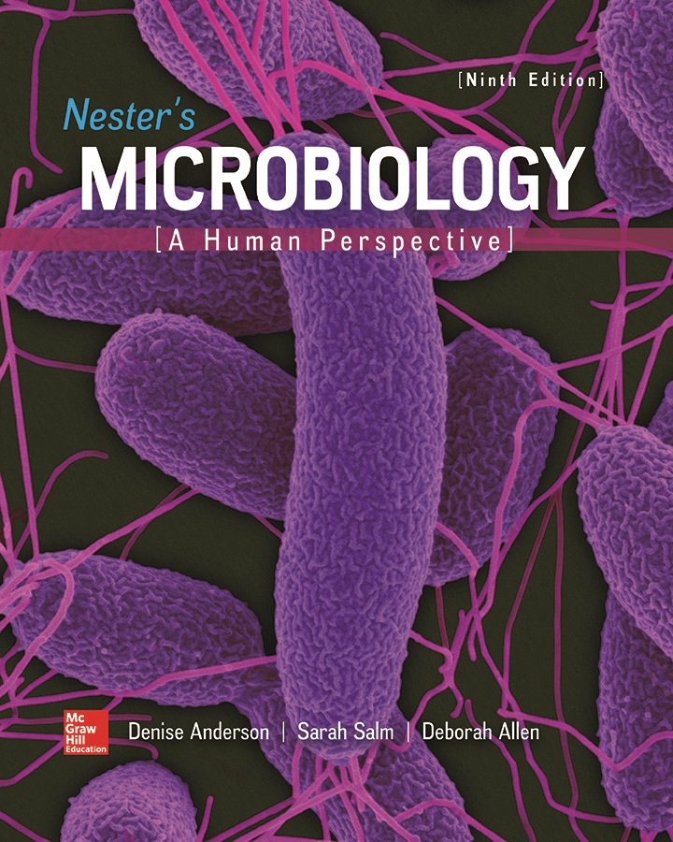
Chapter 02 Lecture Outline
See separate PowerPoint slides for all figures and tables pre-inserted into PowerPoint without notes.

Slide 2
A Glimpse of History
Martinus Beijerinck was a microbiologist from the Netherlands in the Golden Age
Some microorganisms help plants improve soil by accumulating nitrogen from air
Beijerinck isolated nitrogen-fixing microorganisms called rhizobia from the root nodules of legumes
Planting legumes like peas or clover enriches the soil in nitrogen-containing nutrients

Slide 3
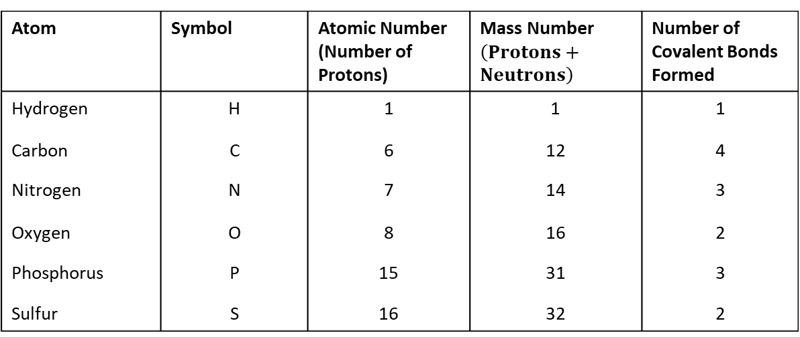
Elements and Atoms – Table 2.1
Elements consist of only one type of atom
  Cannot be chemically separated into simpler parts
Living matter primarily composed of six elements
  Carbon (C), hydrogen (H), oxygen (O), nitrogen (N), phosphorus (P), sulfur (S)
Table 2.1 Characteristics of Atoms Common in Living Organisms
Atom | Symbol | Atomic Number (Number of Protons) | Mass Number $\left(Protons+Neutrons\right)$ | Number of Covalent Bonds Formed
Hydrogen | H | 1 | 1 | 1
Carbon | C | 6 | 12 | 4
Nitrogen | N | 7 | 14 | 3
Oxygen | O | 8 | 16 | 2
Phosphorus | P | 15 | 31 | 3
Sulfur | S | 16 | 32 | 2

Slide 4
Elements and Atoms
Atom: basic unit of matter
Three major components
  Neutrons: uncharged particles
  Protons: positively charged particles
  Electrons: negatively charged particles
An atom normally has equal numbers of protons and electrons, therefore overall it has no charge

Slide 5
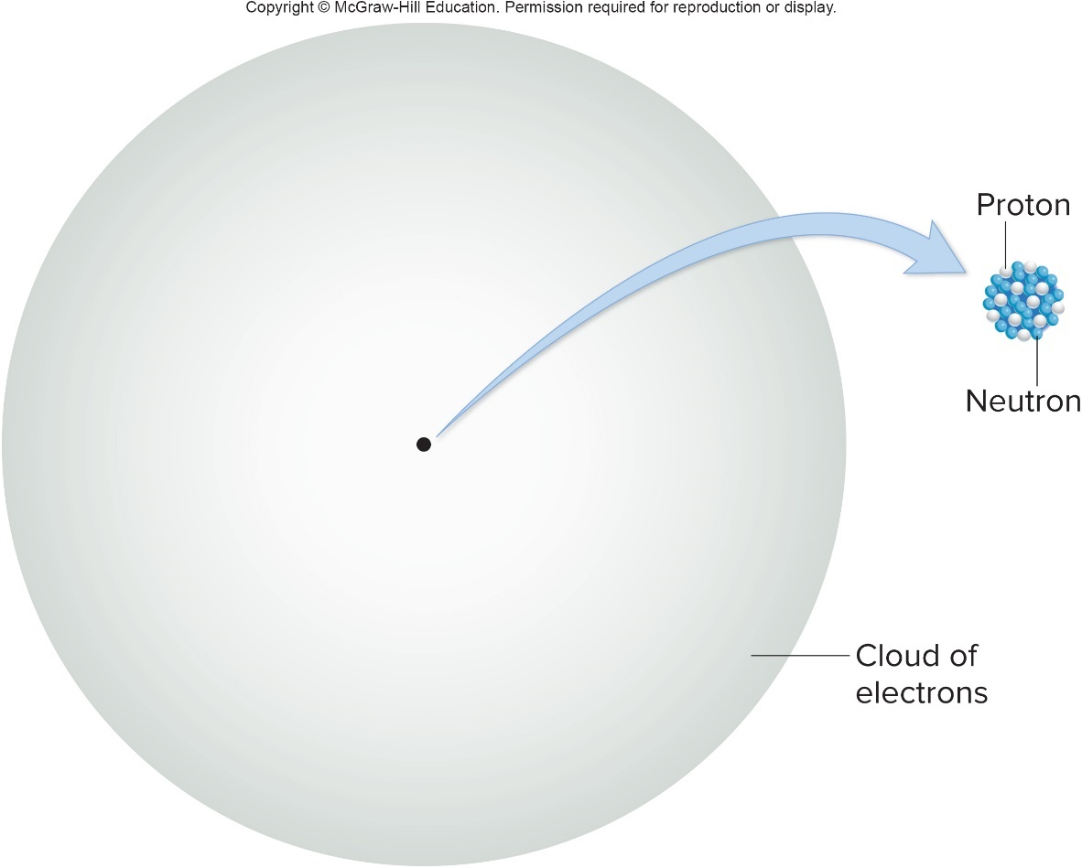
Atomic Structure – Figure 2.1
Protons and neutrons make up central part of atom, or nucleus Electrons form electron “cloud”
Notes:
5

Slide 6
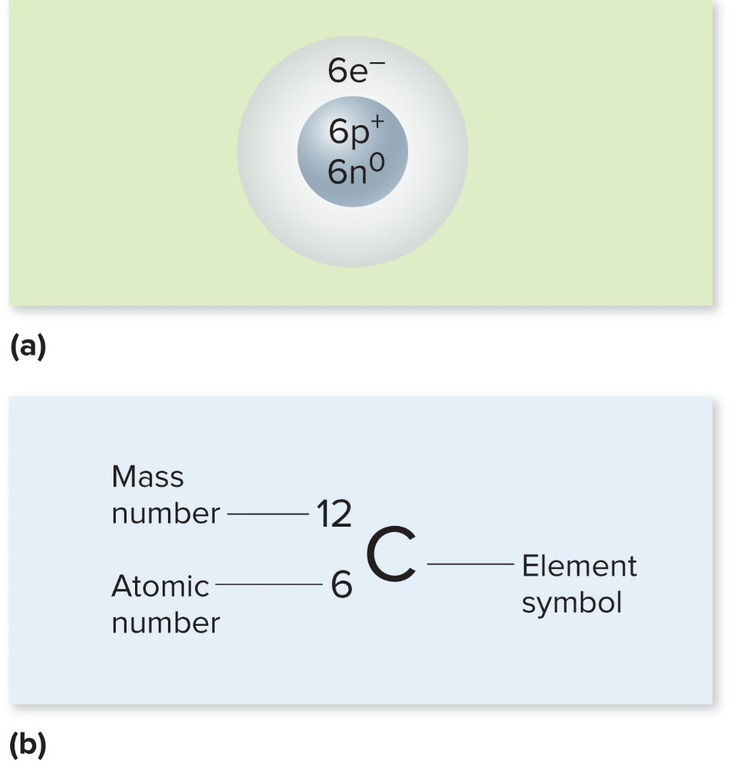
Atomic Structure – Figure 2.2a to b
Atomic number is number of protons in nucleus
Mass number is sum of protons and neutrons (electrons too light)

Slide 7
Isotopes – Figure 2.3
Isotopes of an element have different numbers of neutrons
  Atomic mass is the average of mass numbers of atoms of an element
  Energy emitted from radioactive isotopes may be useful in diagnosis (scan of thyroid gland shows location of radioactive iodine)
© BSIP SA/Alamy Stock Photo
Notes:
7

Slide 8
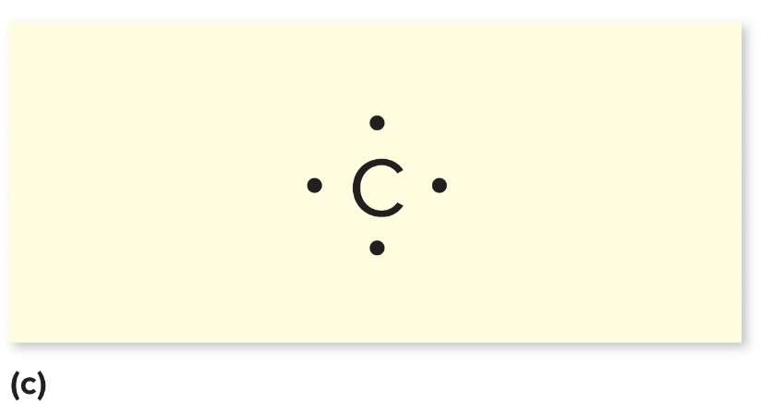
The Role of Electrons – Figure 2.2c
Electrons are arranged in shells around nucleus
  Shells closer to nucleus fill first
Innermost shell can hold up to 2 electrons
  Next shells can hold up to 8 electrons
  Biological molecules are most stable with 8 electrons in outer shell (“octet rule”)
  Electrons farther from nucleus have higher energy level
  Valence electrons are those in outer shell

Slide 9
Chemical Bonds and Reactions
Atoms lose, gain, or share valence electrons to achieve a more stable state
Basis for chemical bond formation
Three main types of chemical bonds:
  Ionic bonds
  Covalent bonds
  Hydrogen bonds

Slide 10
Ions and Ionic Bonds
Ion: atom that has gained or lost electron(s)
  Anions gain electron(s) and are negatively charged
  Cations lose electron(s) and are positively charged

Slide 11
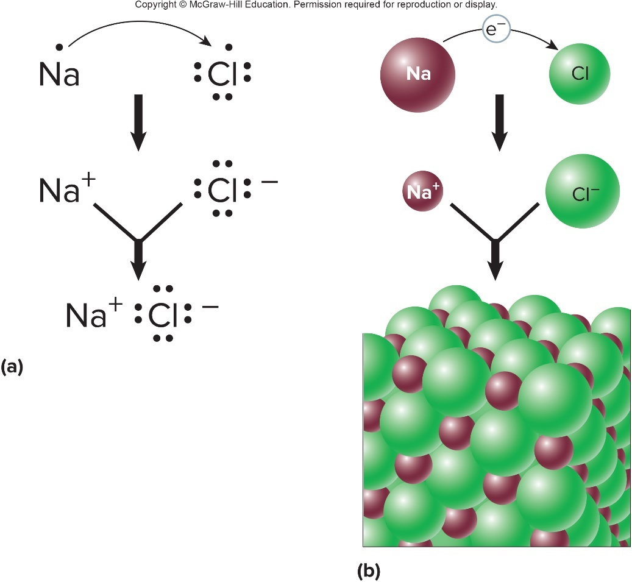
Ions and Ionic Bonds – Figure 2.4
Ionic bonds form because
of attraction between
negative and positive charges
Produces salts also called electrolytes because they conduct electricity
Notes:
11

Slide 12
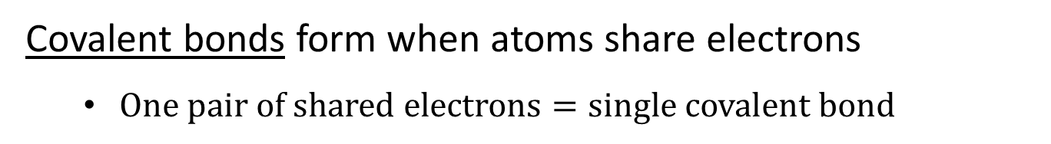
Covalent Bonds
Covalent bonds form when atoms share electrons
  $One pair of shared electrons=single covalent bond$
Molecule: two or more atoms joined together by covalent bonds
  Compound: molecule containing atoms of different elements

Slide 13
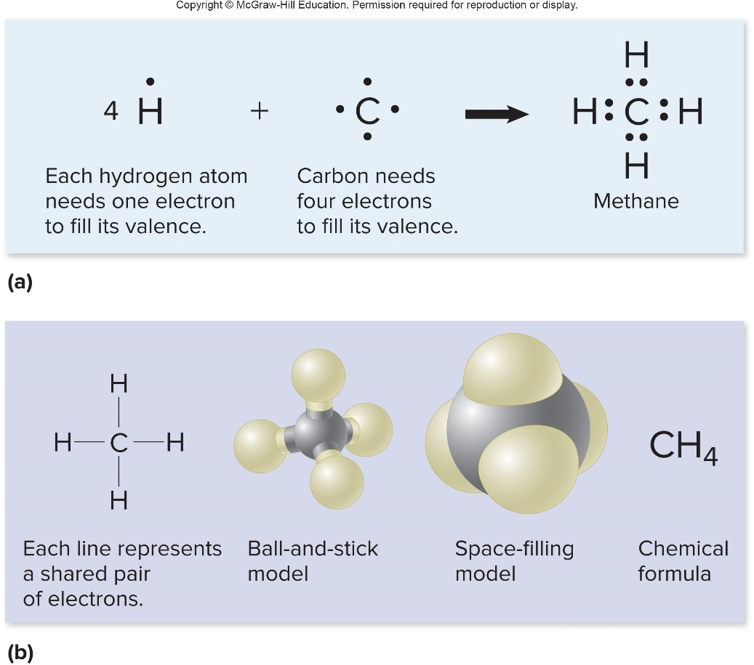
Covalent Bonds – Figure 2.5
Carbon forms four covalent bonds
  Basis for many diverse structures
Carbon bonds with hydrogen to form organic compounds
Other compounds are inorganic compounds
Notes:
13

Slide 14
Covalent Bonds – Tables 2.2 and 2.3
Non-polar covalent bond: equal sharing of electrons
Polar covalent bond: unequal sharing of electrons
  One atom more electronegative than the other
Table 2.2 Non-Polar and Polar Covalent Bonds
Table 2.3 Relative Electronegativities of Some Atoms Common in Biology*
Type of Covalent Bond | Atoms Involved and Charge Distribution | Atoms Involved and Charge Distribution
Non-polar | C—C C—H H—H | C and H have similar attractions for electrons, so there is a nearly equal charge on each atom.
Polar | O—H N—H O—C N—C | The O and N atoms have a stronger attraction for electrons than do C and H, so the O and N have a slight negative charge; the C and H have a slight positive charge.
Element | Relative Electronegativity
Hydrogen | 2.1
Carbon | 2.5
Nitrogen | 3.0
Oxygen | 3.5
*Electronegativity is the ability of an atom to attract electrons to itself in a molecule; an atom with a significantly higher electronegativity is better able to attract electrons.
Notes:
14

Slide 15
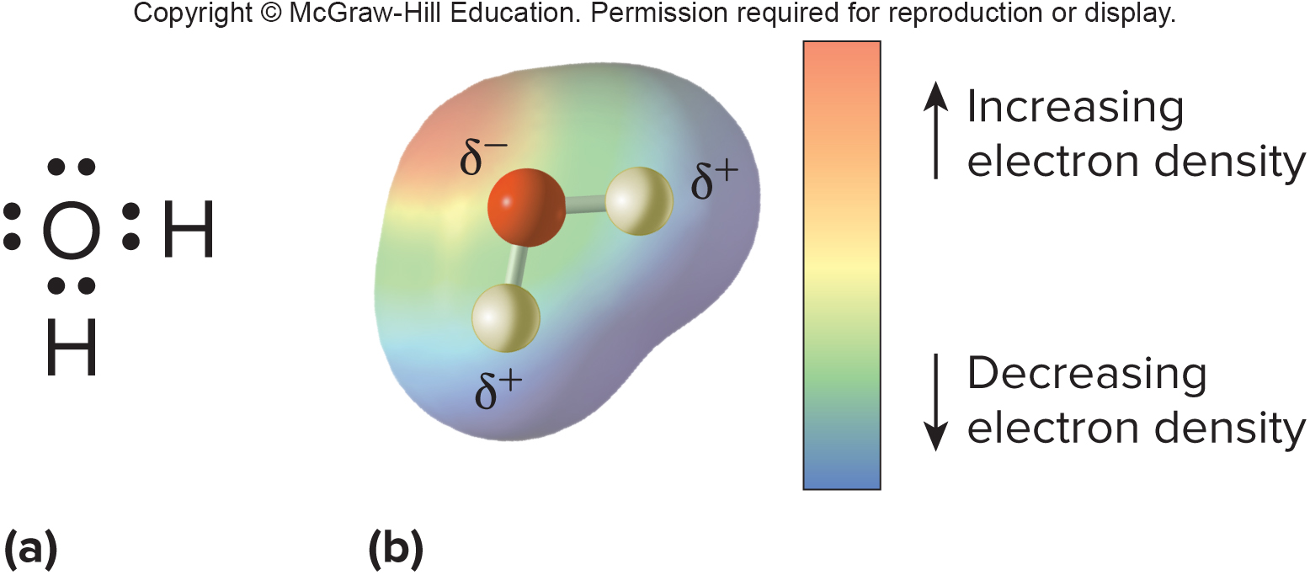
Covalent Bonds – Figure 2.6
Polar covalent bonds result in slight separation of charge
Important in biological systems
  May result in formation of hydrogen bonds

Slide 16
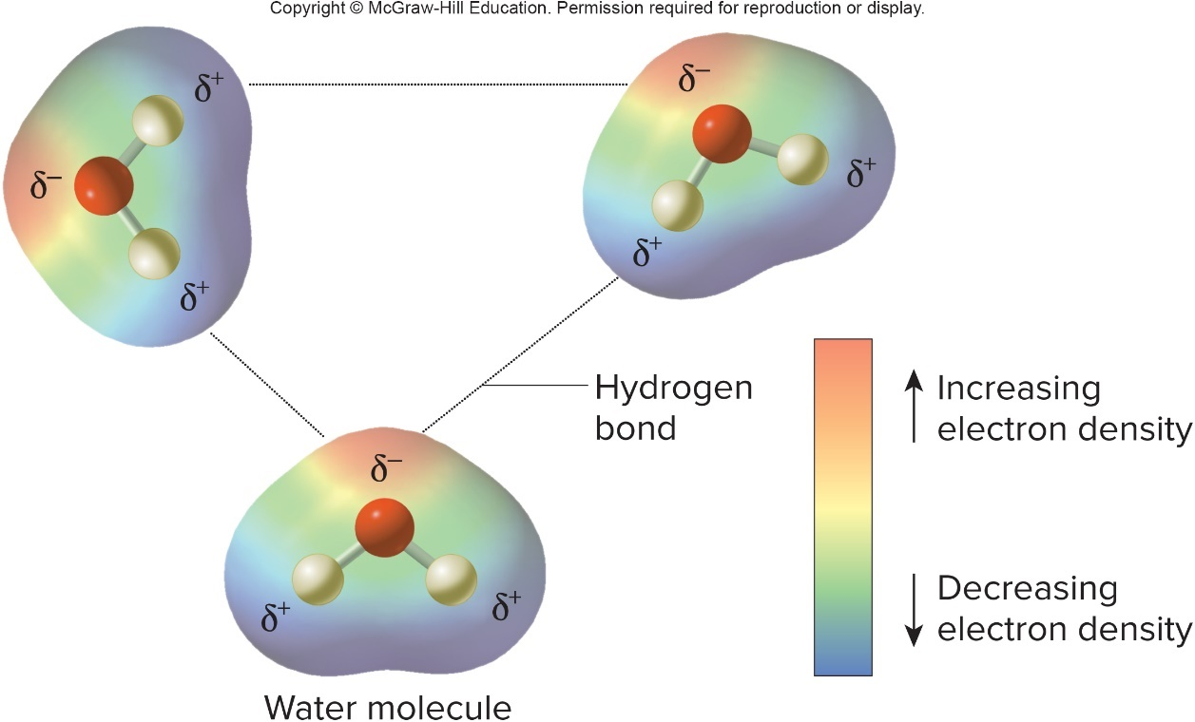
Hydrogen Bonds – Figure 2.7
Hydrogen bonds: weak bonds formed when a hydrogen atom in polar molecule is attracted to electronegative atom in same or another polar molecule
  May be short-lived, but numerous bonds add strength
    Velcro analogy

Slide 17
Molarity
A mole is
  A mole of one substance has the same number of particles as a mole of any other
  Measured in grams
Molarity (M) of a solution is the number of moles dissolved in 1 liter of the solution
  A 1 Molarity solution of NaCl is 58.44 grams of NaCl dissolved in 1 liter of aqueous solution

Slide 18
Chemical Reactions (1)
Chemical reactions transfer electrons, often involving making and breaking bonds
Reactants are starting components of a reaction that are changed to products
  Synthesis reaction
  Decomposition reaction

Slide 19
Chemical Reactions (2)
Covalent bonds are difficult to break at biological temperatures
  Require biological catalysts called enzymes

Slide 20
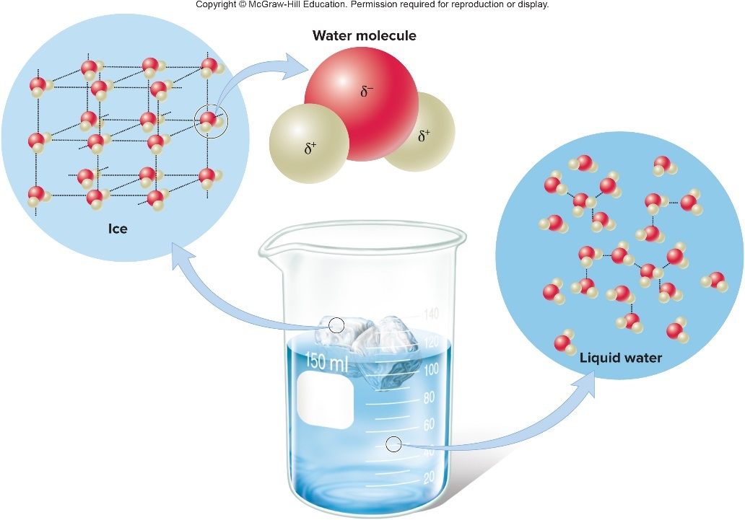
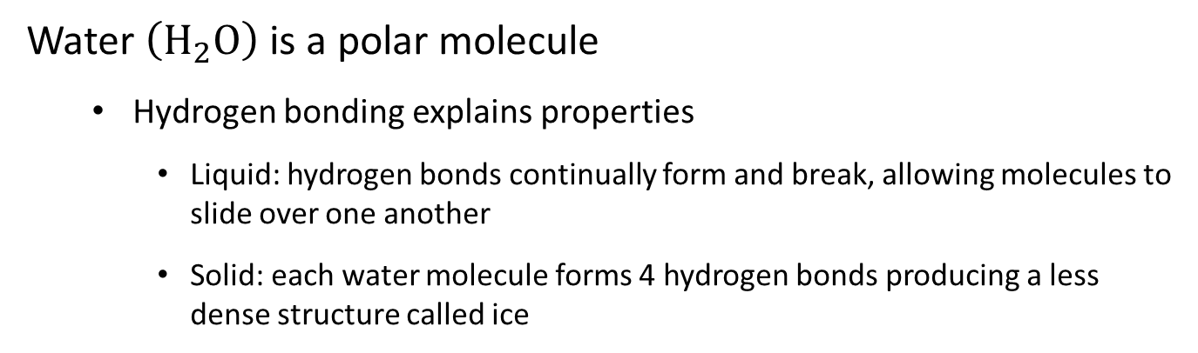
Water, pH, and Buffers – Figure 2.8
Water $\left(H_{2}O\right)$ is a polar molecule
  Hydrogen bonding explains properties
    Liquid: hydrogen bonds continually form and break, allowing molecules to slide over one another
    Solid: each water molecule forms 4 hydrogen bonds producing a less dense structure called ice

Slide 21
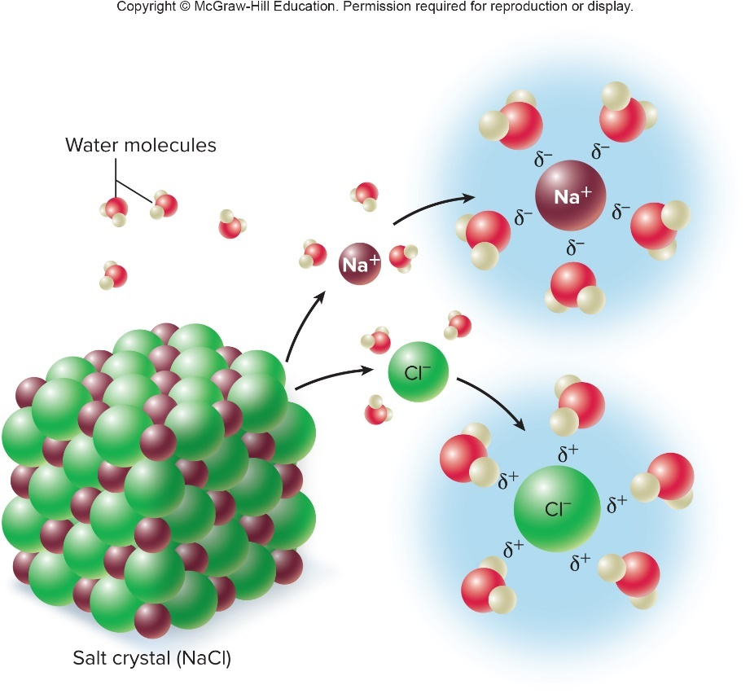
Water – Figure 2.9
Polar nature makes water an excellent solvent in which solutes are dissolved
  Polar and charged substances are
  hydrophilic (“water loving”);
  dissolve in water
  Non-polar substances are hydrophobic (“water fearing”); do not dissolve in water
  Water with dissolved substances freezes at lower temperatures
Jump to Water – Figure 2.9 Long Description

Slide 22
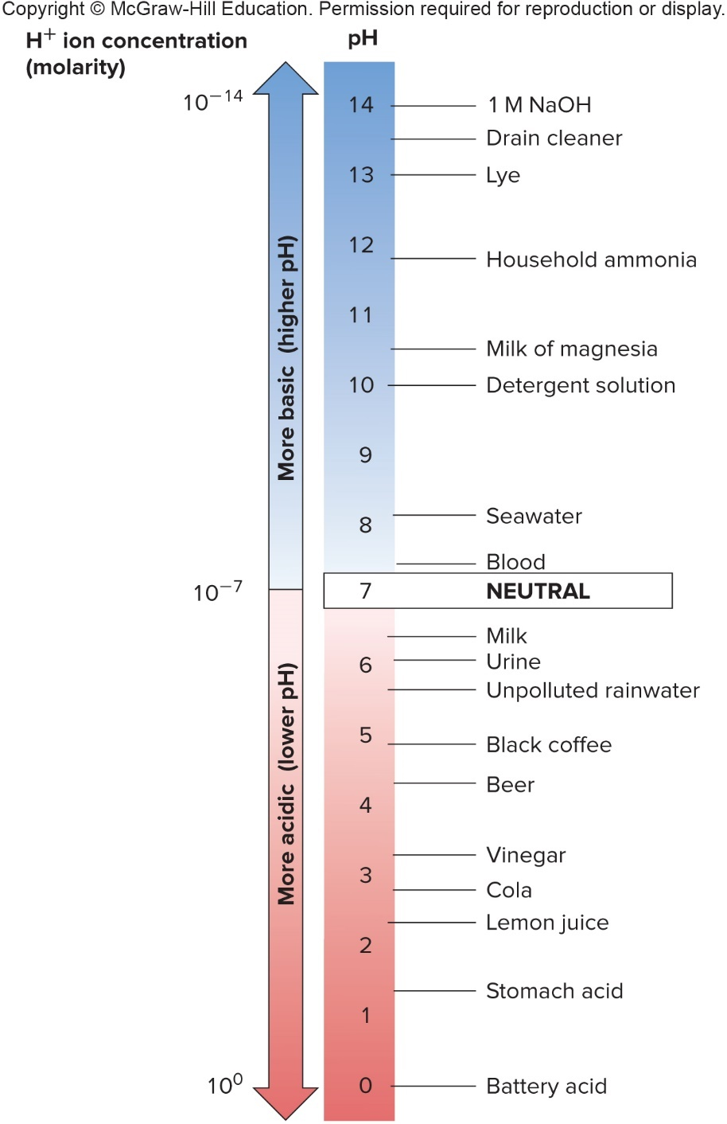
pH of Aqueous Solutions – Figure 2.10
pH is a measure of acidity
  Water (H₂O) tends to split into
  Pure water has equal concentrations
Acids increase
bases decrease it
  Each pH unit (0 to 14) represents ten-fold change in
Jump to pH of Aqueous Solutions – Figure 2.10 Long Description
Notes:
22

Slide 23
Buffers
Buffer: a chemical that helps to maintain a relatively constant pH of solutions
  Base added: buffer releases
Acid added: buffer combines with
Buffers important to action of enzymes that may change shape when pH changes
Notes:
23

Slide 24
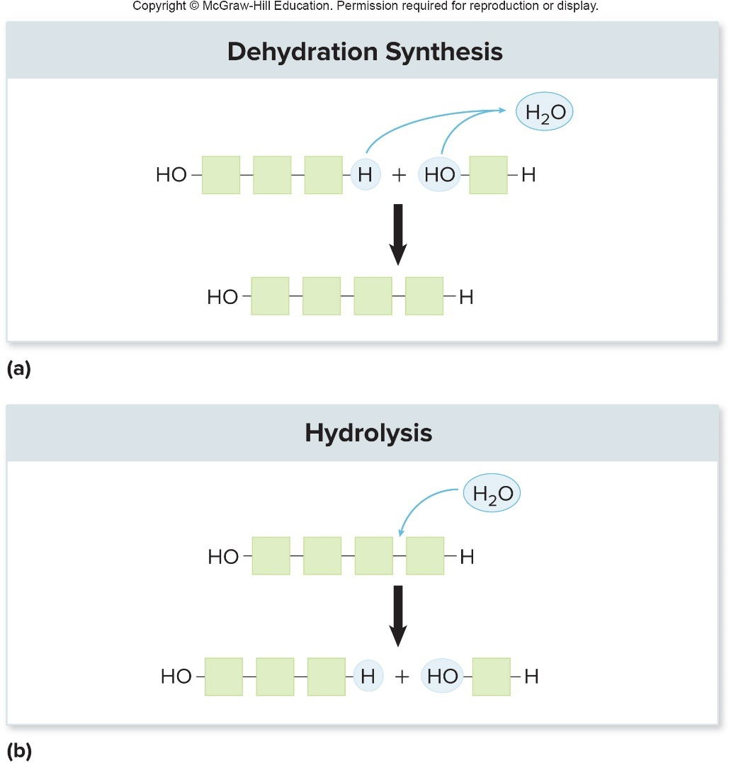
Organic Molecules – Figure 2.11
Polymers are macromolecules made by joining monomers (subunits)
Dehydration synthesis
  Removes water and joins monomers to build polymers
Hydrolysis
  Requires water and breaks a polymer into monomers

Slide 25
Organic Molecules
Carbon skeleton: arrangement of carbon atoms in organic molecule
Functional groups attached to carbon skeleton contribute to molecule’s properties
Notes:
25

Slide 26
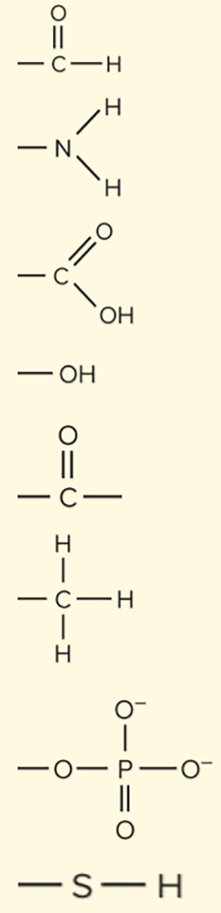
Table 2.5 Biologically Important Functional Groups
Functional Group | Structure | Where Found
Aldehyde |  | Carbohydrates
Amino |  | Amino acids, the subunit of protein
Carboxyl |  | Organic acids, including amino acids and fatty acids
Hydroxyl |  | Carbohydrates, fatty acids, alcohol, some amino acids
Keto |  | Carbohydrates, polypeptides
Methyl |  | Some amino acids, attached to DNA
Phosphate |  | Nucleotides (subunit of nucleic acids), ATP, signaling molecules
Sulfhydryl |  | Part of the amino acid cysteine
Jump to Table 2.5 Biologically Important Functional Groups Long Description

Slide 27
Organic Molecules – Table 2.4
Four major classes of organic molecules: Carbohydrates, Lipids, Proteins & Nucleic acids
Table 2.4 Major Classes of Organic Molecules
Name | Subunits | Major Functions
Carbohydrates | Monosaccharides | Structural component of cell walls; energy source
Lipids | Varies—subunits are not always similar | Important component of cell membranes
Proteins | Amino acids | Enzyme catalysts; structural portion of many cell components
Nucleic acids | Nucleotides
DNA | Deoxyribonucleotides | Carrier of genetic information
RNA | Ribonucleotides | Various roles in protein synthesis; catalysis
Notes:
27

Slide 28
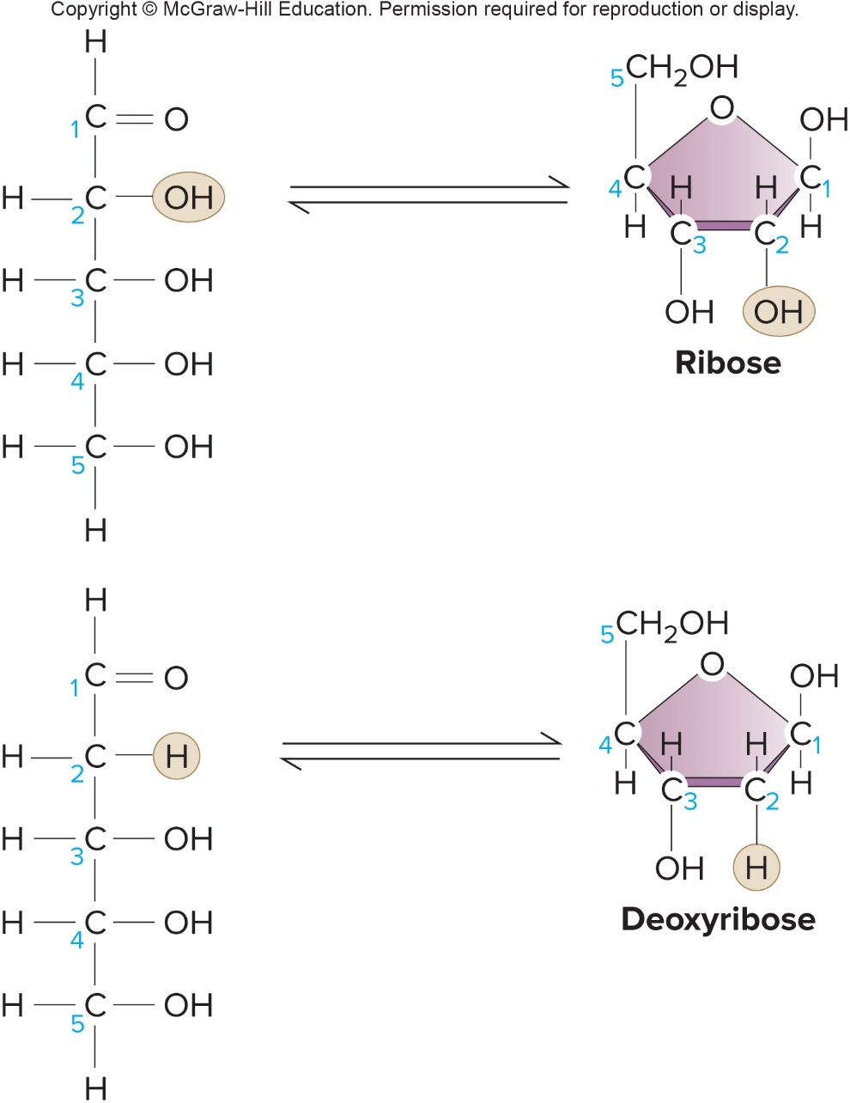
Carbohydrates – Figure 2.12
Diverse group includes sugars and starches
  Energy source
  Energy storage
  Carbon source
  Component of DNA
  and RNA
  Structural components
  of cells
Carbon, hydrogen, oxygen in 1:2:1 ratio
  Building block: CH₂O

Slide 29
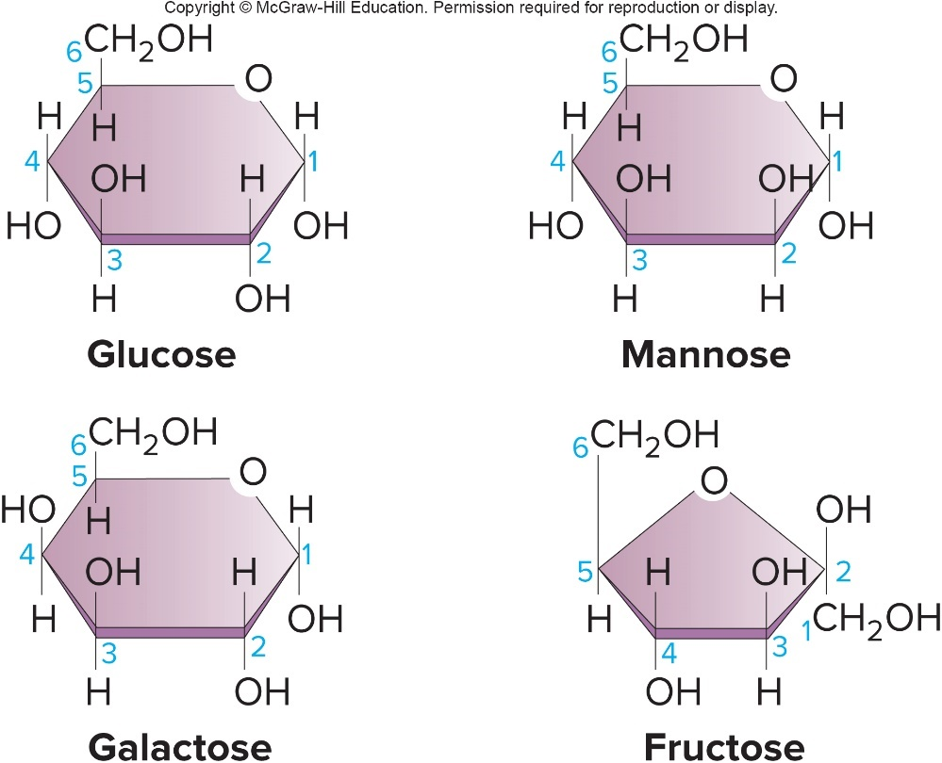
Monosaccharides – Figure 2.13
Monosaccharide: basic unit of carbohydrates
  5-carbon sugars include ribose, deoxyribose
  6-carbon sugars include glucose, galactose, mannose, fructose
    Structural isomers: same atoms, but different arrangement
    Distinct sugars with different properties

Slide 30
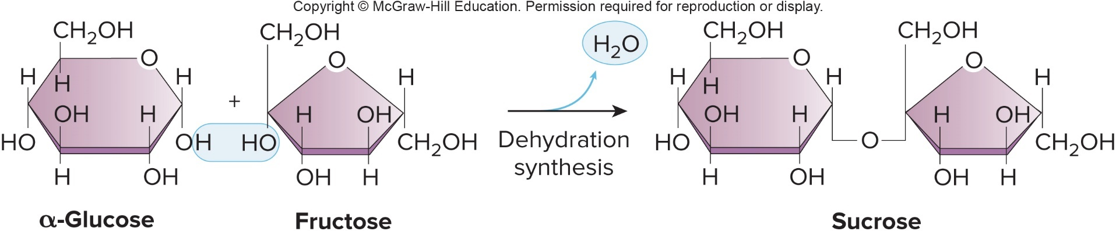
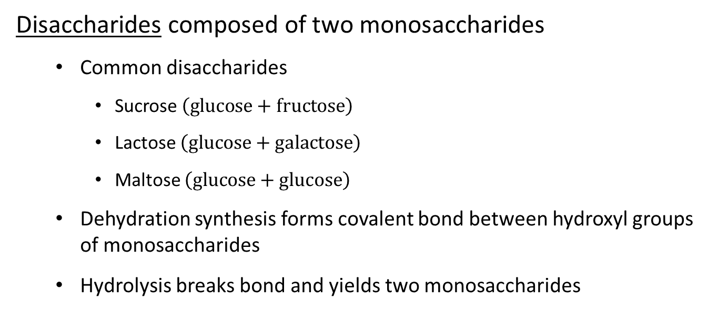
Disaccharides – Figure 2.14
Disaccharides composed of two monosaccharides
  Common disaccharides
    Sucrose $\left(glucose+fructose\right)$
    Lactose $\left(glucose+galactose\right)$
    Maltose $\left(glucose+glucose\right)$
  Dehydration synthesis forms covalent bond between hydroxyl groups of monosaccharides
  Hydrolysis breaks bond and yields two monosaccharides

Slide 31
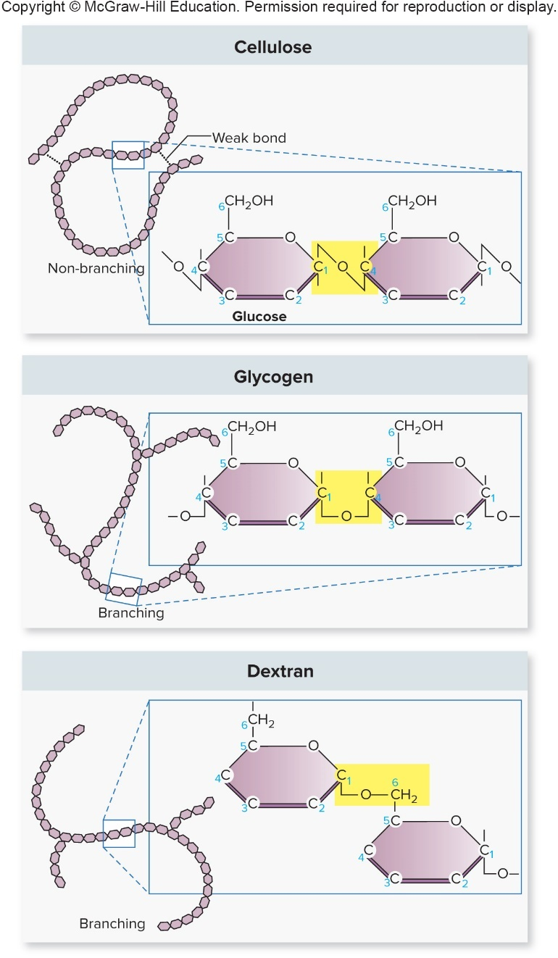
Polysaccharides – Figure 2.15
Polysaccharides are chains of monosaccharides
  Structural diversity from branching, linkages
Important polymers of glucose:
  Cellulose
  Starch
  Glycogen
  Dextran
Chitin, agar also important

Slide 32
Lipids
Lipids are non-polar, hydrophobic molecules
  Diverse group defined by slight solubility in water
    Important in structure of membranes
  Not always composed of similar subunits

Slide 33
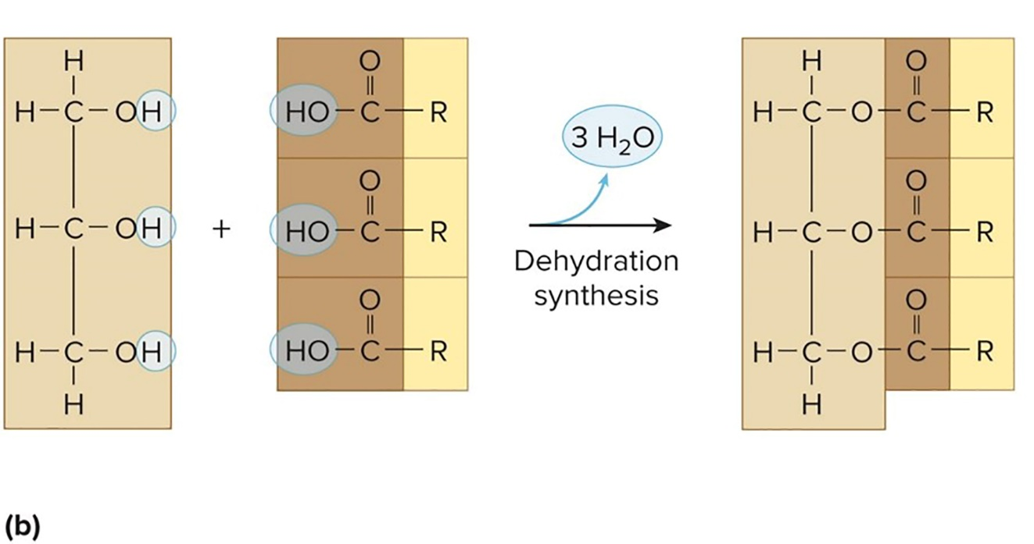
Simple Lipids – Figure 2.16b
Triglycerides: most common simple lipids
  Fats or oils composed of three fatty acids linked to glycerol
  Fatty acids: linear chains of bonded C, H atoms with carboxyl group at one end
$$Glycerol + 3 fatty acids → Triglyceride \left(fat\right)$$
Notes:
33

Slide 34
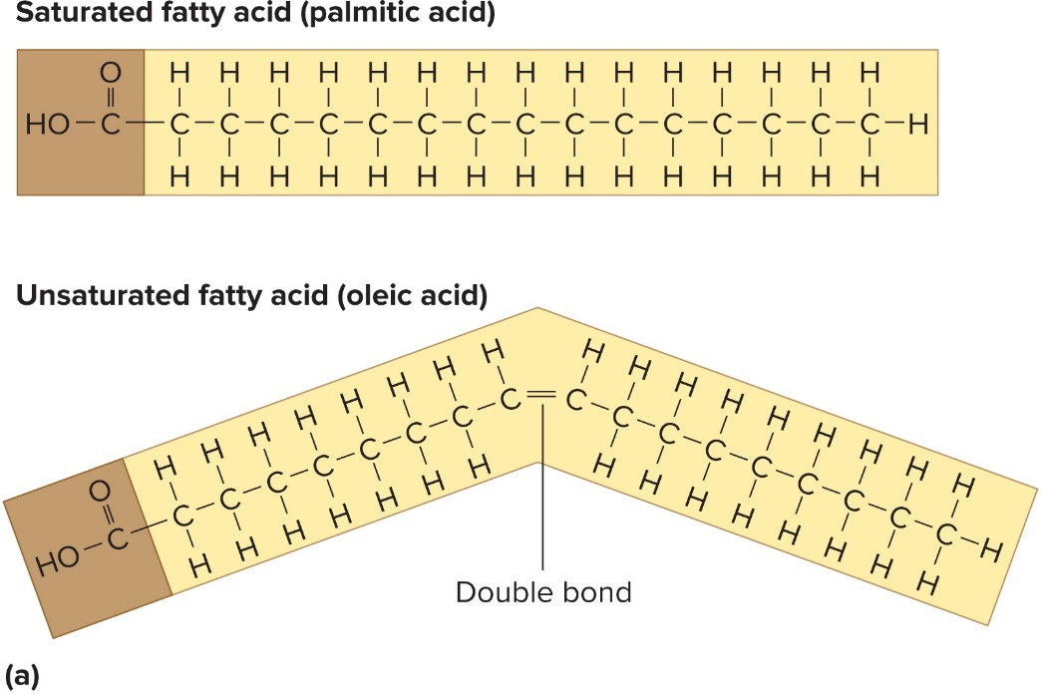
Simple Lipids - Figure 2.16a
Saturated fatty acids
  No double bonds
  Tails pack tightly so solid at room temperature (fats)
Unsaturated fatty acids
  Double bonds between carbon atoms
  Kinks prevent tight packing so liquid at room temperature (oils)

Slide 35
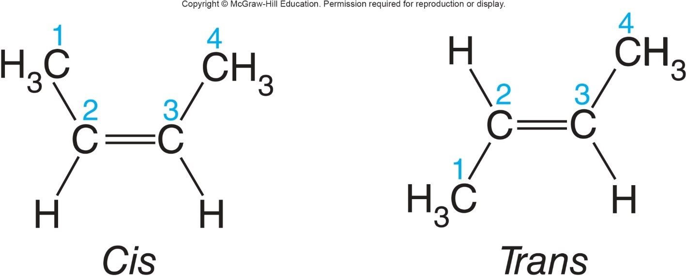
Simple Lipids
Most natural fatty acids are cis: hydrogens attached to same side of double bond
Trans: hydrogens on opposite sides of double bond (linked to certain health problems)
Cis
Trans
Notes:
35

Slide 36
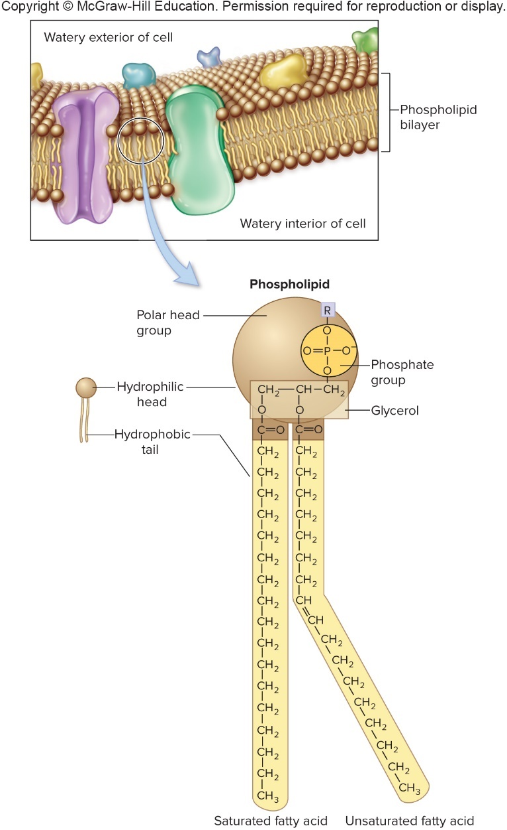
Compound Lipids – Figure 2.17
Compound lipids include elements in addition to C, H, O
Phospholipids contain hydrophilic
phosphate group and hydrophobic fatty acid tails
  Form lipid bilayer with phosphate groups oriented outward toward aqueous environments
  Essential component of cytoplasmic membranes
Lipoproteins, lipopolysaccharides also compound lipids

Slide 37
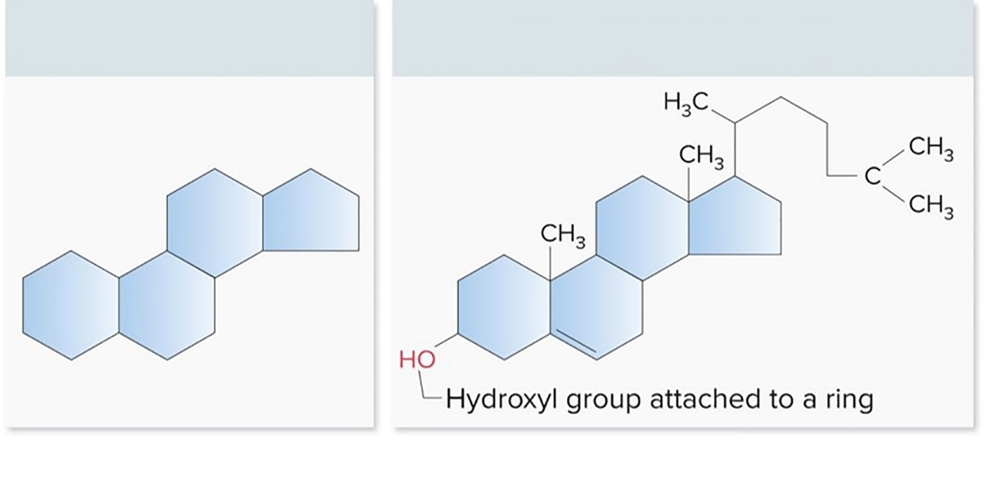
Steroids – Figure 2.18
Steroids have characteristic four-ring structure
  Classified as lipids due to water insolubility
  Sterols such as cholesterol have hydroxyl group attached to one of the rings
  Other steroids include hormones
    Cortisol, progesterone, testosterone
Steroid Ring
Sterol (cholesterol)

Slide 38
Proteins
Some functions of proteins include:
  Enzyme catalysis
  Transport
  Signal reception
  Regulation
  Motility
  Support

Slide 39
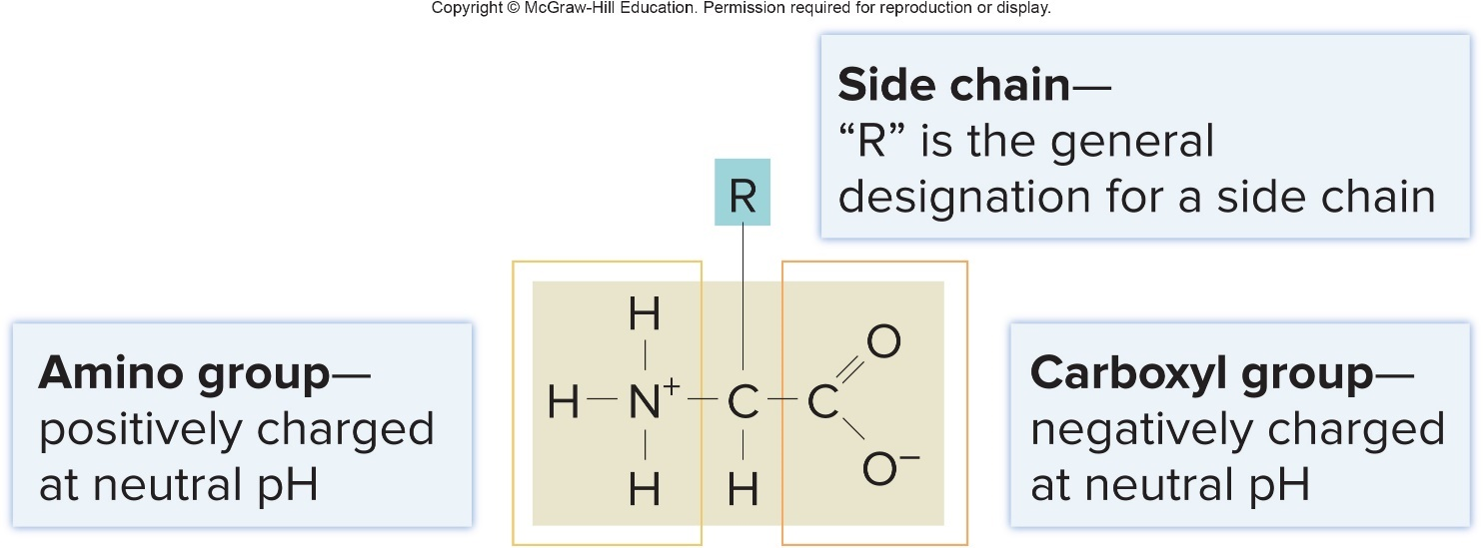
Amino Acids – Figure 2.19
Proteins composed of amino acid subunits
  Amino acids share common structure
    Central carbon, carboxyl group, amino group
    Side chain (R group) differs
    Infinite possible combinations of 20 amino acids
  Protein characteristics depend mainly on shape
    Shape determined by amino acid sequence

Slide 40
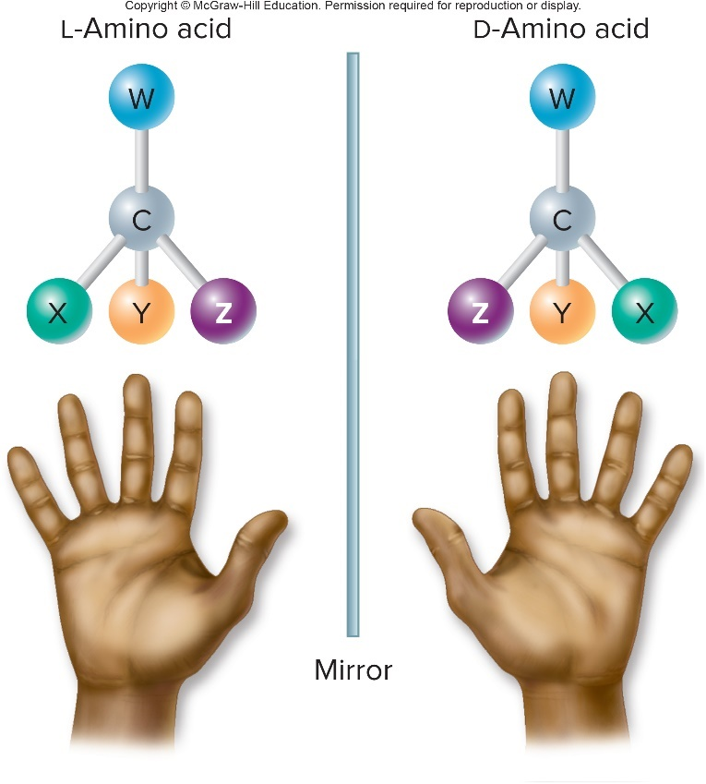
Amino Acids
All amino acids except glycine exist as optical isomers
  Mirror images, but may have different properties
  Most proteins are composed only of L-amino acids
  Bacteria also utilize D-amino acids
Notes:
40

Slide 41
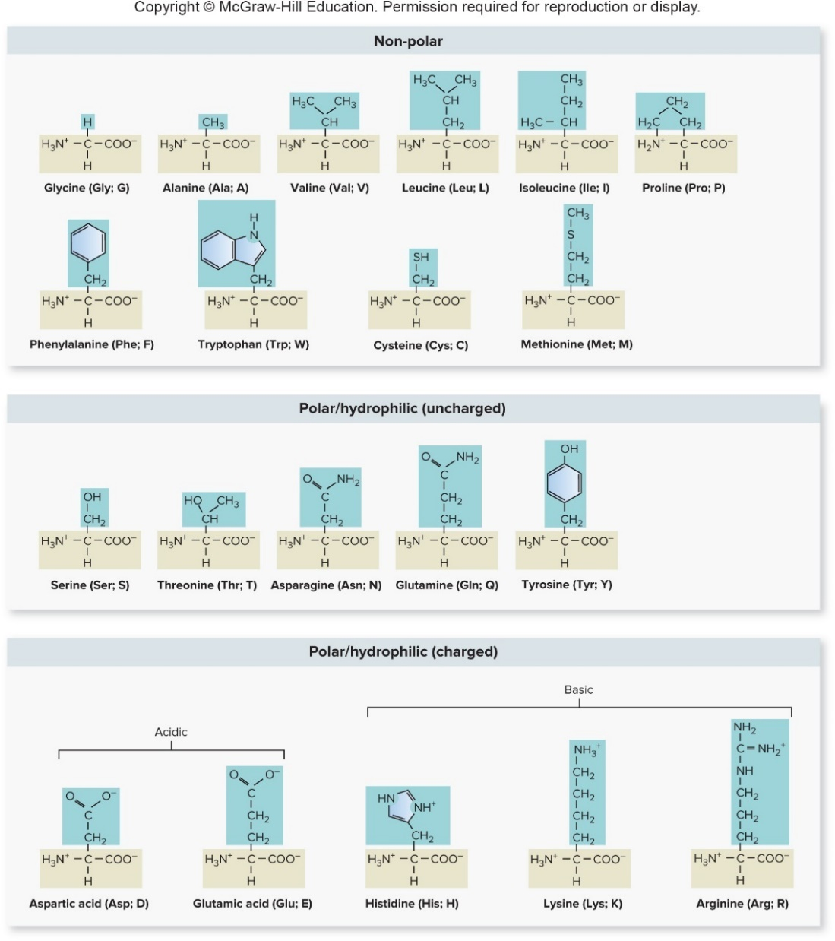

Amino Acids – Figure 2.20
Amino acids characterized by side chains
  Non-polar
  Polar
  Charged
  ($+$ or $−$)
Jump to Amino Acids – Figure 2.20 Long Description

Slide 42
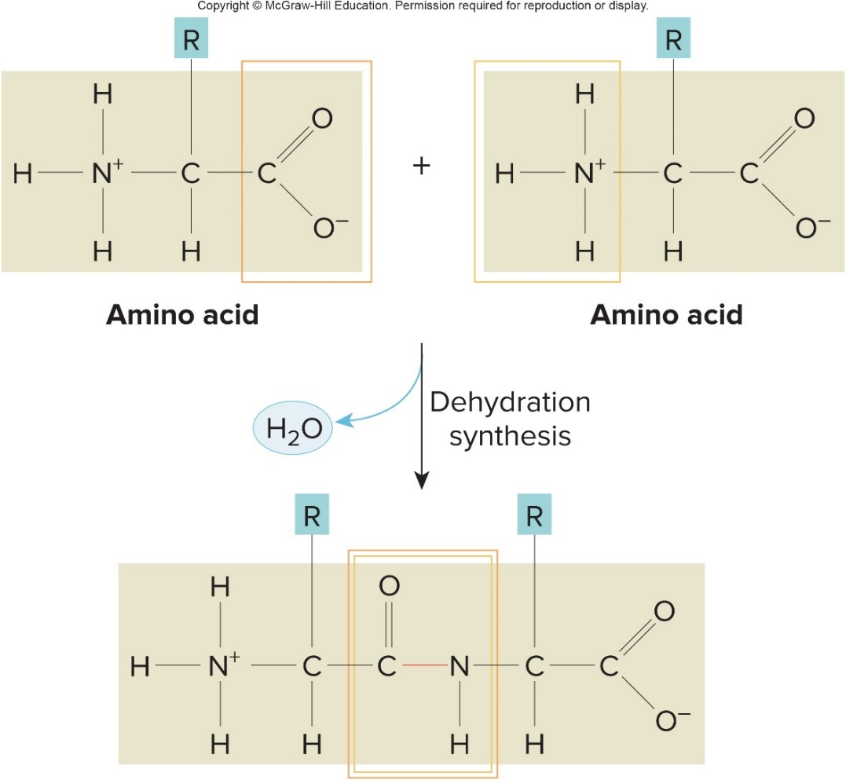
Peptide Bonds – Figure 2.21
Peptide bonds hold amino acids together
  Covalent bond formed by dehydration synthesis reaction between carboxyl group and amino group
Protein is one or more long polypeptides folded to create functional molecule

Slide 43
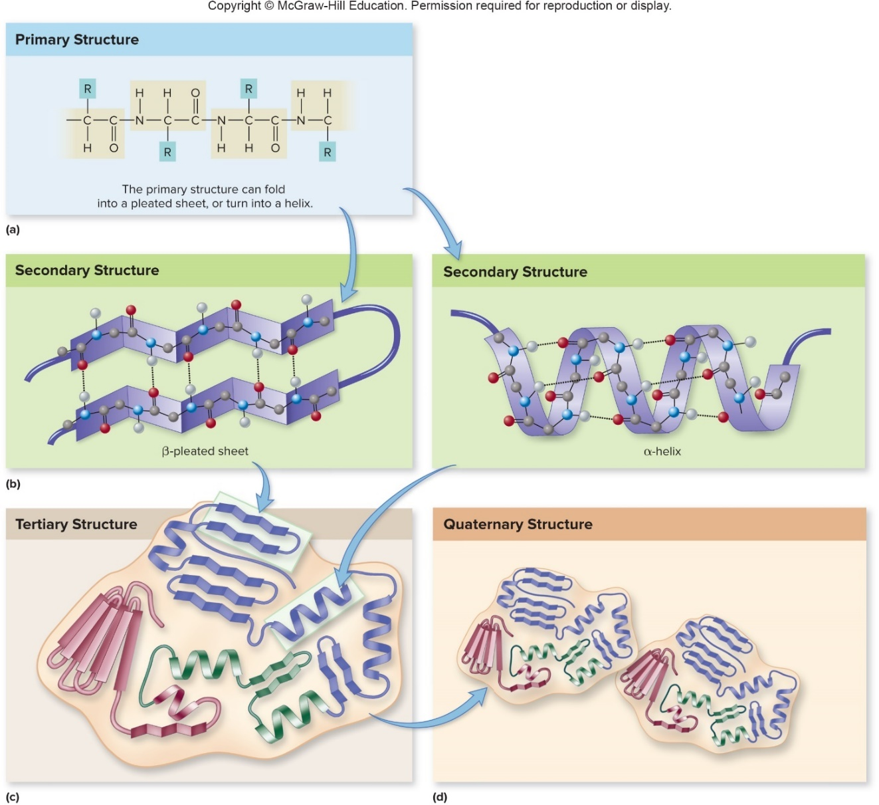
Protein Structure – Figure 2.22
Primary structure: sequence and number of amino acids
Secondary structure: localized coiling (helix) or folding (pleated sheet) largely due to hydrogen bonding
Notes:
43

Slide 44

Protein Structure
Tertiary structure: overall 3-dimensional shape of folded polypeptide largely due to interactions between R groups
  Chaperone may be needed to help with correct folding
Quaternary structure: association between multiple polypeptide chains
Notes:
44

Slide 45
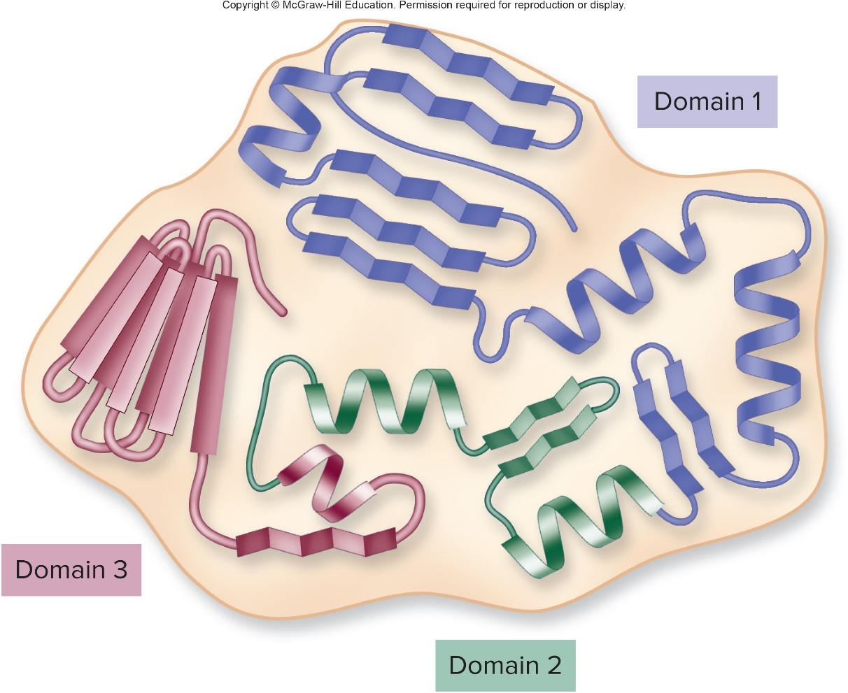
Protein Domains – Figure 2.23
Protein domain: stable substructure associated with a specific function

Slide 46
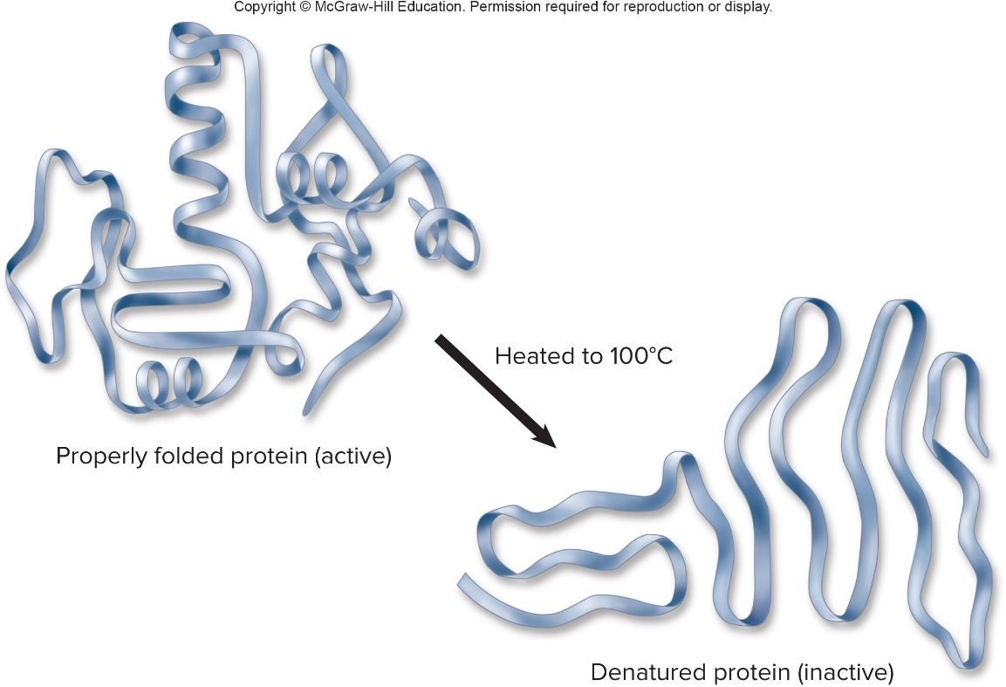
Protein Denaturation – Figure 2.24
When a protein loses its characteristic shape, it is denatured
  Can be caused by high temperature, extreme pH, certain solvents
  Protein may become nonfunctional
  Enzymes function best within narrow range of conditions
Notes:
46

Slide 47
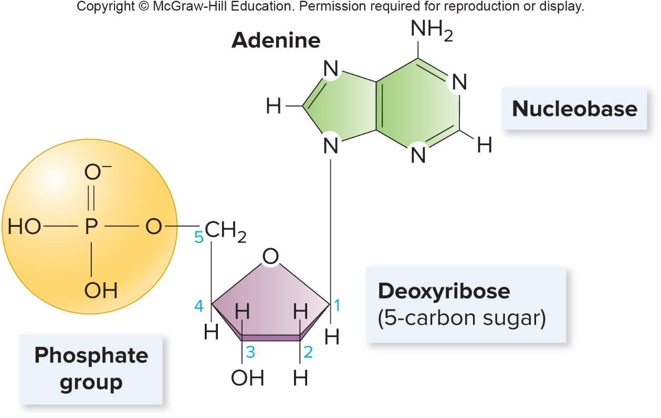
Nucleic Acids – Figure 2.25
Nucleic acids carry genetic information in sequence of nucleotides
Nucleotides are composed of
    Pentose sugar
    Phosphate group
    Nucleobase

Slide 48
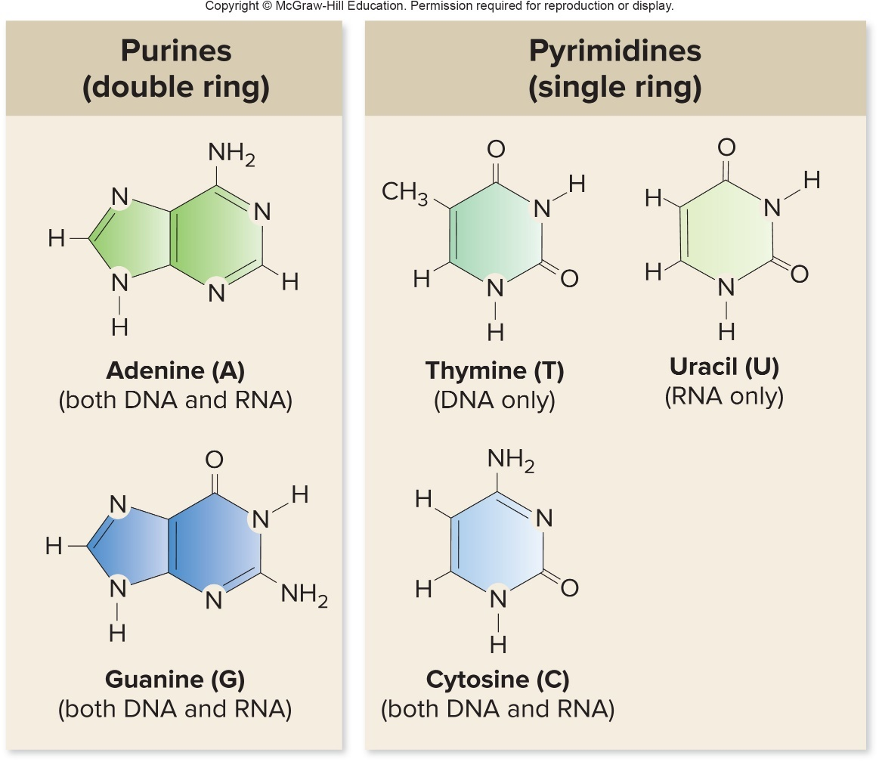
Nucleic Acids – Figure 2.26
Nucleobases include
  Purines: adenine (A), guanine (G)
    Two fused rings
  Pyrimidines: cytosine (C), thymine (T), uracil (U)
    Single ring structure
    Uracil (U) found only in RNA

Slide 49
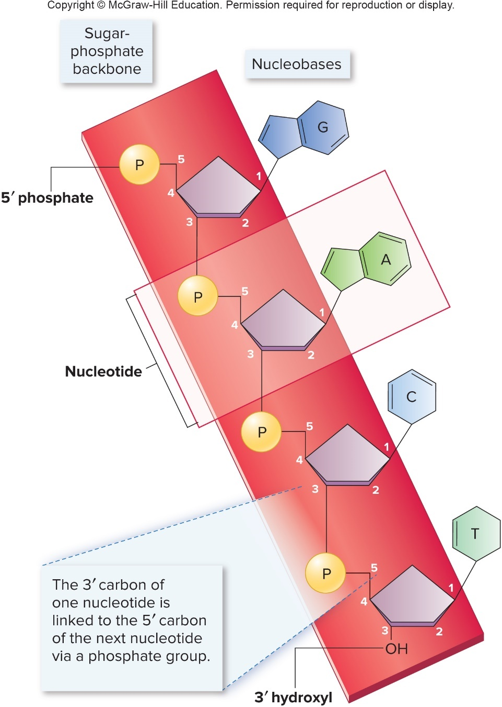
Nucleic Acids – Figure 2.27
Linear chains of nucleotides
  Backbone of alternating sugar and phosphate molecules
  Covalent bond between phosphate group of one nucleotide and sugar of the next
    Phosphate group is on the 5' end of the strand
    Hydroxyl group of sugar is on the 3' end of the strand

Slide 50
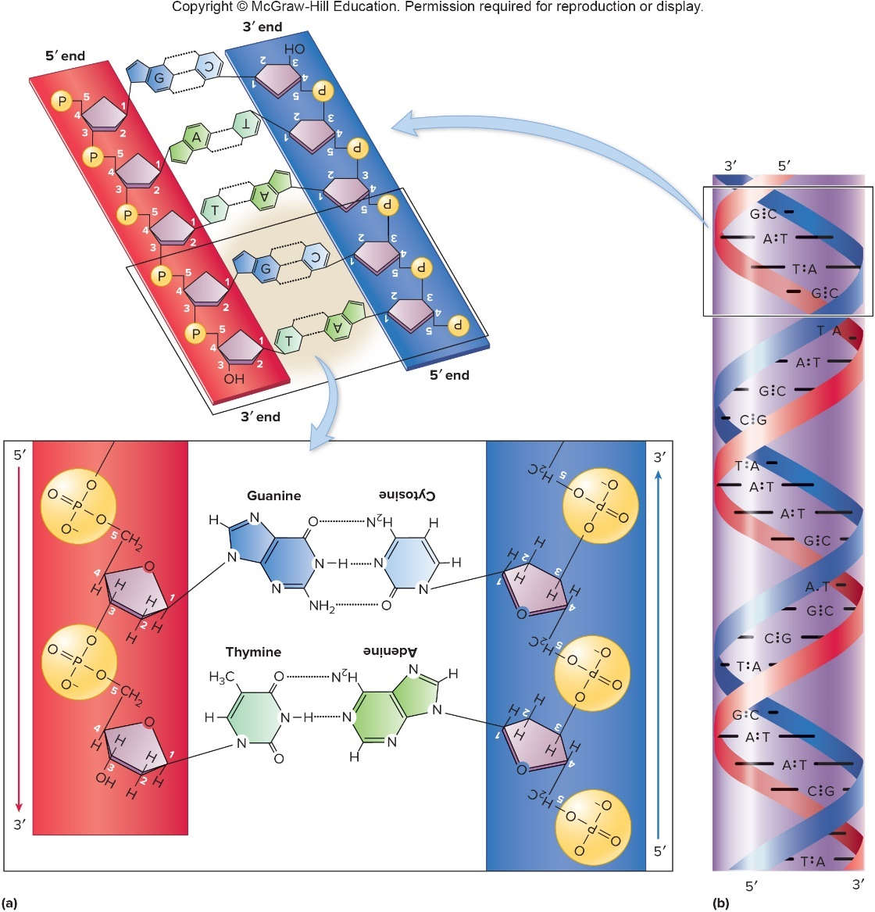
DNA – Figure 2.28
DNA, deoxyribonucleic acid, forms double-stranded helix held together by hydrogen bonding between nucleobases
Strands are antiparallel and complementary
Base-pairing
  A bonds to T
  C bonds to G

Slide 51
RNA
Ribonucleic acid (RNA)
  Several forms of RNA involved in protein synthesis
  Similar to DNA except:
    RNA is mostly single-stranded
    The sugar is ribose instead of deoxyribose
    Uracil is the nucleobase instead of thymine

Slide 52
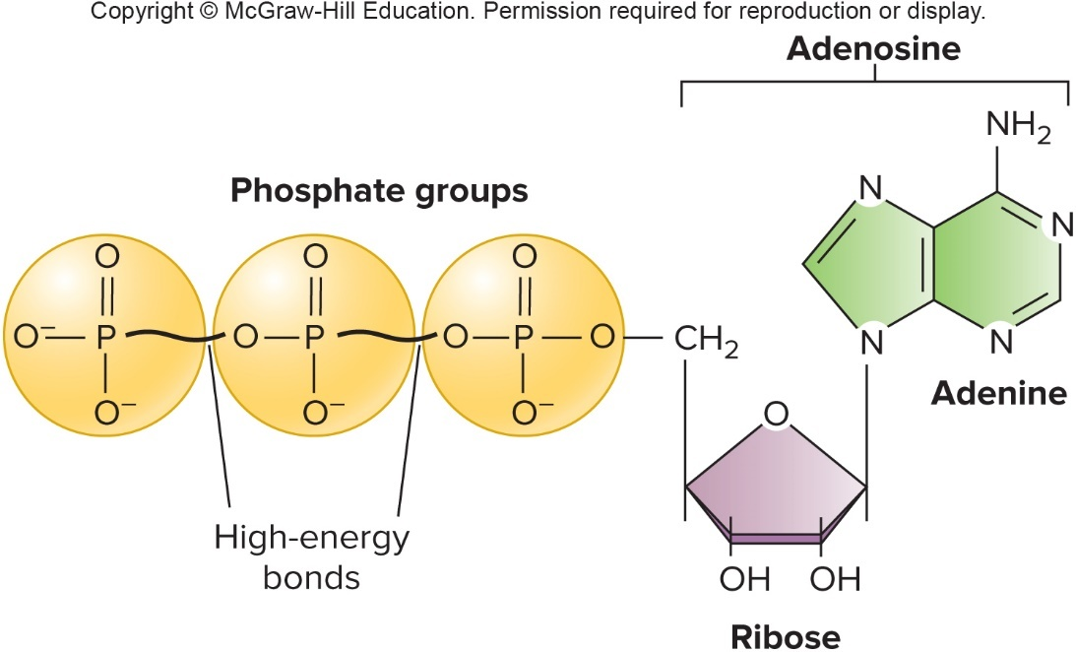
The Role of ATP – Figure 2.29
Adenosine triphosphate (ATP)
  Energy currency of cell
  Three negatively charged phosphate groups repel one another making bonds unstable
    High-energy phosphate bonds break and release energy to drive cellular processes

