Slide 1
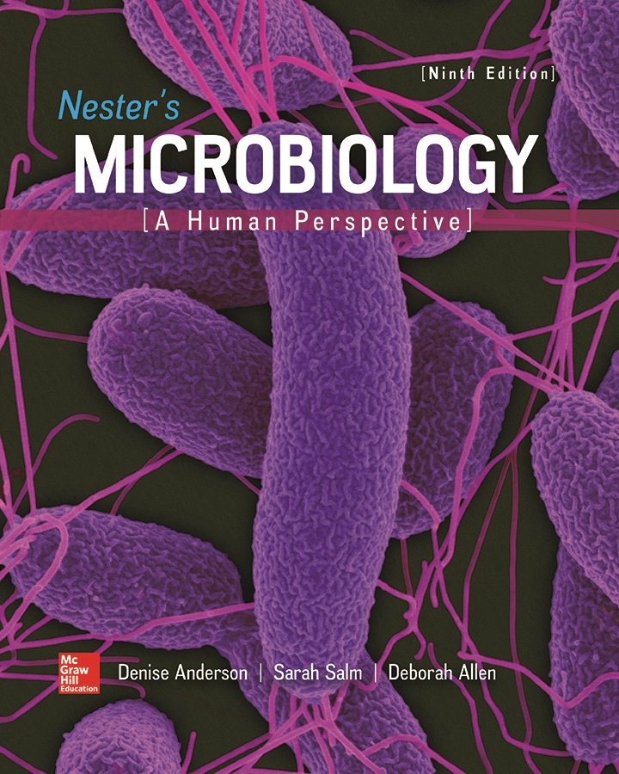
Chapter 08 Lecture Outline
See separate PowerPoint slides for all figures and tables pre-inserted into PowerPoint without notes.
Notes:
1

Slide 2
A Glimpse of History
Barbara McClintock (1902 to 1992)
  Observed that kernel colors in corn not inherited in a predictable manner
  Concluded segments of DNA moved in and out of genes involved in color
    Destroyed function of genes
  Published results in 1950
    Met with skepticism
    DNA believed stable
  Idea established by 1970s
  Awarded Nobel Prize in 1983
  Termed transposons
    “Jumping genes”
©Matt Meadows/Photolibrary/Getty Images

Slide 3
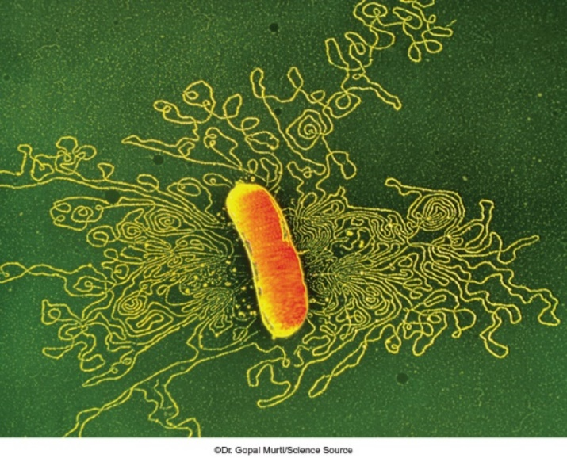
Introduction
Through natural selection, organisms adapt to ever-changing environments
Bacteria have two general mechanisms to adjust to new circumstances
  Regulation of gene expression
  Genetic change
    E. coli often used as model system of genetic change
      Easy to grow, inexpensive, rapid accumulation of large numbers
©Dr. Gopal Murti/Science Source

Slide 4
Genetic Change in Bacteria (1)
Two mechanisms of genetic change in bacteria
  Mutation: changes in existing nucleotide sequence
  Horizontal gene transfer: movement of DNA from one organism to another
Changes are passed to progeny by vertical gene transfer

Slide 5
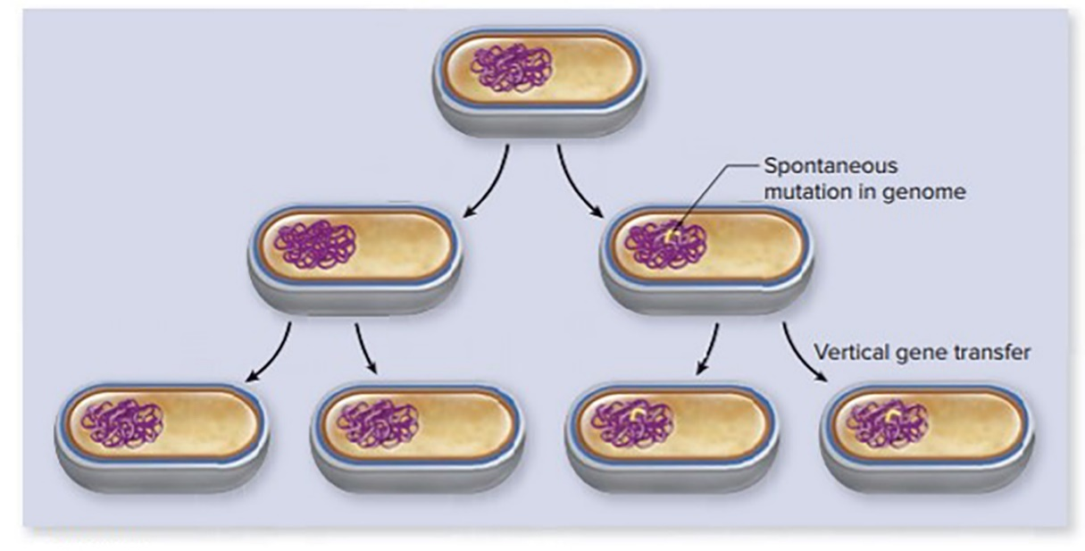

Genetic Change in Bacteria - Figure 8.1
Mutation
Horizontal gene transfer

Slide 6
Genetic Change in Bacteria (2)
Change in organism’s DNA alters genotype
  Sequence of nucleotides in DNA
  Bacteria are haploid, so only one copy, no backup
Change in genotype often changes observable characteristics, or phenotype
  Also influenced by environmental conditions
Notes:
6

Slide 7
Genetic Change in Bacteria (3)
Deletion of gene for tryptophan biosynthesis yields a mutant that only grows if tryptophan is supplied
    Growth factor required; mutant termed auxotroph
      Auxo = “increase”; troph = “nourishment”
    Prototroph does not require growth factors
      Proto = “first”
Geneticists compare mutants to wild type
  Typical phenotype of strains isolated from nature
  For example, wild-type E. coli strain is prototroph
  Strains designated by three-letter abbreviations
cannot make tryptophan
Streptomycin resistance designated

Slide 8
Spontaneous Mutations (1)
Spontaneous mutations are genetic changes that result from normal processes
Occur randomly at infrequent characteristic rates
  Mutation rate: probability of mutation per cell division
  Typically between
Mutations passed to progeny
Occasionally change back to original state: reversion
  Also occurs spontaneously at low frequencies

Slide 9
Spontaneous Mutations (2)
Large populations such as cells in a colony contain mutants; not all cells are identical
Environment does not cause mutations, but selects cells that grow under its conditions
  An organism that has mutated to become resistant to an antimicrobial medication will become dominant in an environment where the medication is present
    Sensitive cells are killed; resistant cells survive
Single mutation is rare; two even more unlikely
  Physicians may give two antimicrobial medications simultaneously to reduce resistance
    Chance that a cell will become resistant to both medications is product of mutation rate for each gene
Notes:
9

Slide 10
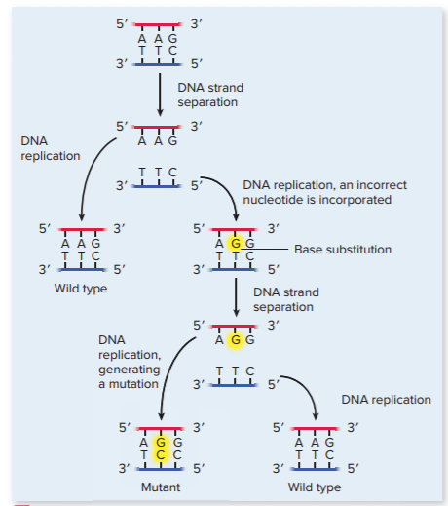
Spontaneous Mutations - Figure 8.2
Base substitution most common
  Incorrect nucleotide
  incorporated during
  DNA synthesis
  Point mutation is change of a single base pair

Slide 11
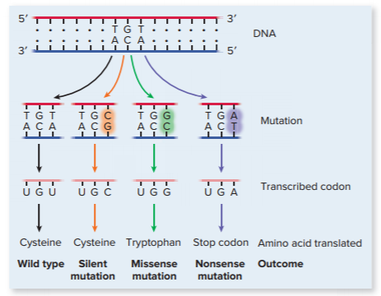
Spontaneous Mutations - Figure 8.3
Base substitution: three possible outcomes
  Silent (synonymous) mutation: wild-type amino acid
  Missense mutation: different amino acid
    Resulting protein often does not function normally
  Nonsense mutation: Specifies stop codon
      Yields shorter, often non-functional protein
Jump to Spontaneous Mutations - Figure 8.3 Long Description

Slide 12
Spontaneous Mutations (3)
Base substitutions that inactivate a gene is termed a null or knockout mutation
Base substitutions more common in aerobic environments
  Reactive oxygen species (ROS) produced from O₂
  Can oxidize nucleobase guanine
    DNA polymerase often mispairs with adenine instead of cytosine

Slide 13
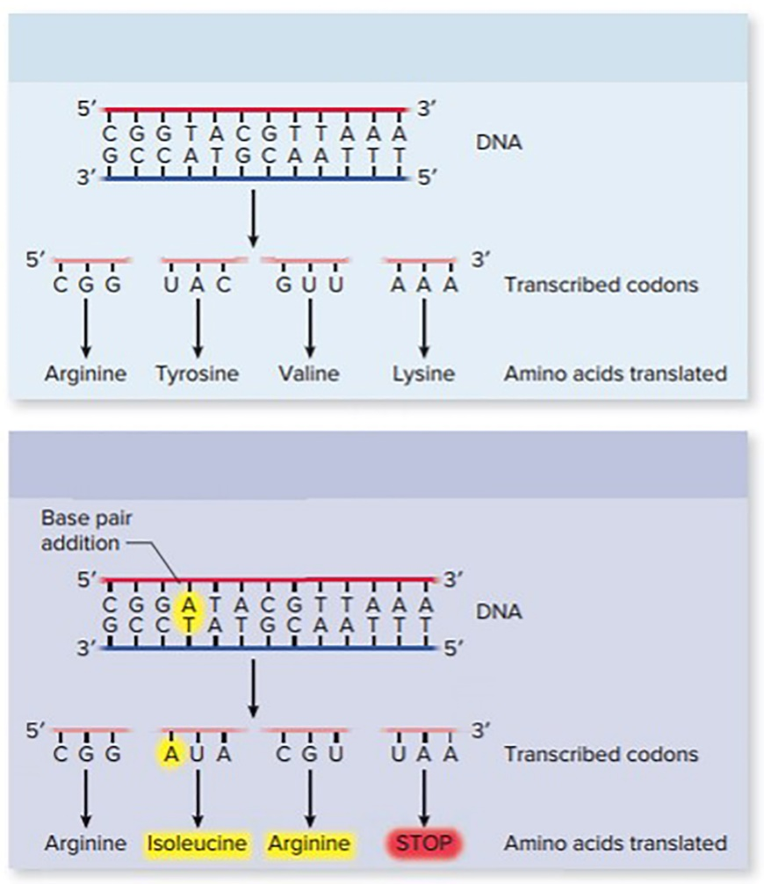
Spontaneous Mutations (4)
Deletion or addition of nucleotides
  Impact depends on number of nucleotides involved
  Three pairs changes one codon
    One amino acid more or less
Wild type
    Impact depends on location within protein
  One or two pairs yields frameshift mutation
    Different set of codons translated
    Often results in premature stop codon
    Shortened, nonfunctional protein
Mutant

Slide 14
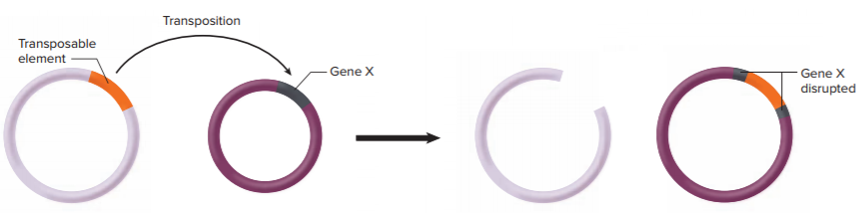
Spontaneous Mutations (5)
Transposons (jumping genes): pieces of DNA that can move from one location to another in a cell’s genome; process of transposition
  Insertional inactivation: gene into which transposon jumps is inactivated; function disrupted
  Most transposons have transcriptional terminators
    Block expression of downstream genes in operon

Slide 15
Table 8.1 Common Mutagens
Induced mutations result from outside influence
  Agent that induces change is mutagen
  Geneticists may use mutagens to increase mutation rate
  Two general types: chemical agent, radiation
Agent | Action | Result
Chemical Mutagens
Chemicals that modify nucleobases | Chemical modifications change base-pairing properties of nucleobases | Nucleotide substitution
Base analogs | Base-pairing properties differ from those of nucleobases normally found in DNA | Nucleotide substitution
Intercalating agents | Insert between base pairs, pushing them apart | Addition or subtraction of nucleotides
Transposons | Randomly insert into DNA | Insertional inactivation
Radiation
Ultraviolet (UV) light | Causes thymine dimers to form | Errors during repair process
X rays | Cause single- and double-strand breaks in DNA | Deletions

Slide 16
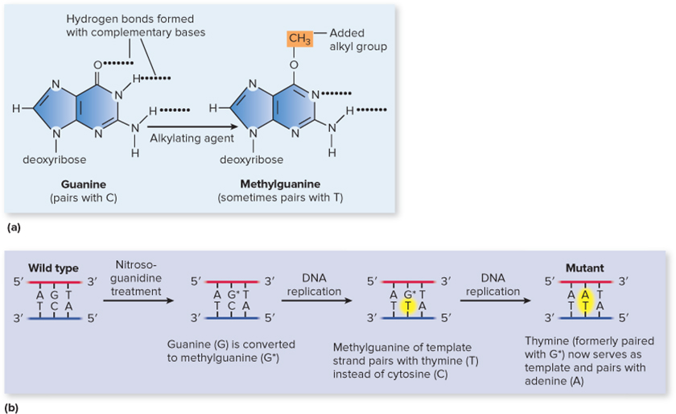
Induced Mutations - Figure 8.7
Chemicals that modify nucleobases
  Change base-pairing properties; increase chance of incorrect nucleotide incorporation
  Alkylating agents add alkyl groups onto nucleobases
    Nitrosoguanidine adds methyl group to guanine
      May base-pair with thymine

Slide 17
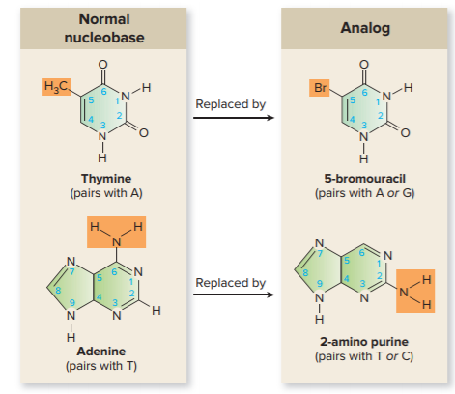
Induced Mutations - Figure 8.8
Base analogs resemble nucleobases, but have different hydrogen-bonding properties
  Can be incorporated into DNA by DNA polymerase
  Wrong nucleotide is incorporated into complementary strand during DNA replication
    5-bromouracil resembles thymine, often base-pairs with guanine
    2-amino purine resembles adenine, often pairs with cytosine

Slide 18
Induced Mutations (1)
Intercalating agents increase frameshift mutations
  Flat molecules that intercalate (insert) between adjacent base pairs in DNA strand
    Pushes nucleotides apart, produces space
    Causes errors during replication
  If in template strand, a base pair added to synthesized strand
  If in strand being synthesized, a base pair deleted
  Often result in premature stop codon

Slide 19
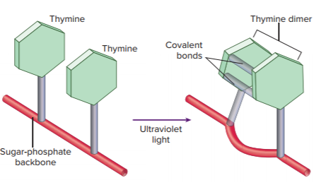
Induced Mutations - Figure 8.9
Radiation can be used as mutagen
  Ultraviolet light causes thymine dimers (covalent bonds between adjacent thymines)
    Distorts molecule; replication and transcription stall
    Mutations result from cell’s SOS repair mechanism
  X rays cause single- and double-strand breaks in DNA
    Double-strand breaks often lethal
    Can alter nucleobases

Slide 20
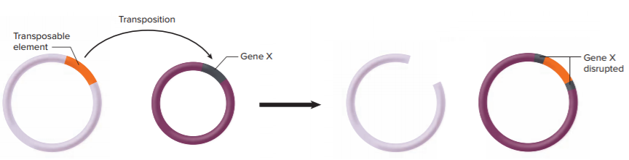
Induced Mutations (2)
Transposition
  Transposons can be introduced intentionally to generate mutations
  Transposon inserts into cell’s genome
  Generally inactivates gene into which it inserts

Slide 21
Repair of Damaged DNA
Enormous amount of spontaneous and mutagen-induced damage to DNA
  If not repaired, can lead to cell death; cancer in animals
    For example, in humans, two genes associated with breast cancer code for DNA repair enzymes; mutations in either result in high probability of breast cancer
Mutations are rare because alterations in DNA generally repaired before being passed to progeny

Slide 22
Table 8.2 Repair of Damaged DNA
 | Type of Defect | Repair Mechanism | Characteristics of Repair
Spontaneous | Error in nucleotide incorporation | Proofreading by DNA polymerase | DNA polymerase removes the mispaired nucleotide and replaces it with the correct one.
Spontaneous | Error in nucleotide incorporation | Mismatch repair | A protein binds to the site of the mismatch and cuts the unmethylated strand. A short stretch of that strand is then degraded and DNA polymerase synthesizes a replacement.
Spontaneous | Modified nucleobase in DNA | Action of glycosylases | A glycosylase removes the oxidized nucleobase. A short stretch of that strand is then degraded, and DNA polymerase synthesizes a replacement.
Mutagen-Induced
Chemical | Error in nucleotide incorporation | Proofreading and mismatch repair | Same as for spontaneous mutations (see characteristics of proofreading and mismatch repair under that heading).
UV light | Thymine dimer | Photoreactivation (light repair) | The energy of light is used to break the covalent bond between the thymine nucleobases, restoring the original molecule.
UV light | Thymine dimer | Excision repair (dark repair) | An enzyme removes a short stretch of the strand containing the thymine dimer; DNA polymerase then synthesizes a replacement.
UV light | Thymine dimer | SOS repair | A special DNA polymerase synthesizes DNA even when the template is extensively damaged; the cell may survive but numerous mutations are introduced.

Slide 23
Repair of Errors in Nucleotide Incorporation
During replication, DNA polymerase sometimes incorporates wrong nucleotide
Mutation prevented by repairing before DNA replication
  Two mechanisms of repair: proofreading and mismatch repair
  Proofreading by DNA polymerases; checks accuracy
    Can back up, remove incorrect nucleotide
    Inserts correct nucleotide
    Very efficient but not perfect

Slide 24
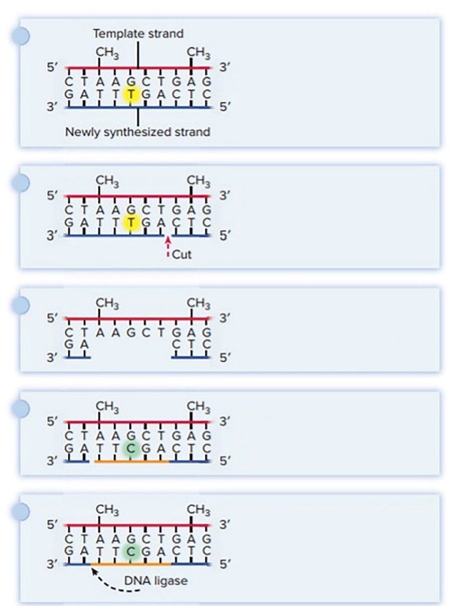
Repair of Errors in Nucleotide Incorporation - Figure 8.10
Mismatch Repair fixes errors missed by DNA polymerase
  Enzyme cuts sugar-phosphate backbone of new DNA strand
  Another enzyme degrades short region of DNA strand with error
    Methylation of DNA indicates template strand
    Newly synthesized strand is unmethylated
  DNA polymerase, DNA ligase fill in and seal the gap
The wrong nucleotide is incorporated during DNA synthesis.
Near the site of the mismatched base, an enzyme cuts the sugar-phosphate backbone of the unmethylated strand.
An enzyme degrades a short stretch of the strand that had the error.
DNA polymerase synthesizes a new stretch, incorporating the correct nucleotide.
DNA ligase joins the 3' end of the newly synthesized segment to the original strand.

Slide 25
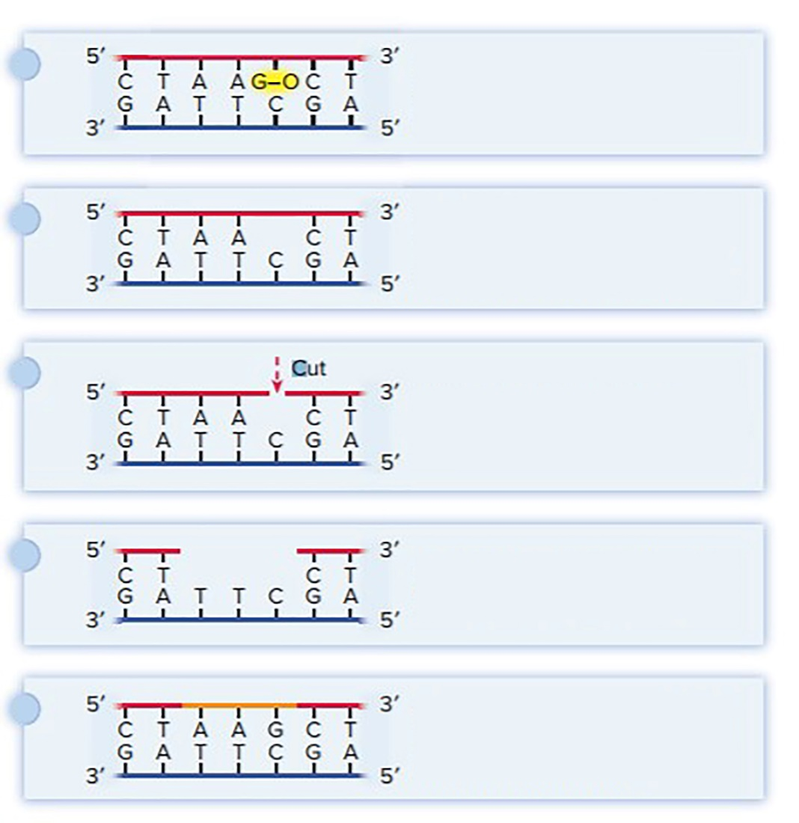
Repair of Modified Nucleobases in DNA - Figure 8.11
Modified nucleobases lead to base substitutions
DNA contains oxidized guanine (G-O) as a result of oxidation damage.
  Glycosylase removes oxidized nucleobase
  Another enzyme cuts DNA at this site
  DNA polymerase removes short section; synthesizes replacement
  DNA ligase seals gap
Glycosylase removes the oxidized nucleobase from the sugar-phosphate backbone.
At the site of the missing nucleobase, an enzyme cuts the sugar-phosphate backbone.
DNA polymerase degrades a short stretch of the strand.
The combined actions of DNA polymerase and DNA ligase fill in and seal the gap.

Slide 26
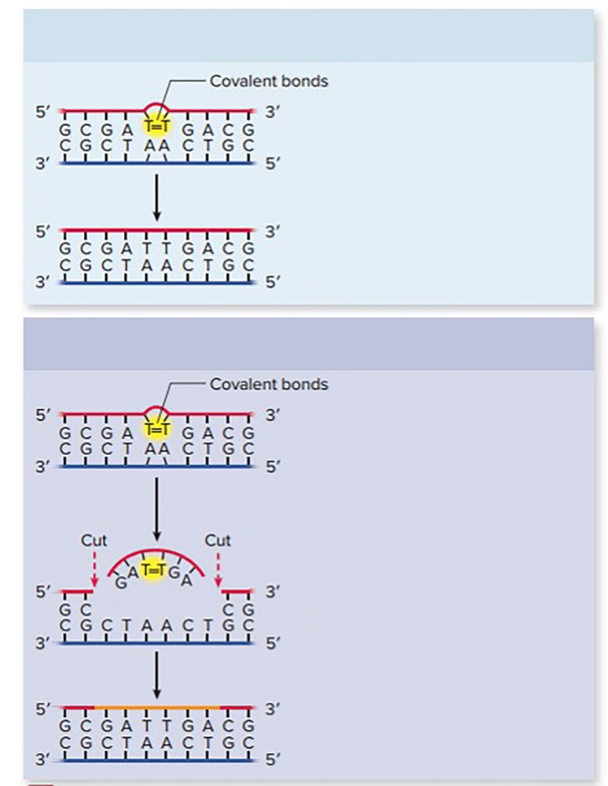
Repair of Thymine Dimers - Figure 8.12
Photoreactivation: light repair
  Enzyme uses energy from light
  Breaks covalent bonds of thymine dimer
  Only found in bacteria
Photoreactivation
Thymine dimer distorts the DNA molecule.
An enzyme uses visible light to break the covalent bond of the thymine dimer, restoring the DNA to its original state.
Excision repair
Thymine dimer distorts the DNA molecule.
Excision repair: dark repair
  Enzyme removes damage
  DNA polymerase, DNA
  ligase fill in and seal the gap
An enzyme removes the damaged section by cutting the DNA backbone on either side of the thymine dimer.
The combined actions of DNA polymerase and DNA ligase fill in and seal the gap.

Slide 27
SOS Repair
SOS repair: last-ditch repair mechanism used when other systems fail
  Induced following extensive DNA damage that stalls DNA and RNA polymerases
  Several dozen genes in SOS system
    Includes a DNA polymerase that synthesizes even in extensively damaged regions
    Has no proofreading ability, so errors made
    Results in SOS mutagenesis

Slide 28
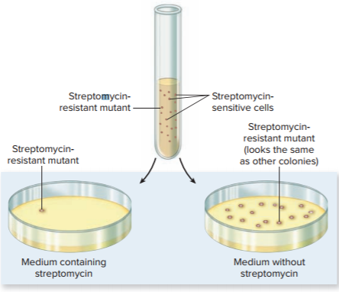
Mutant Selection - Figure 8.13
Direct selection: cells inoculated onto medium that supports growth of mutant but not parent
  Antibiotic-resistant mutants grow on medium with the antibiotic, but parents do not
Notes:
28

Slide 29
Mutant Selection
Indirect selection: isolates auxotroph from prototrophic parent strain
  More difficult since parents grow on any media on
  which auxotroph can grow
  Replica plating indirectly selects auxotrophs
    Master plate with nutrient agar pressed onto velvet
    Velvet with adhering cells pressed onto sterile media in consistent orientation
      All cells will form colonies on nutrient agar
      Auxotrophs fail to grow on glucose-salts agar
    Colonies that are missing on glucose-salts agar allow identification of auxotrophs on master plate

Slide 30
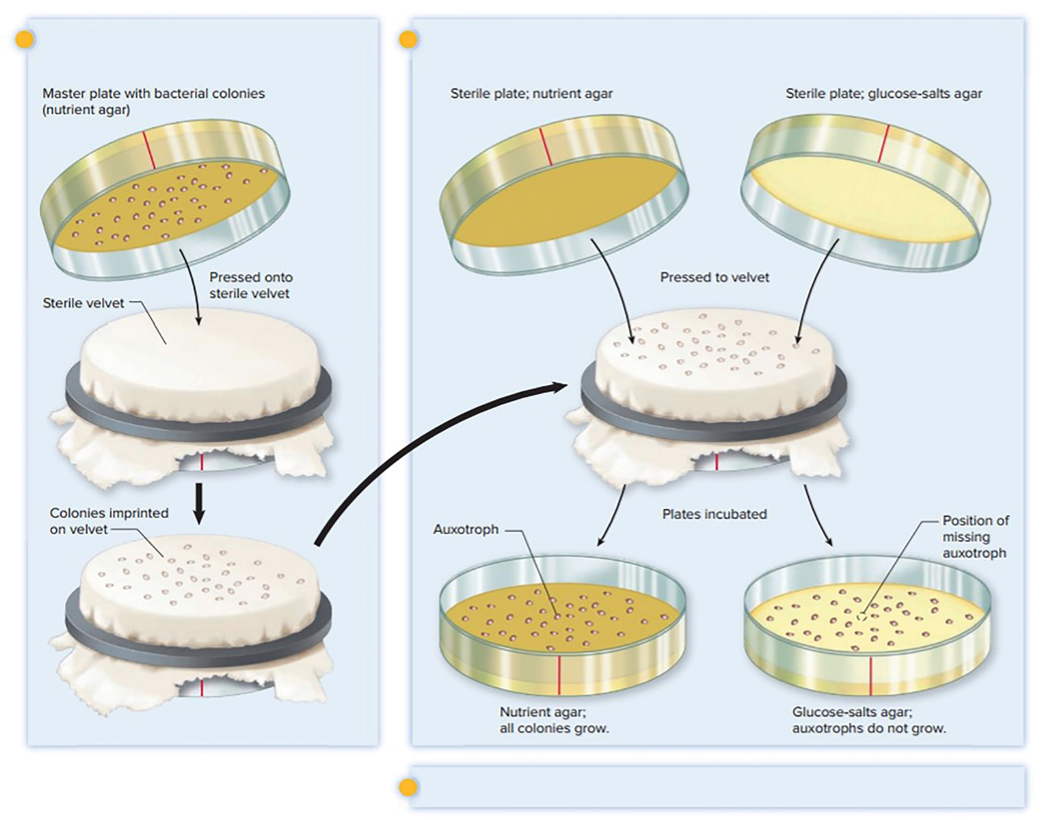
Mutant Selection - Figure 8.14
A plate of bacterial colonies is pressed onto the surface of sterile velvet.
Cells adhering to the velvet are transferred to the sterile media, resulting in exact replicas of the original plate.
Auxotrophic mutants form colonies on the nutrient agar but not on the glucose-salts agar.

Slide 31
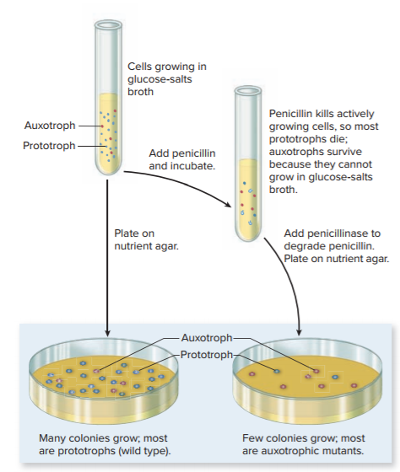
Mutant Selection - Figure 8.15
Penicillin enrichment selectively kills prototrophs
  Increases auxotrophs before replica plating
  Penicillin kills only growing cells
    Prototrophs grow in glucose-salts medium; auxotrophs do not
  Penicillinase added before cells are plated on nutrient agar to create master plate

Slide 32
Screening for Possible Carcinogens
Carcinogens cause many cancers; most are mutagens
  Animal tests expensive, time-consuming; quicker and cheaper to test mutagenic effect of chemicals in microbiological systems
  Mutagens increase low frequency of spontaneous reversions
  Ames test measures effect of chemical on reversion rate of histidine-requiring Salmonella auxotroph
    Uses direct selection on glucose-salts plate
      Only prototrophs that have undergone reversion can grow
    If chemical is mutagenic, reversion rate increases relative to control (more colonies grow)
    Rat liver extract may be added since non-carcinogenic chemicals may be converted to carcinogens by animal enzymes
    Additional tests on mutagenic chemicals to determine if they are also carcinogenic

Slide 33
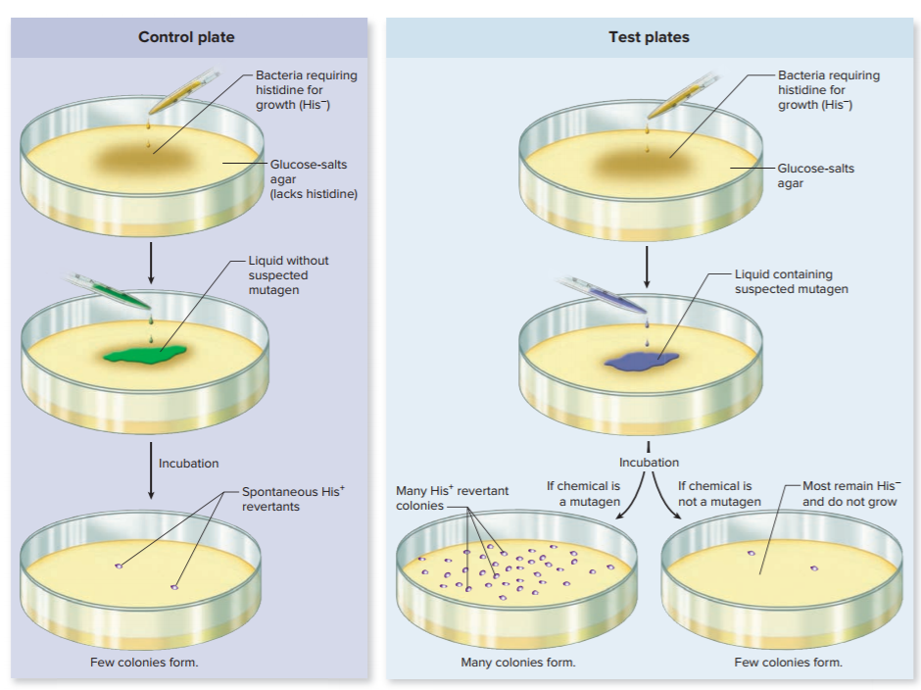
Screening for Possible Carcinogens - Figure 8.16

Slide 34
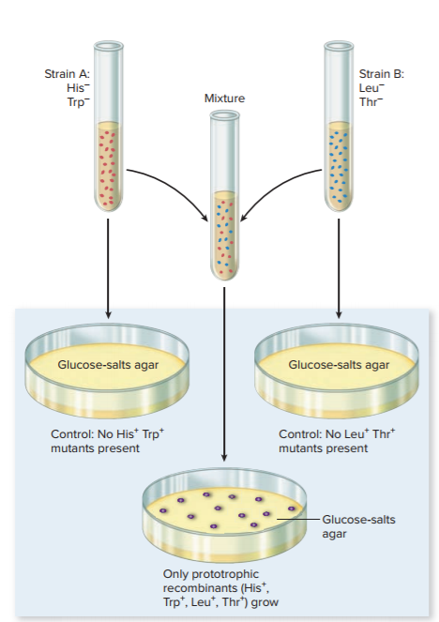
Horizontal Gene Transfer as a Mechanism of Genetic Change (1)
Recombinants acquire genes from other cells by horizontal gene transfer
  Can demonstrate with auxotrophs
    Combine two strains that cannot grow on glucose-salts medium
    Spontaneous mutants unlikely; simultaneous mutations required
    Colonies that can grow on glucose-salts medium most likely acquired genes from other strain

Slide 35
Horizontal Gene Transfer as a Mechanism of Genetic Change (2)
Genes naturally transferred by three mechanisms
  DNA-mediated transformation: “naked” DNA taken up from the environment
  Transduction: bacterial DNA transfer by a virus
  Conjugation: DNA transfer during cell-to-cell contact

Slide 36
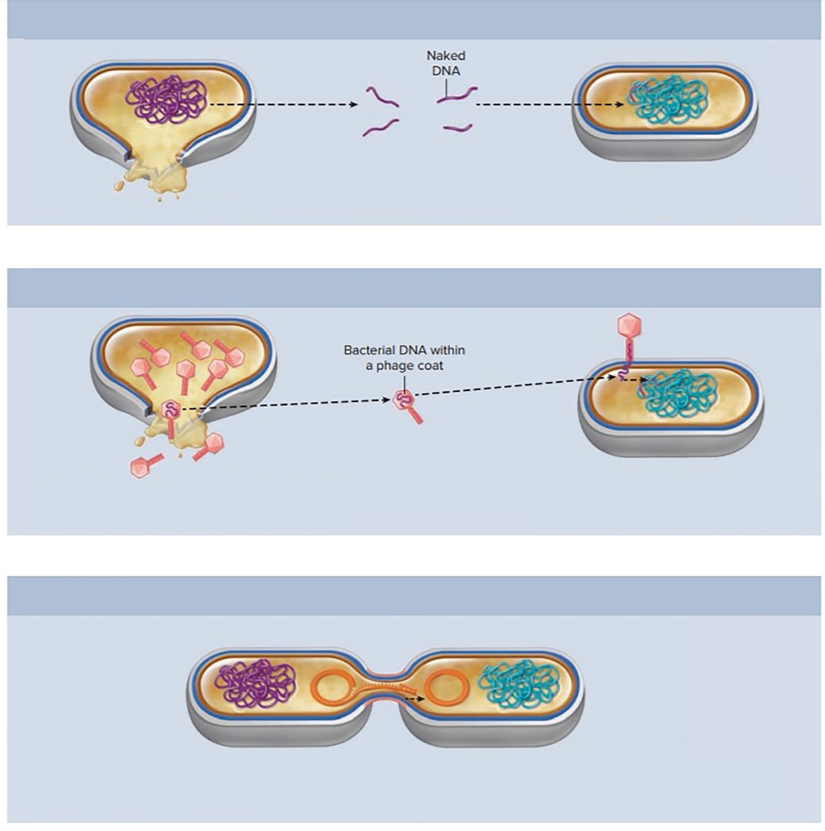
Horizontal Gene Transfer as a Mechanism of Genetic Change - Figure 8.18
DNA-mediated transformation
Donor cell lyses; DNA released
Recipient cell takes up naked DNA; the DNA is then integrated into the chromosome
Transduction
Bacteriophage-infected donor cell lyses, releasing phage particles; error during infection process generates phage coat that contains bacterial DNA
Recipient cell acquires donor DNA from the bacterial DNA-containing phage coat; the DNA then integrates into the chromosome
Conjugation
Donor cell physically contacts recipient cell then directly transfers DNA
Recipient cell acquires donor DNA during cell-to-cell contact; if transferred DNA is a plasmid, then integration into the chromosome is not required for it to be passed to daughter cells
Notes:
36

Slide 37
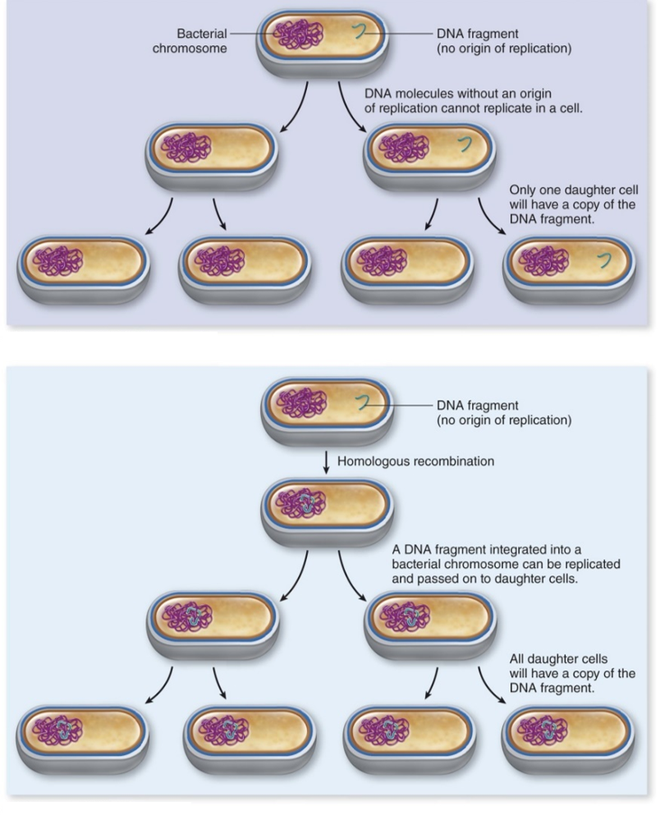
Horizontal Gene Transfer as a Mechanism of Genetic Change - Figure 8.19
Transferred DNA replicated only if a replicon with origin of replication
  Chromosomes, plasmids
DNA fragments can be added to recipient chromosome by homologous recombination
  Donor DNA replaces complementary region of recipient cell’s DNA
Non-integrated DNA fragment
Integrated DNA fragment
Jump to Horizontal Gene Transfer as a Mechanism of Genetic Change - Figure 8.19 Long Description

Slide 38
DNA-Mediated Transformation (1)
Transformation involves uptake of naked DNA
  DNA not within a cell or virus
  Originates from cells that have burst or secreted it
  Addition of DNase prevents transformation
Recipient cell must be competent
  Most take up DNA regardless of origin; some accept DNA only from closely related bacteria
  Some species are always competent; others become so under certain conditions
Notes:
38

Slide 39
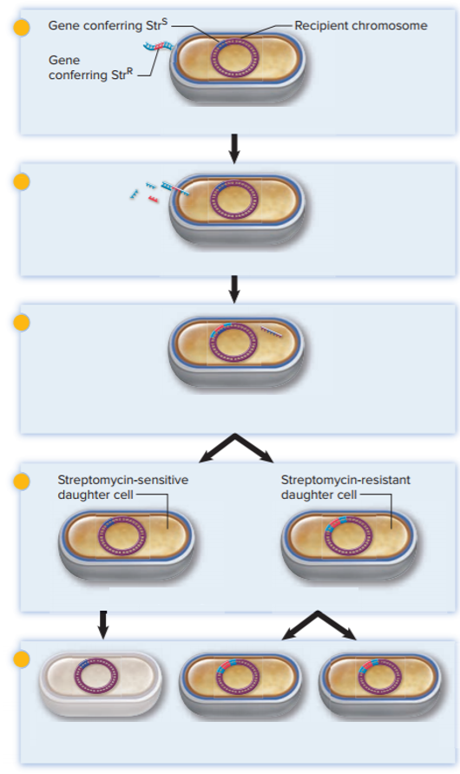

DNA-Mediated Transformation (2)
Single strand of DNA binds to cell surface and enters cell
New DNA integrates into chromosome by homologous recombination
One daughter cell will inherit donor DNA
Transformed cells can be detected by growing on medium that will not allow growth of non-transformed cells
Double-stranded DNA binds to the surface of a competent cell.
Single strand enters the cell; the other strand is degraded.
The strand integrates into the recipient cell’s genome by homologous recombination. The strand it replaced will be degraded.
After replicating the DNA, the cell divides.
Non-transformed cells $\left({Str}^{S}\right)$ die on streptomycin-containing medium, whereas transformed cells $\left({Str}^{R}\right)$ can multiply.

Slide 40
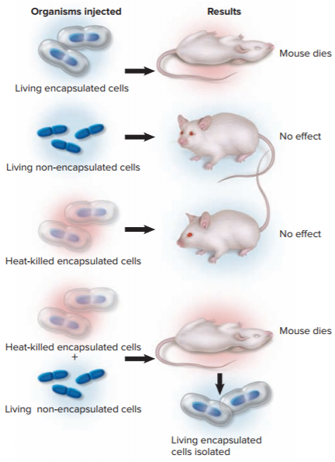
Focus Your Perspective 8.1
Transformation demonstrated by Griffith in 1920
  Streptococcus pneumoniae (“pneumococcus”) only pathogenic when encapsulated
Living non-encapsulated cells were transformed by DNA
from heat-killed encapsulated cells and produced living encapsulated cells
Jump to Focus Your Perspective 8.1 Long Description

Slide 41
Transduction
Transduction: transfer of bacterial genes by bacteriophages (phages)
  Phages infect bacterial cells
    Attaches to cell and injects its nucleic acid
    Phage enzymes cut bacterial DNA into small pieces
    Bacterial cell enzymes produce phage nucleic acid and a phage coat – components of new phage particles
    Phage particles are released from bacterial cell
  Generalized transduction results when a fragment of bacterial DNA enters the phage protein coat
    Produces a transducing particle

Slide 42
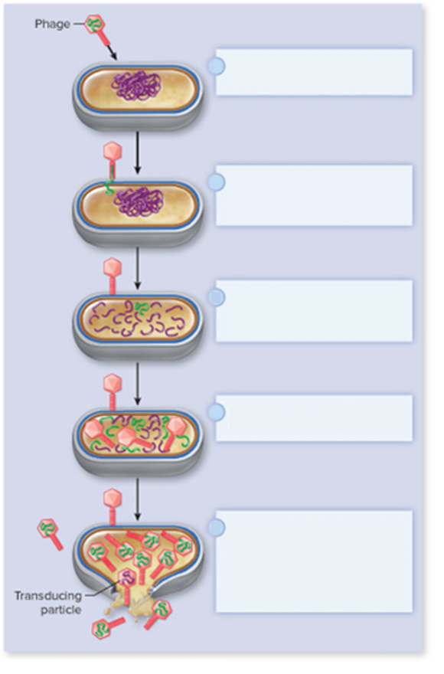
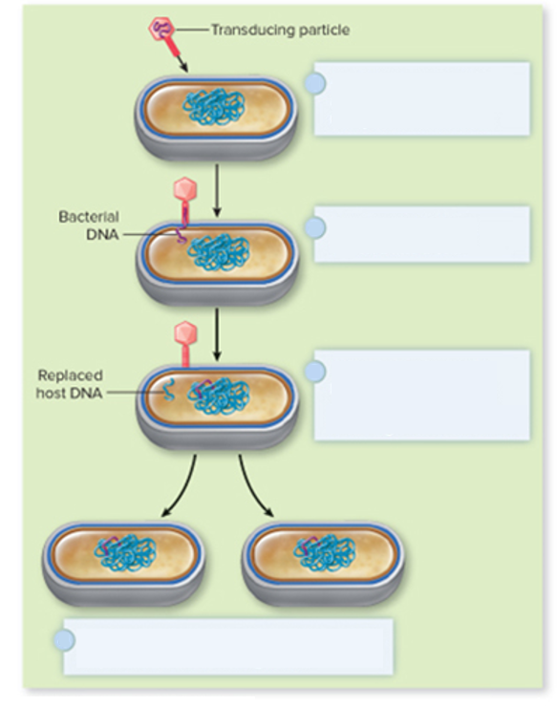
Transduction - Figure 8.21
Transducing particle may attach to another bacterial cell and inject the DNA it contains
  New DNA may be integrated into chromosome
A bacteriophage attaches to a specific receptor on a host cell.
A transducing particle attaches to a specific receptor on a host cell.
The phage DNA enters the cell. The empty phage coat remains on the outside or the bacterium.
The bacterial DNA is injected into a cell.
Enzymes encoded by the phage genome cut the bacterial DNA into small pieces.
The injected bacterial DNA integrates into the chromosome by homologous recombination.
Phage nucleic acid is replicated and coat proteins synthesized.
During construction of viral particles, bacterial DNA can mistakenly enter a protein coat. This creates a transducing particle that carries bacterial DNA instead of phage DNA
Bacteria multiply with new genetic material. Replaced host DNA is degraded.
The process of transduction
Formation of a transducing particle
Notes:
42

Slide 43
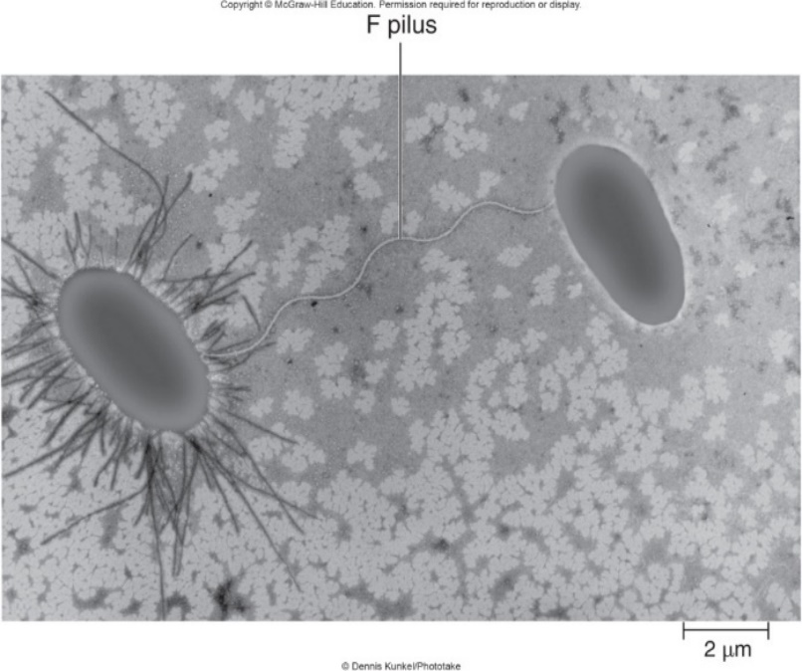
Conjugation - Figure 8.22
Conjugation: DNA transfer between bacterial cells
  Requires contact between donor, recipient cells
  Conjugative plasmids direct their own transfer
    Replicons; do not have to integrate into chromosome
  F plasmid (fertility) of E. coli most studied
    Encodes F pilus (sex pilus)
  cells contain F plasmid;
  cells do not
  Other plasmids encode resistance to some antibiotics
    Spread resistance easily
©Dennis Kunkel/SPL/Science Source
Notes:
43

Slide 44
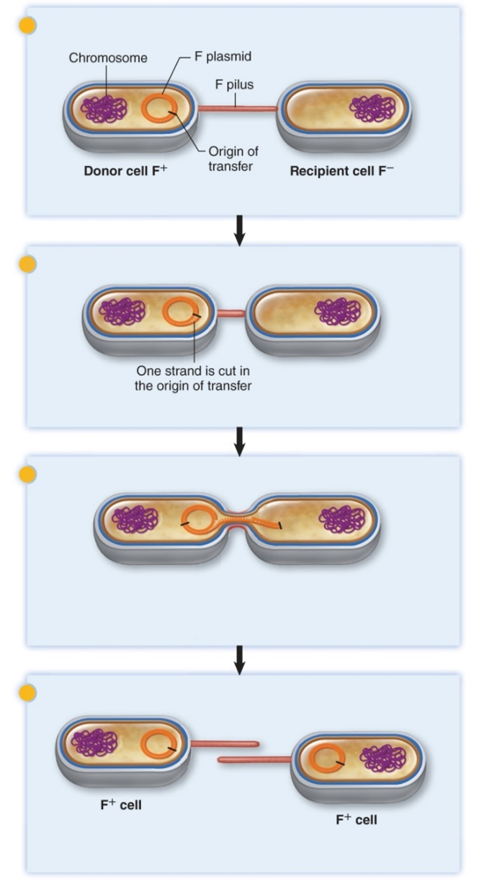


Conjugation - Figure 8.23
Plasmid transfer
  F pilus binds to receptor on recipient cell wall
  F pilus contracts, pulling cells together
  Enzyme cuts plasmid at origin of transfer
  Single DNA strand is transferred
  Complementary strands synthesized
  Both cells are now
Making contact
The F pilus contacts the recipient $F^{−}$ cell.
Initiating transfer
The pilus retracts and pulls the donor and recipient cells together.
Transferring DNA
A single strand of the F plasmid is transferred to the recipient cell; its complement is synthesized as it enters that cell. The strand transferred by the donor is replaced, using the remaining strand as a template for DNA synthesis.
Transfer complete
At the end of the transfer process, both the donor and recipient cells are $F^{+}$ and synthesize the F pilus.

Slide 45
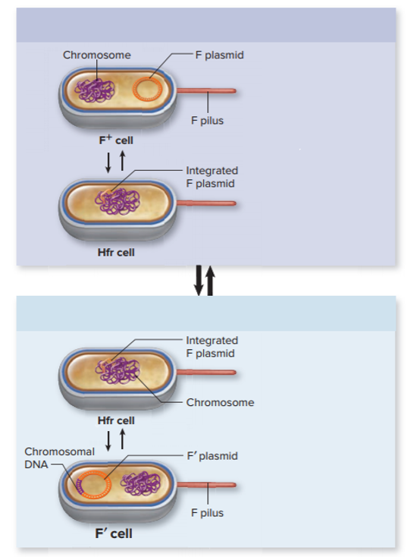
Conjugation - Figure 8.24
Chromosome transfer
  Involves Hfr cells (high frequency of recombination)
    F plasmid is integrated into chromosome via homologous recombination
    Process is reversible
    F′ plasmid results when small piece of chromosome is removed with F plasmid DNA
    F′ plasmid is replicon; transferred to F⁻ cells
      Carries bacterial DNA into new cells
Formation of an Hfr cell
The F plasmid sometimes integrates into the bacterial chromosome by homologous recombination, generating an Hfr cell; the process is reversible.
Formation of an F’ cell
An incorrect excision of the integrated F plasmid brings along a portion of the chromosome, generating an F’ cell.
Jump to Conjugation - Figure 8.24 Long Description

Slide 46
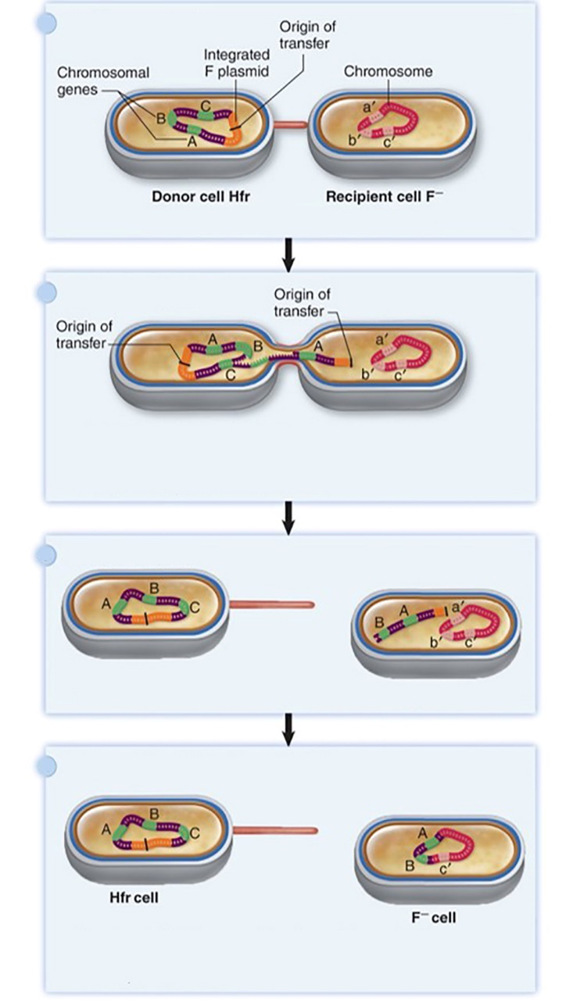


Conjugation - Figure 8.25
Chromosome transfer
  Hfr cell produces F pilus
  Integrated F plasmid begins transfer of genes on one side of origin of transfer of plasmid
  Part of chromosome transferred to recipient cell; chromosome usually breaks before complete transfer
  Recipient cell remains
Making contact
The F pilus contacts the recipient $F^{−}$ cell.
Transferring DNA
A single strand of the donor chromosome begins to be transferred, starting at the origin of transfer. Gene A, closest to the origin, is transferred first. DNA synthesis creates complementary strands in both cells.
Transfer ends
  since incomplete F plasmid transferred
The donor and recipient cells separate, interrupting DNA transfer.
Integration of transferred DNA
The donor DNA is integrated into the recipient cell’s chromosome by homologous recombination. Unincorporated DNA is degraded. The recipient cell is still $F^{−}$.

Slide 47
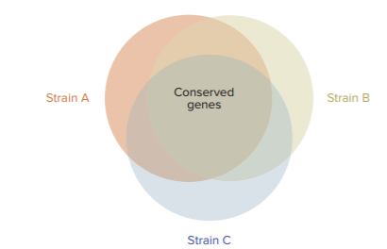
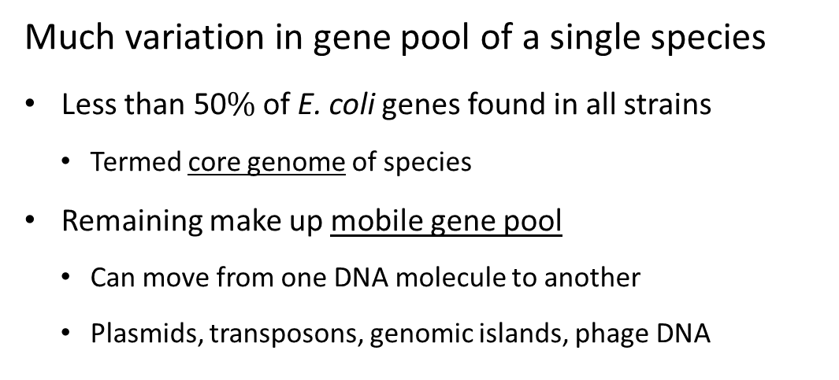
The Mobile Gene Pool - Figure 8.26
Much variation in gene pool of a single species
  Less than 50$\%$ of E. coli genes found in all strains
    Termed core genome of species
  Remaining make up mobile gene pool
    Can move from one DNA molecule to another
    Plasmids, transposons, genomic islands, phage DNA
Notes:
47

Slide 48
Table 8.3 The Mobile Gene Pool
Mobile Genetic Element | Characteristics
Plasmid | Replicon that is independent of the chromosome and generally encodes only non-essential genetic information
Transposon | Segment of DNA that directs its own movement to another location in chromosomal or plasmid DNA
Genomic Island | Large genomic segment in a cell’s genome that originated in another species
Phage DNA | Phage genome that sometimes carries additional genes
Notes:
48

Slide 49
The Mobile Gene Pool (1)
Plasmids common in microbial world
  Usually dsDNA with origin of replication
  Generally encode nonessential information, but may allow survival in particular environment
  Few to many genes
  Low-copy-number (one or a few per cell) to high-copy-number (many, up to 500)
  Most have narrow host range; some replicate in many different species
  Plasmids in same compatibility group cannot be maintained in the same cell
  Mobilizable plasmid requires conjugative plasmid for transfer

Slide 50
Table 8.4 Some Plasmid-Encoded Traits
Trait | Organisms in Which Trait is Found
Antibiotic resistance | Many
Antibiotic synthesis | Streptomyces species
Gas vacuole production | Halobacterium species
Increased virulence | Yersinia and Shigella species
Insect toxin synthesis | Bacillus thuringiensis
Nitrogen fixation | Rhizobium species
Oil degradation | Pseudomonas species
Pilus synthesis | E. coli, Pseudomonas species
Toxin production | Bacillus anthracis
Tumor formation in plants | Agrobacterium species (see Focus Your Perspective 8.2)
Notes:
50

Slide 51
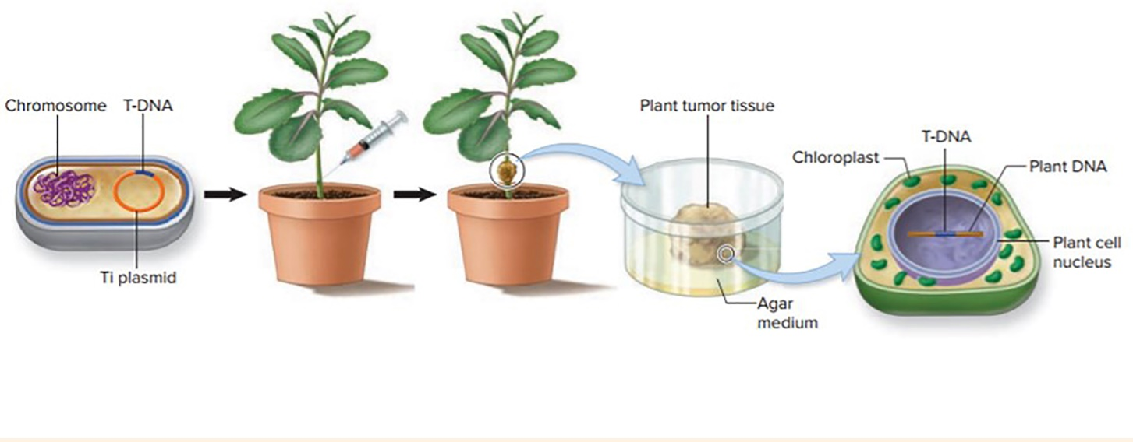
Focus your Perspective 8.2
Bacteria can conjugate with plants
  Agrobacterium tumefaciens causes crown gall
    Cells multiply without hormones and produce opine
    Piece of tumor-inducing (Ti) plasmid called T-DNA (transferred DNA) is incorporated into plant chromosome
    Tumor formation genes can be replaced with beneficial genes and incorporated into plant genome
Agrobacterium tumefaciens cell
Agrobacterium cells inoculated into stem of plant
Crown gall tumor develops at site of inoculation.
Bacteria-free tumor tissue is hormone independent and synthesizes an opine.
Plant tumor cell contains T-DNA integrated into the plant chromosome.

Slide 52
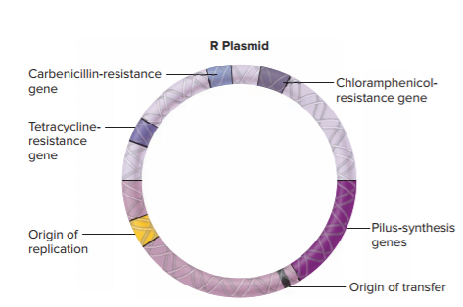
The Mobile Gene Pool - Figure 8.27
Resistance plasmids (R plasmids)
  Encode resistance to antimicrobial medications
  Many are conjugative plasmids with broad host range
  Resistance to many medications can spread quickly
  Normal microbiota with R plasmids may transfer them to pathogens

Slide 53
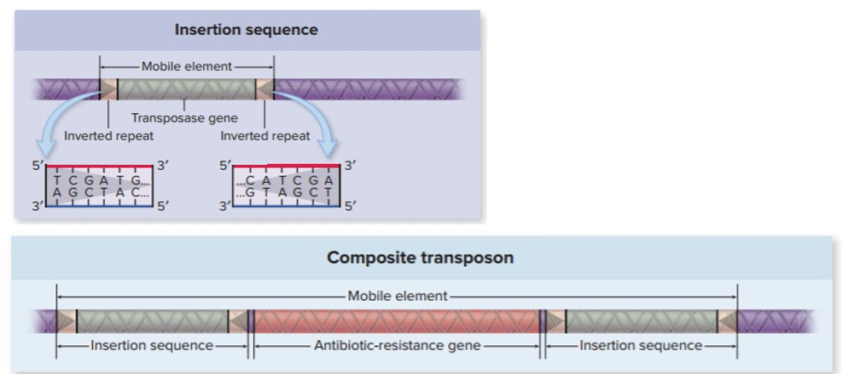
The Mobile Gene Pool - Figure 8.28
Transposons provide mechanism for moving DNA
  Can move into other replicons in same cell
  Simplest is insertion sequence (IS)
    Encodes only transposase enzyme, inverted repeats
  Composite transposons include one or more genes
    Integrate via non-homologous recombination
Jump to The Mobile Gene Pool - Figure 8.28 Long Description

Slide 54
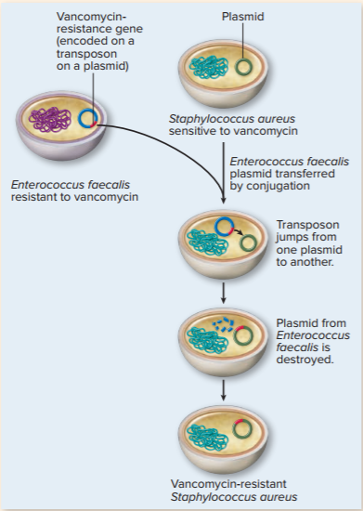
Focus on a Case 8.1
Transposons yielded vancomycin-resistant Staphylococcus aureus strain
  Patient infected with S. aureus that was susceptible to vancomycin
  Normal microbiota included vancomycin-resistant strain of Enterococcus faecalis
    Resistance encoded in transposon of plasmid transferred to S. aureus
    Transposon jumped to plasmid in S. aureus

Slide 55
The Mobile Gene Pool (2)
Genomic islands: large DNA segments in genome that originated in other species
  Nucleotide composition very different from genome
    G-C base pair ratio characteristic for each species
  Characteristics encoded by genomic islands include
    Use of specific energy sources
    Acid tolerance
    Ability to cause disease
      Pathogenicity islands

Slide 56
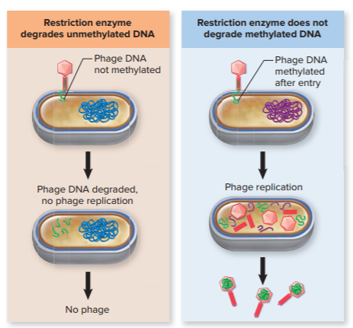
Bacterial Defenses Against Invading DNA - Figure 8.29
Restriction-modification systems degrade foreign DNA
  Restriction enzyme cuts DNA at specific sequence
  Modification enzyme protects cell’s own DNA by adding methyl groups

Slide 57
Bacterial Defenses Against Invading DNA
CRISPR systems include small segments of phage DNA that recognize the specific DNA if it invades the cell again
  First invasion: complex of Cas proteins cuts DNA into short fragments
  Inserted into chromosome at CRISPR array; integrated DNA fragment called a spacer
  Subsequent invasion: transcription of CRISPR array generates crRNAs that direct DNA-cutting enzymes to invading DNA

Slide 58
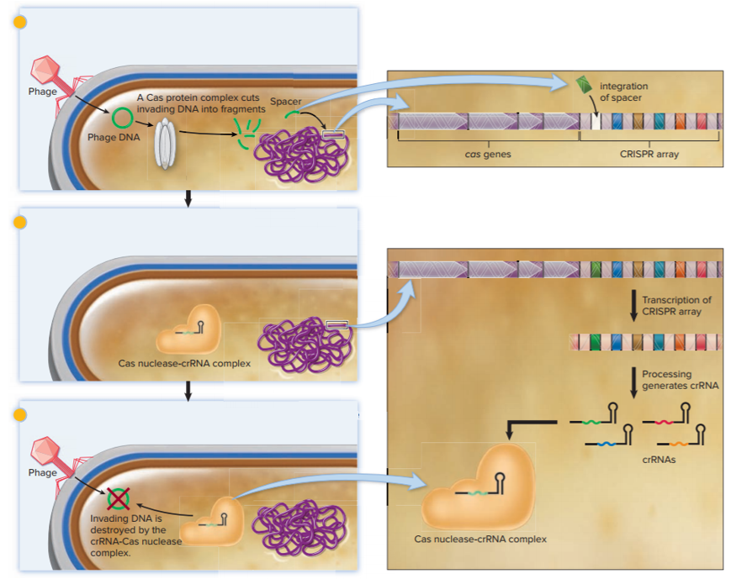
Bacterial Defenses Against Invading DNA - Figure 8.30
Infected bacterial cell
Fragments of invading DNA are captured and then integrated into CRISPR array in cell’s genome.
Surviving bacterial cell and its descendants
CRISPR array is transcribed and the RNA processed to generate crRNAs that bind to a Cas nuclease to form a complex.
Surviving bacterial cell or its descendants re-encounter the same phage
crRNA-guided Cas nuclease degrades invading DNA.

