Slide 1
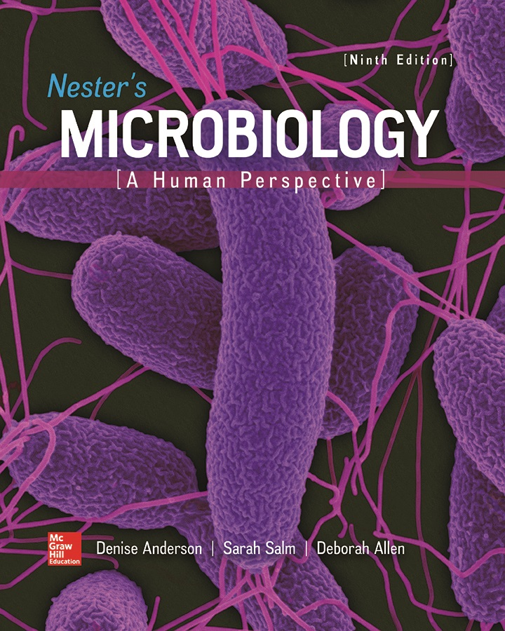
Chapter 16 Lecture Outline
See separate PowerPoint slides for all figures and tables pre-inserted into PowerPoint without notes.
Notes:
1

Slide 2
A Glimpse of History
Ancients thought diseases were divine punishment
Leeuwenhoek’s discovery of microorganisms in 17th century led people to suspect they might cause disease
Robert Koch (1876) offered evidence of what is now known as germ theory of disease
Showed Bacillus anthracis causes anthrax; later work on tuberculosis
Formalized criteria for establishing cause of disease, now known as Koch’s postulates

Slide 3
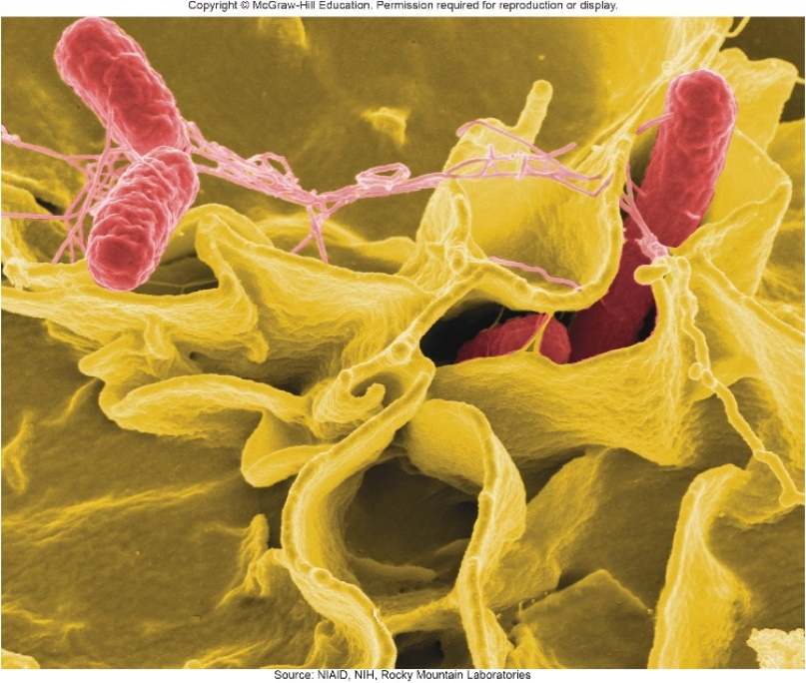
Introduction
We contact numerous microorganisms daily
Breathe in, ingest with food and drink, pick up on skin
Most do not harm us
Some may colonize body surfaces; others shed with dead epithelial cells
Most swallowed microorganisms die in stomach or are eliminated in feces
Relatively few are pathogens that cause damage
Distinct characteristics allow avoidance of some body defenses
Source: NIAID, NIH, Rocky Mountain Laboratories

Slide 4
Microbes, Health, and Disease
Most microbes are harmless; many are beneficial
Some can cause disease if there is an opportunity
Weaknesses or defects in immunity leave people vulnerable to invasion; these individuals are immunocompromised
Factors include malnutrition, cancer, AIDS or other disease, surgery, wounds, genetic defects, alcohol or drug abuse, and immunosuppressive therapy

Slide 5
The Anatomical Barriers as Ecosystems
Skin, mucous membranes are barriers, but also host complex ecosystem of microorganisms
Example of symbiosis or “living together”
Mutualism: both partners benefit
Example: in large intestine, some bacteria synthesize vitamin K and B vitamins, which host can absorb; bacteria are supplied with warmth, energy sources
Commensalism: one partner benefits, other is unharmed
Many microbes living on skin neither harmful nor helpful, but obtain food and necessities from host
Parasitism: one organism benefits at expense of other
All pathogens are parasites, but medical microbiologists often reserve for eukaryotic pathogens (for example, protozoa, helminths)

Slide 6
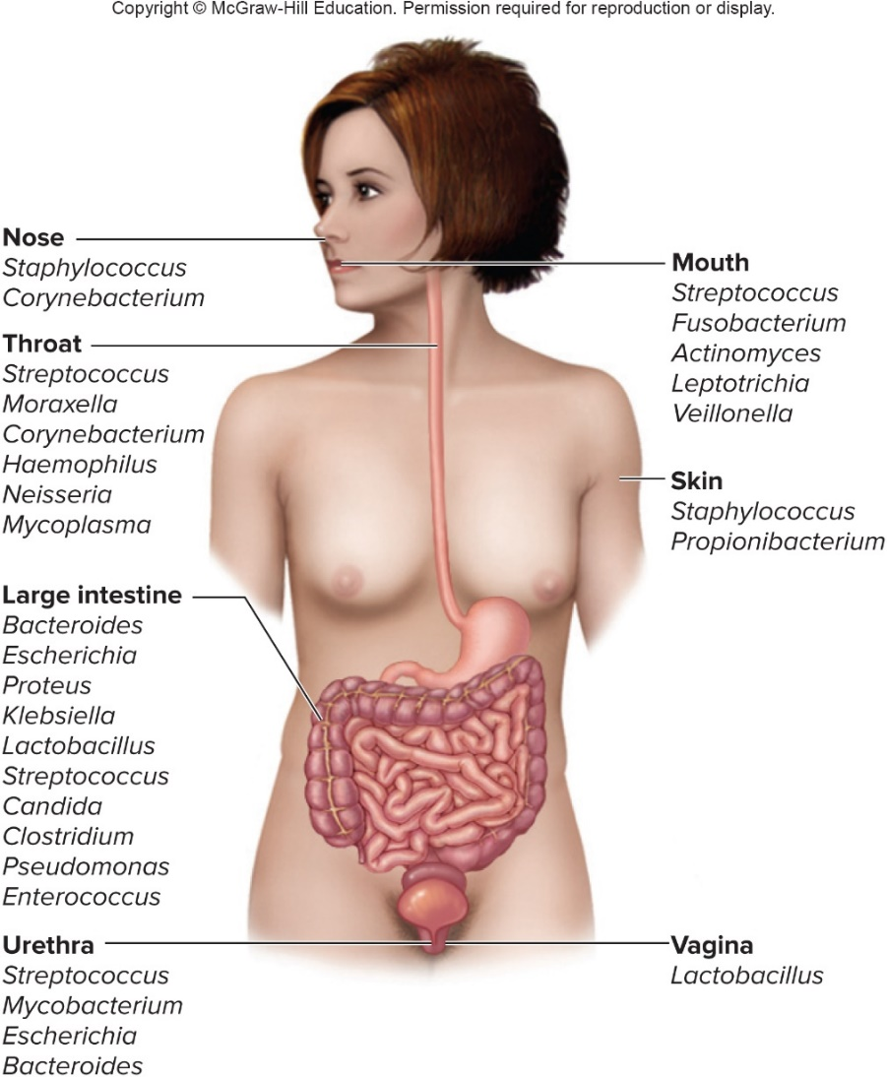
The Human Microbiome – Figure 16.1
Normal microbiota or microbiome: microorganisms routinely growing on a healthy body
Resident microbiota inhabit sites for extended periods
Important to human health
Research underway to study microbiota using metagenomics, analysis of DNA

Slide 7
The Human Microbiome (1)
Composition of the microbiome
Colonization begins at birth; microbiome is different after vaginal birth than after caesarian birth
Breastfeeding affects composition of microbiome
Composition different among individuals and over time
Changes with physiological state and life style of host
Example: more Firmicutes in obese people, more Bacteroidetes in thin people; microbiota change with weight loss
Dysbiosis: imbalance in the microbiome
Related to some disease states

Slide 8
The Human Microbiome (2)
Beneficial Roles of the Human Microbiome
Significant contribution is protection against pathogens
Covering of binding sites prevents attachment
Consumption of available nutrients
Production of compounds toxic to other bacteria
When microbiome is suppressed (for example, during antibiotic treatment), pathogens may colonize, cause disease
Some antibiotics inhibit Lactobacillus (in vagina of mature females, suppress growth of Candida albicans); results in vulvovaginal candidiasis
Oral antibiotics can inhibit intestinal microbiota, allow overgrowth of toxin-producing Clostridium difficile

Slide 9
The Human Microbiome (3)
Beneficial Roles of the Human Microbiome
Stimulation of adaptive immune system
Antibodies against normal microbiota may also bind to pathogens
Mice in microbe-free environment have underdeveloped mucosal-associated lymphoid tissue (MALT);
Important in development of oral tolerance
Immune system lessens response to many microbes in gut as well as food
Basis of hygiene hypothesis, insufficient exposure to microbes leads to allergies
Aid in digestion: break down fiber; increase nutrients
Produce important substances, such as vitamin K

Slide 10
Principles of Infectious Disease (1)
Colonization refers to microbe establishing itself and multiplying; infection used for pathogen
Can be subclinical: no symptoms or mild symptoms
Infectious disease: prevents normal function
Symptoms are subjective effects experienced by patient (pain, nausea)
Signs are objective evidence (rash, pus formation, swelling)
Initial infection is primary infection
Damage can predispose individual to developing a secondary infection (respiratory illness impairing mucociliary escalator)

Slide 11
Principles of Infectious Disease (2)
Pathogenicity
Primary pathogen is microbe or virus that causes disease in otherwise healthy individual
Diseases such as plague, malaria, measles, influenza, diphtheria, tetanus, tuberculosis
Opportunistic pathogen (opportunist) causes disease only when body’s immune defenses are compromised or when introduced into unusual location
Can be members of normal microbiota or common in environment (Pseudomonas)
Virulence refers to degree of pathogenicity
Virulence factors allow microorganism to cause disease

Slide 12
Principles of Infectious Disease (3)
Characteristics of Infectious Disease
Communicable or contagious diseases easily spread from one host to another
Infectious dose: number of microbes necessary to establish infection
Shigellosis results from approximately 10 to 100 ingested Shigella
Salmonellosis results from as many as ${10}^{6}$ ingested Salmonella enterica serotype Enteritidis
Difference partially reflects ability to survive stomach acid
${ID}_{50}$ is number of cells that infects 50% of population

Slide 13
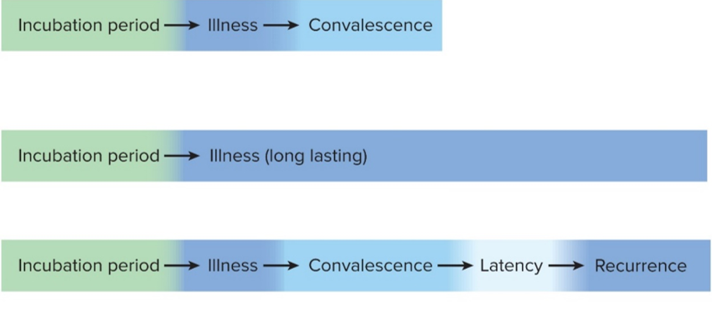
Principles of Infectious Disease – Figure 16.2
Progression of Infectious Disease
Incubation period: time between infection and onset
Varies considerably; depends on growth rate, host’s condition, infectious dose
Illness: signs and symptoms of disease
May be preceded by prodromal phase (vague symptoms)
Convalescence: recuperation, recovery from disease
After recovery (or vaccination) memory cells usually protect from reinfection with the same microbe
Acute. Illness is short term because the pathogen is eliminated by the host defenses; person is usually immune to reinfection.
Chronic. Illness persists over a long time period.
Latent. Illness may recur if immunity weakens.
Notes:
13

Slide 14
Principles of Infectious Disease (4)
Progression of Infectious Disease
Many infectious agents can be spread during incubation and/or convalescent periods
Carriers may harbor and spread infectious agent for long periods of time in absence of signs or symptoms

Slide 15
Principles of Infectious Disease (5)
Duration of Symptoms
Acute infections: symptoms develop quickly, last a short time (strep throat)
Chronic infections: develop slowly, last for months or years (tuberculosis)
Latent infections: never completely eliminated; microbe exists in host tissues without causing symptoms
Decrease in immunity may allow reactivation
Chickenpox (acute illness) results from varicella-zoster virus; immune response stops, but virus hides in sensory nerves, can later produce viral particles resulting in shingles
Tuberculosis, cold sores, genital herpes also examples

Slide 16
Principles of Infectious Disease (6)
Distribution of Pathogen
Localized infection: microbe limited to small area (boil caused by Staphylococcus aureus)
Systemic infection: agent spread throughout body (Lyme disease)
Suffix -emia means “in the blood”
Bacteremia: bacteria circulating in blood
Not necessarily a disease state (can occur transiently following vigorous tooth brushing)
May lead to systemic inflammation called sepsis
Toxemia: toxins circulating in bloodstream
Viremia: viruses circulating in bloodstream

Slide 17
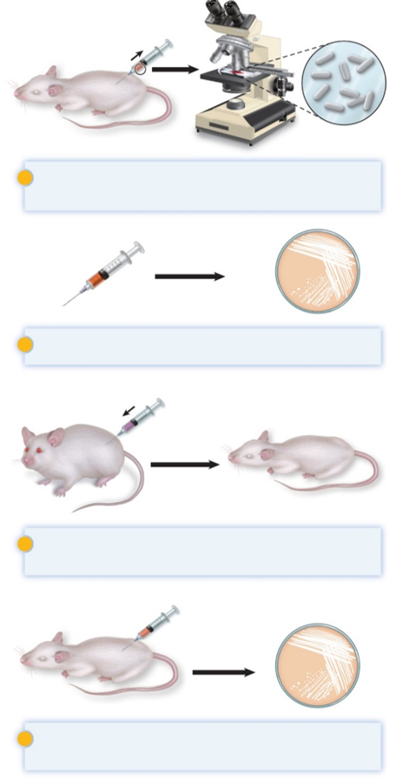
Determining the Cause of an Infectious Disease – Figure 16.3
Koch’s postulates provide foundation for establishing that a given microbe causes a specific infectious disease
Microorganism must be present in every case of disease
Organism must be grown in pure culture from diseased host
Same disease must be produced when pure culture is introduced into susceptible hosts
Organisms must be recovered from experimentally infected hosts
The microorganism must be present in every case of the disease, but not in healthy hosts.
The microorganism must be grown in pure culture from diseased hosts.
The same disease must be produced when a pure culture of the microorganism is introduced into susceptible hosts.
The same microorganism must be recovered from the experimentally infected hosts.

Slide 18
Determining the Cause of an Infectious Disease (1)
Some limitations of Koch’s postulates
Some organisms cannot be grown in laboratory medium (causative agent of syphilis)
Infected individuals do not always have symptoms (cholera, polio)
Some diseases are polymicrobial (periodontal disease)
Suitable animal hosts not always available for testing
Not ethical to test the postulates on humans

Slide 19
Determining the Cause of an Infectious Disease (2)
Molecular Koch’s postulates rely on molecular techniques to study a microbe’s virulence factors
Virulence factor gene or its product found in pathogenic strains of organism
Mutating gene to disrupt function should reduce virulence
Reversion or replacement of gene should restore virulence
Notes:
19

Slide 20
Mechanisms of Pathogenesis (1)
Several general patterns
Produce toxins that are ingested
Clostridium botulinum, Staphylococcus aureus
Colonize mucous membranes, produce toxins
Vibrio cholerae, E. coli O157:H7, Corynebacterium diphtheriae
Invade host tissues, avoid defenses
Mycobacterium tuberculosis, Yersinia pestis, Salmonella enterica
Invade host tissues, produce toxins
Shigella dysenteriae, Clostridium tetani

Slide 21
Mechanisms of Pathogenesis (2)
Successful pathogen needs to overcome host defenses only long enough to multiply and exit
Pathogen that overwhelms the host may kill it and lose nutrients and opportunity for transmission
Pathogens and hosts generally evolve toward balanced pathogenicity
Pathogen becomes less virulent while host becomes less susceptible
Rabbits and myxoma virus
Notes:
21

Slide 22
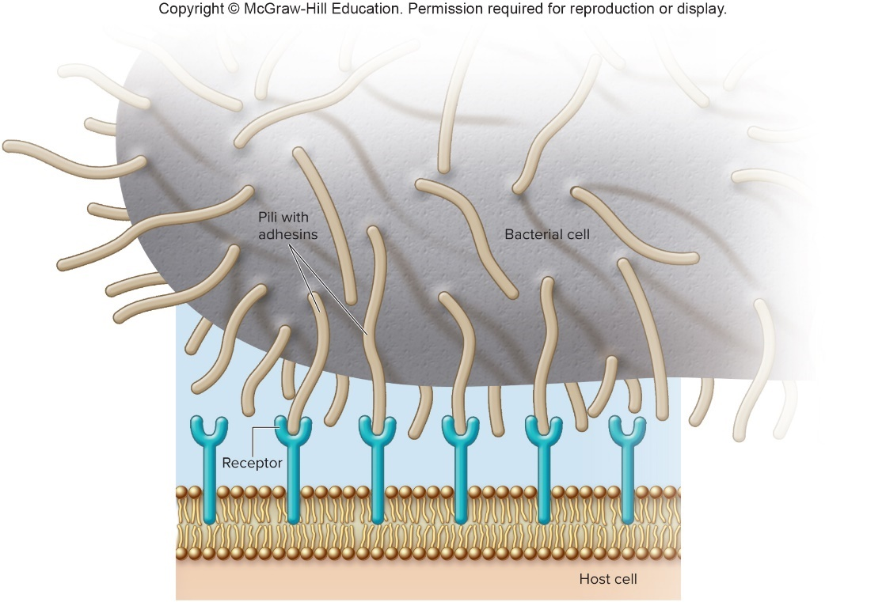
Establishing Infection – Figure 16.4
Adherence
Adhesions attach to host cell receptor
Often located at tips of pili called fimbriae
Can be component of capsules or various cell wall proteins
Binding highly specific; dictates type of cell to which bacterium can attach

Slide 23
Establishing Infection
Colonization
After attachment, the microbe must multiply
Must deal with host defenses
Microbe may produce siderophores to bind iron
Competes with lactoferrin, transferrin of host
Microbe must avoid secretory IgA
Rapid pili turnover, antigenic variation, IgA proteases
Microbe must compete with normal microbiota; tolerate toxic products of other microbes
Notes:
23

Slide 24
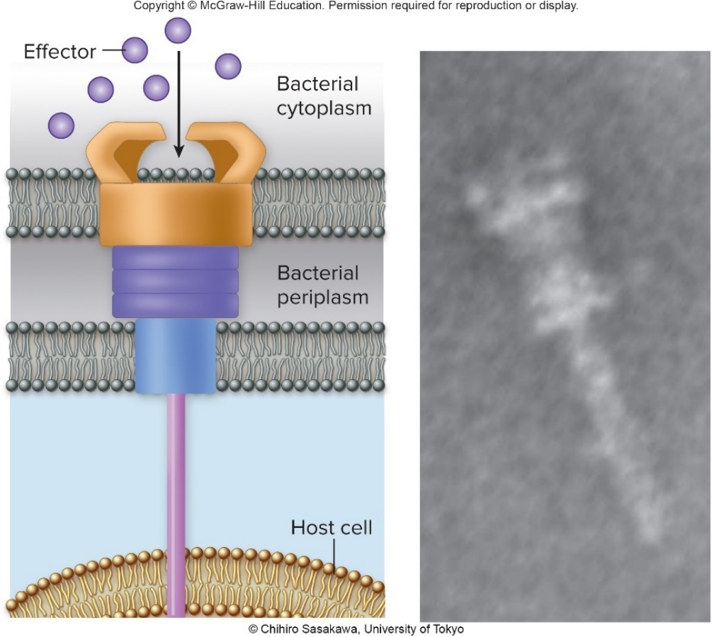
Establishing Infection – Figure 16.5
Delivering Effector Proteins to Host Cells
Secretion systems in some Gram-negatives
Several types discovered; some can inject molecules other than proteins
Type III secretion system (injectisome)
Effector proteins induce changes (altering of cell’s cytoskeleton structure)
Can induce uptake of bacterial cells
Jump to Establishing Infection – Figure 16.5 Long Description
Right: ©Chihiro Sasakawa, University of Tokyo

Slide 25
Invasion—Breaching the Anatomical Barriers
Penetrating the skin
Difficult barrier to penetrate; bacteria rely on injuries
Staphylococcus aureus enters via cut or wound; Yersinia pestis is injected by fleas
Penetrating mucous membranes
Entry point for most pathogens
Directed uptake by cells
Exploiting antigen-sampling processes

Slide 26
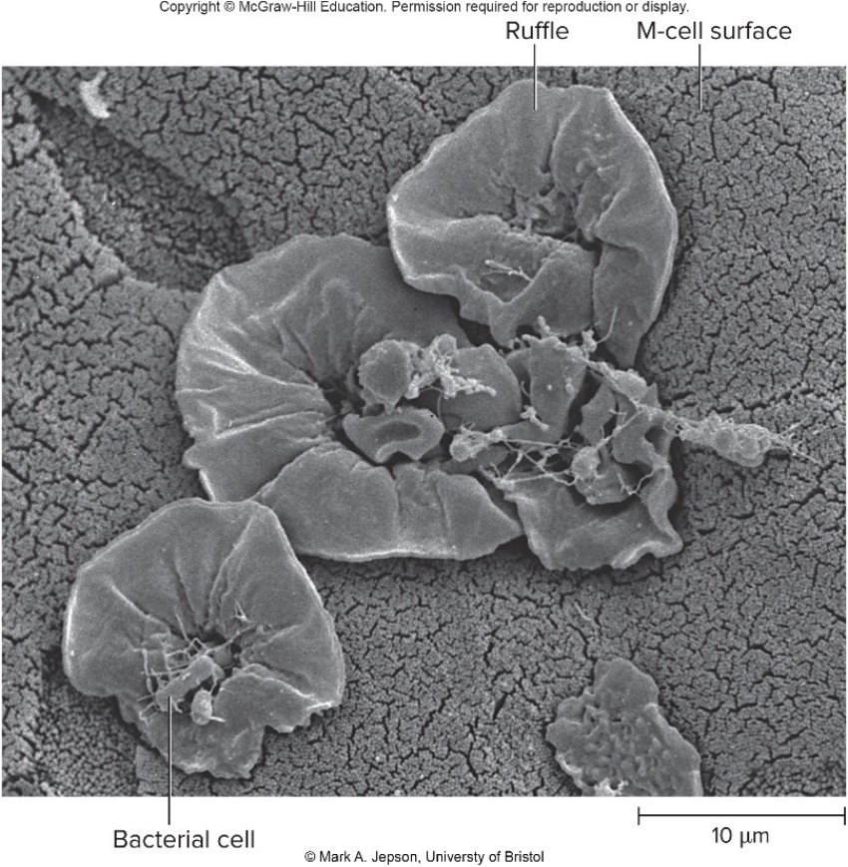
Invasion—Breaching the Anatomical Barriers – Figure 16.6
Directed Uptake by Cells
Pathogen induces non-phagocytic cells to engulf them via endocytosis
Salmonella uses type III secretion system
Actin molecules in host cells rearrange, causing membrane ruffling
Ruffles enclose bacteria, bringing them into cell
©Mark A. Jepson, University of Bristol
Notes:
26

Slide 27
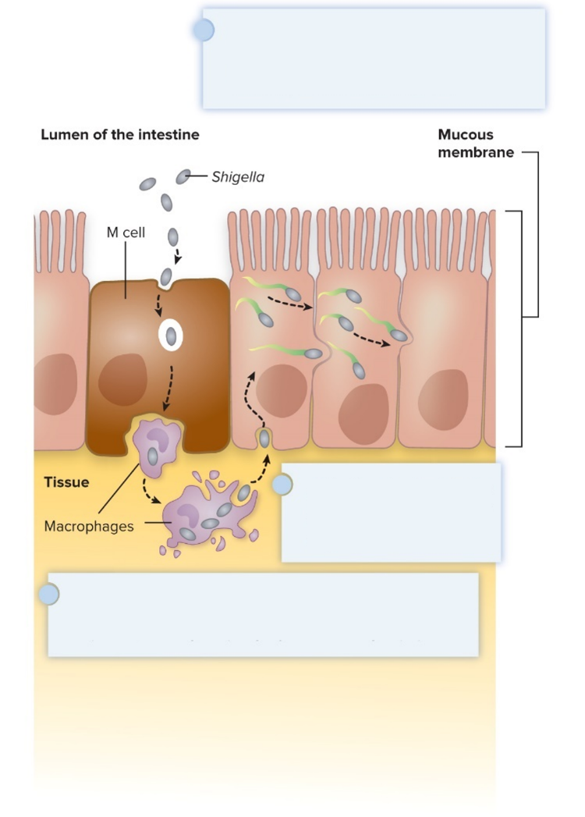
Invasion—Breaching the Anatomical Barriers – Figure 16.7
Exploiting Antigen-Sampling Processes
Mucosal-associated lymphoid tissue (MALT) samples material
Some pathogens use M cells to cross intestinal barrier
Shigella survives phagocytosis by macrophages; induces apoptosis; binds to base of mucosal epithelial cells and induces uptake
Some invade by alveolar macro-phages (Mycobacterium tuberculosis produces surface proteins, directs uptake, avoids macrophage activation)
Within an epithelial cell, Shigella cells cause the host actin to polymerize. This propels the bacterial cell, sometimes with enough force to push it into the next cell.
Shigella cells attach to the base of the epithelial cells and induce these cells to engulf them.
Macrophages in the Peyer’s patches engulf material that passes through M cells. Shigella cells survive and replicate, causing the phagocytes to undergo apoptosis.

Slide 28
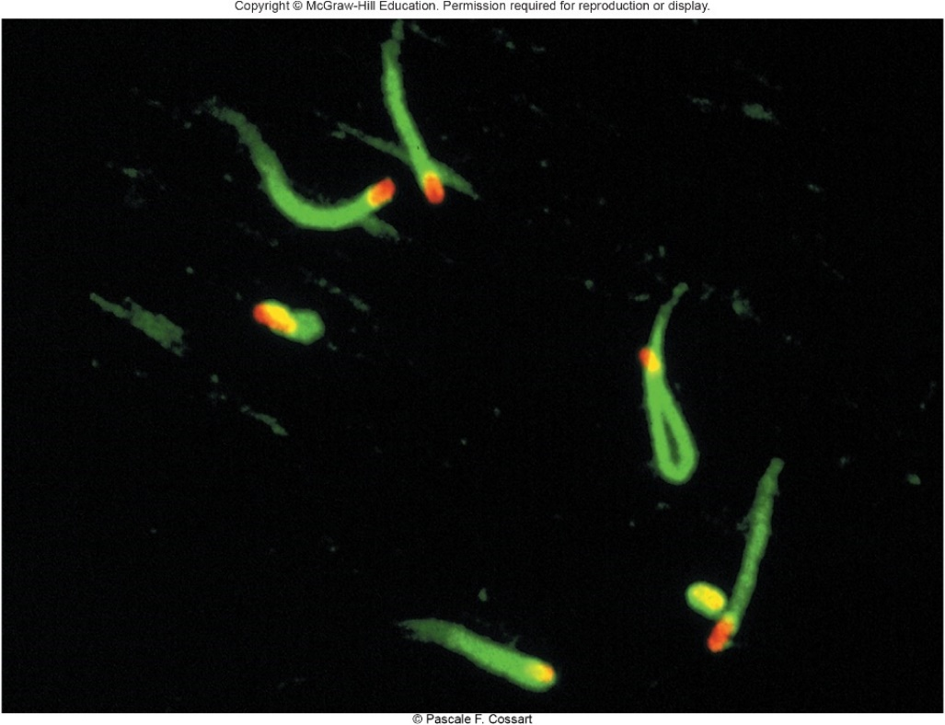
Avoiding the Host Defenses – Figure 16.8
Hiding Within a Host Cell
Allows avoidance of complement proteins, phagocytes, and antibodies
Shigella directs transfer from intestinal epithelial cell to adjacent cells by causing host cell actin polymerization
Listeria monocytogenes does the same
©Pascale F. Cossart

Slide 29
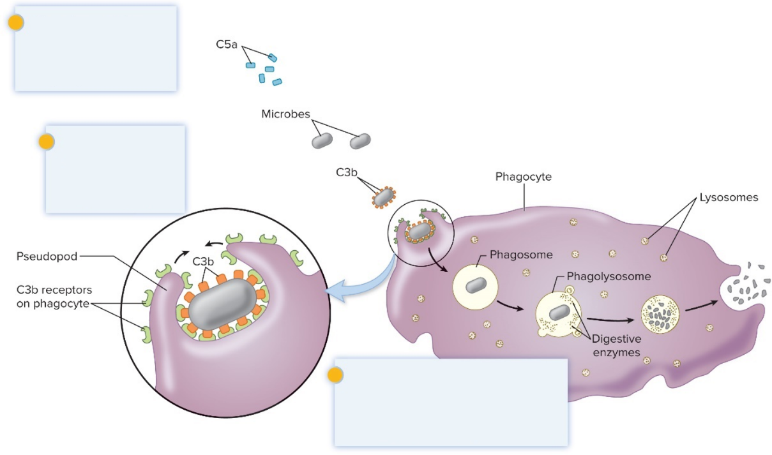
Avoiding the Host Defenses – Figure 16.9
Avoiding Destruction by Phagocytes
Preventing Encounters with Phagocytes
C5a peptidase: degrades chemoattractant C5a
Streptococcus pyogenes
Membrane-damaging toxins: kill phagocytes, other cells
S. pyogenes makes streptolysin O
Prevent encounters with phagocytes
C5a peptidase
Membrane-damaging toxins
Avoid recognition and attachment
Capsules
M protein
Fc receptors
Survive within phagocytes
Escape from the phagosome
Prevent phagosome- lysosome fusion
Survive within the phagolysosome

Slide 30
Avoiding the Host Defenses – Figure 16.10
Avoiding Destruction by Phagocytes
Avoiding Recognition and Attachment
Capsules: interfere with opsonization; some bind host’s regulatory proteins that inactivate C3b
Streptococcus pneumoniae
M protein: cell wall of Streptococcus pyogenes binds regulatory protein that inactivates C3b
Fc receptors: bind Fc region of antibodies
Staphylococcus aureus, Streptococcus pyogenes
Jump to Avoiding the Host Defenses – Figure 16.10 Long Description

Slide 31
Avoiding the Host Defenses (1)
Avoiding Destruction by Phagocytes
Surviving within phagocytes allows pathogens to avoid antibodies, control some immune responses, and move throughout the body
Escape from phagosome: prior to lysis with lysosomes
Listeria monocytogenes produces molecule that forms pores in membrane; Shigella species lyse phagosome
Prevent phagosome-lysosome fusion: avoid destruction
Salmonella sense ingestion by macrophage, produce protein that blocks fusion process
Survive within phagolysosome: few can survive destructive environment
Coxiella burnetii (Q fever) can withstand; delays fusion, allows time to equip itself for growth

Slide 32
Avoiding the Host Defenses (2)
Avoiding killing by complement system proteins
Serum resistant bacteria
Neisseria gonorrhoeae hijacks mechanism that host uses to prevent their surfaces from activating complement
Organism binds complement regulatory proteins to avoid membrane attack complex (MAC)

Slide 33
Avoiding the Host Defenses (3)
Avoiding recognition by antibodies
IgA protease cleaves IgA, found in mucus, secretions
Produced by Neisseria gonorrhoeae and others
Antigenic variation: alter structure of surface antigens, stay ahead of antibody production
Neisseria gonorrhoeae varies antigenic structure of pili
Mimicking host molecules: cover surface with molecules similar to those found in host cell, appear to be “self”
Streptococcus pyogenes form capsule from hyaluronic acid, a polysaccharide found in human tissues
Notes:
33

Slide 34
Damage to the Host (1)
Direct or indirect effects:
Direct (toxins produced)
Indirect (immune response)
Damage may help pathogen to exit and spread
Vibrio cholerae induces watery diarrhea, up to 20 liters/day, which contaminates water supplies
Bordetella pertussis triggers severe coughing, pathogens released into air

Slide 35
Damage to the Host (2)
Exotoxins: proteins with specific damaging effects
Secreted or leak into tissue following bacterial lysis
Foodborne intoxication results from consumption
Most destroyed by heating
Can act locally or systemically
Immune system can usually generate antibodies
Many fatal before adequate immune response; vaccines important
Toxoids are inactivated toxins
Tetanus, diphtheria
Antitoxin is a suspension of neutralizing antibodies

Slide 36
Damage to the Host (3)
Many exotoxins can be grouped according to the tissues they affect
Neurotoxins damage nervous system
Enterotoxins cause intestinal disturbance
Cytotoxins damage variety of cell types
Most exotoxins can be categorized by their structure and mechanism of action
A-B toxins
Membrane-damaging toxins
Superantigens
Notes:
36

Slide 37
Table 16.1 Exotoxins Produced by Various Primary Pathogens (1)
Example | Name of Disease; Name of Toxin | Characteristics of the Disease | Mechanism
A-B TOXINS—Composed of two subunits, A and B. The A subunit is the toxic, or active, part; the B subunit binds to the target cell.
Neurotoxins
Clostridium botulinum | Botulism; botulinum toxin | Flaccid paralysis | Blocks transmission of nerve signals to the muscles by preventing the release of acetylcholine.
Clostridium tetani | Tetanus; tetanospasmin | Spastic paralysis | Blocks the action of inhibitory neurons by preventing the release of neurotransmitters.
Enterotoxins
Enterotoxigenic E. coli (ETEC) | Traveler’s diarrhea; heat-labile enterotoxin (cholera-like toxin) | Severe watery diarrhea | Modifies a regulatory protein in intestinal cells, causing those cells to continuously secrete electrolytes and water.
Vibrio cholerae | Cholera; cholera toxin | Severe watery diarrhea | Modifies a regulatory protein in intestinal cells, causing those cells to continuously secrete electrolytes and water.

Slide 38
Table 16.1 Exotoxins Produced by Various Primary Pathogens (2)
Example | Name of Disease; Name of Toxin | Characteristics of the Disease | Mechanism
Cytotoxins
Bacillus anthracis | Anthrax; edema factor, lethal factor | Inhaled form—septic shock; cutaneous form—skin lesions | Edema factor modifies a regulatory protein in cells, causing accumulation of fluids in the tissues. Lethal factor inactivates proteins involved in cell signaling functions.
Bordetella pertussis | Pertussis (whooping cough); pertussis toxin | Sudden bouts of violent coughing | Modifies a regulatory protein in respiratory cells, causing accumulation of respiratory secretions and mucus. Other factors also contribute to the symptoms.
Corynebacterium diphtheria | Diphtheria; diphtheria toxin | Pseudomembrane in the throat; heart, nervous system, kidney damage | Inhibits protein synthesis by inactivating an elongation factor of eukaryotic cells. Kills local cells (in the throat) and is carried in the bloodstream to various organs.
Shiga toxin– producing E. coli (STEC) | Bloody diarrhea, hemolytic uremic syndrome; Shiga toxin | Diarrhea that may be bloody; kidney damage | Inactivates the 60S subunit of eukaryotic ribosomes, stopping protein synthesis.
Shigella dysenteriae | Dysentery, hemolytic uremic syndrome; Shiga toxin | Diarrhea that contains blood, pus, and mucus; kidney damage | Inactivates the 60S subunit of eukaryotic ribosomes, stopping protein synthesis.

Slide 39
Table 16.1 Exotoxins Produced by Various Primary Pathogens (3)
Example | Name of Disease; Name of Toxin | Characteristics of the Disease | Mechanism
MEMBRANE-DAMAGING TOXINS (cytotoxins)—Disrupt plasma membranes, causing leakiness that results in cell lysis.
Clostridium perfringens | Gas gangrene; α-toxin | Extensive tissue damage | Removes the polar head group on the phospholipids in the membrane, damaging membrane structure.
Staphylococcus aureus | Wound and other infections; leucocidin | Accumulation of pus | Inserts into membranes, forming pores that allow fluids to enter the cells.
Streptococcus pyogenes | Pharyngitis and other infections; streptolysin O | Accumulation of pus | Inserts into membranes, forming pores that allow fluids to enter the cells.

Slide 40
Table 16.1 Exotoxins Produced by Various Primary Pathogens (4)
Example | Name of Disease; Name of Toxin | Characteristics of the Disease | Mechanism
SUPERANTIGENS—Override the specificity of the T-cell response.
Staphylococcus aureus (certain strains) | Foodborne intoxication; staphylococcal enterotoxins | Nausea and vomiting | Not well understood with respect to how the ingested toxins lead to the characteristic symptoms of foodborne intoxication.
Staphylococcus aureus (certain strains) | Staphylococcal toxic shock; toxic shock syndrome toxin (TSST) | Fever, vomiting, diarrhea, muscle aches, rash, low blood pressure | Systemic toxic effects due to the resulting massive release of cytokines.
Streptococcus pyogenes (certain strains) | Streptococcal toxic shock; streptococcal pyrogenic exotoxins (SPE) | Fever, vomiting, diarrhea, muscle aches, rash, low blood pressure | Systemic toxic effects due to the resulting massive release of cytokines
OTHER TOXIC PROTEINS
Staphylococcus aureus | Scalded-skin syndrome; exfoliatin | Separation of the outer layer of skin | Destroys material that holds the layers of skin together.
Various organisms | Various diseases; proteases, lipases, and other hydrolases | Tissue damage | Degrades proteins, lipids, and other compounds that make up tissues.

Slide 41
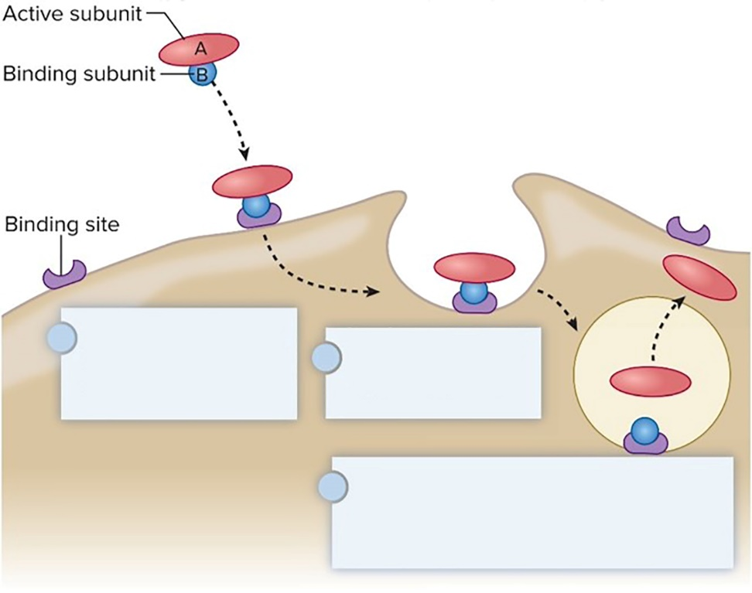
Damage to the Host – Figure 16.11
A-B toxins have two parts
A (active) subunit is toxic, usually an enzyme
B subunit binds to cell, determines cell type to be infected
Structure allows novel approaches for vaccines and therapies; can use B subunit to deliver medically useful compounds to specific cell type
B subunit binds to a specific molecule on the host cell.
Toxin is taken up by endocytosis.
Toxin subunits separate allowing the A subunit to enter the cytoplasm, where it exerts its toxic effects.

Slide 42
Damage to the Host (4)
Membrane-damaging toxins: cytotoxins that disrupt eukaryotic cytoplasmic membranes, lyse cells
Hemolysins lyse red blood cells
Pore-forming toxins insert into membranes, form pores
Streptolysin O from Streptococcus pyogenes
Phospholipases hydrolyze phospholipids of membrane
α-toxin of Clostridium perfringens (gas gangrene)

Slide 43
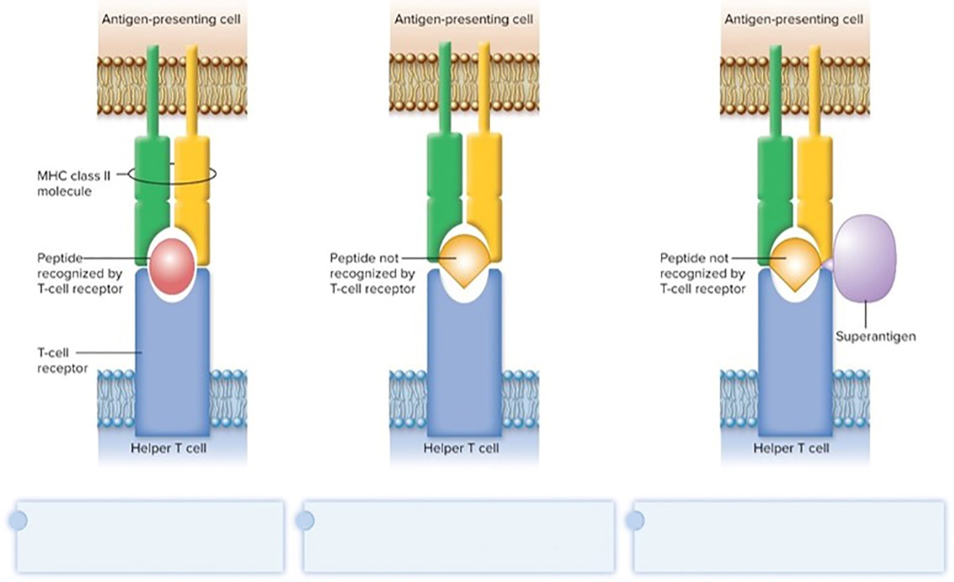
Damage to the Host – Figure 16.12
Superantigens: stimulate high number of $T_{H}$ cells, causing “cytokine storm”
Simultaneously bind MHC class II and T-cell receptor
T-cell interprets this as antigen recognition
Toxic effect is from massive cytokine release
T cells undergo apoptosis; suppresses immune response
Helper T cell that recognizes peptide releases cytokines in response.
Helper T cell that does not recognize peptide is not activated and does not release cytokines
Superantigen binds to the outer portion of the MHC class II molecule and the T cell receptor, causing the T cell to respond as though it recognizes the peptide even when it does not.

Slide 44
Damage to the Host (5)
Other Toxic Proteins
Some damaging proteins are not A-B toxins, membrane-damaging toxins, or superantigens
Exfoliatin from Staphylococcus aureus causes scalded skin syndrome
Destroys material that binds together skin layers
Bacteria may be growing in small lesion, but toxin spreads systemically
Various hydrolytic enzymes including proteases, lipases, and collagenases break down connective tissue
Destroy tissues, some help bacteria spread

Slide 45
Damage to the Host (6)
Endotoxin, other bacterial cell wall components
Endotoxin is lipopolysaccharide (LPS) found in outer membrane of Gram-negative cell wall; contains lipid A
Lipid A triggers inflammatory response
When localized, response helps clear infection
When systemic, causes widespread response: septic shock or endotoxic shock
Lipid A released following cell lysis
Toll-like receptors induce cytokine production
T-independent antigen may activate a variety of B-cells
Heat-stable; autoclaving does not destroy
Limulus amoebocyte lysate (LAL) assay detects endotoxin
Peptidoglycans, other components also trigger sepsis and septic shock

Slide 46
Table 16.2 Comparison of Exotoxins and Endotoxin
Exotoxins from Gram-positives and Gram-negatives
Protein; potent; usually heat-inactivated
Endotoxins only from Gram-negatives
Lipid A component of LPS; small localized amounts yield appropriate response, but systemic distribution can be deadly; heat-stable
Property | Exotoxins | Endotoxin
Bacterial Source | Gram-positive and Gram-negative species | Gram-negative species only
Location in the bacterium | Synthesized in the cytoplasm; may or may not be secreted | Component of the outer membrane of the Gram-negative cell wall
Chemical nature | Protein | Lipopolysaccharide (the lipid A component)
Ability to form a toxoid | Generally, yes | No
Heat stability | Generally inactivated by heat | Heat-stable
Mechanism | A distinct toxic mechanism for each | Innate immune response; a systemic response can lead to fever, a dramatic drop in blood pressure, and disseminated intravascular coagulation
Toxicity | Generally very potent; some are among the most potent toxins known | Small amounts in a localized area lead to an appropriate immune response that helps clear an infection, but systemic distribution can be deadly

Slide 47
Damage to the Host (7)
Damaging Effects of the Immune Response
Damage Associated with Inflammation
Phagocytic cells can release enzymes and toxic products
Bacterial meningitis, certain STIs
Damage Associated with Adaptive Immunity
Immune complexes: antigen-antibody complexes can form, settle in kidneys and joints, and activate complement system leading to inflammation
Acute glomerulonephritis following skin, throat infections of S. pyogenes
Cross-reactive antibodies: may bind to body’s own tissues, promote autoimmune response
Acute rheumatic fever following S. pyogenes infection

Slide 48
Mechanisms of Viral Pathogenesis (1)
To infect a host, virus must
Enter appropriate cell
Use host’s machinery for replication
Avoid recognition and destruction by host cell
Move to new host or hosts
Damage to host may result directly from viral infection or indirectly from immune response to the virus

Slide 49
Mechanisms of Viral Pathogenesis (2)
Binding to Host Cells and Invasion
Viruses attach to target cells via specific receptors
HIV receptor is CD4
Reoviruses bind to M cells in Peyer’s patches of intestine
Viruses enter cells by receptor-mediated endocytosis or by fusion with the cytoplasmic membrane
Viruses spread within body by bloodstream or lymph
Polioviruses infect cells in throat and intestinal tract, but can spread to motor nerve cells and cause paralysis
Notes:
49

Slide 50
Mechanisms of Viral Pathogenesis – Figure 16.13
Regulating Host Cell Death
Prevent apoptosis, control regulatory protein p53
May lead to tumors or warts (papillomaviruses)
Block MHC class I presentation (herpesviruses)
Present “fake” MHC class I molecules to “trick” NK cells (cytomegaloviruses)
Virus infects cell.
Viral genome directs the cell to make fake MHC class I molecules that cannot present peptides from cytoplasmic proteins.
Because of the fake MHC class I molecules, neither $T_{c}$ cells nor NK cells can recognize that the cell is infected.
Infected cell survives and carries the viral genome.

Slide 51
Mechanisms of Viral Pathogenesis (3)
Avoiding antibodies
Avoid antibodies by moving cell to cell or causing cell fusion, forming multinucleated syncytium
Modify surface antigens, outpace body’s capacity to produce effective antibodies
RNA virus replicases, HIV reverse transcriptase lack proofreading ability; mutations common
Use antibodies to facilitate macrophage uptake (dengue hemorrhagic fever)
Notes:
51

Slide 52
Mechanisms of Viral Pathogenesis (4)
Damage to the Host
Direct or indirect
Often cause flu-like symptoms
Malaise, fever, body aches
May cause cytokine storm: exaggerated immune response that can be deadly
Notes:
52

Slide 53
Mechanisms of Eukaryotic Pathogenesis (1)
Fungi: most are saprophytes; those that cause disease are generally opportunists
Dermatophytes cause superficial infections of hair, skin, nails; have keratinase enzymes (ringworm)
Fungi of normal microbiota (Candida albicans) can cause disease in immunocompromised hosts (thrush)
Cryptococcus capsule interferes with phagocytosis
Most serious fungal infections caused by dimorphic fungi
Present as molds in environment, conidia inhaled deep into lungs, develop into other forms (yeasts)
Immune system usually controls unless compromised
Some fungi produce toxins: mycotoxins
Aspergillus flavus produces aflatoxin (liver damage)
Allergic response to conidia

Slide 54
Mechanisms of Eukaryotic Pathogenesis (2)
Protozoa and Helminths
Most live within intestinal tract or enter via arthropod bite
Schistosoma species can enter skin directly
Attach to host cells via specific receptors
Variety of mechanisms to avoid antibodies
Hide within cells (Plasmodium species produce enzyme to penetrate red blood cells; Leishmania species survive, multiply within macrophages)
Vary surface antigens (African trypanosomes)
Coated with host proteins (Schistosoma species)
Damage variable: compete for nutrients; intestinal blockage; production of enzymes; immune response

