Slide 1
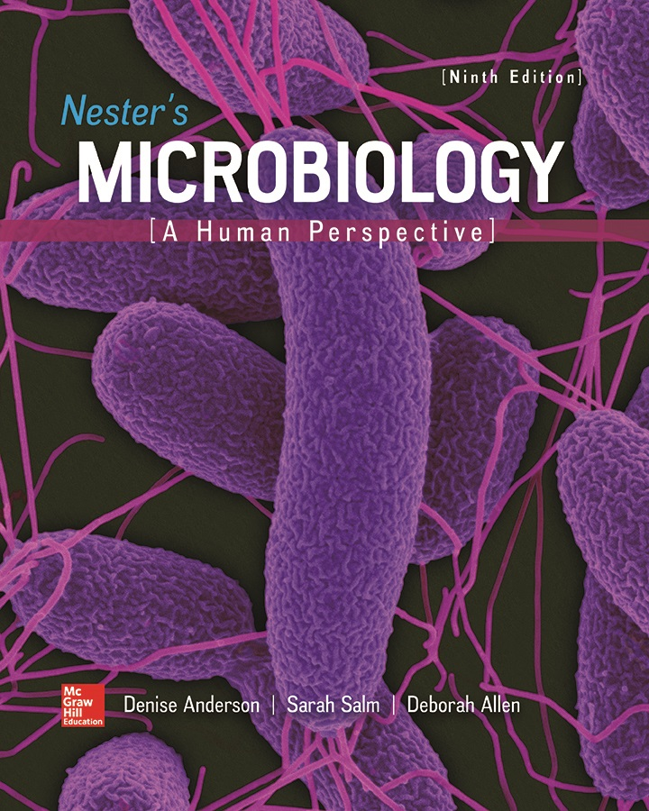
Chapter 22 Lecture Outline
See separate PowerPoint slides for all figures and tables pre-inserted into PowerPoint without notes.
Notes:
1

Slide 2
A Glimpse of History
Howard Ricketts, University of Chicago
Studied Rocky Mountain spotted fever (RMSF)
Noticed tiny rod-shaped bacteria in blood of patients; could transmit disease by injecting blood into animals
Unable to grow on laboratory media; now know they are obligate intracellular parasites
Demonstrated certain species of ticks could transmit the disease from one animal to another
Ticks remained healthy; eggs were often infected
Studied similar louse-borne typhus in Mexico
He contracted typhus, died at age 39
Stanislaus Prowazek, studying same disease, met same fate at nearly the same age
Louse-borne typhus agent named Rickettsia prowazekii
Agent of RMSF named Rickettsia rickettsii

Slide 3
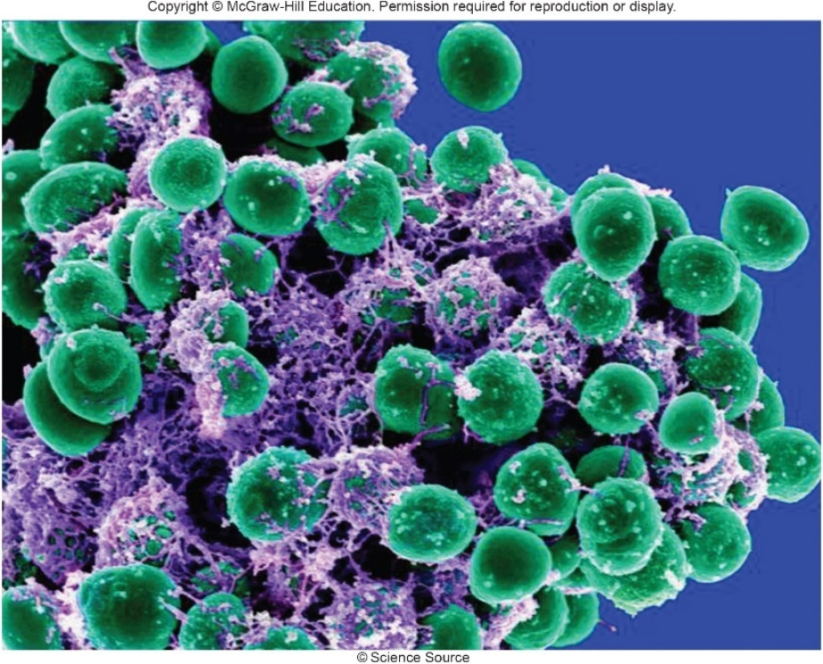
Skin Infections
Skin provides tough, flexible outer covering
But exposed state makes it vulnerable to injuries
Cuts, punctures, burns, chemical injury, and insect or tick bites can break barrier, provide entry for pathogens
Skin infections can occur when pathogens are carried to skin by bloodstream following entry from another site
©Science Source

Slide 4
Anatomy, Physiology, and Ecology (1)
Skin serves several important functions
Prevents entry of microbes
Regulates body temperature
Restricts fluid loss from tissues
Senses environment
Contains skin-associated lymphatic tissue (SALT)
Role in function of immune system

Slide 5
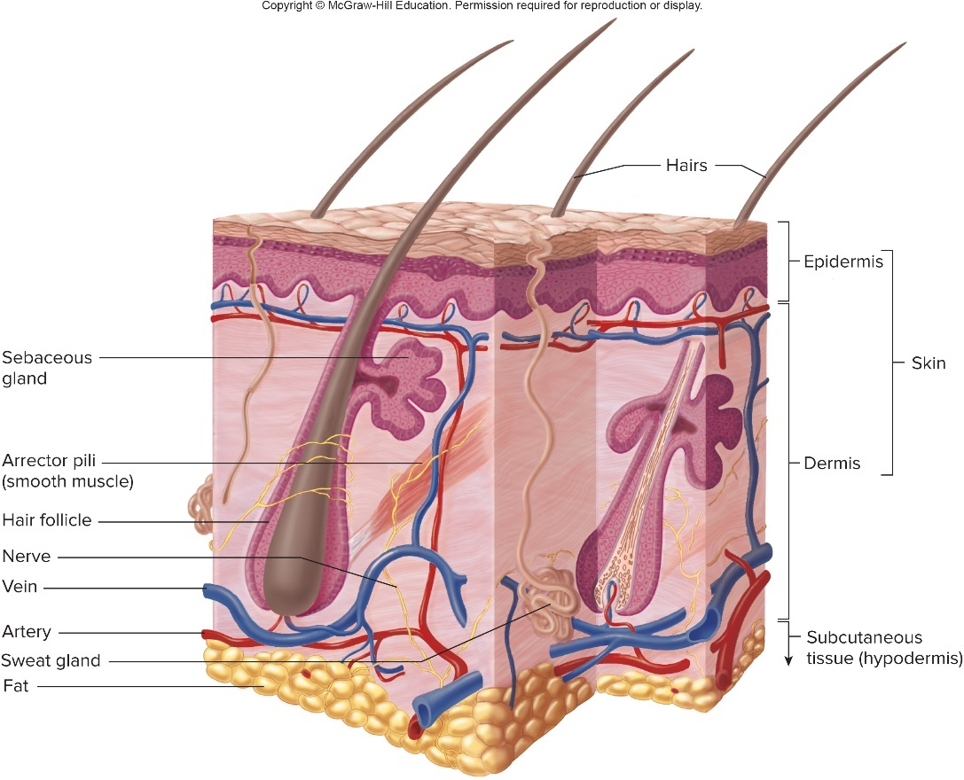
Anatomy, Physiology, and Ecology – Figure 22.1
Skin composed of two layers
Epidermis: surface layer made from layers of flat cells
Outermost are dead and filled with water-resistant keratin
Constantly flake off and replaced from deeper layers
Microbes are shed with flaking skin
Dermis: touch connective tissue
Contains nerves, glands, blood and lymphatic vessels
Subcutaneous tissue: supportive; fat, blood vessels
Notes:
5

Slide 6
Anatomy, Physiology, and Ecology (2)
Outermost layers bathed in secretions
Sweat evaporates; salty residue that inhibits microbes
Sebaceous glands open into hair follicles, secrete oily sebum that keeps hair and skin soft, water-repellant
Normal microbiota adapted to dry, salty, cool habitat
Use substances in sweat, sebum as nutrients; by-products inhibit other microbes
Too dry, salty, acidic, and toxic for most pathogens
Those that tolerate often shed with dead skin cells
Normal microbiota can be troublesome
Some are opportunistic pathogens
Body odor from bacterial breakdown of odorless sweat

Slide 7
Table 22.1 Principal Members of the Normal Skin Microbiota
Different regions of skin have different inhabitants
Drier back may have only 1,000 bacteria per centimeters squared compared with more than 10 million in groin, armpit
Most microbial inhabitants in three groups
Diphtheroids: oily regions (forehead, upper chest, back)
Cutibacterium most common: obligate anaerobes, grow within hair follicles
Name | Characteristics
Diphtheroids | Variably shaped, non-motile, Gram-positive rods of the Cutibacterium (Proprionibacterium) and Corynebacterium genera
Staphylococci | Gram-positive cocci arranged in packets or clusters; facultatively anaerobic
Fungi | Small yeasts of the genus Malassezia that require oily substances for growth are common
Staphylococci: salt-tolerant, use nutrients and produce antimicrobial substances active against other Gram-positive bacteria
Fungi: Malassezia species: tiny lipid-dependent yeasts

Slide 8
Bacterial Diseases of the Skin (1)
Few bacteria invade intact skin directly
Strands of hair provide route of invasion
Acne vulgaris: commonly begins at puberty
Signs and symptoms
Enlarged sebaceous glands, increased sebum secretion
Hair follicle epithelium thickens, sloughs off in clumps
Blockage yields large accumulations of sebum, produces blackheads and whiteheads
Causative agent: Cutibacterium acnes
Gram-positive rods, anaerobic
Use sebum as nutrient source; multiply in trapped sebum

Slide 9
Bacterial Diseases of the Skin (2)
Acne vulgaris
Pathogenesis
Metabolic products cause inflammatory response
Neutrophils recruited, release enzymes that damage follicle wall; follicle may burst to yield abscess
Collection of pus (living and dead neutrophils, bacteria, and tissue debris)
Epidemiology
Most people have C. acnes on skin throughout lives
Higher incidence of acne during puberty likely due to excess sebum production due to increased hormones
Treatment and prevention
Usually mild infection, but medications available
Squeezing lesions may allow bacteria into bloodstream

Slide 10
Bacterial Diseases of the Skin (3)
Hair follicle infections: generally mild
Signs and symptoms
Folliculitis is inflammation, causes red bumps (pimples)
Infection in adjacent tissues yields a furuncle (boil)
Localized redness, swelling, tenderness, pain
Pus may drain from the boil
May worsen to form carbuncle
Large area of redness, swelling, pain, draining pus
Often found in areas of thick skin (back of neck)
Fever often present

Slide 11
Table 22.2 Some Diseases Often Caused by Staphylocuccus aureus
Hair follicle infections: generally mild
Causative agent: commonly Staphylococcus aureus
Produces identifying coagulase and clumping factor (“slide coagulase”), which are virulence factors
Causes a number of other medical conditions
Disease | Comments
Food poisoning | Intoxication from consuming exotoxin in food
Hair follicle infections | Folliculitis, carbuncles, furuncles
Impetigo | Superficial skin disease with pus production
Infective endocarditis | Infection of heart valves or inner lining of heart
Staphylococcal scalded skin syndrome | Toxin-mediated skin disease
Toxic shock syndrome | Superantigens causing low blood pressure and organ failure
Wound infections | Colonization of wounds; possible systemic complications
Notes:
11

Slide 12
Bacterial Diseases of the Skin (4)
Hair follicle infections
Pathogenesis
S. aureus attaches to cells of hair follicle, multiplies, spreads to sebaceous glands
Infection produces inflammatory response
Neutrophils recruited
Plug forms from inflammatory cells, dead tissue
Spread to subcutaneous tissue forms abscess; can expand to other hair follicles and form carbuncle
If infection enters bloodstream, it can spread, reach heart, bones, brain

Slide 13
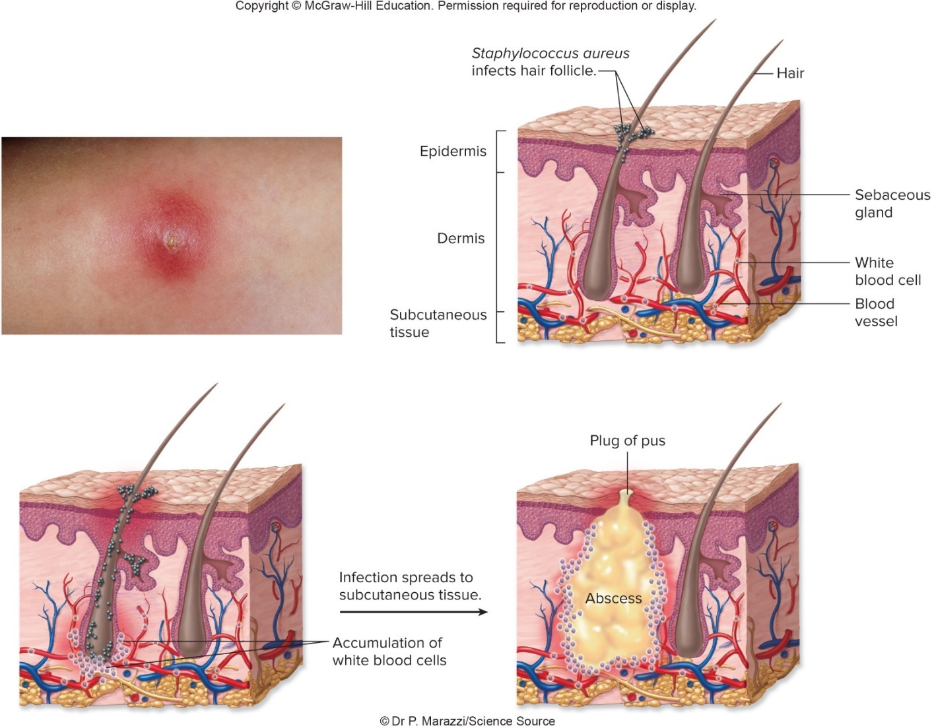
Bacterial Diseases of the Skin – Figure 22.2
Hair follicle infections
Pathogenesis
Top left: ©Dr. P. Marazzi/Science Source

Slide 14
Bacterial Diseases of the Skin (5)
Hair follicle infections
Pathogenesis
S. aureus strains have many different virulence factors
Inhibit phagocytosis
Allow disguise, attachment, colonization
Enzymes that break down host tissues
Toxins that damage host

Slide 15
Table 22.3 Properties of Staphylococcus aureus Implicated in Its Virulence
Product | Effect
Capsule | Inhibits phagocytosis
Clumping factor | Attaches the bacterium to fibrin, fibrinogen, and plastic devices
Coagulase | May slow progress of leukocytes into infected area by producing clots in the surrounding capillaries
Enterotoxins | Superantigens cause food poisoning if ingested, cause toxic shock if systemic
Exfoliatin | Destroys material that binds outer layers of the epidermis together, causing scalded skin syndrome
Fibronectin-binding protein | Attaches bacterium to acellular tissue substances, endothelium, epithelium, clots, indwelling plastic devices
Hyaluronidase | Breaks down hyaluronic acid component of tissue, thereby allowing infection to spread
Leukocidin | Kills neutrophils or causes them to release their enzymes
Lipase | Breaks down fats by hydrolyzing the bond between glycerol and fatty acids
Proteaes | Degrade collagen and other tissue proteins
Protein A | Binds to Fc portion of antibody, thereby interfering with opsonization that otherwise facilitates phagocytosis
Toxic shock syndrome toxin | Causes rash, diarrhea, and shock
α-Toxin | Makes holes in host cell membranes

Slide 16
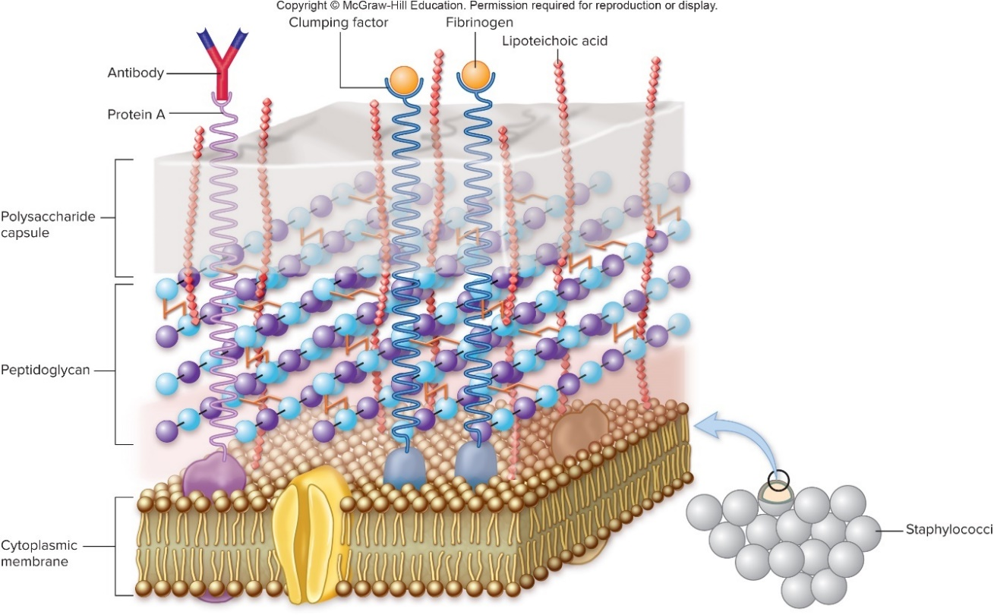
Bacterial Diseases of the Skin – Figure 22.3
Hair follicle infections
Pathogenesis
Nearly all S. aureus strains have protein A (binds to FC region of antibodies); many have polysaccharide capsule
Both interfere with phagocytosis

Slide 17
Bacterial Diseases of the Skin (6)
Hair follicle infections
Epidemiology
S. aureus commonly found in nostrils
30% of healthy adults carry continuously for year or more; 60% will be colonized during a given year
Transmission usually by hands
People with boils, other infections shed large numbers
Should not work with food or near patients with surgical wounds or chronic illnesses
Staphylococci survive well in environment
Fomites easily transmit
Since common, source of outbreak requires precise identification with techniques such as molecular typing or antibiogram determination

Slide 18
Bacterial Diseases of the Skin (7)
Hair follicle infections
Treatment and prevention
Boils, carbuncles may require minor surgery; antibiotics
Many strains resistant to multiple antibacterial medications
Methicillin-resistant S. aureus (MRSA)
Modified version of penicillin-binding protein (PBP2a)
Resistant to nearly all β-lactams
Vancomycin-resistant S. aureus (VRSA)
Most MRSA originally hospital-acquired (HA-MRSA), but new more virulent strains now cause community-acquired (CA-MRSA) infections
Many hospitals now screen patients to limit spread
Prevention difficult, but washing hands limits spread

Slide 19
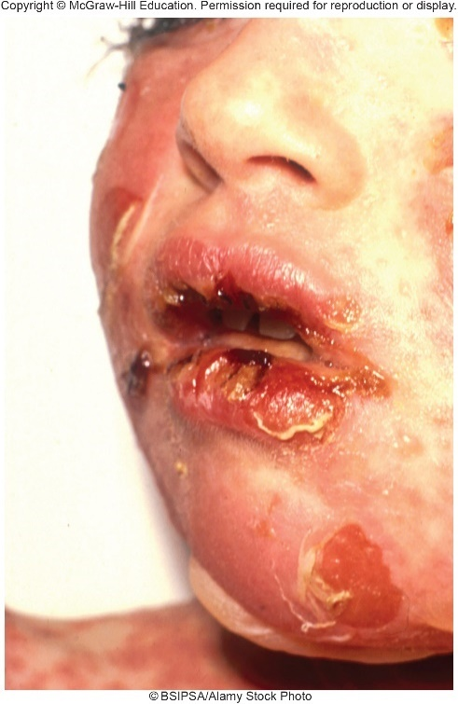
Bacterial Diseases of the Skin – Figure 22.4
Staphylococcal scalded skin syndrome (SSSS)
Signs and symptoms
Begins as redness of skin, malaise, irritability, fever
Nose, mouth, genitalia may become painful
Within 48 hours of redness, skin wrinkles and peels as large fluid-filled blisters develop
Causative agent: Staphylococcus aureus
5% of strains that produce toxin called exfoliatin
Destroys material that binds outer layers of epidermis
©BSIP SA/Alamy Stock Photo

Slide 20
Bacterial Diseases of the Skin (8)
Staphylococcal scalded skin syndrome
Pathogenesis: epidermis splits below dead layer
Exfoliatin carried in blood, widespread areas lose skin
Fluid loss, risk of secondary infection
Epidemiology: any age group; most frequently newborns
Transmission generally person-to-person
Treatment and prevention: antibiotics, dead skin removal
Can be fatal; quick treatment usually yields full recovery

Slide 21
Table 22.4 Staphylococcal Scalded Skin Syndrome
Signs and symptoms | Malaise, irritability, fever, sensitive red rash with sandpaper texture, large blisters, peeling of skin
Incubation period | Variable, usually days
Causative agent | Strains of Staphylococcus aureus that produce exfoliatin toxin
Pathogenesis | Exfoliatin is carried by the bloodstream to the epidermis, where it causes the outer layer to blister and peel; loss of body fluid and secondary infections contribute to mortality.
Epidemiology | Person-to-person transmission; mainly in infants.
Treatment and prevention | Treatment: antibiotics; removal of dead tissue. Prevention: isolation of the patient to prevent secondary infection and to limit the spread of the disease to others.

Slide 22
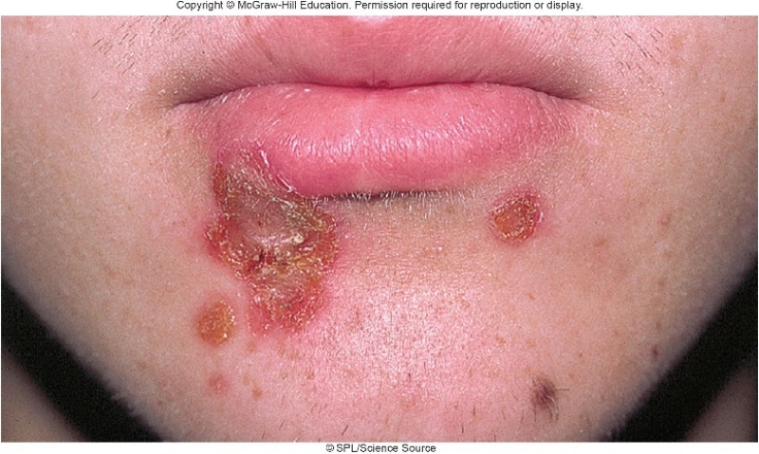
Bacterial Diseases of the Skin – Figure 22.5
Impetigo
Most common type of pyoderma, skin infection with pus production
Infection of insect bite, burn, scrape, or other wound
Signs and symptoms: patches of inflammation
Thin-walled blisters develop within 2 to 5 days; break, replaced by oozing crusts of drying plasma
Usually little fever, pain; nearby lymph nodes may enlarge
Causative agent: often Streptococcus pyogenes
Gram-positive, chain-forming, group A streptococcus
May also be caused by Staphylococcus aureus
©SPL/Science Source

Slide 23
Bacterial Diseases of the Skin (9)
Impetigo
Pathogenesis
Many strains of S. pyogenes; some colonize the skin
Minor injuries introduce into deeper layer of epidermis
Hyaluronic acid capsule and M protein of cell wall interfere with phagocytosis; additional virulence factors include proteases, nucleases, hyaluronidase
Immune response may produce post-streptococcal sequelae including acute glomerulonephritis

Slide 24
Table 22.5 Streptococcus pyogenes Versus Staphylococcus aureus
 | Streptococcus pyogenes | Staphylococcus aureus
Morphology | Chains of Gram-positive cocci | Clusters of Gram-positive cocci
Growth characteristics | Beta-hemolytic colonies; catalase-negative, coagulasenegative, obligate fermenter | Golden, beta-hemolytic colonies, catalase-positive, coagulase-positive, facultative anaerobe
Virulence factors | Cell wall contains group A polysaccharide, an Fc receptor (protein G), and M protein. Bacterium produces hemolysins (streptolysins O and S), streptokinase, DNase, hyaluronidase, and others | Cell wall contains an Fc receptor (protein A). Bacterium produces, hemolysins, leukocidin, hyaluronidase, nuclease, protease, and others
Diseases | Impetigo, strep throat, wound infections, scarlet fever, puerperal fever, toxic shock, and necrotizing fasciitis. Complications: glomerulonephritis and rheumatic fever | Boils, staphylococcal scalded skin syndrome, wound infections, abscesses, bone infections, impetigo, food poisoning, and staphylococcal toxic shock syndrome

Slide 25
Bacterial Diseases of the Skin (10)
Impetigo
Epidemiology
Most common among poor children in hot humid areas
Person-to-person contact, insects, fomites spread
Treatment and prevention
S. pyogenes susceptible to penicillin, erythromycin
Wound cleansing, antiseptics, avoiding contact limit spread
Keeping skin clean, avoiding sharing of personal items

Slide 26
Table 22.6 Impetigo
Signs and symptoms | Blisters that break, releasing plasma and pus; formation of yellowish crusts; lymph node enlargement
Incubation period | 2 to 5 days
Causative organisms | Streptococcus pyogenes, Staphylococcus aureus
Pathogenesis | Organisms entering the skin through minor breaks; certain strains of S. pyogenes that cause impetigo can also cause glomerulonephritis.
Epidemiology | Spread by direct contact, insects, and fomites.
Treatment and prevention | Treatment: appropriate antibiotic. Prevention: keeping clean; treating skin injuries.

Slide 27
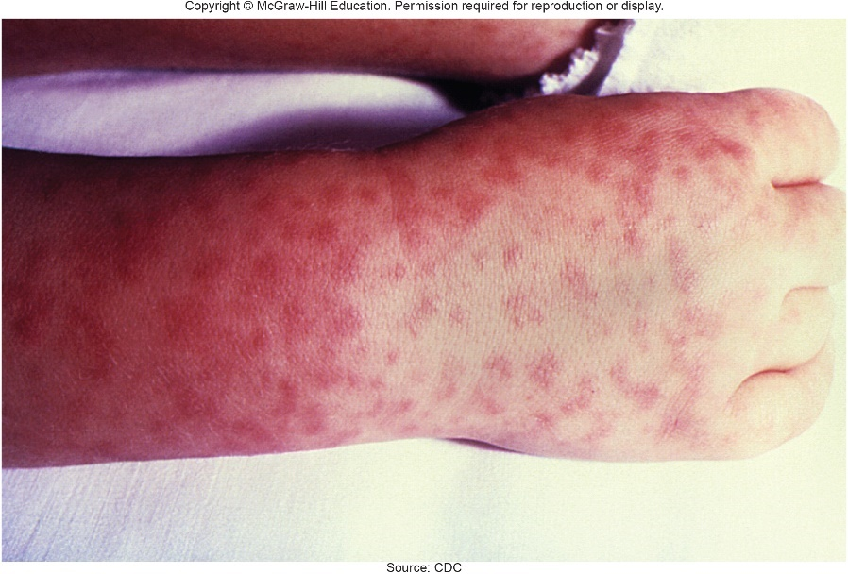
Bacterial Diseases of the Skin – Figure 22.6
Rocky Mountain spotted fever (RMSF)
Signs and symptoms
Sudden headache, pain in muscles and joints, fever
Flat pink rash first appears on wrists, ankles spreads up arms and legs to rest of body
Rash on palms and soles (not typical)
In about half of cases, petechiae (purplish spots) form due to small hemorrhages under skin
Damage to heart, kidneys, brain, other tissues can lead to drop in blood pressure, shock, and death without prompt treatment
Source: CDC

Slide 28
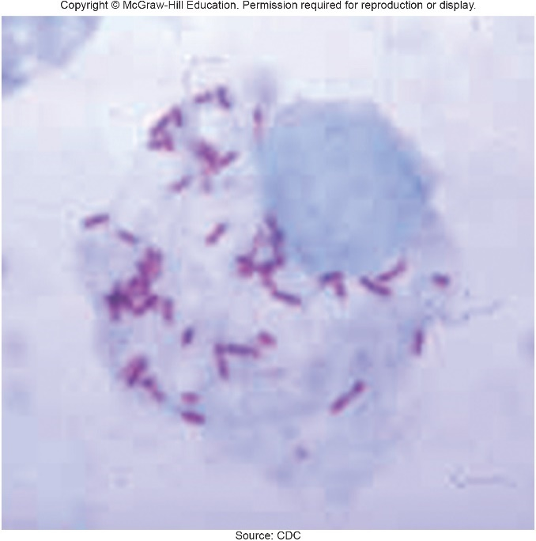
Bacterial Diseases of the Skin – Figure 22.7
Rocky Mountain spotted fever
Causative agent: Rickettsia rickettsii
Tiny Gram-negative non-motile coccobacilli
Obligate intracellular bacteria; difficult to grow in culture
May be identified by skin lesion biopsies, or PCR amplification followed by probe
Pathogenesis
Transmitted by tick bite after 4 to 10 hours of feeding
Bacteria taken up by endothelial cells lining small blood vessels
Bacteria leave phagosome; multiply within cell
Source: CDC

Slide 29
Bacterial Diseases of the Skin (11)
Rocky Mountain spotted fever
Pathogenesis
Bacteria use host actin to form “actin tail” to move into adjacent host cells; cause extensive membrane damage
Cells rupture, release rickettsias into bloodstream
Inflammation in blood vessels leads to clotting, small areas of necrosis, hemorrhagic skin rash, tissue damage
Release of endotoxin into bloodstream causes shock, disseminated intravascular coagulation (DIC)

Slide 30
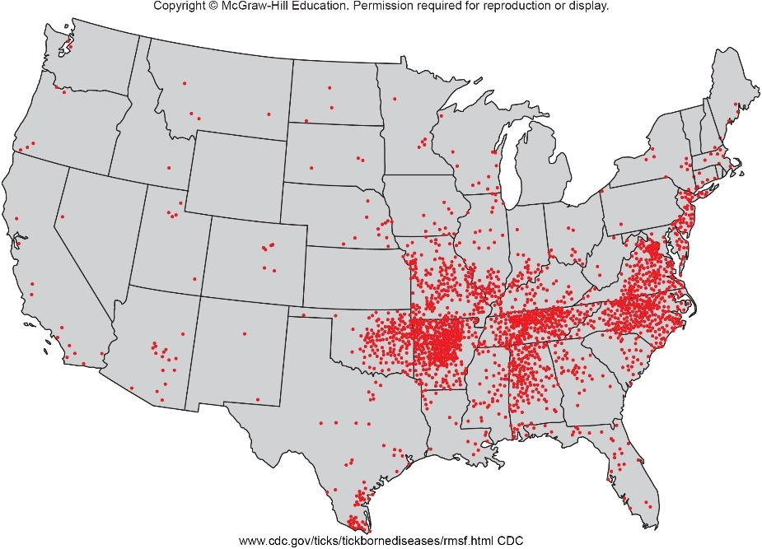
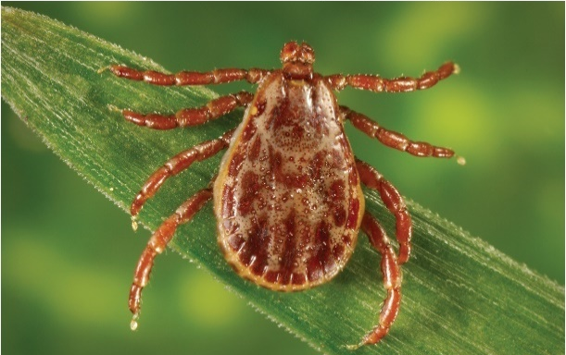
Bacterial Diseases of the Skin – Figures 22.8 and 22.9
Rocky Mountain spotted fever
Epidemiology
Sporadic distribution throughout the Americas
Zoonosis maintained in various species of ticks, mammals
Humans are accidental host; develop severe disease
Major vectors: wood tick, dog tick; active April to Sept.
Left: Source: “Tickborne Diseases of the United States: Rocky Mountain Spotted Fever,” Centers for Disease Control and Prevention. www.cdc.gov/ticks/tickbornediseases/ rmsf.html CDC; Right: Source: Dr. Christopher Paddock/CDC

Slide 31
Table 22.7 Rock Mountain Spotted Fever (RMSF)
Rocky Mountain spotted fever
Treatment and prevention
Doxycycline effective if given prior to irreversible organ damage
Case-fatality rate approximately 20% without treatment, below 5% with
No vaccine, but precautions against tick bites can limit transmission
Signs and symptoms | Headache, pains in muscles and joints, and fever, followed by a hemorrhagic rash that begins on the extremities
Incubation period | 4 to 8 days
Causative organism | Rickettsia rickettsii, an obligate intracellular bacterium
Pathogenesis | Organisms multiply at site of tick bite, invade the bloodstream, and then infect endothelial cells; blood vessel involvement and systemic inflammatory response damage tissues.
Epidemiology | A zoonosis transmitted by bite of infected tick, usually Dermacentor species.
Treatment and prevention | Treatment: appropriate antibiotics. Prevention: avoiding tick-infested areas; using tick repellent; removing ticks within 4 hours.

Slide 32
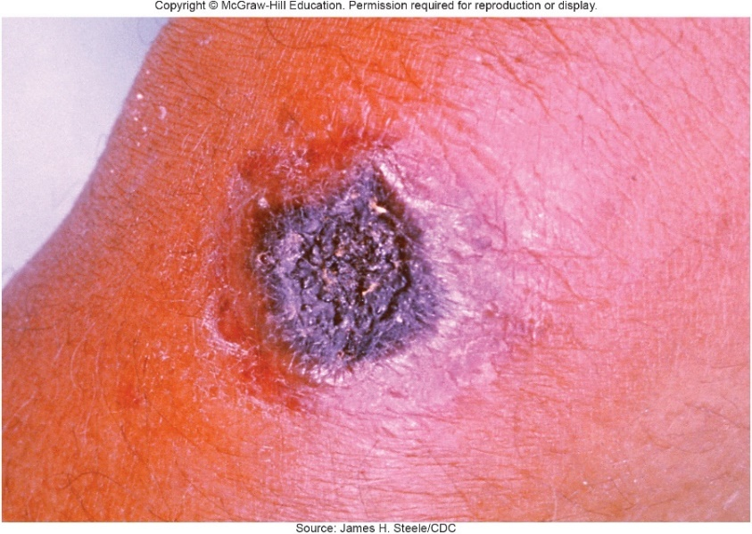
Bacterial Diseases of the Skin – Figure 22.10
Cutaneous anthrax
Anthrax rare in humans, but endospores can enter through inhalation, ingestion, contact with skin
Cutaneous anthrax most common; inhalation anthrax has much higher case-fatality rate
Signs and symptoms: small red bump within a few days
Bump develops blisters, eventually forms ulcer surrounded by swelling
Black eschar covers center of area and persists for several weeks
Seldom results in scarring
Source: James H Steele/CDC
Notes:
32

Slide 33
Bacterial Diseases of the Skin (12)
Cutaneous anthrax
Causative agent: Bacillus anthracis
Endospore-forming, Gram-positive, non-motile rod
Named for black “coal-like” scabs on infected skin
Endospore is infectious form; germinate to form toxin-producing vegetative cells in host
Pathogenesis
Virulence due to capsule and exotoxins
Cutaneous anthrax not likely to become systemic
Epidemiology
Seen in people who work with animals or animal products (farmers, leather tanners, etc.)
No person-to-person transmission
Notes:
33

Slide 34
Table 22.8 Cutaneous Anthrax
Cutaneous anthrax
Treatment and prevention
Antimicrobial medication for 7 to 14 days
No effect on cutaneous lesion, but can prevent organism from spreading systemically
Vaccine available for those at greatest risk
Signs and symptoms | Small red bump develops into painless black eschar
Incubation period | Usually 1 to 7 days
Causative organism | Bacillus anthracis, an endospore-forming, Gram-positive rod
Pathogenesis | Exotoxins cause cell death.
Epidemiology | Seen in people who work with animals or animal products; no person-to-person transmission.
Treatment and prevention | Treatment: antimicrobial medications. Prevention: vaccine for at-risk populations.
Notes:
34

Slide 35
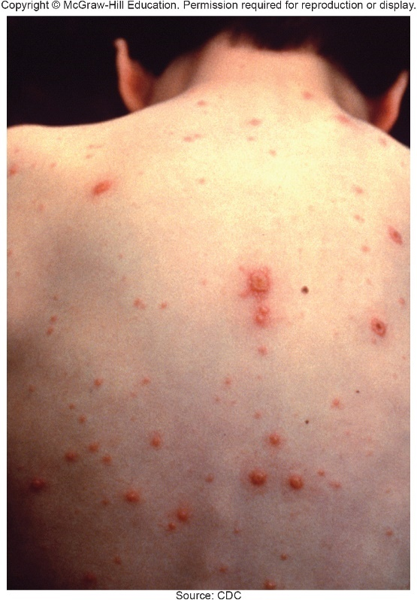
Viral Diseases of the Skin – Figure 22.11
Varicella (chickenpox)
Signs and symptoms: fever, headache, malaise, rash; incubation period 10 to 21 days
Most childhood cases mild
Begins as small, red spots (macules)
Progresses to little bumps (papules)
Finally small blisters (vesicles)
All lesion types present during rash
Occur anywhere on body, but often begin on head, chest, back; perhaps on mucous membranes
Lesions are pruritic (itchy); scratching can lead to serious secondary infection by S. pyogenes or S. aureus
Source: CDC

Slide 36
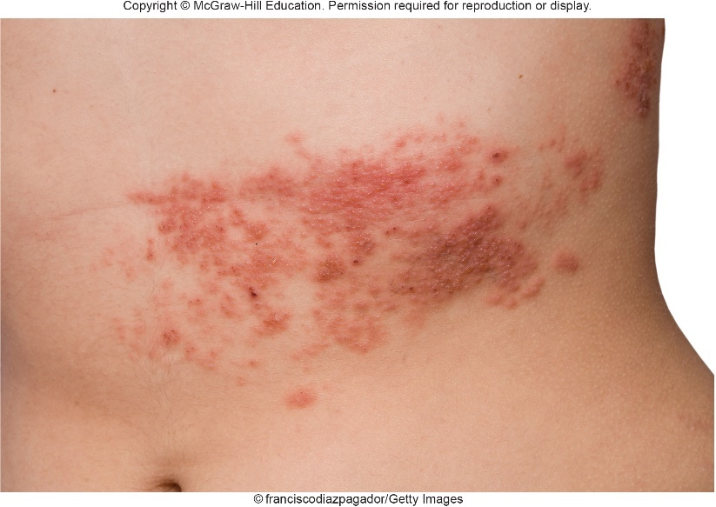
Viral Diseases of the Skin – Figure 22.12
Varicella
Signs and symptoms
More severe in adults; about 20% develop pneumonia
Damages lungs, heart, liver, kidneys, and brain in immunocompromised individuals; death results in approximately 20%
Reactivation of latent virus later in life produces shingles
Begins with tingling, then painful rash along area supplied by involved sensory nerve
Can pose risk to eyes
Not spread from person to person
©franciscodiazpagador/Getty Images

Slide 37
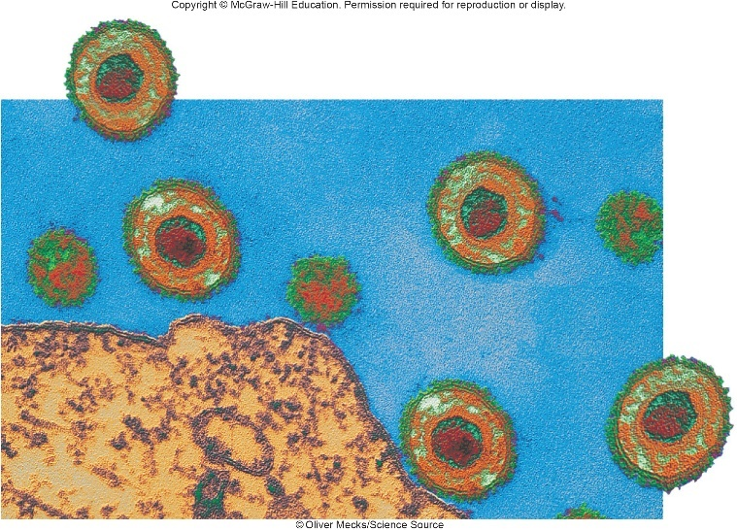
Viral Diseases of the Skin – Figure 22.13
Varicella
Causative agent
Varicella-zoster virus (VZV) of Herpesviridae: enveloped, double-stranded DNA virus
Pathogenesis
VZV enters via respiratory tract, establishes infection, replicates in lymph nodes, travels to skin via bloodstream
Stained preparations of infected cells show intranuclear inclusion bodies where virus reproduces
Some infected cells fuse, form multinucleated giant cells
Infected cells lyse; virus enters nerve, travels to ganglia
Shingles coincides with decline in cell-mediated immunity
Secondary immune response controls shingles
©Oliver Mecks/ Science Source

Slide 38
Viral Diseases of the Skin (1)
Varicella
Epidemiology
Notifiable disease, although many mild cases unreported
In early 1990s, about 4 million cases/year in U.S.
A decade after vaccine release in 1995, fewer than half a million cases, 8 deaths/year
Highly contagious; transmitted by respiratory secretions and skin lesions; most cases in winter and spring months
Humans are only reservoir
Threat to newborns, with case-fatality rate up to 30%
Babies born to mothers who had chickenpox early in pregnancy may develop congenital varicella syndrome
Uninfected person exposed to shingles develops chickenpox

Slide 39
Viral Diseases of the Skin (2)
Varicella
Treatment and prevention
Antivirals acyclovir and famciclovir, others helpful in preventing and treating VZV infections
Avoid aspirin as it increases risk of Reye’s syndrome
Attenuated chickenpox vaccine used in U.S. since 1995
May be given in combination vaccine MMRV
Reduces chance of developing shingles
Shingles vaccine available for
Same attenuated virus as chickenpox vaccine, but much higher dose; reduces risk by 50%
Immunocompromised individuals at risk for severe VZV infections; partial protection achieved by passive immunization with ZVIG (hyperimmune globulin with high concentrations of antibody to VZV)

Slide 40
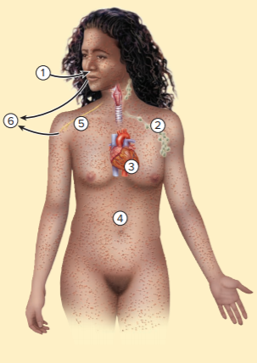
Table 22.9 Varicella (Chickenpox)
Varicella-zoster virus from respiratory secretions or Skin lesions is inhaled; infects nose and throat.
The virus infects nearby lymph nodes, reproduces, and enters the bloodstream.
Infection of other body cells occurs, resulting in spread of virions into the bloodstream.
Virions cause successive skin lesions, which evolve into blisters and crusts.
If immunity decreases, latent virus persisting in sensory nerve ganglia can reactivate and return to the skin, causing shingles.
Transmission occurs from respiratory secretions or skin lesions, causing chickenpox in people not immune to VZV.
Signs and symptoms | Itchy bumps and blisters in various stages of development, fever; latent infections can reactivate, resulting in shingles.
Incubation period | 10 to 21 days
Causative organism | Varicella-zoster virus; enveloped double-stranded DNA herpesvirus.
Pathogenesis | Virus enters respiratory tract, replicates in lymph nodes, spreads via bloodstream to the skin and forms lesions; infected cells fuse, swell, and then lyse.
Epidemiology | Highly infectious. Acquired by the respiratory route; people infected with either chickenpox or shingles are the only source; spread via skin lesions and respiratory secretions.
Treatment and prevention | Treatment: antiviral medication. Prevention: attenuated vaccine (single agent or in the combination MMRV); passive immunization with zoster immune globulin for immunocompromised individuals.

Slide 41
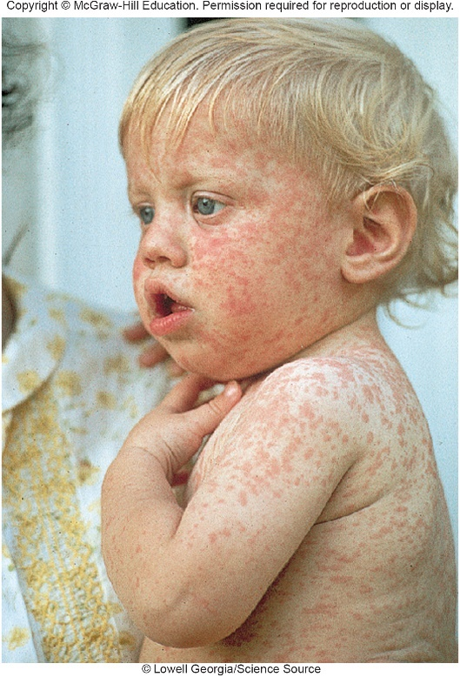
Viral Diseases of the Skin – Figure 22.14
Rubeola (measles)
No longer endemic in Western Hemisphere since 2000, but number of outbreaks has more than doubled in recent years due to parents’ failure to immunize their children
Signs and symptoms: fever, runny nose, cough, and swollen, red eyes, perhaps diarrhea; incubation period 10 to 12 days
Rash appears within a few days, lasts about 1 week
Secondary infections often lead to earaches, pneumonia; rare complication of encephalitis
Very rarely, 2 to 10 years later, measles is followed by subacute sclerosing panencephalitis (SSPE)
Death due to brain degeneration
Measles increases risk of miscarriage, premature labor, low birth weight
©Lowell Georgia/Science Source

Slide 42
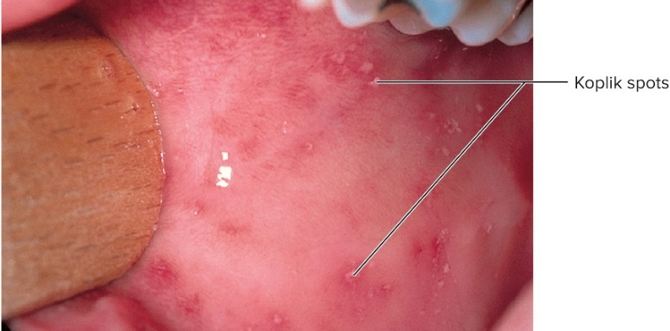
Viral Diseases of the Skin – Figure 22.15
Rubeola
Causative agent
Rubeola virus of Paramyxoviridae; enveloped, single-stranded RNA virus
Hemagglutinin (attachment) and fusion protein on envelope
Pathogenesis
Acquired via respiratory route; spreads to lymphatic tissues, eventually all parts of body
Rash results from cell-mediated immune response in skin
Koplik spots of mucous membranes identifying feature
Suppresses immunity, damages mucous membranes and intestinal epithelium 1-2/1,000 cases fatal in U.S.
©Dr. P. Marazzi/SPL/Science Source

Slide 43
Viral Diseases of the Skin (3)
Rubeola
Epidemiology
Humans only natural host of rubeola virus
Prior to vaccination, probably less than 1% of global population escaped infection
In 2014, nearly 115,000 died globally, mostly children
Treatment and prevention
No antiviral, but attenuated vaccine can prevent
Given in combination with mumps and rubella vaccines (MMR) and sometimes varicella (MMRV)

Slide 44
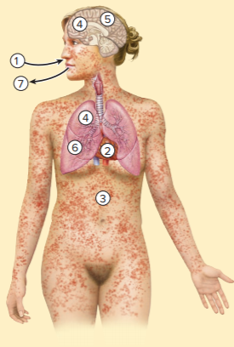
Table 22.10 Rubeola (Measles)
Rubeola virus spread by air or direct contact infects the upper respiratory tract, then the lymph nodes in the region.
Virus enters the bloodstream and is carried to all parts of the body, including the brain, lungs, and skin.
Skin cells infected with the rubeola virus are attacked by cytotoxic T cells, causing a generalized rash.
Virus replicating in the lungs can cause pneumonia; the brain can also be infected.
In rare cases, virus persisting in the brain causes subacute sclerosing panencephalitis, months or years after the acute infection.
Secondary infection of the ears and lungs is common.
Transmission is by respiratory secretions.
Signs and symptoms | Rash, fever, weepy eyes, cough, nasal discharge, and sometimes diarrhea.
Incubation period | 10 to 12 days
Causative organism | Rubeola virus, an enveloped single-stranded RNA paramyxovirus
Pathogenesis | Virus multiplies in respiratory tract; spreads to lymphatic tissues, then to all parts of body, notably skin, lungs, and brain; damage to respiratory tract epithelium leads to secondary infection of lungs (pneumonia) and ears.
Epidemiology | Acquired by respiratory route; highly contagious; humans only source.
Treatment and prevention | Treatment: no antiviral treatment. Prevention: attenuated vaccine (MMR or MMRV).

Slide 45
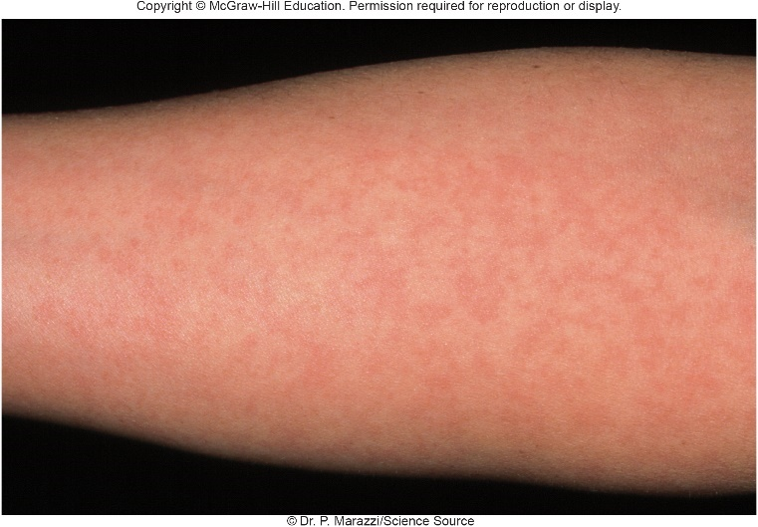
Viral Diseases of the Skin – Figure 22.16
Rubella (German measles)
First described in Germany; also “three-day measles”
Signs and symptoms:
Slight fever, mild cold symptoms, enlarged lymph nodes; faint rash after a day; incubation period 2 to 3 weeks
No diagnostic mouth lesions as in measles
Adults develop painful joints for up to three weeks
Significant threat to developing fetus
Causative agent
Rubella virus of Togaviridae; enveloped, single-stranded RNA
Surface proteins cause in vitro hemagglutination, helpful in identification
©Dr. P. Marazzi/Science Source

Slide 46
Viral Diseases of the Skin (4)
Rubella
Pathogenesis
Entry via respiratory tract, moves to lymph nodes, viremia as it enters bloodstream
Immune complexes may cause rash and joint symptoms
Early in pregnancy, virus particles can cross placenta, infect fetus; commonly causing deafness
Infection in fetus yields characteristic pattern of fetal abnormalities: congenital rubella syndrome (CRS)
Eye defects, brain damage, deafness, heart defects, low birth weight; stillborn babies

Slide 47
Viral Diseases of the Skin (5)
Rubella
Epidemiology
Humans only natural host
Disease highly contagious from one week before rash until one week afterward
Pre-vaccine, estimated 10 to 15% of people reached adulthood without being infected
1964 epidemic in U.S. yielded approximately 30,000 cases of congenital rubella syndrome; “rubella bulge” of hearing-impaired children affected educational system for decades

Slide 48
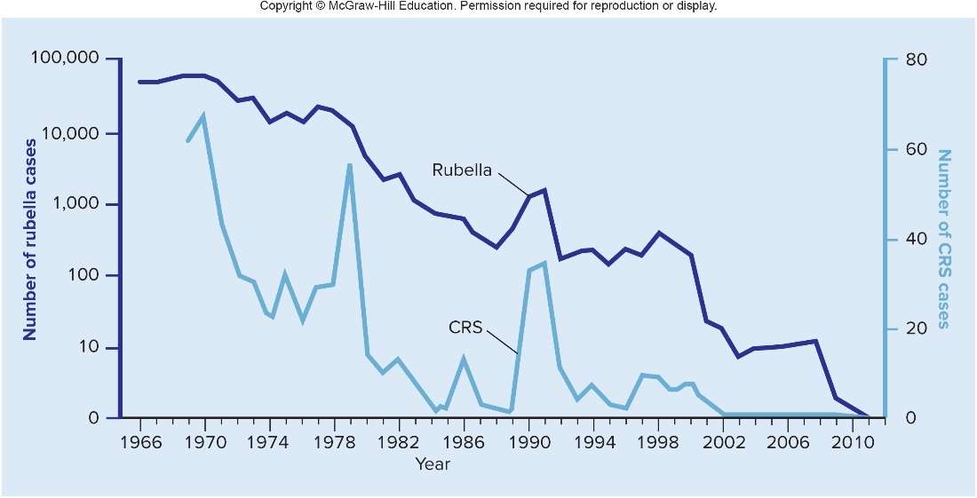
Viral Diseases of the Skin – Figure 22.17
Rubella
Treatment and prevention
No specific antiviral therapy, but attenuated rubella virus has dramatically reduced incidence
Produces long-lasting immunity in nearly all recipients
Not given to pregnant women; women advised not to become pregnant for 28 days after vaccination
U.S. now sees fewer than 10 cases per year

Slide 49
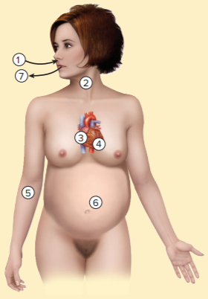
Table 22.11 Rubella (German Measles)
Airborne rubella virus infects nose and throat.
Virus enters lymph nodes in the region.
Rubella virus multiples and enters the bloodstream.
Circulating virus reacts with antibodies, resulting in immune complexes.
Immune complexes lodge in the skin, causing a mild rash, and in the joints, causing pain.
In pregnant women, rubella virus crosses the placenta, infecting the fetus, resulting in congenital rubella syndrome.
Transmission to others is by respiratory secretions.
Signs and symptoms | Mild fever and cold symptoms, rash beginning on forehead and face, enlarged lymph nodes behind the ears; joint pain in adults
Incubation period | 14 to 21 days
Causative organism | Rubella virus, an enveloped RNA virus
Pathogenesis | Following replication in the upper respiratory tract, virus spreads to all parts of the body and crosses the placenta; surviving fetuses often develop abnormally and excrete the virus for months after birth.
Epidemiology | Virus typically present in nose and throat from 1 week before rash to 1 week after; infection occurs via the respiratory route; humans are the only source.
Treatment and prevention | Treatment: no specific antiviral treatment. Prevention: attenuated vaccine (MMR or MMRV).

Slide 50
Viral Diseases of the Skin (6)
Other viral rashes of childhood
Hundreds of different viruses cause childhood rashes
Enteroviruses have about 50 members involved
Causes unknown in early 1900s, so numbered 1 to 6:
(1) Rubeola
(2) Scarlet fever
(3) Rubella
(4) Duke’s disease (fourth disease)
(5) Erythema infectiosum (fifth disease)
(6) Roseola

Slide 51
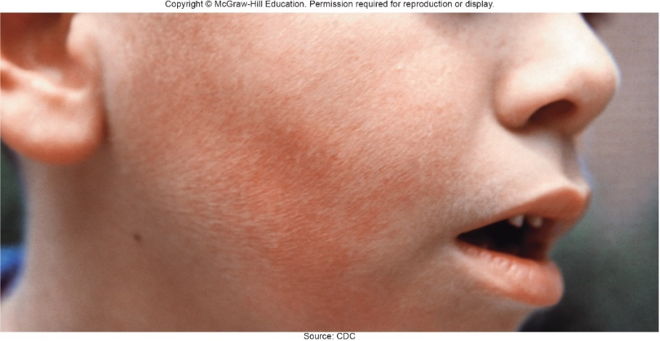
Viral Diseases of the Skin (7)
Other viral rashes of childhood
Fifth disease
Occurs in children and young adults
Spread by respiratory droplets
Mild fever, malaise, headache
Diffuse redness appears on cheeks (as if slapped)
Develops lacy pattern elsewhere on body
May come and go for 2 weeks or more
Adults often have joint pains
Source: CDC

Slide 52
Viral Diseases of the Skin (8)
Other viral rashes of childhood
Fifth disease
Caused by parvovirus B-19: non-enveloped, single-stranded DNA virus
Preferentially infects bone marrow cells
Up to 5% of pregnant women suffer spontaneous abortion
Roseola
Common but mild in children 6 months to 3 years old
Begins abruptly with fever nearing 105 degrees Fahrenheit, convulsions
Children otherwise do not appear ill
After several days, fever subsides, short-lived red rash appears, disappears in a few hours to 2 days
Caused by herpesvirus type 6
No vaccine or treatment except to reduce fever

Slide 53
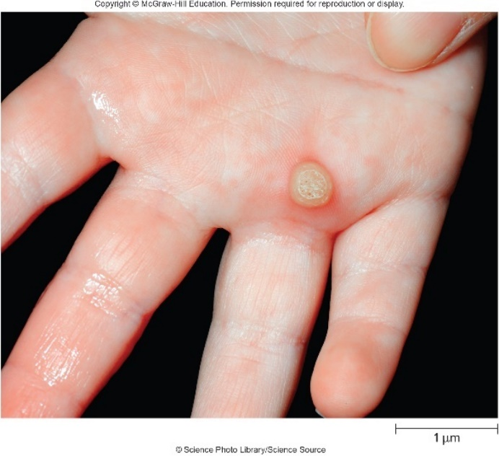
Viral Diseases of the Skin – Figure 22.19
Warts
Papillomaviruses infect skin via minor abrasions
Warts are small benign tumors (papillomas) consisting of protrusions of tissue covered by skin or mucous membrane
About half the time, warts on skin disappear within 2 years without treatment; incubation period 2 to 18 months
Papillomaviruses; non-enveloped, double-stranded DNA viruses
More than 100 types infect humans
Can survive on inanimate objects
Treatment: killing (liquid nitrogen, cauterization), removing abnormal cells
Warts on soles of feet: plantar warts
©Science Photo Library/Science Source

Slide 54
Fungal Diseases of the Skin (1)
Superficial cutaneous mycoses
Mycoses are diseases caused by fungi
Dermatophytes can invade hair, nails, keratin in skin
Result in jock itch, athlete’s foot, ringworm, Latinized names describe location: tinea capitis (scalp), tinea barbae (beard), tinea axillaris (armpit), tinea corporis (body), tinea cruris (groin), and tinea pedis (feet)
Signs and symptoms
Usually none; sometimes itching, bad odor, rash
Ringworm may produce rash: scaly area surrounded by redness, producing irregular rings or lacy pattern on skin
Patchy areas of hair loss can occur on scalp
Infected nails may thicken, separate from nailbed
Rash may develop due to allergy (“id” reaction)

Slide 55
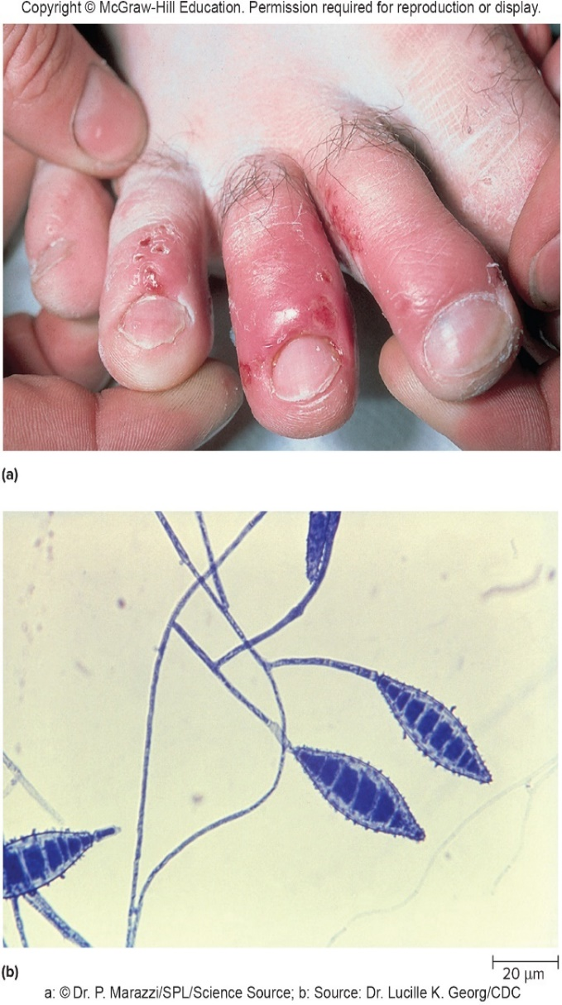
Fungal Diseases of the Skin – Figure 22.20
Superficial cutaneous mycoses
Causative agents
Dermatophytes are group of skin-invading molds (Epidermo- phyton, Microsporum, and Trichophyton)
Cultivated on media designed for molds; identified by colonial and microscopic appearance
Nutritional requirements and biochemical tests also used
a: ©Dr. P. Marazzi/SPL/Science Source; b: Source: Dr. Lucille K. Georg/CDC

Slide 56
Fungal Diseases of the Skin (2)
Superficial cutaneous mycoses
Pathogenesis
Normal skin resists invasion by dermatophytes, but some species relatively virulent, especially in children
Produce keratinase, use keratin as nutrient source
Fungal products enter dermis, provoke immune reaction
Eczema is weepy skin rash due to allergy
Epidemiology
Patient age, virulence of mold, moisture important
Treatment and prevention
Prescription and over-the-counter medications
Keeping clean/dry, changing socks, open shoes, powders, rubbing alcohol may help prevent nail infections

Slide 57
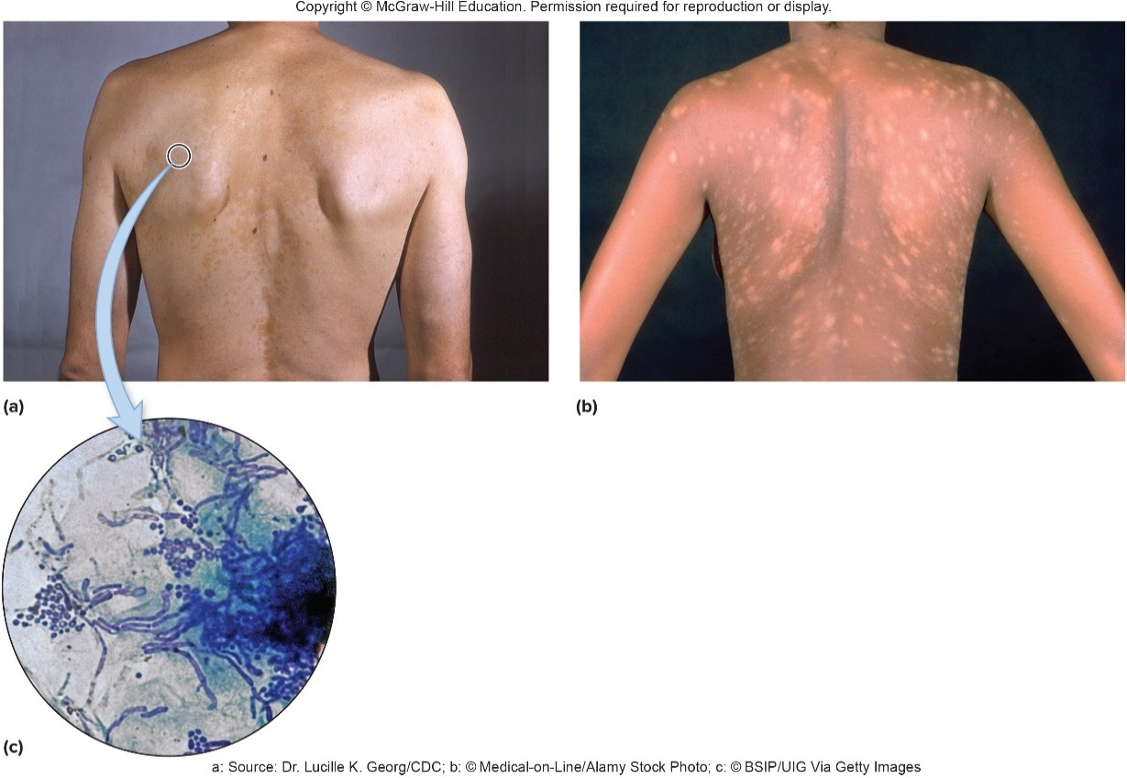
Fungal Diseases of the Skin – Figure 22.21
Other fungal diseases
Malassezia furfur generally harmless, commonly found
Can cause scaly face rash, dandruff, or tinea versicolor
Tinea versicolor characterized by patchy scaliness and increased or decreased pigmentation
a: Source: Dr. Lucille K. Georg/CDC; b: ©Medical-on-Line/ Alamy Stock Photo; c: ©BSIP/UIG Via Getty Images

Slide 58
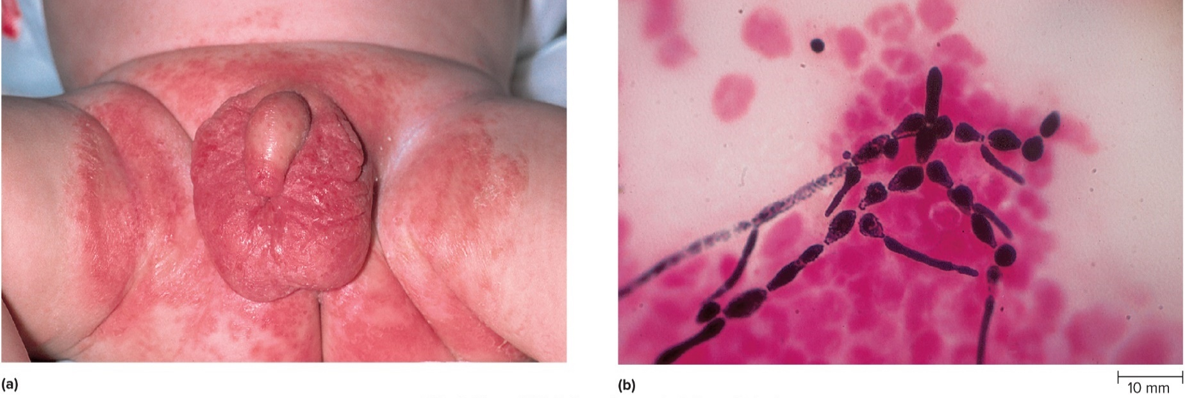
Fungal Diseases of the Skin – Figure 22.22
Other fungal diseases
Yeast Candida albicans found in normal microbiota
Can invade deep layers of skin and subcutaneous tissues
Often no precise cause for invasion can be determined
a: ©Dr. P. Marazzi/SPL/Science Source; b: ©Evans Roberts

