Slide 1
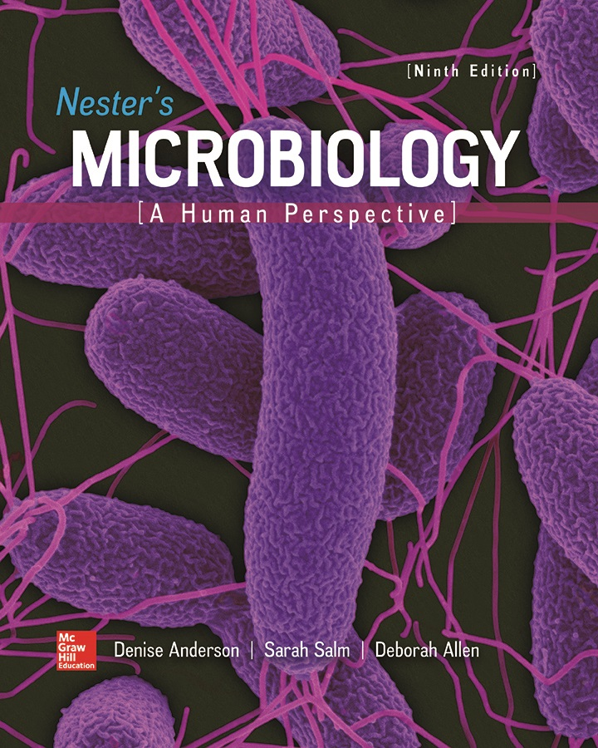
Chapter 25 Lecture Outline
See separate PowerPoint slides for all figures and tables pre-inserted into PowerPoint without notes.
Notes:
1

Slide 2
A Glimpse of History
Alexandre Emile John Yersin (1863 to 1943)
Became a physician, but was bored with research and did not want to charge money to practice medicine
Established medical school in Vietnam, where he studied diseases affecting the people, including plague whose cause and transmission were unknown
In 1894, Yersin went to Hong Kong to study outbreak
Discovered in lymph nodes of plague victims a bacillus, which was named Yersinia pestis
This was used to make a vaccine; later antiserum against the organism cured a patient with plague

Slide 3
Introduction
Cardiovascular system circulates blood and lymph
Supplies nutrients and
to cells, removes waste
Also heats, cools to maintain optimum temperature
Infections can be serious, since infectious agents can become systemic, or carried throughout body
When substance is circulating, conditions are named after infectious agent: bacteremia, viremia, and fungemia
Does not imply a disease state and may not involve symptoms—for example, person can become briefly bacteremic after brushing teeth
Immune system normally removes microbes that enter the bloodstream

Slide 4
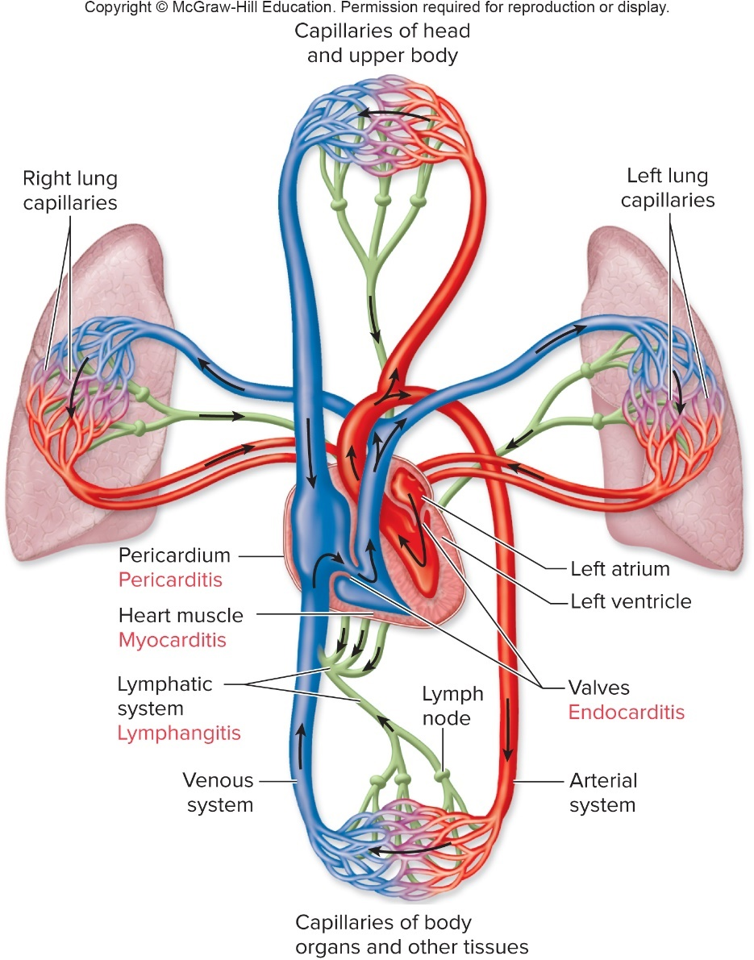
Anatomy, Physiology, and Ecology – Figure 25.1
Cardiovascular system
Heart, blood vessels, blood
Lymphatic system
Lymph, lymph vessels, lymph nodes, and lymphoid organs including tonsils, appendix, spleen
Phagocytic cells remove infectious agents, foreign material
Both systems normally sterile
Jump to Anatomy, Physiology, and Ecology – Figure 25.1

Slide 5
Anatomy, Physiology, and Ecology (1)
The heart
Muscular pump enclosed in fibrous sac, or pericardium
Septum divides into right and left sides; each divided into two chambers: atria (receive blood), ventricles (discharge blood)
Blood from right ventricle flows through lungs and back to heart into left atrium
Blood from left ventricle flows through tissues of the body and back to heart into right atrium
Valves at entrance and exit of each ventricle prevent blood flow from reversing
Infections of heart uncommon; can be serious

Slide 6
Anatomy, Physiology, and Ecology (2)
Blood vessels
Arteries, veins, capillaries
Arteries carry blood away from heart; thick muscular walls
Capillaries have thin walls; exchange between blood and tissues
Veins carry blood back to heart; valves prevent backflow, since pressure is low
Action of skeletal muscles aids flow of venous blood
Notes:
6

Slide 7
Anatomy, Physiology, and Ecology (3)
Lymphatics (lymphatic vessels)
Lymphatic capillaries arise in tissues; carry almost colorless lymph
Fluid seeps from blood capillaries to become interstitial fluid surrounding tissue cells; some enters lymphatics
Lymphatics take up large molecules, microbes
One-way valves, compression by muscles maintain flow through multiple lymph nodes
Contain phagocytic cells and lymphocytes to trap, destroy foreign material such as microbial cells
Lymphatic vessels converge and empty lymph into blood vessels entering the heart

Slide 8
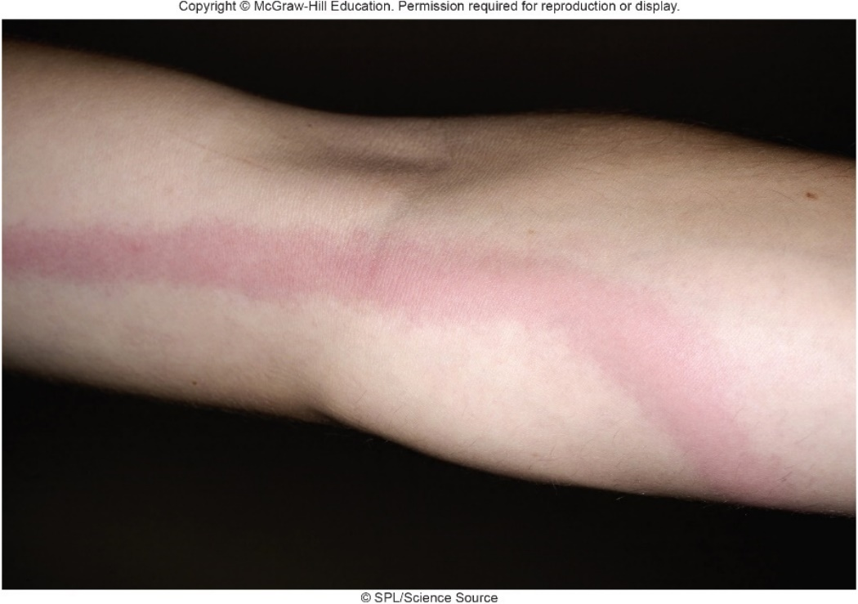
Anatomy, Physiology, and Ecology – Figure 25.2
Lymphatics
Infection of limb may result in visible red streak from infection site to lymph node; called lymphangitis
Blood, lymph both carry leukocytes, antimicrobial proteins (antibodies, complement, lysozyme, interferon); clotting may prevent spread of infection
©SPL/Science Source

Slide 9
Anatomy, Physiology, and Ecology (4)
Spleen
Fist-sized organ behind stomach
Two types of tissues
Red pulp (multiple blood-filled passageways)
Cleans blood by filtration, removes old red blood cells, microbes, foreign materials
Can produce new blood cells
Has reserve of monocytes
White pulp (lymphoid tissue) contains B and T lymphocytes
Notes:
9

Slide 10
Bacterial Diseases of Blood and Lymphatic Systems (1)
Bacteria that cause vascular infections usually carried into bloodstream by flow of lymph from area of infection in tissues
Some multiply in blood, then colonize and form biofilms on structures such as heart valves
Some multiply in cells of mononuclear phagocyte system

Slide 11
Bacterial Diseases of Blood and Lymphatic Systems (2)
Infective endocarditis (IE)
Infection of inner surface of heart, often a heart valve
Predisposing factors include use of indwelling catheters, heart defects, or injected drug abuse
Some types progress slowly; formerly called subacute bacterial endocarditis (SBE)
Signs and symptoms
Noticeable fatigue, slight fever
Typically become ill gradually and slowly lose energy over weeks or months
Small hemorrhagic lesions form in conjunctiva, skin, or under nails
Strokes can be life-threatening complication

Slide 12
Bacterial Diseases of Blood and Lymphatic Systems (3)
Infective endocarditis
Causative agents
Usually normal microbiota of mouth or skin such as Staphylococcus aureus, Staphylococcus epidermidis, enterococci, Streptococcus species, including viridans streptococci normally found in the mouth
Organisms shed from heart valve into blood
Identified by cultivating samples from arm vein
PCR, nucleic acid probes may be used to identify
Notes:
12

Slide 13
Bacterial Diseases of Blood and Lymphatic Systems (4)
Infective endocarditis
Pathogenesis
Bacteria enter blood during dental procedures, tooth brushing, or trauma; can get trapped in thin blood clots that form around deformed heart valves
Multiply, form protective biofilm
Bacteria continually wash into circulation; pieces of infected clot (septic emboli) can break off, block important blood vessels, lead to tissue death
Can cause vessel to weaken and balloon out: aneurysm
High antibody levels can lead to harmful immune complexes that may lodge in body structures; trigger inflammatory response
Glomerulonephritis in kidneys
May penetrate heart tissue: abscesses, damaged valves

Slide 14
Bacterial Diseases of Blood and Lymphatic Systems (5)
Infective endocarditis
Epidemiology
Increasing cases in patients with intravenous catheters, prosthetic heart valves as devices become more common
Increasing injected drug abuse increases disease rate
Usually infected with S. aureus, S. epidermidis, enterococci
Viridans streptococci cause fewer cases, but increasingly antibiotic-resistant

Slide 15
Bacterial Diseases of Blood and Lymphatic Systems (6)
Infective endocarditis
Treatment and prevention
Prolonged treatment with combinations of intravenous antibacterial medications
Devices covered with resistant biofilms must be replaced
Prophylactic antibiotic treatment may precede dental procedures or certain surgeries for those with heart murmurs or abnormalities
Sterile technique when inserting catheters, moving them to different locations, removing as soon as possible

Slide 16
Table 25.1 Infective Endocarditis
Signs and symptoms | Fever, loss of energy over a period of weeks or months; sometimes, a stroke
Incubation period | Poorly defined, usually weeks
Causative agents | Staphylococcus aureus or S. epidermidis; enterococci; streptococci including oral viridans streptococci
Pathogenesis | Normal microbiota or organisms from an infected body site enter bloodstream; turbulent blood flow causes formation of a thin clot that traps circulating organisms; a biofilm forms, protecting the organisms from phagocytes; pieces of clot break off, blocking blood vessels, leading to tissue death.
Epidemiology | People at risk are mainly those with heart abnormalities, including artificial valves or damage from rheumatic fever; may develop after dental procedures or other situations that cause bacteremia; injected drug abuse.
Treatment and prevention | Treatment: a combination of antibiotics. Prevention: in certain cases, administration of an antibiotic immediately before anticipated bacteremia, such as before dental work.
Notes:
16

Slide 17
Bacterial Diseases of Blood and Lymphatic Systems (7)
Sepsis and septic shock
Sepsis: infection-induced systemic inflammatory response; involves pro-inflammatory cytokines
Septic shock: dramatic drop in blood pressure due to uncontrolled inflammatory response of sepsis; may be fatal
Signs and symptoms
Severe sepsis results in violent shaking, chills, fever
Often rapid breathing, anxiety, confusion
In septic shock, urine output drops, respiration and pulse increase, arms and legs become cool, dusky
Possible bruising, bleeding

Slide 18
Bacterial Diseases of Blood and Lymphatic Systems (8)
Sepsis and septic shock
Causative agents
Systemic infection by any microorganism can cause it
Most fatal cases involve Gram-negative bacteria that contain endotoxin
Common causes include members of normal microbiota of large intestine
Facultative anaerobes such as E. coli or other enterobacteria, also anaerobes such as Bacteroides
Environmental bacteria such as Pseudomonas aeruginosa
Notes:
18

Slide 19
Bacterial Diseases of Blood and Lymphatic Systems (9)
Sepsis and septic shock
Pathogenesis
Almost always starts from infection in sites such as lung, urinary tract, meninges, surgical wounds
Infection fostered by compromised immune response
Progresses in stages, excessive inflammatory response
Pattern recognition receptors (PRRs) on macrophages, neutrophils detect microbe-associated molecular patterns (MAMPs: endotoxin, other bacterial products); release pro-inflammatory cytokines
Cytokine storm results
Further amplified by activated complement pathway
Additional phagocytes recruited, produce more PRRs; increased sensitivity to MAMPs further amplifies

Slide 20
Bacterial Diseases of Blood and Lymphatic Systems (10)
Sepsis and septic shock
Pathogenesis
Response to MAMPs and damage-associated molecular patterns (DAMPs)
Inhibition of systems that normally control inflammation
Suppression of adaptive immune response
Activation of blood clotting mechanisms
Widespread clotting called disseminated intravascular coagulation (DIC); may lead to multi-organ failure
Blood depleted of clotting proteins, platelets; hemorrhage
Phagocytes release tissue-damaging lysosomal enzymes; may seriously damage lungs
Decreased muscular tone of heart and vessel walls
Low blood pressure due to fluid leakage from vessels

Slide 21
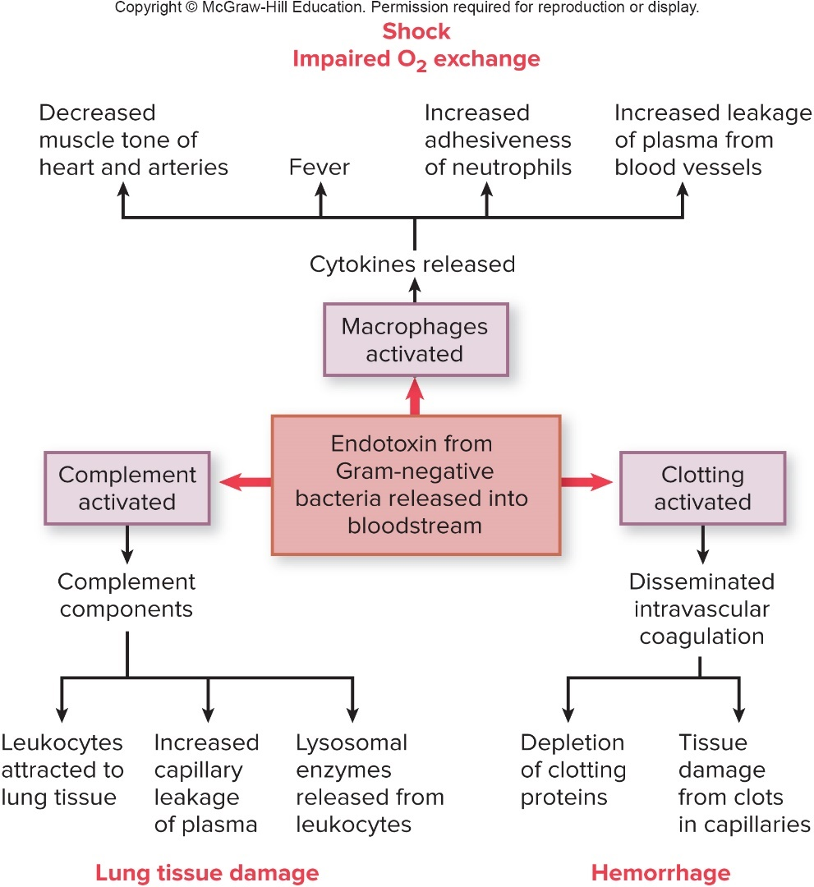
Bacterial Diseases of Blood and Lymphatic Systems – Figure 25.3
Sepsis and septic shock
Pathogenesis
Patient may survive initial sepsis, but later effects may be fatal
Jump to Bacterial Diseases of Blood and Lymphatic Systems – Figure 25.3 Long Description
Notes:
21

Slide 22
Bacterial Diseases of Blood and Lymphatic Systems (11)
Sepsis and septic shock
Epidemiology
Mainly a healthcare-associated disease; bloodstream infections in patients with impaired host defenses
Rates increasing, likely due to longer life spans, antibiotic suppression of normal microbiota, immunosuppressive medications
Use of medical equipment where biofilms readily form (ventilators, catheters) also increases risk

Slide 23
Bacterial Diseases of Blood and Lymphatic Systems (12)
Sepsis and septic shock
Treatment and prevention
Antimicrobial medications to clear causative organisms
But bacteriocidal antibiotics often lyse cells, increase release of endotoxin from Gram-negative organisms
Treatment for shock, tissue hypoxia; fluid replacement and support for organ dysfunction
Sepsis prevented by quick identification, treatment of localized infections
Treatment of predisposing conditions

Slide 24
Table 25.2 Sepsis
Signs and symptoms | Chills, fever, shaking, rapid breathing and pulse, confusion, and anxiety; if shock develops, drop in urine output, bruising, bleeding, and organ failure.
Incubation period | Variable
Causative agents | Usually bacteria (both Gram-positive and Gramnegative) but other microbes as well; common bacterial causes of fatal cases include E. coli, Enterobacter species, and P. aeruginosa.
Pathogenesis | Sepsis starts from infection in the body tissues; macrophages and neutrophils release pro-inflammatory cytokines in response to bacterial products; complement is activated; dysregulated inflammatory response results, leading to disseminated intravascular coagulation (DIC) and organ failure.
Epidemiology | Mainly a healthcare-associated disease.
Treatment and prevention | Treatment: multiple antibiotics as well as fluid and supportive therapy. Prevention: prompt identification and treatment of localized infections.

Slide 25
Bacterial Diseases of Blood and Lymphatic Systems (13)
Plague (black death)
Killed about 25% of Europe’s population between 1346 and 1350; crowded conditions, rat populations
Signs and symptoms
Following flea bite, symptoms appear within 2 to 6 days
Enlarged and tender lymph nodes: buboes; bubonic plague
High fever, shock, delirium, patchy bleeding under skin
Following inhalation of respiratory droplets from infected patient or animal, pneumonic plague may develop within 1 to 3 days
Headache, fever, cough, pneumonia
If spread by bloodstream, septicemic plague may develop
Endotoxin released causes shock; DIC causes bleeding into skin and organs

Slide 26
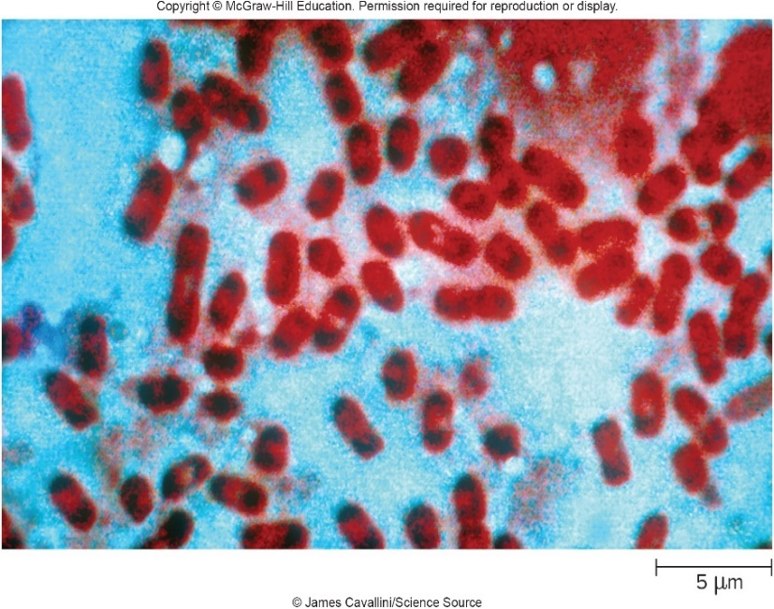
Bacterial Diseases of Blood and Lymphatic Systems – Figure 25.4
Plague
Causative agent: Yersinia pestis
Enterobacteriaceae, a facultative anaerobe, Gram-negative rod
Non-motile, grows best at 28 degrees Celsius
Certain dyes stain ends more intensely; safety pin appearance
©James Cavallini/Science Source

Slide 27
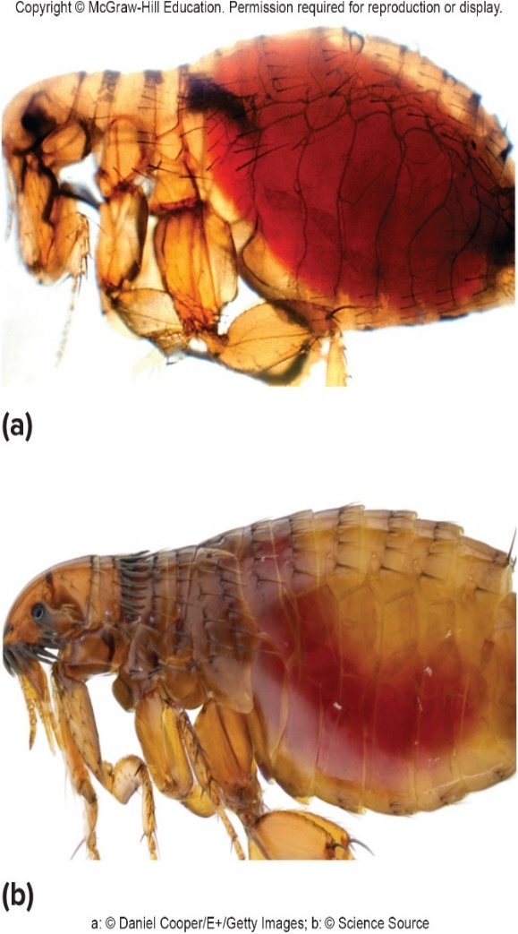
Bacterial Diseases of Blood and Lymphatic Systems – Figure 25.5
Plague
Pathogenesis
Forms biofilms in digestive tract of infected fleas, blocks tract
Fleas starve, increasing likelihood of feeding
Causes bacteria to be regurgitated into bite wound
Can transmit via feces when person scratches flea bite
a: ©Daniel Cooper/E+/Getty Images; b: ©Science Source

Slide 28
Bacterial Diseases of Blood and Lymphatic Systems (14)
Plague
Pathogenesis
Multiple virulence factors allow avoidance of host defenses
Protease (Pla) clears lymphatics and capillaries of clots, inactivates certain complement system components allowing organisms to spread
Taken up by macrophages in regional lymph nodes; resist killing effects of macrophages; multiply
Acute inflammatory reaction develops in lymph nodes
Infected macrophages die, release bacteria ready to withstand host defenses
Capsule to avoid phagocytosis; siderophores trap iron
Yersinia outer proteins (YOPs) delivered into host cells by type III secretion system; multiple effects

Slide 29
Bacterial Diseases of Blood and Lymphatic Systems (15)
Plague
Pathogenesis
Lymph nodes become necrotic; numerous bacteria spread into bloodstream
Endotoxins cause septicemic plague; shock, DIC
10 to 20% infect lungs, leading to pneumonic plague; respiratory droplets can transmit fully virulent pathogen

Slide 30
Table 25.3 Virulence Factors of Yersinia pestis
Factor | Coded by | Action
Pla (protease) | pPCP1 plasmid | Activates plasminogen; destroys C3b, C5a, and clots
Yops (proteins) | pCD1 plasmid | Interfere with phagocytosis and the immune response
V antigen | pCD1 plasmid | Controls type III secretion system that delivers Yops (proteins)
F1 | pMT1 plasmid | Forms antiphagocytic capsule at 37 degrees Celsius
PsaA (adhesin) | Chromosome | Role in attachment to host cells
Complement resistance | Chromosome | Protects against lysis by activated complement
Iron acquisition | Chromosome | Traps iron-containing substances; stores iron compounds intracellularly

Slide 31
Bacterial Diseases of Blood and Lymphatic Systems (16)
Plague
Epidemiology
Zoonotic disease endemic in rodent populations worldwide except Australia
In U.S., mostly occurs in western states
Wild rodents such as prairie dogs and their fleas are the main reservoirs
Rats, rabbits, dogs, cats can also be hosts
Hundreds of species of fleas are able to transmit plague; remain infectious for a year or more
Respiratory droplets from pneumonic plague patients can spread
Category A bioterrorism threat

Slide 32
Bacterial Diseases of Blood and Lymphatic Systems (17)
Plague
Treatment and prevention
Antimicrobial medications, especially if given within 24 hours of onset of symptoms
Bubonic plague has approximately 50 to 80% case-fatality if untreated
Pneumonic plague has approximately 100% case-fatality if untreated
Rat control measures (garbage disposal, rat-proofing buildings, rat extermination programs) important
Extermination must be combined with insecticide use to prevent escape of infected fleas from dead rats
No current vaccine, but efforts underway to develop one
Doxycycline given as preventive to exposed individuals

Slide 33
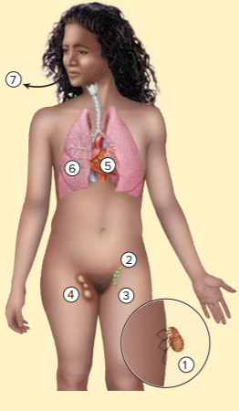
Table 25.4 Plague (“Black Death”)
Yersinia pestis is acquired from the bite of an infected flea or by scratching skin contaminated by the flea’s feces.
The bacteria are carried to regional lymph nodes.
Phagocytes ingest the bacteria but the intracellular conditions activate capsule production and other genes responsible for virulence.
Fully virulent bacteria break out of the phagocytes and infect the lymph nodes, producing the buboes that characterize bubonic plague.
The bacteria may be carried into the bloodstream, causing septicemic plague.
The lungs can become infected, producing the highly contagious and lethal pneumonic plague.
Bacteria exit with coughing.
Signs and symptoms | High fever, large lymph nodes called buboes, skin hemorrhages; sometimes bloody sputum
Incubation period | Usually 1 to 6 days
Causative agents | Yersinia pestis, a Gram-negative rod; a member of the Enterobacteriaceae with multiple virulence factors
Pathogenesis | Enters the body with bite of infected flea or inhalation; bacteria taken up by macrophages. Intracellular environment causes the bacterial cells to produce multiple virulence factors that allow attachment to host cells, and provide defense against the immune system.
Epidemiology | Endemic in rodents and their fleas, particularly in the western United States. Bubonic plague is transmitted by fleas; pneumonic plague can be transmitted person to person in respiratory droplets. Pneumonic plague is the most dangerous because Y. pestis is fully virulent at the time of transmission.
Treatment and prevention | Treatment: prompt diagnosis and antibacterial treatment necessary to prevent high mortality. Prevention: currently no vaccine available; new vaccines are under development. Avoiding contact with wild rodents and their burrows. Insecticides and rat control.
Notes:
33

Slide 34
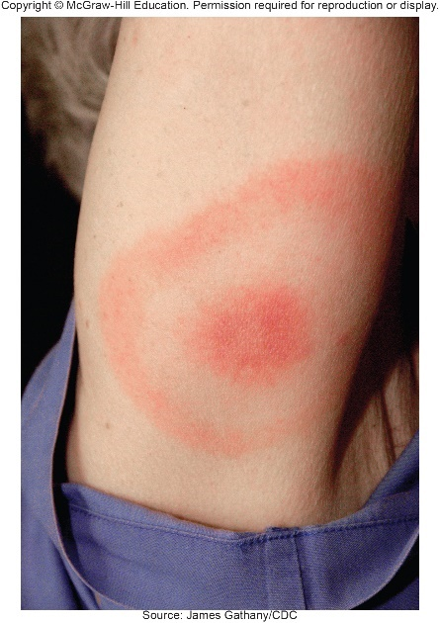
Bacterial Diseases of Blood and Lymphatic Systems – Figure 25.6
Lyme disease
Named after a cluster of cases in Lyme, Connecticut in the 1970’s, but was widespread before then
Approximately 30,000 new cases each year; most common vector-borne disease in U.S.
Signs and symptoms
Three stages; one or more may be asymptomatic
Early localized infection: erythema migrans (bull’s-eye rash), follows few days, weeks after tick bite
Nearby lymph nodes enlarge
Flu-like symptoms: chills, fever, headache, joint/muscle pains, fatigue
Source: James Gathany/CDC
Notes:
34

Slide 35
Bacterial Diseases of Blood and Lymphatic Systems (18)
Lyme disease
Signs and symptoms
Early disseminated infection: 2 to 8 weeks later, nervous system affected, electrical conduction in heart impaired
Dizzy spells, fainting, paralysis of face, severe headache, stiff neck, pain when moving eyes, difficulty concentrating, emotional instability, fatigue, numbness or pain in legs or arms
Late persistent infection: approximately 6 months after skin rash, joint pain, swelling appear; slowly disappear over years
Chronic nervous system impairments may occur
Pain, paralysis, depression
Notes:
35

Slide 36
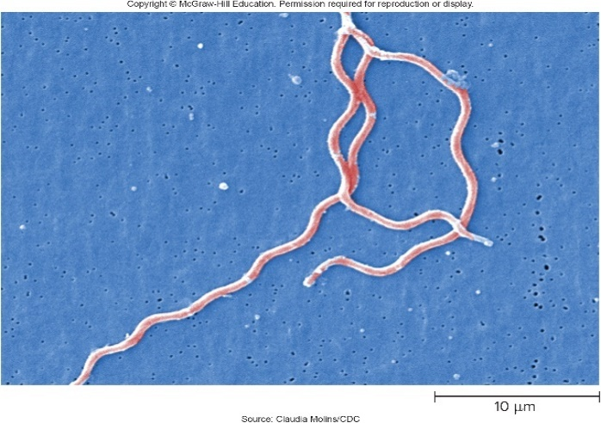
Bacterial Diseases of Blood and Lymphatic Systems – Figure 25.7
Lyme disease
Causative agent: Borrelia burgdorferi
Large, Gram-negative, microaerophilic spirochete with multiple copies of linear chromosome
Plasmids with genes usually found on chromosomes
Pathogenesis
Spirochetes introduced into skin by bite of infected tick
Multiply, migrate outward in circular fashion; LPS causes inflammatory reaction in skin
Enter bloodstream, flu-like symptoms
Immune response likely responsible for signs and symptoms of second and third stages
Possible autoimmune response
Source: Claudia Molins/CDC
Notes:
36

Slide 37
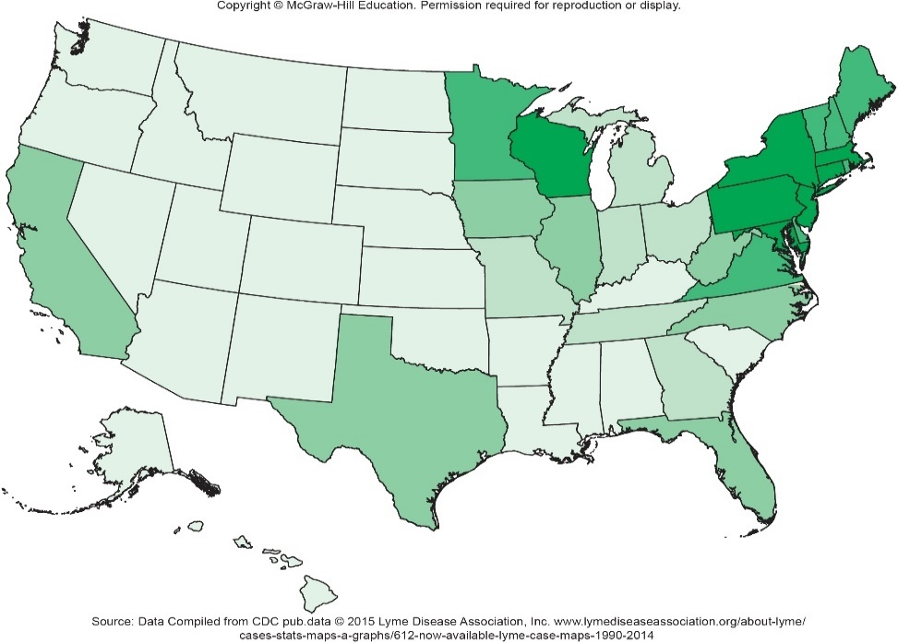
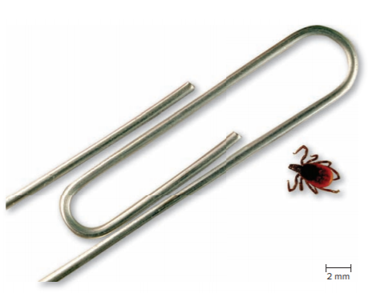
Bacterial Diseases of Blood and Lymphatic Systems – Figures 25.8 and 25.9
Lyme disease
Epidemiology
Zoonosis; humans are accidental host
Widespread in U.S.; several species of ticks are vectors
Most important in eastern states is the black-legged (deer) tick, Ixodes scapularis
80% of these ticks may be infected
Often bite without being detected
Left: ©Scott Camazine/Science Source;
Right: © 2015 Lyme Disease Association, Inc. www. lymediseaseassociation.org/about-lyme/cases-stats-mapsa-graphs/612-now-available-lyme-case-maps-1990 to 2014
Notes:
37

Slide 38
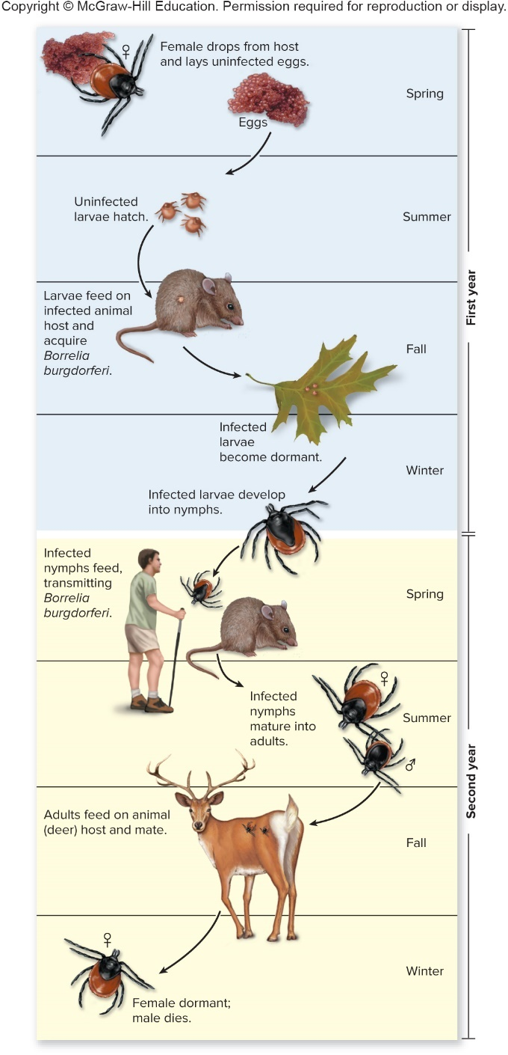
Bacterial Diseases of Blood and Lymphatic Systems – Figure 25.10
Lyme disease
Epidemiology
Ticks mature during 2-year cycle
Nymph mainly responsible for transmitting B. burgdorferi
Preferred host is mouse, which spreads bacteria to other ticks
Deer are preferred host of adult ticks; mating occurs on deer
Deer spread disease widely
Peak incidence from May to December when nymphs are active
Jump to Bacterial Diseases of Blood and Lymphatic Systems – Figure 25.10
Notes:
38

Slide 39
Bacterial Diseases of Blood and Lymphatic Systems (19)
Lyme disease
Treatment and prevention
Antibiotics effective in patients during early stages
In late disease, antibiotics less effective
Likely because spirochetes not actively multiplying
Prolonged treatment with intravenous ampicillin or ceftriaxone has cured many cases
Preventative measures include avoiding exposure to ticks, wearing protective clothing, repellants
No vaccine
Notes:
39

Slide 40
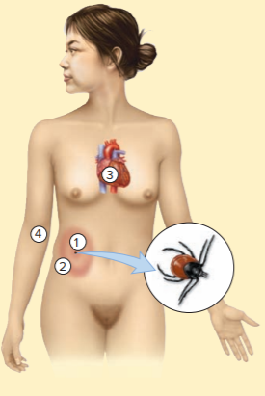
Table 25.5 Lyme Disease
Bite of tick infected with Borrelia burgdorferi introduces the bacteria into the skin.
The bacteria multiply and spread radially in the skin, causing an expanding red rash (erythema migrans), which tends to clear centrally.
The bacteria enter the bloodstream; they cause fever, acute injury to the heart and nervous system.
Chronic symptoms develop, such as arthritis and paralysis due to persisting bacteria and the immune response to them.
Signs and symptoms | Early localized infection: enlarging rash that resembles a bull’s eye develops at the site of the bite; lymph node enlargement near bite, flu-like symptoms. Early disseminated infection: heart and nervous system involvement. Late persistent infection: chronic arthritis and nervous system impairment.
Incubation period | Several days to several weeks
Causative agents | Borrelia burgdorferi, a spirochete
Pathogenesis | Spirochetes injected into the skin by an infected tick multiply and spread radially; spirochetes enter the bloodstream and are carried throughout the body; immune reaction to bacterial antigens causes tissue damage.
Epidemiology | Spread by the bite of ticks, Ixodes species, usually found in association with animals such as whitefooted mice and white-tailed deer living in wooded areas.
Treatment and prevention | Treatment: early treatment with appropriate antibiotic; prolonged antibiotic therapy in chronic cases. Prevention: avoiding ticks, protective clothing, tick repellents. No vaccine.
Notes:
40

Slide 41
Bacterial Diseases of Blood and Lymphatic Systems (20)
Vibrio vulnificus infection
Causes majority of seafood-associated deaths in U.S.; mainly along Gulf Coast
Signs and symptoms
Enters through mouth or open wounds
If ingested by healthy host, self-limiting gastroenteritis
With liver damage, bacterium enters blood, leading to fever, skin blistering, septic shock; often fatal
If entering a wound, blood-filled skin blisters (bullae) lead to cellulitis and necrotizing fasciitis; may spread to blood
Causative agent: Vibrio vulinificus
Curved Gram-negative motile rod related to Vibrio cholerae
Encapsulated halophile found in warmer water

Slide 42
Bacterial Diseases of Blood and Lymphatic Systems (21)
Vibrio vulnificus infection
Pathogenesis
Virulence factors allow avoidance of host immune responses
Capsule protects from complement, siderophores obtain iron, hemolysin lyses red blood cells
Produces toxins and degradative enzymes; controlled by quorum sensing
Cytotoxin kills epithelial cells
Epidemiology
Found in marine waters, sediments, and aquatic organisms
Infection from eating contaminated seafood (most cases from oysters), open wounds
Most infections occur during warmer months

Slide 43
Bacterial Diseases of Blood and Lymphatic Systems (22)
Vibrio vulnificus infection
Treatment and prevention
Prompt and aggressive treatment
Synergistic antibiotics; supportive therapy
Wound cleansing and debridement; amputation
Avoid raw seafood, swimming with open wounds
Wear gloves when handling seafood

Slide 44
Table 25.6 Vibrio vulnificus Infection
Signs and symptoms | If the causative organism enters the bloodstream, it causes sepsis and septic shock, particularly in those with immunodeficiency. In most cases, the organism is ingested, causing fever, vomiting, diarrhea, and abdominal pain; it may also infect wounds, causing blood-filled skin blisters (bullae) and cellulitis.
Incubation period | Vibrio vulnificus, a Gram-negative motile, halophilic, curved rod
Causative agents | 1 to 4 days
Pathogenesis | Encapsulated organism avoids phagocytosis and multiplies using siderophore-acquired iron from host cells; produces a variety of degradative enzymes as well as toxins that cause host cell damage and death.
Epidemiology | Found worldwide in warmer marine habitats; typically acquired by eating raw or undercooked seafood, especially oysters; can also enter via wounds; immunocompromised people, especially those with liver disease or certain underlying conditions, are at risk of developing sepsis.
Treatment and prevention | Treatment: combination of antibiotics; in wound infections, removal of infected tissue and sometimes amputation is essential; supportive care also given, including fluid replacement. Prevention: avoiding raw or undercooked seafood and wearing protective clothing when handling seafood in highrisk areas.

Slide 45
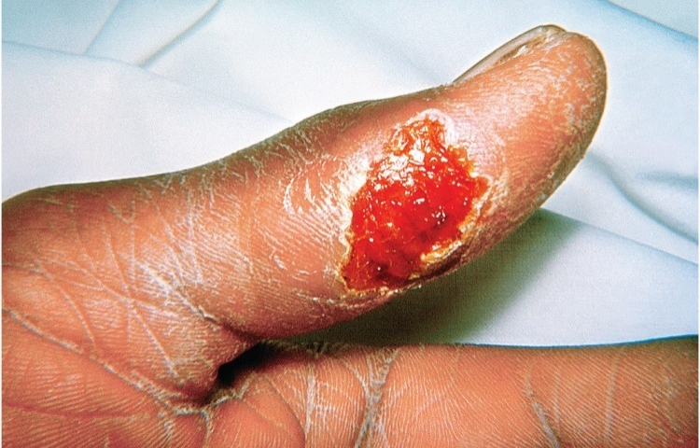
Bacterial Diseases of Blood and Lymphatic Systems – Figure 25.11
Tularemia (“rabbit fever” or “deer fly fever”)
Signs and symptoms
If organism enters skin or mucous membranes, ulcer typically develops at site after 2 to 5 days
Regional lymph nodes enlarge; fever, chills, aches
Usually clear in 1 to 4 weeks, sometimes last months
If organism inhaled or infects lungs from bloodstream, pneumonia can occur
Dry cough, pain beneath sternum due to enlarged lymph nodes
Tularemic pneumonia rare; case-fatality rate approximately 30% if untreated
©Science Source

Slide 46
Bacterial Diseases of Blood and Lymphatic Systems (23)
Tularemia
Causative agent: Francisella tularensis
Non-motile, aerobic, Gram-negative rod
Requires medium enriched with cysteine
Pathogenesis
Enters breaks in skin, mucous membranes
Limited detection by innate immune system
Grows within phagocytic cells
Carried to regional lymph nodes; become large, tender
Spreads via lymphatics and blood vessels
Cell-mediated immunity resolves infection in most cases

Slide 47
Bacterial Diseases of Blood and Lymphatic Systems (24)
Tularemia
Epidemiology
Widespread zoonotic disease in Northern Hemisphere, including all states in U.S. except Hawaii
Infection from tick or fly bites in summer
Infection from skinning rabbits, other wild animals
Animals generally free of illness but are carriers
Fewer than 200 cases reported annually
Epidemics of inhalation tularemia have occurred from dust from mowing lawns, rodent-infested buildings
Can be contracted by ingesting contaminated meat
F. tularensis listed as category A (highest-risk) bioterrorism agent; transmitted in air, low infectious dose

Slide 48
Table 25.7 Tularemia (“Rabbit Fever” or “Deer Fly Fever”)
Tularemia
Treatment and prevention
Streptomycin usually effective
Use of rubber gloves and goggles or face shields when skinning or handling wild animals
Insect repellants, protective clothing help against insect and tick vectors
Signs and symptoms | Ulcer at site of entry, enlarged lymph nodes in area, fever, chills, aches; pneumonia if causative agent is inhaled
Incubation period | 1 to 10 days; usually 2 to 5 days
Causative agents | Francisella tularensis; an aerobic, Gram-negative rod.
Pathogenesis | Organisms are ingested by phagocytic cells, grow within these cells, and then spread throughout body.
Epidemiology | Present among wildlife in Northern Hemisphere; risk mainly to hunters and others who handle wildlife; acquired when the organism penetrates a mucous membrane or enters broken skin, as may occur when skinning wild animals; bite of infected insect or tick.
Treatment and prevention | Treatment: antibiotics. Prevention: avoiding bites of insects and ticks; wearing rubber gloves, goggles, when skinning animals.

Slide 49
Bacterial Diseases of Blood and Lymphatic Systems (25)
Brucellosis (“undulant fever” or “Bang’s disease”)
Signs and symptoms
Symptoms start gradually, are vague
Mild fever, sweating, weakness, aches and pains, enlarged lymph nodes, depression, weight loss
Recurrence of fevers over weeks or months
Recovery within 2 months without treatment; some develop chronic illness
Causative agent: Brucella melitensis
Small, aerobic, non-motile Gram-negative rods with complex nutritional requirements
Only one species causes disease in humans, but other species cause disease in other animals (cattle, pigs, dogs, goats)

Slide 50
Bacterial Diseases of Blood and Lymphatic Systems (26)
Brucellosis
Pathogenesis
Penetrate mucous membranes or wounds, weak initial immune response
Grow within phagocytes, avoid antibodies
Infected macrophages carry to other parts of body
Low mortality rate; death generally from endocarditis or meningitis; osteomyelitis (bone infection) is complication
Epidemiology
Typically chronic zoonotic infection of domestic animals
Contaminates milk; causes abortions
Causes millions of dollars in agricultural losses globally
Occupational exposure; consumption of unpasteurized milk products; hunting, eating meat from infected animals
Category B bioterrorism threat

Slide 51
Bacterial Diseases of Blood and Lymphatic Systems (27)
Brucellosis
Treatment and prevention
Doxycycline with rifampin or streptomycin for 6 weeks
Some chronic cases may require 6 months or more
Pasteurization of dairy products; inspection of domestic animals for evidence of disease
Protective gear (goggles or face shield, gloves) for veterinarians, butchers, slaughterhouse workers
Attenuated vaccine controls disease in domestic animals

Slide 52
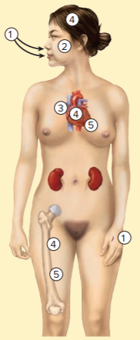
Table 25.8 Brucellosis (“Undulant Fever” or “Bang’s Disease”)
Brucella melitensis enters the body through mucous membranes following ingestion or inhalation, or through skin abrasions.
The bacteria are taken up by phagocytes but resist digestion and grow within cells.
The bacteria enter the lymphatics and bloodstream and are carried throughout the body.
Infection is established in other body tissues, such as the heart valves, meninges, and bones.
Osteomyelitis is a rare but serious complication. Most deaths are due to endocarditis or meningitis.
Signs and symptoms | Recurrent fever, body aches, weight loss, enlargement of lymph nodes; symptoms usually lessen even without treatment but may become chronic.
Incubation period | Usually 5 to 21 days
Causative agents | Brucella melitensis, a small, aerobic, Gram-negative rod
Pathogenesis | Organisms penetrate mucous membranes and are carried to heart, kidneys, meninges, and other parts of the body via the blood and lymphatic system; they resist killing by macrophages and grow within these cells.
Epidemiology | Main sources of human infections: domestic animals. Disease also occurs in wild animals such as moose, caribou, bison; butchers, farmers, veterinarians, those who drink unpasteurized milk are at risk.
Treatment and prevention | Treatment: appropriate antibiotics. Prevention: vaccination of domestic animals; pasteurization of milk and milk products; gloves and face shields.

Slide 53
Viral Diseases of Blood and Lymphatic Systems (1)
Infectious mononucleosis (“mono” or “kissing disease”)
Signs and symptoms
Appear after long incubation period, usually 30 to 60 days
Fever, sore throat covered with pus, marked fatigue, enlargement of spleen and lymph nodes
Fever, sore throat gone in approximately 2 weeks; others in approximately 3 weeks
Exhaustion and difficulty concentrating may persist
Causative agent: Epstein-Barr virus (EBV)
Enveloped double-stranded DNA virus of Herpesviridae

Slide 54
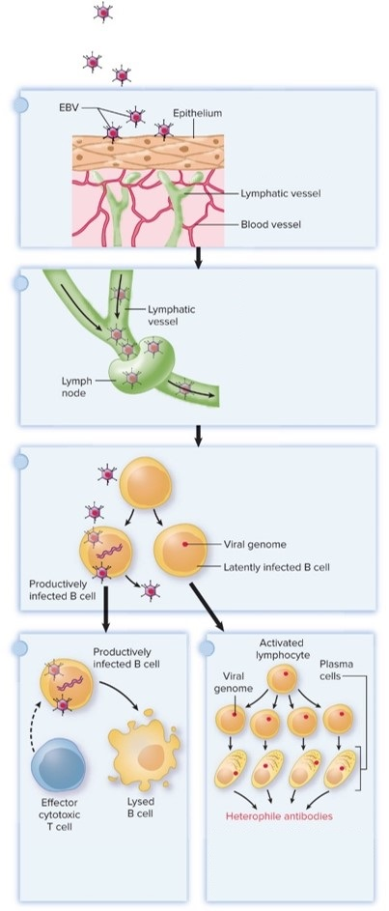
Viral Diseases of Blood and Lymphatic Systems – Figure 25.12
Infectious mononucleosis
Pathogenesis
Infects mouth, throat
Replicates, is carried to lymph nodes
Infects B lymphocytes
Productive: virus replicates, kills B cell
Non-productive: latent infection; most common, causes proliferation of B cells, production of immunoglobulins, including heterophile antibody used for diagnosis
Cytotoxic T cells kill productively infected B cells that display viral antigens
EBV attaches to and infects epithelium of the throat, where It replicates and causes pharyngitis.
Virions enter the lymphatic vessels and are carried to the lymph nodes. Some virions escape the lymph nodes and are carried to the bloodstream.
Virions attach specifically to B lymphocytes and infect them, producing either latent or productive infections.
Latently infected B cells are not attacked by T cells. They differen- tiate into plasma cells and produce random immunoglobulins. Including heterophile antibody.
T cells respond to infection and destroy the lymphocytes that have replicating EBV.

Slide 55
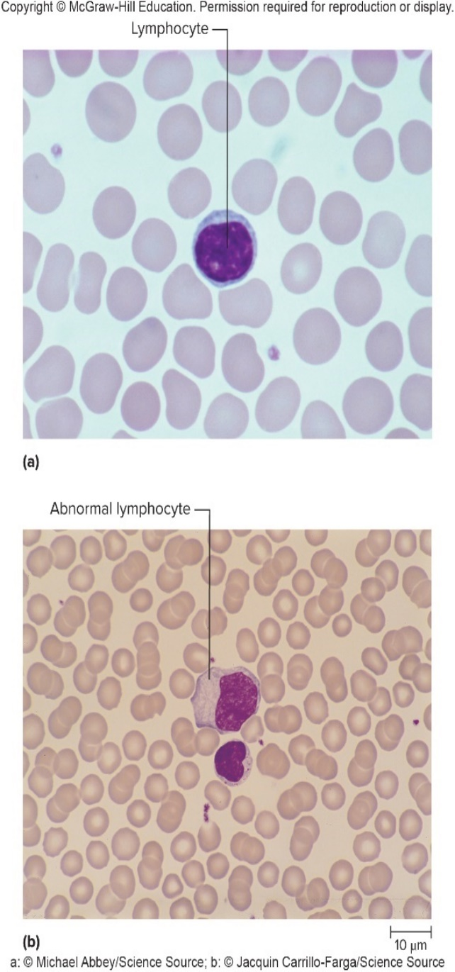
Viral Diseases of Blood and Lymphatic Systems – Figure 25.13
Infectious mononucleosis
Pathogenesis
Abnormal effector cytotoxic T cells seen in blood smears
Proliferation causes lymph node and spleen enlargement
Rare ruptured spleen within 3 to 4 weeks of infection
EBV genome detectable in nearly all cases of Burkitt’s lymphoma and nasopharyngeal carcinoma
Other factors likely involved
May be factor in some malignancies in immunocompromised
a: ©Michael Abbey/Science Source; b: ©Jacquin Carrillo-Farga/ Science Source

Slide 56
Viral Diseases of Blood and Lymphatic Systems (2)
Infectious mononucleosis
Epidemiology
Worldwide distribution
Infects individuals in crowded, poorer groups at early age without significant illness
In more affluent populations, fewer are infected
Lack immunity, may therefore get when exposed later in life (for example, entering college)
In 15 to 24 year olds, only approximately half of infections symptomatic
EBV present in saliva for up to 18 months after infection
Occurs intermittently for life
Mouth-to-mouth kissing is important mode of transmission in young adults
By middle age, most have antibody, indicating infection

Slide 57
Viral Diseases of Blood and Lymphatic Systems (3)
Infectious mononucleosis
Treatment and prevention
Antivirals inhibit productive infection; no activity against latent infection
Analgesics, relief of airway obstruction
Avoiding saliva of others, including contaminated items such as tooth-brushes, drinking glasses
No vaccine

Slide 58
Table 25.9 Infectious Mononucleosis (“Mono” or “Kissing Disease”)
Signs and symptoms | Fatigue, fever, sore throat, and enlargement of lymph nodes
Incubation period | Usually 1 to 2 months
Causative agents | Epstein-Barr virus (EBV), a DNA virus
Pathogenesis | Productive infection of epithelial cells of throat and salivary ducts; latent infection of B lymphocytes; hemorrhage from a ruptured spleen is a rare but serious complication.
Epidemiology | Spread by saliva; lifelong recurrent shedding of virus into saliva of asymptomatic, latently infected individuals.
Treatment and prevention | Treatment: analgesics and sometimes medications that reduce inflammation. Prevention: avoiding saliva of infected people.

Slide 59
Viral Diseases of Blood and Lymphatic Systems (4)
Ebola virus disease (EVD) and Marburg virus disease (MVD)
Typically in Africa, but worldwide concern due to high case-fatality rate and person-to-person transmission; Category A bioterrorism threat
Signs and symptoms
Within 5 to 10 days fever, headache, muscle pain, sore throat; then abdominal pain, diarrhea, macular rash
Bleeding may occur from internal organs, mucous membranes, wounds, body orifices
Case-fatality rate from 25% to 90% depending on strain and supportive care
Death from multi-organ failure or shock

Slide 60
Viral Diseases of Blood and Lymphatic Systems (5)
Ebola virus disease and Marburg virus disease
Causative agents
Ebola virus (named after Ebola River Valley in Democratic Republic of the Congo) or Marburg virus (named after German town where people got infection from African green monkeys)
Filamentous, enveloped single-stranded RNA viruses
Both in Filoviridae
Pathogenesis
Infect monuclear phagocytic cells
Interfere with innate and adaptive immune responses; virus replicates to high levels
Blood clotting disrupted; capillaries become leaky
Notes:
60

Slide 61
Viral Diseases of Blood and Lymphatic Systems (6)
Ebola virus disease and Marburg virus disease
Epidemiology
Natural reservoir suspected to be fruit bats
Found in non-human primates; high mortality makes them unlikely reservoirs
Virus transmitted mostly human-to-human by contact with bodily fluids
Health professionals and family members at risk
Severe outbreak in 2014 caused 11,000 deaths in West Africa

Slide 62
Viral Diseases of Blood and Lymphatic Systems (7)
Ebola virus disease and Marburg virus disease
Treatment and prevention
Patients kept hydrated; blood,
levels maintained
Medication to control bleeding
Quick diagnosis, rapid response to prevent spread
Healthcare workers must use strict infection-control measures
Vaccines in clinical trials

Slide 63
Table 25.10 Ebola Virus Disease and Marbug Virus Disease
Signs and symptoms | Fever, headache, muscle pain, possible sore throat; then abdominal pain, diarrhea, a rash, and possibly bleeding from internal organs and mucous membranes
Incubation period | Usually 5 to 10 days
Causative agents | Ebola virus and Marburg virus, filamentous, enveloped, single-stranded RNA viruses
Pathogenesis | Infect immune cells and interfere with immune responses and blood clotting.
Epidemiology | Both viruses endemic to Africa; fruit bats are possible reservoir; direct human-to-human transmission.
Treatment and prevention | Treatment: fluids and supportive therapy. Prevention: strict infection control measures; vaccines in clinical trials.

Slide 64
Viral Diseases of Blood and Lymphatic Systems (8)
Yellow fever
Signs and symptoms
Mild form most common; yields fever, slight headache
Severe disease produces high fever, nausea, bleeding, “black vomit” from gastrointestinal bleeding, and jaundice
Mortality rate can reach 50% or more
Incubation period 3 to 6 days
Reasons for variation in severity probably due to infectious dose and host immunity
Causative agent
Enveloped, single-stranded RNA arbovirus of Flaviviridae
Transmitted by bite of infected Aedes or Haemagogus mosquito

Slide 65
Viral Diseases of Blood and Lymphatic Systems (9)
Yellow fever
Pathogenesis
Multiplies at site of bite, enters bloodstream
Liver damage results in jaundice and decreased production of clotting proteins
Injury to small blood vessels produces petechiae (tiny hemorrhages) throughout body
Viral replication, immune system response damages circulatory system, causes bleeding, disseminated intravascular coagulation (DIC)
Kidney failure commonly results from loss of blood flow

Slide 66
Viral Diseases of Blood and Lymphatic Systems (10)
Yellow fever
Epidemiology
Infected primates in tropical jungles in Central and South America and Africa
No outbreaks in U.S. since 1905
Treatment and prevention
No proven treatment
Insecticides, eliminating breeding sites of vector
Control in jungle almost impossible
Highly effective attenuated vaccine available

Slide 67
Table 25.11 Yellow Fever
Signs and symptoms | Fever, headache, muscle pain, possible sore throat; then abdominal pain, diarrhea, a rash, and possibly bleeding from internal organs and mucous membranes
Incubation period | Usually 5 to 10 days
Causative agents | Ebola virus and Marburg virus, filamentous, enveloped, single-stranded RNA viruses
Pathogenesis | Infect immune cells and interfere with immune responses and blood clotting.
Epidemiology | Both viruses endemic to Africa; fruit bats are possible reservoir; direct human-to-human transmission.
Treatment and prevention | Treatment: fluids and supportive therapy. Prevention: strict infection control measures; vaccines in clinical trials.
Notes:
67

Slide 68
Viral Diseases of Blood and Lymphatic Systems (11)
Dengue fever (‘break-bone fever”)
Most common vector-borne viral disease in the world
Signs and symptoms
Many cases asymptomatic or subclinical
Begins with sudden onset of fever for 2 to 7 days
May recur 12 to 24 hours later (biphasic fever)
Headache, severe joint and muscle pain, pain behind eyes, rash that may become hemorrhagic, with petechiae
Rash does not appear in mild cases
Mild mucosal bleeding may occur in nose or gums
Sore throat, abdominal pain, vomiting, diarrhea may occur
Usually self-limiting, rarely fatal

Slide 69
Viral Diseases of Blood and Lymphatic Systems (12)
Dengue fever
Signs and symptoms
Dengue hemorrhagic fever (DHF) can occur in second infection; may lead to dengue shock syndrome (DSS)
Weak, rapid pulse, moist skin, restlessness, low blood pressure, bleeding in form of petechiae, easy bruising
Massive gastrointestinal, vaginal bleeding may occur
Widespread blood clotting, DIC may develop later
DHF mostly found in children under 15; can be fatal
Causative agent
Single-stranded RNA virus of Flaviviridae
Four serotypes (DENV1, DENV2, DENV3, DENV4), all transmitted by Aedes mosquitoes

Slide 70
Viral Diseases of Blood and Lymphatic Systems (13)
Dengue fever
Pathogenesis
Dengue viruses injected by mosquito, infect keratinocytes and epidermal dendritic cells
Cells migrate to lymph nodes; monocytes, macrophages are recruited, infected; virus multiplies and is disseminated
Immune responses clear the virus, but process is not well understood as there is no animal model
DHF and DSS better understood, occur in people with second dengue infection by a different strain than the first

Slide 71
Viral Diseases of Blood and Lymphatic Systems (14)
Dengue fever
Pathogenesis
Antibody-dependant enhancement (ADE) suggested to explain severity of DHF, DSS
Pre-existing dengue antibodies thought to bind to viruses in second infection, form immune complexes
Virus is not neutralized since a different strain
Antibodies facilitate viral entry into cells expressing Fc receptors, especially macrophages where virus replicates
Infected cells produce cytokine storm; activated complement and cytokines from memory T cells cause plasma leakage
Plasma leakage, respiratory distress, dehydration, fragile capillaries, bleeding, DIC, low white blood cell count, low blood pressure

Slide 72
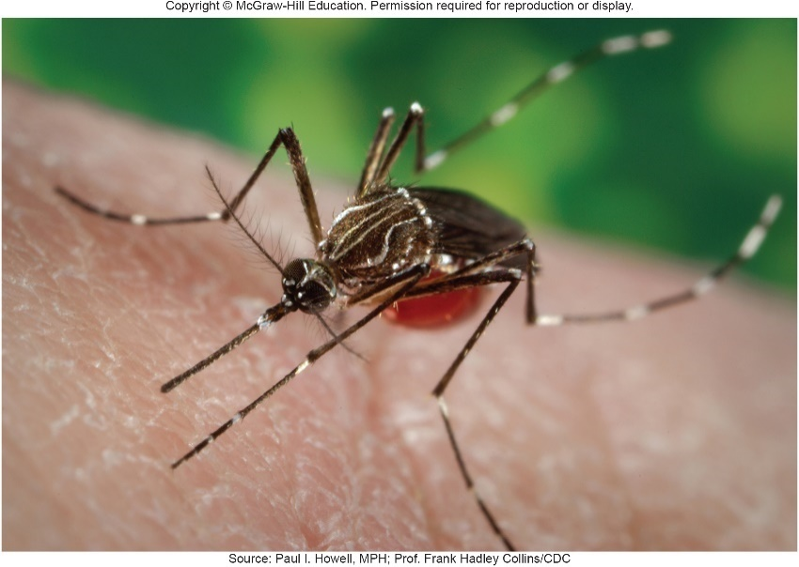
Viral Diseases of Blood and Lymphatic Systems – Figure 25.14
Dengue fever
Epidemiology
Emerging, fast-spreading
Mostly in tropical or subtropical regions with high rainfall and plenty of fresh water for vector breeding
Aedes aegypti; Aedes albopictus, now spreading worldwide
Geographical spread linked to international travel, breakdown of vector control measures, increase in vector habitats
Treatment and prevention
Analgesics; but aspirin, non-steroidal anti inflammatories can worsen bleeding
Oral rehydration therapy, platelet or blood transfusions
Source: Paul I. Howell, MPH; Prof. Frank Hadley Collins/CDC

Slide 73
Viral Diseases of Blood and Lymphatic Systems (15)
Dengue fever
Treatment and prevention
Mosquito control: insecticides, biological control
Use of insecticide-treated mosquito nets, insect repellants
First vaccine approved in several countries in 2016
Recombinant attenuated virus with components from all four virus strains
About 60% effective in persons who are at least 9 years of age
May increase incidence of serious disease in those 2 to 5 years of age

Slide 74
Table 25.12 Dengue Fever, Chikungunya, and Zika Virus Disease Compared
 | Dengue Fever | Chikungunya | Zika Virus Disease
Signs and symptoms | Often asymptomatic; fever, headache, rash, and severe joint pain; in dengue hemorrhagic fever (DHF), bleeding and shock can occur, as well as disseminated intravascular coagulation (DIC). | Similar to dengue fever, but followed by severe joint pain that may become chronic | Usually asymptomatic; mild disease with fever, rash, joint pain, red eyes; rare nervous system involvement; congenital Zika syndrome
Incubation period | Usually 4 to 7 days | Usually 3 to 7 days | 2 to 14 days
Causative agents | Dengue virus serotypes DENV1, DENV2, DENV3, and DENV4; RNA virus of Flaviviridae | Chikungunya virus; RNA virus of Togaviridae | Zika virus; RNA virus of Flaviviridae
Pathogenesis | Pro-inflammatory cytokines cause leaky blood vessels, dehydration, and hemorrhaging. In DHF, DIC and shock may be fatal. | Release of cytokines that affect immune cells; bone destruction. | Virus binds to receptors on a variety of cells; enters fluid around fetus and brain; affects neural stem cells.
Epidemiology | Mosquito-borne; found predominantly in tropical and subtropical regions but range is increasing; DHF usually occurs in children under 15 years old. | Mosquito-borne; mainly in Africa and Asia, but now in Europe and the Americas | Mosquito-borne and sexually transmitted; females should avoid pregnancy for 8 weeks after exposure; males should use condoms for 6 months.
Treatment and prevention | Treatment: analgesics for pain; oral rehydration therapy and blood or platelet transfusions if bleeding occurs. Prevention: vector control; vaccine in limited areas. | Treatment: analgesics for pain and oral rehydration. Prevention: vector control. | Treatment: no specific treatment. Prevention: vector control.
Notes:
74

Slide 75
Viral Diseases of Blood and Lymphatic Systems (16)
Chikungunya (CHIK)
Name from African word meaning “that which bends up” because of bent posture caused by severe joint pain
Signs and symptoms
Fever lasts 2 to 5 days, followed by severe joint pain that can persist weeks or months; chronic joint pain possible
Other symptoms may include rash, headache, conjunctivitis, photophobia, back pain, nausea
Seldom fatal
Causative agent
Chikungunya virus, an enveloped single-stranded RNA virus of Togaviridae
Transmitted by Aedes mosquitoes
Notes:
75

Slide 76
Viral Diseases of Blood and Lymphatic Systems (17)
Chikungunya
Pathogenesis
Mechanism largely unknown, but damage likely related to immune system effects
Release of cytokines; decrease in helper T cells
Epidemiology
Occurs mainly in Africa, Asia, and Southeast Asia
Aedes albopictus now present throughout the Americas and in many European countries; epidemics in those areas
Treatment and prevention
Analgesics for joint pain; fluids to reduce dehydration
Vector control
Vaccine in clinical trials

Slide 77
Table 25.12 Dengue Fever, Chikungunya, and Zika Virus Disease Compared (1)
 | Dengue Fever | Chikungunya | Zika Virus Disease
Signs and symptoms | Often asymptomatic; fever, headache, rash, and severe joint pain; in dengue hemorrhagic fever (DHF), bleeding and shock can occur, as well as disseminated intravascular coagulation (DIC). | Similar to dengue fever, but followed by severe joint pain that may become chronic | Usually asymptomatic; mild disease with fever, rash, joint pain, red eyes; rare nervous system involvement; congenital Zika syndrome
Incubation period | Usually 4 to 7 days | Usually 3 to 7 days | 2 to 14 days
Causative agents | Dengue virus serotypes DENV1, DENV2, DENV3, and DENV4; RNA virus of Flaviviridae | Chikungunya virus; RNA virus of Togaviridae | Zika virus; RNA virus of Flaviviridae
Pathogenesis | Pro-inflammatory cytokines cause leaky blood vessels, dehydration, and hemorrhaging. In DHF, DIC and shock may be fatal. | Release of cytokines that affect immune cells; bone destruction. | Virus binds to receptors on a variety of cells; enters fluid around fetus and brain; affects neural stem cells.
Epidemiology | Mosquito-borne; found predominantly in tropical and subtropical regions but range is increasing; DHF usually occurs in children under 15 years old. | Mosquito-borne; mainly in Africa and Asia, but now in Europe and the Americas | Mosquito-borne and sexually transmitted; females should avoid pregnancy for 8 weeks after exposure; males should use condoms for 6 months.
Treatment and prevention | Treatment: analgesics for pain; oral rehydration therapy and blood or platelet transfusions if bleeding occurs. Prevention: vector control; vaccine in limited areas. | Treatment: analgesics for pain and oral rehydration. Prevention: vector control. | Treatment: no specific treatment. Prevention: vector control.
Notes:
77

Slide 78
Viral Diseases of Blood and Lymphatic Systems (18)
Zika virus disease
Signs and symptoms
75 to 80% of cases are asymptomatic
Mild disease appears in 2 to 14 days with fever, rash, joint pain, red eyes; fades in 2 to 7 days
Complications include Guillain-Barré syndrome and congenital Zika syndrome in fetus of pregnant women
Causative agent
Zika virus (ZIKV) is enveloped single-stranded RNA virus of Flaviviridae
Transmitted by Aedes mosquitoes
Notes:
78

Slide 79
Viral Diseases of Blood and Lymphatic Systems (19)
Zika virus disease
Pathogenesis
Virus binds to receptors on several tissue types
Found in amniotic fluid and brain of fetus, typically immunologically privileged
Congenital Zika syndrome causes pathology in neural stem cells from which the brain develops
Microcephaly is one result, but infants with normal head size may still show developmental delays and neurological abnormalities
Epidemiology
Transmitted by Aedes mosquitoes
Vector distribution expanding as A. albopictus moves into cooler climates
Notes:
79

Slide 80
Viral Diseases of Blood and Lymphatic Systems (20)
Zika virus disease
Epidemiology
ZIKV also sexually transmitted
Found in blood, semen, saliva, female secretions
Females should avoid pregnancy at least 8 weeks after possible exposure; males should avoid unprotected sex for 6 months
In 2016 CDC established U. S. Zika Pregnancy Registry to monitor infections and provide services
Notes:
80

Slide 81
Viral Diseases of Blood and Lymphatic Systems (21)
Zika virus disease
Treatment and prevention
Aspirin and non-steroidal pain relievers should be avoided until dengue fever infection has been ruled out
Best preventive is control of mosquito vector
Eliminate breeding locations, wear protective clothing, use mosquito nets
Biological modification of mosquitoes to prevent breeding
Potential vaccines under development
Notes:
81

Slide 82
Table 25.12 Dengue Fever, Chikungunya, and Zika Virus Disease Compared (2)
 | Dengue Fever | Chikungunya | Zika Virus Disease
Signs and symptoms | Often asymptomatic; fever, headache, rash, and severe joint pain; in dengue hemorrhagic fever (DHF), bleeding and shock can occur, as well as disseminated intravascular coagulation (DIC). | Similar to dengue fever, but followed by severe joint pain that may become chronic | Usually asymptomatic; mild disease with fever, rash, joint pain, red eyes; rare nervous system involvement; congenital Zika syndrome
Incubation period | Usually 4 to 7 days | Usually 3 to 7 days | 2 to 14 days
Causative agents | Dengue virus serotypes DENV1, DENV2, DENV3, and DENV4; RNA virus of Flaviviridae | Chikungunya virus; RNA virus of Togaviridae | Zika virus; RNA virus of Flaviviridae
Pathogenesis | Pro-inflammatory cytokines cause leaky blood vessels, dehydration, and hemorrhaging. In DHF, DIC and shock may be fatal. | Release of cytokines that affect immune cells; bone destruction. | Virus binds to receptors on a variety of cells; enters fluid around fetus and brain; affects neural stem cells.
Epidemiology | Mosquito-borne; found predominantly in tropical and subtropical regions but range is increasing; DHF usually occurs in children under 15 years old. | Mosquito-borne; mainly in Africa and Asia, but now in Europe and the Americas | Mosquito-borne and sexually transmitted; females should avoid pregnancy for 8 weeks after exposure; males should use condoms for 6 months.
Treatment and prevention | Treatment: analgesics for pain; oral rehydration therapy and blood or platelet transfusions if bleeding occurs. Prevention: vector control; vaccine in limited areas. | Treatment: analgesics for pain and oral rehydration. Prevention: vector control. | Treatment: no specific treatment. Prevention: vector control.
Notes:
82

Slide 83
Protozoan Diseases of Blood and Lymphatic Systems (1)
Malaria
Ancient disease; malaria means “bad air”
In 1902, Ronald Ross received Nobel Prize for demonstrating life cycle of protozoan cause of malaria
In 1955, WHO began program for global elimination
Insecticide use; diagnosing and treating infected patients
52 nations participated; by 1960, 10 eradicated malaria
Mosquito vectors developed resistance; program failed
In 2015, over 214 million cases, with over 438,000 deaths

Slide 84
Protozoan Diseases of Blood and Lymphatic Systems (2)
Malaria
Signs and symptoms
Flu-like, with fever, headache, and pain in joints, muscles
Usually begin about 2 weeks after bite, but may be later
After 2 to 3 weeks, symptoms fall into three phases
Cold phase: shaking chills that last up to an hour
Hot phase: temperature rises sharply to 40 degrees Celsius or more
Wet phase: temperature falls, drenching sweat
Cycle of three phases is called a paroxysm
Except for fatigue, patient feels well until 24 or 48 hours later, when next paroxysm occurs

Slide 85
Protozoan Diseases of Blood and Lymphatic Systems (3)
Malaria
Causative agent
Protozoa of genus Plasmodium; transmitted by infected female Anopheles mosquitoes
Five species cause malaria with different severity and treatment: P. vivax, P. falciparum, P. malariae, P. ovale, P. knowlesi
Complex life cycle: liver stage (exoerythrocytic stage) and red blood cell stage (erythrocytic stage)
Infectious form is sporozoite; carried by bloodstream to liver, infects hepatocytes
Parasites enlarge, divide asexually, produce merozoites, which infect red blood cells (RBC)
Some species can form hypnozoites that live in hepatocytes for years before reproducing to form merozoites

Slide 86
Protozoan Diseases of Blood and Lymphatic Systems (4)
Malaria
Causative agent
Merozoites develop into larger motile trophozoites (feeding stage) and then schizont (reproducing stage)
Schizont divides asexually to yield merozoites; when RBC ruptures, they enter new RBCs and multiply, repeat cycle
Some that enter RBCs develop into gametocytes (specialized sexual forms), which are transmittable form
Gametocytes ingested by mosquito; drop in temperature causes them to become gametes, fertilize, form zygotes
Zygotes form oocysts that divide asexually
Sporozoites released from oocysts travel to salivary glands and saliva; injected into new human host

Slide 87
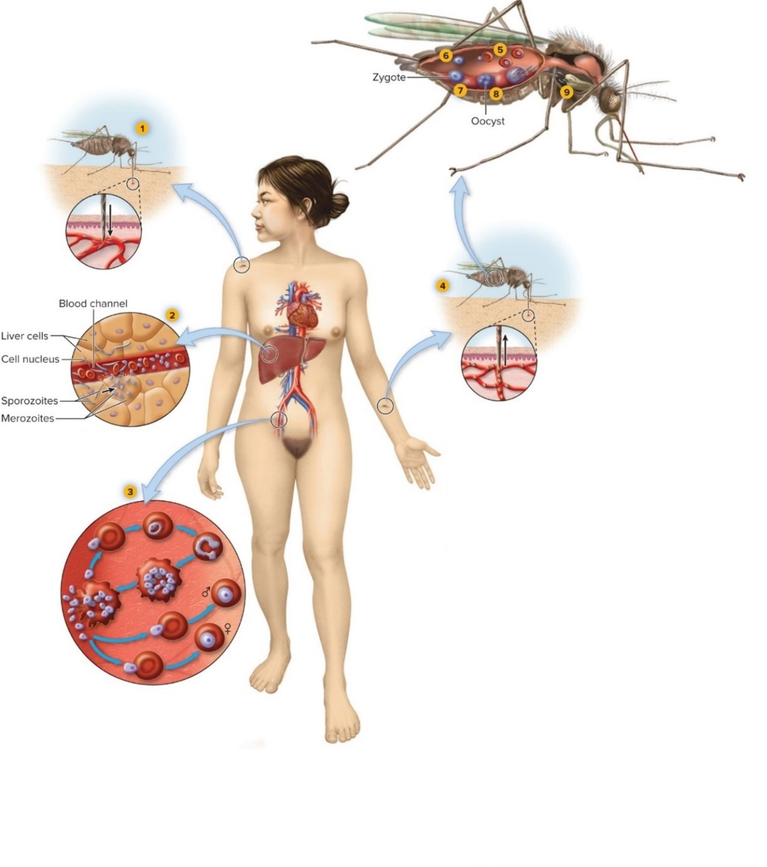
Protozoan Diseases of Blood and Lymphatic Systems – Figure 25.15
Infected mosquito injects P. vivax sporozoites into a capillary as it feeds.
Sporozoites are carried to the liver, where they multiply in liver cells to form merozoites. The liver cells burst, releasing merozoites into liver blood channels.
The merozoites infect and differentiate in red blood cells (RBCs), becoming a ring form, then a trophozoite, then a schizont. The infected RBC breaks open, releasing merozoites. Some merozoites infect new RBCs, repeating this cycle. Others infect new RBCs then differentiate in them, forming male or female gametocytes.
Another feeding mosquito ingests RBCs with gametocytes.
The gametocytes are released as the RBCs are digested.
The gametocytes become gametes, and fertilization occurs, forming a zygote.
The zygote becomes motile and penetrates the gut wall.
In the gut wall, the zygote forms an oocyst and multiplies asexually.
The oocyst releases sporozoites that infect the mosquito salivary glands.

Slide 88
Protozoan Diseases of Blood and Lymphatic Systems (5)
Malaria
Pathogenesis
Recurrent paroxysms result from cycle of growth and release of merozoites from RBCs
Infections in the millions of RBCs becomes synchronous
Anemia due to burst RBCs and loss of recyclable iron
Immune system strongly stimulated, may fail
Spleen enlarges to cope with high levels of foreign material and abnormal red blood cells; may rupture
P. falciparum infections often severe
It can infect all RBCs; other species infect either young or old RBCs

Slide 89
Protozoan Diseases of Blood and Lymphatic Systems (6)
Malaria
Pathogenesis
pfEMP1 (P. falciparum erythrocyte membrane protein) inserts in RBC membranes
Causes RBCs to stick to capillaries
Vessels blocked, tissues deprived of
Cerebral malaria: blockage of blood flow to brain
Can block blood flow to developing fetus
Infected cells not cleared by spleen
Antigenic variation in genes for pfEMP1 allow parasite to evade adaptive immunity

Slide 90
Protozoan Diseases of Blood and Lymphatic Systems (7)
Malaria
Pathogenesis
People generally develop some immunity from repeated infections; crosses placenta and partially protects newborn
Greatest risk of death is to children over 6 months
P. vivax and P. ovale often relapse because they form hypnozoites that live in liver in dormant state
Months or years later, can begin growth, start new erythrocytic cycles of infection
Notes:
90

Slide 91
Protozoan Diseases of Blood and Lymphatic Systems (8)
Malaria
Epidemiology
Once common in temperate and tropical areas of the world
Eliminated from continental U.S. in late 1940s
Mostly a disease of warm climates; half of world’s population lives in endemic areas
Anopheles mosquitoes act as vectors
Only females feed on blood and transmit disease
Blood transfusions, sharing of needles among intravenous drug users can transmit
Some people of black African heritage are genetically resistant, RBCs lack receptors (Duffy antigen) for the parasite
Individuals with certain genetically determined blood diseases (for example, sickle cell anemia) partially protected

Slide 92
Protozoan Diseases of Blood and Lymphatic Systems (9)
Malaria
Treatment and prevention
Different stages of life cycle respond to different medications
Chloroquine, mefloquine effective against erythrocytic stages of sensitive strains; will not cure liver hypnozoites in liver or gametocytes of P. falciparum
Other medications may be effective in cure or prevention
Combination therapy combats development of resistance
Derivatives of artemisinin plus traditional medications
Prevention has become a global focus
In 1998, initiative called Roll Back Malaria started
Goal to reduce deaths by 75% by 2015
Efforts have led to 60% decrease

Slide 93
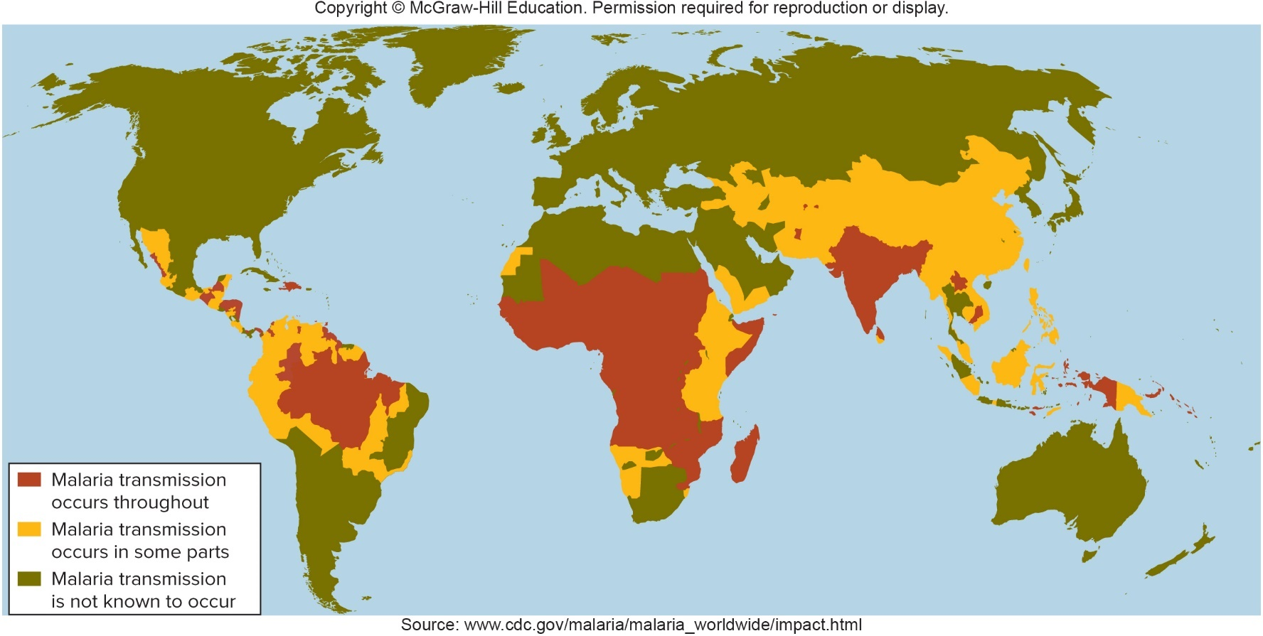
Protozoan Diseases of Blood and Lymphatic Systems – Figure 25.16
Malaria
Treatment and prevention
Artemisinin-resistant strains of P. falciparum now reported
New medications needed
Source: https://www.cdc.gov/malaria/malaria_worldwide/impact.html

Slide 94
Protozoan Diseases of Blood and Lymphatic Systems (10)
Malaria
Treatment and prevention
Best prevention will be through vaccination
Number of potential vaccines being tested
Most promising gives only 30% protection in children
Indoor spraying with DDT, insecticide-impregnated bed nets, elimination of mosquito breeding areas

Slide 95
Table 25.13 Malaria
Signs and symptoms | Recurrent cycles of intense chills and fever alternating with feeling healthy
Incubation period | Varies with species; 6 to 37 days
Causative agents | Five species of protozoa of the genus Plasmodium.
Pathogenesis | Protozoan enters hepatocytes and multiplies in them; cells burst and release protozoa causing fever; organisms infect red blood cells, differentiating in them; spleen enlarges in response to removing large amount of foreign material and many abnormal blood cells from the circulation; with P. falciparum infection, red blood cells stick together and to walls of capillaries, blocking vessels and depriving tissue of O₂.
Epidemiology | Transmitted from person to person by bite of infected Anopheles mosquito.
Treatment and prevention | Treatment: usually ACTs; other medicines if sensitivity known. Prevention: the same medications used for treatment; eradication of mosquito vectors; mosquito netting impregnated with insecticide; vaccines under development.

Slide 96
Appendix of Image Long Descriptions

Slide 97
Anatomy, Physiology, and Ecology – Figure 25.1 Long Description
Blood enters the heart through veins and leaves through arteries. Lymphatic vessels begin in capillaries and empty into veins near the heart. Infectious diseases of the cardiovascular system include endocarditis. myocarditis, pericarditis, and lymphangitis.
Jump back to Anatomy, Physiology, and Ecology – Figure 25.1

Slide 98
Bacterial Diseases of Blood and Lymphatic Systems – Figure 25.3 Long Description
Endotoxin released into the bloodstream by Gram-negative bacteria can activate macrophages, complement, or blood-clotting mechanisms. Macrophages release cytokines leading to decreased muscle tone of heart and arteries, fever, increased adhesiveness of neutrophils, and increased leakage of plasma from blood vessels, all leading to shock and impaired oxygen exchange. Complement activation leads to leukocytes attracted to lung tissue, increased capillary leakage of plasma, and lysosomal enzymes released from leukocytes, all leading to lung tissue damage. Activation of clotting mechanisms leads to disseminated intravascular coagulation which causes depletion of clotting proteins and tissue damage from clots in capillaries, both leading to hemorrhage.
Jump back to Bacterial Diseases of Blood and Lymphatic Systems – Figure 25.3

Slide 99
Bacterial Diseases of Blood and Lymphatic Systems – Figure 25.10 Long Description
In spring of the first year, females lay uninfected eggs that hatch into larvae in the summer. In the fall the larvae feed on infected hosts and acquire Borrelia burgdorferi. In the winter the larvae become dormant and later develop into nymphs. The infected nymphs feed on hosts and transmit Borrelia burgdorferi in spring of the second year. These mature into adults in the summer and feed on animal hosts in the fall where they mate. In the winter of the second year, the female becomes dormant and the male dies.
Jump to Bacterial Diseases of Blood and Lymphatic Systems – Figure 25.10

