Slide 1
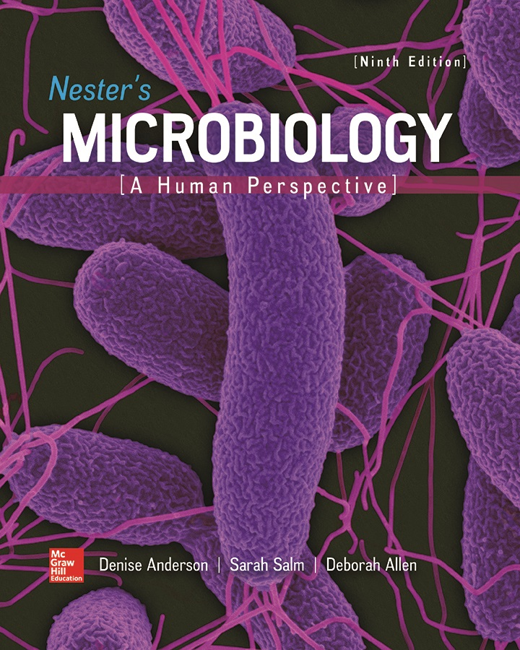
Chapter 26 Lecture Outline
See separate PowerPoint slides for all figures and tables pre-inserted into PowerPoint without notes.
Notes:
1

Slide 2
A Glimpse of History
Gerhard Henrik Armauer Hansen (1841 to 1912)
Worked with Daniel Danielson, a leading authority on leprosy
Danielson believed leprosy was a hereditary disease of the blood, not contagious
Hansen carefully disproved Danielson’s hypothesis over a number of years
Hansen found a unique bacterium associated with leprosy in every patient
Report in 1873 was first to link specific bacterium to disease, almost a decade before Koch’s proof of TB
Because leprosy carries centuries of dark overtones, many people prefer to use the term Hansen’s disease

Slide 3
Introduction
Nervous system infections threaten ability to move, feel, or even think
Poliomyelitis can result in a paralyzed limb or inability to breath without mechanical assistance
Hansen’s disease (leprosy) can result in loss of fingers or toes or deformity in the face
Infections of brain or membranes can render a child deaf or intellectually disabled
Before antibiotics, bacterial infections of nervous system were often fatal
Fortunately, these infections are uncommon

Slide 4
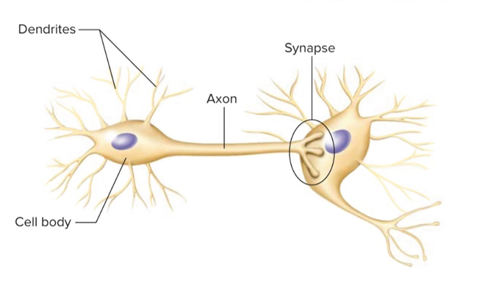
Anatomy, Physiology, and Ecology – Figure 26.1a
Nerve cells transmit electrical impulses
Each neuron has different regions
Dendrites are branching projections, receive information
Convey information to cell body, the command center
Contains cell nucleus
Long, thin extension called axon transmits to another cell
Jump to Anatomy, Physiology, and Ecology – Figure 26.1a Long Description

Slide 5
Anatomy, Physiology, and Ecology (1)
Neurons communicate using neurotransmitters
Chemicals stored in vesicles at end of axon
When released, diffuse to neighboring cell
Receiving cell has receptors for neurotransmitter, responds
Region between cells is a synapse
Notes:
5

Slide 6
Anatomy, Physiology, and Ecology (2)
Central nervous system (CNS)
Brain and spinal cord
Brain is complex; distinct parts have different functions
Generalized inflammation or infection is encephalitis
Spinal cord conveys sensory information from receptors to the brain, and motor commands from the brain to the muscles and internal organs
Circuits for simple reflexes
Generalized inflammation is called myelitis
Peripheral nervous system (PNS)
Nerves composed of bundles of axons
Motor neurons carry messages from CNS to body
Sensory neurons transmit sensations to the CNS

Slide 7
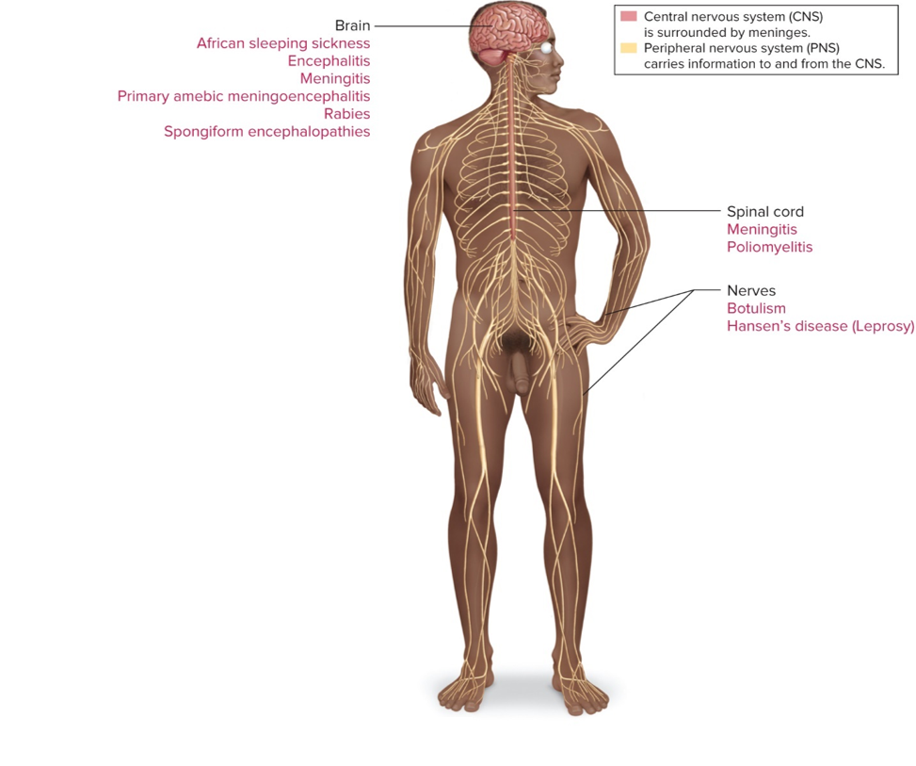
Anatomy, Physiology, and Ecology – Figure 26.1b
Jump to Anatomy, Physiology, and Ecology – Figure 26.1b Long Description

Slide 8
Anatomy, Physiology, and Ecology (3)
CNS encased by bone: skull, vertebral column
Only rarely do infections spread from bone to CNS
Cerebrospinal fluid (CSF)
Four ventricles deep inside brain filled with CSF
CSF continually produced in ventricles, circulates over surface of brain and spinal cord
Cushions, supports brain; transports nutrients
Meninges: three layers of membranes covering surface of brain and spinal cord

Slide 9
Anatomy, Physiology, and Ecology (4)
Meninges
Outer dura mater is tough, fibrous, adheres to bones
Provides barrier to infection from bones
May contain a blood-filled venous sinus
Inner membranes are arachnoid mater and pia mater
Separated by subarachnoid space within which flows cerebrospinal fluid
Inflammation of these membranes is meningitis
When both brain and membranes are infected, condition is meningoencephalitis
Notes:
9

Slide 10
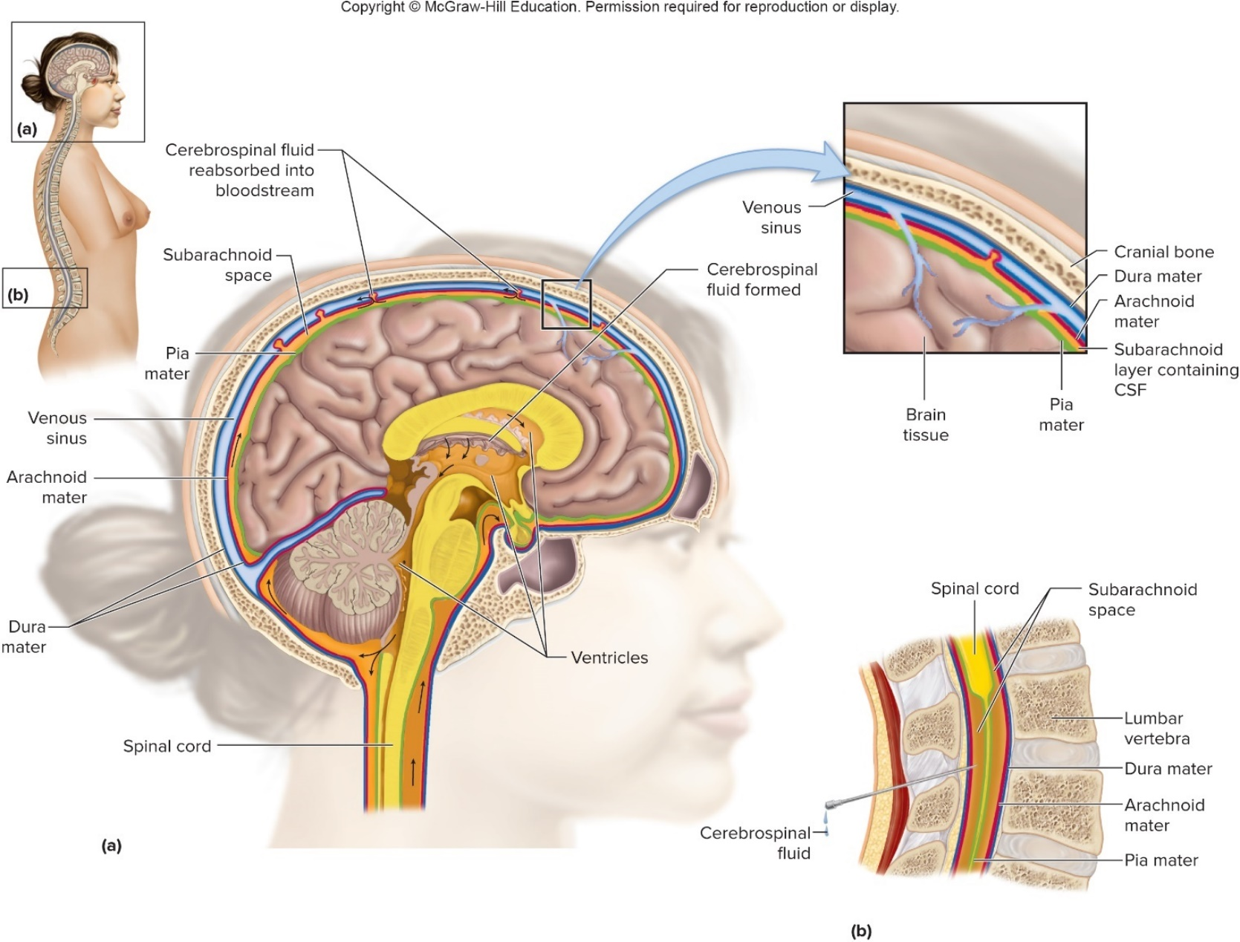
Anatomy, Physiology, and Ecology – Figure 26.2

Slide 11
Anatomy, Physiology, and Ecology (5)
Nervous system lies entirely within body tissues, has no normal microbiota
CSF is generally sterile; presence of microbes indicates infection
In lumbar puncture (spinal tap), a needle withdraws CSF from subarachnoid space to diagnose infection
Bloodstream is primary source of CNS infections
Blood-brain barrier depends upon special cells lining capillaries in CNS
Difficult for pathogens to enter CNS
May also prevent medications from entering CNS
Notes:
11

Slide 12
Bacterial Diseases of the CNS
Bacteria most often infect meninges of CNS rather than neurons (meningitis)
Most common species that cause meningitis are often part of normal microbiota of upper respiratory tract
Newborns can be exposed from mother

Slide 13
Focus on Meningitis (1)
Meningitis (inflammation of meninges) most often results from infection
Signs and symptoms
Symptoms like a mild cold begin after a few days
Then sudden onset of severe, throbbing headache, stiffness of neck and back, fever, photophobia, vomiting
Perhaps deafness, confusion, loss of consciousness, coma
Those who recover may have deafness, blindness, mental impairment
Case-fatality rate of untreated bacterial meningitis can approach 100%; death within a few hours
Viral meningitis more common, but less severe
Notes:
13

Slide 14
Focus on Meningitis (2)
Meningitis
Signs and symptoms
Lumbar puncture secures sample of cerebrospinal fluid (CSF) to diagnose meningitis
CSF is cloudy in bacterial meningitis
Elevated pressure, neutrophils, high levels of protein, low levels of glucose; can be cultured for identification
CSF is clear in viral meningitis
Contains lymphocytes
Called aseptic meningitis
Notes:
14

Slide 15
Focus on Meningitis (3)
Meningitis
Pathogenesis
Bacteria may enter CNS due to bacteremia or trauma
Much of the damage to CNS is result of inflammation
Accumulation of fluids can cause brain swelling and nerve damage
Obstruction of CSF flow can increase internal pressure and squeeze brain against skull
Blood-brain barrier disrupted
Clots form in capillaries, leading to cell death
Viral meningitis usually resolves itself in a few days
Notes:
15

Slide 16
Focus on Meningitis (4)
Meningitis
Epidemiology
Relatively rare; most risk in newborns and elderly, those with lowered immunity
Bacteria transmitted by respiratory droplets
Military barracks, dormitories
Viruses transmitted by fecal-oral route
Notes:
16

Slide 17
Focus on Meningitis (5)
Meningitis
Treatment and prevention
Bacterial meningitis treated immediately with broad-spectrum antibiotics
May switch to narrow-spectrum once specific bacterium is identified
No effective treatment for viral meningitis
Vaccines against bacterial meningitis
Prophylactic doses of antimicrobial medications upon exposure
Avoidance of crowds
Increased handwashing for viral meningitis
Notes:
17

Slide 18
Bacterial Diseases of the CNS (1)
Pneumococcal meningitis
Signs and symptoms
Begins like mild cold, followed by sudden onset of severe, throbbing headache; fever; pain and stiffness of neck and back; nausea and vomiting
Deafness, confusion, loss of consciousness, coma may develop; death may occur rapidly
Causative agent
Streptococcus pneumoniae (pneumococcus), a Gram-positive lancet-shaped diplococcus
Capsule protects from phagocytosis
Antigenic differences produce over 90 serotypes
Part of normal respiratory microbiota

Slide 19
Bacterial Diseases of the CNS (2)
Pneumococcal meningitis
Pathogenesis
Can cause of otitis media, sinusitis, and pneumonia
May precede pneumococcal meningitis
Encapsulated strains enter bloodstream, pass into cerebrospinal fluid
Damage largely from inflammatory response
Fluids accumulate, cause swelling; clots in capillaries can block blood supply, lead to tissue death
Inflammation can obstruct CSF flow, pressure can squeeze brain against skull
Mortality and neurological damage more common with this type of meningitis than others

Slide 20
Bacterial Diseases of the CNS (3)
Pneumococcal meningitis
Epidemiology
Causes over 50% of bacterial meningitis in U.S.
Case-fatality rate <10% in adults; higher in elderly
Spread by respiratory droplets
Very few who are infected will develop meningitis

Slide 21
Bacterial Diseases of the CNS (4)
Pneumococcal meningitis
Treatment and prevention
Penicillin is drug of choice unless strain is resistant, then cephalosporins are given, possible addition of vancomycin
Conjugate vaccine (PCV13) effective against 13 serotypes; given to children under 2, adults over 65, and those with certain health problems
Capsular polysaccharide vaccine (PPSV23) effective against 23 serotypes, but not effective in children since they do not respond to T-independent antigens
Notes:
21

Slide 22
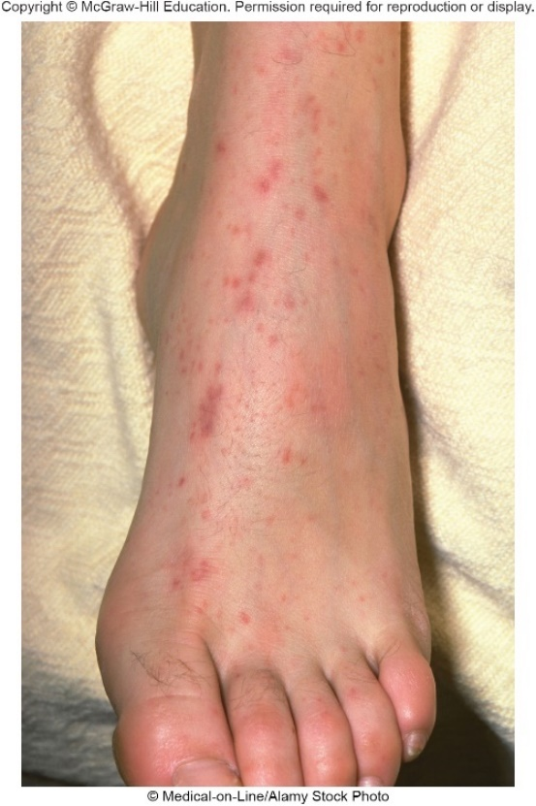
Bacterial Diseases of the CNS – Figure 26.3.
Meningococcal meningitis
Signs and symptoms
Appear in 1 to 7 days; similar to pneumococcal meningitis
Distinguished by presence of purplish spots on skin called petechiae; due to capillary damage
Can lead to rapidly fatal septic shock
Causative agent: Neisseria meningitidis
Gram-negative encapsulated diplococcus
Most infections due to serotypes A, B, C, W, and Y
B,C and Y most common in U.S., Europe
A most common in Africa, Asia
Can vary antigens, easily acquir DNA via horizontal gene transfer
©Medical-on-Line/Alamy Stock Photo

Slide 23
Bacterial Diseases of the CNS (5)
Meningococcal meningitis
Pathogenesis
Meningococci inhaled in airborne droplets, attach by pili to mucous membranes, multiply
Proteins in outer membrane allow passage through respiratory epithelial cells; cells enter bloodstream
Release vesicles of outer membrane; endotoxin causes vasodilation and capillary leakage, drop in blood pressure
Shock results when blood pressure is so low that $O_{2}$ is not sufficiently supplied to tissues
Capillary damage causes petechiae
Capsule protects from phagocytosis, complement system; numerous neutrophils enter CSF, but bacteria multiply faster than they can be destroyed
Damage largely results from inflammation

Slide 24
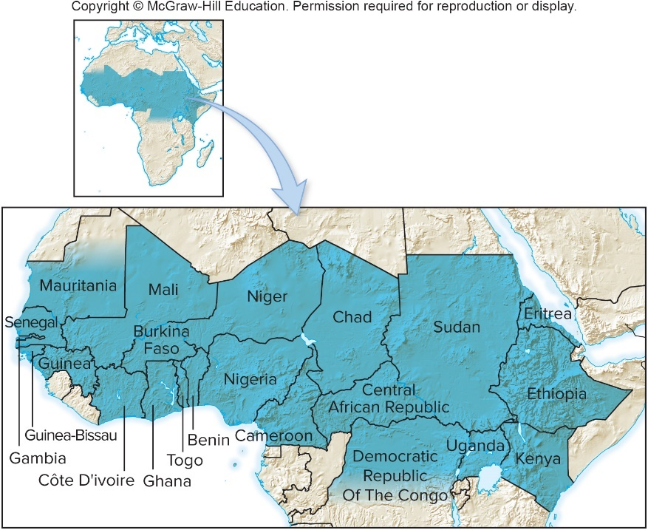
Bacterial Diseases of the CNS – Figure 26.4
Meningococcal meningitis
Epidemiology
Transmission can occur from exposure to person with disease or asymptomatic carrier
Most cases sporadic; epidemics can occur if spread via respiratory droplets through crowded, stressed populations
Highest incidence worldwide in African “meningitis belt”
May reach 500 cases per 100,000 during dry season
Vaccination campaign begun in 2010 resulted in 98% decrease in some areas

Slide 25
Bacterial Diseases of the CNS (6)
Meningococcal meningitis
Treatment and prevention
Usually cured with penicillin or ceftriaxone if treated in time
Recovery without damage; case-fatality rate $<10$%
Vaccines against A, C, W, and Y strains
Conjugate vaccine (MenACWY) recommended for 11 to 12 year old children with booster at age 16; also those over 2 months at increased risk
Polysaccharide vaccine (MPSV4) preferred for some
In 2015 a recombinant subunit vaccine was approved in U.S. following two outbreaks of serotype B meningitis on university campuses in 2013
Antibacterial medications help control outbreaks
People exposed given prophylactic antibiotic

Slide 26
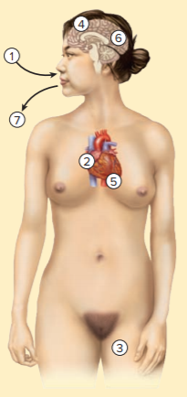
Table 26.1 Meningococcal Meningitis
Neisseria meningitidis inhaled, infects upper airways.
Bacteria enter the bloodstream and are circulated throughout the body.
The bacteria damage skin capillaries and cause petechiae.
Bacteria infect the meninges causing meningitis.
Lysing bacteria in the circulation release endotoxin, producing shock.
Inflammatory response in meninges can damage nerves of hearing, causing deafness, and obstruct the flow of cerebrospinal fluid, causing increased pressure inside the brain.
Bacteria exit with respiratory secretions.
Signs and Symptoms | Mild cold followed by headache, fever, pain, stiff neck and back, vomiting, petechiae
Incubation period | 1 to 7 days
Causative agent | Neisseria meningitidis, the meningococcus; a Gram-negative diplococcu
Pathogenesis | Meningococci adhere by pili, colonize upper respiratory tract, enter bloodstream; carried to meninges and spinal fluid; inflammatory response obstructs normal outflow of fluid; increased pressure caused by obstructed flow impairs brain function; damage to motor nerves produces paralysis: endotoxin release leads to shock.
Epidemiology | Close contact with a case or carrier; inhalation of infectious droplets; crowding and fatigue predispose to the disease.
Treatment and prevention | Treatment: antibiotics. Prevention: age-specific vaccines; antibiotics given to people exposed.

Slide 27
Bacterial Diseases of the CNS (7)
Haemophilus influenzae meningitis
Once caused meningitis in about 1 out of 200 children under 5 years of age
Since late 1980’s, Hib vaccine reduced incidence by over 99%
Signs and symptoms
Begins with mild cold symptoms; progresses to severe headache, fever, vomiting
Older children may have stiff neck
Infants may show bulging “soft spot”
May progress to coma and death

Slide 28
Bacterial Diseases of the CNS (8)
Haemophilus influenzae meningitis
Causative agent: Haemophilus influenzae
Gram-negative non-motile coccobacillus (short rod)
Named when it was thought to have caused the influenza epidemic in late 1890s
Not the cause; but often isolated from influenza patients
Encapsulated strains a through f cause disease in children
Type b, abbreviated Hib, causes most serious disease
Unencapsulated strains often in normal microbiota
First free-living organism to have genome sequenced
Notes:
28

Slide 29
Bacterial Diseases of the CNS (9)
Haemophilus influenzae meningitis
Pathogenesis
Encapsulated H. influenzae in upper respiratory tract can bind to, penetrate epithelium with aid of pili
Enter capillaries; bacteremia can result in meningitis
Unencapsulated strains generally do not enter bloodstream, but can cause local infections
Epidemiology
Usually does not cause epidemics
Healthy adult carriers often source of sporadic infections
Children rarely carry Hib due to high immunization rate
Pathogen carried by respiratory droplets
Untreated case-fatality rate approximately 90%; approximately 5% with treatment
Approximately 10 to 30% of children have lasting neurological damage

Slide 30
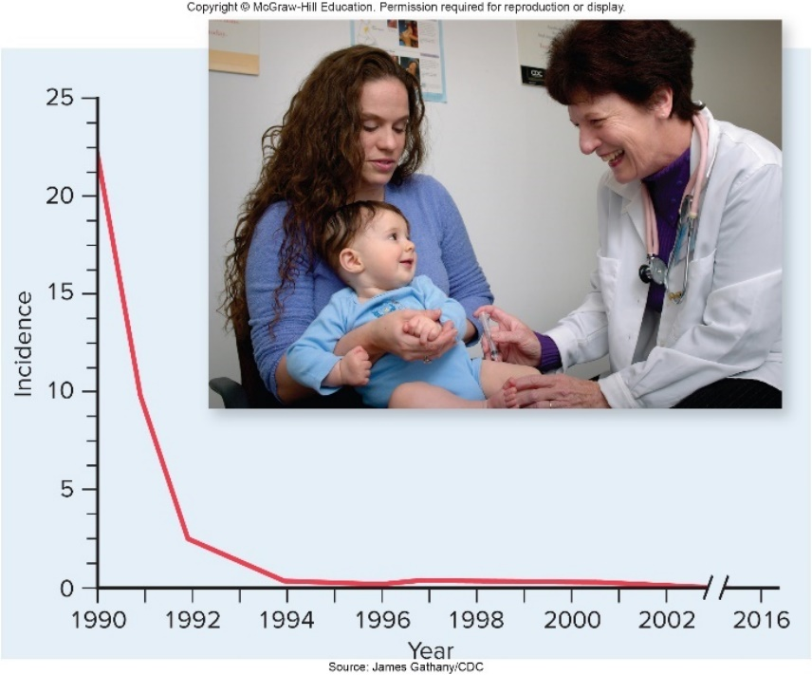
Bacterial Diseases of the CNS – Figure 26.5
Haemophilus influenzae meningitis
Treatment and prevention
Third-generation cephalosporins usually effective
People in close contact given rifampin to prevent
Conjugate Hib vaccine has type b polysaccharide plus bacterial protein (such as diphtheria toxoid)
Children <2 years respond poorly to polysaccharide antigens
Relatively expensive; less practical in developing countries where most meningitis deaths still are due to Hib
Source: James Gathany/CDC

Slide 31
Bacterial Diseases of the CNS (10)
Neonatal meningitis
Most caused by bacteria colonizing mother’s birth canal
Streptococcus pneumoniae, Neisseria meningitidis, Haemophilus influenzae selcom cause meningitis in newborns because most mothers pass antibodies against them; protect baby for about 6 months
Signs and symptoms
Difficult to determine headache, stiff neck in babies
Fever, vomiting, irritability, poor feeding, lethargy
Possible bulging soft spot due to increased pressure within cranium

Slide 32
Bacterial Diseases of the CNS (11)
Neonatal meningitis
Causative agents
Most common is Streptococcus agalactiae, often called group B streptococcus (GBS) that often colonizes vagina
Certain Gram-negative rods (encapsulated strains of E. coli) that originate from mother’s intestinal tract
Listeria monocytogenes from bloodstream of infected mother
Notes:
32

Slide 33
Bacterial Diseases of the CNS (12)
Neonatal meningitis
Pathogenesis
Bacteremia leads to infection of meninges
Inflammation increases intracranial pressure
Can block CSF flow, cause hydrocephalus
Disruption of blood flow may damage nervous tissue
Infection may lead to brain abscess
Epidemiology
Usually acquired from mother’s genital tract just before or during birth; premature, low weight babies at highest risk
Causes death in 5 to 20% of affected newborns
Survivors often have long-lasting consequences

Slide 34
Bacterial Diseases of the CNS (13)
Neonatal meningitis
Treatment and prevention
Intravenous dosage with mixture of antibacterials effective against both group B streptococci and E. coli
Others may be used once causative agent is identified
CDC recommends testing vagina and rectum of pregnant women for group B streptococci late in pregnancy
Women with positive cultures treated with antibacterials shortly before or during labor
Screening, treatment can decrease incidence >75%

Slide 35
Bacterial Diseases of the CNS (14)
Listeriosis
Signs and symptoms
Infections asymptomatic or mild in most healthy people
If symptomatic, characterized by fever, muscle aches
Sometimes nausea or diarrhea
Most cases requiring medical attention have meningitis with fever, headache, stiff neck, and vomiting
Pregnant women often miscarry or deliver terminally ill infants
Babies infected at birth usually develop meningitis after incubation of 1 to 4 weeks

Slide 36
Bacterial Diseases of the CNS (15)
Listeriosis
Causative agent: Listeria monocytogenes
Motile, non-spore-forming, facultatively anaerobic, Gram-positive rod
Can grow at 4 degrees Celsius (refrigerator) even if vacuum-packed
Pathogenesis
During epidemics, mode of entry is generally via gastrointestinal tract
Listeriosis is generally foodborne
Bacteria induce phagocytosis, penetrate cells, and enter bloodstream
Bacteremia is source of meningeal infection
L. monocytogenes crosses placenta; produces widespread abscesses in fetal tissues

Slide 37
Bacterial Diseases of the CNS (16)
Listeriosis
Epidemiology
Widespread in natural waters, vegetation; can be carried in intestines of asymptomatic humans, other animals
Pregnant women, elderly, those with underlying illnesses especially susceptible
Epidemics have resulted from contaminated coleslaw, non-pasteurized milk, pork tongue in jelly, some soft cheeses, and hot dogs
Can grow in commercially prepared food stored at refrigeration temperatures, so thousands of infections have originated from a single food-processing plant

Slide 38
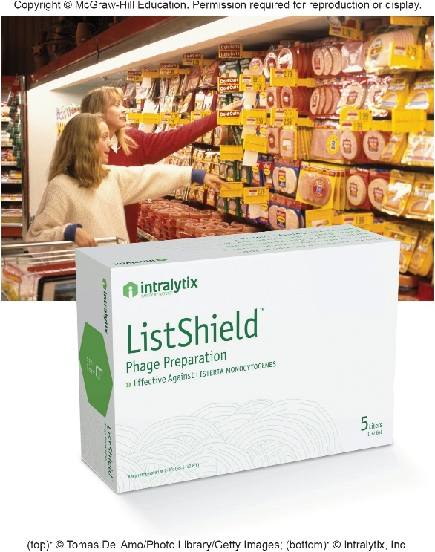
Bacterial Diseases of the CNS – Figure 26.6
Listeriosis
Treatment and prevention
Most strains susceptible to antibacterials
Often mild in pregnant women, but prompt treatment important to protect fetus
Cook food thoroughly; avoid cross-contamination
Pregnant women, others at risk should avoid soft cheeses, refrigerated meat spreads, smoked seafood
Bacteriophage mixture that lyses L. monocytogenes can be sprayed on meats during production
Increased safety 80 to 99%
(top): ©Tomas Del Amo/Photo Library/Getty Images; (bottom): ©Intralytix, Inc.

Slide 39
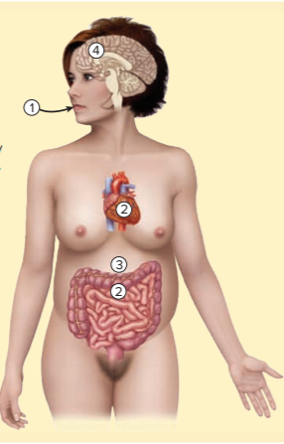
Table 26.2 Listeriosis
Listeria monocytogenes is ingested with food such as soft cheeses, unpasteurized milk, raw fruits and vegetables, hot dogs, or smoked fish.
The bacteria rapidly penetrate the intestinal epithelium and establish bacteremia, especially in pregnant women, the elderly, and the immunodeficient.
In pregnant women, circulating L. monocytogenes cells cross the placenta and fatally infect the fetus; bacteria transmitted to the baby at birth cause meningitis in 1 to 4 weeks. The mother usually does not have a serious illness.
In older people and those with underlying diseases, L. monocytogenes attacks the brain and meninges.
Signs and Symptoms | Fever and muscle aches, with or without gastrointestinal symptoms; headache and stiff neck mark the onset of meningitis
Incubation period | A few days to 2 to 3 months; in newborn babies, 1 to 4 weeks
Causative agent | Listeria monocytogenes, a non-spore-forming Gram-positive rod able to grow at 4 degrees Celsius
Pathogenesis | Ingested L. monocytogenes cells penetrate the intestinal epithelium and enter the bloodstream; the resulting bacteremia spreads to the meninges, causing meningitis.
Epidemiology | Epidemics from contaminated foods. Pregnant women develop bacteremia that may result in fetal infection or miscarriage. Infants contract infection in the uterus or at birth. Elderly and those with immunodeficiency, cancer, and diabetes also at high risk.
Treatment and prevention | Treatment: antibacterial medications. Prevention: care in handling, cooking of raw meats; thorough washing of vegetables; reheating of cold cuts, hot dogs, and refrigerated leftovers.

Slide 40
Table 26.3 Main Causes of Acute Bacterial Meningitis Compared
Agent | Characteristics | Source | Vaccine? | Age Group Usually Affected
Streptococcus pneumoniae | Gram-positive diplococci | Respiratory system | Yes, against multiple serotype | Mostly late teens and adults
Neisseria meningitides | Gram-negative diplococci | Respiratory system | Yes, against multiple serotypes | Mostly infants, adolescents, and young adults; can cause epidemics
Haemophilus influenza | Gram-negative coccobacilli | Respiratory system | Yes, against type b | Infants and young children
Streptococcus agalactiae | Gram-positive cocci in chains | Colon, vagina | No | Mostly neonates
Escherichia coli | Gram-negative rods | Colon | No | Mostly neonates
Listeria monocytogenes | Gram-positive rods; multiply at refrigerator temperatures | Environment; contaminated cheeses, cold cuts, other foods | No | Pregnant women, neonates; elderly

Slide 41
Viral Diseases of the CNS (1)
Viral meningitis
Signs and symptoms
Abrupt onset within 1 to 4 weeks; fever, severe headache, sensitivity to light, stiff neck, often vomiting
Possible sore throat, chest pain, swollen salivary glands, skin rash
Causative agents
Non-enveloped RNA viruses of enterovirus subgroup of Picornaviridae responsible for at least half of cases
Most common are coxsackie viruses (cause throat, chest pain) and echoviruses (cause rash)

Slide 42
Viral Diseases of the CNS (2)
Viral meningitis
Pathogenesis
Infect throat, intestinal epithelium, lymphoid tissue
Spread to bloodstream, can result in meningeal infection
Inflammatory response differs from bacterial meningitis; fewer neutrophils and more monocytes enter CSF
Typically less severe; causes little lasting damage
Epidemiology
Enteroviruses relatively stable in environment
Can sometimes persist in chlorinated swimming pools
Transmitted via fecal-oral route
Feces of infected individuals contain viruses for weeks

Slide 43
Table 26.4 Viral Meningitis
Viral meningitis
Treatment and prevention
No specific treatment
Handwashing
Avoiding crowded swimming pools
No vaccines against most causes
Signs and Symptoms | Abrupt onset, fever, severe headache, stiff neck, often vomiting; sometimes sore throat, rash, or chest pain
Incubation period | Usually 1 to 4 weeks
Causative agent | Most cases: small non-enveloped RNA enteroviruses of Picornaviridae, usually coxsackie or echoviruses
Pathogenesis | Viruses from primary infection spread through the bloodstream to the meninges. Fewer leukocytes enter cerebrospinal fluid than with bacterial infections, and many are monocytes rather than neutrophils.
Epidemiology | Enteroviruses are transmitted by the fecaloral route.
Treatment and prevention | Treatment: no specific treatment. Prevention: handwashing, avoiding crowded swimming pools during enterovirus outbreaks.

Slide 44
Viral Diseases of the CNS (3)
Viral encephalitis
More likely than viral meningitis to cause death or permanent disability
Can be sporadic or epidemic
Sporadic cases usually due to activation of latent herpes simplex viruses
Signs and symptoms
Onset abrupt within one week of infection
Fever, headache, vomiting
Possible disorientation, localized paralysis, seizures, deafness, seizures, coma

Slide 45
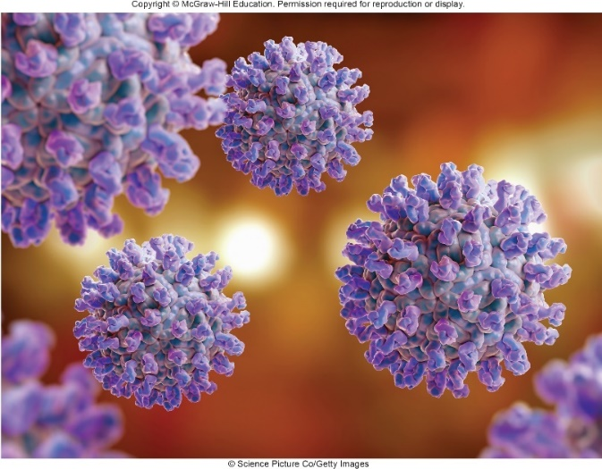
Table 26.5 Arboviruses That Cause Encephalitis in the United State
Viral encephalitis
Causative agents
Usually arboviruses (arthropod-borne viruses)
Enveloped, single-stranded RNA viruses
Leading causes in U.S. transmitted by mosquitoes
Virus | Family
LaCrosse encephalitis virus | Bunyaviridae
St. Louis encephalitis virus | Flaviviridae
West Nile encephalitis virus | Flaviviridae
Eastern equine encephalitis virus | Togaviridae
Western equine encephalitis virus | Togaviridae
©Science Picture Co/Getty Images
Notes:
45

Slide 46
Viral Diseases of the CNS (4)
Viral encephalitis
Pathogenesis
Viruses multiply at site of bite and in local lymph nodes
Produce mild, brief viremia
If viruses infect cells of blood-brain barrier, can enter brain, replicate in neurons, destroy brain tissue
Case-fatality rates range from approximately 2% with LaCrosse encephalitis to 35 to 50% with eastern equine encephalitis
Emotional instability, epilepsy, blindness, or paralysis may occur in 5 to 50% of those who recover
Depends on kind of virus and age of patient
Very young, elderly most affected

Slide 47
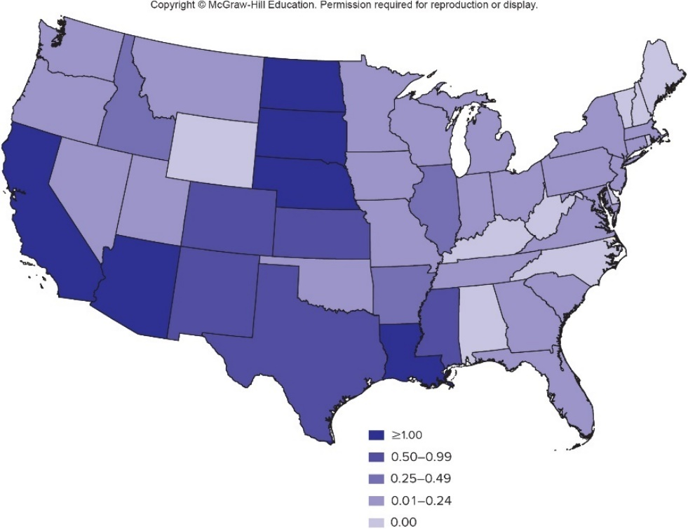
Viral Diseases of the CNS – Figure 26.7
Viral encephalitis
Epidemiology
Zoonoses; natural reservoir in birds, small animals
Humans are accidental dead-end host, do not develop sufficient viremia to transmit back to arthropod vector
Some arboviruses have broad host range; cause disease in animals and humans
West Nile virus introduce in NY in summer of 1999, spread by migrating birds

Slide 48
Viral Diseases of the CNS (5)
Viral encephalitis
Treatment and prevention
No proven antiviral therapy
Blood of sentinel chickens in cages tested periodically
Positive test triggers encephalitis alert
Equine encephalitis viruses generally infect horses 1 to 2 weeks before first human cases
Vaccine against eastern equine encephalitis approved for use in horses and emus
Human vaccine against West Nile virus in clinical trials
Best preventive is to avoid mosquito bites
Wear long sleeves and pants, screen windows and porches, use repellents and insecticides

Slide 49
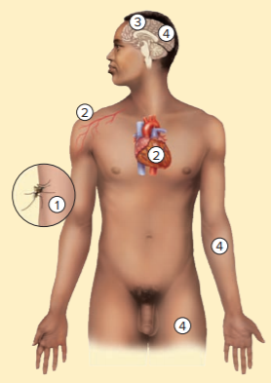
Table 26.6 Viral Encephalitis
Infected mosquito introduces encephalitis virus.
Virus multiplies locally, establishes brief low-level viremia.
Virus crosses blood-brain barrier and preferentially attacks the brain.
Destruction of brain tissue causes death or permanent disabilities such as emotional instability, mental disability, paralysis of face, arm, leg.
There is no exit for the virus; thus, humans are dead-end hosts.
Signs and Symptoms | Abrupt onset, fever, headache, vomiting, disorientation, paralysis, seizures, deafness, coma
Incubation period | First symptoms within a few days; encephalitic symptoms often within the first week
Causative agent | One of five arboviruses: LaCrosse, St. Louis, West Nile, western equine, or eastern equine
Pathogenesis | Replication of virus at the site of the mosquito bite, replication in lymph nodes, then viremia and invasion of brain tissue. Nerve cells in the brain destroyed.
Epidemiology | Viruses transmitted to humans from birds or rodents by mosquitoes.
Treatment and prevention | Treatment: no accepted treatment for arboviral encephalitis. Prevention: chicken sentinels to warn of arbovirus epidemics; insecticides and other anti-mosquito measures.

Slide 50
Viral Diseases of the CNS (6)
Poliomyelitis
Characteristic feature is destruction of motor neurons resulting in paralysis of a group of muscles
Salk and Sabin vaccines decreased incidence in developed countries
Global Polio Eradication Initiative had goal of eliminating polio worldwide
In 1988, 125 countries had polio with 350,000 cases of paralysis each year
In 2016, 3 countries had polio; fewer than 40 cases
Afghanistan, Nigeria, Pakistan

Slide 51
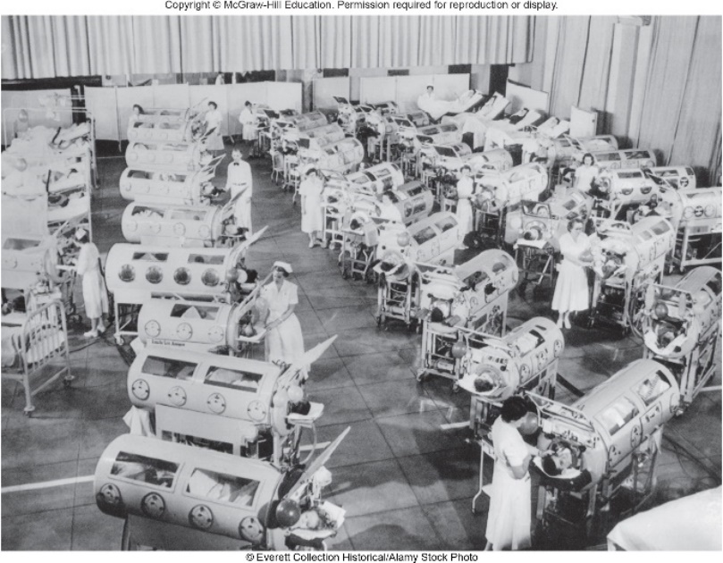
Viral Diseases of the CNS - Figure 26.8
Poliomyelitis
Signs and symptoms
95% of cases are asymptomatic; mil disease begins in 6 to 20 days with headache, fever, nausea for about a week
In 1% of cases, infection spreads to CNS; back pain and muscle spasms last about 10 days
In some, this is followed by paralysis
Muscles, bones affected; lasts weeks to months
In severe cases, respiratory muscles are paralyzed
Ventilator must be used
Survivors recover some function
©Everett Collection Historical/Alamy Stock Photo
Notes:
51

Slide 52
Viral Diseases of the CNS (7)
Poliomyelitis
Signs and symptoms
Survivors may develop post-polio syndrome
Muscle pain, weakness, muscle degeneration
15 to 50 years post-recovery
Thought to be secondary effect of initial damage
During recovery, surviving nerve cells branch out, take over functions; probably ultimately die from extra work
Notes:
52

Slide 53
Viral Diseases of the CNS (8)
Poliomyelitis
Causative agent
Three serotypes of polioviruses (1, 2, and 3)
Type 1 might be only serotype circulating today
Type 2 declared eradicated in 2015; last seen in 1999
Type 3 last detected in 2012
Non-enveloped, single-stranded RNA viruses
Members of enterovirus subgroup of Picornaviridae
Stable under natural conditions
Notes:
53

Slide 54
Viral Diseases of the CNS (9)
Poliomyelitis
Pathogenesis
Virus enters body orally, infects throat and intestinal tract, invades bloodstream
Symptoms usually mild; recovery complete
Rarely, virus binds to specific receptors on motor neurons, replicates, destroys cells during release
Infection is in CNS, but effects are peripheral as motor neurons degenerate and muscles are paralyzed and atrophy

Slide 55
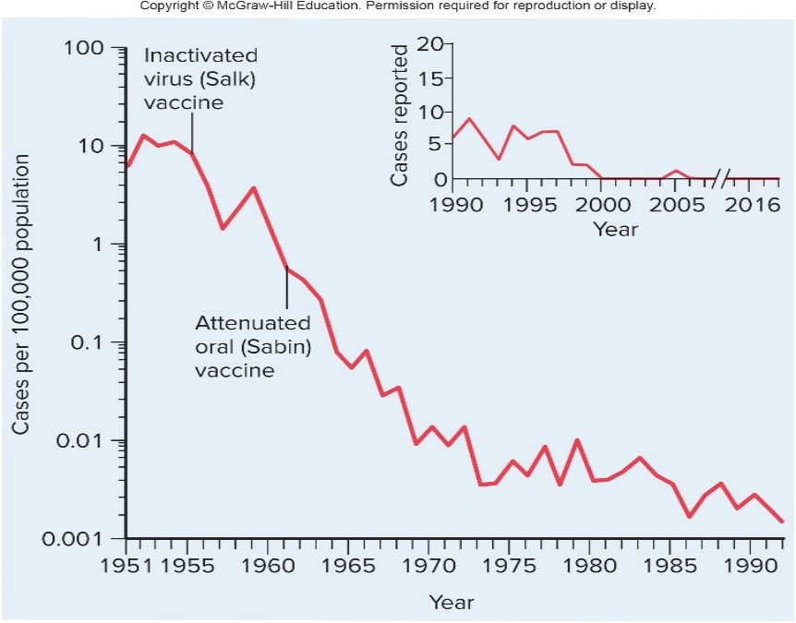
Viral Diseases of the CNS – Figure 26.9
Poliomyelitis
Epidemiology
Fecal-oral transmission; easily spread
In endemic areas, newborns are usually infected while they are protected by material antibodies
Mild infections result in lifelong immunity
Paralysis more likely to result when exposed later in life

Slide 56
Viral Diseases of the CNS (10)
Poliomyelitis
Treatment and prevention
Supportive care, ventilator if required
Virus inactivated by pasteurization, chlorination
Oral polio vaccine (OPV) is attenuated poliovirus
Can be administered on tongue, less expensive
Replicate in intestines, eliminated in feces
Can spread to others, immunizing them
Prevents spread of poliovirus in a population
Inactivated polio vaccine (IPV) is injected
Unreliable at eliciting production of mucosal antibodies
Can prevent infection, but not spread of poliovirus

Slide 57
Viral Diseases of the CNS (11)
Poliomyelitis
Treatment and prevention
OPV strain can mutate resulting in vaccine-associated paralytic polio (1 case per 2.4 million doses)
Vaccine-derived poliovirus (VDPV) rather than wild poliovirus (WPV) caused all polio in U.S. after elimination of wild virus
U.S. now uses IPV routinely
OPV contains types 1 and 3 poliovirus; IPV contains all three serotypes

Slide 58
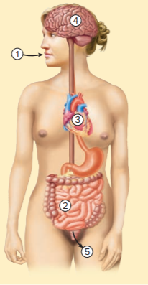
Table 26.7 Poliomyelitis
Poliovirus enters the body orally.
The virus replicates in cells lining the throat and the intestines.
In some cases, the virus spreads via the bloodstream, causing mild symptoms of fever, headache, and nausea.
In a small percentage of cases, the virus enters the CNS and may then cause the paralysis that characterizes poliomyelitis.
Poliovirus exits the body with feces.
Signs and Symptoms | Headache, fever, stiff neck, nausea, pain, muscle spasm, followed by paralysis
Incubation period | 7 to 14 days
Causative agent | Poliovirus serotypes 1, 2, 3; member of Picornaviridae
Pathogenesis | Virus infects the throat and intestine, circulates via the bloodstream, and enters some motor nerve cells of the brain or spinal cord (CNS); infected nerve cells lyse upon release of mature virus.
Epidemiology | Spreads by the fecal-oral route; asymptomatic and non-paralytic cases common
Treatment and prevention | Treatment: artificial ventilation for respiratory paralysis; physical therapy and rehabilitation. Prevention: vaccination

Slide 59
Viral Diseases of the CNS (12)
Rabies
Signs and symptoms
Symptoms begin 1 to 2 months after infection with fever, head and muscle aches, sore throat, fatigue, nausea
Characteristic tingling or twitching at site of viral entry
Progress rapidly to agitation, confusion, hallucinations, seizures, increased sensitivity, encephalitis
Later stages characterized by increased salivation, difficulty swallowing, causing “frothing at the mouth”
Swallowing, sight of fluids, leads to severe spasms of throat and respiratory muscles
Common name “hydrophobia” means fear of water
Within a few days, coma, death from respiratory failure or cardiac arrest

Slide 60
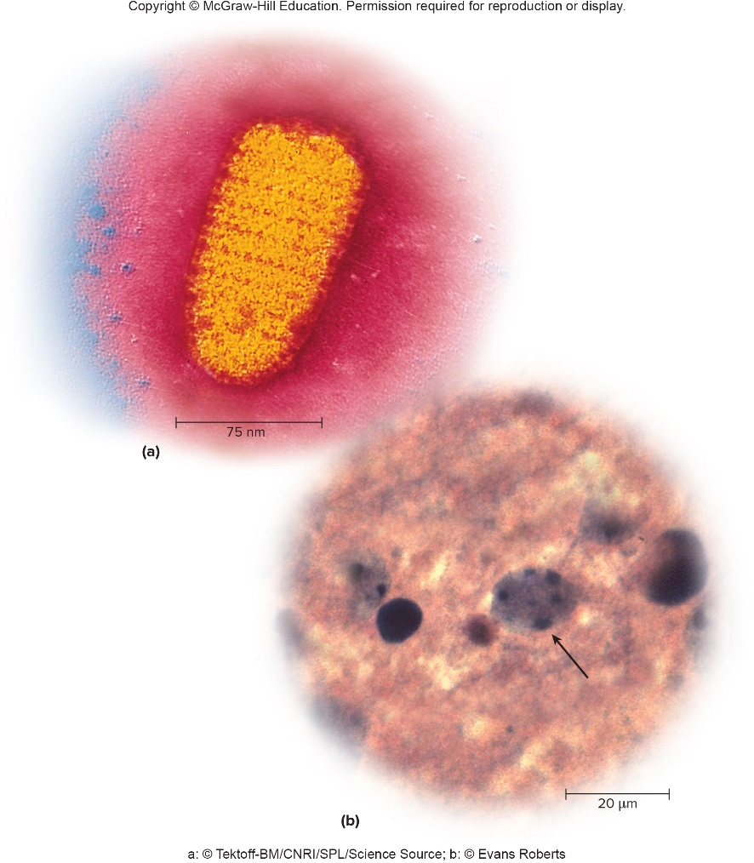
Viral Diseases of the CNS – Figure 26.10
Rabies
Causative agent
Rabies virus, member of Rhabdoviridae
Bullet shape, enveloped, single-stranded, negative-sense RNA genome
a: ©Tektoff-BM/CNRI/SPL/Science Source; b: ©Evans Roberts

Slide 61
Viral Diseases of the CNS (13)
Rabies
Pathogenesis
Multiplies in cells at site of infection for some time
Enters sensory neuron, travels to spinal cord, then to brain
Location of bite, infectious dose, host condition determine time before symptoms appear
Virus multiplies in brain tissue; symptoms of encephalitis
Characteristic Negri bodies found in most cases
Virus spreads outward via nerves to salivary glands, eyes, fatty tissue under skin, heart, other vital organs
Can be diagnosed before death by identifying virus in smears collected from surface of eyes

Slide 62
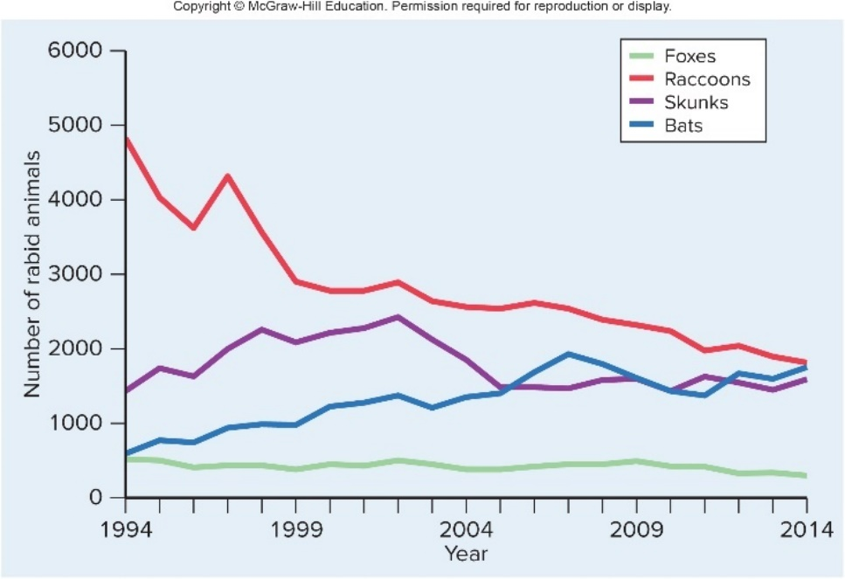
Viral Diseases of the CNS – Figure 26.11
Rabies
Epidemiology
Classic zoonotic disease; transmission via saliva from bite of rabid animal
Main reservoir in U.S. is wild animals such as raccoons, bats, skunks, and foxes
Immunization of dogs has practically eliminated them as source of human disease
>5,000 wild animal cases/year
Nearly all human cases from bats
Only 1 to 3 cases/year in U.S.
Jump to Viral Diseases of the CNS – Figure 26.11 Long Description

Slide 63
Viral Diseases of the CNS (14)
Rabies
Epidemiology
About 40,000 to 70,000 deaths worldwide
Most from dog bites in areas without regular vaccination
30% risk of rabies from bite if virus in saliva
Observe unvaccinated dog for 10 days to see if symptoms develop
“Furious” rabies make dog irritable, hyperactive with excessive saliva
“Paralytic” rabies makes dog inactive with paralysis of throat and leg muscles

Slide 64
Viral Diseases of the CNS (15)
Rabies
Treatment and prevention
Wash wound with soap and water, then apply antiseptic
If animal might be rabid, person receives post-exposure prophylaxis (PEP); effective due to long period before virus enters neurons
Human rabies immune globulin (HRIG) neutralizes virus
Four injections of rabies vaccine to provoke immune response
No effective treatment once symptoms appear
In U.S., approximately 30,000/year receive vaccine after bite from suspected rabid animal
Those at risk should be immunized before exposure
Programs underway to administer oral vaccine to wild animals
Notes:
64

Slide 65
Table 26.8 Rabies
Signs and Symptoms | Fever, headache, nausea, vomiting, sore throat, cough at onset; later, spasms of the muscles of mouth and throat, coma, and death
Incubation period | Usually 30 to 60 days
Causative agent | Rabies virus, single-stranded RNA; bullet shape
Pathogenesis | During incubation period, virus multiplies at site of bite, then travels via nerves to the central nervous system; it multiplies and spreads outward via multiple nerves to infect heart and other organs.
Epidemiology | Bite of rabid animal, usually a bat.
Treatment and prevention | Treatment: immediately wash wound with soap and water and apply antiseptic; inject rabies vaccine and human rabies immunoglobulin as soon as possible. No effective treatment once symptoms begin. Prevention: avoid suspect animals; immunize pets.

Slide 66
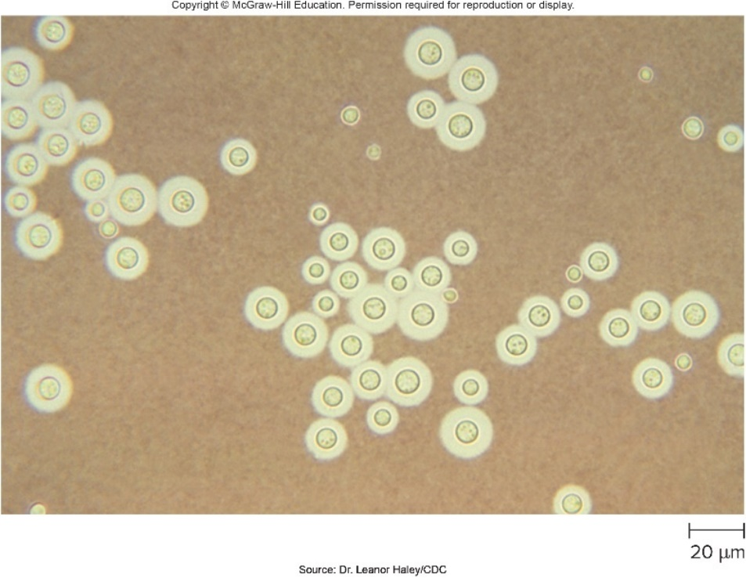
Fungal Diseases of the CNS – Figure 26.12
Cryptococcal meningoencephalitis
Signs and symptoms
Difficulty thinking, dizziness, intermittent headache, fever
After weeks or months, vomiting, weight loss, paralysis, seizures, and coma may appear
Progresses much faster in immunodeficient
Causative agent
Cryptococcus neoformans (opportunistic) or C. gattii (causes disease even in healthy individuals)
Yeasts approximately 3 to 20 micrometers diameter
Surrounded by thick capsule
Resists immune response
Source: Dr. Leanor Haley/CDC

Slide 67
Fungal Diseases of the CNS (1)
Cryptococcal meningoencephalitis
Pathogenesis
Infection established in lung, usually mild or no symptoms
Eliminated by immune defenses of healthy people
In immunocompromised, cells more likely to multiply, enter bloodstream, travel throughout the body
Meningoencephalitis most common infection outside lung
Can also infect skin, bones, other tissues
Capsular material detected in spinal fluid, urine helps in diagnosis
Meninges typically thicken, sometimes hinder flow of cerebrospinal fluid, increase pressure in brain
Also invade brain tissue, produce multiple abscesses

Slide 68
Fungal Diseases of the CNS – Figure 26.13
Cryptococcal meningoencephalitis
Epidemiology
Worldwide distribution of C. neoformans in soil, vegetation contaminated with bird droppings
Symptomatic infection sometimes first indication of AIDS
C. gattii once associated with eucalyptus trees in tropical, subtropical regions; emerged in 1999 in Canada
More virulent strains have increased case-fatality rate from 5% to about 25%
More fungal pneumonia

Slide 69
Fungal Diseases of the CNS (2)
Cryptococcal meningoencephalitis
Treatment and prevention
Antifungal amphotericin B often effective, especially if given with flucytosine, fluconazole
Monitored carefully for toxic effects
Given intravenously or via tube inserted through skull
Approximately 70% success, except in AIDS patients
No vaccine or other preventive measures

Slide 70
Table 26.9 Cryptococcal Meningocencephalitis
Signs and Symptoms | Headache, vomiting, confusion, and weight loss; slight or no fever; symptoms may progress to seizures, paralysis, coma, and death
Incubation period | Widely variable, few to many weeks
Causative agent | Cryptococcus neoformans, Cryptococcus gattii— encapsulated yeasts
Pathogenesis | Infection starts in lung; encapsulated organisms multiply, enter bloodstream, and are carried to various parts of the body; phagocytosis inhibited; meninges and adjacent brain tissue become infected.
Epidemiology | Inhalation of material contaminated with the fungus; other sources; most people resistant to the disease.
Treatment and prevention | Treatment: antifungal medications. Prevention: none.

Slide 71
Protozoan Diseases of the CNS (1)
African trypanosomiasis (“African sleeping sickness”)
Signs and symptoms
Tender nodule develops at site within a week after person bitten by tsetse fly; regional lymph nodes may enlarge
In chronic form, fever recurs for months, years
CNS involvement marked by loss of interest, decreased activity, indifference to food
Eyelids droop, individual falls asleep while eating or standing, speech is slurred
Person eventually becomes comatose, dies
In acute cases, neurological symptoms develop much more rapidly

Slide 72
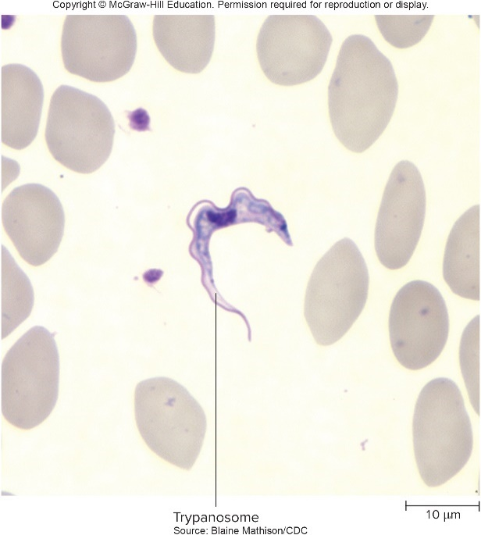
Protozoan Diseases of the CNS – Figure 26.14
African trypanosomiasis
Causative agent: Trypanosoma brucei
Flagellated protozoan; slender, wavy undulating membrane
Two morphologically identical subspecies
T. brucei rhodesiense: causes acute disease; occurs in cattle-raising areas of East Africa
T. brucei gambiense: causes chronic disease; occurs mainly in forests of Central, West Africa
Transmitted by tsetse flies of genus Glossina
Source: Blaine Mathison/CDC

Slide 73
Protozoan Diseases of the CNS (2)
African trypanosomiasis
Pathogenesis
Protozoan enters bite wound in saliva of infected tsetse fly
Multiplies at skin site, enters lymphatics, blood circulation
Fever, antibody production lessen early symptoms
At weekly intervals, number of parasites in blood increases
Timed with appearance of new surface glycoprotein
Cycles of parasitemia and antibody production continue until patient is treated or dies
T. brucei rhodesiense: disease progresses rapidly; parasite enters heart and brain within 6 weeks; death usually within 6 months from heart failure
T. brucei gambiense: chronic infection slower; years may pass before death, often from secondary infection

Slide 74
Protozoan Diseases of the CNS (3)
African trypanosomiasis
Epidemiology
Record low of 3,000 cases in 2015
Acute Rhodesian form is a zoonosis; wild animals are main reservoir, so more difficult to control
Humans main reservoir for chronic Gambian form
Human-to-human transmission more common
Treatment and prevention
Treatment problematic due to toxic side effects of available medications
Pentamidine for chronic form; suramin for acute form
Other medications that cross blood-brain barrier

Slide 75
Table 26.10 African Trypanosomiasis (“African Sleeping Sickness”)
African trypanosomiasis
Treatment and prevention
Vector control against tsetse fly
Insect repellents, protective clothing, traps, insecticides, clearing of brush
Signs and Symptoms | Tender nodule at site of tsetse fly bite; fever, enlargement of lymph nodes; later, involvement of the central nervous system, withdrawal, uncontrollable sleepiness, coma, death
Incubation period | Weeks (acute) to several years (chronic)
Causative agent | Trypanosoma brucei, a flagellated protozoan
Pathogenesis | The protozoa multiply at site of a tsetse fly bite, then enter the circulation; the parasites can change their surface protein, making previously formed antibodies ineffective.
Epidemiology | Bites of infected tsetse flies transmit the trypanosomes through saliva; wild animal reservoir for T. brucei rhodesiense.
Treatment and prevention | Treatment: antiprotozoal medications. Prevention: protective clothing, insecticides, clearing of brush where flies breed.

Slide 76
Protozoan Diseases of the CNS (4)
Toxoplasmosis
Signs and symptoms
Usually asymptomatic in healthy people; some develop sore throat, fever, enlarged lymph nodes and spleen; subside over weeks or months
Often life-threatening in immunodeficient
Commonly occurs as reactivation of latent infection
Encephalitis with confusion, seizures, paralysis, etc.
May develop brain masses with headaches, symptoms such as poor coordination, sensory loss
Fetal toxoplasmosis can be acquired across placenta if woman contracts disease for first time during pregnancy
Most severe during first trimester; miscarriage, birth defects
Retinitis may appear later in life; possible intellectual disability or epilepsy

Slide 77
Protozoan Diseases of the CNS (5)
Toxoplasmosis
Causative agent: Toxoplasma gondii
Obligate intracellular protozoan; apicomplexan
Definitive host, in which organism reproduces sexually, is cats and other felines
Oocysts released in feces of infected cat
Mature in 1 to 5 days; infectious to other animals that eat it
Remain viable for up to a year
Oocysts contain two sporocysts; sporozoites emerge from these and invade cells of small intestine
Form a tachyzoite that spreads through blood and lymph
Capsule forms around infected cells forming tissue cyst
Cysts contain bradyzoite that can survive for months, years resulting in latent infection
Tissue cysts are infectious to other animals when eaten

Slide 78
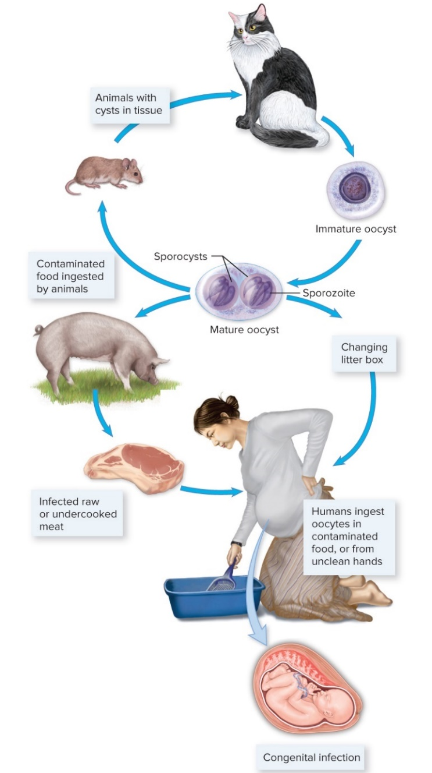
Protozoan Diseases of the CNS – Figure 26.15
Toxoplasmosis
Causative agent
Jump to Protozoan Diseases of the CNS – Figure 26.15 Long Description
b: Source: Dr. L.L. Moore, Jr./CDC; c: ©Dr. Thomas Fritsche
Notes:
78

Slide 79
Protozoan Diseases of the CNS (6)
Toxoplasmosis
Pathogenesis
Organism enters by ingestion of oocysts or undercooked meat containing tissue cysts
Infects any kind of nucleated cell
Tachyzoites destroy infected cell until brought under control by immune response
Tissue cysts persist
In immunodeficient, infection can be widespread and uncontrolled, producing widespread tissue necrosis
Can result from newly acquired infection or reactivation of latent infection

Slide 80
Protozoan Diseases of the CNS (7)
Toxoplasmosis
Epidemiology
Worldwide distribution
Many latent infections in areas where raw meat is eaten; tissue cysts destroyed by thorough cooking
Infections acquired by consuming something contaminated with cat feces containing oocysts
Contamination of hands, vegetables can occur when gardening in areas with stray cats that eat live rodents and birds and then defecate in the soil

Slide 81
Protozoan Diseases of the CNS (8)
Toxoplasmosis
Treatment and prevention
Not treated in otherwise healthy people
Immunocompromised treated with medications like pyrimethamine with sulfadiazine, folinic acid
Immune-suppressed given prophylactic medication
Wash hands after touching raw meat, soil, cat litter
Cook meat thoroughly
Wash fruits and vegetables
Clean litter boxes regularly, before oocysts mature
Prevent cats from hunting birds, rodents, eating undercooked or raw meat

Slide 82
Table 26.11 Toxoplasmosis
Signs and Symptoms | Usually asymptomatic in healthy individuals, but sometimes sore throat, fever, enlarged lymph nodes. Encephalitis may develop in immunodeficient individuals, resulting in confusion, poor coordination, weakness, paralysis, seizures, and coma. Fetal infections can result in stillbirth, birth defects, seizures, intellectual disability, retinitis
Incubation period | Usually unknown
Causative agent | Toxoplasma gondii, an apicomplexan protozoan infectious for most warm-blooded animals
Pathogenesis | When mature oocysts are ingested, a form of T. gondii penetrates host cells, develops into a rapidly multiplying form, and spreads throughout the body. With development of immunity the infection is brought under control. Tissue cysts persist, resulting in a latent infection. Organisms are released from tissue cysts if immunity is impaired.
Epidemiology | Worldwide distribution. Infected cats discharge oocysts with their feces. Infection acquired by eating inadequately cooked meat containing tissue cysts or by ingesting mature oocysts.
Treatment and prevention | Treatment: not usually treated in healthy adults; antimicrobial medications if the patient is pregnant or immunocompromised. Prevention: avoid inadequately cooked meat and contact with material that may contain oocysts from cat feces. Antimicrobial medications are given to immunodeficient individuals with latent infections.
Notes:
82

Slide 83
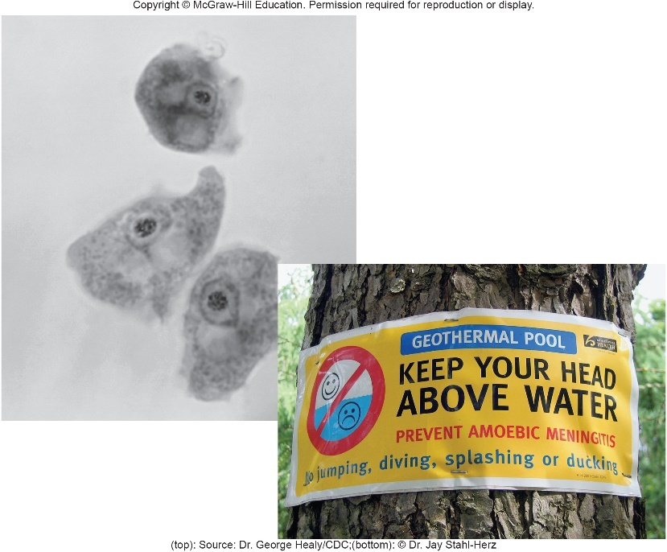
Protozoan Diseases of the CNS – Figure 26.16
Primary amebic meningoencephalitis (PAM)
Signs and symptoms
Appear within a week: headache, fever, stiff neck, vomiting
Once confusion or seizures appear, death quickly follows
Causative agent: Naegleria fowleri
Free-living protozoan; prefers warm temperatures
Can use phagocytosis to literally “eat your brain”
Ameboid trophozoite gives rise to flagellated forms and spherical cysts
(top): Source: Dr. George Healy/CDC; (bottom): ©Dr. Jay Stahl-Herz

Slide 84
Protozoan Diseases of the CNS (9)
Primary amebic meningoencephalitis
Pathogenesis
Penetrates skull along olfactory nerves of nasal mucosa
Multiplies, migrates to brain, destroys nervous tissue
Hemorrhage, coma, death occur within a week
Epidemiology
Commonly found in warm, fresh water and soils; recently found in piped water
Fewer than 200 cases reported globally; fewer than five per year become infected in the U.S.
Usually from swimming, diving in warm natural fresh water
No person-to-person transmission

Slide 85
Table 26.12 Primary Amebic Meningoencephalitis (PAM)
Primary amebic meningoencephalitis
Treatment and prevention
Some success with miltefosine in combination with other treatments
No vaccine
Signs and Symptoms | Headache, fever, stiff neck, vomiting, confusion, seizures Incubation period
Incubation period | Less than a week
Causative agent | Naegleria fowleri
Pathogenesis | Destroys brain tissue
Epidemiology | Rare incidence after swimming or diving in warm, natural waters
Treatment and prevention | Treatment: investigational use of miltefosine combined with other medications. Prevention: none.

Slide 86
Diseases Caused by Prions (1)
Transmissible spongiform encephalopathy (TSE) is rare in humans (0.5 to 1 case per million people)
Most cases are Creutzfeldt-Jakob disease (CJD)
Generally occurs in individuals over 45 years of age
May run in families
May be acquired by eating infected animals
Variant of CJD called vCJD
Both are invariably fatal

Slide 87
Diseases Caused by Prions (2)
Transmissible spongiform encephalopathy in humans
Signs and symptoms
Vague behavioral changes, anxiety, insomnia, fatigue
Progress to characteristic muscle jerks, lack of coordination, memory loss, dementia
Incubation period may last years
Once symptoms appear, death generally occurs within a year

Slide 88
Diseases Caused by Prions (3)
Transmissible spongiform encephalopathy in humans
Causative agent
Proteinaceous infectious particles, or prions
Misfolded form of normal cellular protein
Misfolding results in protein that is protease-resistant
Pathogenesis
acts as template, promotes misfolding of normal
on surface of neurons
Aggregate in insoluble masses in brain; damage tissue
May be taken up by neurons or phagocytic cells, but cannot be degraded by proteases
Death of neurons produces spongy brain appearance
Typically do not evoke immune response

Slide 89
Diseases Caused by Prions (4)
Transmissible spongiform encephalopathy in humans
Epidemiology
CJD has been transmitted human to human through corneal transplants, contaminated surgical instruments, injections of human hormone replacements
Scrapie in sheep known for more than two centuries
No evidence of transmission to humans
Cattle prions can be transmitted to humans through consumption of contaminated beef, cause vCJD
vCJD differs from CJD in symptoms, brain pathology, age of onset
Radical measures may minimize occurrence of “mad cow disease”

Slide 90
Table 26.13 Transmissible Spongiform Encephalopathies
Transmissible spongiform encephalopathy in humans
Treatment and prevention
No treatment; always fatal
Signs and Symptoms | Behavioral changes, anxiety, insomnia, fatigue, progressing to muscle jerks, lack of coordination, dementia
Incubation period | Usually many years
Causative agent | Proteinaceous infectious particles known as prions; lack nucleic acids; identical amino acid sequence to a normal protein, but folded differently, and relatively resistant to proteases; resistant to heat, radiation, and disinfectants
Pathogenesis | Prions increase in quantity by converting normal protein to more prions; transmission to the brain; aggregation into masses outside the nerve cells; cell malfunction and death.
Epidemiology | Human-to-human transmission by corneal transplantation and by contaminated surgical instruments; probable transmission of cattle prions to humans through consumption of contaminated beef; sporadic Creutzfeldt-Jakob disease in those over age 45 years; median age of variant Creutzfeldt-Jakob cases only 28 years.
Treatment and prevention | Treatment: none, invariably fatal. Prevention: inactivated by autoclaving in concentrated sodium hydroxide.
Important to avoid eating animals that show neurological symptoms
Prions resistant to disinfectants heat, UV, ionizing radiation
Can be inactivated by extended autoclaving in 1 Molar NaOH

Slide 91
Bacterial Diseases of the PNS – Figure 26.17a
Hansen’s disease (leprosy)
Most of human population not susceptible; easily treated
Prevalence declined by 99% over last 30 years due to multidrug treatment program of WHO
About 6000 people in U.S. treated for lasting effects of disease
Signs and symptoms
Gradual onset of pigmentation changes, increased or decreased sensation in areas of skin
May thicken, lose hair, sweat glands, sensation
a: ©Biophoto Associates/Science Source

Slide 92
Bacterial Diseases of the PNS – Figure 26.17b
Hansen’s disease
Signs and symptoms
Nerves of arms, legs may become visibly enlarged
Pain, later numbness
Muscle wasting, ulceration, and finally loss of fingers or toes due to unnoticed or untreated injury
In more severe cases: thickening of nose and ears, deep wrinkling of facial skin, collapse of supporting structure of nose
b: ©Palo Koch/Science Source

Slide 93
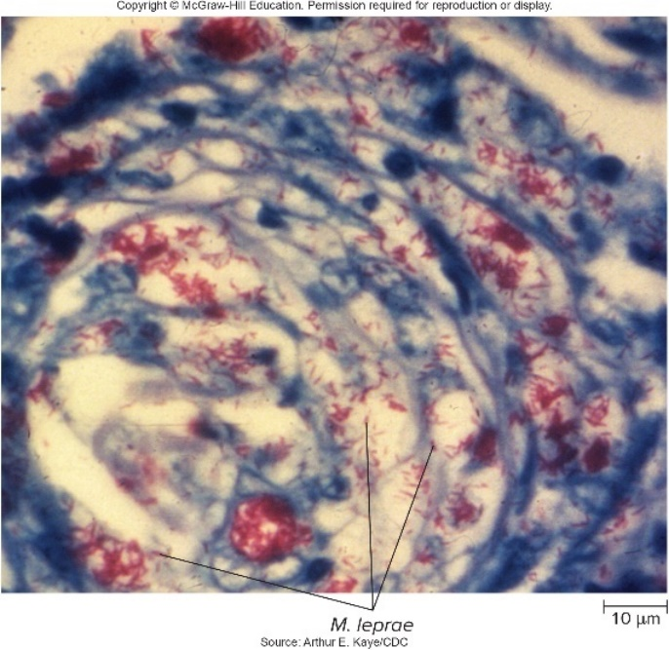
Bacterial Diseases of the PNS – Figure 26.18
Hansen’s disease
Causative agent: Mycobacterium leprae
Aerobic, rod-shaped, acid-fast
Generation time of approximately 12 days; prefers slightly cooler temperatures of body’s extremities
Usually diagnosed by clinical findings; skin biopsies can show acid-fast rods
Has not been grown in absence of living cells; can grow in footpads of mice and in armadillos, mangabey monkeys
DNA library has been made, expressed in E. coli
Provides antigens for study
Source: Arthur E. Kaye/CDC

Slide 94
Bacterial Diseases of the PNS (1)
Hansen’s disease
Pathogenesis
Only known human pathogen that preferentially infects peripheral nerves
Tuberculoid leprosy: usually not transmitted to others
Cell-mediated immunity develops, limits spread
Chronically infected nerve cells are damaged by attacking immune cells, leading to disabling deformities, resorption of bone, skin ulcerations
Disease stops spontaneously; damage permanent
Lepromatous leprosy: easily transmitted to others
Cell-mediated immunity suppressed or fails to develop
Bacteria multiply in cooler tissues, disseminate
Almost no inflammatory response

Slide 95
Bacterial Diseases of the PNS (2)
Hansen’s disease
Epidemiology
Transmission via direct human-to-human contact
Mainly by nasal secretions of lepromatous cases
Disease develops in only tiny minority of exposed
Also occurs in wild armadillos; may spread to humans
Eradication, defined as <1 case per 10,000, achieved in most countries
Difficult to eradicate since long generation time produces incubation period of about 3 years (range is 3 months to 20 years)
Disease may remain undetected
WHO Global Leprosy Strategy

Slide 96
Bacterial Diseases of the PNS (3)
Hansen’s disease
Treatment and prevention
Since 1995, WHO has provided free multidrug therapy
Tuberculoid leprosy treated by dapsone and rifampin for 6 months
Lepromatous leprosy treated with addition of clofazimine for at least 2 years
Multiple drug therapy to avoid development of resistance
No proven vaccine

Slide 97
Table 26.14 Hansen’s Disease (Leprosy)
Signs and Symptoms | Skin lesions that lack sensation, deformed face, loss of fingers or toes
Incubation period | 3 months to 20 years; usually 3 years
Causative agent | Mycobacterium leprae, an acid-fast rod that has not been grown in the absence of living cells
Pathogenesis | Invasion of small nerves of skin; multiplication in macrophages; course of disease depends on immune response of host; in tuberculoid leprosy, activated macrophages limit the growth of the bacterium but the damage to infected nerve cells leads to disabling deformities; in lepromatous leprosy, cell-mediated immunity fails, allowing unrestrained growth of M. leprae.
Epidemiology | Direct contact with M. leprae from mucous membrane secretions.
Treatment and prevention | Treatment: antimicrobial medication. Prevention: no vaccine.

Slide 98
Bacterial Diseases of the PNS (4)
Botulism
Not a nervous system infection, but does cause paralysis
Caused by effects of powerful botulinum exotoxin
Different forms of botulism
Foodborne botulism caused by ingestion of exotoxin
Endospores that are not destroyed may germinate in food; vegetative cells produce exotoxin
Intestinal botulism caused by ingestion of endospores that germinate to produce vegetative cells that colonize intestine
Rare in adults; also called infant botulism
Wound botulism caused by germination of endospores contaminating a wound

Slide 99
Bacterial Diseases of the PNS (5)
Botulism
Signs and symptoms
Begin 12 to 36 hours after ingesting toxin-contaminated food
Dizziness, dry mouth, blurred or double vision
Abdominal symptoms can include pain, nausea, vomiting, and diarrhea or constipation
Progressive paralysis involves all voluntary muscle
Respiratory paralysis most common cause of death
Causative agent: Clostridium botulinum
Strictly anaerobic, Gram-positive, endospore-forming rod
Different strains produce different types of neurotoxin
Endospores survive boiling; can germinate in favorable environment (nutrient-rich, anaerobic, pH above 4.5, temperature above 4 degrees Celsius)
Notes:
99

Slide 100
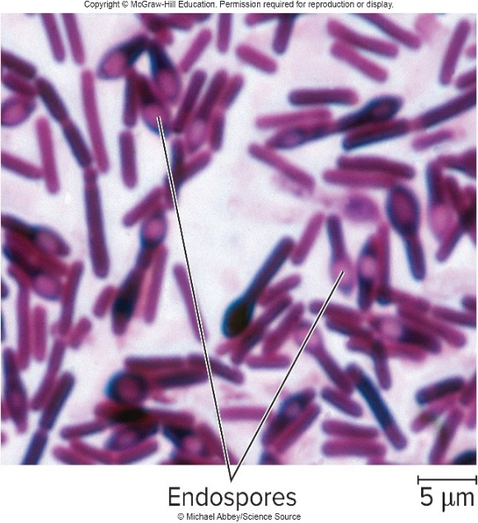
Bacterial Diseases of the PNS – Figure 26.19
Botulism
Pathogenesis
Vegetative cells release powerful botulinum toxin
Botulism has resulted from licking a finger when tasting contaminated food; toxin absorbed in small intestine
Vegetative cells cannot compete with normal microbiota in adults, but toxin causes infant botulism; also affects immunodeficient
Vegetative cells in wounds do not enter body, but release toxin that diffuses into bloodstream
©Michael Abbey/ Science Source
Notes:
100

Slide 101
Bacterial Diseases of the PNS (6)
Botulism
Pathogenesis
Botulinum toxin is A-B toxin
B binds to receptors on motor nerve endings
A enters nerve cell, inactivates proteins regulating release of neurotransmitter
Stops muscle contraction; flaccid paralysis results
Commercial applications of Botox
Prevention of headaches
Relief from conditions involving muscle contractions
Cosmetic use to reduce wrinkles

Slide 102
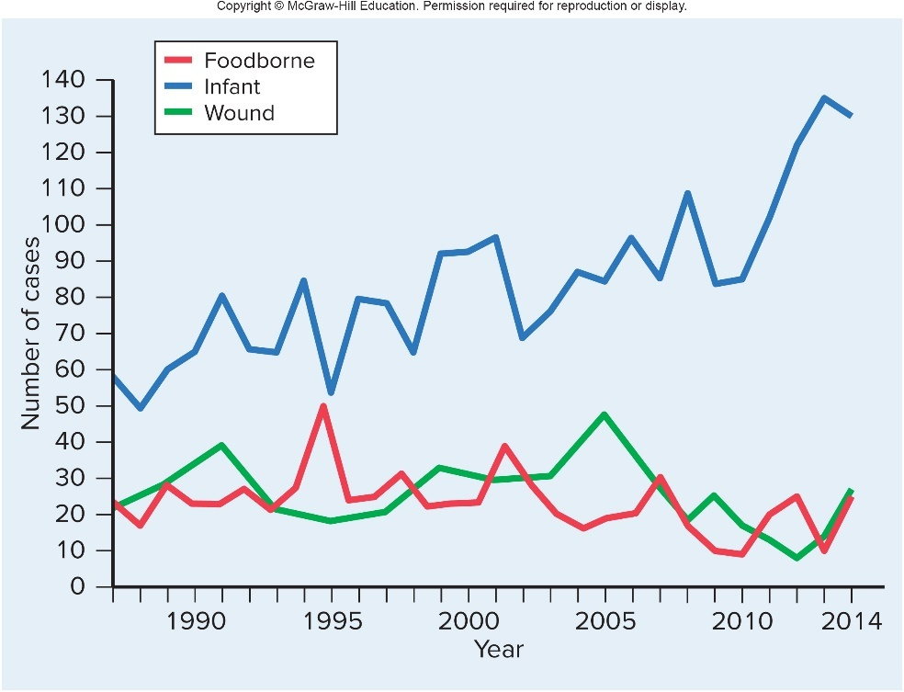
Bacterial Diseases of the PNS – Figure 26.20
Botulism
Epidemiology
Endospores widely distributed in soils, aquatic sediments
Fewer than 30 cases/year of foodborne botulism in U.S.
Most from preserved fish or home-canned foods
Commercial canners strictly controlled
Intestinal (infant) more common in U.S.
Still <150 cases/year
Honey implicated
Most wound botulism in U.S. due to abuse of injected drugs

Slide 103
Bacterial Diseases of the PNS (7)
Botulism
Treatment and prevention
Intravenous antitoxin; only neutralizes toxin in blood
Affected nerves slowly recover over weeks or months
Mechanical ventilator may be needed
Intestinal botulism: respiratory, feeding support until normal microbiota replace pathogen; antitoxin
Wound botulism: surgical removal of dirt, dead tissues
Proper sterilization, sealing of food
Toxin is heat-labile; cooking can destroy
Avoid feeding honey to babies under 1 year of age
Prompt treatment of wounds; discourage drug abuse
Immunity does not develop

Slide 104
Table 26.15 Botulism
Signs and Symptoms | Blurred or double vision, weakness, nausea, vomiting, diarrhea or constipation; generalized paralysis and respiratory insufficiency
Incubation period | Usually 12 to 36 hours for foodborne; variable or unknown for other types
Causative agent | Clostridium botulinum, an anaerobic, Grampositive, endospore-forming, rod-shaped bacterium
Pathogenesis | Clostridium botulinum endospores germinate and the resulting vegetative cells multiply in favorable environments, releasing botulinum toxin. The toxin may be consumed in food (foodborne botulism), produced by cells growing in the intestinal tract (intestinal botulism; in babies this is called infant botulism), or made by cells infecting a wound (wound botulism). Circulating toxin binds to motor nerves and stops the transmission of signals to the muscles, producing flaccid paralysis.
Epidemiology | Endospores widespread in soils and aquatic sediments. Foodborne botulism is often due to consuming an improperly processed homecanned, low-acid food. Intestinal botulism typically seen in infants (infant botulism), and may involve endospore-containing honey. Wound botulism often involves injection-drug abuse.
Treatment and prevention | Treatment: depends on the type of botulism, but may involve intravenous administration of antitoxin and artificial ventilation for respiratory paralysis. Prevention: specific for the type of botulism. Foodborne botulism is prevented through proper food handling and home-canning methods; also, boiling home-canned foods for 10 minutes just prior to serving. Intestinal botulism is difficult to prevent, but honey should not be fed to infants under 1 year of age. Wound botulism is prevented through prompt wound care.
Notes:
104

Slide 105
Appendix of Image Long Description

Slide 106
Anatomy, Physiology, and Ecology – Figure 26.1a Long Description
The top of the neuron has an oval shaped cell body. From the cell body branching projections called Dendrites receive information. A long thin extension called the axon extends from the cell body and transmits to other cells.
Jump back to Anatomy, Physiology, and Ecology – Figure 26.1a

Slide 107
Anatomy, Physiology, and Ecology – Figure 26.1b Long Description
Diseases affecting the brain include: African sleeping sickness
encephalitis
meningitis
primary amebic meningoencephalitis rabies
spongiform encephalopathies
Diseases affecting the spinal cord include: meningitis
poliomyelitis
Diseases affecting the nerves include: botulism
Hansen's disease (leprosy)
Jump back to Anatomy, Physiology, and Ecology – Figure 26.1b

Slide 108
Viral Diseases of the CNS – Figure 26.11 Long Description
In 2014, about 2000 each of rabies-infected raccoons, bats, and skunks were reported. A few hundred rabies-infected foxes were reported. The number of raccoon cases decreased from almost 5000 in 1994. During that same time, the number of bat cases about doubled.
Jump back to Viral Diseases of the CNS – Figure 26.11

Slide 109
Protozoan Diseases of the CNS – Figure 26.15 Long Description
Immature Toxoplasma oocysts can be eliminated in feces of infected cats. These can be eaten by other animals in which they can form tissue cysts. If the meat of those animals is eaten raw or undercooked, it can result in human infection. Oocysts can also infect humans who are exposed when cleaning a cat litter box.
Jump back to Protozoan Diseases of the CNS – Figure 26.15

