Slide 1
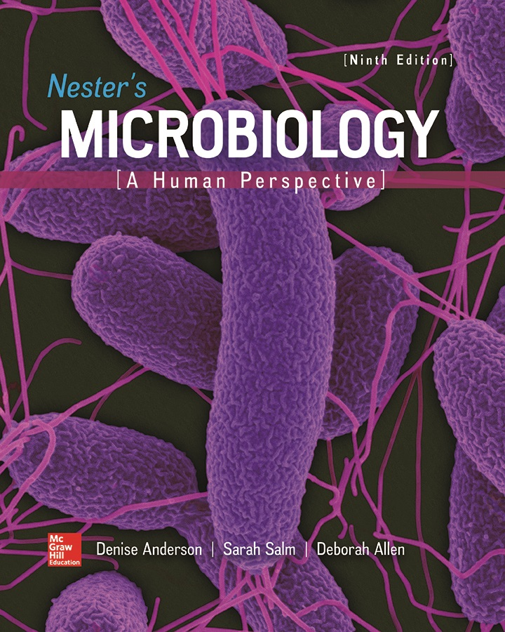
Chapter 20 Lecture Outline
See separate PowerPoint slides for all figures and tables pre-inserted into PowerPoint without notes.
Notes:
1

Slide 2
A Glimpse of History
Paul Ehrlich (1854 to 1915)
German physician and bacteriologist
Observed some dyes stain bacterial but not animal cells
Indicated fundamental difference between cell types
Searched for “magic bullet” that would kill microbial pathogens without harming human host
Tested arsenic compounds to treat syphilis, caused by spirochete Treponema pallidum
The 606th tested compound proved effective in laboratory animals
Arsphenamine, named Salvarsan
Potentially lethal for patients but did cure infections previously considered hopeless
Proved some chemicals could selectively kill microbes

Slide 3
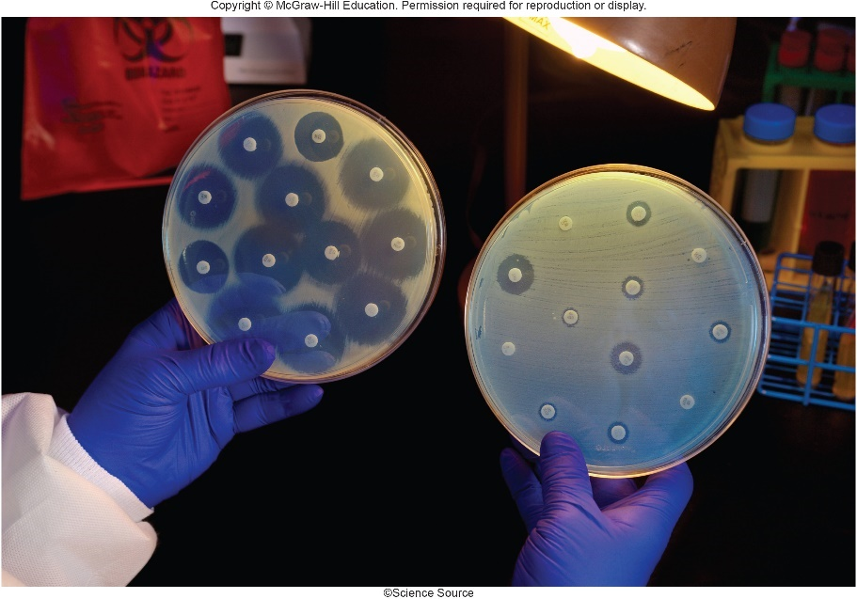
Importance of Antimicrobial Medications
Imagine a world without antimicrobial medications
Prognosis for people with common diseases (bacterial pneumonia, severe staphylococcal infections) was grim before availability of penicillin in 1940s
Physicians could identify cause of disease, but only treatment was usually bed rest
Misuse coupled with evolution of microbial resistance threatens these medications
Scientists scrambling to develop new medications
©Science Source

Slide 4
History and Development of Antimicrobial Medications
Discovery of antimicrobial medications
Salvarsan (Paul Ehrlich,1910) first documented case
Red dye Prontosil (Gerhard Domagk, 1932) used to treat streptococcal infections in animals
No effect in test tubes; enzymes in blood split to produce sulfanilamide, the first sulfa drug
Both are chemotherapeutic agents
Chemicals used to treat disease
Antimicrobial medications, antimicrobial drugs, or antimicrobials

Slide 5
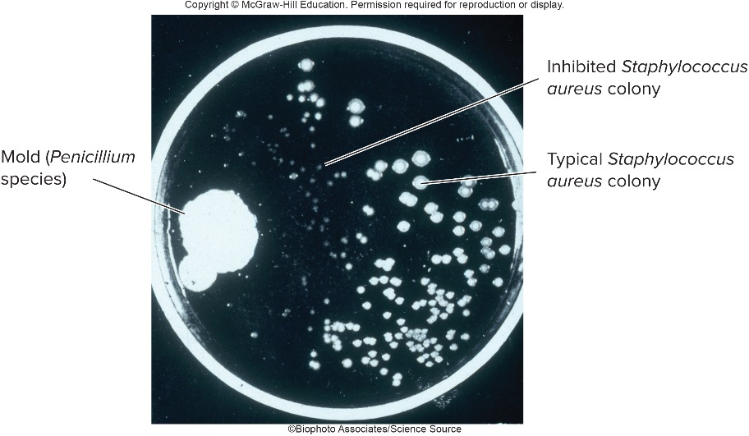
History and Development of Antimicrobial Medications – Figure 20.1
Discovery of antibiotics
In 1928, Fleming identified mold Penicillium secreting compound toxic to Staphylococcus (penicillin)
Showed effective in killing many bacterial species
Unable to purify, he later abandoned research
Chain and Florey purified, tested compounds in 1941 on police officer with Staphylococcus aureus infection
Patient improved but supply of purified penicillin ran out and he later died
WWII spurred research and development; penicillin G, the first antibiotic (naturally-produced antimicrobial)
©Biophoto Associates/Science Source

Slide 6
History and Development of Antimicrobial Medications (1)
Discovery of antibiotics
Selman Waksman purified streptomycin from soil bacterium Streptomyces griseus
Researchers began screening hundreds of thousands of microbes for antibiotics
Pharmaceutical companies today examine soil samples from around world

Slide 7
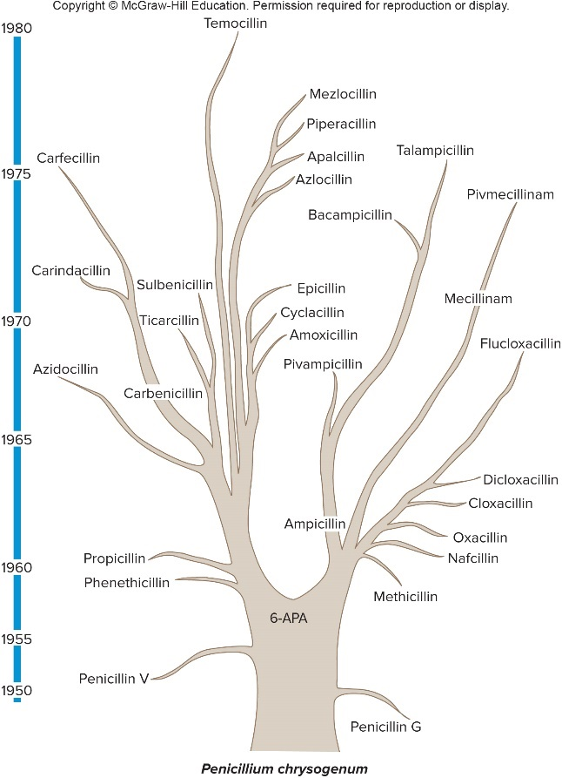
History and Development of Antimicrobial Medications – Figure 20.2
Development of new antimicrobial medications
Altering structure of antibiotics such as penicillin yields new medications (ampicillin, methicillin)
Development of new antimicrobial drugs is financially risky because
FDA demands strict and expensive testing
Resistance will likely develop soon after drug is used
Drug may be held as last resort to avoid resistance
Notes:
7

Slide 8
History and Development of Antimicrobial Medications (2)
Development of new antimicrobial medications
Generating Antibiotic Incentives Now (GAIN) is U.S. law to encourage companies to develop new antimicrobials against certain pathogens
If promising, a drug may be designated a Qualified Infectious Disease Product (QIDP)
Receives high priority for review
Company has exclusive marketing rights for 5 years
Notes:
8

Slide 9
Characteristics of Antimicrobial Medications (1)
Selective toxicity: causes greater harm to microbes than to human host
Interfere with essential structures or properties common in microbes but not human cells
Toxicity is relative and expressed as therapeutic index
Calculated as the lowest dose toxic to patient divided by dose used for therapy
Penicillin G useful, has high therapeutic index; interferes with cell wall synthesis, a process not present in humans
Also has high therapeutic window, the range between the therapeutic dose and the toxic dose
Medications too toxic for systemic use may be used topically (applied to body surface)

Slide 10
Characteristics of Antimicrobial Medications (2)
Antimicrobial action
Bacteriostatic chemicals inhibit bacterial growth
Patient’s defenses must eliminate pathogen (sulfa drugs)
Bactericidal chemicals kill bacteria
Sometimes only inhibitory, depending upon drug concentration and stage of microbial growth
Notes:
10

Slide 11
Characteristics of Antimicrobial Medications (3)
Spectrum of activity
Broad-spectrum antimicrobials affect a wide range
Important for treating acute life-threatening diseases
Especially when no time to culture for identification
Disrupt microbiome that helps keep out other pathogens
Narrow-spectrum antimicrobials affect limited range
Requires identification and susceptibility of pathogen
Less disruptive to microbiome
Patients may be started on broad-spectrum antimicrobial and later switched to narrow-spectrum once more is known about the pathogen

Slide 12
Characteristics of Antimicrobial Medications (4)
Effects of antimicrobial combinations
Some medications interfere with others (antagonistic)
For example, bacteriostatic antimicrobials that prevent cell division interfere with bacteriocidal antimicrobials that kill only dividing cells
Some medications enhance one another (synergistic)
Other combinations are additive
Notes:
12

Slide 13
Characteristics of Antimicrobial Medications (5)
Tissue distribution, metabolism, and excretion of the medication
Antimicrobial behaviors differ in body
Only some can access the brain; only some can withstand stomach acid
Half-life of medication is time it takes for serum concentration to decrease by 50%
Dictates frequency of doses required to maintain effective level in body
Penicillin V is taken 4 times a day; azithromycin is taken no more than once a day
Patients with kidney or liver dysfunction excrete or metabolize medications more slowly; must adjust dosage to avoid toxic levels
Notes:
13

Slide 14
Characteristics of Antimicrobial Medications (6)
Adverse effects
Antimicrobials have saved countless lives when properly prescribed and used
Allergic reactions
May be life-threatening; may wear bracelet alert
Toxic effects
Monitor those taking low therapeutic index drugs
Some side effects are life-threatening (chloramphenicol may cause aplastic anemia)
Dysbiosis: imbalance in the microbiome
For example, broad-spectrum antimicrobials may allow growth of Clostridium difficile without competition, resulting in diarrhea or colitis

Slide 15
Characteristics of Antimicrobial Medications (7)
Resistance to antimicrobials
Certain bacteria have intrinsic (innate) resistance
For example, Mycoplasma lack cell wall, resistant to penicillin that interferes with peptidoglycan synthesis
Outer membrane of Gram-negatives blocks many medications
Bacteria may develop acquired resistance
Spontaneous mutations
Horizontal gene transfer

Slide 16
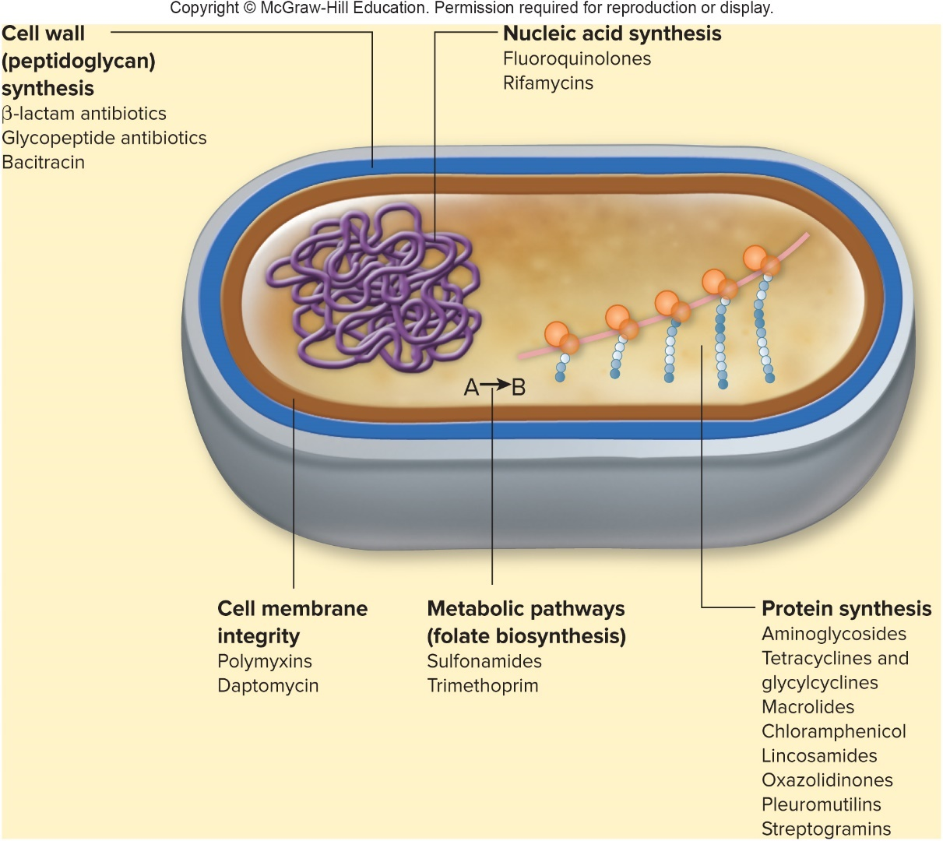
Mechanisms of Action of Antibacterial Medications – Figure 20.3
Antibacterial medications target specific bacterial processes and structures
Cell wall synthesis
Protein synthesis
Nucleic acid synthesis
Metabolic pathways
Cell membranes
Jump to Mechanisms of Action of Antibacterial Medications – Figure 20.3 Long Description

Slide 17
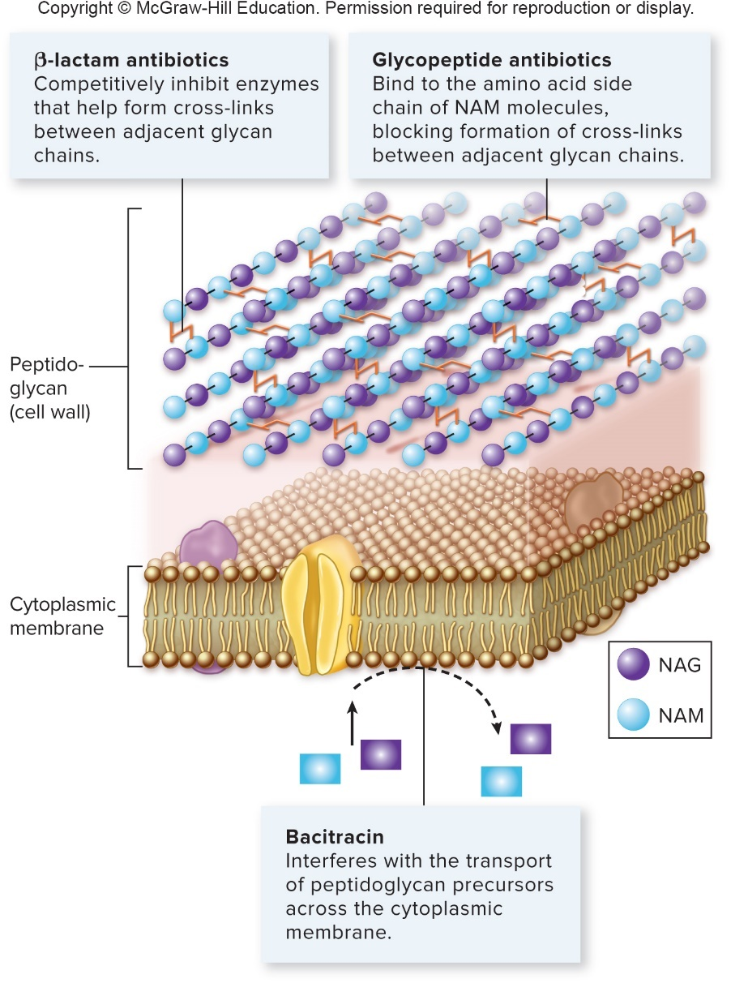
Mechanisms of Action of Antibacterial Medications – Figure 20.4
Inhibit cell wall synthesis
Bacterial cell walls are unique, contain peptidoglycan
Include β-lactam antibiotics, glycopeptide antibiotics, and bacitracin
Jump to Mechanisms of Action of Antibacterial Medications – Figure 20.4 Long Description

Slide 18
Inhibit Cell Wall Synthesis – Figure 20.5
β-lactam antibiotics
All have β-lactam ring and high therapeutic index
Penicillins, cephalosporins, carbapenems, monobactams
Competitively inhibit penicillin-binding proteins (PBPs) that catalyze formation of peptide bridges between adjacent glycan strands; disrupt cell wall synthesis
Only effective against actively growing cells
Penicillin
Cephalosporin
Notes:
18

Slide 19
Inhibit Cell Wall Synthesis (1)
β-lactam antibiotics
Vary in activity
Peptidoglycan of Gram-positives exposed; outer membrane of Gram-negatives blocks
PBPs different in Gram-positives versus Gram-negatives; also aerobes versus anaerobes, and in different species
Some bacteria synthesize a β-lactamase, which breaks β-lactam ring; destroys activity of antibiotic
Penicillinase inactivates members of penicillin family
Extended-spectrum β-lactamases (ESBLs) inactivate a wide variety of β-lactam medications
Gram-negatives produce a more extensive array of β-lactamases than Gram-positives

Slide 20
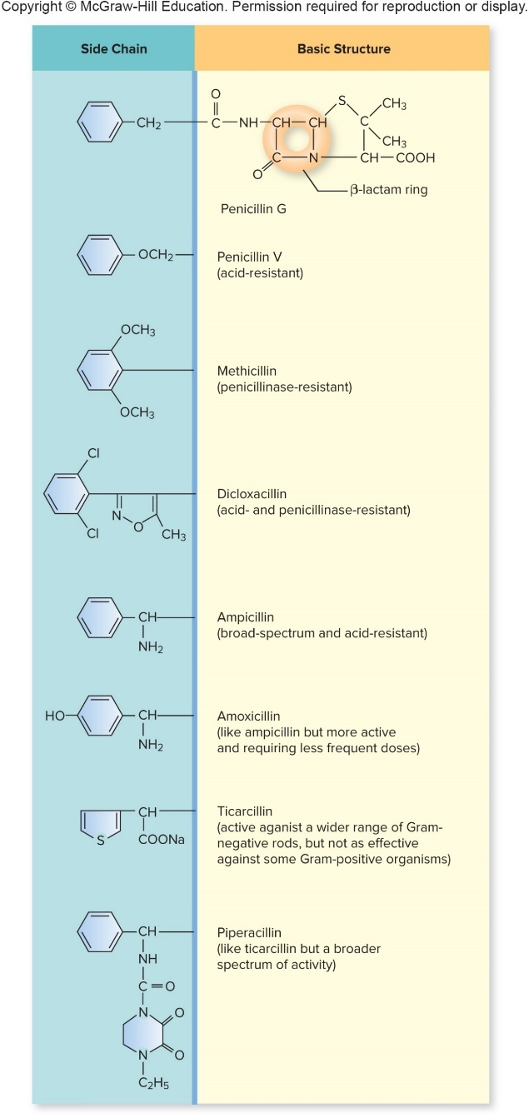
Inhibit Cell Wall Synthesis (2)
β-lactam antibiotics
The penicillins are grouped by modifications in their side chain
Natural penicillins are from Penicillium chrysogenum
Narrow-spectrum, act against Gram-positives and a few Gram-negatives; deactivated by penicillinases
Penicillinase-resistant penicillins developed in response to penicillinase from S. aureus strains
Some can produce altered PBPs to which β-lactam antibiotics do not bind well (methicillin-resistant S. aureus, or MRSA
Jump to Inhibit Cell Wall Synthesis (2) Long Description

Slide 21
Inhibit Cell Wall Synthesis (3)
β-lactam antibiotics
Broad-spectrum penicillins act against Gram-positives and many Gram- negatives (ampicillin, amoxicillin)
Inactivated by many β-lactamases
Extended-spectrum penicillins have greater activity against Enterobac- teriaceae, Pseudomonas species
Reduced activity against Gram-positives; destroyed by many β-lactamases
Penicillins + β-lactamases includes inhibitor to protect penicillin (Augmentin)
Jump to Inhibit Cell Wall Synthesis (3) Long Description

Slide 22
Inhibit Cell Wall Synthesis (4)
β-lactam antibiotics
Cephalosporins
Structure makes resistant to some β-lactamases
Some have low affinity for PBPs of Gram-positives
Chemical modifications have led to five generations
Later generations more effective against Gram-negatives, resist β-lactamases
Fifth generation effective against MRSA
Others available with β-lactamase inhibitor
Zerbaxa was first medication approved under GAIN act

Slide 23
Inhibit Cell Wall Synthesis (5)
β-lactam antibiotics
Carbapenems
Effective against wide range of Gram-positive and Gram-negative bacteria
Not inactivated by extended-spectrum β-lactamases
Often reserved as last resort against ESBL-producing organisms
Inactivated by carbapenemases
Monobactam
Aztreonam used against Enterobacteriaceae
Notes:
23

Slide 24
Inhibit Cell Wall Synthesis (6)
Glycopeptide antibiotics
Bind to amino acid side chain of NAM molecules; block peptidoglycan synthesis
Effective only against Gram-positives; does not cross outer membrane of Gram-negatives
Side effects give low therapeutic index
Vancomycin is most widely used glycopeptide
Poorly absorbed from intestinal tract, usually administered via IV except for intestinal infections
Often antibiotic of last resort to treat Gram-positives resistant to β-lactam antibiotics

Slide 25
Inhibit Cell Wall Synthesis (7)
Bacitracin: toxicity limits to topical applications
Interferes with transport of peptidoglycan precursors across membrane
Common in first-aid skin ointments
Notes:
25

Slide 26
Table 20.1 Characteristics of Antibacterial Medications (1)
Target/Class/Example(s) | Comments/Characteristics
Cell Wall Synthesis
β-lactam antibiotics | Bactericidal against a variety of bacteria; interfere with peptidoglycan synthesis by inhibiting enzymes called penicillin-binding proteins (PBPs) that help form cross-links between adjacent glycan chains.
Penicillins Penicillin G, methicillin, dicloxacillin, ampicillin, amoxicillin, ticarcillin, piperacillin | Groups include natural penicillins, penicillinase-resistant penicillins, broad-spectrum penicillins, and extendedspectrum penicillins; these differ in spectrum of activity and susceptibility to β-lactamases.
Cephalosporins Cephalexin, cefazolin, cefaclor, cefprozil, cefixime, ceftriaxone, cefepime, ceftaroline | The later generations are usually more effective against Gram-negative bacteria and less susceptible to destruction by certain β-lactamases.
Carbapenems Imipenem, meropenem, ertapenem, and doripenem | Broad spectrum of activity; not destroyed by most β-lactamases including extended-spectrum β-lactamases, but susceptible to carbapenemases.
Monobactams Aztreonam | Primarily active against members of the family Enterobacteriaceae. Not inactivated by most β-lactamases but susceptible to extended-spectrum β-lactamases and some carbapenemases.
Glycopeptide antibiotics Vancomycin, televancin, dalbavancin, and oritavancin | Bactericidal against Gram-positive bacteria; interfere with peptidoglycan synthesis by binding to the amino acid side chain of NAM molecules, blocking formation of cross-links between adjacent glycan chains. Dalbavancin and oritavancin also disrupt membrane integrity. Used to treat serious infections caused by Gram-positive bacteria that are resistant to most other options.
Bacitracin | Bactericidal against Gram-positive bacteria; interferes with the transport of peptidoglycan precursors across the cytoplasmic membrane. Common ingredient in non-prescription antibiotic ointments.

Slide 27
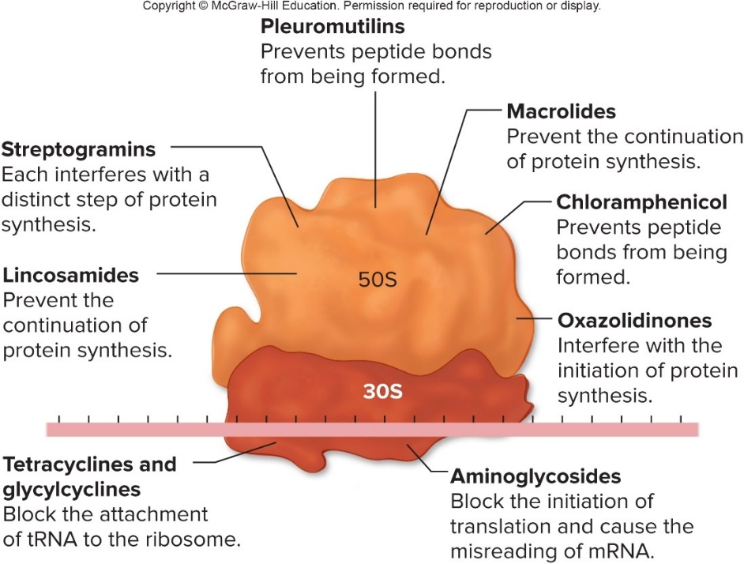
Mechanisms of Action of Antibacterial Medications –Figure 20.7
Inhibit protein synthesis
Generally bacteriostatic
Can exploit differences between prokaryotic and eukaryotic ribosomes
Prokaryotes have 70S, eukaryotes have 80S ribosomes
Mitochondria also have 70S ribosomes
May account for toxicity of some of these antibiotics
Jump to Long Description Mechanisms of Action of Antibacterial Medications –Figure 20.7

Slide 28
Inhibit Protein Synthesis (1)
Aminoglycosides
Irreversibly bind to 30S ribosomal subunit, causing it to malfunction; bacteriocidal
Blocks initiation of translation; causes misreading of mRNA by ribosomes past initiation
Often toxic; generally used when alternatives unavailable
Generally ineffective against anaerobes, enterococci, and streptococci because enter it cannot cells
Sometimes used synergistically with a penicillin that allows the aminoglycoside to enter cells
Inhaled form of tobramycin treats Pseudomonas lung infections in cystic fibrosis patients
Neomycin too toxic for systemic use; common in first-aid skin ointments

Slide 29
Inhibit Protein Synthesis (2)
Tetracyclines and glycylcyclines
Tetracyclines reversibly bind to 30S ribosomal subunit
Block tRNA attachment; prevent translation
Effective against certain Gram-positives and Gram-negatives
Some have longer half-life meaning less frequent doses
Resistance from decreased uptake or increased excretion
The Glycylcyclines are related to the tetracyclines
Wider activity
Effective against bacteria resistant to the tetracyclines
Relatively new, so acquired resistance is rare
Tigecycline is only one currently approved

Slide 30
Inhibit Protein Synthesis (3)
Macrolides
Reversibly bind to 50S subunit; prevent continuation of translation
Often antibiotic of choice for patients allergic to penicillin
Bacteriostatic against many Gram-positives and most common causes of atypical pneumonia
Outer membrane of Enterobacteriaceae blocks
Resistance occurs from modification of ribosomal RNA target, enzyme that modifies chemical, and decreased uptake
Notes:
30

Slide 31
Inhibit Protein Synthesis (4)
Chloramphenicol
Binds to 50S ribosomal subunit; blocks translation
Active against wide range of bacteria
Used as last resort due to rare, but lethal side effect
May cause aplastic anemia, inability to form white, red blood cells

Slide 32
Inhibit Protein Synthesis (5)
Lincosamides
Bind 50S ribosomal subunit; block continuation of translation
Inhibit variety of Gram-negatives and Gram-positives
Useful against Bacteroides fragilis (resists antibiotics)
Increases risk of developing C. difficile infection; most strains are resistant to lincosamides
Oxazolidinones
Bind 50S ribosomal subunit; interfere with initiation of translation
Useful against variety of Gram-positives strains resistant to β-lactams, vancomycin

Slide 33
Inhibit Protein Synthesis (6)
Pleuromutilins
Bind to 50s ribosomal subunit; prevent formation of peptide bonds during translation
Active against many types of Gram-positives
Once used only in animals; a topical now approved in humans
Streptogramins
Bind to 50S rinbosomal subunit; inhibit translation
Quinupristin and dalfopristin each are bacteriostatic, but bactericidal when given together
Effective against variety of Gram-positives, but often reserved for treating infections caused by strains that are resistant to other antimicrobials
Notes:
33

Slide 34
Mechanisms of Action of Antibacterial Medications (1)
Inhibit nucleic acid synthesis
Fluoroquinolones
Inhibit topoisomerases, enzymes that maintain supercoiling of DNA; bactericidal against wide variety of bacteria
DNA gyrase breaks, rejoins strands to relieve strain from localized unwinding of DNA; function is essential
Resistance usually due to alteration in DNA gyrase target
Rifamycins
Block prokaryotic RNA polymerase; prevents initiation of transcription
Rifampin is bactericidal against Gram-positives, some Gram-negatives, Mycobacterium
Resistance develops quickly due to mutation in RNA polymerase gene

Slide 35
Mechanisms of Action of Antibacterial Medications (2)
Inhibit nucleic acid synthesis
Fidaxomicin
Binds to RNA polymerase; interferes with transcription
Relatively new; bactericidal
Not absorbed in intestinal tract; effective in treating C. difficile infections
Metronidazole (Flagyl)
Anaerobic metabolism required to convert to active form
Active form binds DNA, interferes with synthesis, causes breaks
Notes:
35

Slide 36
Table 20.1 Characteristics of Antibacterial Medications (2)
Target/Class/Example(s) | Comments/Characteristics
Protein Synthesis
Aminoglycosides Streptomycin, gentamicin, tobramycin, neomycin | Bactericidal against aerobic and facultative bacteria; bind to the 30S ribosomal subunit, blocking the initiation of translation and causing the misreading of mRNA. Toxicity limits the use. Neomycin is commonly used in nonprescription topical antibiotic ointments.
Tetracyclines and glycylcyclines Tetracyline and doxycycline (tetracyclines), tigecycline (a glycylcycline) | Bacteriostatic against some Gram-positive and Gram-negative bacteria; bind to the 30S ribosomal subunit, blocking the attachment of tRNA.
Macrolides Erythromycin, clarithromycin, azithromycin | Bacteriostatic against many Gram-positive bacteria as well as the most common causes of atypical pneumonia; bind to the 50S ribosomal subunit, preventing the continuation of protein synthesis.
Chloramphenicol | Bacteriostatic and broad-spectrum; binds to the 50S ribosomal subunit, preventing peptide bonds from being formed. Generally used only as a last resort for life-threatening infections
Lincosamides Lincomycin, clindamycin | Bacteriostatic against a variety of Gram-positive and Gram-negative bacteria. Bind to the 50S ribosomal subunit, preventing the continuation of protein synthesis.
Oxazolidinones Linezolid, tedizolid | Bacteriostatic against a variety of Gram-positive bacteria. Useful for treating infections caused by bacteria that are resistant to other options. Bind to the 50S ribosomal subunit, interfering with the initiation of protein synthesis.
Pleuromutilins Retapamulin | Bacteriostatic against a variety of Gram-positive bacteria. Bind to the 50S ribosomal subunit, preventing peptide bonds from being formed. The only derivative currently approved for humans is for topical use only.
Streptogramins Quinupristin, dalfopristin | Used as a synergistic bactericidal combination; the two drugs bind to two different sites on the 50S ribosomal subunit. Effective against a variety of Gram-positive bacteria, but generally reserved for strains that are resistant to other antimicrobials.
Notes:
36

Slide 37
Table 20.1 Characteristics of Antibacterial Medications (3)
Target/Class/Example(s) | Comments/Characteristics
Nucleic Acid Synthesis
Fluoroquinolones Ciprofloxacin, levofloxacin, moxifloxacin | Bactericidal against a wide variety of Gram-positive and Gram-negative bacteria; inhibit topoisomerases.
Rifamycins Rifampin | Bactericidal against Gram-positive and some Gram-negative bacteria. Bind RNA polymerase, blocking the initiation of RNA synthesis.
Fidaxomicin | Bactericidal, particularly against Clostridium species; interferes with RNA polymerase activity.
Metronidazole | Bactericidal against anaerobes. Activated by anaerobic metabolism and then binds DNA, interfering with synthesis and causing damaging breaks.

Slide 38
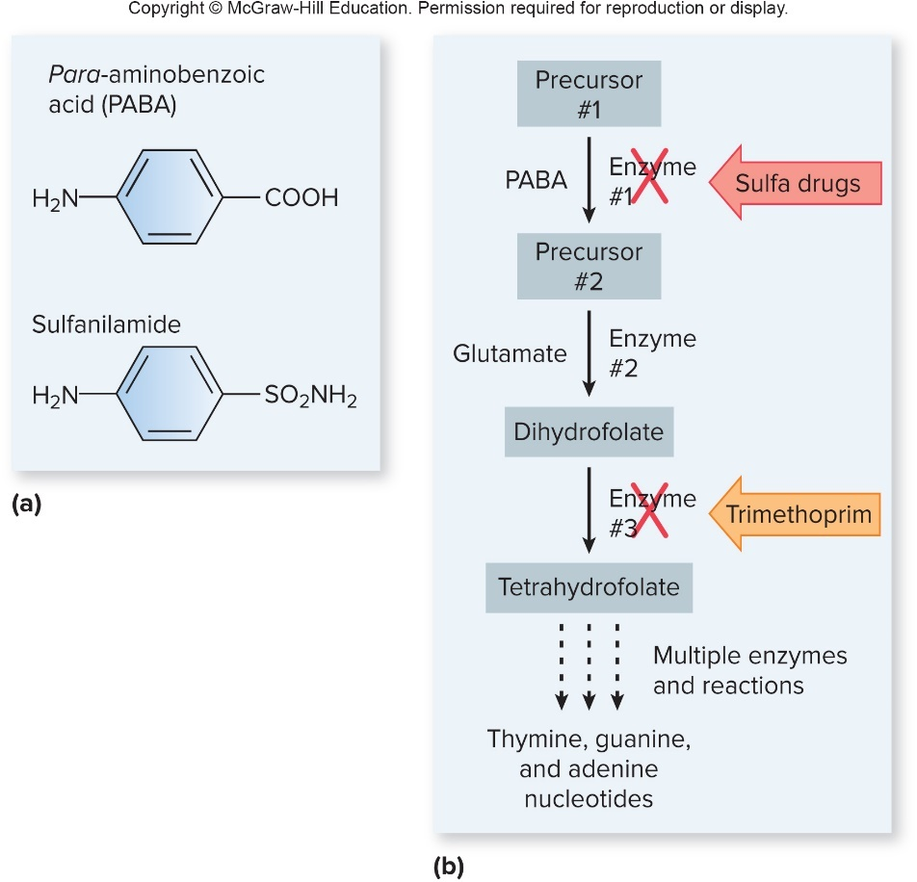
Mechanisms of Action of Antibacterial Medications – Figure 20.8
Interfere with metabolic pathways
Folate inhibitors are most useful
Inhibit steps in synthesis of folate and ultimately synthesis of coenzyme required for nucleotide biosynthesis
Animals lack enzymes to synthesize folate; required in diet
Sulfonamides, trimethoprim inhibit different steps in synthesis

Slide 39
Mechanisms of Action of Antibacterial Medications (3)
Interfere with metabolic pathways
Sulfonamides and related are called sulfa drugs
Inhibit many Gram-positives and Gram-negatives
Structurally similar to PABA, so enzyme binds chemical
Example of competitive inhibition
Human cells lack enzyme
Trimethoprim inhibits enzyme in later step
Has little effect on enzyme’s counterpart in human cells
Combination of trimethoprim and sulfonamide has synergistic effect; co-trimoxazole

Slide 40
Mechanisms of Action of Antibacterial Medications (4)
Interfere with cell membrane integrity
A few antimicrobials damage bacterial membranes causing cells to leak, leading to cell death
Daptomycin inserts into cytoplasmic membrane
Used against Gram-positives resistant to other antibiotics
Ineffective against Gram-negatives; cannot penetrate outer membrane
Polymyxins bind to membranes of Gram-negatives
Generally limits usefulness to topical applications
Also bind to eukaryotic cells, though to a lesser extent
Newest glycopeptide antibiotics disrupt cell membranes (albavancin, oritavancin)

Slide 41
Mechanisms of Action of Antibacterial Medications (5)
Effective against Mycobacterium tuberculosis
Few antimicrobials effective against Mycobacterium
Waxy cell wall prevents entry of many chemicals; slow growth
First-line drugs are most effective, least toxic
Combination therapy decreases chance of development of resistant mutants
Second-line drugs given for strains resistant to first-line drugs
Less effective or have greater toxicity risk
Some target unique cell wall of mycobacteria
Isoniazid inhibits mycolic acid synthesis; ethambutol inhibits enzymes required for synthesis of other cell wall components; pyrazinamide interferes with protein synthesis

Slide 42
Table 20.1 Characteristics of Antibacterial Medications (4)
Target/Class/Example(s) | Comments/Characteristics
Folate Biosynthesis
Sulfonamides | Bacteriostatic against a variety of Gram-positive and Gram-negative bacteria. Structurally similar to paraaminobenzoic acid (PABA) and therefore inhibit the enzyme for which PABA is a substrate.
Trimethoprim | Often used with a sulfonamide for a synergistic effect, a combination called co-trimoxazole. Inhibits the enzyme that catalyzes a step following the one inhibited by the sulfonamides.
Cell Membrane Integrity
Daptomycin | Bactericidal against Gram-positive bacteria by damaging the cytoplasmic membrane.
Polymyxins Polymyxin B, polymyxin E (colistin) | Bactericidal against Gram-negative bacteria by damaging cell membranes. Toxicity limits their use.
Mycobacterium tuberculosis
Ethambutol | Inhibits the synthesis of a component of the mycobacterial cell wall.
Isoniazid | Inhibits synthesis of mycolic acids, a major component of the mycobacterial cell wall.
Pyrazinamide | Interferes with a process that mycobacterial cells use to restart stalled ribosomes.

Slide 43
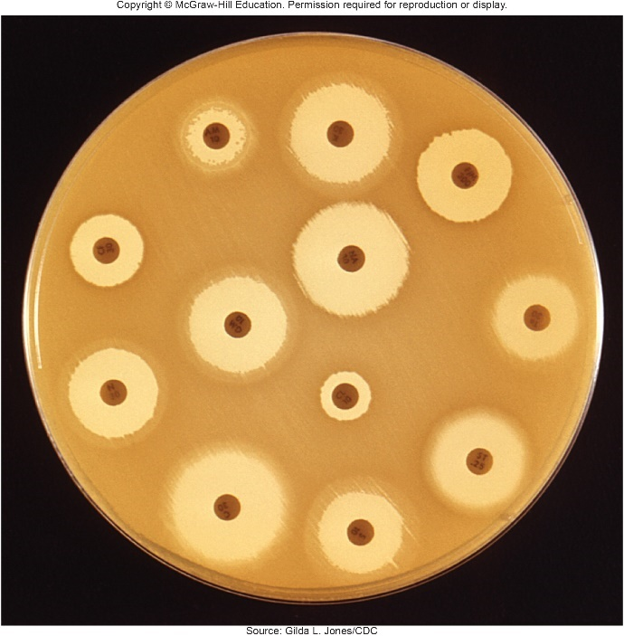
Antimicrobial Susceptibility Testing – Figure 20.9
Conventional disc diffusion method
Kirby-Bauer disc diffusion test routinely used to determine susceptibility of bacterial strain to antibiotics
Standard sample of strain uniformly spread on agar plate; discs containing different antibiotics placed on surface
Drugs diffuse outward, establish concentration gradients
Resulting zone of inhibition compared with specially prepared charts to determine whether strain is susceptible, intermediate, or resistant
Drug characteristics must be taken into account (for example molecular weight, stability, amount)
Source: Gilda L. Jones/CDC

Slide 44
Antimicrobial Susceptibility Testing
Minimum inhibitory concentration (MIC) is lowest concentration that prevents growth in vitro
Serial dilutions of chemical in suitable growth medium used; cultures added, incubated, examined for turbidity
Inhibition does not necessarily mean successful treatment; level may not be achieved in person’s blood
Microbes with MIC between susceptible (treatable) and resistant (untreatable) are intermediate
Minimum bacterial concentration (MBC) is lowest concentration that kills 99.9% of cells in vitro
Determined from plate count prepared from tubes with no growth in MIC test
Techniques precise but labor-intense, expensive

Slide 45
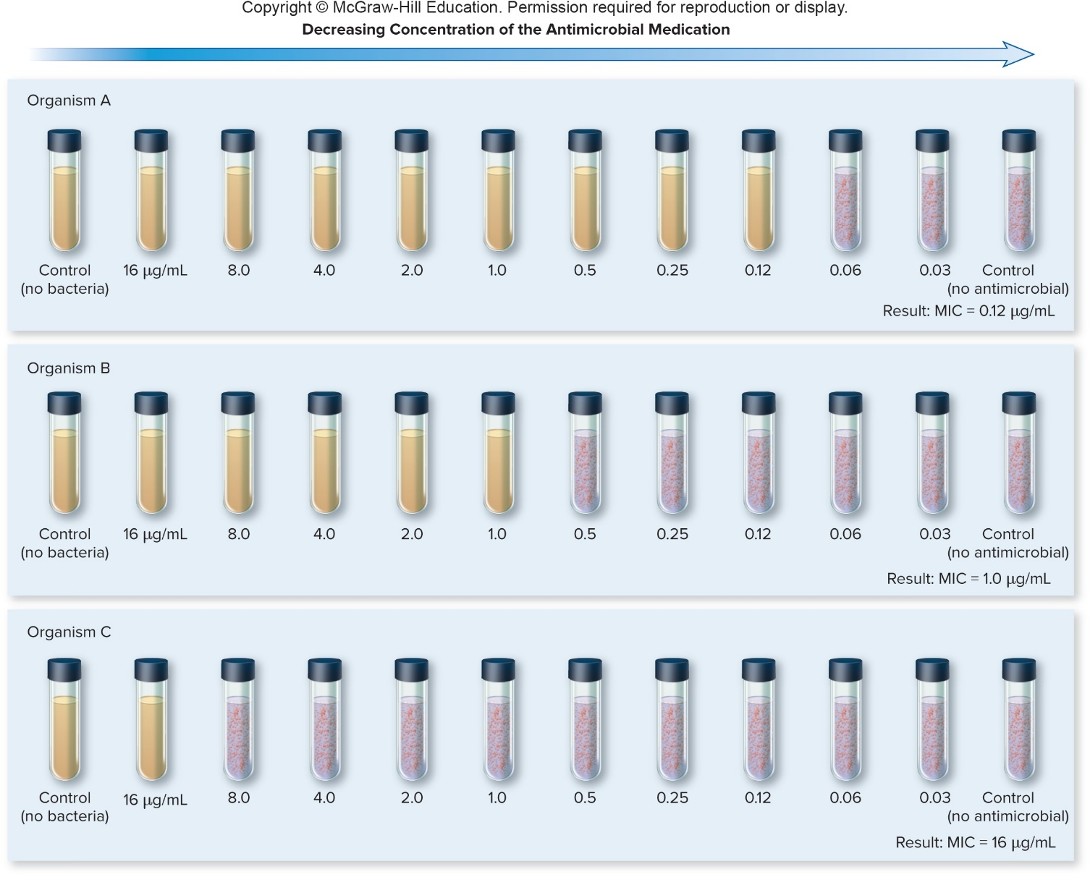
Antimicrobial Susceptibility Testing – Figure 20.10
Minimum inhibitory concentration (MIC)

Slide 46
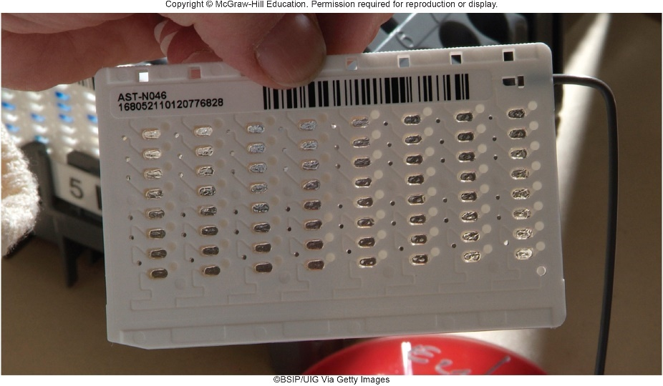
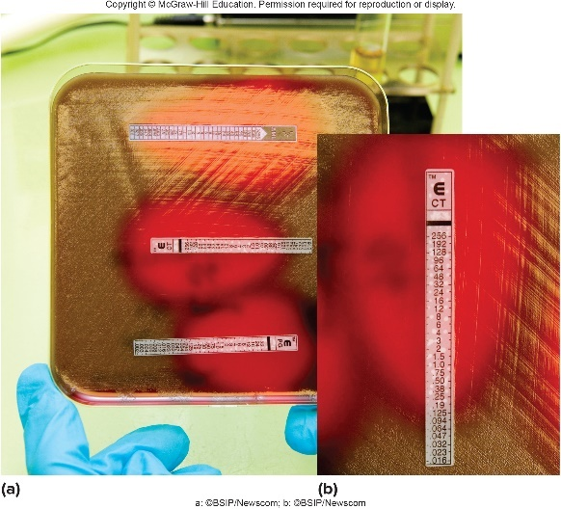
Antimicrobial Susceptibility Testing – Figures 20.11 and 20.12
Commercial modifications of susceptibility testing
Less labor-intensive, often faster results
One automated system determines growth rate via turbidity in cards, interprets results to determine MICs in 6 to 15 hours
E test is modification of disc diffusion test, uses strip with gradient of antibiotic; intersection of zone of inhibition indicates MIC
New systems detect genes encoding antibiotic resistance
Left: ©BSIP/UIG Via Getty Images; Right: a: ©BSIP/Newscom; b: ©BSIP/Newscom

Slide 47
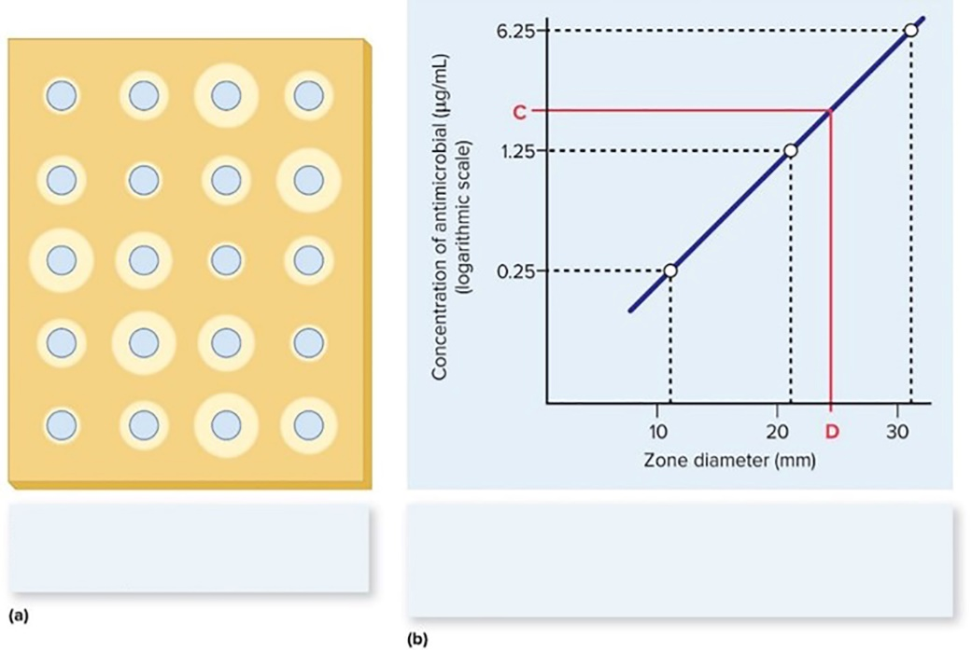
Focus Your Perspective 20.1
Prepare solid medium inoculated with organism sensitive to medication
Create wells in the medium; add standard dilutions of the medication along with patient sample
Produce standard curve from zone diameters measured for standard dilutions
Prepare line correlating zone diameter with antimicrobial concentration; read concentration of sample
Standards and patient's serum are added to agar that has been seeded with a susceptible strain of bacteria.
A standard curve that correlates the zone diameter with the antimicrobial concentration is constructed. The antimicrobial concentration in the serum can be determined using the line relating zone size to concentration.

Slide 48
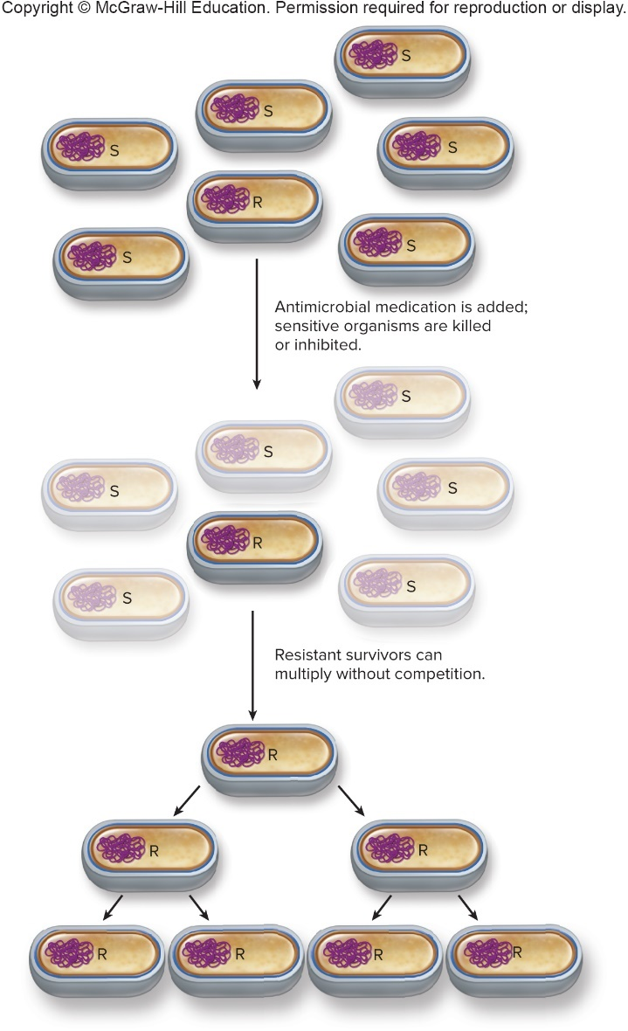
Resistance to Antimicrobial Medications – Figure 20.13
Increasing use, misuse selects for resistant microorganisms
Only 3% of Staphylococcus aureus originally resistant to penicillin G; now more than 90% are resistant
Antimicrobial resistance alarming
Impact on cost, complications, and outcomes of treatment
Dealing with problem requires understanding of mechanisms and spread of resistance

Slide 49
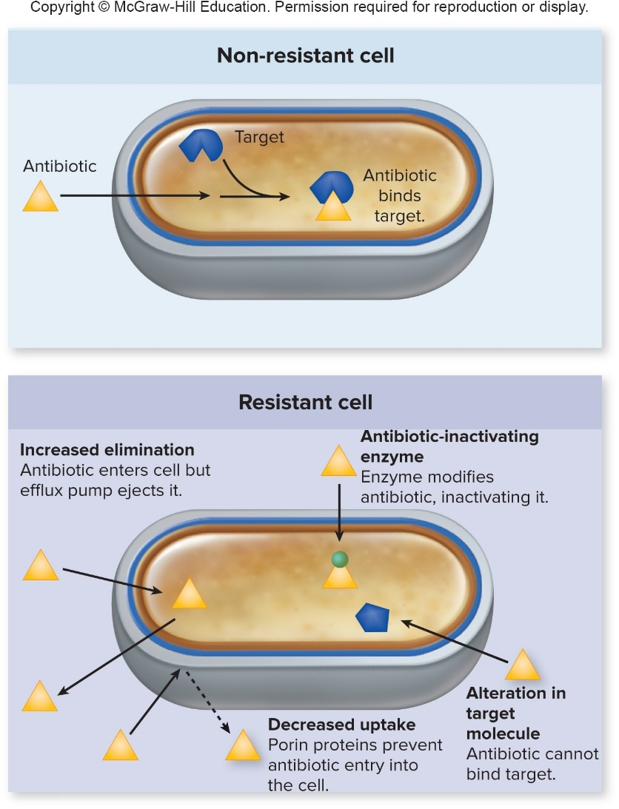
Resistance to Antimicrobial Medications – Figure 20.14 (1)
Mechanisms of acquired resistance
Antibiotic-inactivating enzymes
Bacteria produce enzymes that interfere with drug
Penicillinase, extended spectrum β-lactamases, chloramphenicol acetyltransferase
Alteration in target molecule
Minor structural changes can prevent binding
PBPs (β-lactam antibiotics), ribosomal RNA (macrolides, lincosamides, streptogramins)

Slide 50
Resistance to Antimicrobial Medications – Figure 20.14 (2)
Mechanisms of acquired resistance
Decreased uptake of the medication
Changes in porin proteins of outer membrane of Gram-negatives
Increased elimination of medication
Efflux pumps remove compounds from cell
Increased production or structural changes of pumps allows faster removal
Resistance to range of antimicrobials
Notes:
50

Slide 51
Resistance to Antimicrobial Medications (1)
Acquisition of resistance
Spontaneous mutations
Mutations happen at low rate during replication, but can have significant effect
Just a single base-pair change in gene encoding a ribosomal protein yields resistance to streptomycin
In a population of
cells, at least one likely has that mutation; if
streptomycin is added, only that cell and progeny will replicate, yielding resistant population
Spontaneous resistance to antibiotics with several different targets or multiple binding sites is less likely
Combination therapy of multiple antibiotics is often used; unlikely cells will simultaneously develop resistance

Slide 52
Resistance to Antimicrobial Medications (2)
Acquisition of resistance
Gene transfer
Genes encoding resistance can spread to different strains, species, even genera
Most commonly through conjugative transfer of R plasmids, which often carry several different resistance genes
Resistance genes on R plasmids originate from
Spontaneous mutations
Microbes that naturally produce the antibiotic
Gene coding for enzyme that modifies aminoglycoside likely originated from the Streptomyces species that produces the antibiotic

Slide 53
Table 20.2 Threats of Resistance to Antimicrobial Medications (1)
Examples of emerging resistance
CDC published Antibiotic Resistance Threats in the United States
Most serious threats categorized as urgent, serious, or concerning
Microorganism | Comments
CDC’s Threat Level: Urgent
Clostridium difficile | C. difficile causes antibiotic-associated intestinal infections that can sometimes be life-threatening; the organism is considered an urgent threat because Clostridium difficile infection (CDI) is related to the use of antimicrobials.
Carbapenem-resistant Enterobacteriaceae (CRE) | Members of the family Enterobacteriaceae are a common cause of healthcare-associated infections (HAIs). Carbapenems are often a last resort for treating Enterobacteriaceae that are resistant to other options, so CRE infections are very difficult or impossible to treat effectively.
Drug-resistant Neisseria gonorrhoeae | N. gonorrhoeae causes gonorrhea, a sexually transmitted infection. Multi-drug resistance is so widespread that combination therapy using ceftriaxone (a cephalosporin) and azithromycin (a macrolide) is now recommended.

Slide 54
Table 20.2 Threats of Resistance to Antimicrobial Medications (2)
Microorganism | Comments
CDC’s Threat Level: Serious
Multi-drug-resistant Acinetobacter | Acinetobacter species are a common cause of healthcare-associated infections (HAIs); many strains are resistant to multiple antimicrobial medications.
Drug-resistant Campylobacter | Campylobacter species are a common cause of foodborne diarrhea; resistance to ciprofloxacin and azithromycin is increasing.
Fluconazole-resistant Candida (a fungus) | Candida species (fungi) are a common cause of healthcare-associated infections (HAIs); relatively few antifungal medications are available, so acquired resistance to even one type is significant.
Extended-spectrum β-lactamase (ESBL) producing Enterobacteriaceae | Members of the family Enterobacteriaceae are a common cause of healthcare-associated infections (HAIs). ESBL-producing Enterobacteriaceae are resistant to all the β-lactam antibiotics, leaving carbapenem as the last treatment option.
Vancomycin-resistant Enterococcus (VRE) | Enterococcus species are a common cause of healthcare-associated infections (HAIs), including urinary tract and bloodstream infections. Enterococci are innately resistant to many antimicrobials, and VRE strains are resistant to nearly all antimicrobial medications.
Multi-drug-resistant Pseudomonas aeruginosa | P. aeruginosa is a common cause of healthcare-associated infections (HAIs); it is also a common cause of pneumonia in cystic fibrosis patients. P. aeruginosa is innately resistant to many antimicrobials, so multi-drug resistance makes a difficult situation even more challenging.
Drug-resistant non-typhoidal Salmonella | Non-typhoidal Salmonella strains are a common cause of foodborne diarrhea. Uncomplicated infections are not usually treated with antimicrobial medications, but infections that spread to the bloodstream can be life-threatening and should be treated.
Drug-resistant Salmonella Typhi | Salmonella Typhi causes typhoid fever, a life-threatening systemic disease. Most illnesses are travelrelated, and strains are becoming increasingly resistant to certain treatment options.
Drug-resistant Shigella | Shigella species cause diarrheal diseases that spread easily in conditions of poor sanitation. Widespread antimicrobial resistance makes treatment more difficult.
Notes:
54

Slide 55
Table 20.2 Threats of Resistance to Antimicrobial Medications (3)
Microorganism | Comments
CDC’s Threat Level: Concerning
Methicillin-resistant Staphylococcus aureus (MRSA) | S. aureus is a common cause of healthcare-associated (HA) and community-acquired (CA) skin and wound infections. MRSA is resistant to nearly all β-lactam antibiotics; HA-MRSA strains are generally resistant to many other antimicrobial medications as well, so severe infections are typically treated with vancomycin; CA-MRSA strains are usually susceptible to some other options.
Drug-resistant Streptococcus pneumoniae | S. pneumoniae causes pneumonia and meningitis, as well as bloodstream, ear, and sinus infections. Some strains are resistant to a variety of antibiotics, including penicillins and macrolides.
Drug-resistant tuberculosis | M. tuberculosis causes tuberculosis. Treatment has always been a long and complicated process because the organism is slow-growing and innately resistant to many antimicrobials. Treatment of infections caused by drug-resistant strains takes longer, is more expensive, and carries more health risks. Drug-resistant strains are an increasing problem worldwide, but are relatively rare in the United States.
Vancomycin-resistant Staphylococcus aureus (VRSA) | S. aureus causes hospital-acquired (HA) and community-acquired (CA) infections. VRSA strains are resistant to nearly all antimicrobial medications.
Erythromycin-resistant Group A streptococcus | Group A streptococcus causes a variety of infections, including pharyngitis, impetigo, and tissue infections. A main concern regarding antibiotic resistance is invasive infections (infections of otherwise sterile body sites).
Clindamycin-resistant Group B streptococcus | Group B streptococcus is an important cause of neonatal meningitis; pregnant women who are colonized with the organism are treated to prevent infection of the newborn.
Notes:
55

Slide 56
Resistance to Antimicrobial Medications (3)
Examples of emerging resistance
Enterococci: part of normal intestinal microbiota
Common cause of healthcare-associated infections
Intrinsically less susceptible to many antimicrobials
PBPs have low affinity to many β-lactam antibiotics
Many have R plasmids
Some code for resistance to vancomycin, yield vancomycin-resistant enterococci (VRE), which is transferable to other organisms
Vancomycin often antibiotic of last resort
Notes:
56

Slide 57
Resistance to Antimicrobial Medications (4)
Examples of emerging resistance
Enterobacteriaceae intrinsically resistant to many antibiotics
Outer membrane prevents entry of medications
Some enterics developed ability to produce β-lactamases
Some further developed ability to produce extended-spectrum β-lactamases (ESBLs); resist cephalosporins and monobactams in addition to penicillins
More recently, carbapenem-resistant Enterobacteriaceae (CRE) strains found
Resistant to nearly all antibiotics
Replaced with colistin, once considered too toxic for use
Plasmid-encoded resistance to colistin recently discovered

Slide 58
Resistance to Antimicrobial Medications (5)
Examples of emerging resistance
Mycobacterium tuberculosis requires long treatment
Can become resistant to first-line antibiotics via mutation
Large numbers of cells found in active infection, so likely at least one cell has developed resistance
Combination therapy is therefore required
6 months or more of treatment necessary due to slow rate of growth; many patients do not comply
Multi-drug-resistant tuberculosis (MDR-TB) resist two favored first-line antibiotics: isoniazid and rifampin
Directly observed therapy (DOT) can prevent emergence
Extensively drug-resistant tuberculosis (XDR-TB) of even greater concern, additionally resist three or more second-line anti-TB medications

Slide 59
Resistance to Antimicrobial Medications (6)
Examples of emerging resistance
Neisseria gonorrhoeae was once very susceptible to penicillin
Some strains developed resistance through mutation; others acquired a plasmid that encoded production of penicillinase
Other treatments were used, but led to more resistance
Only certain cephalosporins are reliably effective
Newer combination therapy minimizes resistance
Intramuscular dose of ceftriaxone with oral dose of azithromycin

Slide 60
Resistance to Antimicrobial Medications (7)
Examples of emerging resistance
Staphylococcus aureus: increasingly resistant
Common cause of healthcare-associated infections
Most strains resistant to penicillin, encode penicillinase
New strains emerged having PBPs with low affinity for most β-lactam antibiotics (ceftaroline binds new PBP)
Methicillin-resistant Staphylococcus aureus (MRSA)
Healthcare-associated (HA-MRSA) resistant to wide range of antibiotics, usually treated with vancomycin
Hospitals have reported resistant isolates; strict guidelines have halted spread of vancomycin-intermediate S. aureus (VISA) and vancomycin-resistant S. aureus (VRSA) strains
Community acquired (CA-MRSA) currently treatable

Slide 61
Resistance to Antimicrobial Medications (8)
Examples of emerging resistance
Streptococcus pneumoniae
Historically susceptible; some recently acquired penicillin resistance
Produce PBPs with lower affinity, likely via DNA-mediated transformation involving other Streptococcus species

Slide 62
Resistance to Antimicrobial Medications –Figure 20.15
Preventing resistance
Will require cooperation from everyone globally
Responsibilities of physicians and healthcare workers
Increase efforts to identify cause of infection
Only prescribe suitable antimicrobials when appropriate
Antimicrobial stewardship programs to monitor

Slide 63
Resistance to Antimicrobial Medications (9)
Preventing resistance
Responsibilities of patients
Carefully follow instructions even if inconvenient
Essential to maintain adequate blood levels of antibiotic; skipping a dose may reduce levels, allowing less-sensitive microbes a chance to grow and spread
Failure to complete treatment may not kill least-sensitive organisms, allowing subsequent spread
The importance of an educated public
Antibiotics ineffective against viruses; cannot cure common cold!
Misuse selects for antibiotic-resistant bacteria in normal microbiota; they can eventually transfer R plasmids to pathogens

Slide 64
Resistance to Antimicrobial Medications (10)
Preventing resistance
Global impacts of the use of antimicrobial medications
Overuse is a worldwide concern; resistant microbes recognize no political boundaries
Antimicrobial antibiotics available without prescription in many parts of the world, may allow improper use
Antimicrobial antibiotics used in animal feeds at low levels to enhance growth; selects for antibiotic-resistant microbes
Resistant Salmonella strains linked to animals

Slide 65
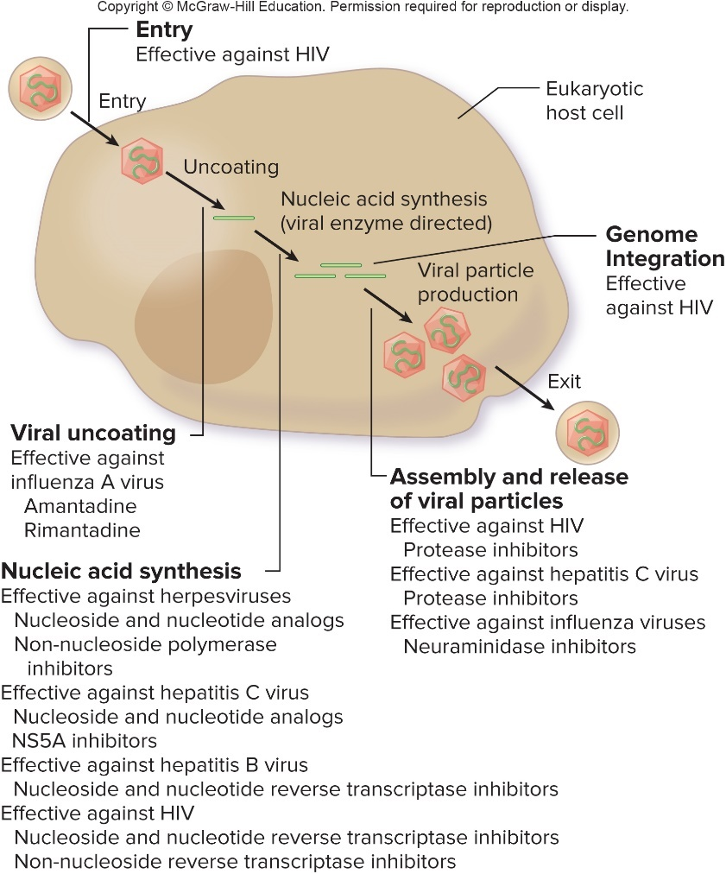
Mechanisms of Action of Antiviral Medications – Figure 20.16
Viruses difficult to target selectively
Rely on host cell’s metabolic machinery; lack cell walls, ribosomes, other structures targeted by antibiotics
Many encode polymerases; represent potential targets
Scientists trying to develop antiviral medications that interfere with viral replication
Current options effective only against specific type of virus; none eliminate latent infections
Fixed dose combinations counter development of viral resistance
Jump to Mechanisms of Action of Antiviral Medications – Figure 20.16 Long Description

Slide 66
Mechanisms of Action of Antiviral Medications (1)
Prevent viral entry
Some HIV medications prevent viral entry
Enfuvirtide (ENF) is a fusion inhibitor; binds to an HIV protein that promotes fusion of viral envelope with cell membrane
Maraviroc (MCV) blocks HIV co-receptor CCR5
Interfere with viral uncoating
Nucleic acid must separate from protein coat
Two chemicals target this step in influenza, but they are no longer used due to widespread resistance

Slide 67
Mechanisms of Action of Antiviral Medications (2)
Interfere with nucleic acid synthesis
Most effective target virally encoded enzymes used during replication of viral nucleic acid
Mostly limited to treating herpesviruses, HBV, HCV, HIV
Nucleoside and nucleotide analogs
Structure similar to building blocks of DNA, RNA
When incorporated into growing nucleotide chain, many analogs act as chain terminators
Selective toxicity since virally encoded enzymes more likely than host cell polymerases to incorporate
More damage done to rapidly replicating viral genome

Slide 68
Interfere with Nucleic Acid Synthesis (1)
Nucleoside and nucleotide analogs
Acyclovir and others; little harm to uninfected cells since converted by virally encoded enzymes in infected cells
Herpesviruses (chickenpox, cold sores)
Sofosbuvir interferes specifically with HCV’s replicase
Highly effective against hepatitis C when used with another anti-HCV medication
Nucleoside/nucleotide reverse transcriptase inhibitors (NRTIs) used to treat HBV, HIV
Often used in combination with other anti-retroviral medications to minimize development of resistance
Include zidovudine (anti-HIV), tenofovir (anti-HBV)
Some reserved for severe infections; significant side effects
Ganciclovir used to treat life- or sight-threatening cytomegalovirus (CMV) infections in immunocompromised

Slide 69
Interfere with Nucleic Acid Synthesis (2)
Non-nucleoside polymerase inhibitors
Inhibit viral polymerases by binding to site other than nucleotide-binding site
Dasabuvir is component of fixed-dose combination to treat HCV
Foscarnet used to treat ganciclovir-resistant CMV and acyclovir-resistant HSV
Non-nucleoside reverse transcriptase inhibitors (NNRTIs)
Inhibit reverse transcriptase by binding to site other than nucleotide-binding site (efavirenz, etravirine)
NS5A inhibitors
Relatively new option for treating HCV
Inhibit NS5A, HCV-encoded protein required for replication of viral genome (elbasvir, ombitasvir)

Slide 70
Mechanisms of Action of Antiviral Medications
Prevent genome integration
Integrase inhibitors interfere with action of HIV-encoded enzyme integrase
Prevent virus from inserting DNA copy of genome into host cell
Prevent assembly and release of viral particles
Protease inhibitors
During replication of some viruses, several proteins translated as a polyprotein that must be cleaved by a protease
Virus-specific
Include atazanavir (anti-HIV) and grazoprevir (anti-HCV)
Neuraminidase inhibitors
Enzyme encoded by influenza viruses, needed for release
Several available, ingested, inhaled, or injected

Slide 71
Table 20.3 Characteristics of Antiviral Medications (1)
Target/Class/Example(s) | Comments/Characteristics
Viral Entry
Fusion Inhibitors | Prevent viral particles from fusing with host cell.
Enfuvirtide (ENF), maraviroc (MVC) | Used to treat HIV infections.
Viral Uncoating
Uncoating inhibitors | Prevent release of viral nucleic acid from the protein coat.
Amantadine and rimantadine | Used in the past to reduce severity and duration of influenza A infections.
Nucleic Acid Synthesis
Nucleoside and nucleotide analogs | Incorporated by error-prone virally encoded polymerases, resulting in defective viral nucleic acid.
Acyclovir, famciclovir, valacyclovir | Used to treat shingles, chickenpox, cold sores, and genital herpes—diseases all caused by herpesviruses.
Sofosbuvir | Used to treat HCV infections.
Nucleoside and nucleotide reverse transcriptase inhibitors (NRTIs): abacavir (ABC), emtricitabine (FTC), lamivudine (3TC), tenofovir alafenamide (TAF), and zidovudine (AZT, ZDV) | Used to treat HIV infections; some are used to treat chronic hepatitis B.
Ganciclovir | Used to treat life- or sight- threatening cytomegalovirus infections.

Slide 72
Table 20.3 Characteristics of Antiviral Medications (2)
Target/Class/Example(s) | Comments/Characteristics
Nucleic Acid Synthesis
Non-nucleoside polymerase inhibitors | Inhibit the activity of viral polymerases by binding to a site other than the nucleotide-binding site.
Dasabuvir | Used in a fixed-dose combination to treat HCV infections.
Foscarnet | Used to treat severe infections caused by CMV and HSV strains that are resistant to other medications.
Non-nucleoside reverse transcriptase inhibitors (NNRTIs) | Inhibit the activity of reverse transcriptase by binding to a site other than the nucleotide-binding site.
Efavirenz (EFV), etravirine (ETR), nevirapine (NVP), and rilpivirine (RPV) | Used to treat HIV infections.
NS5A inhibitors | Inhibit NS5A, an HCV-encoded protein required for replication of the viral genome.
Elbasvir, ombitasvir, velpatasvir | Used to treat HCV infections.

Slide 73
Table 20.3 Characteristics of Antiviral Medications (3)
Target/Class/Example(s) | Comments/Characteristics
Genome Integration
Integrase strand transfer inhibitors | Interfere with the HIV-encoded enzyme integrase.
Dolutegravir (DTG), elvitegravir (EVG), and raltegravir (RAL) | Used to treat HIV infections.
Assembly and Release of Viral Particles
Protease inhibitors | Inhibit virally encoded proteases, which cleave viral polyproteins to release individual proteins.
Atazanavir (ATV), darunavir (DRV), ritonavir (RTV) | Used to treat HIV infections.
Grazoprevir, paritaprevir, simeprevir | Used to treat hepatitis C.
Neuraminidase inhibitors | Inhibit an influenza virus–encoded enzyme required for release of viral particles from infected cells.
Oseltamivir, zanamivir, peramivir | Used to treat influenza.

Slide 74
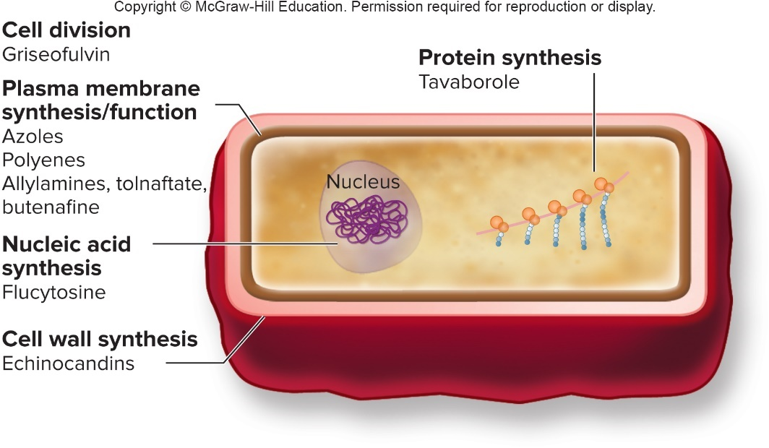
Mechanisms of Action of Antifungal Medications – Figure 20.17
Eukaryotic pathogens difficult to target
More closely resemble human cells than bacteria
Antifungal medications can interfere with
Fungal cytoplasmic membrane
Cell wall synthesis
Cell division
Nucleic acid synthesis
Protein synthesis
Notes:
74

Slide 75
Mechanisms of Action of Antifungal Medications (1)
Interfere with cytoplasmic membrane synthesis and function
Most antifungal chemicals target ergosterol, which humans lack
Azoles inhibit ergosterol synthesis, membrane leaks
Newer less toxic triazoles used to treat systemic infections and nail infections
Polyenes produced by Streptomyces, bind to ergosterol, cause membrane to leak
Toxic to humans (Amphotericin B, nystatin)
Allylamines, tolnaftate, butenafine
Inhibit enzyme in ergosterol synthesis pathway
Most applied to skin for dermatophyte infections

Slide 76
Mechanisms of Action of Antifungal Medications (2)
Interfere with cell wall synthesis
Fungal cell walls have some components animals lack
Echinocandins interfere with synthesis of β-1, 3 glucan
Causes cells to burst
Caspofungin treats systemic Candida, invasive aspergillosis
Interfere with cell division
Griseofulvin targets cell division, interferes with tubulin
Tubulin found in eukaryotic cells; selective toxicity may be due to greater uptake by fungal cells
Treats skin and nail infections

Slide 77
Mechanisms of Action of Antifungal Medications (3)
Interfere with nucleic acid synthesis
Common to all eukaryotes, generally poor chemical target
Flucytosine taken up by yeast cells, converted to active form, inhibits nucleic acid synthesis
Significant side effects
Interfere with protein synthesis
New antifungal inhibits protein synthesis by preventing enzyme to add amino acid to tRNA (tavaborole)
Used topically to treat nail infections
Notes:
77

Slide 78
Table 20.4 Characteristics of Antifungal Medications (1)
Target/Class/Example(s) | Comments
Cytoplasmic Membrane
Azoles | Interfere with ergosterol synthesis, leading to defective fungal membranes.
Imidazoles: miconazole, clotrimazole | Used in non-prescription creams, ointments, and suppositories to treat vaginal yeast infections; also used on skin to treat dermatophyte infections.
Triazoles: fluconazole, voriconazole, posaconazole, and isavuconazole, eficonazole | Most are extremely important for treating a variety of systemic fungal infections; eficonazole is only used topically.
Polyenes | Bind to ergosterol, causing the fungal membrane to leak. Very toxic
Amphotericin B, nystatin | Amphotericin is used as a last resort for treating life-threatening infections; nystatin is used topically.
Allylamines, tolnaftate, butenafine | Inhibit an enzyme in the pathway of ergosterol synthesis.
Naftifine, terbinafine (allylamines); tolnaftate; butenafine | Used topically to treat dermatophyte infections; terbinafine can be taken orally.

Slide 79
Table 20.4 Characteristics of Antifungal Medications (2)
Target/Class/Example(s) | Comments
Cell Wall Synthesis
Echinocandins | Interfere with, β-1,3 glucan synthesis.
Caspofungin, micafungin, and anidulafungin | Used to treat Candida infections; some are used to treat invasive aspergillosis that resists other medications.
Cell Division
Griseofulvin | Used to treat skin and nail infections. Active only against fungi that invade keratinized cells.
Nucleic Acid Synthesis
Flucytosine | Used to treat systemic yeast infections; inhibits an enzyme required for nucleic acid synthesis.
Protein Synthesis
Tavaborole | Used topically to treat nail infections.

Slide 80
Mechanisms of Action of Antiprotozoan and Antihelminthic Medications
Relatively little research and development
Most parasitic diseases concentrated in poorer areas of the world; medications unaffordable
Most chemicals interfere with biosynthetic pathways of protozoan parasites or neuromuscular function of worms

Slide 81
Table 20.5 Characteristics of Some Antiprotozoan and Antihelminthic Medications (1)
Causative Agent/Medication | Comment
Intestinal protozoa
Iodoquinol | Used as a follow-up treatment to eliminate the cysts of the protozoan that causes intestinal amebiasis; mechanism unknown.
Metronidazole, tinidazole | Used to treat amebiasis, giardiasis, and trichomoniasis; activated by the metabolism of anaerobic organisms, forming reactive compounds that alter DNA.
Nitazoxanide | Used to treat cryptosporidiosis and giardiasis; interferes with anaerobic energy metabolism.
Parmomycin | Used as a follow-up treatment to eliminate the cysts of the protozoan that causes intestinal amebiasis; mechanism against cysts unclear.

Slide 82
Table 20.5 Characteristics of Some Antiprotozoan and Antihelminthic Medications (2)
Causative Agent/Medication | Comment
Plasmodium (Malaria) and Toxoplasma
Artemether-lumefantrine | A type of ACT (artemisinin-based combination therapy) used to treat malaria, particularly that acquired in regions where chloroquine resistance occurs; the combination therapy is intended to prevent development of additional resistance. Artemether, an artemisinin derivative, is thought to be activated by heme digestion products released by the parasite, forming a reactive molecule that then damages parasite components. Lumefantrine action is thought to be associated with heme.
Atovaquone-proguanil | A synergistic combination used to treat malaria, particularly that acquired in regions where chloroquine resistance occurs. Atovaquone interferes with mitochondrial electron transport, and proguanil disrupts folate synthesis.
Chloroquine | Used to treat malaria; thought to interfere with the parasite’s ability to detoxify heme, a substance that accumulates as the parasite grows in red blood cells.
Mefloquine | Used to treat malaria, particularly that acquired in regions where chloroquine resistance occurs; thought to interfere with the parasite’s ability to detoxify heme.
Primaquine | Used as an additional treatment component for the relapsing forms of malaria; it kills the dormant liver stage, but the mechanism is not understood.
Pyrimethamine, sulfonamide | A synergistic combination used to treat toxoplasmosis and malaria; interferes with folate metabolism.

Slide 83
Table 20.5 Characteristics of Some Antiprotozoan and Antihelminthic Medications (3)
Causative Agent/Medication | Comment
Trypanosomes and Leishmania
Amphotericin B | Used to treat some types of leishmaniasis.
Benznidazole | Used to treat acute Chagas’ disease; enzymes in the parasite convert it into a reactive form that damages certain cell components.
Eflornithine | Used to treat some types/stages of African trypanosomiasis; inhibits the enzyme ornithine decarboxylase.
Melarsoprol | Used to treat advanced stages of some types/stages of African trypanosomiasis but treatment can be lethal; inactivates enzymes by binding sulfhydryl groups.
Miltefosine | Used to treat some types of leishmaniasis; mechanism of action likely involves interaction with lipids and interference with mitochondrial function.
Nifurtimox | Used to treat acute Chagas’ disease and, in combination with other medications, some types of African trypanosomiasis; thought to form reactive compounds that damage certain cell components.
Parmomycin | Used to treat some types of leishmaniasis; mechanism of action against the parasite unclear.
Pentamidine | Used to treat infections caused by some types/stages of African trypanosomiasis; mechanism is poorly understood, but appears to involve inhibition of nucleic acid synthesis.
Sodium stibogluconate | Used to treat some types of leishmaniasis; complex mechanism of action that involves sulfhydryl groups of cell components.
Suramin | Used to treat infections caused by some types/stages of African trypanosomiasis; mechanism is poorly understood, but appears to involve inhibition of certain enzymes.
Notes:
83

Slide 84
Table 20.5 Characteristics of Some Antiprotozoan and Antihelminthic Medications (4)
Causative Agent/Medication | Comment
Intestinal and Tissue Helminths
Albendazole, mebendazole | Albendazole is used to treat a variety of helminth infections, including tissue and intestinal infections; mebendazole is poorly absorbed, so it is only used to treat intestinal helminths; both bind to tubulin of helminths, resulting in immobilization of the worm.
Diethylcarbamazine | Used to treat infections caused by certain filarial nematodes; results in damage to the outer surface of the microfilaria, making it easier for the immune system to eliminate them.
Ivermectin | Used to treat infections caused by Strongyloides and certain tissue nematodes; interferes with nerve transmission in the worm, causing flaccid (limp) paralysis.
Praziquantel | Effective in eliminating a variety of trematodes (flukes) and cestodes (tapeworms); results in sustained contractions of the worm.
Pyrantel pamoate | Used to eliminate certain intestinal nematodes (roundworms); interferes with neuromuscular activity of worms, causing paralysis.
Notes:
84

