Slide 1
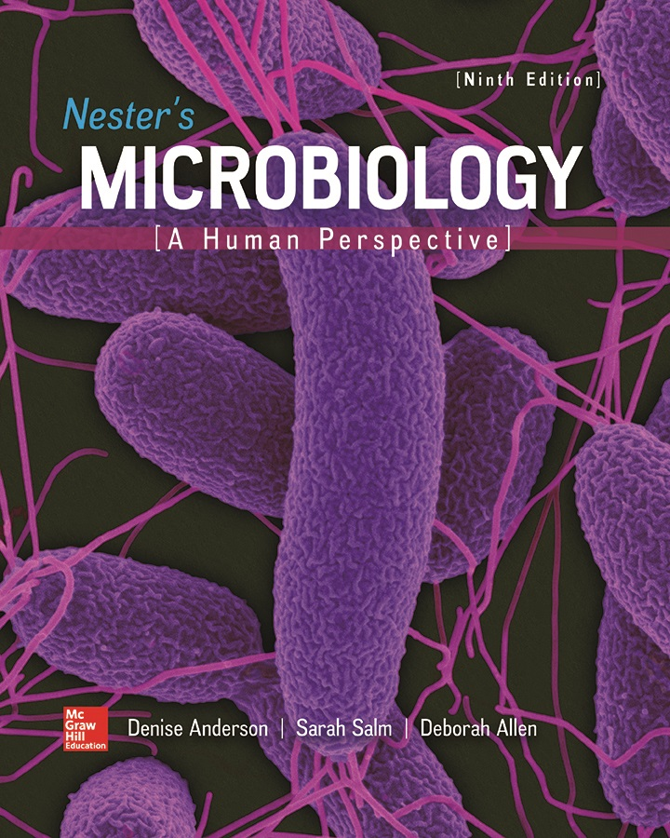
Chapter 03 Lecture Outline
See separate PowerPoint slides for all figures and tables pre-inserted into PowerPoint without notes.

Slide 2
A Glimpse of History
Hans Christian Joachim Gram (1853 to 1938)
Danish physician working at morgue in Berlin
Worked for Dr. Carl Friedlander
Attempting to identify cause of pneumonia
Gram was developing methods to stain bacteria
With one method, bacteria stained unequally
Some retained dye, others did not
Revealed two different kinds of bacteria
Basis for modern Gram stain
Identifies two major groups of bacteria according to cell wall structure and chemistry
Gram-positive and Gram-negative

Slide 3
Microscopy and Cell Structure
Microscopy reveals two fundamental cell types:
Prokaryotic cells (Bacteria, Archaea)
Smaller size gives high surface area to low volume
Facilitates rapid uptake of nutrients, excretion of wastes
Allows rapid growth
Disadvantages include vulnerability to threats including predators, parasites, and competitors
Eukaryotic cells (Eukarya)
Larger, more complex, many cellular processes take place in membrane-bound compartments
Defined by the presence of a nucleus

Slide 4
Microscopes
Light microscope can magnify 1,000x
Common, important tool in microbiology
Electron microscope (1931) can magnify more than 100,000x
Scanning probe microscope (1980s) can produce images of individual atoms on a surface

Slide 5
Principles of Light Microscopy (1)
Light passes through specimen and then series of magnifying lenses
Bright-field microscope is most common type
Three key concepts:
Magnification: apparent increase in size
Resolution: resolving power, or ability to distinguish two objects that are very close together
Contrast: difference in color intensity between an object and the background; determines how easily cells can be seen

Slide 6
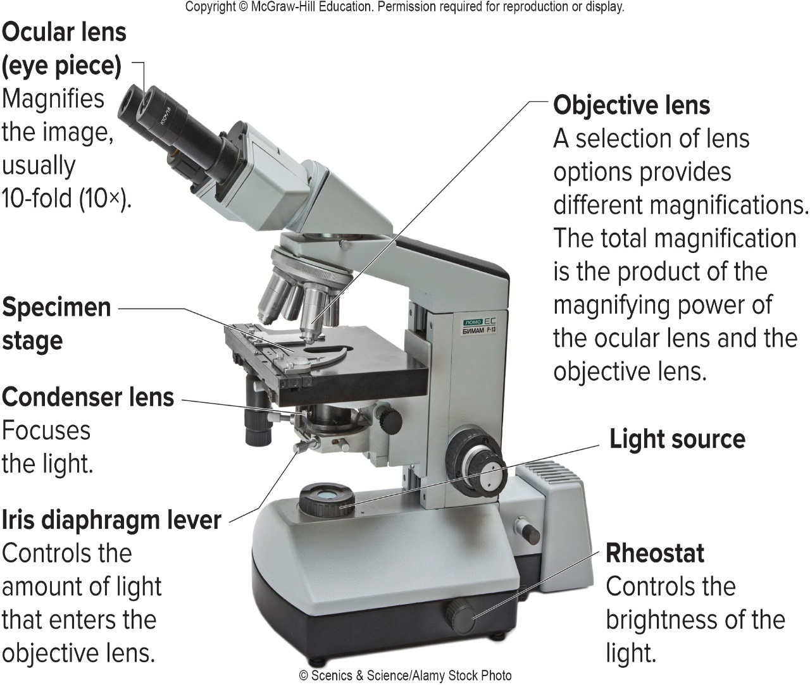
Principles of Light Microscopy – Figure 3.1
© Scenics & Science/Alamy Stock Photo

Slide 7
Principles of Light Microscopy (3)
Resolution: resolving power, or ability to distinguish two objects that are very close together
Defined as minimum distance between two points at which those points can be observed as separate
Depends on quality and type of lens, wavelength of light, magnification, and specimen preparation
Maximum resolving power of light microscope is 0.2 micrometer

Slide 8
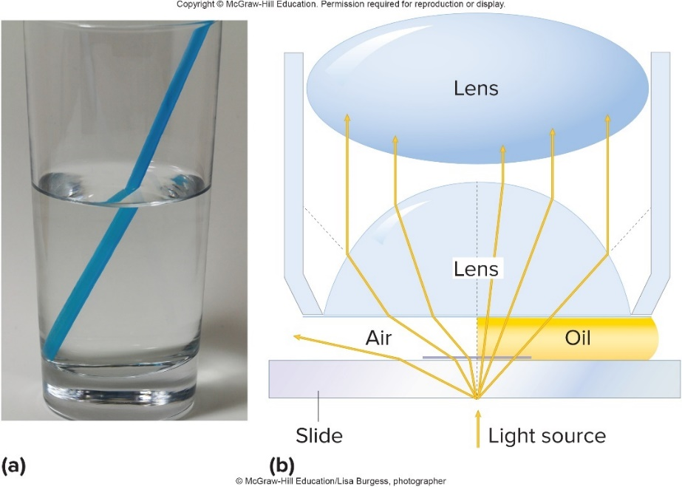
Principles of Light Microscopy – Figure 3.2
Immersion oil used to displace air between lens and specimen when using high powered 100x objective
Has same refractive index (measure of speed of light passing through medium) as glass
Prevents refraction of light; keeps rays from missing opening in objective lens
© McGraw-Hill Education/Lisa Burgess, photographer

Slide 9
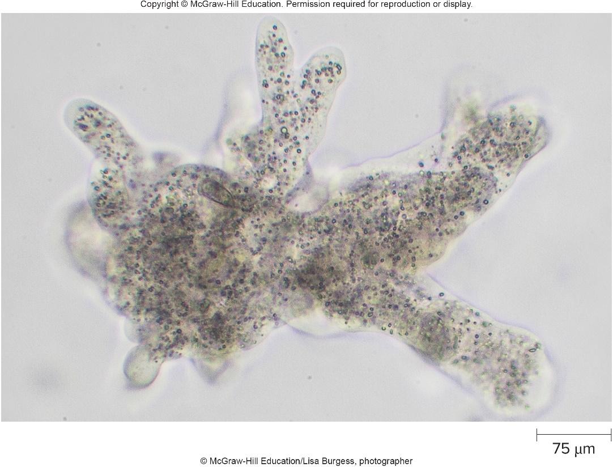
Principles of Light Microscopy – Figure 3.3
Contrast determines how easily cells can be seen
Transparent bacteria lack contrast, difficult to see against colorless background
Stains increase contrast but kill microbes
© McGraw-Hill Education/Lisa Burgess, photographer

Slide 10
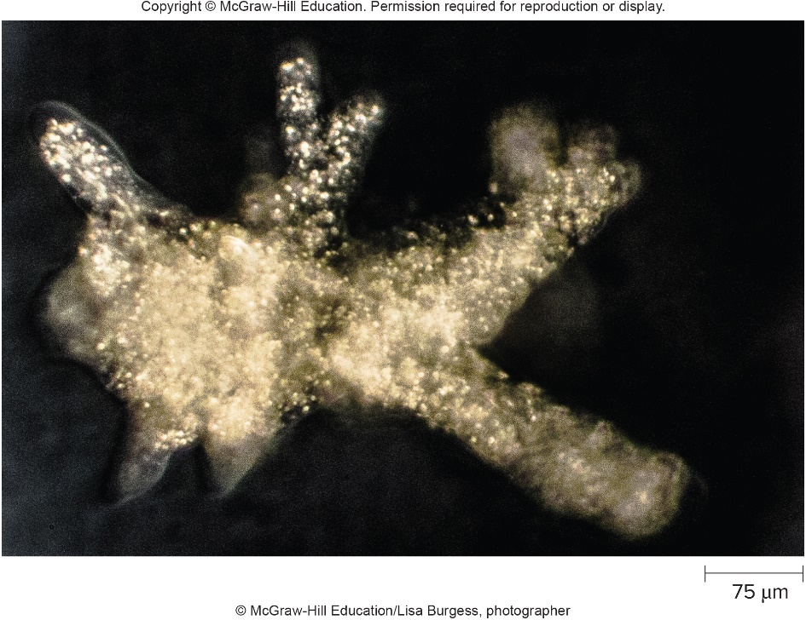
Light Microscopes That Increase Contrast – Figure 3.4
Dark-Field Microscope
Cells appear as bright objects against dark background
Directs light toward specimen at angle
Only light scattered by specimen enters objective lens
© McGraw-Hill Education/Lisa Burgess, photographer

Slide 11
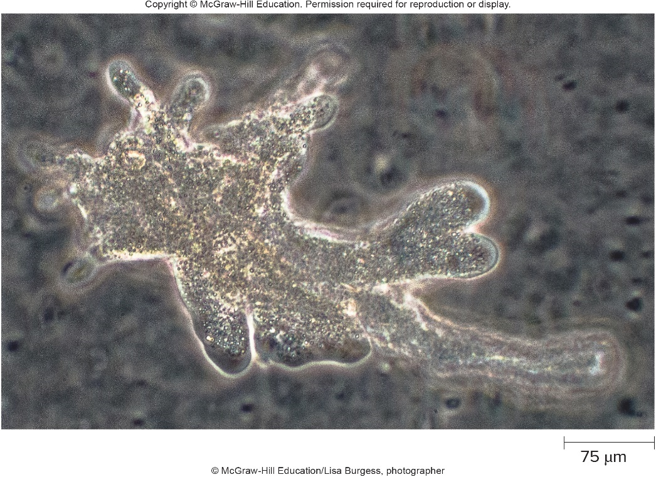
Light Microscopes That Increase Contrast – Figure 3.5
Phase-Contrast Microscope
Special optics amplify difference between refractive index of dense material and surrounding medium
Makes cells and other dense material appear darker
© McGraw-Hill Education/Lisa Burgess, photographer

Slide 12
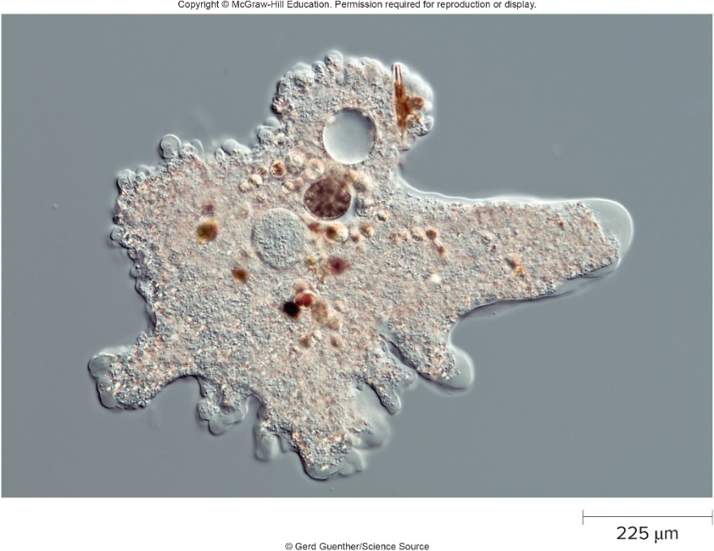
Light Microscopes That Increase Contrast – Figure 3.6
Differential Interference Contrast (DIC) Microscope
Like phase-contrast, has special optics that depend upon differences in refractive index
Separates light into two beams that pass through specimen and recombine
Light waves are out of phase when recombined, yield three-dimensional appearance of image
© Gerd Guenther/Science Source

Slide 13
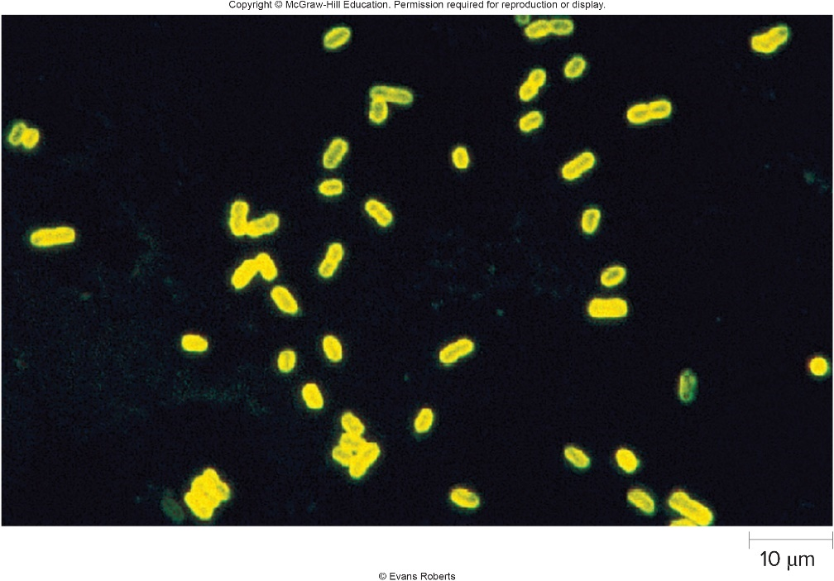
Light Microscopes That Detect Fluorescence – Figure 3.7
Fluorescence Microscope
Used to observe cells or materials either naturally fluorescent or tagged with fluorescent dyes
Molecules absorb light at one wavelength (usually ultraviolet light) and emit light at longer wavelength
Most today are epifluorescent: UV light projected onto, not through, specimen
© Evan Roberts

Slide 14
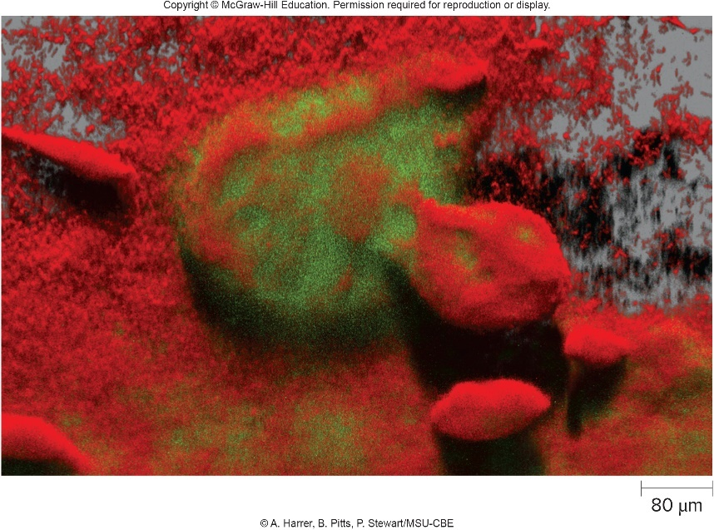
Light Microscopes That Detect Fluorescence – Figure 3.8
Scanning Laser Microscope (SLM)
Specimens stained with fluorescent dye
Fluorescent molecules bind to certain internal compounds; marks their precise location
Allows detailed interior views of intact cells
May provide 3-dimensional images of thick structures
Courtesy of A. Harrer, B. Pitts, P. Stewart/MSU-CBE

Slide 15
Light Microscopes That Detect Fluorescence (1)
Confocal Microscopy
Laser beam illuminates a point on one vertical plane of specimen
Mirrors scan laser beam across specimen, illuminating successive planes
Each plane represents one fine slice of specimen
Computer constructs 3-dimensional image
Like a miniature computerized axial tomography (CAT) scan for cells

Slide 16
Light Microscopes That Detect Fluorescence (2)
Two-photon Microscopy (multiphoton microscopy)
Similar to confocal, but lower energy used
Less damaging to cells; allows time-lapse images
Light penetrates deeper to give interior views of relatively thick structures
Notes:
16

Slide 17
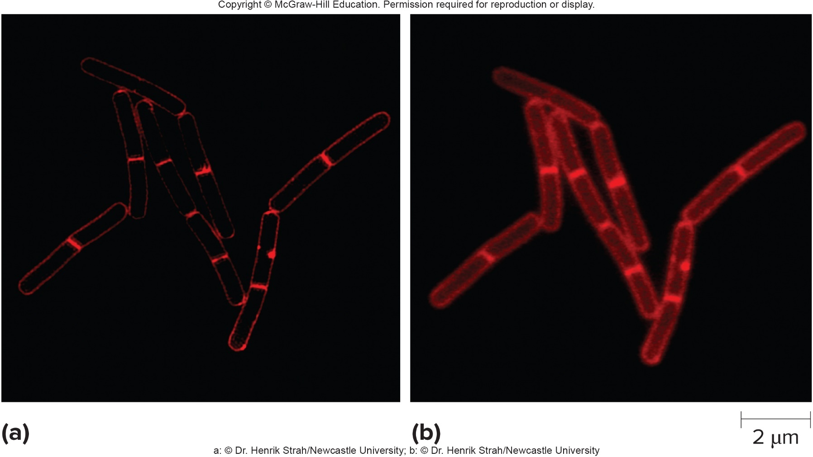
Light Microscopes That Detect Fluorescence – Figure 3.9
Super-Resolution Microscope
Can improve resolution down to 10 nanometers
both: © Dr. Henrik Strah/Newcastle University
Notes:
17

Slide 18
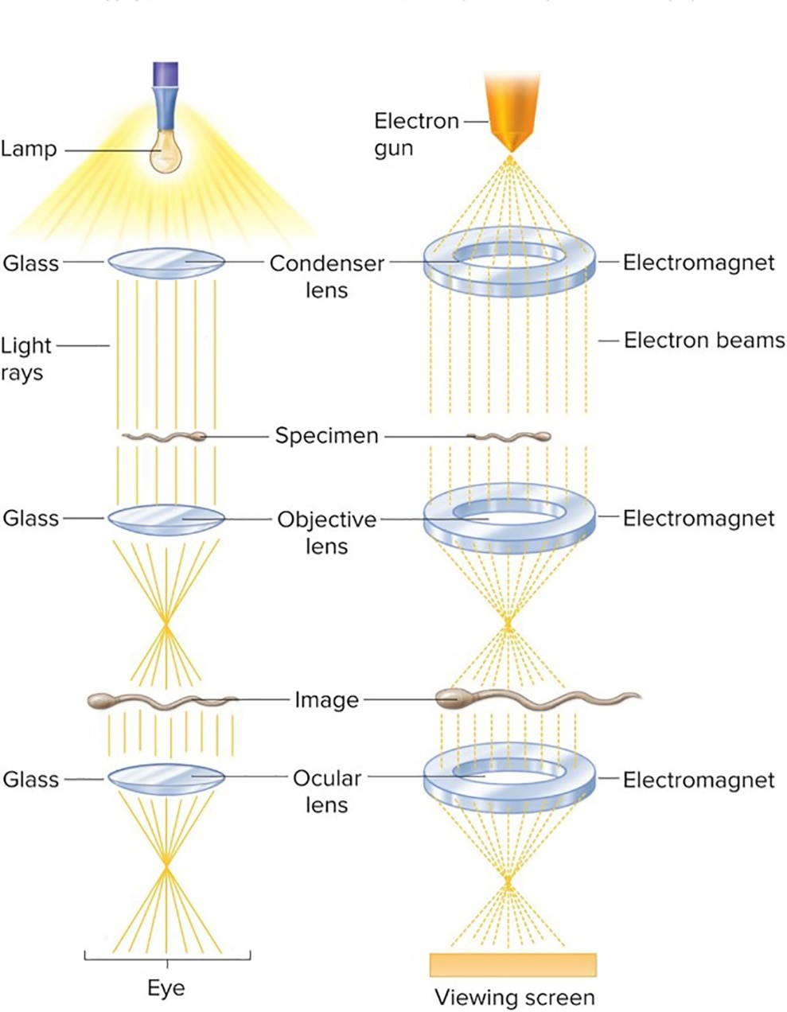
Electron Microscopes – Figure 3.10
Can clearly magnify objects 100,000x
Uses electromagnetic lenses, electrons, and a fluorescent screen to replace glass lenses, visible light, and the eye
Image photographed as black-and-white electron photomicrograph
May be artificially colored
Light Microscope
Transmission Electron Microscope

Slide 19
Electron Microscopes (1)
Wavelength of electrons approximately 1,000 shorter than light
Resolving power approximately 1,000-fold greater: approximately 0.3 nanometer
Light Microscope
Transmission Electron Microscope
Notes:
19

Slide 20
Electron Microscopes (2)
Lenses and specimen must be in vacuum
Air molecules would interfere with electrons
Impossible to observe living specimens
Results in large, expensive unit and complex specimen preparation
Two major types:
Transmission Electron Microscope (TEM)
Scanning Electron Microscope (SEM)

Slide 21
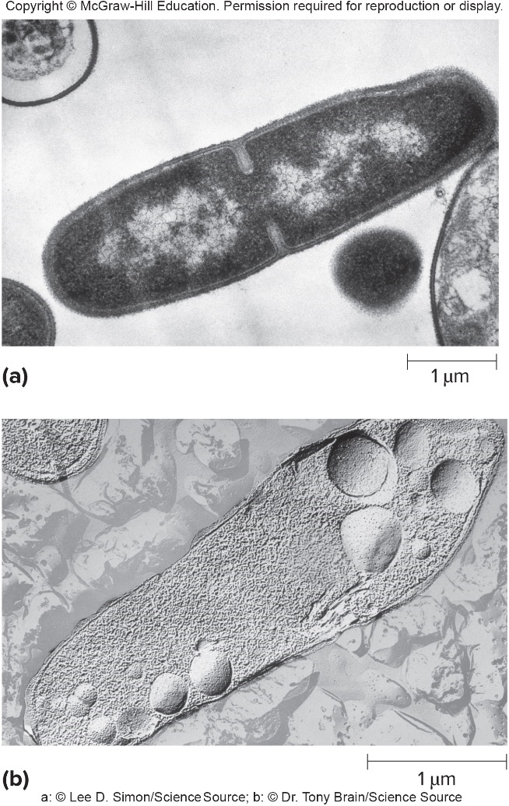
Electron Microscopes – Figure 3.11
Transmission Electron Microscope (TEM): beam of electrons passes through specimen or scatters
Depends on density of region: dark areas are dense
Thin-sectioning used to view internal details, but process can distort cells
Freeze-fracturing, freeze-etching reveal shape of internal structures
Newer methods that reduce damage to cells include cryo-electron microscopy (cryo-EM), and cryo-electron tomography for 3-D images
a: © Lee D. Simon/Science Source; b: © Dr. Tony Brain/Science Source

Slide 22
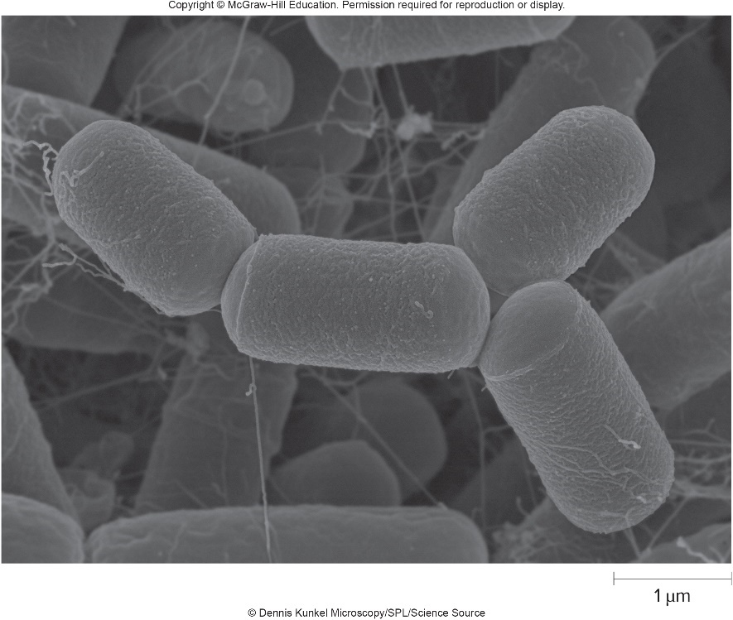
Electron Microscopes – Figure 3.12
Scanning Electron Microscope (SEM): beam of electrons scans over surface of specimen
Used to observe surface details
Surface coated with thin film of metal
Electrons released from specimen are observed
Yields 3-D effect
© Dennis Kunkel Microscopy/SPL/Science Source

Slide 23
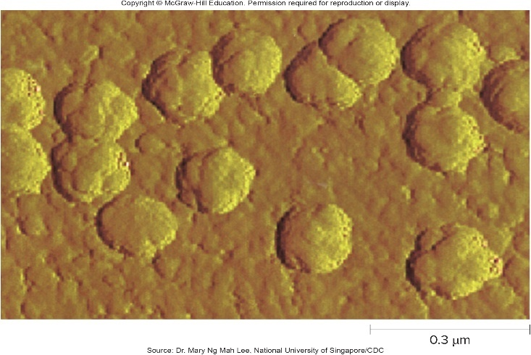
Scanning Probe Microscopes – Figure 3.13
Detailed images of surfaces
Example: atomic force microscope (AFM)
Resolving power much greater than that of EM
Avoids special preparation required for EM
Sharp probe moves across sample’s surface
“Feels” bumps, valleys of atoms
Laser measures motion, computer produces surface map
Source: Dr. Mary Ng Lee, National University of Singapore/CDC

Slide 24
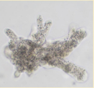
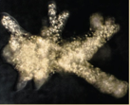
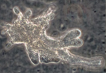
Summary of Microscopic Instruments – Table 3.1 (1)
Table 3.1 A Summary of Microscopic Instruments and Their Characteristics
Instrument | Mechanism | Comment
Light Microscopes | Visible light passes through a series of lenses to produce a magnified image. | Relatively easy to use; considerably less expensive than electron and scanning probe microscopes.
Bright-field | Illuminates the field of view evenly and generates a bright background. | Most common type of microscope.
Dark-field | Light is directed toward the specimen at an angle. | Makes unstained cells easier to see; organisms stand out as bright objects against a dark background.
Phase-contrast | Increases contrast by amplifying differences in refractive index. | Dense material appears darker than normal.
All: © McGraw-Hill Education/Lisa Burgess, photographer

Slide 25
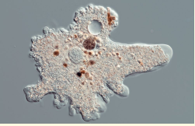
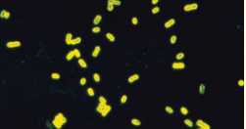
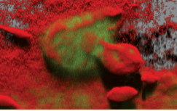
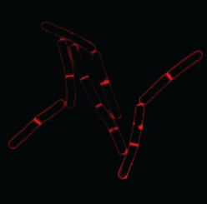
Summary of Microscopic Instruments – Table 3.1 (2)
Instrument | Mechanism | Comment
Light Microscopes | Visible light passes through a series of lenses to produce a magnified image. | Relatively easy to use; considerably less expensive than electron and scanning probe microscopes.
Differential Interference contrast | Two light beams pass through the specimen and then recombine. | The image of the specimen appears three-dimensional.
Fluorescence | Projects ultraviolet light, causing fluorescent molecules in the specimen to emit longer wavelength light. | Used to observe cells stained or tagged with a fluorescent dye.
Scanning laser | Mirrors scan a laser beam across successive regions and planes of a specimen. From that information, a computer constructs an image. | Used to obtain a three-dimensional image of a structure that has been stained with a fluorescent dye; provides detailed sectional views of intact cells.
Super-resolution | Complex illumination mechanisms and merged data are used to construct the image. | Higher resolving power than that of a conventional fluorescence microscope.
From top to bottom: © Gerd Guenther/Science Source; © Evan Roberts; © A. Harrer, B. Pitts, P. Stewart/MSU-CBE; © Dr. Henrik Strah/Newcastle University

Slide 26
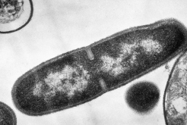
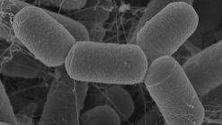
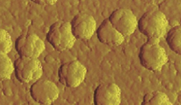
Summary of Microscopic Instruments – Table 3.1 (3)
Instrument | Mechanism | Comment
Electron Microscopes | Electron beams are used in place of visible light to produce the magnified image. | Can clearly magnify images 1000,000x.
Transmission | Transmits a beam of electrons through a specimen. | Complicated specimen preparation is required.
Scanning | A beam of electrons scans back and forth over the surface of a specimen. | Used for observing surface details; produces a three-dimensional effect.
Scanning Probe Microscopes | A physical probe is used to produce detailed images of surfaces. | Produces a map showing the bumps and valleys of the sample’s surface.
Atomic Force | Probe moves in response to even the slightest force between it and the sample. | No special sample preparation required; produces a three-dimensional effect.
Top: © Lee D. Simon/Science Source; Middle: © Dennis Kunkel Microscopy/SPL/Science Source; Bottom: Source: Dr. Mary Ng Mah Lee, National University of Singapore/CDC

Slide 27
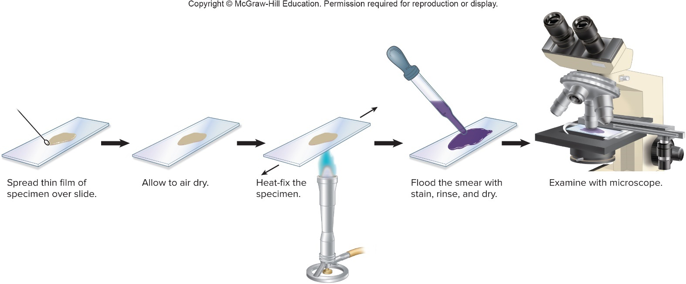
Preparing Specimens for Light Microscopy – Figure 3.14
Wet mount uses a drop of liquid specimen overlaid with a coverslip
Allows observation of living organisms
Can be difficult to see when they are colorless
Smear involves drying and fixing specimen before staining to visualize

Slide 28
Preparing Specimens for Light Microscopy – Table 3.2
Table 3.2 A Summary of Stains and Their Characteristics
Stain | Characteristic
Simple Stains | A basic dye is used to stain cells. Easy way to increase the contrast between otherwise colorless cells and a colorless background.
Differential Stains | A multistep procedure is used to stain cells and distinguish one group of microorganisms from another.
Gram Stain | Used to separate bacteria into two major groups: Gram-positive and Gram-negative. The staining characteristics of these groups reflect a fundamental difference in the chemical structure of their cell walls. This is by far the most widely used staining procedure.
Acid-fast stain | Used to detect organisms that do not easily take up stains, particularly members of the genus Mycobacterium.
Special Stains | A special procedure is used to stain specific cell structures.
Capsule stain | The common procedure darkens the background, so the capsule stands out as a clear area surrounding the cell.
Endospore stain | Stains endospores, a type of dormant cell that does not readily take up stains. Endospores are produced by Bacillus and Clostridium species.
Flagella stain | The staining agent adheres to and coats the otherwise thin flagella, making them visible with the light microscope
Fluorescent Dyes and Tags | Fluorescent dyes and tags absorb ultraviolet light and then emit light of a longer wavelength.
Fluorescent dyes | Some fluorescent dyes bind to compounds found in all cells; others bind to compounds specific to only certain types of cells.
Fluorescent tags | Antibodies to which a fluorescent molecule has been attached are used to tag specific molecules.

Slide 29
Simple Staining
Simple staining uses a single dye to stain the specimen
Basic dyes carry positive charge
Attracted to negatively charged cellular components
Examples are methylene blue and crystal violet
Acidic dyes can be used for negative staining
Cells repel the negatively charged dye; colorless cells stand out against background
Can be done as wet mount
Notes:
29

Slide 30
Differential Staining
Differential staining used to distinguish different groups of bacteria
Gram stain most widely used for bacteria
Two groups: Gram-positive bacteria and Gram-negative bacteria
Reflects fundamental difference in cell wall structure

Slide 31
Gram Stain – Figure 3.15a
Flood smear with primary stain
Rinse and flood with iodine, a mordant that stabilizes the dye in the cell
Rinse and briefly add alcohol, a decolorizing agent, to remove dye complex from Gram-negative cells
Rinse and flood smear with counterstain that adds a different color to Gram-negative cells
Jump to Gram Stain – Figure 3.15a Long Description
Notes:
31

Slide 32
Differential Staining – Figure 3.15
Success of Gram stain relies upon length of time of decolorizing step and age of culture
b: © McGraw-Hill Education/Lisa Burgess, photographer
Notes:
32

Slide 33
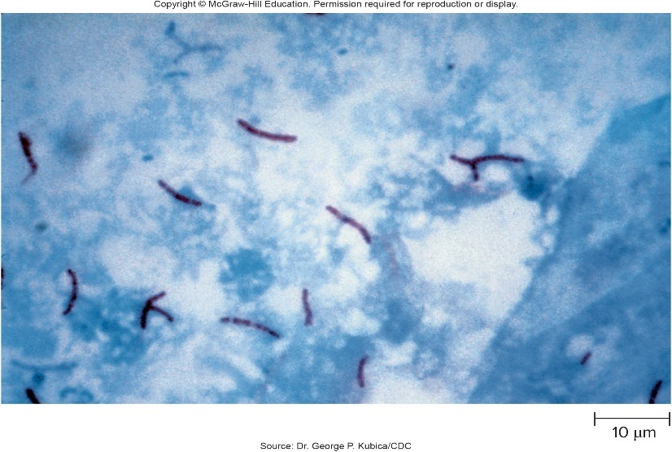
Acid-Fast Stain – Figure 3.16
Acid-fast stain used to detect organisms that do not readily take up dyes
Detects Mycobacterium species such as causative agents of tuberculosis and Hansen’s disease (leprosy)
Cell wall contains high concentrations of mycolic acids
Multi-step procedure
Primary stain is concentrated red dye
Acid-fast cells retain red dye after being flooded with acid-alcohol
Methylene blue used as counterstain
Source: Dr. George P. Kubica/CDC

Slide 34
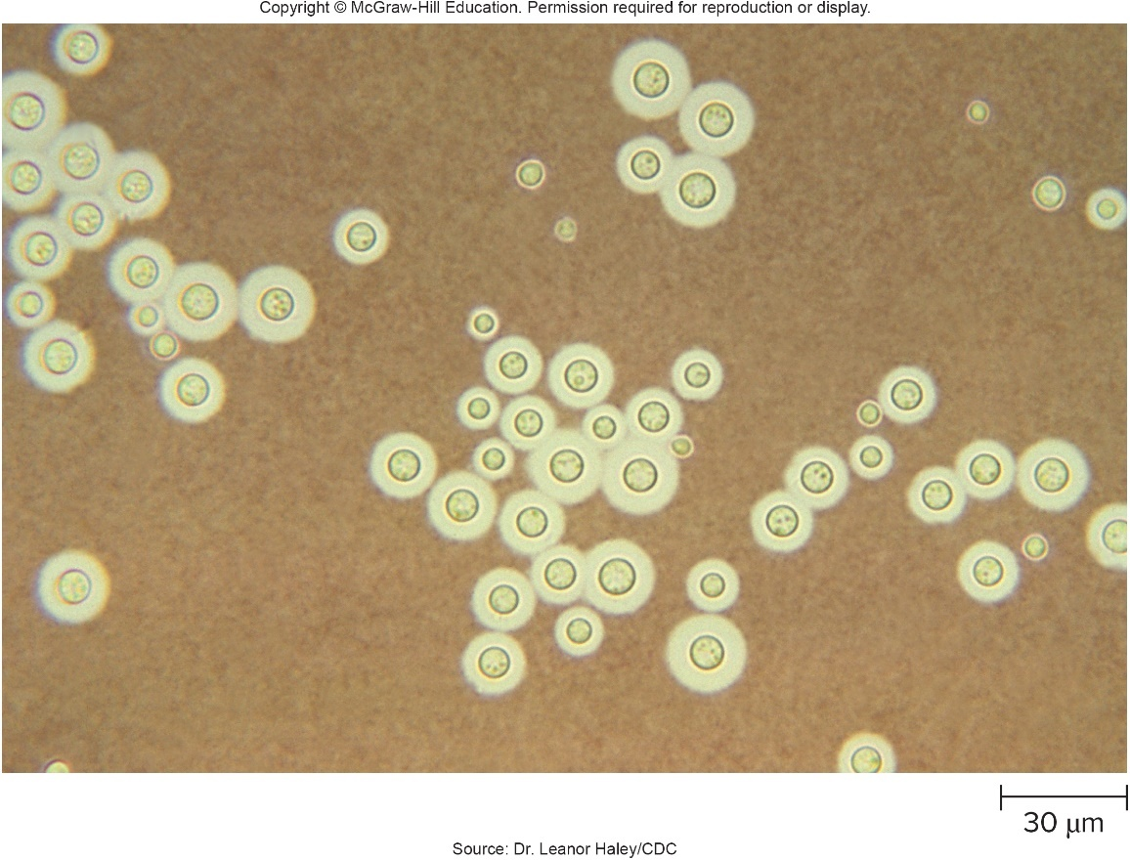
Special Stains to Observe Cell Structures – Figure 3.17
Capsule stain allows observation of gel-like layer that surrounds some microbes
Capsule stains poorly, so background is stained to make capsule visible
India ink added to wet mount is common method
Source: Dr. Leanor Haley/CDC

Slide 35
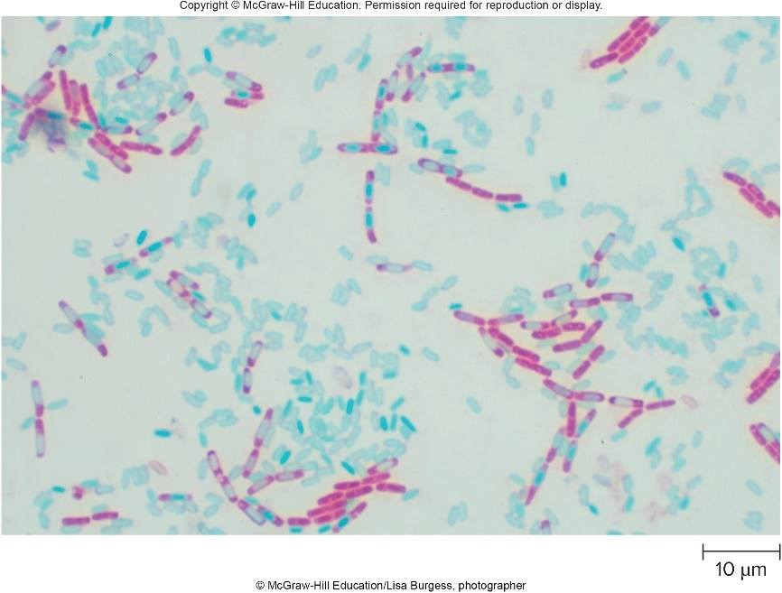
Special Stains to Observe Cell Structures – Figure 3.18
Endospore stain allows visualization of endospores, resistant dormant cells often formed by Bacillus and Clostridium
Endospore resists Gram stain; appears as clear object
Endospore stain uses heat to facilitate uptake of the primary dye malachite green by endospore
Counterstain (usually safranin) colors other cells pink
© McGraw-Hill Education/Lisa Burgess, photographer

Slide 36
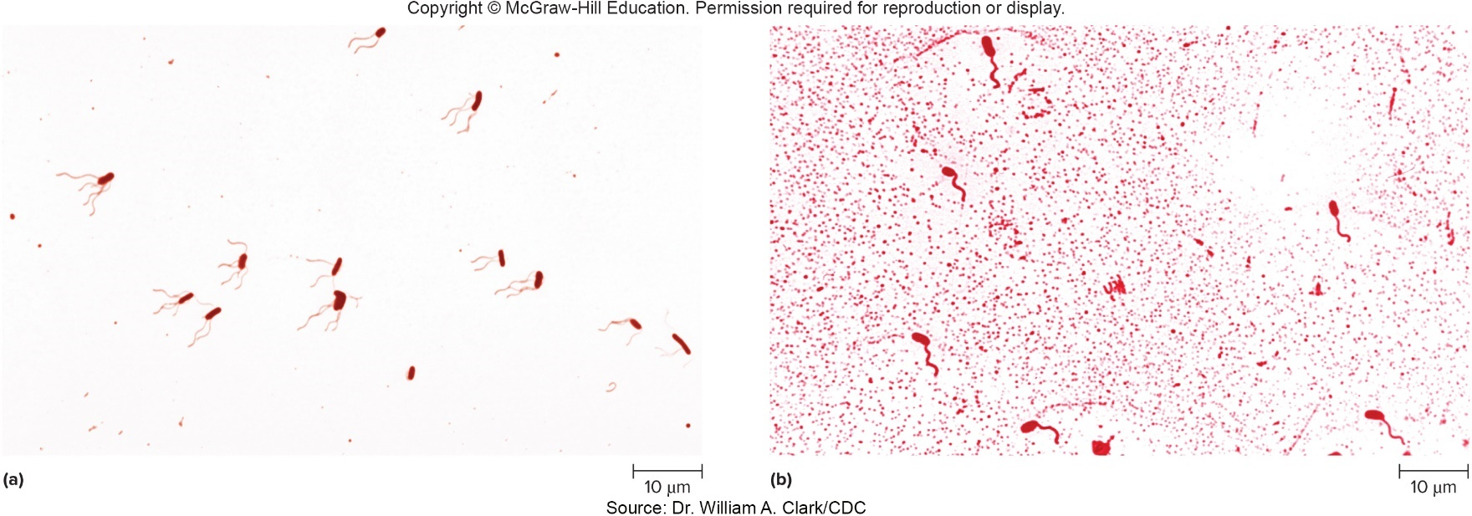
Special Stains to Observe Cell Structures – Figure 3.19
Flagella stain uses a substance that makes the dye adhere to thin flagella, making them visible
Presence and distribution of flagella can help in identification
Peritrichous: flagella surround cell
Polar: flagellum on one end
both: Source: Dr. William A. Clark/CDC

Slide 37
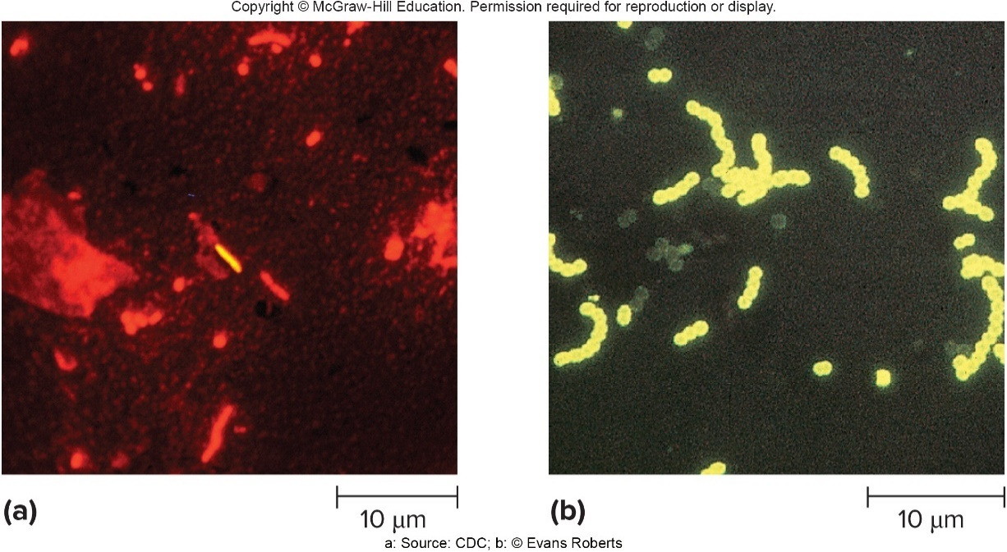
Special Stains to Observe Cell Structures – Figure 3.20
Fluorescent Dyes and Tags
Some dyes bind to structures in all cells
Some are changed by cellular processes: can distinguish between living and dead cells
Immunofluorescence uses fluorescent dye-antibody labels to tag a unique microbe protein
a: Source: CDC; b: © Evan Roberts

Slide 38
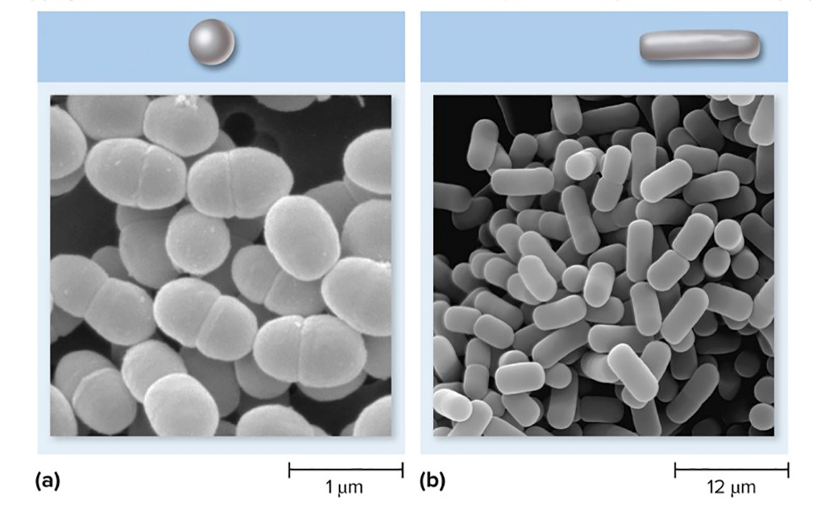
Morphology of Prokaryotic Cells: Shapes – Figure 3.21a to b
Two types most common:
Coccus: spherical
Rod: cylindrical
Also called a bacillus
Short rods sometimes called coccobacillus
Coccus
Rod (bacillus)
a: ©SciMAT/Science Source; b: ©Dennis Kunkel Microscopy/SPL/ Science Source

Slide 39
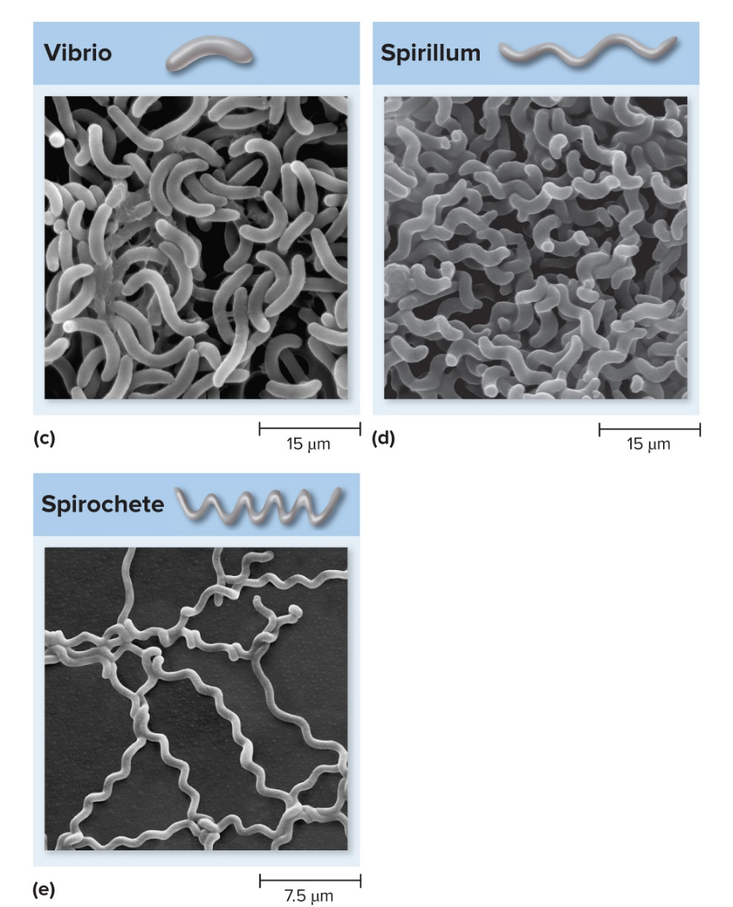
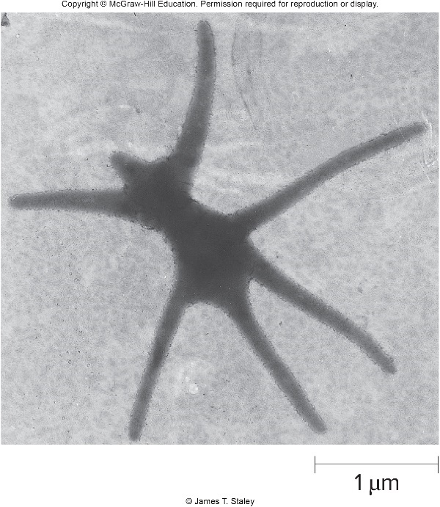
Morphology of Prokaryotic Cells: Shapes – Figures 3.21c-e and 3.22
Variety of other shapes:
Vibrio, spirillum, spirochete
Pleomorphic (many shapes)
Great diversity often found in low nutrient environments
Far left: © James Staley; c: ©Dennis Kunkel Microscopy/SPL/Science Source; d: ©Dennis Kunkel Microscopy/SPL/ Science Source; e: ©Dennis Kunkel Microscopy/SPL/Science Source
Notes:
39

Slide 40
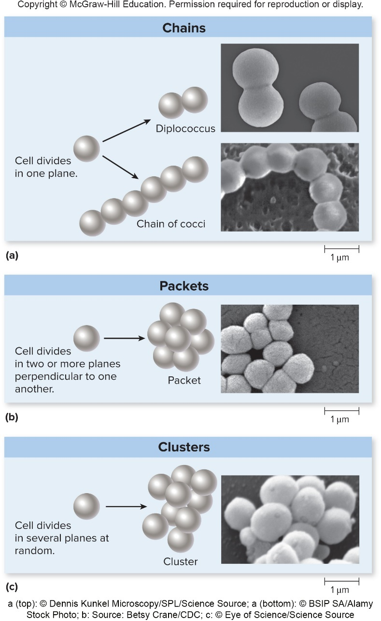
Morphology of Prokaryotic Cells: Arrangements – Figure 3.23
Most prokaryotes divide by binary fission
Cells often stick together following division to form characteristic groupings
Examples:
Neisseria gonorrhoeae (diplococci)
Streptococcus (chains)
Sarcina (cubical packets)
Staphylococcus (grape-like clusters)
a (top): ©Dennis Kunkel Microscopy/SPL/Science Source; a (bottom): ©BSIP SA/Alamy Stock Photo; b: Source: Betsy Crane/CDC; c: ©Eye of Science/Science Source

Slide 41
Multicellular Associations
Some prokaryotes live as multicellular associations
Myxobacteria form swarms of cells that glide over moist surfaces as a pack
Collectively release enzymes and degrade organic material, including other bacterial cells
When water or nutrients become limiting, cells form fruiting body visible to naked eye
Most bacteria on surfaces in natural habitat form polymer-encased communities called biofilms

Slide 42
Prokaryotic Cells
Surface layers are cell envelope
Cytoplasmic membrane
Cell wall
Capsule (if present)
Cytoplasm
Nucleoid
Location of chromosome
Locomotor appendages (if present)

Slide 43
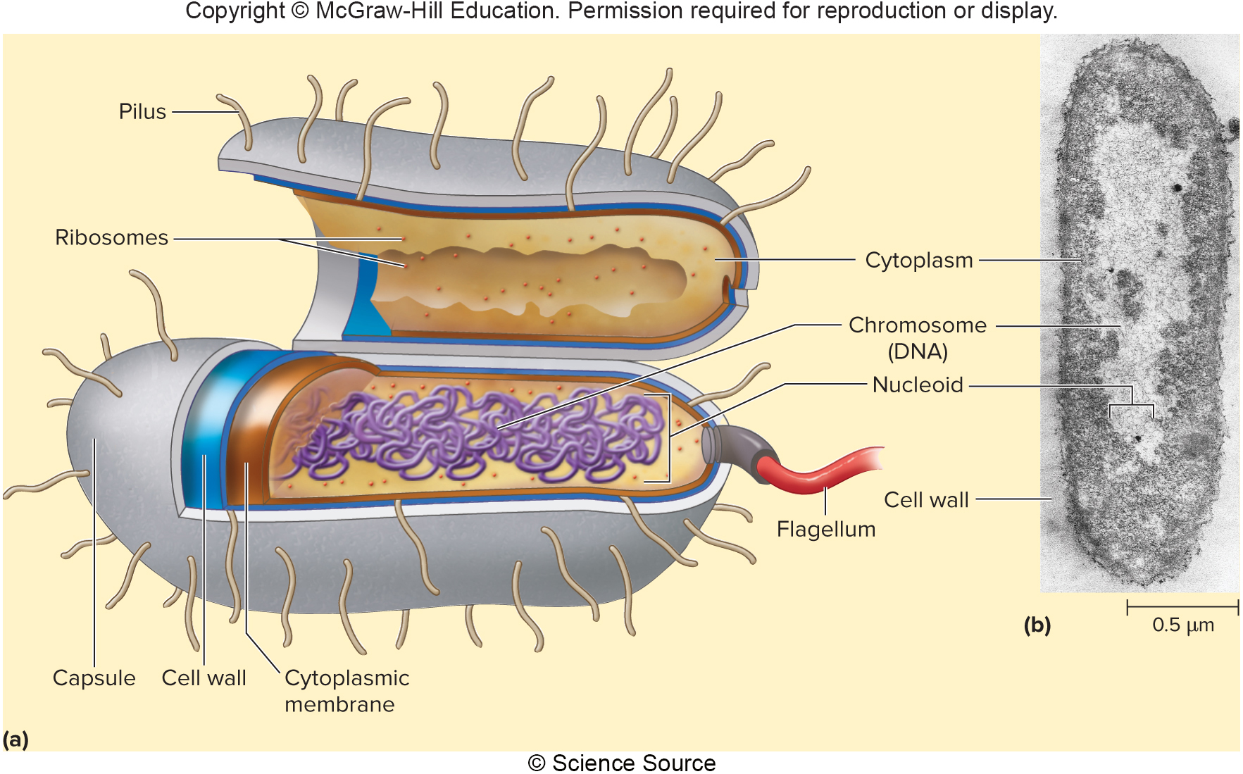
Prokaryotic Cells – Figure 3.24
Jump to Prokaryotic Cells – Figure 3.24 Long Description
b: © Science Source
Notes:
43

Slide 44
Prokaryotic Cells – Table 3.3 (1)
Table 3.3 Typical Prokaryotic Cell Structures
Structure | Characteristics
Structures Outside the Cell Wall Filamentous appendages | Composed of protein subunits that form a helical chain.
Flagella | Provide the most common mechanism of motility.
Pili | Different types of pili have different functions. The common types, often called fimbriae, allow cells to adhere to surfaces. A few types are used for twitching or gliding motility. Sex pili are involved in DNA transfer.
Capsules and slime layers | Layers outside the cell wall, usually made of polysaccharide.
Capsule | Distinct and gelatinous. Allows bacteria to adhere to specific surfaces; allows some organisms to avoid the body’s defense systems and thus cause disease.
Slime layer | Diffuse and irregular. Allows bacteria to adhere to specific surfaces.
Cell Wall | Peptidoglycan provides rigidity to bacterial cell walls, preventing the cells from lysing.
Gram-positive | Thick layer of peptidoglycan that contains teichoic acids and lipoteichoic acids.
Gram-negative | Thin layer of peptidoglycan surrounded by an outer membrane. The outer layer of the outer membrane is lipopolysaccharide.

Slide 45
Prokaryotic Cells – Table 3.3 (2)
Table 3.3 Typical Prokaryotic Cell Structures
Structure | Characteristics
Cytoplasmic Membrane | Phospholipid bilayer embedded with proteins. Surrounds the cytoplasm, separating it from the external environment. Also transmits information about the external environment to the inside of the cell.
Internal Components DNA | Carries the genetic information of the cell.
Chromosome | Carries the genetic information required by a cell. Typically a single, circular, double-stranded DNA molecule.
Plasmid | Generally carries only genetic information that may be advantageous to a cell in certain situations.
Endospore | A type of dormant cell that is extraordinarily resistant to heat, desiccation, ultraviolet light, and toxic chemicals.
Cytoskeleton | Protein framework involved in cell division and control of cell shape.
Gas vesicles | Small, rigid structures that provide buoyancy to a cell.
Granules | Accumulations of high-molecular-weight polymers, synthesized from a nutrient available in relative excess.
Ribosomes | Involved in protein synthesis. Two subunits, 30S and 50S, join to form the 70S ribosome.

Slide 46
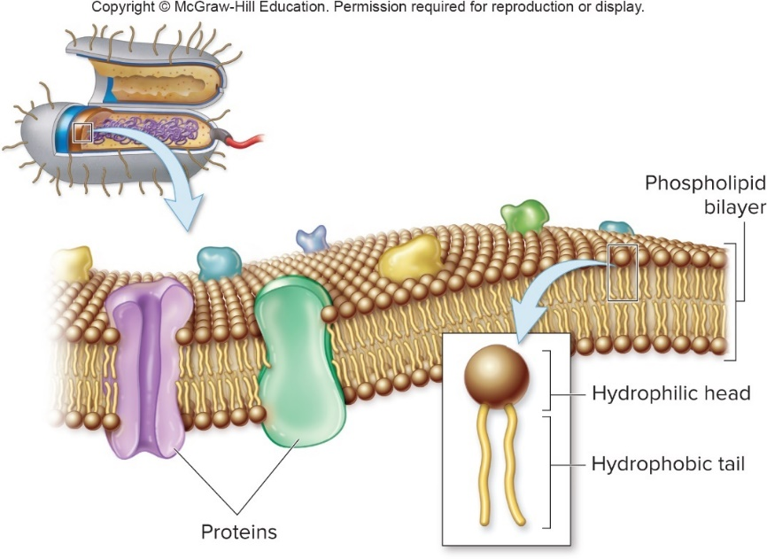
The Cytoplasmic Membrane – Figure 3.25
Cytoplasmic membrane defines boundary of cell
Phospholipid bilayer embedded with proteins
Hydrophobic tails face in; hydrophilic tails face out
Proteins serve numerous functions
Selective gates
Sensors of environmental conditions
Enzymes
Fluid mosaic model:
proteins drift about in lipid bilayer

Slide 47
The Cytoplasmic Membrane
Bacteria and Archaea have same general structure of cytoplasmic membranes
Distinctly different phospholipid compositions
Lipid tails of Archaea are not fatty acids
Connected differently to glycerol

Slide 48
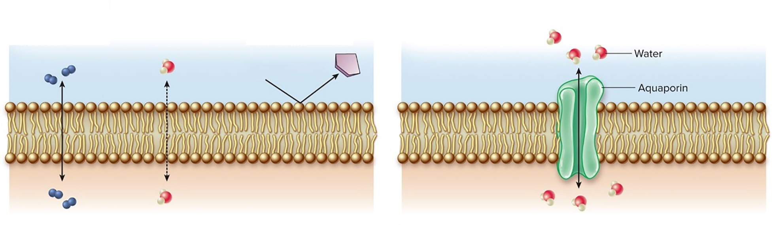
Permeability of Cytoplasmic Membrane – Figure 3.26
Cytoplasmic membrane is selectively permeable
O₂, CO₂, N₂, small hydrophobic molecules, and water pass freely
Some cells facilitate water passage with aquaporins
Other molecules must be moved across membrane via transport systems
Pass through easily: Gases ($O_{2}$, ${CO}_{2}$, $N_{2}$) Small hydrophobic molecules
Passes through: Water
Do not pass through:
Sugars
lons
Amino acids
ATP
Macromolecules
The cytoplasmic membrane is selectively permeable. Gases, small hydrophobic molecules, and water are the only substances that pass freely through the phospholipid bilayer.
Aquaporins allow water to pass through the cytoplasmic membrane more easily.

Slide 49
Permeability of Cytoplasmic Membrane
Simple Diffusion
Movement from high to low concentration until equilibrium is reached
Speed of diffusion depends on concentration
The greater the difference in concentration on either side of a membrane, the higher the rate of diffusion

Slide 50
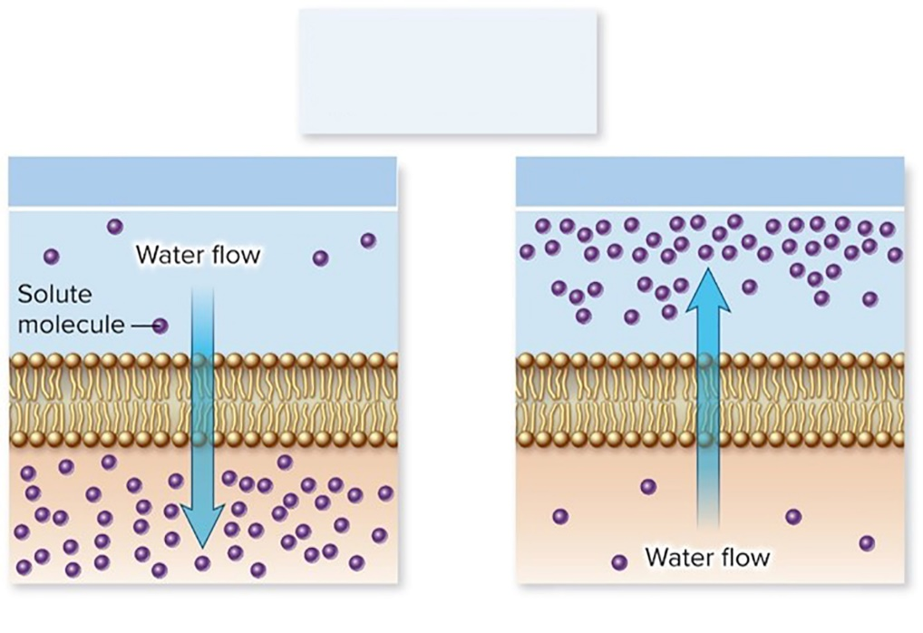
Permeability of Cytoplasmic Membrane – Figure 3.27 (1)
Osmosis: Diffusion of water across a selectively permeable membrane due to unequal solute concentrations
Water diffuses from high water concentration (low solute concentration) to low water concentration (high solute concentration)
Water flows from hypotonic to hypertonic solution
No net water flow between isotonic solutions
Water flows across a membrane toward the hypertonic solution.
Hypotonic solution
Hypertonic solution
Notes:
50

Slide 51
Permeability of Cytoplasmic Membrane – Figure 3.27 (2)
Environment of prokaryotes are typically dilute (hypotonic)
Water flows into the cell where cytoplasm is a concentrated solution (hypertonic)
Cell wall prevents cell from bursting
Jump to Permeability of Cytoplasmic Membrane – Figure 3.27 (2) Long Description
Notes:
51

Slide 52
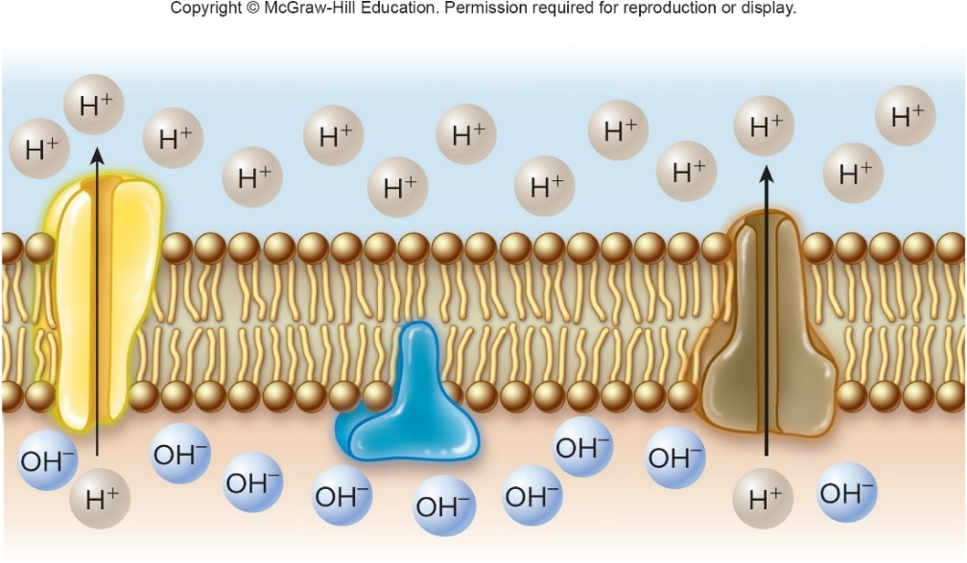
Cytoplasmic Membrane in Energy Transformation – Figure 3.28
Electron Transport Chain (ETC) embedded in cytoplasmic membrane
Uses energy from electrons to move protons out of cell
Creates electrochemical gradient across membrane
Energy called proton motive force
Harvested to drive ATP synthesis and some forms of transport, motility

Slide 53
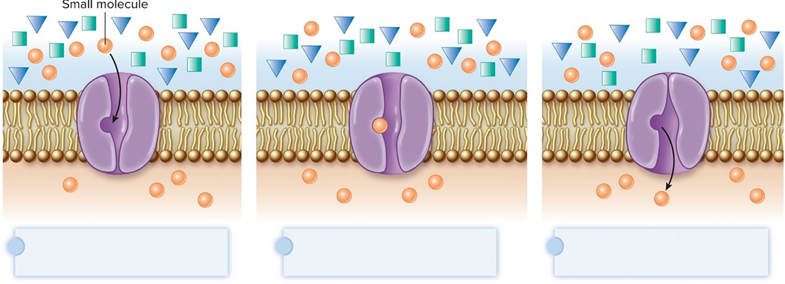
Transport of Small Molecules Across Cytoplasmic Membrane – Figure 3.29
Most molecules must pass through proteins functioning as selective gates
Transport systems: permeases or carriers
Membrane-spanning
Highly specific: carriers transport certain molecule type
A given transport protein recognizes a specific molecule.
Binding of that molecule changes the shape of the transport protein.
The molecule is released on the other side of the membrane.

Slide 54
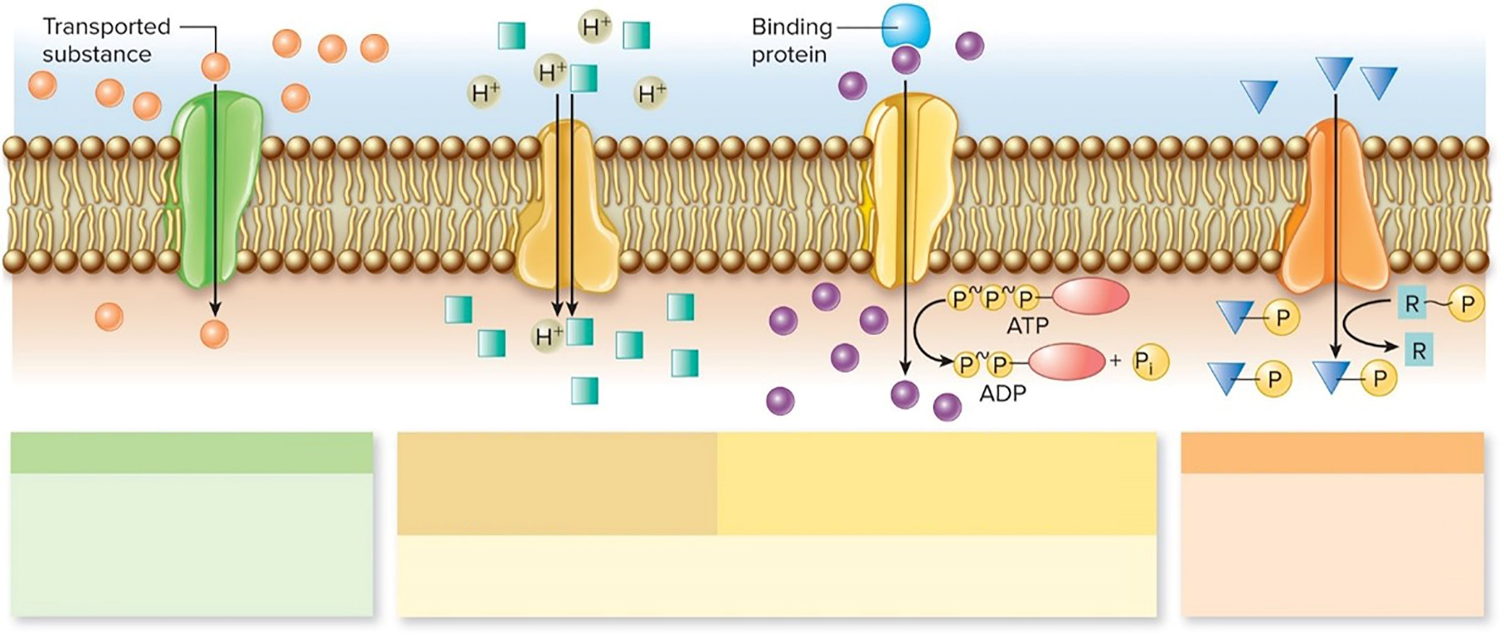
Transport of Small Molecules Across Cytoplasmic Membrane - Figure 3.30 (1)
Facilitated diffusion is a form of passive transport
Movement down gradient; no energy required
Not typically useful in low-nutrient environments
Facilitated diffusion
Active transport, using proton motive force as an energy source.
Active transport, using ATP as an energy source. A binding protein gathers the transported molecules.
Group translocation
Transporter allows a substance to move across the membrane, but only down its concentration gradient.
Transporter chemically alters the substance as it is transported across the membrane.
Transporter uses energy (ATP or proton motive force) to move a substance across the membrane against a concentration gradient.

Slide 55
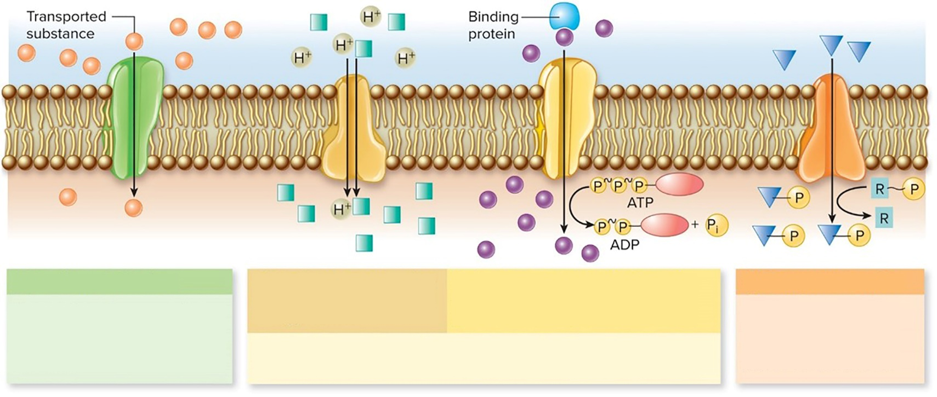
Transport of Small Molecules Across Cytoplasmic Membrane - Figure 3.30 (2)
Active transport requires energy
Moves material against concentration gradient
Sometimes driven by proton motive force
Example is efflux pump
Sometimes driven by ATP (ABC transporter)
Facilitated diffusion
Active transport, using proton motive force as an energy source.
Active transport, using ATP as an energy source. A binding protein gathers the transported molecules.
Group translocation
Transporter allows a substance to move across the membrane, but only down its concentration gradient.
Transporter chemically alters the substance as it is transported across the membrane.
Transporter uses energy (ATP or proton motive force) to move a substance across the membrane against a concentration gradient.
Notes:
55

Slide 56
Transport of Small Molecules Across Cytoplasmic Membrane - Figure 3.30 (3)
Group Translocation is common in bacteria
Chemically alters compound during passage through cytoplasmic membrane
Phosphorylation common
Often used by bacteria to bring glucose into the cell
Facilitated diffusion
Active transport, using proton motive force as an energy source.
Active transport, using ATP as an energy source. A binding protein gathers the transported molecules.
Group translocation
Transporter allows a substance to move across the membrane, but only down its concentration gradient.
Transporter chemically alters the substance as it is transported across the membrane.
Transporter uses energy (ATP or proton motive force) to move a substance across the membrane against a concentration gradient.
Notes:
56

Slide 57
Transport of Small Molecules Across Cytoplasmic Membrane – Table 3.4
Table 3.4 Transport Mechanisms Used by Prokaryotic Cells
Transport Mechanism | Characteristics
Facilitated Diffusion | Rarely used by prokaryotes. Exploits a concentration gradient to move molecules; can only eliminate a gradient, not create one. No energy is used.
Active Transport | Energy is used to accumulate molecules against a concentration gradient.
Transporters that use proton motive force | As a proton is allowed into the cell, another substance is either brought along or expelled.
ABC transporters | ATP is used as an energy source. Binding proteins deliver a molecule to the transporter.
Group Translocation | The transported molecule is chemically altered as it passes into the cell.

Slide 58
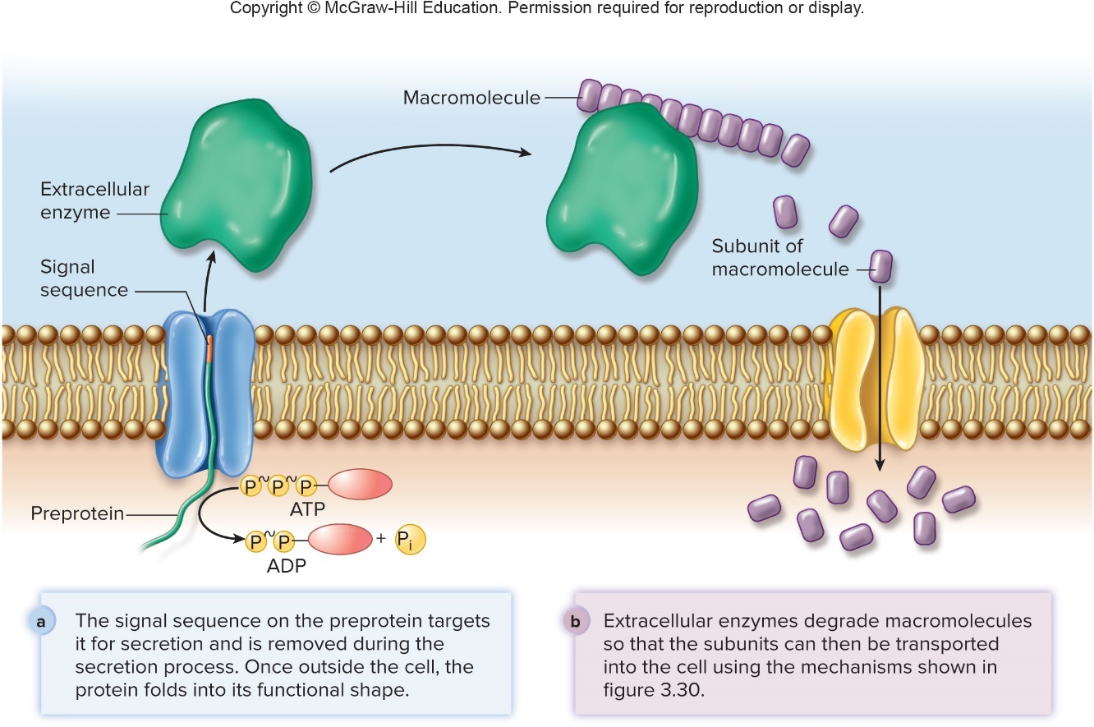
Transport of Small Molecules Across Cytoplasmic Membrane – Figure 3.31
Protein secretion: active movement out of cell
Examples: extracellular enzymes, external structures
Polypeptides tagged for secretion via signal sequence of amino acids
Jump to Transport of Small Molecules Across Cytoplasmic Membrane – Figure 3.31 Long Description

Slide 59
The Cell Wall of Prokaryotic Cells
Cell wall is strong, somewhat rigid structure that prevents cell from bursting
Distinguishes two main types of bacteria:
Gram-positive
Gram-negative

Slide 60
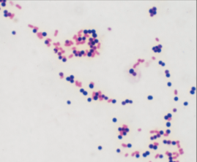
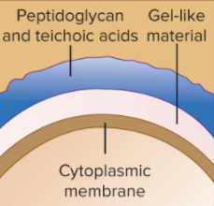
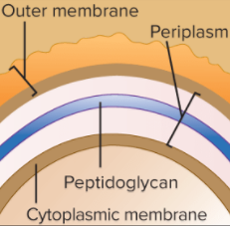
The Cell Wall of Prokaryotic Cells – Table 3.5
Table 3.5 Comparison of Features of Gram-Positive and Gram-Negative Bacteria
 | Gram-Positive | Gram-Negative
Color of Gram-Stained Cell | Purple | Pink
Representative Genera | Bacillus, Staphylococcus, Streptococcus | Escherichia, Neisseria, Pseudomonas
Distinguishing Structures/Components
Peptidoglycan | Thick layer | Thin layer
Teichoic acids | Present | Absent
Outer membrane | Absent | Present
Lipopolysaccharide (endotoxin) | Absent | Present
Porin proteins | Absent (unnecessary because there is no outer membrane) | Present; allow molecules to pass through outer membrane
General Characteristics
Sensitivity to penicillin | Generally more susceptible (with notable exceptions) | Generally less susceptible (with notable exceptions)
Sensitivity to lysozyme | Yes | No
Top left: © McGraw-Hill Education/Lisa Burgess, photographer

Slide 61
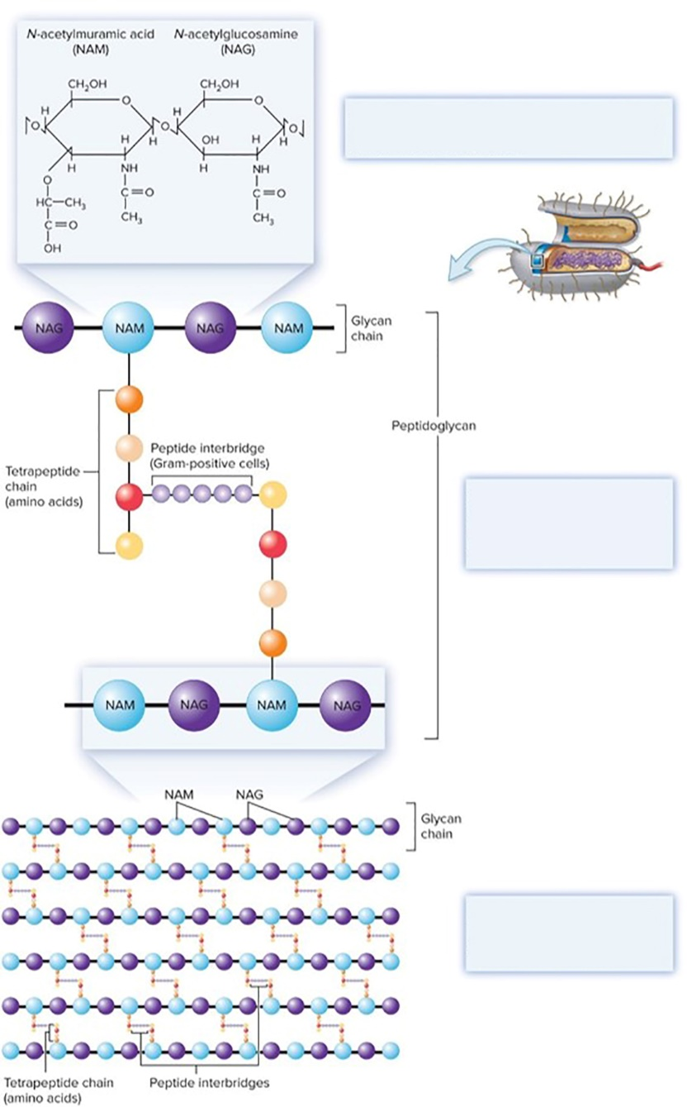
Peptidoglycan – Figure 3.32
Peptidoglycan found only in bacteria
Alternating series of subunits form glycan chains
N-acetylmuramic acid (NAM)
N-acetylglucosamine (NAG)
Tetrapeptide chain links glycan chains
Peptide interbridge in Gram-positive cells
Chemical structure of N-acetylglucosamine (NAG) and N-acetylmuramic acid (NAM); the ring structure of each molecule is glucose.
Glycan chains are composed of alternating subunits of NAG and NAM. They are cross-linked via their tetrapeptide chains to create peptidoglycan.
Interconnected glycan chains form a large sheet. Multiple connected layers create a three-dimensional molecule.

Slide 62
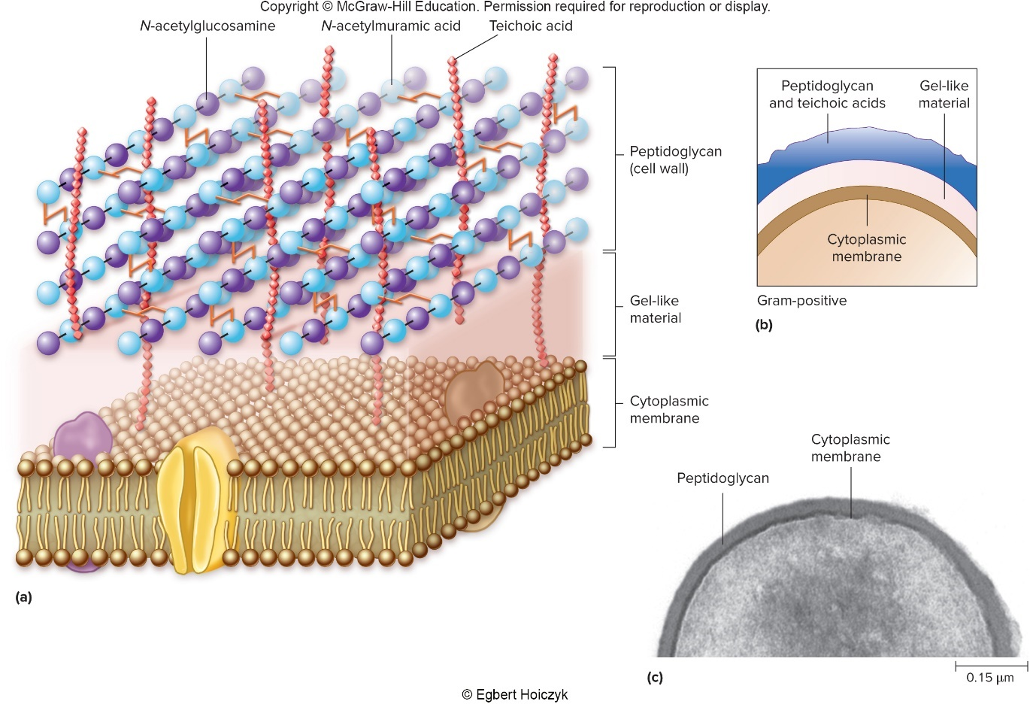
The Gram-Positive Cell Wall – Figure 3.33
Relatively thick peptidoglycan layer
Teichoic acids extend above peptidoglycan layer
Gel-like material below peptidoglycan layer
c: © Egbert Hoiczyk

Slide 63
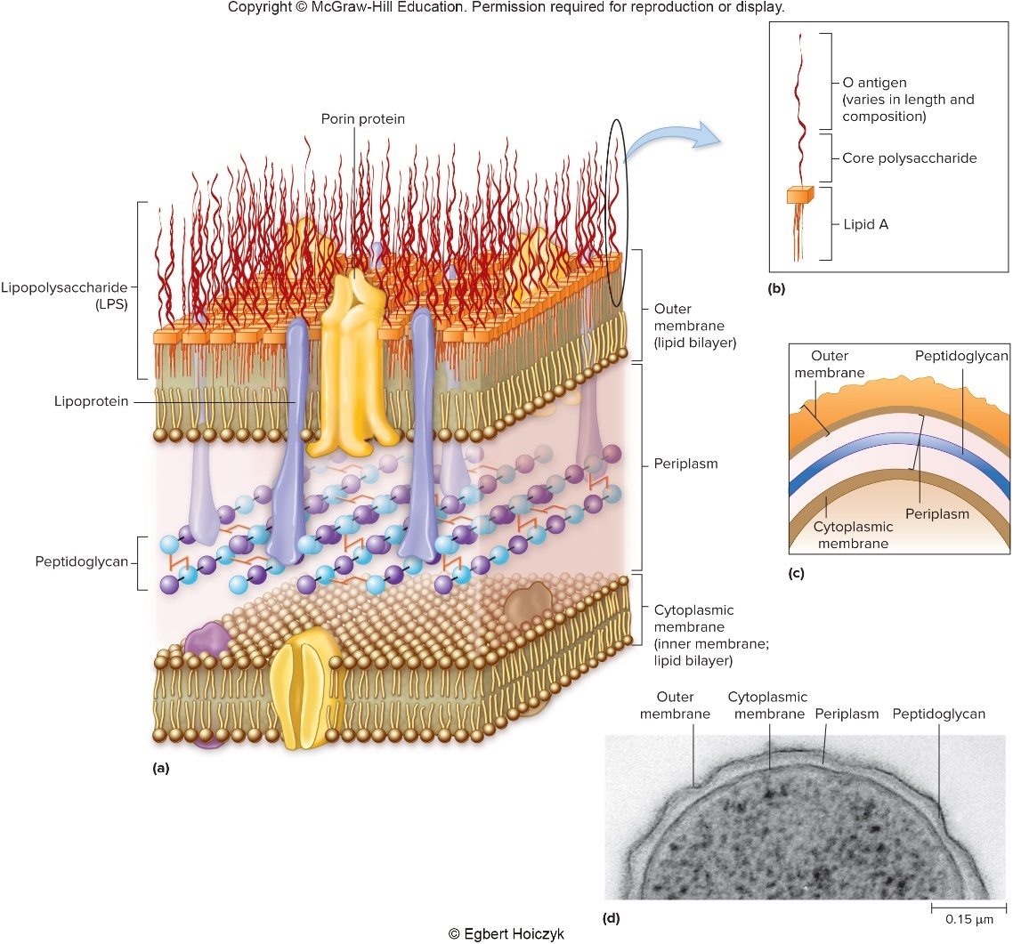
The Gram-Negative Cell Wall – Figure 3.34
Thin peptidoglycan layer
Outside is unique outer membrane
© Egbert Hoiczyk

Slide 64
The Gram-Negative Cell Wall (1)
Outer membrane: outside layer is lipopolysaccharide (LPS)
Signals immune system of invasion by Gram-negative bacteria
Small levels elicit response to eliminate invader
LPS is also called endotoxin
Large amounts accumulating in bloodstream can be deadly
Includes Lipid A
Recognized by immune system
Includes O antigen
Can be used to identify species or strains

Slide 65
The Gram-Negative Cell Wall (2)
Outer membrane blocks passage of many molecules including certain antimicrobial medications
Small molecules and ions can cross via porins
Secretion systems important in pathogenesis
Between cytoplasmic membrane and outer membrane is periplasmic space
Filled with gel-like periplasm
Exported proteins accumulate unless specifically moved across outer membrane
Binding proteins of ABC transport systems

Slide 66
Antibacterial Substances That Target Peptidoglycan
Interference with peptidoglycan can weaken cell wall and allow cell to burst
Penicillin interferes with peptidoglycan synthesis
Prevents cross-linking of adjacent glycan chains
Usually more effective against Gram-positive bacteria than Gram-negative bacteria
Outer membrane of Gram-negative cells blocks access
Derivatives have been developed that can cross
Lysozyme breaks bonds linking glycan chains
Enzyme found in tears, saliva, other body fluids
Destroys structural integrity of peptidoglycan molecule
Usually more effective against Gram-positive bacteria

Slide 67
Cell Wall Type and the Gram Stain
Crystal violet stains inside of cell
Gram-positive cell wall prevents crystal violet–iodine complex from being washed out
Decolorizing agent dehydrates thick layer of peptidoglycan; desiccated state acts as barrier
Solvent action of decolorizing agent damages outer membrane of Gram-negative cell wall
Thin layer of peptidoglycan cannot retain dye complex

Slide 68
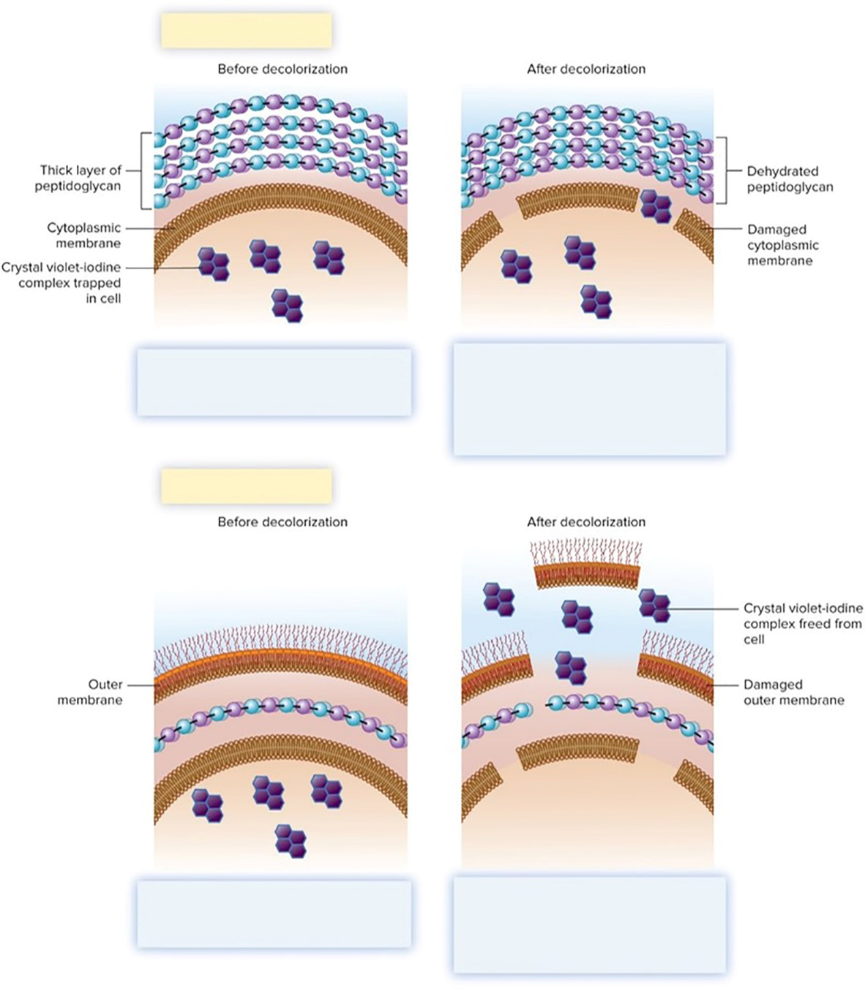
Cell Wall Type and the Gram Stain – Figure 3.35
Gram-positive cell wall
Large crystal violet-iodine complexes form within the cytoplasm as a result of the first two steps of the Gram stain.
The decolorizing agent dehydrates the thick layer of peptidoglycan, causing it to become a tight mesh-like structure that prevents the crystal violet-iodine complexes from being washed out of the cell.
Gram-negative cell wall
Large crystal violet-iodine complexes form within the cytoplasm as a result of the first two steps of the Gram stain.
The decolorizing agent damages the outer membrane. The thin peptidoglycan layer cannot prevent the crystal violet-iodine complexes from being washed out of the cell.

Slide 69
Bacteria That Lack a Cell Wall – Figure 3.36
Some bacteria lack a cell wall
Mycoplasma species are flexible
Unaffected by penicillin and lysozyme
Cytoplasmic membrane contains sterols that increase its strength
© Don W. Fawcett/Science Source

Slide 70
Cell Walls of Archaea
Members of Archaea have variety of cell walls
Probably due to wide range of environments
Includes extreme environments
Archaea less well studied than Bacteria
No peptidoglycan, but some have similar molecule pseudopeptidoglycan
Many have S-layers that self-assemble
Built from sheets of flat protein or glycoprotein subunits

Slide 71
Capsules and Slime Layers – Figure 3.37
Gel-like layer outside cell wall protects or allows attachment
Capsule: distinct, gelatinous
Slime layer: diffuse, irregular
Most composed of glycocalyx (sugar shell), but some are polypeptides
Once attached to a surface, cells can grow as biofilm
Polymer-encased community
Example: dental plaque
Some capsules allow bacteria to evade host immune system
a: © Scimat/Science Source; b: © Scimat/Science Source

Slide 72
Flagella – Figure 3.38
Flagella involved in motility
Spin like propellers to move cell
Some important in disease
Helicobacter pylori
Numbers and arrangements help with characterization of bacteria
a: ©CAMR/A. Barry Dowsett/Science Source; b: ©Dennis Kunkel Microscopy/SPL/ Science Source

Slide 73
Flagella – Figure 3.39
Three parts of bacterial flagellum:
Basal body: anchors to cell wall and cytoplasmic membrane
Hook
Filament: made up of flagellin subunits
Archael flagella:
Chemically distinct
Use energy from ATP instead of proton motive force

Slide 74
Chemotaxis – Figure 3.40
Chemotaxis: Bacteria sense a chemical and move toward it (nutrient) or away from it (toxin)
Movement is series of runs (straight line) and tumbles (changes in direction) due to coordinated rotation of flagella
Jump to Chemotaxis – Figure 3.40 Long Description

Slide 75
Chemotaxis – Figure 3.41
Other responses observed:
Aerotaxis
Magnetotaxis
Thermotaxis
Phototaxis
©Dennis Kunkel Microscopy/SPL/Science Source
Notes:
75

Slide 76
Pili – Figure 3.42
Pili (singular: pilus) are shorter than flagella
Types that allow surface attachment also called fimbriae
Twitching motility and gliding motility involve pili
Sex pilus used to join bacteria for a type of DNA transfer
a: ©Dennis Kunkel/SPL/Science Source; b: Source: Harley W. Moon/U.S. Department of Agriculture

Slide 77
Internal Components of Prokaryotic Cells – Figure 3.43
Chromosome forms gel-like region: the nucleoid
Single circular double-stranded DNA molecule
Packed tightly via binding proteins and supercoiling
Plasmids
Do not encode essential genetic information
Similar structure to chromosome, but much smaller
May be shared with other bacteria; antibiotic resistance can spread this way
©CNRI/SPL/Science Source

Slide 78
Internal Components of Prokaryotic Cells – Figure 3.44
Ribosomes involved in protein synthesis
Facilitate joining of amino acids
Relative size and density expressed as S (Svedberg unit) that reflects how fast they settle when centrifuged
Prokaryotic ribosomes are 70S
Composed of 30S and 50S subunits
Eukaryotic ribosomes are 80S
Important medically: antibiotics
impacting 70S ribosome do not
affect 80S ribosome

Slide 79
Internal Components of Prokaryotic Cells
Cytoskeleton: interior protein framework
Bacterial proteins similar to eukaryotic cytoskeleton have been characterized
Likely involved in cell division and controlling cell shape
Storage granules: accumulations of polymers
Synthesized from nutrients available in excess
Carbon, energy storage:
Glycogen
Poly-β-hydroxybutyrate (PHB)
Metachromatic granules stain red with methylene blue
Gas vesicles: controlled to provide buoyancy

Slide 80
Endospores – Figure 3.45
Endospores: unique type of dormant cell
Produced by members of Bacillus, Clostridium
May remain dormant for 100 years or longer
Extremely resistant to heat, desiccation, chemicals, ultraviolet light, boiling water
Endospores can germinate to become vegetative cells that can multiply
Found virtually everywhere
© Dr. Kari Lounatmaa/Science Source

Slide 81
Endospores
Sporulation triggered by limited carbon or nitrogen
Starvation begins 8-hour process
Endospore layers prevent damage
Exclude molecules (for example, lysozyme)
Cortex maintains core in dehydrated state, protects from heat
Core has small proteins that bind to and protect DNA
Calcium dipicolinate seems to play important protective role
Germination triggered by heat, chemical exposure
Not a means of reproduction

Slide 82
Endospores – Figure 3.46
Jump to Endospores – Figure 3.46 Long Description

Slide 83
Eukaryotic Cells – Figure 3.47c
Eukaryotic cells are larger and more complex than prokaryotic cells
Membrane-enclosed compartments called organelles
Nucleus contains cell’s DNA
Cells within an organism vary
Similar cells form tissues
Various tissues form organs
© Dr. Thomas Fritsche

Slide 84
Eukaryotic Cells – Figure 3.48
Membrane-bound vesicles bud off from one organelle and fuse with another, delivering material to lumen of organelle
A vesicle forms when a section of an organelle buds off.
The mobile vesicle can then move to other parts of the cell, ultimately fusing with the membrane of another organelle.

Slide 85
Eukaryotic Cells – Figure 3.47a to b
Eukaryotic cells are highly variable
Protozoa are self-contained units with no cell wall
Animal cells also lack a cell wall
Fungal cells have a cell wall containing polysaccharides such as chitin
Plant cells have a cell wall composed of cellulose
Notes:
85

Slide 86
Eukaryotic Cells – Table 3.6
Table 3.6 Typical Eukaryotic Cell Structures
Structure | Characteristics
Cytoplasmic Membrane | Asymmetrical phospholipid bilayer embedded with proteins. Permeability barrier, transport, and cell-to-cell communication.
Internal Protein Structures Cilia | Beat in synchrony to provide movement. Composed of microtubules in a 9 + 2 arrangement.
Cytoskeleton | Dynamic filamentous network that provides structure to the cell.
Flagella | Propel or push the cell with a whip-like or thrashing motion. Composed of microtubules in a 9 + 2 arrangement.
Ribosomes | Two subunits, 60S and 40S, join to form the 80S ribosome.
Membrane-Bound Organelles Chloroplasts | Site of photosynthesis; the organelle harvests the energy of sunlight to generate ATP, which is then used to convert CO₂ to carbohydrates.
Endoplasmic reticulum | Site of synthesis of macromolecules destined for other organelles or the external environment.
Rough | Attached ribosomes thread proteins they are synthesizing into the lumen of the organelle.
Smooth | Site of lipid synthesis and degradation, and calcium ion storage.
Golgi apparatus | Site where macromolecules synthesized in the endoplasmic reticulum are modified before being transported in vesicles to other destinations.
Lysosome | Site of digestion of macromolecules.
Mitochondria | Harvest the energy released during the degradation of organic compounds to generate ATP.
Nucleus | Contains the genetic information (DNA).
Peroxisome | Site where oxidation of lipids and toxic chemicals occurs.

Slide 87
Eukaryotic Cells – Table 3.7 (1)
Table 3.7 Comparison of Typical Prokaryotic and Eukaryotic Cell Structures/Functions
 | Prokaryotic | Eukaryotic
General Characteristics Size | Generally 0.3 to 2 micrometers in diameter. | Generally 5 to 50 micrometers in diameter.
Cell Division | Chromosome replication followed by binary fission. | Chromosome replication and mitosis followed by division.
Chromosome location | Located in the nucleoid, which is not membrane-bound. | Contained within the membrane-bound nucleus.
Structures Cytoplasmic membrane | Relatively symmetrical with respect to the phospholipid content of the bilayers. | Highly asymmetrical; phospholipid composition of outer layer differs significantly from that of inner layer.
Cell wall | Composed of peptidoglycan (Bacteria);Gram-negative bacteria have an outer membrane as well. | Absent in animal cells; composition in other cell types may include chitin, glucans, and mannans (fungi), and cellulose (plants).
Chromosome | Single, circular DNA molecule is typical. | Multiple, linear DNA molecules. DNA is wrapped around histones.
Flagella | Composed of protein subunits; attached to the cell envelope. | Made up of a 9 + 2 arrangement of microtubules; covered by an extension of the cytoplasmic membrane.
Membrane-bound organelles | Absent. | Present; includes the nucleus, mitochondria, chloroplasts (only in plant cells), endoplasmic reticulum, Golgi apparatus, lysosomes, and peroxisomes.
Nucleus | Absent; DNA resides as an irregular mass forming the nucleoid region. | Present.
Ribosomes | 70S ribosomes, which are made up of 50S and 30S subunits | 80S ribosomes, which are made up of 60S and 40S subunits. Mitochondria and chloroplasts have ribosomes similar to those of bacteria.

Slide 88
Eukaryotic Cells – Table 3.7 (2)
Table 3.7 Comparison of Typical Prokaryotic and Eukaryotic Cell Structures/Functions
 | Prokaryotic | Eukaryotic
Functions
Degradation of extracellular substances | Enzymes are secreted that degrade macromolecules outside the cell. The resulting small molecules are transported into the cell. | Macromolecules can be brought into the cell by endocytosis. Lysosomes carry digestive enzymes.
Motility | Generally involves flagella, which are composed of protein subunits. Flagella rotate like propellers. | Involves cilia and flagella, which are made up of a 9 + 2 arrangement of microtubules. Cilia move in synchrony; flagella propel a cell with a whip-like motion or thrash back and forth to pull a cell forward.
Protein secretion | Secretion systems transport proteins across the cytoplasmic membrane. | Secreted proteins are moved to the lumen of the rough endoplasmic reticulum as they are being synthesized. From there, they are transported to the Golgi apparatus for processing and packaging. Ultimately, vesicles deliver them to the outside of the cell by the process of exocytosis.
Strength and rigidity | Peptidoglycan-containing cell wall (Bacteria). Cytoskeletal components. | Cytoskeleton composed of microtubules, intermediate filaments, and microfilaments. Some have a cell wall; some have sterols in the membrane.
Transport | Primarily active transport. Group translocation (Bacteria). | Facilitated diffusion and active transport. Ion channels.

Slide 89
Cytoplasmic Membrane of Eukaryotic Cells
Cytoplasmic membrane similar to prokaryotic cells
Phospholipid bilayer embedded with proteins
Layer facing cytoplasm differs from that facing outside
Proteins in outer layer serve as receptors
Bind specific molecule called a ligand
Important in cell communication
Membranes of many eukaryotes contain sterols
Provide strength to otherwise fluid structure
Cholesterol in mammals, ergosterol in fungi
Lipid rafts: allow cell to detect, respond to signals
Many viruses use to enter, exit cells
Electrochemical gradient maintained by sodium or proton pumps
Membrane not involved in ATP synthesis; performed in mitochondria

Slide 90
Transfer of Molecules Across Cytoplasmic Membrane
Aquaporins: water passage
Channels: small gated pores, allow small molecules or ions to diffuse
Carriers: facilitated diffusion, active transport

Slide 91
Transfer of Molecules Across Cytoplasmic Membrane – Figure 3.49
Endocytosis: cell takes up material from surrounding environment by forming invaginations in cytoplasmic membrane
Exocytosis: internal vesicles fuse with the cytoplasmic membrane and release their contents
Jump to Transfer of Molecules Across Cytoplasmic Membrane – Figure 3.49 Long Description
Notes:
91

Slide 92
Transfer of Molecules Across Cytoplasmic Membrane (1)
Pinocytosis most common in animal cells
Forms endosome, which fuses to lysosomes
Material degraded in endolysosome
Receptor-mediated endocytosis allows cell to take up specific extracellular ligands that bind to surface receptors
Phagocytosis used by protozoa, phagocytes to engulf
Pseudopods surround, bring material into phagosome
Phagosome fuses with lysosome to form phagolysosome where material is degraded

Slide 93
Transfer of Molecules Across Cytoplasmic Membrane (2)
Secretion
Secreted proteins carry a signal sequence that acts as a tag
Ribosomes synthesizing protein with a signal sequence attach to endoplasmic reticulum (ER)
Protein enters lumen of ER
Membrane of ER buds off and binds to cytoplasmic membrane, releasing protein outside the cell
Proteins going to other organelles have specific tags
Notes:
93

Slide 94
Protein Structures Within Eukaryotic Cells
Ribosomes: protein synthesis
Eukaryotic ribosome is 80S, made up of 60S and 40S subunits
Prokaryotic ribosomes are 70S
Antibacterial medications typically do not interfere with 80S ribosome

Slide 95
Protein Structures Within Eukaryotic Cells – Figure 3.50
Cytoskeleton: cell framework
Actin filaments (microfilaments) allow movement
Polymers of actin polymerize and depolymerize
Microtubules are thickest component
Long, hollow structures made of tubulin
Found in mitotic spindles, cilia, flagella
Framework for organelle and vesicle movement
Intermediate filaments provide mechanical support
Actin filament
Microtubule
Intermediate filament

Slide 96
Perspective 3.1 Pathogens Hijacking Actin
Some pathogens control polymerization and depolymerization of host cell’s actin
Top left: © Mark A. Jepson, University of Bristol; Top right: © Pascale F. Cossart; Bottom: © SPL/Science Source

Slide 97
Protein Structures Within Eukaryotic Cells – Figure 3.51
Flagella and cilia function in motility
Covered by extensions of cytoplasmic membrane
Composed of microtubules in 9 + 2 arrangement
Eukaryotic flagella are very different from prokaryotic flagella
Propel cell or pull it forward
Cilia are shorter than flagella, move synchronously
Can move cell forward or move material past stationary cells

Slide 98
Membrane-Bound Organelles – Figure 3.52
Nucleus contains the genetic information
Surrounded by two phospholipid bilayer membranes
Nuclear pores allow large molecules to pass
Nucleolus is region where ribosomal RNAs synthesized
b: © Biophoto Associates/Science Source

Slide 99
Membrane-Bound Organelles – Figure 3.53
Mitochondria generate ATP
Bounded by two phospholipid bilayers
Inner membrane forms folds (cristae), increasing surface area for ATP generation
Mitochondrial matrix contains DNA, 70S ribosomes
b: © Keith Porter/Science Source

Slide 100
Membrane-Bound Organelles – Figure 3.54
Chloroplasts are site of photosynthesis
Found only in plants, algae
Harvest sunlight energy to generate ATP
ATP used to convert CO₂ to sugar and starch
Contain DNA and 70S ribosomes, two membranes
Stroma contains thylakoids containing pigments that capture radiant energy
© Dr. Jeremy Burgess/Science Source

Slide 101
Membrane-Bound Organelles (1)
Endosymbiotic theory: ancestors of mitochondria and chloroplasts were bacteria residing within other cells
Endosymbiont lost key features (cell wall, replication) as partners because indispensable to one another
Lines of evidence
Carry DNA for some ribosomal proteins, ribosomal RNA
Ribosomes similar to bacterial 70s ribosomes
Double membrane surrounds both organelles
Multiplication is by binary fission
Mitochondrial DNA sequences resemble those of obligate intracellular parasites: rickettsias
Chloroplast DNA sequences resemble those of cyanobacteria

Slide 102
Membrane-Bound Organelles – Figure 3.55
Endoplasmic reticulum (ER)
System of flattened sheets, sacs, tubes
Rough endoplasmic reticulum dotted with ribosomes
Synthesize proteins not destined for cytoplasm
Smooth endoplasmic reticulum: lipid synthesis and degradation, calcium storage
© Don W. Fawcett/Science Source

Slide 103
Membrane-Bound Organelles – Figure 3.56
The Golgi Apparatus
Membrane-bound flattened compartments
Macromolecules synthesized in ER are modified
Addition of carbohydrate, phosphate groups
Molecules sorted and delivered in vesicles
© Biophoto Associates/Science Source

Slide 104
Membrane-Bound Organelles (2)
Lysosomes contain degradative enzymes
Could destroy cell if not contained
Endosomes, phagosomes fuse with lysosomes
Material taken up by cell is degraded
Old organelles, vesicles fuse with lysosomes: autophagy
Peroxisomes use O₂ to degrade lipids, detoxify chemicals
Peroxisome generates, contains, and ultimately degrades hydrogen peroxide, superoxide
Protects cell from toxic effects of these molecules

