Slide 1
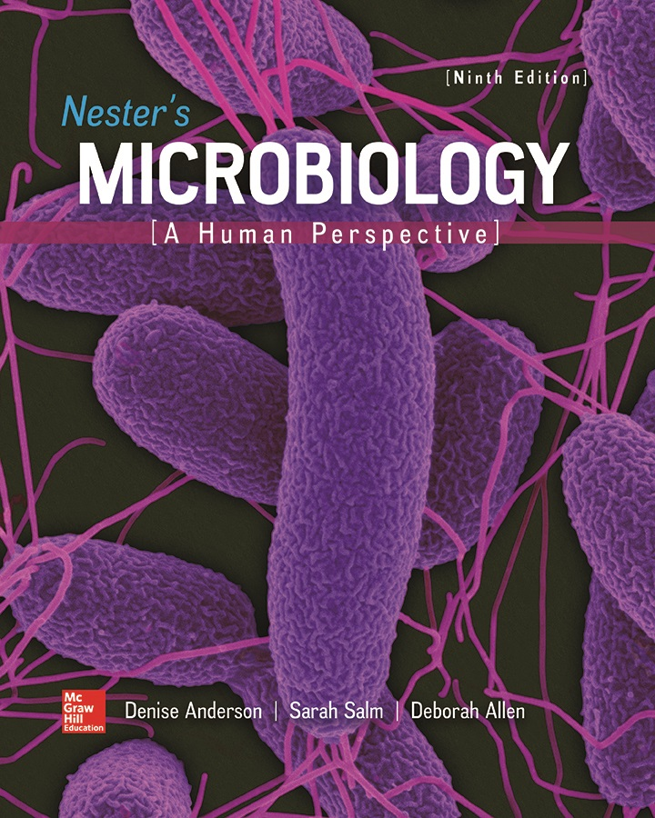
Chapter 12 Lecture Outline
See separate PowerPoint slides for all figures and tables pre-inserted into PowerPoint without notes.
Notes:
1

Slide 2
A Glimpse of History
Irish Potato Famine (1845 to 1847)
Water mold Phytophthora infestans ruined crop
Estimated 1.5 million people died during famine; more than 1 million moved; Ireland’s population fell by 25%
Easy to grow, nearly complete food source that could be stored for months led to dependence on single food source
Infection transmitted by spores that can persist in soil
In 2009, genomes of potato and P. infestans sequenced
Potato blight results in nearly $10 billion/year in losse

Slide 3
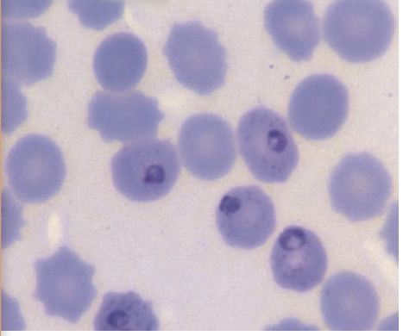
Microscopic Eukaryotes
Informal groups of microscopic eukaryotes
Algae: simple autotrophs (photosynthesizers)
Fungi: heterotrophic organisms; chitin in cell wall
Protozoa: unicellular heterotrophs that are not fungi
Protists: microscopic eukaryotes that are not fungi, plants, animals
Multicellular organisms:
Certain arthropods that transmit disease
Worms
Involved in human disease
Carried or transmitted in microscopic forms
©Biophoto Associates/Science Source

Slide 4
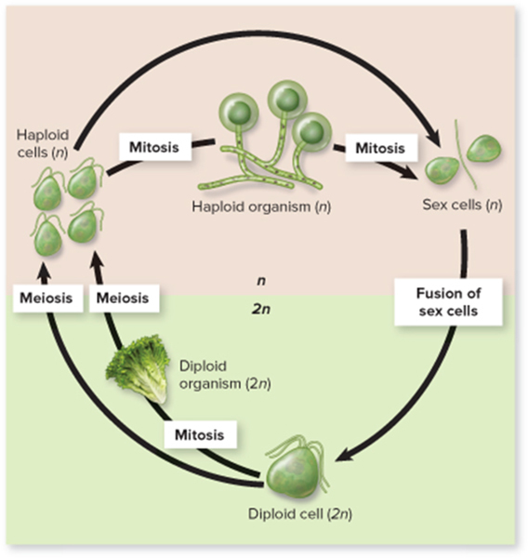
Microscopic Eukaryotes – Figure 12.1
Eukaryotes differ from prokaryotes
Nucleus; membrane-bound organelles; no peptidoglycan; usually well-developed cytoskeleton
May be haploid and/or diploid; complex life cycles
Asexual reproduction via mitosis
Sexual reproduction via meiosis
Diploid cells produce haploid cells
Can develop into haploid organisms or gametes (sex cells)
Fusion of two gametes forms diploid cell; recombination of genetic material
Jump to Microscopic Eukaryotes – Figure 12.1 Long Description

Slide 5
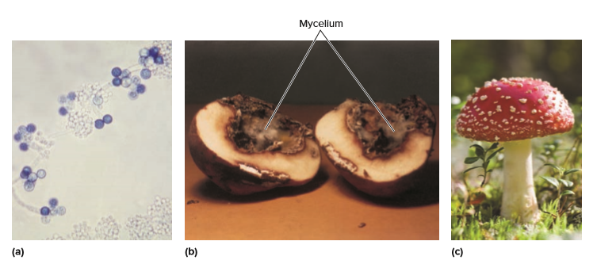
Fungi – Figure 12.2
Fungi (singular: fungus): molds, yeasts, mushrooms
Mycology is study of fungi
Molds, yeasts, mushrooms: refer to morphological forms, not classification
Yeasts: single-celled fungi
Molds: filamentous fungi
Mushrooms: reproductive structures of certain fungi
a: Source: Dr. Godon Roberstad/CDC; b: ©Martha Nester; c: ©Jorgen Bausager/Getty Images

Slide 6
Fungi (1)
Fungi: cell wall contains chitin; fungal membranes typically contain ergosterol
Secrete enzymes to break up large molecules
Along with bacteria, fungi are main decomposers
Can degrade cellulose and lignin (wood)
Release
nitrogen compounds into soils
Saprophytic: nutrients from dead or decaying matter
Some act as parasites of living tissue
Few infect humans; plant infections common
Some fungi form symbiotic relationships
Lichens

Slide 7
Fungi (2)
Classification of fungi in state of flux
Approximately 100,000 recognized species; 100 fungal genomes sequenced
Likely over 1.5 million species in nature

Slide 8
Table 12.1 Characteristics of Major Groups of Fungi
Group and Representative Member(s) | Appearance | Usual Habitat | Some Distinguishing Characteristics | Asexual Reproduction | Sexual Reproduction
Ascomycetes Neurospora, Saccharomyces cerevisiae (baker’s yeast), Penicillium, Aspergillus |  | Terrestrial, on fruit and other organic materials | Unicellular and multicellular; multicellular forms have septate hyphae | Budding is common; conidia are produced | Involves the formation of an ascus (sac) on specialized hyphae
Basidiomycetes Agaricus campestris (meadow mushroom), Cryptococcus neoformans |  | Terrestrial | Some unicellular; multicellular forms have septate hyphae; group includes mushrooms, smuts, rusts | Commonly absent | Produce basidiospores that are borne on club-shaped structures
Zygomycetes Rhizopus stolonifer (black bread mold) |  | Terrestrial | Multicellular; hyphae generally lack septa | Sporangiospores develop in sporangia on the tips of aerial hyphae | Sexual spores known as zygospores can remain dormant in adverse environments
Chytridiomycete Batrachochytrium dendrobatidis |  | Aquatic, guts of herbivores, parasitic | Most are unicellular but some are multicellular; motile reproductive cells | Motile zoospores | Flagellated gametes in male and female

Slide 9
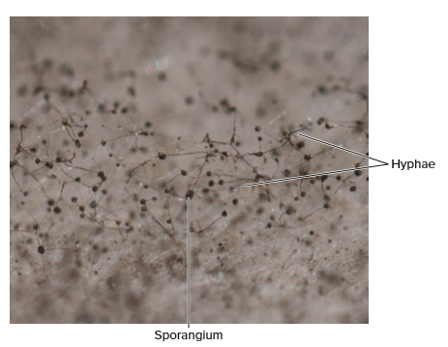
Types of Fungi – Figure 12.3
Ascomycetes (sac fungi) include approximately 75% of known fungi
Penicillium; pathogens – Dutch elm disease; morels and truffles; lichens
Basidiomycetes (club fungi) reproduce with mushrooms
Plant parasites (smuts, rusts)
Zygomycetes include black bread mold Rhizopus
Reproductive structures called sporangia
Chytrids usually live in water; some in mammalian gut
Batrachochytrium dendrobatidis infects frogs
Only fungi with motile forms: reproductive cells have flagella
©McGraw-Hill Education/Lisa Burgess

Slide 10
Structure of Fungi – Figure 12.4
Most fungi are multicellular molds; composed of thread-like hyphae
Visible mass of hyphae is a mycelium
Tips of hyphae grow rapidly in direction of food source, pores in septa between cells allow movement along hyphae
High surface-to-volume ratio aids nutrient absorption
Enzymes repel other hyphae; spread throughout food source
©McGraw-Hill Education/Steven P. Lynch

Slide 11
Structure of Fungi
Fungi most successful in moist environments
Some have specialized hyphae
Parasitic fungi: haustoria protrude into host cells
Saprophytic fungi: rhizoids may anchor to substrate
Dimorphic fungi can grow as single yeast cells or multicellular hyphae
Histoplasma capsulatum is a mold in soil; reproductive spores easily airborne
Develop into yeast form when inhaled; cause disease

Slide 12
Fungal Habitats
Fungi mostly terrestrial, but found everywhere
Thermal pools, volcanic craters, high salt environments
Some widespread; others grow on a specific plant
Group degrades many compounds, even plastics
Grow in salts, sugars, acids that inhibit bacteria
Most prefer 20 degrees Celcius to 35 degrees Celcius but easily survive lower temperatures; some grow below freezing
Most are aerobic
Some yeasts are facultative anaerobes; produce ethanol
Some obligate anaerobes live in rumen of cows

Slide 13
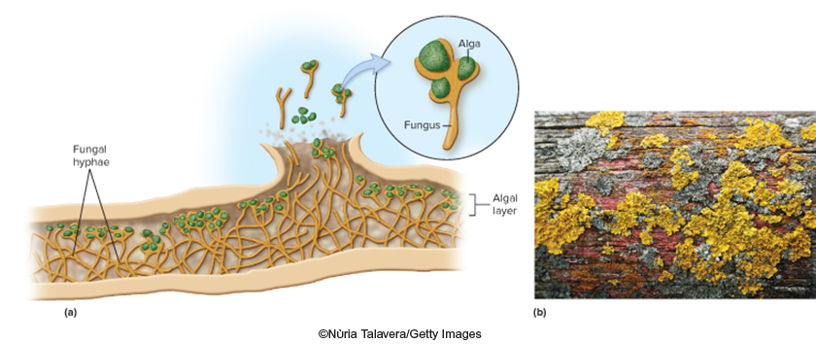
Symbiotic Relationships of Fungi – Figure 12.5
Lichens are association of fungus and photosynthesizer (alga or cyanobacterium)
Fungus protects, absorbs water and minerals; photosynthetic member provides organic nutrients
Grow in ecosystems where neither partner alone could survive, for example, sub-Arctic tundra, bare rock
Good indicator of air quality
b: ©Núria Talavera/Getty Images

Slide 14
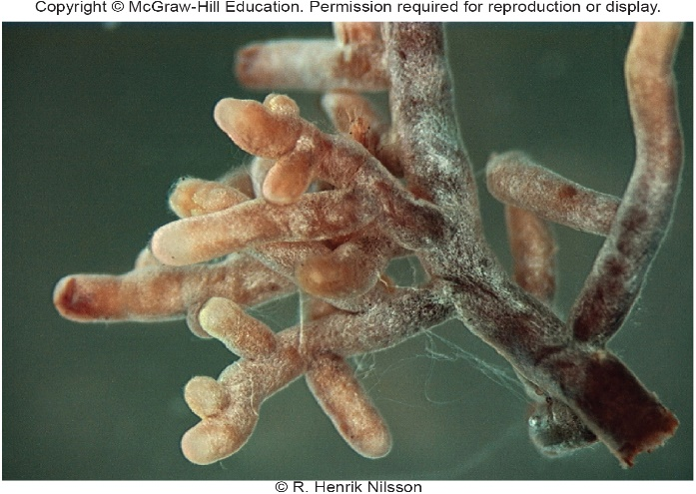
Symbiotic Relationships of Fungi – Figure 12.6
Mycorrhizas: beneficial association with plant roots
High surface area of hyphae increases plant’s absorption of water and minerals
Fungi supply nitrogen, phosphorus from breakdown of organic material in soil
Plant supplies fungus with organic compounds
Estimated 80% of vascular plants have mycorrhizas
Plants grow better; most orchids require mycorrhizas
©Ellen Larsson

Slide 15
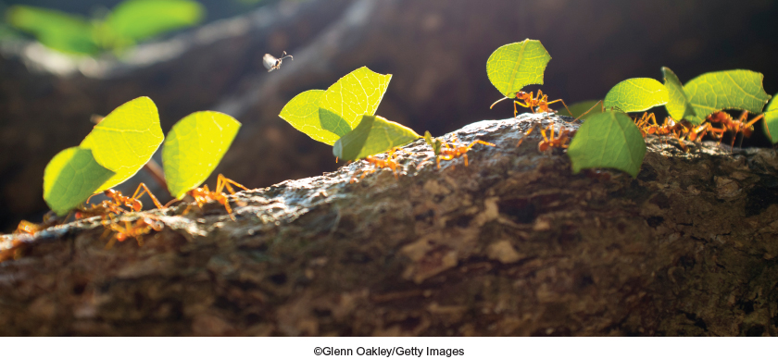
Symbiotic Relationships of Fungi – Figure 12.7
Certain insects depend on fungi
Leaf-cutter ants farm fungal gardens
Ants cannot eat often poisonous tropical vegetation
Instead, chop plants into bits, add mycelium
Fungi grow, digest plant material, produce reproductive structures eaten by ant
©Glenn Oakley/Getty Images

Slide 16
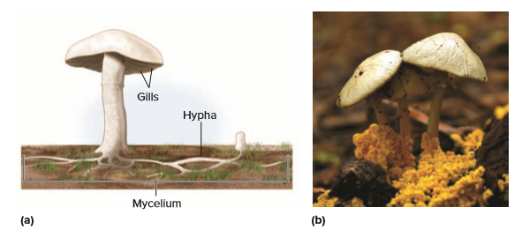
Reproduction in Fungi – Figure 12.8
Asexual and sexual forms
Asexual forms grow pure cultures in laboratory
Some forms “discovered” and named twice
Reproductive structures important in identification
Mushrooms: contain sexual structures of basidiomycetes
©Paulina Lenting-Smulders/ Getty Images

Slide 17
Reproduction in Fungi (1)
Asexual spores called conidia (sporangiospores in zygomycetes)
Numerous; easily carried by wind or water
Resistant to drying and other conditions
Germinate; grow hyphae in direction of food source
Molds also reproduce by fragmentation
Notes:
17

Slide 18
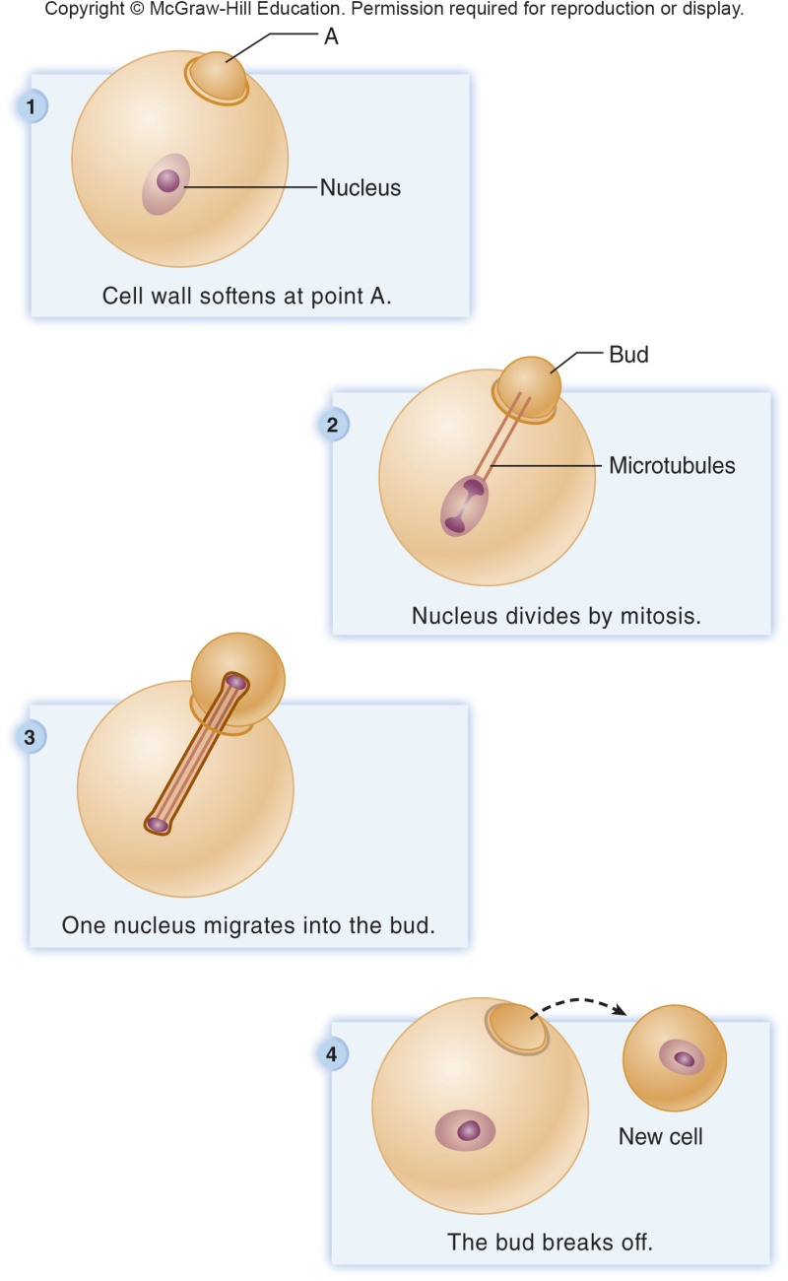
Reproduction in Fungi – Figure 12.9
Yeast cells reproduce by mitosis or budding

Slide 19
Reproduction in Fungi (2)
Most fungal cells are not motile
Sexual reproduction results when hyphae from two mating types (+, −) grow toward one another
Fusion of hyphae yields dikaryon (two nuclei)
Nuclei fuse, undergo meiosis, form haploid spores
Fungal spores are not the same as bacterial endospores
Notes:
19

Slide 20
Economic Importance of Fungi
Antimicrobial medicines (for example, penicillin)
Yeasts genetically engineered to produce molecules like human insulin, hepatitis B vaccine
Useful tools for study of eukaryotic cells
Saccharomyces cerevisiae (brewer’s or baker’s yeast) used in production of wine, beer, bread
Other species used in cheese making
Greatest spoilers of food; tons thrown away each year
Plant diseases cost billions of dollars (Dutch elm disease, coffee rust)

Slide 21
Table 12.2 Some Medically Important Fungal Diseases
Relatively few infect humans, but many produce important antimicrobials; net impact likely positive
Some common (athlete’s foot, jock itch); serious diseases rare (for example, cryptococcal meningitis)
Serious disease in immunocompromised patients
Human illnesses caused in three ways
Hypersensitivity reaction: allergy or asthma
Fungus grows on/in body; causes mycosis (disease)
Intoxication
Disease | Causative Agent
Candidial skin infection | Candida albicans
Coccidioidomycosis | Coccidioides immitis
Cryptococcal | Cryptococcus neoformans or
meningoencephalitis | C. gattiii
Histoplasmosis | Histoplasma capsalatum
Pneumocystis pneumonia | Pneumocystis jirovecii
Sporotrichosis | Sporothrix schenckii
Tinea versicolor | Malassezia furfur
Vulvovaginal candidiasis | Candida albicans

Slide 22
Medical Importance of Fungi
Fungal spores everywhere, up to altitudes over 7 miles; air contains >10,000 cells/cubic meter
May trigger allergy or asthma attack
Mycoses often named after causative agent or affected body part
Cutaneous mycoses caused by skin-invading molds called dermatophytes
Some fungi produce toxins
Aflatoxins produced by Aspergillus species; found in grains, peanuts; carcinogenic
Rye mold Claviceps purpurea (ergot) produces hallucinogenic toxin, purified drug ergotamine
Amanita species produce toxins that cause fatal liver damage

Slide 23
Algae (1)
Algae: simple photosynthetic eukaryotes
Differ from plants by lack of organized vascular system; simple reproductive structures
Most are aquatic; microscopic or macroscopic
Contain pigments that absorb radiant energy

Slide 24
Table 12.3 Characteristics of Major Groups of Algae
Group | Usual Habitat | Principal Pigments (in addition to chlorophyll a) | Storage Product | Cell Wall
Brown algae | Salt water | Xanthophylls, especially fucoxanthin | Starch-like carbohydrates; mannitol; fats | Cellulose and pectin; alginic acid
Diatoms, golden brown algae | Fresh water; salt water; soil; higher plants | Carotenes | Starch-like carbohydrates | Pectin, often containing silica or calcium
Dinoflagellates | Mostly salt water but common in fresh water | Carotenes; xanthophylls | Starch; oils | Cellulose and pectin
Euglenids | Fresh water | Chlorophyll b; carotenes; xanthophylls | Fats; starch-like carbohydrates | Lacking
Green algae | Fresh water; salt water, soil; tree bark; lichens | Chlorophyll b; carotenes; xanthophylls | Starch | Cellulose and pectin
Red algae, corallines | Mostly salt water, several genera in fresh water | Phycobilins; carotenese, xanthophylls | Starch-like carbohydrates | Cellulose and pectin; agar; carrageenan

Slide 25
Algae (2)
Algae are diverse group of protists
Other organisms depend upon them for food
All contain chloroplasts and chlorophyll a
May contain other pigments that extend range of light waves used for photosynthesis
Rigid cell walls mostly cellulose
Red algae also have agar (used in growth media)
Brown algae also have alginic acid (used in ice cream and cosmetics)
Not unified group; appear along evolutionary continuum based upon ribosomal RNA sequences

Slide 26
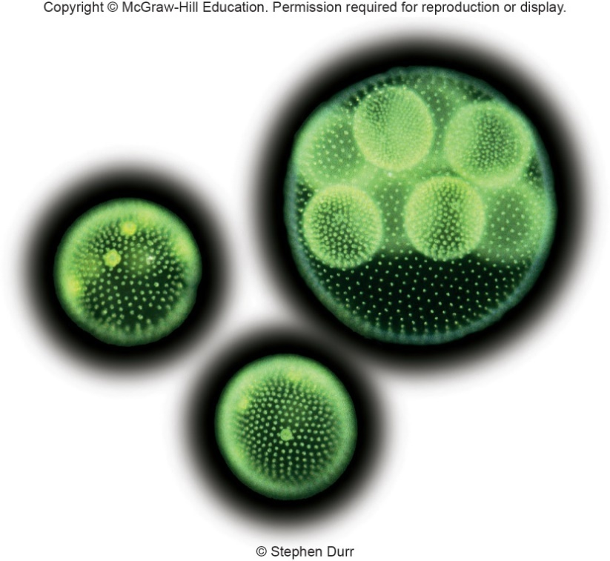
Algae – Figure 12.10
Microscopic Algae
Single cells propelled by flagella or free floating; or growth in long chains or filaments
Unicellular algae include diatoms, some green algae, dinoflagellates, euglenids, a few red algae
Relatively large absorptive surface
Some (for example, Volvox) form colonies
Diatoms incorporate silicon dioxide into cell walls
Diatomaceous earth
Crude oil, natural gas
©Stephen Durr

Slide 27
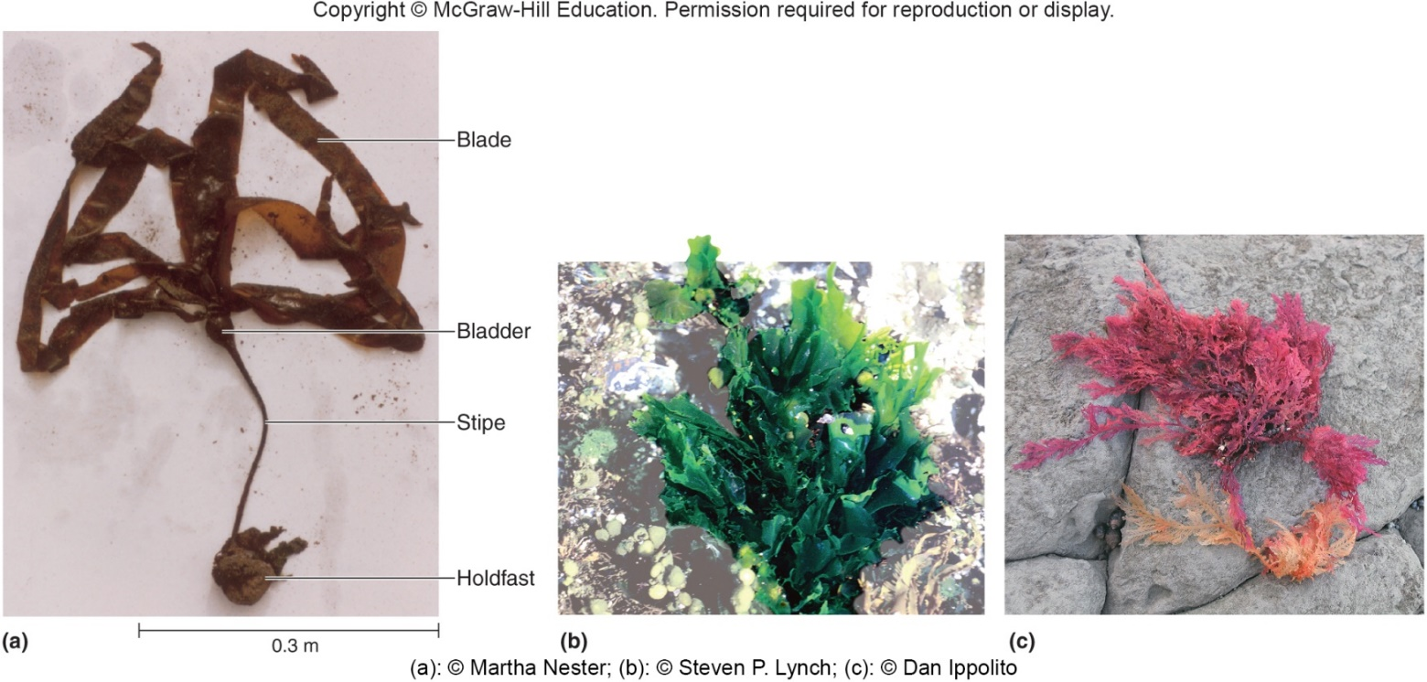
Algae – Figure 12.11
Macroscopic Algae
Multicellular brown algae, green algae, red algae
Some (like kelp) possess holdfast; used for anchoring
Stalk (stipe) usually has attached leaflike structures
Blades are main site of photosynthesis
Bladders help blades float for maximum sun exposure
a: ©Martha Nester; b: ©Steven P. Lynch; c: ©Dan Ippolito

Slide 28
Algae (3)
Algal habitats: fresh and salt water; moist soil
Major producers of
Algae with different pigments live at different depths
Plankton float near surface; unicellular algae comprise significant portion of phytoplankton
Form base of food chain
Microscopic heterotrophs in zooplankton graze upon phytoplankton; both become food for other organisms
Algal reproduction is varied
Asexually by fragmentation
Alternation between haploid, diploid generation
Generations may look similar or different

Slide 29
Medical Importance of Algae
Do not directly cause human disease, but may do so indirectly via toxins
Algal blooms from upwelling of nutrients and warmer temperatures, fertilizer runoff, untreated sewage
Algal blooms of dinoflagellates: red tides
Gonyaulax species produce potent neurotoxins saxitoxin and gonyautoxin
Shellfish feed upon Gonyaulax without harm, but accumulate neurotoxin in tissues
Humans consuming can suffer paralytic shellfish poisoning; cooking does not destroy

Slide 30
Protozoa (1)
Protozoa means “animal-like”
Term has little meaning in terms of evolutionary relatedness
Unicellular heterotrophic organisms that are not fungi, slime molds, or water molds
Protozoa are protists
Historically grouped primarily by means of locomotion; DNA sequences indicate that such groups may not be closely related

Slide 31
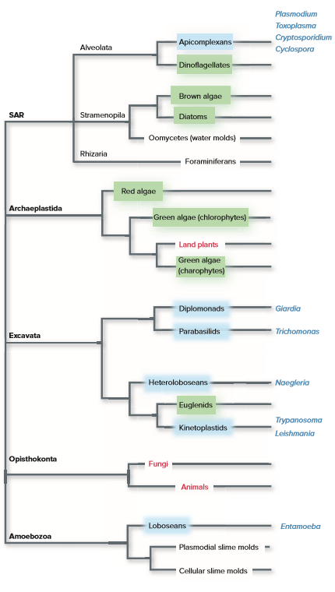
Protozoa – Figure 12.12
Protozoa are not a unified group based upon DNA sequences coding for rRNA
Jump to Protozoa – Figure 12.12 Long Description
Notes:
31

Slide 32
Types of Protozoa (1)
Apicomplexans: parasites with apical complex at one end; helps penetrate membrane of host cells
Many have complex life cycles, alternate between sexual and asexual forms
Plasmodium causes malaria, one of most significant infectious diseases in world
Other human pathogens include Toxoplasma gondii, Cryptosporidium parvum, and Cyclospora cayetanensis

Slide 33
Types of Protozoa (2)
Diplomonads and parabasalids: flagellated protists lacking mitochondria
Diplomonads reside in stagnant water low in
anaerobic conditions inside hosts
Giardia lamblia causes diarrhea in campers
Typically have two nuclei
Reproduces asexually
Parabasalids live within host (in termites they digest cellulose)
Others may cause disease (Trichomonas vaginalis)
Hydrogenosome produces some ATP while generating hydrogen
A few parabasalids also reproduce sexually

Slide 34
Types of Protozoa (3)
Kinetoplastids have a distinctive mass of DNA made of interlocking rings in their large single mitochondrion
May be a useful target for medications
Includes some human pathogens
Trypanosoma brucei (African sleeping sickness; trypanosomiasis)
Trypanosoma cruzi (Chagas’ disease)
Leishmania species (leishmaniasis)

Slide 35
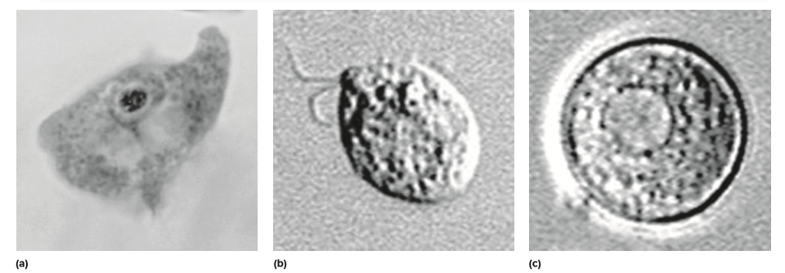
Types of Protozoa – Figure 12.13
Loboseans and heteroloboseans both have ameboid (flexible) body forms, but are only distantly related to one another
Loboseans extend, retract pseudopodia
Engulf food particles by phagocytosis
Entamoeba histolytica causes diarrhea in humans
Heteroloboseans also form flagellated cells
Naegleria fowleri swims in water; assumes ameboid form upon entering human body, eats host brain
a: Source: Dr. George Healy/ CDC; b: Source: CDC; c: Source: CDC

Slide 36
Protozoa (2)
Structure of Protozoa
No cellulose or chitinous cell walls
Foraminifera secrete hard calcium carbonate shell
Traditionally grouped by locomotor structures: cilia, flagella, pseudopodia
Protozoan Habitats
Majority are free living aquatic organisms; also found in soil or in or on plants and animals
Essential decomposers in many ecosystems
Some are parasitic
Zooplankton (food source) in marine environments
Eat large numbers of bacteria and algae

Slide 37
Protozoan Reproduction
Many have complex life cycles with more than one habitat or host
May exist as trophozoite (vegetative or feeding form) or cyst (resting form)
Environmental conditions such as lack of nutrients or low
can trigger cyst formation
Some cysts have cell wall; helps protect during host transfer and from stomach acid (Cryptosporidium, Entamoeba)
Asexual and sexual reproduction both common
Binary fission, also schizogony (multiple fission)

Slide 38
Table 12.4 Protozoa of Medical Importance
Majority do not cause disease, but protozoan pathogens have significant world health impact
Approximately 214 million had malaria in 2015; approximately 438,000 deaths
Amebiasis (amebic dysentery) affects approximately 50 million/year, kills approximately 100,000
Cryptosporidium, Giardia among leading causes of diarrhea worldwide
Trypanosomes (sleeping sickness) have made some regions of Africa uninhabitable for centuries
rRNA Classification | Genus of Disease-Causing Protozoan | Disease Caused by Protozoan
Apicomplexan | Plasmodium Toxoplasma Cryptosporidium Cyclospora | Malaria Toxoplasmosis Cryptosporidiosis Cyclosporiasis
Diplomonad | Giardia | Giardiasis
Heterolobosean | Naegleria | Primary amebic meningoencephalitis
Kinetoplastid | Trypanosoma | African sleeping sickness
Lobosean | Entameoba | Amebiasis
Parabasalid | Trichomonas | Trichomoniasis

Slide 39
Slime Molds and Water Molds
These protists were once considered types of fungi
May look, act like fungi, but at cellular and molecular levels are completely unrelated
Fungi and water molds are good examples of convergent evolution: organisms develop similar characteristics independently as they adapt to similar environments

Slide 40
Slime Molds
Slime molds: composed of ameboid cells; live on soil, leaf litter, decaying vegetation
Ingest organic matter by phagocytosis
Important link in food chain: ingest microorganisms, serve as food for larger predators
Cellular slime molds: vegetative form is single cells
When food is low, aggregrate into mass called a slug; some cells differentiate into spores
Dictyostelium discoideum is model organism
Plasmodial slime molds: cells fuse forming diploid multi-nucleated plasmodium that ingests organic material
When food is low, forms spore-bearing bodies
Haploid spores fuse to form diploid plasmodium
Notes:
40

Slide 41
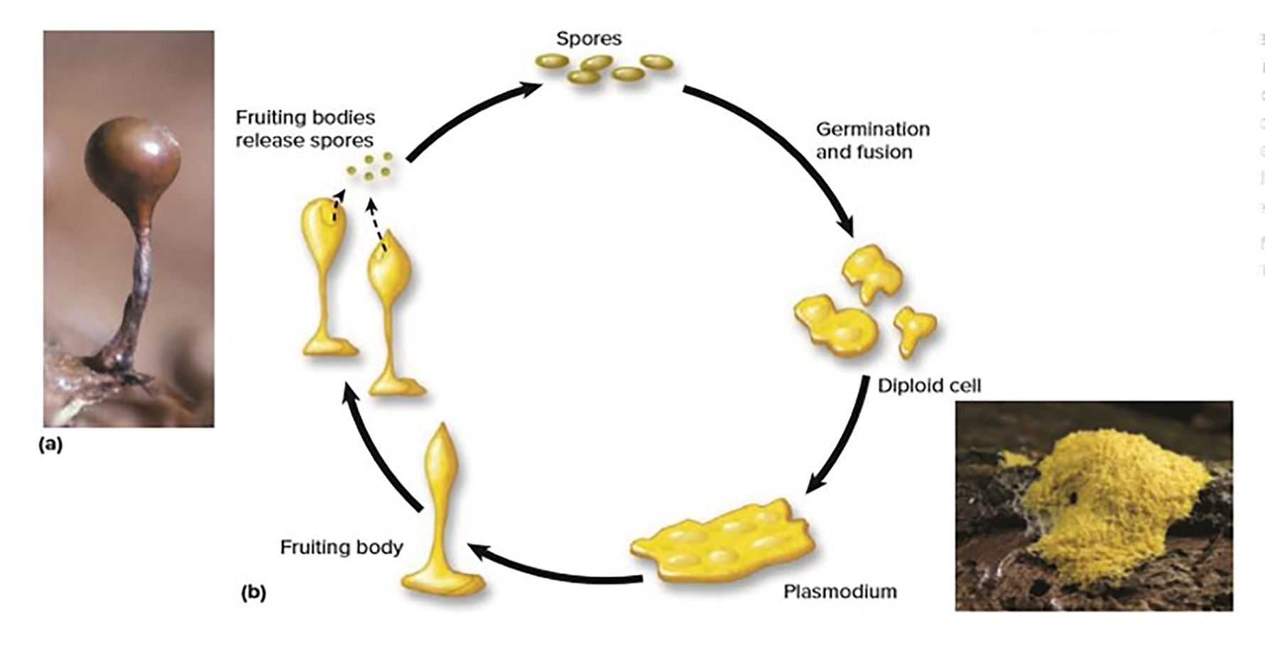
Slime Molds – Figure 12.14
a: ©Ray Simons/Science; Source; b: ©Laurie Knight/Getty Images

Slide 42
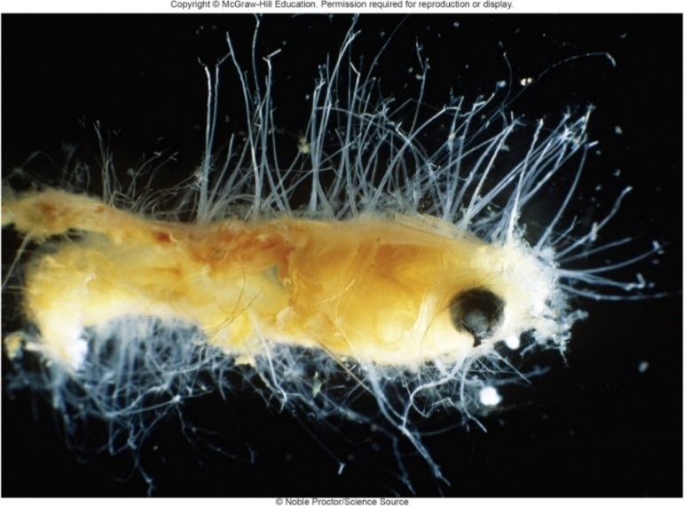
Water Molds – Figure 12.15
Water molds (oomycetes) form masses of white threads on decaying material
Secrete digestive enzymes onto substrate
Cytoplasm in filaments continuous with many nuclei
Cellulose in cell walls (not chitin)
Lack chloroplasts; reproductive cells are flagellated
Important food crop diseases include downy mildew of grapes, potato blight
©Noble Proctor/ Science Source

Slide 43
Multicellular Parasites: Helminths (1)
Helminths are animals; often identified by microscopic eggs
Include roundworms (nematodes), and flatworms (tapeworms: cestodes; flukes: trematodes)
Some invade host tissue, rob host of nutrients
Largely controlled in industrialized nations; infect hundreds of millions in developing world
Notes:
43

Slide 44
Multicellular Parasites: Helminths (2)
Helminths may have complex life cycle with one or more intermediate hosts that house an immature stage
Snails are intermediate host for fluke Schistosoma mansoni (schistosomiasis)
Reproduction takes place in a definitive host
Humans are definitive host for Schistosoma
Humans may become accidental or dead-end host if infected by parasite that normally completes its life cycle in another host
“Swimmer’s itch” caused by larval flukes

Slide 45
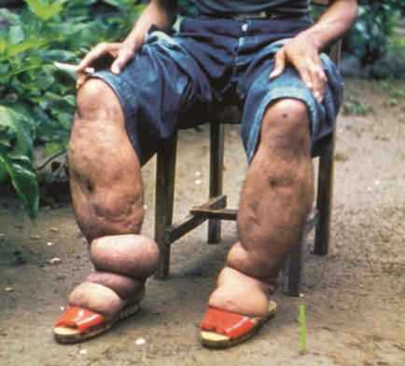
Multicellular Parasites: Helminths (3)
Helminths enter body in number of ways
Hookworm larvae live in soil, burrow through skin
Multiply in digestive tract, eliminated with feces
Poor sanitation, bare feet aid in transmission
Approximately 740 million individuals infected
Some helminths eaten with food
Nematode larvae Trichinella spiralis ingested in animal flesh, especially undercooked pork
Pinworm eggs (Enterobius vermicularis) ingested on food
Some transmitted through insect bites
Wuchereria bancrofti transmitted by mosquitoes (elephantiasis)
Onchocerca volvulus transmitted by flies (river blindness)
Source: CDC
Notes:
45

Slide 46
Table 12.5 Nematodes, Cestadoes, and Trematodes
Infectious Agents | Disease | Disease Characteristics
Nematodes (roundworms)
Ascaria (Ascaris lumbricoides) | Ascariasis | Abdominal pain, vomiting, intestinal blockage
Filaria (Wuchereria bancrofti and Brugia malayi) | Filariasis | Fever, swelling of lymphatic structures, genitals, and extremities
Hookworm (Necator americanus and Ancylostoma duodenale) | Hookworm disease | Anemia, weakness, fatigue, physical and intellectual disability in children
Pinworm (Enterobius vermicularis) | Enterobiasis | Anal itching, restlessness, irritability, nervousness, poor sleep
Threadworm (Strongyloides stercoralis) | Strongyloidiasis | Skin rash at site of penetration, cough, abdominal pain, weight loss
Trichinella (Trichinella spiralis) | Trichinellosis | Fever, swelling of upper eyelids, muscle soreness
Whipworm (Trichuris trichiura) | Trichuriasis | Abdominal pain, bloody stools, weight loss
Cestodes (tapeworms)
Beef tapeworm (Taenia saginata) | Tapeworm disease | Few or no symptoms
Fish tapeworm (Diphyllobothrium latum) | Tapeworm disease | Few or no symptoms, sometimes anemia
Pork tapeworm (Taenia solium) | Tapeworm disease | Few or no symptoms
 | Cysticercosis | Variable symptoms depending on location and number of eggs that form larval cysts (cysticerci) in the body
Trematodes (flukes)
Blood fluke (Schistosoma species) | Schistosomiasis | Liver damage, malnutrition, weakness, and accumulation of fluid in the abdominal cavity
Cercaria that infect birds and other animals | Swimmer’s itch | Inflammation of the skin, itching

Slide 47
Multicellular Parasites: Helminths (4)
Roundworms or nematodes have a cylindrical, tapered body with a digestive tract that extends from mouth to anus
Caenorhabditis elegans is model eukaryotic organism
Genome sequenced; all 959 cells identified
Many nematodes free-living in soil, water; some are parasites
Ascaris lumbricoides causes ascariasis, most common roundworm disease
Females may exceed 30 centimeters long; release 200,000 eggs per day that are eliminated in feces
Ingested eggs release immature worms that burrow into bloodstream
When worms reach lungs, they are coughed up and swallowed; produce eggs when reach intestine
Worms feed on nutrients passing through digestive tract

Slide 48
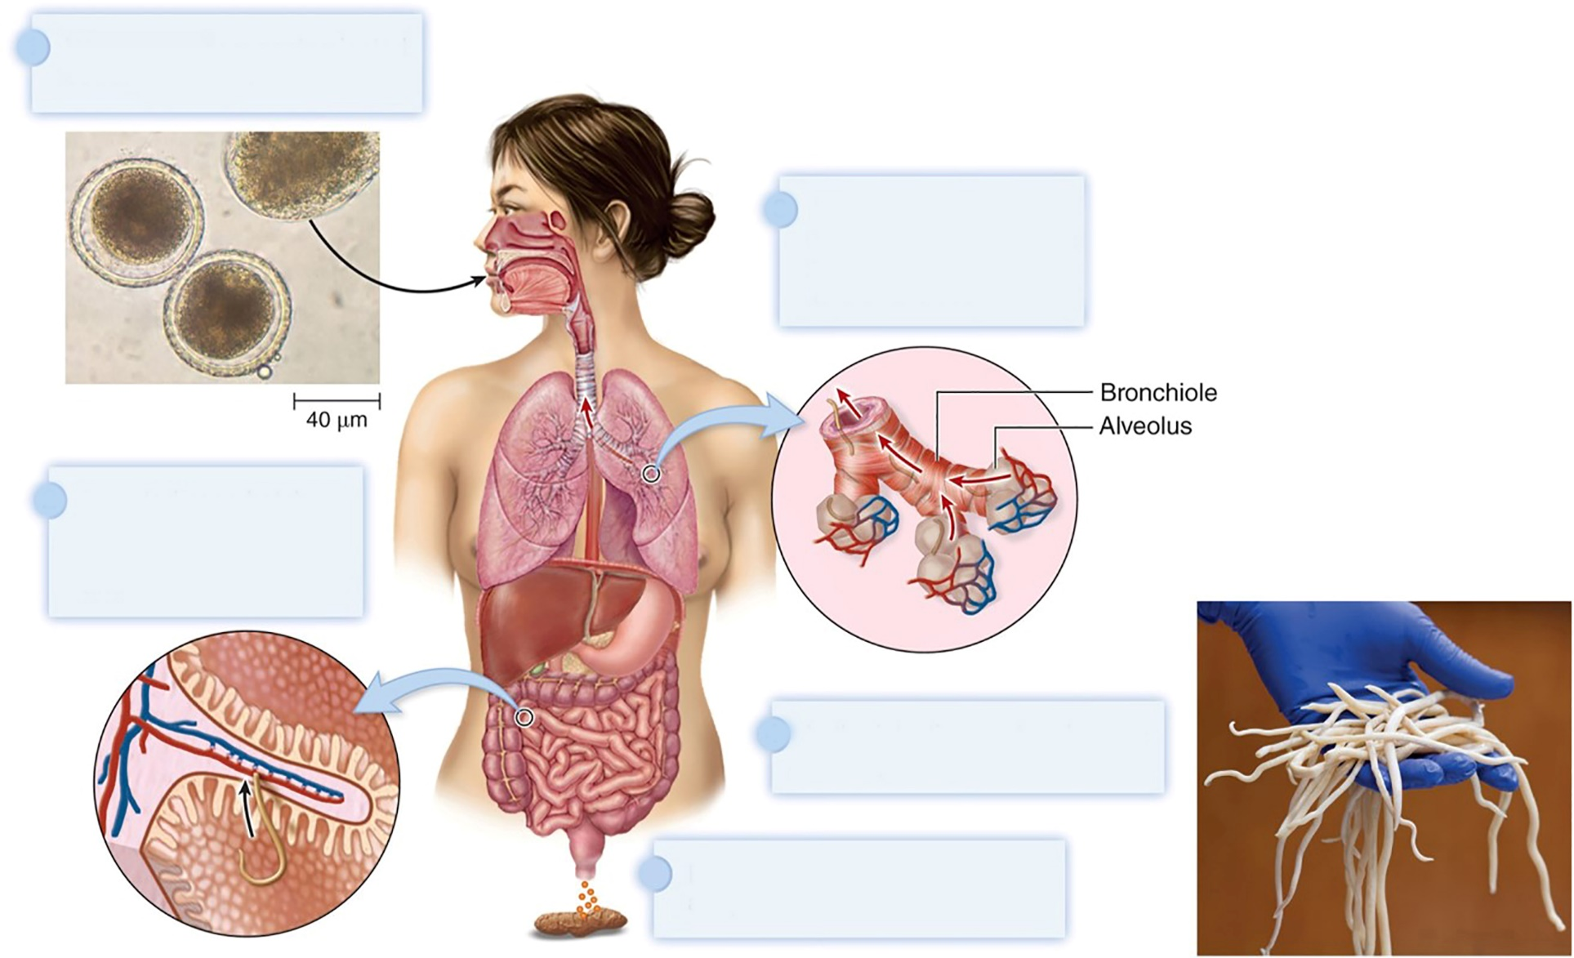
Multicellular Parasites: Helminths – Figure 12.17
Worm eggs from contaminated soil are ingested.
Larvae enter the lungs from capillaries and can then be coughed up and swallowed.
Ingested eggs hatch; larvae penetrate intestinal capillaries and are carried to lungs.
In the intestine, mature larvae develop into adult worms.
Eggs released from adult worms are passed in the feces.
(eggs): ©McGraw-Hill Education/Lisa Burgess; (worms): ©McGraw-Hill Education/Lisa Burgess

Slide 49
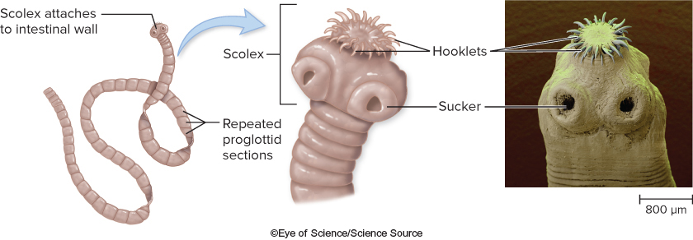
Multicellular Parasites: Helminths (5)
Tapeworms or cestodes have flat, ribbon-shaped bodies; absorb nutrients across body surface
Head end (scolex) attaches to intestines of host
Segments (proglottids) contain male, female structures
Proglottids contain eggs; eliminated in feces
Humans can get larvae in undercooked meat
©Eye of Science/Science Source

Slide 50
Multicellular Parasites: Helminths (6)
Flukes or trematodes have flat leaf shape with suckers to attach or move along a surface
Mouth, but no anus
Complex life cycle with at least two hosts
Snail is intermediate host
Mammal or other vertebrate is definitive host
Tissue flukes are hermaphroditic; blood flukes have separate sexes
Schistosomes (blood flukes) cause devastating disease – schistosomiasis
Notes:
50

Slide 51
Multicellular Parasites: Helminths (7)
Schistosomiasis requires snail host; releases larval form called cercaria
Cercaria burrow through human skin and mature in blood vessels where females lay eggs
Causes inflammation that can rupture vessel and release eggs into intestines or urinary bladder
Eggs leave human host and hatch; ciliated larvae infect snail to continue life cycle
Eggs that are not released continue inflammatory response and damage tissues

Slide 52
Arthropods
Arthropods: insects and arachnids
Serve as vectors that can transmit infectious agents
Mechanical vector transfers pathogen from one surface to another
Biological vector is essential part of life cycle (for example, Plasmodium that causes malaria in Anopheles mosquito)
Incidence of disease can be decreased by controlling vectors or hosts
For example, plague controlled by eliminating rat populations carrying Yersinia pestis
Some cause disease directly
Pubic lice, dist mites, “chiggers,” scabies

Slide 53
Table 12.6 Some Arthropods That Transmit Infectious Agents
Arthropod | Infectious Agent | Disease and Characteristic Features
Insects
Black fly (Simulium species) | Onchocercus | Onchocerciasis (river blindness)—rash, itching, visual impairment
Flea (Xenopsylla cheopis) | Yersinia pestis | Plague—fever, headache, confusion, enlarged lymph nodes, skin hemorrhage
Louse (Pediculus humanus) | Rickettsia prowazekii | Typhus—fever, hemorrhage, rash, confusion
Mosquito (Aedes species) | Flavivirus | Yellow fever—fever, vomiting, jaundice, bleeding
Mosquito (Aedes species) | Flavivirus | Dengue fever—high fever; headache; joint, muscle, and bone pain
Mosquito (Anopheles species) | Plasmodium species | Malaria—chills, bouts of recurring fever
Mosquito (Culex species) | Togavirus | Viral encephalitis—fever, nausea, convulsions, coma
Sand fly (Phlebotomus species) | Leishmania | Leishmaniasis—ulcers, nosebleeds, diarrhea, fever, cough
Tsetse fly (Glossina species) | Trypanosomes | African sleeping sickness—sleepiness, headache, coma
Arachnids
Tick (Dermacentor species) | Rickettsia rickettsia | Rocky Mountain spotted fever—fever, hemorrhagic rash, confusion
Tick (Ixodes species) | Borrelia burgdorferi | Lyme disease—fever, rash, joint pain, nervous system impairment

