Slide 1
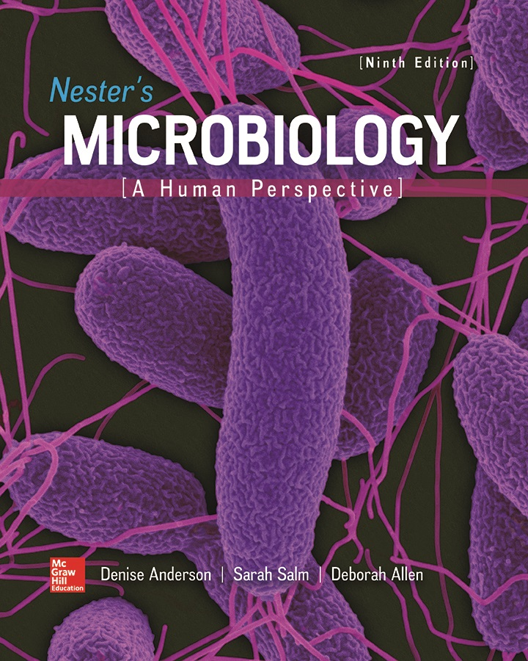
Chapter 13 Lecture Outline
See separate PowerPoint slides for all figures and tables pre-inserted into PowerPoint without notes.
Notes:
1

Slide 2
A Glimpse of History
Tobacco mosaic disease (1890s)
Many microorganisms were identified as infectious agents, but this was caused by an unusual agent
D. M. Iwanowsky, Martinus Beijerinck determined it caused by “filterable virus” too small to be seen with light microscope, passed through filters for bacteria
F. W. Twort and F. d’Herelle discovered “filterable virus” that destroyed bacteria
Virus means “poison”
Viruses have many features more characteristic of complex chemicals (for example, still infective following precipitation from ethyl alcohol suspension or crystallization)

Slide 3
Viruses: Obligate Intracellular Parasites (1)
Viruses are genetic information — DNA or RNA — contained within protective protein coat
Inert particles: no metabolism, replication, motility
Genome hijacks host cell’s replication machinery
Inert outside cells; inside, direct activities of cell
Infectious agents, not organisms
Viruses require live organisms as hosts; cannot be grown in pure culture
Cannot be seen with light microscopy
Classified generally based on type of cell they infect: eukaryotic or prokaryotic

Slide 4
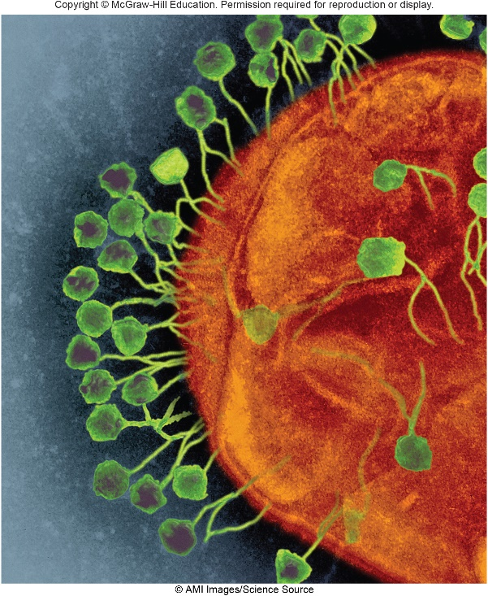
Viruses: Obligate Intracellular Parasites (2)
Viruses are genetic information — DNA or RNA — contained within protective protein coat
Viruses that infect bacteria are called bacteriophages, or phages
Easy to grow in the lab as a good model for how animal viruses interact with their hosts
Vehicle for horizontal gene transfer
Their ability to kill bacteria is important ecologically and medically
©AMI Images/Science Source
Notes:
4

Slide 5
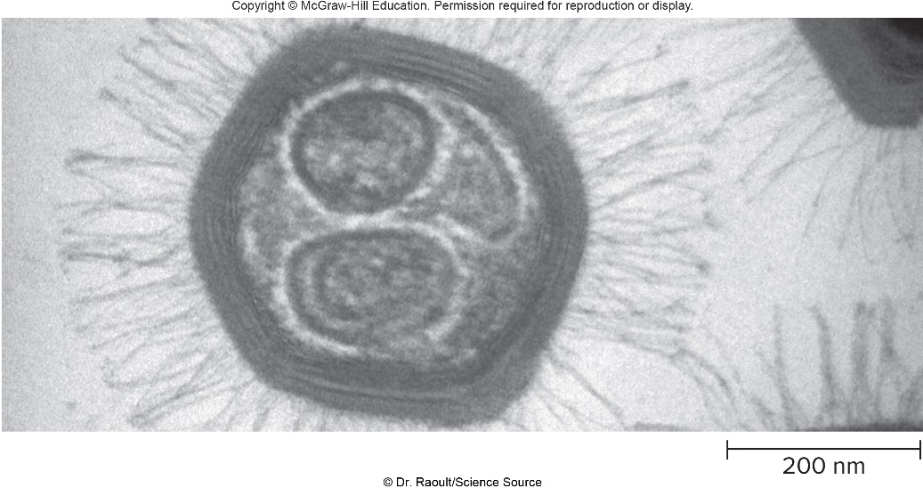
Focus Your Perspective 13.1
Viruses notable for small size
Smallest viruses are approximately 10 nanometer in diameter
Largest viruses are approximately 800 nanometer (Megaviridae)
Mimivirus carries about 1.2 million base pairs in its genome, but has no ribosomes
Sputnik is a parasite of mimivirus
Pandoraviruses were discovered in 2013; genome twice the size of mimivirus
©Dr. Raoult/Science Source

Slide 6
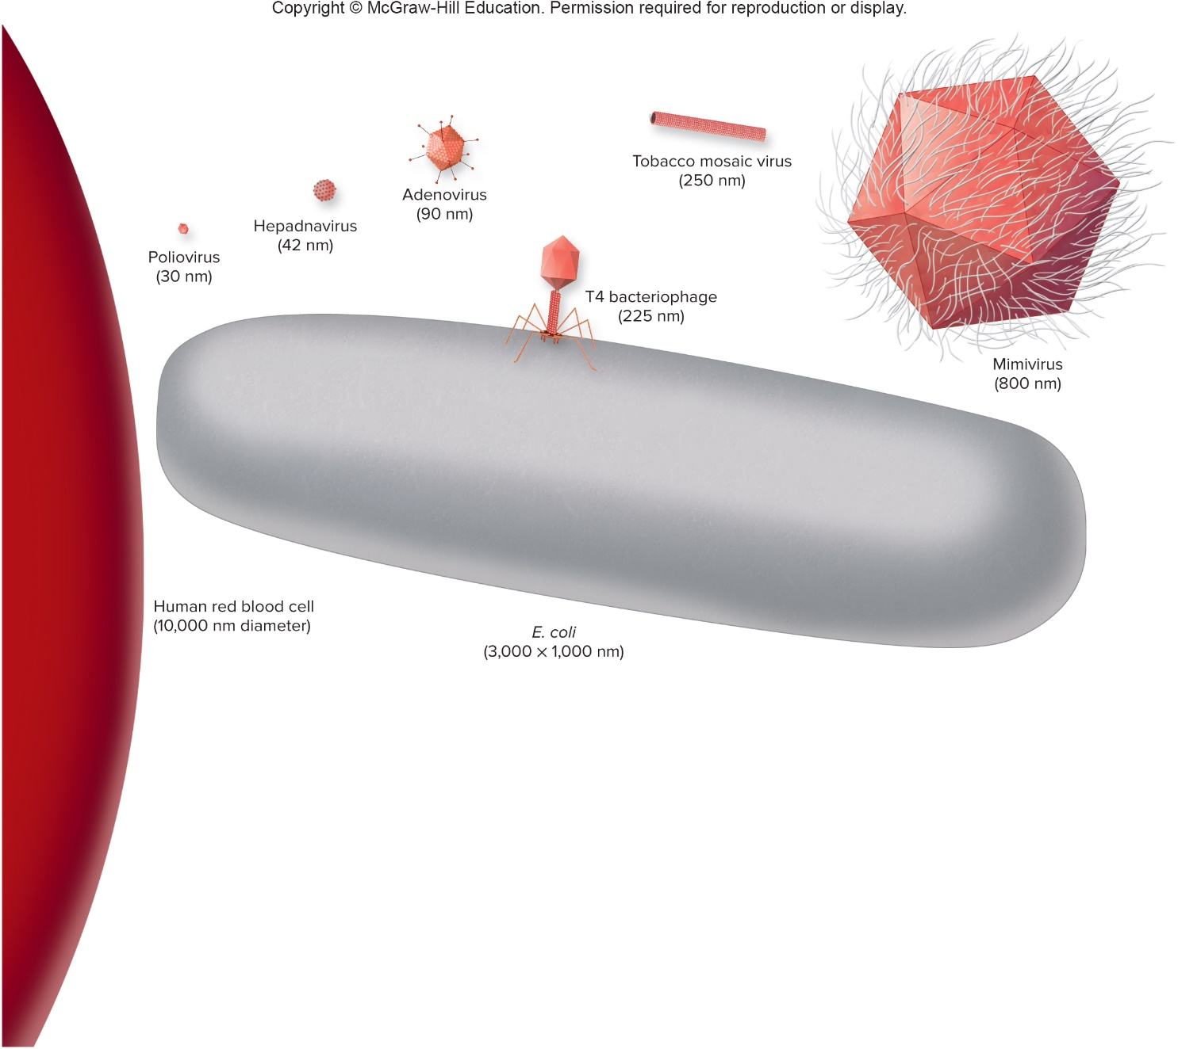
General Characteristics of Viruses – Figure 13.1
Jump to General Characteristics of Viruses – Figure 13.1 Long Description
Notes:
6

Slide 7
Viral Architecture – Figure 13.2
Virion (viral particle) is nucleic acid surrounded by a capsid (protein coat)
Capsid composed of simple identical subunits called capsomeres
Capsid plus nucleic acids called nucleocapsid
Nucleic acid is either DNA or RNA; may be circular or linear, single-stranded or double-stranded
Enveloped viruses are surrounded by lipid bilayer obtained from host cell
Matrix protein between nucleocapsid and envelope
Non-enveloped (naked) viruses are more resistant to disinfectants
Spikes attach to receptor sites on host cells; phages attach by tail fibers
Non-enveloped virus
Enveloped virus

Slide 8
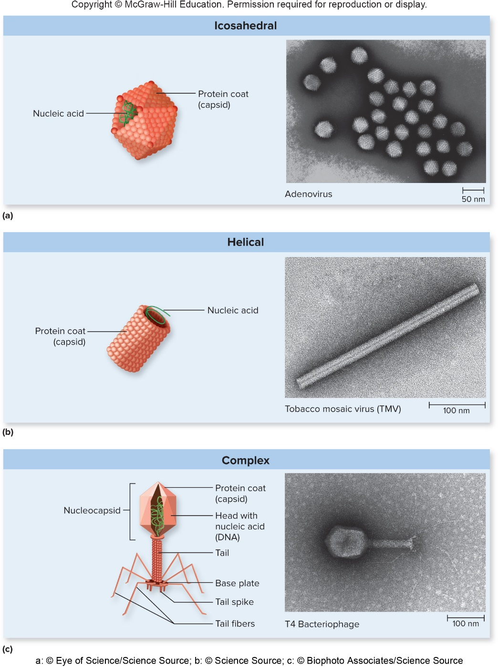
Viral Architecture – Figure 13.3
Three shapes:
Icosahedral
20 flat triangles
Helical
Capsomeres arranged in helix
Complex
Phage
Icosahedral nucelocapsid (head) and helical protein (tail)
a: ©Eye of Science/Science Source; b: ©Science Source; c: ©Biophoto Associates/ Science Source

Slide 9
Viral Taxonomy
International Committee on Taxonomy of Viruses (ICTV) keeps online database and publishes features, classification, nomenclature of viruses
2015 report:
>6,000 viruses → 3,704 species → 609 genera → 27 subfamilies → 111 families →7 orders
Key characteristics include genome structure (nucleic acid and strandedness) and hosts infected
Other characteristics (for example, viral shape, disease symptoms) also considered

Slide 10
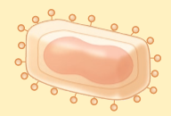
Table 13.1 Classification of Some Human Viruses (1)
Nucleic Acid | Outer Covering | Family | Drawing or Virion (Not to Scale) | Representative Member (and Disease Caused)
DNA Viruses
Double-stranded DNA | Non-enveloped | Papillomaviridae |  | Human papillomaviruses (some types cause warts; others cause cancers)
Double-stranded DNA | Non-enveloped | Polyomaviridae |  | Merkel cell polyomavirus (Merkel skin cancer)
Double-stranded DNA | Non-enveloped | Adenoviridae |  | Human adenoviruses (respiratory infections
Double-stranded DNA | Enveloped | Herpesviridae |  | Herpes zoster virus (chickenpox); herpes simplex viruses (cold sores, genital herpes)
Double-stranded DNA | Enveloped | Poxviridae |  | Smallpox virus (smallpox)
Single-stranded DNA | Non-enveloped | Parvoviridae |  | Human parvovirus B19 (fifth disease)
Notes:
10

Slide 11
Table 13.1 Classification of Some Human Viruses (2)
Nucleic Acid | Outer Covering | Family | Drawing or Virion (Not to Scale) | Representative Member (and Disease Caused)
RNA Viruses
Double-stranded | Non-enveloped | Reoviridae |  | Human rotaviruses (diarrheal disease)
Single-stranded (plus strand) | Non-enveloped | Picornaviridae |  | Polioviruses (poliomyelitis); rhinovirus (colds); hepatitis A virus (hepatitis A)
Single-stranded (plus strand) | Non-enveloped | Caliciviridae |  | Norovirus (gastroenteritis)
Single-stranded (plus strand) | Enveloped | Togaviridae |  | Rubella virus (rubella); Chikungunya virus (Chikungunya fever)
Single-stranded (plus strand) | Enveloped | Flaviviridae |  | Yellow fever virus (yellow fever); dengue virus (dengue fever); hepatitis C virus (hepatitis C); Zika virus (Zika virus disease)
Single-stranded (plus strand) | Enveloped | Coronaviridae |  | Severe acute respiratory syndrome coronavirus (SARS), Middle East respiratory syndrome coronavirus (MERS)

Slide 12
Table 13.1 Classification of Some Human Viruses (3)
Nucleic Acid | Outer Covering | Family | Drawing or Virion (Not to Scale) | Representative Member (and Disease Caused)
Single-stranded (minus strand) | Enveloped | Rhabdoviridae |  | Rabies virus (rabies)
Single-stranded (minus strand) | Enveloped | Filoviridae |  | Ebola virus (Ebola virus disease)
Single-stranded (minus strand) | Enveloped | Paramyxoviridae |  | Mumps virus (mumps); measles virus (measles)
Single-stranded (minus strand) | Enveloped | Orthomyxoviridae |  | Influenza virus (influenza)
Single-stranded (minus strand) | Enveloped | Bunyaviridae |  | Hantavirus (hantavirus pulmonary syndrome)
Single-stranded (minus strand) | Enveloped | Arenaviridae |  | Lassa virus (Lassa fever)
Reverse Transcribing Viruses
DNA | Enveloped | Hepadnaviridae |  | Hepatitis B virus (hepatitis B)
RNA | Enveloped | Retroviridae |  | Human immunodeficiency virus (AIDS)

Slide 13
Viral Taxonomy (1)
Virus families end in suffix -viridae
Names follow no consistent pattern
Some indicate appearance (for example, Coronaviridae from corona, meaning “crown”)
Others named for geographic area from which first isolated (for example, Bunyaviridae from Bunyamwera in Uganda, Africa)
Genus ends in -virus (for example, Enterovirus)
Species name often name of disease
For example, poliovirus causes poliomyelitis
Viruses commonly referred to only by species name

Slide 14
Viral Taxonomy (2)
Viruses often referred to informally
Groups of unrelated viruses sharing routes of infection
Oral-fecal route: enteric viruses
Respiratory route: respiratory viruses
Zoonotic viruses cause zoonoses (animal to human)
Arboviruses (from arthropod borne) are spread by arthropods; often can infect widely different species
Cause diseases such as yellow fever, dengue fever, West Nile encephalitis, La Crosse encephalitis

Slide 15
Table 13.2 Grouping of Human Viruses Based on Route of Transmission
Virus Group | Mechanism of Transmission | Common Viruses Transmitted
Enteric | Fecal-oral route | Enteroviruses (polio); noroviruses; rotaviruses (diarrhea)
Respiratory | Respiratory or salivary route | Influenza; measles; rhinoviruses (colds)
Sexually transmitted | Sexual contact | Herpes simplex virus type 2 (genital herpes); HIV
Zoonotic | Vector (such as arthropods) | West Nile encephalitis; Zika virus disease, dengue fever
Zoonotic | Animal to human directly | Rabies; cowpox

Slide 16
Bacteriophages
Three general types of bacteriophages based on relationship with host
Lytic (virulent) phages
Temperate phages
Filamentous phages
General strategies for phage replication
Productive infection
New viral particles are produced
Latent state
Viral genome remains silent within cell, but is replicated along with host cell genome

Slide 17
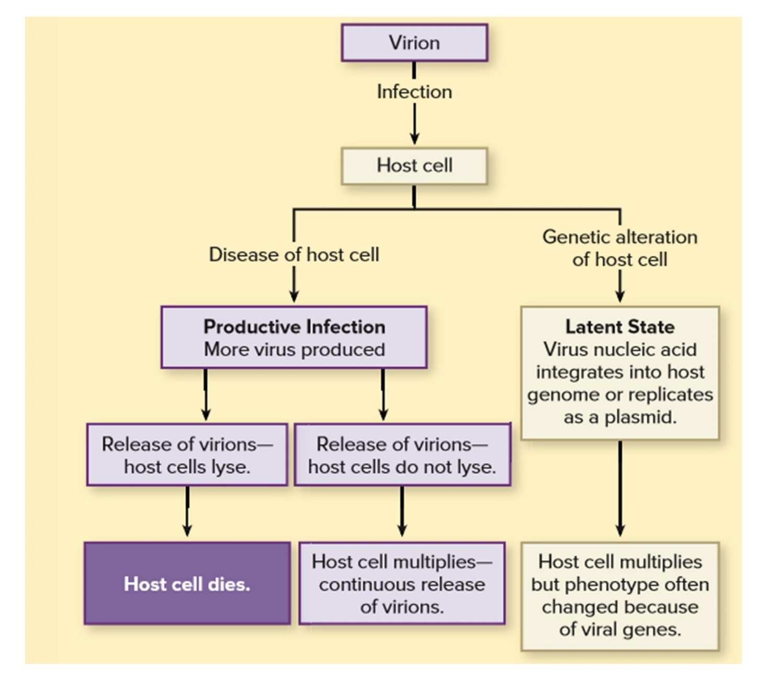
Bacteriophages – Figure 13.4
Jump to Bacteriophages – Figure 13.4 Long Description

Slide 18
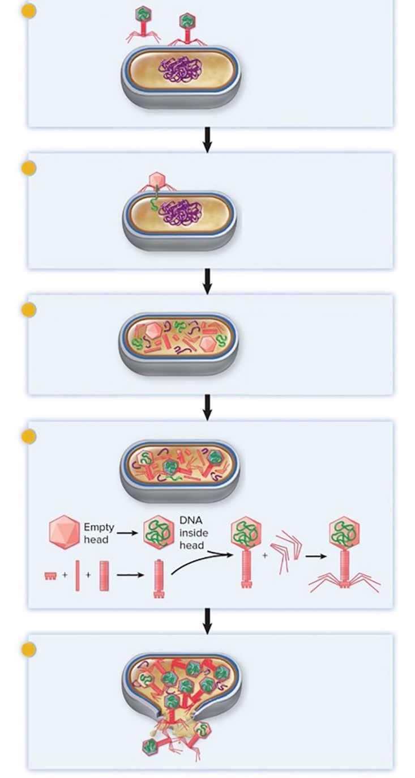
Lytic Phage Infections – Figure 13.5 (1)
Lytic or virulent phages exit host by lysing the cell
Productive infection: new viral particles formed
T4 phage (dsDNA) is model; entire process takes approximately 30 minutes
Infection cycle is five step process
Attachment
Genome entry
Synthesis
Assembly
Release
Attachment
Phage attaches to specific receptors on the E. coli cell wall.
Genome Entry
The tail contracts and phage DNA is injected into the bacterial cell, leaving the phage coat outside.
Synthesis
Phage genome is trans-cribed and phage proteins synthesized. Phage DNA is replicated, other virion components are made, and host DNA is degraded.
Assembly
Phage components are assembled into mature virions.
Release
The bacterial cell lyses and many new infectious virions are released.

Slide 19
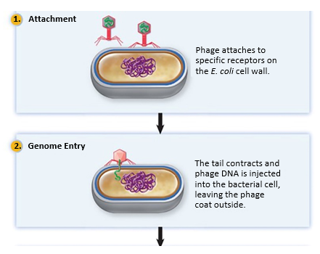
Lytic Phage Infections – Figure 13.5 (2)
Infection Cycle
Attachment
Phage attaches to receptors
Receptors are molecules that typically perform other functions
Cells that lack specific receptor are resistant to infection by that phage
Genome entry
T4 lysozyme degrades cell wall
Tail contracts, injects genome through cell wall and membrane
Capsid remains outside the cell
Jump to Lytic Phage Infections – Figure 13.5 (2) Long Description

Slide 20
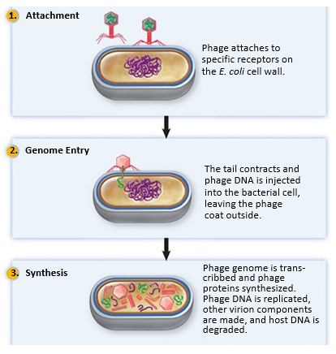
Lytic Phage Infections – Figure 13.5 (3)
Infection Cycle
Synthesis of phage proteins and genome
Early proteins translated within minutes; nuclease degrades host DNA
Phage genome synthesized
Late proteins are structural proteins (capsid, tail); produced toward end of cycle
Jump to Lytic Phage Infections – Figure 13.5 (3) Long Description
Notes:
20

Slide 21
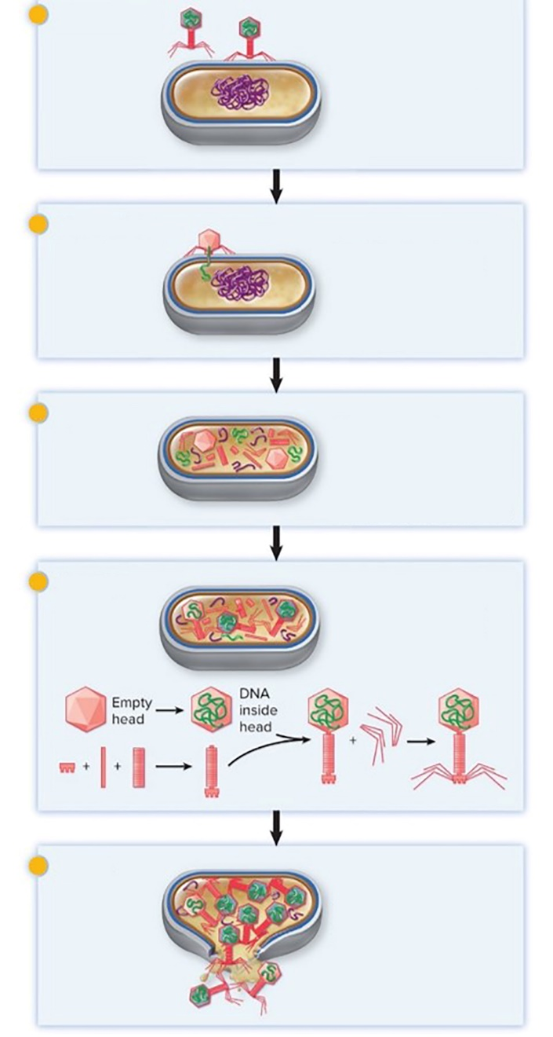
Lytic Phage Infections – Figure 13.5 (4)
Infection cycle
Assembly (maturation)
Some components assemble spontaneously, others require protein scaffolds
Release
Lysozyme produced late in infection; digests cell wall
Cell lyses, releases phage
Burst size of T4 is approximately 200
Attachment
Phage attaches to specific receptors on the E. coli cell wall.
Genome Entry
The tail contracts and phage DNA is injected into the bacterial cell, leaving the phage coat outside.
Synthesis
Phage genome is trans-cribed and phage proteins synthesized. Phage DNA is replicated, other virion components are made, and host DNA is degraded.
Assembly
Phage components are assembled into mature virions.
Release
The bacterial cell lyses and many new infectious virions are released.

Slide 22
Temperate Phage Infections
Temperate phages can direct a lytic infection or incorporate their DNA into host cell genome (lysogenic infection)
Infected cell is lysogen
Integrated phage DNA is prophage
When the cell divides, the prophage is replicated
Prophage can begin process of lytic infection
Metabolic state of host cell can influence type of infection
Lambda

Slide 23
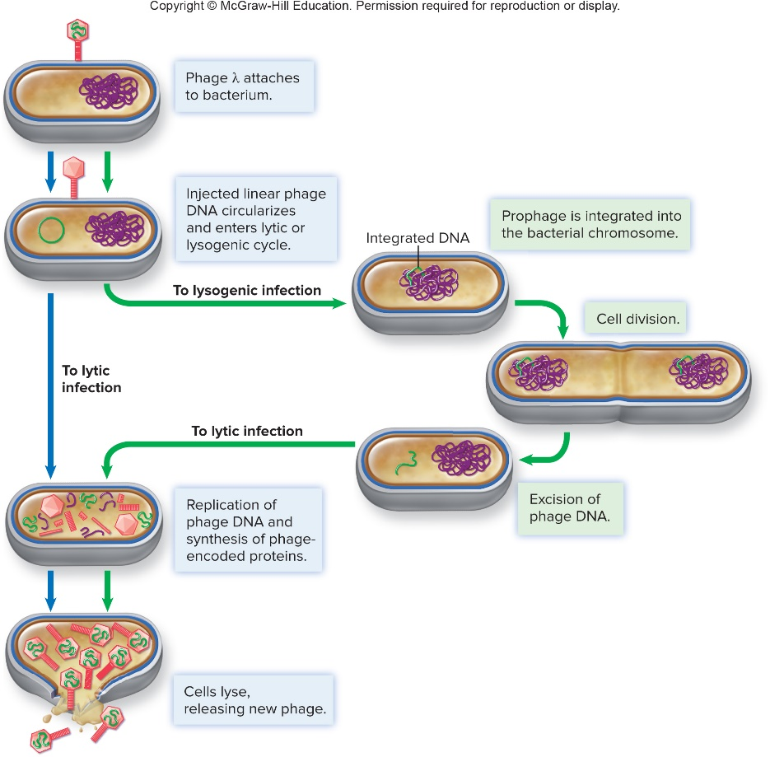
Temperate Phage Infections – Figure 13.6 (1)
Phage-encoded enzyme integrase inserts phage DNA at specific site on host chromosome
Prophage replicates along with host chromosome
Can be excised by phage encoded enzyme, resulting in lytic infection
A phage-encoded repressor prevents excision, maintains lysogenic state
Jump to Temperate Phage Infections – Figure 13.6 (1) Long Description

Slide 24
Temperate Phage Infections – Figure 13.6 (2)
DNA excised from chromosome only about once per 10,000 divisions of lysogen
If DNA damaged (for example, UV light exposure), SOS repair system turns on, activates a protease
Protease destroys repressor, allows prophage to be excised, enter lytic cycle
Called phage induction; allows phage escape damaged host

Slide 25
Table 13.3 Some Properties Encoded by Prophage (Lysogenic Conversion)
Lysogen is immune to superinfection (infection by same phage)
Repressor maintaining integrated prophage also binds to operator on incoming phage DNA, prevents gene expression
Lysogen may show change in phenotype due to prophage DNA – called lysogenic conversion
Toxins encoded by phage genes; only strains carrying prophage produce the toxins
Microorganism | Medical Importance | Property Encoded by Phage
Clostridium botulinum | Causes botulism | Botulinum toxin
Corynebacterium diphtheria | Causes diphtheria | Diptheria toxin
Escherichia coli O157:H7 | Causes hemolytic uremic syndrome | Shiga toxin
Salmonella enterica | Causes food poisoning | Modification of lipopolysaccharide of outer membrane
Streptococcus pyogenes | Causes scarlet fever | Streptococcal pyrogenic exotoxins(SPEs)
Vibrio cholerae | Causes cholera | Cholera toxin

Slide 26
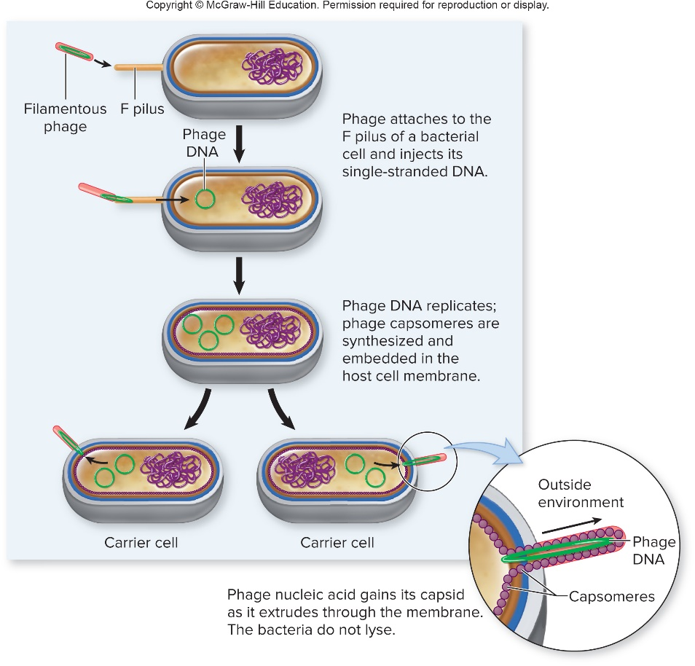
Filamentous Phage Infections – Figure 13.7
Filamentous Phages
Single-stranded DNA phages
Look like long fibers
Cause productive infections
Host cells not killed, but grow more slowly
M13 phage is model
Attaches to protein on F pilus of E. coli
Single-stranded DNA genome enters cytoplasm

Slide 27
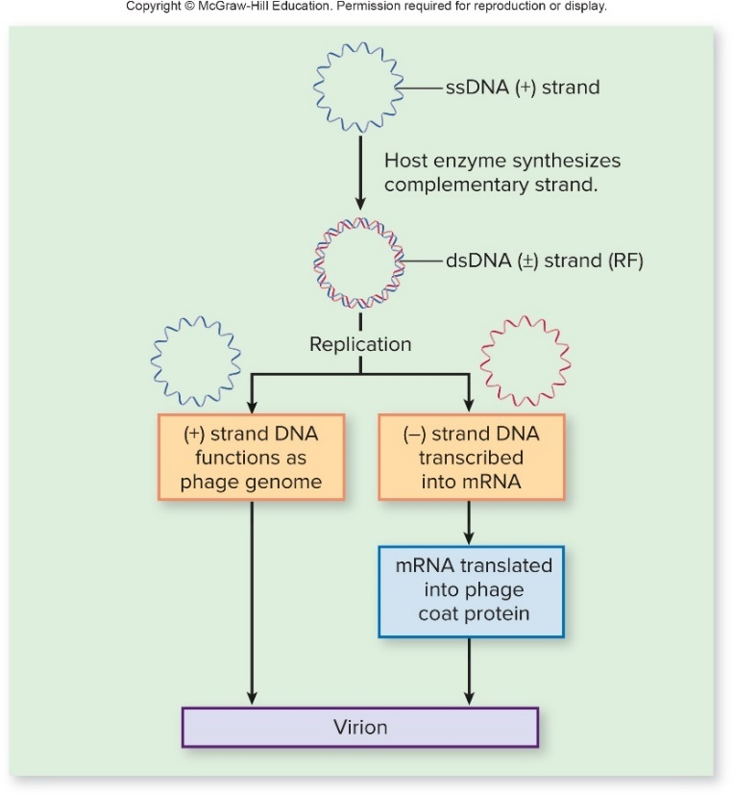
Filamentous Phage Infections – Figure 13.8
Filamentous Phages
DNA polymerase of host cell synthesizes complementary strand
Called replicative form (RF); one strand used as template for synthesis of mRNA, copies of genome
M13 particles assembled in process of extrusion
M13 phage coat protein molecules inserted into cytoplasmic membrane
Other proteins form pores
As phage DNA secreted through pores, coat proteins coat the DNA, form nucleocapsids

Slide 28
Bacteriophages in Horizontal Gene Transfer (1)
Generalized Transduction
Results from packaging error during phage assembly
Some phages degrade host chromosome; fragments can be mistakenly packaged into phage head
These phages cannot direct phage replication cycle
Called transducing particles
Following release, transducing particles can bind to new host, inject DNA
DNA may integrate via homologous recombination, replacing host DNA
Any gene from donor cell can be transferred

Slide 29
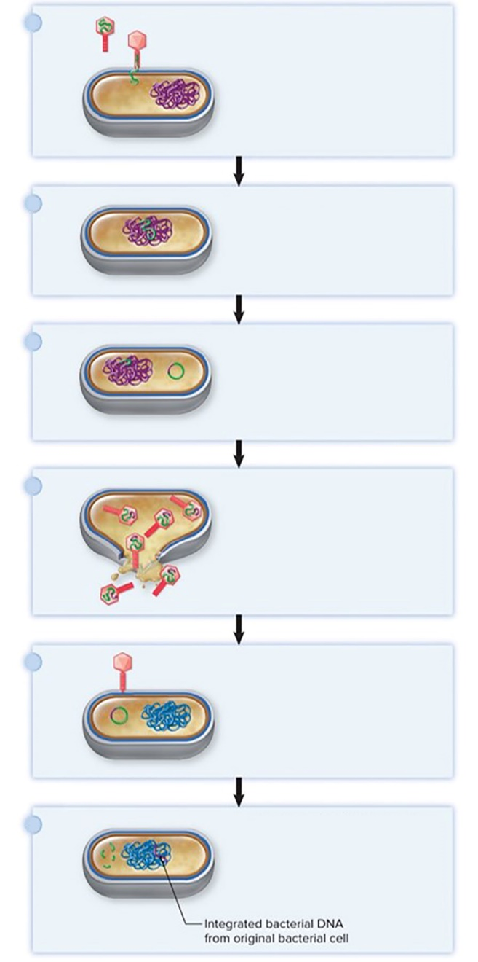
Bacteriophages in Horizontal Gene Transfer (2)
Specialized Transduction
Excision mistake during transition from lysogenic to lytic cycle of temperate phage
Short piece of bacterial DNA removed
Excised DNA incorporated into phage heads; defective particles released
Can bind to new host, inject DNA
Bacterial genes may integrate via homologous recombination
Only bacterial genes adjacent to integrated phage DNA transferred
A temperate phage injects its DNA into a bacterial host.
The phage DNA integrates into the host cell DNA to become a prophage.
When the prophage is excised from the bacterial chromosome, a mistake is made; some bacterial DNA flanking the phage DNA is taken and a piece of the phage DNA is left behind.
Replication and assembly produces defective phage particles that carry certain bacterial DNA in place of some phage DNA.
The DNA of the defective phage is injected into the new host but cannot cause a productive infection.
The bacterial DNA integrates into the host genome via homologous recombination; it can now be replicated along with the rest of the host DNA.

Slide 30
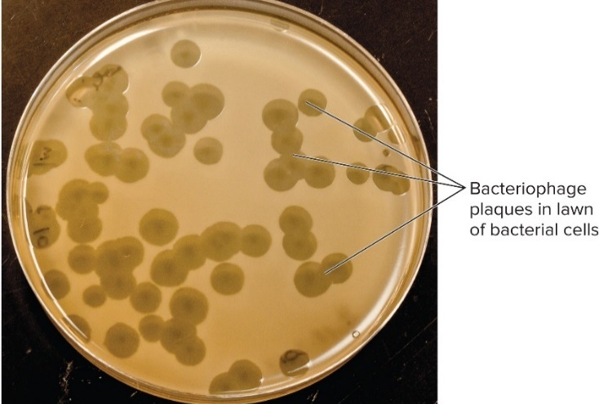
Methods Used to Study Bacteriophages – Figure 13.10
Viruses multiply only inside living cells; must cultivate suitable host cells to grow viruses
Plaque assays used to count phage particles in samples: sewage, seawater, soil
Soft agar inoculated with bacterial host and phage-containing specimen
Bacterial lawn forms
Zones of clearing from bacterial lysis are plaques
Plaque-forming unit (PFU) represents single phage
Counting plaques yields the titer, which is concentration of phage in the original sample
©McGraw-Hill Education/Lisa Burgess

Slide 31
Animal Virus Replication (1)
Five-step infection cycle
Attachment
Viruses bind to receptors on host cell surface, usually glycoproteins on cytoplasmic membrane
Often more than one receptor attachment is required (for example, HIV binds to two)
Normal function of receptor molecule unrelated to viral infection
Particular viruses must attach to specific receptor; limits cell types and tissues a virus can infect
Most viruses infect a single species (dogs do not contract measles from humans), but that is not always true (rabies virus infects dogs and humans)

Slide 32
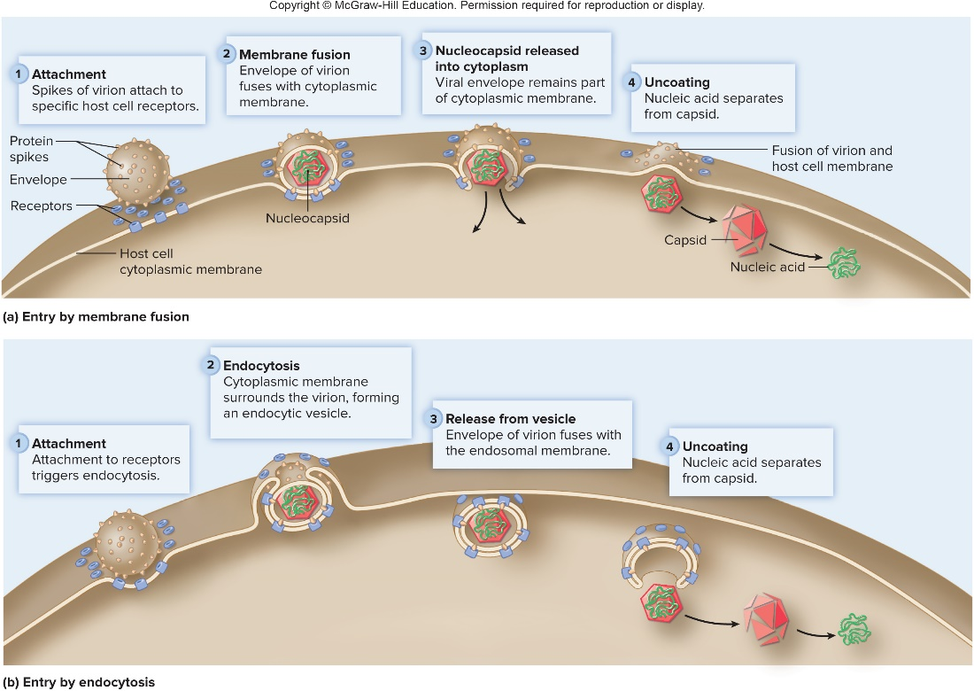
Animal Virus Replication – Figure 13.11
Five-step infection cycle
Penetration and uncoating
Enveloped viruses enter by fusion or endocytosis
Non-enveloped viruses cannot fuse
Entire virion enters cell; nucleic acid separates from protein coat in process of uncoating
Jump to Animal Virus Replication – Figure 13.11 Long Description

Slide 33
Animal Virus Replication (2)
Five-step infection cycle
Synthesis
Expression of viral genes to produce viral structural and catalytic genes (for example, capsid proteins, enzymes required for replication)
Often synthesized as polyprotein that is cleaved by viral proteases (a target site of antiviral medications)
Synthesis of multiple copies of genome
Three general replication strategies depending on type of genome of virus
DNA viruses
RNA viruses
Reverse transcribing viruses

Slide 34
Animal Virus Replication – Figure 13.12a
Five-step infection cycle
Replication of dsDNA viruses
dsDNA (+/ −) is replicated to form viral genome
(−) strand transcribed to produce mRNA; translated to make viral proteins
Replication of ssDNA viruses
Complement to ssDNA synthesized first; then acts as template to produce more copies of viral genome
(−) strand transcribed to produce mRNA

Slide 35
Animal Virus Replication (3)
Five-step infection cycle
Replication of RNA viruses
Majority are single-stranded; replicate in cytoplasm
Require virally encoded RNA-dependent RNA polymerase (replicase)
Allows use of RNA template to make new strand of RNA
Replication strategy varies with viral genome
(+) ssRNA genome also serves as mRNA
(−)ssRNA genome is complement to mRNA
(+/ −) dsRNA genome contains both

Slide 36
Animal Virus Replication – Figure 13.12b (1)
Five-step infection cycle
Replication of (+) ssRNA viruses
Viral RNA binds to ribosome; produces viral replicase
Viral replicase produces multiple copies of complementary (−)
RNA strand
These act as templates to produce more (+) strands
Can serve as viral genome or be translated to produce viral proteins
Notes:
36

Slide 37
Animal Virus Replication – Figure 13.12b (2)
Five-step infection cycle
Replication of (−) ssRNA viruses
Viral RNA and replicase both enter host cell to make complementary (+) RNA strand
(+) RNA strand can serve as mRNA to make viral proteins
Multiple copies of complementary (−) RNA strand produced to serve as viral genome
Notes:
37

Slide 38
Animal Virus Replication – Figure 13.12b (3)
Five-step infection cycle
Replication of dsRNA viruses
Replicase enters host cell with dsRNA because host cell cannot translate dsRNA
Replicase uses (−) RNA strand to produce (+) RNA strand
(+) RNA strand can serve as mRNA to make viral proteins
Notes:
38

Slide 39
Animal Virus Replication (4)
Five-step infection cycle
Replication of RNA viruses
Replicase lacks proofreading ability
Generates mutations during replication
Results in antigenic variation called antigenic drift
Mutations in surface proteins may not be recognized by immune system
Some RNA viruses have segmented genomes
When two different viruses or strains infect a host, new viral particles may contain segments from each virus
New subtype results from this reassortment – process called antigenic shift
Notes:
39

Slide 40
Animal Virus Replication – Figure 13.12c
Five-step infection cycle
Replication of reverse-transcribing viruses
Encode reverse transcriptase: makes DNA from RNA
Retroviruses have (+) ssRNA genome (such as HIV)
Reverse transcriptase enters the cell and synthesizes a single DNA strand from RNA template
Complementary DNA strand synthesized; dsDNA integrated into host cell chromosome
Can be transcribed to produce new viral genome, mRNA

Slide 41
Animal Virus Replication (5)
Five-step infection cycle
Assembly and maturation
Spontaneous self-assembly when viral nucleic acid and capsid proteins accumulate in host cell
Site of assembly varies with virus type and affects release
Release
Most enveloped viruses leave via budding
Viral protein spikes insert into host cell membrane; matrix proteins accumulate; nucleocapsids extruded
Covered with matrix protein and lipid envelope
Some obtain envelope from organelles
Non-enveloped viruses released when host cell dies, often by apoptosis initiated by virus or host

Slide 42
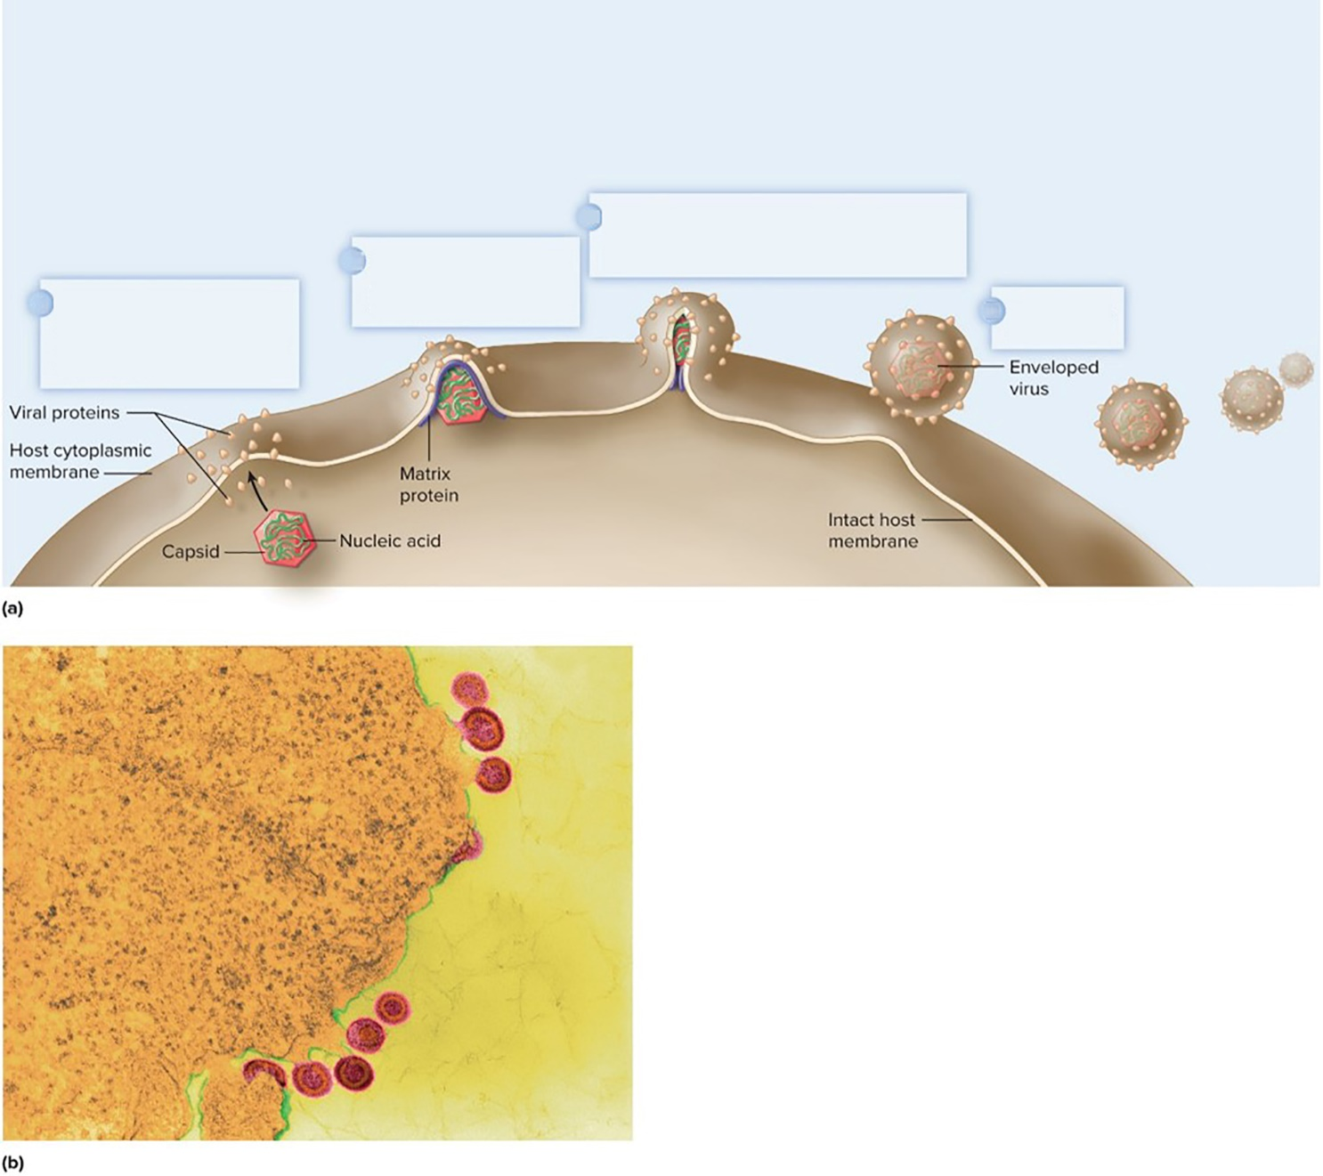
Animal Virus Replication – Figure 13.13
Nucleocapsid extrudes from the host cell, becoming coated with matrix proteins and envelope with protein spikes.
Viral matrix protein coats inside of cytoplasmic membrane.
Viral proteins that will become envelope spikes insert into host cytoplasmic membrane.
New virus is released.
b: ©Dennis Kunkel Microscopy/SPL/ Science Source

Slide 43
Categories of Animal Virus Infections (1)
Acute Infections
Rapid onset; short duration
Burst of virions released from infected host cell
Immune system gradually eliminates virus
Persistent Infections
Continue for years or lifetime
May or may not have symptoms
Some viruses exhibit both (for example, HIV)

Slide 44
Categories of Animal Virus Infections (2)
Persistent infections may be chronic or latent
Chronic infections: continuous production of low levels of virus particles
Carriers may lack symptoms, but still transmit virus
Latent infections: viral genome remains silent in host cell; can reactivate to cause productive infection

Slide 45
Table 13.4 Examples of Persistent Infections
Virus | Type | Cells Involved | Disease
Cytomegalovirus (CMV; Herpesviridae family) | Latent | Salivary glands, kidney epithelium, leukocytes | CMV pneumonia, eye infections, congenital CMV infection
Epstein-Barr virus | Latent | B cells, which are involved in antibody production | Mononucleosis, Burkitt’s lymphoma
Hepatitis B virus | Chronic | Hepatocytes (liver cells) | Hepatitis, cirrhosis, hepatocellular carcinoma
Hepatitis C virus | Chronic | Hepatocytes (liver cells) | Hepatitis, cirrhosis, hepatocellular carcinoma
Herpes simplex virus type 1 | Latent | Neurons of sensory ganglia | Primary oral herpes and recurrent herpes simplex (cold sores)
Herpes simplex virus type 2 | Latent | Neurons of sensory ganglia | Genital herpes and recurrent genital herpes
Human immunodeficiency virus (HIV) | Mixed | Chronic: Activated helper T cells, macrophages Latent: Memory helper T cells | AIDS
Varicella zoster (Herpesviridae family) | Latent | Satellite cells of sensory ganglia | Chickenpox and shingles

Slide 46
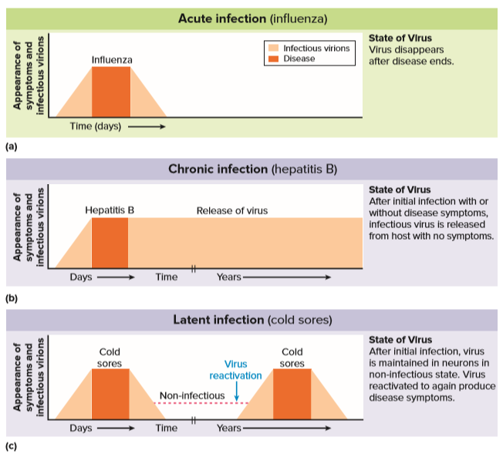
Categories of Animal Virus Infections – Figure 13.14
Jump to Categories of Animal Virus Infections – Figure 13.14 Long Description

Slide 47
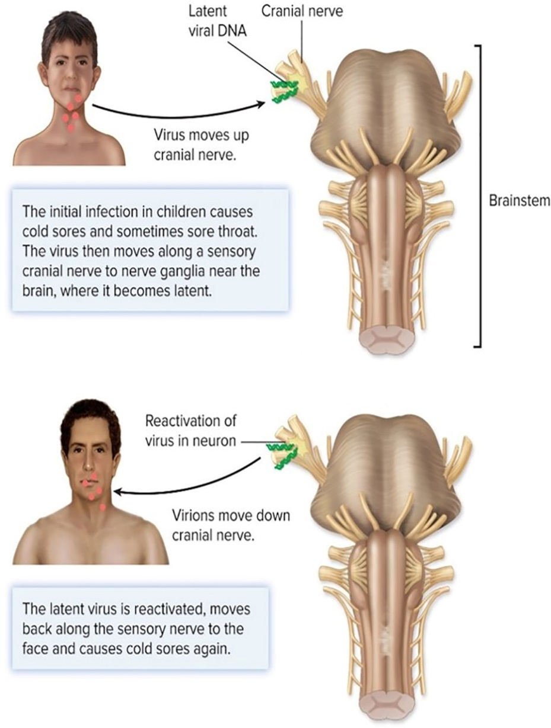
Categories of Animal Virus Infections – Figure 13.15
Latent infections
Silent viral genome is called a provirus
Provirus integrates into host chromosome or replicates separately, much like a plasmid
Cannot be eliminated; can later be reactivated
Examples are varicella zoster virus (VSV) and herpes simplex type 1 virus (HSV-1)
Virus becomes latent after initial infection
Activation of latent virus
Jump to Long Description Categories of Animal Virus Infections – Figure 13.15

Slide 48
Viruses and Human Tumors
Tumor is abnormal growth
Cancerous or malignant can metastasize; benign do not
Proto-oncogenes stimulate cell growth and division; tumor suppressor genes inhibit growth division
Mutations in these genes cause abnormal and/or uncontrolled growth
Usually multiple changes at different sites required
Oncogene is proto-oncogene that has been changed to promote uncontrolled growth
Insertion of provirus may disrupt proto-oncogene
Chronic infection may damage DNA (inflammation)
Virus may carry an oncogene
Human papillomaviruses (HPVs) associated with cancer

Slide 49
Table 13.5 Viruses Associated with Cancers in Humans
Virus | Type of Nucleic Acid | Kind of Tumor
Epstein-Barr | DNA | Burkitt’s lymphoma; nasopharyngeal carcinoma; B-cell lymphoma
Hepatitis B | DNA | Hepatocellular carcinoma
Human herpesvirus type 8 | DNA | Kaposi’s sarcoma
Human papillomaviruses (HPVs) | DNA | Different kinds of tumors, caused by different HPV types
Hepatitis C | RNA | Hepatocellular carcinoma
HTVL-1 | RNA (retrovirus) | Adult T-cell leukemia (rare)
Notes:
49

Slide 50
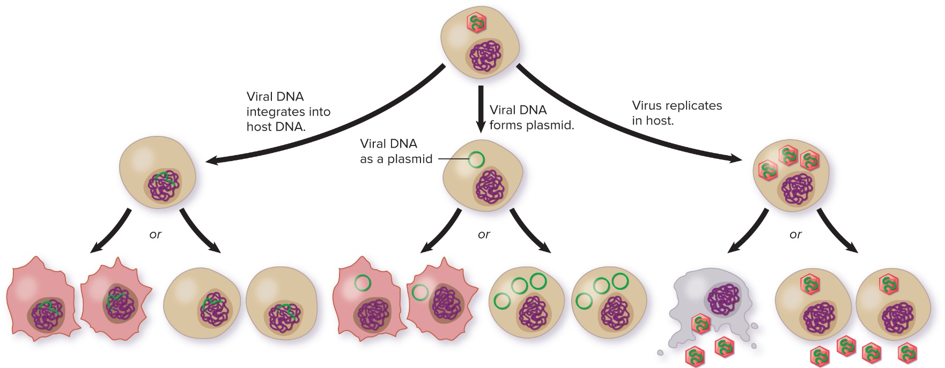
Viruses and Human Tumors – Figure 13.16
Infection may lead to latent infections, productive infections, or virus-induced tumors
Virus-induced tumors are rare; most result from mutations
Tumor Normal cells are transformed into tumor cells.
Latent infection Viral DNA replicates as part of the chromosome without harming the host.
Tumor Normal cells are transformed into tumor cells.
Latent infection Viral DNA replicates as a plasmid without harming the host.
Productive infection New virions released when host cell lyses.
Productive infection New virions released by budding.
Jump to Viruses and Human Tumors – Figure 13.16 Long Description

Slide 51
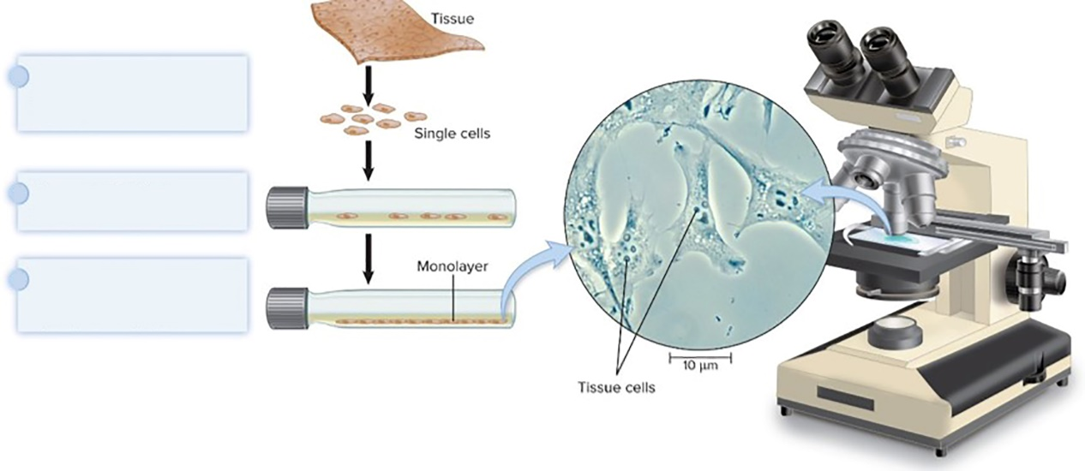
Cultivating and Quantitating Animal Viruses – Figure 13.17
Viruses must be grown in appropriate host
Once done by inoculating live animals; or preparing embryonated (fertilized) chicken eggs
Cell culture or tissue culture now commonly used
Process animal tissues to obtain primary cultures
Cells divide slowly and only a limited number of times
Tumor cells often used, multiply indefinitely
Cut tissue into small pieces and incubate with a protease (trypsin) to separate cells.
Place cells into flask with growth medium.
Allow cells to settle on bottom of flask and grow into a single layer (a monolayer).
Source: Dr. Cecil Fox/National Cancer Institute (NCI)

Slide 52
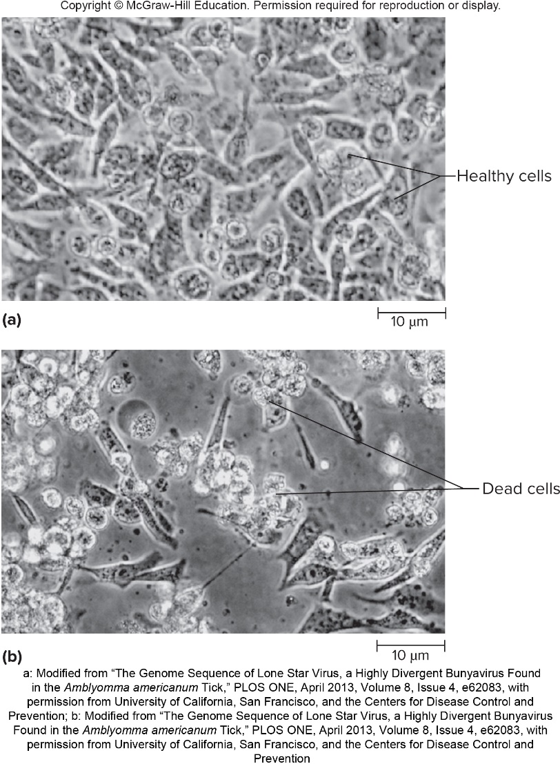
Cultivating and Quantitating Animal Viruses – Figure 13.18
Effects of Viral Replication of Cell Cultures
Many viruses cause distinct morphological alterations called cytopathic effect
Cells may change shape, detach from surface, lyse, fuse into giant multinuclear cell (syncytium), or form inclusion body (site of viral replication)
a: Modified from “The Genome Sequence of Lone Star Virus, a Highly Divergent Bunyavirus Found in the Amblyomma americanum Tick,”
PLOS ONE, April 2013, Volume 8, Issue 4, e62083, with permission from University of California, San Francisco, and the Centers for Disease Control and Prevention;
b: Modified from “The Genome Sequence of Lone Star Virus, a Highly Divergent Bunyavirus Found in the Amblyomma americanum Tick,”
PLOS ONE, April 2013, Volume 8, Issue 4, e62083, with permission from University of California, San Francisco, and the Centers for Disease Control and Prevention

Slide 53
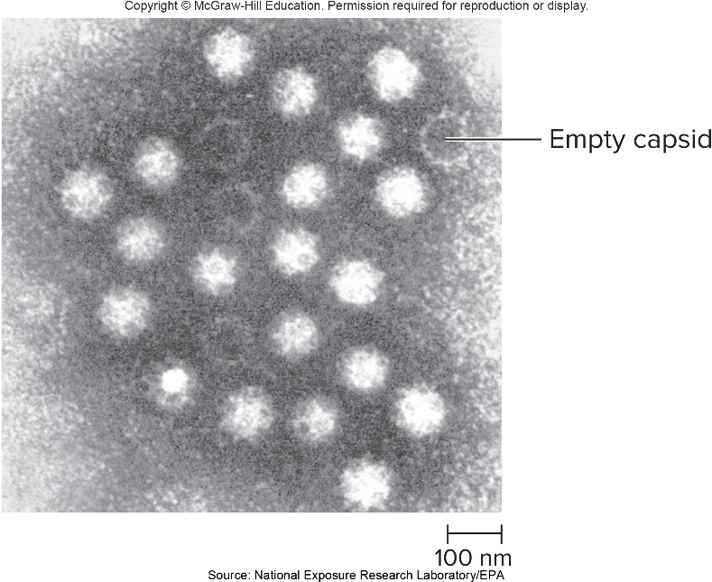
Cultivating and Quantitating Animal Viruses – Figure 13.19
Quantitating Animal Viruses
Plaque assay using monolayer of tissue culture cells
Direct count via electron microscopy
Quantal assay: dilutions of virus given to hosts
Titer is dilution at which 50% of hosts are infected (ID₅₀– infective dose) or killed (LD₅₀– lethal dose)

Slide 54
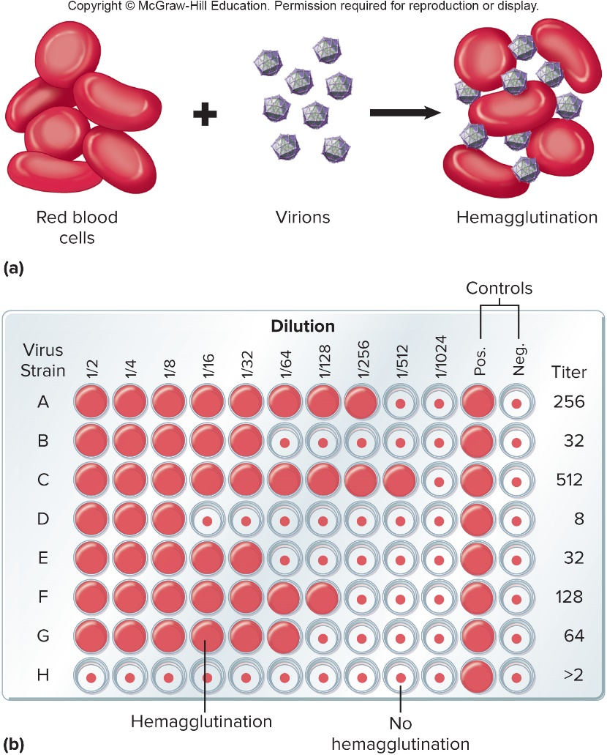
Cultivating and Quantitating Animal Viruses – Figure 13.20
Quantitating Animal Viruses
Hemagglutination: some viruses cause red blood cells to agglutinate (clump)
Mix virus with dilutions of red blood cells
Highest dilution with maximum agglutination is titer of the virus
Notes:
54

Slide 55
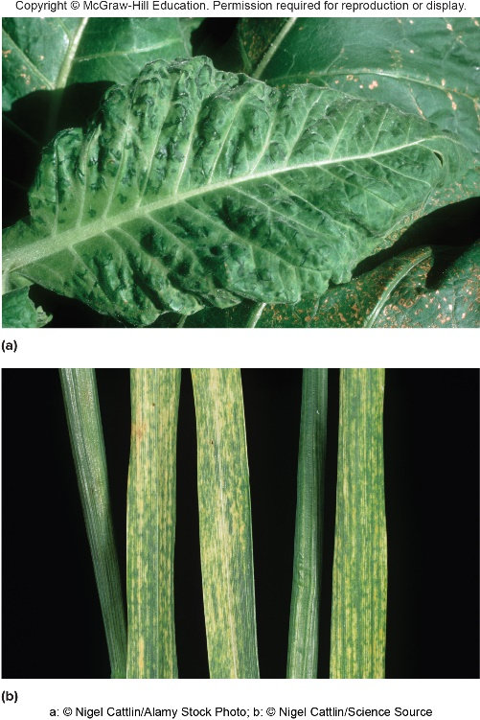
Plant Viruses – Figures 13.21 and 13.22
Plant viruses are economically important
Do not attach to cell receptors; enter via wounds in cell wall, spread through cell openings (plasmodesmata)
Plants rarely recover, lack specific immunity
Transmitted by soil; humans; insects; contaminated seeds, tubers, pollen; grafting
Difficult to eliminate
a: ©Nigel Cattlin/Alamy Stock Photo; b: ©Nigel Cattlin/Science Source; bottom: ©Dr. Jeremy Burgess/Science Source

Slide 56
Other Infectious Agents: Viroids and Prions (1)
Viroids are small single-stranded RNA molecules
Thus far only found in plants; enter through wound sites
Many questions remain:
How do they replicate?
How do they cause disease?
How did they originate?

Slide 57
Other Infectious Agents: Viroids and Prions (2)
Prions are proteinaceous infectious agents
Composed solely of protein; no nucleic acids
Linked to slow, fatal human diseases; animal diseases
Usually transmitted only within a species
Mad cow disease killed more than 170 people in England

Slide 58
Table 13.6 Prion Diseases
Disease | Host
Scrapie | Sheep and goats
Bovine Spongiform encephalopathy (mad cow disease) | Cattle
Chronic wasting disease | Deer and elk
Transmissible mink encephalophaty | Ranched mink
Exotic ungulate encephalopathy | Antelope in South Africa
Feline spongiform encephalopathy | Cats
Kuru | Humans (transmitted by cannibalism)
Variant Creutzfeldt-Jakob disease | Humans (transmitted by consumption of contaminated beef)
Creutzfeldt-Jakob disease | Humans (inherited)
Gertsmann-Sträussler-Scheinker syndrome | Humans (inherited)
Fatal familial insomnia | Humans (inherited)

Slide 59
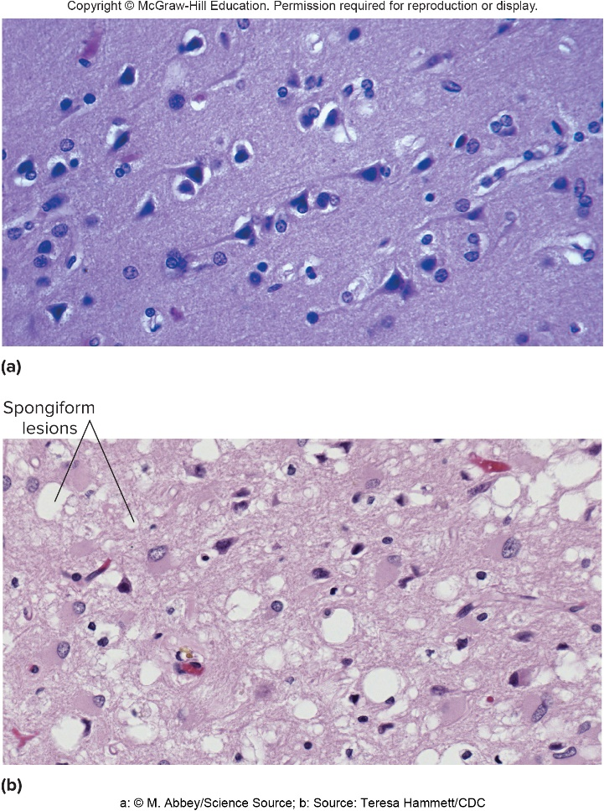
Other Infectious Agents: Viroids and Prions – Figure 13.23
Prion proteins accumulate in neural tissue
Neurons die
Tissues develop holes
Brain function deteriorates
Characteristic appearance gives rise to general term for all prion diseases: transmissible spongiform encephalopathies
a: ©M. Abbey/Science Source; b: Source: Teresa Hammett/CDC

Slide 60
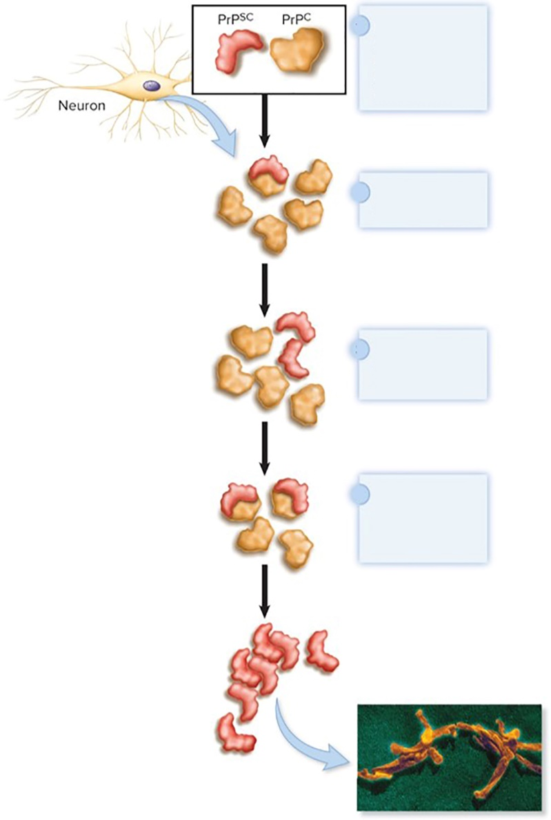
Other Infectious Agents: Viroids and Prions – Figure 13.24
Cells produce normal form of neuronal protein
Infectious prion proteins
Both normal $\left({PrP}^{C}\right)$ and abnormal $\left({PrP}^{SC}\right)$ proteins are present.
Resistant to proteases
Insoluble, forms aggregates
${PrP}^{SC}$ interacts with ${PrP}^{C}$.
Appears that
${PrP}^{C}$ is converted into ${PrP}^{SC}$.
folding of
Conversion continues and ${PrP}^{SC}$ accumulates.
Prions resistant to heat and chemical treatments
©Dr. Raoult/Science Source

