Slide 1
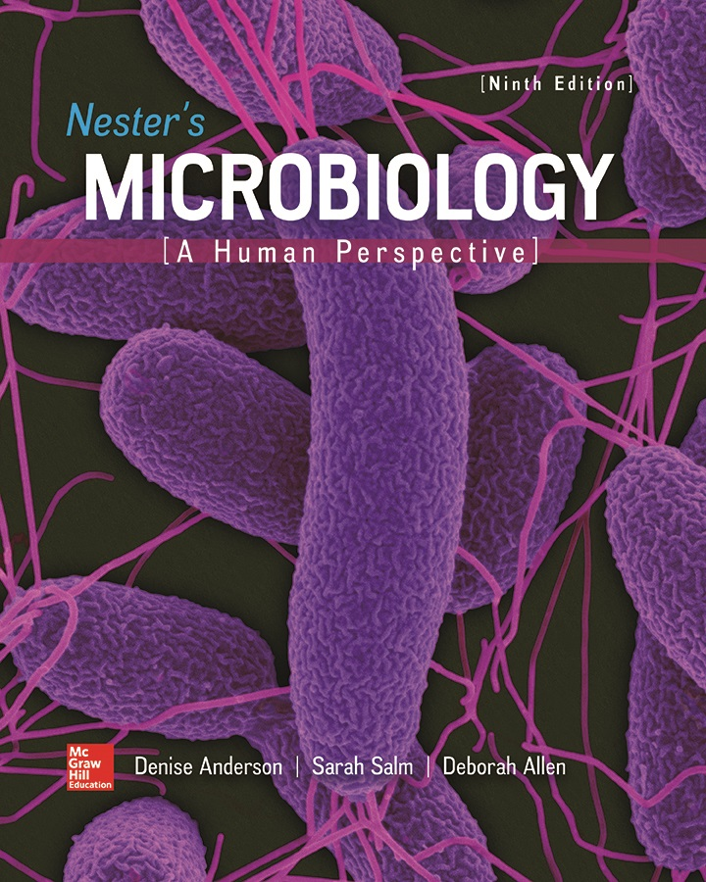
Chapter 05 Lecture Outline
See separate PowerPoint slides for all figures and tables pre-inserted into PowerPoint without notes.

Slide 2
A Glimpse of History
British physician Joseph Lister (1827 to 1912) revolutionized surgery: introduced methods to prevent infection of wounds
Impressed with Pasteur’s work, he wondered if ‘minute organisms’ might be responsible for infections
Applied carbolic acid (phenol) directly onto damaged tissues, where it prevented infections
Improved methods further by sterilizing instruments and maintaining clean operating environment
Oral antiseptic Listerine named for him in 1879 when it was introduced as a surgical antiseptic

Slide 3
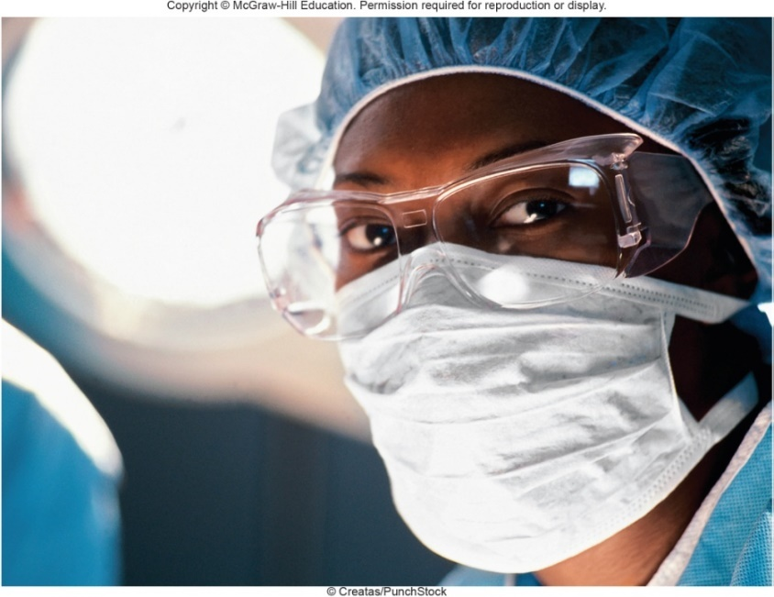
Introduction
Until late 19th century, patients undergoing even minor surgeries were at great risk of developing fatal infections
Physicians did not know their hands could pass diseases from one patient to the next
Did not understand airborne microbes could infect open wounds
Modern hospitals use strict procedures to avoid microbial contamination
Microbial growth reduces quality of many goods
©Arthur Tilley/Getty Images

Slide 4
Approaches to Control (1)
Principles of Control
Sterilization: removal or destruction of all microorganisms and viruses
Sterile item is free of microbes including endospores, but does not consider prions
Disinfection: elimination of most or all pathogens
Some viable microbes may remain
Disinfectants: chemicals used on inanimate objects
Often called germicides
Bactericides kill bacteria
Fungicides kill fungi
Virucides inactivate viruses
Antiseptics: chemicals used on living tissues

Slide 5
Approaches to Control (2)
Decontamination: reduces number of pathogens to a safe level
Washing, use of heat, or chemicals
Sanitization: substantially reduces microbial population to meet accepted health standards that minimize spread of disease
Not a specific level of control
Preservation: process of delaying spoilage of perishable products
Adjust conditions of storage to slow growth
Add bacteriostatic (growth-inhibiting) preservatives
Pasteurization: brief heating to reduce number of spoilage organisms, destroy pathogens without changing characteristics of product

Slide 6
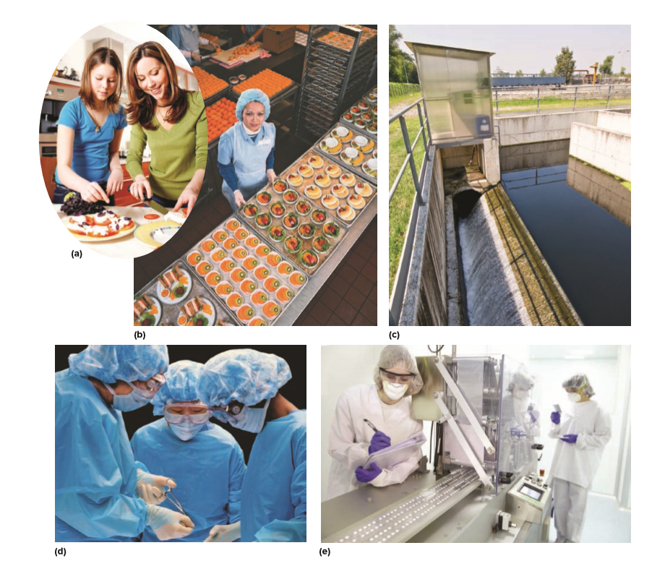
Approaches to Control – Figure 5.1
Situational considerations: Microbial control methods depend upon situation and level of control required
a: ©Anna Bryukhanova/Getty Images; b: ©Don Tremain/Getty Images; c: ©Marka/Alamy Stock Photo; d: ©Ryan McVay/Getty Images; e: ©Javier Larrea/Getty Images

Slide 7
Approaches to Control (3)
Daily Life
Washing and scrubbing with soaps and detergents achieves routine control
Soap aids in mechanical removal of organisms
Beneficial skin microbiota reside deeper on underlying layers of skin, hair follicles
Not adversely affected by regular washing
Other control methods used in daily life include cooking foods, cleaning surfaces, and refrigeration

Slide 8
Approaches to Control (4)
Hospitals and Other Healthcare Facilities
Minimizing microbial population very important due to danger of healthcare-associated infections (HAIs)
Weakened patients more susceptible to infection; may undergo invasive procedures (surgery)
Pathogens more likely found in hospital setting
Feces, urine, respiratory droplets, bodily secretions

Slide 9
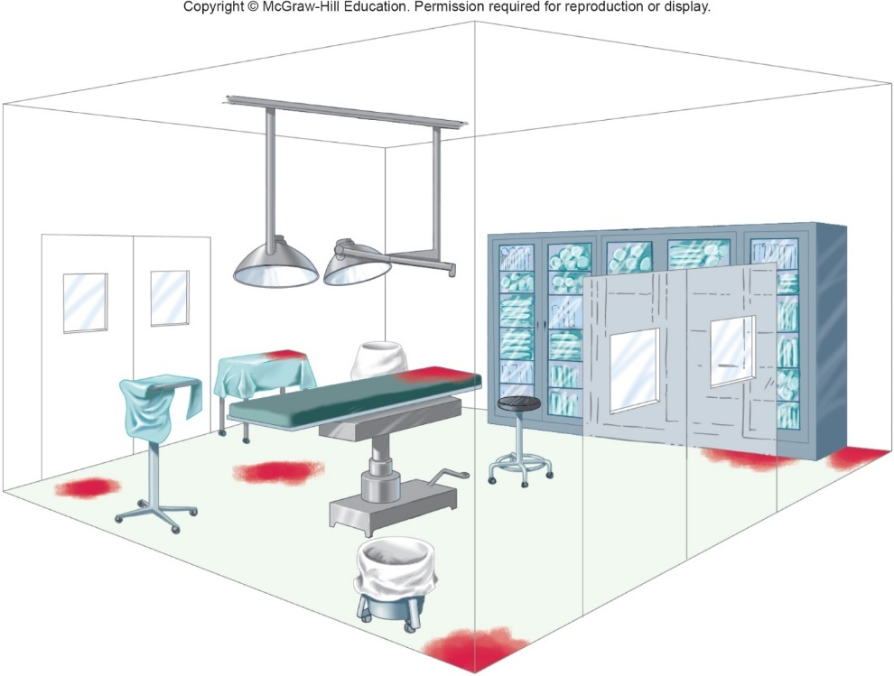
Approaches to Control – Figure 5.2
Hospitals and Other Healthcare Facilities
Special care must be taken to control microorganisms in operating rooms
Instruments must be sterilized to avoid introducing infection to deep tissues during surgery
Prions are a relatively new concern; difficult to destroy

Slide 10
Approaches to Control (5)
Microbiology Laboratories
Routinely work with microbial cultures
Use rigorous methods of control
Must eliminate microbial contamination to both experimental samples and environment
Careful treatment both before work (use sterile materials) and after work (sterilize cultures, waste)
Aseptic technique used to prevent contamination of samples, workers, environment
CDC guidelines for labs working with microorganisms
Biosafety levels range from BSL-1 (microbes not known to cause disease) to BSL-4 (lethal pathogens for which no vaccine or treatment exists)

Slide 11
Approaches to Control (6)
Food and Food Production Facilities
Perishables retain quality longer when contaminating microbes destroyed, removed, inhibited
Heat treatment most common and reliable mechanism
Can alter flavor, appearance of products
Irradiation and high pressure used to treat certain foods without altering it
Chemical additives can prevent spoilage; regulated by FDA due to risk of toxicity
Food-processing facilities must keep surfaces and machinery clean and relatively free of microorganisms

Slide 12
Approaches to Control (7)
Water Treatment Facilities
Ensure drinking water free of pathogens
Chlorine traditionally used to disinfect water
Can react with naturally occurring chemicals
Form disinfection by-products (DBPs)
Some DBPs linked to long-term health risks
Some organisms resistant to chemical disinfectants
Cryptosporidium parvum (causes diarrhea)
Regulations require facilities to minimize DBPs and C. parvum in treated water
Other industries
Pharmaceuticals, cosmetics, deodorants must not carry microbial contamination

Slide 13
Selecting an Antimicrobial Procedure (1)
Selection of effective procedure is complicated
Ideal method does not exist; each has drawbacks
Choice depends on numerous factors
Type and number of microbes
Environmental conditions
Risk of infection
Composition of item to be treated

Slide 14
Selecting an Antimicrobial Procedure (2)
Type of Microbes
Multiple highly resistant microbes
Bacterial endospores: most resistant; only extreme heat or chemical treatment destroys them
Protozoan cysts and oocysts: resistant to disinfectants; excreted in feces; causes diarrheal disease if ingested; destroyed by boiling
Mycobacterium species: waxy cell walls makes resistant to many chemical treatments
Pseudomonas species: resistant to and can actually grow in some disinfectants
Non-enveloped viruses: lack lipid envelope; more resistant to disinfectants

Slide 15
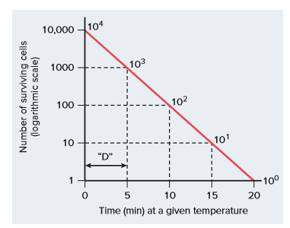
Selecting an Antimicrobial Procedure – Figure 5.3
Number of Microorganisms
Only a fraction of population dies during given time interval so it takes more time to kill a large population than a small one
Removing some organisms by washing reduces time needed to sterilize or disinfect a product
Decimal reduction time (D value) is time required to kill 90% of population under specific conditions

Slide 16
Selecting an Antimicrobial Procedure (3)
Environmental Conditions
Dirt, grease, body fluids can interfere with heat penetration, action of chemicals
Important to thoroughly clean items
Microorganisms in biofilm are more resistant to disinfectants
Temperature and pH can influence effectiveness
For example, sodium hypochlorite (household bleach) solution can kill suspension of M. tuberculosis at 55 degrees Celsius in half the time as at 50 degrees Celsius
Even more effective at low pH

Slide 17
Selecting an Antimicrobial Procedure (4)
Risk for Infection
Medical instruments categorized according to risk for transmitting infectious agents
Critical items come into contact with body tissues
Must be sterile
Include needles and scalpels
Semicritical instruments contact mucous membranes but do not penetrate body tissues
Must be free of viruses and vegetative bacteria
Any endospores blocked by mucous membranes
Includes endoscopes and endotracheal tubes
Non-critical instruments and surfaces contact unbroken skin only
Low risk of transmission
Countertops, stethoscopes, blood pressure cuffs

Slide 18
Selecting an Antimicrobial Procedure (5)
Composition of the Item
Some sterilization and disinfection methods inappropriate for certain items
Heat can damage plastics and other materials
Irradiation provides alternative, but damages some types of plastic
Moist heat, liquid chemical disinfectants cannot be used to treat moisture-sensitive material

Slide 19
Using Heat to Destroy Microorganisms and Viruses
Heat treatment useful for microbial control
Reliable, safe, relatively fast, inexpensive, non-toxic
Can be used to sterilize or disinfect
Moist heat: irreversibly denatures proteins
Boiling destroys most microorganisms and viruses
Does not sterilize: endospores can survive
Pasteurization destroys heat-sensitive pathogens, spoilage organisms
High-temperature–short-time (HTST) method: Milk - 72 degrees Celsius for 15 seconds; ice cream - 82 degrees Celsius for 20 seconds
Ultra-high-temperature (UHT) method: shelf-stable boxed juice and milk; known as “ultra-pasteurization”
Milk - 140 degrees Celsius for a few seconds, then rapidly cooled

Slide 20
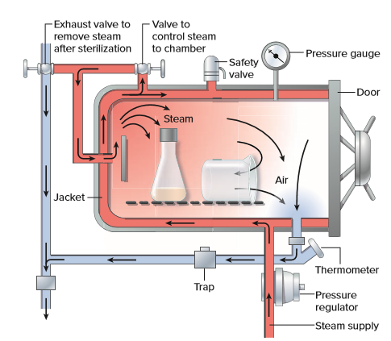
Using Heat to Destroy Microorganisms and Viruses – Figure 5.4
Sterilization Using Pressurized Steam
Autoclave used to sterilize using pressurized steam
Increased pressure raises temperature; kills endospores
Sterilization typically at 121 degrees Celsius and 15 pound per square inch in 15 minutes
Longer for larger volumes
Flash sterilization at higher
temperature can be used
Prions thought destroyed
at 132 degrees Celsius for 1 hour

Slide 21
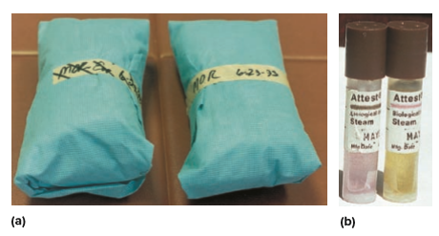
Using Heat to Destroy Microorganisms and Viruses – Figure 5.5
Sterilization Using Pressurized Steam
Autoclave used to sterilize using pressurized steam
To be effective, steam must enter item and displace air
Place long, thin containers on their sides
Do not close containers tightly
Tape with a heat-sensitive indicator can confirm heating
Biological indicators can confirm lack of microbial growth after autoclaving
(a&b): ©Evans Roberts

Slide 22
Using Heat to Destroy Microorganisms and Viruses (1)
Commercial Canning Process
Uses industrial-sized autoclave called retort
Designed to destroy Clostridium botulinum endospores
Reduce
endospores to only 1 (a 12 D process)
Virtually impossible to have that many endospores
Critical because endospores could germinate in canned foods; cells grow in low-acid anaerobic conditions and produce botulinum toxin
Canned food commercially sterile
Endospores of some thermophiles may survive
Usually not a concern; only grow at temperatures well above normal storage

Slide 23
Using Heat to Destroy Microorganisms and Viruses (2)
Dry heat
Less effective than moist heat; longer times, higher temperatures necessary
200 degrees Celsius for 90 minutes versus 121 degrees Celsius for 15 minutes
Hot air ovens destroy cell components, denature proteins
Used for glass, powders, oils, dry materials
Incineration is a method of dry heat sterilization
Burns cells to ashes
Laboratory inoculation loop sterilized by flaming
Used to destroy medical waste and animal carcasses

Slide 24
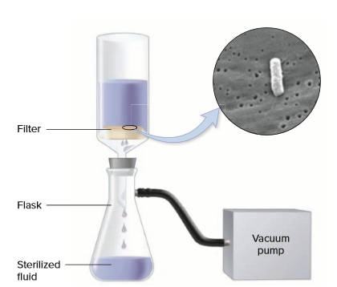
Using Other Physical Methods to Remove or Destroy Microbes – Figure 5.6
Filtration used extensively to remove organisms from heat-sensitive fluids
Membrane filters or microfilters
Small pore size (0.2 micrometer) to remove bacteria
Vacuum used to move fluid through filter
Depth filters
Thick porous filtration
material (for example, cellulose)
Electrical charges trap cells
Source: Margaret Williams, PhD; Claressa Lucas, PhD; Tatiana Travis, BS/CDC

Slide 25
Using Other Physical Methods to Remove or Destroy Microbes (1)
Filtration of air
High-efficiency particulate air (HEPA) filters remove nearly all microbes over 0.3 micrometer from air
Specialized hospital rooms
Biological safety cabinets

Slide 26
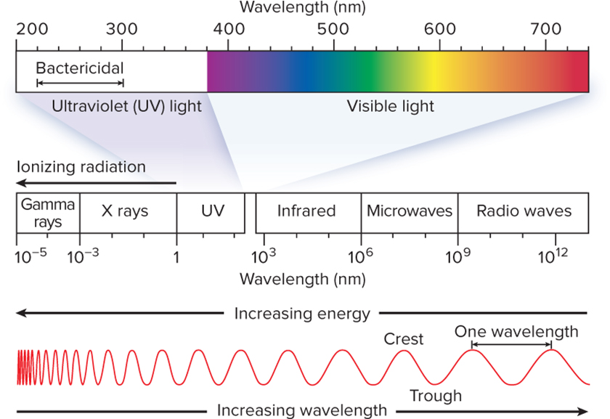
Using Other Physical Methods to Remove or Destroy Microbes – Figure 5.7
Irradiation
Electromagnetic radiation: radio waves, microwaves, visible and ultraviolet light, X rays, and gamma rays
Energy travels in waves
Wavelength inversely proportional to frequency
High frequency has more energy than low frequency

Slide 27
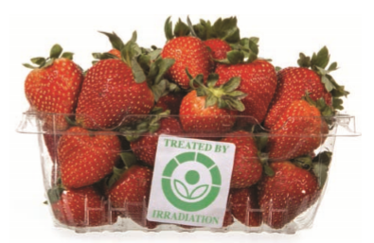
Using Other Physical Methods to Remove or Destroy Microbes – Figure 5.8
Ionizing radiation (gamma rays, X rays) directly destroys DNA and damages cytoplasmic membranes
Also reacts with O₂ to produce reactive oxygen species
High energy gamma-rays
Used to sterilize heat-sensitive materials
Generally used after packaging
Approved for use on a variety of foods, but some consumers refuse irradiated products
©H. S. Photos/Science Source

Slide 28
Using Other Physical Methods to Remove or Destroy Microbes (2)
Ultraviolet radiation destroys microbes directly
Damages DNA
Used to destroy microbes in air, water, and on surfaces
Poor penetrating power
Thin films or coverings can limit effect
Cannot kill microbes in solids or turbid liquids
Most glass and plastic block rays
Must be carefully used since damaging to skin, eyes
Microwaves do not affect microorganisms, but the heat they generate can be lethal
Microwave ovens heat food unevenly, so cells can survive

Slide 29
Using Other Physical Methods to Remove or Destroy Microbes (3)
High Pressure Processing (HPP)
Decreases number of microorganisms in commercial food products like fruit juice and guacamole
Employs high pressure up to 120,000 pound per square inch
Destroys microbes by denaturing proteins and altering cell permeability
Products maintain color, flavor associated with fresh food

Slide 30
Table 5.1 Physical Methods Used to Destroy Microorganisms and Viruses (1)
Method | Characteristic | Use
Moist Heat | Denatures proteins. Relatively fast, reliable, safe, and inexpensive.
Boiling | Boiling for 5 minutes destroys most microorganisms and viruses; a notable exception is endospores. | Boiling for at least 5 minutes can be used to treat drinking water.
Pasteurization | Significantly decreases the numbers of heat-sensitive microorganisms, including spoilage microbes and pathogens (except endospore formers). | Milk is pasteurized by heating it to 72 degrees Celsius for 15 seconds. Juices are also routinely pasteurized.
Pressurized steam (autoclaving) | Typical treatment is 121 degrees Celsius/15 pound per square inch for 15 minutes or longer, a process that destroys endospores. | Widely used to sterilize microbiological media, laboratory glassware, surgical instruments, and other items that steam can penetrate. The canning process renders foods commercially sterile.
Dry Heat | Destroys cell components and denatures proteins.
Incineration | Burns cell components to ashes. | Flaming of wire inoculating loops. Also used to destroy medical wastes and contaminated animal carcasses.
Dry heat ovens | Less efficient than moist heat, requiring longer times and higher temperatures. | Laboratory glassware is sterilized by heating at 160 degrees Celsius to 170 degrees Celsius for 2 to 3 hours. Oils and dry materials are also sterilized in ovens.

Slide 31
Table 5.1 Physical Methods Used to Destroy Microorganisms and Viruses (2)
Method | Characteristic | Use
Filtration | Filter retains microbes while letting the suspending fluid or air pass through small holes.
Filtration of fluids | Various pore sizes are available; 0.2 micrometer is commonly used to remove bacteria. | Used for beer and wine, and to sterilize some heat-sensitive medications.
Filtration of air | HEPA filters are used to remove microbes that have a diameter of 0.3 micrometer or greater. | Used in biological safety cabinets, specialized hospital rooms, and airplanes. Also used in some vacuum cleaners and home air purification units.
Irradiation | Type of cell damage depends on the wavelength of the radiation.
Ionizing radiation | Destroys DNA and possibly damages cytoplasmic membranes. Produces reactive molecules that damage other cell components. Items can be sterilized even after packaging. | Used to sterilize heat-sensitive materials including medical equipment, disposable surgical supplies, and drugs such as penicillin. Also used to destroy microbes in spices, herbs, and approved types of produce and meats.
Ultraviolet radiation | Damages DNA. Penetrates poorly. | Used to destroy microbes in the air and drinking water, and to disinfect surfaces.
High Pressure | Treatments up to 120,000 pound per square inch may denature proteins and alter the permeability of the cell. Products retain color, flavor, and nutrients. | Used to extend the shelf life of certain food products such as guacamole.

Slide 32
Using Chemicals to Destroy Microorganisms and Viruses (1)
Effectiveness of Germicidal Chemicals
Sterilants destroy all microbes; also called sporocides
Heat-sensitive critical instruments
High-level disinfectants destroy viruses, vegetative cells
Do not reliably kill endospores
Semi-critical instruments
Intermediate-level disinfectants destroy vegetative bacteria, mycobacteria, fungi, and most viruses
Disinfect non-critical instruments
Low-level disinfectants destroy fungi, vegetative bacteria except mycobacteria, and enveloped viruses
Do not kill endospores, non-enveloped viruses
Disinfect furniture, floors, walls

Slide 33
Using Chemicals to Destroy Microorganisms and Viruses (2)
Effectiveness of Germicidal Chemicals
Regulated by FDA or EPA
Follow instructions regarding dilution, temperature, and duration of time needed for effectiveness
Clean objects before treatment with germicide

Slide 34
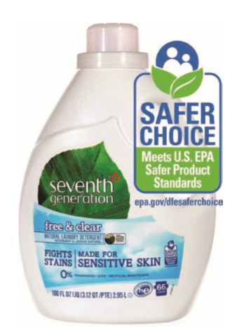
Using Chemicals to Destroy Microorganisms and Viruses – Figure 5.9
Selecting the Appropriate Germicidal Chemical
Toxicity: benefits must be weighed against risk of use
Activity in presence of organic material
Compatibility with material being treated
Liquids cannot be used on electrical equipment
Residues - can be toxic or corrosive
Cost and availability
Storage and stability
Concentrated stock decreases storage space
Environmental risk
Agent may need to be neutralized before disposal
©H. S. Photos/Alamy Stock Photo

Slide 35
Classes of Germicidal Chemicals (1)
Alcohols
60 to 80% aqueous solutions of ethyl or isopropyl alcohol
Kills vegetative bacteria and fungi
Not reliable against endospores, non-enveloped viruses
Denatures essential proteins, damages membranes
Proteins more soluble in water; pure alcohol less effective
Commonly used as antiseptic and disinfectant; non-toxic, inexpensive, no residue
Limitations
Evaporates quickly, limiting contact time
Can damage rubber, some plastics, and others
Tincture: antimicrobial chemical dissolved in alcohol

Slide 36
Classes of Germicidal Chemicals (2)
Aldehydes
Includes glutaraldehyde, formaldehyde, and ortho-phthalaldehyde (OPA)
Inactivates proteins and nucleic acids
2% alkaline glutaraldehyde common sterilant
Immersion of medical items for 10 to 12 hours
Toxic; requires thorough rinsing after use
Ortho-phthalaldehyde less toxic, but turns skin gray
Formaldehyde used as gas or as formalin (37% solution)
Effective germicide that kills most microbes quickly
Used to kill bacteria and inactivate viruses for vaccines
Used to preserve specimens
Probable carcinogen

Slide 37
Classes of Germicidal Chemicals (3)
Biguanides
Chlorhexidine most effective
Extensive use as antiseptics
Stays on skin, mucous membranes
Relatively low toxicity
Destroys vegetative bacteria, fungi, some enveloped viruses
Common in many products: skin cream, mouthwash

Slide 38
Classes of Germicidal Chemicals (4)
Ethylene oxide
Gaseous sterilant for heat- or moisture-sensitive items
Reacts with proteins to destroy microbes, including endospores and viruses
Penetrates fabrics, equipment, implantable devices
Mattresses, electrical equipment, artificial hips
Used for many disposable laboratory items
Petri dishes, pipettes
Applied in special chamber resembling autoclave
Limitations: explosive, toxic, potentially carcinogenic
Must be eliminated by heated forced air for 8 to 12 hours

Slide 39
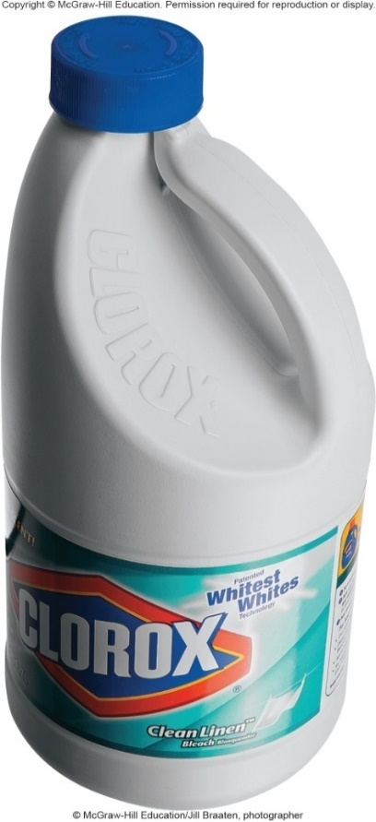
Classes of Germicidal Chemicals – Figure 5.10
Halogens: react with proteins, cellular components
Chlorine: Destroys all microorganisms and viruses
Used as disinfectant
Caustic to skin and mucous membranes
1:100 dilution of household bleach effective
Very low levels disinfect drinking water
Cryptosporidium oocysts, Giardia cysts survive
Can react with organic compounds in water
Disrupts germicidal activity
Can produce potential carcinogens
Chlorine dioxide (ClO₂) used as disinfectant and sterilant
©McGraw-Hill Education/ Jill Braaten, photographer

Slide 40
Classes of Germicidal Chemicals (5)
Halogens: react with proteins, cellular components
Iodine: Kills vegetative cells, unreliable on endospores
Used as tincture (in alcohol)
Used as iodophore
Iodine slowly released from carrier molecule
Less irritating
Pseudomonas species can survive in stock solution

Slide 41
Classes of Germicidal Chemicals (6)
Metal Compounds
Combine with sulfhydryl groups (–SH) of proteins
High concentrations too toxic to be used medically
Silver used in creams, bandages
Antibiotics replaced silver nitrate eye drops once given at birth to prevent Neisseria gonorrhoeae infections
Compounds of mercury, tin, copper, and others once widely used as preservatives
Extensive use led to environmental pollution
Now strictly regulated

Slide 42
Classes of Germicidal Chemicals (7)
Ozone (O₃)
Unstable form of oxygen
Decomposes quickly, so generated on-site
Powerful oxidizing agent
Used as alternative to chlorine
Disinfectant for drinking and wastewater

Slide 43
Classes of Germicidal Chemicals (8)
Peroxygens: powerful oxidizers used as sterilants
Readily biodegradable, no residue
Less toxic than ethylene oxide, glutaraldehyde
Hydrogen peroxide: effectiveness depends on surface
Aerobic cells (humans) produce enzyme catalase
Breaks down H₂O₂ to O₂ + H₂O
More effective on inanimate object
Doesn’t damage most materials, no residue
Hot solutions or vapor-phase used as sterilant
Peracetic acid: more potent than H₂O₂
Sterilizes in less than 1 hour
Effective in presence of organic compounds, no residue, used on wide range of materials

Slide 44
Classes of Germicidal Chemicals (9)
Phenolic Compounds (Phenolics)
Phenol (carboic acid) one of earliest disinfectants
Has unpleasant odor, irritates skin
Destroy cytoplasmic membranes, denature proteins
Phenolics kill most vegetative bacteria; not reliable on all virus groups
Wide activity range, reasonable cost, remain effective in presence of detergents and organic contaminants
Leave antimicrobial residue
Hexachlorophene and triclosan have been widely used in medical and personal care products
FDA recently limited some use of triclosan

Slide 45
Classes of Germicidal Chemicals (10)
Quaternary Ammonium Compounds (Quats)
Cationic detergents
Low toxicity, disinfection of food preparation surfaces
Charged hydrophilic and uncharged hydrophobic regions
Reduces surface tension of liquids
Aids in removal of dirt, organic matter, organisms
Positive charges of quats attracted to negative charges of cell surface
React with membrane and destroys vegetative bacteria and enveloped viruses
Found in many personal care products
Pseudomonas resists, can grow in solutions

