Slide 1
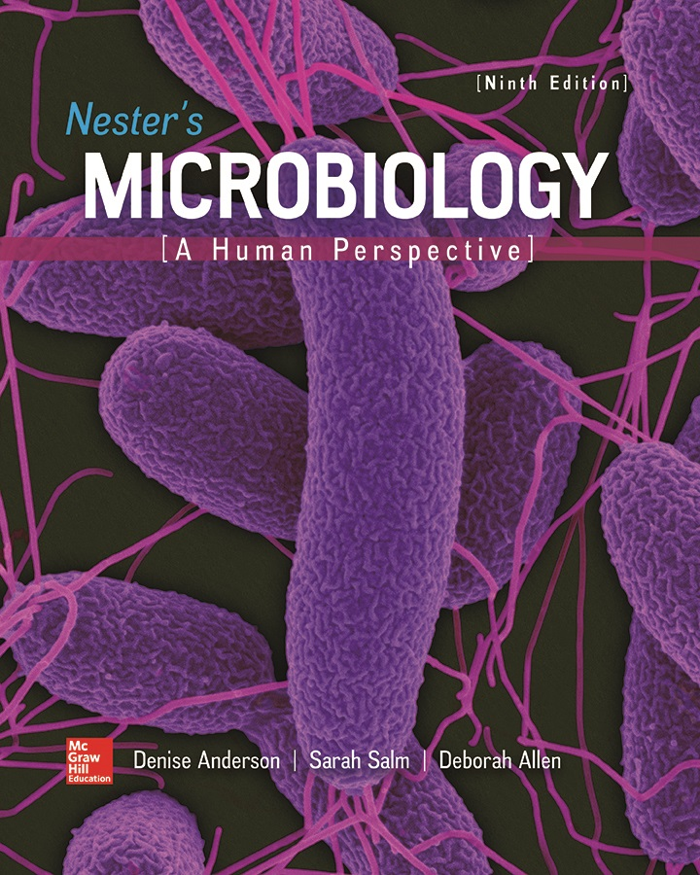
Chapter 18 Lecture Outline
See separate PowerPoint slides for all figures and tables pre-inserted into PowerPoint without notes.
Notes:
1

Slide 2
Immunization – Figure 18.1
Immunization is process of inducing immunity
Has probably had greatest impact on human health of any other medical procedure
Example of how knowledge is power with respect to fighting disease
Useful applications of immunological reactions in diagnostic tests
The Immune Wars
Innate Immunity (chapter 14) Adaptive Immunity (chapter 15)
The Pathogens Fight Back Pathogenesis (part of chapter 16)
The Return of the Humans
(Knowledge Is Power)
Immunization (part of chapter 18) Epidemiology (chapter 19) Antimicrobial Medications (chapter 20)

Slide 3
Principles of Immunization (1)
Naturally acquired immunity is gained through normal events, such as illness
Artificially acquired immunity is gained through immunization
Active immunity results from exposure to antigen
Lymphocytes are activated; memory cells provide long-lasting protection
Natural by infection; passive through vaccination
Passive immunity results from addition of other’s antibodies
Temporary protection; no memory cells formed

Slide 4
Principles of Immunization (2)
Natural passive immunity
During pregnancy, mother’s IgG antibodies cross placenta
Breast milk contains secretory IgA
Artificial passive immunity
Injection of antiserum containing antibodies
Can prevent disease before or after likely exposure
Limit duration of certain diseases
Block action of microbial toxins
Antitoxin is antiserum that protects against a toxin
Hyperimmune globulin (antibodies to specific disease)
Immune globulin (IgG fraction from many donors; variety of antibodies)

Slide 5
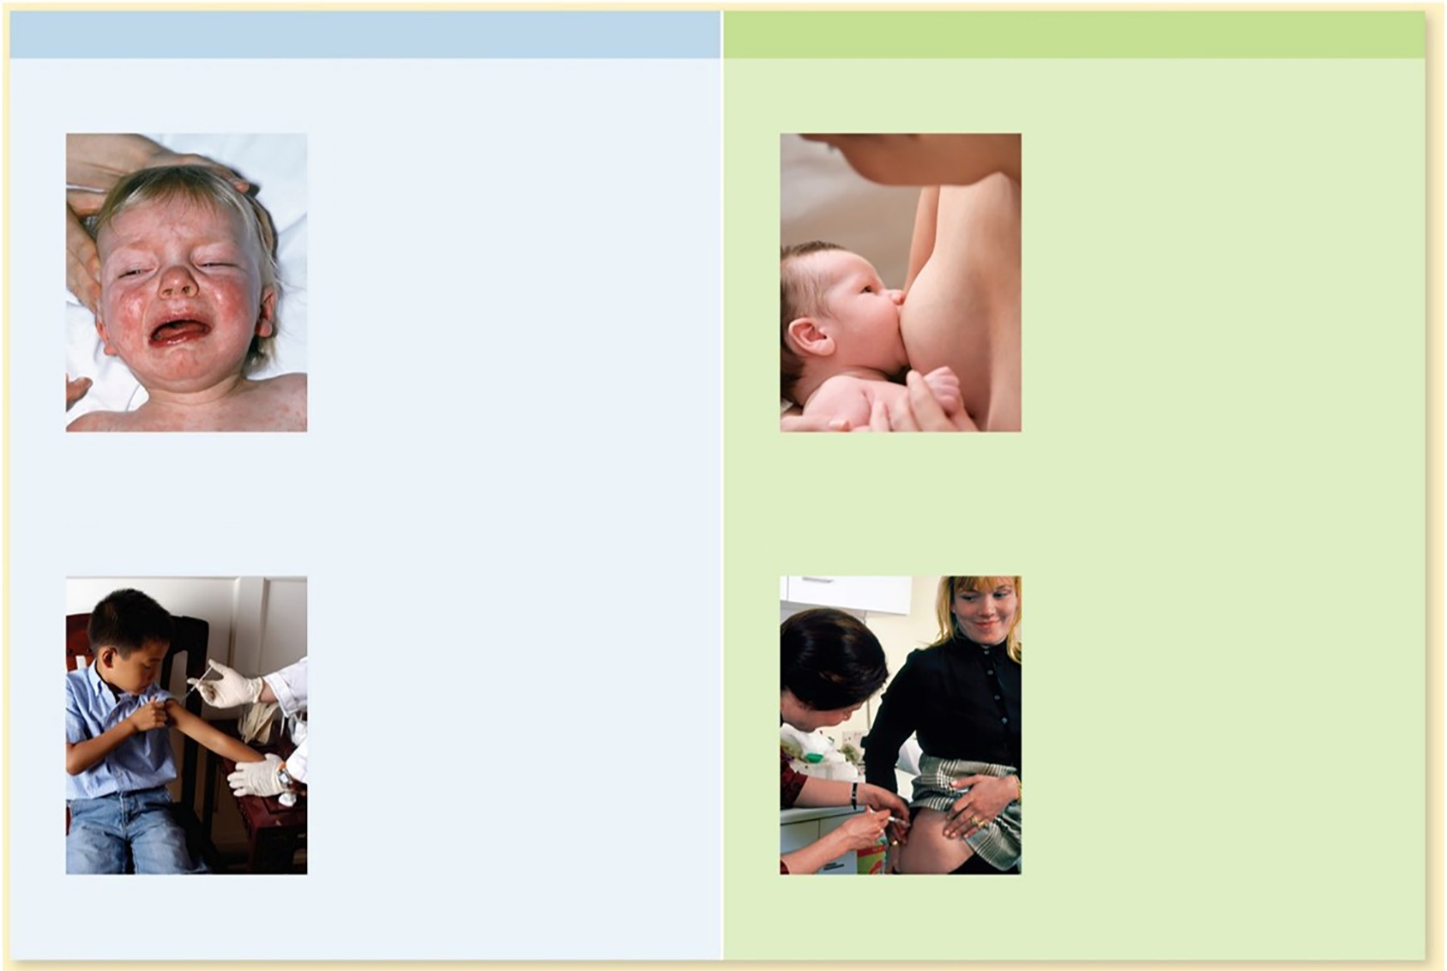
Principles of Immunization – Figure 18.2
Active Immunity
Passive Immunity
Natural Active Immunity
Natural Passive Immunity
Immunity that results from an immune response in an individual after exposure to an infectious agent.
Immunity that results when antibodies from a woman are transferred to her developing fetus during pregnancy or to an infant during breast feeding.
Artificial Active Immunity
Artificial Passive Immunity
Immunity that results from an immune response in an individual after vaccination.
Immunity that results when antibodies contained in the serum of other people or animals are injected into an individual.
(top left): ©SPL/Science Source; (top right): ©Jose Luis Pelaez Inc/Blend Images LLC; (bottom left): ©McGraw-Hill Education/Jill Braaten; (bottom right): ©SPL/Science Source
Notes:
5

Slide 6
Vaccines and Immunization Procedures (1)
Vaccine is preparation of pathogen or its products used to induce active immunity
Protect individual; prevent spread in population
Herd immunity develops when critical portion of population is immune to disease; infectious agent unable to spread due to insufficient susceptible hosts
Responsible for dramatic declines in childhood diseases
Diseases sometimes reappear and spread as result of failure to vaccinate children
Effective vaccines should be safe, have few side effects
Give long lasting protection
Ideally low in cost, stable, easy to administer

Slide 7
Table 18.1 A Comparison of Characteristics of Attenuated and Inactivated Vaccines
Two general categories of vaccines
Attenuated vaccine (agent can replicate): stronger immune response, but may cause disease
Inactivated vaccine (agent cannot replicate): weaker immune response, but cannot cause infections
Characteristic | Attenuated Vaccines | Inactivated Vaccines
Types | Attenuated viruses, attenuated bacteria | Inactivated whole agents, toxoids, subunits, VLPs (virus-like particles), polysaccharides, conjugates
Route of administration | Injection, oral, or nasal | Injection
Need for adjuvant | No | Yes
Antibody response (memory) | IgG; secretory IgA if administered orally or nasally | IgG
Cell-mediated immune response | Good | Poor
Relative duration of protection | Longer | Shorter
Number of doses | Usually one or two | Multiple
Risk of mutation to virulence | Very low | Absent
Risk to immunocompromised recipient | Can be significant | Absent
Stability in warm temperatures | Poor | Good

Slide 8
Vaccines and Immunization Procedures (2)
Attenuated vaccine: weakened form of pathogen
Grown under conditions that foster mutations, or genetically manipulated to replace genes – both lower pathogenicity
Advantages:
Single dose usually induces long-lasting immunity due to microbe multiplying in body
Can inadvertently immunize others by spreading
Disadvantages:
Can sometimes cause disease in immunosuppressed individuals
Can occasionally revert or mutate, become pathogenic
Generally not recommended for pregnant women
Usually require refrigeration
Examples: measles, mumps, rubella, chickenpox, yellow fever, rotavirus

Slide 9
Vaccines and Immunization Procedures (3)
Inactivated vaccine: unable to replicate, but still immunogenic
Advantage: cannot cause infections or revert to pathogenic forms
Disadvantage: no replication, so no amplification; several booster doses usually needed
Often contains adjuvant that enhances immune response to antigens
Thought to provide danger signals to dendritic cells
Some hold antigen and release it slowly over time
Some trigger inflammatory response

Slide 10
Vaccines and Immunization Procedures (4)
Types of inactivated vaccines
Inactivated whole agent vaccines: contain killed microorganisms or inactivated viruses
Treated with formalin or other chemical that does not significantly change surface epitopes
Includes influenza, rabies, hepatitis A
Toxoid vaccines: toxins treated to destroy toxic part, retain antigenic epitopes
Includes diphtheria, tetanus
Subunit vaccines: consist of key protein antigens or antigenic fragments from pathogen
Avoids cell parts that may cause side effects
For example, acellular pertussis (aP) vaccine
Notes:
10

Slide 11
Vaccines and Immunization Procedures (5)
Types of inactivated vaccines
Recombinant subunit vaccines: subunit vaccines produced using genetically engineered microorganisms
For example, hepatitis B virus; yeast cells produce part of viral protein coat
VLP (virus-like particle) vaccines: empty capsids produced by genetically engineered organisms
For example, human papillomavirus (HPV)
Polysaccharide vaccines: contain polysaccharides from capsules
Not effective in young children; polysaccharides are T-independent antigens, which elicit poor response
For example, pneumococcal vaccine for adults

Slide 12
Vaccines and Immunization Procedures (6)
Types of inactivated vaccines
Conjugate vaccines: polysaccharides linked to proteins
Converts polysaccharides into T-dependent antigens
For example Haemophilus influenzae type b (Hib) has nearly eliminated Hib meningitis in children; Streptococcus pneumoniae vaccine promises to do the same for a variety of infections
Nucleic acid-based vaccines: promising research underway
Segments of naked DNA or RNA from infectious agent
Some cells express genes for a short period after injection
Induce immune response

Slide 13
Vaccines and Immunization Procedures (7)
The Importance of Vaccines
Benefits greatly outweigh very slight risk
Child with measles has 1:2,000 chance of serious brain inflammation versus 1:1,000,000 chance from vaccine
Prior to vaccinations, numerous deaths, disabilities
Many still become ill or die from preventable diseases
Some parents refuse to vaccinate children, fear harm
No evidence of link between vaccines and autism
Vaccines have become victims of their own success
People no longer see how serious these diseases are
Reports of adverse effects of vaccine lead some to falsely believe that the risk of vaccination is greater than the risk of diseases

Slide 14
Vaccines and Immunization Procedures (8)
The Importance of Vaccines
Vaccination dramatically reduces incidence of diseases
Drops in immunization rates lead to disease outbreaks
Disease | Cases per Year Before Immunization | Decrease After Immunization
Diphtheria | 175,885 (1920 to 1922) | Nearly 100%
Haemophilus influenzae type b invasive disease | 20,000 (estimated) | 98.8%
Measles | 503,282 (1958 to 1962) | Nearly 100%
Mumps | 152,209 (1968) | 99.2%
Pertussis (whopping cough) | 147,271 (1922 to 1925) | 77.6%*
Poliomyelitis | 16,316 (1951 to 1954) | 100%
Rubella (German measles) | 50,230 (1966 to 1969) | Nearly 100%
Smallpox | 48,164 (1900 to 1904) | 100%
Tetanus | 1,314 (1922 to 1926) | 98%
*Reflects the recent increase in number of cases.
Notes:
14

Slide 15
Table 18.3 Bacterial Diseases Prevented by Routine Vaccines
CDC publishes recommended schedule for routine immunizations
Vaccines against bacterial infections
Disease | Vaccine Type (Vaccine Acronym) | Persons Who Should Receive the Vaccine
Diphtheria | Toxoid (the “D” in the DTaP, and the “d” in Td and Tdap; the lowercase letter indicates a lower dose | DTaP: infants, toddlers, and preschoolers Td: adolescents and adults; every 10 years as a booster (Tdap should be used once instead)
Haemophilus influenzae type b disease | Conjugate (Hib) | Infants and toddlers; older children and adults with certain medical conditions that put them at increased risk
Meningococcal disease | Conjugate against serogroups ACWY (MenACWY) Polysaccharide against serogroups ACWY (MPSV4) Recombinant subunit against serogroup B (MenB) | MenACWY: adolescents age 11 or 12, with booster at age 16; anyone 2 months or older who is at increased risk due to certain medical conditions or potential exposures (MPSV4 is the preferred alternative for some older adults) MenB: people 10 years or older who are at increased risk due to certain medical conditions or potential exposure
Pertussis (whooping cough) | Subunit (the “aP” in DTaP and the “ap” in Tdap; the lowercase letter indicates a lower dose) | DTaP: infants, toddlers, and preschoolers Tdap: adolescents, pregnant women, and anyone who did not receive it as an adolescent
Pneumococcal disease | Conjugate (PCV13) Polysaccharide (PPSV23) | PCV13: infants and toddlers; adults age 65 and over; people with certain health conditions PPSV23: adults age 65 and over; people with certain health conditions
Tetanus | Toxoid (the “T” in DTaP, Td, and Tdap) | DTaP: infants, toddlers, and preschoolers Td: adolescents and adults; every 10 years as a booster (Tdap should be used once instead)

Slide 16
Table 18.4 Viral Diseases Prevented by Routine Vaccines
Disease | Vaccine Type (Vaccine Acronym) | Persons Who Should Receive the Vaccine
Hepatitis A | Inactivated virus (HepA) | Toddlers; older children and adolescents who have not received the vaccine; adults who are at increased risk due to potential exposure
Hepatitis B | Recombinant subunit (HepB) | Newborns, infants, and toddlers; older children and adolescents who have not received the vaccine; adults who are at increased risk due to certain medical conditions or potential exposure
Human papillomavirus (HPV)–related diseases | VLPs of 9 serotypes (9vHPV) | Adolescents age 11 or 12 (but may be given ages 9 through 26)
Influenza | Inactivated virus (IIV is produced in chicken eggs; ccIV is from cell-culture) Recombinant subunit (RIV) Attenuated virus (LAIV), taken as a nasal mist; not always recommended due to lack of effectiveness | People 6 months of age or older (vaccine type used depends on patient’s age, allergies, or other characteristics; given yearly because the antigens of the virus change frequently)
Measles | Attenuated virus (an “M” in MMR and MMRV) | Toddlers and preschoolers; older children who have not received the vaccine; adults without evidence of immunity
Mumps | Attenuated virus (an “M” in MMR and MMRV) | Toddlers and preschoolers; older children who have not received the vaccine; adults without evidence of immunity
Polio | Inactivated virus (IPV); an attenuated virus (OPV) is used in some parts of the world | Infants, toddlers, and preschoolers; older children who have not received the vaccine; adults at increased risk due to potential exposure
Rotavirus gastroenteritis | Attenuated virus (RV) | Infants
Rubella (German measles) | Attenuated virus (an “R” in MMR and MMRV) | Toddlers and preschoolers; older children who have not received the vaccine; adults without evidence of immunity
Shingles | Attenuated virus (HZV) | Adults age 60 and over
Varicella-zoster (chickenpox) | Attenuated virus (the “V” in the MMRV vaccine; also VAR) | Toddlers and preschoolers; school-age children and adults without evidence of immunity

Slide 17
Table 18.5 Diseases Prevented by Non-Routine Vaccines
Non-routine vaccines prevent disease in the relatively few people at increased risk for certain diseases
Disease | Vaccine Type | Persons Who Should Receive the Vaccine
Adenovirus respiratory infection | Two serotypes of active virus (taken orally) | Military recruits entering basic training and certain other military personnel at higher risk for infection
Anthrax | Subunit | Adults in occupations that put them at risk of exposure, such as some military personnel
Cholera | Attenuated bacterium (taken orally) | People age 18 to 64 traveling to endemic areas
Japanese encephalitis | Inactivated virus | Certain people traveling to Asia where the disease occurs
Rabies | Inactivated virus | People at high risk for exposure, such as veterinarians and other animal handlers; people who have recently been exposed to the virus
Smallpox | Vaccinia virus | Used only in response to biological warfare threat
Tuberculosis | Attenuated bacterium (BCG strain) | Used only in special circumstances in the United States; widely used in other countries
Typhoid fever | Two forms— attenuated bacterium (taken orally) and polysaccharide | People traveling to parts of the world where typhoid fever is common; people living with a typhoid carrier; laboratory personnel who work with Salmonella Typhi
Yellow fever | Attenuated virus | Certain people traveling to parts of the world where the disease is known to exist

Slide 18
Vaccines and Immunization Procedures (9)
The Campaign to Eliminate Poliomyelitis
Three serotypes of poliovirus; entry is via the mouth
Virus infects throat and intestinal tract, invades blood
From bloodstream, can invade nerve cells, cause disease
Salk vaccine (mid-1950s) contains inactivated viruses of all three types: inactivated polio vaccine (IPV)
Dramatically lowered rate of disease but required series of injections for maximum protection
Sabin attenuated vaccine (1961): oral polio vaccine (OPV)
Cheaper oral administration; induces better mucosal immunity (secretory IgA response); better herd immunity
Attenuated viruses can mutate; approximately 1 out of 2.4 million doses results in poliomyelitis

Slide 19
Vaccines and Immunization Procedures (10)
The Campaign to Eliminate Poliomyelitis
To avoid vaccine-related poliomyelitis, use IPV
IPV allows wild poliovirus to replicate in intestines
Disease can be transmitted to others, spread rapidly
To eradicate disease completely, use OPV
Stops spread of wild poliovirus
OPV campaign successful in eliminating wild poliovirus from United States by 1980
To avoid vaccine-related disease, children are first given IPV, followed by OPV
Efforts continue toward global eradication
Type 2 polio strain eradicated in 2015; new OPV contains only serotypes 1 and 3

Slide 20
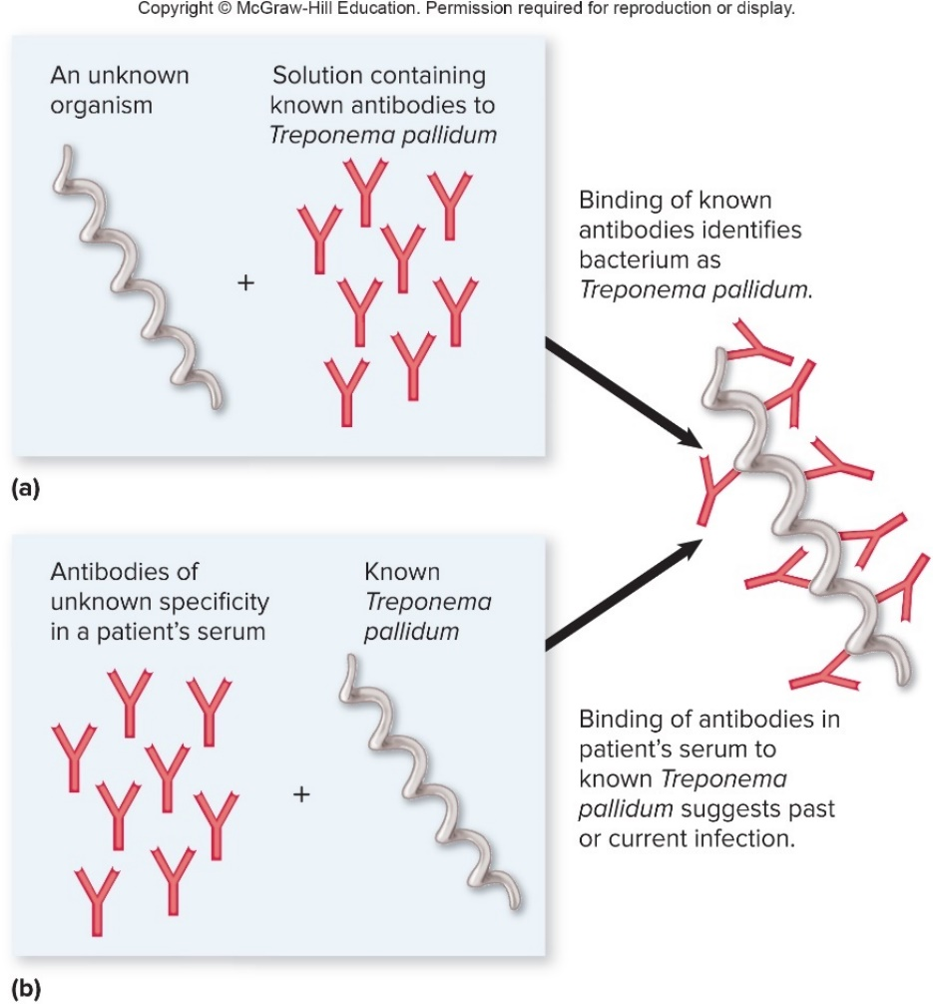
Principles of Immunoassays – Figure 18.3
Immunoassay: in vitro test that uses antibody-antigen interactions to detect or quantify given antigens or antibodies in a sample
Binding of known antibodies identifies unknown pathogen
Binding of patient’s antibodies to known pathogen demonstrates current or previous infection

Slide 21
Principles of Immunoassays (1)
Serology is study of in vitro antibody-antigen interactions
Serum is fluid portion of blood after blood clots
Plasma is fluid portion of blood treated to prevent clotting
Seronegative: individual not yet exposed to antigen
Has no specific antibodies to that pathogen
Seropositive: individual has been exposed
Has produced specific antibodies to pathogen
Seroconversion, process of producing antibodies; rise in titer is characteristic of active infection
Small, steady antibody level indicates previous exposure

Slide 22
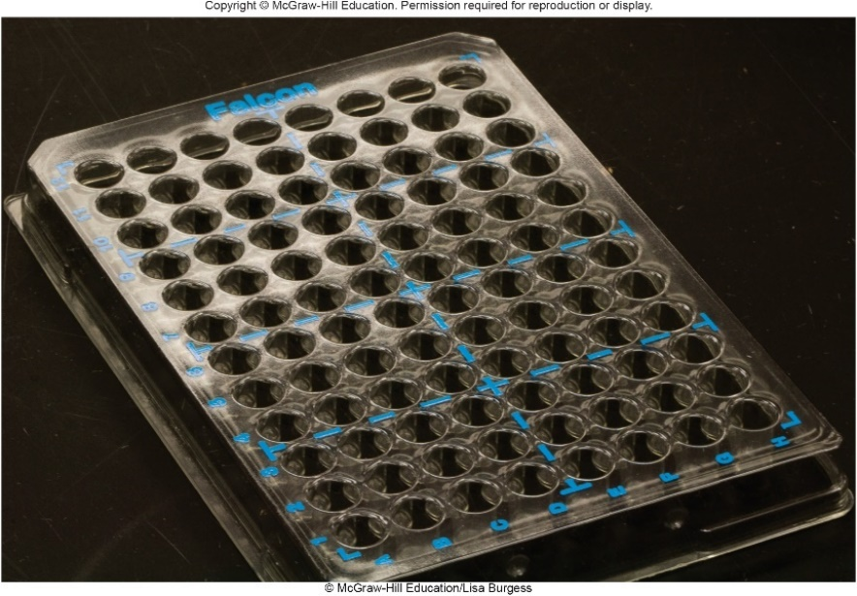
Principles of Immunoassays – Figure 18.4
Quantifying Antigen-Antibody Reactions
Antibody concentration determined by serial dilution
Sequential 2- or 10-fold dilutions
Antigen added to each dilution
Titer (concentration) is reciprocal of last dilution that gives a detectable antigen-antibody reaction
For example, positive observed in 1:256 but not 1:512, antibody titer is 256
Usually done in plastic microtiter plates
©McGraw-Hill Education/Lisa Burgess

Slide 23
Principles of Immunoassays (2)
Obtaining Known Antibodies
Polyclonal antibodies bind to various epitopes on antigen
Animals immunized with whole or partial agent; resulting antibodies are collected from animal’s serum
Multiple B cells respond, produce mix of antibodies to variety of epitopes
More complex antigens will yield more antibodies
Some may bind closely related organisms (for example, Shigella sp. and E. coli outer membrane proteins)
Anti-human IgG antibodies produced by animals immunized with IgG from human serum
These and other anti-human antibodies available commercially

Slide 24
Principles of Immunoassays (3)
Obtaining Antibodies
Monoclonal antibodies (MAbs, Mabs, mAbs) recognize a single epitope
Difficult and expensive to produce
Complex process requires fusing animal B cells and cells that divide continuously in culture
Produces clones of a single cell and antibody to one epitope
Mabs can be used in immunoassays or in therapy
Medications end in “-mab”
Obiltoxaximab neutralizes anthrax toxin
Mabs can be tagged with drug or toxin and delivered to specific cells in vivo
Antibody-drug conjugates (ADCs) being developed against certain types of cancers

Slide 25
Principles of Immunoassays (4)
Obtaining Antibodies
Monoclonal Antibodies can be “humanized”
Most of the animal-derived antibody molecule is replaced with human equivalents using recombinant DNA techniques
Called a rhuMab: recombinant humanized monoclonal antibody
Longer half-life than standard monoclonal antibodies
Human immune system less likely to destroy antibodies
Medications have names ending in “-zumab”
Some used to treat certain cancers
Notes:
25

Slide 26
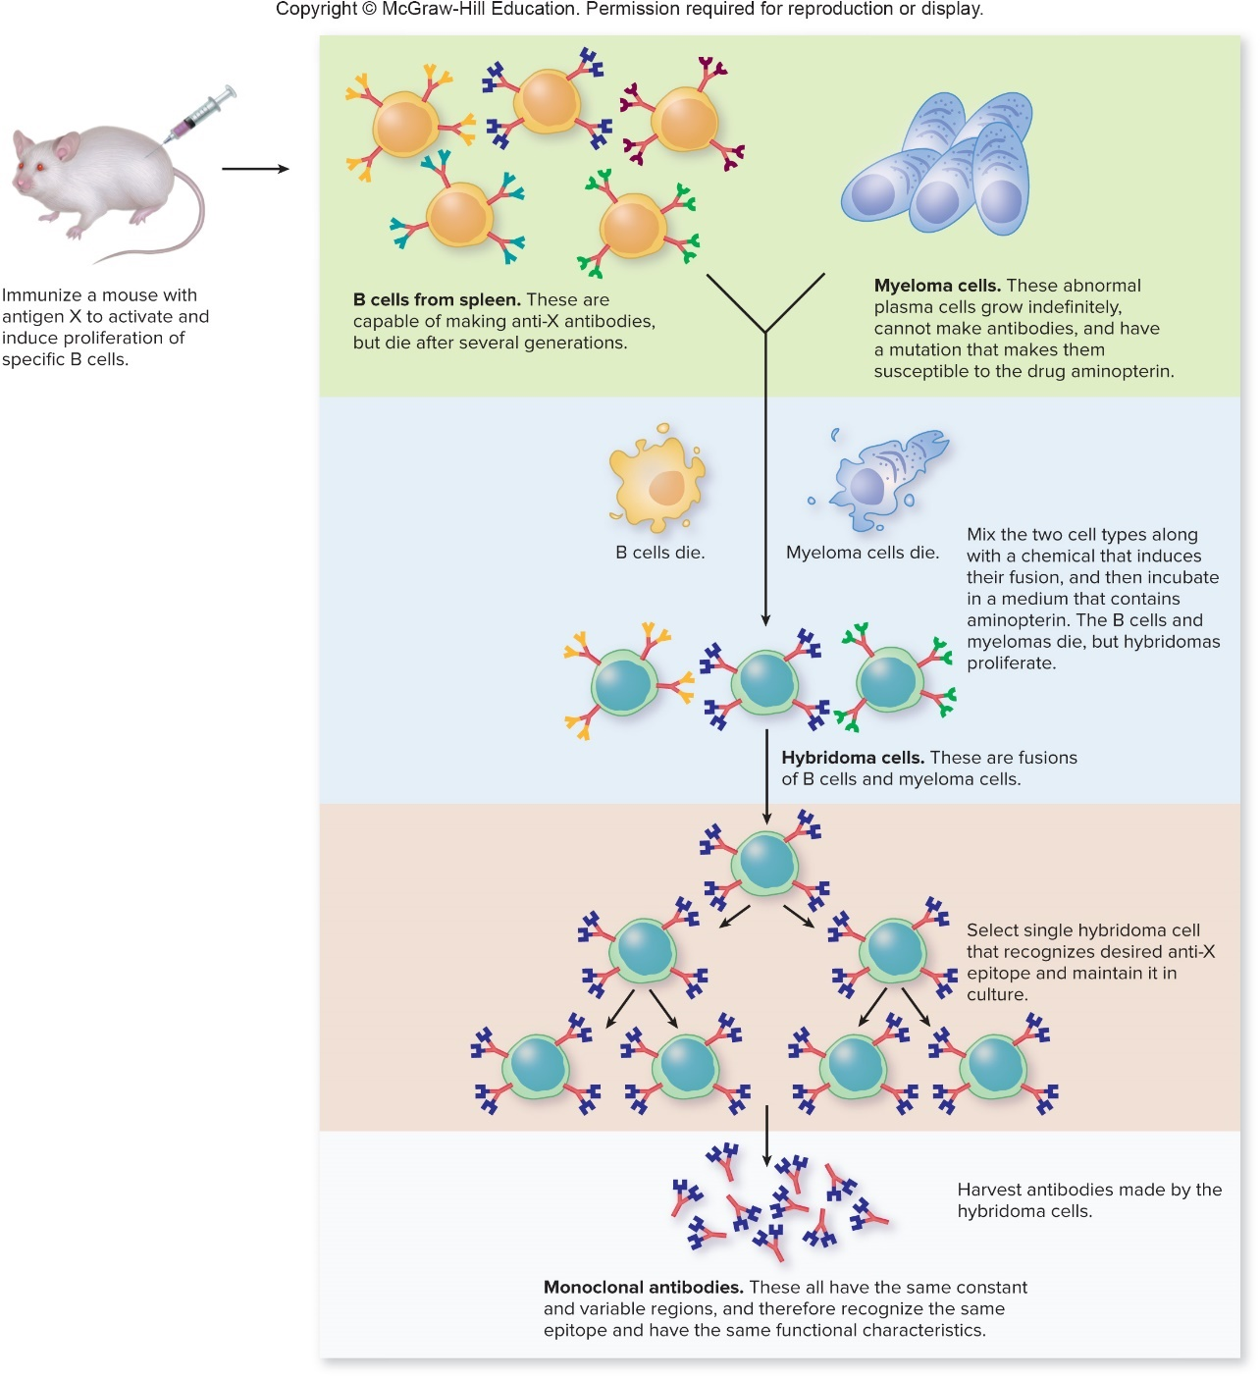
Focus Your Perspective 18.1
Kohler and Milstein won a Nobel prize in 1984 for their work on monoclonal antibodies.

Slide 27
Common Types of Immunoassays (1)
Immunoassays that use labeled antibodies
Markers are enzymes, fluorescent dye or radioactive isotopes
Sensitive
Immunoassays that involve visible antigen-antibody aggregates
Simple, cheaper
Largely replaced by labeled antibody tests

Slide 28
Common Types of Immunoassays (2)
Labeled antibodies can detect a given antigen, or can detect antibodies that bind to a given antigen
Direct immunoassays: identify unknown antigen
Antigen attached to solid surface
Labeled antibodies of known specificity added
Washing removes unbound; binding identifies antigen
Indirect immunoassays: detect specific antibodies
Known antigen attached to surface; serum added
Washing removes unbound primary antibodies
Secondary antibodies (labeled anti-human IgG) added
Washing removes unbound; binding identifies primary antibody bound to antigen

Slide 29
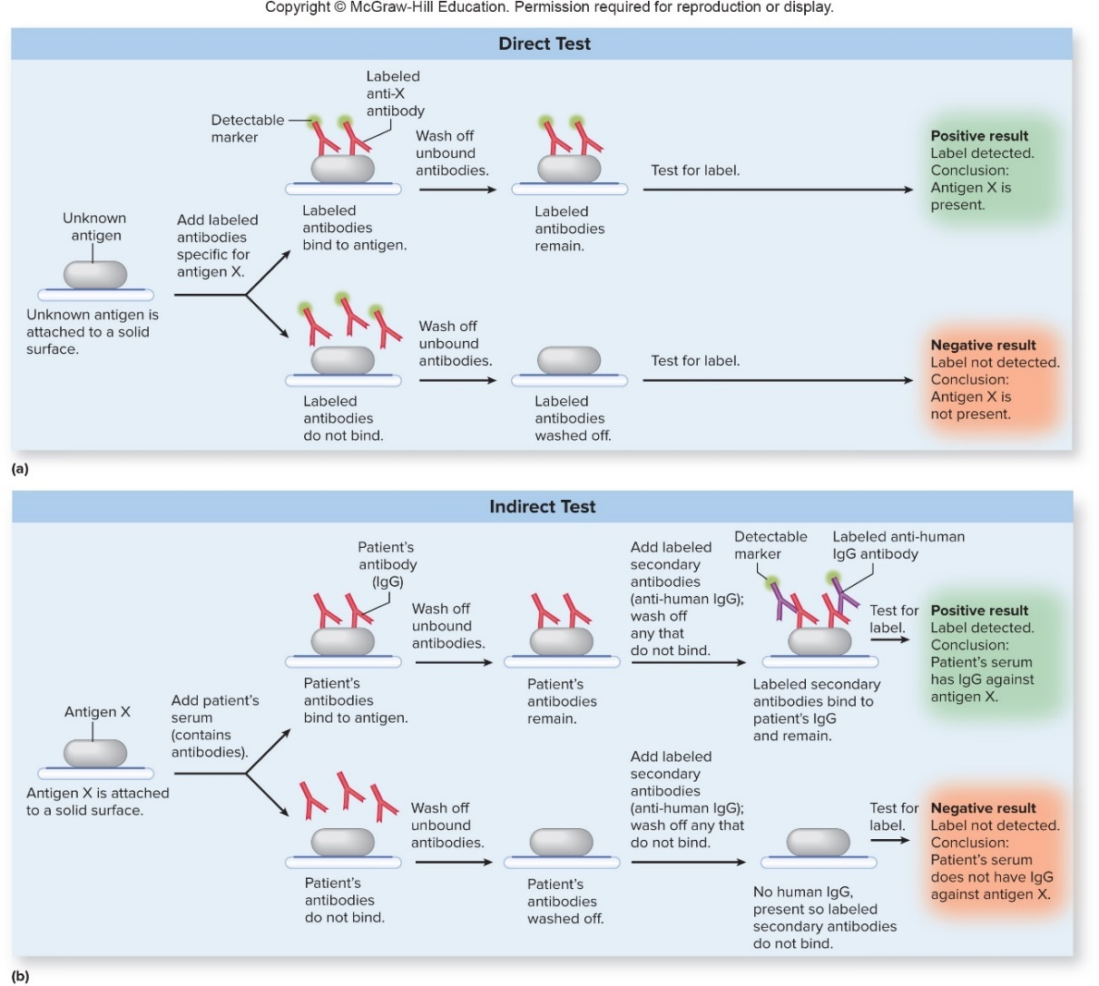
Common Types of Immunoassays – Figure 18.5
Direct immunoassays identify unknown antigen
Indirect immunoassays detect specific antibody in patient’s serum

Slide 30
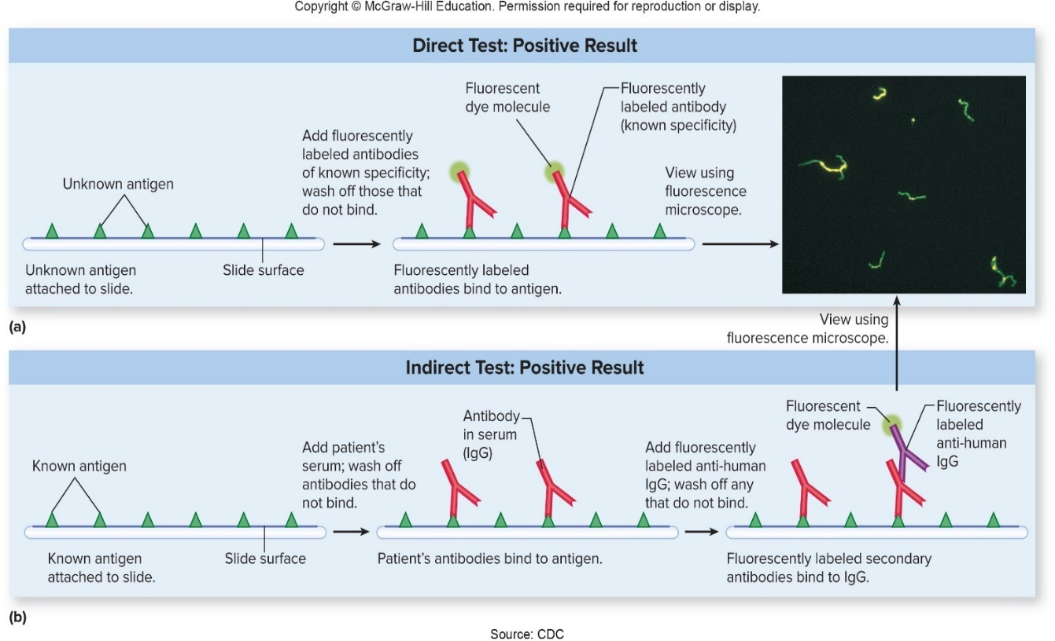
Common Types of Immunoassays – Figure 18.6
Fluorescent antibody (FA) test
Use fluorescence microscopy to locate labeled antibodies bound to antigens fixed to microscope slide
Size/shape of antigens seen, but procedure is time-consuming
Using different colored labels can detect more than one antigen
Detect rabies virus in brain tissue, antibodies to agent that causes syphilis
Photo: Source: CDC

Slide 31
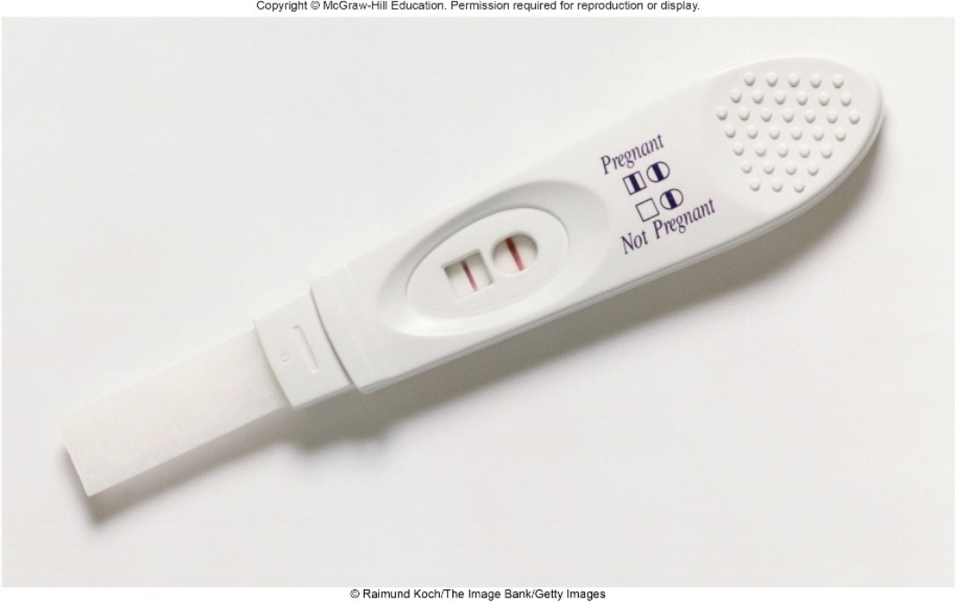
Common Types of Immunoassays – Figure 18.7
Enzyme-linked immunosorbent assay (ELISA)
Antibodies labeled with enzyme (such as peroxidase)
Enzyme converts colorless substrate to colored product; detected using colorimetric assay
Relatively easy; basis of many rapid tests, blood screening
Often in microtiter plate to test many samples at once
©Raimund Koch/The Image Bank/Getty Images

Slide 32
Common Types of Immunoassays (3)
Enzyme-linked immunosorbent assay
Direct ELISA, “sandwich method”
Antigen “captured” by antibodies attached to surface
Enzyme-labeled antibody added to detect antigens
Commercial modifications available, including rapid group A strep tests, home pregnancy kits
Indirect ELISA
Detects antibodies in human blood and serum
Blood routinely screened for antibodies to HIV
May yield false positives; more reliable test (Western blotting) used to confirm

Slide 33
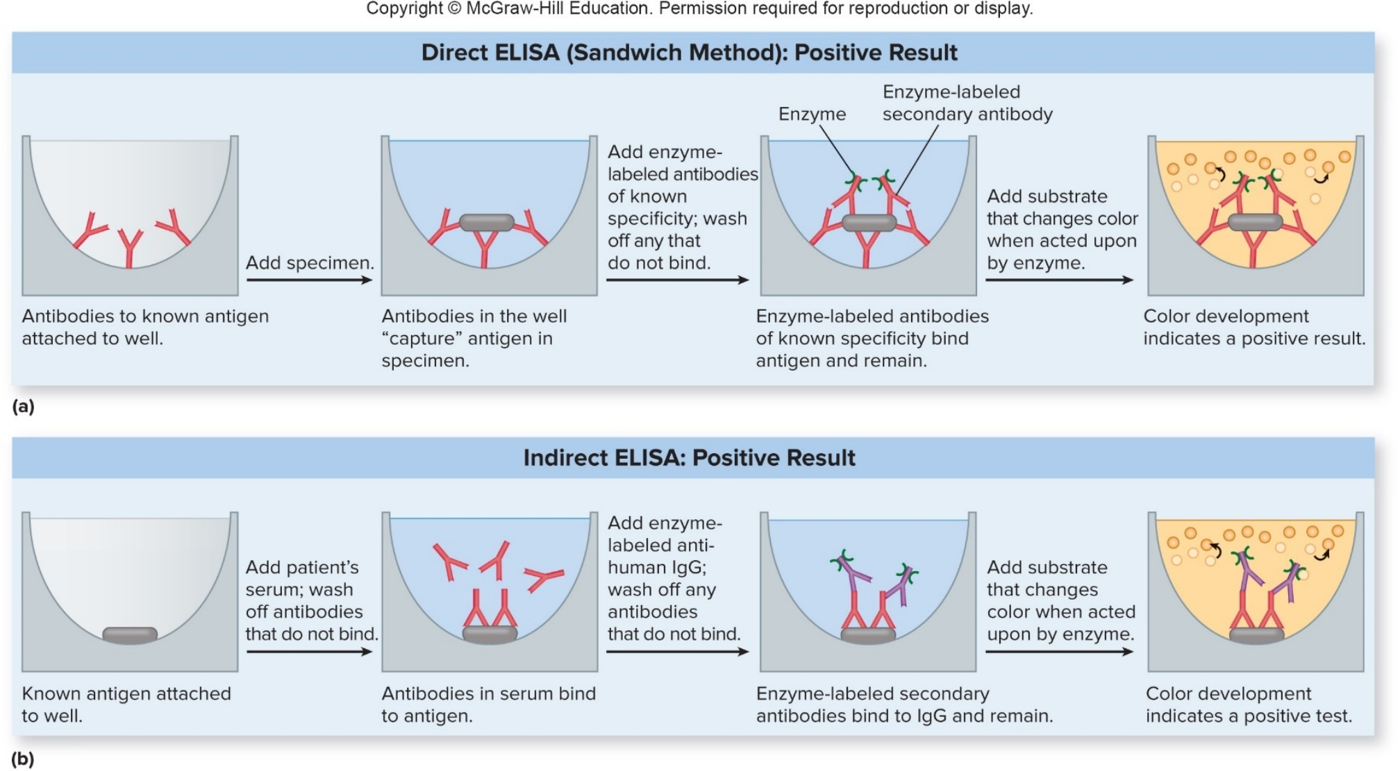
Common Types of Immunoassays – Figure 18.8
Enzyme-linked immunosorbent assay
Jump to Common Types of Immunoassays – Figure 18.8 Long Description
Notes:
33

Slide 34
Common Types of Immunoassays (4)
Western blotting first separates proteins of antigen by size using SDS-PAGE
Proteins then transferred to nylon membrane (blotted)
Serum added; unbound antibodies washed off
Enzyme- or radioactively labeled secondary antibodies added; unbound washed off
Label is detected
Indicates which proteins on the blot were recognized by antibodies in the serum

Slide 35
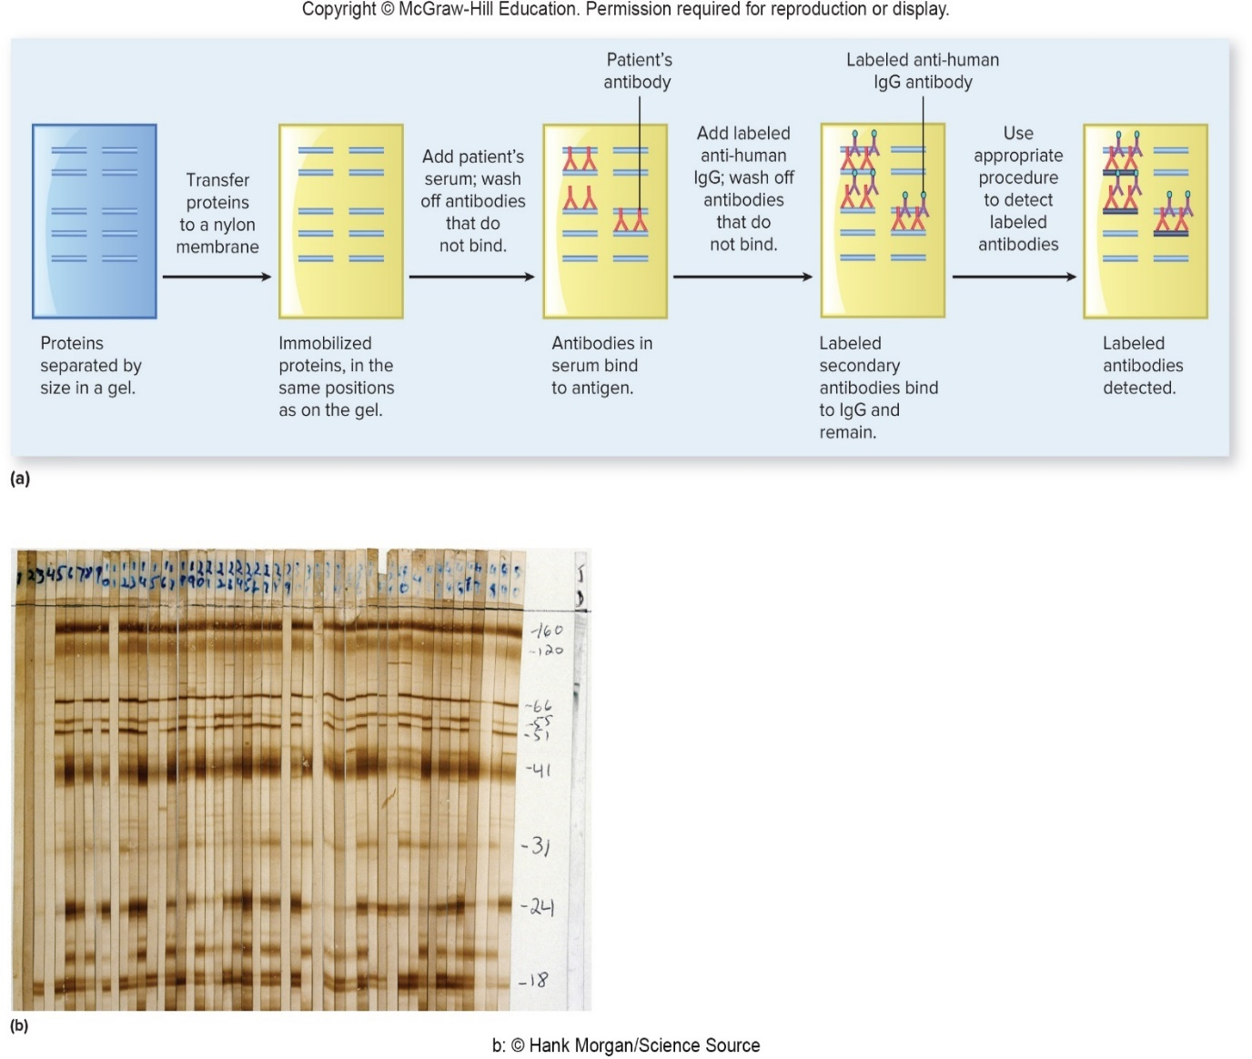
Common Types of Immunoassays – Figure 18.9
Western blotting
b: ©Hank Morgan/Science Source
Notes:
35

Slide 36
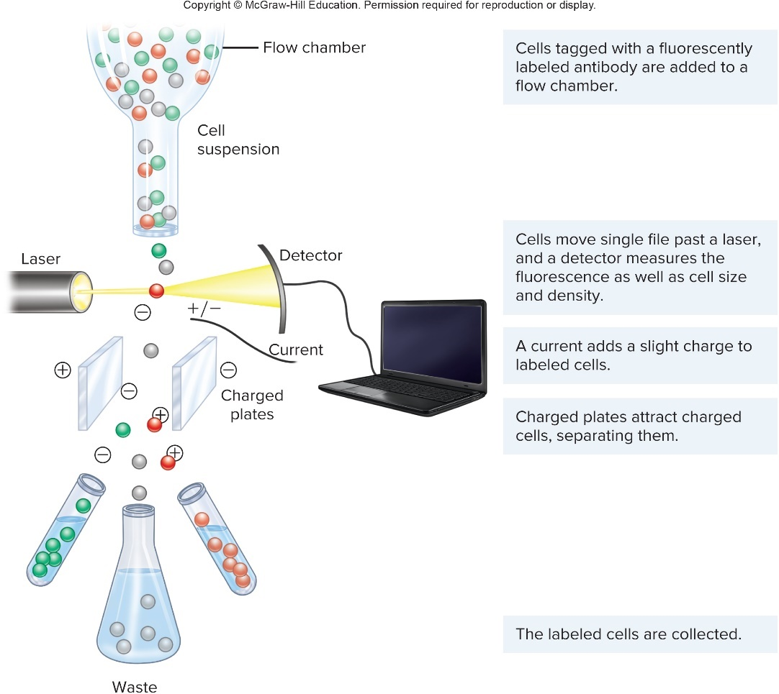
Common Types of Immunoassays – Figure 18.10
Fluorescence-activated cell sorter (FACS)
Counts, sorts cells labeled with fluorescent antibodies
For example, can track progression of HIV by determining serum levels of CD4 T cells
Jump to Common Types of Immunoassays – Figure 18.10 Long Description

Slide 37
Table 18.6 Comparison of Immunoassays That Use Labeled Antibodies
Method | Characteristics | Examples of Use
Fluorescent antibody (FA) tests | Fluorescence microscopy is used to locate fluorescently labeled antibodies bound to antigens. The size and shape of the antibody-bound antigens can often be determined, but each specimen needs to be examined individually. | Used in clinical labs to diagnose certain diseases including syphilis and rabies.
Enzyme-linked immunosorbent assay (ELISA) | A colorimetric assay is used to locate enzyme-labeled antibodies bound to antigens. When done in microtiter plates, large numbers of specimens can be screened all at once, but in some cases false positives can be a problem. Commercially available options are easy to perform and widely used. | Used in over-the-counter pregnancy tests; in physicians’ offices to diagnose strep throat; in clinical labs as part of the diagnosis of a wide range of diseases, including Lyme disease, West Nile fever, hepatitis B and C, and HIV disease. Also used to screen donated blood for antibodies that suggest that the blood may contain HIV, hepatitis B virus, or hepatitis C virus.
Western blot | Various methods are used to detect labeled antibodies bound to proteins that have been separated by size. The results are generally more reliable than with the ELISA because they provide more information, but fewer samples can be tested at a time. | Used in clinical labs to confirm certain positive ELISA tests, such as for HIV and Lyme disease.
Fluorescence-activated cell sorter | Separates and determines the relative concentrations and certain characteristics of fluorescent-antibody-labeled cells. Widely used to diagnose and monitor the progression of diseases involving white blood cells. | Used in clinical labs to track progression of HIV disease, to characterize different types and stages of lymphomas and leukemias, and to diagnose immunodeficiency diseases.

Slide 38
Common Types of Immunoassays (5)
Immunoassays may involve visible antigen-antibody aggregates
Antibodies that cross-link antigens create larger “mouthfuls” for phagocytic cells
Clumped antigen-antibody complexes form the basis of:
Agglutination reactions
Precipitation reactions

Slide 39
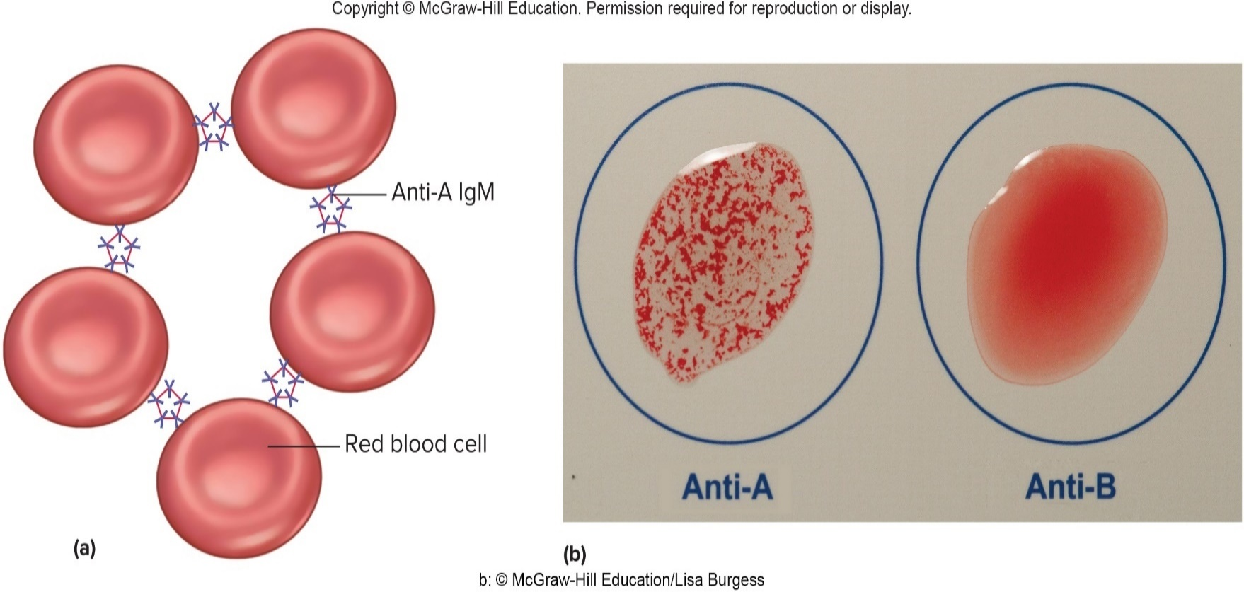
Common Types of Immunoassays – Figure 18.11
Agglutination reactions cross-link relatively large particles such as cells
Direct agglutination test (DAT): antibody mixed with antigen (cells, microorganisms); binding yields clumping
Hemagglutination used for blood typing
b: ©McGraw-Hill Education/Lisa Burgess
Notes:
39

Slide 40
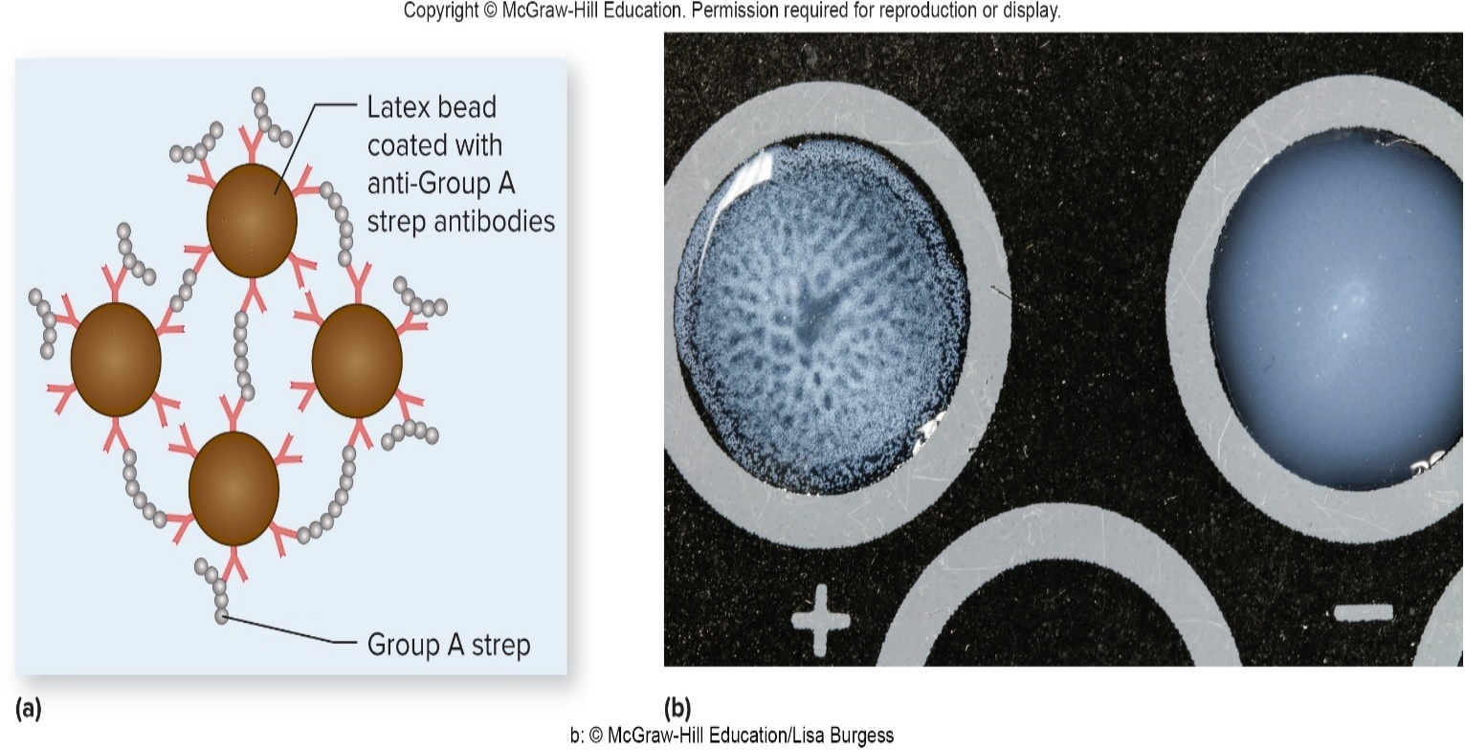
Common Types of Immunoassays – Figure 18.12
Agglutination Reactions
Passive agglutination used when antigens are small
Antibodies or antigens attached to particles (latex beads) to form larger aggregates
Beads mixed with drop of body fluid or microbial culture
b: ©McGraw-Hill Education/Lisa Burgess

Slide 41
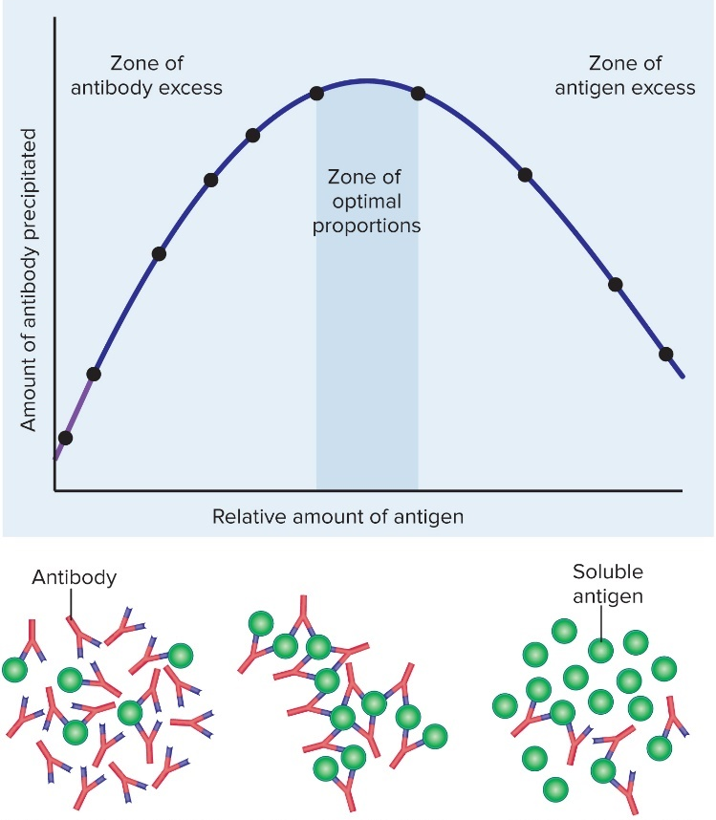
Common Types of Immunoassays – Figure 18.13
Precipitation Reactions
Antibodies bound to soluble antigens can cross-link, form precipitate
Certain relative concentrations of antibody and antigen
Proper concentrations determined by placing separate suspensions near each other in gel, allow molecules to diffuse
Precipitate will form in “zone of optimal proportions”
In the zone of antibody excess, little or no cross-linking occurs; no visible precipitate forms.
In the zone of optimal proportions, extensive cross-linking occurs; a visible precipitate forms.
In the zone of antigen excess, little or no cross-linking occurs; no visible precipitate forms.

Slide 42
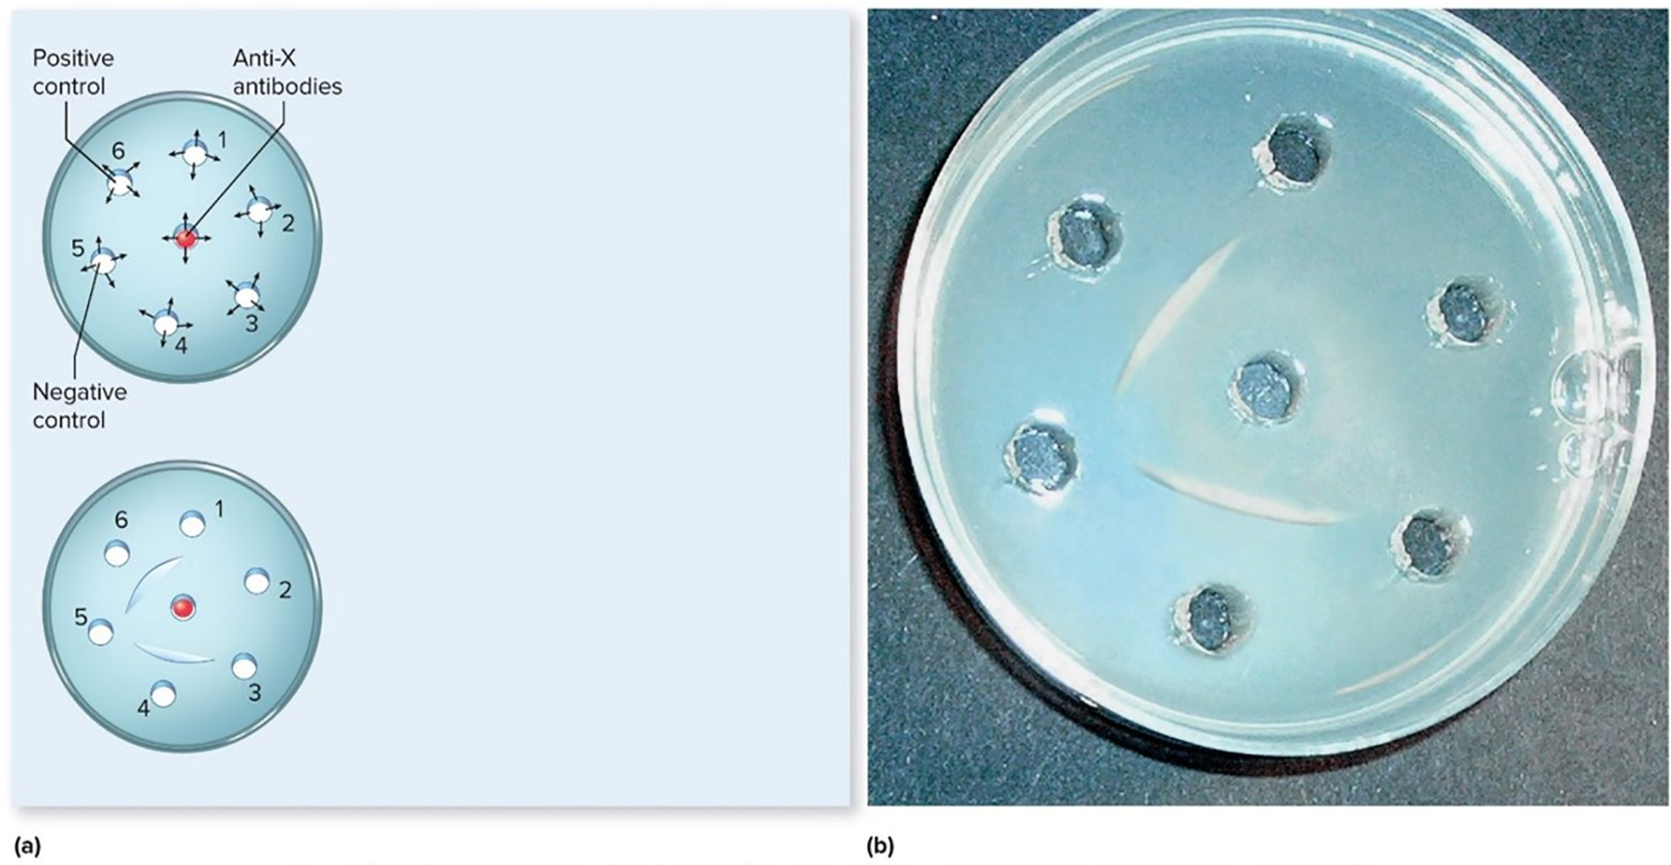
Common Types of Immunoassays – Figure 18.14
Precipitation reactions
Although largely replaced, Ouchterlony technique illustrates immunodiffusion test
Antibody and antigen solutions are placed into separate wells cut into the gel. The antigens and antibodies diffuse toward each other. In this example, antibodies that bind antigen X (called anti-X antibodies) were added to the well in the center of the gel. Samples that contain unknown antigens are added to wells 1 through 4. A negative control (contains no antigen X) was added to well 5, and a positive control (contains known antigen X) was added to well 6.
When antibody molecules that recognize the antigen meet at the zone of optimal proportions, antigen-antibody complexes precipitate out of solution, forming a visible line. In this example, a line has formed between the center well and well 6 (the positive control). A line has also formed between the center well and the sample in well 4, indicating that the sample contains antigen X. The other samples do not contain detectable amounts of antigen X.
Jump to Common Types of Immunoassays – Figure 18.14 Long Description
Source: Reproduced by permission from Schadler, D. L. 2003. Antigen-antibody testing: A visual simulation or virtual reality. The Plant Health Instructor. DOI: 10.1094/PHI-K-2003-0224-01

