Slide 1
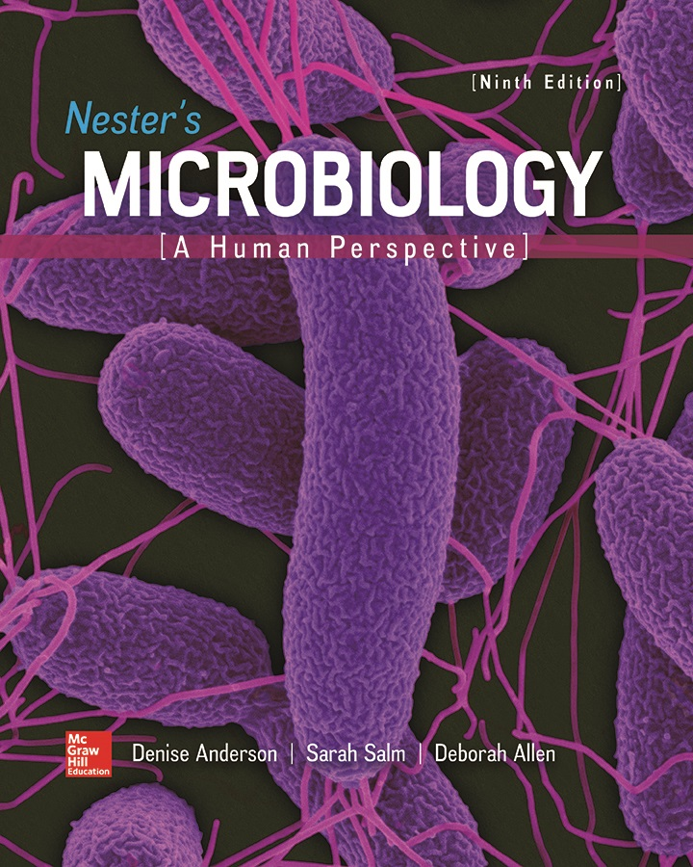
Chapter 01 Lecture Outline
See separate PowerPoint slides for all figures and tables pre-inserted into PowerPoint without notes.

Slide 2
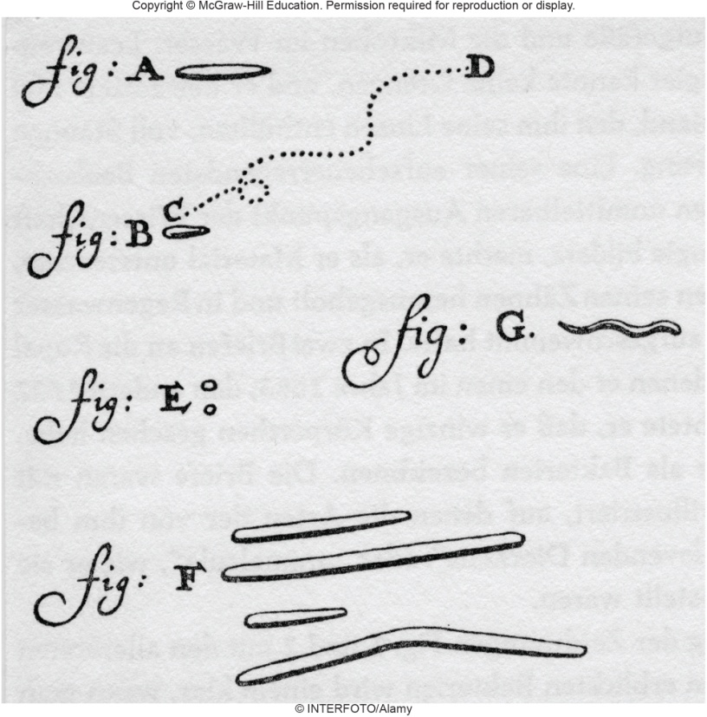
A Glimpse of History
Science of microbiology born in 1674
Antony van Leeuwenhoek
Made simple magnifying glass
Studied lake water
Observed ‘animalcules’
Robert Hooke
Also credited with discovery of microbes
Described ‘microscopical
mushroom’ (common bread
mold) in 1665
© INTERFOTO/Alamy

Slide 3
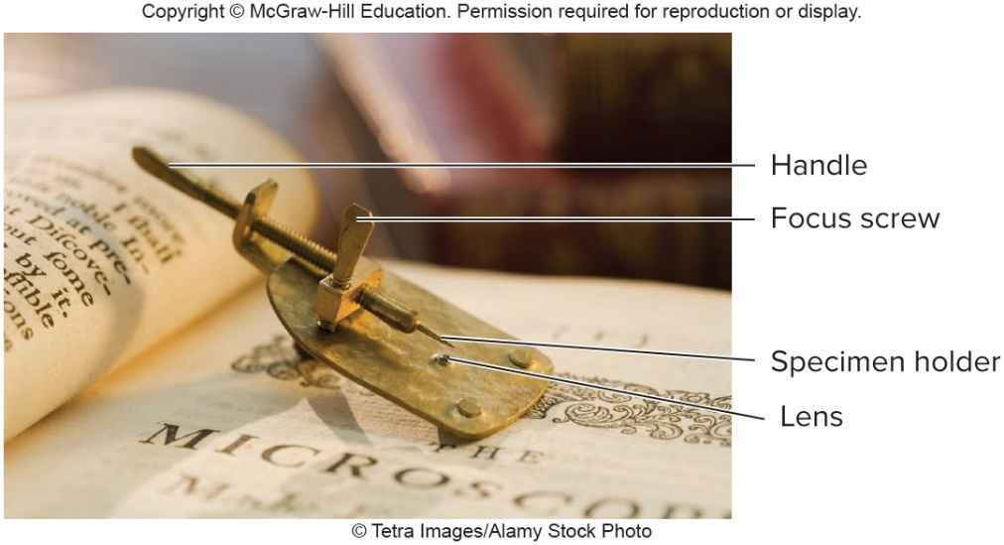
Humans and the Microbial World - Figure 1.1
Microorganisms are organisms too small to be seen with the naked eye.
The term microbes includes acellular members of the microbial world.
Microorganisms are the foundation for all life on Earth.
Have existed for approximately 3.5 billion years
Plants, animals, modern microorganisms all evolved from ancestral bacteria
Our life depends on their activities
© Tetra Images/Alamy Stock Photo

Slide 4
The Dispute Over Spontaneous Generation (1)
Spontaneous Generation
Belief that life arises spontaneously from non-living material
Took over 200 years and many experiments to refute

Slide 5
The Dispute Over Spontaneous Generation (2)
Italian biologist and physician Francesco Redi demonstrated worms on rotting meat came from eggs of flies landing on meat (1668)
Placed meat in two jars
Covered one jar with gauze
Gauze prevented flies from depositing eggs
No eggs →no worms

Slide 6
The Dispute Over Spontaneous Generation (3)
Multiple contributions helped define question
In 1749, John Needham demonstrated boiled broths still produced microorganisms
In 1776, Father Spallanzani contradicted Needham’s results
Boiled broths longer; sealed flasks by melting necks
Broths remained sterile unless neck cracked
Controversy remained
Some argued heating destroyed “vital force” necessary for spontaneous generation

Slide 7
The Dispute Over Spontaneous Generation (4)
French chemist Louis Pasteur demonstrated air is filled with microorganisms
Filtered air through cotton plug
Observed trapped microorganisms
Many looked identical to those found in broths
Plug in sterilized broth gave rise to microorganisms

Slide 8
The Dispute Over Spontaneous Generation - Figure 1.2
Pasteur constructed swan-necked flasks
Boiled infusions remained sterile despite opening to air
Microorganisms from air settled in bends of flasks
Ended arguments that unheated air or broths contained “vital force” necessary for spontaneous generation
Biogenesis describes the production of living things from other living things
Broth sterilized-air escapes.
Broth allowed to cool slowly- air enters.
Broth stays sterile indefinitely.
Flask tilted so that the sterile broth comes in contact with micro-organisms from air.
Microorganisms multiply in broth.

Slide 9
The Dispute Over Spontaneous Generation (5)
Pasteur’s results not fully reproducible
English physicist John Tyndall explained conflicting data and showed Pasteur correct
Sterilizing broths required different times
Some sterilized in 5 minutes; others not sterilized after 5 hours!
Realized broths made from hay contained heat-resistant microbes
Labs that could not reproduce Pasteur’s results used broths made from hay

Slide 10
The Dispute Over Spontaneous Generation (6)
In same year (1876), German botanist Ferdinand Cohn discovered endospores
Heat-resistant form of bacteria
Extreme heat resistance of endospores explains differences between Pasteur’s results and those of other investigators
Pasteur used broths made with sugar or yeast extract
Highlights importance of reproducing all conditions as closely as possible when conducting research

Slide 11
The Golden Age of Microbiology
As spontaneous generation was disproved, the Golden Age of Microbiology was born.
The principle that microorganisms cause diseases is called the Germ Theory of Disease.

Slide 12
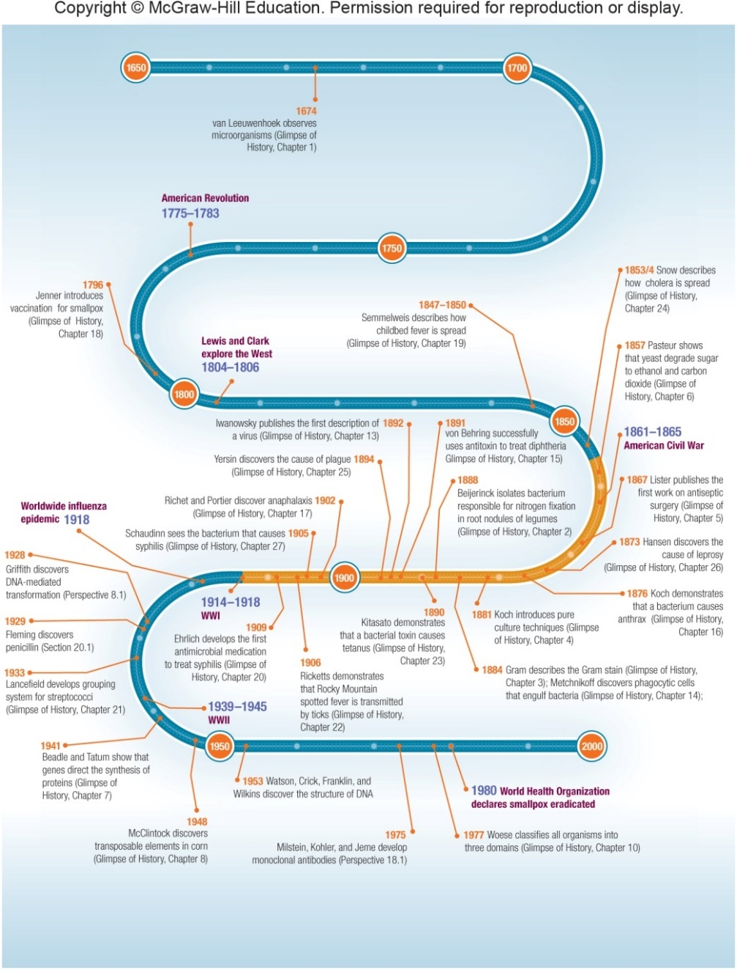
The Golden Age of Microbiology - Figure 1.3
Some major milestones in microbiology in relation to other historical events

Slide 13
The Scientific Method
The scientific method describes the process of science
Make an observation and ask a question about it
Develop a testable explanation called a hypothesis
Design experiments to test the hypothesis
Include a control to help rule out alternative explanations
Do the experiment, collect and analyze data
Draw a conclusion
Communicate methods, results, and conclusions
A scientific theory is an explanation supported by a large amount of evidence.

Slide 14
The Human Microbiome (1)
Human body carries enormous population of microorganisms called the normal microbiota
Play essential role in human health
Prevent disease by competing with disease-causing microbes
Aid in digestion
Promote development of immune system
May decrease allergies, asthma
May affect brain chemistry and body weight

Slide 15
The Human Microbiome (2)
Human Microbiome Project
Started in 2007
DNA sequencing studies to characterize microbial communities that inhabit the human body
Microbiome
Total genetic content of the microbial community
The microbial community itself
Less than 1% of microbes can be cultured; others are characterized by DNA sequencing
Some consider the human body a superorganism in which our own cells interact with our normal microbiota to form a single cooperative unit

Slide 16
Microorganisms in the Environment
Recycling of nutrients
Oxygen production through photosynthesis
Nitrogen fixation
Decomposers of material
Cellulose degraded in the environment and in the digestive tracts of ruminants
National Microbiome Initiative (NMI)
Started in 2016
Expands scope of microbiome research

Slide 17
Commercial Benefits of Microorganisms (1)
Food production
Baking bread using yeast
Fermentation of grains to produce beer
Fermentation of milk → yogurt, cheeses, buttermilk
Biodegradation
Degrade environmental pollutants
Lessen damage from oil spills
Bioremediation: use of microorganisms to hasten decay of pollutants

Slide 18
Commercial Benefits of Microorganisms (2)
Bacteria synthesize commercially valuable products
Antibiotics (treatment of diseases)
Ethanol (biofuel)
Hydrogen gas and certain oils (possible biofuels)
Amino acids (dietary supplements)
Insect toxins (insecticides)
Cellulose (headphones)
Hydroxybutyric acid (disposable diapers and plastics)

Slide 19
Commercial Benefits of Microorganisms (3)
Biotechnology
Use of microbiological and biochemical techniques to solve practical problems
Genetic engineering
Production of medications by certain microorganisms, such as insulin for treatment of diabetes
Production of plants with desirable qualities

Slide 20
Microbes as Research Tools
Model organisms have same fundamental metabolic and genetic properties as higher life forms
All cells composed of same chemical elements
Synthesize cell structures by similar mechanisms
Duplicate DNA
Degrade foods via same metabolic pathways
“What is true of elephants is also true of bacteria, and bacteria are much easier to study” (Jacques Monod)
Grow very quickly on inexpensive growth media

Slide 21
Microbes and Disease (1)
Most microorganisms are beneficial or not harmful
Some are pathogens that can cause disease
Damage to body tissues
Result of pathogen’s growth and products
Result of body’s defense mechanisms
Influenza in 1918 to 1919 killed more Americans than died in WWI, WWII, Korean, Vietnam, and Iraq wars combined

Slide 22
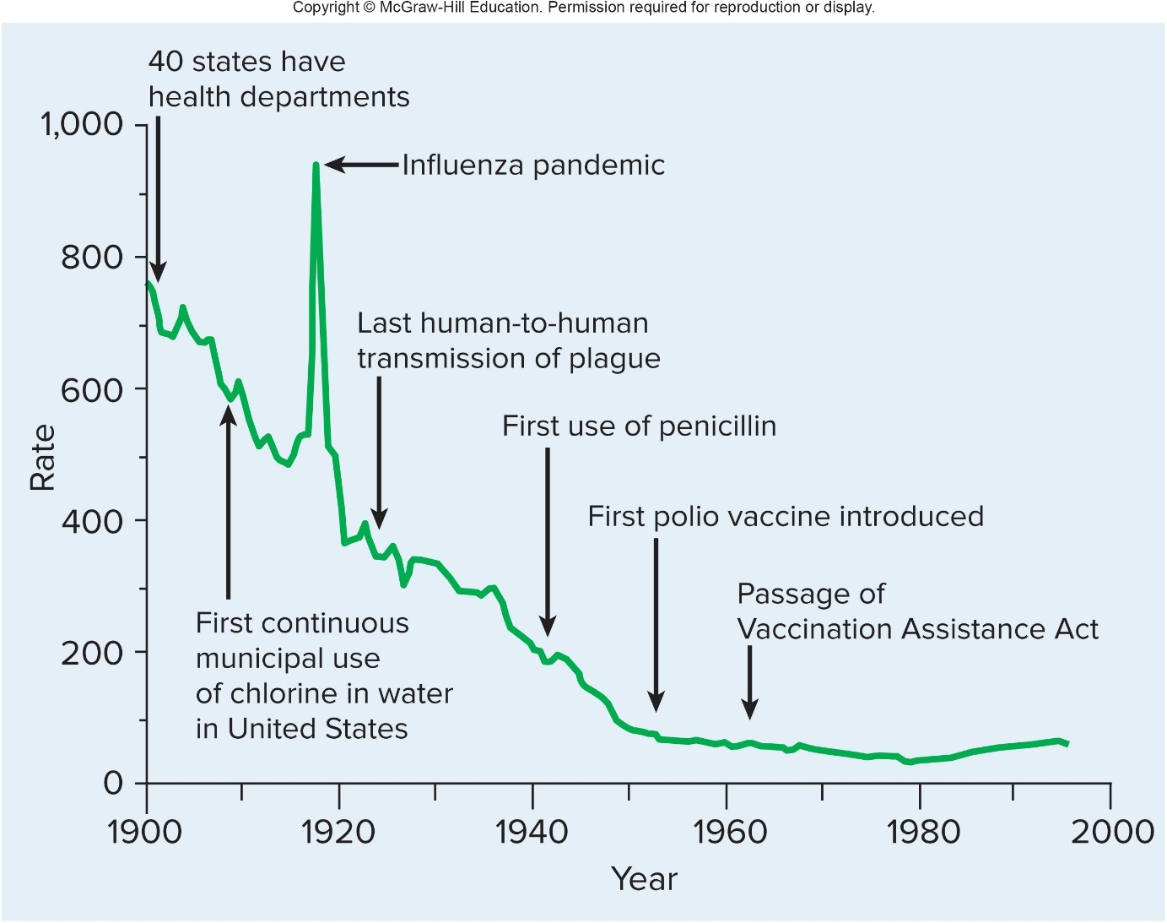
Microbes and Disease - Figure 1.4
Modern sanitation, vaccination, and antibiotic treatments have reduced incidence of infectious diseases
Jump to Microbes and Disease - Figure 1.4 Long Description

Slide 23
Microbes and Disease (2)
Smallpox eradicated
Once killed one-third of victims; left others blind or scarred
Devastated unexposed populations, such as native inhabitants of Americas
No reported cases since 1977, but laboratory stocks of virus remain
Plague deaths less than 100 per year
Killed one-third of population of Europe (approximately 25 million people) between 1347 to 1351
Control of rodent populations and human respiratory secretions to prevent spread
Antibiotics for treatment
Polio nearly eliminated by vaccination

Slide 24
Microbes and Disease (3)
Infectious disease in non-human populations
Irish potato famine in 1800s
English foot-and-mouth disease in 2001
Nearly 4 million pigs, sheep, and cattle destroyed
“Wheat Blast” in 2016
Over 35,000 acres of wheat crops lost

Slide 25
Microbes and Disease (4)
Emerging infectious disease (EID): one that has become more common in last 35 years
Newly recognized diseases
Ebola virus disease
Congenital Zika syndrome
Middle East respiratory syndrome (MERS)
Influenza (certain types)
Lyme disease
AIDS
Hantavirus pulmonary syndrome
Mad cow disease (bovine spongiform encephalopathy)
Diseases that have become more common
Malaria
Tuberculosis

Slide 26
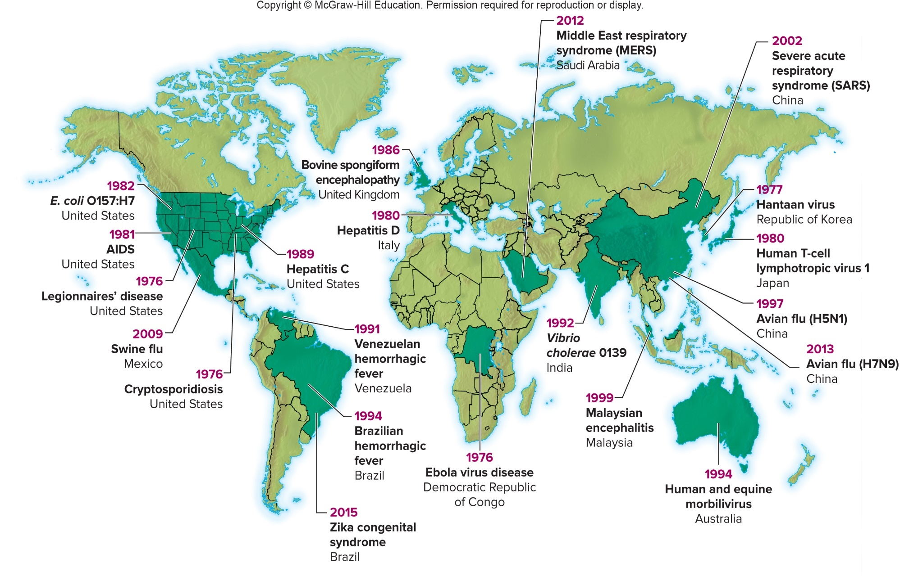
Microbes and Disease - Figure 1.5

Slide 27
Microbes and Disease (5)
Emerging infectious disease
Disease agents evolve
Infect new host (HIV-1)
Cause different types of damage to host (E. coli O104:H4)
Become resistant to antibiotics (tuberculosis, malaria)
Changes in society
Mobile populations can carry pathogens around globe
Diseases such as malaria and cholera have largely been eliminated from developed countries, but still exist in many parts of the world
Expansion into rural areas allows closer contact with organisms that people have not encountered previously

Slide 28
Microbes and Disease (6)
Decades of vaccination have controlled many common diseases in developed countries
Lack of first-hand knowledge of the dangers of diseases can lead people to fear vaccines more than the diseases they prevent
Diseases such as measles, mumps, and whooping cough are nearly eliminated from developed countries, but could become common again with declining vaccination rates

Slide 29
Microbes and Disease (7)
Chronic diseases may be caused by pathogens
Stomach ulcers caused by Helicobacter pylori
Cervical cancer caused by human papilloma virus (HPV)

Slide 30
Members of the Microbial World
Huge variety of microbes that occupy every conceivable environment on Earth
Two basic cell structures
Prokaryotic cells do not have a membrane-bound nucleus
Eukaryotic cells have a membrane-bound nucleus and organelles
All living things can be classified into one of three domains
Bacteria (prokaryotes)
Archaea (prokaryotes)
Eukarya (eukaryotes)

Slide 31
Members of the Microbial World – Table 1.1
Table 1.1 Characteristics of Members of the Three Domains
Characteristic | Bacteria | Archaea | Eukarya
Cell Type | Prokaryotic | Prokaryotic | Eukaryotic
Number of Cells | Unicellular | Unicellular | Unicellular or multicellular
Membrane-bound organelles | No | No | Yes
Ribosomal RNA sequences unique to the group | Yes | Yes | Yes
Peptidoglycan in cell wall | Yes | No | No
Typical size range | 0.3 to 2 micrometers | 0.3 to 2 micrometers | 5 to 50 micrometers

Slide 32
Scientific Names (1)
Binomial System of Nomenclature: two words
Genus (capitalized)
Specific epithet, or species name (not capitalized)
Genus and species are italicized or underlined
Genus may be abbreviated (E. coli)

Slide 33
Scientific Names – Table 1.2
Table 1.2 Origin of Various Scientific Names
Name | Genus Derivation | Species Derivation
Escherichia coli (bacterium) | Honors Theodor Escherich, the scientist who discovered the bacterium. | Derived from the word “colon,” the body site inhabited by the bacterium.
Haemophilus influenzae (bacterium) | Derived from haemo (blood) and phil (loving), reflecting that the bacterium requires certain components of blood for growth. | Derived from the word “influenza,” the disease mistakenly thought to be caused by the bacterium; we now know that influenza is caused by a virus.
Saccharomyces cereviseae (fungus) | Derived from haemo (blood) and phil (loving), reflecting that the bacterium requires certain components of blood for growth. | Derived from cerevisia (beer), reflecting that the fungus (a yeast) is used to make beer.
Shigella dysenteriae (bacterium) | Honors Kiyoshi Shiga, the scientist who discovered the bacterium. | Derived from the word “dysentery,” the disease caused by the bacterium.
Staphylococcus aureus (bacterium) | Derived from staphylo (bunch of grapes) and kokkus (berry), reflecting the grouping and shape of the cells. | The term aureus (golden) indicates the common color of visible masses of the cells.

Slide 34
Scientific Names (2)
Name often reflects characteristic of organism or honors a scientist who worked with it
Escherichia (honors Theodor Escherich)
coli (indicates the colon, where the bacteria live)
Members of a species with important minor differences may be indicated with a strain designation (E. coli K12)
Informal names that resemble genus names are not italicized
Members of the genus Staphylococcus are often called staphylococci

Slide 35
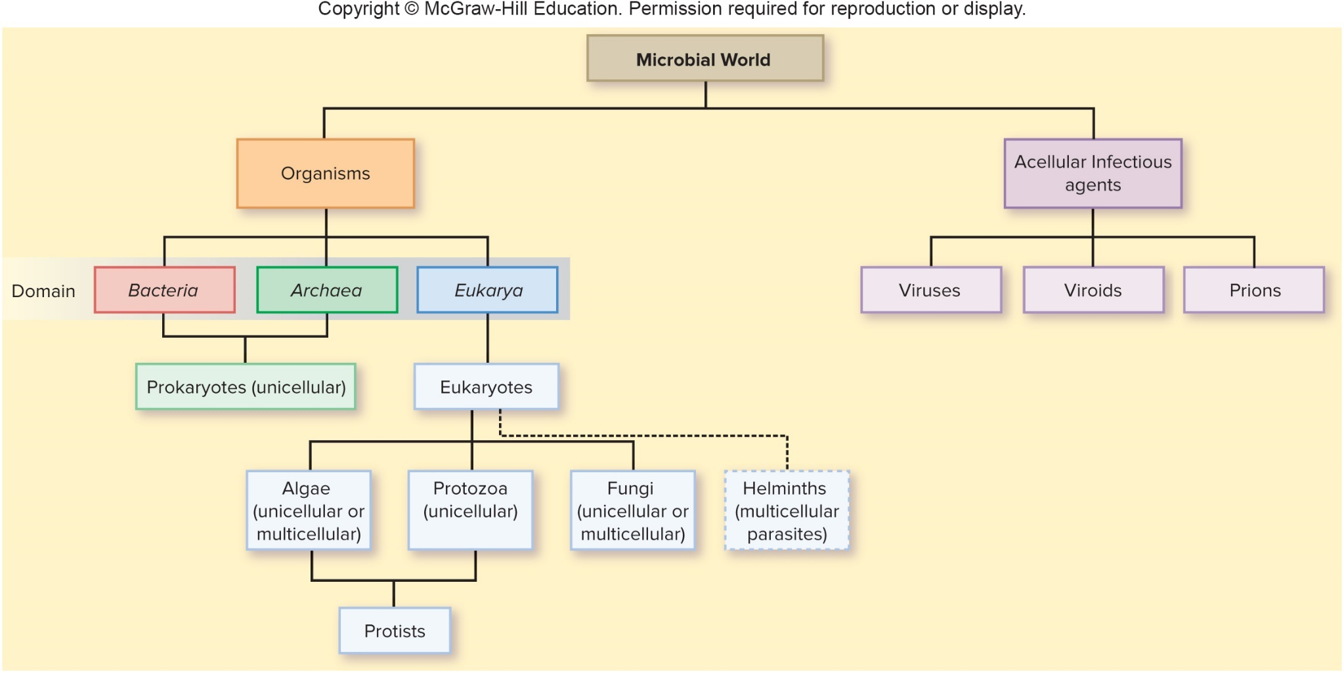
Members of the Microbial World - Figure 1.6
Jump to Members of the Microbial World - Figure 1.6 Long Description

Slide 36
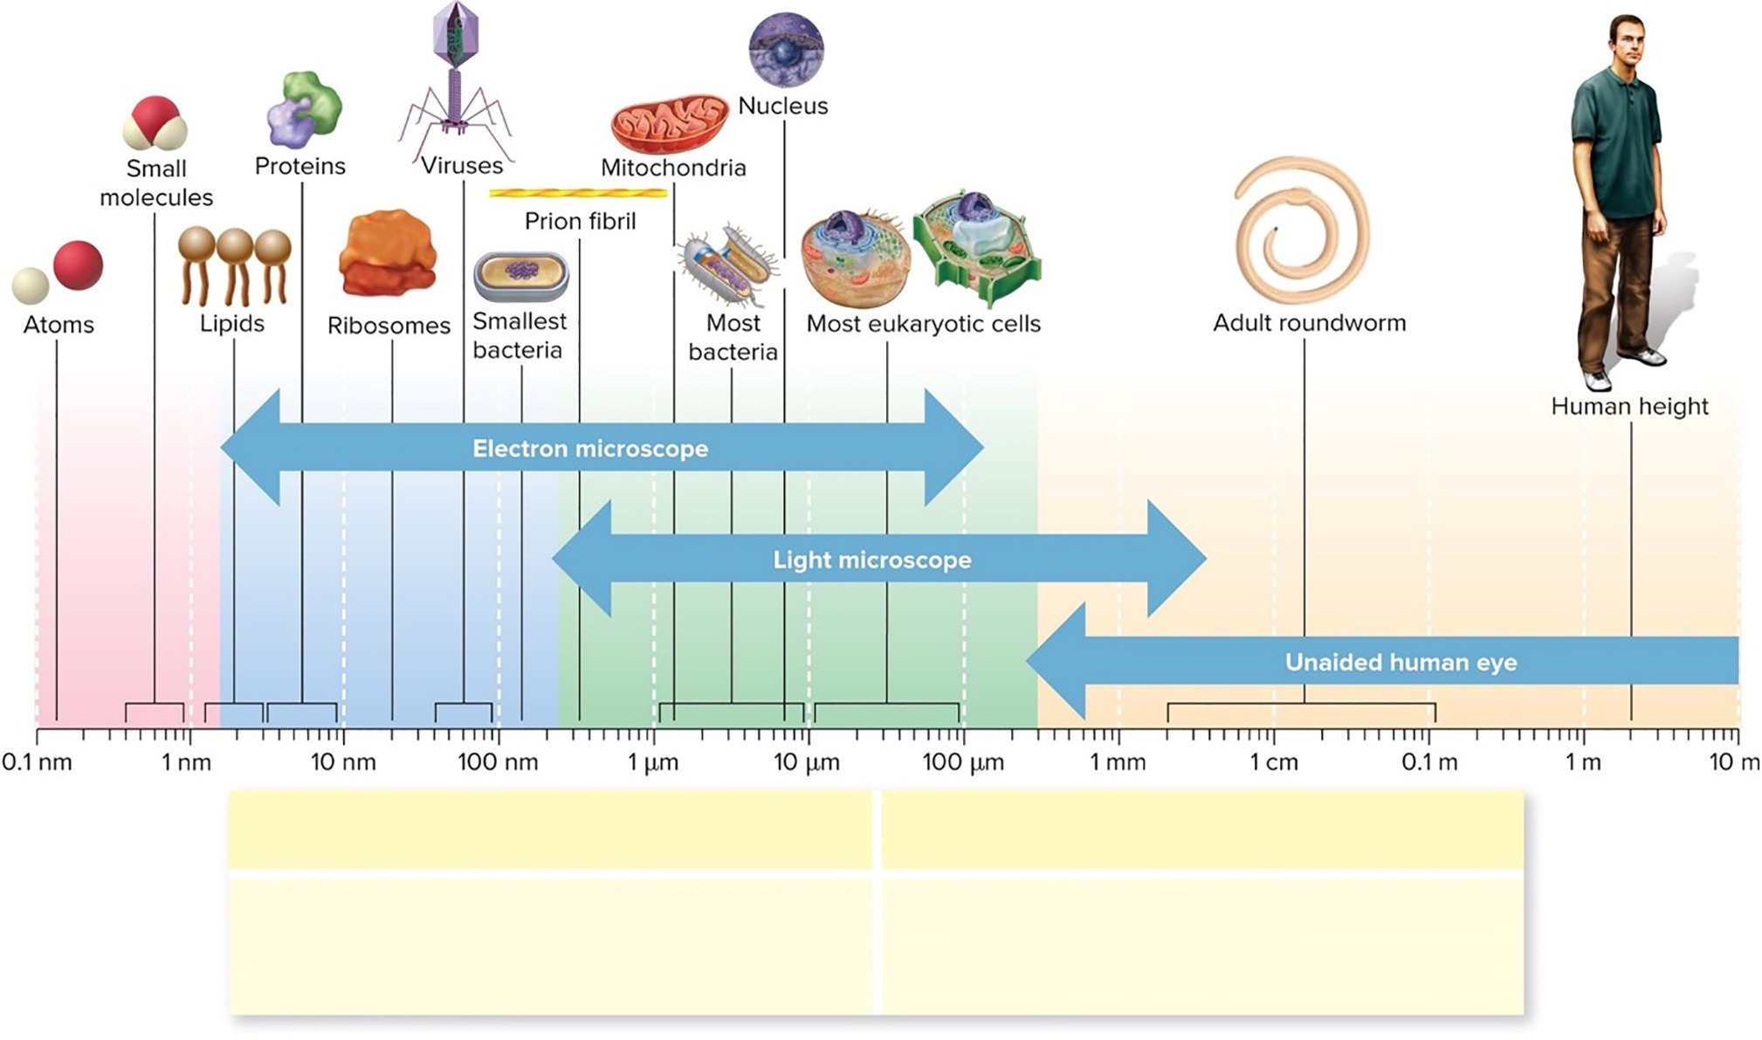
Sizes in the Microbial World - Figure 1.7
The basic unit of length is the meter (m), and all other units are fractions of a meter.
These units of measurement correspond to units in an older but still widely used convention.
$$nanometer \left(nm\right)={10}^{−9}meter=0.000000001 meter$$
$$micrometer\left(μm\right)={10}^{−6}meter=0.000001 meter$$
$$millimeter\left(mm\right)={10}^{−3}meter=0.001 meter$$
$$1 meter=39.4 inches$$
$$1 angstrom\left(Å\right)={10}^{−10}meter$$
$$1 micron\left(μ\right)={10}^{−6} meter$$
Jump to Sizes in the Microbial World - Figure 1.7 Long Description

Slide 37
Bacteria
Bacteria: single-celled prokaryotes
Most have specific shapes (cylindrical, spherical, spiral)
Rigid cell wall contains peptidoglycan (unique to bacteria)
Many move using flagella
Multiply via binary fission
Obtain energy from a wide variety of sources; some are photosynthetic

Slide 38
Archaea
Archaea: single-celled prokaryotes similar in size, shape, and properties to bacteria
Major differences in chemical composition
Cell walls lack peptidoglycan
Ribosomal RNA sequences different
Many are extremophiles
High salt concentration, temperature
Many are common in moderate environments

Slide 39
Eukarya – Table 1.3
Eukarya: single-celled or multicellular eukaryotes
Eukaryotes studied by microbiologists include fungi, algae, protozoa, and helminths (worms)
Algae and protozoa also referred to as protists
Table 1.3 Eukaryotic Organisms Studied by Microbiologists
Organism | Characteristics
Fungi | Use organic material for energy. Size range from microscopic (yeasts) to macroscopic (molds and mushrooms).
Algae | Use sunlight for energy. Size range from microscopic (single-celled algae) to macroscopic (multicellular algae).
Protozoa | Use organic material for energy. Single-celled microscopic organisms.
Helminths | Use organic material for energy. Adult worms are typically macroscopic and often quite large, but their eggs and larval forms are microscopic.

Slide 40
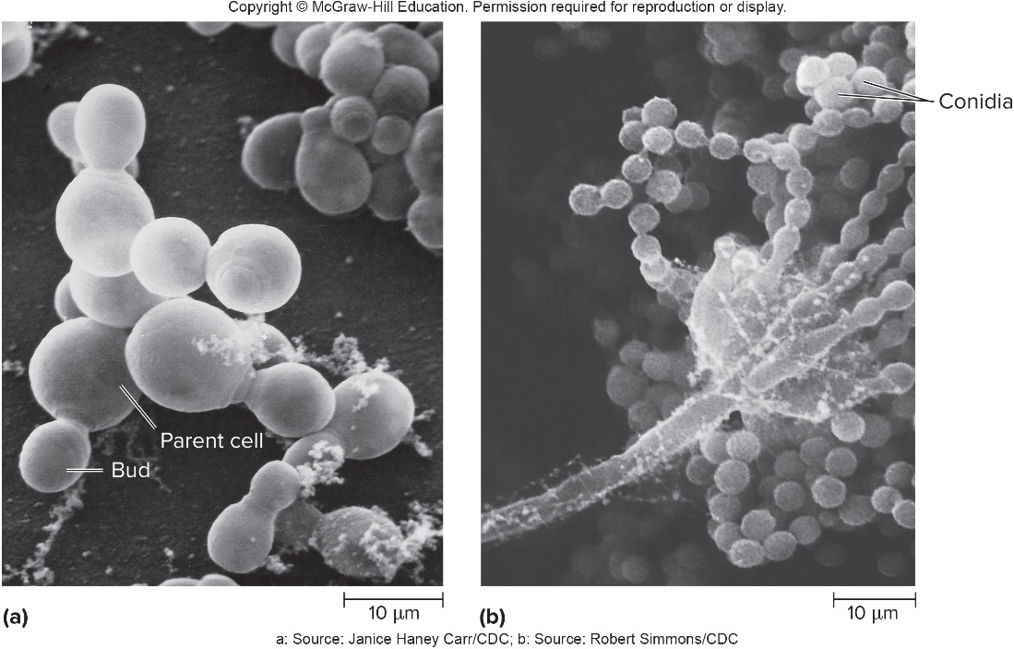
Eukarya - Figure 1.8
Fungi: diverse group ranging from single-celled yeasts to multicellular molds
Filamentous molds spread by release of microscopic spores (conidia)
Mushroom: macroscopic reproductive structure characteristic of some fungi
Secrete enzymes onto organic materials, and then take in the released nutrients
a: Source: Janice Haney Carr/CDC; b: Source: Robert Simmons/CDC

Slide 41
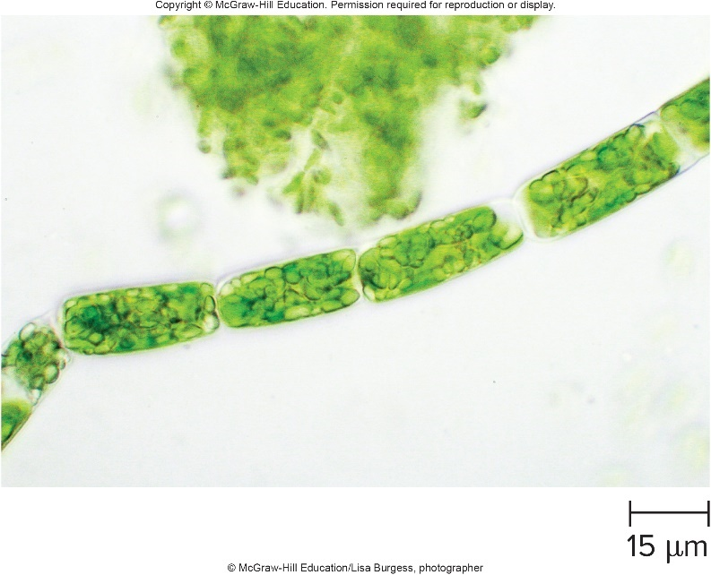
Eukarya - Figure 1.9
Algae: diverse group of photosynthetic eukaryotes
Single-celled or multicellular
Chloroplasts contain chlorophyll or other pigments that give characteristic colors
Usually live near surface of water or in moist habitat
Rigid cell walls and flagella distinct from those of prokaryotes
© McGraw-Hill Education/Lisa Burgess, photographer

Slide 42
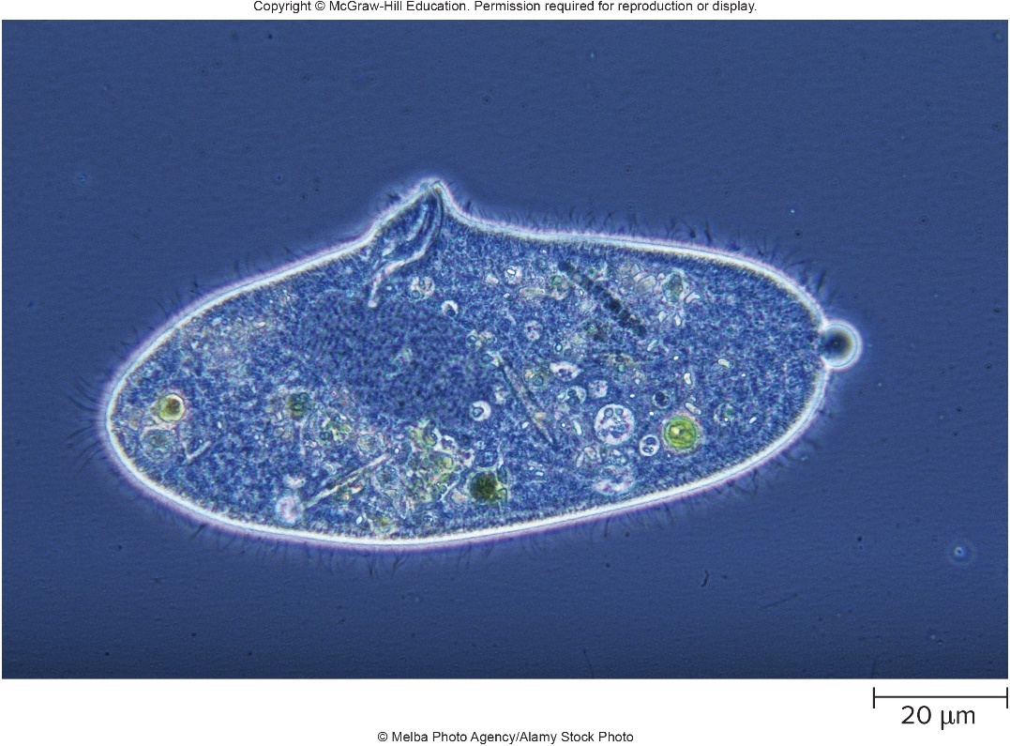
Eukarya - Figure 1.10
Protozoa: diverse group of single-celled eukaryotes
Complex, larger than prokaryotes
Most ingest organic compounds
No rigid cell wall
Most are motile
Energy from ingested organic material
© Melba Photo Agency/Alamy Stock Photo

Slide 43
Eukarya
Parasitic helminths are worms that live at the expense of a host.
Adult worms can usually be seen with the naked eye, but microbiologists study their eggs and larvae, which are microscopic.
Helminths include roundworms, tapeworms, and flukes.

Slide 44
Acellular Infectious Agents – Table 1.4
Viruses, viroids, prions
Not composed of cells, so they are considered non-living
Table 1.4 Acellular Infectious Agents
Agent | Characteristic
Viruses | Consist of either DNA or RNA, surrounded by a protein coat. Obligate intracellular agents that use the machinery and nutrients of host cells to replicate.
Viroids | Consist only of RNA; no protein coat. Obligate intracellular agents that use the machinery and nutrients of host cells to replicate.
Prions | Consist only of protein; no DNA or RNA. Misfolded versions of normal cellular proteins that cause the normal versions to misfold.

Slide 45
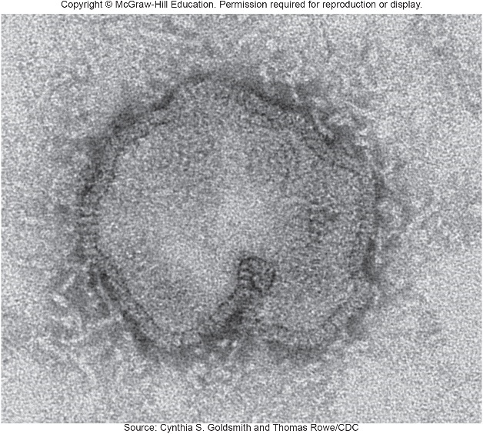
Acellular Infectious Agents - Figure 1.11
Viruses
Nucleic acid packaged in protein coat
Infect living cells, referred to as hosts
Obligate intracellular agents
Multiply using host cell machinery and nutrients
Inactive outside of host
All forms of life can be infected by different types
May kill host cell
May remain within host cell and replicate viral genetic information as host cell multiplies
Source: Cynthia A. Goldsmith and Thomas Rowe/CDC

Slide 46
Acellular Infectious Agents
Viroids
Consist only of a single short piece of RNA
Obligate intracellular agents
Cause plant diseases
No evidence they cause disease in humans

Slide 47
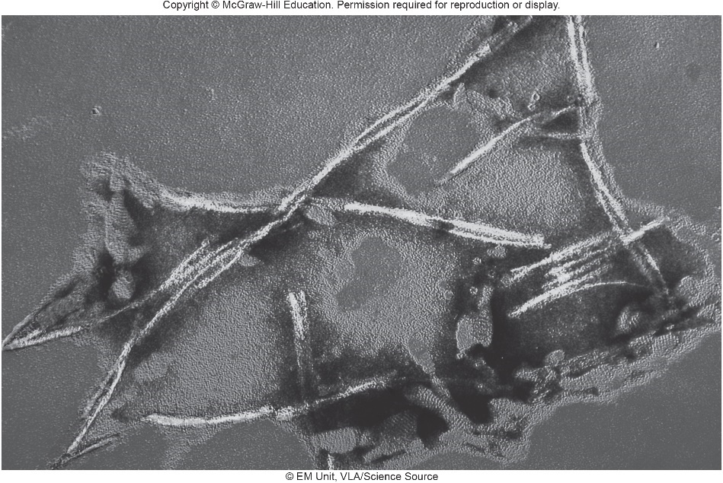
Acellular Infectious Agents - Figure 1.12
Prions
Infectious proteins: misfolded versions of normal cellular proteins found in the brain
Misfolded version in contact with normal version causes it to also misfold
Abnormal proteins form fibrils
Cells die leaving spaces in brain (spongiform encephalopathy)
Resistant to usual sterilization procedures
© EM Unit, VLA./Science Source

