Slide 1
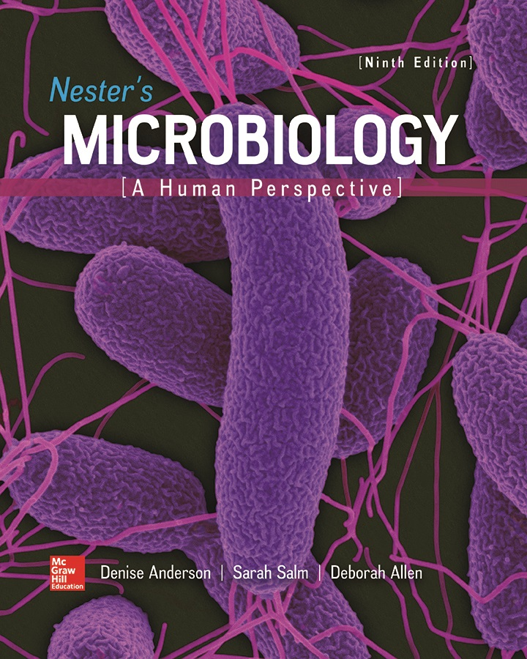
Chapter 21 Lecture Outline
See separate PowerPoint slides for all figures and tables pre-inserted into PowerPoint without notes.
Notes:
1

Slide 2
A Glimpse of History
Rebecca Lancefield (1895 to 1981)
Demonstrated that streptococci can be classified based on cell wall carbohydates; “Lancefield grouping”
Streptococci had been previously classified by their type of blood agar hemolysis
Recognized that streptococci have antigens on their surface that correlate with disease-causing potential
Most strains of β-hemolytic strep from human infections have same “A” cell wall carbohydrate; others differ
Better predictor of pathogenic potential than hemolysis
Discovered M protein on Streptococcus pyogenes
First woman president of American Associate of Immunologists; elected to National Academy of Sciences

Slide 3
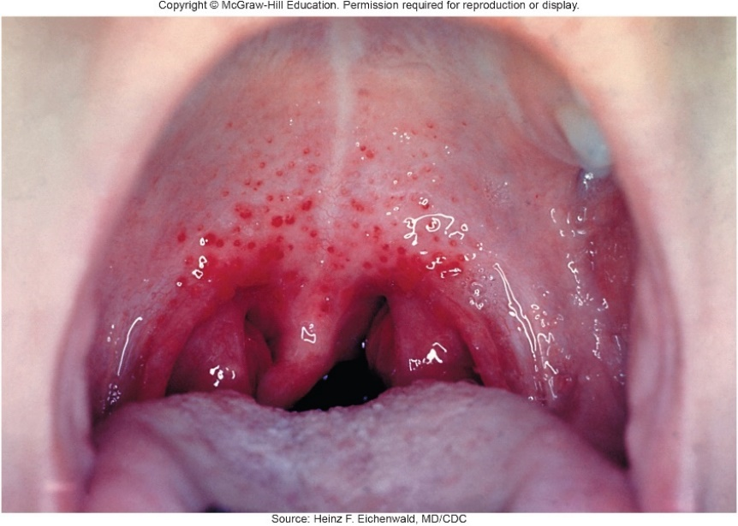
Respiratory System Infections
Enormous variety of respiratory system infections
Illnesses range from trivial to fatal
Divided into infections of upper respiratory tract (head and neck) and lower respiratory tract (chest)
Upper respiratory infections (for example, colds) very common and uncomfortable, but not life-threatening,
Lower respiratory infections (for example, pneumonia, tuberculosis) often serious, may be fatal
Source: Heinz F. Eichenwald, MD/CDC

Slide 4
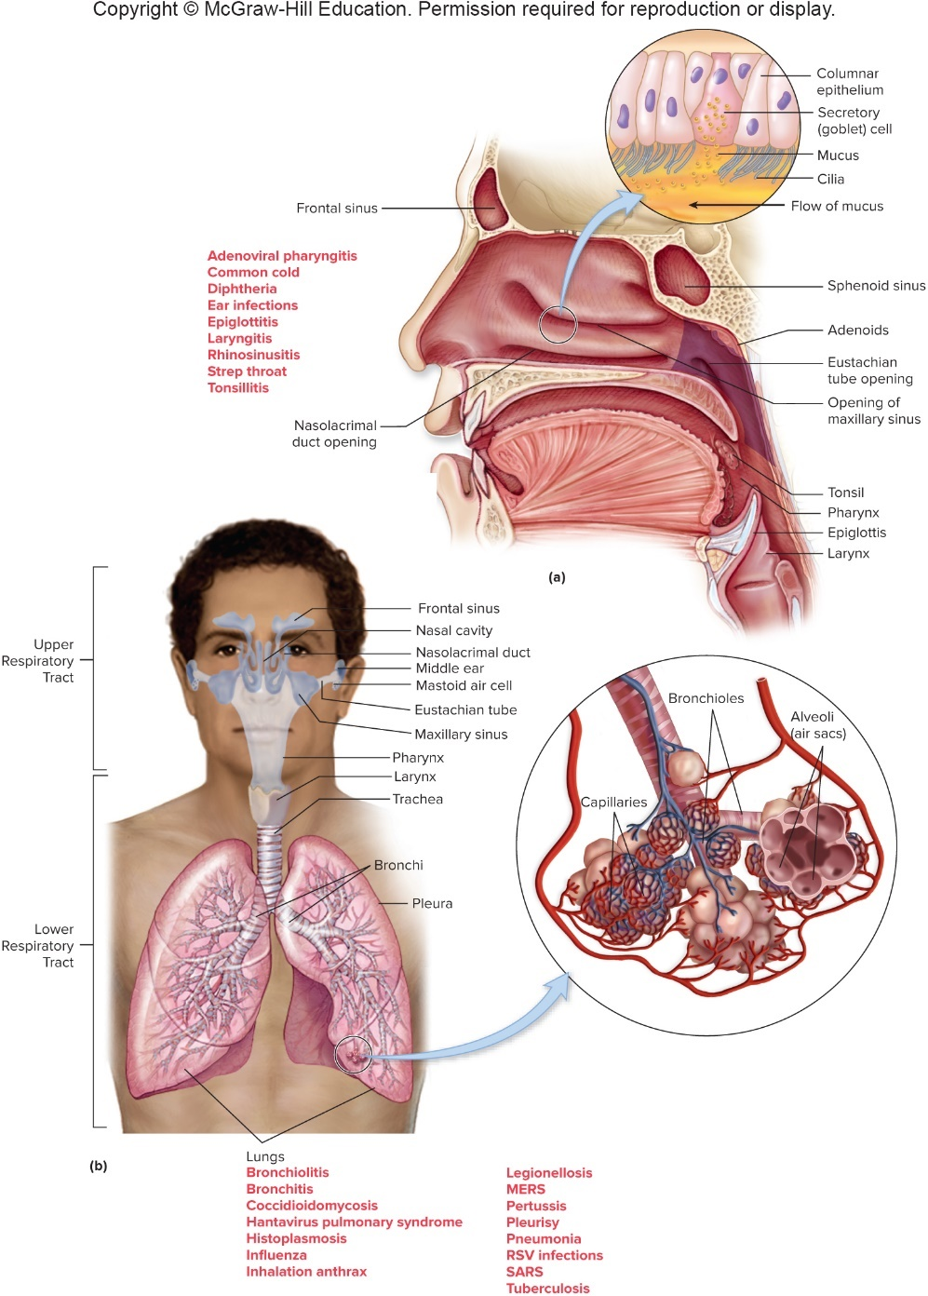
Anatomy, Physiology, and Ecology – Figure 21.1
Respiratory system
Replenishes
Releases
Vocal cords: sounds
Nose detects odors
Upper and lower respiratory tracts
Eyes and ears associated with ducts to nasal cavity, throat
Jump to Anatomy, Physiology, and Ecology – Figure 21.1 Long Description

Slide 5
Anatomy, Physiology, and Ecology (1)
Upper respiratory tract
Nose and nasal cavity, pharynx (throat), and epiglottis
Lined by mucous membranes
Goblet cells produce mucus, a slimy glycoprotein
Traps air-borne dust and particles including microbes
Mucociliary escalator propels mucus, trapped particles away from lungs
Impaired by smoking, alcohol/drug abuse, viral infections; increases chance of infection
Tonsils are lymphoid organs, come into contact with microbes entering upper respiratory tract
Important in immune response but can become infected

Slide 6
Anatomy, Physiology, and Ecology (2)
Upper respiratory tract
Nose and nasal cavity warm, humidify air
Approximately 30% of healthy people carry Staphylococcus aureus
Infection of nose is usually by viruses, results in rhinitis
Sinuses in skull; “sinus headache,” post-nasal “drip”
Pharynx, epiglottis also important in digestive system
Inflammation of throat (pharyngitis)
Epiglottis covers lower respiratory tract during swallowing
Inflammation (epiglottitis) can be life-threatening

Slide 7
Table 21.1 Normal Microbiota of the Upper Respiratory System
Genus | Characteristics | Comments
Corynebacterium | Pleomorphic, often club-shaped Gram-positive rods; non-motile | Aerobic or facultatively anaerobic. Those that look similar to C. diphtheriae, the cause of diphtheria, are included in a group called diphtheroids.
Fusobacterium, Porphyromonas, Prevotella | Gram-negative rods | Obligate anaerobes. Most often found in the space between teeth and gums.
Haemophilus | Small, Gram-negative rods | Facultative anaerobes. Commonly include the potential pathogen H. influenza.
Moraxella | Gram-negative diplococci and diplobacilli | Aerobic. Some microscopically resemble pathogenic Neisseria species such as N. meningitidis.
Staphylococcus | Gram-positive cocci in clusters | Facultative anaerobes. Potential pathogen Staphylococcus aureus commonly inhabits the nostrils.
Streptococcus | Gram-positive cocci in chains | Aerotolerant (obligate fermenters). Viridans streptococci, which are α-hemolytic (greenish partial hemolysis), and non-hemolytic streptococci are common. β-hemolytic (clear hemolysis) streptococci and the potential pathogen S. pneumoniae may also be present.

Slide 8
Anatomy, Physiology, and Ecology (3)
Upper respiratory tract
Eyes and lining of eyelids covered by conjunctiva
Bathed in tears rich in lysozyme and secretory IgA, cleaned by blinking reflex
Very few bacteria present; infection termed conjunctivitis
Tear ducts connect to nasal cavity
Ears have three parts: external, middle, and inner
External ear protected by cerumen (ear wax)
Middle ear sterile, connected by Eustachian tubes to pharynx to allow drainage, equalize pressure
Infection is otitis media
Inner ear typically microbe-free
Infectious agents may enter from upper respiratory tract infection; may spread to mastoid air cells

Slide 9
Anatomy, Physiology, and Ecology (4)
Lower respiratory tract: usually sterile
Larynx (voice box), trachea (windpipe), bronchi, lungs
Inflammation of larynx is laryngitis; hoarseness
Trachea branches into two bronchi; infection is bronchitis
Often from viral infection, coughing due to smoking
Bronchi branch repeatedly to become bronchioles; viral infection is bronchiolitis
Bronchioles end in alveoli, the sites of gas exchange
Inflammation of lungs is pneumonitis; called pneumonia when alveoli fill with pus and fluid
Lung tissue contains many macrophages to prevent
Lungs surrounded by two membranes (pleura); inflammation is pleurisy (pleuritis)

Slide 10
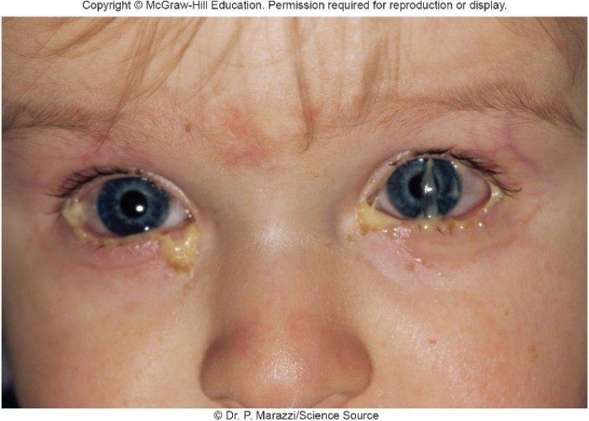
Bacterial Infections of Upper Respiratory System – Figure 21.2
Pink eye, earache, and sinus infections
Common, often occur together, often from same agent
Signs and symptoms
Conjunctivitis (“pink eye”): tears, redness, swollen eyelids, sensitivity to bright light, pus
Otitis media: severe earache; pain often causes vomiting
Sinusitis: facial pain, pressure; headache, malaise, thick green nasal discharge may develop
©Dr. P. Marazzi/Science Source

Slide 11
Bacterial Infections of Upper Respiratory System (1)
Pink eye, earache, and sinus infections
Causative agents
Haemophilus influenzae (Gram-negative rod) and Streptococcus pneumoniae (Gram-positive encapsulated diplococcus) are common causes; others also cause
Strains that infect conjunctiva have adhesins
Approximately one third of otitis media, sinusitis caused by respiratory viruses
Pathogenesis of conjunctivitis
Organisms likely from airborne respiratory droplets or contaminated hands
Resist destruction by lysozyme
Attachment sometimes aided by degradation of mucin (protective component of epithelial surface mucous)
Release tissue-damaging enzymes and sometimes toxins
Notes:
11

Slide 12
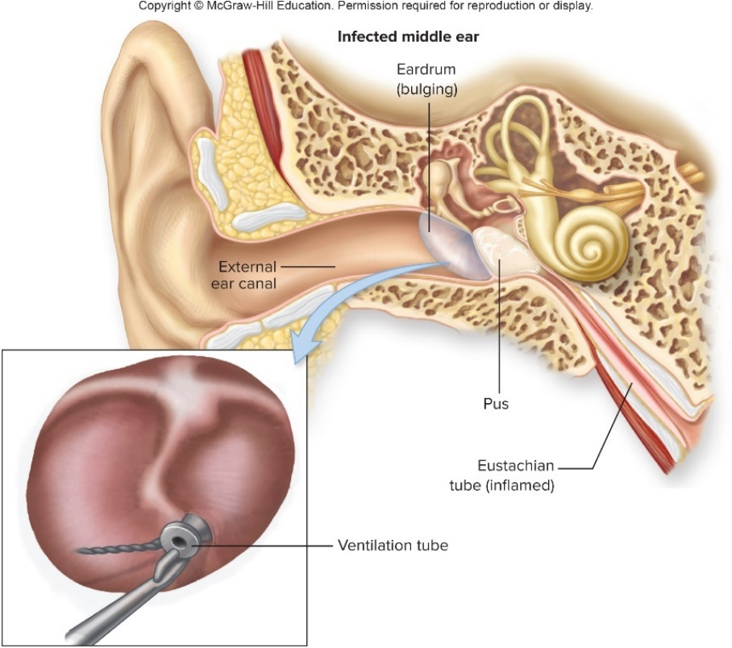
Bacterial Infections of Upper Respiratory System – Figure 21.3
Pink eye, earache, and sinus infections
Pathogenesis of otitis media, sinusitis
Usually preceded by infection of nasal cavity and pharynx that spreads through Eustachian tube
Infection damages ciliated cells, results in inflammation and swelling, prevents movement of secretions
Fluid, pus collect behind eardrum, cause pressure
Eardrum may burst
Biofilm may lead to chronic infections

Slide 13
Bacterial Infections of Upper Respiratory System (2)
Pink eye, earache, and sinus infections
Epidemiology
Virulence of bacteria, crowding of potential hosts, presence of respiratory viruses all likely important
Preceding or concurrent viral illness is common
Virus may damage protective mucociliary mechanisms
Otitis media rare in first month of life, but common in early childhood; increased risk from pacifiers beyond age two; older children develop immunity so rare beyond age five
Nasal allergies, air pollution, smoking may play role
Sinusitis tends to affect adults and older children with more developed sinuses

Slide 14
Bacterial Infections of Upper Respiratory System (3)
Pink eye, earache, and sinus infections
Treatment and prevention
Antibiotics generally effective when properly used
Have often been used indiscriminately to treat otitis media
Proper use decreases risk of complications (for example, meningitis)
Decongestants, antihistamines generally ineffective; can actually reduce immune response
Bacterial conjunctivitis highly contagious
Preventive measures include handwashing, avoiding touching eyes
Preventive measures for otitis media include plastic tubes through eardrums if chronic, influenza vaccine, or removal of adenoids to improve drainage

Slide 15
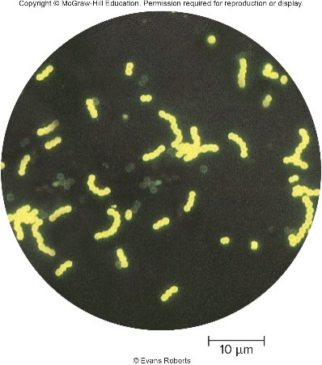
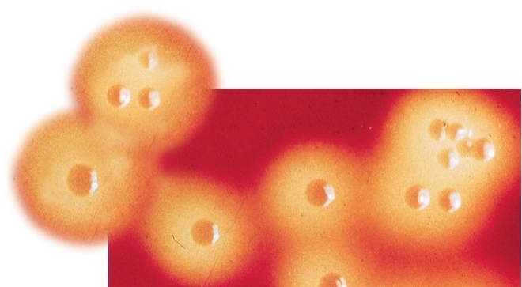
Bacterial Infections of Upper Respiratory System – Figures 21.4 and 21.5
Streptococcal Pharyngitis (“Strep Throat”)
Signs and symptoms
Sore throat, difficulty swallowing, fever
Throat is red with patches of pus, tiny hemorrhages
Most patients recover after about a week; some have mild or no symptoms
Causative agent is Streptococcus pyogenes
Gram-positive; grows in chains
β-hemolysis of blood agar
Group A streptococcus (GAS) from Lancefield grouping
Different strains within GAS distinguished by M protein
Left: ©Evan Roberts

Slide 16
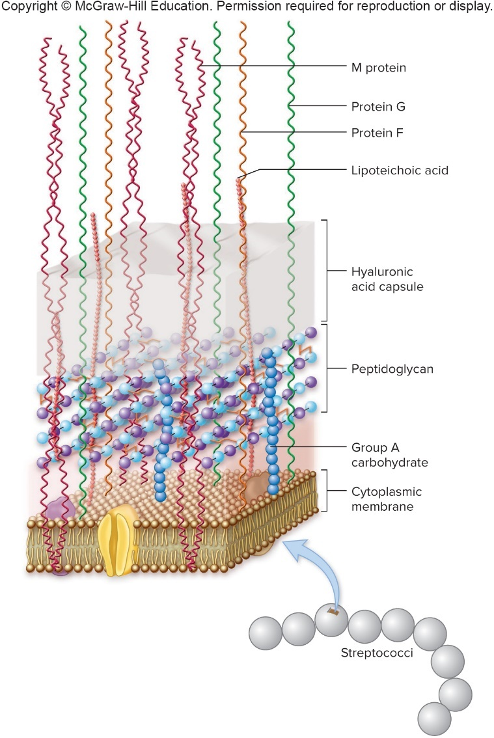
Bacterial Infections of Upper Respiratory System – Figure 21.6
Pathogenesis of Streptococcus pyogenes
Structural components of outer cell wall allow evasion of host defenses
M protein acts as adhesin (80 different types)
Antibodies that bind to it prevent infection
Antibodies to one strain do not stop others
Protein F adheres to fibrin of epithelial cells in throat
DNase, hyaluronidase, proteases degrade intracellular connections; streptokinase breaks blood clots

Slide 17
Bacterial Infections of Upper Respiratory System (4)
Pathogenesis of Streptococcus pyogenes
Avoidance of host immune system
Some have hyaluronic acid capsule thought to disguise bacteria from immune system
M protein prevents opsonization via C3b
Protein G is an Fc receptor; binds Fc portion of IgG, prevents IgG mediated phagocytosis
Produces C5a peptidase; destroys C5a responsible for attracting phagocytes to site of infection
Streptolysins O and S make holes in membranes of erythrocytes and leukocytes; yields β-hemolysis, inhibits immune system

Slide 18
Bacterial Infections of Upper Respiratory System (5)
Pathogenesis of Streptococcus pyogenes
Avoidance of host immune system
A few strains produce streptococcal pyrogenic exotoxins (SPEs) leading to high fever
May lead to scarlet fever, streptococcal toxic shock syndrome, or “flesh-eating disease”
Product | Effect
C5a peptidase | Inhibits recruitment of phagocytes by destroying complement component C5a Inhibits phagocytosis
Hyaluronic acid capsule | Interferes with phagocytosis by causing inactivation of complement component C3b, an opsonin; involved in attachment to host cells
M protein | Interferes with phagocytosis by causing inactivation of complement component C3b, an opsonin; involved in attachment to host cells
Protein F | Responsible for attachment to host cells
Protein G | Binds to Fc portion of antibodies, thereby interfering with opsonization
Streptococcal pyrogenic exotoxins (SPEs) | Superantigens responsible for scarlet fever, toxic shock, “flesh-eating” fasciitis
Streptolysins O and S | Lyse leukocytes and erythrocytes
Tissue-degrading enzymes | Enhance spread of bacteria by breaking down DNA, proteins, blood clots, tissue, hyaluronic acid
Notes:
18

Slide 19
Bacterial Infections of Upper Respiratory System (6)
Epidemiology of Streptococcus pyogenes
Naturally only infects humans
Spread by respiratory droplets or contaminated food
Nasal carriers more likely to spread than pharyngeal
Anal carriers uncommon; can be source of healthcare-associated infections
Individuals can be asymptomatic carriers for weeks
Some long-term carriers; strain usually becomes deficient in M protein
Treatment and prevention
Confirmation via diagnostic tests and throat culture
Treatment with penicillin prevents some post-streptococcal sequelae

Slide 20
Bacterial Infections of Upper Respiratory System (7)
Post-streptococcal sequelae
Complications that develop after streptococcal infections
Thought to result from immune response
Acute rheumatic fever can begin approximately 3 weeks after recovery
Fever, joint pains, chest pains, rash, nodules under skin
Uncontrollable body movements (chorea) can occur
Carditis develops in 30 to 50% of patients, can lead to chronic rheumatic heart disease
Heart valve damage; infective endocarditis
Some MHC class II alleles involved in susceptibility
Thought to involve autoimmune response
Occurs in up to 3% of severe untreated cases, results in about 10 to 20 million cases per year globally

Slide 21
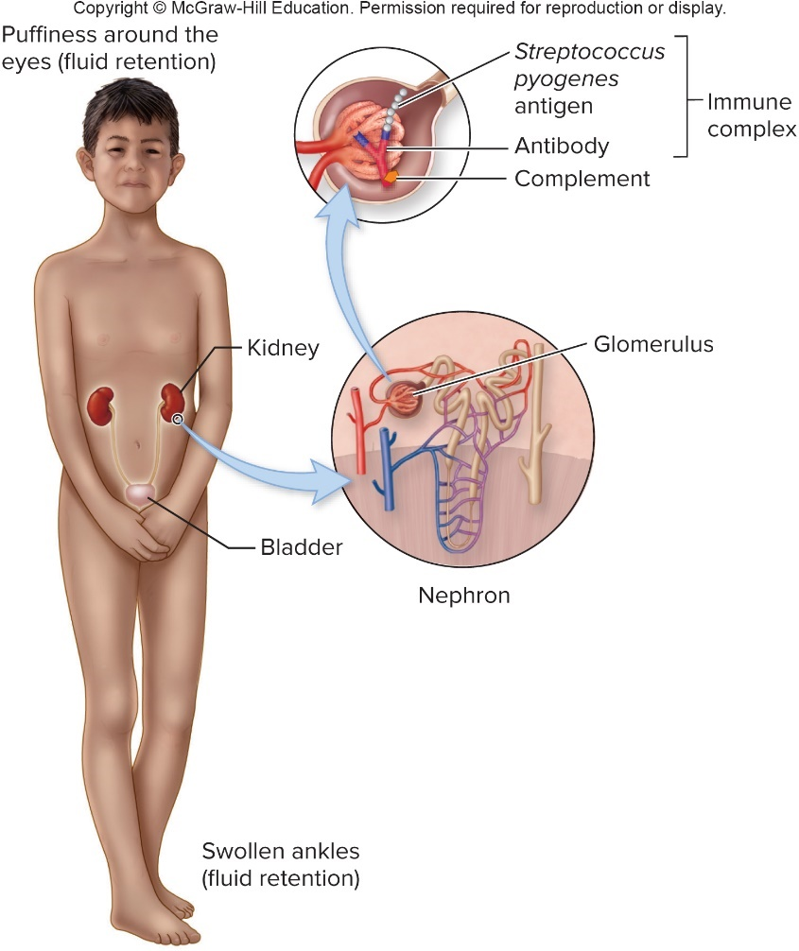
Bacterial Infections of Upper Respiratory System – Figure 21.7
Post-streptococcal sequelae
Acute post-streptococcal glomerulonephritis
Fever, fluid retention, high blood pressure; blood and protein in urine
S. pyogenes generally eliminated before symptoms appear
Damage to kidneys from inflammatory reaction to streptococcal antigens in kidney glomeruli
Antibodies bind, activate complement system
Only a few strains of S. pyogenes cause this

Slide 22
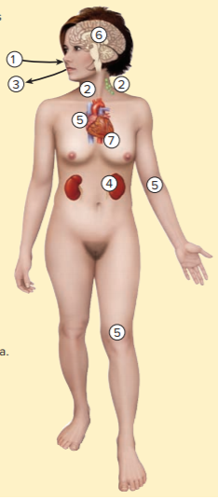
Table 21.3 Strep Throat (Streptococcal Pharyngitis) and Post-Streptococcal Sequelae
Streptococcus pyogenes enters by inhalation (nose), or by ingestion (mouth).
Pharyngitis, fever, enlarged lymph nodes; scarlet fever with strains that produce erythrogenic toxin. Symptoms go away.
S. pyogenes exits by nose and mouth. Late complications appear:
Glomerulonephritis
Rheumatic fever affects heart and joints.
Rheumatic fever may cause neurological abnormalities resulting in chorea. Complications subside.
Heart valves damaged by rheumatic fever leak; heart failure develops.
Signs and symptoms | Sore, red throat, with pus and tiny hemorrhages, enlargement and tenderness of lymph nodes in the neck; occasionally, rheumatic fever and glomerulonephritis as sequelae
Incubation period | 2 to 5 days
Causative agent | Streptococcus pyogenes, Lancefield group A β-hemolytic streptococci
Pathogenesis | Virulence associated with hyaluronic acid capsule and M protein, both of which inhibit phagocytosis; protein G binds Fc segment of IgG; protein F allows bacteria to attach to mucous membranes; multiple enzymes damage tissues.
Epidemiology | Direct contact and droplet infection; ingestion of contaminated food.
Treatment and prevention | Treatment: appropriate antibiotic. Prevention: avoiding crowds; adequate ventilation; daily penicillin to prevent recurrent infection in those with a history of rheumatic heart disease.

Slide 23
Bacterial Infections of Upper Respiratory System (8)
Diphtheria is deadly toxin-mediated disease
Rare in U.S. because of immunization, found elsewhere
Epidemic (1990 to 1995) began in Russian Federation, spread to all newly independent states of former USSR
125,000 cases with 4,000 deaths reported
Signs and symptoms
Mild sore throat, slight fever, extreme fatigue, malaise
Swelling of neck, formation of pseudomembrane on tonsils and throat or in nasal cavity
Heart and kidney failure and paralysis may occur later

Slide 24
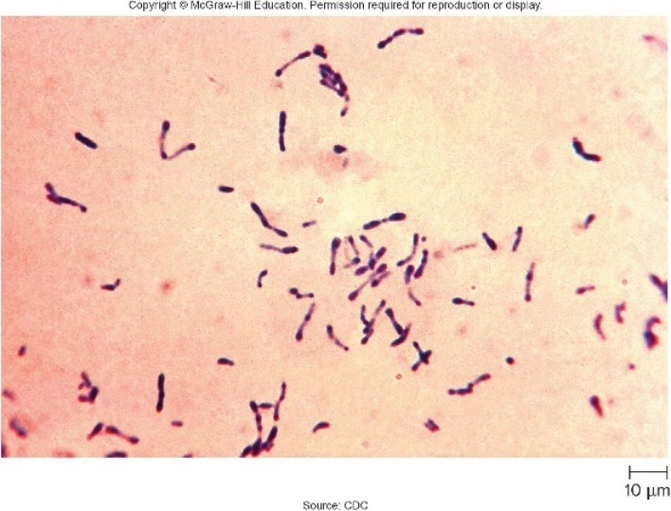
Bacterial Infections of Upper Respiratory System – Figure 21.8
Diphtheria
Causative agent: Corynebacterium diphtheriae
Pleomorphic, non-motile, non-spore forming Gram-positive rod that often stains irregularly due to metachromatic granules
Club-shaped, often occur side by side in “palisades”
Release diphtheria toxin (powerful exotoxin)
Gene is carried by specific lysogenic bacteriophage
Isolated on selective medium containing potassium-tellurite (inhibits normal microbiota; C. diphtheriae forms dark colonies)
Also grown on Loeffler’s
Source: CDC

Slide 25
Bacterial Infections of Upper Respiratory System (9)
Diphtheria
Pathogenesis
Little invasive ability; disease results from potent diphtheria exotoxin absorbed into bloodstream
Pseudomembrane made of cells killed by the exotoxin along with blood clots, fibrin, and leukocytes
May come loose and obstruct airways
A-B exotoxin: B subunit attaches to cell receptors; entire molecule taken up by endocytosis
Cells lacking receptor are unaffected
A subunit catalyzes reaction, inactivates elongation factor 2 (EF-2) required for movement of ribosome on mRNA
Protein synthesis stops, cell dies

Slide 26
Bacterial Infections of Upper Respiratory System – Figure 21.9
Diphtheria
Pathogenesis
Toxin subunits separate and A enters the cytoplasm.
The A subunit becomes a functional enzyme that inactivates a protein in the 80S ribosomes, stopping protein synthesis and causing cell death.
A-B toxin attaches by B subunit to membrane receptor of susceptible cell.
Toxin enters cell by endocytosis.
Notes:
26

Slide 27
Bacterial Infections of Upper Respiratory System (10)
Diphtheria
Epidemiology: humans are primary reservoir
Spread by air; acquired via inhalation or from fomites
Cutaneous diphtheria; chronic ulcers may be source
Treatment and prevention
Injection of antiserum to toxin; delaying treatment to wait for culture results can be fatal
Antibiotics can clear C. diphtheriae, but toxins already absorbed are unaffected
Even with treatment, approximately 10% mortality
Immunization with toxoid very effective; inactivated toxoid included with childhood DTaP vaccination (diphtheria and tetanus toxoids with components of Bordetella pertussis)

Slide 28
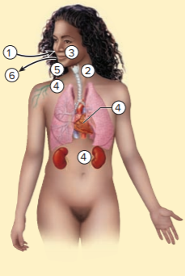
Table 21.4 Diptheria
Corynebacterium diphtheriae enters by inhalation.
Infection established in throat.
Toxin released locally, pseudomembrane forms.
Circulating toxin may cause paralysis, or damage heart muscle, kidneys, nerves.
Membrane may come loose and obstruct breathing.
Exit from body by respiratory secretions
Signs and symptoms | Sore throat, fever, fatigue, and malaise; pseudomembrane forms on tonsils and throat or in nose; paralysis, heart and kidney failure
Incubation period | 2 to 6 days
Causative agent | Corynebacterium diphtheriae, an A-B toxin–producing, non-spore-forming Gram-positive rod
Pathogenesis | Infection in upper respiratory tract; exotoxin is released and absorbed by bloodstream; toxin kills cells by interfering with protein synthesis; affects cells that have receptors for the toxin—mainly heart, kidney, and nerve tissue.
Epidemiology | Inhalation of infectious droplets; indirect contact with fomites.
Treatment and prevention | Treatment: antitoxin; appropriate antibiotic to prevent transmission. Prevention: immunization of infants and children with toxoid; boosters for adults.

Slide 29
Viral Infections of the Upper Respiratory System (1)
Viral infections of upper respiratory system are common
Average person in U.S. gets two to five per year
Hundreds of kinds of viruses involved; symptoms similar
Infections usually subside without treatment or permanent damage, but can impair defenses
Allow for more serious secondary bacterial infections

Slide 30
Viral Infections of the Upper Respiratory System (2)
The common cold
Most frequent infectious disease in humans
Accounts for over half of upper respiratory tract infections
Leading cause of absence from school, work
Signs and symptoms
Malaise, sore throat, runny nose, cough, hoarseness
Nasal secretions initially watery, may thicken, get cloudy
No fever unless secondary bacterial infection occurs
Symptoms mostly gone within a week; mild cough may persist
Notes:
30

Slide 31
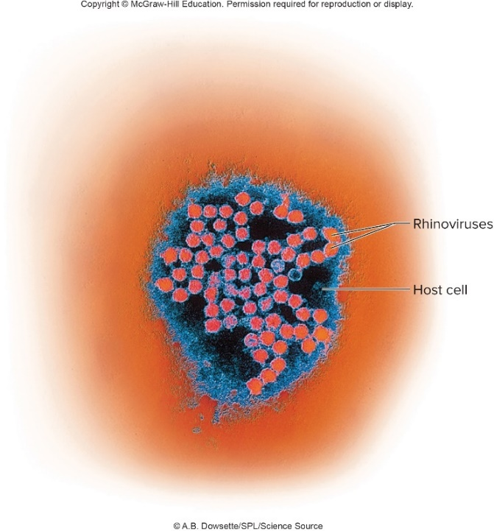
Viral Infections of the Upper Respiratory System –Figure 21.10
The common cold
Causative agents: “cold viruses”
100 or more types of human rhinoviruses cause approximately 30 to 50%
Members of Picornavirus family (small RNA viruses)
Non-enveloped, single-stranded RNA genome
Grown in cell culture at 33 degrees Celsius and slightly acid pH
Inactivated in acid of stomach
Many other viruses, some bacteria produce cold signs and symptoms
©A.B. Dowsette/SPL/Science Source

Slide 32
Viral Infections of the Upper Respiratory System (3)
The common cold
Pathogenesis of rhinoviruses
Infect epithelial cells lining upper respiratory tract
Ciliary motion of infected cells stops; cells may die
Damage leads to release of pro-inflammatory cytokines and stimulation of nervous reflexes
Increased nasal secretions, tissue swelling, sneezing
Infection can spread to ears, sinuses, lower respiratory tract
Eventually stopped by immune responses

Slide 33
Viral Infections of the Upper Respiratory System (4)
The common cold
Epidemiology
Humans only source; spread by close contact
Airborne droplets inhaled; touching eyes, nose
Transmission more likely during first 2 to 3 days of infection when virus concentrations in nasal secretions high
Levels nearly undetectable by days 4 to 5 although low levels can remain for 2 weeks
Only need a few virions to infect
Reasonable preventive measures effective, such as handwashing

Slide 34
Table 21.5 The Common Cold
The common cold
Treatment and Prevention
No proven treatments
Viruses not affected by antibiotics, antibacterial medications
Analgesics, antipyretics can reduce symptoms, but may prolong symptoms and duration
Prevention of spread effective: handwashing, avoiding touching face, avoiding crowded places and infected individuals in first few days of symptoms
No vaccine due to large number of causative viruses
Signs and symptoms | Malaise, runny nose, sneezing, cough, sore throat, hoarseness
Incubation period | 1 to 2 days
Causative agent | Mainly rhinoviruses—more than 100 types; many other viruses; some bacteria
Pathogenesis | Viruses attach to respiratory epithelium; ciliary action stops, and cells slough; secretion of mucus increases, and inflammatory reaction occurs.
Epidemiology | Inhalation of infectious droplets; transfer of infectious mucus to nose or eye by contaminated fingers.
Treatment and prevention | Treatment: no treatment except for control of symptoms. Prevention: handwashing, avoiding people with colds, and keeping hands away from face.

Slide 35
Viral Infections of the Upper Respiratory System (5)
Adenovirus respiratory tract infections
Adenoviruses widespread, cause variety of upper respiratory tract infections characterized by fever
Signs and symptoms: runny nose, fever is typical (unlike common cold), sore throat, pus on pharynx and tonsils
Symptoms may be confused with those of strep throat
Lymph nodes of neck become large, tender; mild cough
Conjunctivitis and diarrhea may occur
Patients may develop severe cough and chest pain
May be confused with pneumonia
Recovery in 1 to 3 weeks

Slide 36
Viral Infections of the Upper Respiratory System (6)
Adenovirus respiratory tract infections
Causative agent: more than 50 antigenic types of adenoviruses infect humans
Non-enveloped, double-stranded DNA
Can remain infectious in environment for a long time
Resistant to destruction by detergents, alcohol solutions
Heat, chlorine, other disinfectants effective
Pathogenesis: attach to, infect epithelial cells
Avoids host defenses by delaying apoptosis, blocking interferon function, interfering with antigen presentation by MHC class I molecules
Following replication, “death protein” causes host cell lysis
Severe infections can result in extensive cell destruction

Slide 37
Viral Infections of the Upper Respiratory System (7)
Adenovirus respiratory tract infections
Epidemiology: humans are only reservoir
Virus can persist in environment; healthcare personnel must take precautions to prevent transmission
Commonly infect schoolchildren
Can be spread in inadequately chlorinated swimming pools
Spread by respiratory droplets; crowded conditions can lead to spread
Asymptomatic infections common; fosters spread
Viruses shed from respiratory tract, can be eliminated in feces for months

Slide 38
Table 21.6 Adenovirus Respiratory Tract Infections
Adenovirus respiratory tract infections
Treatment and prevention: no specific treatment
Most patients recover on own; secondary bacterial infections may occur
Attenuated oral vaccine given only to military
Signs and Symptoms | Fever, sore throat, cough, swollen lymph nodes of neck, pus on tonsils and throat
Incubation period | 5 to 10 days’
Causative agent | Adenoviruses—more than 50 serotypes— non-enveloped, double-stranded DNA genome
Pathogenesis | Virus multiplies in host cells; cell destruction and inflammation occur; different serotypes produce different symptoms.
Epidemiology | Inhalation of infectious droplets; possible spread from gastrointestinal tract.
Treatment and prevention | Treatment: no treatment except for control of symptoms. Prevention: handwashing, avoiding crowds.

Slide 39
Focus on Pneumonia (1)
Pneumonia is disease of lower respiratory tract
Alveoli fill with fluids like pus and blood
Inflammatory response to microbial infection
Leading cause of death due to infectious disease in the U.S.

Slide 40
Focus on Pneumonia (2)
Signs and symptoms
Cough, chills, shortness of breath, fever, chest pain, sometimes cyanosis due to poor oxygenation
Cough is often productive, sputum containing pus and blood comes up from lungs
May be examined microscopically to identify cause
Cracking or bubbling sound with stethoscope
White shadows on chest X ray

Slide 41
Focus on Pneumonia (3)
Pathogenesis
Often caused by opportunists when mucociliary escalator is compromised
Causative agent often has capsule that delays phagocytosis by lung macrophages
Damaging effects are largely due to inflammatory response
Fluids collect in alveoli, along with leukocytes and mucus
May cause consolidation, clogged alveoli
May affect nerve endings in pleura, causing pain

Slide 42
Focus on Pneumonia (4)
Epidemiology
Categorized as community-acquired pneumonia (CAP) or healthcare-associated pneumonia (HAP)
Some CAPs are contagious, but most come from patient’s own upper respiratory microbiota when throat secretions are inhaled
HAPs often arise from normal microbiota
Ventilators increase risk

Slide 43
Focus on Pneumonia (5)
Treatment and prevention
Antimicrobial medications useful for bacterial and fungal pneumonias; no effective treatment for viral
Many healthcare-associated pneumonias are caused by multi-drug-resistant bacteria
Prevention involves avoiding crowds and other respiratory illnesses
Vaccines available for pneumococcal disease

Slide 44
Bacterial Infections of Lower Respiratory System (1)
Pneumococcal pneumonia
Account for approximately 60% of adult community-acquired pneumonia patients requiring hospitalization
Signs and symptoms: cough, fever, chest pain, sputum production (incubation period 1 to 3 days)
Usually preceded by 1 to 2 days of runny nose, congestion that ends with sudden fever and shaking chills
Sputum becomes pinkish or rust-colored from blood
Severe chest pain aggravated by each breath or cough
Causes shallow rapid breathing
Patient develops cyanosis from poor oxygenation
Without treatment, survivors sweat heavily and return to normal temperature after 7 to 10 days

Slide 45
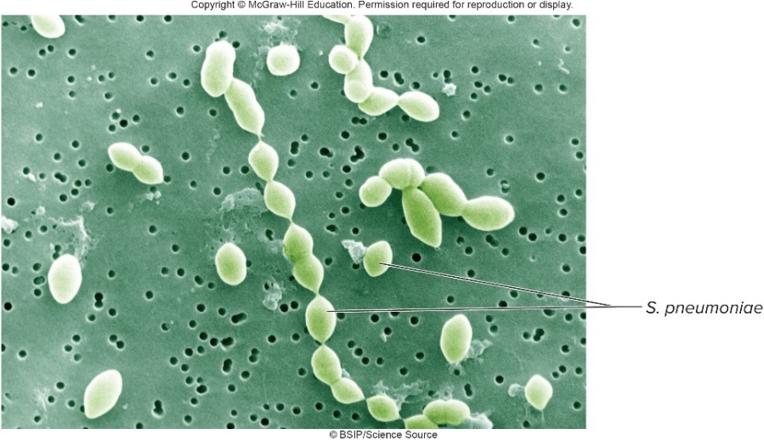
Bacterial Infections of Lower Respiratory System – Figure 21.11
Pneumococcal pneumonia
Causative agent: Streptococcus pneumoniae
Gram-positive diplococcus known as pneumococcus; lancet-shaped
Thick polysaccharide capsule responsible for virulence
90 different serotypes each with different capsular antigens
Certain serotypes more commonly invasive
Strains lacking capsule do not cause invasive disease
©BSIP/Science Source

Slide 46
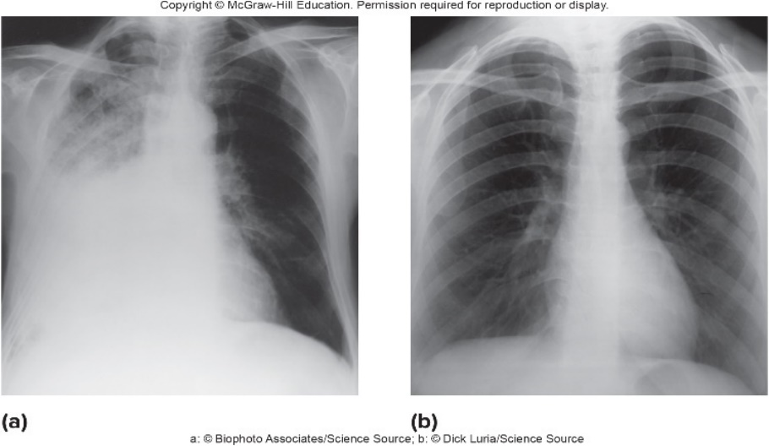
Bacterial Infections of Lower Respiratory System – Figure 21.12
Pneumococcal pneumonia
Pathogenesis:
Capsule, pneumococcal surface protein (PspA) interfere with C3b of complement system, block phagocytosis
Pneumolysin damages ciliated epithelium
Accumulations in alveoli cause difficulty breathing; sputum coughed from lungs
Pneumococci may enter blood-stream, lead to sepsis of blood, endocarditis (heart valve infection), meningitis (infection of brain, spinal cord membranes)
In several days, antibodies allow phagocytosis and destruction of pneumococci, recovery
a: ©Biophoto Associates/Science Source; b: ©Dick Luria/Science Source

Slide 47
Bacterial Infections of Lower Respiratory System (2)
Pneumococcal pneumonia
Epidemiology: up to 30% of healthy people carry encapsulated pneumococci in throat; mucociliary escalator effectively keeps from reaching lungs
Risk of infection increases when this defense is impaired
Increased risk in those over 50, or with heart or lung disease, diabetes or cancer
Treatment and prevention: penicillin cures if given early; resistant strains increasingly common
Conjugate vaccine (PCV13) against 13 strains available for children under 2, adults over 65 and those with certain health conditions
Vaccine (PPSV23) available for 23 most common pneumococcal strains

Slide 48
Bacterial Infections of Lower Respiratory System (3)
Klebsiella pneumonia
Enterobacteria such as Klebsiella species and other Gram-negative rods can cause pneumonia
Especially if host defenses are impaired
Cause most of the deaths from healthcare-associated infections
Signs and symptoms: cough, chills, shortness of breath, fever, chest pain, cyanosis (incubation period 1 to 3 days)
Most symptoms similar to pneumococcal pneumonia
Distinguished by repeated chills, production of bloody jelly-like sputum
Notes:
48

Slide 49
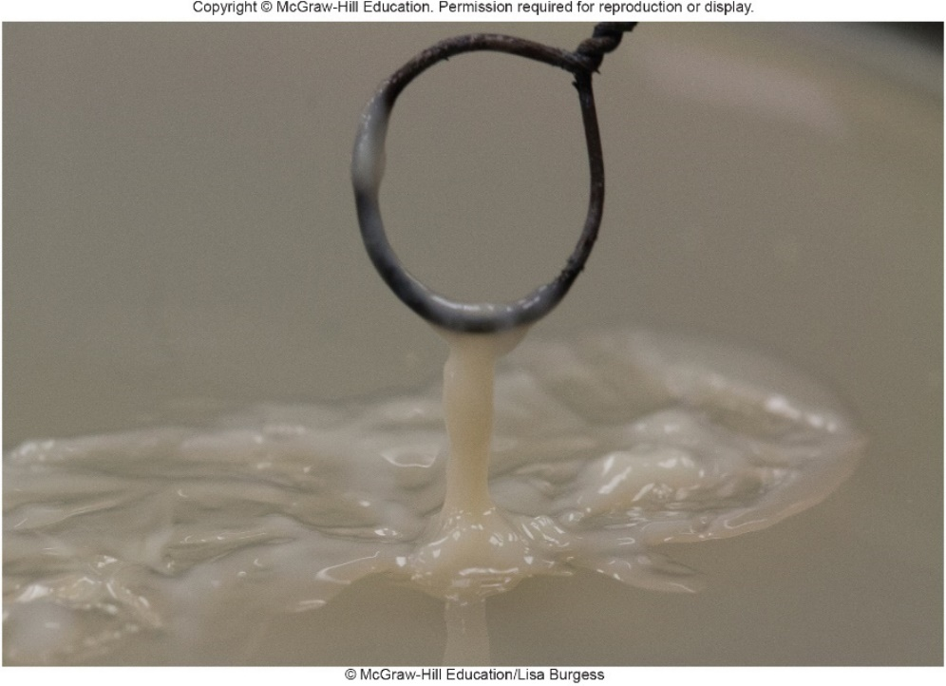
Bacterial Infections of Lower Respiratory System –Figure 21.13
Klebsiella pneumonia
Causative agent: Klebsiella pneumoniae
Gram-negative rod with large capsule; produces big mucoid colonies when cultured on agar
Normal microbiota of gastrointestinal tract; may be found in mouth and throat
©McGraw-Hill Education/Lisa Burgess

Slide 50
Bacterial Infections of Lower Respiratory System (4)
Klebsiella pneumonia
Pathogenesis
Contracted through secretions that are transmitted by contact, or from medical equipment (for example, ventilators)
Klebsiella colonize throat; reach lung via inhaled air, mucus
Adhesins aid colonization
Capsule is virulence factor: likely interferes with C3b
Siderophore “steals” iron, causing cellular stress that induces inflammation and spread of bacteria
Tissue death, lung abscesses may cause permanent damage to lung, perhaps leading to death
Often enters blood, causes abscesses, septic shock

Slide 51
Bacterial Infections of Lower Respiratory System (5)
Klebsiella pneumonia
Epidemiology: Klebsiella species widespread in nature
Commonly part of normal microbiota
Typically affects very old or very young, or those with compromised immune system (for example, alcoholics, patients in hospital or other institution)
Strains circulating in hospitals, nursing homes often resistant to antimicrobials; increasingly multi-drug-resistant

Slide 52
Bacterial Infections of Lower Respiratory System (6)
Klebsiella pneumonia
Treatment and prevention:
Treated with antibiotics, but more strains are developing increasing antibiotic resistance
Commonly produces plasmid-encoded β-lactamase; often produces extended-spectrum β-lactamase (ESBL) as well
Some (CRKP strains) produce carbapenemases; few treatment choices remain
Fatality rate for CRKP pneumonia can reach 50%
Surgery may be required to drain abscesses
No vaccine; follow infection control measures
Gloves, gowns, disinfection, handwashing, etc.
Wise use of antimicrobials to avoid resistance
Notes:
52

Slide 53
Bacterial Infections of Lower Respiratory System (7)
Mycoplasmal pneumonia
Leading pneumonia of children, young adults (college students, military recruits)
Generally mild; often called “walking pneumonia” or atypical pneumonia
Signs and symptoms
Onset is gradual (incubation period 2 to 3 weeks)
Initial symptoms are sore throat, chills, fever, headache, muscle pain, fatigue
Dry cough after several days; mucoid sputum may be produced later
Some develop otitis media

Slide 54
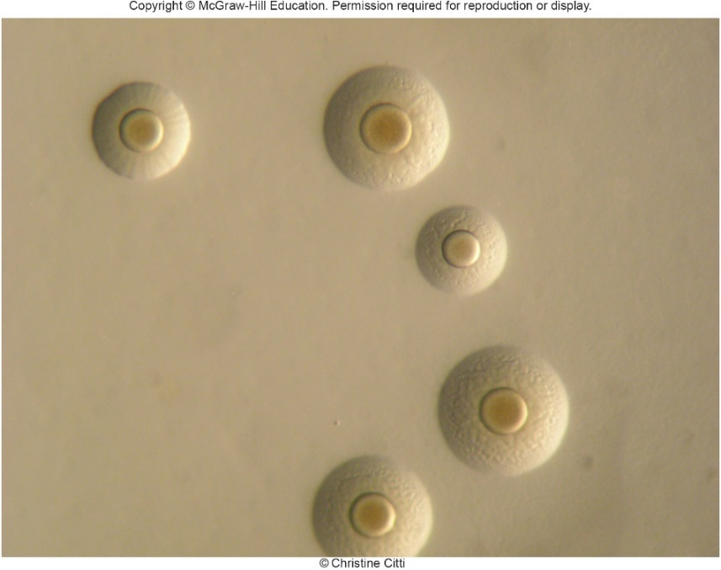
Bacterial Infections of Lower Respiratory System –Figure 21.14
Mycoplasmal pneumonia
Causative agent: Mycoplasma pneumoniae
Small bacterium lacking cell wall
Slow, aerobic growth
Colonies on agar look like fried eggs
©Christine Citti
Notes:
54

Slide 55
Bacterial Infections of Lower Respiratory System (8)
Mycoplasmal pneumonia
Pathogenesis
Only a few inhaled cells can start infection
Bacteria attach to receptors on respiratory epithelium
Interfere with ciliary action, cause cells to slough off
Increases chance of secondary infection
Inflammatory response with accumulation of lymphocytes and macrophages thickens walls of bronchial tubes and alveoli

Slide 56
Bacterial Infections of Lower Respiratory System (9)
Mycoplasmal pneumonia
Epidemiology: spread by aerosolized droplets shed from about 1 week before symptoms begin to many weeks afterward
Accounts for approximately one fifth of bacterial pneumonias
Immunity following recovery not permanent; repeat infections have occurred within 5 years
Treatment and prevention: M. pneumoniae lacks cell wall, so antibiotics that target cell wall are ineffective
Macrolides shorten illness if given early
No preventative measures except avoiding crowding in schools, military facilities

Slide 57
Table 21.7 Pneumococcal, Klebsiella, and Mycoplasmal Pneumonias Compared
 | Pneumococcal Pneumonia | Klebsiella Pneumonia | Mycoplasmal Pneumonia
Signs and symptoms | Cough, sudden chills and fever, shortness of breath, chest pain, cyanosis, rust-colored sputum from blood | Cough, repeated chills, fever, shortness of breath, chest pain, cyanosis, bloody jelly-like sputum | Gradual onset of dry cough, fever, fatigue, headache, and muscle aches
Incubation period | 1 to 3 days | 1 to 3 days | 2 to 3 weeks
Causative agent | Streptococcus pneumoniae (pneumococcus); encapsulated strains | Klebsiella pneumoniae, encapsulated enterobacterium | Mycoplasma pneumoniae; lacks cell wall
Pathogenesis | Inhalation of encapsulated pneumococci; colonization of alveoli triggers an inflammatory response; fluid and inflammatory cells fill the alveoli. | Inhalation of colonized mucus droplets from the throat. Destruction of lung tissue and abscess formation common; infection spreads via blood to other body tissues. | Inhalation of infected droplets. Bacterial cells attach to receptors on respiratory epithelium; inhibition of ciliary motion and destruction of cells.
Epidemiology | High carrier rates for S. pneumoniae. Risk of pneumonia increases with conditions such as alcoholism, narcotic use, and viral infections that impair the mucociliary escalator. Other risk factors are chronic heart or lung disease, diabetes, and cancer. | Klebsiella species and other Gramnegative rods are common causes of fatal healthcare-associated pneumonias. Often resistant to antibiotics. | Mild infections are common; infected people spread the disease.
Treatment and prevention | Treatment: antibiotics. Prevention: PCV13: conjugate vaccine against 13 serotypes; PPSV23: polysaccharide vaccine against 23 serotypes. | Treatment: a combination of antibiotics; resistance is a problem. Prevention: no vaccine available. | Treatment: antibiotics, excluding cell wall synthesis inhibitors. Prevention: no vaccine available; avoid crowding in schools and military facilities.

Slide 58
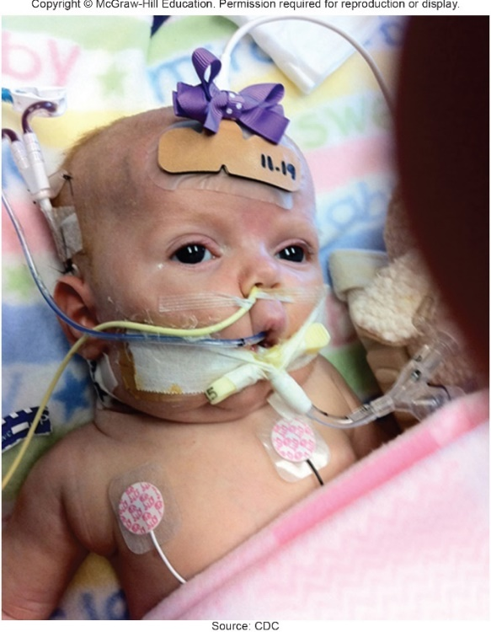
Bacterial Infections of Lower Respiratory System – Figure 21.16
Pertussis (“whooping cough”)
Vaccination-preventable disease, but still endemic in many countries including U.S.
Causes up to half a million deaths annually globally
Source: CDC

Slide 59
Bacterial Infections of Lower Respiratory System (10)
Pertussis
Signs and symptoms: three stages
Catarrhal stage (inflammation of mucous membranes)
1 to 2 weeks of signs resembling upper respiratory infection (runny nose, sneezing, low fever, mild cough)
Paroxysmal stage (repeated sudden attacks)
Frequent bursts of violent uncontrollable coughing lasting 2 to 4 weeks or longer
Dry but severe; small blood vessels in eyes rupture, tongue protrudes, neck veins stand out
Forceful inhalation of air: “whoop” sound
Vomiting, seizures, cyanosis may occur
Convalescent stage (recovery)
Not contagious; coughing decreases over several weeks
Notes:
59

Slide 60
Bacterial Infections of Lower Respiratory System (11)
Pertussis
Causative agent: Bordetella pertussis
Tiny encapsulated aerobic Gram-negative rod
Sensitive to sunlight, drying: quickly die outside of host
Pathogenesis: cells are inhaled, attach to ciliated cells of epithelium
Increased mucus production, decreased ciliary action results in severe cough
Some bronchioles completely obstructed, lead to small areas of collapsed lung
Spasms, partial mucus plugging let air enter but not escape
Chief cause of death is pneumonia due to B. pertussis or (more commonly) secondary bacterial infections
Three toxins released

Slide 61
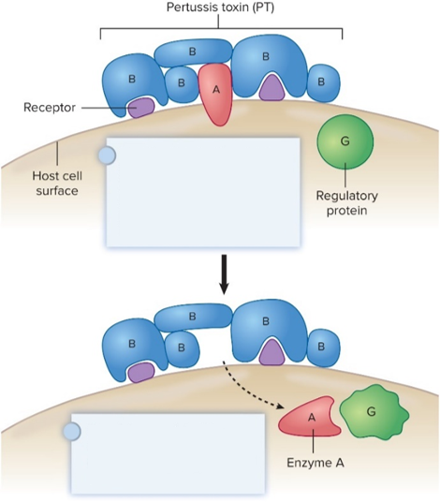
Bacterial Infections of Lower Respiratory System – Figure 21.15
Pertussis
Pathogenesis
Pertussis toxin (PT) is A-B exotoxin: B attaches to receptors, A moves through cytoplasmic membrane
Increases cAMP: yields increased mucus, decreased killing ability of phagocytes, release of lymphocytes into bloodstream, ineffectiveness of natural killer cells, low blood sugar
Adenylate cyclase (ACT) lyses leuko cytes; catalyzes ATP to cAMP
Tracheal cytotoxin (TCT) causes release of fever-inducing interleukin-1; toxic to ciliated epithelial cells
The B subunits of pertussis toxin bind to receptors on the host cell surface. The A subunit is transferred into the host cell, becoming a functional enzyme on entry.
Regulatory protein G is inactivated by enzyme A, causing an increase in cAMP production.

Slide 62
Bacterial Infections of Lower Respiratory System (12)
Pertussis
Epidemiology: highly contagious
Spread via respiratory secretions suspended in air
Patients most infectious during catarrhal stage
Classically disease of infants; most fatalities in those under 1 year of age
Milder in older children, adults; may be mistaken for another disease such as a common cold, which fosters transmission
Incidence increasing
Better surveillance, suboptimal vaccination, decreasing immunity in vaccinated, development of resistance

Slide 63
Bacterial Infections of Lower Respiratory System (13)
Pertussis
Treatment and prevention
Macrolides during catarrhal stage; ineffective in paroxysmal stage
Intensive supportive therapy sometimes needed in infants
Prevented with acellular pertussis vaccine (aP) given in combination with diphtheria and tetanus toxoids (DTaP)
Additional booster for adolescents (Tdap)
Also given to pregnant women to provide passive immunity to newborn

Slide 64
Table 21.8 Pertussis (“Whopping Cough”)
Signs and symptoms | Characterized by three stages: catarrhal stage includes a runny nose, cough, and fever; paroxysmal stage consists of spasms of violent coughing, sometimes leading to vomiting and convulsions; convalescent stage is indicated by less frequent coughing as the person recovers.
Incubation period | 1 to 2 weeks
Causative agent | Bordetella pertussis, a tiny Gram-negative rod
Pathogenesis | Colonization of the surfaces of the upper respiratory tract; ciliary action slowed; toxins released by B. pertussis cause death of epithelial cells and increased cAMP; fever, excessive mucus output, and a rise in the number of lymphocytes result.
Epidemiology | Inhalation of infected droplets; older children and adults have mild symptoms.
Treatment and prevention | Treatment: certain antibiotics given before coughing spasms start. Prevention: acellular vaccine (DTaP) for immunization of infants and children; Tdap booster for adolescents and pregnant women.
Notes:
64

Slide 65
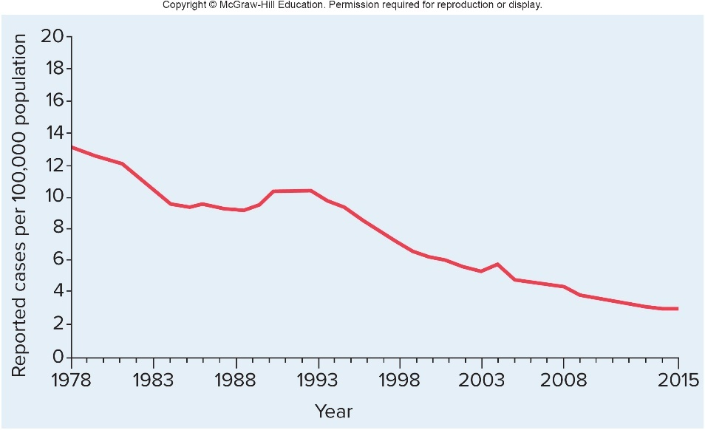
Bacterial Infections of Lower Respiratory System – Figure 21.17
Tuberculosis (TB)
Once very common; incidence declined in industrialized nations as living standards improved
In 1985, incidence began to rise due to expanding AIDS epidemic, increasing prevalence of drug-resistant strains
CDC developed plan to increase efforts to identify and treat cases in high-risk groups
Incidence began to decrease by 1993

Slide 66
Bacterial Infections of Lower Respiratory System (14)
Tuberculosis (TB)
Signs and symptoms
Initial infection by Mycobacterium tuberculosis usually results in asymptomatic lung infection
Immune response controls, but unable to eliminate
Yields latent tuberculosis infection (LTBI); later may develop active tuberculosis disease (TB disease), or active tuberculosis
Slight fever, weight loss, night sweating, persistent cough, often blood-streaked sputum
Primarily infects lungs, but bacterial cells can travel through bloodstream to other tissues including kidneys, bones, joints, central nervous system
Miliary TB

Slide 67
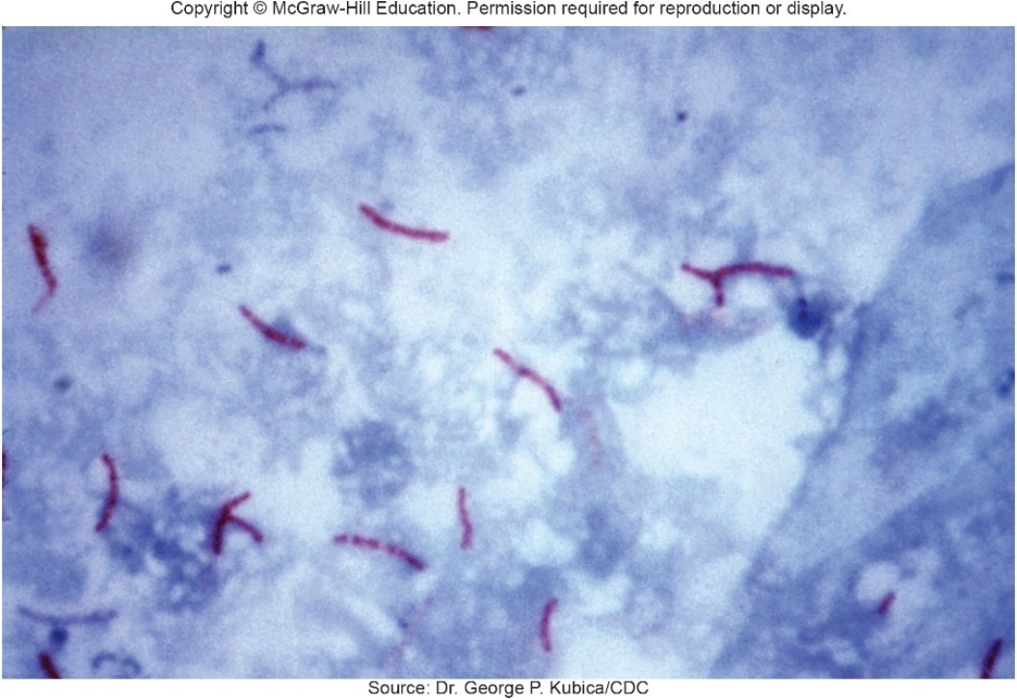
Bacterial Infections of Lower Respiratory System (15)
Tuberculosis (TB)
Causative agent: Mycobacterium tuberculosis
Slender, acid-fast, rod-shaped bacterium
Strict aerobe with generation time over 16 hours
Unusual cell wall contains mycolic acids: cells resist drying, disinfectants, strong acids and alkali; responsible for acid-fast staining
Easily killed by pasteurization
Source: Dr. George P. Kubica/CDC

Slide 68
Bacterial Infections of Lower Respiratory System (16)
Tuberculosis (TB)
Pathogenesis: airborne cells inhaled into lungs
Alveolar macrophages quickly engulf; unable to destroy
Mycolic acids prevent fusion of phagosome with lysosomes
Bacteria exit, multiply within macrophage cytoplasm
Pro-inflammatory response recruits more macrophages
Some fuse to form giant multinucleated cells
Others induced by bacteria to accumulate oil droplets, become foamy macrophages
Lymphocytes wall off infected area, granuloma forms
Called tubercles

Slide 69
Bacterial Infections of Lower Respiratory System (17)
Tuberculosis (TB)
Pathogenesis
In granuloma, effector helper T cells release cytokines
Activate macrophages to destroy infecting bacteria
Fibrous layer forms around macrophages, keeps lymphocytes outside of tubercle
Seen on X-rays as Ghon foci
Called Ghon complex if adjacent lymph nodes involved
Some bacteria survive; prevented from multiplying
Remain as latent TB infection (LTBI)
In many cases infection resolves
Active TB results if inflammatory response cannot contain or destroy mycobacteria

Slide 70
Bacterial Infections of Lower Respiratory System (18)
Tuberculosis (TB)
Pathogenesis
Macrophages in tubercle die; bacteria, enzymes, cytokines released, forming area of necrosis
Caseous necrosis; foamy macrophages (with lipids) thought to play important role
Tubercle ruptures, releases bacteria, dead material
Causes large lung defect called tuberculous cavity
Spreads bacteria in lungs
Lung cavity persists, enlarges for months or years, spreads bacteria; can be transmitted by coughing

Slide 71
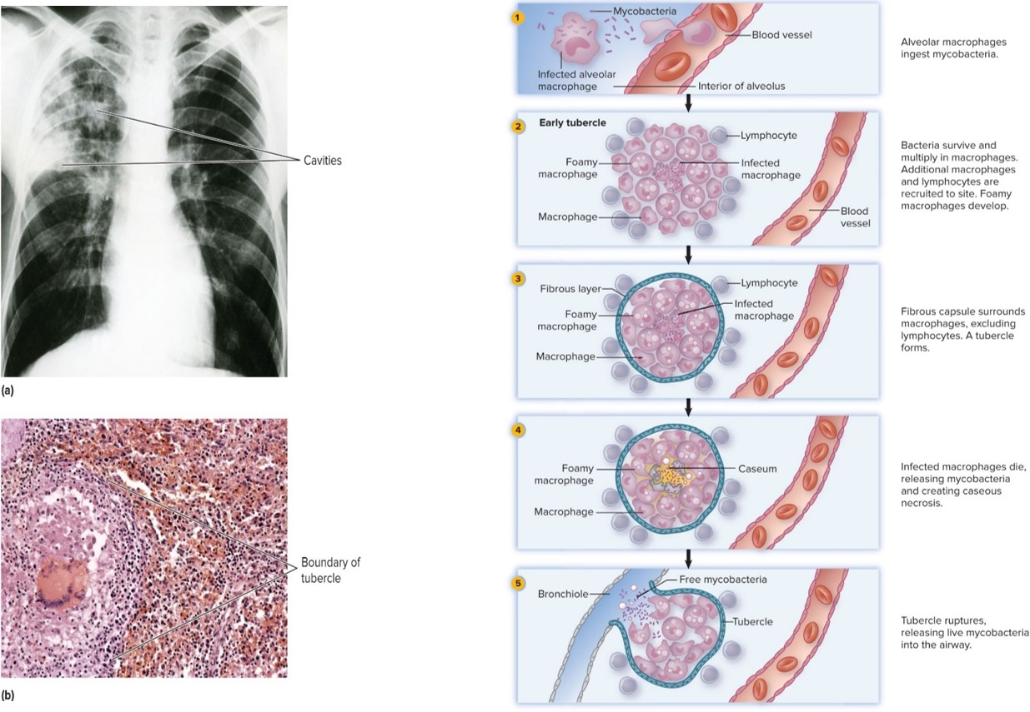
Bacterial Infections of Lower Respiratory System – Figures 21.19 and 21.20
Jump to Bacterial Infections of Lower Respiratory System – Figures 21.19 and 21.20 Long Description
Left: a: ©Walter Dawn/Science Source; b: ©Steve Gschmeissner/Science Source

Slide 72
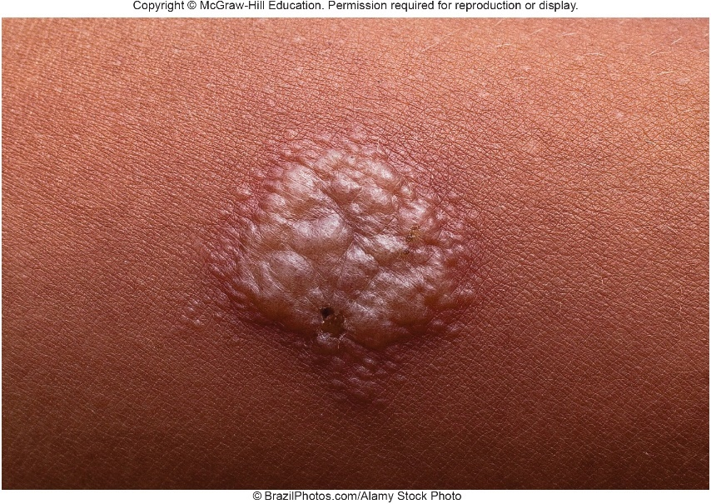
Bacterial Infections of Lower Respiratory System – Figure 21.21
Tuberculosis (TB)
Epidemiology: Approximately 13 million Americans have LTBI
Only approximately 5 to 10% will reactivate, progress to active TB
Transmission almost entirely via respiratory route
10 or fewer inhaled mycobacterium can cause infection
Frequency of coughing, ventilation, crowding, immunodeficiency (especially AIDS) important
Identification of infection
Tuberculin skin test (TST; Mantoux test)
Blood tests (IGRAs)
Xpert MTB/RIF (detect Mycobacterium DNA)
©BrazilPhotos.com/Alamy Stock Photo

Slide 73
Bacterial Infections of Lower Respiratory System (19)
Tuberculosis (TB)
Treatment and prevention: multiple drugs over long time
Combination therpy needed; mycobacteria grow slowly, resist body defenses; mutants likely present given high numbers of cells involved in infection
Rifampin (RIF), isoniazid (INH), pyrazinamide (PZA), and ethambutol (EMB) given for 8 weeks; then INH, RIF for another 18 weeks
Resistant strains often evolve as symptoms disappear, and patient becomes careless in taking medications
DOTS (directly observed therapy short-course) used
Multi-drug-resistant TB (MDR-TB) resists RIF, INH (1990s)
Extensively drug-resistant TB (XDR-TB) resists both first and many second-line drugs; threaten global control
New medication (bedaquiline) for MDR-TB in 2012

Slide 74
Bacterial Infections of Lower Respiratory System (20)
Tuberculosis (TB)
Treatment and prevention
In U.S., skin or blood tests, lung X-rays used to identify cases; both TB disease and are LTBI treated
Prevention and control are global challenge
BCG vaccine used in many countries (live attenuated from M. bovis); prevents childhood TB, but ineffective against LTBI reactivation
BCG vaccine discouraged in U.S. as it causes positive tuberculin test
Interferes with disease prevention
Not safe in severely immunocompromised patients
New vaccines being developed

Slide 75
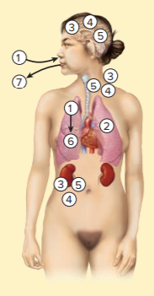
Table 21.9 Tuberculosis (“TB”)
Airborne Mycobacterium tuberculosis cells are inhaled and lodge in the lungs.
The bacteria are phagocytized by lung macrophages and multiply within them, protected by lipid-containing cell walls and other mechanisms.
Infected macrophages are carried to various parts of the body such as the kidneys, brain, lungs, and lymph nodes; release of M. tuberculosis occurs.
Delayed-type hypersensitivity develops; wherever M. tuberculosis has lodged, an intense inflammatory reaction develops.
The bacteria are surrounded by macrophages and lymphocytes; growth of the bacteria ceases.
Intense inflammatory reaction and release of enzymes can cause caseous necrosis and cavity formation.
With uncontrolled or reactivated infection, M. tuberculosis exits the body through the mouth with coughing.
Signs and symptoms | Chronic fever, weight loss, cough, sputum production
Incubation period | 2 to 10 weeks
Causative agent | Mycobacterium tuberculosis; unusual cell wall with high lipid content
Pathogenesis | Colonization of alveoli causes inflammatory response; ingestion by macrophages follows; organisms survive in macrophages and are carried to lymph nodes, lungs, and other body tissues; infecting bacteria multiply; granulomas form.
Epidemiology | Inhalation of airborne organisms; latent infections can reactivate.
Treatment and prevention | Treatment: lengthy process requiring four and then two anti-TB medications; DOTS. Prevention: tuberculin (Mantoux) skin test, interferon-gamma release assays (IGRAs), and rapid tests for detection of infection allows early treatment of active TB; treatment of latent infections.

Slide 76
Bacterial Infections of Lower Respiratory System (21)
Legionellosis (“legionnaires’ disease”)
Attendees of 1976 American Legion Convention in Philadelphia developed mysterious pneumonia
Fatal in many cases
Signs and symptoms: headache, muscle aches, high fever, confusion, shaking chills (incubation 2 to 10 days)
Dry cough develops, produces sputum, sometimes blood
Shortness of breath or pleurisy can occur
About 25% of cases have digestive tract symptoms (for example, diarrhea, abdominal pain, vomiting)
Recovery is slow; weakness, fatigue last for weeks

Slide 77
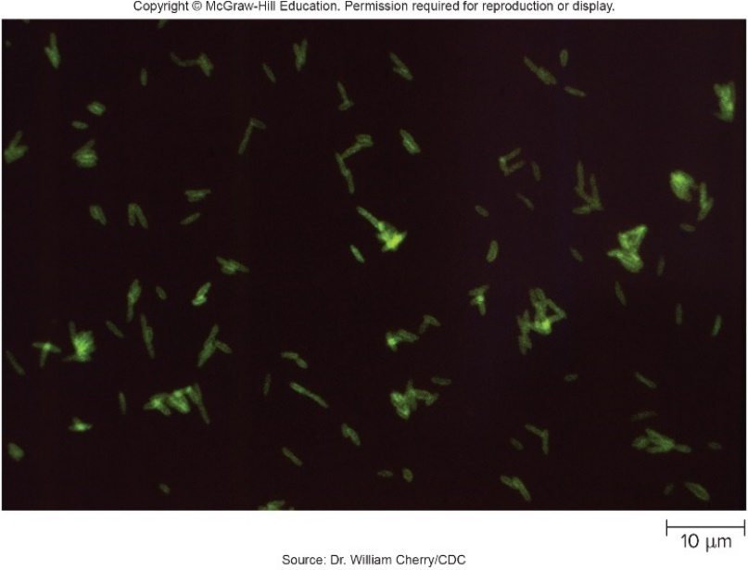
Bacterial Infections of Lower Respiratory System (22)
Legionellosis
Causative agent: Legionella pneumophila
Gram-negative rod; fastidious
Stains poorly in tissue; immunofluorescence
Facultative intracellular parasite; survives well in freshwater amebas, which can form cysts during adverse conditions, allowing bacteria within to survive
Persist in biofilms; if disturbed, huge numbers released
Source: Dr. William Cherry-CDC

Slide 78
Bacterial Infections of Lower Respiratory System (23)
Legionellosis
Pathogenesis
Acquired by inhaling aerosolized water with organism
Promote uptake by alveolar macrophages
Mip aids entry into macrophages
Bind C3b, an opsonin
Bacteria survive by preventing phagosome-lysosome fusion; multiply within macrophages
Necrosis of host cells and inflammatory response lead to abscesses, pneumonia, pleurisy, and often bacteremia
Fatal in about 15% of hospitalized cases
Notes:
78

Slide 79
Bacterial Infections of Lower Respiratory System (24)
Legionellosis
Epidemiology
Widespread in warm natural waters containing protozoa, which house the bacteria
Also found in water systems
L. pneumophila protected from chlorine inside protozoa
Cases have originated from aerosols from central air-conditioning systems, nebulizers, sprays to freshen produce, showers, and water faucets,
No direct person-to-person spread

Slide 80
Bacterial Infections of Lower Respiratory System (25)
Legionellosis
Treatment and prevention:
Appropriate antibiotic (for example, macrolides)
Produces a β-lactamase
Must reach high level within protozoal cell
Some require
Prevention directed at equipment design to minimize aerosols, disinfection procedures
Notes:
80

Slide 81
Table 21.10 Legionellosis (“Legionnaires’ Disease”)
Signs and symptoms | Muscle aches, headache, fever, cough, shortness of breath, chest and abdominal pain, diarrhea, vomiting
Incubation period | 2 to 10 days
Causative agent | Legionella pneumophila, a Gram-negative bacterium that stains poorly
Pathogenesis | Organism multiplies within phagocytes; released with death of the cell; necrosis of cells lining the alveoli; inflammation and formation of multiple small abscesses.
Epidemiology | Originates mainly from warm water contaminated with protozoa, such as found in air-conditioning systems.
Treatment and prevention | Treatment: antibiotics. Prevention: avoiding contaminated water aerosols; regular cleaning and disinfection of humidifying devices.

Slide 82
Bacterial Infections of Lower Respiratory System (26)
Inhalation anthrax
Primarily a disease of livestock; but Bacillus anthracis is also a Category A bioterrorism agent
Signs and symptoms
Begins with flu-like symptoms in 1 week to 2 months
Followed by fever, shortness of breath, chest pain, possibly cyanosis
Anthrax meningitis occurs in about half the cases
Notes:
82

Slide 83
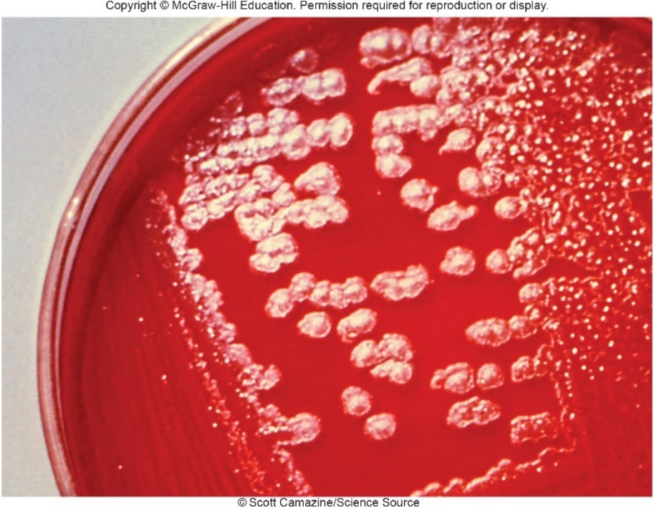
Bacterial Infections of Lower Respiratory System –Figure 21.23
Inhalation anthrax
Causative agent: Bacillus anthracis
Endospore-forming, Gram-positive, non-hemolytic, non-motile, rod-shaped bacterium
Vegetative cells have capsule composed of amino acid polymer
©Scott Camazine/Science Source
Notes:
83

Slide 84
Bacterial Infections of Lower Respiratory System (27)
Inhalation anthrax
Pathogenesis
Endospores inhaled, taken up by macrophages, and carried to lymph nodes in chest where they germinate
Anthrax toxin composed of three proteins; results in pulmonary edema and cell death
Protective antigen (PA)
Edema factor (LF)
Lethal factor (LF)
Toxin-producing, encapsulated cells enter bloodstream, overwhelm defenses, damage tissues
Untreated, case-fatality rate is near 95%; early treatment reduces fatalities to about 45%
Notes:
84

Slide 85
Bacterial Infections of Lower Respiratory System (28)
Inhalation anthrax
Epidemiology
Zoonosis can be transmitted to humans working with animals or animal products
Not transmitted from person to person
Treatment and prevention
Antimicrobials doxycycline or ciprofloxacin, along with monoclonal antibody that binds to protective antigen (PA), preventing it from attaching to host cells
Prophylactic antimicrobial treatment for those suspected of having been exposed; up to 60 days
Control by reducing infection in livestock
Acellular vaccine available for those at increased risk
Notes:
85

Slide 86
Table 21.11 Inhalation Anthrax
Signs and symptoms | Fever, nonproductive cough; progressing to shortness of breath, chest pain; meningitis in about 50% of cases
Incubation period | 3 to 60 days
Causative agent | Bacillus anthracis, an endospore-forming Grampositive rod
Pathogenesis | Endospores engulfed by macrophages in lung germinate and produce toxins that kill macrophages, cause pulmonary edema, and damage respiratory cells.
Epidemiology | Rare zoonotic disease that may be transmitted by animals or animal products; no human transmission; possible agent of bioterrorism.
Treatment and prevention | Treatment: antimicrobial medications; monoclonal antibody that binds to PA. Prevention: vaccinate livestock; acellular vaccine given to at-risk groups and military.
Notes:
86

Slide 87
Viral Infections of the Lower Respiratory System (1)
Influenza (“Flu”)
Antigenic changes responsible for serious annual epidemics; infects approximately 20% of humans annually
Three major virus types based on protein coat; type A causes most serious disease
Influenza viruses do not cause “stomach flu”
Signs and symptoms:
Headache, muscle aches, fever, sore throat, fatigue; peaks in 6 to 12 hours; dry cough develops and worsens over a few days (incubation period approximately 2 days)
Acute symptoms last approximately 1 week; lingering cough, fatigue, weakness last additional days or weeks

Slide 88
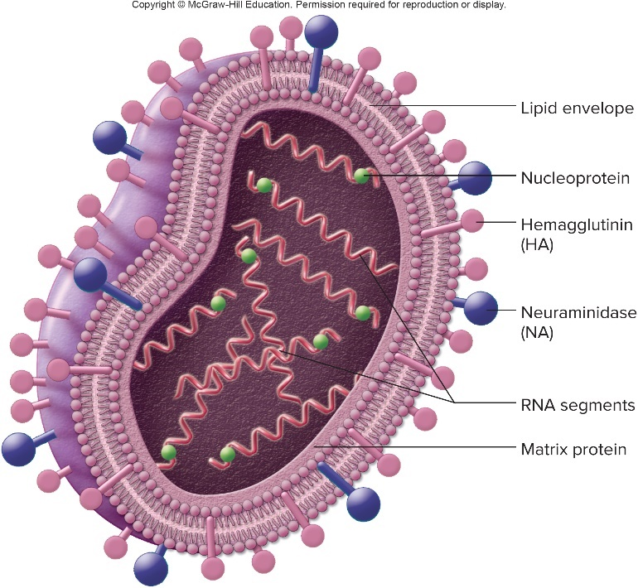
Viral Infections of the Lower Respiratory System – Figure 21.24
Influenza
Causative agent: Influenza A in Orthomyxoviridae
Enveloped virus with 8 segments of single-stranded RNA
Glycoprotein spikes embedded in envelope: hemagglutinin antigen (HA) and neuraminidase antigen (NA)
HA attaches to receptors on host epithelial cells
NA critical in release: destroys surface receptors that bind budding virions
Subtypes based on HA and NA
1997 “avian flu” was H5N1; 2009 “swine flu” was H1N1
18 HA, 11 NA subtypes; only H1, H2, H3 and N1, N2 infect humans

Slide 89
Viral Infections of the Lower Respiratory System (2)
Influenza
Pathogenesis: inhalation of aerosolized secretions or from contaminated fomites
Virions attach by HA spikes to respiratory epithelial cells; enter by endocytosis
Rapid synthesis of viral RNA and proteins
Host membrane embedded with HA and NA; mature virions acquire these as they bud from host cell
Infected cells die, slough off, destroy mucociliary escalator
Person susceptible to secondary respiratory infections
Immune system quickly controls influenza virus infections in most cases; complete recovery of respiratory epithelium may take 2 months or more

Slide 90
Viral Infections of the Lower Respiratory System (3)
Influenza
Epidemiology:
Only small percentage of cases are fatal, but there are many cases, so overall number of deaths is high
Most deaths due to secondary bacterial infections (for example, pneumonia)
Epidemics occur annually; pandemics periodically
Antigenic drift: minor mutations in HA and NA genes; responsible for seasonal influenza
Immunity developed from previous year less effective
Antigenic shift: uncommon; concurrent infection allows mixture of 8 RNA segments; causes pandemic influenza
Human strain can gain novel HA and/or NA antigens to which humans have no immunity

Slide 91
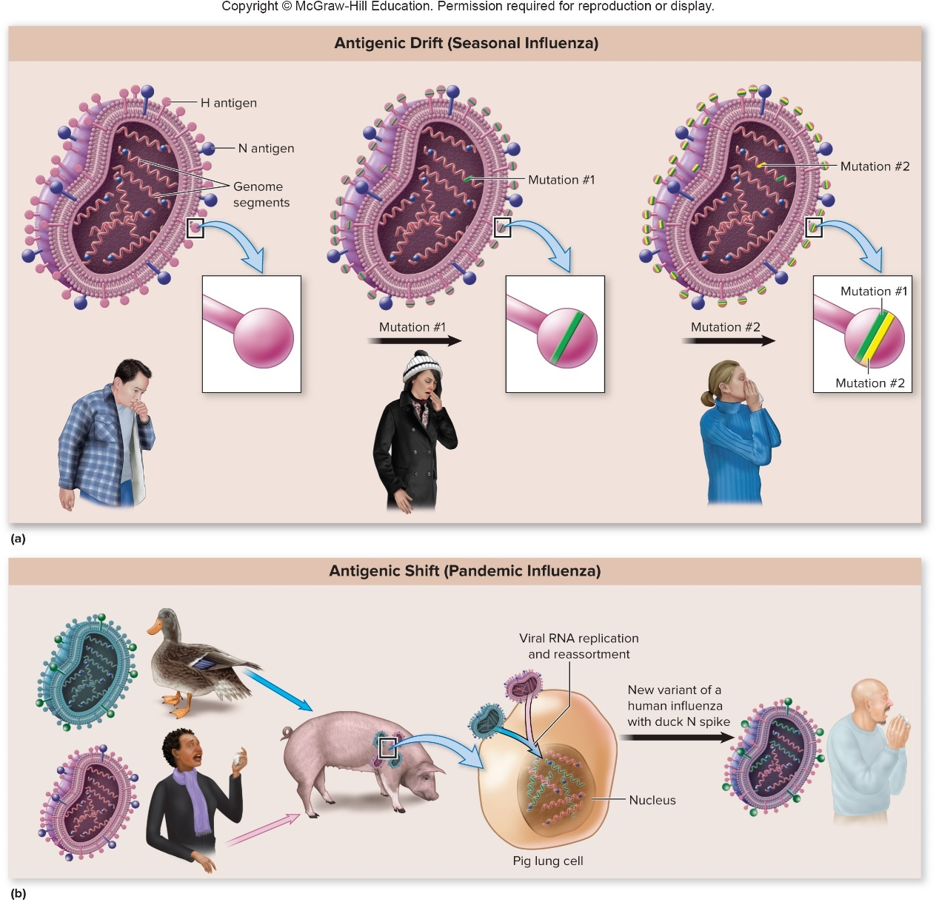
Viral Infections of the Lower Respiratory System – Figure 21.25
Influenza
Epidemiology

Slide 92
Viral Infections of the Lower Respiratory System (4)
Influenza
Epidemiology
All known influenza A viruses found in birds
In 1997 in Hong Kong, H5N1 virus from chickens spread to humans
LPAI (low pathogenic avian influenza)
HPAI (high pathogenic avian influenza)
Does not spread easily from person to person
H7N9 avian virus appeared in China (2013)
30 to 40% case-fatality rate
Found in birds in U.S., but no human cases
Fear is that virus will evolve to allow transmission from person to person

Slide 93
Viral Infections of the Lower Respiratory System (5)
Influenza
Treatment and prevention:
Antiviral medications such as neuraminidase inhibitors
Children 5 to 15 with influenza should not be given aspirin due to risk of Reye’s syndrome
Potentially fatal liver disease
Variety of trivalent or quadrivalent vaccines
Against 3 or 4 strains in circulation (two A strains and 1 to 2 B strains)
New vaccine required each year because of antigenic drift

Slide 94
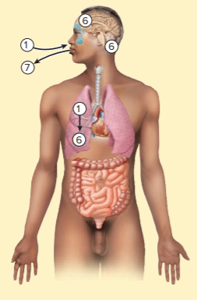
Table 21.12 Influenza (“Flu”)
Influenza virus is inhaled and carried to the lungs.
Viral hemagglutinin attaches to receptors on ciliated epithelial cells and the virus enters the cell by endocytosis.
Host cell synthesis is diverted to producing virions.
Newly formed virions bud from infected cells; they are released by viral neuraminidase and infect ciliated epithelium, mucus-secreting, and alveolar cells.
Infected cells ultimately die and slough off; recovery of the mucociliary escalator may take weeks.
Secondary bacterial infection of the lungs, ears, and sinuses is common.
The virus exits with coughing.
Signs and symptoms | Fever, muscle aches, lack of energy, headache, sore throat, nasal congestion, cough
Incubation period | 1 to 2 days
Causative agent | Influenza virus, an enveloped single-stranded RNA virus with a segmented genome
Pathogenesis | Infection of respiratory epithelium; cells destroyed and virus released to infect other cells. Secondary bacterial infection results from damaged mucociliary escalator.
Epidemiology | Antigenic drift and antigenic shift prevent immunity.
Treatment and prevention | Treatment: antiviral medications somewhat effective for treatment when given early in the disease. Prevention: vaccines developed and given annually.
Notes:
94

Slide 95
Viral Infections of the Lower Respiratory System (6)
Respiratory syncytial virus (RSV) infections
Most common cause of serious lower respiratory tract infections in infants and young children; elderly
Signs and symptoms: Runny nose followed by cough, wheezing, difficulty breathing; possibly fever (incubation period 1 to 4 days)
Bluish color indicates insufficient
In healthy older children and adults, similar to bad cold
RSV causes croup; high-pitched cough and noisy inhalation from airway obstruction
Sometimes fatal for elderly with underlying diseases

Slide 96
Viral Infections of the Lower Respiratory System (7)
Respiratory syncytial virus (RSV)
Causative agent: Enveloped, single-stranded RNA paramyxovirus
Causes cells in cultures to fuse into syncytia, giving name respiratory syncytial virus (RSV)
Pathogenesis: infects respiratory tract epithelium
Cells die and slough off; bronchiolitis is common
Bronchioles partially plugged by sloughed cells, mucus
Obstruction causes wheezing; may allow air into lungs but not out
Pneumonia often results; secondary infections common
Epidemiology: common from late fall to late spring
Recovery yields only weak and short-lived immunity
Healthy children, adults usually have mild illness and readily spread virus

Slide 97
Viral Infections of the Lower Respiratory System (8)
Respiratory syncytial virus (RSV)
Treatment and prevention: no effective antivirals
Preventing healthcare-associated RSV requires strict isolation techniques
Passive immunity via monthly injections of immune globulin or RhuMab (palivizumab)
No vaccine

Slide 98
Table 21.13 Respiratory Syncytial Virus (RSV) Infections
Signs and symptoms | Runny nose, cough, fever, wheezing, difficulty breathing, bluish color
Incubation period | 1 to 4 days
Causative agent | Respiratory syncytial virus (RSV), a paramyxovirus that produces syncytia
Pathogenesis | Sloughing of respiratory epithelium and inflammatory response plug bronchioles, cause bronchiolitis; pneumonia from bronchiolar or alveolar inflammation; secondary infection.
Epidemiology | Yearly epidemics during the cool months; readily spread by otherwise healthy older children and adults with mild symptoms; no lasting immunity.
Treatment and prevention | Treatment: no satisfactory antiviral treatment. Prevention: no vaccine. For high-risk individuals, passive immunization with immune globulin or a monoclonal antibody.

Slide 99
Viral Infections of the Lower Respiratory System (9)
Hantavirus pulmonary syndrome
Newly emerging disease caused small outbreak in 1993
Most victims were vigorous young adults who developed influenza-like symptoms, then died within days
CDC showed disease associated with exposure to mice
Caused by hantavirus related to one that plagued American troops during 1950s Korean War
Signs and symptoms: fever, muscle aches in lower back, nausea, vomiting, diarrhea (incubation 3 days to 6 weeks)
Unproductive cough, severe shortness of breath appear within a few days, often followed by shock and death
Causative agent
Hantavirus called Sin Nombre virus (SNV) of Bunyaviridae
Enveloped; single-stranded RNA genome in three segments
Each type infects rodent species; apparently harmless to them

Slide 100
Viral Infections of the Lower Respiratory System (10)
Hantavirus pulmonary syndrome
Pathogenesis
Virus enters by inhalation of dust contaminated with urine, feces, saliva of infected rodents
Enters circulation, is carried throughout body; infects cells lining capillaries
Inflammatory response to viral antigen causes capillaries to leak fluid into lungs, suffocating patient, causing blood pressure to fall
Shock and death occur in more than 30% of cases
Few mature infectious virions enter air passages of lungs, so person-to-person transmission is rare

Slide 101
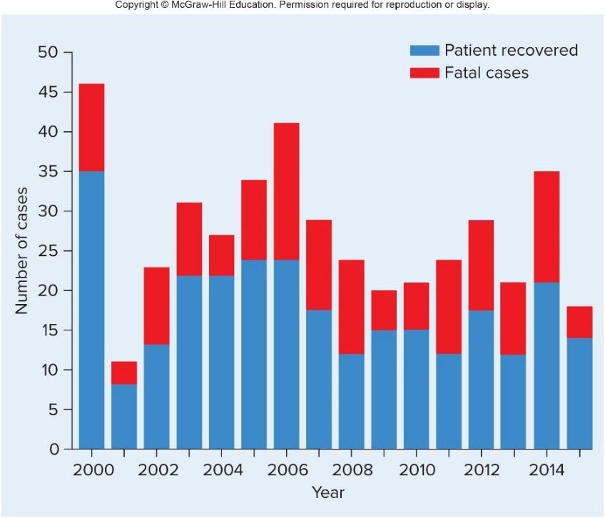
Viral Infections of the Lower Respiratory System –Figure 21.26
Hantavirus pulmonary syndrome
Epidemiology: zoonosis; considered emerging disease
Associated with increases in mouse populations in poor communities with substandard housing
Complex ecological factors influence mouse population

Slide 102
21.5. Viral Infections of the Lower Respiratory System
Hantavirus pulmonary syndrome
Treatment and prevention: no proven treatment
Prevention based on minimizing exposure to rodents and contaminated dust
Mouse-proofing buildings, keeping food in containers
Use of mops rather than brooms or vacuums

Slide 103
Table 21.14 Hantavirus Pulmonary Syndrome
Signs and symptoms | Fever, muscle aches, vomiting, diarrhea, cough, shortness of breath, shock
Incubation period | 3 days to 6 weeks
Causative agent | Sin Nombre and related hantaviruses; enveloped viruses with segmented single-stranded RNA
Pathogenesis | Viral antigen localizes in capillary walls in the lungs; inflammation.
Epidemiology | Zoonotic disease; epidemics associated with increases in mouse populations near housing; generally no person-to-person spread.
Treatment and prevention | Treatment: no antiviral treatment. Prevention: avoiding contact with rodents; sealing access to houses, food supplies; good ventilation; avoiding dust; using disinfectants in cleaning rodent-contaminated areas.

Slide 104
Viral Infections of the Lower Respiratory System (11)
SARS and MERS
Two novel coronaviruses caused new diseases
Severe acute respiratory syndrome (SARS) seen in 2003 involved 27 countries resulting in over 8000 cases and 800 deaths
No new cases reported since 2004
Reminder that a disease can emerge in one part of the world and spread rapidly across the globe
Middle East respiratory syndrome (MERS) seen in 2012 involved more than 25 countries by 2016 resulting in over 1800 cases and 600 deaths
Notes:
104

Slide 105
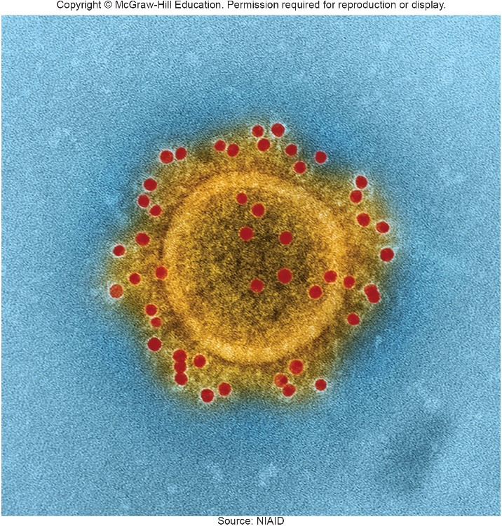
Viral Infections of the Lower Respiratory System – Figure 21.27
SARS and MERS
Signs and symptoms
Typical flu-like symptoms of fever, malaise, muscle aches, non-productive cough, shortness of breath (incubation period 2 to 7 days)
Many develop pneumonia
Causative agents
SARS coronavirus (SARS-CoV) and MERS coronavirus (MERS-CoV) of Coronaviridae
Enveloped, single-stranded RNA viruses with spikes on surface, giving crown-like appearance
Source: NIAID
Notes:
105

Slide 106
Viral Infections of the Lower Respiratory System (12)
SARS and MERS
Pathogenesis
Infect cells in lower respiratory tract and replicate genome within virus-induced vesicles that hide them from host responses
Damages cells and strong immune response
Cytokine storm
Epidemiology: zoonotic viruses; likely originated in bats
Transmitted by respiratory droplets during close person-to-person contact
Some are “super-spreaders”
Spread in healthcare settings; MERS primarily affects patients rather than staff
Notes:
106

Slide 107
Viral Infections of the Lower Respiratory System (13)
SARS and MERS
Treatment and prevention: no specific treatments
Experimental medications for severe cases
Mechanical ventilator may aid in breathing
Typical prevention measures like handwashing, avoiding crowds
Research to develop MERS-CoV vaccine
Notes:
107

Slide 108
Table 21.15 SARS and MERS
Signs and symptoms | Fever, muscle aches, cough; eventual respiratory distress or pneumonia
Incubation period | 2 to 7 days
Causative agent | Coronaviruses: SARS-CoV and MERS-CoV
Pathogenesis | Alveolar damage, inflammation, fluid accumulation; cytokine storm may damage tissue.
Epidemiology | Zoonotic viruses; spread by respiratory droplets; seen in healthcare facilities.
Treatment and prevention | Treatment: supportive therapy. Prevention: no vaccine.

Slide 109
Fungal Infections of the Lung (1)
Coccidioidomycosis (“valley fever”)
In U.S. mainly in southwest
People exposed to dust and soil (for example, farm workers) most likely to be infected
Only approximately 40% develop symptoms
Signs and symptoms: Fever, cough, chest pain, loss of appetite and weight are common
Other signs and symptoms include joint pain, rash, painful nodules
Most recover spontaneously within a month; small percentage develop chronic disease

Slide 110
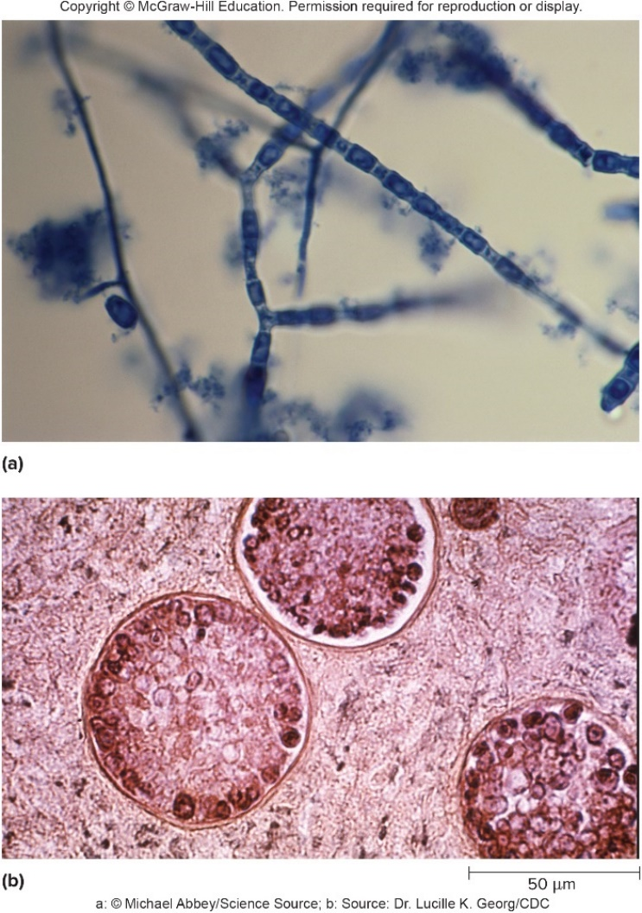
Fungal Infections of the Lung – Figure 21.28
Coccidioidomycosis
Causative agent: Coccidioides immitis
Dimorphic fungus that grows in soil as mold
Hyphae produce highly infectious arthroconidia that are inhaled
Develop into thick-walled spherules that contain several hundred small cells called endospores
Not the same as bacterial endospores
a: ©Michael Abbey/Science Source; b: Source: Dr. Lucille K. Georg/CDC

Slide 111
Fungal Infections of the Lung (2)
Coccidioidomycosis
Pathogenesis: arthroconidia inhaled
Endospores released when spherules rupture; endospores develop into more endospore-containing spherules
Each cycle provokes damaging inflammatory response
Usually eliminated but caseous necrosis occasionally occurs, resulting in lung cavities
Infection may spread in bloodstream; occurs more often in those with immunodeficiencies
Fatal without treatment
Notes:
111

Slide 112
Fungal Infections of the Lung (3)
Coccidioidomycosis
Epidemiology: semi-arid areas of Western Hemisphere
Infections occur during hot, dry, dusty seasons
Dust from earthquakes can result in epidemics
Can be contracted by traveling through endemic area
Treatment and prevention:
Approved medications given for a long time
Disseminated disease can reactivate months or years later
Prevention includes dust avoidance and control

Slide 113
Table 21.16 Coccidioidomycosis (“Valley Fever”)
Signs and symptoms | Fever, cough, chest pain, loss of appetite and weight; less frequently, painful nodules on extremities, pain in joints; skin, mucous membranes, brain, and internal organs sometimes involved
Incubation period | 2 days to 3 weeks
Causative agent | Coccidioides immitis, a dimorphic fungus
Pathogenesis | Inhaled arthroconidia develop into spherules that mature and rupture to release endospores, each of which then develops into another spherule; inflammatory response damages tissue; hypersensitivity to fungal antigens causes painful nodules and joint pain.
Epidemiology | Occurs only in certain semi-arid regions of the Western Hemisphere.
Treatment and prevention | Treatment: antifungal medications. Prevention: dust control methods such as grass planting and watering.

Slide 114
Fungal Infections of the Lung (4)
Histoplasmosis (“Spelunker’s Disease”)
Usually benign; occasionally mimics tuberculosis
Serious forms suggest underlying immunodeficiency
Signs and symptoms: most infections asymptomatic
Fever, cough, chest pain most common
Sometimes shortness of breath
Mouth sores may develop, especially in children

Slide 115
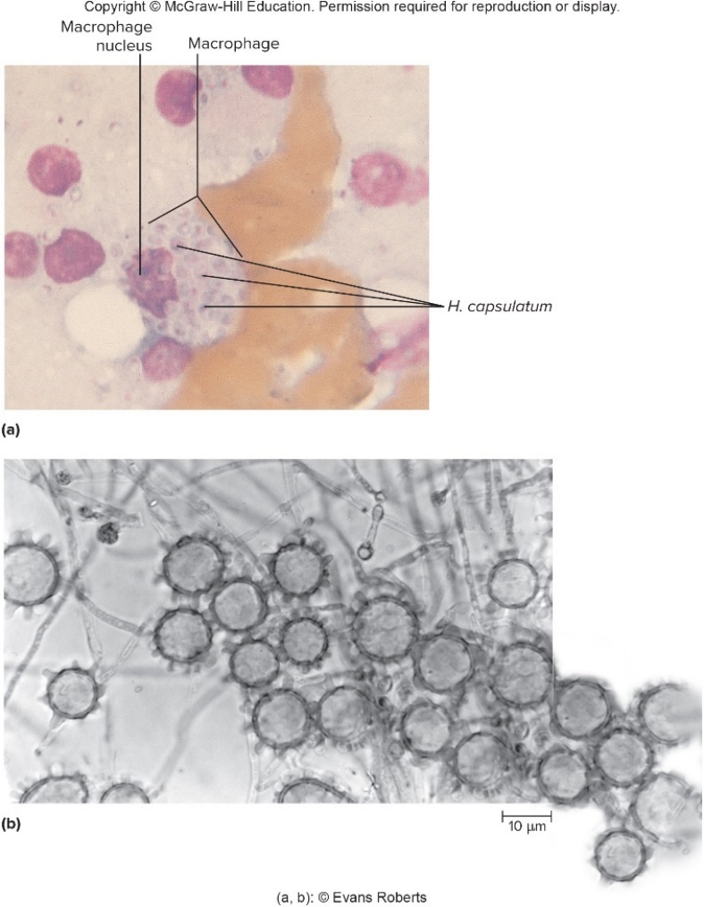
Fungal Infections of the Lung – Figure 21.29
Histoplasmosis (“Spelunker’s Disease”)
Causative agent: dimorphic Histoplasma capsulatum
Grows in soils contaminated by bird or bat droppings
Grows within host macrophages as tiny oval yeast
Mold form produces macroconidia (with numerous projecting knobs) and tiny pear-shaped or spherical microconidia
a: ©Evans Roberts; b: ©Evans Roberts
Notes:
115

Slide 116
Fungal Infections of the Lung (5)
Histoplasmosis
Pathogenesis
Inhaled microconidia taken up by macrophages
Fungus develops into yeast form, multiplies within phagocytes
Granulomas develop; resemble those of TB
Lesions eventually replaced with scar tissue; many calcify
Disease spreads throughout body in rare cases, particularly in immunodeficient

Slide 117
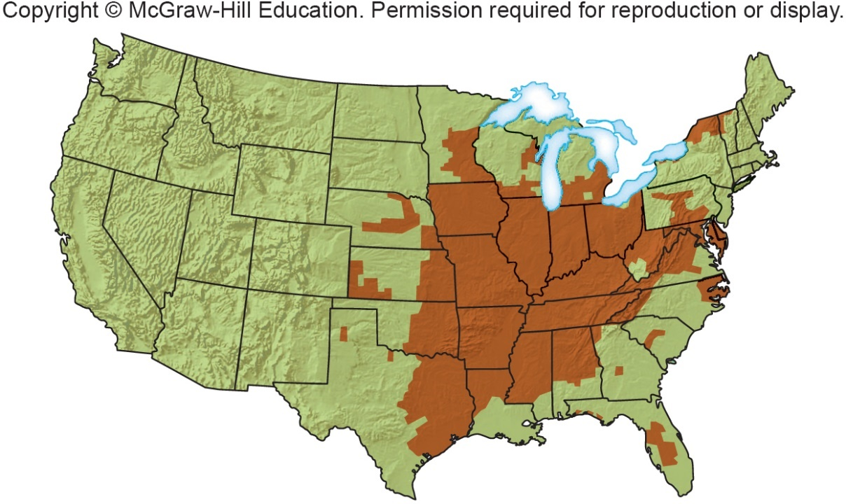
Fungal Infections of the Lung – Figure 21.30
Histoplasmosis
Epidemiology: found in U.S., also tropical and temperate zones scattered around the world
Cave explorers at risk due to bat droppings in many caves
Skin tests reveal millions in Mississippi and Ohio River drainage area, South Atlantic states have been infected

Slide 118
Fungal Infections of the Lung (6)
Histoplasmosis
Treatment and prevention: similar to coccidioidomycosis
Anti-fungals have potentially serious side effects
No proven preventive methods other than avoiding areas where soil is heavily enriched with bat and bird droppings

Slide 119
Table 21.17 Histoplasmosis (“Spelunker’s Disease”)
Signs and symptoms | Mild respiratory symptoms; less frequently, fever, chest pain, cough, chronic mouth sores
Incubation period | 5 to 8 days
Causative agent | Histoplasma capsulatum, a dimorphic fungus
Pathogenesis | Microconidia inhaled, change to yeast phase, multiply in macrophages; granulomas form; disease spreads throughout the body in people with AIDS or other immunodeficiencies.
Epidemiology | The fungus grows in soil contaminated by bird or bat droppings, especially in Ohio and Mississippi River valleys, and in the southeast United States. Found in many other countries. Spelunkers are at risk.
Treatment and prevention | Treatment: antifungal medications. Prevention: avoiding soils contaminated with bird or bat droppings.

Slide 120
Fungal Infections of the Lung (7)
Pneumocystis pneumonia (PCP)
Severe infectious lung disease recognized after WW II in Europe when it killed malnourished premature infants
Common opportunistic infection in AIDS patients who are not receiving preventive care
Signs and symptoms
Many have latent infection controlled by immune system; disease appears in immunocompromised
Symptoms appear slowly after incubation of 4 to 6 weeks
Shortness of breath, low/no fever, non-productive cough
Bluish skin. mucus membranes as disease progresses

Slide 121
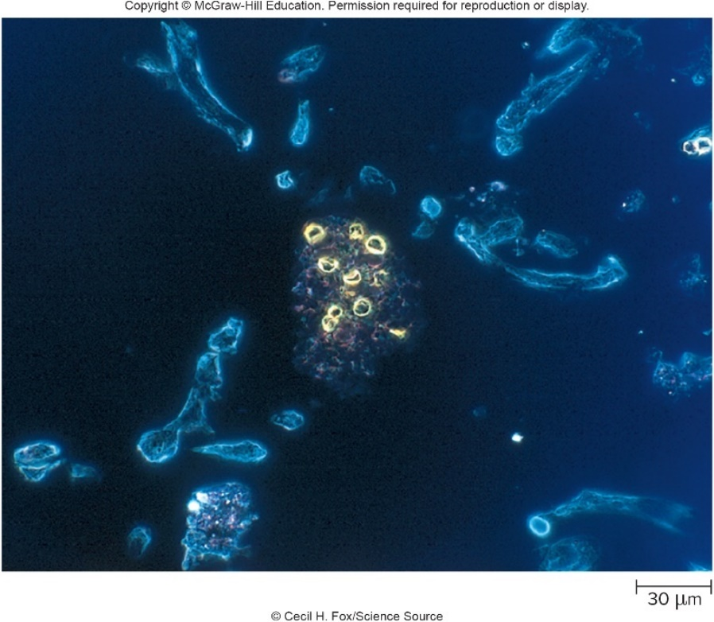
Fungal Infections of the Lung – Figure 21.31
Pneumocystis pneumonia (PCP)
Causative agent: Pneumocystis jiroveci
Once known as P. carinii, explaining acronym PCP
Tiny yeast-like fungus
Different cell wall makes it resistant to many anti-fungal medications
Forms cysts with characteristic appearance

Slide 122
Fungal Infections of the Lung (8)
Pneumocystis pneumonia (PCP)
Pathogenesis: cells inhaled into lung tissue
Infect alveolar walls; they become thickened and scarred, preventing free passage of
Epidemiology: distributed worldwide
Most children have asymptomatic infection
Seen in immunodeficient, infants, elderly
Treatment and prevention
Treated with co-trimoxazole; alternative if side effects are not tolerated
Prophylactic doses given to HIV-infected people
To prevent PCP, HIV-infected individuals are given medication as soon as they become immunodeficient

Slide 123
Table 21.18 Pneumocystis Pneumonia (PCP)
Signs and symptoms | Gradual onset, shortness of breath, rapid breathing, non-productive cough, slight or absent fever, and dusky color of skin and mucous membranes
Incubation period | 4 to 8 weeks
Causative agent | Pneumocystis jirovecii (previously known as P. carinii)—a fungus
Pathogenesis | Inhaled fungal cells attach to alveolar walls, causing alveoli to fill with fluid, macrophages, and fungal cells. Alveolar walls thicken, impairing $O_{2}$ exchange.
Epidemiology | Most humans become infected in early childhood—source of human infections is unknown. Epidemics can arise in immunodeficient groups.
Treatment and prevention | Treatment: antimicrobial medications. Prevention: prophylactic doses to those with AIDS of the

