Slide 1
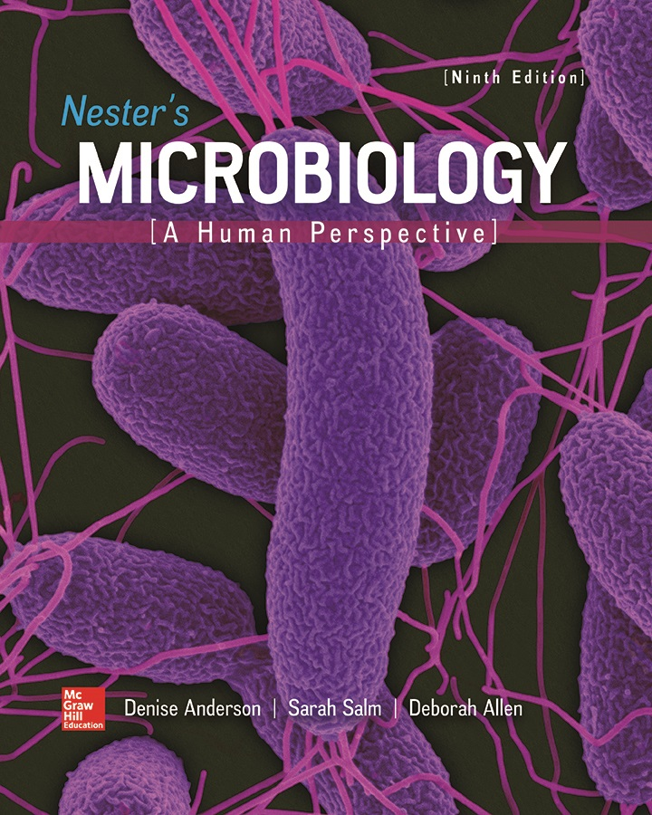
Chapter 10 Lecture Outline
See separate PowerPoint slides for all figures and tables pre-inserted into PowerPoint without notes.
Notes:
1

Slide 2
A Glimpse of History
1870s: Bacteria classified by shape (Cohn)
1908: Classification by physiology (Orla-Jensen)
1930s: Classification based on evolutionary relationships (Kluyver, van Niel)
1970: Relationships determined by comparing physical traits, nucleotide sequences (Stanier)
Late 1970s: Prokaryotes divided into two major groups based upon ribosomal RNA sequences (Woese)
Led to current three domain system: Bacteria, Archaea, Eukarya

Slide 3
Principles of Taxonomy (1)
Taxonomy is the science that characterizes and names organisms to arrange them into hierarchical groups (taxa)
Three separate but interrelated areas:
Identification
Process of characterizing in order to group
Classification
Arranging organisms into similar or related groups
Nomenclature
System of assigning names

Slide 4
Principles of Taxonomy (2)
Strategies used to identify microorganisms
Microscopic examination
Culture characteristics
Biochemical tests
Nucleic acid analysis
Patient symptoms (for pathogens)
Identification may be more important than determining evolutionary relationships
Notes:
4

Slide 5
Table 10.1 Taxonomic Ranks of the Bacterium Escherichia coli
Strategies used to classify microorganisms
Phylogeny considers evolutionary relatedness
Species is basic unit: in prokaryotes, a group of closely related isolates or strains
Difficulty is determining separate species or separate strains within a species
Species may be divided into subspecies
Informal groupings also used for microorganisms
May share phenotype and physiology, but are not genetically unrelated
Lactic acid bacteria
Anoxygenic phototrophs
Endospore-formers
Sulfate reducers
Formal Rank | Example
Domain | Bacteria
Phylum | Proteobacteria
Class | Gammaproteobacteria
Order | Enterobacteriales
Family | Enterobacteriaceae
Genus | Escherichia
Species | coli

Slide 6
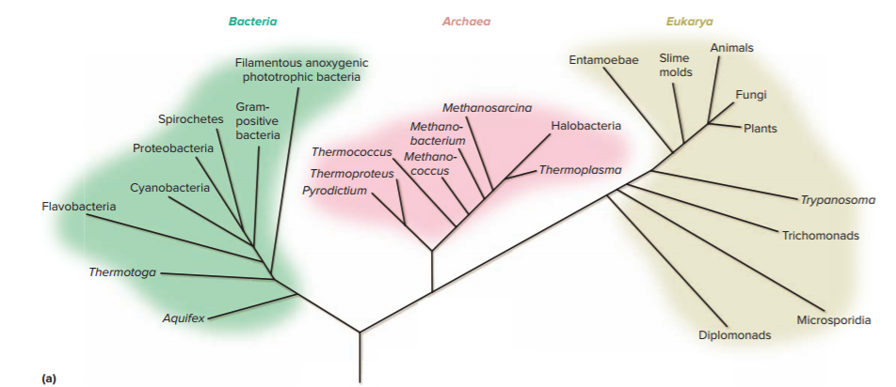
Principles of Taxonomy - Figure 10.1a
Current classification is three-domain system based on nucleotide sequences in rRNA
Replaces Whittaker’s five-kingdom system (1969)

Slide 7
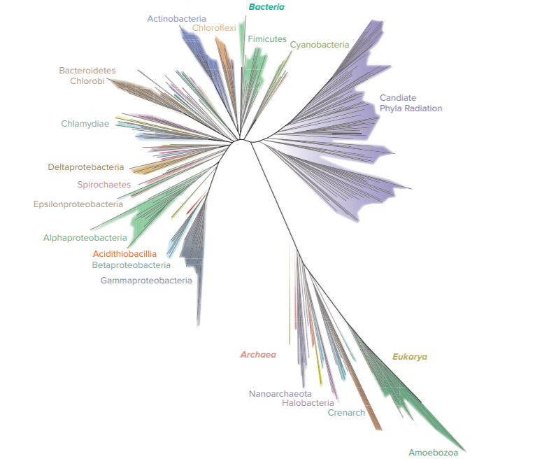
Principles of Taxonomy - Figure 10.1b
Three-domain system expanded by comparing amino acid sequences of ribosomal proteins
Shows many bacteria not grown in culture
Notes:
7

Slide 8
Table 10.2 A Comparison of Properties Typical of Members of the Three Domains
Cell Feature | Archaea | Bacteria | Eukarya
Cytoplasmic membrane lipids | Hydrocarbons (not fatty acids) linked to glycerol by ether linkage | Fatty acids linked to glycerol by ester linkage | Fatty acids linked to glycerol by ester linkage
Membrane-bound nucleus | No | No | Yes
Peptidoglycan cell wall | No | Yes | No
Presence of introns | Sometimes | No | Yes
Ribosomes | 70S | 70S | 80S

Slide 9
Principles of Taxonomy
Bergey’s Manual of Systematic Bacteriology
Describes all known prokaryotic species
Newest edition in five volumes
Classifies according to genetic relatedness (phylogeny)
Provides information on ecology, methods of enrichment, culture, and isolation, and methods for maintenance
International Code of Nomenclature of Bacteria
Provides rules for naming bacteria and archaea

Slide 10
Table 10.3 Methods Used to Identify Microorganisms (1)
Method | Comments
Phenotypic Characteristics | Most of these methods do not require sophisticated equipment and can easily be done anywhere in the world.
Microscopic morphology | Size, shape, and staining characteristics can give suggestive information as to the identity of the organism. Further testing, however, is needed to confirm the identification.
Culture characteristics | Colony morphology can give initial clues to the identity of an organism.
Metabolic capabilities | A set of biochemical tests can be used to identify a microorganism.
Serological testing | Proteins and polysaccharides that make up a microorganism are sometimes characteristic enough to be considered identifying markers. These can be detected using specific antibodies.
Protein profile | MALDI-TOF MS separates and sorts an organism’s proteins by mass, generating a profile that provides a fast way to identify an organism grown in culture.
Genotypic Characteristics | These methods are increasingly being used to identify microorganisms. Even an organism that occurs in very low numbers in a mixed culture can be identified.
Detecting specific nucleotide sequences | Nucleic acid probes and nucleic acid amplification tests can be used to identify a microorganism grown in culture. In some cases, the method is sensitive enough to detect the organism directly in a specimen.
Sequencing rRNA genes | This requires amplifying and then sequencing rRNA genes, but it can be used to identify organisms that have not yet been grown in culture.

Slide 11
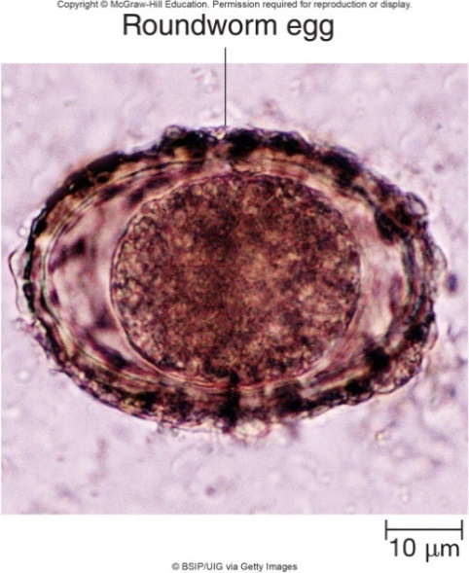
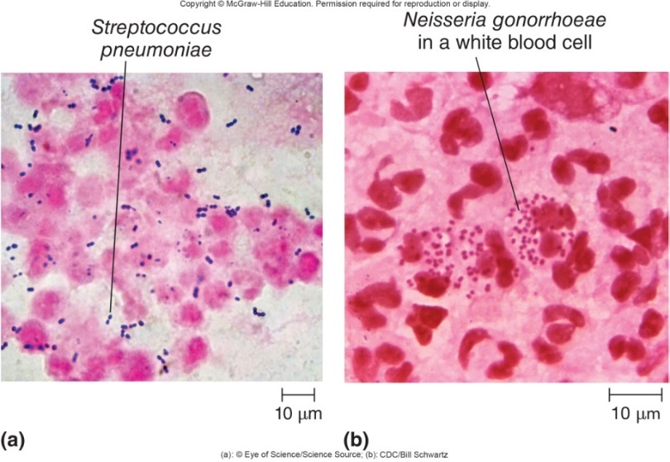
Identification Methods Based on Phenotype - Figures 10.2 and 10.3
Microscopic morphology is important initial step
Quickly determines size, shape, staining characteristics
Sometimes enough to diagnose eukaryotic infections
Gram stain distinguishes between Gram-positive and Gram-negative bacteria
Result may be enough to start appropriate therapy
Special stains may help with identification
Acid-fast stain may help identify Mycobacterium tuberculosis
Left: ©BSIP UIG via Getty Images; Middle: ©Eye of Science/Science Source; Right: CDC/Bill Schwartz

Slide 12
Identification Methods Based on Phenotype (1)
Culture characteristics can give clues
Serratia marcescens colonies often red at 22 degrees Celsius
Pseudomonas aeruginosa often produces green pigment
Cultures also have distinct fruity odor
Differential media aids in identification
Streptococcus pyogenes (strep throat) yields β-hemolytic colonies on blood agar
E. coli (urinary tract infection) ferments lactose, forms pink colonies on MacConkey agar

Slide 13
Identification Methods Based on Phenotype - Figure 10.4
Metabolic capabilities revealed by biochemical tests
Catalase test: positive if O₂ bubbles are seen after H₂O₂ is added to colony on microscope slide
Many tests rely on pH indicators
Sugar fermentation lowers pH and may trap gas in inverted tube
Urease raises pH
a: ©Denise Anderson; b,c: ©McGraw-Hill Education/Lisa Burgess, photographer

Slide 14
Table 10.4 Characteristics of Some Important Biochemical Tests
Biochemical Tests | Principle of the Test | Positive Reaction
Catalase | Rapid test that detects the activity of the catalase, an enzyme that breaks down hydrogen peroxide to form O₂ and water. | The reagent bubbles.
Citrate | Determines whether or not citrate can be used as a sole carbon source. | Growth, usually accompanied by the color change of a pH indicator.
Gelatinase | Detects enzymatic breakdown of gelatin to polypeptides. | The solid gelatin is converted to liquid.
Hydrogen sulfide production | Detects H₂S released as sulfur-containing amino acids are degraded. | A black precipitate forms due to the reaction of H₂S with iron salts in the medium.
Indole | Detects the enzymatic removal of the amino group from tryptophan. | The product, indole, reacts with an added chemical reagent, turning the reagent a deep red color.
Lysine decarboxylase | Detects the enzymatic removal of the carboxyl group from lysine. | The medium becomes more alkaline, causing a pH indicator to change color.
Methyl red | Detects mixed acids, the characteristic end products of a particular fermentation pathway. | The medium becomes acidic (pH below 4.5); a red color develops upon the addition of a pH indicator.
Oxidase | Rapid test that detects the activity of cytochrome c oxidase, a component of the electron transport chain of specific organisms. | A dark color develops after a specific reagent is added.
Phenylalanine deaminase | Detects the enzymatic removal of the amino group from phenylalanine. | The product of the reaction, phenylpyruvic acid, reacts with ferric chloride to give the medium a green color.
Sugar fermentation | Detects the acidity resulting from fermentation of a specific sugar incorporated into the medium; also detects gas production. | The medium becomes acidic, causing a pH indicator to change color. An inverted tube traps any gas that is made.
Urease | Detects the enzymatic degradation of urea to carbon dioxide and ammonia. | The medium becomes alkaline, causing a pH indicator to change color.
Voges-Proskauer | Detects acetoin, an intermediate of the fermentation pathway that leads to 2,3-butanediol production. | A red color develops after chemicals that detect acetoin are added.

Slide 15
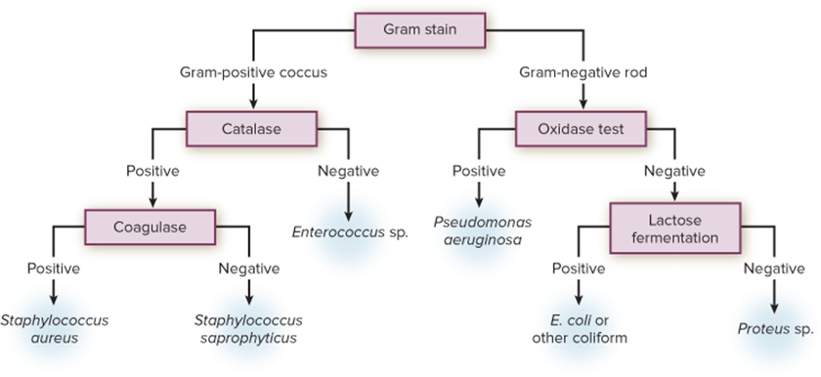
Identification Methods Based on Phenotype - Figure 10.5
Basic strategy for identification using biochemical tests relies on dichotomous key
Series of alternative choices
Simultaneous tests speed process and provide more conclusive results
Some tests accomplished without culturing (breath test to assay urease and identify Helicobacter pylori)
Jump to Identification Methods Based on Phenotype - Figure 10.5 Long Description

Slide 16
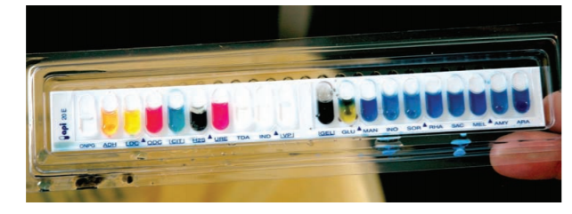
Identification Methods Based on Phenotype - Figure 10.6
Commercial kits allow rapid identification via biochemical tests
Require incubation period
Pattern of results is scored and a computer identifies the organism
©BSIP/Science Source

Slide 17
Identification Methods Based on Phenotype (2)
Serological testing uses antibodies to detect specific molecules
Proteins, polysaccharides of prokaryotic cells can serve as identifying markers
Most useful include surface structures of cell wall, capsule, flagella, pili
Some Streptococcus species contain unique carbohydrate in cell wall

Slide 18
Identification Methods Based on Phenotype (3)
An organism’s protein profile can be determined by MALDI-TOF (matrix-assisted laser desorption ionization time of flight mass spectrometry)
Can take less than 15 minutes
Measure the masses of various components using mass spectrophotometer
Sample spotted on sample plate with matrix
Laser beam vaporizes and ionizes sample
Time of flight: small ions travel faster than large ones
Mass spectrum a “fingerprint” or profile of the proteins and other macromolecules in the cell
Computer compares spectrum to database

Slide 19
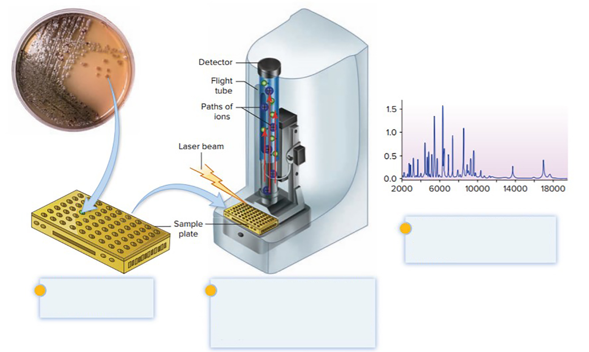
Identification Methods Based on Phenotype - Figure 10.7
MALDI-TOF provides rapid identification
A mass spectrum is generated. Computer software then compares the profile with a reference database.
An isolated colony and matrix solution are added to a sample plate.
A laser beam converts the molecules in the sample to an ionized gaseous form. As the ions travel through the flight tube, they separate and sort by mass. A detector records them as they arrive.
©McGraw-Hill Education, Lisa Burgess, photographer

Slide 20
Table 10.3 Methods Used to Identify Microorganisms (2)
Method | Comments
Phenotypic Characteristics | Most of these methods do not require sophisticated equipment and can easily be done anywhere in the world.
Microscopic morphology | Size, shape, and staining characteristics can give suggestive information as to the identity of the organism. Further testing, however, is needed to confirm the identification.
Culture characteristics | Colony morphology can give initial clues to the identity of an organism.
Metabolic capabilities | A set of biochemical tests can be used to identify a microorganism.
Serological testing | Proteins and polysaccharides that make up a microorganism are sometimes characteristic enough to be considered identifying markers. These can be detected using specific antibodies.
Protein profile | MALDI-TOF MS separates and sorts an organism’s proteins by mass, generating a profile that provides a fast way to identify an organism grown in culture.
Genotypic Characteristics | These methods are increasingly being used to identify microorganisms. Even an organism that occurs in very low numbers in a mixed culture can be identified.
Detecting specific nucleotide sequences | Nucleic acid probes and nucleic acid amplification tests can be used to identify a microorganism grown in culture. In some cases, the method is sensitive enough to detect the organism directly in a specimen.
Sequencing rRNA genes | This requires amplifying and then sequencing rRNA genes, but it can be used to identify organisms that have not yet been grown in culture.

Slide 21
Identification Methods Based on Genotype (1)
Detecting Specific Nucleotide Sequences
Tests can identify sequences unique to species or group
Nucleic acid probes
Nucleic acid amplification tests (NAATs)
Limitation is each detects only single possibility
Need to run multiple probes if organism being tested could be one of multiple different species or related groups

Slide 22
Identification Methods Based on Genotype - Figure 10.8
Nucleic acid probes locate nucleotide sequence characteristic of species or group
Most methods first increase DNA in sample
Inoculation on agar or in vitro DNA amplification
Fluorescence in situ hybridization (FISH) probes for 16S rRNA
Amplification step not needed
Signature sequence characterizes certain group
Jump to Identification Methods Based on Genotype - Figure 10.8 Long Description

Slide 23
Identification Methods Based on Genotype (2)
Nucleic acid amplification tests (NAATs) used to increase number of copies of specific DNA sequences
Allows detection of small numbers of organisms
Often from body fluids, soil, food, water
Detection of organisms that cannot be cultured
Polymerase chain reaction (PCR) is common technique

Slide 24
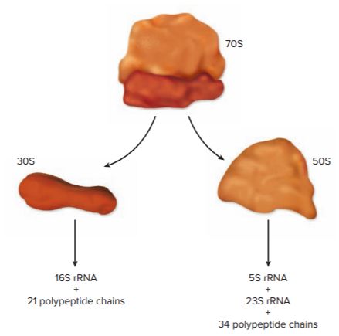
Identification Methods Based on Genotype - Figure 10.9
Sequencing Ribosomal RNAs (rRNAs) or the DNA that encodes them (rDNA) is used in identification
Sequences relatively stable
16S rRNA most useful because of moderate size
Approximately 1,500 nucleotides
Sequence compared with
extensive databases
Can identify organisms that cannot be grown in culture
Jump to Identification Methods Based on Genotype - Figure 10.9 Long Description

Slide 25
Table 10.5 Summary of Methods Used to Characterize Different Strains
Characterizing different strains is important
Foodborne illnesses
Forensic investigations of bioterrorism, biocrimes
Diagnosing certain diseases
Method | Comment
Biochemical typing | Biochemical tests are most commonly used to identify various species of bacteria, but in some cases they can be used to distinguish different strains. A group of strains that have a characteristic biochemical pattern is called a biovar or a biotype.
Serological typing | Proteins and carbohydrates that vary among strains can be used to differentiate strains. A group of strains that have a characteristic serological type is called a serovar or a serotype.
Molecular typing | Gel electrophoresis can be used to detect restriction fragment length polymorphisms (RFLPs). Whole-genome sequencing (WGS) is increasingly being used to detect differences.
Phage typing | Strains of a given species sometimes differ in their susceptibility to various types of bacteriophages.
Antibiograms | Antibiotic susceptibility patterns can be used to characterize strains.

Slide 26
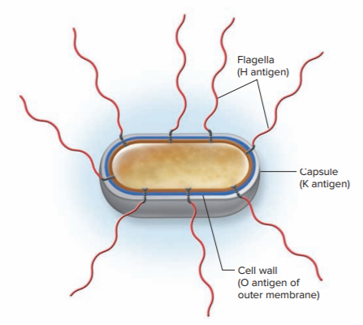
Characterizing Strain Differences - Figure 10.10
Biochemical Typing
Group with characteristic pattern: biovar, or biotype
Can trace Vibrio cholerae El Tor
Serological Typing
E. coli distinguished by antigenic type of flagella, capsules, lipopolysaccharide molecules
E. coli O157:H7 (O antigen is lipopolysaccharide; H antigen is flagella)
Group with characteristic antigens: serovar, or serotype

Slide 27
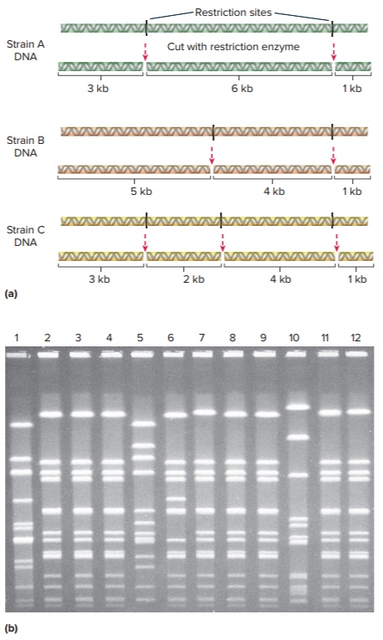
Characterizing Strain Differences - Figure 10.11
Molecular typing uses differences in DNA sequences to distinguish strains
Cut DNA samples with same restriction enzyme
Separate via gel electrophoresis
Patterns called restriction fragment length polymorphisms (RFLPs)
Different RFLPs indicate different strains
Jump to Characterizing Strain Differences - Figure 10.11 Long Description
b: ©Patricia Moor, Gadi Research Center, University of Canberra

Slide 28
Characterizing Strain Differences
PulseNet makes it easier to use RFLP data to track foodborne disease outbreaks
Established by CDC
Labs can submit RFLP patterns to database and quickly receive information about other isolates
Whole genome sequencing (WGS) can trace outbreaks caused by closely related stains
Genome Trakr established by FDA
Network of labs that use WGS data for tracking outbreaks
Notes:
28

Slide 29
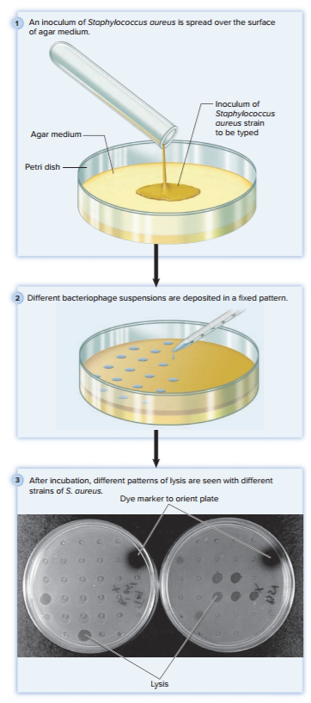
Characterizing Strain Differences - Figure 10.12
Phage typing relies on differences in susceptibility to bacteriophages (phages)
Susceptibility pattern determined by adding different bacteriophage suspensions to agar plate growing bacteria
If phage lyses cells, a clear area forms
Largely replaced by molecular methods, but still useful in labs lacking equipment for molecular typing
Jump to Characterizing Strain Differences - Figure 10.12 Long Description
3: ©Evans Roberts

Slide 30
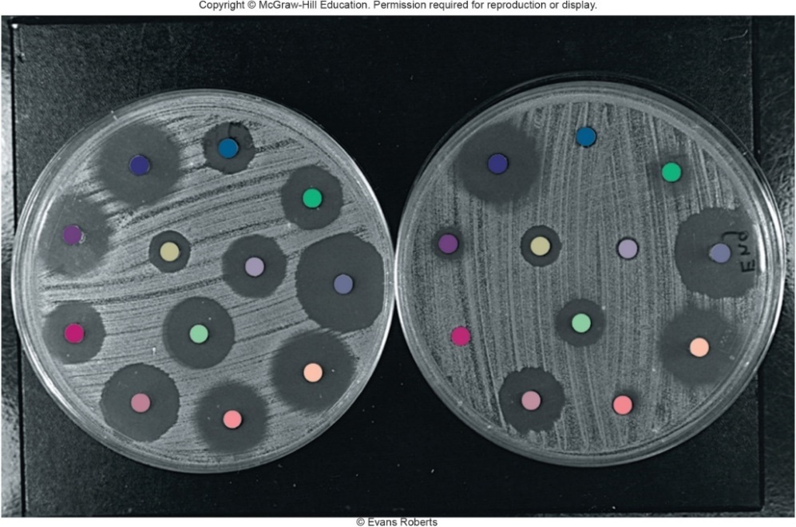
Characterizing Strain Differences - Figure 10.13
Antibiograms reveal differences in susceptibility to antimicrobial medications
Bacteria grown on agar plate
Discs containing different antimicrobials placed on agar
If cells are susceptible, a clear area forms
Largely replaced by molecular methods
©Evans Roberts

Slide 31
Classifying Microorganisms (1)
Classification historically based on phenotypic traits
Size, shape, staining, metabolic capabilities
But phenotypically similar organisms may be only distantly related; conversely, closely related organisms may appear dissimilar
New molecular techniques more accurate
Provide relative measure of time elapsed since divergence from common ancestor
Random mutations accumulate over time
DNA sequencing allows construction of phylogenetic tree

Slide 32
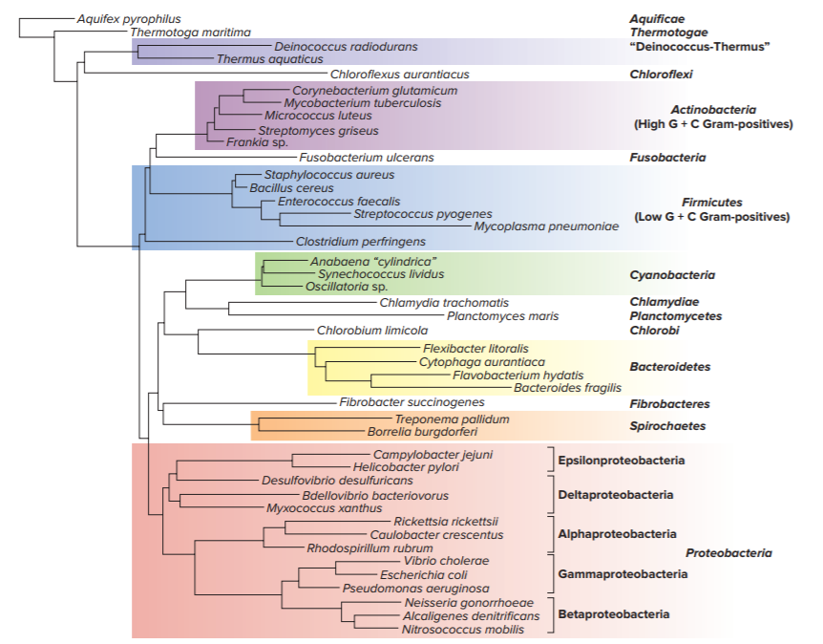
Classifying Microorganisms – Figure 10.14

Slide 33
Table 10.6 Methods Used to Determine the Relatedness of Different Microorganisms
Relatedness of organisms determined by genotypic and phenotypic characteristics
Method | Comment
Genotypic Characteristics | Differences in DNA sequences can be used to determine the point in time at which two organisms diverged from a common ancestor.
Sequence analysis of ribosomal components | Certain regions of the SSU rDNA (16S in bacteria and archaea and 18S in eukaryotes) can be used to determine distant relatedness of diverse organisms; other regions can be used to determine more recent divergence. Amino acid sequences of ribosomal proteins can also be compared.
DNA hybridization | The extent of nucleotide sequence similarity between two isolates can be determined by measuring how completely single strands of their DNA hybridize to one another.
G + C content | Determining the G + C content offers a crude comparison of genomes. Organisms with identical G + C contents can be entirely unrelated, however.
Phenotypic Characteristics | Traditionally, relatedness of different bacteria has been decided by comparing phenotypes. These characteristics, however, do not necessarily reflect the evolutionary relatedness of organisms.

Slide 34
Classifying Microorganisms (2)
Sequence analysis of ribosomal components
Reliable indicators because ribosomes perform crucial and functionally constant tasks in all organisms
Only a limited number of mutations can be tolerated
Some sequences will be similar even if organisms diverged long ago
Ribosomal genes are not commonly horizontally transferred
Notes:
34

Slide 35
Classifying Microorganisms (3)
Sequence analysis of ribosomal components
Comparisons of rRNAs revolutionized classification
Small subunit (SSU) RNAs most useful
rDNAs that encode rRNAs used due to ease of DNA sequencing methods
Culturing not necessary
Environmental samples may be amplified by PCR
May not resolve at species level because closely related prokaryotes can have identical SSU rDNA sequences
DNA hybridization a better tool in these cases
Analysis of ribosomal proteins accounts for novel organisms; more gene products compared

Slide 36
Classifying Microorganisms (4)
DNA Hybridization: relatedness of organisms determined by similarity of nucleotide sequences
Measured by how completely single strands of their DNA hybridize with each other
Extent of hybridization reflects degree of similarity
Bacterial strains with over 70% similarity are considered members of the same species
Shigella and Escherichia would be grouped in same species based only on DNA hybridization

Slide 37
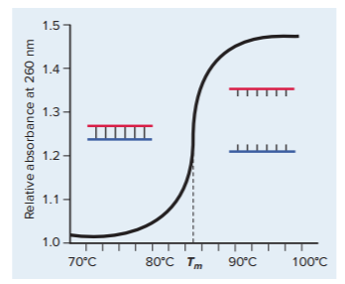
Classifying Microorganisms - Figure 10.15
G + C Content the percentage of G-C base pairs in DNA
If G + C content differs by more than a few percent, organisms are not related
Similarity of G + C content does not guarantee relatedness
DNA with higher G + C content melts at a higher temperature due to 3 hydrogen bonds between the bases

