Slide 1
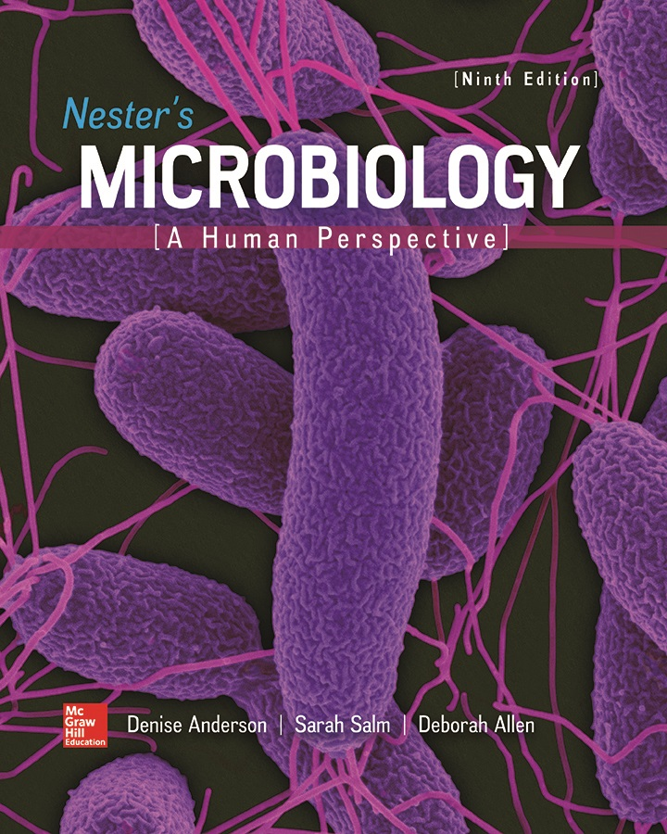
Chapter 23 Lecture Outline
See separate PowerPoint slides for all figures and tables pre-inserted into PowerPoint without notes.
Notes:
1

Slide 2
A Glimpse of History
Shibasaburo Kitasato (1853 to 1931)
Studied tetanus (lockjaw) in Robert Koch’s laboratory
Spores of Clostridium tetani found in soil and dust
Kitasato determined that C. tetani is an obligate anaerobe, devised method of cultivating
Discovered animals injected with C. tetani developed tetanus, but no bacterial cells found elsewhere in body
Showed bacterial toxin is responsible for disease
Emil von Behring similarly demonstrated diphtheria is caused by a toxin from Corynebacterium diphtheriae

Slide 3
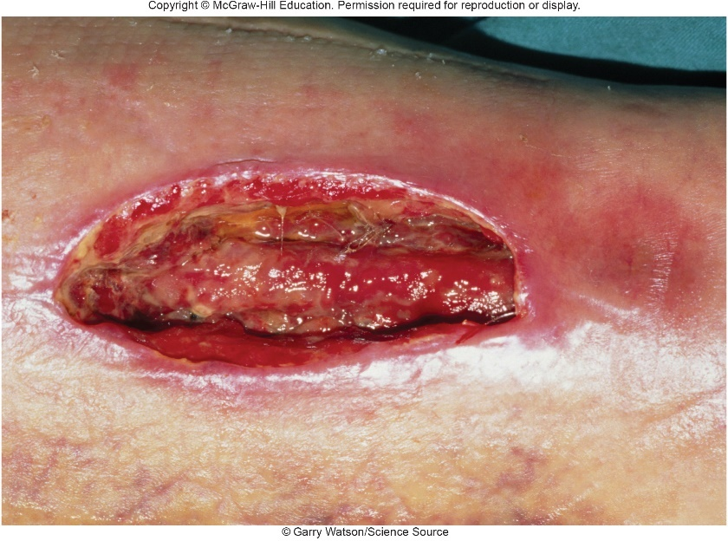
Introduction
Breaks in skin, mucous membranes allow microorganisms to enter
Infection may result, depending on several factors
Virulence of microbes
Number of microbial cells in wound
Host’s immune system
Type of wound
Foreign matter in a wound provides surface for biofilm, may shield from immune defenses, and may reduce available $O_{2}$
©Garry Watson/Science Source

Slide 4
Anatomy, Physiology, and Ecology (1)
Wounds vary in characteristics, severity, risk
Incisions: produced by knife or other sharp object
Punctures: result from penetration by small sharp object
Lacerations: occur when tissue is torn
Contusions: produced by blow that crushes tissue
Abrasions: occur when epidermis is scraped off
Gunshot wounds: caused by bullets, other projectiles
Burns: caused by heat, electricity, chemicals, radiation, or friction

Slide 5
Anatomy, Physiology, and Ecology (2)
Wounds expose normally protected tissue components
Collagen: fibrous material, main supportive protein of skin, tendons, scars, other body structures
Fibronectin: fibrous glycoprotein found in circulating form and as binding component of tissues
Fibrinogen: blood protein; converted to fibrin, which forms clots in damaged vessels

Slide 6
Anatomy, Physiology, and Ecology (3)
Wound healing
Begins as new capillaries form and connective tissue fibroblasts multiply producing red translucent granulation tissue
Fills space created by wound
Shrinks, is converted to collagen (component of scar tissue) that will be covered by skin or mucous membrane
Debridement is used to remove dead, damaged, and infected tissue
Notes:
6

Slide 7
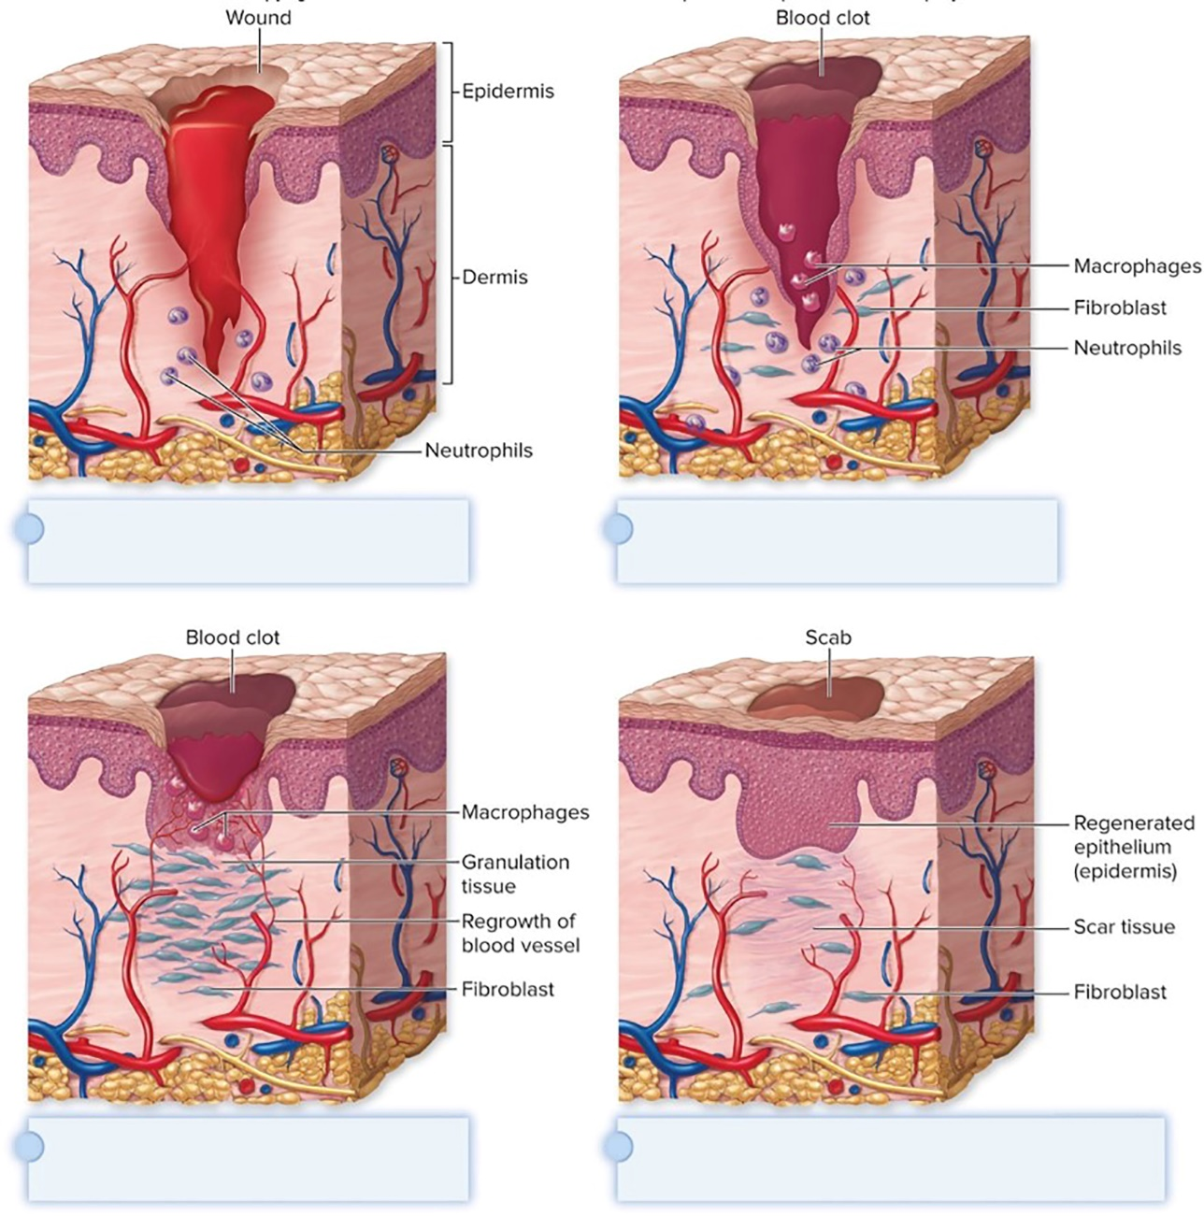
Anatomy, Physiology, and Ecology – Figure 23.1
Cut blood vessels bleed into the wound.
Blood clot forms in wound, and phagocytes destroy microbes.
Wound fills with granulation tissue and blood vessels regrow.
Scar tissue forms. Collagen contracts and epithelium regenerates.

Slide 8
Anatomy, Physiology, and Ecology (4)
Wound Abscesses
Abscess is localized pus surrounded by inflamed tissue
Pus: thick, yellowish fluid composed of living and dead leukocytes, tissue debris, and proteins
Abscesses form as result of body’s defenses
Help localize infection and prevent spread, unless microbial cells enter blood or lymph
Difficult to treat: no blood vessels; adjacent blood vessels often blocked by clots
Lack of circulation may prevent antimicrobials from reaching infected site; pus may interfere with action
Microbes typically stop dividing, so most antimicrobial medications ineffective
Abscesses usually must burst to body surface or be drained surgically

Slide 9
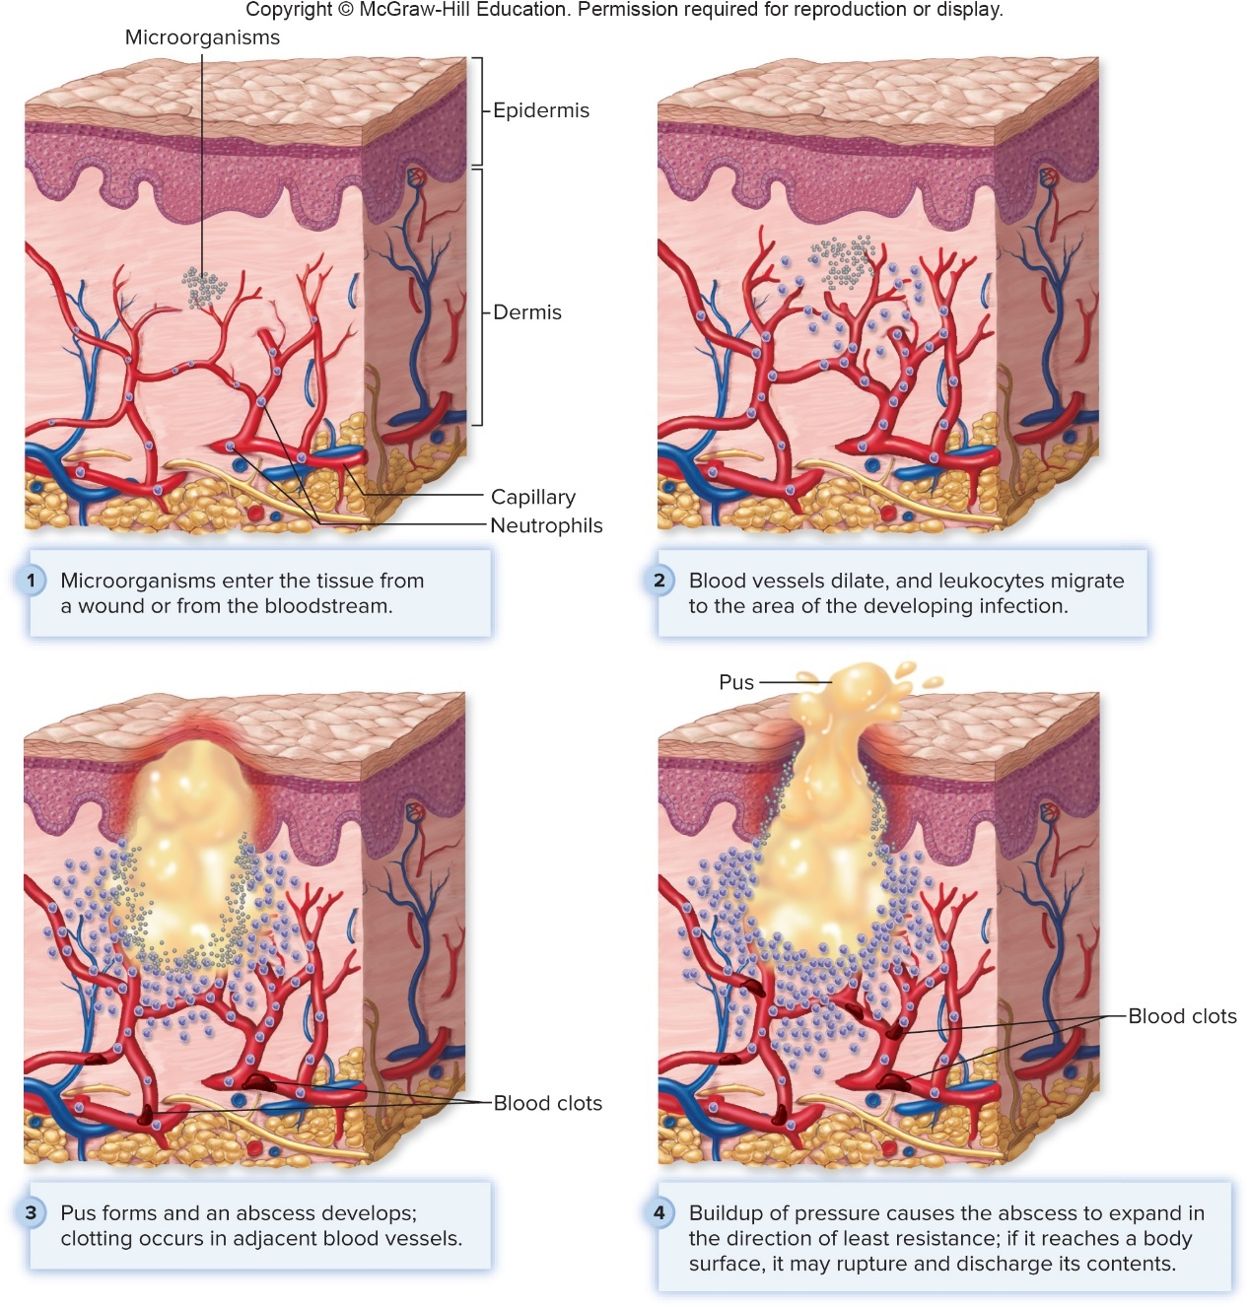
Anatomy, Physiology, and Ecology – Figure 23.2
Jump to Anatomy, Physiology, and Ecology – Figure 23.2 Long Description

Slide 10
Anatomy, Physiology, and Ecology (5)
Anaerobic Wounds
Many wounds relatively anaerobic, allow growth of obligate anaerobes such as Clostridium tetani
Wounds with extensive tissue damage, small but deep punctures, or those contaminated with dirt
Polymicrobial infections may produce anaerobic conditions as aerobic or facultative anaerobes use up available oxygen

Slide 11
Table 23.1 Leading Causes of Wound Infections
Infected wounds can have serious consequences
Delayed healing
Formation of abscesses
Spread of bacteria or toxins elsewhere in body
Infected surgical wounds often split from swelling, may allow infection to spread to devices (artificial hip, knee)
Devices may have to be removed to eliminate infection
Causative Organism | Characteristics | Consequences
Staphylococcus aureus | Gram-positive cocci in clusters, coagulase-positive | Delayed healing; abscess formation; extension into tissues, artificial devices, or bloodstream; some strains can cause toxic shock syndrome
Streptococcus pyogenes | Gram-positive cocci in chains; Lancefield group A | Same as above, except some strains can cause “flesh-eating” necrotizing fasciitis
Pseudomonas aeruginosa | Gram-negative rods; pigments produced result in a green color | Delayed healing; abscess formation; extension into tissues, artificial devices, or bloodstream; septic shock

Slide 12
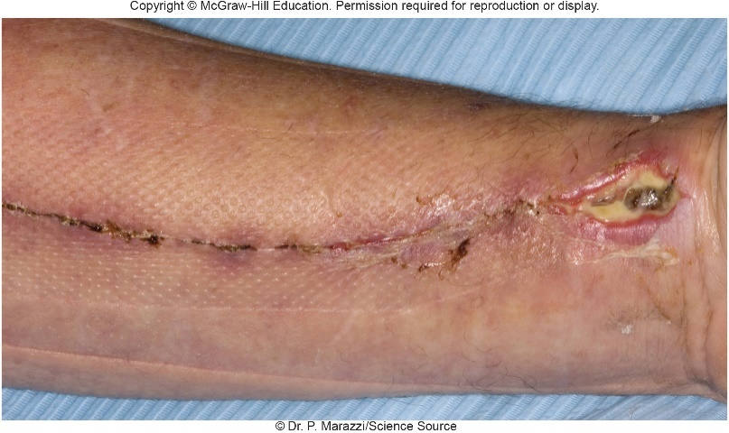
Common Bacterial Infections of Wounds – Figure 23.3
Staphylococcal wound infections
Staphylococcus species commonly inhabit nostrils, skin
S. aureus, S. epidermidis leading causes of wound infections
Signs and symptoms
Staphylococcus are pyogenic: cause production of pus
Inflammatory reaction; fever if infection is large or spreads to blood, lymph
Toxic shock syndrome results from toxin-producing strain: high fever, muscle aches, life-threatening drop in blood pressure, shock
©Dr. P. Marazzi/Science Source

Slide 13
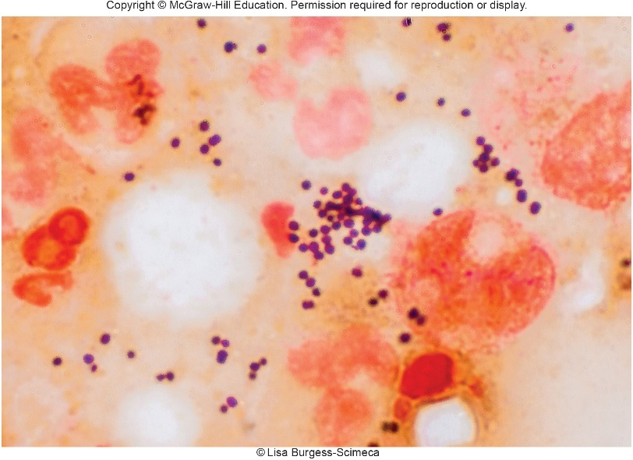
Common Bacterial Infections of Wounds (1)
Staphylococcal wound infections
Causative agents: S. aureus, S. epidermidis
Gram-positive cocci that grow in clusters
Facultative anaerobes; thrive on dry salty skin
Survive well in environment; easily transferred
Coagulase test distinguishes S. aureus from others
S. epidermidis most common cause of healthcare-associated infections
S. aureus causes serious wound infections more commonly
©Lisa Burgess-Science

Slide 14
Common Bacterial Infections of Wounds (2)
Staphylococcal wound infections
Pathogenesis: Staphylococcus aureus
Multiple virulence factors play role in wound infections
Clumping factor, other proteins allow attachment
Lipases, proteases, hyaluronidases damage tissue
Capsules, coagulase, protein A protect from complement system, phagocytes, antibodies
Immunity weak since organism evades immune system
Systemic complications may result
Bacteria can spread, form abscesses
Some strains produce superantigens
Many helper T cells activated; cytokine storm that can lead to toxic shock syndrome

Slide 15
Common Bacterial Infections of Wounds (3)
Staphylococcal wound infections
Pathogenesis: Staphylococcus epidermidis
Not particularly virulent, cannot invade healthy tissues
Often causes minor abscesses around sutures
Biofilms may form on medical devices (catheters, joints)
Cells adhere to devices by binding to fibronectin, a blood protein that quickly coats surgical implants
Antibacterial medications diffuse slowly, may be ineffective since many bacteria metabolically inactive
Bacteria may come loose, be carried by bloodstream to heart or other tissues,
Multiple tissue abscesses or infective endocarditis in immunocompromised

Slide 16
Common Bacterial Infections of Wounds (4)
Staphylococcal wound infections
Epidemiology
S. aureus carriers at increased risk for surgical wound infection
Age, poor general health, immunosuppression, prolonged preoperative hospital stay, infection at other site all factors
S. epidermidis usually part of normal microbiota; opportunist in immunocompromised
Treatment and prevention
Methicillin-resistant S. aureus (MRSA) resists multiple antibiotics; ceftaroline, vancomycin usually effective
Vancomycin-intermediate S. aureus (VISA) and vancomycin-resistant S. aureus (VRSA) have emerged
Thorough cleaning of wounds reduces infections

Slide 17
Table 23.2 Staphylococcal Wound Infections
Signs and symptoms | Redness, swelling, and pain at wound site; pus formation; sometimes fever; occasionally shock
Incubation period | Variable
Causative agent | Staphylococcus aureus and S. epidermidis
Pathogenesis | S. aureus produces many virulence factors that cause tissue damage and destruction; S. epidermidis is less virulent but may form biofilms.
Epidemiology | S. aureus carriers at greater risk for wound infection; predisposing factors also include advanced age, general poor health, immunosuppression, and prolonged hospital stay. S. epidermidis is opportunistic and affects the immunocompromised.
Treatment and prevention | Treatment: antibiotics; resistance a problem with S. aureus. Prevention: cleaning wounds, pre- and post-operative wound care.

Slide 18
Common Bacterial Infections of Wounds (5)
Group A streptococcal “flesh-eating disease”
Streptococcus pyogenes commonly infects wounds
Generally easy to treat: susceptible to penicillin
Occasionally, severe infections can progress rapidly
Invasive, spread into tissues and organs, cause pneumonia, meningitis, puerperal fever, fasciitis, streptococcal toxic shock, necrotizing fasciitis (“flesh-eating disease”)

Slide 19
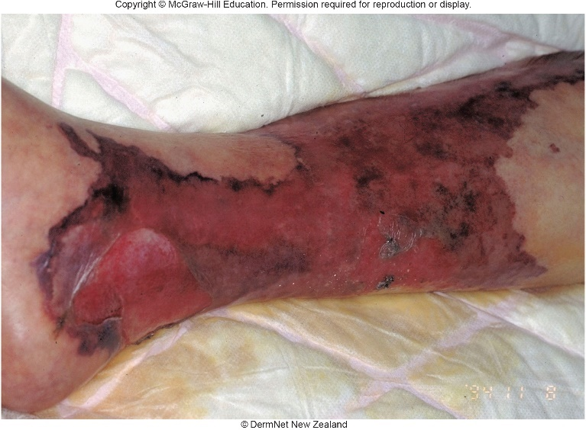
Common Bacterial Infections of Wounds – Figure 23.5
Group A streptococcal “flesh-eating disease”
Signs and symptoms
Fulminant disease: appears suddenly and progresses over a few hours, very serious
Acute/subacute disease progresses over several days
Severe pain at wound site
Swelling stretches, discolors skin
Fever, confusion develop
Without treatment, shock and death usually follow shortly
©DermNet New Zealand
Notes:
19

Slide 20
Common Bacterial Infections of Wounds (6)
Group A streptococcal “flesh-eating disease”
Causative agent
Streptococcus pyogenes is β-hemolytic, Gram-positive, chain-forming, aerotolerant anaerobe
Lancefield group A cell wall polysaccharide and capsule of hyaluronic acid
Pathogenesis
F protein helps in colonization
Enzymes destroy subcutaneous fatty tissue and fascia
Streptokinases break blood clots
Hyaluronidases break connections between cells
Deoxyribonucleases break down DNA
Streptolysins break down red blood cells, neutrophils

Slide 21
Common Bacterial Infections of Wounds (7)
Group A streptococcal “flesh-eating disease”
Pathogenesis
Virulent strains produce damaging streptococcal pyrogenic exotoxins (SPEs)
SPE A: superantigen that causes toxic shock
SPE B: protease that destroys tissue; intense swelling
M protein binds fibrinogen: complex activates neutrophils that release inflammatory molecules increasing vascular permeability
Life-threatening drop in blood pressure and shock
M protein also helps avoid phagocytosis by breaking down complement protein C3b

Slide 22
Common Bacterial Infections of Wounds (8)
Group A streptococcal “flesh-eating disease”
Epidemiology
Very few deaths from S. pyogenes infections in U. S. are due to necrotizing fasciitis; rare in healthy individuals
Risk factors include diabetes, cancer, alcoholism, AIDS, recent surgery, abortion, childbirth, chickenpox, injected-drug abuse
Treatment and prevention
Toxins spread so rapidly that immediate surgery often essential to remove dead tissue and reduce pressure
Combination of broad-spectrum antibiotics given intravenously; supportive care
Vaccines against M proteins being tested in animals

Slide 23
Table 23.3 Necrotizing Fasciitis
Signs and symptoms | Severe pain and swelling at wound site; skin discoloration; fever, confusion, and shock
Incubation period | Varies; several hours in fulminant disease to several days in less severe cases
Causative agent | Streptococcus pyogenes, Lancefield group A β-hemolytic streptococci
Pathogenesis | Organism attaches and colonizes using protein F, then destroys muscle and organ fascia by releasing destructive enzymes and exotoxins; strong inflammatory response caused by M protein.
Epidemiology | Very rare; most cases occur in people with predisposing conditions such as diabetes, cancer, AIDS, and alcoholism, among others.
Treatment and prevention | Treatment: aggressive treatment essential with removal of affected tissue (debridement), or sometimes amputation, and intravenous antibiotics. Supportive care also given. Prevention: no proven preventive measures.

Slide 24
Common Bacterial Infections of Wounds (9)
Pseudomonas aeruginosa infections
Opportunistic pathogen; major cause of healthcare-associated infection
Lung infections, wound infections (thermal burns)
Occasionally causes community-acquired infections
Skin rashes, external ear canal from pools/hot tubs
Eyes from contaminated contact lens solutions
Bone from puncture wounds
Heart valves in injection-drug abusers
Soft tissues from procedures like ear-piercing
Often forms biofilms in lungs of people with cystic fibrosis

Slide 25
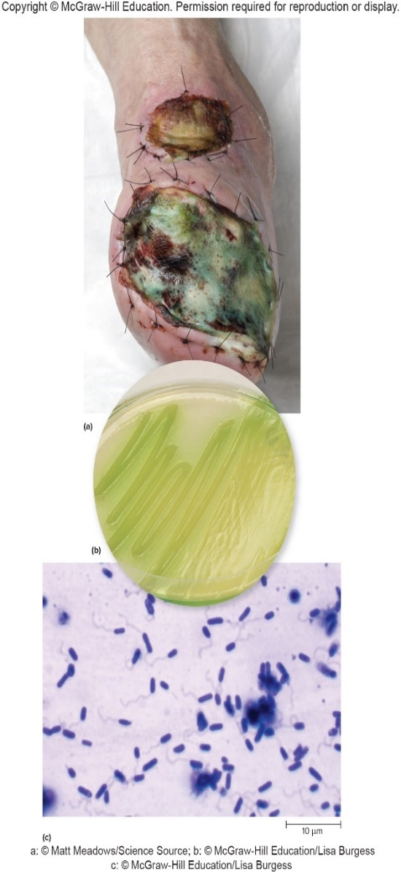
Common Bacterial Infections of Wounds – Figure 23.6
Pseudomonas aeruginosa infections
Signs and symptoms
Chills, fever, skin lesions, shock
Characteristic green pus
Causative agent: Pseudomonas aeruginosa
Gram-negative rod with polar flagellum
Found in soils, water
Aerobic; respires anaerobically in absence of $O_{2}$ if nitrate is present important in biofilm formation
a: ©Matt Meadows/ Science Source; b: ©McGraw-Hill Education/Lisa Burgess c: ©McGraw-Hill Education/Lisa Burgess

Slide 26
Common Bacterial Infections of Wounds (10)
Pseudomonas aeruginosa infections
Pathogenesis
Expands tissue damage, delays healing, increases risk of septic shock
Exotoxin A stops host cell protein synthesis
Exoenzyme S (ExoS)
Prevents phagocytosis, causes apoptosis of host cells
Destroys lecithin; membrane disruption and cell death
Destroys collagen, elastin helping organism to spread
Pigments are virulence factors
Pyocyanin plays role in biofilm formation
Pyoverdin is siderophore used to acquire iron, a limiting nutrient, from host

Slide 27
Common Bacterial Infections of Wounds (11)
Pseudomonas aeruginosa infections
Epidemiology
Pseudomonas aeruginosa widespread in nature, grows in most places that have moisture
Soaps, ointments, eye drops, contact lens solutions, cosmetics, disinfectants, swimming pools, hot tubs, even distilled water
Introduced into hospitals on ornamental plants, flowers, fruit baskets
Not allowed in burn wards or intensive care units
Also found on hospital equipment, soles of shoes, illegal injectable drugs

Slide 28
Common Bacterial Infections of Wounds (12)
Pseudomonas aeruginosa infections
Treatment and prevention
Resistant to many antibiotics; form biofilms that increase resistance to treatment
Only a few antimicrobial medications effective, and not against all strains
Sensitivity tests determine most appropriate medication
Eliminate possible sources of infection; treat wounds promptly; remove dead tissue from burn wounds; apply antibacterial cream
Notes:
28

Slide 29
Table 23.4 Pseudomonas Infections
Signs and symptoms | Chills, fever, skin lesions, and shock; green-colored pus
Incubation period | Variable, depending on site of infection
Causative agent | Pseudomonas aeruginosa; a Gram-negative motile rod that can respire both aerobically and anaerobically
Pathogenesis | Uses flagellum and pili for attachment and colonization. Secretes exotoxin A and injects effector proteins that alter cell activities; produces toxins that disrupt host cytoplasmic membranes; pigments contribute to pathogenicity.
Epidemiology | Widespread organism carried on vegetation; difficult to avoid.
Treatment and prevention | Treatment: antibiotics, although resistance and biofilm formation are problematic. Prevention: eliminating bacterial source; proper wound care, including removal of dead tissue.

Slide 30
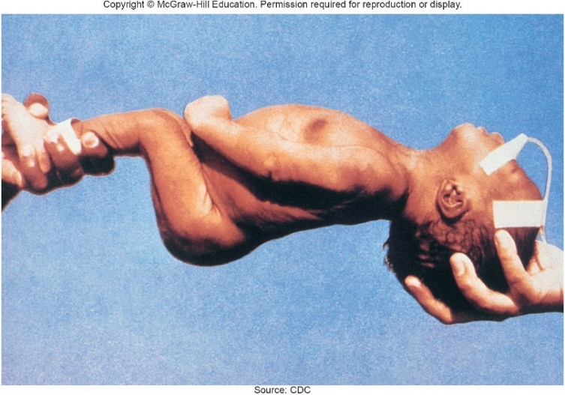
Diseases Due to Anaerobic Bacterial Wound Infections – Figure 23.7 (1)
Tetanus (lockjaw)
Signs and symptoms
About a week after infection, irritability, difficulty swallowing, muscle spasms (often starting in the jaw)
Then continuous, painful, uncontrollable muscle spasms
Breathing becomes difficult, abnormal heart rhythms may occur, bones can fracture; severe pain
Death may follow lung damage from pneumonia or regurgitation of stomach contents
Neonatal tetanus may occur 4 to 14 days after birth; as mouth muscles are affected, baby cannot feed
Source: CDC

Slide 31
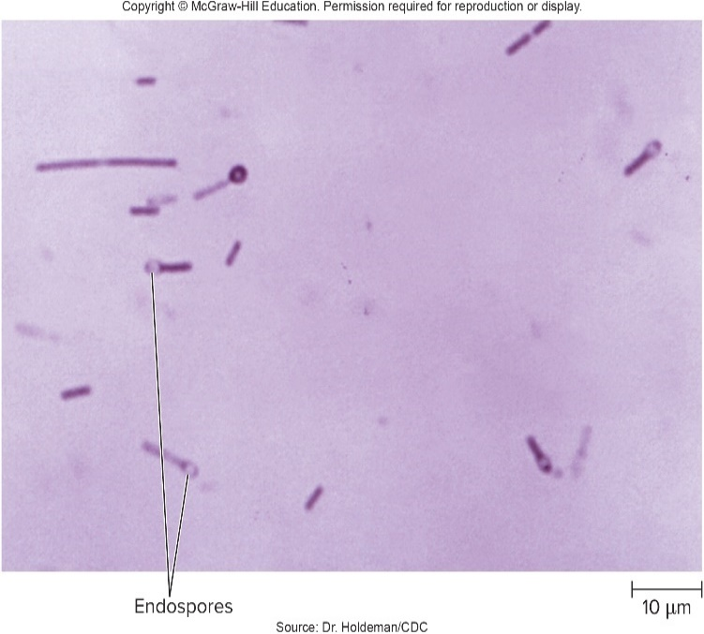
Diseases Due to Anaerobic Bacterial Wound Infections – Figure 23.7 (2)
Tetanus
Causative agent: Clostridium tetani
Anaerobic, Gram-positive, rod-shaped; forms spherical endospore at one end of cell; has swarming growth that quickly spreads over media surface
Pathogenesis
Not invasive; colonization localized to wound
Exotoxin tetanospasmin released from cells
Causes spastic paralysis (uncontrolled contraction)
A-B toxin
Source: Dr. Holdeman/CDC

Slide 32
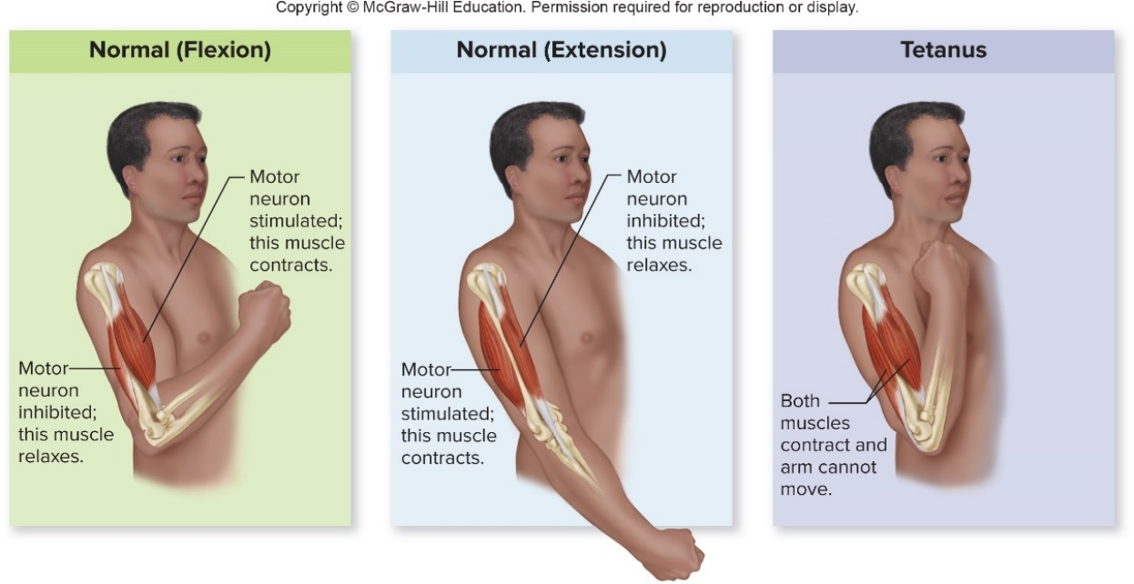
Diseases Due to Anaerobic Bacterial Wound Infections – Figure 23.9
Tetanus
Pathogenesis
B subunit attaches to receptor on motor neurons
A subunit taken up and toxin travels to neuron cell body in spinal cord
Prevents release of neurotransmitter from inhibitory neurons; muscles contract without control

Slide 33
Diseases Due to Anaerobic Bacterial Wound Infections (1)
Tetanus
Epidemiology
C. tetani widespread in dirt and dust, also in feces of those who have eaten endospore-contaminated food
Anaerobic puncture wounds: stepping on a nail, body piercing, tattooing, animal bites, splinters, injected-drug abuse, insect stings, also surgery; abrasions, and burns if anaerobic due to dirt, dead tissue
In developed world, individuals who get tetanus either not immunized, or missed scheduled booster shot
In developing world, vaccination less available
Improper wound care
Neonatal tetanus from cutting umbilical cord with contaminated instruments

Slide 34
Diseases Due to Anaerobic Bacterial Wound Infections (2)
Tetanus
Treatment and prevention
Clean wound to avoid anaerobic conditions
Human tetanus immune globulin (TIG) injection
Antibodies bind to free toxin molecules, provide passive immunity, but do not neutralize attached tetanospasmin or repair nerve damage
Muscle relaxants, supportive care necessary
Antibiotics kill actively dividing vegetative cells
Tetanus vaccine; tetanus toxoid (inactivated tetanospasmin)

Slide 35
Table 23.5 Tetanus Prevention in the Management of Wounds
Tetanus
Treatment and prevention
Vaccine (DTaP) includes diphtheria toxoid and acellular pertussis vaccine
Booster given every 10 years (Tdap)
Vaccinate pregnant mother to prevent neonatal tetanus
Recovery from tetanus does not provide immunity
 | CLEAN MINOR WOUNDS | CLEAN MINOR WOUNDS | ALL OTHER WOUNDS | ALL OTHER WOUNDS
Immunization History | Toxoid | TIG | Toxoid | TIG
Unknown, or fewer than three injections of toxoid | Yes | No | Yes | Yes
Fully vaccinated (three or more injections of toxoid)
5 years or less since last dose | No | No | No | No
5 to 10 years since last dose | No | No | Yes | No
More than 10 years since last dose | Yes | No | Yes | No
Notes:
35

Slide 36
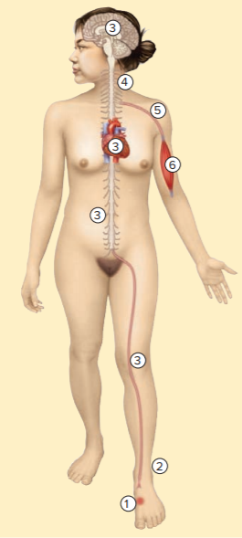
Table 23.6 Tetanus (“Lockjaw”)
Clostridium tetani spores from dust or dirt enter a wound.
In anaerobic wounds, the spores germinate, and vegetative bacteria release an exotoxin called tetanospasmin.
Tetanospasmin is carried to the central nervous system by motor nerve axons or by the bloodstream.
The toxin prevents any inhibitory neurons it reaches from functioning.
Other neurons that cause muscle contraction act unopposed, causing muscle spasms.
The result is a sustained, painful cramp-like muscle spasm.
Signs and symptoms | Restlessness, irritability, difficulty swallowing; muscle pain and spasm in jaw, abdomen, back, or entire body.
Incubation period | 3 days to 3 weeks; average 8 days
Causative agent | Clostridium tetani, an anaerobic, spore-forming, Gram-positive rod
Pathogenesis | Tetanus results from tetanospasmin, an A-B exotoxin produced by the bacterium. The toxin is carried to the brain and spinal cord by motor nerve axons or circulating blood; toxin acts against nerve cells that normally inhibit muscle contraction. Other nerves that normally cause muscle contraction then act unopposed, causing muscle spasms.
Epidemiology | Organisms common in soil; spores contaminate wounds, germinate in those having anaerobic conditions, particularly dirty or puncture wounds.
Treatment and prevention | Treatment: antibiotics and tetanus immune globulin (TIG); supportive care also given. Prevention: immunization of infants and children with toxoid; boosters for adults.

Slide 37
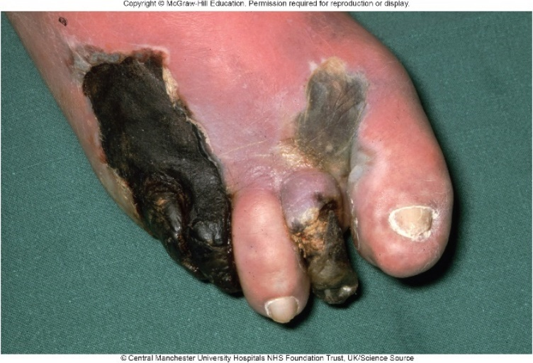
Diseases Due to Anaerobic Bacterial Wound Infections (3)
Clostridial myonecrosis (“gas gangrene”)
Before antibiotics, killed many wounded soldiers; mostly in untended wounds because agent requires anaerobic conditions for growth
Signs and symptoms
Severe pain, swelling, and fluid leaks from wound; may look frothy (gas bubbles); incubation period 1 to 5 days
Tight skin mottled with black
Near death, victim becomes delirious and goes into coma
Causative agent:
Clostridium perfringens most common
Encapsulated, Gram-positive anaerobic rod
©Central Manchester University Hospitals NHS Foundation Trust, UK/Science Source

Slide 38
Diseases Due to Anaerobic Bacterial Wound Infections (4)
Clostridial myonecrosis
Pathogenesis
Two main factors in disease development
Presence of dirt and dead tissue in wound
Long delays before wound is treated
In poorly oxygenated tissues, α-toxin destroys lecithin in host cell membranes, resulting in cell lysis
Collagenase and hyaluronidase break down host tissues
Organisms ferment breakdown products, releasing gases that increase pressure and aid spread of toxins
Without treatment, α-toxin diffuses into bloodstream, destroys red blood cells, tissue capillaries
Widespread cytokine release leads to shock, organ failure

Slide 39
Diseases Due to Anaerobic Bacterial Wound Infections (5)
Clostridial myonecrosis
Epidemiology
C. perfringens widespread in soil, common in feces of animals, humans; sometimes in vagina of healthy women
Gas gangrene occurs in trauma wounds and occasional surgical wounds; in uterus after self-induced abortions, occasionally after miscarriages or childbirth
Arteriosclerosis or diabetes (poor oxygenation of tissue) and cancer are predisposing factors
Treatment and prevention
Prompt removal of all dead and infected tissue; perhaps amputation
Antibiotics, perhaps hyperbaric oxygen treatment
No available vaccine

Slide 40
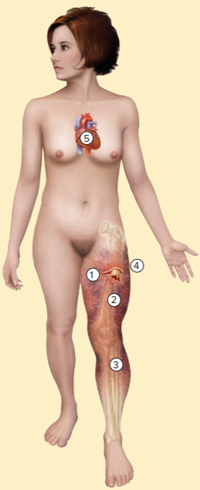
Table 23.7 Clostridial Myonecrosis (“Gas Gangrene”)
Clostridium perfringens spores enter a wound that has two essential characteristics: dead tissue and anaerobic conditions.
The spores germinate, and the vegetative bacteria multiply in dead tissue, producing α-toxin.
α-Toxin diffuses into normal tissue and kills it. The infection spreads into the dead tissues as bacterial enzymes break down host cells.
Swelling occurs; gas produced by fermentation aids rapid progress of the infection.
Massive amounts of α-toxin are produced and diffuse into the bloodstream, destroying blood cells and other cells throughout the body. Systemic response to the damage leads to shock and organ failure.
Signs and symptoms | Severe pain; gas and fluid seep from wound, blackening of overlying skin; shock and death commonly follow.
Incubation period | Usually 1 to 5 days
Causative agent | Usually Clostridium perfringens; other clostridia less frequently.
Pathogenesis | Organism grows in dead and poorly oxygenated tissue and releases α-toxin; toxin kills leukocytes and normal tissue cells by degrading lecithin in their cell membranes; systemic response to the damage leads to shock and organ failure.
Epidemiology | Trauma wounds; dirt contamination of wounds, tissue death, impaired circulation to tissue as in people with diabetes or arteriosclerosis; self-induced abortions.
Treatment and prevention | Treatment: surgical removal of dirt and dead tissues of primary importance; hyperbaric $O_{2}$ of possible value; antibiotics to kill vegetative C. perfringens. Prevention: prompt cleaning and debridement of wounds; no vaccine available.

Slide 41
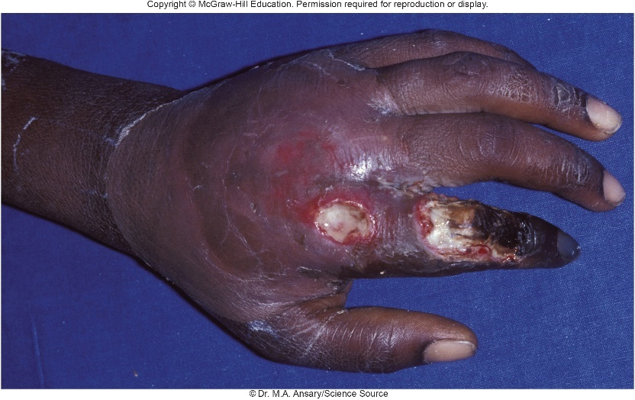
Bacterial Infections of Bite Wounds – Figure 23.11
More than 3 million animal bites in U.S. annually
Infection risk depends on type of wound (crushing, lacerated, or puncture) and pathogens in animal’s mouth
Human bites
Can result in serious infections from normal mouth microbiota; occasionally diseases when agents are in blood or saliva
Signs and symptoms
Within a few hours, may become painful, swell, leak foul-smelling pus
Causative agents
Usually members of normal mouth microbiota including streptococci, fusiforms, spirochetes, Bacteroides species, with Staphylococcus aureus
©Dr. M.A. Ansary/Science Source

Slide 42
Bacterial Infections of Bite Wounds (1)
Human bites
Pathogenesis
Bite wounds usually infected with both aerobic and anaerobic species
Crushed tissue, facultative anaerobes create anaerobic conditions that allow anaerobes to establish infection
Alone, usually harmless; together, produce large numbers of toxins and enzymes including leukocidin, collagenase, hyaluronidase, ribonuclease, various proteinases, neuraminidase, and enzymes that destroy complement system proteins and antibodies; yield synergistic infection
Epidemiology
Most result from fights related to drunkenness or during forcible restraint; poor mouth hygiene increases risk

Slide 43
Table 23.8 Human Bite Wound Infections
Human bites
Treatment and prevention
Should be treated immediately to avoid serious infections
Opening infected area with scalpel, washing wound with sterile fluid, removing dirt, foreign matter, dead tissue
Multiple antibacterial medications
Avoiding situations that lead to biting and hitting
Prompt cleaning of wound and application of antiseptic can help prevent infection
Signs and symptoms | Rapid onset, pain, massive swelling, drainage of foul-smelling pus
Incubation period | Usually 6 to 24 hours
Causative agent | Mixed mouth microbiota: anaerobic streptococci, fusiforms, spirochetes, anaerobic Gram-negative rods; sometimes Staphylococcus aureus
Pathogenesis | Various mouth bacteria act synergistically to destroy tissue.
Epidemiology | Fighting; forcible restraint; poor mouth care and extensive dental disease.
Treatment and prevention | Treatment: antibiotics and surgery. Prevention: no proven preventive measures except to avoid fights: prompt cleaning of wound and application of antiseptic is advised.

Slide 44
Bacterial Infections of Bite Wounds (2)
Pasteurella multocida bite wound infections
Single species causes bite infections from many animals
Signs and symptoms
Within 24 hours spreading redness, tenderness, swelling; then pus discharge; abscesses common
Can lead to bloodstream invasion, loss of function
Causative agent: Pasteurella multocida
Gram-negative, facultatively anaerobic encapsulated coccobacillus
Pathogenesis
Details unknown; some strains produce toxin that affects protein synthesis and cell cycle regulation
Can cause bacteremia, leading to endocarditis, meningitis

Slide 45
Table 23.9 Pasteurella multocida Bite Wound Infections
Pasteurella multocida bite wound infections
Epidemiology
Humans and many animals carry P. multocida as normal oral and upper respiratory microbiota, serve as reservoirs
Cats more likely to carry than dogs
Treatment and prevention
Signs and symptoms | Spreading redness, tenderness, swelling, discharge of pus.
Incubation period | 24 hours or less
Causative agent | Pasteurella multocida, a Gram-negative, facultatively anaerobic, encapsulated coccobacillus
Pathogenesis | P. multocida introduced by bite, resists phagocytes because encapsulated; may produce a cytotoxin that kills host cells.
Epidemiology | Carried by many animals in their mouth or upper respiratory tract.
Treatment and prevention | Treatment: antibiotics, effective if given promptly. Prevention: no vaccine available for humans; prompt wound care.
Susceptible to penicillin
β-lactamase inhibitor given since wound may contain β-lactamase producing Staphylococcus aureus
No vaccine
Immediate cleaning

Slide 46
Bacterial Infections of Bite Wounds (3)
Bartonellosis (“cat scratch disease”)
Signs and symptoms
Pus-filled pimple appears within a week of scratch or bite
Within 1 to 7 weeks, nearby lymph nodes enlarge painfully
Possible fever; lymph nodes may be pus-filled and soft
Disease generally disappears without treatment in 2 to 4 months; small number have complications
Causative agent
Bartonella henselae: curved, Gram-negative rod
Pathogenesis: largely unknown
Entry via cat bite or scratch or from cat saliva contaminating mucous membrane
May enter bloodstream, causing complications

Slide 47
Table 23.10 Bartonellosis (“Cat Scratch Disease”)
Bartonellosis
Epidemiology
Occurs worldwide, often in children and young adults
Zoonosis of cats
No person to person spread
Transmission cat to cat by fleas; may transmit to humans
Treatment and prevention
Prompt cleaning of scratch or bite followed by antiseptic
Severe infections usually respond to antibacterial medications
Avoiding stray cats, fleas
Signs and symptoms | Pimple appears at the bite or scratch site, followed by local lymph node enlargement; nodes may soften and drain pus; prolonged fever and convulsions indicate spread to other body parts. Complications (peliosis hepatis or bacillary angiomatosis) may occur, mostly in people with AIDS.
Incubation period | Usually less than 1 week
Causative agent | Bartonella henselae, a Gram-negative rod
Pathogenesis | Bacteria enter with cat bite or scratch and reach lymph nodes, where the disease is usually stopped.
Epidemiology | A zoonosis, spread among cats by fleas. No person-to-person spread.
Treatment and prevention | Treatment: antibiotics. Prevention: promptly washing wounds, applying antiseptic; avoiding rough play with cats and keeping them free of fleas.

Slide 48
Bacterial Infections of Bite Wounds (4)
Streptobacillary rat bite fever
Signs and symptoms
Bite wound usually heals promptly
2 to 10 days later, person develops chills, fever, head and muscle aches, vomiting
Fever comes and goes; rash in a few days, then joint pain
Causative agent: Streptobacillus moniliformis
Facultatively anaerobic, Gram-negative pleomorphic rod; spontaneously develops L-forms lacking cell wall
Pathogenesis
Entry via bite, scratch or sometimes ingestion
Bacteria quickly enter bloodstream
Recovery in 2 weeks; some develop fatal complications

Slide 49
Bacterial Infections of Bite Wounds (5)
Streptobacillary rat bite fever
Epidemiology
Many healthy rodents carry S. moniliformis in nose, throat
Laboratory, pet store workers at increased risk
Epidemics due to consumption of food/liquid contaminated by rodent feces
Exposure to animals that have eaten rodents
Treatment and prevention
Penicillin given intravenously
Control of wild rat populations; care in handling laboratory rats and feces

Slide 50
Table 23.11 Streptobacillary Rat Bite Fever
Signs and symptoms | Chills, fever, muscle aches, headache, and vomiting; later, rash and pain in one or more of the large joints
Incubation period | Usually 2 to 10 days (range, 1 to 22) after a rat bite
Causative agent | Streptobacillus moniliformis, a highly pleomorphic, Gram-negative bacterium
Pathogenesis | S. moniliformis invades bloodstream, spreads throughout body. Most patients recover without treatment but occasionally life-threatening complications (brain abscesses, endocarditis) occur.
Epidemiology | Transmitted by rats or other animals that prey on them; may also be spread by food or drink contaminated with rat feces.
Treatment and prevention | Treatment: antibiotics. Prevention: controlling wild rats and mice; care in handling laboratory animals.

Slide 51
Fungal Wound Infections (1)
Usually more serious than cutaneous mycoses
Typically caused by soil fungi that enter via injuries
Sporotrichosis (“rose gardener’s disease”)
Signs and symptoms
Chronic ulcer forms, usually within 1 to 3 weeks
Series of ulcerating nodules that develop toward center of body
Lymph nodes enlarge, but patients generally do not become ill unless immunocompromised

Slide 52
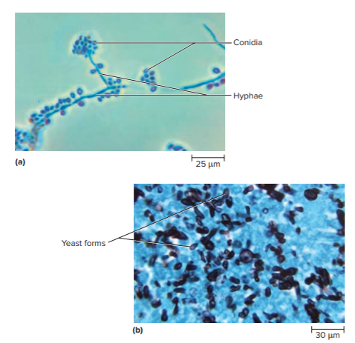
Fungal Wound Infections – Figure 23.12
Sporotrichosis
Causative agent:
Sporothrix schenckii
Dimorphic fungus
Soil, vegetation
a: Source: Dr. Libero Ajello/CDC; b: Source: Dr. Libero Ajello/CDC
Notes:
52

Slide 53
Fungal Wound Infections (2)
Sporotrichosis
Pathogenesis
Conidia enter through injury caused by plant material
Small pimple slowly enlarges, ulcerates, produces painless red lesion that easily bleeds
After a week or more, process repeats, following flow of lymphatic vessel
Epidemiology
Mostly associated with puncture wounds from plant material; farmers, carpenters, gardeners
Can be transmitted by infected animals
Risk factors include immunosuppression, diabetes, alcoholism, lung disease

Slide 54
Table 23.12 Sporotrichosis (“Rose Gardener’s Disease”)
Sporotrichosis
Treatment and prevention
Antifungal medications
Oral potassium iodide (KI) used in developing regions
Prevention includes wearing protective gloves, clothing
Signs and symptoms | Painless, ulcerating nodules appearing in sequence in a linear pattern
Incubation period | Usually 1 to 3 weeks
Causative agent | Sporothrix schenckii, a dimorphic fungus
Pathogenesis | Fungal cells multiply at site of introduction, causing a small nodule that ulcerates. Fungi carried by lymph flow repeat the process along the lymphatic vessel. May spread beneath the skin irrespective of lymphatic vessels.
Epidemiology | Distributed worldwide in tropical and temperate climates. Veterinarians and people in occupations that require contact with sharp plant materials are at particular risk.
Treatment and prevention | Treatment: antifungal medications. Prevention: protective gloves and clothing when handling plant material, avoiding scratches by infected animals.

Slide 55
Appendix of Image Long Description

Slide 56
Anatomy, Physiology, and Ecology – Figure 23.2 Long Description
Step 1: Microorganisms enter the tissue from a wound or from the bloodstream. Step 2: Blood vessels dilate, and leukocytes migrate to the area of the developing infection. Step 3: Pus forms and an abscess develops; clotting occurs in adjacent blood vessels. Step 4: Buildup of pressure causes the abscess to expand in the direction of least resistance. If it reaches a body surface, it may rupture and discharge its contents.
Jump back to Anatomy, Physiology, and Ecology – Figure 23.2

