Slide 1
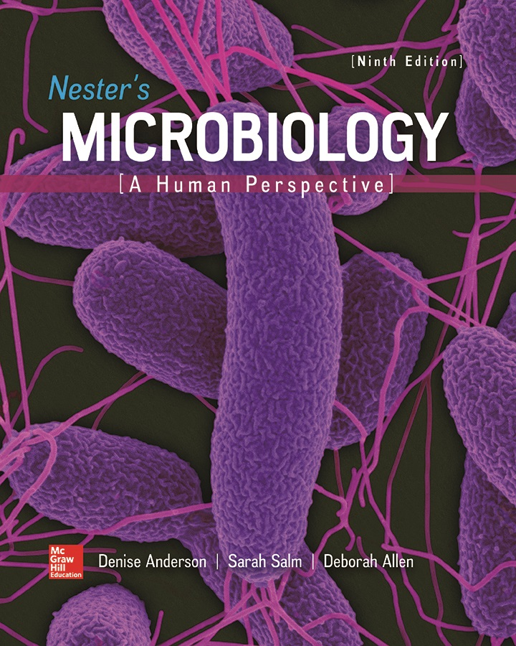
Chapter 24 Lecture Outline
See separate PowerPoint slides for all figures and tables pre-inserted into PowerPoint without notes.
Notes:
1

Slide 2
A Glimpse of History
Sanskrit writings document that cholera likely originated in Far East thousands of years ago
Increased shipping, mobility in 19th century allowed spread from Asia to Europe and then North America
Caused major epidemics in 19th century
John Snow (London physician) demonstrated cholera transmitted by contaminated water in 1854
During outbreak, observed victims got water from well on Broad Street; neighbors elsewhere unaffected
Even though germ theory not yet described, Snow convinced authorities to remove handle on pump
Number of new cases decreased
In 1883, Robert Koch isolated Vibrio cholerae

Slide 3
Introduction
Cholera outbreak in Haiti in 2010, one year after a major earthquake
Within a month, 16,000 cases and approximately 1,000 deaths
Public health groups set up treatment and prevention facilities, educated the public, and trained workers
Since 2010, epidemic sickened approximately 800,000, killed approximately 9,400
Long-term solution requires improvements to country’s water treatment and sanitation facilities
In 2016, up to 50% of residents still lacked reliable access to clean water

Slide 4
Anatomy, Physiology, and Ecology
Function of digestive system is to convert foods into absorbable nutrients to use for energy and raw materials for growth
Digestive tract: Hollow tube from mouth to anus
Gastrointestinal tract refers to stomach and intestines
Accessory organs include salivary glands, liver, pancreas
Major boundary with environment
Contents provide ready source of food for microbes
Mucous membrane only one cell layer thick separates microbial population from underlying tissue
Damage allows microbes to penetrate; ingested pathogens often have mechanisms to breach

Slide 5
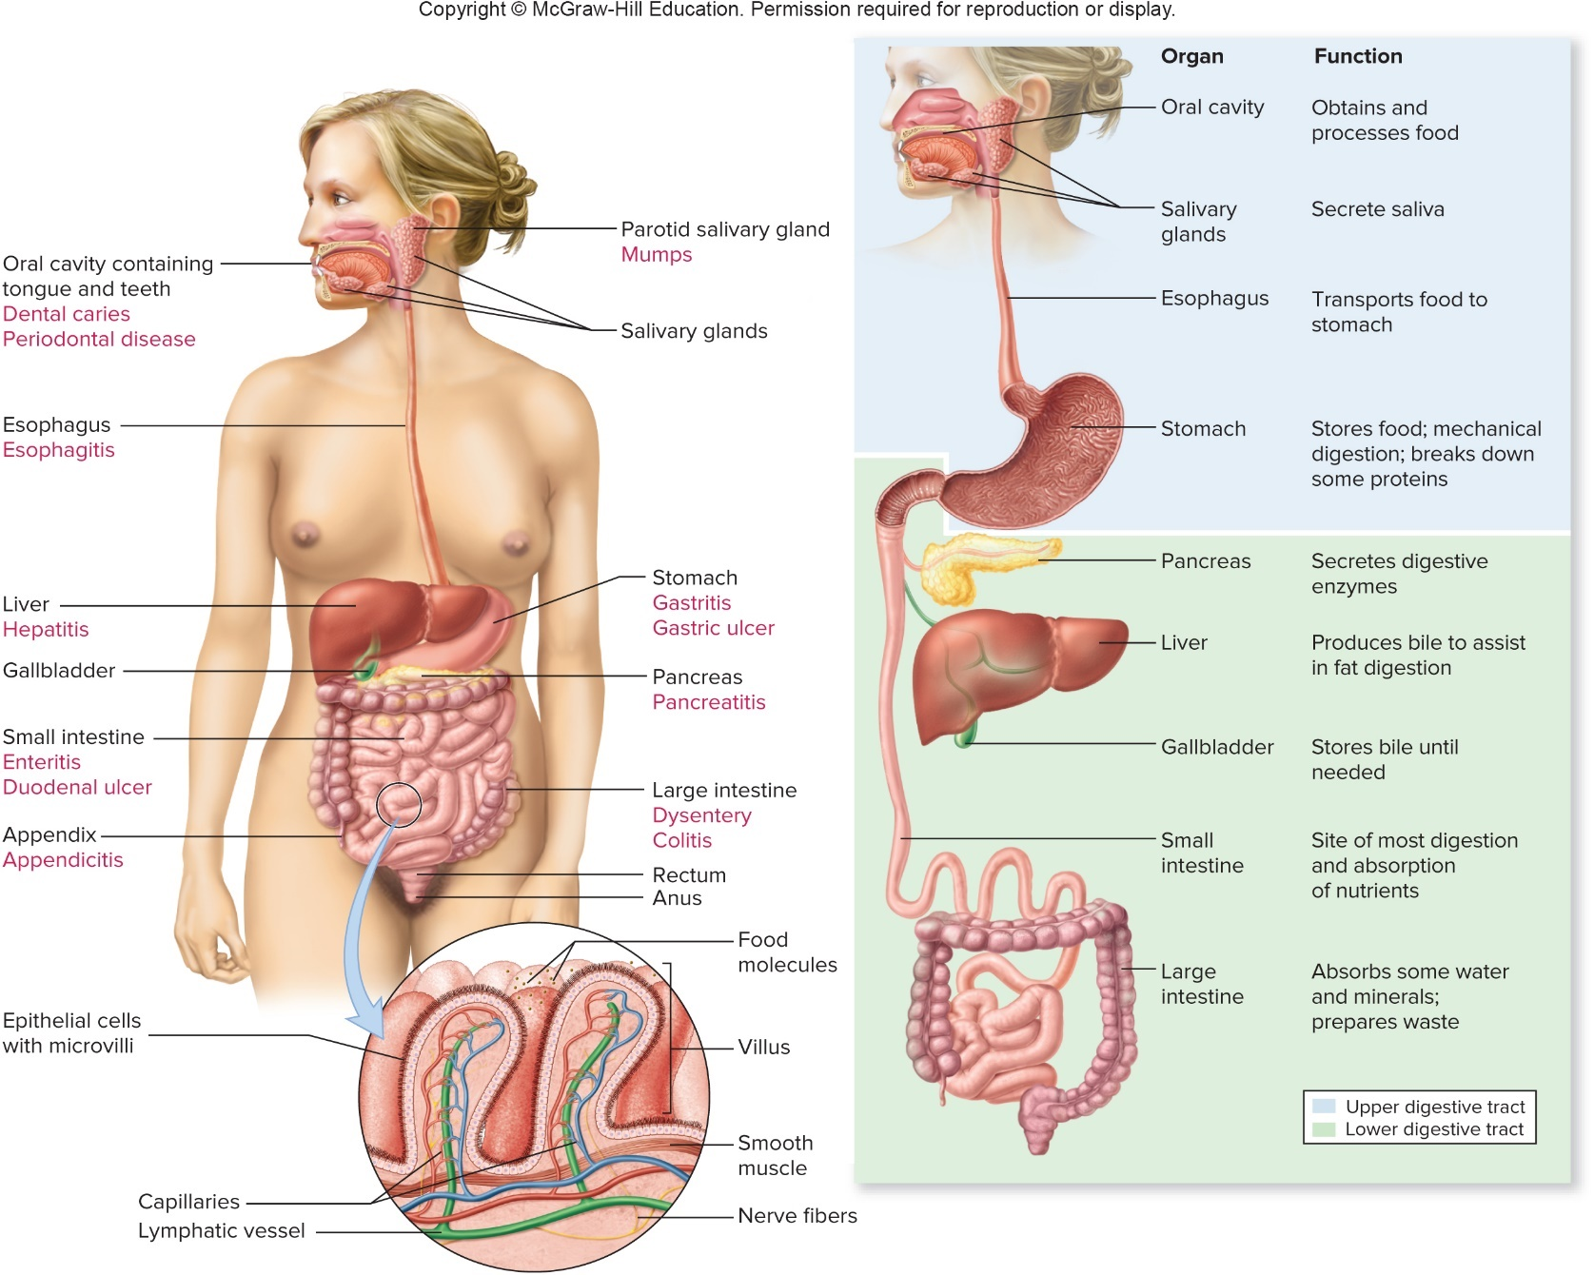
Anatomy, Physiology, and Ecology – Figure 24.1
Jump to Anatomy, Physiology, and Ecology – Figure 24.1 Long Description

Slide 6
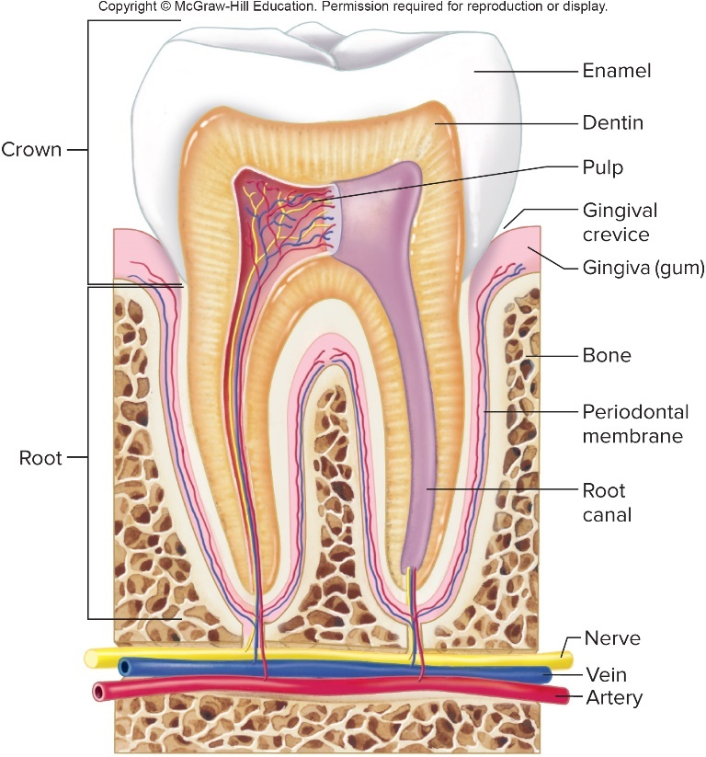
Anatomy, Physiology, and Ecology – Figure 24.2
The upper digestive system
Includes mouth, salivary glands, esophagus, stomach
The mouth and salivary glands
Chewing grinds food into smaller pieces; saliva moistens, while amylase begins breakdown of starches
Teeth protected by enamel
Proteinaceous material from saliva adheres, creates thin film (pellicle)
Bacteria attach, create biofilm called dental plaque
Mineral salts deposit over time, create dental calculus or tartar

Slide 7
Anatomy, Physiology, and Ecology (1)
The upper digestive system
The mouth and salivary glands
Damage to enamel allows microorganisms to enter tooth, cause decay or dental caries
Microbes can accumulate in gingival crevice
Gums become inflamed in response: gingivitis
May recede from tooth root, allow bacteria access
About 1,500 milliliter saliva produced daily
Largest glands are the parotid glands
Rich in protective secretory IgA, antibacterial lysozyme, lactoferrin
Over 600 types of bacteria found in mouth; members of Streptococcus most common
Obligate anaerobes associated with halitosis

Slide 8
Anatomy, Physiology, and Ecology (2)
The upper digestive system
The esophagus: muscular tube from mouth to stomach
Peristalsis pushes food toward stomach
Mucus and saliva containing secretory IgA bathes lining
Microbial population relatively sparse
The stomach
Expandable, sac-like structure with muscular wall
Breaks down and stores food
Highly acidic gastric juices denature proteins, activate pepsinogen to form protein-digesting enzyme pepsin
Cells lining stomach protected by alkaline mucus
Most bacterial cells cannot survive, so normal empty stomach has few

Slide 9
Anatomy, Physiology, and Ecology (3)
The lower digestive system
Small and large intestines, pancreas, liver
The small intestine
As stomach contents enter, pancreas and liver add alkaline digestive fluids that neutralize acid
Emulsifying agent bile, helps break down fat globules; help absorb oils, fats, fat-soluble vitamins
Residents resistant to bacteriocidal effects
Villi, microvilli increase surface area to about 250 meters squared
Major role in nutrient and fluid absorption: approximately 9 liters/day
Amino acids, monosaccharides taken up by active transport that brings in
Fatty acids, vitamins, minerals absorbed
Dendritic cells, M cells, and Peyer’s patches monitor bacterial population

Slide 10
Anatomy, Physiology, and Ecology (4)
The lower digestive system
The large intestine
Absorbs water; vitamins produced by resident microbiota
Bacteria make up about one-third of fecal weight
Anaerobic bacteria make up approximately 99% of population; facultative anaerobes make up balance
Degrade wide variety of foods including substances (for example, fibers) indigestible by stomach, small intestines
Important to human health: synthesize vitamins (like niacin, thiamine, riboflavin,, vitamin
folic acid, vitamin K)
Prevent pathogens from colonizing; stimulate mucosal immunity; opportunistic pathogens
Antibiotic treatment causes dysbiosis (imbalance in normal microbiota), that may lead to antibiotic-associated diarrhea

Slide 11
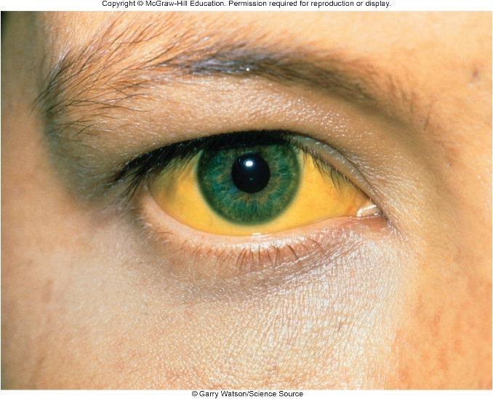
Anatomy, Physiology, and Ecology (5)
The lower digestive system
The pancreas: located behind stomach
Produces hormones, alkaline digestive enzymes
The liver: upper right portion of abdomen
Produces bile, which is concentrated and stored in gallbladder; released into upper intestine
Severe liver disease or obstruction of bile ducts can cause jaundice, yellow color of skin and eyes from buildup of bile component bilirubin in blood
Inactivates toxic substances (for example, ammonia, medications)
©Garry Watson/Science Source

Slide 12
Bacterial Diseases of the Upper Digestive System (1)
Dental caries (tooth decay)
Most common chronic disease; in 60% of U.S. teens
Signs and symptoms
Usually advanced before symptoms develop
Discoloration, roughness, defect; tooth may break
Severe throbbing pain of toothache usually first sign
Causative agent
Streptococcus mutans, related Gram-positive cocci are cariogenic (caries generating); live only on teeth
Thrive in acidic environments
Produce lactic acid from fermentation
Convert sucrose into extracellular insoluble polysaccharides called glucans
Glucans essential for development of dental caries on smooth tooth surfaces

Slide 13
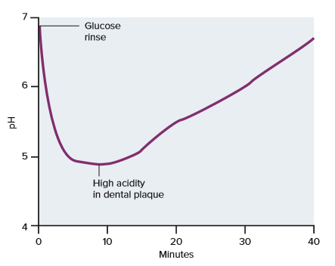
Bacterial Diseases of the Upper Digestive System (2)
Dental caries
Pathogenesis
Streptococci adhere to pellicle on tooth, create plaque
Split sucrose into glucose and fructose; polymerize glucose into glucans and ferment fructose
Lactic acid lowers pH; glucans create thicker biofilm
Following entry of sugar, pH of plaque in mouth drops from about 7 to below 5 in minutes
S. mutans, sucrose-rich diet required for dental caries on smooth teeth
Plaque can accumulate in fissures or pits in absence of S. mutans

Slide 14
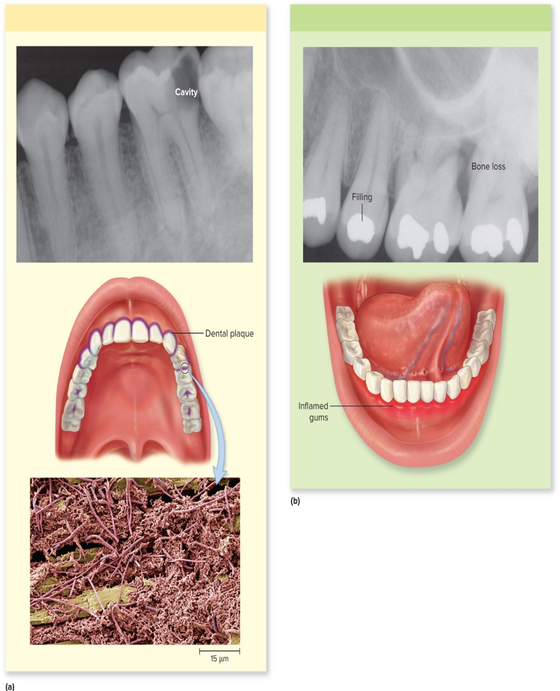
Bacterial Diseases of the Upper Digestive System (3)
Dental caries
Tooth infection
Gum infection
a (top): ©Dr. Larry Hoffman; a (bottom): ©Steve Gschmeissner/Science Source; b: ©Dr. Larry Hoffman

Slide 15
Bacterial Diseases of the Upper Digestive System (4)
Dental caries
Epidemiology
Worldwide distribution; sucrose consumption, access to preventive dental care, genetics important factors
Incidence peaks during teen years, declines with age as pits and fissures on teeth wear down
Treatment and prevention
Drill out cavity, replace with filling, restore tooth contour
Restrict dietary sucrose, especially frequency and length of time sugary food remains on teeth
Fluoridation in U.S. has reduced dental caries by 60%
Brushing, flossing reduce incidence
Sealant can prevent caries

Slide 16
Bacterial Diseases of the Upper Digestive System (5)
Periodontal disease
Bacterial products in plaque near gum margin trigger inflammation
Gingivitis: swelling and redness of the gums
Chronic periodontitis: destructive response that damages structures that support teeth

Slide 17
Bacterial Diseases of the Upper Digestive System (6)
Periodontal disease
Signs and symptoms
Gingivitis: gums are tender, bleed easily
Occurs within days of plaque formation; goes away when plaque is removed
Chronic periodontitis: bad breath, red shiny gums that bleed easily, loosening of teeth
Base of teeth becomes discolored, gums recede
Causative agent
Mostly Gram-negative anaerobes: Poryphyromonas, Treponema, Tannerella, Prevotella, and others
Polymicrobial infections; hundreds of species in plaque
Notes:
17

Slide 18
Bacterial Diseases of the Upper Digestive System (7)
Periodontal disease
Pathogenesis
Plaque, tartar accumulate, extend into gingival crevice
Bacterial products incite inflammatory response
Microbes release tissue-degrading enzymes that widen and deepen gingival crevice; allow plaque to spread
Tissues detect LPS endotoxin, release pro-inflammatory cytokines that damage nearby tissues
Membrane attaching root to bone weakens, bone softens
Tooth becomes loose, may fall out
Epidemiology
Almost 90% at 65; smokers, impaired immunity are factors
Treatment and prevention
Cleaning, minor surgery; antibiotics, flossing and brushing

Slide 19
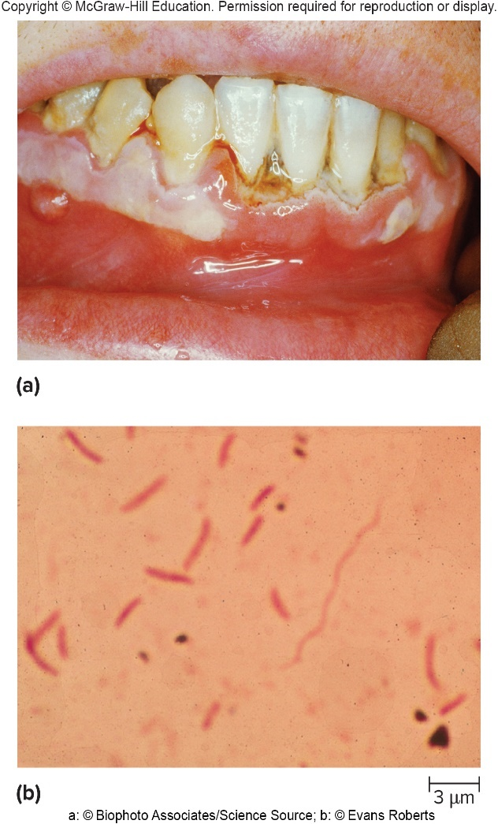
Bacterial Diseases of the Upper Digestive System (8)
Acute necrotizing ulcerative gingivitis (ANUG)
First called trench mouth, common during World War I
Since 2005, increase in ANUG associated with methamphetamine use: “meth mouth”
Signs and symptoms
Bleeding painful gums, abscessed and broken teeth, bad breath
Causative agent
Heavy growth of anaerobes at gum line
Polymicrobial infection that includes spirochetes
a: ©Biophoto Associates/Science Source; b: ©Evans Roberts

Slide 20
Bacterial Diseases of the Upper Digestive System (9)
Acute necrotizing ulcerative gingivitis
Pathogenesis
Precise mechanisms of tissue destruction unknown
Plaque always present with large numbers of spirochetes that invade tissue causing necrosis, ulceration
Methamphetamine use lowers saliva production
Tooth grinding increases risk of fracturing teeth
Epidemiology
Any age; poor oral hygiene, poor nutrition, high sugar diet, chronic stress, immunodeficiency; methamphetamine use
Treatment and prevention
Hydrogen peroxide, antibiotics; removing plaque and tartar
Daily brushing and flossing; professional cleaning 2x/year

Slide 21
Table 24.1 Important Infections of the Teeth and Gums
 | Dental Caries | Periodontal Diseases | Acute Necrotizing Ulcerative Gingivitis
Signs and symptoms | None until advanced disease; then roughness, discoloration, broken tooth, throbbing pain | Gingivitis characterized by tender, bleeding gums. Chronic periodontitis characterized by bad breath; red, shiny gums that bleed easily; loose teeth; and exposed bases of teeth | Pain, bleeding gums, abscessed and broken teeth, bone loss, and extremely bad breath
Incubation period | Months before cavity is detectable | Gingivitis—days; periodontitis—months or years | Undetermined
Causative agent | Cariogenic bacteria in dental plaque, particularly Streptococcus mutans | Anaerobic microbes in dental plaque | Probably a spirochete of the genus Treponema acting with other anaerobes
Pathogenesis | Bacteria in plaque produce acid from dietary sugars; slowly dissolves the tooth enamel; sucrose is critical for cariogenic plaque formation. | Plaque formed at the gum margins causes the inflammatory response associated with gingivitis. If plaque extends into the gingival crevices, the strong inflammatory response damages tissues that support the teeth, causing chronic periodontitis. | The spirochetes and certain other anaerobes act synergistically to destroy tissues. The spirochetes invade tissue, causing necrosis and ulceration.
Epidemiology | Worldwide distribution, incidence depending on dietary sucrose, natural or supplemental fluoride. More prevalent in the young. | Gingivitis can begin in childhood; periodontitis primarily affects older people, particularly smokers and immunodeficient individuals. | Associated with poor oral hygiene, malnutrition, immunodeficiency, or methamphetamine use. All ages are susceptible.
Treatment and prevention | Treatment: mechanical removal of plaque. Prevention: sealing pits and fissures in children’s teeth, restriction of dietary sucrose, supplemental fluoride. | Treatment: surgical treatment in severe cases of periodontitis to clean tooth roots. Prevention: avoid buildup of plaque. | Treatment: local treatment with possible antibiotic therapy, followed by removal of plaque and tartar. Prevention: avoid buildup of plaque.

Slide 22
Bacterial Diseases of the Upper Digestive System (10)
Helicobacter pylori gastritis
Barry Marshall drank culture of Helicobacter pylori in 1980s, demonstrated association with stomach ulcers
Signs and symptoms
Most infections asymptomatic
Gastritis with belching, vomiting may occur
Chronic gastritis can lead to stomach cancer
Peptic ulcers produce localized abdominal pain, tenderness, bleeding
Causative agent: Helicobacter pylori
Short, curved, Gram-negative microaerophile with multiple sheathed polar flagella

Slide 23
Bacterial Diseases of the Upper Digestive System (11)
Helicobacter pylori gastritis
Pathogenesis
H. pylori survives acidic environment of stomach
Produces urease, which converts urea to ammonia, creating alkaline microenvironment
Burrows within mucus layer that coats stomach lining
Avoids recognition by immune system receptors
VacA (vacuolating cytotoxin) promotes flow of urea, induces apoptosis in epithelial cells, interferes with T cells
CagA (cytotoxin-associated gene) in strains with higher risk of cancer; alters host cytoskeleton, cell signaling
Damage to epithelial cells and inflammatory response results in decreased mucus production, cell damage
Infections persist for years, often for life; 90% of those with stomach cancer are infected

Slide 24
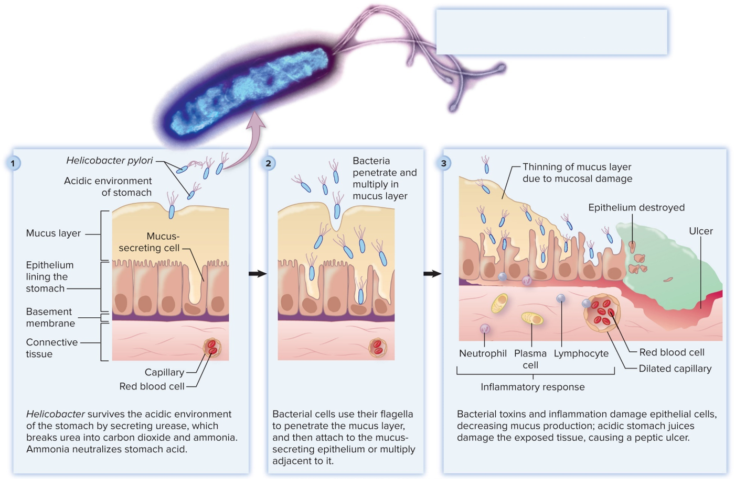
Bacterial Diseases of the Upper Digestive System (12)
$\begin{matrix}CO{\left({NH}_{2}\right)}_{2} \\ Urea\end{matrix} + H_{2}O \underset{→}{Urease} {CO}_{2} + \begin{matrix}{2NH}_{3} \\ Ammonia\end{matrix}$
Jump to Bacterial Diseases of the Upper Digestive System (12) Long Description
©Science Photo Library RF/Getty Images

Slide 25
Bacterial Diseases of the Upper Digestive System (13)
Helicobacter pylori gastritis
Epidemiology
About 1 in 5 adults in U.S. infected with H. pylori; incidence increases to approximately 80% for those over 75, clusters in families
Infection rates highest in low socioeconomic groups
Likely transmitted via fecal-oral route
Bacteria found in well water
Treatment and prevention
Antibiotics plus medication to inhibit acid production

Slide 26
Table 24.2 Helicobacter pylori Gastritis
Signs and symptoms | Infections are often asymptomatic, but peptic ulcers can cause abdominal pain, tenderness, and bleeding.
Incubation period | Usually undetermined
Causative agent | Helicobacter pylori, a curved, Gram-negative, microaerophilic bacterium, with multiple polar flagella covered by sheaths
Pathogenesis | H. pylori cells survive stomach acidity by producing urease and burrowing within the stomach’s mucous coating. Bacterial products and inflammation damage the mucosal layer, which can lead to peptic ulcers. Cancer rarely develops, but most with stomach cancer are infected with H. pylori.
Epidemiology | Probably fecal-oral transmission. Incidence increases with age.
Treatment and prevention | Treatment: a combination of antibiotics and a medication that inhibits stomach acid production. Prevention: no proven preventive

Slide 27
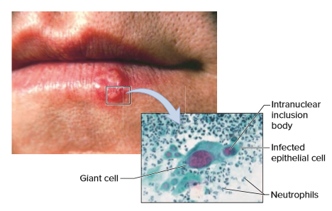
Viral Diseases of the Upper Digestive System – Figure 24.7
Oral herpes simplex (cold sores; fever blisters)
Signs and symptoms
Fever, small blisters in mouth that break in a day or two; produce painful superficial ulcers (incubation 2 to 20 days)
Lesions heal within approximately 10 days, but virus persists
Recurrent cold sores usually less severe
Tingling, itching, burning; blisters, ulcerations usually heal within 7 to 10 days
Source: CDC; (inset): ©Frederick C. Skvara, M.D.

Slide 28
Viral Diseases of the Upper Digestive System (1)
Oral herpes simplex
Causative agent: Herpes simplex viruses (HSVs)
Enveloped viruses with double-stranded linear DNA
Two types: HSV-1 (most oral infections) and HSV-2 (usually genital infections)
Persist throughout life as latent viruses; can reactivate
Pathogenesis
Virus multiplies in epithelium, destroys cells
Some cells fuse to produce multinucleated giant cells
Cell nucleus contains deeply staining area called intranuclear inclusion body where viruses replicate
Viral DNA persists in nerve cells in latent form
Stresses can reactivate (menstruation, sunburn, fever)

Slide 29
Viral Diseases of the Upper Digestive System (2)
Oral herpes simplex
Epidemiology
Initial infection during childhood; symptoms usually mild
About one in three Americans suffers from cold sores
Virus transmitted by close contact, but transmission by fomites such as plastic and cloth is possible
Greatest risk is contact with lesions or saliva within few days of disease onset since many virions present
Saliva of asymptomatic people can be infectious
HSV can infect almost any body tissue
Herpetic whitlow (finger infection)
Blindness can result if rubbed into the eyes

Slide 30
Viral Diseases of the Upper Digestive System (3)
Oral herpes simplex
Treatment and prevention
Medications like acyclovir target HSV DNA polymerase
Do not affect latent virus and so cannot cure
Sunlight can trigger, so sunscreens useful as preventive

Slide 31
Table 24.3 Oral Herpes Simplex (Cold Sores)
Signs and symptoms | Initial infection: fever, ulcerations of the mouth and throat. Recurrences: itching, tingling, or pain usually on the lip, then blisters that break, leaving a painful sore.
Incubation period | 2 to 20 days
Causative agent | Herpes simplex virus (HSV), usually type 1
Pathogenesis | Virus multiplies in the epithelium and destroys the cells. An immune response limits the infection, but HSV DNA persists in sensory nerves. This DNA becomes the source of infectious virions that are carried to the skin or mucous membranes, usually of the lip, causing recurrent sores.
Epidemiology | Widespread distribution; transmitted by close physical contact. Blisters contain large numbers of infectious virions. Saliva of asymptomatic people can be infectious.
Treatment and prevention | Treatment: medications that target HSV DNA polymerase can shorten the duration of the symptoms or prevent recurrences. Prevention: sunscreen can prevent recurrences due to ultraviolet exposure.

Slide 32
Viral Diseases of the Upper Digestive System (4)
Mumps
Signs and symptoms
Onset marked by fever, loss of appetite, headache; incubation 15 to 21 days
Followed by painful swelling of one or both parotid glands
Spasm of underlying muscle makes talking, chewing hard
Symptoms can arise elsewhere in body
Headache, stiff neck indicate of meningitis
Pregnant women often miscarry
Serious consequences most likely in elderly
Sudden-onset deafness
Symptoms generally more severe past onset of puberty
Orchitis is swelling of testicles to 3 to 4 times normal size
Ovarian involvement is manifested by pelvic pain

Slide 33
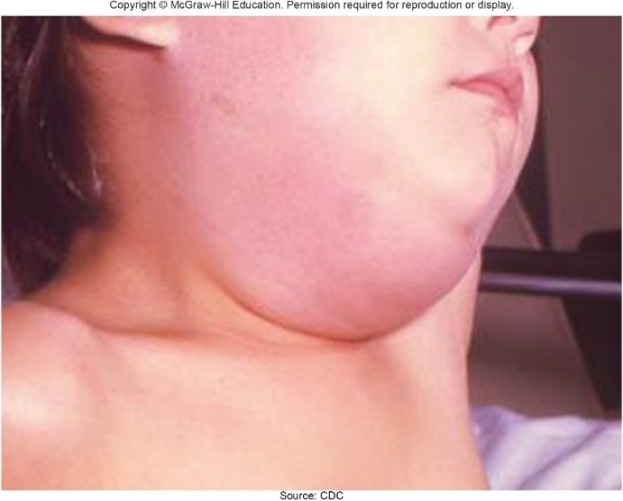
Viral Diseases of the Upper Digestive System (5)
Mumps
Causative agent: Mumps virus
Enveloped, single-stranded RNA virus of Paramyxoviridae
Pathogenesis
Virus inhaled via saliva droplets, spreads via bloodstream
Symptoms begin after tissues are infected
Virus multiplies in epithelium of ducts
In parotid salivary glands, inflammatory response yields severe swelling, pain
Similar process in tubules of testicles or kidneys
Swelling can impair blood supply to testicular tissue
Source: CDC

Slide 34
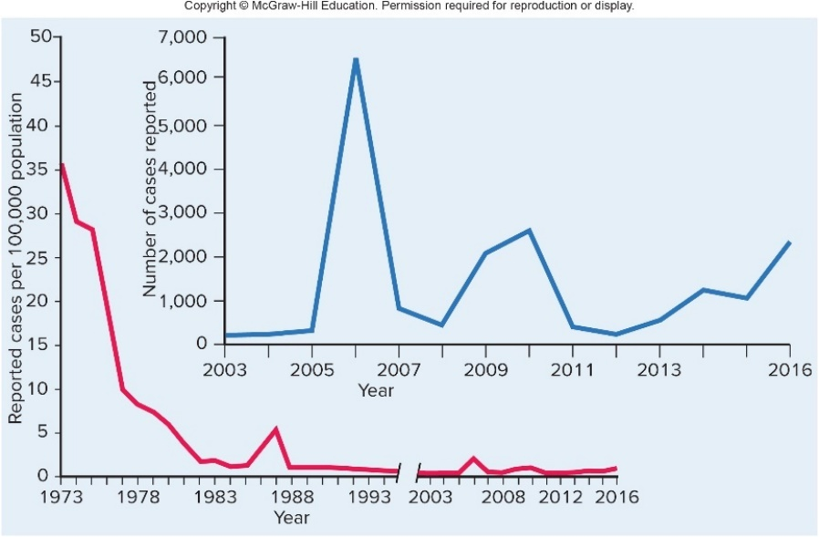
Viral Diseases of the Upper Digestive System (6)
Mumps
Epidemiology
Humans only natural host
Virus often spread from asymptomatic infections
Can spread a week before or two weeks after symptoms
Peak infectivity is 1 to 2 days before parotid swelling until gland begins to return to normal size
Infection gives lifelong immunity
Common in the U.S. prior to routine vaccination; now rare, but outbreaks occur as immunity wanes in young adults

Slide 35
Viral Diseases of the Upper Digestive System (7)
Mumps
Treatment and prevention
No effective treatment
Attenuated vaccine as part of measles, mumps, rubella (MMR), and varicella (MMRV) vaccine
Good candidate for eradication

Slide 36
Table 24.4 Mumps
Signs and symptoms | Fever, headache, loss of appetite, followed by painful swelling of parotid gland(s). Meningitis can occur. Painful enlargement of the testicles; pelvic pain in women.
Incubation period | Generally 15 to 21 days
Causative agent | Mumps virus, a single-stranded RNA virus
Pathogenesis | The virus initially replicates in the upper respiratory tract, then spreads throughout the body in the bloodstream. In the salivary glands, the virus multiplies in the cells that line the ducts and kills them. Inflammatory responses cause swelling and pain.
Epidemiology | Humans are the only source of the virus. Infections are often asymptomatic, so the disease can be spread unknowingly.
Treatment and prevention | Treatment: no antiviral therapy is available. Prevention: an effective attenuated vaccine is available.

Slide 37
Focus on Diarrheal Diseases (1)
Gastroenteritis; “stomach flu” (not influenza)
Signs and symptoms: diarrhea, loss of appetite, nausea, vomiting, perhaps fever; incubation period 1 to 2 days
Small intestine: abundant, watery diarrhea
Large intestine: small amounts of diarrhea with mucus, pus, and sometimes blood
Dysentery: blood and pus in feces

Slide 38
Focus on Diarrheal Diseases (2)
Pathogenesis
Virulence genes often shared by horizontal transfer
Infectious dose related to acid tolerance; organism must survive passage through stomach
Attachment of pathogen typically needed for infection
Disrupts fluid exchange in small intestine; can result in dehydration; potentially fatal
Causes strong inflammatory response in large intestine
Mechanisms include alteration of intestinal epithelial cells, cell invasion, exotoxin production
Enterotoxins cause water and electrolyte loss
Cytotoxins cause cell death
Some absorbed into bloodstream; systemic effects
Notes:
38

Slide 39
Focus on Diarrheal Diseases (3)
Epidemiology
Hundreds of thousands of children die of diarrheal disease every year; most are infants
Transmitted by fecal-oral route
Ingestion of contaminated food, water
Sexual practices with oral-anal contact
Pathogens with low infectious dose can be transmitted by person-to-person contact
Sewage treatment, handwashing, chlorination of drinking water are important control measures
PulseNet in the U.S. is a DNA subtyping resource that helps track illness caused by specific intestinal pathogens
Notes:
39

Slide 40
Focus on Diarrheal Diseases (4)
Treatment and prevention
Oral rehydration therapy (ORT): appropriate fluids counteract loss of fluid and electrolytes
Plain water cannot be absorbed enough to keep pace
Glucose increases absorptive capacity of intestine
ORS is mixture of glucose and salts; premeasured packets added to clean water
Antimicrobial medications often prolong bacterial infection as they suppress normal microbiota; zinc supplements may decrease severity of disease
No treatment for viral diarrhea
A few pathogen-specific vaccines are available
Notes:
40

Slide 41
Bacterial Diseases of the Lower Digestive System (1)
Cholera
Seven pandemics have occurred since early 1800s
South America was cholera-free for 100 years until 1991 when an outbreak occurred in Peru
Lima’s water supply was not chlorinated; in 2 years, more than 700,000 cases, 6,323 deaths in South and Central America
In 2011 Haiti had the most recorded cases in a country in a single year
Due to the disruptions of civil war, that number was surpassed in Yemen during the first seven months of 2017
Notes:
41

Slide 42
Bacterial Diseases of the Lower Digestive System (2)
Cholera
Signs and symptoms
Incubation period of 12 to 48 hours
Classic example of severe watery diarrheal disease
“Rice water stool” appearance; can amount to 20 liters/day; dehydration can lead to organ failure and death
Vomiting may occur at onset; severe muscle cramps result from loss of fluids and electrolytes
Causative agent: Vibrio cholerae
Curved, Gram-negative rod
Several serotypes grouped by O antigen
O1 serotype is pandemic; O139 in Asia
Halotolerant, can grow in alkaline conditions

Slide 43
Bacterial Diseases of the Lower Digestive System (3)
Cholera
Pathogenesis
Sensitive to acid, so large numbers must be ingested
Adhere to epithelial cells of small intestine, establish infection, produce cholera toxin, an A-B toxin
B portion attaches to receptors of microvilli
A portion enters cells, activates a G protein that turns on adenylate cyclase to convert ATP to cAMP
High cAMP causes cell to secrete chloride ions
Sodium and other ions follow, and water follows the salts, yielding outpouring from cells
Toxin does not affect large intestine, but volume of fluid is too much to be absorbed, causing diarrhea
Toxin encoded by bacteriophage: lysogenic conversion

Slide 44
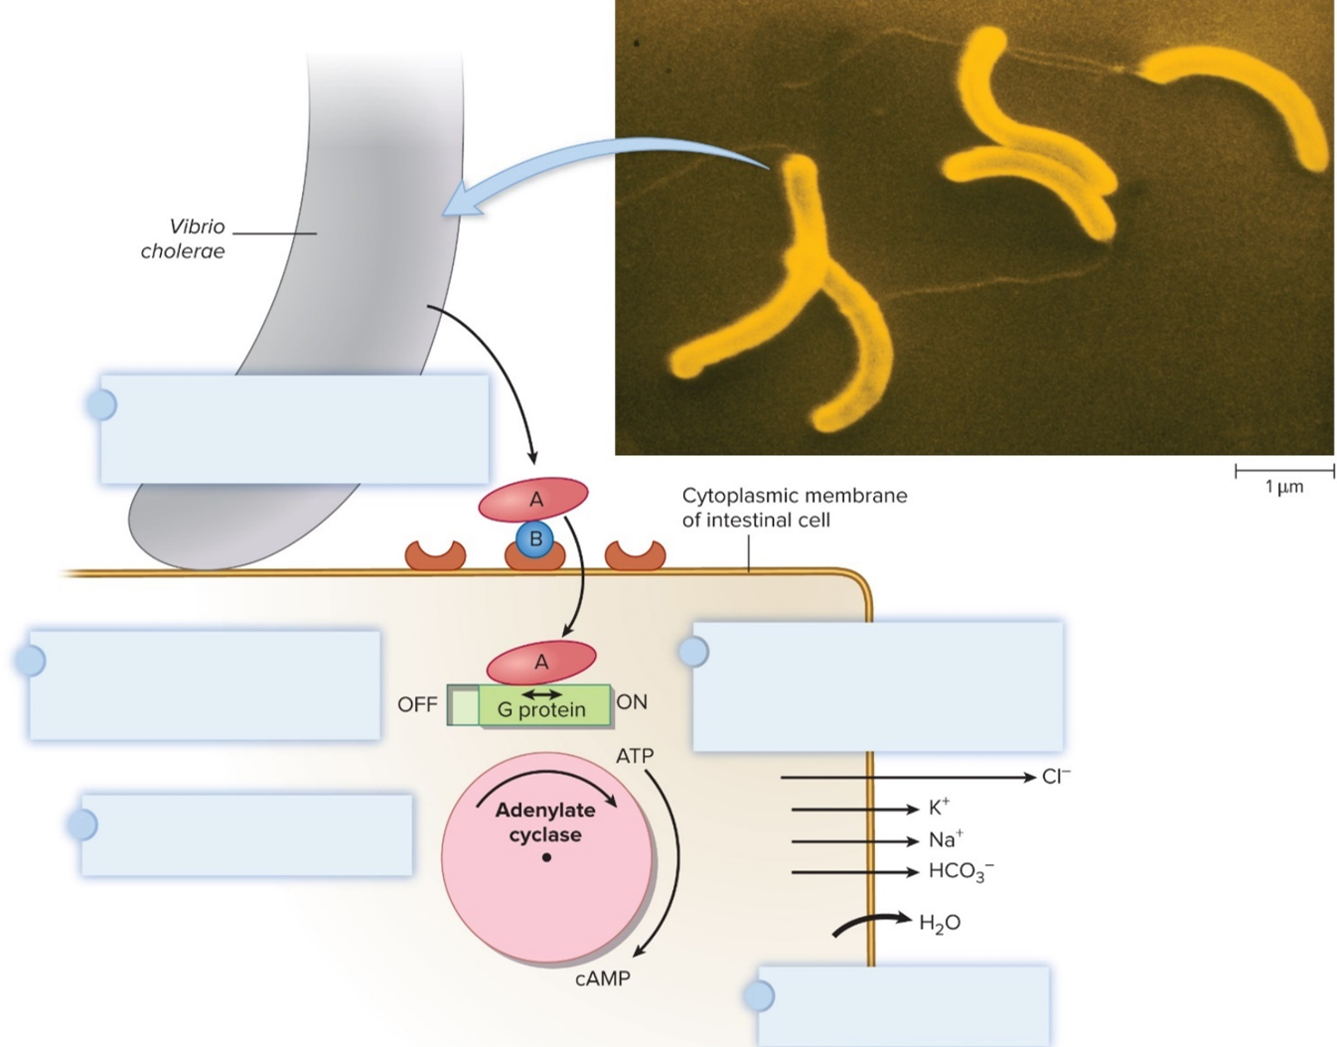
Bacterial Diseases of the Lower Digestive System – Figure 24.10
The A-B toxin’s B subunit attaches to receptors on cell membrane; the A subunit enters the cell.
The A subunit locks a G protein in the “active" mode, turning on adenylate cyclase.
cAMP activates ion transport channels in the membrane causing ${Cl}^{−}$ and other electrolytes to pour out of the cell.
Adenylate cyclase causes the conversion of ATP to cAMP.
Water follows electrolytes out of the cell by osmosis.
©London School of Hygiene & Tropical Medicine/Science Source

Slide 45
Bacterial Diseases of the Lower Digestive System (4)
Cholera
Epidemiology
Fecally contaminated water most common source
Foods including crab, oysters, vegetables implicated
A person can discharge a million or more V. cholerae cells in each milliliter of feces
Relatively common worldwide; most cases in U.S. involve international travel
Effective wastewater treatment can eliminate spread

Slide 46
Bacterial Diseases of the Lower Digestive System (5)
Cholera
Treatment and prevention
Rapid replacement of fluids and electrolytes given before damage to vital organs can occur
Intravenous or oral rehydration therapy can decrease mortality from over 30% to less than 1%
Clean water and adequate sanitation are key control measures
Travelers should cook food immediately before eating and avoid fruit and ice contaminated with local water
Vaccines available in many parts of world
In 2016 FDA approved live attenuated oral vaccine against serotype 01 intended for travelers to endemic areas

Slide 47
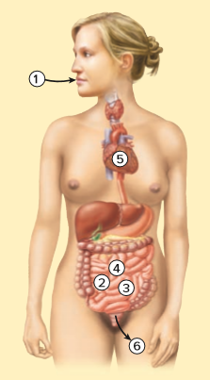
Table 24.5 Cholera
Vibrio cholerae enters the mouth with fecally contaminated food or drink.
The bacteria attach to epithelial cells of the small intestine.
Cholera toxin enters the cells and causes them to continuously secrete chloride ions. Other electrolytes and water follow.
The outpouring of water and electrolytes into the intestinal lumen causes watery diarrhea.
Fluid loss causes severe dehydration, resulting in shock and death unless the fluid can be replaced.
The bacteria exit the body with feces.
Signs and symptoms | Abrupt onset of massive diarrhea, vomiting, muscle cramps
Incubation period | Short, generally 12 to 48 hours
Causative agent | Vibrio cholerae, an alkali- and salttolerant, curved Gram-negative rod
Pathogenesis | Cholera toxin causes chloride, other electrolytes, and water to pour out of the intestinal epithelium and into the lumen; leads to dehydration and shock.
Epidemiology | Ingestion of fecally contaminated food or water; sometimes associated with marine crustaceans.
Treatment and prevention | Treatment: replacement of fluid and electrolytes using intravenous or oral rehydration therapy. Prevention: purifying water and handwashing; vaccines available.
Notes:
47

Slide 48
Bacterial Diseases of the Lower Digestive System (6)
Shigellosis
Signs and symptoms
Incubation period 1 to 3 days
Usually dysentery, some species cause watery diarrhea
Headache, vomiting, fever, stiff neck, convulsions, joint pain
Often fatal for infants in developing countries
Causative agents
Four species of Shigella, Gram-negative rods: S. dysenteriae, S. flexneri, S. boydii, and S. sonnei
S. dysenteriae most virulent, S. sonnei least virulent
S. dysenteriae and S. flexneri most common in developing countries
S. sonnei causes over two-thirds of cases in U.S.

Slide 49
Bacterial Diseases of the Lower Digestive System (7)
Shigellosis
Pathogenesis
Shigella taken up using antigen sampling function of M cells
Multiply inside macrophages, released at bases of epithelial cells after macrophages die
Attach to specific receptors, induce uptake by epithelial cells, multiply, cause actin polymerization to propel cell to cell
Invasion results in death of epithelial cells, sloughing of patches of epithelium; strong inflammatory response
Some strains produce Shiga toxin, an A-B toxin responsible for hemolytic uremic syndrome (HUS)
B subunit binds to endothelial cells lining small blood vessels
A subunit halts protein synthesis, leading to cell death
HUS may cause anemia and kidney failure; often fatal

Slide 50
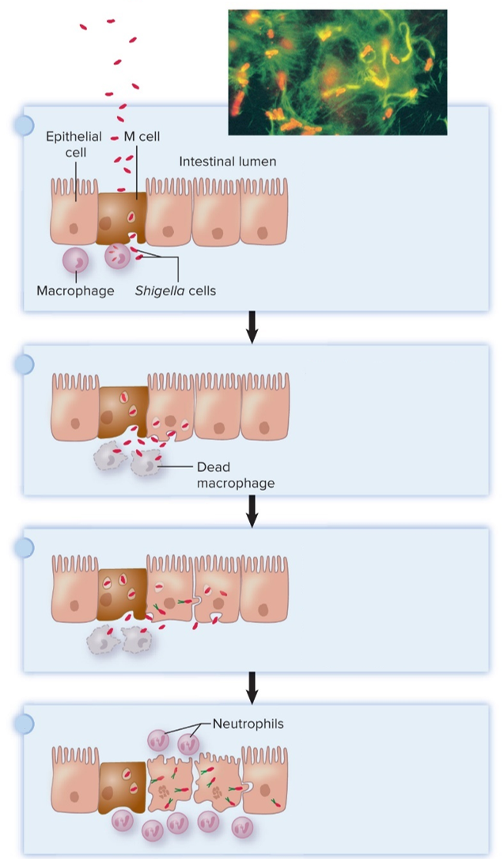
Bacterial Diseases of the Lower Digestive System – Figure 24.11
Shigellosis
Pathogenesis
M cells take up Shigella cells and transport them across the epithelium. They multiply in the macrophages that ingest them, leading to death of that host cell.
Shigella cells attach to the base of the epithelial cells and induce those cells to take them in. From there, they escape the endosome and multiply in the cytoplasm.
Shigella cells cause the host cell actin to polymerize. This forms an "actin tail” that propels a bacterium within the host cell, sometimes with enough force to move it into a neighboring cell.
Infected epithelial cells die and slough off. An intense inflammatory response leads to bleeding and abscess formation.
Top: Dr. Philippe J. Sansonetti, Professeur Institut Pasteur
Notes:
50

Slide 51
Bacterial Diseases of the Lower Digestive System (8)
Shigellosis
Epidemiology
Disease of humans; fecal-oral route
Small infectious dose; Shigella resistant to stomach acid
Spreads rapidly in populations with poor sanitation
Fecally contaminated food and water cause outbreaks
Anal intercourse
Treatment and prevention
Antimicrobials shorten duration; some strains resistant
Sanitary measures control spread
Cases can be tracked through PulseNet

Slide 52
Table 24.6 Shigellosis
Signs and symptoms | Fever, dysentery, vomiting, headache, stiff neck, convulsions, and joint pain
Incubation period | 1 to 3 days
Causative agent | Four species of Shigella, Gram-negative, members of the Enterobacteriaceae
Pathogenesis | Bacteria cross the intestinal mucous membrane via M cells; induce uptake by epithelial cells; “actin tails” allow bacteria to spread to neighboring cells, leading to death and sloughing of epithelium. Some strains make Shiga toxin.
Epidemiology | Fecal-oral transmission; low infectious dose; humans generally the only source.
Treatment and prevention | Treatment: antimicrobial medications shorten duration of symptoms and pathogen excretion; many strains have R plasmids. Prevention: spread is controlled by sanitary measures.
Notes:
52

Slide 53
Bacterial Diseases of the Lower Digestive System (9)
Escherichia coli gastroenteritis
Signs and symptoms
Depend on strain
Some cause watery diarrhea, others dysentery
One group causes hemolytic uremic syndrome (HUS)
Causative agent: Escherichia coli
Gram-negative rod closely related to Shigella
Unlike Shigella, most strains ferment lactose

Slide 54
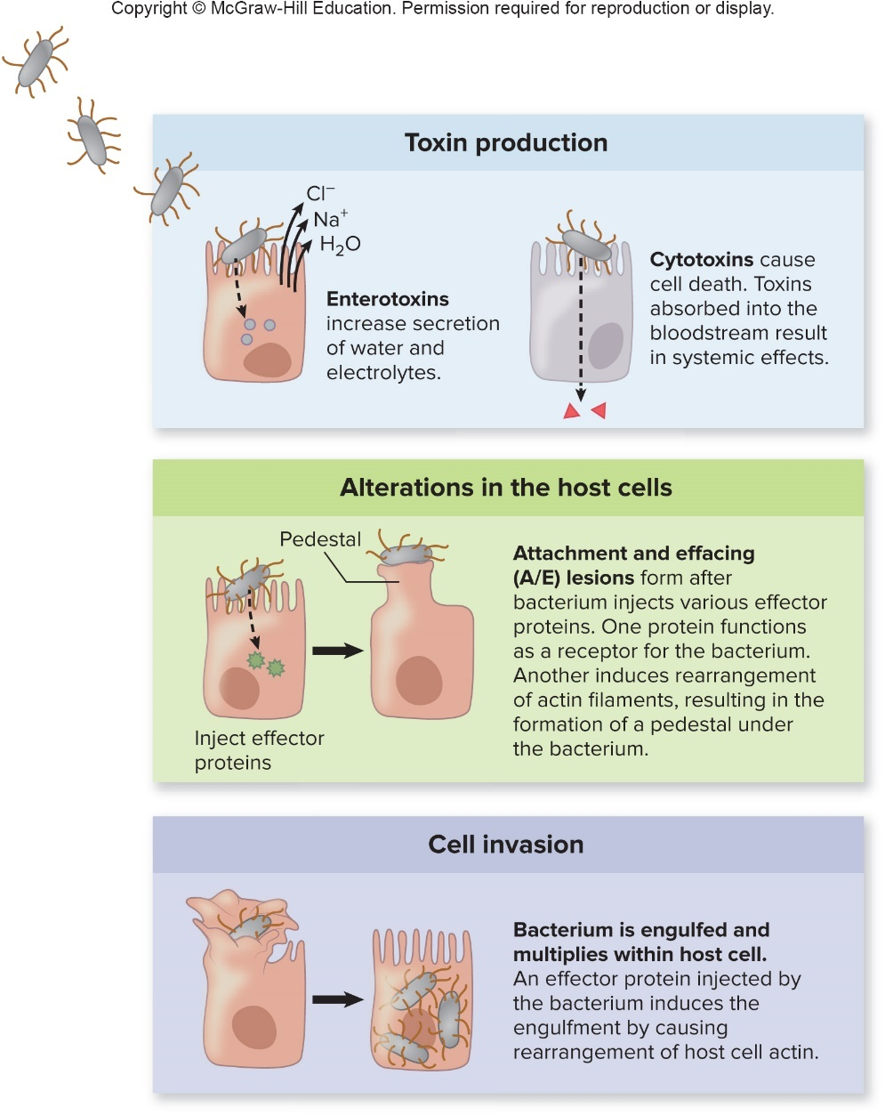
Bacterial Diseases of the Lower Digestive System – Figure 24.12
Escherichia coli Gastroenteritis
Pathogenesis
Jump to Bacterial Diseases of the Lower Digestive System – Figure 24.12 Long Description
Notes:
54

Slide 55
Table 24.7 Characteristics of Diarrhea-Causing Escherichia coli
Escherichia coli gastroenteritis
Pathogenesis
Strains grouped into six pathovars (pathogenic varieties) based on their virulence factors
Designation | Characteristic Features | Clinical Picture
Diffusely adhering E. coli (DAEC) | Grows as a diffuse layer in a thick mucus-associated biofilm on the intestinal epithelium; produces toxins | Diarrhea, particularly in children
Enteroaggregative E. coli (EAEC) | Grows in brick-like aggregations in a thick mucus-associated biofilm on the intestinal epithelium; produces toxins | Variable symptoms; nausea, watery diarrhea (both acute and persistent)
Enteroinvasive E. coli (EIEC) | Invades the intestinal epithelium, causing a disease very similar to shigellosis | Fever, cramps, diarrhea containing blood and pus
Enteropathogenic E. coli (EPEC) | Colonizes the small intestine; induces changes in actin filaments, causing the microvilli to be replaced by pedestals under the bacterial cells (A/E lesions) | Fever, vomiting, watery diarrhea containing mucus
Enterotoxigenic E. coli (ETEC) | Colonizes the small intestine and produces toxins, one nearly identical to cholera toxin | Nausea, vomiting, abdominal cramps, massive watery diarrhea leading to dehydration
Shiga toxin– producing E. coli (STEC) | Same as EPEC, except it produces Shiga toxin and colonizes the large intestine rather than the small intestine | Fever, abdominal cramps, bloody diarrhea without pus; some patients develop hemolytic uremic syndrome; most strains identified in outbreaks are serotype O157:H7

Slide 56
Bacterial Diseases of the Lower Digestive System (10)
Escherichia coli gastroenteritis
Epidemiology
STEC strains foodborne; epidemics have involved ground beef, unpasteurized milk, bean sprouts, others
Initial source often untreated cow manure
Infectious dose low, so direct contact also spreads
ETEC strains cause diarrhea in infants in developing countries, also visitors; relatively high infectious dose
EIEC primarily cause disease in young children in developing countries; not easily spread by direct contact
EPEC strains important in infants; antibodies in breast milk protective; relatively low infectious dose
EAEC strains infect children, travelers, AIDS patients
DEAC strains have caused outbreaks in children

Slide 57
Bacterial Diseases of the Lower Digestive System (11)
Escherichia coli gastroenteritis
Treatment and prevention
Replacement of lost fluid
Most cases self-limiting, so antibiotics not routinely used
Worsen outcome in patients with STEC infections
Handwashing, pasteurization of drinks, cooking of food
PulseNet tracks STEC strains such as E. coli O157:H7
Traveler’s diarrhea usually prevented with bismuth preparations (Pepto-Bismol)
Widespread use of antibiotics to prevent diarrhea has promoted development of resistant strains

Slide 58
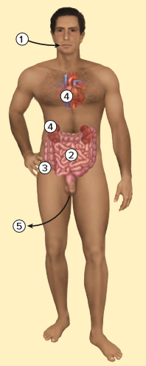
Table 24.8 Escherichia coli Gastroenteritis
Pathogenic strain of E. coli enters by the fecal-oral route, either directly from an infected person or with contaminated food or drink.
Most strains colonize the small intestine and produce watery diarrhea.
Others invade the large intestine and cause dysentery.
Some strains produce Shiga toxin, which is absorbed by the bloodstream and causes hemolytic-uremic syndrome.
The bacteria exit the body with feces
Signs and symptoms | Watery diarrhea or dysentery
Incubation period | 2 hours to 6 days
Causative agent | Escherichia coli, certain strains only
Pathogenesis | Various mechanisms; attachment to small intestinal cells allows colonization; some strains produce one or more enterotoxins; some strains invade large intestinal epithelium; others alter actin polymerization to cause attachment and effacing lesions, and may produce Shiga toxin.
Epidemiology | Common in travelers; can be foodborne or waterborne; fecal-oral route transmission; some strains have an animal source.
Treatment and prevention | Treatment: replacement of fluids and electrolytes. Prevention: handwashing; pasteurization of drinks, thorough cooking of meats. Bismuth compounds help prevent traveler’s diarrhea.

Slide 59
Bacterial Diseases of the Lower Digestive System (12)
Salmonella gastroenteritis
About 1.2 million cases in U.S. each year
Outbreaks due to foods contaminated by animal feces
Signs and symptoms: Diarrhea, abdominal cramps, nausea, vomiting, headache, fever
Incubation period 6 hours to 3 days
Often short-lived and mild depending on strain, dose
Causative agent: Salmonella enterica
Gram-negative rod; Enterobacteriaceae
More than 2,400 serotypes based on somatic (O), flagellar (H), and capsular (K) antigens
Significant in terms of epidemiology and disease

Slide 60
Bacterial Diseases of the Lower Digestive System (13)
Salmonella gastroenteritis
Pathogenesis
Most sensitive to acid, so high infectious dose
Attach to epithelial cells of distal small intestine; effector proteins via type III secretion system induce endocytosis
Inflammatory response causes diarrhea
Inflammation also produces tetrathionate that Salmonella can use in anaerobic respiration

Slide 61
Bacterial Diseases of the Lower Digestive System (14)
Salmonella gastroenteritis
Epidemiology
Most cases from nonhuman animal sources
Bacteria sometimes survive for months in soil and water
Untreated manure can spread
Poultry, eggs often contaminated; many other products (for example, tomatoes, alfalfa sprouts) have started outbreaks
Children commonly infected by pet reptiles
Notes:
61

Slide 62
Table 24.9 Salmonella Gastroenteritis
Salmonella gastroenteritis
Treatment and prevention
Most recover without antibiotics; many strains antibiotic resistant
Likely due to subtherapeutic levels in animal feed
Sanitary handling of food; cooking to 160 degrees Fahrenheit
Signs and symptoms | Diarrhea, vomiting, headache, abdominal pain, and fever
Incubation period | Usually 6 to 72 hours
Causative agent | Salmonella enterica, Gram-negative, member of the Enterobacteriaceae
Pathogenesis | Induce uptake by epithelial cells in the distal small intestine; bacteria multiply in the phagosome and then are discharged at the base of the cell; inflammatory response increases fluid secretion
Epidemiology | Ingestion of food contaminated by animal feces, especially poultry
Treatment and prevention | Treatment: antimicrobial medication is generally not advised. Prevention: relies on adequate cooking and proper handling of food.
Notes:
62

Slide 63
Bacterial Diseases of the Lower Digestive System (15)
Typhoid and paratyphoid fevers
Examples of enteric fevers: systemic diseases that originate in the intestine
Signs and symptoms
Incubation period of 1 to 4 weeks
Progressively increasing fever over a number of days, severe headache, constipation, abdominal pain
In severe cases, intestinal rupture, bleeding, shock, death
Causative agents
Salmonella serotypes Typhi and Paratyphi
Cases confirmed by blood culture

Slide 64
Bacterial Diseases of the Lower Digestive System (16)
Typhoid and paratyphoid fevers
Pathogenesis
Enteric fevers caused by bacteria that colonize intestines, cross mucous membrane via M cells, multiply within macrophages, and are carried in bloodstream throughout the body
Systemic infection causes fever, abscesses, sepsis, and shock, often with little or no diarrhea
Peyer’s patches sometimes destroyed, leading to rupture of intestine, hemorrhage, and death
Toxin produced when cells are within a host cell
Role of toxin in disease under study
Notes:
64

Slide 65
Bacterial Diseases of the Lower Digestive System (17)
Typhoid and paratyphoid fevers
Epidemiology
Humans only known host, so spread person to person often via contaminated food or water
Some survivors remain colonized in gallbladder; can shed high numbers for years (for example, “Typhoid Mary”)
Treatment and prevention
Antibiotics; some strains resistant
Surgical removal of gallbladder and months of antibiotic therapy often necessary to rid carriers of infection
Two vaccines against Salmonella Typhi, each approximately 50 to 75% effective: attenuated live oral or injectable capsular polysaccharide
No vaccine against Salmonella Paratyphi

Slide 66
Table 24.10 Typhoid and Paratyphoid Fevers
Signs and symptoms | Fever, severe headache, constipation, and abdominal pain; sometimes followed by intestinal rupture, internal bleeding, shock, and death
Incubation period | 1 to 4 weeks
Causative agent | Salmonella serotype Typhi (typhoid fever) and Salmonella serotype Paratyphi (paratyphoid fever), Gram-negative, members of the Enterobacteriaceae
Pathogenesis | Cross the intestinal epithelium via M cells; multiply within macrophages and carried in the bloodstream throughout the body. The Peyer’s patches are sometimes destroyed, leading to rupture of the intestine and hemorrhage.
Epidemiology | Humans are the only source of infection. Personto-person fecal-oral transmission.
Treatment and prevention | Treatment: antimicrobial medications. Prevention: attenuated and inactivated vaccines for typhoid fever; no vaccine for paratyphoid fever.
Notes:
66

Slide 67
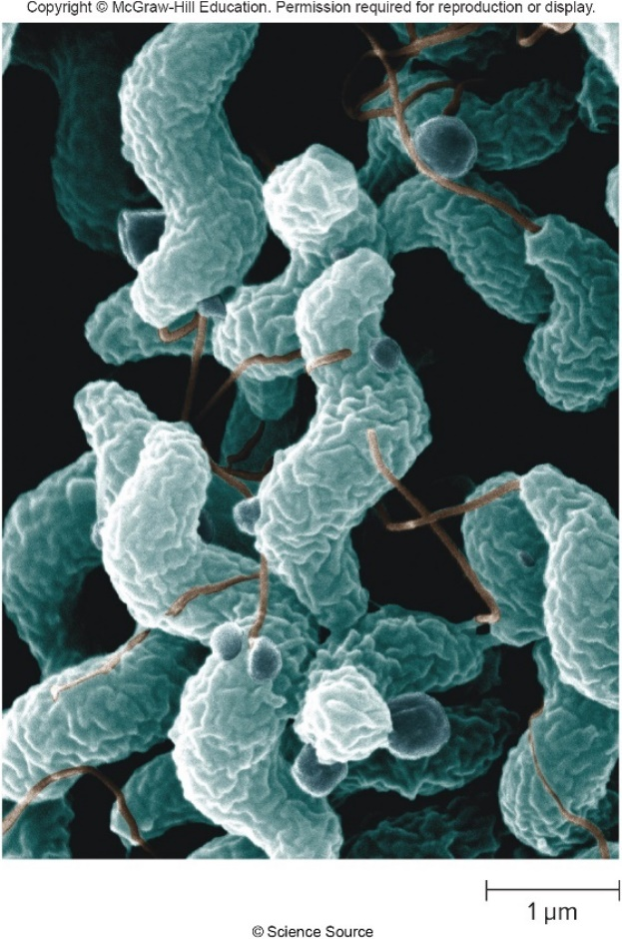
Bacterial Diseases of the Lower Digestive System (18)
Campylobacteriosis
Signs and symptoms
Incubation period 1 to 11 days; usually 2 to 5 days
Fever, vomiting, diarrhea, abdominal cramps
Dysentery occurs in about half the cases
Causative agent: Campylobacter jejuni
Curved, Gram-negative rod first isolated in 1972
Can be cultivated under microaerophilic conditions with a selective medium
©Science Source

Slide 68
Bacterial Diseases of the Lower Digestive System (19)
Campylobacteriosis
Pathogenesis
Penetrate epithelial cells of small and large intestines, cause localized inflammatory reaction
Up to 40% of Guillain-Barré syndrome cases preceded by campylobacteriosis; autoimmunity likely involved
Epidemiology
Estimated 1.3 million cases and approximately 100 deaths/year in U.S., most in elderly or immunodeficient
Numerous foodborne and waterborne outbreaks reported, although most cases are sporadic
C. jejuni lives in intestines of domestic animals; poultry is common source of infection, with up to 90% containing it
Low infectious dose (approximately 500 organisms)

Slide 69
Table 24.11 Campylobacteriosis
Campylobacteriosis
Treatment and prevention
Typically self-limiting, leaves patient immune
Antibiotics used to treat severe cases
Cooking and proper handling of raw poultry to avoid cross- contamination
Handwashing after contact with animal feces
Keeping outdoor play areas free of bird droppings
Chlorinating drinking water, pasteurizing beverages
Signs and symptoms | Diarrhea, fever, abdominal cramps, vomiting, bloody stools
Incubation period | Usually 2 to 5 days
Causative agent | Campylobacter jejuni, a curved Gram-negative, microaerophilic rod
Pathogenesis | Low infectious dose. The bacteria multiply within and beneath the epithelial cells, causing an inflammatory response. Bloodstream invasion is uncommon. Complicated by Guillain-Barré syndrome on rare occasions.
Epidemiology | Large foodborne and waterborne outbreaks originate from poultry and other animals; personto-person spread rare
Treatment and prevention | Treatment: antibiotics in severe cases. Prevention: relies on adequate cooking and proper handling of food, particularly poultry. Water chlorination and pasteurization of beverages are effective control measures.

Slide 70
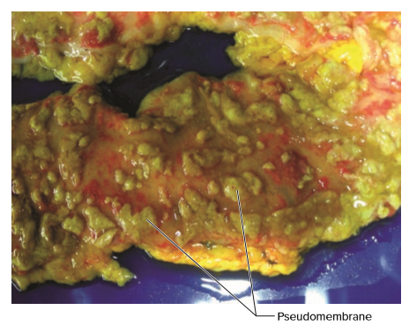
Bacterial Diseases of the Lower Digestive System (20)
Clostridium difficile infection (CDI)
Antibiotic-associated diarrhea, increasing in incidence and severity since early 2000’s
Signs and symptoms
Ranges widely in severity
Mild cases characterized by diarrhea with fever, pain beginning less than a week after infection
More serious cases progress to colitis, sometimes with pseudomembranes; known as pseudomembranous colitis
Severe cases are life-threatening
©McGraw-Hill Education

Slide 71
Bacterial Diseases of the Lower Digestive System (21)
Clostridium difficile infection
Causative agent: Clostridium difficile (“C. diff”)
Gram-positive, obligate anaerobic rod
Forms endospores highly resistant to disinfectants, environmental conditions, so control is difficult
Ingested endospores develop into vegetative cells that sometimes colonize large intestine
Many strains; differ in pathogenicity
Strains causing CDI produce toxins; hypervirulent strains increasing in prevalence
Resistant to fluoroquinolones
CDC considers C. diff an urgent health threat
Notes:
71

Slide 72
Bacterial Diseases of the Lower Digestive System (22)
Clostridium difficile infection
Pathogenesis
Dysbiosis due to antibiotic use allows proliferation of C. diff
Two toxins (A and B) lethal to intestinal epithelium
Disrupt host cell actin polymerization
Induce strong inflammatory response
Sometimes pseudomembranes form composed of dead epithelium, inflammatory cells, clotted blood
Binary toxin produced by hypervirulent strains; interferes with host actin polymerization
Notes:
72

Slide 73
Bacterial Diseases of the Lower Digestive System (23)
Clostridium difficile infection
Epidemiology
Primarily in hospitalized patients on antibiotic therapy
C. difficile can grow to high numbers when normal microbiota is disrupted
Patients acquire in hospital or have in normal microbiota
Infectious endospores shed in feces
Treatment and prevention
If possible, stop antibiotics; symptoms often disappear
Vancomycin, metronidazole, or fidaxomicin may be used
Fecal microbiota transplant (FMT) repairs dysbiosis
Preventive measures include minimizing use of antibiotics, handwashing, wearing gloves, disinfectants

Slide 74
Table 24.2 Clostridium difficile Infection (CDI)
Signs and symptoms | Variable; mild diarrhea to pseudomembranous colitis, a potentially fatal inflammation of the colon
Incubation period | Usually less than a week
Causative agent | Clostridium difficile, a Gram-positive, rod-shaped, endospore-forming anaerobe
Pathogenesis | Toxins disrupt host cell actin and cell signaling, causing lethal effects to the intestinal epithelium.
Epidemiology | Primarily occurs in patients on antibiotic therapy.
Treatment and prevention | Treatment: when practical, stop antimicrobial medications; otherwise, an antimicrobial medication that targets C. difficile. Fecal transplant to restore normal intestinal microbiota. Prevention: includes handwashing and disinfection of surfaces.
Notes:
74

Slide 75
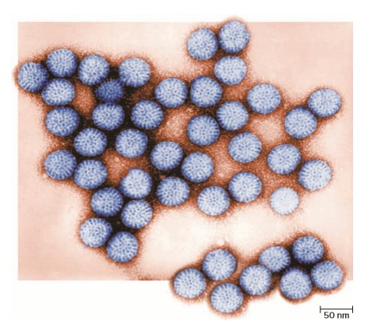
Viral Diseases of Lower Digestive System: Intestinal Tract – Figure 24.15
Rotavirus gastroenteritis
Most viral gastroenteritis around the world in infants and children is caused by rotaviruses
Signs and symptoms: abrupt vomiting, slight fever, followed shortly by profuse watery diarrhea
Incubation 24 to 48 hours; usually clears within a week, but fatal dehydration can occur if fluids are not replaced
Causative agents: Rotaviruses
Non-enveloped with double-walled capsid and double-stranded segmented RNA genome
Major subgroup of Reoviridae
Source: Dr. Erskine Palmer & Byron Skinner/CDC

Slide 76
Viral Diseases of Lower Digestive System: Intestinal Tract (1)
Rotavirus gastroenteritis
Pathogenesis
Damages lining of upper small intestine; less fluid absorbed
Viral protein acts as enterotoxin
Epidemiology
Transmitted via fecal-oral route
Childhood epidemics; if not vaccinated, most are infected before age 5
Infection yields some immunity; later infections milder
About 25% of traveler’s diarrhea
Infects variety of other animals; most do not also infect humans, but genetic reassortment could occur

Slide 77
Viral Diseases of Lower Digestive System: Intestinal Tract (2)
Rotavirus gastroenteritis
Treatment and prevention
No direct treatment; infants and small children sometimes hospitalized, given intravenous fluids
Handwashing, disinfectant use, other sanitary measures
Attenuated vaccines administered to infants result in substantial decline in incidence
Notes:
77

Slide 78
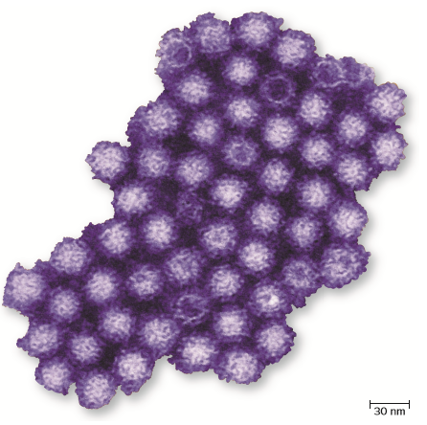
Viral Diseases of Lower Digestive System: Intestinal Tract (3)
Norovirus gastroenteritis
Most common cause of viral gastroenteritis in U.S. with about 21 million cases annually
Class B bioterrorism agent due to easy spread
Signs and symptoms: Abrupt onset of nausea, vomiting, watery diarrhea
Incubation period is 1 to 2 days
Vomiting most severe in older children and adults
Causative agent: Noroviruses
Non-enveloped, single-stranded RNA viruses in Caliciviridae
New strains frequently emerge
Source: Charles D. Humphrey/CDC

Slide 79
Viral Diseases of Lower Digestive System: Intestinal Tract (4)
Norovirus gastroenteritis
Pathogenesis
Infect epithelium of upper small intestine, causing cell death and decreased production of digestive enzymes
Epithelium recovers fully within about 2 weeks
Natural immunity is short-lived
Virus recently cultivated in lab and is under study

Slide 80
Viral Diseases of Lower Digestive System: Intestinal Tract (5)
Norovirus gastroenteritis
Epidemiology
Transmission primarily by fecal-oral route, but also via aerosols and contaminated surfaces
Highly contagious, infectious dose of fewer than 20 virions
Virions resist destruction, stable in environment
Epidemics common on cruise ships, in dormitories
More than 50% of foodborne disease outbreaks due to norovirus
CaliciNet established in 2009 to trace strains
Notes:
80

Slide 81
Table 24.13 Rotavirus and Norovirus Gastroenteritis Compared
Norovirus gastroenteritis
Treatment and prevention
No proven medications, no vaccine
Thorough handwashing with soap and water is vital
Disinfectants, other sanitary measures
Infected food workers should be restricted from working for 72 hours after symptoms subside
Causative Agent | Rotavirus | Norovirus
Virus characteristics | Double-walled capsid; double-stranded segmented RNA genome | Single-stranded RNA genome
Incubation period | 24 to 48 hours | 12 to 48 hours
Signs and symptoms | Vomiting, abdominal cramps, diarrhea, lasting 3 to 8 days | Vomiting, abdominal cramps, diarrhea, lasting 1 to 3 days
Epidemiology | Most children infected before age 5; milder disease in older children | Low infectious dose; limited immunity; epidemics common
Prevention | Attenuated vaccine | No vaccine

Slide 82
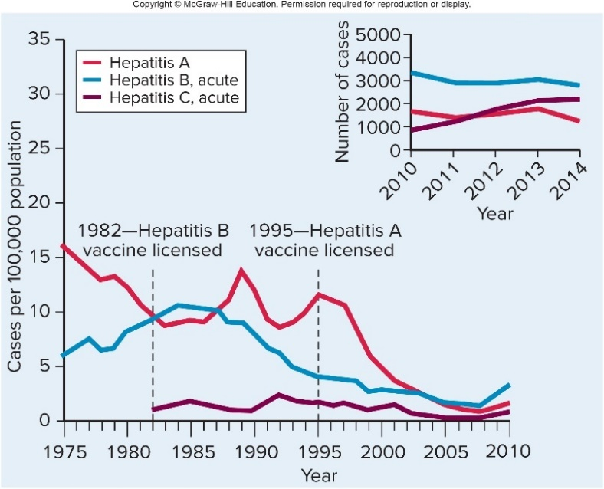
Viral Diseases of Lower Digestive System: Intestinal Tract – Figure 24.17
At least 5 unrelated viruses can cause hepatitis, an inflammation of the liver
Three types (A, B, and C) account for most cases
Jaundice (yellowing of skin and whites of eyes) is most noticeable sign
Patients should avoid alcohol, acetaminophen, and other chemicals that damage the liver
Jump to Viral Diseases of Lower Digestive System: Intestinal Tract – Figure 24.17 Long Description

Slide 83
Viral Diseases of the Lower Digestive System—Liver (1)
Hepatitis A (formerly, infectious hepatitis)
Signs and symptoms
Acute illness; no known chronic form or carrier state
Older children and adults develop jaundice, fever, fatigue, clay-colored feces, and vomiting after approximately 1 month incubation
Most young children (<6 years) and many older children (6 to 14 years) are asymptomatic
About 1 in 5 adults requires hospitalization
Causative agent: Hepatitis A virus (HAV)
Non-enveloped single-stranded RNA virus of Picornaviridae
Pathogenesis
Following ingestion, reaches liver via unknown route
Replicates, is released into bile, eliminated in feces

Slide 84
Viral Diseases of the Lower Digestive System—Liver (2)
Hepatitis A
Epidemiology
Spreads via fecally contaminated hands, food, or water
Many outbreaks traced to restaurants where food-handlers failed to wash hands
Raw shellfish may be source; virus is concentrated from fecally polluted seawater
High risk groups: children in day care centers, residents in nursing homes, international travelers, individuals having sexual contact with infected person
Long incubation period; HAV can spread widely through population before detection
Infants, children can shed virus in feces for several months

Slide 85
Viral Diseases of the Lower Digestive System—Liver (3)
Hepatitis A
Treatment and prevention
No antiviral treatment available, but post-exposure prophylaxis (PEP) can prevent disease if given within 2 weeks of exposure
Immune globulin provides immediate but short-term protection
Vaccination provides long-term protection in those who develop adequate response to vaccine
Effective inactivated HAV vaccine recommended for all children 1 to 2 years of age; for older children who have not been vaccinated, and for high-risk groups

Slide 86
Viral Diseases of the Lower Digestive System—Liver (4)
Hepatitis B (formerly, serum hepatitis)
Signs and symptoms
Acute form ranges from asymptomatic to severe
Incubation varies from 2 to 5 months depending on dose
Acute disease rarely fatal; virus usually cleared within weeks or months of initial infection
Can become chronic; one in five develop cirrhosis (scarring of the liver), liver failure, liver cancer, or other chronic liver disease

Slide 87
Viral Diseases of the Lower Digestive System—Liver (5)
Hepatitis B
Causative agent: Hepatitis B virus (HBV)
Enveloped, mostly double-stranded DNA genome
Resistant; virions infectious after a week outside the body
Member of Hepadnaviridae
Three notable components serve as useful markers
Hepatitis B surface antigen (HBsAg)
Appear in bloodstream before signs of liver damage are evident
Hepatitis B core antigen (HBcAg)
Indicate active viral replication
Hepatitis B e antigen (HBeAg)
Correlate with increased risk of liver damage and risk of spread
Complete virion is Dane particle; less common than empty envelopes with HBsAg but no DNA

Slide 88
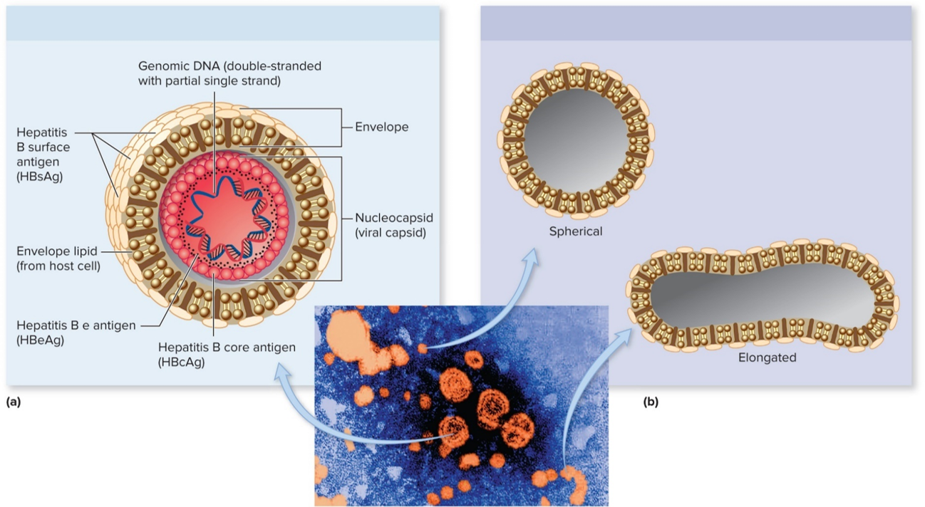
Viral Diseases of the Lower Digestive System—Liver –Figure 24.18
Complete infectious virion
Viral envelope particles containing HBsAg
bottom: Source: Dr. Erskine Palmer/CDC

Slide 89
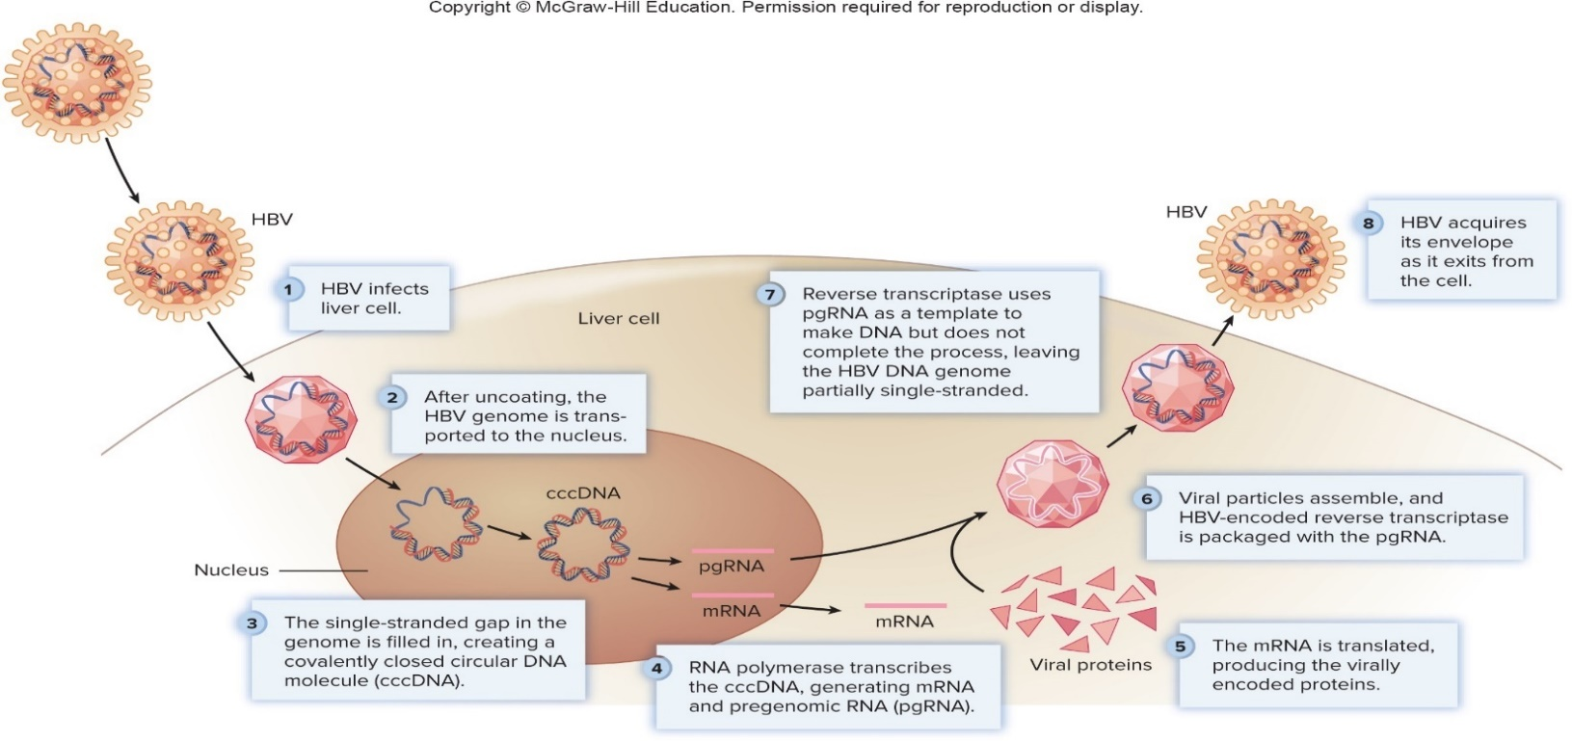
Viral Diseases of the Lower Digestive System—Liver –Figure 24.19
Hepatitis B
Pathogenesis
Bloodstream carries to liver; HBsAg allows virus to attach
Replication involves HBV-encoded reverse transcriptase
Liver damage likely from cell-mediated immune response
Jump to Viral Diseases of the Lower Digestive System—Liver –Figure 24.19 Long Description

Slide 90
Viral Diseases of the Lower Digestive System—Liver (6)
Hepatitis B
Epidemiology
Transmitted in body fluids (saliva, blood, blood products, semen); activities that mix fluids are risk factors
Sharing needles, toothbrushes, razors, towels, unsterile tattooing or ear-piercing instruments
About half of new cases in U.S. from unprotected sex
In chronic infection, virus replicates and circulates in blood for years, often asymptomatically, which increases spread
Failure to clear infection is age related
More than 90% of infants infected around birth develop chronic infection
About 6 to 10% of older individuals develop chronic infection
About 1 million people in U.S. are chronically infected

Slide 91
Viral Diseases of the Lower Digestive System—Liver (7)
Hepatitis B
Treatment and prevention
No curative antiviral treatment, but PEP with hepatitis B immune globulin (HBIG) or vaccination can protect
Reverse transcriptase inhibitors plus interferon injections
First vaccine approved in early 1980s, consisted of HBsAg from blood of chronic carriers
Since 1986, genetically engineered subunit vaccine available, given to all newborns before leaving hospital
Combined vaccine against hepatitis A and B
Prevents hepatitis B, may also prevent many of the 500,000 to 1 million new liver cancers that occur globally each year
Educating high risk groups, teaching proper condom use

Slide 92
Viral Diseases of the Lower Digestive System—Liver (8)
Hepatitis C
Signs and symptoms
Similar to A and B except generally milder; incubation period about 6 weeks (2 weeks to 6 months)
Approximately 65% of individuals have no symptoms of acute infection, only approximately 25% have jaundice
>80% develop chronic infection; related to cirrhosis, liver cancer
Causative agent: Hepatitis C virus
Enveloped, single-stranded RNA virus of Flaviviridae, first cultivated in vivo in 2005
Much genetic variability; types differ in pathogenicity, response
Pathogenesis
Infection generally from exposure to contaminated blood
Disease process starts and stops

Slide 93
Viral Diseases of the Lower Digestive System—Liver (9)
Hepatitis C
Epidemiology
Most common chronic blood-borne infection in U.S.
Mechanism of exposure not always obvious, although about 50% in U.S. is from sharing of syringes
Tattoos and body piercing with unclean instruments have also transmitted
Toothbrushes, razors, towels possible sources
Sexual intercourse uncommon mode, but individuals with multiple partners and other STIs at increased risk
Risk from blood transfusions now extremely low

Slide 94
Viral Diseases of the Lower Digestive System—Liver (10)
Hepatitis C
Treatment and prevention
New group of anti-HCV medications called direct acting antivirals (DAAs) interfere with HCV-encoded proteins
Targets include polymerase, protease, and NS5A (required for replication of viral genome)
Combinations taken orally, variations related to differences in HCV genotypes
Have resulted in >97% cure rate
No vaccine, but vaccination against hepatitis A and B often recommended to help prevent a combination of infections that might severely damage the liver

Slide 95
Table 24.14 Viral Hepatitis
 | Hepatitis A | Hepatitis B | Hepatitis C
Causative agent | Non-enveloped, single-stranded RNA picornavirus, HAV | Enveloped, double-stranded DNA hepadavirus, HBV | Enveloped, single-stranded RNA flavivirus, HCV
Transmission | Fecal-oral | Blood, semen | Blood, possibly sems
Incubation period | 3 to 5 weeks (range, 2 to 7 weeks) | 10 to 15 weeks (range, 6 to 23 weeks) | 6 to 7 weeks (range, 2 to 24 weeks)
Prevention | Inactivated vaccine; immune globulin | Subunit vaccine; hepatitis B immune globulin (HBIG) | No vaccine
Comments | Usually mild symptoms, but often prolonged; full recovery; no chronic carriers; combined hepatitis A and B vaccine available | Acute symptoms often more severe than in hepatitis A; chronic disease can lead to cirrhosis and cancer; chronic carriers; can cross the placenta; combined hepatitis A and B vaccine available | Usually few or no symptoms; progressive liver damage can lead to cirrhosis and cancer; chronic carriers; highly effective treatments are newly available
 | Hepatitis D | Hepatitis E
Causative agent | Defective single-stranded RNA virus, HDV | Non-enveloped, single-stranded RNA calicivirus, HEV
Transmission | Blood, semen | Fecal-oral
Incubation period | 2 to 12 weeks | 2 to 6 weeks
Prevention | No vaccine | No vaccine
Comments | Prior or concurrent HBV infection necessary; can cause worsening of hepatitis B; can cross the placenta | Similar to hepatitis A, except severe disease in pregnant women

Slide 96
Protozoan Diseases of the Lower Digestive System (1)
Protozoa—single-celled eukaryotes—important causes of human intestinal diseases
All transmitted via fecal-oral route
Giardiasis
Signs and symptoms
About two-thirds of exposed individuals develop symptoms; incubation is 6 to 20 days
Symptoms mild (indigestion, “gas,” nausea) to severe (vomiting, explosive diarrhea, abdominal cramps, fatigue, weight loss)
Usually end without treatment in 1 to 4 weeks; some cases become chronic
Long-term carriers excrete infectious cysts in feces

Slide 97
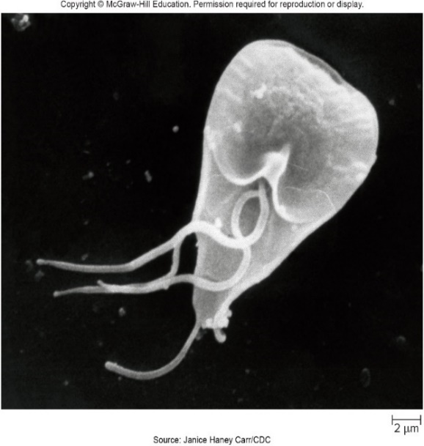
Protozoan Diseases of the Lower Digestive System –Figure 24.20
Giardiasis
Causative agent: Giardia lamblia
Flagellated protozoan with two side-by-side nuclei, adhesive disc on undersurface
Two forms: growing, feeding trophozoite and dormant cyst
Cysts: thick protective chitin-like polysaccharide walls
Have mitosomes that likely evolved from mitochondria
Source: Janice Haney Carr/CDC

Slide 98
Protozoan Diseases of the Lower Digestive System (2)
Giardiasis
Pathogenesis
Cysts infectious, survive stomach acid, unlike trophozoites
Two trophozoites emerge from each cyst that reaches upper part of small intestine
Some attach to epithelium by adhesive disc
Others use flagella to move freely in intestinal mucus
Some migrate to gallbladder, cause cramping or jaundice
Trophozoites interfere with intestine’s ability to absorb nutrients, secrete digestive enzymes
Result in bulky feces containing fat, intestinal gas from bacterial digestion, and malnutrition
Trophozoites detach, are carried to large intestine
If transit time is long, trophozoites develop into cysts
If person has diarrhea, trophozoites are eliminated in feces

Slide 99
Protozoan Diseases of the Lower Digestive System Figure 24.21
Jump to Protozoan Diseases of the Lower Digestive System –Figure 24.21 Long Description
(3): Dr. Stan Erlandsen/CDC; (4): Dr. Stan Erlandsen/CDC

Slide 100
Protozoan Diseases of the Lower Digestive System (3)
Giardiasis
Epidemiology
Low infective dose (10 cysts); easily spread
Water contaminated with human feces common source of infection; feces from other animals also implicated
Cysts infectious, remain viable in cold water >2 months
Hikers drinking from streams are at risk
Person-to-person transmission, especially in daycare centers where hands contaminated while changing diapers
Sexual practices involving oral-anal contact can transmit
Transmission by fecally contaminated food reported
Good personal hygiene and handwashing minimize spread

Slide 101
Table 24.15 Giardiasis
Giardiasis
Treatment and prevention
Tinidazole, metronidazole (Flagyl), and nitazoxanide
Municipal chlorination does not destroy cysts, so water generally filtered to remove
Hikers should boil for 1 minute or use portable filter
Chemical methods are less reliable
Time, temperature important
Signs and symptoms | Mild: indigestion, intestinal gas, nausea. Severe: vomiting, diarrhea, abdominal cramps, weight loss
Incubation period | 6 to 20 days
Causative agent | Giardia lamblia, a flagellated pear-shaped protozoan with two nuclei
Pathogenesis | Ingested cysts survive stomach passage; trophozoites emerge from cysts in the small intestine, where some attach to epithelium; mucosal function is impaired by adherent protozoa and immune response.
Epidemiology | Ingestion of fecally contaminated water; low infectious dose; person-to-person spread.
Treatment and prevention | Treatment: several antimicrobial medication options. Prevention: boiling, filtering, or disinfecting drinking water

Slide 102
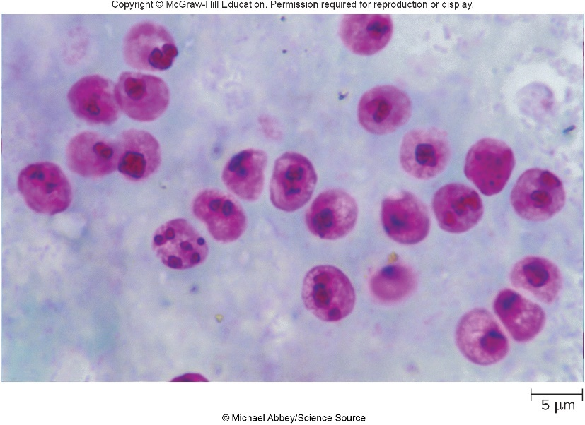
Protozoan Diseases of the Lower Digestive System –Figure 24.2
Cryptosporidiosis (“Crypto”)
Signs and symptoms
Fever, loss of appetite, nausea, abdominal cramps, profuse watery diarrhea begin after 4 to 12 days
Symptoms last 10 to 14 days; can last months and be life-threatening in immunocompromised individuals
Causative agent: Cryptosporidium parvum
An apicomplexan; completes entire life cycle in single host
Oocyst stage is acid-fast sphere with four sporozoites
©Michael Abbey/Science Source

Slide 103
Protozoan Diseases of the Lower Digestive System (4)
Cryptosporidiosis
Pathogenesis
Sporozoites released from ingested oocysts, which then invade epithelial cells of small intestine
Cause inflammation, water and electrolyte secretion, decrease in nutrient absorption
Epidemiology
Infectious dose as few as 10 oocysts; can easily spread person-to-person
Responsible for many cases of traveler’s diarrhea
Oocysts can survive up to 6 months in food, water
Resistant to chlorine; too small for some filtration methods
Feces from dogs, pigs, cattle can contaminate food, water

Slide 104
Table 24.16 Cryptosporidiosis
Cryptosporidiosis
Treatment and prevention
Nitazoxanide may be used in those with healthy immune systems; most recover without treatment
Sanitary disposal of human, animal feces
Treat water with filtration, UV, or ozone
Pasteurize liquids
Wash hands with soap, water
Immunodeficient individuals should avoid animals, boil or filter water, avoid recreational water activities
Signs and symptoms | Fever, loss of appetite, nausea, abdominal cramps, watery diarrhea
Incubation period | 4 to 12 days
Causative agent | Cryptosporidium parvum, an apicomplexan. Its life cycle takes place entirely within the epithelial cells of the small intestine.
Pathogenesis | Ingested oocysts release sporozoites in the intestine. The sporozoites invade epithelial cells, causing an inflammatory response. Secretion of water and electrolytes increases; absorption of nutrients decreases.
Epidemiology | Oocysts of C. parvum are immediately infectious. The infectious dose is low, so person-to-person spread occurs easily. Infected individuals can discharge the oocysts for weeks after symptoms subside. The oocysts resist chlorination, and pass through many municipal water filtration systems. Wide host range.
Treatment and prevention | Treatment: antimicrobial medication. Prevention: pasteurization of beverages, boiling or filtering drinking water. Sanitary disposal of human and animal feces.

Slide 105
Protozoan Diseases of the Lower Digestive System (5)
Cyclosporiasis
Signs and symptoms
Fatigue, loss of appetite, slight fever, vomiting, and watery diarrhea begin after about 1 week, followed by weight loss
Diarrhea subsides in 3 to 4 days; relapses up to 4 weeks
Causative agent: Cyclospora cayetanensis
An apicomplexan; oocysts similar to C. parvum but larger, and not infectious in feces
Under favorable conditions outside body, sporocysts containing sporozoites develop within infectious oocyst
Pathogenesis
Little known; no known hosts other than humans
Biopsies confirm sexual and asexual forms are both present in intestinal epithelium

Slide 106
Table 24.17 Cyclosporiasis
Cyclosporiasis
Epidemiology
No person-to-person transmission
Warm, moist conditions favor maturation of oocysts
Fresh produce implicated in epidemics
Has been found in natural waters; source undetermined
Treatment and prevention
Co-trimoxazole
No specific preventive measures; boil or filter drinking water, thoroughly wash produce during outbreaks
Signs and symptoms | Fatigue, loss of appetite, vomiting, watery diarrhea, and weight loss. Symptoms improve in 3 to 4 days, but relapses can occur for up to a month.
Incubation period | Usually about 1 week (range, 1 to 12 days)
Causative agent | Cyclospora cayetanensis, an apicomplexan
Pathogenesis | Little is known. Biopsies show sexual and asexual stages in the intestinal epithelium.
Epidemiology | The oocysts of C. cayetanensis are not infectious when discharged in the feces, and so person-to person spread does not occur. Travelers to tropical countries are at risk of infection. Produce, especially raspberries imported from tropical Central America, has been implicated in most North American outbreaks.
Treatment and prevention | Treatment: antimicrobial medication. Prevention: use of boiled or filtered drinking water is advised in the tropics. Thorough washing of imported fruits and vegetables.

Slide 107
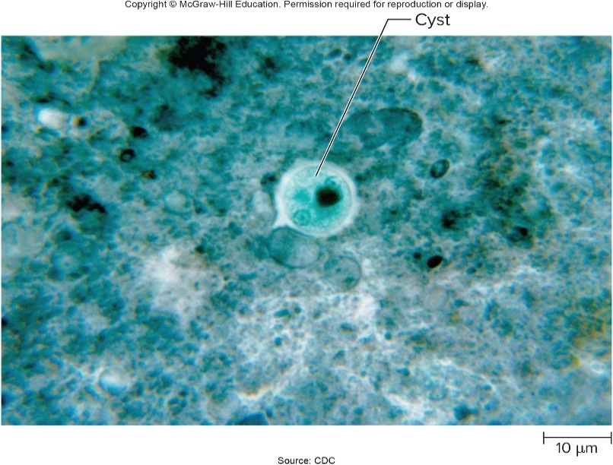
Protozoan Diseases of the Lower Digestive System –Figure 24.23
Amebiasis
Signs and symptoms
Commonly asymptomatic; some suffer from chronic, mild diarrhea lasting months or years
In severe cases, acute dysentery can be fatal
Incubation period varies from a few days to a few months
Causative agent: Entamoeba histolytica
Forms cysts with chitin- containing wall; mature cysts (infectious form) have four nuclei
Source: CDC

Slide 108
Protozoan Diseases of the Lower Digestive System (6)
Amebiasis
Pathogenesis
Cysts survive passage through stomach, release trophozoites, which are passed to large intestine
Trophozoites feed on mucus, bacteria; cause intestinal cramps, diarrhea; many strains produce cytotoxic enzyme
May penetrate intestinal lining, causing ulceration and bloody diarrhea called amebic dysentery
Sometimes penetrate blood vessels and are carried to liver or other organs resulting in amebic abscesses

Slide 109
Table 24.18 Amebiasis
Amebiasis
Epidemiology
Low infectious dose; spread by fecal-oral route
Most common in tropical areas with poor sanitation
In U.S., mainly in poverty-stricken areas, among migrant farm workers, and men who have sex with men
Humans only important reservoir
Treatment and prevention
Metronidazole, paromomycin
Sanitary measures prevent
Signs and symptoms | Diarrhea, abdominal pain, blood in feces
Incubation period | 2 days to several months
Causative agent | Entamoeba histolytica
Pathogenesis | Ingested cysts excyst, releasing trophozoites; these feed on mucus and bacteria in the large intestine; cytotoxic enzyme kills intestinal cells. The trophozoites may penetrate the intestinal wall and are sometimes carried to the liver and other organs, resulting in abscesses.
Epidemiology | Ingestion of fecally contaminated food or water; disease associated with poverty, migrant workers, and men who have sex with men.
Treatment and prevention | Treatment: antimicrobial medication. Prevention: good sanitation and personal hygiene.

Slide 110
Appendix of Image Long Descriptions

Slide 111
Anatomy, Physiology, and Ecology – Figure 24.1 Long Description
Diseases of the digestive tract include oral cavity dental caries periodontal disease parotid salivary gland mumps esophagus esophagitis stomach gastritis gastric ulcer liver hepatitis pancreas pancreatitis small intestine enteritis duodenal ulcer large intestine dysentery colitis appendix appendicitis
Jump back to Anatomy, Physiology, and Ecology – Figure 24.1

Slide 112
Bacterial Diseases of the Upper Digestive System (12) Long Description
Helicobacter survives acidic stomach environment by secreting urease, which breaks urea into carbon dioxide and ammonia. Ammonia neutralizes stomach acid. Bacterial cells use flagella to penetrate the mucus layer, and then attach to the epithelium. Bacterial toxins and inflammation damage cells, decreasing mucus production. Acidic stomach juices damage the exposed tissue, causing an ulcer.
Jump back to Bacterial Diseases of the Upper Digestive System (12)

Slide 113
Bacterial Diseases of the Lower Digestive System – Figure 24.12 Long Description
Enterotoxins increase secretion of water and electrolytes. Cytotoxins cause cell death. Toxins absorbed into the bloodstream result in systemic effects. Attachment and effacing (A/E) lesions form after bacteria inject various effector proteins. One protein functions as a receptor for the bacterium. Another induces rearrangement of actin filaments, resulting in the formation of a pedestal under the bacterium. In cell invasion, the bacterium is engulfed and multiplies within a host cell. An effector protein injected by the bacterium induces the engulfment by causing rearrangement of host cell actin.
Jump back to Bacterial Diseases of the Lower Digestive System – Figure 24.12

Slide 114
Viral Diseases of Lower Digestive System: Intestinal Tract – Figure 24.17 Long Description
Hepatitis A has declined since 1995 when the vaccine was introduced, but was the most common type until about 2005. Hepatitis B has declined since the mid-1980's, but is the most common type since 2005. Hepatitis C is the least common type, but has increased in incidence since 2012.
Jump back to Viral Diseases of Lower Digestive System: Intestinal Tract – Figure 24.17

Slide 115
Viral Diseases of Lower Digestive System: Intestinal Tract – Figure 24.19 Long Description
HBV infects a liver cell. After uncoating, the HBV genome is transported to the nucleus. The single-stranded gap in the genome is filled in, creating a covalently closed circular DNA molecule (ccDNA). RNA polymerase transcribes the cccDNA, generating mRNA and pregenomic RNA (pgRNA). The mRNA is translated, producing the virally encoded proteins. Viral particles assemble, and HBV-encoded reverse transcriptase is packaged with the pgRNA. Reverse transcriptase uses pgRNA as a template to make DNA, but does not complete the process, leaving the HBV DNA genome partially single-stranded. HBV acquires its envelope as it exits the cell.
Jump back to Viral Diseases of Lower Digestive System: Intestinal Tract – Figure 24.19

Slide 116
Protozoan Diseases of the Lower Digestive System –Figure 24.21 Long Description
Giardia cysts enter the mouth and pass through the acidic stomach to the lower small intestine where trophozoites are released and multiply. Dehydration in large intestine stimulates cyst development. Mature cysts or trophozoites are eliminated in feces.
Jump back to Protozoan Diseases of the Lower Digestive System –Figure 24.21

