Slide 1
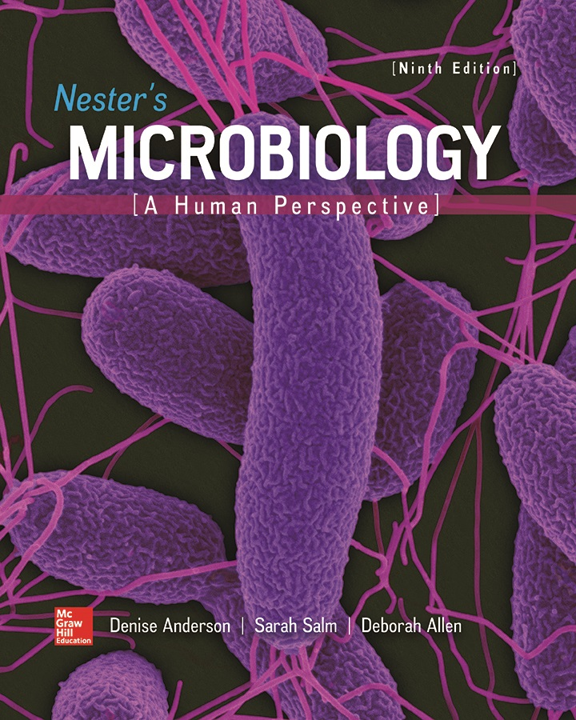
Chapter 27 Lecture Outline
See separate PowerPoint slides for all figures and tables pre-inserted into PowerPoint without notes.
Notes:
1

Slide 2
A Glimpse of History
Syphilis an ancient disease, once very common
History and literature record many cases
Fritz Schaudinn (1905) observed pale, slender, motile organisms in fluid from syphilitic sore; corkscrew shape
Now known as spirochetes
Schaudinn concluded they caused syphilis, even though they could not be cultured on laboratory media
Named Spirochaeta pallida for “the pale spirochete”
Now called Treponema pallidum for “turning thread”

Slide 3
Reproductive and Urinary Tract Infections
Infections of reproductive, urinary tracts common
Urinary tract infections (UTIs) most frequent healthcare-associated infections
May be origin of fatal, bacterial bloodstream infections
Healthcare-associated uterine infections require attention
Puerperal fever from childbirth
Sexually transmitted infections (STIs) widespread and may be life-threatening
Transmitted by sexual contact, but also by drug needles or through childbirth or breast feeding.

Slide 4
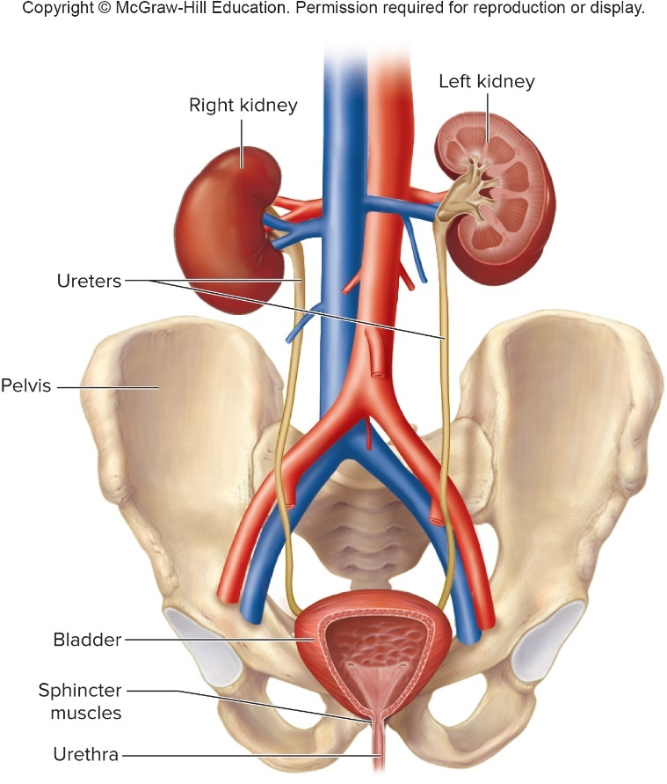
Anatomy, Physiology, and Ecology – Figure 27.1
The urinary system
Kidneys, ureters, bladder, urethra
Kidneys filter waste from blood
Reabsorb useful substances
Connected to bladder by ureters
Bladder stores urine
Wastes excreted in urine; emptied through urethra
Number of mechanisms protect
Sphincter muscles near urethra keep system closed
Downward urine flow washes away microorganisms
Urine contains organic acids, antimicrobial substances
Women have shorter urethras, more likely to get UTIs

Slide 5
Anatomy, Physiology, and Ecology (1)
The urinary system
Urine and urinary tract above urethra have generally been considered free of microorganisms in both women and men
Lower urethra has normal resident microbiota
Includes species of Lactobacillus, Staphylococcus, Corynebacterium, Haemophilus, Streptococcus, Bacteroides
Notes:
5

Slide 6
Anatomy, Physiology, and Ecology – Figure 27.2a
The genital system
Females: two ovaries; two fallopian tubes; uterus; vagina; external genitalia (vulva) includes labia, clitoris
Egg (ovum) released each month during ovulation
Swept into adjacent fallopian tube
If fertilization occurs, ovum moved via cilia to uterus
Implants in epithelial lining
Otherwise, menstruation
Lower end of uterus is cervix
Filled with antimicrobial mucus except during menstruation
Cervix opens to vagina

Slide 7
Anatomy, Physiology, and Ecology (2)
The genital system
Female infections occur in several places
Vagina is portal of entry for infectious organisms
Infection of cervix often results in inflammation (cervicitis)
Infection of fallopian tubes can cause scarring, destruction of ciliated epithelium, leading to infertility
Open at both ends; allows passage to abdominal cavity; may infect liver, other organs

Slide 8
Anatomy, Physiology, and Ecology – Figure 27.2b
The genital system
Males: testes; various tubes, ducts, glands; penis
Testes outside abdominal cavity in scrotum
Sperm cells collected in epididymis
Carried to urethra by vas deferens
Sperm, secretions of prostate gland and seminal vesicles make up semen
Antimicrobial properties
Systems join at prostate gland
Urinary, sexually transmitted pathogens can infect
In older men, prostate often enlarges, slows urine flow

Slide 9
Anatomy, Physiology, and Ecology (3)
The genital system
Microbiota of female genital tract affected by hormones
Glycogen deposited in vaginal epithelium when estrogens present
Converted to lactic acid by lactobacilli
Results in acidic pH, inhibits many potential pathogens
Lactobacilli may release hydrogen peroxide, inhibits some anaerobic bacteria

Slide 10
Urinary Tract Infections (1)
Bacterial cystitis (bladder infection)
Cystitis is most common UTI
Signs and symptoms
Sometimes asymptomatic
Typically start suddenly, include burning pain during urination, urgent need to urinate, frequent release of small amounts of urine
Urine cloudy from leukocytes; may be pale red from blood
Often has bad odor
Area above pubic bone may be painful
Sometimes pyelonephritis occurs: fever, chills, vomiting, back pain, tenderness overlying kidneys
Repeated episodes lead to scarring, shrinkage of kidneys; can cause kidney failure

Slide 11
Urinary Tract Infections (2)
Bacterial cystitis
Causative agents
Usually originate from normal intestinal microbiota
More than 80% of cases from specific uropathogenic strains of Escherichia coli
Klebsiella, Proteus, Staphylococcus saprophyticus cause remaining infections in young women
Hospitalized patients and people with long-standing bladder catheters often chronically infected with multiple species, for example, Serratia marcescens, Pseudomonas aeruginosa, Enterococcus faecalis
Many antibiotic resistant, difficult to treat

Slide 12
Urinary Tract Infections (3)
Bacterial cystitis
Pathogenesis
Pathogens generally move up urethra to bladder
Uropathogenic E. coli (UPEC) have pili that attach to receptors on bladder epithelial cells
Death, sloughing results, allowing bacteria to enter underlying epithelium via endocytosis
Create intracellular bacterial communities (IBCs)
Bacteria detach, move into bladder lumen, create IBCs
UPEC establishes chronic reservoir in epithelium that resists antibiotics, is undetected by immune system
Filamentous forms observed, help avoid innate immune response

Slide 13
Urinary Tract Infections (4)
Bacterial cystitis
Epidemiology
Anything that inhibits urine flow increases risk
About 30% of women develop during life
Factors that predispose women:
Short urethra
Sexual intercourse
Birth control devices
Other factors involved in UTIs:
Enlarged prostate
Catheterization
Paraplegia

Slide 14
Urinary Tract Infections (5)
Bacterial cystitis
Treatment and prevention
Few days of an antimicrobial
Pyelonephritis usually requires hospitalization, IV antibiotic
Drink enough water
Urinate following intercourse
Wipe front to back
Low doses of antimicrobials, since many accumulate in urine can prevent recurrence
Cranberry juice, green tea
Effectiveness inconclusive

Slide 15
Table 27.1 Bacterial Cystitis
Signs and symptoms | Sudden onset, burning pain on urination, frequent need to urinate; cloudy, red-colored urine that smells bad; fever, chills, back pain, and vomiting suggest pyelonephritis
Incubation period | Usually 1 to 3 days
Causative agents | Most commonly Escherichia coli, but also other Enterobacteriaceae as well as Staphylococcus saprophyticus; in the case of healthcare-associated infections, Pseudomonas, Serratia, and Enterococcus species
Pathogenesis | Bacteria ascend the urethra, enter the bladder, and attach by pili to receptors on epithelium; sloughing of cells and an inflammatory response follow; bacterial spread to the kidneys can occur via the ureters, causing pyelonephritis and possible kidney failure.
Epidemiology | Bacterial cystitis is common in women, promoted by a relatively short urethra, sexual intercourse, and use of a diaphragm. Older men are at risk of infection because enlargement of the prostate gland partially obstructs their urethra; catheterization often results in infection.
Treatment and prevention | Treatment: short-term antimicrobial medication usually sufficient; longer treatment for pyelonephritis. Prevention: drinking enough liquid to urinate at least four to five times daily; wiping from front to back; low daily dose of antibiotic may help prevent recurrent bacterial cystitis in women.

Slide 16
Urinary Tract Infections (6)
Leptospirosis
Signs and symptoms
Often asymptomatic
Following 10 day incubation, mild cases flu-like: headache, spiking fever, chills, and muscle pain; possible dry cough
First (septicemic) phase includes photophobia, redness of eyes; symptoms fade within a week
In severe cases, symptoms recur after 1 to 3 days
Second (immune) phase includes bleeding from various sites, vomiting, rash, and confusion
Usually requires medical treatment
In rare cases, Weil’s disease; includes jaundice, liver and kidney failure, hemorrhage in many organs, meningitis
Can be fatal

Slide 17
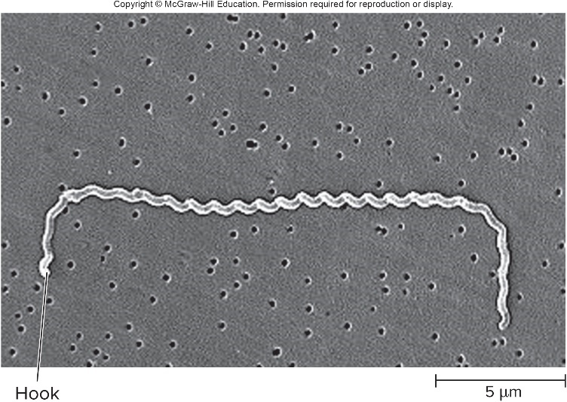
Urinary Tract Infections – Figure 27.3
Leptospirosis
Causative agent: Leptospira interrogans
Slender, aerobic Gram-negative spirochete, hooked ends
More than 250 antigenic types
Pathogenesis
Entry through mucous membranes, eyes, breaks in skin
No lesion; organisms multiply, spread via bloodstream
Severe pain may confuse diagnosis
No inflammation or tissue damage
Immune system clears bacteria within a week, except in kidneys
Source: Rob Weyant/CDC

Slide 18
Urinary Tract Infections (7)
Leptospirosis
Pathogenesis
If disease progresses, person seems healthy a few days
New symptoms thought due to immune response
Called “immune phase”
Injury to cells lining lumen of tiny blood vessels, causing clotting and impaired blood flow throughout body
Can result in kidney failure, main cause of fatalities
Epidemiology
Worldwide; more common in tropics
Infects many species of wild and domestic animals
Contaminated urine main mode of transmission
Can survive in mud, water for several weeks
No person-to-person transmission

Slide 19
Urinary Tract Infections (8)
Leptospirosis
Treatment and prevention
Mild cases resolve, although antibiotics can be given
Antibiotics effective if started within first 4 days of illness
Person often shows temporary worsening due to massive release of antigens from lysing of bacteria
Avoid animal urine
Multivalent vaccines (against different serotypes) available for domestic animals, but do not always prevent carriers
Small doses of tetracycline can prevent in high risk individuals (veterinarians, slaughterhouse workers, farmers, sewer workers, water sports enthusiasts)

Slide 20
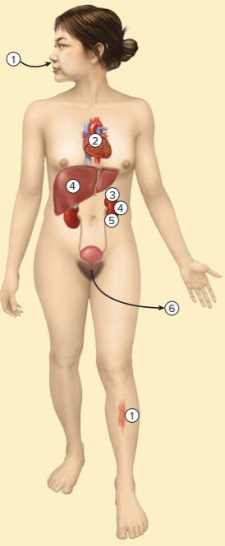
Table 27.2 Leptospirosis
Water or animal urine contaminated with Leptospira interrogans splashes onto mucous membrane or damaged skin.
The bacteria enter the bloodstream and are carried throughout all body tissue, sometimes causing fever and intense pain.
Signs and symptoms resolve and bacteria disappear from blood and tissues, except kidneys.
Second phase of the biphasic illness is associated with severe damage to liver and kidneys.
Complete recovery occurs if kidney failure can be effectively treated.
Excretion of L. interrogans continues in urine.
Sign and symptoms | Many mild and asymptomatic cases; others have a biphasic illness: spiking fever, headache, muscle pain, bloodshot eyes in the first (septicemic) phase, then 1 to 3 days of improvement; heart, brain, liver, and kidney damage in the second (immune) phase.
Incubation period | Usually about 10 days (range, 2 to 30 days)
Causative agents | Leptospira interrogans, a spirochete with many serotypes
Pathogenesis | The bacteria penetrate mucous membranes or breaks in the skin, multiply in the bloodstream, and are carried to all parts of the body. Septicemic phase: severe pain with penetration of body tissues, but little or no tissue damage. Immune phase: damage to cells that line small blood vessels and clotting of blood; causes severe damage to the liver, kidneys, heart, brain, and other organs.
Epidemiology | Worldwide distribution; wide range of animal hosts chronically excrete the bacteria in their urine, causing contamination of natural waters and soils; organisms remain infectious under warm, moist, neutral or alkaline conditions for long periods of time.
Treatment and prevention | Treatment: various antibacterial medications useful but only if given early in the disease. Prevention: avoiding contact with animal urine; vaccines prevent disease in domestic animals, but may not prevent urinary carriage; antibiotics preventive in epidemics.

Slide 21
Genital System Diseases (1)
Bacterial vaginosis (BV)
Signs and symptoms
Thin, grayish-white, slightly bubbly vaginal discharge with characteristic strong fish-like smell
Bacteria may spread to uterus or fallopian tubes, causing pelvic inflammatory disease (PID); can lead to sterility
About half of BV cases asymptomatic
Causative agent
Cause or causes unknown
Most cases show significant decrease in vaginal lactobacilli, so conditions that suppress thought to cause
Discharge contains many bacteria including several previously uncultured species

Slide 22
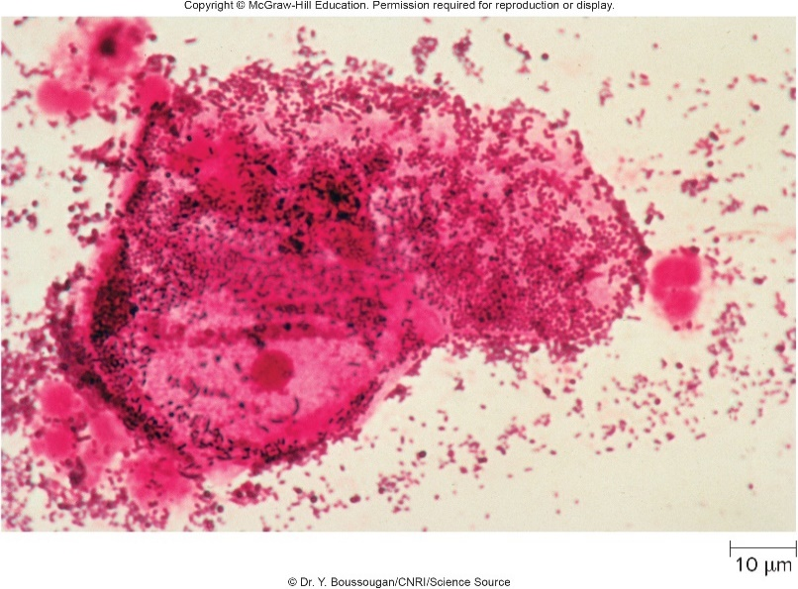
Genital System Diseases – Figure 27.4
Bacterial vaginosis
Pathogenesis
Characteristic changes in vagina including loss of acidity of secretions (normally pH 3.8 to 4.2), disruption of normal microbiota, and substantial increase in clue cells
Clue cells are epithelial cells from vaginal wall covered with bacteria
No inflammation unless other, concurrent infection present
Fishy odor caused by metabolic products of anaerobic bacteria
Used to diagnose in whiff test
©Dr. Y. Boussougan/CNRI/Science Source

Slide 23
Genital System Diseases (2)
Bacterial vaginosis
Epidemiology
Not well understood since causative agent unknown
Most common among sexually active women
Sometimes in sexually abused children
Pregnant women at increased risk
Women who douche, have multiple sex partners, have sex with other women, have a new sex partner, or use an IUD also at increased risk
No proof of sexual transmission, but virgins seldom get BV
Infected women at higher risk of getting other STIs such as gonorrhea, HIV, or chlamydia

Slide 24
Genital System Diseases (3)
Bacterial vaginosis
Treatment and prevention
Most cases respond quickly to antibiotics, but can recur
Treatment important in pregnant women since BV may cause premature birth
Studies using yogurt to restore vaginal lactobacilli have conflicting results
Prevention by abstinence, limiting number of sex partners, avoiding douching
Treatment of male sex partners does not prevent recurrences

Slide 25
Table 27.3 Bacterial Vaginosis
Signs and symptoms | Gray-white vaginal discharge with unpleasant fishy odor
Incubation period | Unknown
Causative agents | Unknown
Pathogenesis | Uncertain; obvious change in normal microbiota composition; increased sloughing of vaginal epithelium in the absence of inflammation; odor due to metabolic products of anaerobic bacteria; may cause complications of pregnancy, including premature births.
Epidemiology | Associated with many sexual partners or a new partner, but can occur in the absence of sexual intercourse.
Treatment and prevention | Treatment: antibacterial medications. Prevention: abstinence, limiting number of sexual partners, avoiding douching.

Slide 26
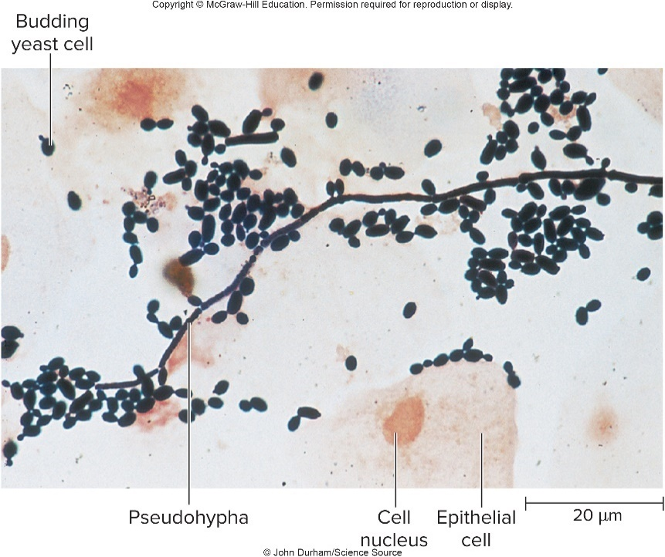
Genital System Diseases – Figure 27.5
Vulvovaginal candidiasis (VVC)
Signs and symptoms
Constant, intense itching and burning of vagina or vulva
Red, swollen
Much thick, clumpy whitish or whitish-gray discharge
Causative agent: Candida albicans
Yeast; part of normal microbiota in about a third of women
©John Durham/Science Source

Slide 27
Genital System Diseases (4)
Vulvovaginal candidiasis
Pathogenesis
Normally, colonization causes no symptoms
Usually limited by immune system and normal vaginal lactobacilli
Disruption of balance (menstruation, pregnancy, oral contraceptives or antibiotics) can allow multiplication
Inflammatory response results
Epidemiology
Late pregnancy, poorly controlled diabetes, use of oral contraceptives or antibiotics, hormone replacement therapy may increase risk
Most patients with VVC have no predisposing factors
Does not spread person to person

Slide 28
Table 27.4 Vulvovaginal Candidiasis
Signs and symptoms | Itching, burning, thick, white vaginal discharge, redness and swelling
Incubation period | Usually unknown; generally 3 to 10 days when associated with antibacterial medications
Causative agents | Candida albicans, a yeast
Pathogenesis | Inflammatory response to overgrowth of the yeast, which is often present among the normal microbiota
Epidemiology | Not contagious; associated with antibacterial therapy, use of oral contraceptives, pregnancy, and uncontrolled diabetes, but most cases have no identifiable predisposing factor.
Treatment and prevention | Treatment: intravaginal antifungal medications usually effective. Prevention: minimizing antibiotic use and treating known predisposing conditions.

Slide 29
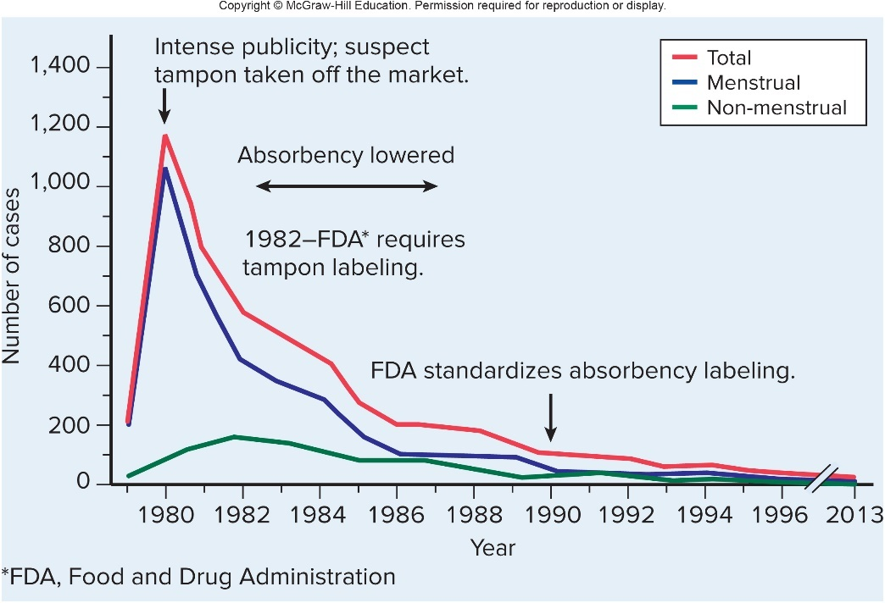
Genital System Diseases – Figure 27.6
Staphylococcal toxic shock syndrome (STSS)
Toxic shock syndrome first described in late 1970s in several children
In 1980, became epidemic in young, healthy, menstruating women using brand of high-absorbency tampon
Not a new disease, but emerged in new form due to changes in technology, behavior

Slide 30
Genital System Diseases (5)
Staphylococcal toxic shock syndrome
Signs and symptoms
Sudden development of high temperature, headache, muscle aches, bloodshot eyes, vomiting, diarrhea, sunburn-like rash, and confusion
Skin peels in about a week
Without treatment, blood pressure can drop, leading to multi-organ failure, coma, sometimes death
Causative agent
Staphylococcus aureus strains that produce toxic shock syndrome toxin-1 (TSST-1) or related exotoxins

Slide 31
Genital System Diseases (6)
Staphylococcal toxic shock syndrome
Pathogenesis
During menstruation when tampons are used
Bacteria grow in blood-soaked tampon
Rarely spread throughout body, but toxins are absorbed into bloodstream
Toxins act as superantigens; cause activation of T cells, leading to massive release of cytokines (cytokine storm)
Cause drop in blood pressure, multi-organ failure
Epidemiology
Can occur after infection with exotoxin-producing strain; TSST-1 responsible for 75% of cases
Not spread person to person
Use of tampons, contraceptive sponges increases risk
Infection does not always result in immunity

Slide 32
Genital System Diseases (7)
Staphylococcal toxic shock syndrome
Treatment and prevention
Severe disease, requires hospitalization
Antibacterials, IV fluid, other measure to prevent shock
Most recover within 2 to 3 weeks
Can be fatal within a few hours
Appropriate use of tampons
Wash hands
Use lower absorbency
Change every 6 hours
Use a pad when sleeping
Avoid trauma when inserting
Women who have had STSS should not use tampons

Slide 33
Table 27.5 Staphylococcal Toxic Shock Syndrome
Signs and symptoms | Fever, vomiting, diarrhea, muscle aches, a rash that peels, and low blood pressure that may lead to multi-organ failure
Incubation period | 3 to 7 days
Causative agents | Certain toxin-producing strains of Staphylococcus aureus
Pathogenesis | Toxin (TSST-1 and others) produced by certain strains of S. aureus; toxins are superantigens, causing cytokine release and drop in blood pressure.
Epidemiology | Associated with certain high-absorbency tampons, leaving tampons in place for long periods of time, and abrasion of the vagina from tampon use; also as a result of infection by certain toxin-producing S. aureus strains in other parts of the body.
Treatment and prevention | Treatment: antimicrobial medication effective against the causative S. aureus strain; intravenous fluids. Prevention: awareness of symptoms; prompt treatment of S. aureus infections; frequent change of tampons by menstruating women.

Slide 34
Focus on Sexually Transmitted Infections (1)
Signs and symptoms
Many are asymptomatic
May be unknowingly transmitted
Symptoms vary by pathogen, but often include
Vaginal or urethral discharge, pain with urination, genital sores, rashes, abnormal vaginal bleeding, abdominal pain
Some ascend female tract to cause pelvic inflammatory disease (PID)
Some spread to other parts of the body or become systemic

Slide 35
Focus on Sexually Transmitted Infections (2)
Pathogenesis
Intimate contact generally required for transmission
Enter through mucous membranes of vagina, urethra, rectum, or mouth and throat
Do not survive well in environment; survival dependent on how well they can evade immune system
Damage due to bacterial STIs usually due to inflammation; may cause permanent problems
Viral STIs usually associated with direct damage to cells
Notes:
35

Slide 36
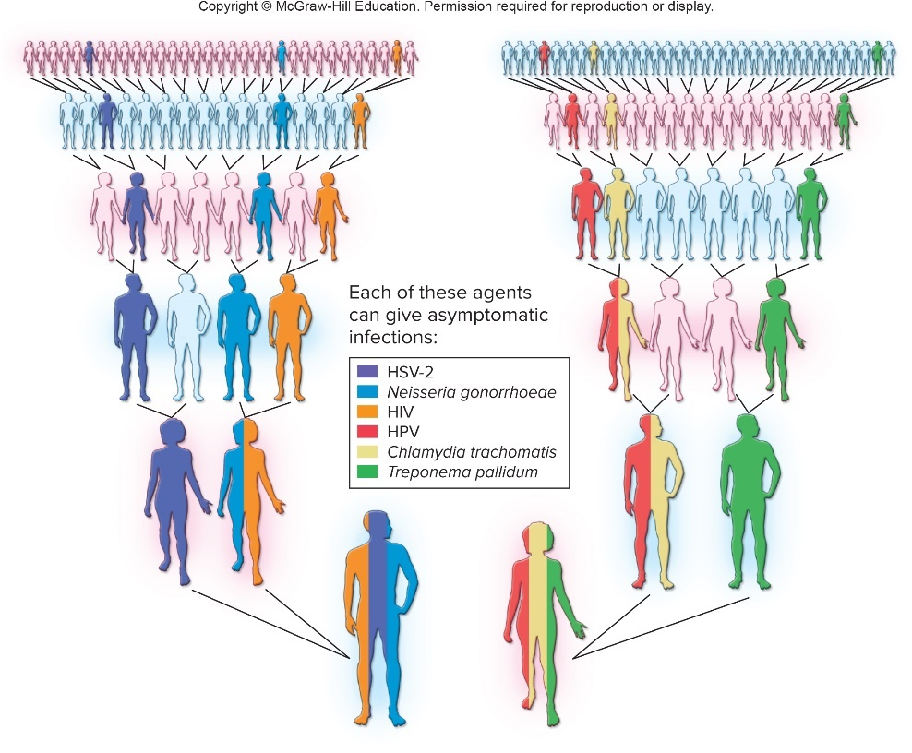
Focus on Sexually Transmitted Infections (3)
Epidemiology
May be transmitted in absence of symptoms
Open sores, inflammation increase risk of HIV infection
Fetuses, newborns at risk by transmission from mother
Risk increases with more unprotected sex
Notes:
36

Slide 37
Focus on Sexually Transmitted Infections (4)
Treatment and prevention
Bacterial STIs curable with antimicrobials, but some are resistant to most available options
Viral STIs cannot be cured with antivirals, but these medications can reduce severity and duration
Most reliable ways to prevent STIs include
Not having sex
Monogamous relationship with uninfected person
Condom use
Vaccination
Male circumcision

Slide 38
Bacterial STIs (1)
Chlamydial infections
Signs and symptoms
75% of women and 50% of men asymptomatic
Symptoms generally appear 7 to 14 days after exposure
Men: thin, gray-white discharge from urethra; sometimes painful testes, pain on urination, fever
Women: increased vaginal discharge, sometimes painful urination, abnormal vaginal bleeding, abdominal pain, and pain during sexual intercourse; can lead to PID
Newborns infected at birth may have eye inflammation
Some strains cause lymphogranuloma venereum; lymph nodes of groin swell and drain pus
Painful; eventual obstruction of lymphatic vessels may cause extreme swelling of genitalia

Slide 39
Bacterial STIs (2)
Chlamydial infections
Causative agent: Chlamydia trachomatis
Spherical, obligate intracellular Gram-negative bacterium
Elementary body (EB) is infectious form; survives outside of host cell
Reticulate body (RB) is intracellular replicating form
Different antigenic types cause distinct diseases
About 8 types responsible for most chlamydial STIs
3 other types cause lymphogranuloma venereum
4 others cause trachoma, an eye infection that can lead to blindness

Slide 40
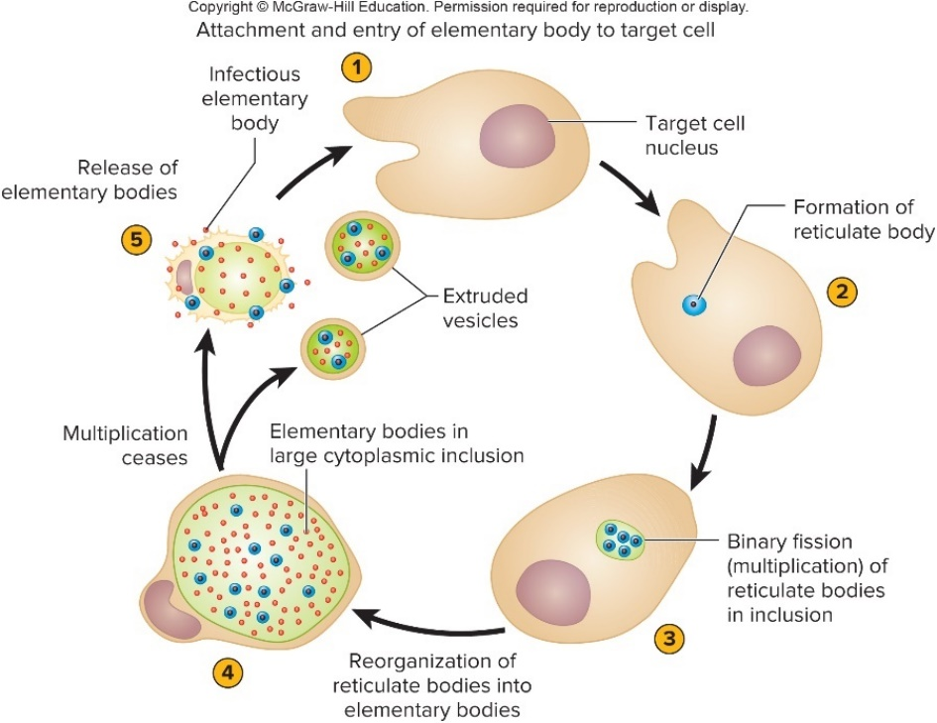
Bacterial STIs – Figure 27.7
Chlamydial infections
Pathogenesis
EB attaches to mucosal epithelial cell, induces endocytosis
Creates an inclusion body inside which RB multiplies
Divides by binary fission, produces EBs that emerge, infect other cells

Slide 41
Bacterial STIs (3)
Chlamydial infections
Pathogenesis
Can persist for months by avoiding host defenses
Interferes with MHC-antigen complex formation
Inhibits apoptosis in infected cells
Damage largely due to immune responses
Men: usually involves urethra; spreads to epididymis, causes acute pain, swelling that may lead to infertility
Women: involves cervix; may lead to PID
Uterus often becomes infected, leads to pain, bleeding
Infection of fallopian tubes can lead to infertility

Slide 42
Bacterial STIs (4)
Chlamydial infections
Epidemiology
Most common notifiable bacterial infectious disease
Number of reported cases has been rising
Increased awareness, better diagnostic tests
Treatment and prevention
Antibiotics; sexual partners also treated
Abstinence, monogamy, correct condom use
All sexually active people advised to get tested each year, or twice yearly if they have (or their partner has) multiple partners

Slide 43
Table 27.6 Chlamydial Reproductive Tract Infections
Signs and symptoms | Frequently asymptomatic. Men: thin, gray-white penile discharge, painful testes. Women: vaginal discharge, vaginal bleeding, abdominal pain
Incubation period | Usually 7 to 14 days
Causative agents | Chlamydia trachomatis, an obligate intracellular bacterium, certain serotypes
Pathogenesis | Elementary body (EB) attaches to specific receptors on the epithelial cell, and is engulfed by that cell; becomes reticulate body (RB) in the endosome; replicates and then differentiates into EBs, which infect other cells when released; tissue damage results from inflammation and the cell-mediated immune response to infection; if scar tissue forms in the fallopian tubes, ectopic pregnancy and infertility risk increase.
Epidemiology | The leading reportable bacterial infection in the United States; large numbers of asymptomatic infections.
Treatment and prevention | Treatment: antibacterial medications. Prevention: abstinence, monogamous relationships, correct use of condoms; test sexually active people at least once yearly to rule out asymptomatic infection.

Slide 44
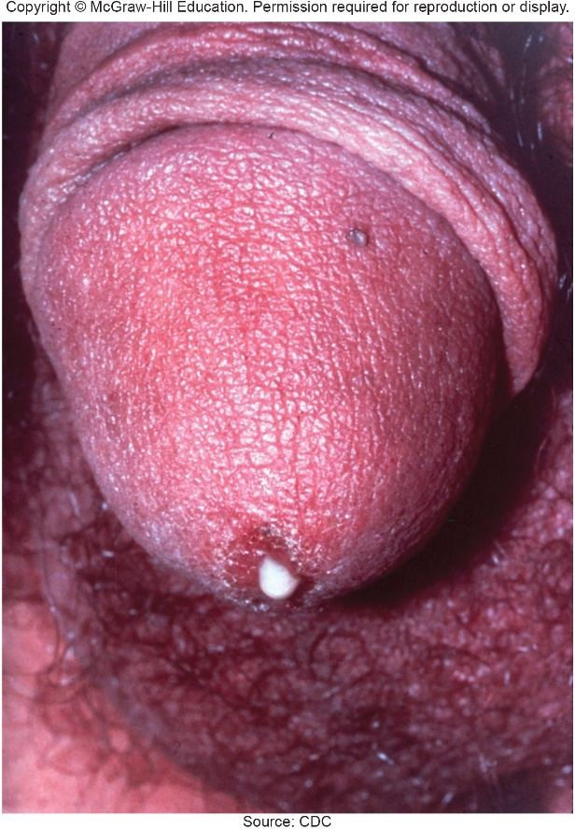
Bacterial STIs – Figure 27.8
Gonorrhea
Signs and symptoms
Incubation period 2 to 5 days; frequently asymptomatic
Men: with pain during urination; thick, pus-containing discharge from penis
Women: painful urination, vaginal discharge; PID, possible scarring
If untreated in men:
Inflammation can produce scar tissue that obstructs urethra, slows urination, increases risk of UTIs
Infection may produce prostatic abscesses and orchitis; infertility can result
Source: CDC

Slide 45
Bacterial STIs (5)
Gonorrhea
Signs and symptoms
If untreated in women:
Infection can spread to fallopian tubes, cause pelvic inflammatory disease (PID), sometimes infertility
Infection perhaps carried by sperm cells
Scarring of fallopian tube can lead to ectopic pregnancy
Occasionally spreads into abdominal cavity
Disseminated gonococcal infection (DGI): systemic infection causing fever, rash, arthritis
May lead to endocarditis or meningitis
Neonatal conjunctivitis infection in newborns

Slide 46
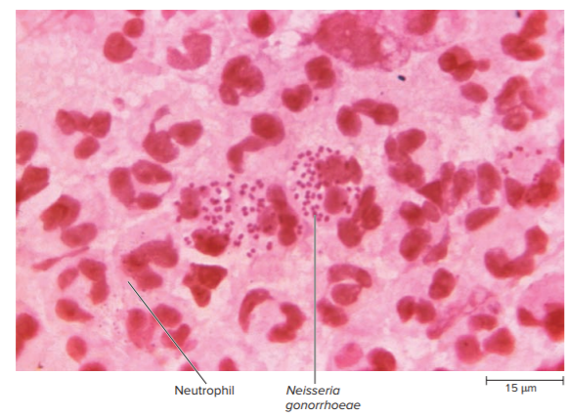
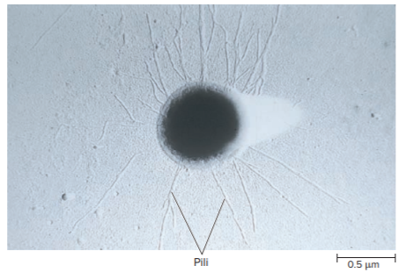
Bacterial STIs – Figures 27.9 and 27.10
Gonorrhea
Causative agent: Neisseria gonorrhoeae
Gonococcus (GC), a fastidious, Gram-negative diplococcus
Pili (fimbriae) for attachment
Outer membrane has highly branched oligosaccharide structure (lipooligosaccharide - LOS)
Plays role in GC virulence and pathogenicity
Left: Source: Bill Schwartz/CDC; Right: ©Stanley Falkow

Slide 47
Bacterial STIs (6)
Gonorrhea
Pathogenesis
Attachment by pili to receptors on non-ciliated columnar mucosal cells
Urethra, cervix, mouth, pharynx, rectum, conjunctiva
Cannot attach to squamous epithelium such as that lining adult vagina, or ciliated cells
Some bacteria direct host cells to engulf them; multiply within cells or released on other side of mucosal lining
Symptoms due to intense inflammatory response
Bacteria release blebs with LOS and peptidoglycan
Causes release of pro-inflammatory cytokines
Complement activated; neutrophils release damaging chemicals
Peptidoglycan toxic to ciliated epithelial cells

Slide 48
Bacterial STIs (7)
Gonorrhea
Pathogenesis
Numerous mechanisms to avoid immune response
Bind to host’s complement regulatory proteins
Antigenic variation delays production of effective antibodies
Binds host sialic acid to disguise from immune cells
Stimulate uptake by neutrophils, where they replicate
Attach to helper T cells, preventing activation, proliferation
Produces proteases that destroy IgA of mucosa
Produces protein that prevents phagosome maturation
Produces protein that “steals” iron from host
Significant mechanisms of horizontal gene transfer

Slide 49
Bacterial STIs (8)
Gonorrhea
Epidemiology
Among most common STIs; only infects humans
Increasingly resistant to antimicrobial medications; now considered by CDC to be an “urgent threat”
In U.S., decline since emergence of HIV/AIDS, probably due to increased condom use
Most strains susceptible to UV light, cold, desiccation
Transmission almost exclusively by direct contact
Almost always sexual, including vaginal, oral, anal
Also transmitted mother to child during vaginal birth
Factors influencing incidence include use of birth control pills, asymptomatic infection (20% of men, 60% of women), and lack of immunity after recovery from infection

Slide 50
Bacterial STIs (9)
Gonorrhea
Treatment and prevention
Frequently resistant to many antibacterial medications
Combination therapy of ceftriaxone injection plus azithromycin recommended to prevent spread of resistance
Abstinence, monogamous relationships, and consistent, correct use of condoms, rapid identification and treatment of sexual contacts
No vaccine
Antigenic variation
Lack of animal model
Neonatal gonococcal conjunctivitis prevented by prophylactic treatment of eyes of newborns within 1 hour
Required by law in U.S.

Slide 51
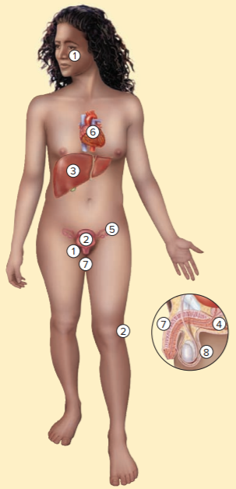
Table 27.7 Gonorrhea
Neisseria gonorrhoeae attaches to mucous membranes of the genitalia, mouth, anus, rectum, or eyes; serious infections leading to loss of vision are a risk in newborns.
The cervix is the usual site of primary infection in women.
The outer covering of the liver is infected when gonococci enter the abdominal cavity from infected fallopian tubes.
Prostatic gonococcal abscesses may be difficult to eliminate.
Infection of the fallopian tubes results in scarring, which can cause infertility or ectopic pregnancy.
Organisms carried by the bloodstream infect the heart valves and joints.
Urethral scarring from gonococcal infection can predispose to urinary infections by other organisms.
Scarring of testicular tubules can cause infertility.
Sign and symptoms | Frequently asymptomatic. Men: pain on urination, urethral discharge; complications may include impaired urinary flow, infertility, and arthritis. Women: abnormal vaginal discharge, pain on urination; complications can include pelvic pain, infertility, ectopic pregnancy, and arthritis.
Incubation period | 2 to 5 days
Causative agents | Neisseria gonorrhoeae (also called gonococcus or GC), a Gram-negative diplococcus
Pathogenesis | Organisms attach to certain non-ciliated epithelial cells by pili; phase and antigenic variation in surface proteins and pili allows attachment to different host cells and escape from immune mechanisms; inflammation, scarring; can spread by bloodstream.
Epidemiology | Transmitted by sexual contact; asymptomatic infections are common; no immunity following recovery.
Treatment and prevention | Treatment: combination of antibiotics; widespread resistance limits medication options. Prevention: abstinence, monogamous relationships, condoms, early treatment of sexual contacts.

Slide 52
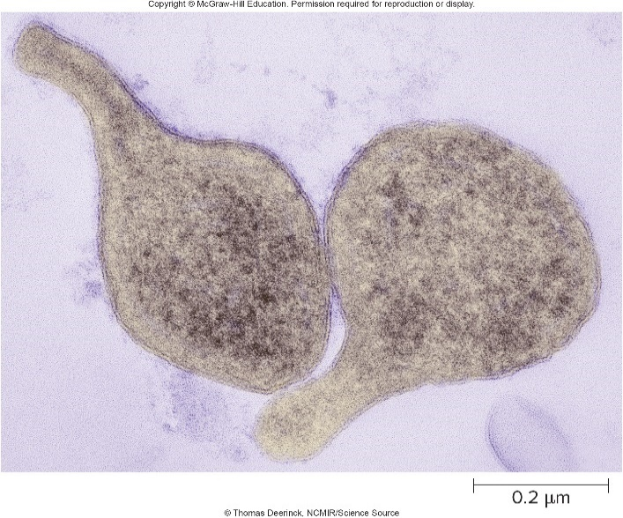
Bacterial STIs – Figure 27.11
Mycoplasma genitalium infections
Emerging cause of infections in men and women
Nucleic acid detection tests developed for detection
Signs and symptoms
Frequently asymptomatic; otherwise, symptoms similar to chlamydia and gonorrhea
Causative agent: Mycoplasma genitalium
No cell wall, fastidious
Generation time of at least 16 hours
Produces terminal organelle at one end; role in pathogenesis
©Thomas Deerinck, NCMIR/ Science Source
Notes:
52

Slide 53
Bacterial STIs (10)
Mycoplasma genitalium infections
Pathogenesis
Terminal organelle used in gliding movement; adhesions at tip involved in attachment
Antigenic variation
Symptoms caused by host’s inflammatory response
Epidemiology
Spread by unprotected sex
May be more common than reported
Detection is difficult
Infections are often asymptomatic
Signs and symptoms similar to other STIs
Not a notifiable disease
Notes:
53

Slide 54
Table 27.8 Mycoplasma genitalium Infections
Mycoplasma genitalium infections
Treatment and prevention
Antibiotics that are not peptidoglycan inhibitors; some resistance to azithromycin; both sex partners treated
Abstinence, monogamy, use of condoms
Signs and symptoms | Frequently asymptomatic. Men: urethral discharge, painful urination. Women: cervicitis, vaginal discharge.
Incubation period | Not well established.
Causative agents | Mycoplasma genitalium, a fastidious bacterium that grows very slowly in culture; has distinctive “flask” shape.
Pathogenesis | Causative agent attaches to host cells by adhesins in terminal organelle. Signs and symptoms result from host’s inflammatory response.
Epidemiology | Transmission of M. genitalium is through direct mucosal contact, and occurs during unprotected sex. Infection increases a person’s risk of contracting and transmitting HIV.
Treatment and prevention | Treatment: antibacterial medications. Prevention: abstinence, monogamous relationships, correct use of condoms.
Notes:
54

Slide 55
Bacterial STIs – Figure 27.12
Syphilis
Signs and symptoms
Primary syphilis: painless, red ulcer (hard chancre) that appears at site of infection within about 3 weeks
Usually on genitalia, but may occur anywhere on body
Often unnoticed if hidden in vagina or rectum
Local lymph nodes enlarge
Source: M. Rein, VD/CDC

Slide 56
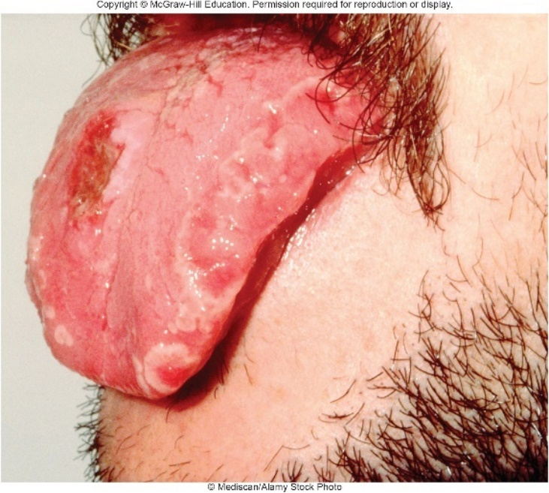
Bacterial STIs – Figure 27.13
Syphilis
Signs and symptoms
Secondary syphilis: 2 to 10 weeks later; systemically spread
Most common sign is rash that includes palms and soles; white patches on mucous membranes
Also runny nose and watery eyes, aches and pains, sore throat, fever, malaise, weight loss, headache
Occasionally, hepatitis, renal disease
Most infectious at this stage
Latent syphilis: no outward signs
Antibodies present
25% recover; 25% remain at this stage; remainder progress to next stage
©Mediscan/Alamy Stock Photo

Slide 57
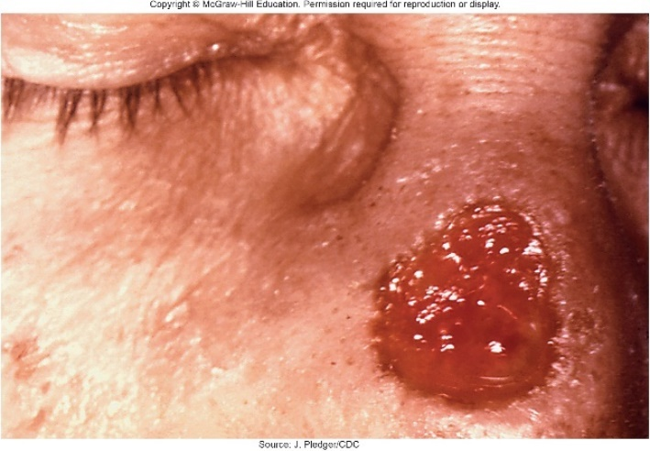
Bacterial STIs – Figure 27.14
Syphilis
Signs and symptoms
Tertiary syphilis: latent period can last years
Gummatous syphilis: localized tissue damage from prolonged inflammation; gummas are chronic granulomas, can occur anywhere in body
Cardiovascular syphilis: aneurysms in ascending aorta
Neurosyphilis is rare: includes personality change, emotional instability, delusions, hallucinations, memory loss, impaired judgment, speech defects, pupil abnormalities, blindness, vertigo, insomnia, stroke, meningitis
May also appear in earlier stages of disease
Source: J. Pledger/CDC

Slide 58
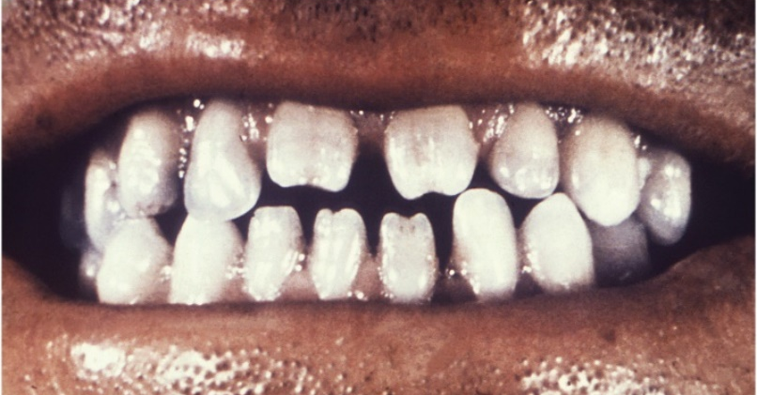
Bacterial STIs – Figure 27.15
Syphilis
Signs and symptoms
Congenital syphilis: T. pallidum can easily cross placenta
Can occur in absence of any signs or symptoms in mother, and at any stage of pregnancy
Damage to fetus usually not until fourth month
Spontaneous abortion, stillbirth, and neonatal death common; nearly all survivors develop signs, symptoms
Early signs resemble adult secondary syphilis
Late symptoms occur after 2 years; bones, cartilage, teeth can become deformed; eye inflammation, deafness
Source: Robert Sumpter/CDC

Slide 59
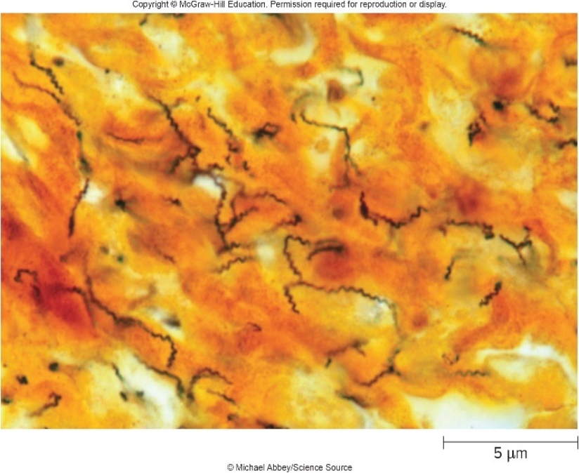
Bacterial STIs – Figure 27.16
Syphilis
Causative agent: Treponema pallidum
Very slender, highly motile spirochete; outer membrane lacks LPS
Viewed with dark-field microscopy, silver stain
Endoflagella propel in corkscrew-like motion, allow penetration of variety of tissues and organs
In nature, only infects humans
Does not replicate in vitro, grown in testicles of laboratory rabbits
Lacks many metabolic abilities including TCA cycle, electron transport chain; thought to obtain most macromolecules from host
©Michael Abbey/Science Source

Slide 60
Bacterial STIs (11)
Syphilis
Pathogenesis
Easily penetrates mucous membrane, damaged skin; infectious dose less than 100 cells
In primary syphilis, grows, multiplies in localized area of genitalia, spreads to lymph nodes and bloodstream
Hard chancre caused by inflammatory response; disappears within 2 to 6 weeks
Secondary syphilis symptoms from immune complexes that form as antibodies bind to circulating spirochetes
Spirochetes systemic; infectious lesions occur on skin and mucous membranes
Lasts weeks to months or even a year, then subsides
After 5 to 20 years or longer, some develop tertiary syphilis

Slide 61
Table 27.9 Stages of Syphilis
Syphilis
Pathogenesis
Tertiary syphilis symptoms from hypersensitivity reactions to small numbers of T. pallidum that persist in tissues
Patient no longer infectious
Organisms present in almost any part of body; outcome depends on location
Infection in skin, bones not life-threatening; in major blood vessel, could lead to rupture
Stage of Disease | Main Characteristics | Infectious?
Primary | Firm, painless ulcer (hard chancre) at site of infection; lymph node enlargement | Yes
Secondary | Rash, aches, and pains; rash and mucous membrane lesions | Yes
Latent | No signs or symptoms | Early – yes; Late – no
Tertiary | Gummas; damage to large blood vessels, eyes, nervous system; mental illness | No

Slide 62
Bacterial STIs (12)
Syphilis
Epidemiology
Transmitted by sexual intercourse
Can occur via kissing person with secondary syphilis or by contact with a primary ulcer
Treatment and prevention
Antibiotics effective except against tertiary syphilis when most T. pallidum are not actively multiplying
Treatment of tertiary syphilis limits progression of disease, but does not correct tissue damage that has occurred
Congenital syphilis prevented by treating mother before fourth month of pregnancy
No vaccine
Abstinence, monogamous relationships, condom use
Identification and treatment of sexual contacts

Slide 63
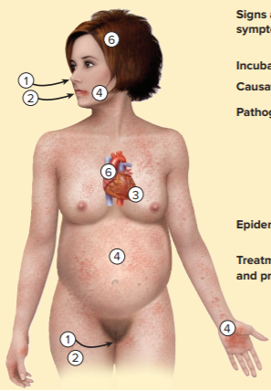
Table 27.10 Syphilis
Treponema pallidum enters the body through a microscopic abrasion or mucous membranes, usually genitalia, mouth, or rectum.
A chancre develops at site of entry.
Organisms multiply locally and spread throughout the body by the bloodstream.
Infectious mucous patches and skin rashes of secondary syphilis appear; a fetus may become infected, resulting in miscarriage or a live-born infant with congenital syphilis.
An asymptomatic latent period occurs. T. pallidum disappears from blood, skin, and mucous membranes.
After months or years, symptoms of tertiary syphilis appear: heart and blood vessel defects, gummas, strokes, eye abnormalities, general neurological symptoms, mental illness.
Sign and symptoms | Chancre, fever, rash, stroke, nervous system deterioration; can imitate many other diseases
Incubation period | 10 to 90 days
Causative agents | Treponema pallidum, a spirochete
Pathogenesis | Primary lesion, or chancre, appears at site of inoculation, heals after 2 to 6 weeks; T. pallidum invades the blood vessel system and is carried throughout the body, causing fever, rash, mucous membrane lesions; damage to brain, arteries, and peripheral nerves occurs years later.
Epidemiology | Sexual contact with infected partner; kissing; transplacental passage
Treatment and prevention | Treatment: antibiotics. Prevention: abstinence, monogamous relationships, correct use of condoms.

Slide 64
Bacterial STIs – Figure 27.17
Chancroid
Signs and symptoms
One or more painful genital sores called soft chancres
Begin as small pimple at site of bacterial entry
Ulcerate, quickly get bigger
Lymph nodes enlarge, become tender; sometimes pus-filled and may rupture
In women, chancres typically on labia or thighs, cause pain during urination and sexual intercourse
Causative agent: Haemophilus ducreyi
Fastidious, pleomorphic, Gram-negative coccobacillus
Source: Dr. Pirozzi/CDC

Slide 65
Bacterial STIs (13)
Chancroid
Pathogenesis
Intense inflammatory response with accumulation of neutrophils, macrophages
Produce proteins that prevent phagocytes from engulfing and protect against complement proteins
Genital sores increase risk of contracting HIV
Epidemiology
Relatively rare, but outbreaks in U.S. cities have occurred with prostitution

Slide 66
Table 27.11 Chancroid
Chancroid
Treatment and prevention
Antibiotics, single dose or injection often sufficient
Effectiveness significantly reduced if patient has AIDS
Abstinence, monogamous relationships, condom use
Signs and symptoms | One or more painful, gradually enlarging, soft chancres on or near the genitalia; large, tender regional lymph nodes
Incubation period | 3 to 10 days
Causative agents | Haemophilus ducreyi, a pleomorphic, fastidious Gram-negative rod requiring special growth media
Pathogenesis | A small pimple appears first, which ulcerates and gradually enlarges; multiple lesions may join together; lymph nodes enlarge, liquefy, and may discharge to the skin surface.
Epidemiology | Sexual transmission; common in sex workers.
Treatment and prevention | Treatment: several antibacterial medications effective; resistance can be a problem. Prevention: abstinence, monogamous relationships; correct use of condoms.

Slide 67
Viral STIs (1)
At least as common as bacterial STIs, but incurable
Effects can be severe and long-lasting
Genital herpes can recur for years
Human papillomavirus infections can lead to cancer
Untreated HIV infections usually result in AIDS

Slide 68
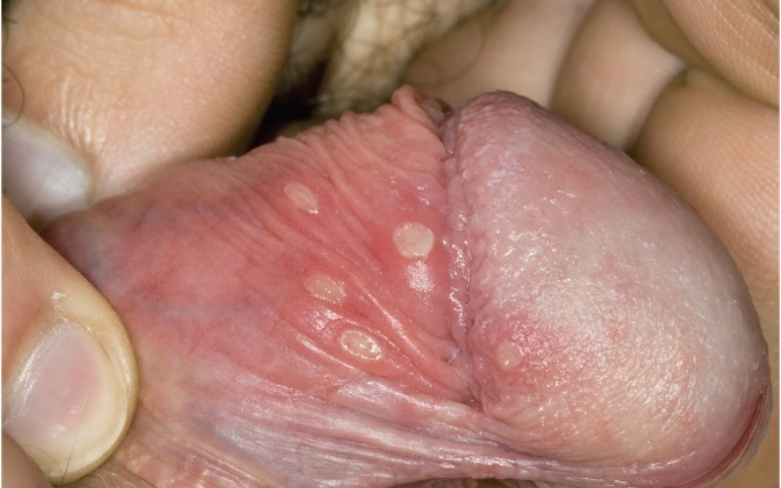
Viral STIs – Figure 27.18
Genital herpes
Signs and symptoms
Genital itching and burning after about a week (range 2 to 20 days); sometimes, severe pain
Clusters of small, red bumps appear on genitalia or anus, depending on site of infection
Become blisters surrounded by redness; break in 3 to 5 days to leave ulcerated area that dries, crusts
Less commonly, discharge from penis or vagina, headache, fever, muscle pain, and in women, painful urination
Most severe in first 1 to 2 weeks; disappear within 3 weeks
Recurrences common, but usually less severe
©Dr. P. Marazzi/Science Source
Notes:
68

Slide 69
Viral STIs (2)
Genital herpes
Causative agents
Usually herpes simplex virus type 2 (HSV-2), an enveloped, double-stranded DNA virus of Herpesviridae
Herpes simplex virus type 1 (HSV-1; cause of “cold sores”) can also cause genital herpes
Either can infect mouth and genitalia, but HSV-2 usually causes more severe genital lesions with greater frequency of recurrence

Slide 70
Viral STIs (3)
Genital herpes
Pathogenesis
Infection of epithelial cells, which lyse following replication
Create small, fluid-filled blisters (vesicles) with infectious virions
Rupture produces painful ulcers
Viral DNA usually exists within nerve cells in non-infectious form, no symptoms
Single gene expressed as microRNA
At times, entire chromosome is transcribed and infectious virions are produced
Symptoms recur
Notes:
70

Slide 71
Viral STIs (4)
Genital herpes
Epidemiology
45 million infected in U.S.; 500,000 new cases each year
Sexual transmission most likely during first few days of symptomatic disease, but can happen in absence of signs, symptoms
Once infected, individual forever at risk of transmitting
Ulceration increases risk of HIV infection
HSV-2 can survive for short periods on fomites, in water
Non-sexual transmission is rare
No animal reservoirs for HSV-1 or HSV-2

Slide 72
Viral STIs (5)
Genital herpes
Treatment and prevention
No cure
Anti-HSV medications (acyclovir, famciclovir) can decrease severity of attack, incidence of recurrences
Abstinence, monogamy, avoiding intercourse during outbreak; using condoms with spermicide that inactivates HSVs
Condom may not cover location of lesion
Baby delivered to mother with primary infection has approximately 30% risk of acquiring infection
Often dies or is disabled by infection
Delivered by cesarean section to prevent infection
Risk low if mother has recurrent disease
Notes:
72

Slide 73
Table 27.12 Genital Herpes
Signs and symptoms | Itching, burning pain at the site of infection, painful urination, tiny blisters with underlying redness; the blisters break, leaving a painful superficial ulcer, which heals without scarring; recurrences are common.
Incubation period | Usually 1 week (range, 2 to 20 days)
Causative agents | Usually herpes simplex virus type 2, but sometimes herpes simplex type 1 (the cold sore virus); herpesviruses are enveloped, double-stranded DNA viruses.
Pathogenesis | Lysis of infected epithelial cells results in fluid-filled blisters containing infectious virions; vesicles burst, causing a painful ulcer; the acute infection is controlled by immune defenses; viral genome persists within nerve cells in a non-infectious form; reactivation can occur and cause recurrent symptoms in the area supplied by the nerve; newborn babies can contract generalized herpes infection if their mother has a primary infection at the time of delivery.
Epidemiology | Transmission by sexual intercourse, oral-genital contact; transmission risk greatest first few days of active disease; transmission can occur in the absence of symptoms; herpes simplex increases the risk of contracting HIV.
Treatment and prevention | Treatment: no cure; anti-HSV medications help prevent recurrences, shorten duration of symptoms. Prevention: abstinence, monogamy, and correct use of condoms help prevent transmission.

Slide 74
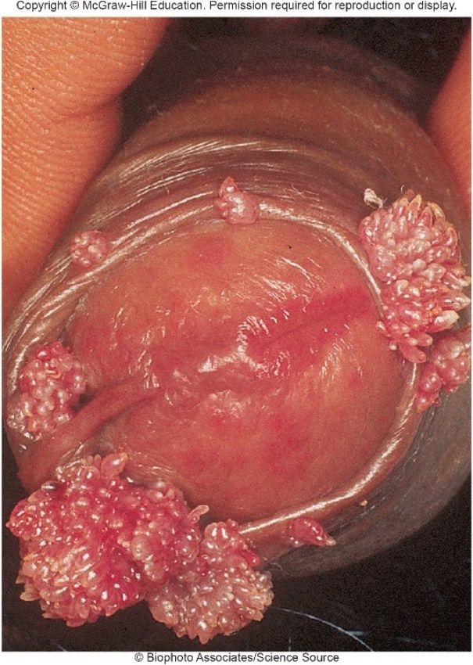
Viral STIs – Figure 27.19
Human papillomavirus STIs: Genital warts and cervical cancer
Some strains cause papillomas (warty growths) on external and internal genitalia
Other strains cause non-warty lesions of mucosal surfaces, such as uterine cervix
Major factor in development of cervical cancer
©Biophoto Associates/Science Source

Slide 75
Viral STIs (6)
Human papillomavirus STIs
Signs and symptoms
Most HPV infections cleared without signs or symptoms
Warts can appear approximately 3 months after infection on head or shaft of penis, at vaginal opening, or around anus
HPV persists after wart removal; causes more warts
Can sometimes partially block urethra or birth canal
Infants can be infected at birth
Cervical cancer; also oral, penile, vaginal, anal cancers
Oral sex may be risk factor for mouth, throat cancers
Notes:
75

Slide 76
Viral STIs (7)
Human papillomavirus STIs
Causative agents
Human papillomaviruses, non-enveloped, double-stranded DNA viruses of Papillomaviridae
More than 100 types of HPVs; tissue- and species-specific
At least 40 transmitted by sexual contact; approximately 15 strongly associated with cancer
Pathogenesis
Thought to infect epithelium through tiny abrasions
Low-risk HPV: genome is extrachromosomal DNA circles
High-risk HPV: genome integrates into chromosome; codes for protein that allows excessive cell growth
Small percentage of infections result in cancer; takes average of 20 years to develop

Slide 77
Viral STIs (8)
Human papillomavirus STIs
Epidemiology
Spread by intercourse; asymptomatic individuals infectious
History of multiple sex partners most important risk factor
Treatment and prevention
Warts often regress, but can be removed by laser treatment, freezing with liquid nitrogen, surgical excision, acid treatment; variety of creams/ointments
Do not cure infection; warts may recur
Abstinence, monogamy, proper condom use (does not offer complete protection)

Slide 78
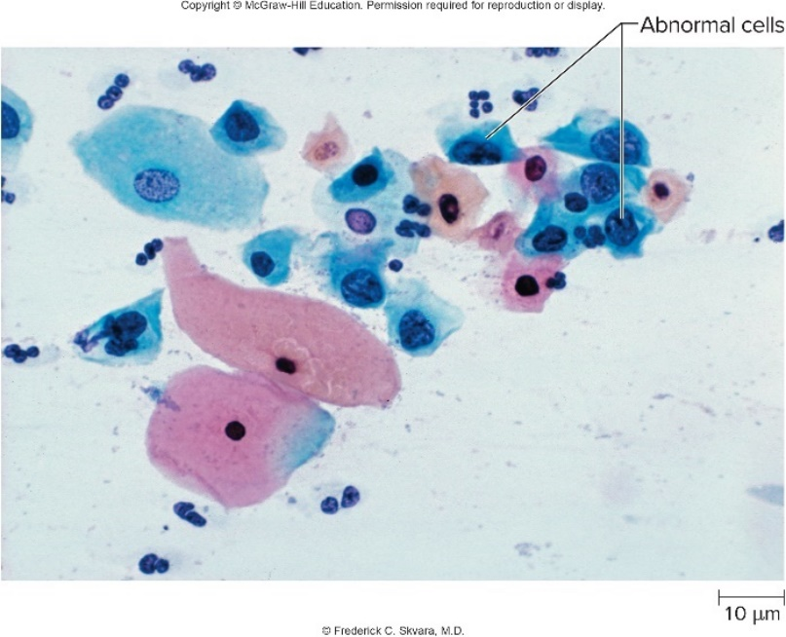
Viral STIs – Figure 27.20
Human papillomavirus STIs
Treatment and prevention
Annual Pap smear for women
Gardasil 9 (9vHPV) vaccine
Protects against HPV types 16, 18 that cause about 70% of cancers
Protects against types 6, 11 that cause about 90% of genital warts
Part of routine vaccines for adolescents 11 to 12 years
©Frederick C. Skvara, M.D.

Slide 79
Table 27.13 Human Papillomavirus STIs
Signs and symptoms | Often asymptomatic; warts of the external and internal genitalia the most common symptom; symptoms are strain-specific.
Incubation period | Usually 3 months (range, 3 weeks to 8 months)
Causative agents | Human papillomaviruses (many strains): non-enveloped DNA viruses of the papillomavirus family; different types infect different tissues and produce different lesions.
Pathogenesis | Virus enters epithelium through abrasions, infects deep layer of epithelium; establishes latency; cycles of replication occur when host cell begins maturation; cancer-associated viral types can integrate into the host cell chromosome and can cause precancerous lesions.
Epidemiology | Asymptomatic people can transmit the disease; multiple sex partners the greatest risk factor; warts can be transmitted to the mouth with oral sex, and to newborn babies at birth.
Treatment and prevention | Treatment: wart removal by multiple techniques. Prevention: latex condoms advised to minimize transmission and avoiding sexual contact with people having multiple sex partners; vaccine protects against the most common cancer- and wart-causing strains.
Notes:
79

Slide 80
Viral STIs (9)
HIV/AIDS
First recognized in 1981 after Pneumocystis pneumonia cases in previously healthy homosexual men; seldom occurs in healthy people
As other groups developed opportunistic infections for no apparent reason; CDC began calling these AIDS
Various opportunistic infections became known as “AIDS-defining conditions”

Slide 81
Table 27.14 AIDS-Defining Conditions
Cancer of the uterine cervix, invasive
Candidiasis involving the esophagus, trachea, bronchi, or lungs
Coccidioidomycosis, of tissues other than the lung
Cryptococcosis, of tissues other than the lung
Cryptosporidiosis of duration greater than 1 month
Cytomegalovirus disease of the retina with vision loss or other involvement outside liver, spleen, or lymph nodes
Encephalopathy (brain involvement with HIV)
Herpes simplex virus causing ulcerations lasting a month or longer involving the esophagus, bronchi, or lungs
Histoplasmosis of tissues other than the lung
Isosporiasis (a protozoan disease of the intestine) of more than 1 month’s duration
Kaposi’s sarcoma
Lymphomas, such as Burkitt’s lymphoma
Mycobacterial diseases, including tuberculosis
Pneumocystis (pneumonia due to Pneumocystis jirovecii)
Pneumonias occurring repeatedly
Progressive multifocal leukoencephalopathy (a brain disease caused by the JC polyomavirus)
Salmonella infection of the bloodstream, recurrent
Toxoplasmosis of the brain
Wasting syndrome (weight loss of more than 10% due to HIV); also known as slim disease

Slide 82
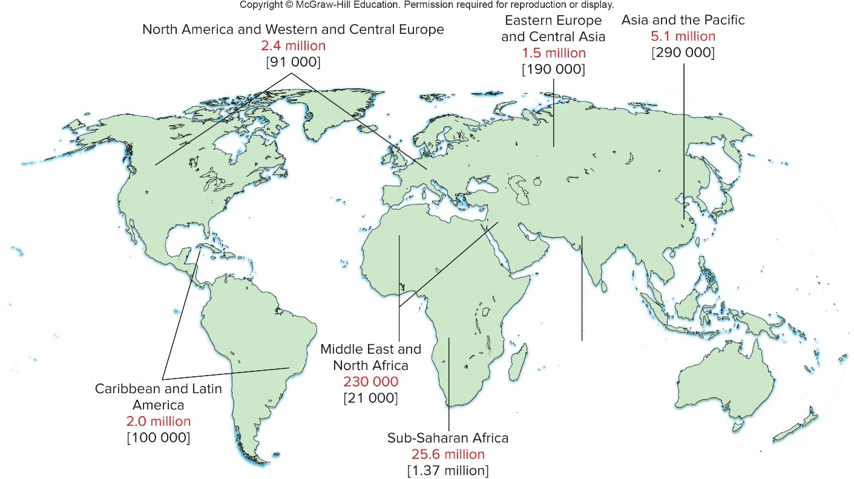
Viral STIs – Figure 27.21
HIV/AIDS
More than 35 million people have died of AIDS. Over 37 million live with HIV (human immunodeficiency virus)
Sub-Saharan Africa region most affected; 1 in 20 adults
Significant advances, but still cannot be cured
Jump to Viral STIs – Figure 27.21 Long Description

Slide 83
Viral STIs (10)
HIV/AIDS
Signs and symptoms
HIV infection indicates person has contracted HIV; may not be ill
HIV disease develops 6 days to 6 weeks after initial infection; many are asymptomatic
Fever, head and muscle aches, sore throat, enlarged lymph nodes; perhaps a rash
Acute retroviral syndrome (ARS) is mild, for 4 to 6 weeks
After initial burst of viral replication, levels decrease but persist in period of clinical latency
Concentration of virions is stable; HIV (viral) set point is predictor of disease progression

Slide 84
Viral STIs (11)
HIV/AIDS
Signs and symptoms
AIDS is the last stage of HIV disease
Level of helper T cells drops
Certain cancers and opportunistic infections develop
AIDS-related complex (ARC), includes weight loss, fever, fatigue, diarrhea

Slide 85
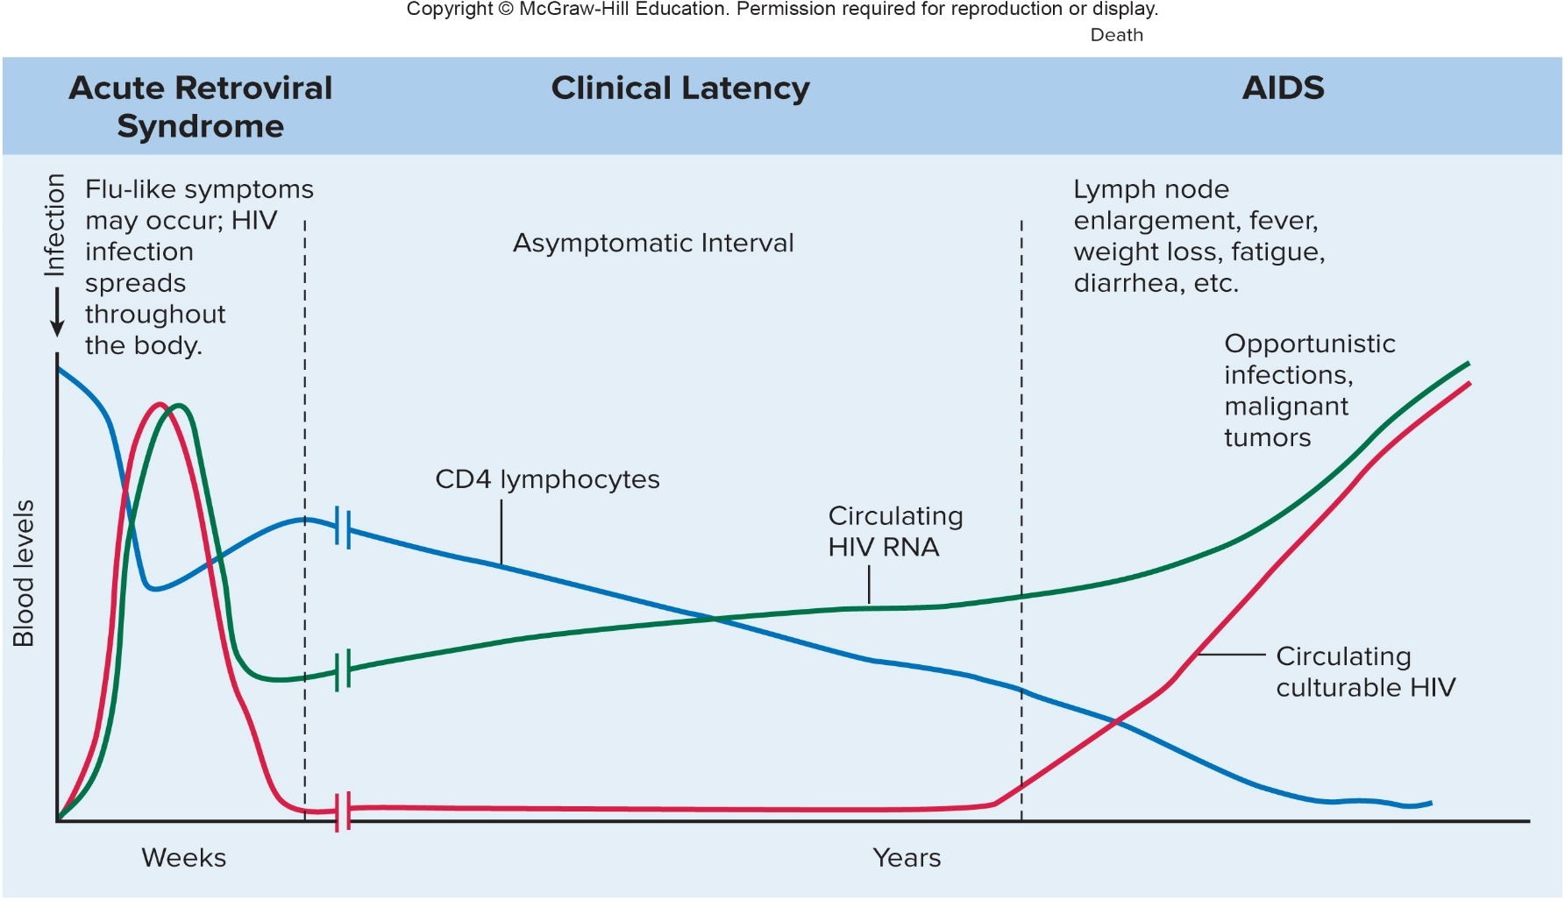
Viral STIs – Figure 27.22
HI/AIDS
Signs and symptoms
Jump to Viral STIs – Figure 27.22 Long Description

Slide 86
Viral STIs (12)
HIV/AIDS
Causative agent: Human immunodeficiency viruses
Enveloped retroviruses; duplicate copies of single-stranded RNA genome
Two types: HIV-1 causes most AIDS cases (many strains); HIV-2 causes less severe disease in Africa
Structural proteins named by 1) abbreviation of function or location and 2) size in kilodaltons
CA for capsid protein is same as p24 for 24 kDa
Abundant; can be used to detect early HIV infection
Env proteins project from envelope
Transmembrane protein called TM or gp41; anchors
Surface protein called SU or gp 120; allows viral
attachment and entry
Matrix protein (MA) between capsid protein and envelope

Slide 87
Viral STIs (13)
HIV/AIDS
Causative agent
Core carries three important HIV-encoded enzymes that are targets of HIV medications
Reverse transcriptase (RT); makes DNA copy of RNA genome
Integrase (IN) inserts DNA copy of viral genome into host cell genome
Protease (PR) cleaves viral polyprotein into functional components
Notes:
87

Slide 88
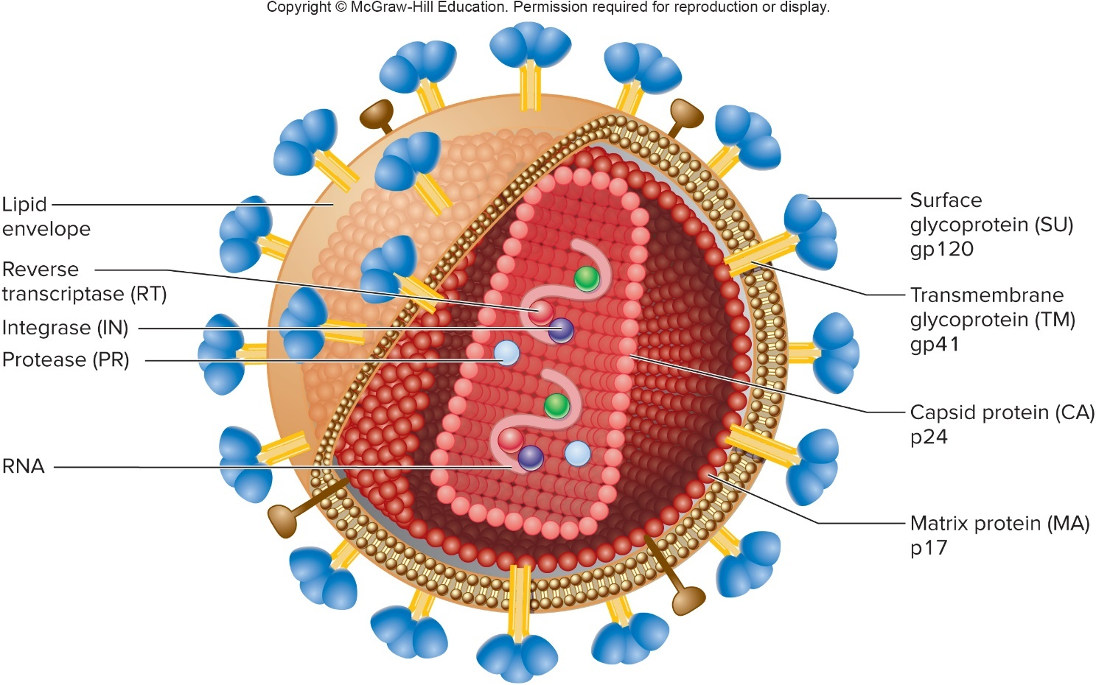
Viral STIs – Figure 27.23
HIV/AIDS
Causative agent

Slide 89
Table 27.15 HIV Components
Protein | Function
Capsid protein (CA or p24) | Coat protein
Matrix protein (MA or p17) | Stabilize virion
Transmembrane protein (TM or gp41) | Stalk-like portion of the spikes; it anchors the spikes to the viral envelope
Surface glycoprotein (SU or gp120) | Cap-like portion of the spikes, with which virus attaches to host receptors
Reverse transcriptase (RT) | Enzyme that makes copy of viral RNA into DNA
Integrase (IN) | Enzyme that inserts viral cDNA into host genome
Protease (PR) | Enzyme involved in viral protein processing

Slide 90
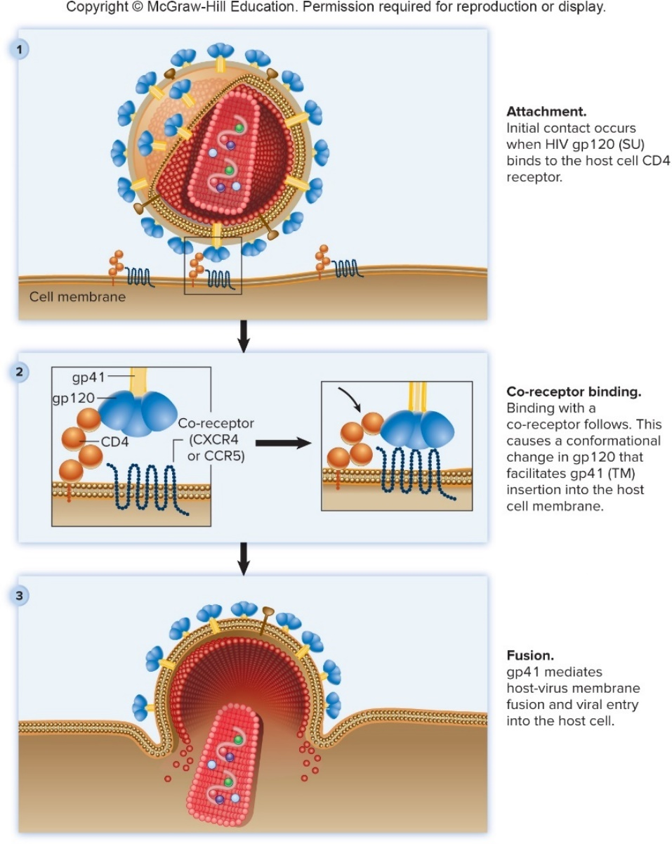
Viral STIs – Figure 27.24
HIV/AIDS
Pathogenesis
Attachment and entry of virus
Virus attaches to CD4 protein found on helper T cells, macrophages, dendritic cells
Then binds to co-receptor, usually cytokine receptors CCR5 or CXCR4
Membranes fuse and virus enters cell
Virus causes infected cells to fuse with those nearby, allowing virus to spread while hidden from antibodies
Jump to Viral STIs – Figure 27.24 Long Description

Slide 91
Viral STIs (14)
HIV/AIDS
Pathogenesis
RT makes DNA copy of viral RNA genome; sequence slightly different due to frequent mistakes
DNA copy enters nucleus; IN inserts randomly into host genome
HIV DNA copy is transcribed, creating RNA copies
RNA genome for new viral particles
mRNA that is transcribed to make viral proteins
New virions bud from host cell, gaining envelope
Slight differences in new virions due to mutations allow HIV to evolve quickly, altering antigens and avoiding immune response

Slide 92
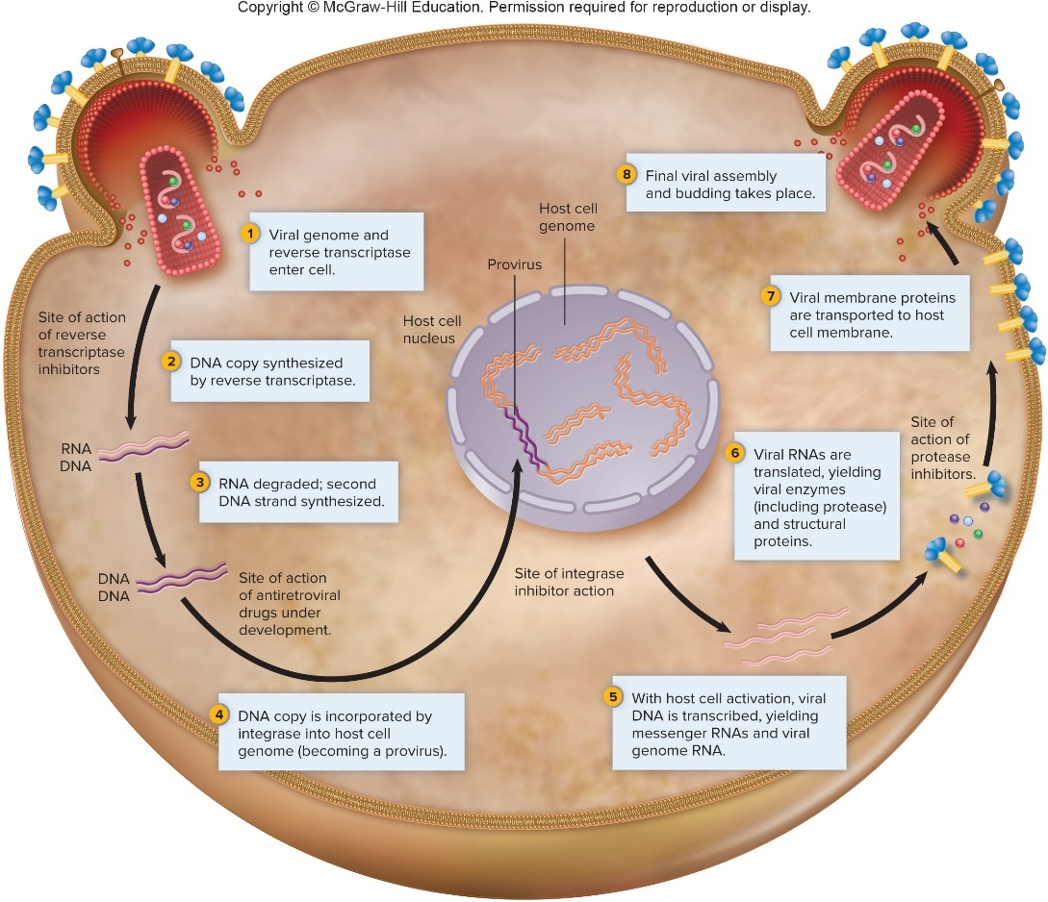
Viral STIs – Figure 27.25
HIV/AIDS
Pathogenesis
Jump to Viral STIs – Figure 27.25 Long Description

Slide 93
Viral STIs (15)
HIV/AIDS
Pathogenesis
Helper T cells killed by HIV infection; adaptive immune response weakens
Infected macrophages and dendritic cells survive, but serve as reservoir for replicating HIV
Do not function normally; weakens immune response
Signs and symptoms appear when helper T cell counts fall below 200 cells/microliter
Viral load increases
Infections, cancers increase
Half of untreated patients progress to AID within 9 to 10 years; others with low viral set points survive many years
Notes:
93

Slide 94
Viral STIs (16)
HIV/AIDS
Epidemiology
HIV present in blood, semen, vaginal secretions
Person-to-person transmission
Sexual contact
Transmitted male-to-male and male-to-female
Risk for transmission greater for anal versus vaginal sex
Blood and Blood Products
IV drug abusers who share needles
Health care workers by a needle stick, low risk
Blood and blood products now screened (presence of HIV antibodies means blood is not used)
Vertical transmission
From mother to fetus or newborn during pregnancy, passage through birth canal, or breast-feeding

Slide 95
Table 27.16 – People at Increased Risk for HIV Disease
HIV/AIDS
Epidemiology
HIV not highly contagious; most transmission prevented by behavioral changes
Not spread by insect bites, casual contact, or through sweat, urine, saliva, or tears
Injected-drug abusers who have shared needles.
Sexually promiscuous men and women, especially sex workers, drug abusers, and men who have sex with men.
People with history of hepatitis B, syphilis, gonorrhea, or other sexually transmitted infections that may be markers for unprotected sex with multiple partners.
People who have had blood or sexual exposure to any of the people listed above.

Slide 96
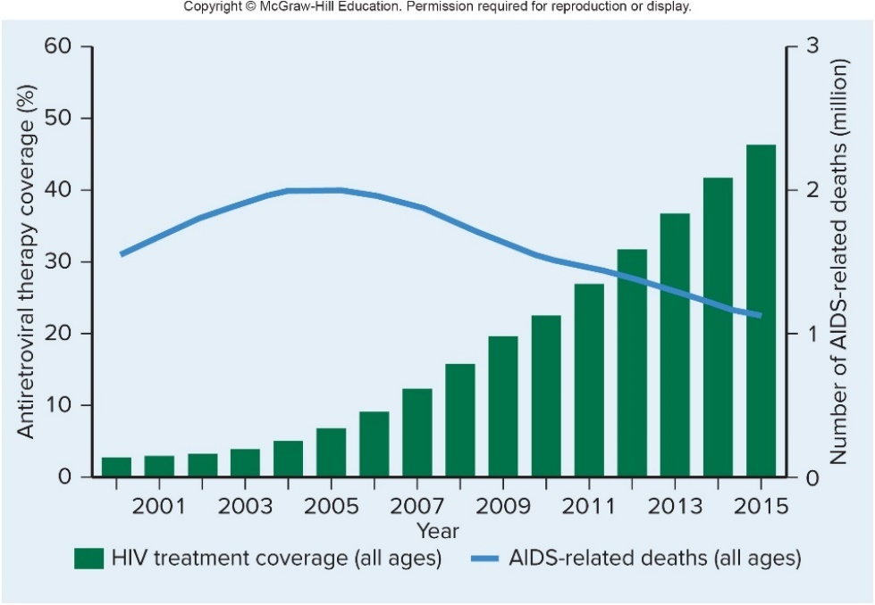
Viral STIs – Figure 27.26
HIV/AIDS
Treatment
Medications to treat HIV are antiretrovirals (ARVs)
Block replication of virus, but do not affect viral nucleic acid already integrated into host genome
Number of AIDS deaths significantly decreased

Slide 97
Table 27.17 Antiretroviral Medications
Medication | Actions | Examples
Entry inhibitors | Interfere with viral entry into host cell | Enfuviritide (ENF), maraviroc (MVC)
NRTIs (nucleoside reverse transcriptase inhibitors) | Chain terminators that stop DNA replication | Abacavir (ABC), emtricitabine (FTC), lamivudine (3TC), tenofovir alafenamide (TAF), zidovudine (AZT or ZDV).
NNRTIs (non-nucleoside reverse transcriptase inhibitors) | Inhibit reverse transcriptase | Efavirenz (EFV), etravirine (ETR), nevirapine (NVP), rilpivirine (RPV)
Integrase inhibitors | Prevent integration of HIV cDNA into host genome | Dolutegravir (DTG), elvitegravir (EVG), raltegravir (RAL)
Protease inhibitors | Prevent virions from maturing | Atazanavir (ATV), darunavir (DRV), ritonavir (RTV)

Slide 98
Viral STIs (17)
HIV/AIDS
Treatment
ARVs given in combinations; highly active antiretroviral therapy (HAART) or antiretroviral therapy (ART)
Resistant mutants less likely to develop
ART three drugs: two NRTIs plus protease inhibitor or NNRTI
Does not cure HIV; improves quality of life, reduces risk of other diseases, and lowers HIV set point
Lower set point reduces chance of resistance
Does not eliminate HIV DNA copy from host cell genome
Viral set point rebounds in absence of treatment
Problems include resistance, toxic side effects, cost

Slide 99
Table 27.18 Behaviors That Help Control an AIDS Epidemic
HIV/AIDS
Preventing transmission via sexual contact
Use of latex condoms
Testing to determine HIV status
Circumcision lowers risk of transmission up to 60%
Pre-exposure prophylaxis (PrEP) for high-risk uninfected adults
Pill with fixed dose of two reverse transcriptase inhibitors
Not 100% effective; use in combination with other prevention methods
Abstinence.
Staying in a mutually monogamous relationship.
Avoiding sex with people at risk for HIV infection.
Avoiding genital and rectal trauma. Small breaks in the skin and mucous membranes allow HIV to infect.
Avoiding sex when sores from herpes simplex or other causes are present. These are sites where HIV can infect.
Not engaging in unprotected anal intercourse. Receptive anal intercourse carries a high risk of HIV transmission.
Using latex condoms from beginning to end of sex. Polyurethane condoms are a reasonable alternative for those allergic to latex. Condoms made from other materials are not reliable for disease prevention, nor are those marketed in many countries outside the United States. Oil-based lubricants cannot be used with latex condoms. Condoms for women are available.
Being aware of HIV status before pregnancy and, if HIV-positive, taking appropriate steps during pregnancy to prevent transmission to fetus.

Slide 100
Viral STIs (18)
HIV/AIDS
Preventing transmission via blood, blood products
Donor and blood screening have lowered risk to 1 in 1.5 million transfusions
Also reduced in artificial insemination and organ transplantation
Needle and syringe exchange programs
Drug rehab and education about safer sex practices
High-level disinfectants can decontaminate surfaces exposed to body fluids
Dilute household bleach effective for general use

Slide 101
Viral STIs (19)
HIV/AIDS
Preventing vertical transmission
Anti-HIV therapy for mother
Delivery of infant by cesarean section
Avoid breastfeeding
Problem in developing countries due to need to transmit maternal antibodies to other endemic diseases, and lack of clean water to make formula
Notes:
101

Slide 102
Viral STIs (20)
HIV/AIDS
Vaccine prospects
HIV highly variable genetically due to high error rate
Antibodies do not protect against new variants
Syncytia form; virus can pass from cell to cell without contacting antibodies
Lack of good animal model to test new vaccines
Much research effort directed at developing vaccine
Recombinant vector vaccine protected about 30% of trial participants
DNA, peptide vaccines under development

Slide 103
Table 27.19 HIV Disease
Signs and symptoms | Often no early symptoms but over half develop flu-like symptoms, including fever, sore throat, head and muscle aches, rash, and enlarged lymph nodes, early in the infection; after a period of clinical latency, symptoms arise due to immunodeficiency and resulting infections of lung, intestine, skin, eyes, and brain, as well as certain cancers.
Incubation period | Usually 6 days to 6 weeks for flu-like symptoms; without treatment, immunodeficiency symptoms occur within 10 years in half the infections (10% within 5 years and 90% within 17 years)
Causative agents | Mainly human immunodeficiency virus type 1 (HIV-1), many subtypes and strains; HIV-2 mostly in West Africa
Pathogenesis | HIV infects various body cells, notably those vital to adaptive immunity, including CD4 T lymphocytes and antigen-presenting cells; T cells are killed—their numbers slowly decline until the immune system can no longer resist infections or tumor development.
Epidemiology | Three main routes of transmission: intimate sexual contact, transfer of blood or blood products, and from mother to child around the time of childbirth; transmission can also occur by breast milk, and possibly by oral-genital contact; other STIs such as syphilis increase transmission.
Treatment and prevention | Treatment: ART, consisting of combinations of several anti-HIV medications, slows disease progression; medications and vaccines can prevent infections that can complicate HIV disease. Prevention: no vaccine yet available; abstinence, monogamous relationships, and condom use, avoidance of sexual contact with injected-drug abusers and those with multiple partners or history of STIs; circumcision and pre-exposure prophylaxis also preventive; anti-HIV medications and cesarean section decrease mother-to-newborn transmission; other effective preventive measures include sex education for schoolchildren, and needle exchange programs for drug abusers.

Slide 104
Protozoan STIs (1)
Trichomoniasis (“Trich”)
Signs and symptoms
Often asymptomatic, especially in men
Women may have itching of vulva, inner thighs; itching, burning of vagina; frothy, sometimes smelly, yellowish-green vaginal discharge
Sometimes burning pain with urination
Vulva, vaginal wall red and slightly swollen
May develop pinpoint hemorrhages
Pregnant women may have preterm birth
Men may have urethral discharge, burning pain with urination, painful testes, or tender prostate gland

Slide 105
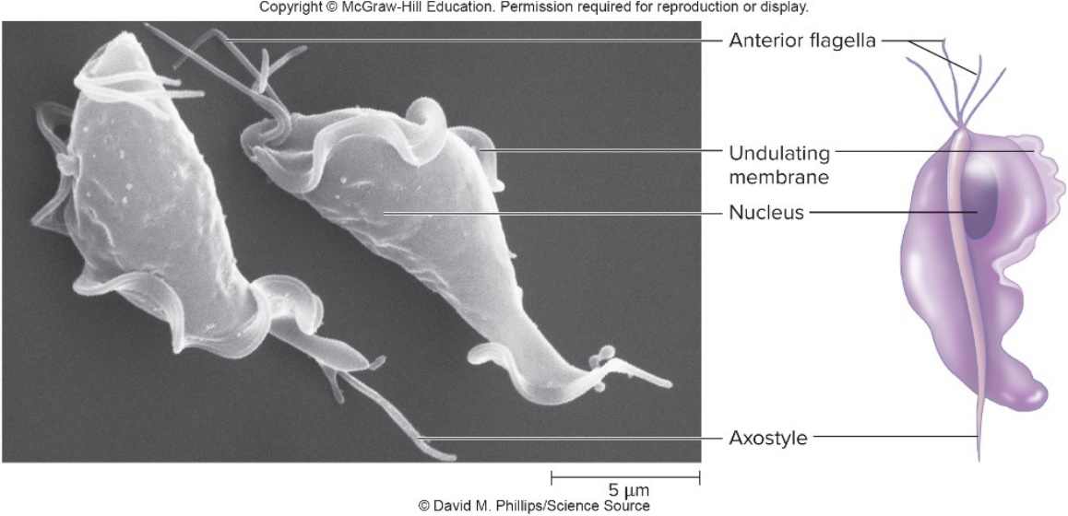
Protozoan STIs – Figure 27.17
Trichomoniasis
Causative agent: Trichomonas vaginalis
Protozoan with four anterior flagella and a posterior flagellum attached to undulating membrane
Slender rigid rod (axostyle) protrudes from posterior; used for attachment
Unmistakable jerky motility by microscopy
Lacks cyst to aid in survival away from host’s body
Does not have mitochondria; instead, hydrogenosomes
©David M. Phillips/Science Source

Slide 106
Protozoan STIs (2)
Trichomoniasis
Pathogenesis
Not fully understood
Produces variety of adherence factors specific to vaginal epithelium; allows colonization of vulva, vaginal walls
Mechanical trauma by axostyle of moving protozoan thought to produce symptoms
Frothy discharge probably due to hydrogen gas produced

Slide 107
Protozoan STIs (3)
Trichomoniasis
Epidemiology
Worldwide distribution; no reservoirs other than humans
Easily killed by drying, so transmission usually by sexual contact
Can survive on moist objects (towels); occasional non-sexual transmission
Infants can contract from mothers at birth
High percentage of asymptomatic infections, especially in men, helps in transmission
Rates highest in men, women with multiple sex partners
Causes tissue damage; increases risk of infection by HIV

Slide 108
Table 27.20 Trichomoniasis
Trichomoniasis
Treatment and prevention
Most strains respond quickly to metronidazole or tinidazole
A few are resistant
Abstinence, monogamy, use of condoms
Signs and symptoms | Many women, most men asymptomatic. Women: itching, burning, swelling, vaginal redness; frothy, sometimes bad-smelling, yellow-green discharge, and burning on urination; preterm births sometimes a complication. Men: urethral discharge, burning on urination, painful testes, tender prostate.
Incubation period | 4 to 20 days
Causative agents | Trichomonas vaginalis, a protozoan with unmistakable jerky motility
Pathogenesis | Unexplained; inflammatory changes and pinpoint hemorrhages suggest mechanical trauma from the motile organisms.
Epidemiology | Worldwide distribution; asymptomatic infections foster spread; easily killed by drying due to lack of cyst form; transmission by intimate contact; high rate of infection with multiple sex partners; newborn infants of infected mothers can acquire the organism at birth.
Treatment and prevention | Treatment: appropriate antimicrobial agent. Prevention: abstinence, monogamy, and consistent use of condoms.

Slide 109
Appendix of Image Long Descriptions

Slide 110
Viral STIs – Figure 27.21 Long Description
At the end of 2015, about 37 million people were living with HIV/AIDS: 2.4 million in North America and Western and Central Europe 1.5 million in Eastern Europe and Central Asia 5.1 million in Asia and the Pacific 2.0 million in Caribbean and Latin America 230,000 in Middle East and North Aftica 25.6 million in Sub-Saharan Africa About 2 million people were newly infected during 2015: 91,000 in North America and Western and Central Europe 190,000 million in Eastern Europe and Central Asia 290,000 million in Asia and the Pacific 100,000 million in Caribbean and Latin America 21,000 in Middle East and North Aftica 1.37 million in Sub-Saharan Africa
Jump back to Viral STIs – Figure 27.21

Slide 111
Viral STIs – Figure 27.22 Long Description
During the acute retroviral syndrome, viral levels are very high; CD4 levels decrease, but rebound before entering clinical latency. HIV infection spreads through the body. Flu-like symptoms may occur. The clinical latency period is asymptomatic, but the disease continues to progress, as shown by the falling CD4 cell count and rising viral RNA levels. The onset of AIDS is marked by a very low CD4 cell count. HIV levels increase. Symptoms include lymph node enlargement, fever, weight loss, fatigue, and diarrhea. Opportunistic infections and malignant tumors may occur.
Jump back to Viral STIs – Figure 27.22

Slide 112
Viral STIs – Figure 27.24 Long Descriptions
Initial contact occurs when HIV gp120 (SU) binds to the host cell CD4 receptor. Binding with a co-receptor follows. This causes a conformational change in gp120 that facilitates gp41 (TM) insertion into the host cell membrane. gp41 mediates host-virus membrane fusion and viral entry into the host cell.
Jump back to Viral STIs – Figure 27.24

Slide 113
Viral STIs – Figure 27.25 Long Description
Viral genome and reverse transcriptase enter cell. DNA copy synthesized by reverse transcription. RNA degraded; second DNA strand synthesized. DNA copy is incorporated by integrase into host cell genome (becoming a provirus). With host cell activation, viral DNA is transcribed, yielding messenger RNAs and viral genome RNA. Viral RNAs are translated, yielding viral enzymes (including protease) and structural proteins. Viral membrane proteins are transported to host cell membrane. Final viral assembly and budding takes place.
Jump back to Viral STIs – Figure 27.25

