Slide 1
Chapter 8
Microbial Metabolism
Notes:
1

Slide 2
What is metabolism?
Metabolism = creation of energy and building blocks for the cell
What is Energy?
Energy = the force to move/change matter
“The force”
Notes:
Please know this brief definitions.

Slide 3
Potential Energy
potential energy – stored energy or the capability to do work
“inactive” energy
Batteries in an unused toy have potential energy
Leg muscles when you are sitting on the couch have potential energy
When potential energy is released it becomes kinetic energy
ATP
Notes:
Please be familiar with the concepts on this slide.

Slide 4
Kinetic Energy
Kinetic energy – energy of motion
Does work by moving objects which in turn can do more work by moving or pushing other objects
depends on speed & mass
Notes:
Know this concept and definition.

Slide 5
Forms of Energy
Energy is easily converted from one form to another
Energy conversions are quite inefficient and some initial energy is “lost” to the environment as heat
Notes:
Radiant to Chemical to Electrical to Mechanical to Thermal to electrical to mechanical to thermal to electrical……
Metabolism is a combination of chemical reactions that result in energy and products that the cell needs to survive
Metabolism creates heat
Please remember that energy can neither be created nor destroyed, but can be transferred.

Slide 6
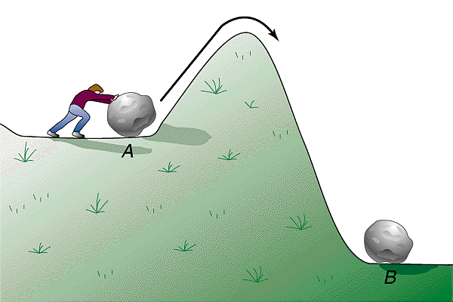
Enzymes: Collision Theory
Collision theory – atoms, ions, & molecules continuously moving; chemical reactions occur when they collide
activation energy – collision energy needed for chemical reaction to occur
reaction rate – frequency of collisions with enough energy to bring about a reaction
increased by increasing:
temperature
pressure
reactant concentration
enzymes
in living systems
Notes:
Please be very comfortable with these concepts. See text for further information.

Slide 7
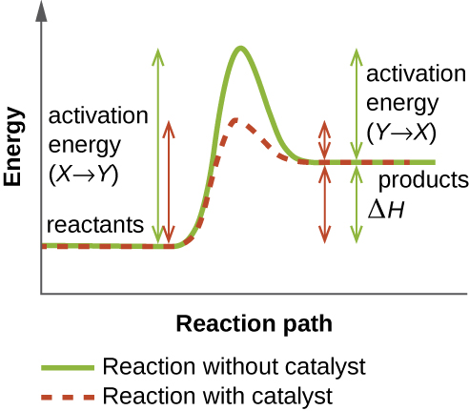
Activation Energy
Almost all reactions must begin with breaking bonds
breaking bonds absorbs (“costs”) energy
Start by going “uphill”
all reactions begin by being endothermic, even if ultimately exothermic
Notes:
This is a very important concept to understand.

Slide 8
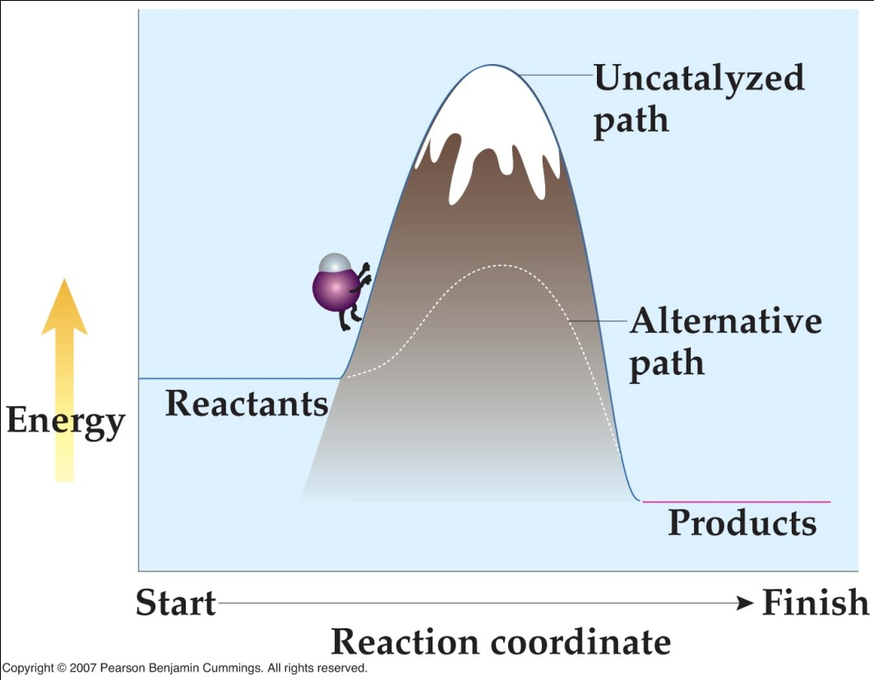
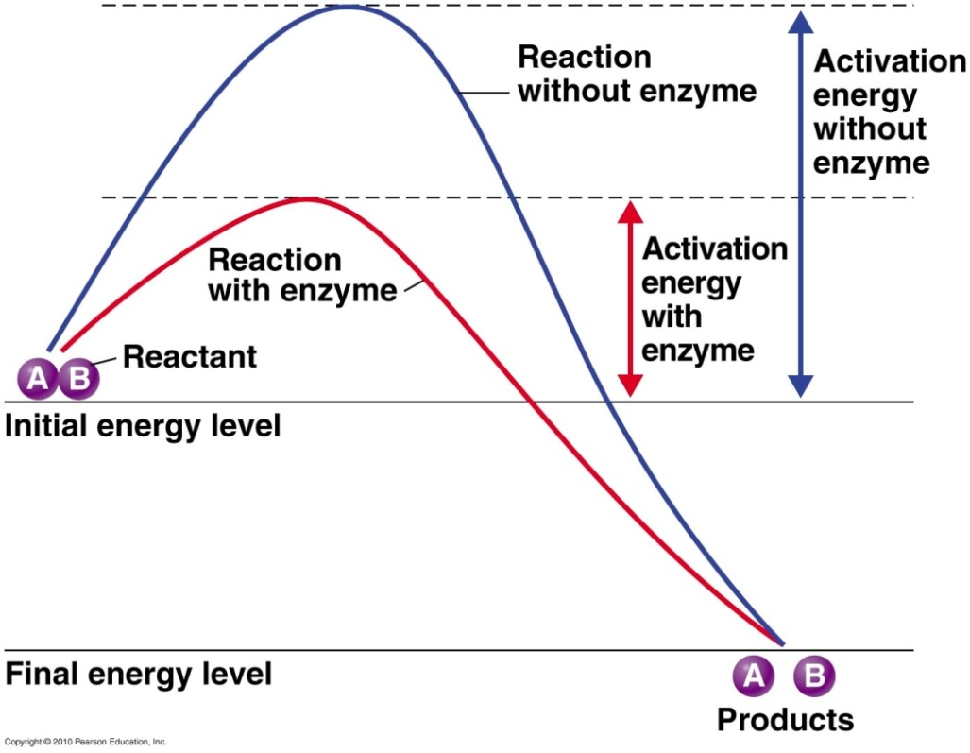
Catalysts
Catalyst – something that, when added to a reaction, increases the rate of reaction by lowering its activation energy
catalysts are NOT used up in reactions; only need small amounts
some metals are good physical catalysts
Notes:
Catalysts increase the rate of a reaction (how fast it occurs); however, they decrease the amount of total time required to complete the reaction.

Slide 9
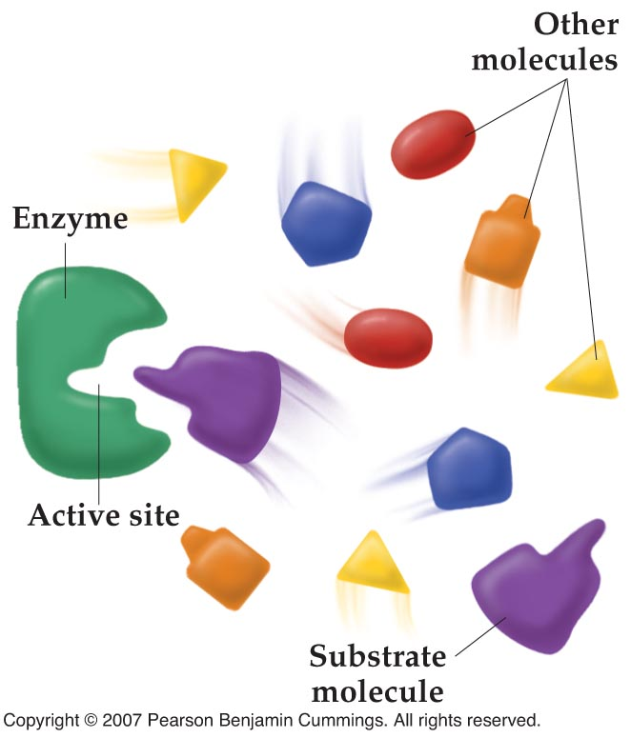
Enzymes - biological catalysts
Large biomolecules that act as catalysts and are made of protein
Each enzyme interacts with only certain reactants (very specific)
substrate fits into active site of enzyme like a key in a lock
enzyme weakens certain substrate bonds; makes reaction more likely to occur
products don’t fit into enzyme; released
specific shape
If denatured the enzyme will not work
Enzyme is not altered or used up
Notes:
Enzymes end with the suffix –ase

Slide 10
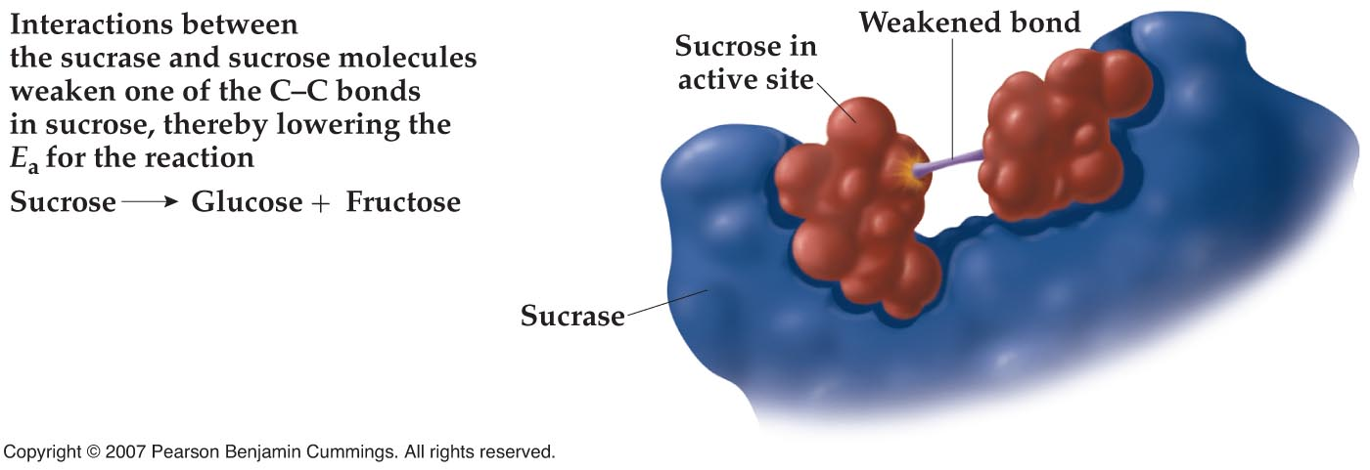
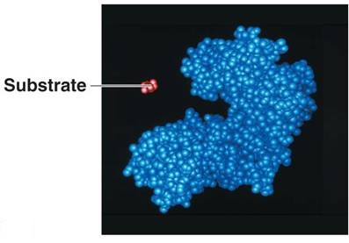
Enzymes
Notes:
Enzymes speed up chemical reactions by lowering the activation energy of the reaction.

Slide 11
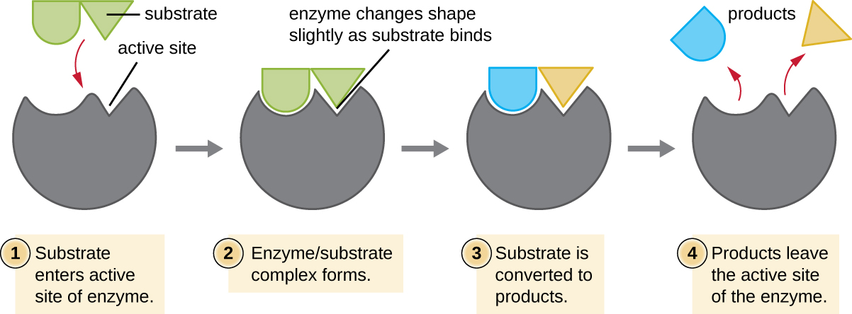
Enzyme Components
Enzyme components:
some enzymes need non-protein components to be active
apoenzyme – protein component
inactive without cofactor
cofactor – non-protein component
Ex. iron, zinc, magnesium, or calcium
coenzyme – organic cofactor
vitamins
holoenzyme – apoenzyme & cofactor
active
Notes:
Please know these definitions and examples of cofactors versus coenzymes.

Slide 12
Factors Influencing Enzyme Activity
Enzyme activity influenced by temperature:
chemical reaction rate increases with increasing temperature
different enzymes, different optimum temperatures
very high temperatures denature enzymes, drastically reducing reaction rate
hydrogen bonds break, active site shape lost
may be reversible
not reversible if enzyme coagulates
Notes:
Please understand this concept.

Slide 13
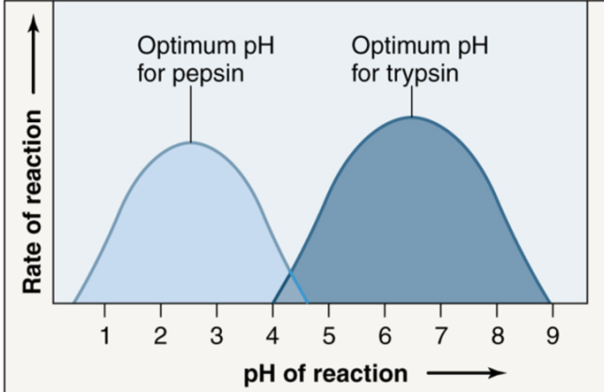
Factors Influencing Enzyme Activity
Enzyme activity influenced by pH:
work best at optimal pH
different enzymes, different optimum pHs
extreme pHs cause denaturation
Enzyme activity influenced by substrate concentration:
reaction rate increases with increasing substrate concentration
until saturation – active site always occupied by substrate or product
enzymes not normally saturated
Notes:
Please understand these concepts.

Slide 14
Enzyme Inhibitors
Enzyme activity influenced by inhibitors:
competitive inhibitors
fill active site, compete with substrate (same shape)
may bind reversibly or irreversibly
reversible competitive inhibition slows reaction; overcome when substrate concentration increases
noncompetitive inhibitors
interact with allosteric site of enzyme
allosteric site not at active site
binding changes shape of active site
may bind reversibly or irreversibly
allosteric interactions can activate or inactivate enzyme
Notes:
Please know these definitions.

Slide 15
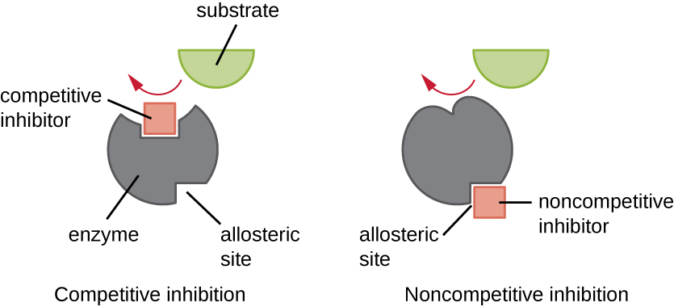
Enzyme Inhibitors Cont’d
Notes:
A visual of the previous slide.

Slide 16
Metabolic Pathways and Feedback Inhibition
Metabolic pathway – sequence of chemical reactions
product of one is substrate of next
Feedback (end-product) inhibition:
final product allosterically inhibits activity of enzyme early in metabolic pathway
entire pathway shuts down
cell doesn’t make more than it needs
might use substrate for other things
Notes:
Please be able to discuss and explain this process. Think of this concept as once enough product has been made, the final product shuts down the pathway so that too much is not produced.

Slide 17
Catabolic and Anabolic Reactions
Metabolism – sum of chemical reactions in living organism
determined by enzymes, encoded by genes
catabolism
break down complex compounds into simpler ones (provides building blocks for anabolism)
exergonic – release energy for the cells
hydrolytic (use water to break bonds)
anabolism
build complex organic molecules from simpler ones (biosynthetic)
endergonic – requires energy to build lg. molecules
involve dehydration synthesis reactions (release water)
Notes:
Catabolism: provides energy and building blocks for anabolism
Anabolism: uses energy and building blocks to build large molecules

Slide 18
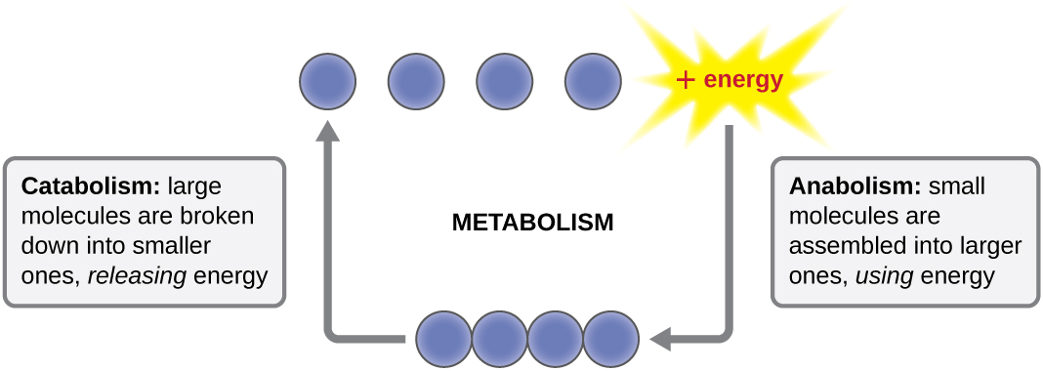
Catabolic and Anabolic Reactions
Notes:
A visual representation of this concept.

Slide 19
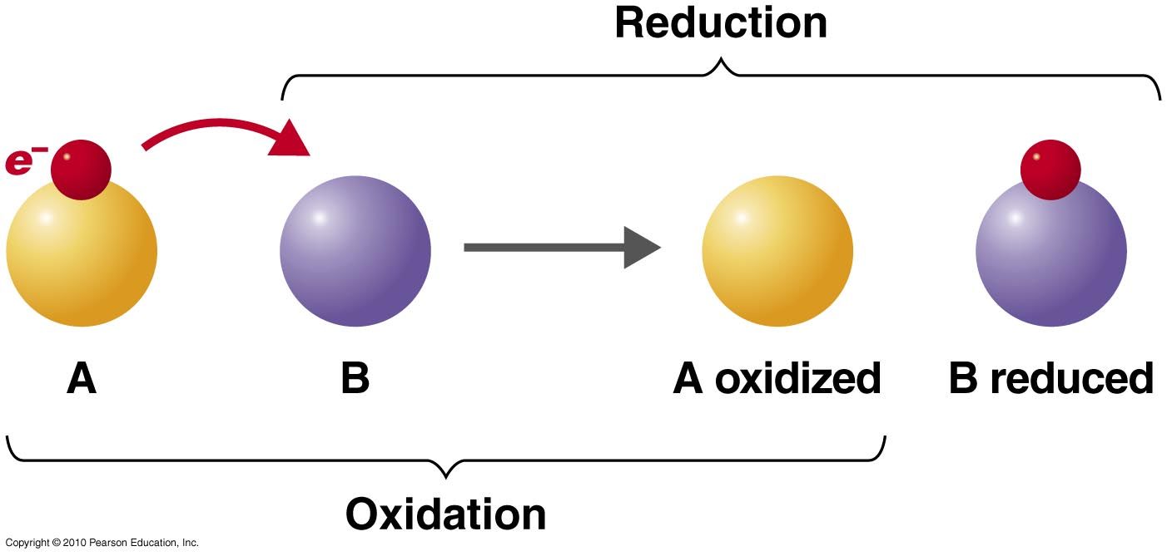
Oxidation-Reduction Reactions
Energy in nutrient molecules associated with electrons
nutrients broken down; energy transferred to ATP
Oxidation-reduction (redox) reaction –
2 coupled reactions:
oxidation – loss of electrons
often produces energy
reduction – gain of electrons
Notes:
“LEO THE LION SAYS GER!” A way of remembering that “Loss of Electrons is Oxidation” and “Gain of Electrons is Reduction”
OR “OIL RIG” – Oxidation Is Loss Reduction Is Gain.

Slide 20
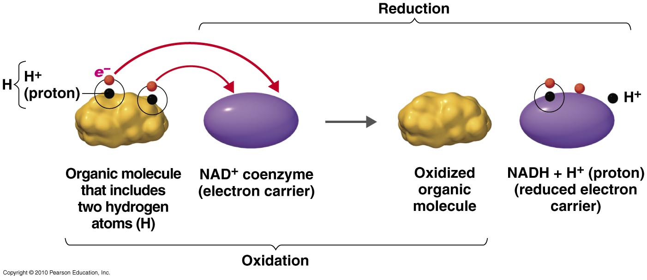
Oxidation-Reduction Reactions
Electrons (e–) & protons (H⁺) often removed at same time, as hydrogen atoms (H)
dehydrogenation – oxidation involving loss of H atom
example:
organic molecule catabolized
NAD⁺ reduced, forms high-energy NADH
oxidized organic molecule now has less energy

Slide 21
Catabolic and Anabolic Reactions
Energy-requiring & releasing reactions coupled by ATP
bonds in ATP unstable
easily broken to release energy
ATP → ADP + P_{i} + energy
provides energy for anabolism
ADP + P_{i} + energy → ATP
phosphorylation – adding a phosphate group
energy provided by catabolism
break down glucose, etc.
some energy lost as heat
Notes:
ATP has a weak bond with phosphate so more energy is released when the bond is broken.
Please understand this concept. We will see it time and time again as ATP is the primary method with which the body transports energy.

Slide 22
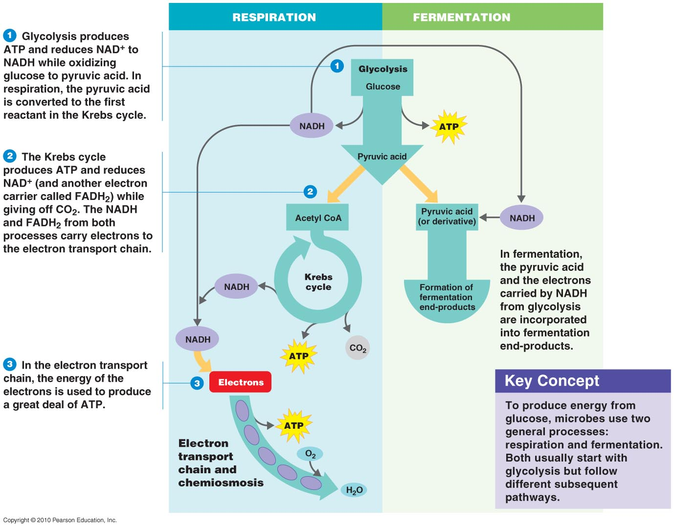
Carbohydrate Catabolism
Carbohydrate catabolism – breakdown of carbohydrates (glucose) to release energy & make ATP
cell respiration & fermentation
both begin with glycolysis
cell respiration
long series of redox reactions
3 main steps:
glycolysis
makes e–s & some ATP
pyruvic acid modification
Krebs cycle
makes e–s & some ATP
electron transport chain
makes much ATP
Notes:
Please familiarize yourself with these concepts.

Slide 23
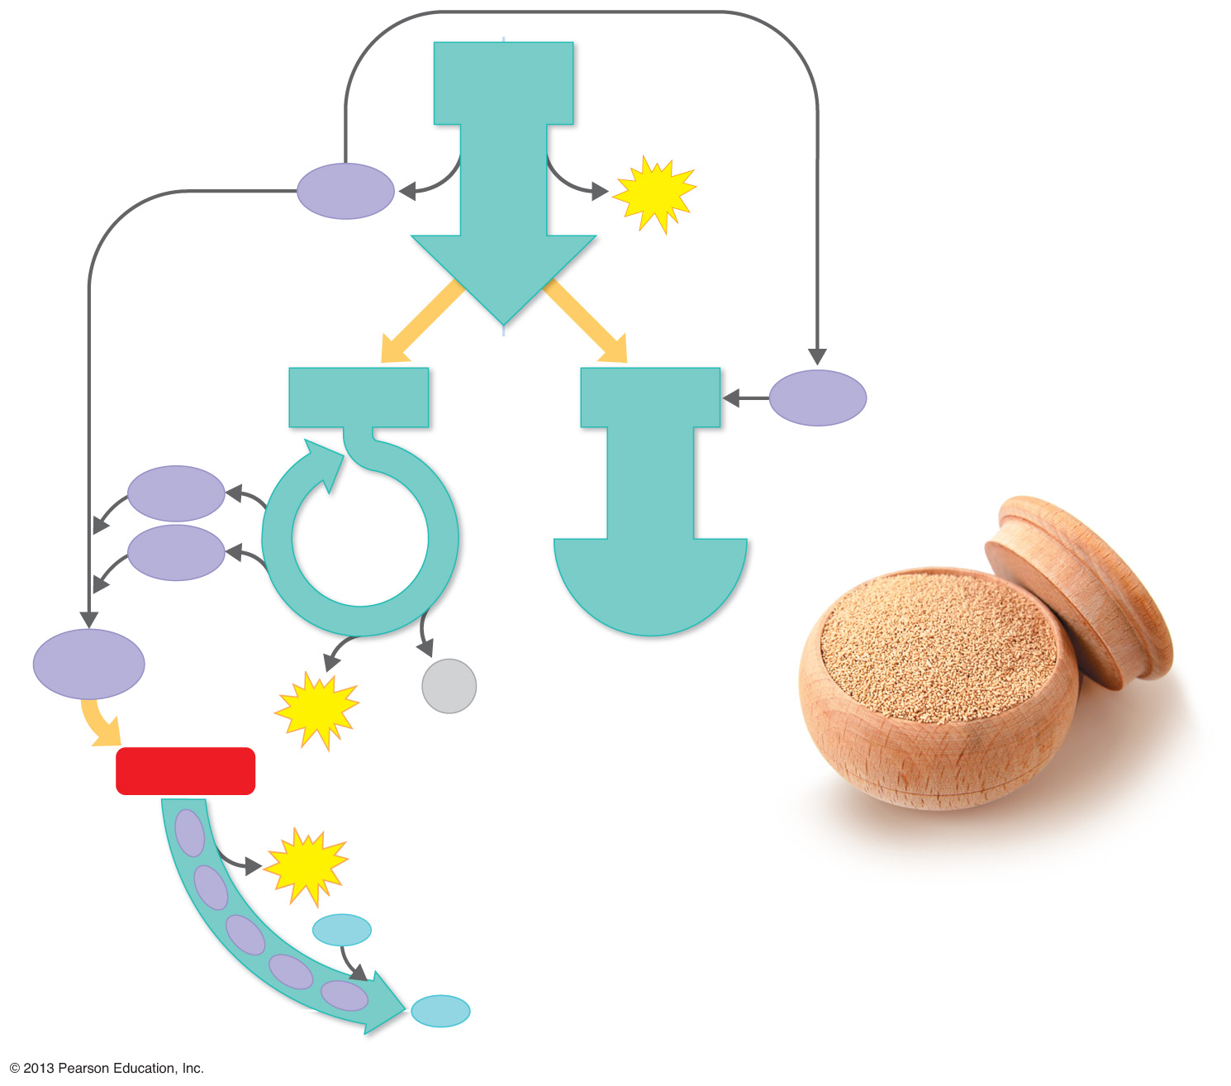
Figure 5.11 An Overview of Respiration and Fermentation.
respiration
fermentation
Glycolysis produces ATP and reduces NAD⁺ to NADH while oxidizing glucose to pyruvic acid. In respiration, the pyruvic acid is converted to the first reactant in the Krebs cycle, acetyl CoA.
1
Glycolysis
Glucose
NADH
ATP
The Krebs cycle produces some ATP by substrate-level phosphorylation, reduces the electron carriers NAD⁺ and FAD, and gives off CO₂. Carriers from both glycolysis and the Krebs cycle donate electrons to the electron transport chain.
Pyruvic acid
In fermentation, the pyruvic acid and the electrons carried by NADH from glycolysis are incorporated into fermentation end-products.
2
Acetyl CoA
Pyruvic acid
(or derivative)
NADH
NADH
Kreb’s
brewer’s yeast
FADH₂
cycle
Formation of
fermentation
end-products
In the electron transport
chain, the energy of the
electrons is used to
produce a great deal of
ATP by oxidative
phosphorylation.
NADH &
FADH₂
CO₂
ATP
3
Electrons
Electron
transport
chain and
chemiosmosis
ATP
O₂
H₂O
Notes:
Credit to Tortora’s Microbiology text.

Slide 24
Important Coenzymes
NAD⁺
NADP⁺
FAD
Coenzyme A
Oxidative Phosphorylation: is a metabolic pathway that uses energy released by the oxidation of nutrients to produce adenosine triphosphate (ATP)
Notes:
Understand this concept and remind yourself what a coenzyme is.

Slide 25
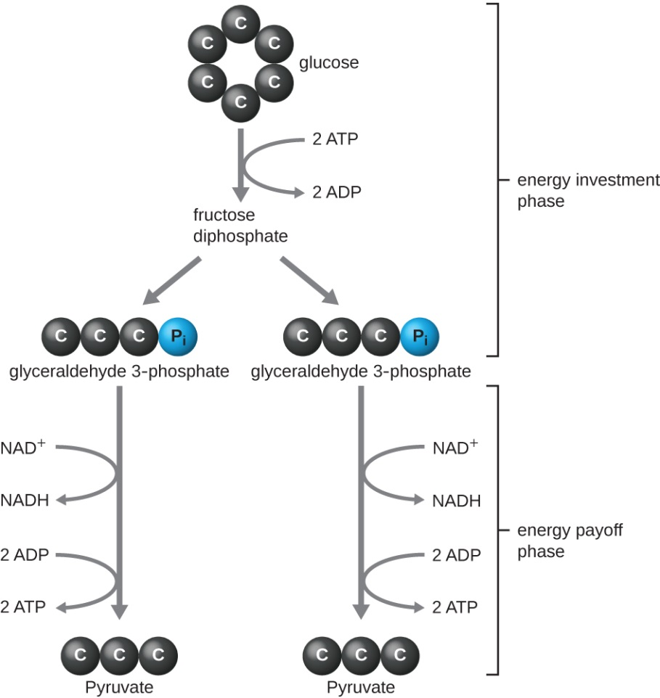
Glycolysis
The oxidation of glucose to pyruvic acid produces ATP and NADH
Glucose (C₆H₁₂O₆) is broken down and energy is released
Cytosolic
10 enzyme-catalyzed reactions
occurs in most living cells
doesn’t require O₂
Uses 2 ATP but gain 4 ATP
Converts 2 NAD+ into 2 NADH
Start with 1 glucose (6 carbons) end with 2 pyruvate molecules (3 carbons)
Notes:
Please note the term “Pyruvic Acid” is also known as “Pyruvate”. Understand that in this 10 step process, one molecule of glucose is broken down into two molecules of pyruvate and energy is released from the broken bond.

Slide 26
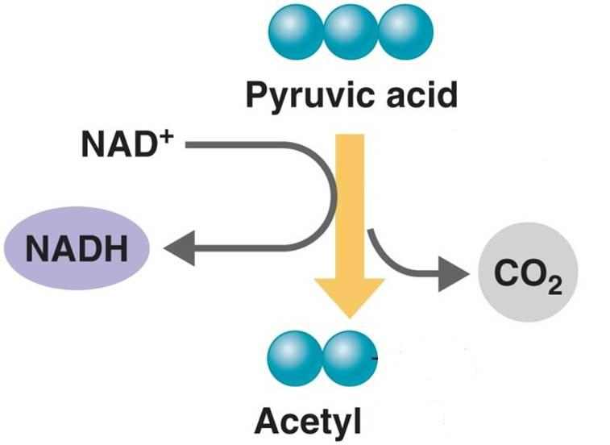
Precursor to Krebs Cycle
Happens in the mitochondria
Pyruvic acid (3C) modified to 2C before Krebs cycle:
decarboxylation – CO₂ released (1C lost)
acetyl group (2C) remains
attaches to coenzyme A, forms acetyl CoA
products for 1 glucose (2 pyruvic acids):
2 CO₂
2 NADH
2 acetyl CoA
CoA is a large cofactor group that is attached to the acetyl molecule
Notes:
Please understand that pyruvate must be converted to the two-carbon molecule Acetyl CoA prior to entering the Krebs cycle.

Slide 27
Precursor to Krebs Cycle
The following has to happen to a molecule of Pyruvic acid before it can enter the Krebs cycle
Decarboxylation (3 carbon to 2 carbon with loss of CO₂)
Production of reduced NADH (high energy molecule)
Formation of acetyl CoA
Notes:
Understand these concepts; however, you do not need to know the chemical formulas or structures of any of the components of cellular respiration, just their names.

Slide 28
The Krebs Cycle
Mitochondrial
A.k.a. the tricarboxylic acid cycle (TCA cycle) and citric acid cycle
generates energy through oxidization
provides precursors for the biosynthesis of compounds (amino acids as well NADH)
Notes:
Know where in the cell the Krebs cycle occurs.

Slide 29
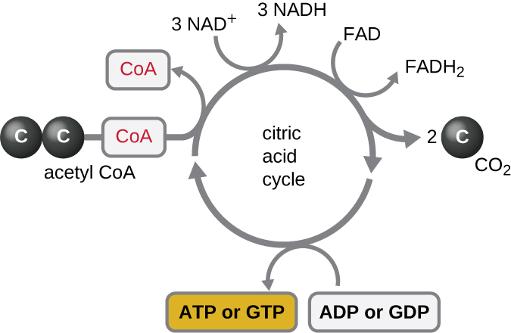
The Krebs Cycle
Krebs cycle:
acetyl CoA (2C) enters cycle
coenzyme A recycled
acetyl group joins 4C molecule, forms 6C molecule
6C molecule: decarboxylation & redox reactions
regenerates 4C molecule
each turn generates:
2 CO₂
1 ATP
3 NADH & 1 FADH₂
e– carriers
contain most of glucose’s energy
go to electron transport chain
2 turns per glucose

Slide 30
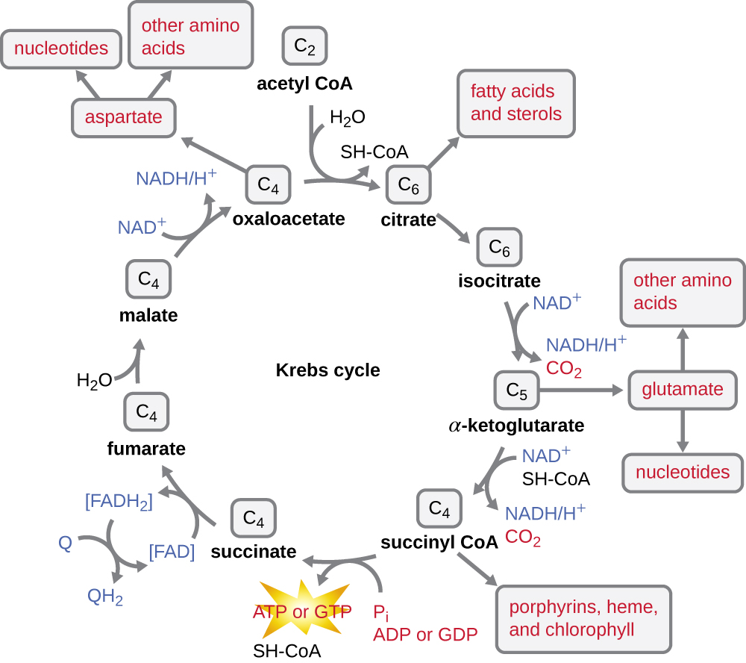
The Krebs cycle.
A turn of the cycle begins as enzymes strip off the CoA portion from acetyl CoA and combine the remaining two-carbon acetyl group with oxaloacetic acid. Adding the acetyl group produces the six-carbon molecule citric acid.
1
– Oxidations generate
NADH. Step 2 is a rearrangement. Steps 3 and 4 combine oxidations and decarboxylations to dispose of two carbon atoms that came from oxaloacetic acid. The carbons are released as CO₂, and the oxidations generate NADH from NAD⁺. During the second oxidation (step 4), CoA is added into the cycle, forming the compound succinyl CoA.
2
4
Notes:
Please know the products of the Krebs cycle in order. However, you do not need to know which coenzyme is used, etc. at each step.
“Can I Keep Silver Staples For My Office?” = Citric Acid, Isocitric Acid, (alpha)ketoglutaric acid, succinyl-CoA, Succinic acid, Fumaric acid, Malic acid, Oxaloacetic acid.

Slide 31
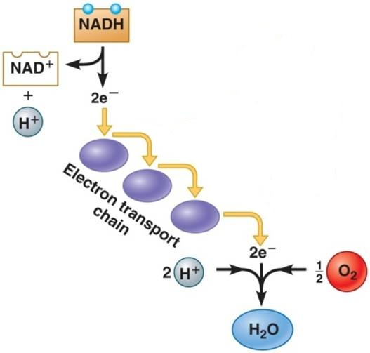
The Electron Transport Chain
Electron transport chain:
prokaryotes: on plasma membrane
eukaryotes: on mitochondrial inner
membrane
e–s from NADH & FADH₂ pass down
chain of carrier molecules
regenerates NAD⁺ & FAD for glycolysis & Krebs
O₂ final e– acceptor in aerobic respiration; makes H₂O
Notes:
Know location of ETC in proks versus euks.

Slide 32
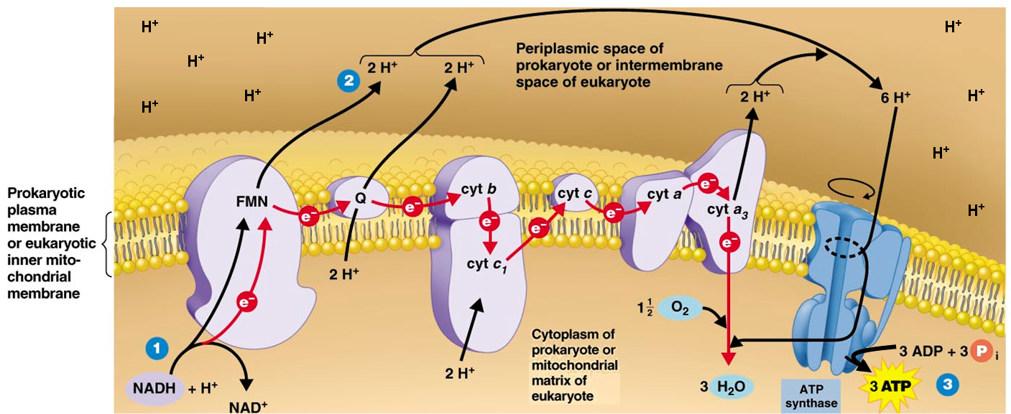
The Electron Transport Chain
Electron transport chain:
energy from movement of e–s pumps H⁺s into periplasmic (bacteria) or intermembrane (mitochondria) space
chemiosmosis – H⁺ concentration gradient used to power ATP synthase
phosphorylates ADP, makes 34 ATPs per glucose
Notes:
Please know these concepts but again you do not need to know the complexes in order.
Understand that the reduced coenzymes from the Krebs cycle travel to the ETC where the Hydrogen ion is “cashed” into energy in the form of ATP.

Slide 33
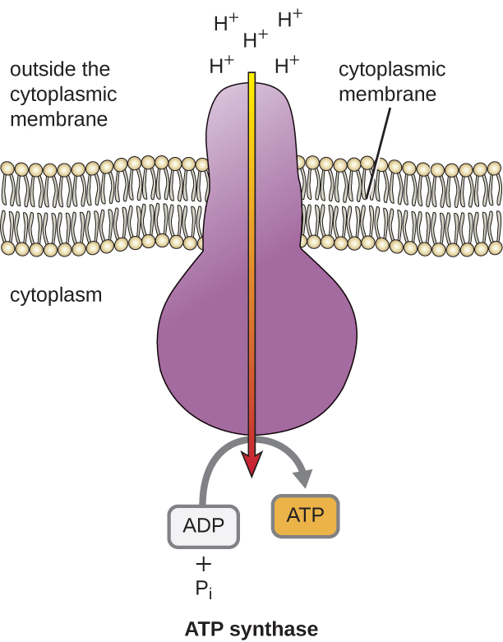
Chemiosmosis.
ATP synthase is a complex integral membrane protein through which H⁺ flows down an electrochemical gradient, providing the energy for ATP production by oxidative phosphorylation. (credit: modification of work by Klaus Hoffmeier)

Slide 34
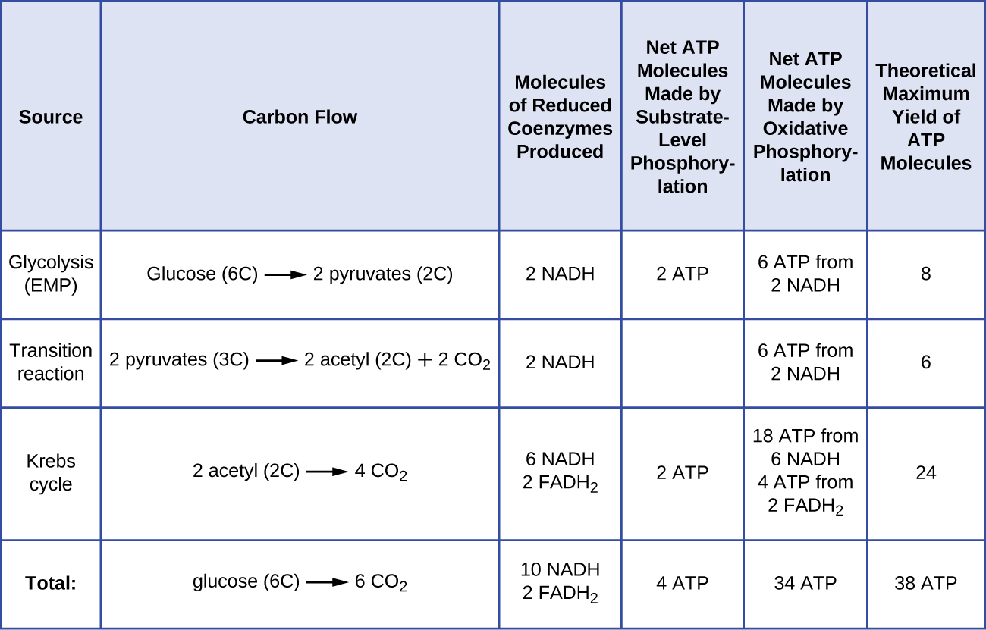
Carbohydrate Catabolism
Notes:
Please know this chart (most of it is a review).

Slide 35
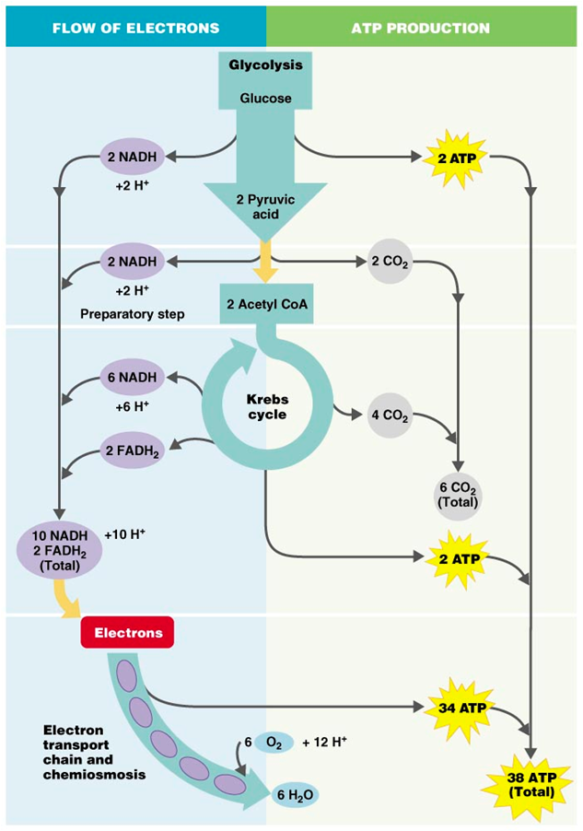
Aerobic Cell Respiration Yield
For 1 glucose molecule:
38 ATP for prokaryotes
36 ATP for eukaryotes
all 6 Cs lost in CO₂
e–s combine with O₂, form 6 H₂O
Notes:
Please know this overview for each glucose molecule.

Slide 36
Anaerobic Respiration
2 types of cell respiration:
aerobic – final e– acceptor O₂
produces H₂O
anaerobic – final e– acceptor inorganic molecule other than O₂
products strong smelling
yields fewer ATP than aerobic respiration
varies with organism & pathway
Electron Acceptor | Products | Bacteria
O₂ | H₂O | many
NO₃– | NO₂–, N₂, or N₂O | Pseudomonas, Bacillus
SO₄^{2–} | H₂S | Desulfovibrio
CO₃^{2 –} | CH₄ | Methanococcus

Slide 37
Fermentation
Any spoilage of food by microorganisms (general use)
Any process that produces alcoholic beverages or acidic dairy products (general use)
Any large-scale microbial process occurring with or without air (common definition used in industry)
Scientific definition:
Releases energy from oxidation of organic molecules
Does not require oxygen
Does not use the Krebs cycle or ETC
Uses an organic molecule as the final electron acceptor

Slide 38
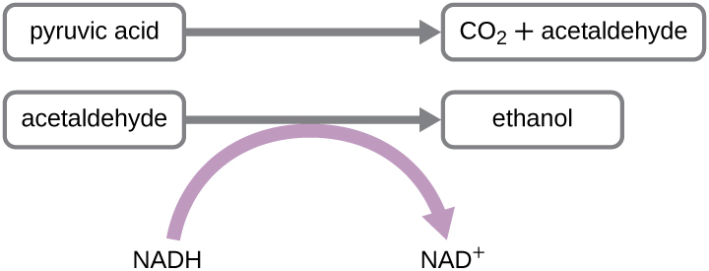
Fermentation
Fermentation:
may occur after glycolysis
regenerates NAD⁺ so glycolysis can continue
produces no ATP (besides those produced by glycolysis)
doesn’t require O₂
doesn’t require Krebs or electron transport chain
final e– acceptor an organic molecule
Notes:
Please be familiar with these concepts. When an organic molecule is present instead of oxygen as the final electron acceptor, fermentation may occur in some organisms.

Slide 39
End-Products of Fermentation
End products depend on:
particular microorganism
substrate
enzymes
Identify end-products to identify microbes:
Notes:
You do not need to know the end products for each organism; however, please understand the concept that identifying the end products of particular reactions can assist in identifying the microorganism.

Slide 40
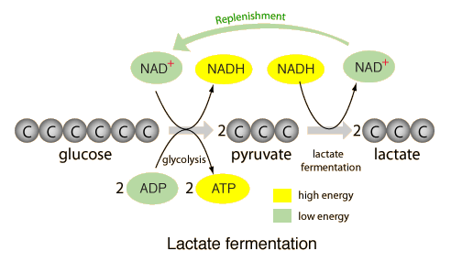
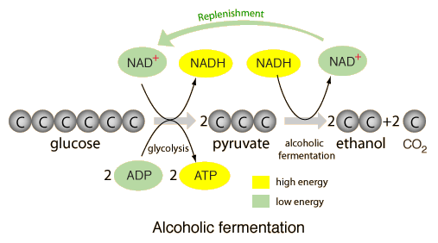
Types of Fermentation
Lactic acid fermentation
produces lactic acid
makes yogurt, cheese, pickles
Alcohol fermentation
produces ethanol & CO₂
many bacteria & yeasts
makes bread, beer, etc.
Notes:
Please know the concepts and examples on the left side of the slide.

Slide 41
A Summary of Respiration
Aerobic respiration: the final electron acceptor in the electron transport chain is molecular oxygen (O₂)
Anaerobic respiration: the final electron acceptor in the electron transport chain is NOT O₂
Yields less energy than aerobic respiration because only part of the Krebs cycle operates under anaerobic conditions

Slide 42
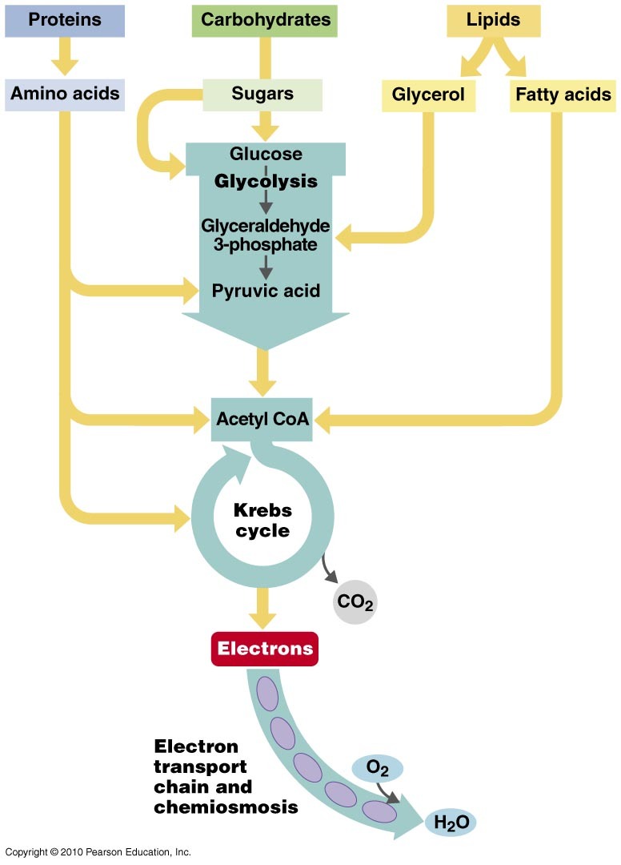
Lipid and Protein Catabolism
Lipids & proteins also oxidized for energy
Lipids – fatty acids & glycerol
broken apart by lipases
parts metabolized separately
Proteins – amino acids
broken down by extracellular proteases
amino acids enter cell
modified, then metabolized
Notes:
This explains how proteins and lipids also have the ability to enter cellular respiration. You do NOT need to know the specifics, simply that they can do so.

Slide 43
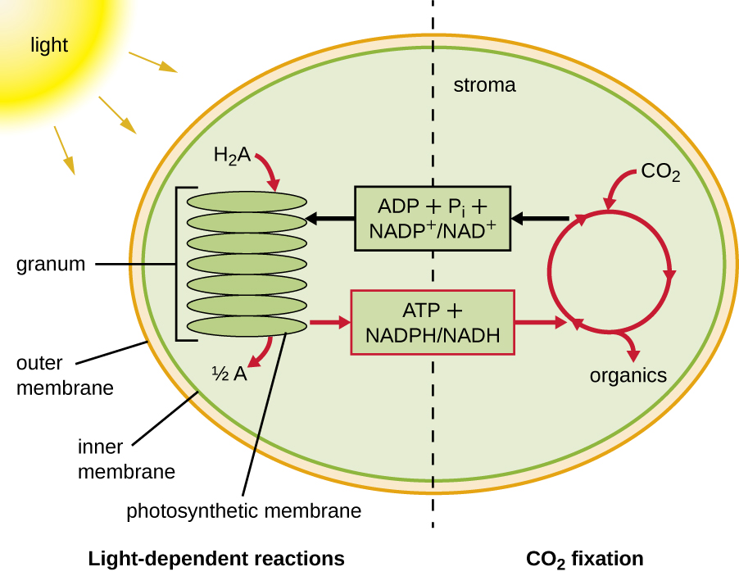
Photophosphorylation
Light causes chlorophyll to give up electrons
Energy released from transfer of electrons (oxidation) of chlorophyll through a system of carrier molecules is used to generate ATP
Notes:
When you hear photophosphorylation, think chlorophyll.

Slide 44
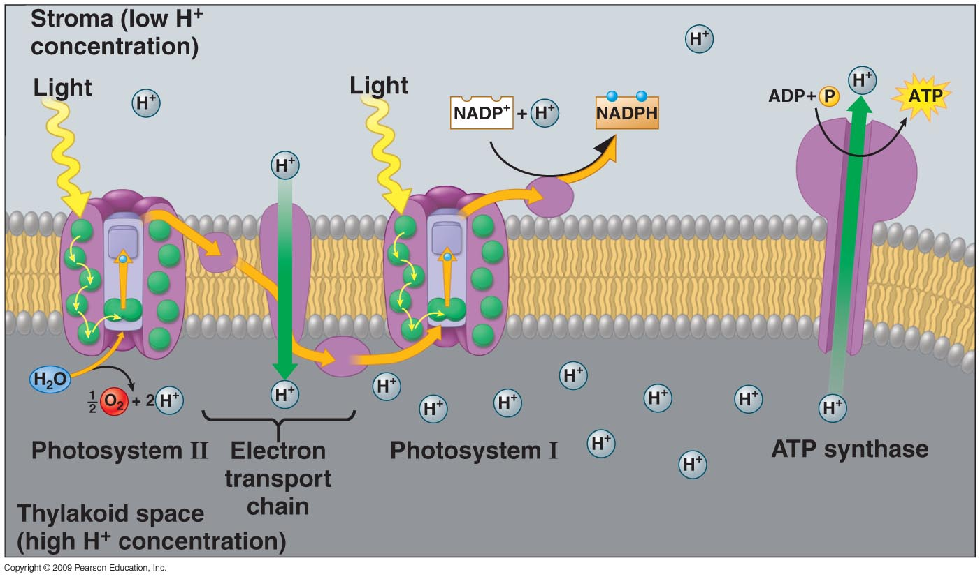
Light-Dependent Reactions
Light reactions:
light energy absorbed by chlorophyll (pigment) molecules
excited e–s jump from chlorophyll to electron transport chain
e–s picked up by e– carrier, making NADPH
energy used to pump protons across thylakoid membrane
ADP → ATP by chemiosmosis

Slide 45
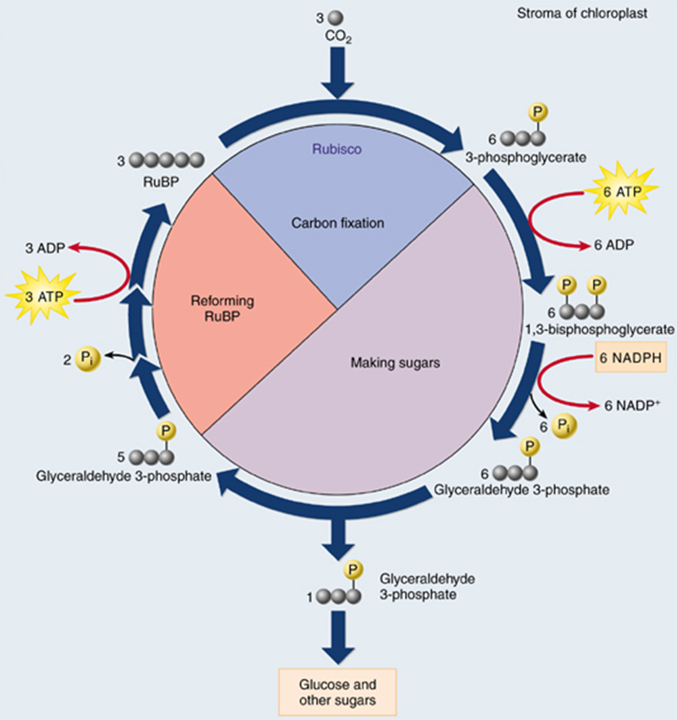
Light-Independent Reactions
Dark reactions
inputs:
atmospheric CO₂
fixed into organic molecule by enzyme rubisco
ATP & NADPH (e–s)
from light reactions
products:
ADP & NADP⁺ regenerated
3C sugar, G3P
used make glucose & other sugars

Slide 46
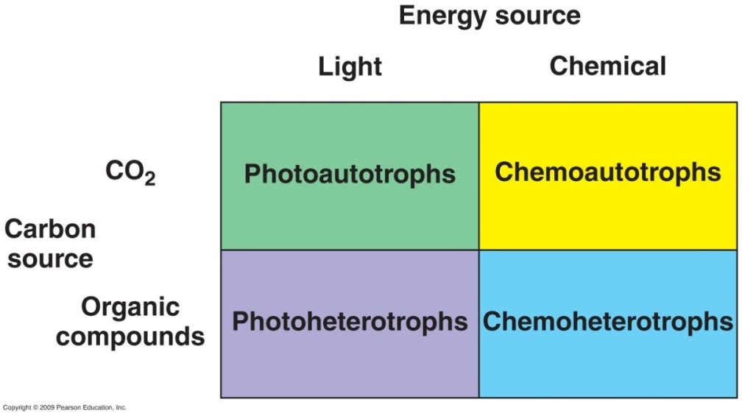
Metabolic Diversity Among Organisms
Nutritional pattern – organism’s source of energy & carbon
energy sources:
light – phototrophs
organic or inorganic compounds – chemotrophs
carbon sources:
CO₂ – autotrophs
organic compounds –
heterotrophs
Notes:
Please be very familiar with this chart.

Slide 47
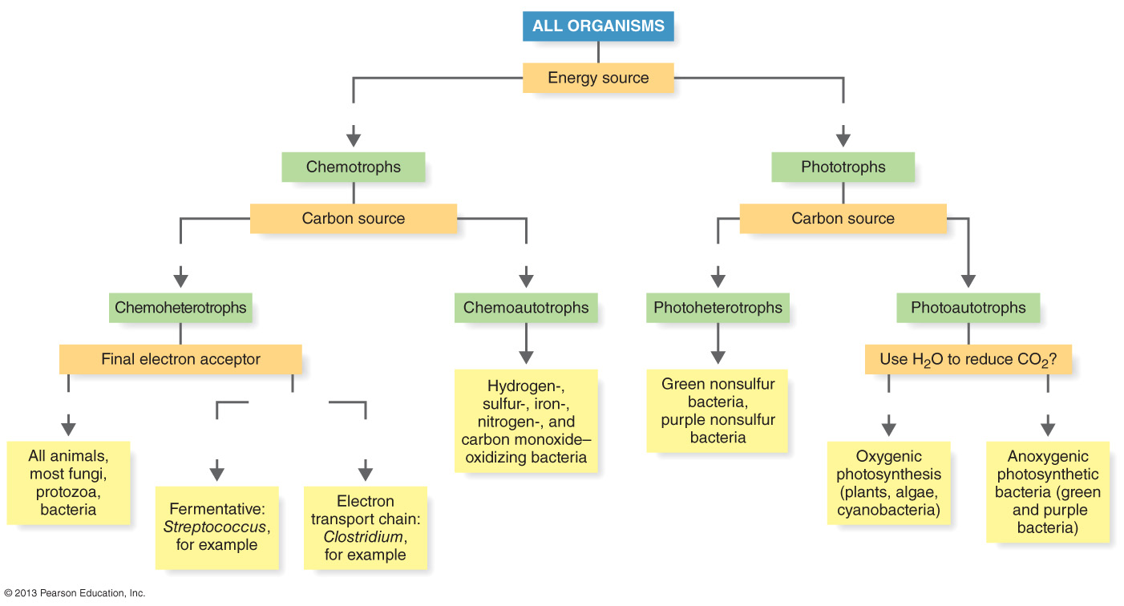
Figure 5.28 A nutritional classification of organisms.
Chemical
Light
Organic compounds
CO₂
Organic compounds
CO₂
O₂
Not O₂
Yes
No
Organic
compound
Inorganic
compound

Slide 48
Metabolic Diversity among Organisms
Nutritional Type | Energy Source | Carbon Source | Example
Photoautotroph | Light | CO₂ | Oxygenic: Cyanobacteria, plants Anoxygenic: Green bacteria, purple bacteria
Photoheterotroph | Light | Organic compounds | Green bacteria, purple nonsulfur bacteria
Chemoautotroph | Chemical | CO₂ | Iron-oxidizing bacteria
Chemoheterotroph | Chemical | Organic compounds | Fermentative bacteria Animals, protozoa, fungi, bacteria

Slide 49
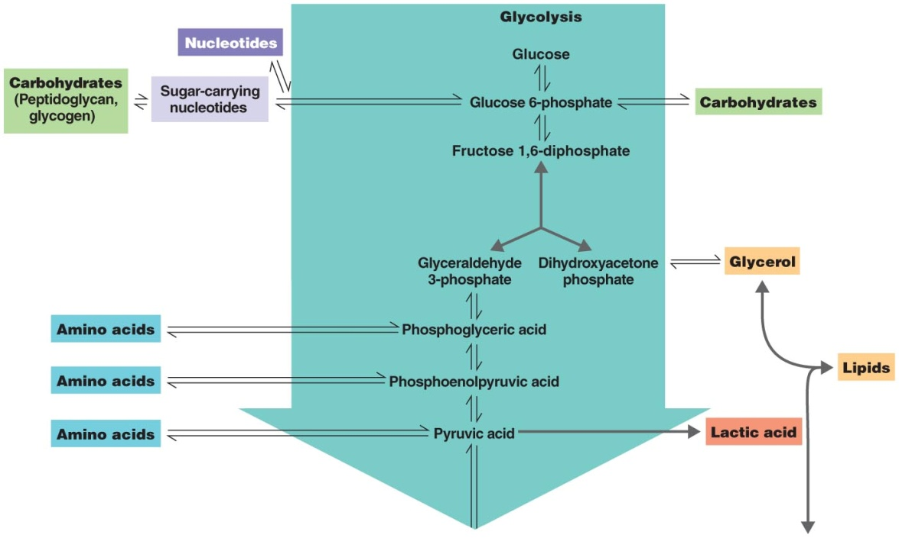
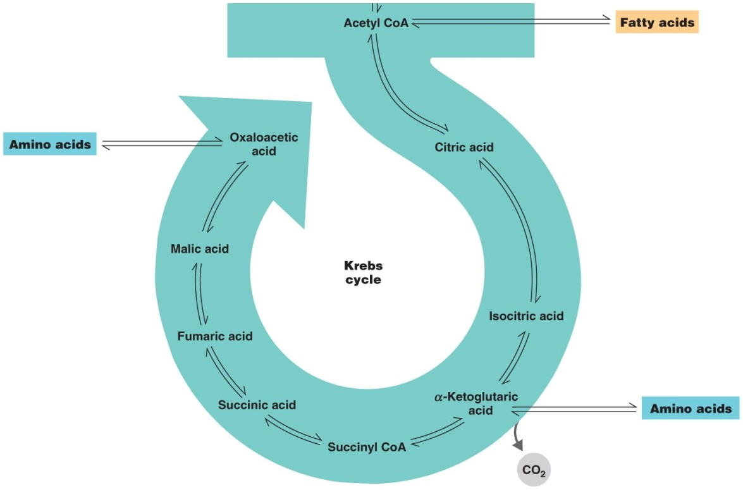
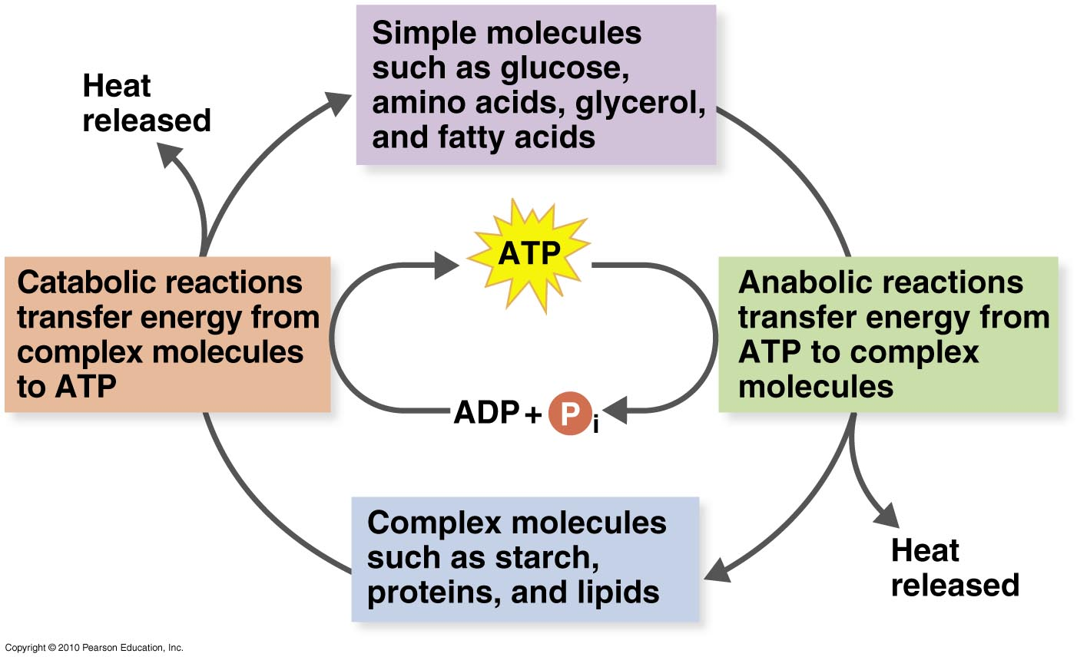
The Integration of Metabolism
Amphibolic pathways – metabolic pathways with catabolic & anabolic functions
Notes:
Please know this definition. The images are simply examples we have already discussed.

