Slide 1
Chapter 6
Viruses, Prions and Cancer
Notes:
1

Slide 2
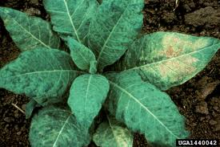
Viruses
Martinus Willem Beijerinck – “founder” of virology
In 1898, he determined tobacco mosaic disease is caused by an agent smaller than a bacterium.
He named that new pathogen virus (Latin word meaning “poison”)
He said that viruses were liquid in nature – which was proved wrong later
Notes:
Please know who the founder of virology is.

Slide 3
What are the Characteristics of Viruses?
Virus:
A tiny, non-living?? particle
Are not cells
Do not use their own energy to grow
Do not respond to their surroundings
Cannot reproduce without being within a cell
Cannot make their own food or take in food
Do not create wastes
Enters and then reproduces inside a living cell
They require a host
Outside of a cell a virus lies dormant (like hibernation) but still has the ability to infect cells
Notes:
Understand why a virus is considered to be non-living? Hint: does it possess all of the six characteristics required to maintain life we discussed previously.

Slide 4
General Characteristics of Viruses
Obligate intracellular parasites
require living hosts to multiply
Almost all viruses destroy the cells that they multiply in
Viruses can infect all different types of organisms: animals, plants, bacteria
living or nonliving?
Viral characteristics:
all have DNA or RNA (Never both)
all have a protein coat (some enclosed by
lipid envelope)
lack all or nearly all enzymes: use host machinery
No ribosomes
No ATP-generating mechanism
Notes:
Please know the information on the left side of the slide.

Slide 5
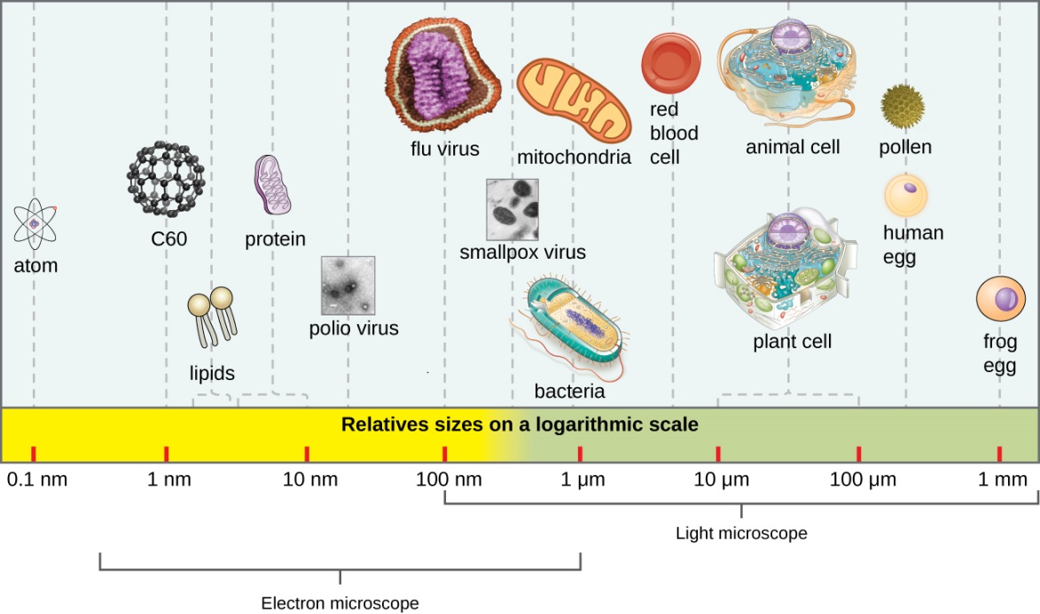
Host Range & Viral Size
Large variation in viral size (~20nm)
Host range – spectrum of host cells a virus can infect
most: specific cell types in 1 host
some can cross species barriers (influenza)
determined by specific host attachment sites & cellular factors
Phages or bacteriophages – viruses that infect bacteria
Experimental uses of viruses:
phage therapy – using
bacteriophages to treat
bacterial infections
oncolytic viruses –
selectively destroy
tumor cells
Notes:
Viruses Sizes
Smaller than cells and Bacteria
Cannot be seen with normal (compound light) microscopes
They are roughly 20 nanometers – 1 billionth of a meter

Slide 6
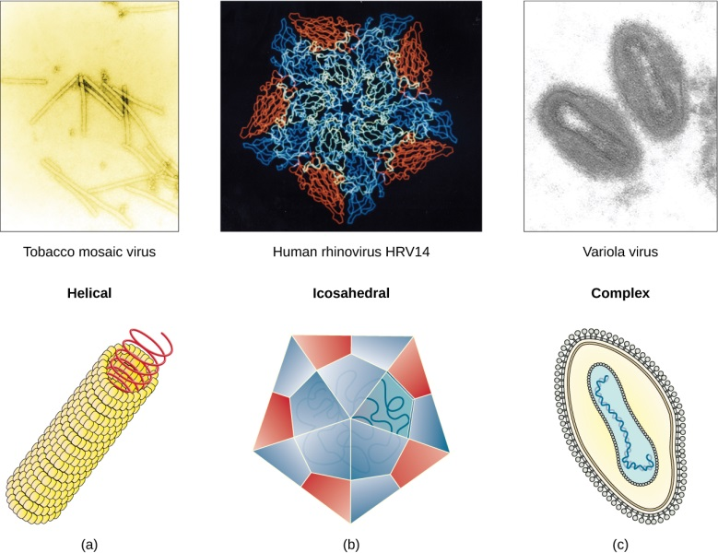
Viral Structure
Virion – complete infectious viral particle
Two parts: Inner core with genetic material & Protein coat that protects the genetic material
nucleic acid: DNA or RNA
Never both
double or single stranded
linear or circular
in one or many segments
capsid – protein coat
protection from environment
vehicle of transmission
made of one or several types
of protein subunits – capsomeres
Notes:
Please be familiar with the bolded terms.

Slide 7
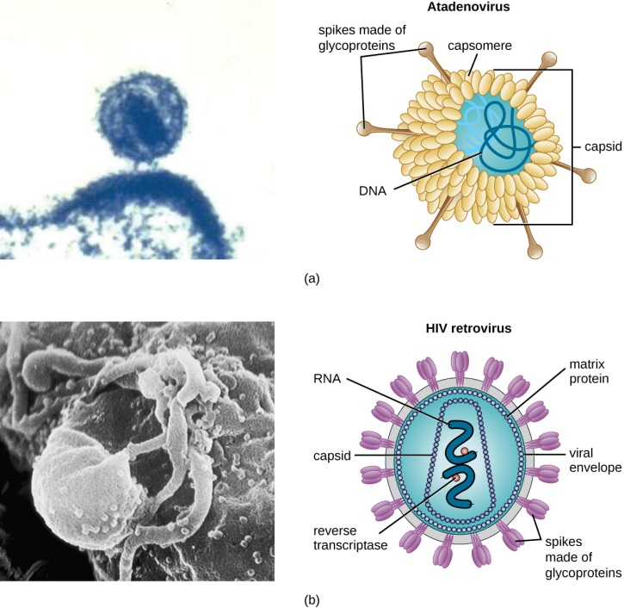
Viral Structure
Virions may have:
envelope – may cover capsid
made of lipids, proteins, & carbohydrates
may be host plasma membrane
spikes – carbohydrate-protein complexes
identification, attachment
may change over generations via mutation & escape host antibodies
Notes:
Please understand these structures well and be familiar with their importance to the virus.

Slide 8
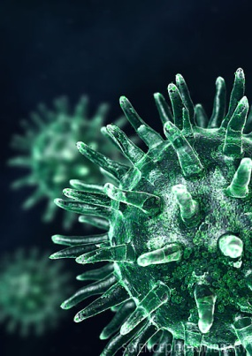
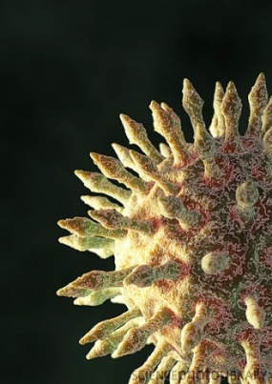
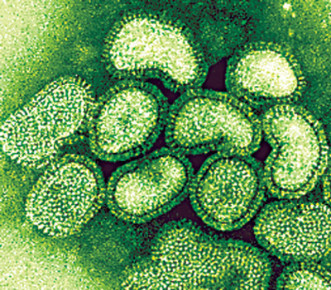
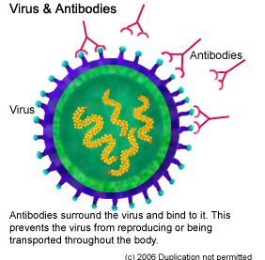
Viral Structure
Each virus contains unique spikes (surface carbs and proteins ) that help them infect their target cells
Viruses usually only affect certain types of cells
The cold virus infects the throat and nose
HIV infects immune cells
Bacteriophage infects bacteria cells
Analogy:
The virus particles have protein “keys” that will only interact with specific protein “locks” on the cell membrane. …. Specificity.
V
Notes:
Please understand how specific viruses tend to be and that most viruses, unlike bacteria, tend to be pathogenic.

Slide 9
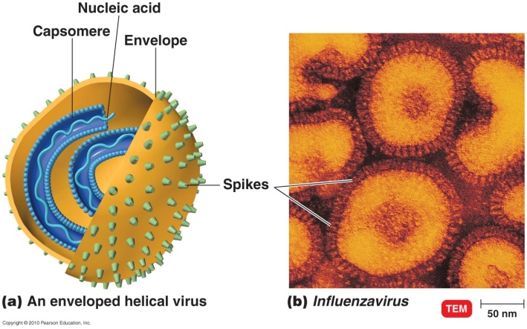
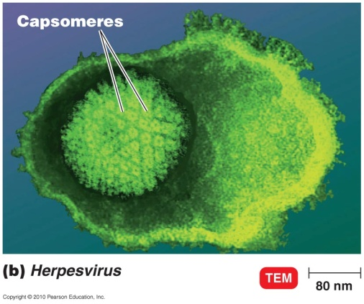
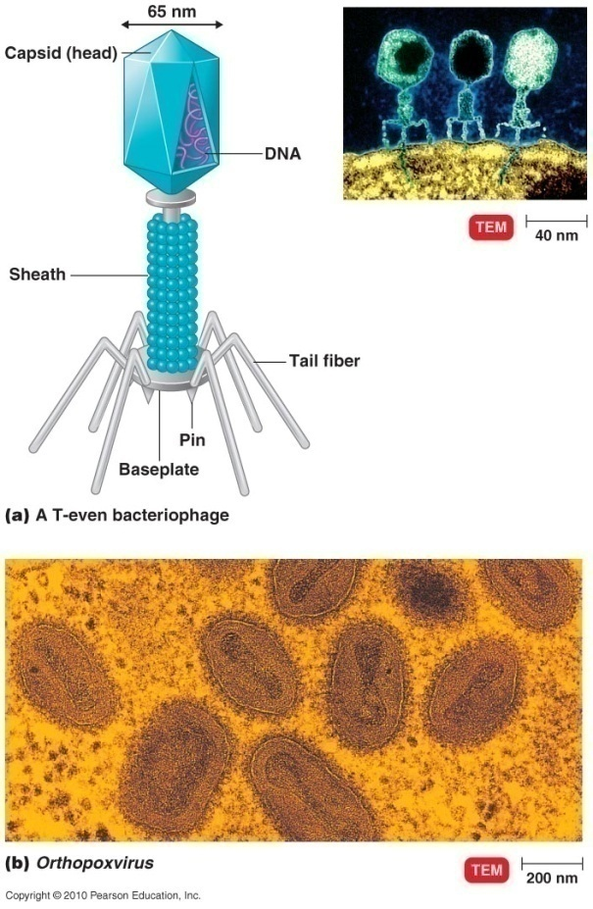
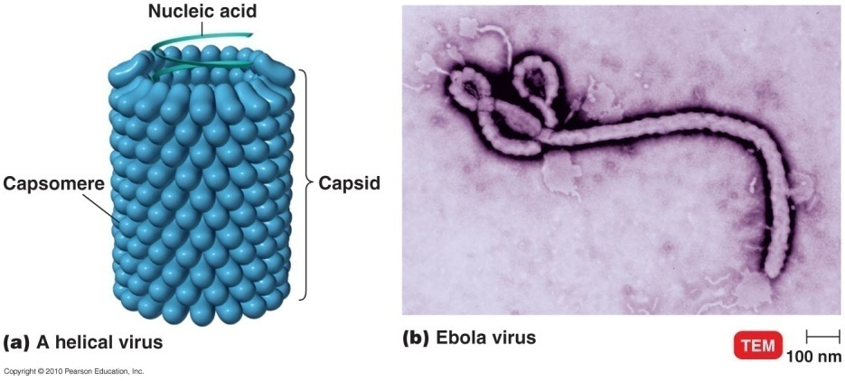
Viral Morphology
Morphological types:
helical – long rods, rigid or flexible
rabies, Ebola
polyhedral – multi-sided
adenovirus, poliovirus
enveloped – spherical
helical or polyhedral inside
influenza, herpes
complex – additional structures
bacteriophages, poxviruses
Notes:
Please know what the shapes look like and the examples of viral illness associated with certain shapes. You do not need to be able to identify the virus shapes based on the pictures.

Slide 10
Taxonomy of Viruses
Grouped based on:
nucleic acid type
replication strategy
morphology
Naming:
order names end in -ales
family names end in -viridae
genus names end in -virus
no species names: common names instead
subspecies designated by number
Viral species – group of viruses sharing same genetic information & ecological niche (host range)
Notes:
Please be familiar with the concepts regarding taxonomy of viruses.

Slide 11
Bacteriophage Multiplication: The Lytic Cycle
V
Lytic cycle – causes host cell lysis
attachment – phage attaches by tail fibers to host receptor sites
penetration – phage lysozyme (enzyme) opens cell wall; tail sheath contracts, forces tail core & DNA into cell
biosynthesis – host protein synthesis stopped; phage DNA & protein made
maturation – assembly of phage virions
release – phage lysozyme breaks cell wall (lysis) & releases phages
Notes:
Please understand this concept well.

Slide 12
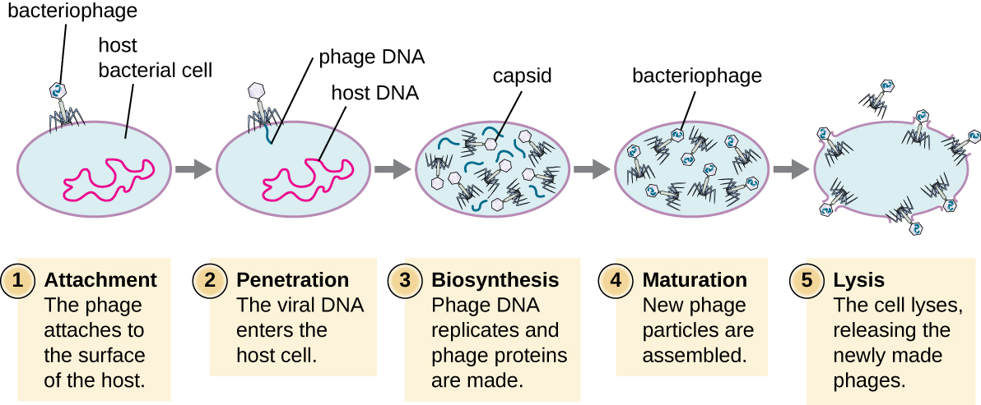
Lytic Cycle Cont’d
Notes:
Visual representation of material on previous slide.

Slide 13
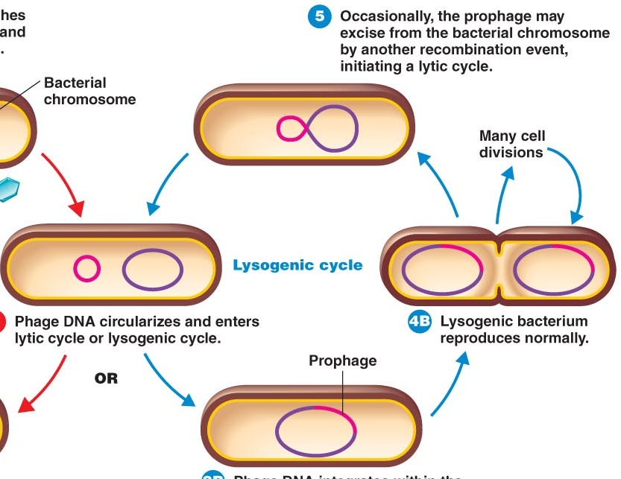
Bacteriophage Multiplication: The Lysogenic Cycle
Lysogenic cycle – virus doesn’t necessarily lyse host cell
phage DNA injected into host, circularizes; lytic or lysogenic
lytic cycle – kills host cell
lysogenic cycle – doesn’t kill host cell
prophage – phage DNA incorporated in host DNA
prophage repressed but stays in genome through cell divisions
rare events (UV
or chemical
damage)
may remove
prophage
from host
chromosome
& begin lytic cycle
Notes:
Please understand this concept well.

Slide 14
Lysogenic Cycle
A temperate bacteriophage has both lytic and lysogenic cycles. In the lysogenic cycle, phage DNA is incorporated into the host genome, forming a prophage, which is passed on to subsequent generations of cells. Environmental stressors such as starvation or exposure to toxic chemicals may cause the prophage to be excised and enter the lytic cycle.

Slide 15
Transduction by a Bacteriophage
This flowchart illustrates the mechanism of specialized transduction. An integrated phage excises, bringing with it a piece of the DNA adjacent to its insertion point. On reinfection of a new bacterium, the phage DNA integrates along with the genetic material acquired from the previous host.
Notes:
Please understand how this concept can occur. You do not need to know the steps in order; however, please be able to explain what the result of transduction by a bacteriophage is and how it may effect bacterial cells.

Slide 16
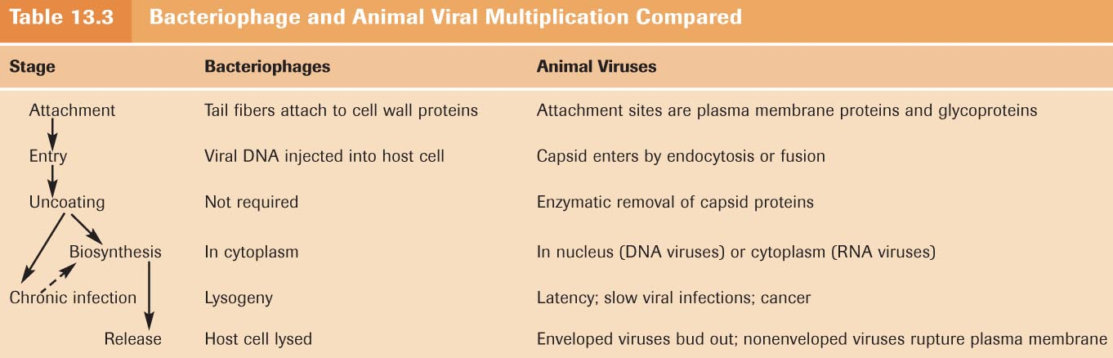
Multiplication of Animal Viruses
Animal virus entry, synthesis, maturation, & release somewhat different from bacteriophage multiplication
Multiplication of DNA & RNA -containing animal viruses:
attachment, entry, uncoating, biosynthesis, maturation, & release
Attachment – viruses attach to cell membrane receptors
different animal cells have different receptors
viral attachment sites distributed all over virus
Notes:
A visual, more detailed information on the following slides. This is an overview.

Slide 17
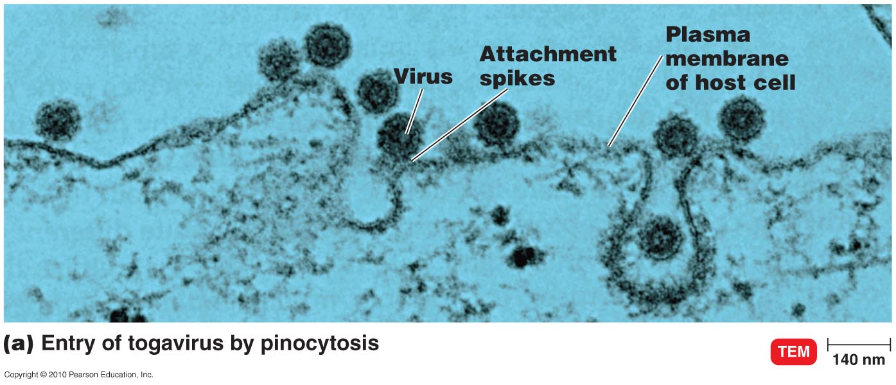
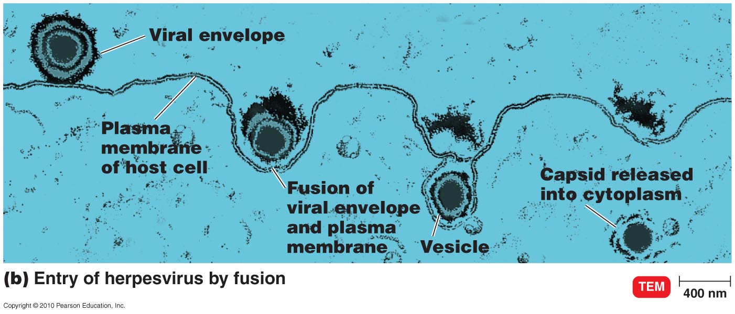
Multiplication of Animal Viruses
Entry – by pinocytosis or fusion
pinocytosis – cell brings in nutrients by membrane infolding & vesicle formation
brings anything attached to membrane
fusion – for enveloped viruses
envelope fuses with cell membrane & releases contents into cell
Notes:
Please understand how viruses are able to enter an animal cell.

Slide 18
Multiplication of Animal Viruses
Uncoating – separation of viral nucleic acid from protein coat by viral or host enzymes
Biosynthesis – production of nucleic acid & proteins
varies for different types of DNA & RNA viruses
Notes:
Please know the bolded terms.

Slide 19
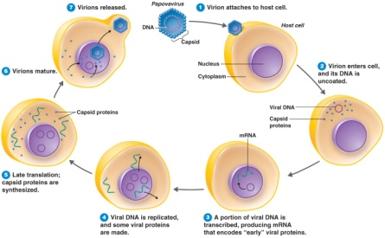
Biosynthesis DNA viruses
DNA made in nucleus,
proteins in cytoplasm
virions assembled in
nucleus
Attachment, entry,
uncoating and viral DNA
released into the nucleus of the host cell
Transcription and Translation of “early” genes
enzymes that are required for multiplication of viral DNA
Replication/multiplication of viral DNA
Transcription and Translation of “late” genes
Capsid and other structural proteins
Capsid proteins migrate to the nuclei and fuse with the DNA creating complete virions

Slide 20
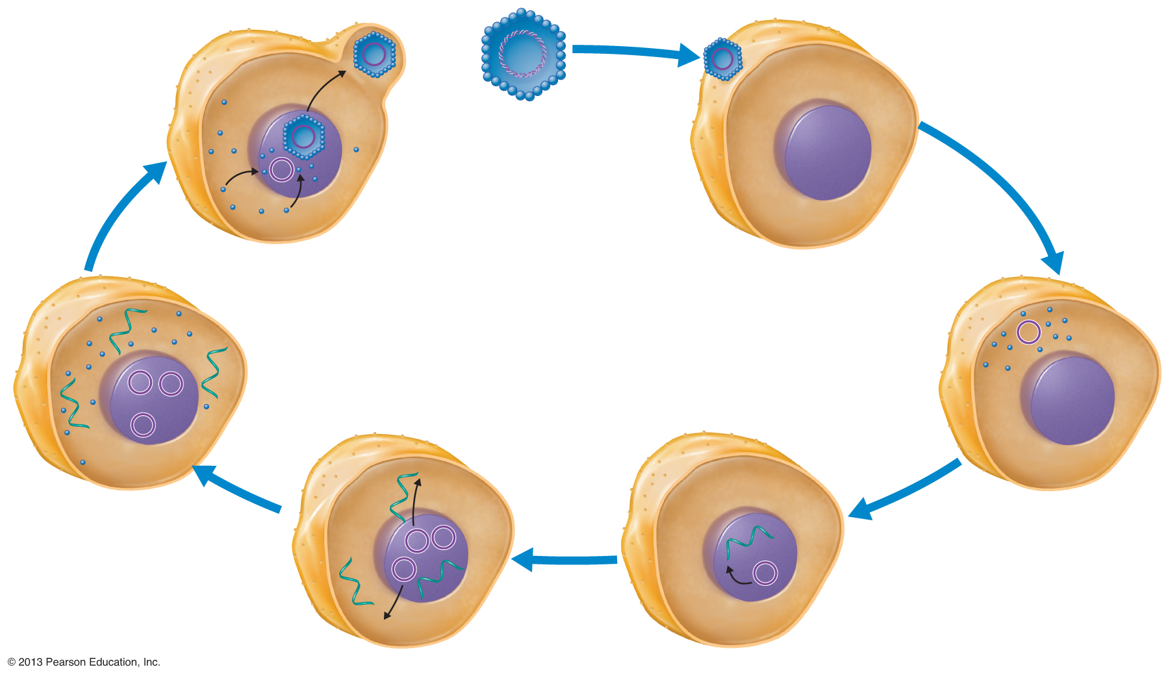
Figure 13.15 Replication of a DNA-Containing Animal Virus.
1
ATTACHMENT
Virion attaches to host cell.
A papovavirus is a typical
DNA-containing virus that
attacks animal cells.
7
RELEASE
Virions are
released.
Papovavirus
DNA
Host cell
2
ENTRY and
UNCOATING
Virion enters cell,
and its DNA is uncoated.
6
MATURATION
Virions
mature.
Capsid
Nucleus
Cytoplasm
Viral DNA
Capsid proteins
Capsid proteins
4
BIOSYNTHESIS Viral DNA is replicated, and some viral proteins are made.
mRNA
5
Late translation;
capsid proteins are
synthesized.
3
A portion of viral DNA is
transcribed, producing
mRNA that encodes
“early” viral proteins.
Notes:
Please know these steps in order and a basic description of what occurs at each step.

Slide 21
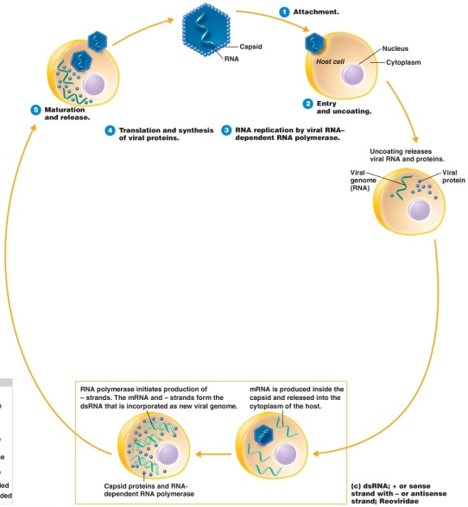
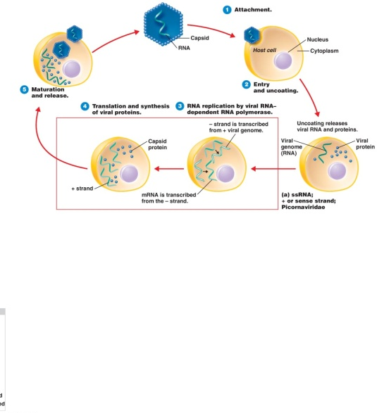
Biosynthesis RNA viruses
RNA & proteins made in cytoplasm
depends on number & type of RNA strands
After uncoating, single stranded RNA virus are able to synthesize proteins directly
with 2 identical sense strands, reverse transcriptase makes double stranded DNA from viral RNA
integrated into host genome as provirus
never leaves
may be latent or expressed
Notes:
Please know the concepts on this slide well.

Slide 22
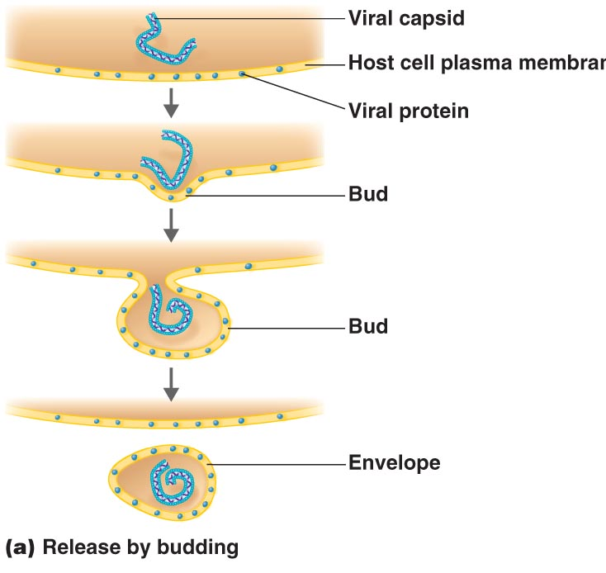
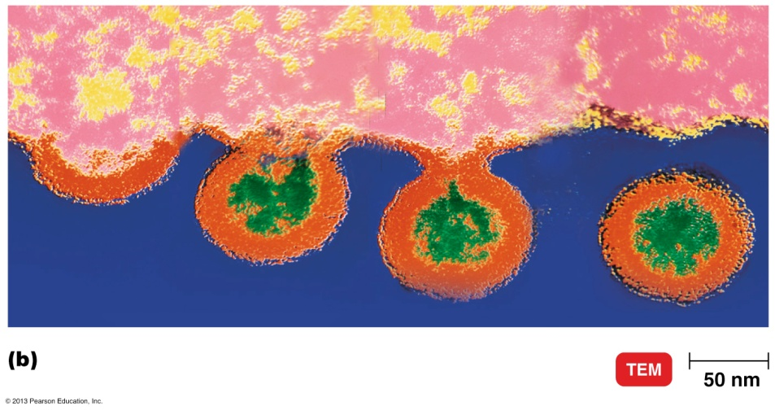
Multiplication of Animal Viruses
Maturation
capsid proteins assemble spontaneously
capsid contains nucleic acid
Release
by budding for enveloped viruses
viral envelope proteins incorporated into cell membrane; envelope develops around capsid during release
host cell may survive
by rupture for nonenveloped viruses
usually kills host cell
Notes:
Please know these concepts well.

Slide 23
Growing Animal Viruses
V
Animal viruses grown in:
living animals, embryonated eggs, or cell cultures
Living animals
mice, rabbits, guinea pigs
Some human viruses have no animal models
can’t be grown, or don’t cause disease
Use of embryonated eggs
hole drilled in shell
virus injected into appropriate fluid
viral growth: causes death,
damage, or pocks
Notes:
Please understand that some viruses can be grown in animal models, but not all can. Also, know that embryonated eggs can be used in some instances.

Slide 24
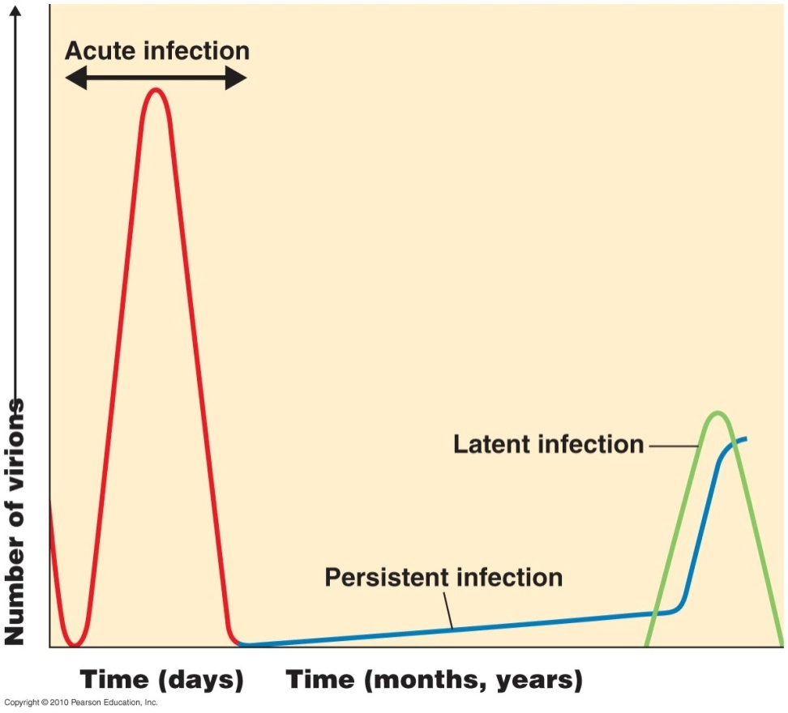
Latent Viral Infections
Latent – virus remains in asymptomatic host cell for long periods
sometimes, virus is produced without causing symptoms
oncogenic viruses & cancer, herpesviruses & cold sores, chickenpox virus & shingles
Notes:
Understand the term latent infection. You need not know the examples. Photo credit Tortora Microbiology.

Slide 25
Persistent Viral Infections
Persistent (chronic) – disease processes occurs over long period; generally fatal
measles virus & subacute sclerosing panencephalitis
Notes:
Understand the term persistent virus. Photo credit: Tortora Microbiology.

Slide 26
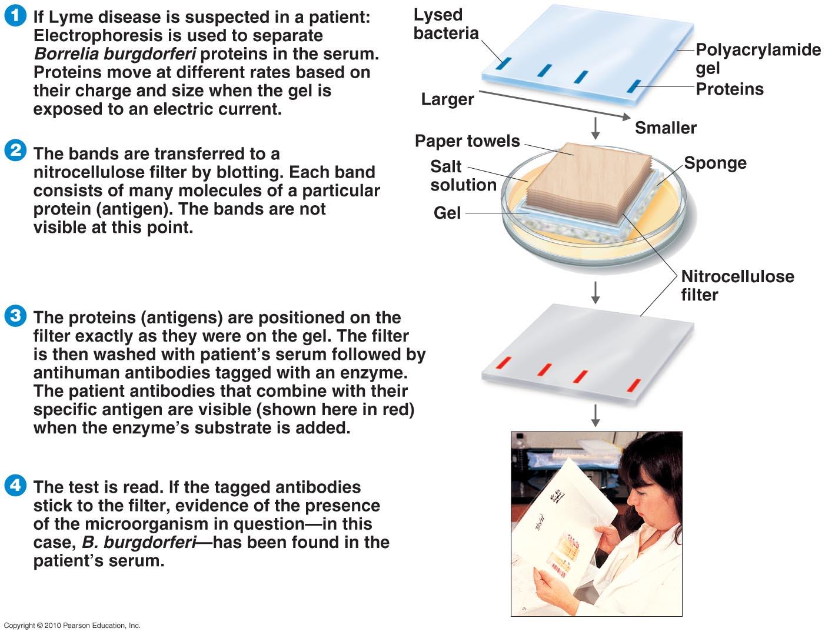
Virus Identification
Viruses can’t be seen without electron microscope
Identification methods:
serological tests – detect & identify by reaction with antibodies
Western blotting
cytopathic effects – visible effects on host cells
nucleic acids
PCR – amplifies small
amounts of nucleic acid
RFLPs – restriction
fragment length
polymorphisms
Notes:
Know that viruses can only be seen using an electron microscope due to their small size.

Slide 27
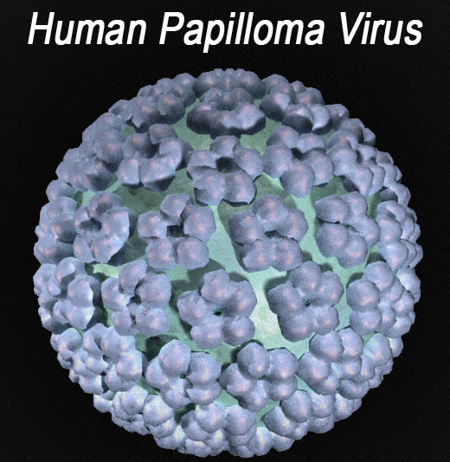
Oncogenic Viruses
Some cancers caused by viruses
oncogenic DNA viruses:
papovaviridae
human papillomavirus (HPV) causes cervical cancer
Epstein-Barr
hepatitis B
oncogenic RNA viruses:
retroviridae
adult T-cell leukemia & lymphoma
Notes:
Epstein-Barr - mononucleosis, Hodgkin's lymphoma, Burkitt's lymphoma, nasopharyngeal carcinoma. Please known these assocaitions.

Slide 28
Cancer
Activated oncogenes transform normal cells into cancerous cells
Transformed cells have increased growth, loss of contact inhibition, tumor-specific transplant antigens, and T antigens
The genetic material of oncogenic viruses becomes integrated into the host cell’s DNA

Slide 29
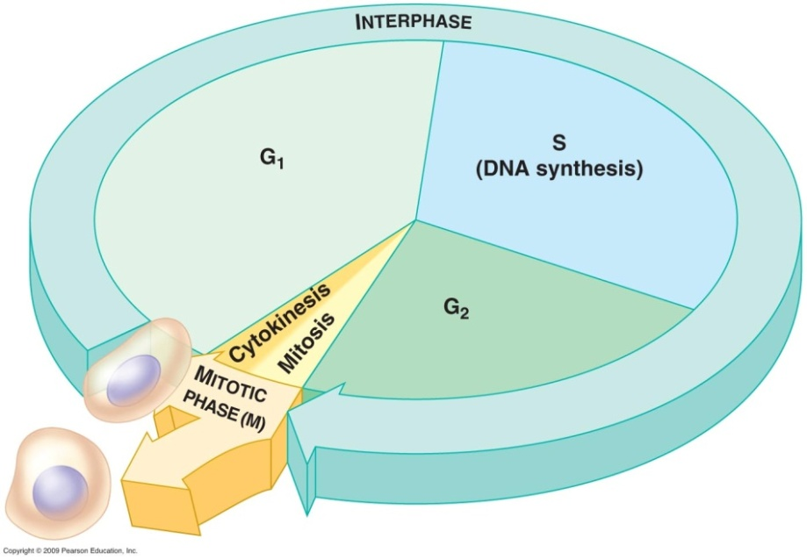
The Cell Cycle
0
Cell cycle – ordered sequence of events for cell division
interphase – 90% of cell cycle; duplication of cell contents
G₁ (first gap) – growth, increase in cytoplasm
S (DNA synthesis) – chromosome duplication
G₂ (second gap) – growth, preparation for division
M (mitotic) phase – cell division
mitosis – division of nucleus & contents
cytokinesis – division of cytoplasm
produces genetically identical
daughter cells
Notes:
Differences in the length of the cell cycle can be instructive. Yeast cells have a 2-hour life cycle, while human cells in culture take about 24 hours to divide. Mitosis and cytokinesis represent a shorter section of the cycle, lasting one hour for cultured human cells.
Please know the stages of the cycle by name, in order, and a brief description of what is occurring during each stage.

Slide 30
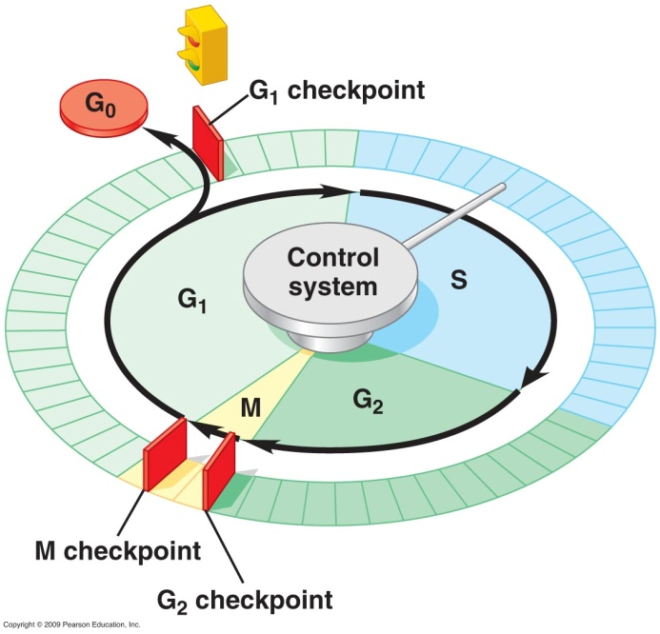
Growth Factors and the Cell Cycle
0
Cell cycle control system
set of molecules that triggers & coordinates cell cycle events
Checkpoints – control points; signals regulate cell cycle
G₁ checkpoint
assesses cell growth
allows entry into S phase, or
causes cell to leave cycle &
enter non-dividing G₀ phase
G₂ checkpoint
assesses DNA replication
M checkpoint
assesses mitosis
regulated by 2 types of genes:
Notes:
Understand there are multiple checkpoints and why this is important.

Slide 31
Mutations In Genes That Control Cell Division
0
Tumor-suppressor genes
normally inhibit cell division or repair damaged DNA
promote cancer when mutated
mutations inactivate genes & allow uncontrolled division
Notes:
Understand this concept.

Slide 32
Mutations In Genes That Control Cell Division
0
Proto-oncogenes
normally promote cell division
promote cancer when oncogenes
some oncogenes come from viruses
genetic material of oncogenic viruses integrates into host cell's DNA
some oncogenes come from proto-oncogenes:
mutation causing increased protein activity
extra gene copies, producing
excess protein
change in gene
location; new
promoter causes
increased transcription
Notes:
The following analogy can be used to compare the rate of cell division to the speed of a car. A proto-oncogene is like the accelerator. When mutated to form an oncogene, it is as if the accelerator is pushed to the floor so that the speed of cell growth is even faster. Tumor-suppressor genes are like the brakes. If the brake lines are cut, the speed increases as the vehicle is out of control.
Understand what a proto-oncogene is and its function in cancer.
Tumor-suppressor genes function like the repressor in the E. coli lactose operon. The lac operon is expressed, and cancers appear when their respective repressors do not function.
The production of a vaccine (Gardasil) against a virus known to contribute to cervical cancer has helped students become aware of the risks of HPV exposure. The website of the National Cancer Institute describes the risks of HPV infection at www.cancer.gov/cancertopics/factsheet/Risk/HPV.

Slide 33
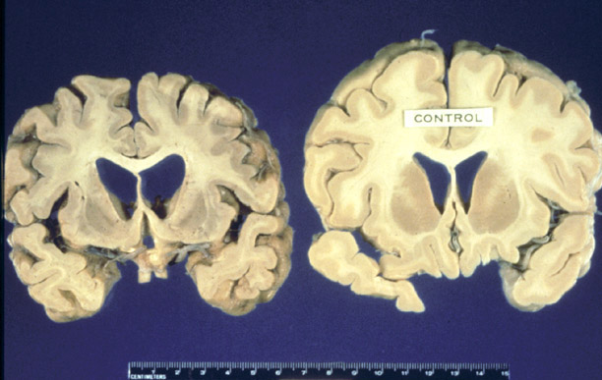
Prions
Prions – proteinaceous infectious particle
infective proteins
infectivity reduced by treatment with proteases
inherited & transmissible
by ingestion, transplant, & surgical instruments
cause neurological spongiform encephalopathies: large vacuoles develop in brains
kuru
Creutzfeldt-Jakob disease
fatal familial insomnia
sheep scrapie
mad cow disease
Notes:
Please be familiar with this slide.

Slide 34
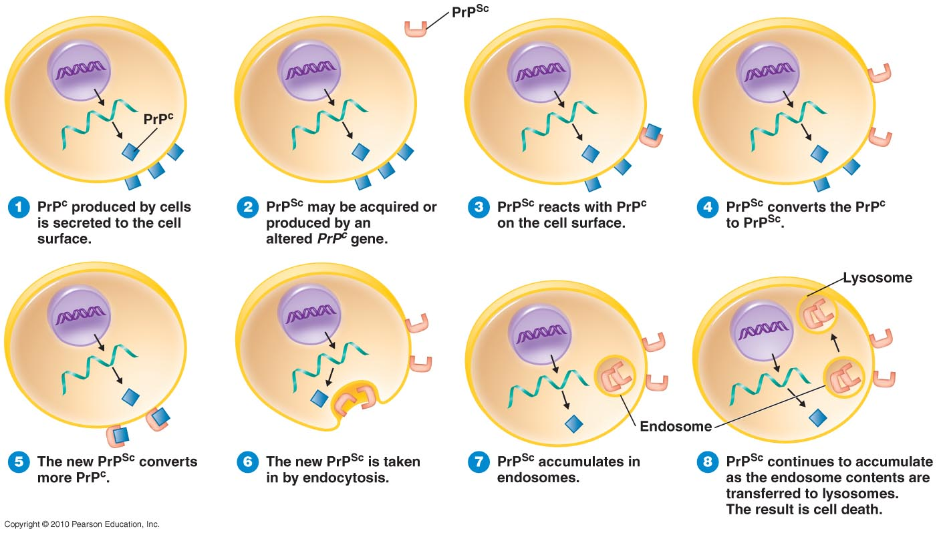
How a Protein Can Be Infectious
PrP^{C} (normal host glycoprotein, on cell surface) converted to PrP^{Sc} (scrapie prion protein)
PrP^{Sc} fragments accumulate in brain cells, forming plaques
Notes:
Just a visual.

Slide 35
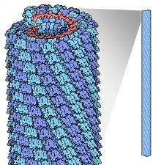
Tobacco mosaic virus
The first virus discovered
The virus only infects plants
Found throughout the US
The infection causes characteristic
patterns (mottling and discoloration) on the leaves
It will over-winter in infected tobacco stalks and leaves in the soil, on the surface of contaminated seed
Virus can lie dormant for up to 2 years in the soil
Treatment – remove and destroy plants, do not use the soil for at least two years
Notes:
Please know this slide well.

Slide 36
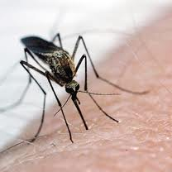
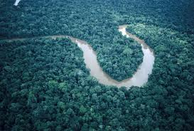
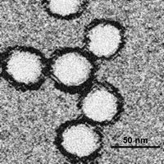
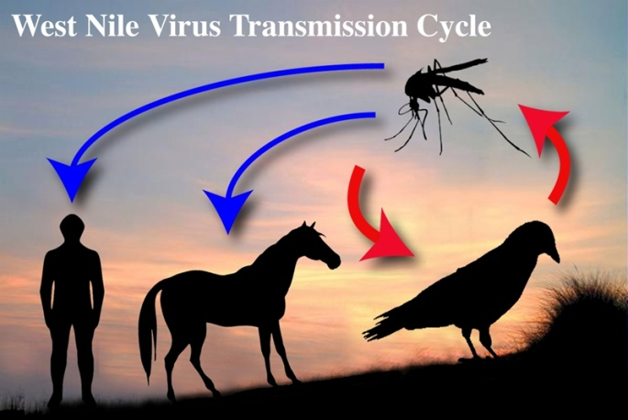
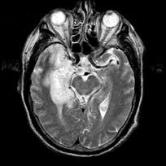
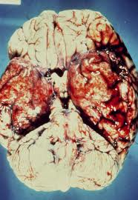
West Nile Virus
mainly infects birds, but is known to infect humans, horses, dogs, cats, bats….
Route of human infection is through the bite of an infected mosquito
3 outcomes with the virus:
Approximately 90% of West Nile Virus infections are asymptomatic
Mild febrile syndrome termed West Nile Fever
Neuroinvasive disease termed West Nile meningitis or encephalitis – most deadly and rare
Notes:
Please know this virus well.

Slide 37
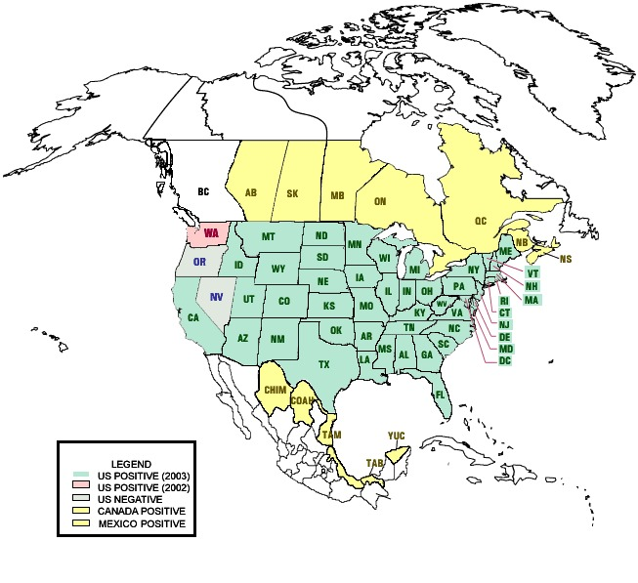
West Nile Virus
Incubation period is ~ 2-8 days
Avoiding mosquito bites
No vaccine available
Africa, Europe, and now the US

Slide 38
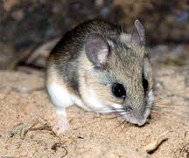
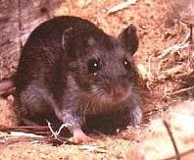
Hantavirus
Bunyaviridae Hantavirus
Causes hantavirus pulmonary syndrome
Spread through contact with the deer
mouse, the white-footed mouse, the rice
rat and the cotton rat
Very Rare disease – but worldwide
Incubation is 1 to 5 weeks
Symptoms include: Fever, severe muscle
aches, fatigue and within a few days the
person has a hard time breathing and
start vomiting
Notes:
Know these concepts well.

Slide 39
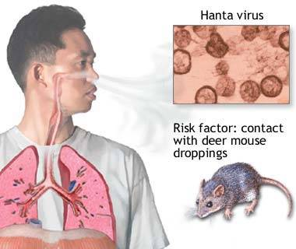
Hantavirus
Transmission through breathing in the virus from rodent urine and droppings that are stirred up and rodent bites
Never been a case of human
to human transmission
How to prevent the spread:
keep mice out of your house,
cleanup mouse dropping with
bleach water

Slide 40
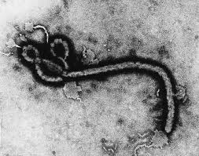
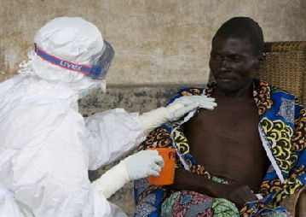
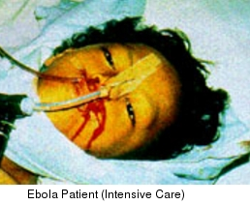
Ebola Virus
Filoviridae Ebolavirus
AKA Ebola
hemorrhagic fever
Its name is derived from the Ebola River in the Democratic Republic of the Congo
1976 first recognized at a mission hospital run by Belgian nuns
Fatal disease in humans and non-human primates
Spread through contact with an infected monkey or secretions from an infected person
Notes:
Please know Ebola well.

Slide 41
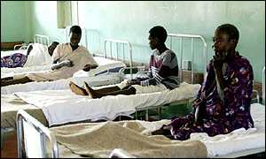
Ebola
Incubation period ranges from 2 to 21 days
Onset is abrupt and is characterized by fever, headache, joint and muscle aches, weakness, diarrhea, vomiting, red eyes, internal and external bleeding from eyes, nose, mouth and ears
Ebola is not highly contagious, but bodily fluids from diarrhea, vomiting, and bleeding represent a huge hazard
No treatment for the virus
Only in Africa (until recently)
Notes:
Please know Ebola well.

Slide 42
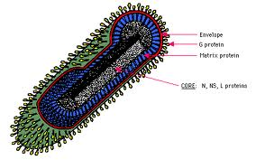
Rabies Virus
Rhabdoviridae Lyssavirus
Transmission occurs through the saliva of animals
For a human, rabies is almost invariably fatal
The incubation period is usually a few months in humans, but once the symptoms begin to show the infection is effectively untreatable and usually fatal within days
Early-stage symptoms of rabies are headache and fever, progressing to acute pain, violent movements, uncontrolled excitement, depression, and hydrophobia
Final stage is mania (craziness), lethargy, and coma
Death caused by acute encephalitis
Notes:
Know this slide well.

Slide 43
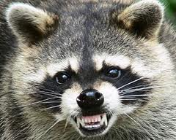
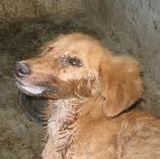
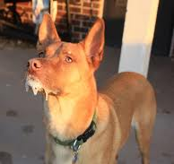
Rabies Virus
The salivary glands primary site of virus production
Roughly 97% of rabies cases come from dog bites
Worldwide except Australia and New Zealand

