Slide 1
Appendix A and Ch. 7
Chemical Principles
Joseph Dionne
CCV - Rutland
Notes:
1

Slide 2
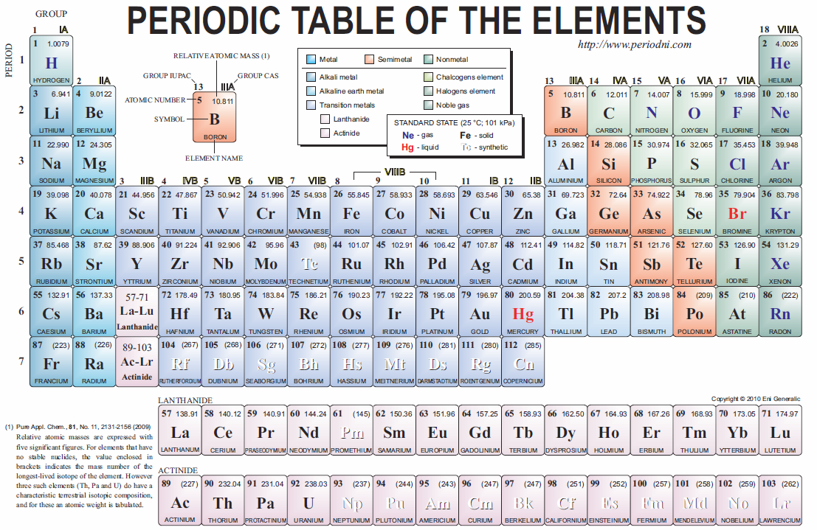
Composition of Matter
Notes:
Please listen to audio.

Slide 3
Composition of Matter
Matter – anything that has mass & occupies space
Elements – basic building blocks of matter
Atom – smallest possible piece of an element
Atoms are composed of
Electrons: negatively charged particles
Protons: positively charged particles
Neutrons: uncharged particles
Notes:
Know this slide well.

Slide 4
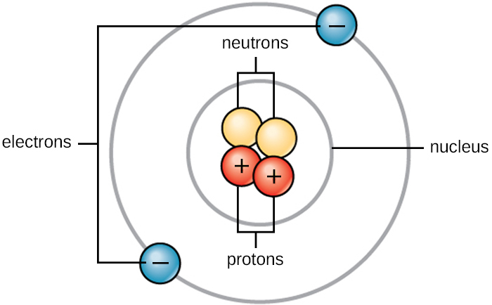
Basic Atomic Structure
Atoms – made of protons (+1), neutrons (0), & electrons (–1)
nucleus – center of atom
contains protons & neutrons (positive)
electrons move around outside the nucleus, creating an electron cloud
negative electrons attracted to positive nucleus
electrons can’t leave atom without input of energy
Notes:
Understand where electrons are located in comparison to protons, neutrons and the nucleus of an atom.
Hint: Do not confuse the nucleus of an atom with that of a cell.

Slide 5
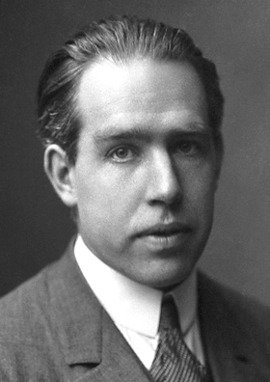
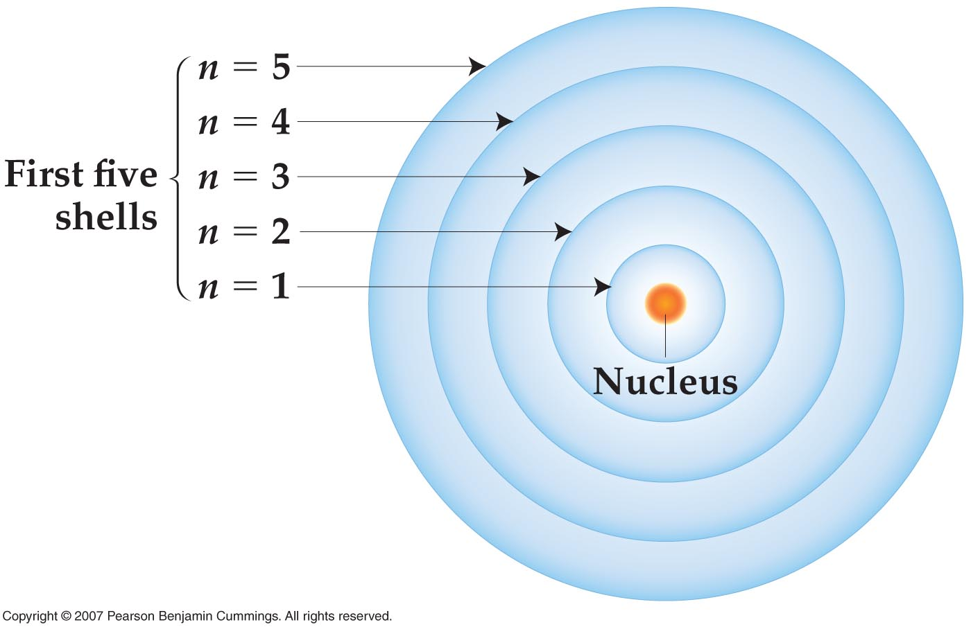
Bohr’s Atomic Structure
Niels Bohr (1913): Bohr Theory of Atomic Structure
electrons in an atom travel around nucleus like planets orbiting sun
can only be found in discrete electron shells; not in between

Slide 6
Heisenberg’s Uncertainty Principle
Bohr’s model not perfect…… electrons don’t actually travel in orbits
Heisenberg’s uncertainty principle – it’s impossible to know exactly where subatomic particles are
electrons are likely to be within an electron cloud
Notes:
Understand why Bohr’s model was not correct and discuss the Heisenberg’s uncertainty principle.

Slide 7
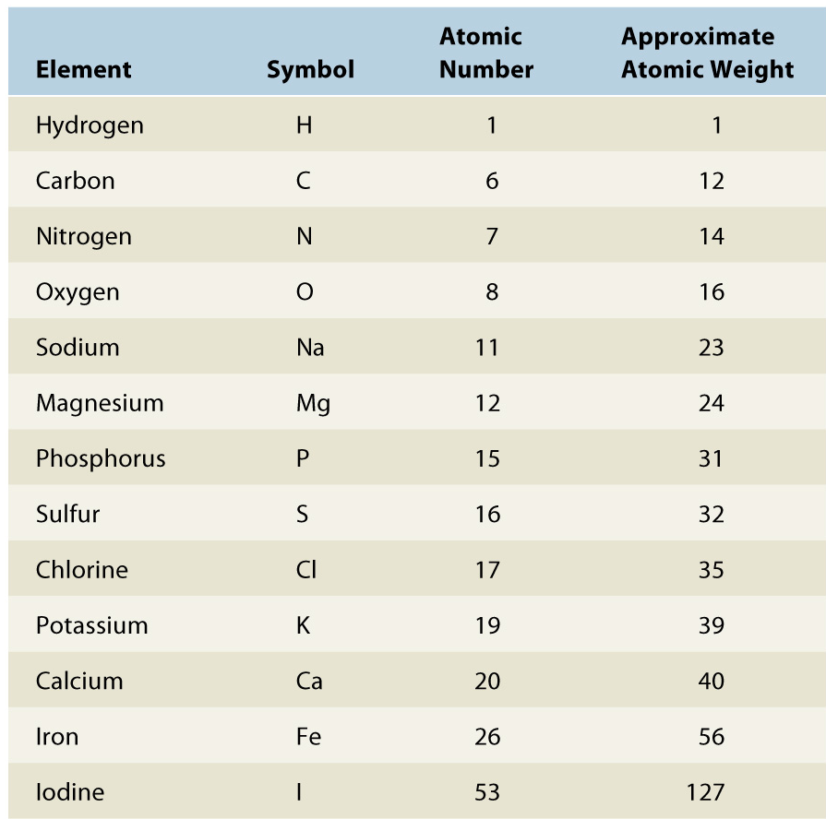
Elemental Properties
Atomic Number – number of protons
Defines an element
Mass Number (atomic weight) – number of protons and neutrons
Almost every element will have an isotope (a version of the element with more neutrons)
Notes:
Note: If an element is neutral in charge, then the atomic number (number of protons) will indirectly equal the number of electrons present.

Slide 8
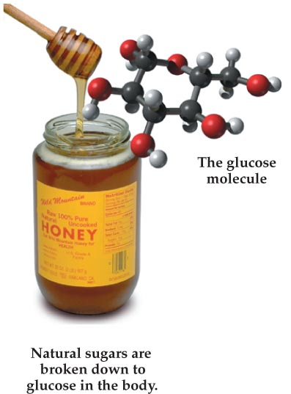
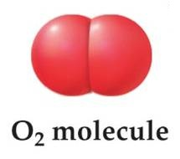
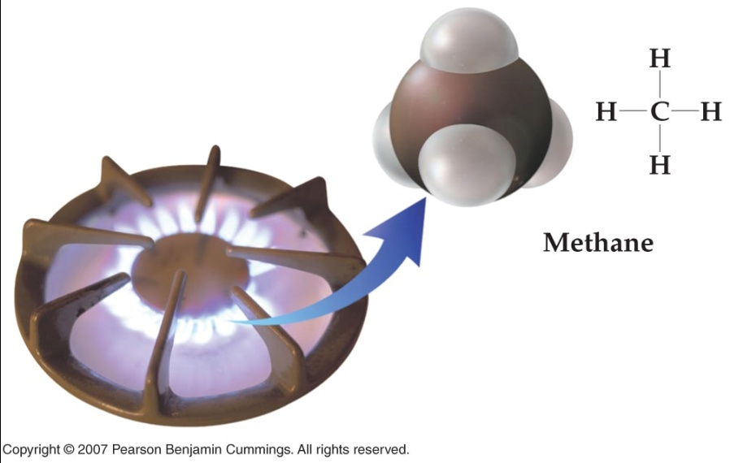
Chemical Bonds
Molecule – a collection of atoms bound together
atmospheric oxygen: O₂
methane: CH₄
glucose: C₆H₁₂O₆
Molecules can have chemical and physical properties that are very different from those of the atoms from which they are made
Chemical bonds – hold molecules together
Covalent bonds
Ionic bonds
Hydrogen bonds

Slide 9
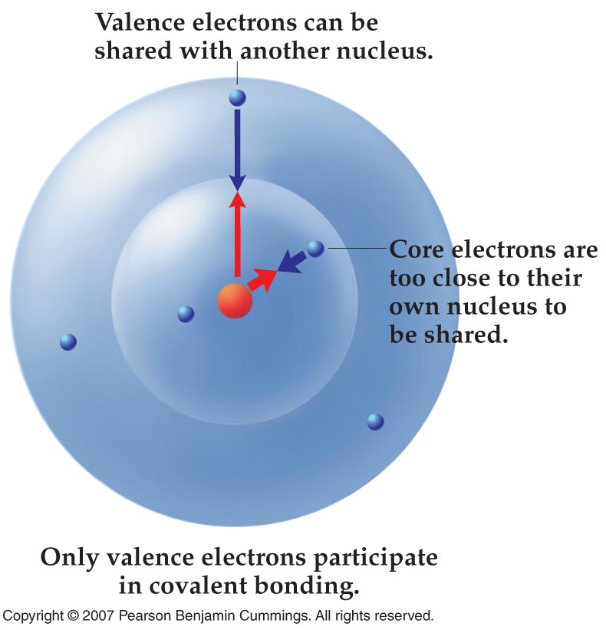
Covalent Bonds
When atoms come together to form molecules, it’s always the valence electrons that interact
valence electrons – in outer shell
Covalent bond –results from valence electrons being shared between two nuclei; bond holds molecules together
electrons are shared
very strong bond
generally between nonmetals
Notes:
Here, most atoms want to share a total of 8 electrons in the valence shell, this is known as the octet rule. An exception is Hydrogen, which only wants to share a total of 2 electrons.

Slide 10
Ionic Bonds – Transferring Electrons
Ionic bond – a bond between two ions, formed when atoms of one give up electrons and the atoms of the other accept electrons
electrons are transferred, NOT shared
electrons lost by metal, gained by nonmetal
oppositely charged ions attract each other
moderately strong bond
Notes:
Chlorine takes an electron from sodium, causing Na+ and Cl-, opposites attract so the two atoms bond together
In general, non-metals form covalent bonds and metals form ionic bonds with non-metals
Question: If Sodium lost an electron, why is it designated as being “+”? Hint: what charge does an electron have?

Slide 11
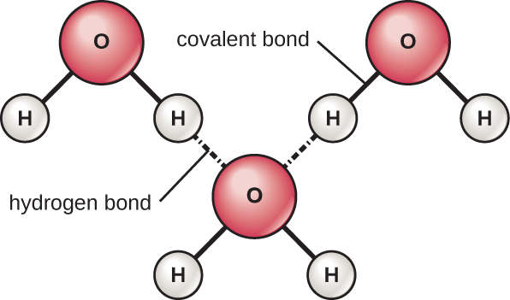
Hydrogen Bonds
Hydrogen bond – attraction between δ+ H covalently bonded to O, N, or F and δ– O, N, or F of another molecule
Hydrogen bonds:
individually fairly weak
collectively quite strong
responsible for unique
properties of water
Notes:
δ means partially, or weakly (negative or positive) in charge
Hydrogen bonding is what allows for the surface tension of water. For example, if you have two droplets of water near each other what happens as they touch? Do they remain as two drops? What happens when you jump into a pool? Does the water break into individual molecules or do droplets cause a splash? Which is less painful a cannonball into a pool or a belly flop? Why? (Hint: think surface area versus surface tension). These are all examples of Hydrogen bonding.

Slide 12
Dissociation of ions in water
When table salt (NaCl) is mixed in water, spheres of hydration form around the ions.

Slide 13
Chemical Reactions
Chemical reactions involve the making or breaking of bonds between atoms
A change in chemical energy occurs during a chemical reaction
Endergonic reactions absorb energy (as in making a bond)
Exergonic reactions release energy (as in breaking a bond)
Notes:
Please know the bolded definitions.

Slide 14
Chemical reactions
Synthesis Reaction
Occur when atoms, ions, or molecules combine to form new, larger molecules
Anabolism is the synthesis of molecules in a cell
Decomposition Reaction
Occur when a molecule is split into smaller molecules, ions, or atoms
Catabolism is the decomposition reactions in a cell
Combines to form
A
+
B
AB
Breaks down into
AB
A
+
B
Notes:
Be able to identify the type of reaction and define the terms in bold.

Slide 15
Important Biological Molecules
Inorganic compounds:
lack carbon
usually ionic bonds – somewhat strong
transfer of electrons
Organic compounds:
always contain carbon & hydrogen
usually covalent bonds – very strong
sharing of electrons
usually structurally complex
straight or branched chains, rings
macromolecules – giant molecules

Slide 16
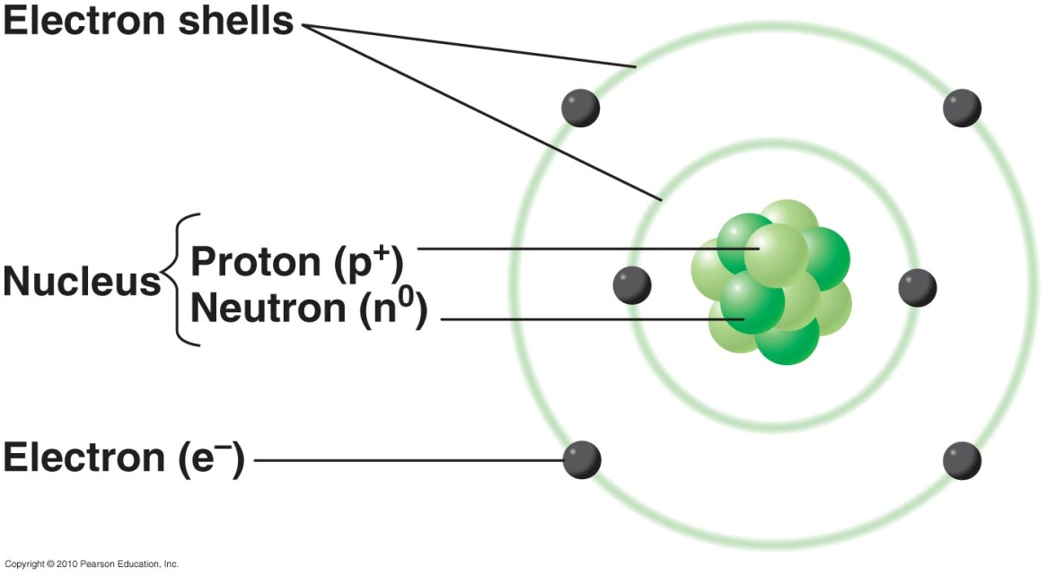
Carbon
Carbon has 4 outer electrons (e–s):
can form up to 4 covalent bonds
atoms “want” filled outer shells: 8 e–s in 2nd shell
All living things based on carbon

Slide 17
Nonpolar versus Polar Covalent Bonds
The water molecule (top left) depicts a polar bond with a slightly positive charge on the hydrogen atoms and a slightly negative charge on the oxygen. Methane (top right) is an example of a nonpolar covalent bond. Sodium chloride (bottom) is a substance formed from ionic bonds between sodium and chlorine.

Slide 18
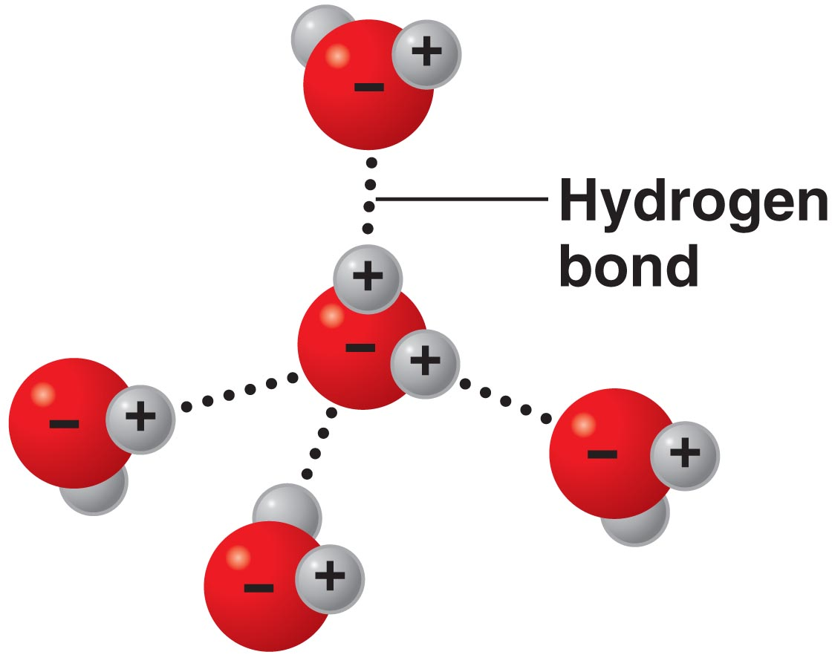
Water
Water: H₂O; abundant, necessary for life
Polar molecule – unequal distribution of charges
O slightly negative, Hs slightly positive
forms hydrogen bonds with nearby molecules
weak bonds between partially positive & negative parts of nearby molecules
Notes:
Please understand this concept well.

Slide 19
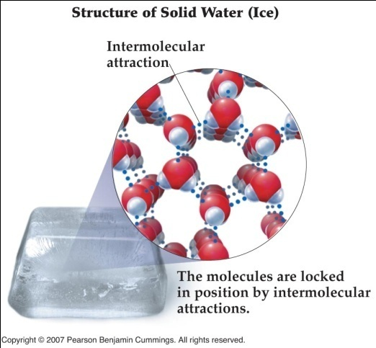
Unique Properties of water
Polarity causes important properties of water:
ice less dense than water
high boiling point
good temperature buffer
Notes:
Please know these properties of water

Slide 20
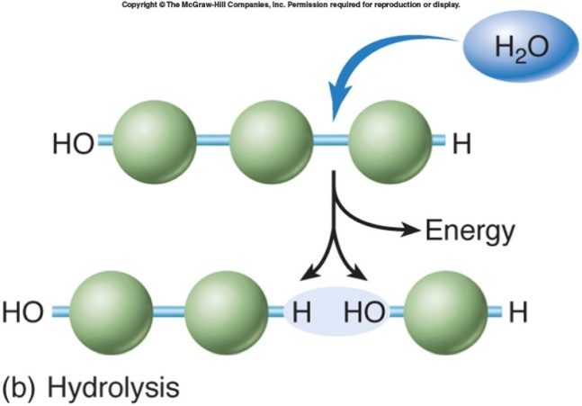
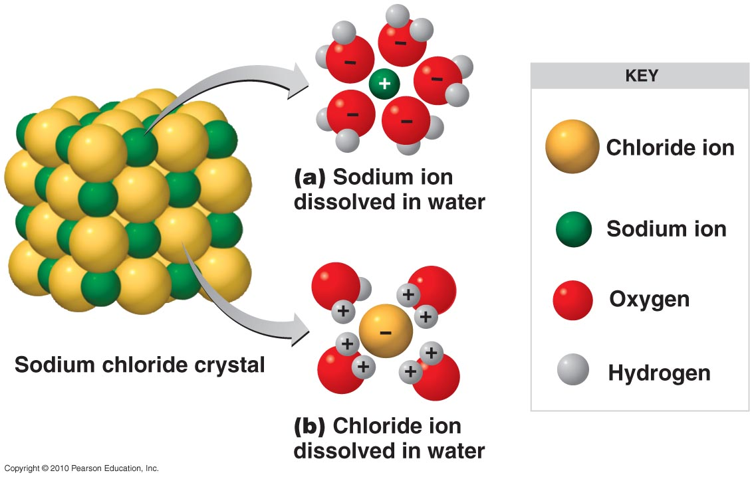
Water
Solvent – dissolves other substances
water: the universal solvent
polar substances dissociate (ionize) in water, forming solutes
water surrounds ions, forms hydrogen bonds
facilitates many chemical reactions
Notes:
The importance of water in biochemical (life sustaining) reactions. Please know the definitions of solvent, solute and solution.

Slide 21
Acids, Bases, and Salts
Acids – H⁺ donor; dissociate into one or more H⁺
HCl → H⁺ + Cl⁻
Bases – H⁺ acceptor; dissociate into one or more OH⁻
NaOH → Na⁺ + OH⁻
Salts – dissociate into cations (positive ions) & anions (negative ions), but not H⁺ or OH⁻
NaCl → Na⁺ + Cl⁻
Notes:
Please know these definitions

Slide 22
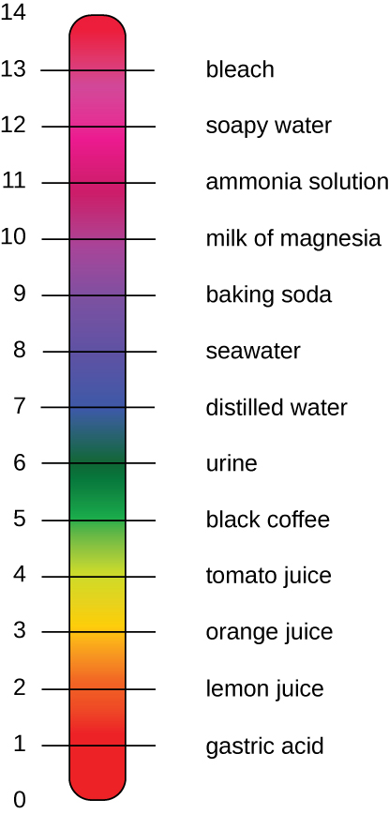
Acid-Base Balance
pH – concentration of H⁺ in solution: pH = −log[H⁺]
pH scale: logarithmic
from 0 (strong acid) to 14 (strong base); 7 is neutral
Buffers – prevent changes in pH
release & accept H⁺
Most organisms grow best at pH 6.5-8.5
enzymes require particular pHs to retain shape
biochemical reactions very sensitive to pH
Notes:
Please be familiar with the info on the left side of the slide. You do NOT need to know the pH of the liquids given, they are simply a reference for you.

Slide 23
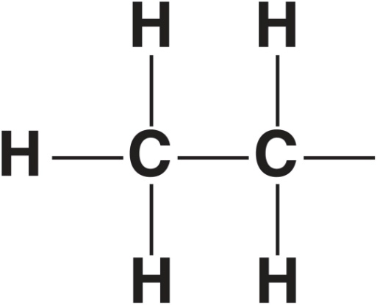
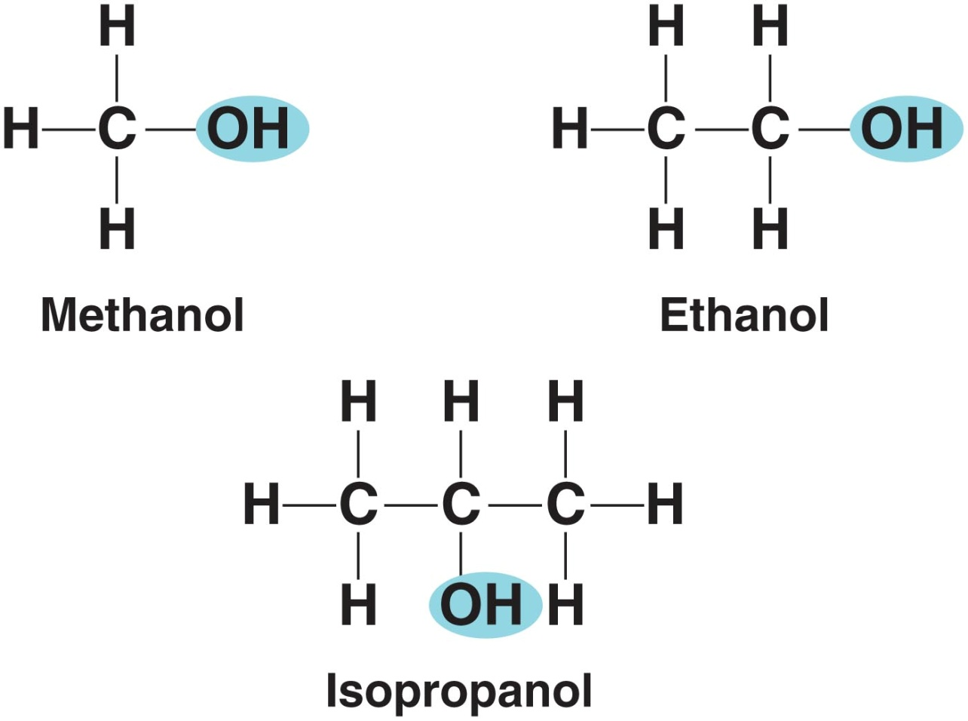
Structure and Chemistry
Carbon skeleton – chain of carbon atoms in an organic molecule
Functional groups – specific groups of atoms
responsible for most chemical properties of organic compounds
e.g. alcohols have hydroxyl (–OH) groups

Slide 24
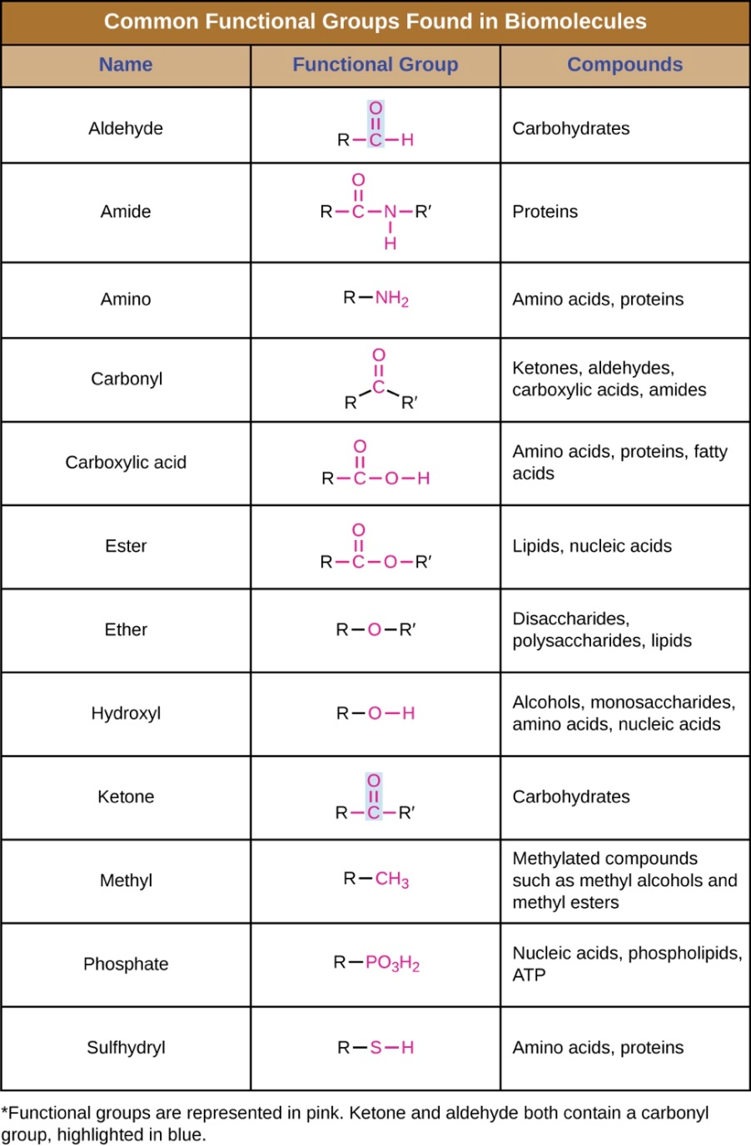
Functional Groups
Biological molecules often have >1 functional group
Notes:
You do not need to identify these. I simply want you to have heard of them so when we name molecules later in the term, you have an idea of where the name came from. Please understand that the varying functional groups are what define the chemical properties of each compound.

Slide 25
Macromolecules
Macromolecules – polymers consisting of many small repeating monomers, bonded covalently
Macromolecules & their monomers:
carbohydrates: monosaccharides
lipids: fatty acids & glycerol
proteins: amino acids
nucleic acids: nucleotides
Notes:
Please be ABLE to name the macromolecules and their respective monomers.

Slide 26
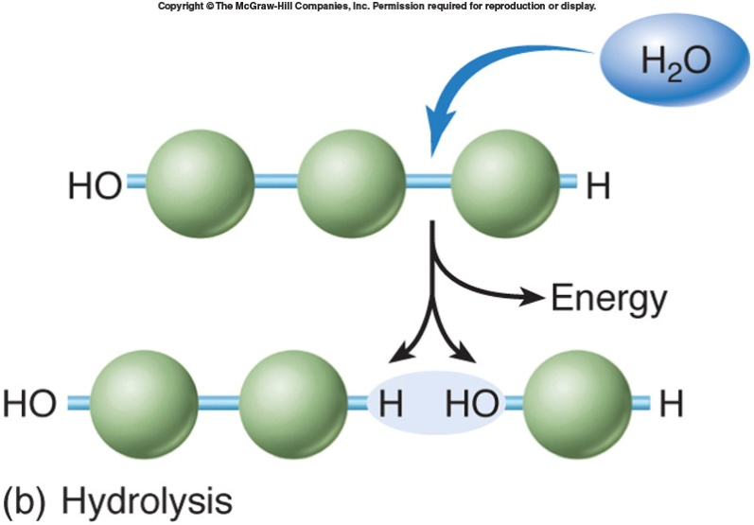
Polymers
Monomers joined into polymers by dehydration synthesis or condensation reactions
produces water
energy required to make bonds
“building”
Polymers broken apart into monomers by hydrolysis
requires water
energy released when bonds broken
“burning”
Notes:
Please know the difference between dehydration and hydrolysis reactions.

Slide 27
Simple Carbohydrates
Cell structures & energy sources
Made of C, H, & O; formula (CH₂O)_{n}
Monosaccharides – simple sugars; 3-7 C atoms
glucose, fructose, galactose
Disaccharides – 2 monosaccharides joined by dehydration synthesis (broken down by hydrolysis)
sucrose, lactose, maltose

Slide 28
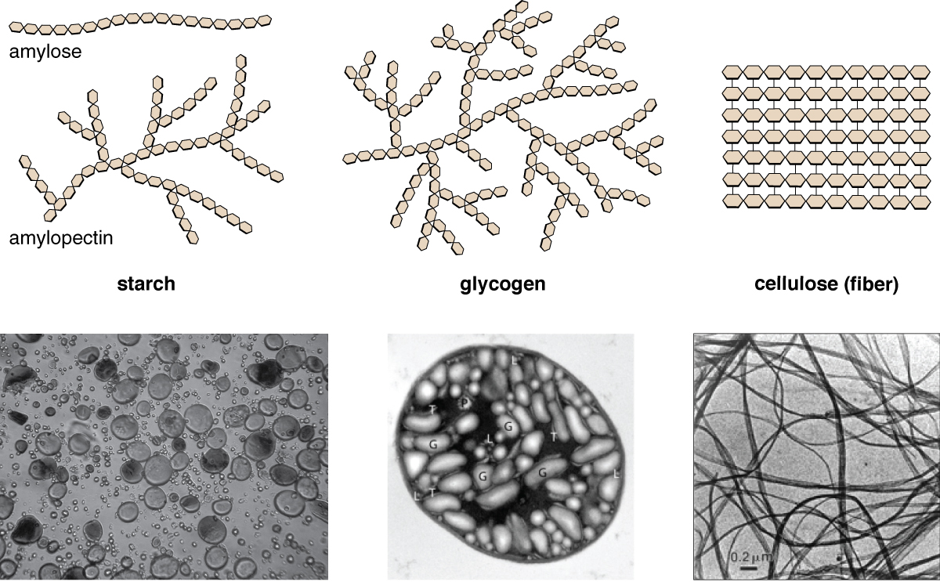
Complex Carbohydrates
Polysaccharides – 10s or 100s of monosaccharides joined through dehydration synthesis
not sweet or soluble in water
starch (storage in plants), glycogen (storage in animals), & cellulose (structural in plants)
all glucose polymers; different types of covalent bonds

Slide 29
Lipids
Energy storage & primary cell membrane component
Nonpolar & insoluble in water
Simple lipids: fats or triglycerides
made of C, H, & O
contain 1 glycerol & 1-3 fatty acids
formed by dehydration synthesis making ester linkages

Slide 30
Simple Lipids
Saturated fats – no double bonds
maximum number of Hs attached to C skeleton
pack closely; solid at room temperature
Unsaturated fats – one or more double bonds
bent at double bonds; liquid at room temperature
Notes:
Please know the bolded terms.

Slide 31
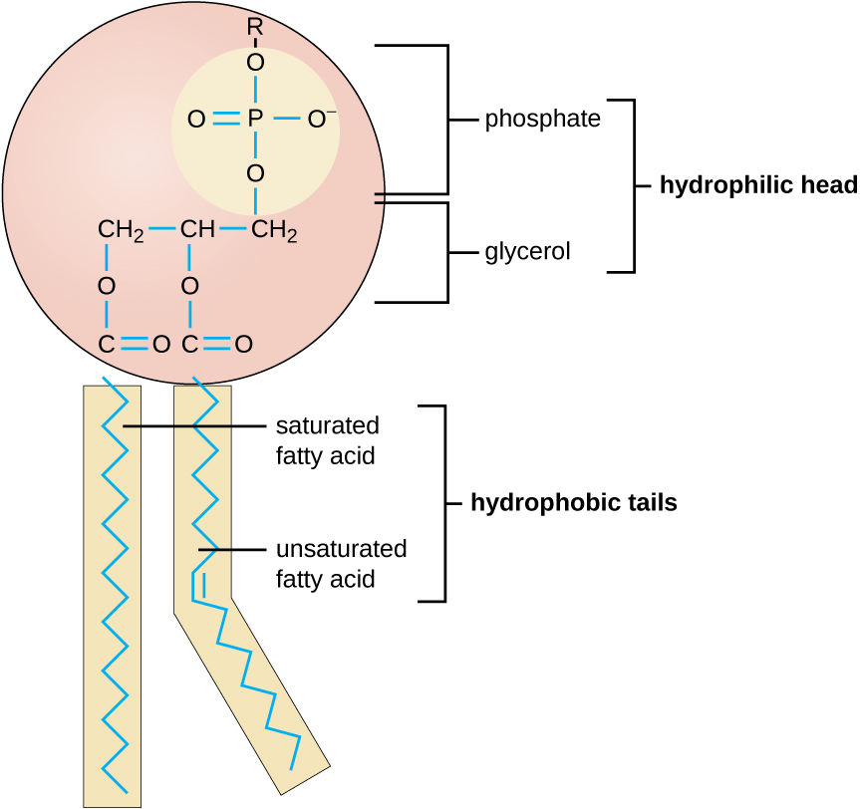
Complex Lipids
Complex lipids – have C, H, & O, plus P, N, or S
Membranes made of phospholipids
1 glycerol, 2 fatty acids, 1 phosphate group
polar (hydrophilic) head, nonpolar (hydrophobic) tail
spontaneously form bilayer in water: nonpolar tails in, polar heads out
Steroids – 4 carbon rings
also in membranes
Notes:
We will see these again when we discuss the plasma membrane of cells.

Slide 32
Lipid Bilayers
Phospholipids tend to arrange themselves in aqueous solution forming liposomes, micelles, or lipid bilayer sheets. (credit: modification of work by Mariana Ruiz Villarreal)
Notes:
This is an excellent diagram of the phospholipid bilayer.

Slide 33
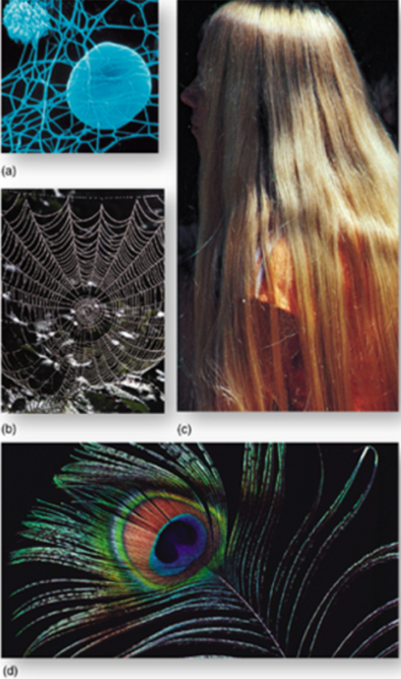
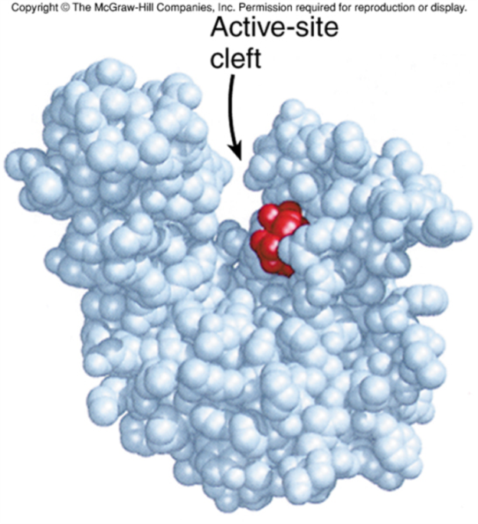
Proteins
Essential in cell structure & function
enzymes, transporter proteins, cell structure & movement components, some bacterial toxins, hormones, antibodies
Made of C, H, O, & N, & sometimes S
Notes:
It is important to note that enzymes are proteins that speed up biochemical reactions.

Slide 34
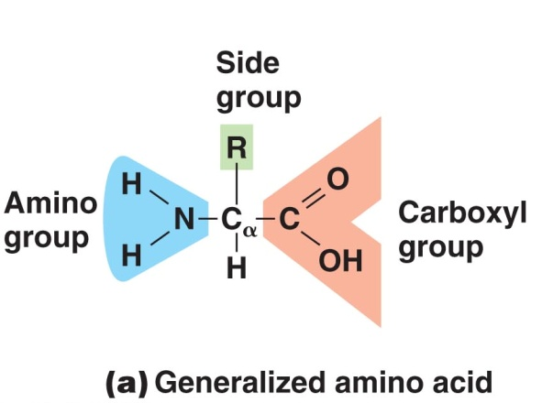
Proteins
Proteins made of amino acid subunits
20 different amino acids
same general structure, different side groups
side groups determine structure & function
Peptide bonds join amino acids by dehydration synthesis into polypeptides

Slide 35
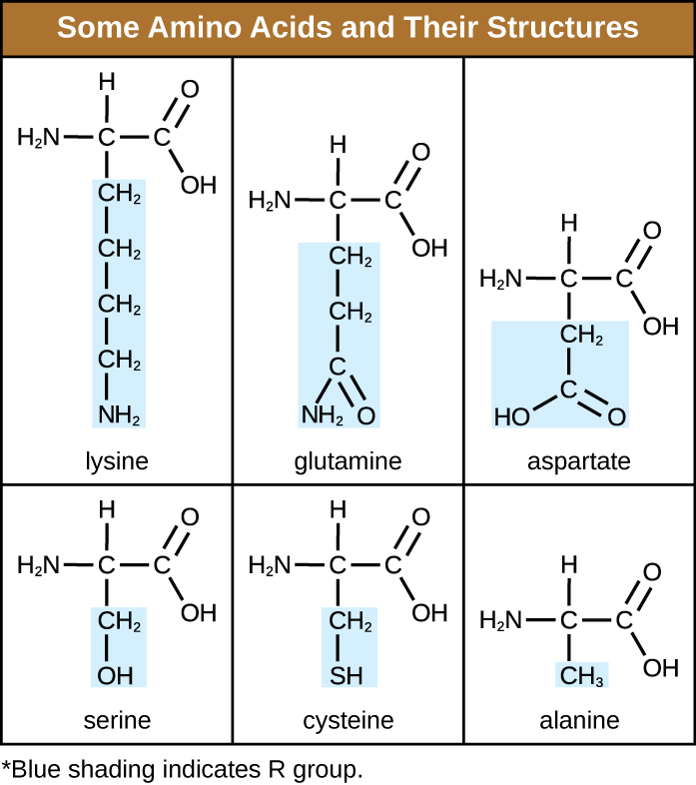
Proteins
20 amino acids
9 are essential: we can not synthesize them they come from our diets
They differ by the “R” group
Nonpolar, polar, acidic, basic
Notes:
You do NOT need to be able to identify these. Please know there are 20. We will go over what we need to know in lab and chapter 4.

Slide 36
Protein Structure
Levels of protein structure:
primary structure – amino acid sequence
secondary structure –hydrogen bonding causes helices or pleats
tertiary structure – 3-D structure; hydrophobic interactions, ionic & hydrogen bonds, & disulfide bridges between amino acid side groups
quaternary structure – ≥2 folded polypeptides
Notes:
Please know these levels well.

Slide 37
Protein Structure
Notes:
Please know these levels well.

Slide 38
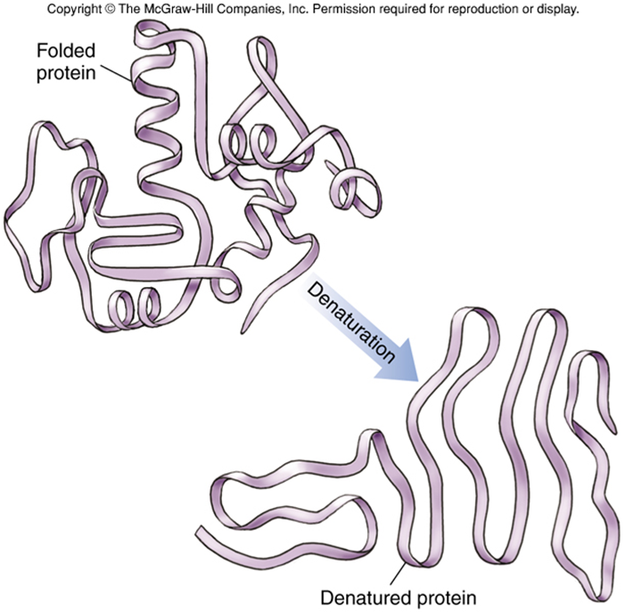
Levels of Protein Structure
Protein function depends on structure
proteins bind to other molecules
specific shape determines specific interaction
denatured proteins have lost their shape; no longer function
due to temperature, pH, or salt conditions
Notes:
This is a very important concept to understand.

Slide 39
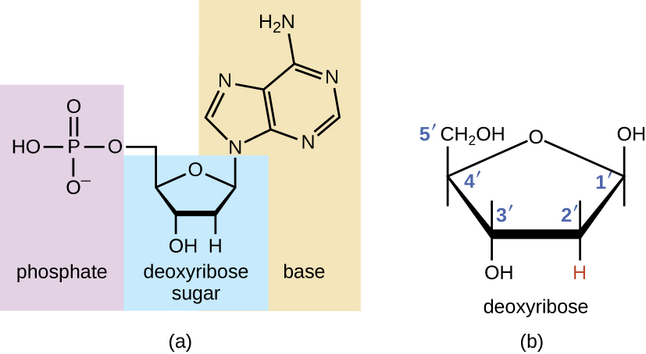
Nucleic Acids
Nucleic acids – RNA & DNA
store genetic information
made of nucleotides, with 3 parts:
phosphate group
pentose (5 C) sugar
deoxyribose in DNA, ribose in RNA
nitrogen-containing base
purine – double ring: adenine (A) & guanine (G)
pyrimidine – single ring: thymine (T), cytosine (C), & uracil (U, in RNA)

Slide 40
DNA
DNA – deoxyribonucleic acid
double helix (like a twisted ladder)
sugar-phosphate backbones
hydrogen bonds between particular bases, connecting strands:
adenine with thymine
cytosine with guanine
strands are complementary
order of base pairs contains
genetic information
nucleotides form genes
genes determine
hereditary traits
Notes:
Please know complementary base pairing (i.e. A with T and C with G)

Slide 41
DNA
Watson and Crick proposed the double helix model for DNA.
The sugar-phosphate backbones are on the outside of the double helix and purines and pyrimidines form the “rungs” of the DNA helix ladder.
The two DNA strands are antiparallel to each other.
The direction of each strand is identified by numbering the carbons (1 through 5) in each sugar molecule. The 5ʹ end is the one where carbon #5 is not bound to another nucleotide; the 3ʹ end is the one where carbon #3 is not bound to another nucleotide.

Slide 42
Complementary Base Pairing
Hydrogen bonds form between complementary nitrogenous bases on the interior of DNA.
Notes:
Please understand why base pairing occurs. Due to the number of Hydrogen bonds each nucleotide can form.

Slide 43
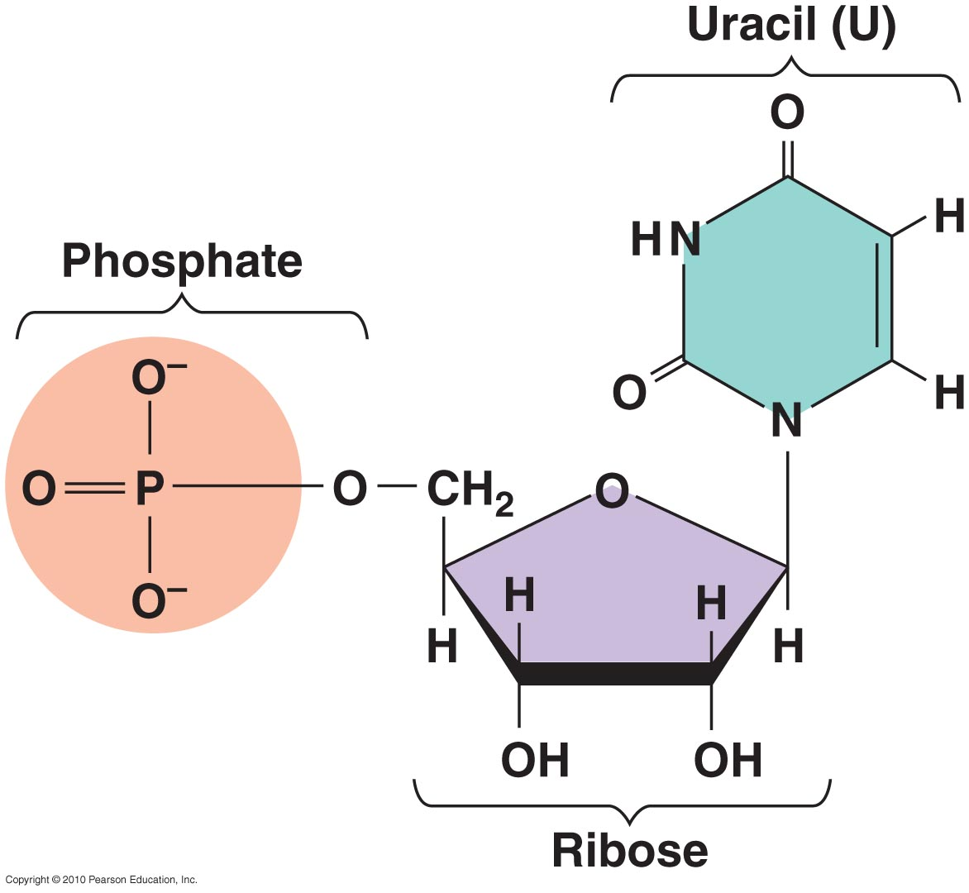
RNA
RNA – ribonucleic acid
single-stranded
sugar-phosphate backbone with ribose (instead of deoxyribose)
base pairing (when it occurs) very similar to DNA:
adenine with uracil (instead of thymine)
cytosine with guanine
3 types of RNA:
messenger RNA
ribosomal RNA
transfer RNA

Slide 44
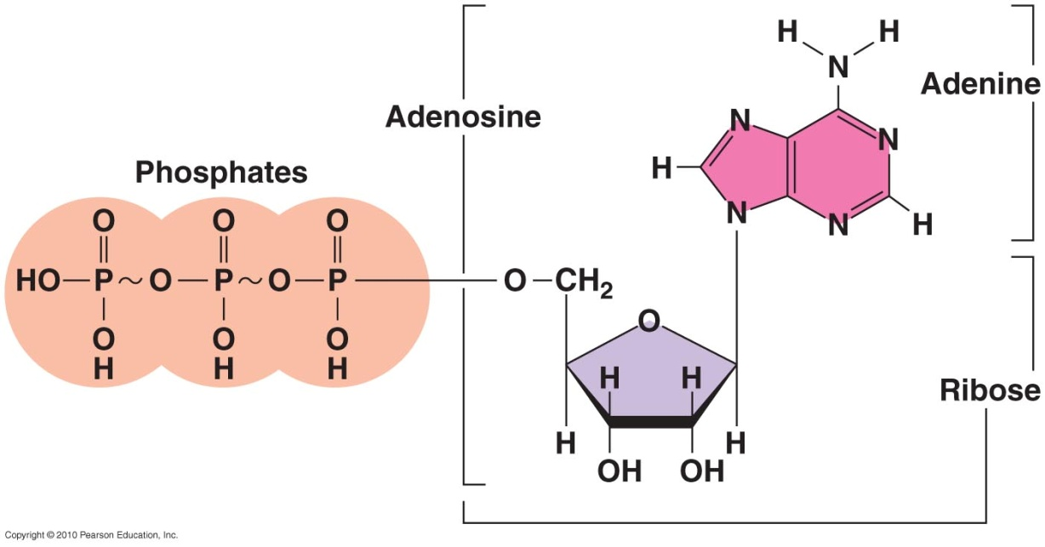
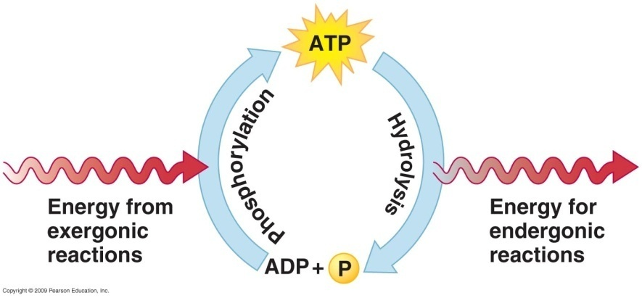
ATP
ATP – adenosine triphosphate
adenine & ribose (adenosine), & 3 phosphate groups
Energy-carrying molecule in cells
made by dehydration synthesis (energy from glucose breakdown)
broken by hydrolysis to release energy
ATP + H₂O → ADP + P_{i} + energy
ADP + H₂O → AMP + P_{i} + energy
Notes:
This provides energy for many of the cells of organisms.

Slide 45
Monomers and Polymers
Polymers – large units made of similar monomer units
4 major types of biological macromolecules (polymers):
Macromolecule Polymer Type | Monomers | Examples
Carbohydrate | monosaccharides | glucose, table sugar, starch
Lipid | glycerol & fatty acids | fats, oils, steroids, phospholipids
Protein | amino acids | enzymes, muscle fibers, etc.
Nucleic Acid | nucleotides | DNA, RNA, ATP
Notes:
This is a nice review chart

