Slide 1
How to look up peer-reviewed journal articles
Wellness for Life
CCV
Prof. D

Slide 2
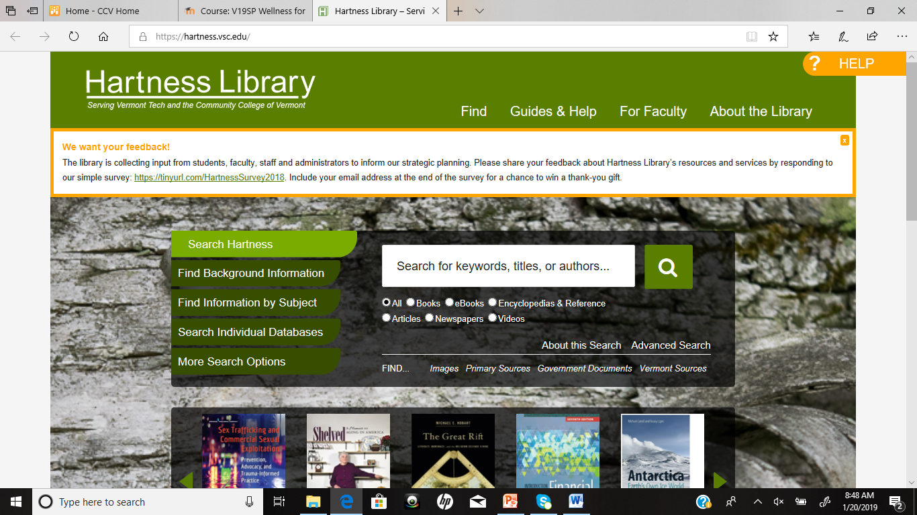
The Hartness Library
https://hartness.vsc.edu/
Notes:
As students at CCV, you have access to many peer-reviewed journal articles through the Hartness Library search engine.

Slide 3
Select Peer-Reviewed Articles and type in search words

Slide 4
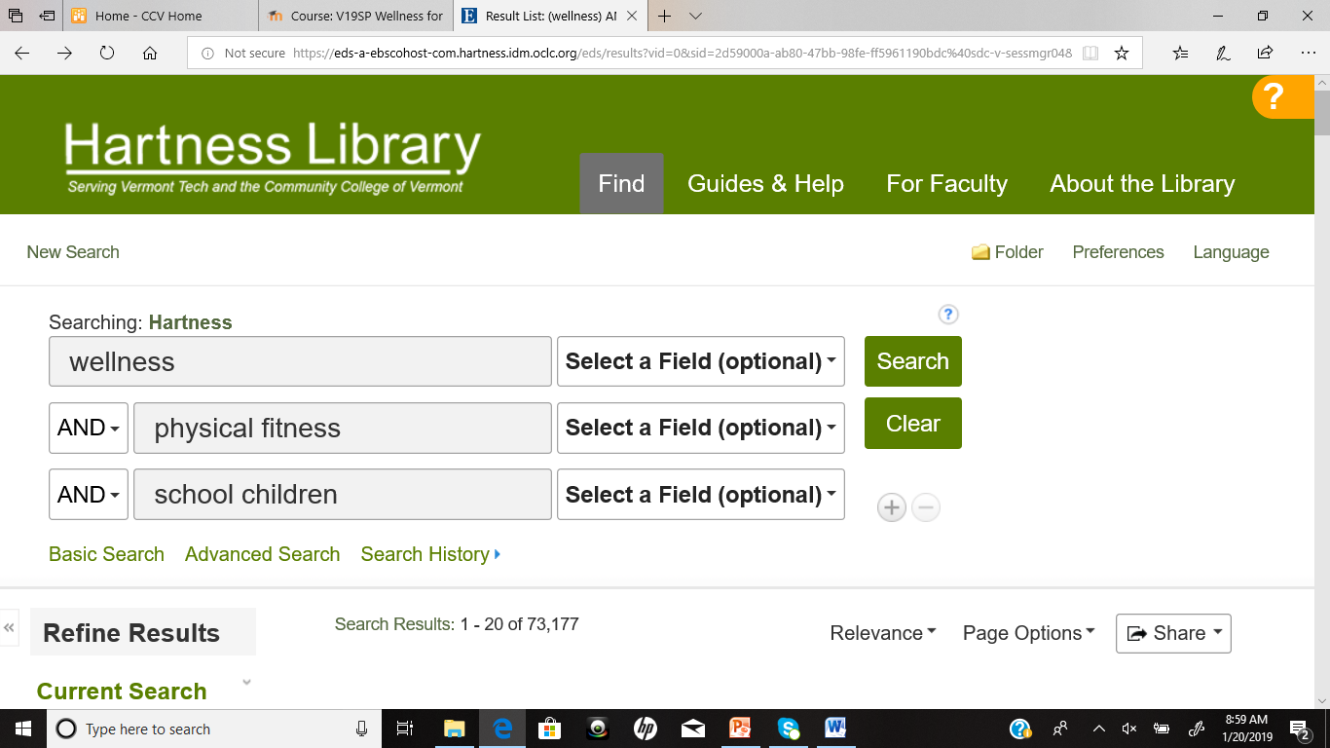
Narrow Your Search with More Specific Search Words

Slide 5
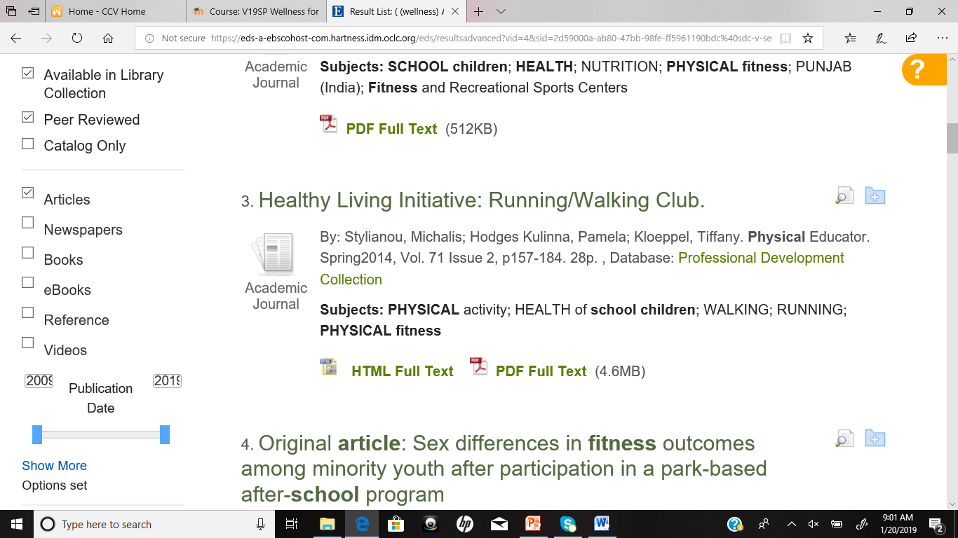
Be certain that you have selected “Available in Library collection”, “Peer Reviewed” and limit the dates within the past decade for accuracy

Slide 6
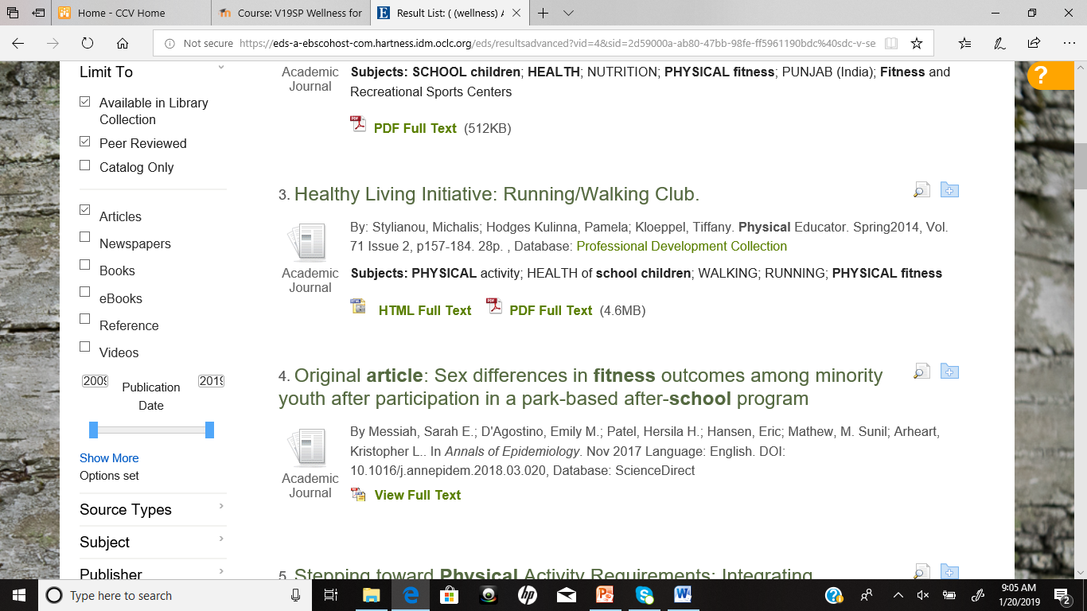
Browse results, choose article, and open full text article (pdf when possible)

Slide 7
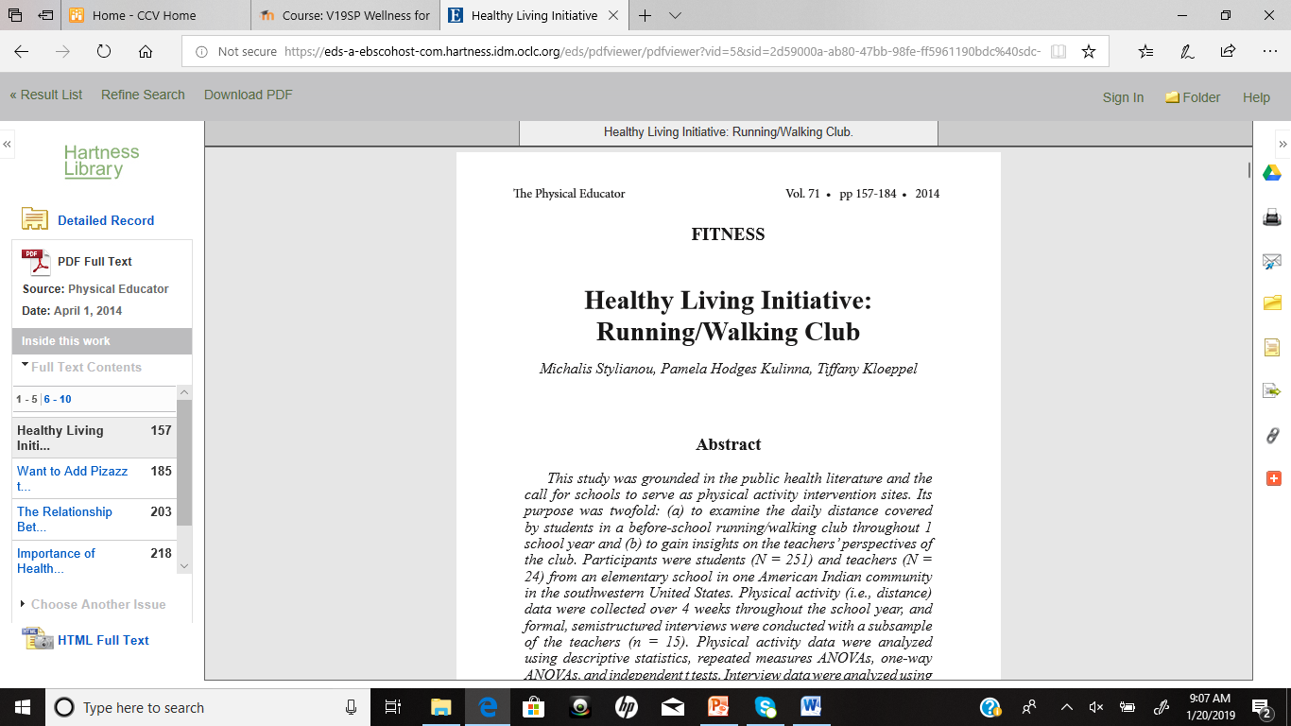
Read your article and save/print as needed

Slide 8
Reminders
Choose a wellness topic you are interested in
Use specific search terms to narrow down your results
Save full text pdf article whenever possible for easy retrieval
NEVER PAY FOR AN ARTICLE, only read ones available through Hartness Library

