Slide 1
Chapter 4
Prokaryotes
Notes:
Please be familiar with the content within these slides even if the material is beyond the content of Chapter 4 in the text. Unless additional information is provided within these slides or in complementary videos, you do not need to know signs and symptoms of the infectious diseases. In most cases, being able to identify a microorganism as the cause of a named illness is sufficient.
1

Slide 2
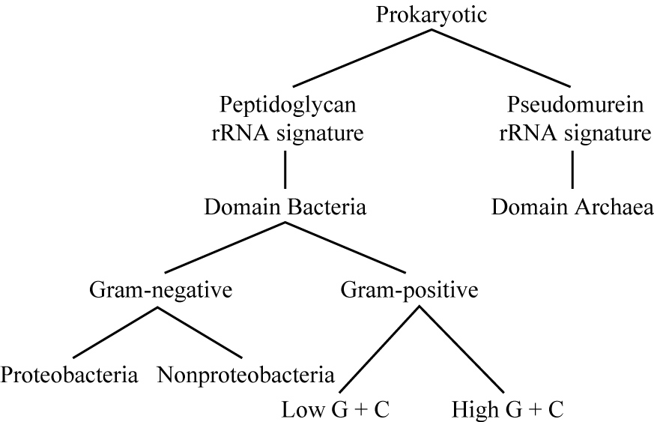
Domain Bacteria
Proteobacteria
largest group of bacteria
gram-negative
Chemoheterotrophic
5 classes:
alphaproteobacteria
betaproteobacteria
gammaproteobacteria
deltaproteobacteria
epsilonproteobacteria
Notes:
Please know the information in the left column. Understand that 5 classes of proteobacteria exist and that all are Gram-negative; however, you will not need to identify which organisms fall into each class.

Slide 3
The Alphaproteobacteria
Alphaproteobacteria
growth at low nutrient levels
unusual morphology
prosthecae – stalks or buds
nitrogen fixers
pathogens
Pelagibacter ubique
most abundant organism by weight in oceans
20% of prokaryotes in oceans
0.5% of all prokaryotes
discovered by FISH technique, 2002
small genome: 1354 genes
Notes:
Please be able to associate the bolded terms.

Slide 4
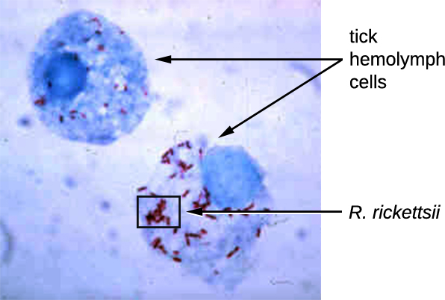
The Alphaproteobacteria
Obligate intracellular parasites
Bartonella
B. henselae: cat-scratch disease
Brucella
obligate parasites of mammals
Rickettsia
gram negative rods or coccobacilli
grow only in host cells
transmitted to humans by insect & tick bites
responsible for spotted fevers
R. prowazekii: epidemic typhus, lice
R. typhi: endemic murine typhus, rat fleas
R. rickettsii: Rocky Mountain spotted fever, ticks
Notes:
Please know these microorganisms and the diseases for which they are responsible.
Cat-Scratch disease is surprisingly common among cat owners and usually begins with swelling 3-10 days after scratch. It is usually self-limiting (runs its course) in a few weeks; however, severe cases may require antibiotic treatment.

Slide 5
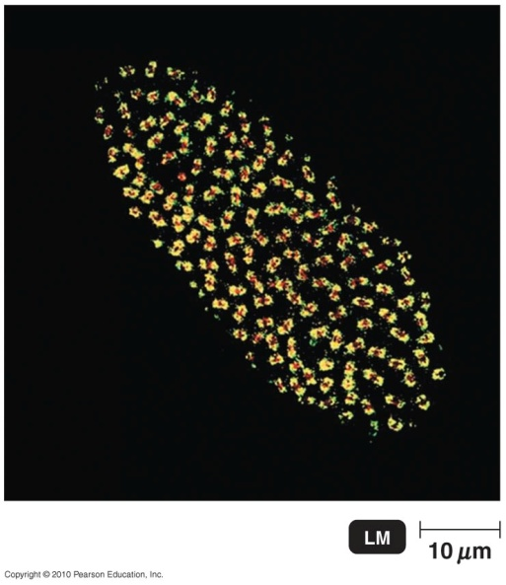
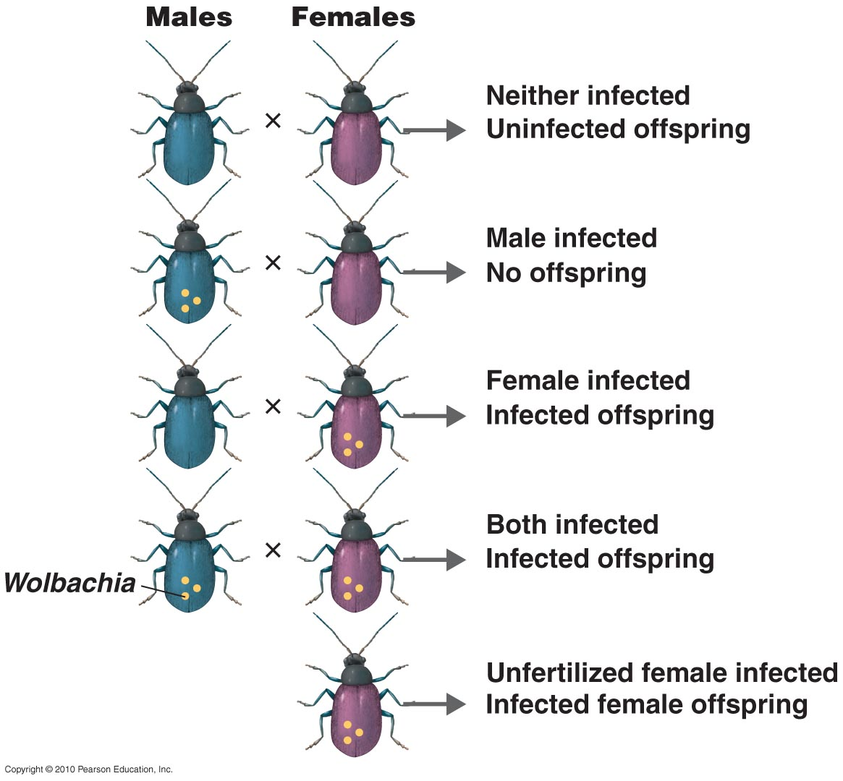
The Alphaproteobacteria
Live in insects & other invertebrates
Wolbachia
common
destroys males and/or turns males into females
parthenogenesis – females reproduce without males, producing females
Wolbachia transmitted to next
generation in egg cytoplasm
Notes:
Know that this organism can undergo parthenogenesis and what that is.

Slide 6
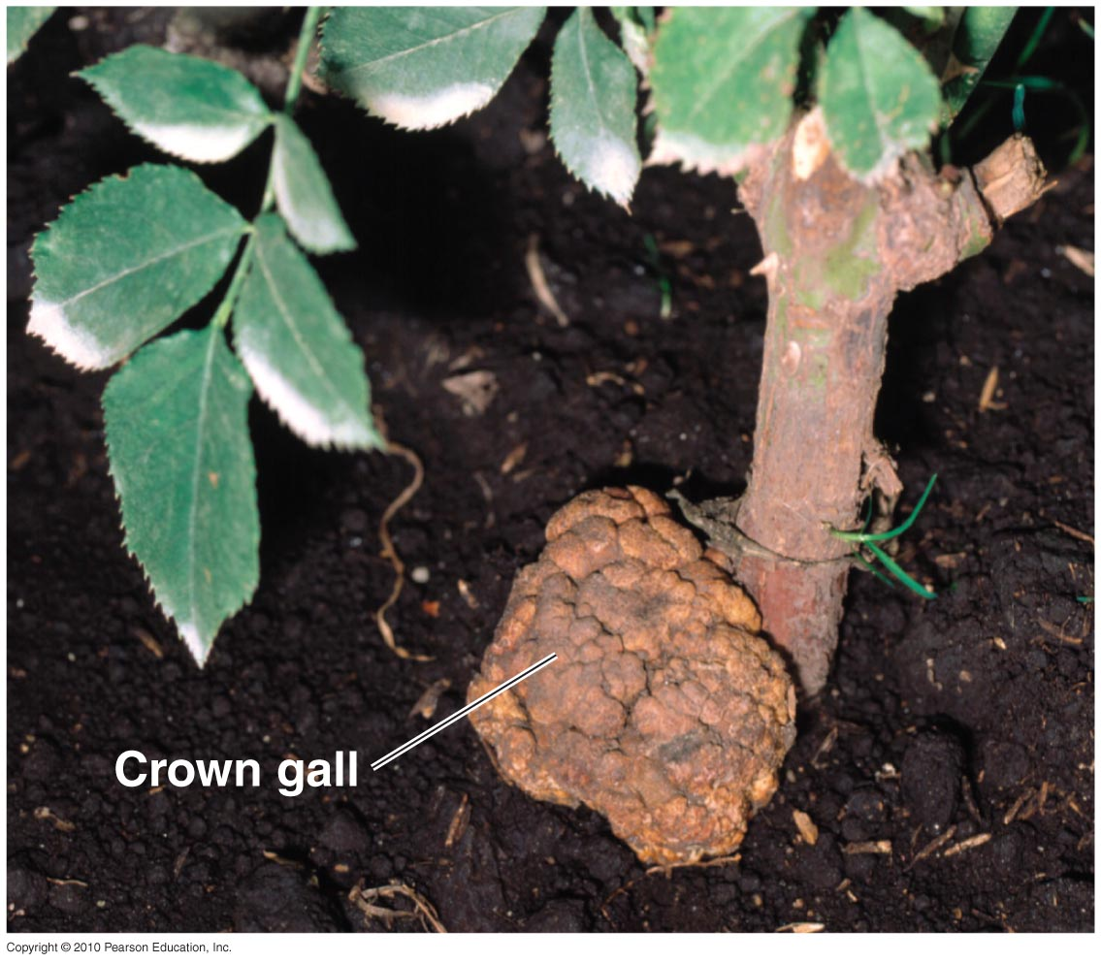
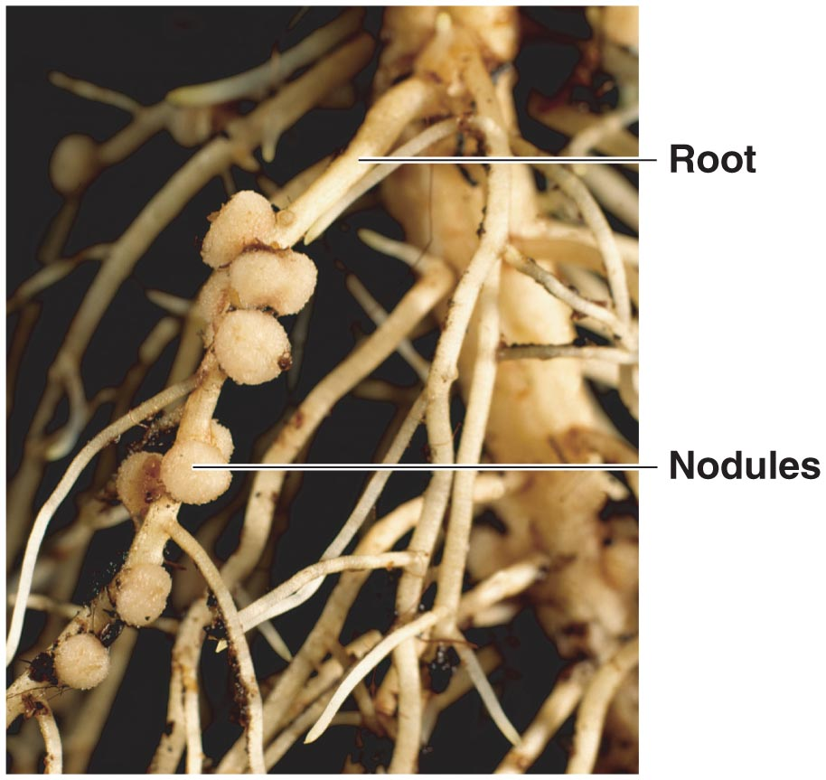
The Alphaproteobacteria
Plant pathogen
Agrobacterium tumefaciens
causes crown gall
inserts plasmid into plant cells, induces tumor
Nitrogen-fixing bacteria
make atmospheric nitrogen (N₂) usable
convert to other forms
Azospirillum
Grow in soil, using nutrients excreted by plants
Fix nitrogen
rhizobia
symbiotic relationship: plant & bacteria
bacteria live in legume root nodules
Fix nitrogen in the roots
Notes:
Please know the information on this slide well.

Slide 7
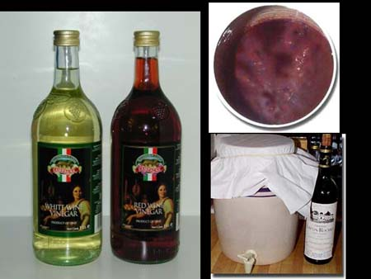
The Alphaproteobacteria
Chemoautotrophic
fix CO₂
oxidize nitrogen for energy
Nitrobacter: ammonium → nitrite (NH₄⁺ → NO₂–)
Nitrosomonas: nitrite → nitrate (NO₂– → NO₃–)
nitrate in soil used by plants
Produce acetic acid (vinegar) from ethanol
Acetobacter
Notes:
Please know the info in the second blue bullet.

Slide 8
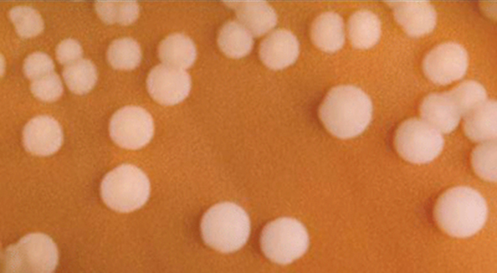
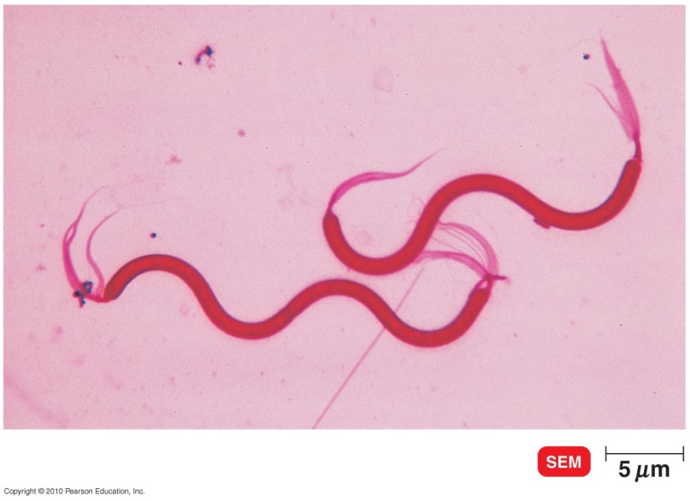
The Betaproteobacteria
Neisseria
chemoheterotrophic cocci
aerobic; inhabit mammal mucous membranes
N. meningitidis: meningococcal meningitis
N. gonorrhoeae: gonorrhoea
fimbriae – adhere to each other & surfaces; involved in aggregations & biofilms
capsule – organized & firmly attached glycocalyx; prevents phagocytosis by host
Spirillum
chemoheterotrophic; helical
polar flagella, large, aerobic
fresh water
Notes:
Be very comfortable with the information on this slide.
Meningococcal meningitis – Often occurs in children under 2 years, significant residuals may arise such as deafness. Antibiotic treatment significantly decreases mortality rate. Causes swelling of meninges (layers protecting brain and spinal cord)
Gonorrhea – Very common STI. Mostly men become aware of infection due to painful urination and pus discharging from urethra.

Slide 9
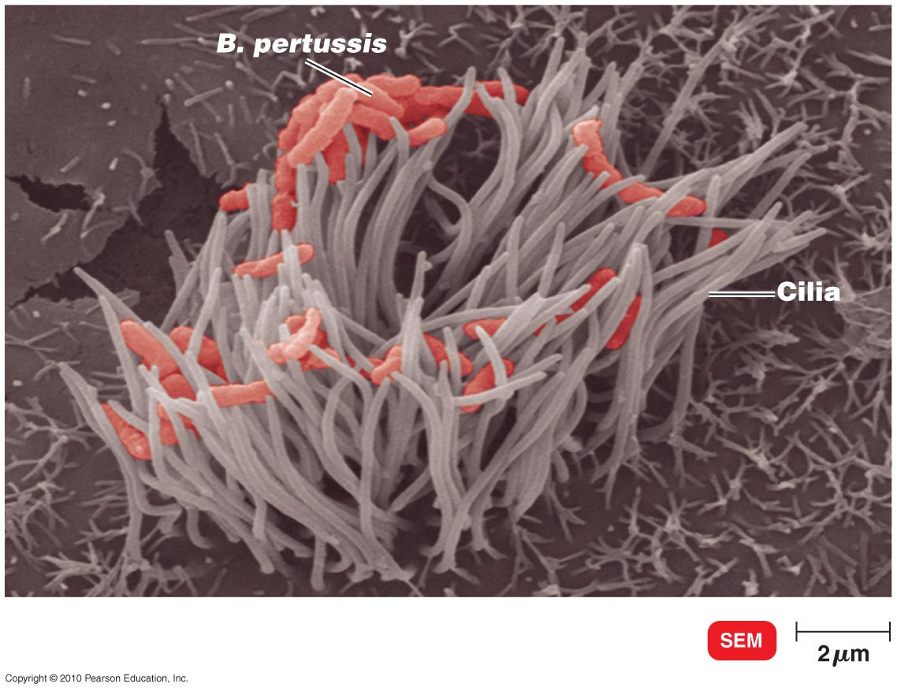
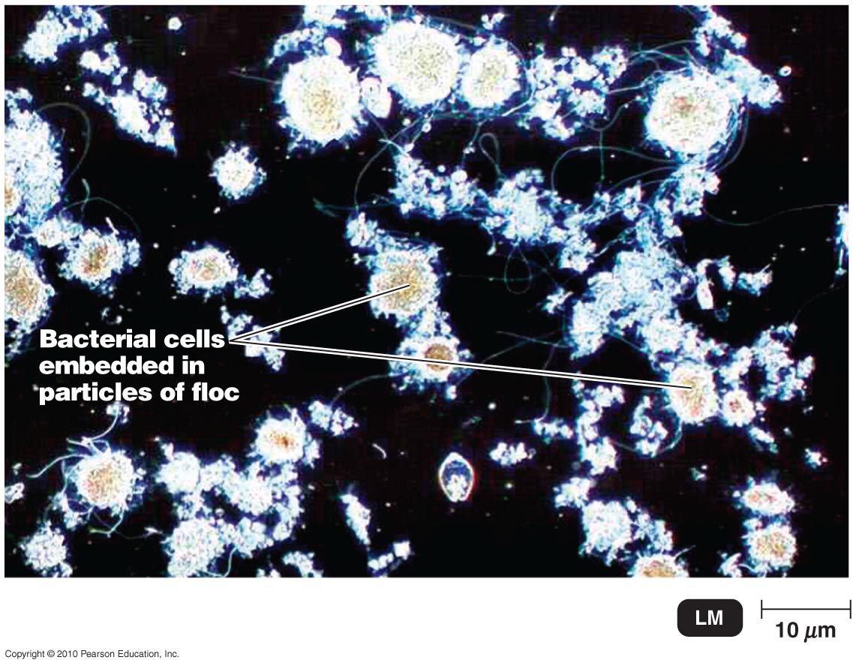
The Betaproteobacteria
Bordetella
chemoheterotrophic; rods
nonmotile, aerobic
B. pertussis: whooping cough
Burkholderia
chemoheterotrophic; rods
motile: single polar flagellum or tuft
can degrade >100 organic molecules: even grows in disinfectant
contaminates hospital equipment & drugs, causes infections
Zoogloea
chemoheterotrophic; rods
aerobic; used in sewage treatment
form fluffy, slimy masses
Notes:
Please know which organism causes which disease.
Whooping cough – Strong, persisting cough especially in children.

Slide 10
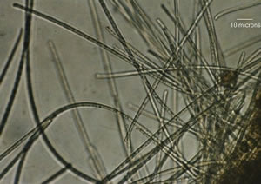
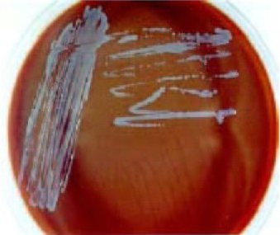
The Gammaproteobacteria
Beggiatoa
chemoautotrophic
aquatic sediments
motility by gliding via slime production
B. alba: oxidizes H₂S for energy
accumulates sulfur granules
Francisella
chemoheterotrophic
grow only on complex media enriched with blood or tissues
F. tularensis: tularemia
Notes:
Know the info regarding Francisella
Tularemia – Fever, malaise, painful swollen lymph nodes, skin sloughing off where bite occurred. Often from pet rodents such as hamsters.

Slide 11
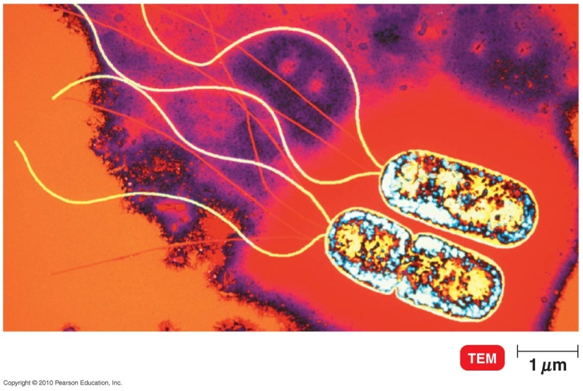
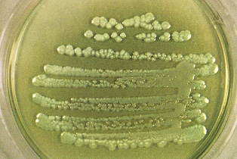
The Gammaproteobacteria
Pseudomonadales
chemoheterotrophic rods
motile with polar flagella
Pseudomonas
aerobic, but may substitute nitrogen for oxygen as e– acceptor
common in soil; deplete soil nitrogen
some excrete pigments (Pseudomonas aeruginosa)
metabolically diverse – good decomposers
spoil food – grow at refrigerator temperatures
opportunistic pathogens – hospital infections,
particularly burn & cystic fibrosis patients
can grow on small traces of carbon
sources & in some antiseptics
antibiotic resistant
Notes:
Be very comfortable with this info.

Slide 12
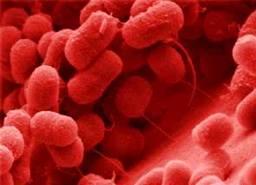
The Gammaproteobacteria
Pseudomonadales
Azotobacter and Azomonas
nitrogen fixing
Moraxella
aerobic coccobacilli
M. lacunata: conjunctivitis
Acinetobacter
aerobic
in soil & water
rapid antibiotic resistance
A. baumanii: hospital infections
Notes:
Know the species of Moraxella and Acinetobacter and the diseases they cause.
Conjunctivitis a.k.a. Pink eye – swelling of the conjunctiva of the eye.

Slide 13
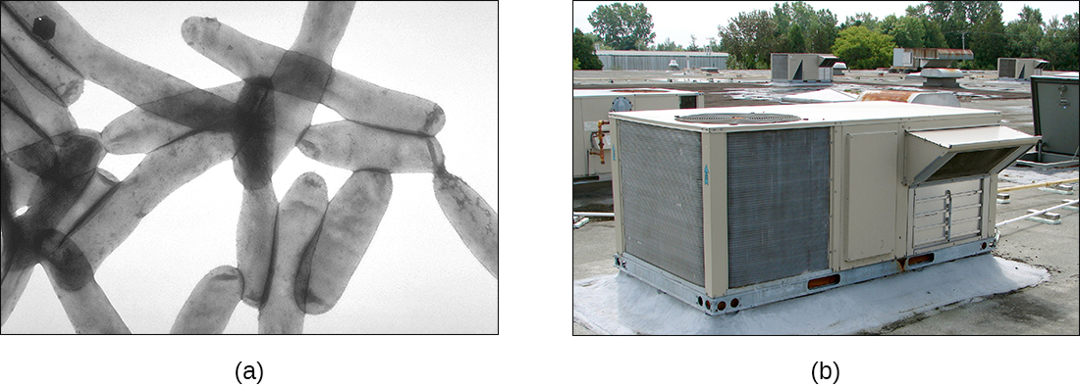
The Gammaproteobacteria
Legionellales
chemoheterotrophic
Legionella
common in streams & warm-water pipes
Legionnaires' disease
Coxiella
C. burnetii: Q fever
transmitted via aerosols or milk
endospores
Notes:
Know these concepts well.
Legionnaires’ disease – causes a type of pneumonia. Often spreads through water supply lines in hospitals and in air conditioning systems of hotels, etc.
Q fever – flu-like pneumonia

Slide 14
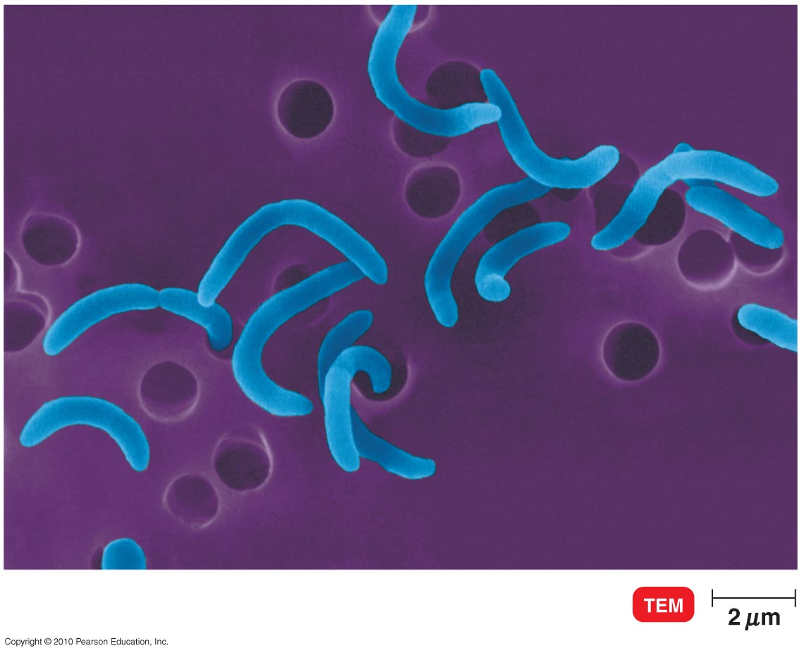
The Gammaproteobacteria
Vibrionales
chemoheterotrophic curved rods
facultative anaerobes
in coastal waters
Vibrio cholerae: cholera
V. parahaemolyticus: gastroenteritis
transmitted in raw or undercooked shellfish
Notes:
Cholera – serious GI disease. Causes host cells to secrete water and electrolytes, especially potassium. Results in very watery stools.

Slide 15
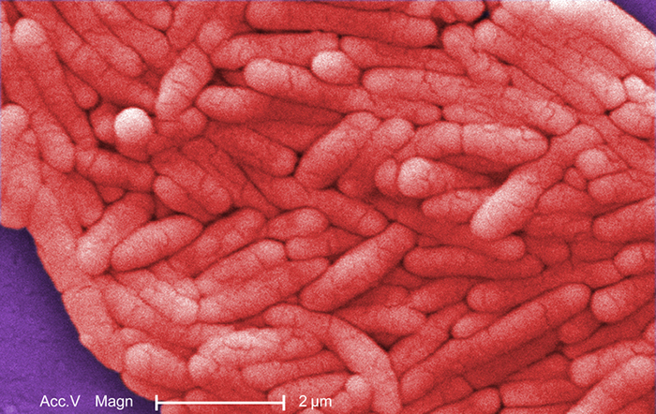
The Gammaproteobacteria
Enterobacteriales
Escherichia
E. coli: human intestinal tract; not usually pathogenic
Salmonella
poultry & cattle intestinal tracts
potentially pathogenic
S. enterica: 1 infectious species; >2400 serovars (serological varieties) differentiated into biotypes
S. bongori: in cold-blooded animals
S. typhi: typhoid fever
Shigella
dysentery in humans
Notes:
Know this info well.

Slide 16
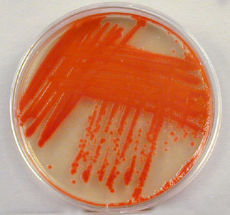
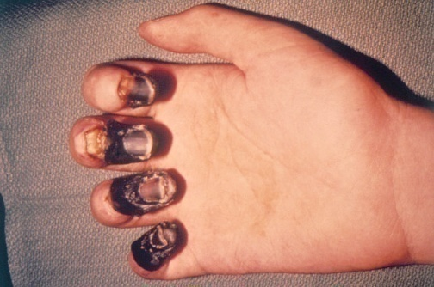
The Gammaproteobacteria
Enterobacteriales
Klebsiella
nitrogen fixation; pneumonia
Serratia
S. marcescens: contaminates catheters; produces red pigment
Proteus
swarmer cells – many flagella; migrate, then revert to normal cells
Yersinia
Y. pestis: plague; carried by rats & ground squirrels, transmitted by fleas
Enterobacter
E. aerogenes: urinary
tract infections
Notes:
Know these diseases and the causative agents. You need not know signs and symptoms of these diseases.

Slide 17
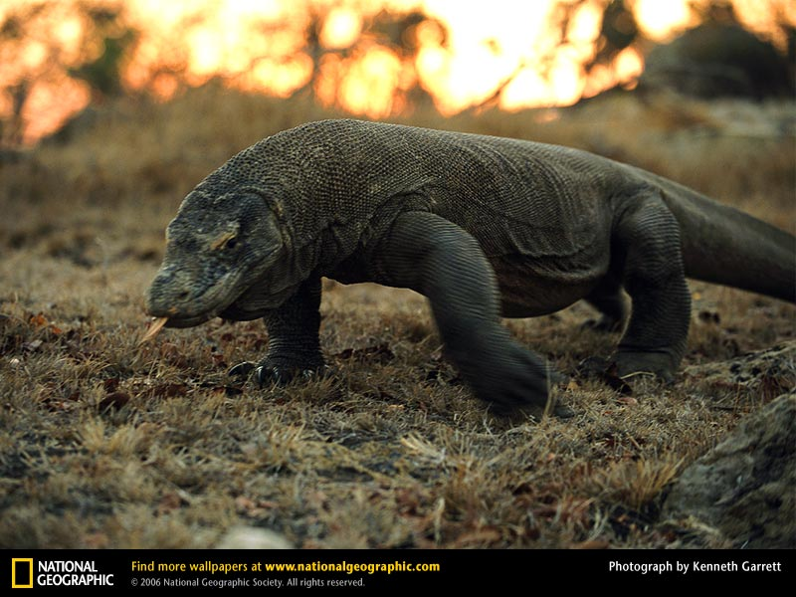
The Gammaproteobacteria
Pasteurellales
chemoheterotrophic nonmotile rods
human & animal pathogens
Pasteurella
pneumonia and sepsis in domestic animals
P. multocida: pets, Komodo dragons (virulent strain); transmitted to humans in bites
Haemophilus
mucous membranes
require blood & NAD⁺ or
NADP⁺ in culture medium
(X & V factors)
Notes:
Know that P. multocida is transmitted from dog, cat and Komodo dragon bites. Can cause sepsis.

Slide 18
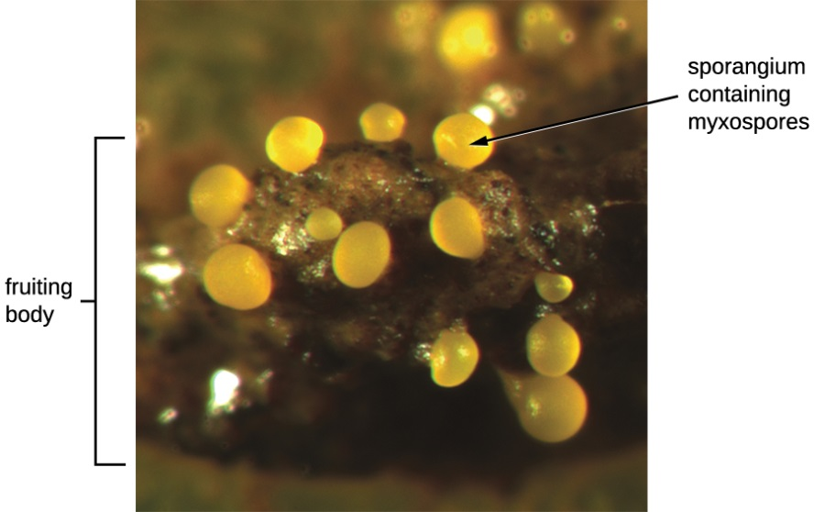
The Deltaproteobacteria
Myxococcales
aerobic, gliding
Myxococcus
complex life cycle:
vegetative cells move by gliding, eat other bacteria
when nutrients low, aggregate & differentiate; form fruiting body containing myxospores (resting cells)

Slide 19
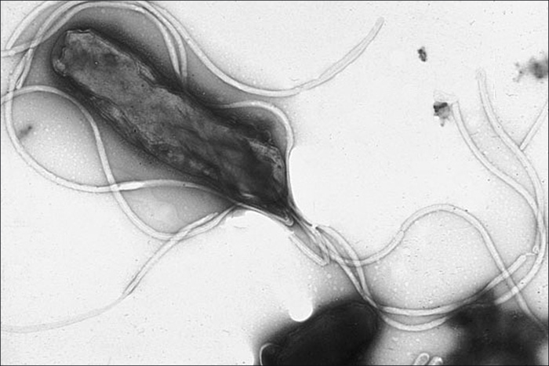
The Epsilonproteobacteria
Campylobacter
helical or curved rods, microaerophilic
one polar flagellum
foodborne intestinal disease
Helicobacter
curved rods, microaerophilic
multiple flagella
H. pylori: peptic ulcers, stomach cancer
Notes:
Know these concepts very well.

Slide 20
Oxygenic Photosynthetic Bacteria
Oxygenic photosynthesis – produces oxygen from water
2H₂O + CO₂ + light → (CH₂O) + H₂O + O₂
Cyanobacteria
formerly called blue-green algae; but not protists
unicellular, colonial, or filamentous
gas vacuoles to float, gliding motility on solid surfaces
first oxygen producers on earth
Notes:
Understand the name change occurred and why.

Slide 21
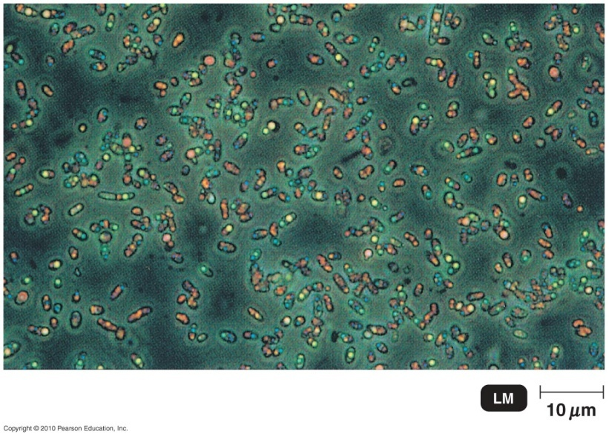
Anoxygenic Photosynthetic Bacteria
Anoxygenic photosynthesis – doesn’t produce oxygen
2H₂S + CO₂ + light → (CH₂O) + H₂O + 2S⁰
Anoxygenic photosynthetic bacteria
generally anaerobic, in lake sediments
morphologically diverse
use H₂S to reduce CO₂
alphaproteobacteria – purple sulfur
chlorobi – green sulfur
use other organic compounds to reduce CO₂
gammaproteobacteria – purple nonsulfur
chloroflexi – green nonsulfur

Slide 22
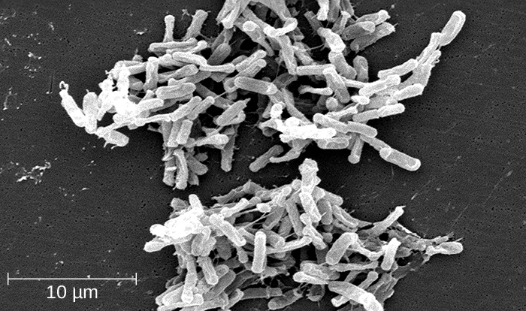
Clostridiales
Clostridium
rods
obligate anaerobes
produce endospores
resistant to heat & chemicals
C. tetani: tetanus
C. botulinum: botulism
Epulopiscium
extremely large: 80 μm X 600 μm
Giant prokaryote
bacteria usually 1 μm X 2 μm
Notes:
Tetanus – Neurotoxin released and causes severe muscle rigidity without relaxation. Jaw affected early and known as “lockjaw”.
Botulism – Food poisoning from endospores. Can cause neurological deficits.

Slide 23
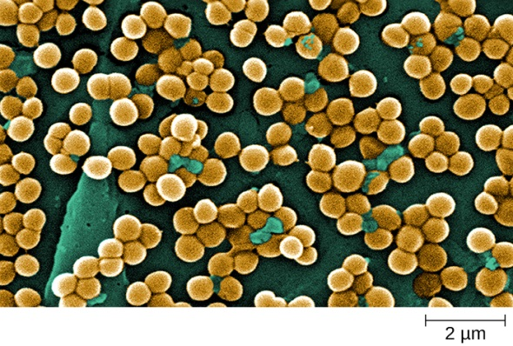
Bacillales
Bacillus
rods, produce endospores
common in soil
some produce antibiotics
B. anthracis: anthrax
Staphylococcus
cocci in clusters, facultative anaerobes
many pathogenic
grow well with low moisture & high osmotic pressure
S. aureus: toxic shock syndrome, surgical wound infections
produces toxins
quickly develops antibiotic resistance
Notes:
Anthrax – Pustule, bloody diarrhea or septic shock. A disease of cattle, sheep and horses that can be transmitted to humans.

Slide 24
Lactobacillales
Streptococcus
spherical, generally in chains
majority pathogenic
extracellular substances destroy phagocytes, digest connective tissue, & lyse fibrin of blood clots
beta-hemolytic – form clear zone on blood agar
S. pyrogenes (beta-hemolytic group A Streptococcus): scarlet fever, rheumatic fever
non-beta-hemolytic – colonies surrounded by greening on blood agar when O₂ present
S. pneumoniae: pneumococcal pneumonia
Notes:
Know this info well.

Slide 25
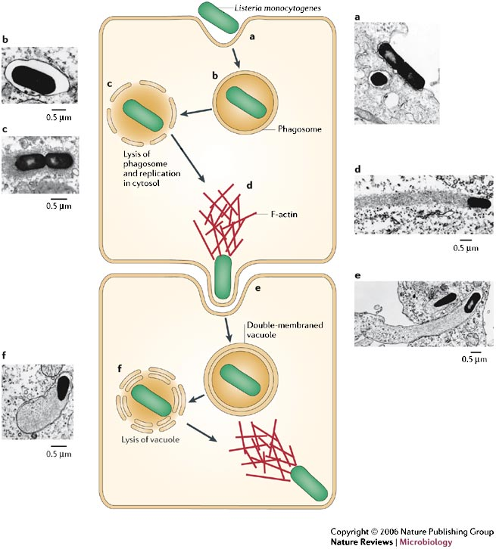
Lactobacillales
Lactobacillus
production of pickles & yogurt
Enterococcus
facultative anaerobes
persist as contaminants
E. faecalis: hospital infections
Listeria
facultative anaerobes
L. monocytogenes: survives & reproduces in phagocytic cells
Notes:
L. Monocytogenes contaminates food, especially dairy.

Slide 26
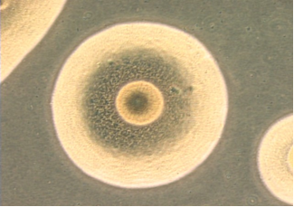
Mycoplasmatales
Mycoplasmatales
pleomorphic – many distinct forms
no cell wall: no gram reaction
can produce filaments like fungi
colonies look like fried eggs
small cells: 0.1 – 0.24 µm
few genes (one has 517)
degenerative evolution
Mycoplasma pneumoniae: mild pneumonia
Spiroplasma: plant pathogen
Notes:
Know the term pleomorphic and that Mycoplasmatales organisms are an example.

Slide 27
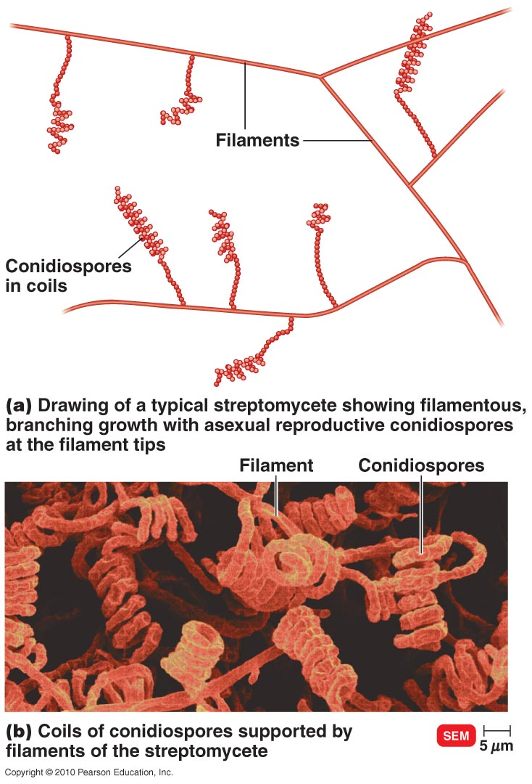
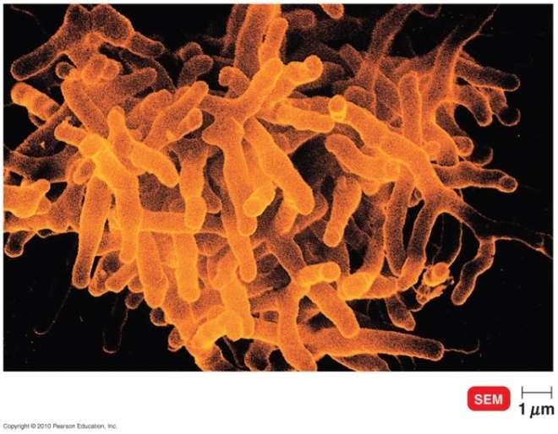
Actinobacteria
Actinomycetes:
form filaments (resemble molds)
high surface-to-volume ratio for better nutrient absorption; common in soil
Streptomyces
aerobic, form conidiophores, common in soil
grow as branching filaments, spores at ends
produce commercial antibiotics
Actinomyces
facultative anaerobes, in mouth & throat
form conidiophores
Nocardia
acid fast, aerobic, common in soil
filaments fragment for reproduction
Notes:
Know the bolded items.

Slide 28
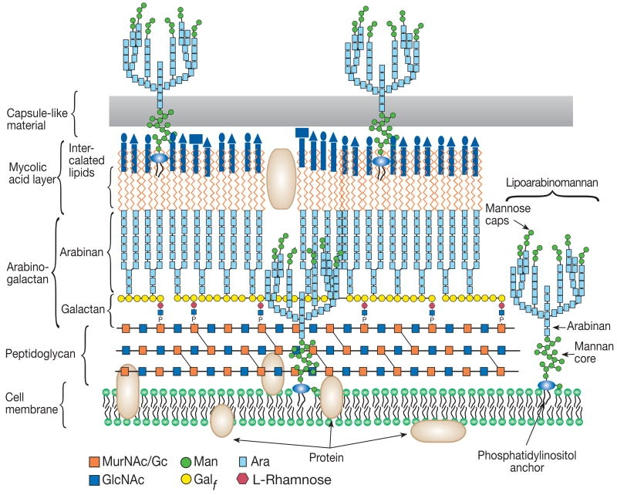
Actinobacteria
No mycelia
Mycobacterium
aerobic, non-endospore-forming rods
distinctive cell wall: waxy mycolic acids outside peptidoglycan
stain acid fast
resistant to drying & antimicrobial drugs
nutrients enter slowly: slow colony growth
M. tuberculosis: tuberculosis
M. leprae: leprosy
Corynebacterium
pleomorphic
C. diptheriae: diphtheria
Propionibacterium
P. acnes: acne
Notes:
Know these concepts well.

Slide 29
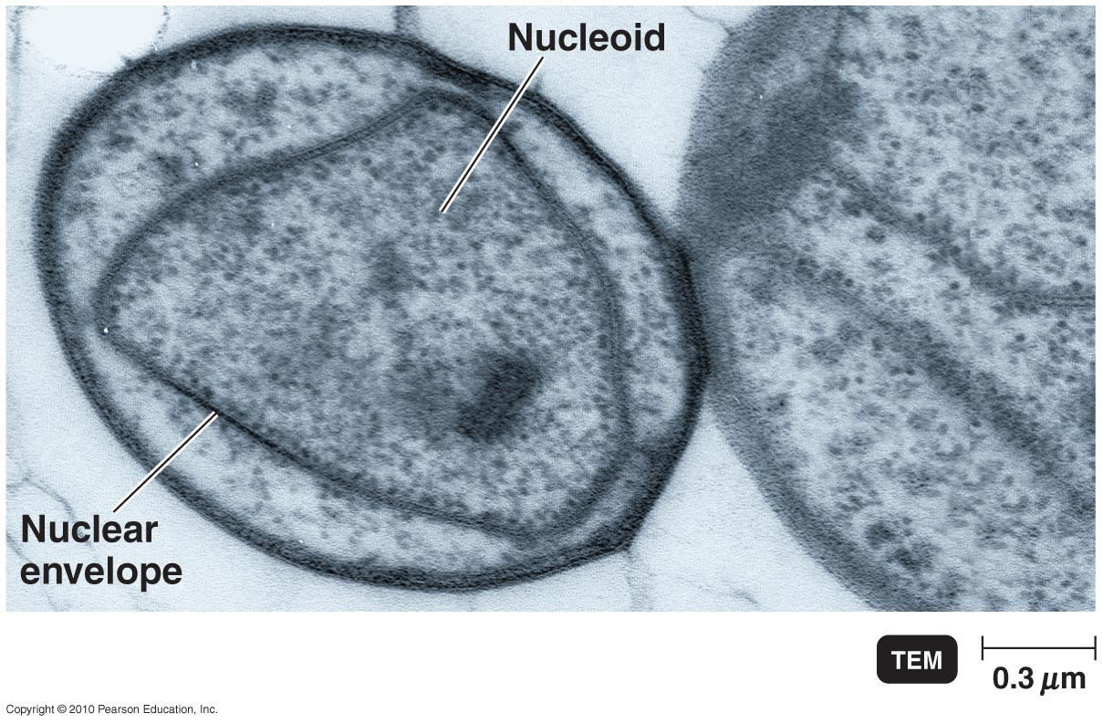
Planctomycetes
Planctomycetes
DNA like bacteria, cell wall like archaea, organelles like eukaryotes
gram negative, budding
Planctomyces
aquatic, stalked
Gemmata obscuriglobus
double internal membrane around DNA
Notes:
Double internal membrane around DNA

Slide 30
Chlamydiae
Chlamydiae
no peptidoglycan in cell walls
unique developmental cycle
elementary bodies phagocytosed by host cells
develop into reticulate bodies
convert back to elementary bodies & released
Chlamydia trachomatis
trachoma (blindness), STIs
Chlamydophila
pneumoniae
mild pneumonia
Notes:
Know this slide well.

Slide 31
Chlamydia Life Cycle
Chlamydia begins infection of a host when the metabolically inactive elementary bodies enter an epithelial cell. Once inside the host cell, the elementary bodies turn into active reticulate bodies. The reticulate bodies multiply and release more elementary bodies when the cell dies after the Chlamydia uses all of the host cell’s ATP. (credit: modification of work by Centers for Disease Control and Prevention)

Slide 32
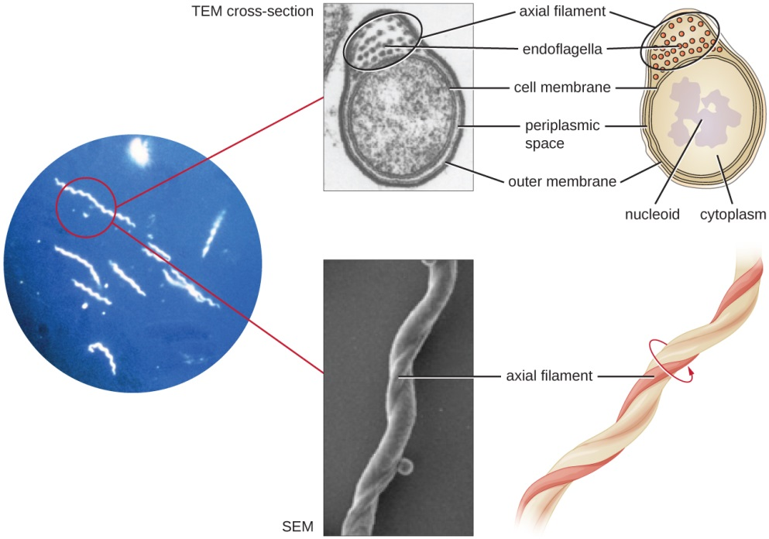
Spirochetes
Spirochetes
coiled morphology
motile by axial filaments (endoflagella)
between cell body & outer sheath
rotate like a corkscrew
Borrelia: Lyme disease
Treponema pallidum: syphilis
Notes:
Know this info well. Especially know these as two examples of spirochetes.

Slide 33
Domain Archaea
Prokaryotes; unique rRNA sequences
Conventional & unusual morphologies
no peptidoglycan; some lack cell walls altogether
gram positive or negative
divide by binary fission or budding
No pathogens
Diverse extremophiles: 5 physiological groups
halophiles: >25% salt
thermophiles: >80 °C
acidophiles: pH near 0, also high temperatures
nitrifying: in oceans & soil
methanogens: anaerobic
Notes:
Know this info well.

Slide 34
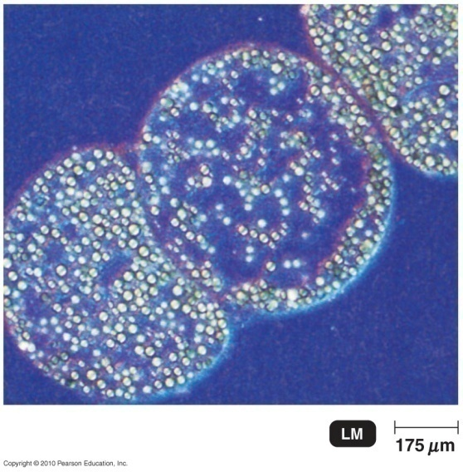
Microbial Diversity
Bacteria size range:
largest bacteria (Thiomargarita): 750 µm
nanobacteria: 0.02 µm (in rocks)
smallest genome (Carsonella ruddii): 182 genes
May be millions of bacteria; 5000 currently described
many bacteria not yet identified:
haven't been cultured
need special nutrients
require products of other bacteria
Need to be cultured to understand their metabolism and ecological role
PCR indicates 10,000 bacterial types per gram soil
1 μm

