Slide 1

Chapter 17
Innate Immunity: Nonspecific Defenses of the Host
Notes:
1

Slide 2

Fever
Advantages
  Increases transferrins
  Increases IL-1 activity
  Produces interferon
Disadvantages
  Tachycardia
  Acidosis
  Dehydration
  44–46°C fatal

Slide 3
The Concept of Immunity
Susceptibility: lack of resistance to a disease
Immunity: ability to ward off disease
Innate immunity: defenses against any pathogen
Adaptive immunity: immunity or resistance to a specific pathogen

Slide 4
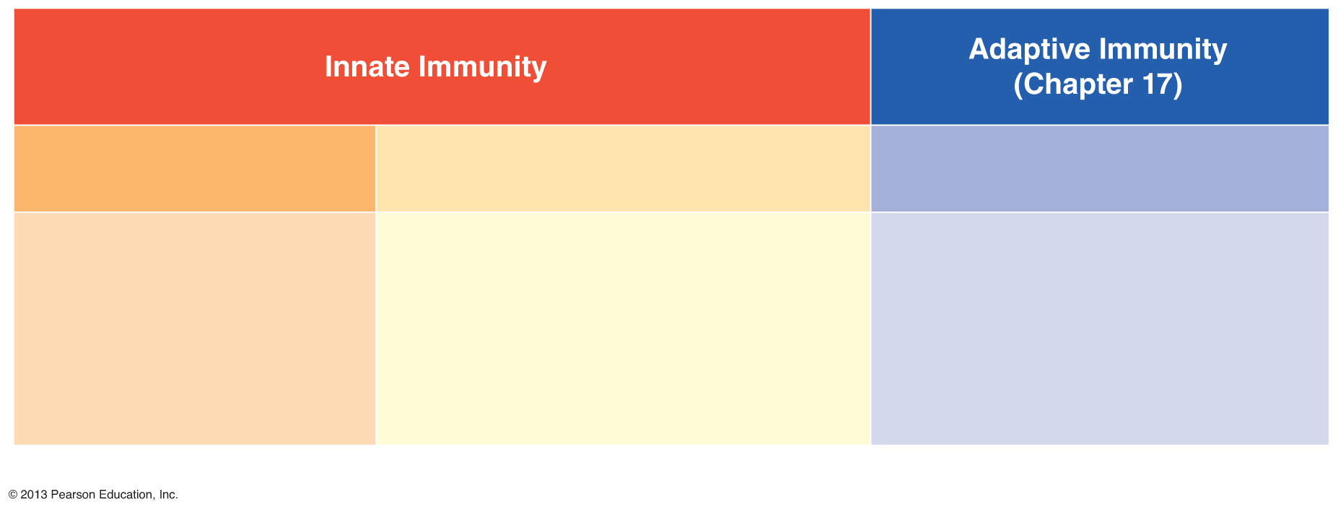
Figure 16.1 An overview of the body’s defenses.
First line of defense
Second line of defense
Third line of defense
Intact skin
Mucous membranes
and their secretions
Normal microbiota
Phagocytes, such as neutrophils,
eosinophils, dendritic cells, and
macrophages
Inflammation
Fever
Antimicrobial substances
Specialized lymphocytes:
T cells and B cells
Antibodies

Slide 5
Physical Factors
Skin
Epidermis consists of tightly packed cells with
  Keratin, a protective protein

Slide 6
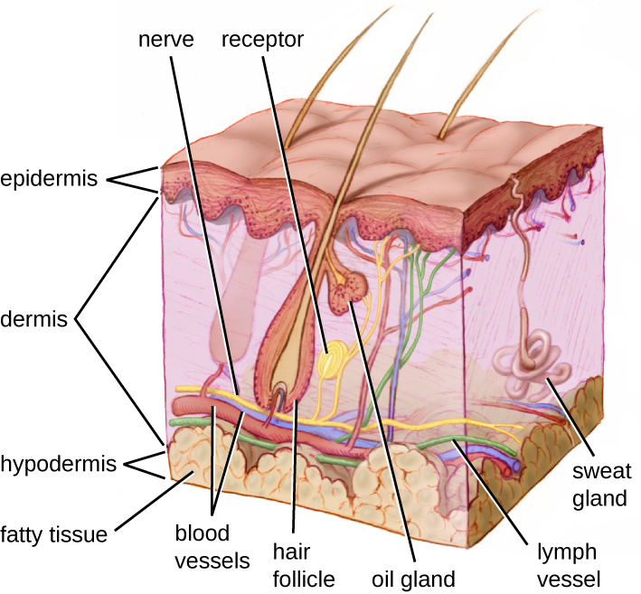
Figure 16.2 A section through human skin.

Slide 7
Physical Factors
Mucous membranes
Mucus: traps microbes
Ciliary escalator: transports microbes trapped in mucus away from the lungs

Slide 8
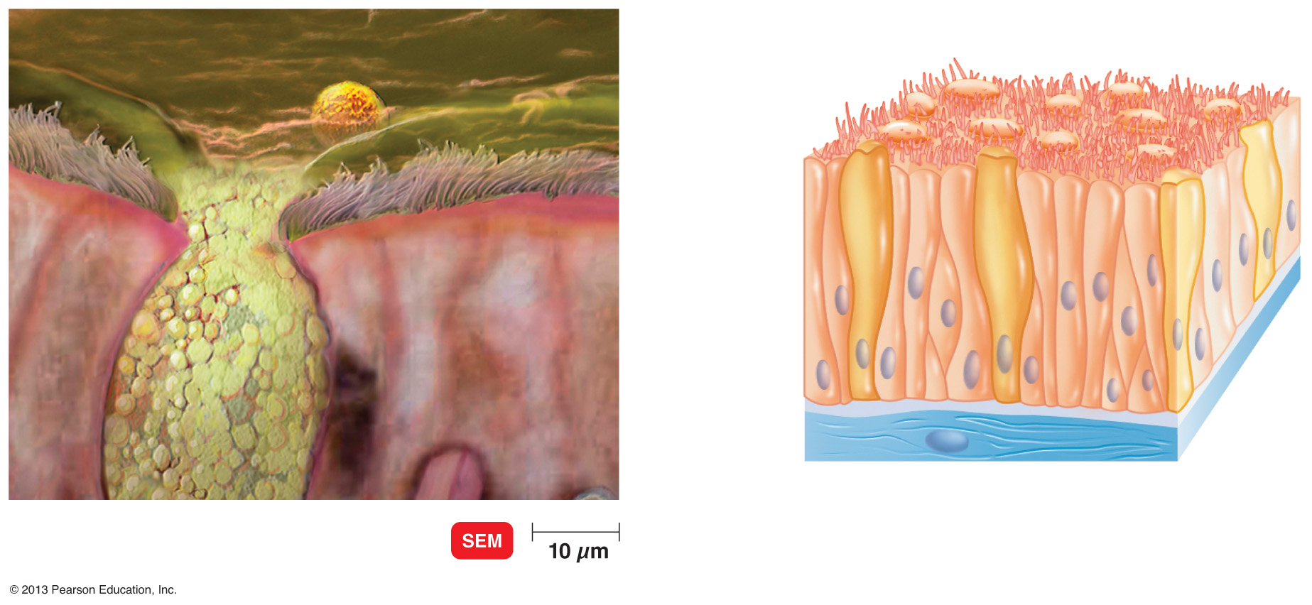
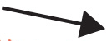
Figure 16.4 The ciliary escalator.
Trapped
particles
in mucus
Cilia
Insert Fig 16.4
Goblet cells
Ciliated cells
Computer-enhanced

Slide 9
Physical Factors
Lacrimal apparatus: washes eye
Saliva: washes microbes off
Urine: flows out
Vaginal secretions: flow out

Slide 10
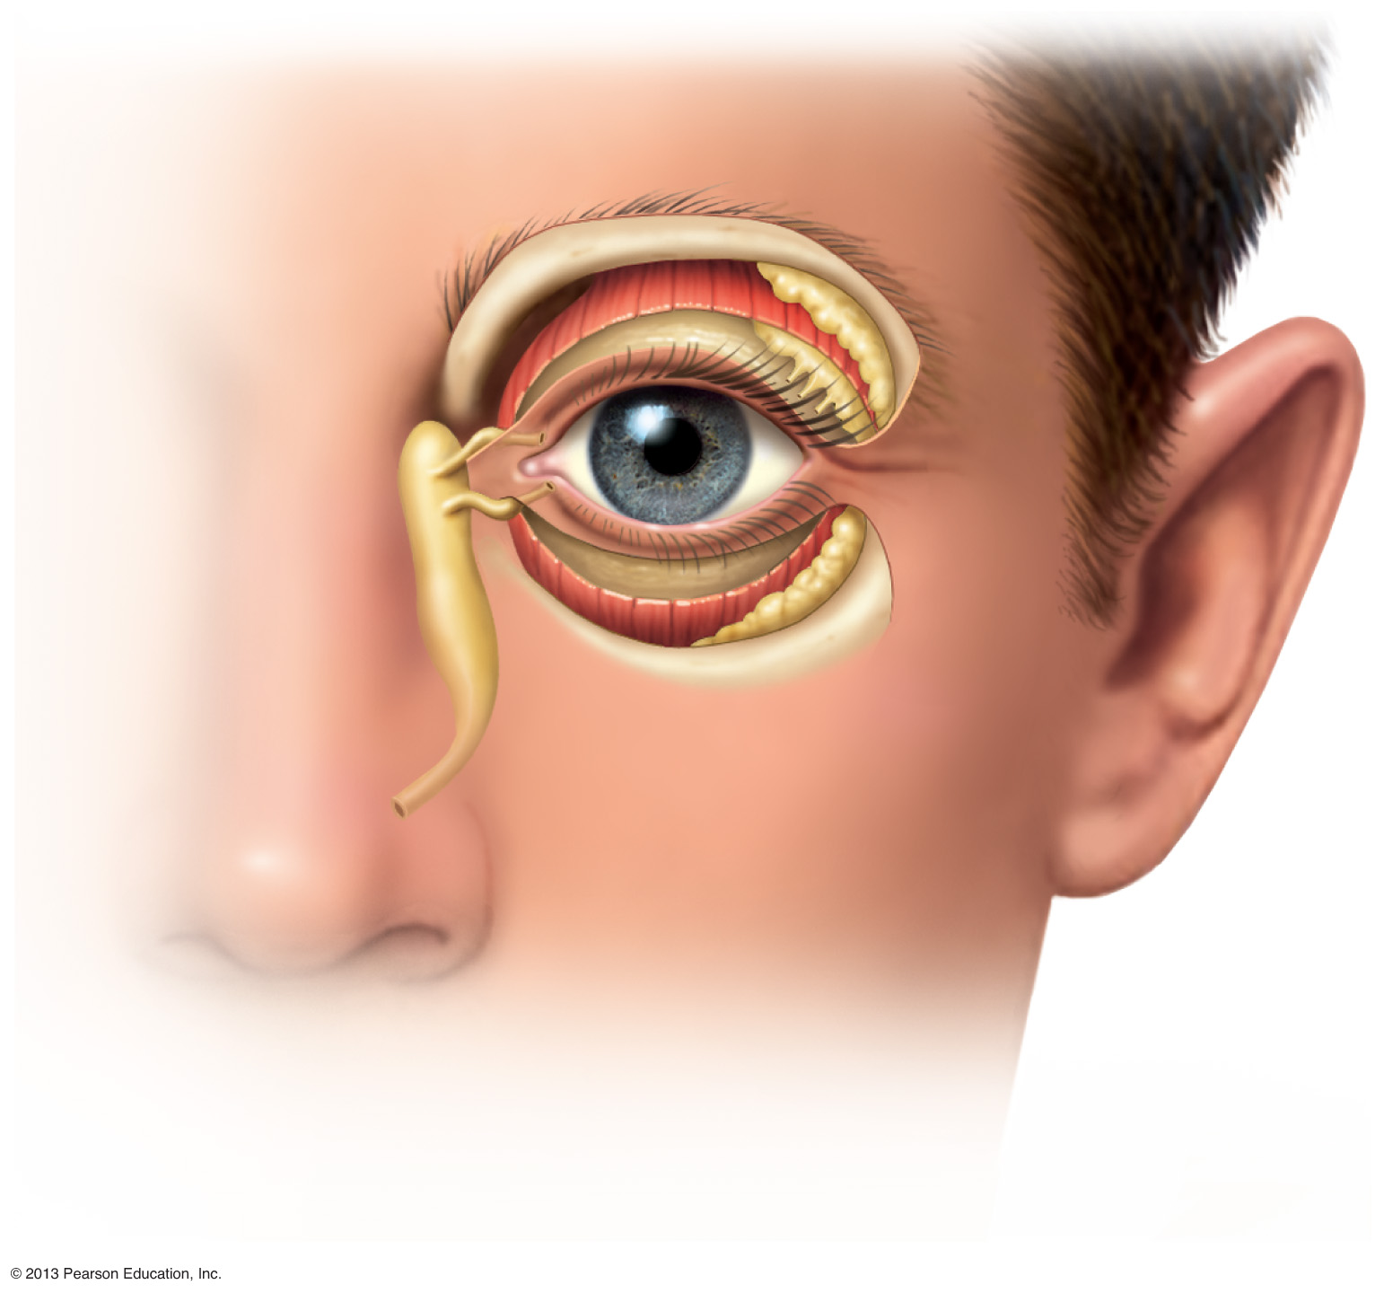
Figure 16.3 The lacrimal apparatus.
Lacrimal glands
Upper eyelid
Lacrimal canal
Nasolacrimal
duct
Nose

Slide 11
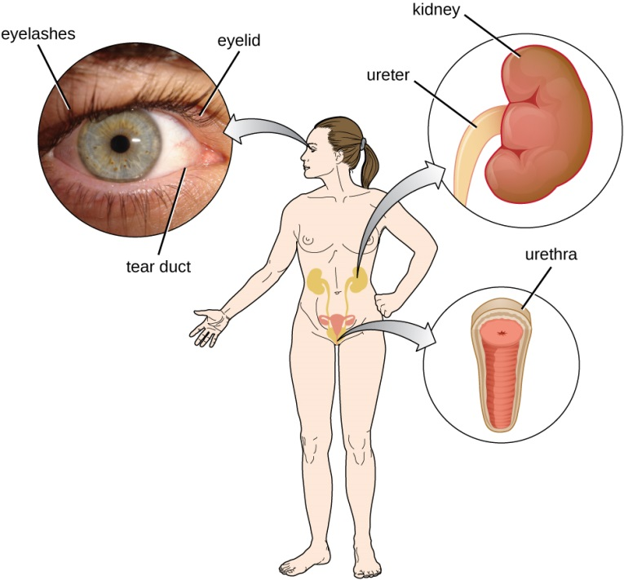
Chemical Factors
Fungistatic fatty acid in sebum
Low pH (3–5) of skin
Lysozyme in perspiration, tears, saliva, and urine
Low pH (1.2–3.0) of gastric juice
Low pH (3–5) of vaginal secretions

Slide 12
Normal Microbiota and Innate Immunity
Microbial antagonism/competitive exclusion: normal microbiota compete with pathogens or alter the environment
Commensal microbiota: one organism (microbe) benefits, and the other (host) is unharmed
  May be opportunistic pathogens

Slide 13
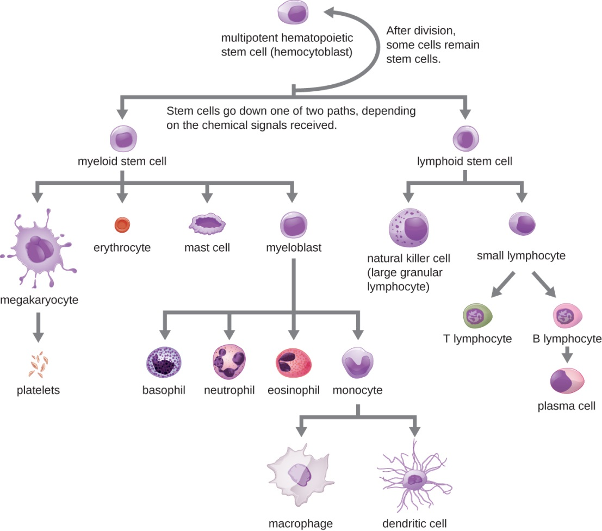
Table 16.1 Formed Elements in Blood (Part 1 of 2)

Slide 14

Table 16.1 Formed Elements in Blood (Part 2 of 2)

Slide 15
Differential White Cell Count
Percentage of each type of white blood cell in a sample of 100 white blood cells
Neutrophils | 60–70%
Basophils | 0.5–1%
Eosinophils | 2–4%
Monocytes | 3–8%
Lymphocytes | 20–25%

Slide 16
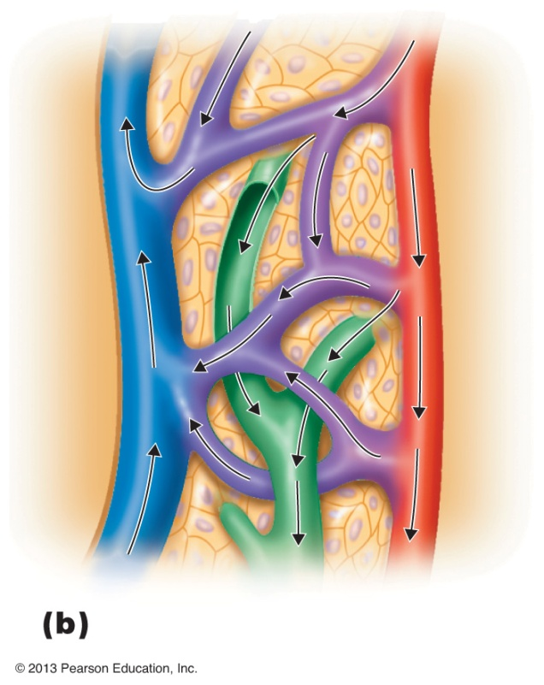
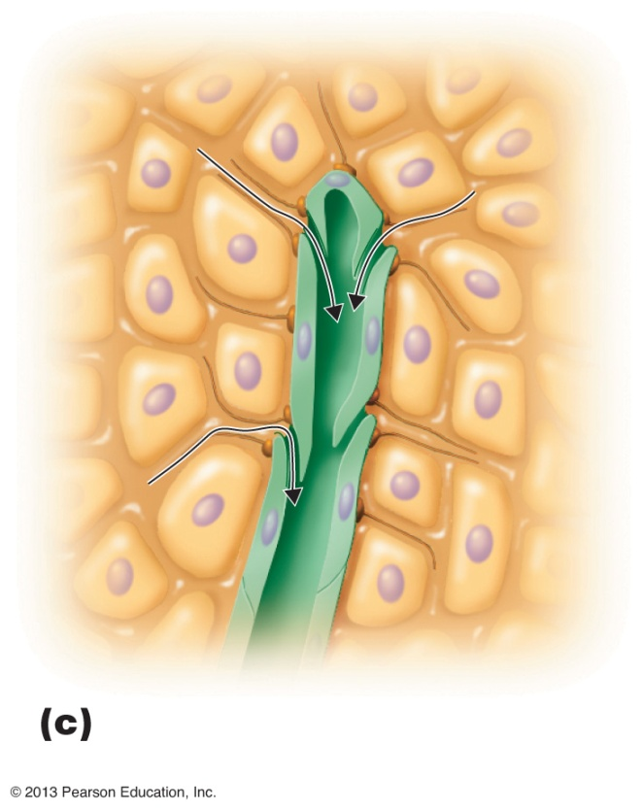
Figure 16.5b-c The lymphatic system.
Venule
Blood capillary
Interstitial fluid
Tissue cell
Blood
Arteriole
One-way opening
Blood
Interstitial
fluid (between cells)
Lymphatic capillary
Lymph
Tissue cell
Lymphatic capillary
Lymph
Relationship of lymphatic capillaries to tissue cells and blood capillaries
Details of a lymphatic capillary

Slide 17
Phagocytosis
Phago: from Greek, meaning eat
Cyte: from Greek, meaning cell
Ingestion of microbes or particles by a cell, performed by phagocytes

Slide 18
Phagocytosis
Neutrophils
Fixed macrophages
Wandering macrophages

Slide 19
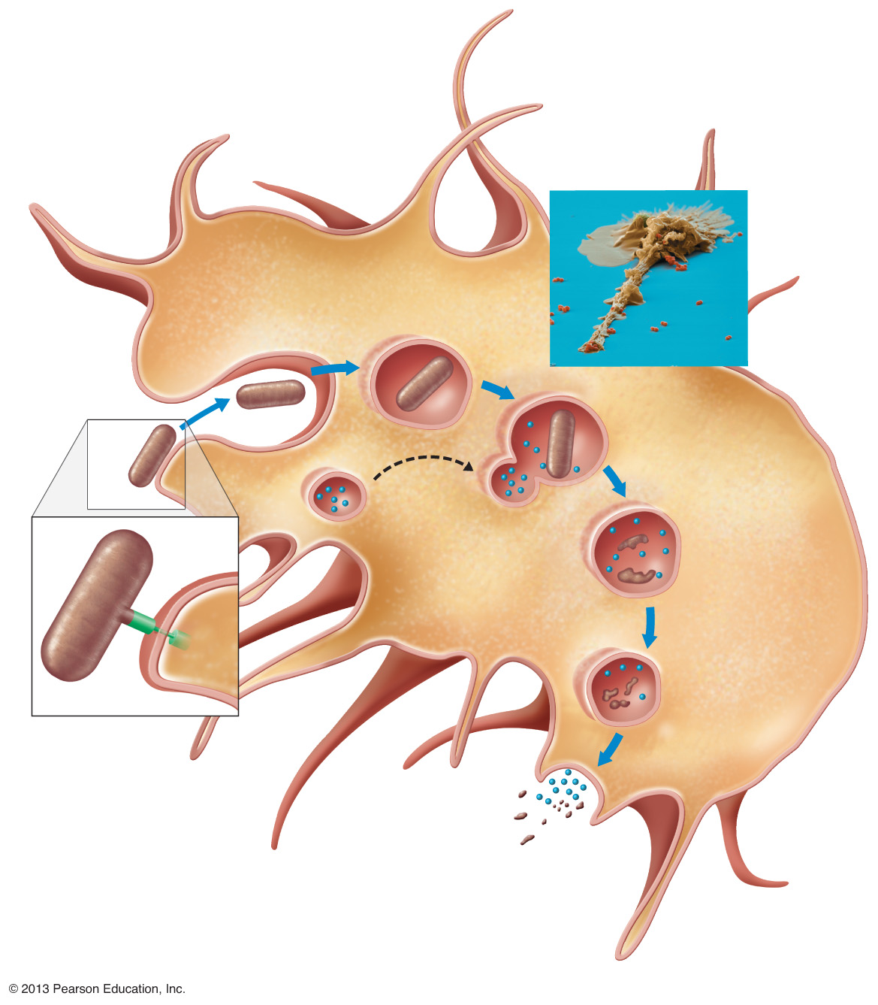
Figure 16.7 The Phases of Phagocytosis.
A phagocytic macrophage uses a pseudopod to engulf nearby bacteria.
Pseudopods
Phagocyte
Cytoplasm
3
Formation of phagosome
(phagocytic vesicle)
1
CHEMOTAXIS
and
ADHERENCE
of phagocyte to
microbe
2
INGESTION
of microbe by phagocyte
4
Fusion of phagosome
with a lysosome
to form a phagolysosome
Microbe
or other
particle
Lysosome
Details of
adherence
PAMP (peptidoglycan
in cell wall)
Digestive
enzymes
5
DIGESTION
of ingested
microbes by
enzymes in the
phagolysosome
Partially
digested
microbe
Indigestible
material
TLR
(Toll-like receptor)
6
Formation of
the residual body
containing
indigestible
material
Plasma membrane
7
DISCHARGE of
waste materials

Slide 20
Microbial Evasion of Phagocytosis
Inhibit adherence: M protein, capsules | Streptococcus pyogenes, S. pneumoniae
Kill phagocytes: Leukocidins | Staphylococcus aureus
Lyse phagocytes: Membrane attack complex | Listeria monocytogenes
Escape phagosome | Shigella, Rickettsia
Prevent phagosome–lysosome fusion | HIV, Mycobacterium tuberculosis
Survive in phagolysosome | Coxiella burnettii

Slide 21
Inflammation
Activation of acute-phase proteins (complement, cytokine, and kinins)
Vasodilation (histamine, kinins, prostaglandins, and leukotrienes)
Redness
Swelling (edema)
Pain
Heat

Slide 22
Chemicals Released by Damaged Cells
Histamine | Vasodilation, increased permeability of blood vessels
Kinins | Vasodilation, increased permeability of blood vessels
Prostaglandins | Intensify histamine and kinin effect
Leukotrienes | Increased permeability of blood vessels, phagocytic attachment

Slide 23
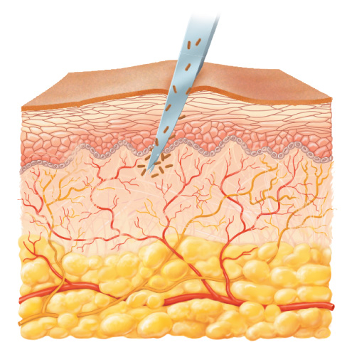
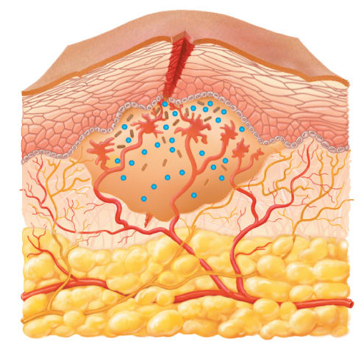
Figure 16.8a-b The process of inflammation.
Bacteria entering
on knife
Bacteria
Epidermis
Blood vessel
Dermis
Nerve
Subcutaneous
tissue
(a) Tissue damage
1
Chemicals such as histamine, kinins, prostaglandins, leukotrienes, and cytokines (represented as blue
dots) are released by
damaged cells.
2
Blood clot forms.
3
Abscess starts to form
(orange area).
(b) Vasodilation and increased
permeability of blood vessels

Slide 24
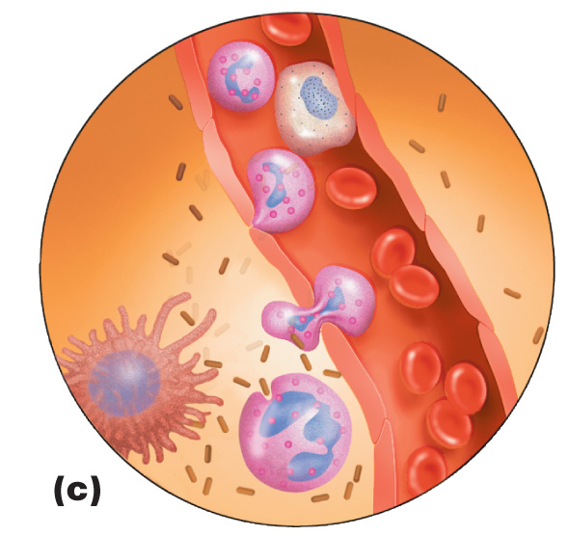
Figure 16.8c The process of inflammation.
Blood vessel
endothelium
Monocyte
4
Margination—
phagocytes stick
to endothelium.
5
Diapedesis—phagocytes squeeze between endothelial cells.
Insert Fig 16.8c
6
Phagocytosis of
invading bacteria occurs.
Red
blood
cell
Macrophage
(c) Phagocyte migration
and phagocytosis
Bacterium
Neutrophil

Slide 25
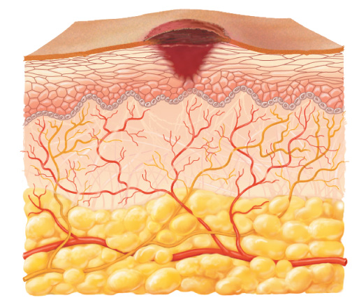
Figure 16.8d The process of inflammation.
Scab
Blood clot
Regenerated epidermis
(parenchyma)
Insert Fig 16.8d
Regenerated
dermis
(stroma)
(d) Tissue repair

Slide 26
Fever
Abnormally high body temperature
Hypothalamus is normally set at 37°C
Gram-negative endotoxins cause phagocytes to release interleukin-1 (IL-1)
Hypothalamus releases prostaglandins that reset the hypothalamus to a high temperature
Body increases rate of metabolism, and shivering occurs, which raise temperature
Vasodilation and sweating: body temperature falls (crisis)

Slide 27
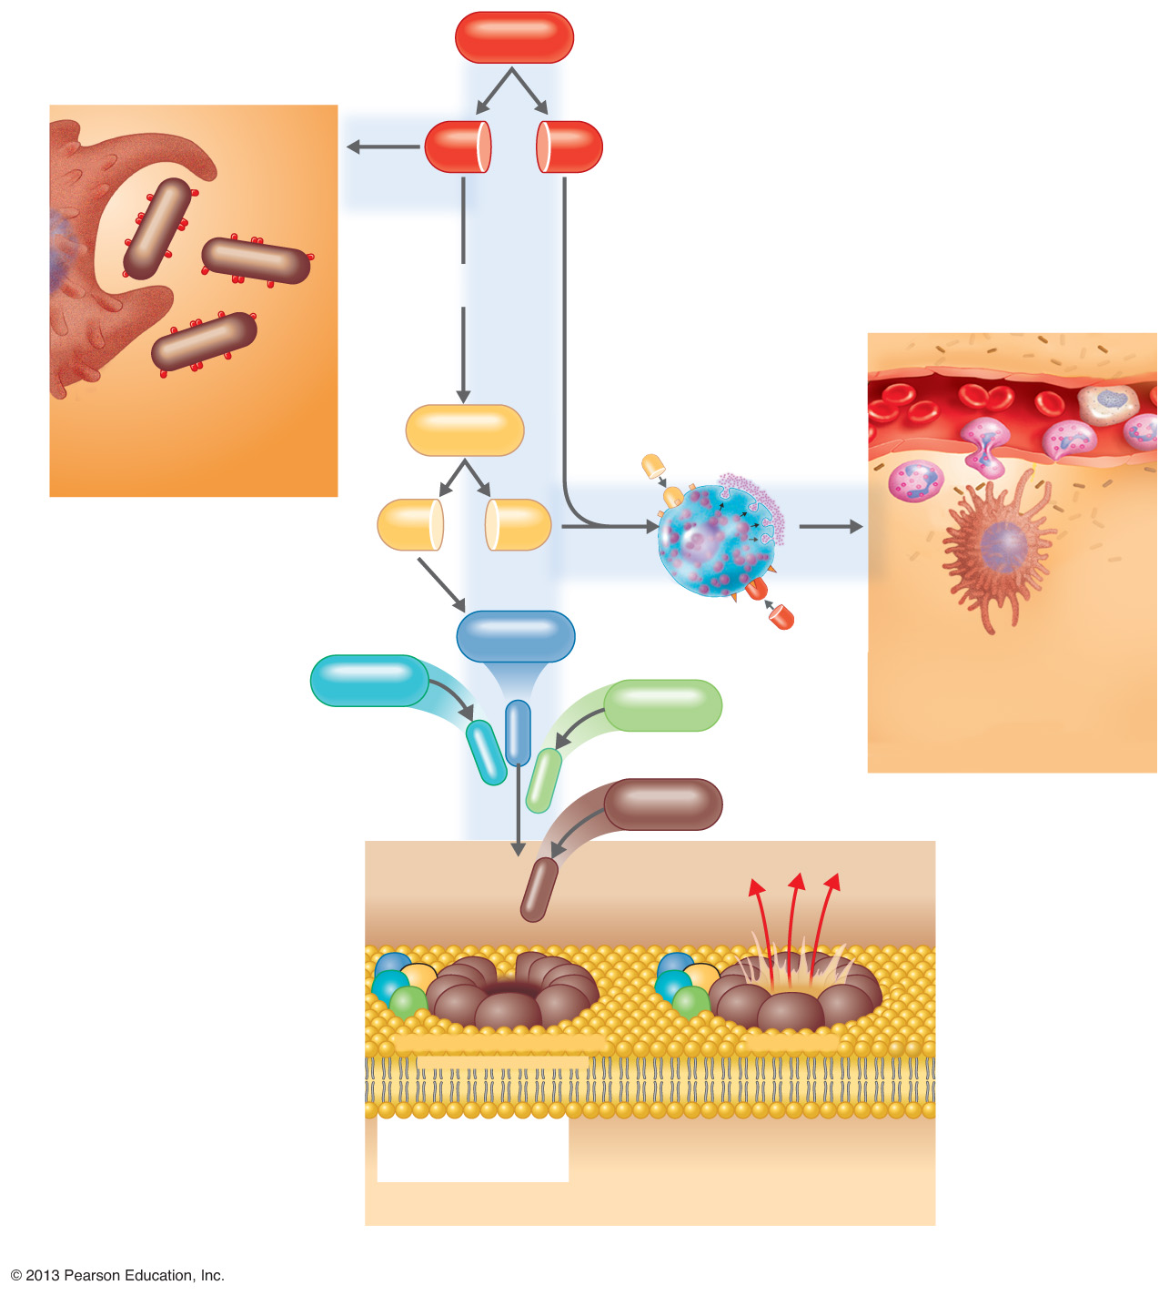
Figure 16.9 Outcomes of Complement Activation.
1
Inactivated C3 splits into activated
C3a and C3b.
C3
2
C3b binds to microbe, resulting
in opsonization.
C3b
C3a
C3b
proteins
3
C3b also splits C5
into C5a and C5b
5
C3a and C5a cause
mast cells to release
histamine, resulting
in inflammation;
C5a also attracts
phagocytes.
opsonization
Enhancement of phagocytosis
by coating with C3b
C5
C5a receptor
C5a
Histamine
C5b
C5a
Insert Fig 16.9
4
C5b, C6, C7, and C8 bind
together sequentially and
insert into the microbial
plasma membrane, where
they function as a receptor
to attract a C9 fragment;
additional C9 fragments are
added to form a channel.
Together, C5b through C8
and the multiple C9
fragments form the
membrane attack complex,
resulting in cytolysis.
Mast cell
C6
C3a receptor
C3a
inflammation
C7
C8
Increase of blood vessel
permeability and chemotactic
attraction of phagocytes
C9
Microbial
plasma
membrane
Channel
C6
C5b
C6
C5b
C7
C8
C7
C8
C9
C9
Formation of membrane
attack complex (MAC)
Cytolysis
cytolysis
© 2013 Pearson Education, Inc.
Bursting of microbe due to inflow of extracellular fluid through
transmembrane channel formed by membrane attack complex

Slide 28
Effects of Complement Activation
Opsonization, or immune adherence: enhanced phagocytosis
Membrane attack complex: cytolysis
Attract phagocytes

Slide 29

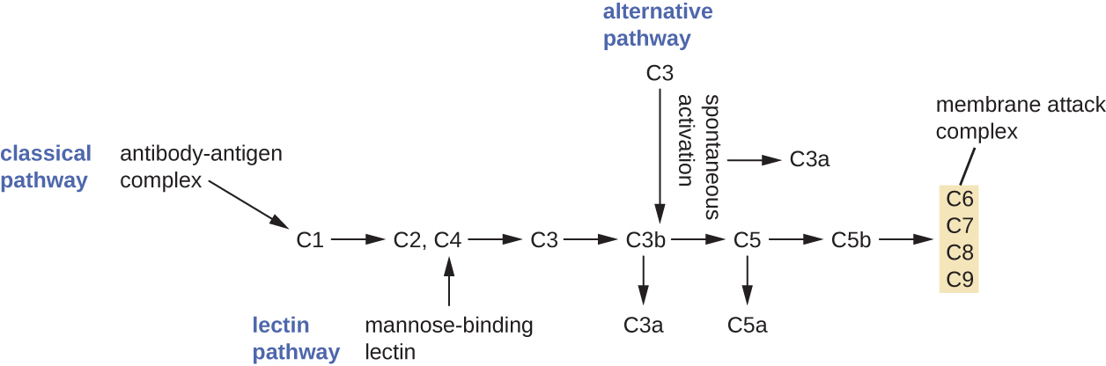
Complement Activation
The three complement activation pathways have different triggers, as shown here, but all three result in the activation of the complement protein C3, which produces C3a and C3b. The latter binds to the surface of the target cell and then works with other complement proteins to cleave C5 into C5a and C5b. C5b also binds to the cell surface and then recruits C6 through C9; these molecules form a ring structure called the membrane attack complex (MAC), which punches through the cell membrane of the invading pathogen, causing it to swell and burst.

Slide 30
Interferons (IFNs)
IFN-α and IFN-β: cause cells to produce antiviral proteins that inhibit viral replication
IFN-γ: causes neutrophils and macrophages
to phagocytize bacteria

Slide 31
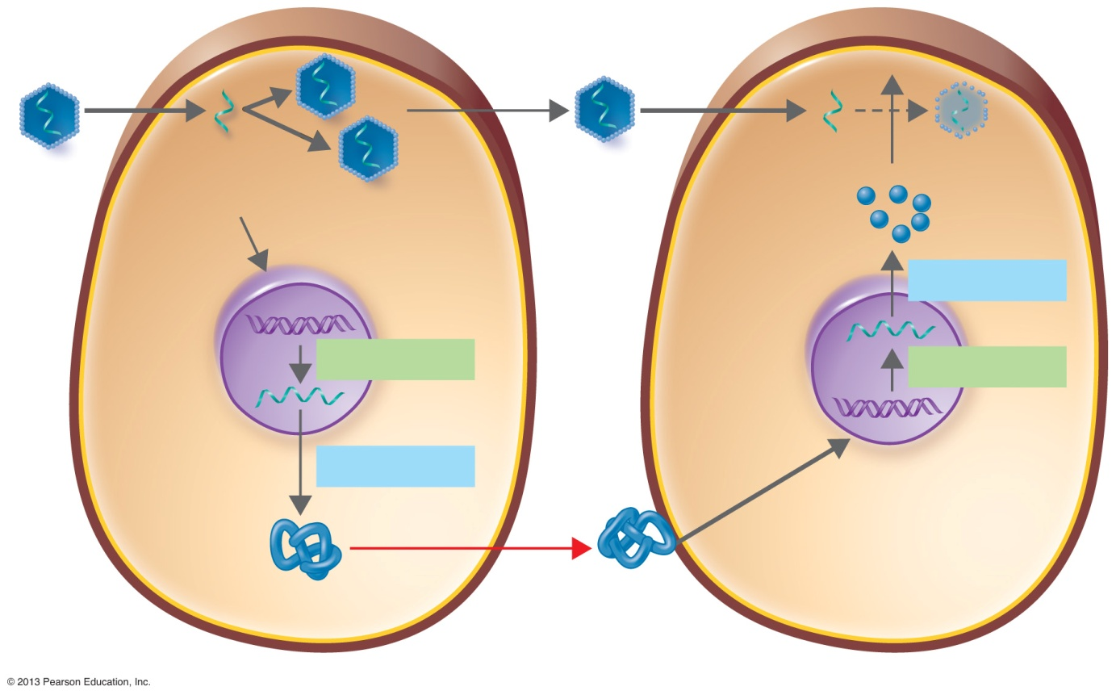
Figure 16.15 Antiviral action of alpha and beta interferons (IFNs).
1
Viral RNA from
an infecting virus
enters the cell.
2
The infecting virus
replicates into
new viruses.
5
New viruses released by the virus-infected host cell infect neighboring host cells.
Viral RNA
3
The infecting virus
also induces the
host cell to produce
interferon mRNA
(IFN-mRNA), which
is translated into
alpha and beta interferons.
Infecting
virus
Viral RNA
Antiviral
proteins
(AVPs)
Nucleus
Translation
Insert Fig 16.15
6
AVPs degrade
viral mRNA and
inhibit protein
synthesis—and
thus interfere
with viral
replication.
Transcription
Transcription
IFN-mRNA
4
Interferons released by the
virus-infected host cell bind
to plasma membrane or
nuclear membrane receptors on uninfected neighboring host cells, inducing them to
synthesize antiviral proteins
(AVPs). These include
oligoadenylate synthetase
and protein kinase.
Alpha
and beta
interferons
Translation
Virus-infected
host cell
Neighboring host cell

Slide 32
Innate Immunity
Transferrins
  Bind serum iron
Antimicrobial peptides
  Lyse bacterial cells

