Slide 1
Chapter 15
Mechanisms of Pathogenicity
Notes:
1

Slide 2
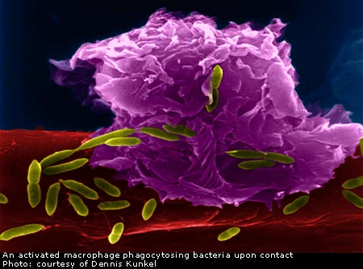
Mechanisms of Pathogenicity
Pathogenicity – ability to cause disease
Virulence – extent of pathogenicity
Activities of pathogens:
gain access to host
adhere to host
penetrate or evade host defenses (i.e. phagocytes)
most damage the host:
Use host nutrients
Direct damage to tissues near invasion site
Toxins
Waste Products
Hypersensitivity reactions
Notes:
Please know the bolded terms well.

Slide 3
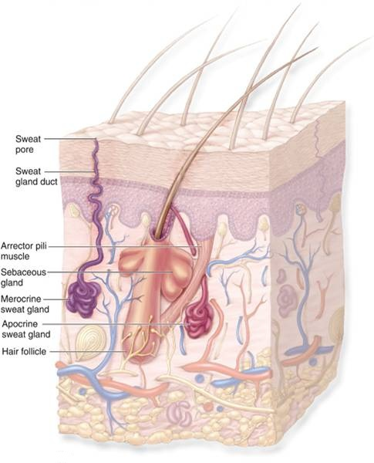
Portals of Entry
Portals of entry for pathogens:
Mucous membranes – most common
respiratory tract: inhaled through mouth or nose
gastrointestinal tract: in food & water, or on fingers
genitourinary tract: sexually transmitted
conjunctiva: eyes
Skin
impenetrable by most microbes when unbroken
entry through sweat glands & hair follicles
fungi can grow on skin, hookworm larvae can penetrate it
Parenteral route
deposited into tissues through punctures or other wounds
Preferred portal of entry
many microbes only pathogenic if entering through preferred portal of entry
Notes:
Please know this information well.
parenteral – pronounced pah-RENT-uh-rull

Slide 4
Portals of Entry
Shown are different portals of entry where pathogens can gain access into the body. With the exception of the placenta, many of these locations are directly exposed to the external environment.

Slide 5
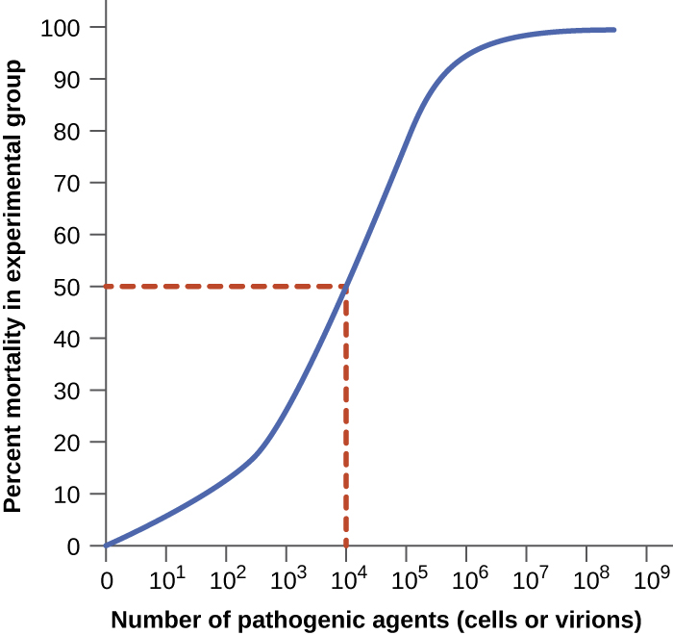
Numbers of Invading Microbes
Disease likelier with more pathogens
ID₅₀: infectious dose for 50% of test population
virulence (how easy it is to acquire)
LD₅₀: lethal dose (of a toxin) for 50% of test population
potency (how much is necessary for lethality)
Notes:
Please understand the difference between infectious and lethal doses. Also, know the terms virulence versus potency. You do not need to know any of the numbers in the tables.

Slide 6
Adherence
Almost all pathogens attach themselves to the host tissue at their portal of entry = Adherence
Adhesins (ligands) bind microbes to receptors on host cells
adhesins: mostly glycoproteins or lipoproteins
may vary between pathogen strains
receptors: typically sugars
may vary between cell types
Adhesins bind specifically to complementary receptors
If adhesins and/or receptors are altered, adherence can be prevented
Notes:
Understand this information well.

Slide 7
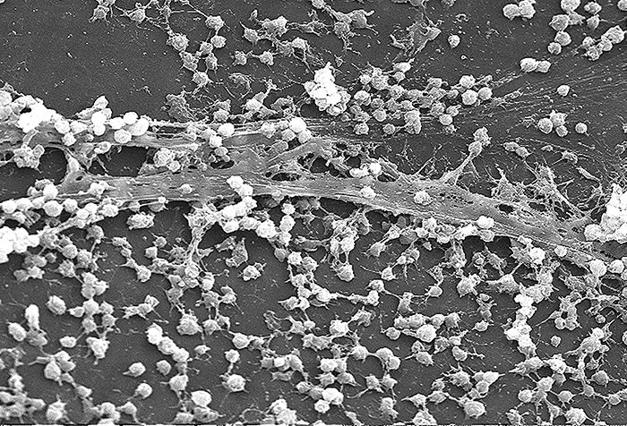
Biofilms
Biofilms – microbial communities; form in layers on surfaces
bacteria adhere, secrete glycocalyx, more bacteria adhere
Can be several layers thick and can contain more than 1 organsim
resist disinfectants & antibiotics
dental plaque – biofilm that mineralizes over time
Biofilms of E.coli in the intestine
Notes:
A review from past chapters.

Slide 8
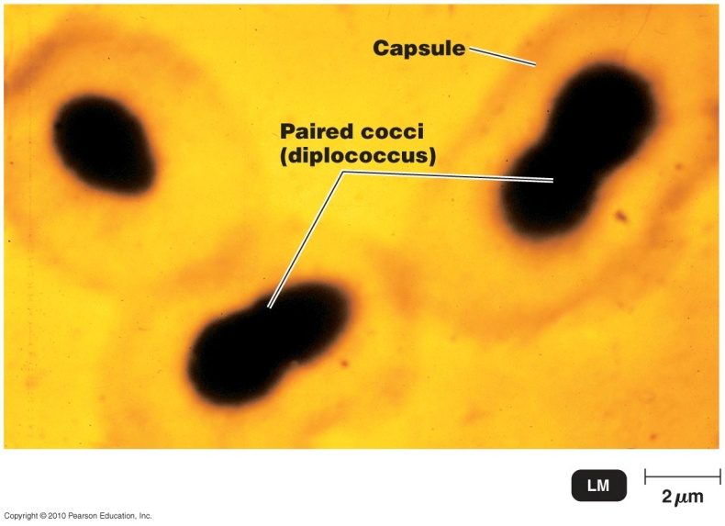
Penetrating Host Defenses
Capsule – glycocalyx material around cell wall
generally increases virulence
keeps phagocytic cells from adhering
unless immune system antibodies are attached
Cell wall components:
M protein
resists phagocytosis
heat & acid-resistant
opa protein
inhibits T helper cells
attaches to host cells & induces them to take in bacterial cells
mycolic acid (waxy lipid)
resists digestion by phagocytes
Notes:
Please understand all of these penetration components well.

Slide 9
Penetrating Host Defenses
Exoenzymes – extracellular enzymes
coagulase – coagulates (clots) fibrinogen into fibrin
protects bacteria from host defenses – isolates it from the host immune cells
kinase – digests fibrin clots formed by the body to isolate the infection
keeps body from isolating infection
IgA protease – destroys IgA antibodies
lets pathogens adhere to mucosal surfaces
Collagenase – breaks down the protein collagen which forms the connective tissues
Notes:
Please know these enzymes well and how they benefit the bacteria and increase the chances of infecting a host cell.

Slide 10
Figure 15.17
A micrograph of capsules around bacterial cells.
Antibodies normally function by binding to antigens, molecules on the surface of pathogenic bacteria. Phagocytes then bind to the antibody, initiating phagocytosis.
Some bacteria also produce proteases, virulence factors that break down host antibodies to evade phagocytosis. (credit a: modification of work by Centers for Disease Control and Prevention)

Slide 11
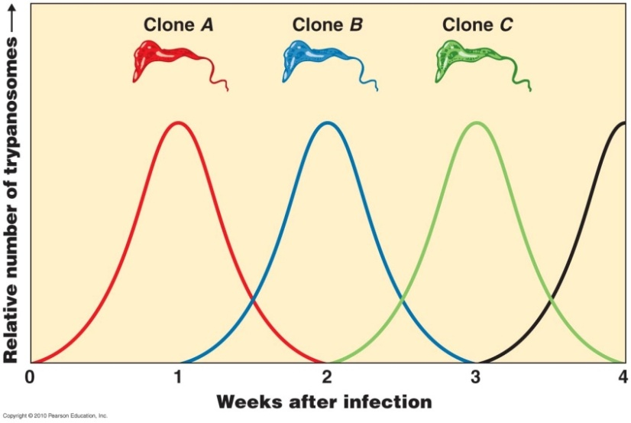
Penetrating Host Defenses
Antigenic variation
Some species can alter their surface proteins (antigens)
The immune system creates antibodies against antigens (this takes time to complete)
By the time the antibodies are formed and ready to attack the bacteria has changed its antigens so…
The antibodies formed against a pathogen can’t adhere; become ineffective
Influenzavirus and
N. gonorrhoeae are
notorious for antigenic
varitaion
Notes:
Please understand how antigenic variation improves a microorganisms ability to infect host cells.

Slide 12
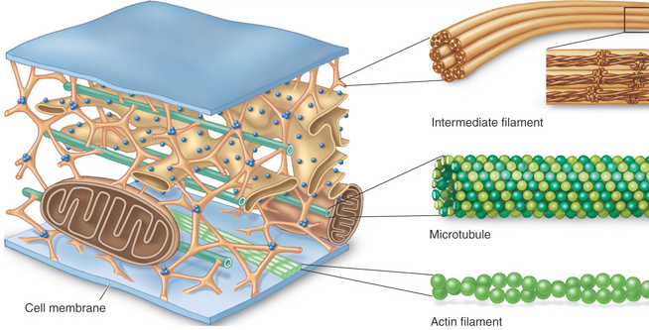
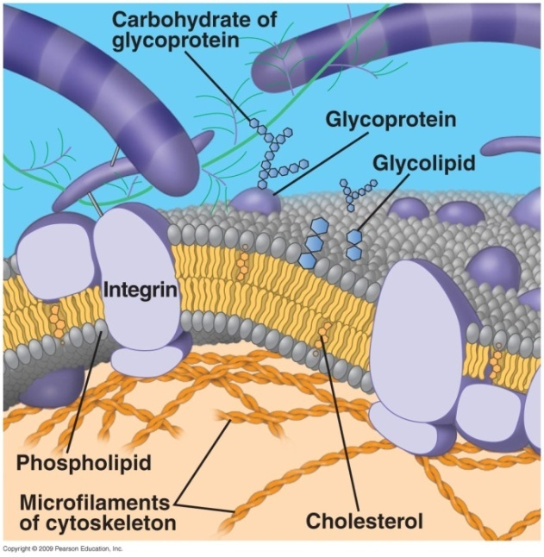
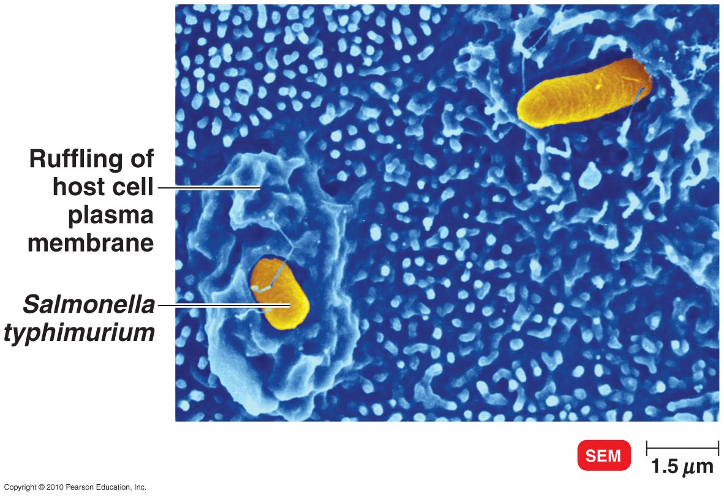
Penetration into the Host Cell Cytoskeleton
Attachment by adhesins can activate host cytoskeleton & allow entrance
invasins – bacterial surface proteins
rearrange cytoskeleton actin filaments into membrane ruffles
bacterium sinks into ruffles & into cell

Slide 13
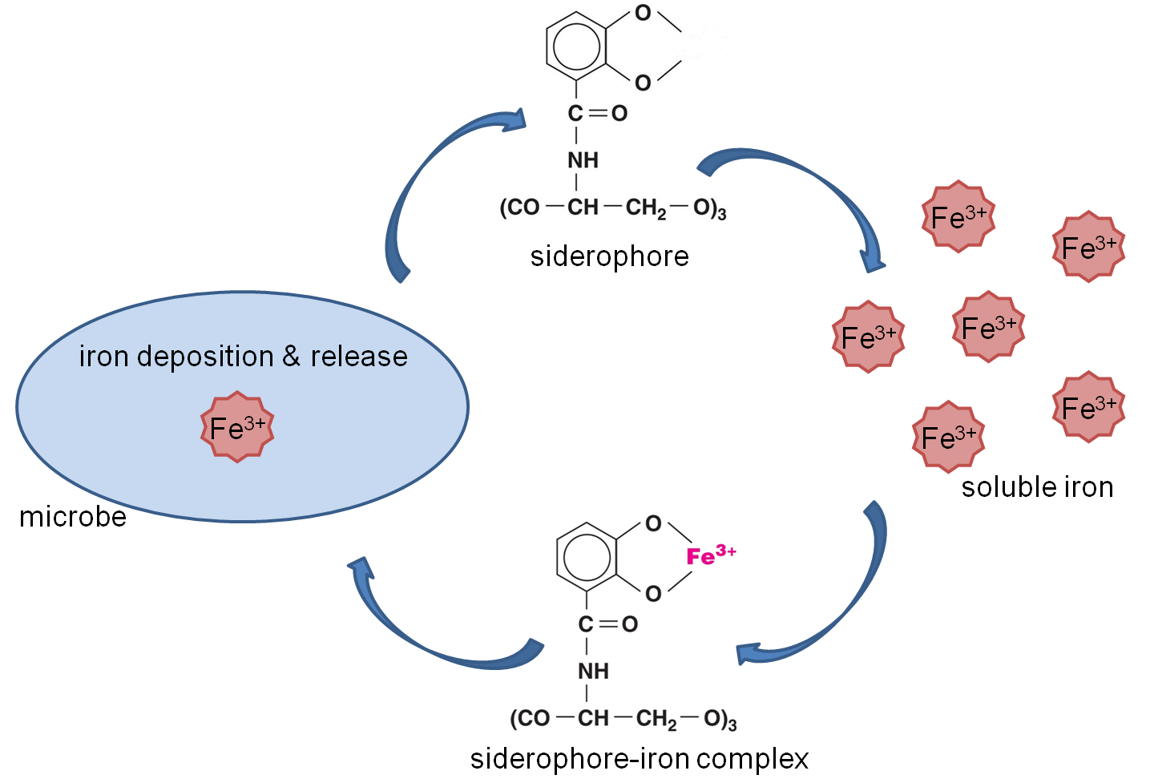
How Bacterial Pathogens Damage Host Cells
Using the host’s nutrients
siderophores – proteins; sequester host iron for bacteria use
Most bacteria need iron to survive, human body has relatively small amount of free iron
bind iron more tightly than host molecules
bring iron into bacteria
indirect damage
Direct damage
multiply in cells, make them rupture
disrupt host cell function
produce waste products
produce toxins
Notes:
Please understand this concept well. Know what a siderophore is and its effects on bacterial and host cells.

Slide 14
The Production of Toxins
Toxin – poisonous substance; contributes to pathogenicity
toxigenicity – ability to produce a toxin
toxemia – presence of toxin in host's blood
effects:
fever, heart disturbances, diarrhea, shock
shock – life-threatening decrease in blood pressure
septic shock – shock from bacteria
inhibit protein synthesis
destroy blood cells
disrupt nervous system
damage cell membranes
Notes:
Please know the bolded terms.

Slide 15
Figure 15.4 Mechanisms of Exotoxins and Endotoxins.
exotoxins
endotoxins
Exotoxins are proteins produced inside pathogenic bacteria, most commonly gram-positive bacteria, as part of their growth and metabolism. The exotoxins are then secreted into the surrounding medium during log phase.
Endotoxins are the lipid portions of lipopolysaccharides (LPS) that are part of the outer membrane of the cell wall of gram-negative bacteria (lipid A; see Figure 4.13c). The endotoxins are liberated when the bacteria die and the cell wall breaks apart.
Cell wall
Exotoxin: toxic
substances released
outside the cell
Clostridium botulinum, an example of a gram-positive bacterium that
produces exotoxins
Salmonella typhimurium, an example of a gram-negative bacterium that produces endotoxins
Endotoxins: toxins
composed of lipids
that are part of the
cell membrane
Notes:
A summary of the information on the following slides. Photo credit Tortora Microbiology.

Slide 16
The Production of Toxins
Exotoxins – toxic proteins secreted by bacteria into surroundings
Work by destroying particular part’s of the host cell or by inhibiting metabolic functions
Produced inside some bacteria as part of growth and metabolism
Toxins can be specific from genes on plasmids
often enzymes: specific effects on host tissues
even small amounts very harmful
Released via secretion or during lysis of the cell
From gram-positive or negative bacteria
antitoxins – antibodies that provide immunity to exotoxins
toxoid – inactivated toxin used in a vaccine
Notes:
Exotoxins are among the most lethal substances known
Exotoxins produce the signs and symptoms of the disease, not the bacteria
Example – Botulism is caused by the ingestion of the exotoxin not a bacterial infection
Please know this slide well.

Slide 17
The Production of Toxins
Exotoxins are divided into three principle types based on their structure and function
A-B Toxins
Membrane disrupting toxins
Superantigens

Slide 18
Types of Exotoxins
A-B Toxins
most exotoxins
2 polypeptide parts:
A: active enzyme component
alters cell function
B: binding component
binds to host cell & allows entry
Notes:
You do not need to know the steps in order; however, please understand the difference between part A and B and their functions in the process of toxicity.

Slide 19
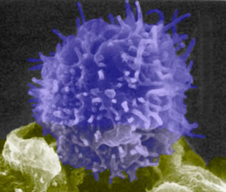
Types of Exotoxins
Membrane-disrupting toxins
lyse host cells by disrupting cell membrane
Can form protein channels in the membrane
kill phagocytes & macrophages (leukocidins)
Superantigens
cause intense immune response
stimulate T cell (regulatory white blood cell) proliferation
T cells release huge amounts of cytokines (regulate immune communication)
symptoms: fever, nausea, vomiting, diarrhea, shock, death
Notes:
Please know the bolded terms well.

Slide 20
Exotoxin
Source | Mostly gram-positive
Relation to microbe | By-products of growing cell
Chemistry | Protein
Fever? | No
Neutralized by antitoxin? | Yes
LD₅₀ | Small
Notes:
Understand these concepts well.

Slide 21
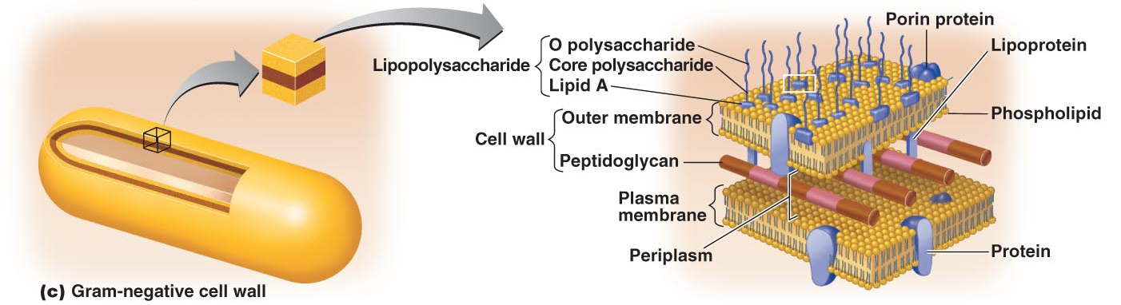
The Production of Toxins
Endotoxins – toxic outer portion of gram-negative cell wall
lipid A: lipopolysaccharide (LPS)
released when bacteria die and cell wall undergoes lysis
Can also be released during multiplication
If you treat a bacterial infection with antibiotics, the bacterial will die and release the endotoxins making the patient worse at first
Notes:
Understand how endotoxins are released and which portion causes the symptoms. Also, understand why symptoms may worsen at the start of antibiotic chemotherapy.

Slide 22
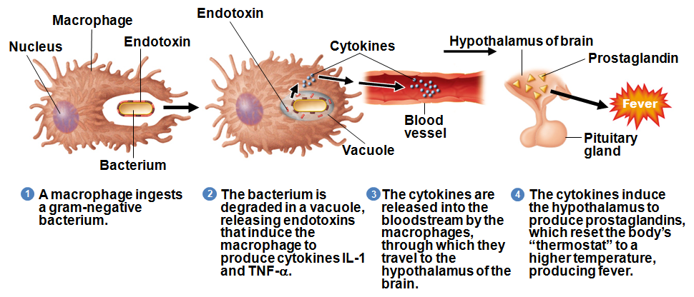
Pyrogenic response - Fever
endotoxins released as bacteria are digested by phagocytes
cytokines released and travel to brain - reset “thermostat”

Slide 23
Endotoxins
Source | Gram-negative
Relation to Microbe | Outer membrane
Chemistry | Lipid A
Fever? | Yes
Neutralized by Antitoxin? | No
LD₅₀ | Relatively large
Notes:
Know these concepts well.

Slide 24
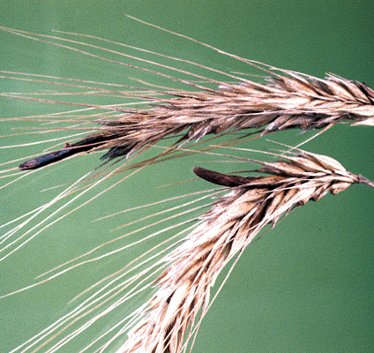
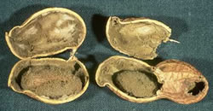
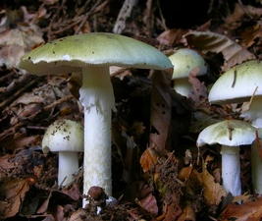
Pathogenic Properties of Fungi
Fungal waste products may cause symptoms
Chronic infections provoke allergic response
Ergot toxin
grows on grains (rye)
natural source of LSD, causes hallucinations
Outbreak in the Middle Ages
Aflatoxin
carcinogenic toxin on plants (peanuts)
Mycotoxins
produced by mushrooms
phalloidin & amanitin: neurotoxins produced
by Amanita phalloides (“death cap”)
Notes:
Please know what (rye, peanuts or mushrooms) produces these three fungal toxins

Slide 25
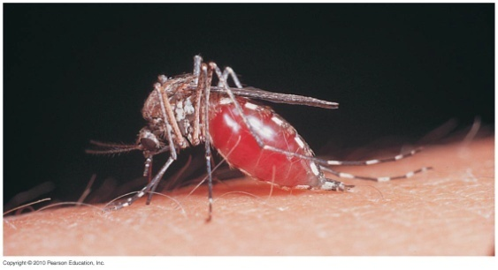
Portals of Exit
Generally similar to portals of entry
Secretion, excretion, discharge, or shed tissue
Respiratory tract
coughing and sneezing: mucous droplets
Gastrointestinal tract
feces and saliva
Genitourinary tract
urine, secretions from penis or vagina
Skin
Blood
biting arthropods, needles or syringes
Drainage from wounds
Notes:
Know these well.

Slide 26
Figure 15.18
Antigenic drift and antigenic shift in influenza viruses.
In antigenic drift, mutations in the genes for the surface proteins neuraminidase and/or hemagglutinin result in small antigenic changes over time.
In antigenic shift, simultaneous infection of a cell with two different influenza viruses results in mixing of the genes. The resultant virus possesses a mixture of the proteins of the original viruses. Influenza pandemics can often be traced to antigenic shifts.

