Slide 1
Math Skills and Chemistry Workshop for Elements of Microbiology
Revised Fall 2018
CCV – Rutland
Professor Dionne
Notes:
Regardless of your background in Chemistry and Algebra, please consult all of these slides. Pay attention to these notes at the bottom of the slides as well as the audio clips I have embedded on some of the slides. You will also need to complete the quiz and earn a 100% to move forward in this course. If you have questions with any of this information, please do not hesitate to email me as needed.

Slide 2
Why?
Why Algebra?
Solve equations
Critical thinking
Scientific notation
Metric system
Why Chemistry?
Everything is made of chemicals
Biochemical reactions
pH ranges
Notes:
Why do we need to know basic math and chemistry concepts in Microbiology?

Slide 3
Basic Algebra/Math Skills
Notes:
Let’s begin with basic Algebra/Math skills….

Slide 4
Scientific Notation
Professional method of expressing numbers that are otherwise too large or too small to be easily written in standard decimal format
Follows the format: m × 10^{n}
For example:
1 x 10³ = 1,000
5 x 10² = 500
Coefficient
Exponent
Notes:
Please be very comfortable with this concept.

Slide 5
Scientific Notation – Large #s
Large numbers can be simplified using the exponent to determine how many places (x 10) to move the decimal.
For example:
Please write 3,000,000 in scientific notation:
3,000,000 = 3.0 x 10?
3,000,000 = 3.0 x 10⁶
Please write 4.5 x 10⁴ in standard decimal notation:
4.5 x 10⁴ = ?
4.5 x 10⁴ = 45,000

Slide 6
Scientific Notation – Small #s
Small numbers can be simplified using the exponent to determine how many places (x 10) to move the decimal to the left, as signified by a negative exponent.
For example:
Please write 0.00034 in scientific notation:
0.00034 = 3.4 x 10?
0.00034 = 3.4 x 10⁻⁴
Please write 2.3 x 10⁻⁶ in standard decimal notation:
2.3 x 10⁻⁶ = ?
2.3 x 10⁻⁶ = 0.0000023

Slide 7
Scientific Notation - Practice
Convert the following to scientific notation:
4,560,000,000 =
2,400 =
0.000345 =
0.0000006 =
Convert the following to standard decimal notation:
5.6 x 10⁸ =
1.4 x 10⁴ =
3.0 x 10⁻⁵ =
Notes:
Please make the following conversions on a piece of paper. You may check your answers below:
4.56 x 10⁹
2.4 x 10³
3.45 x 10⁻⁴
6.0 x 10⁻⁷
560,000,000
14,000
0.00003

Slide 8
The Metric System
The metric system is a standard unit of measure used in most countries and in all scientific fields.
In this course, we will measure:
Mass in grams (g.)
Length in meters (m.)
Volume in Liters (L.)

Slide 9
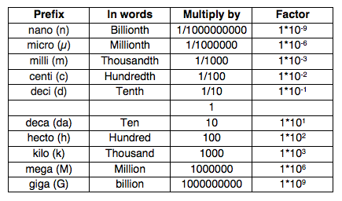
Metric Prefixes
Notes:
Please know the following prefixes well as they will be used often in this course: nano, micro, milli, centi, kilo, mega and giga.

Slide 10
Working in the Metric System
Please complete the following conversions:
4 µm. = ___________m.
34 mg. = ____________g.
150 mL. = ____________L.
3 mL. = _____________µL.
10 mm. = ___________ cm.
6 µg. = _____________ mg.
Notes:
Please practice the following conversions and then look below for the answers (hint: please write in scientific notation whenever possible):
4 x 10⁻⁶ m.
3.4 x 10⁻² g.
1.50 x 10⁻¹ L.
3.0 x 10³ µL
1.0 cm.
6.0 x 10⁻³ mg.

Slide 11
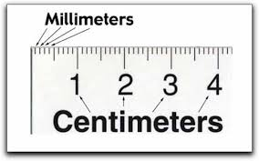
Reading a Metric Ruler
Notes:
We will be using a metric ruler often to measure small lengths in this course. Please be familiar with how a metric ruler is read. For example, please realize that 10mm is the same as 1cm. When listing your measurements in this course you must be careful to label your units correctly as mm or cm.

Slide 12
Solving Equations - Tips
Simplify equation when possible
Think of “=“ as a balance
Do each step separately
What you do to one side of equation, you must do to the other side
Keep track of units when necessary
Reduce whenever possible
Proceed in order of priority: PEMDAS

Slide 13
Order of Operations
PEMDAS – “Please Excuse My Dear Aunt Sally”
When two or more operations are present in a single equation, the order of the letters PEMDAS, tells you what to calculate first, second, etc.
P - Parenthesis
E - Exponents
M - Multiplication
D - Division
A - Addition
S - Subtraction
Highest Priority
Lowest Priority

Slide 14
Solving for an Unknown Variable
Please convert the following equation to solve for A:
A x B = C x D
A x B = C x D
B B
A = C x D
B
If B = 2, C = 4, and D = 6, what is A?
A = ?

Slide 15
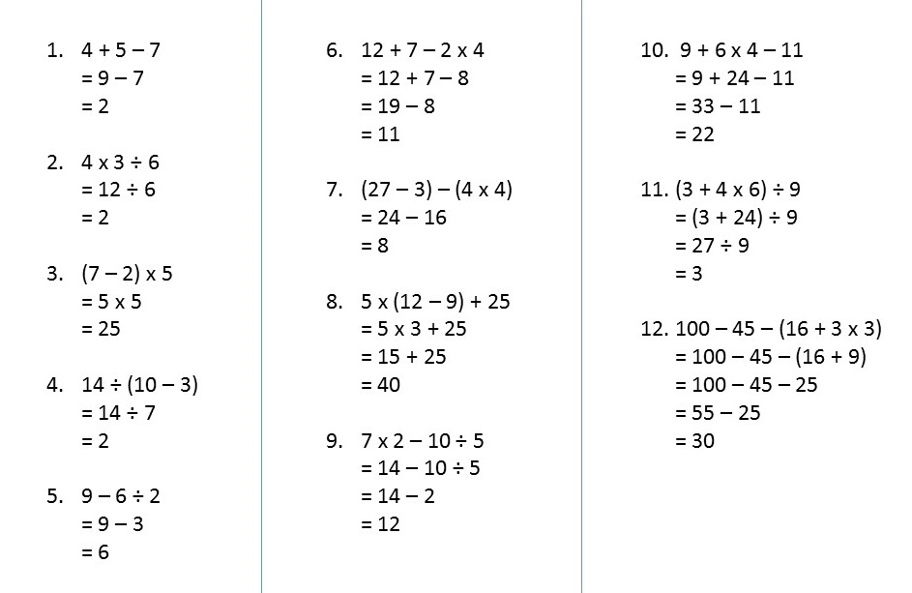
Practice
https://www.basic-math-explained.com/order-of-operations.html#.WluUZmwwvIU
Notes:
Please review these practice examples. Please note: for the examples without visible answers, please perform them on a sheet of paper and then if you click just below the equation, you will be able to move the white box and reveal the answer.

Slide 16
Chemistry for Microbiology
Notes:
Now we will move onto the basic chemistry concepts to be familiar with for Microbiology.

Slide 17
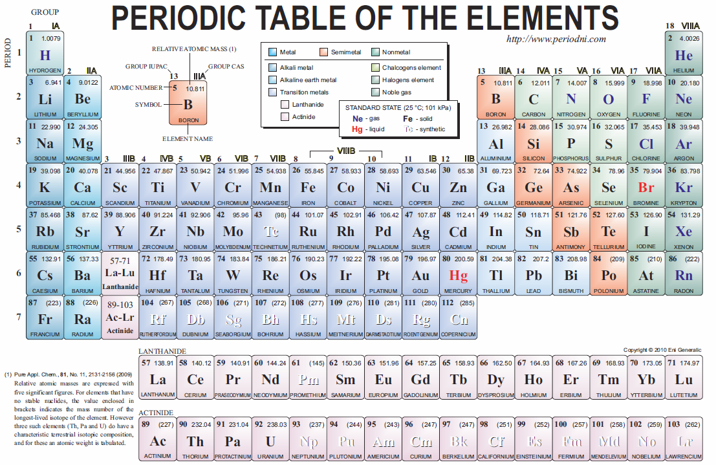
Composition of Matter
Notes:
Please listen to audio.

Slide 18
Element Symbols to Know for this Course
H - Hydrogen
C - Carbon
N - Nitrogen
O - Oxygen
Na – Sodium
P - Phosphorus
S - Sulfur
Cl - Chlorine
K - Potassium
Ca - Calcium
Notes:
Please know these symbols well for this course.

Slide 19
Composition of Matter
Matter – anything that has mass & occupies space
Elements – basic building blocks of matter
Atom – smallest possible piece of an element
Atoms are composed of
Electrons: negatively charged particles
Protons: positively charged particles
Neutrons: uncharged particles
Notes:
Please know this slide and these definitions well.

Slide 20
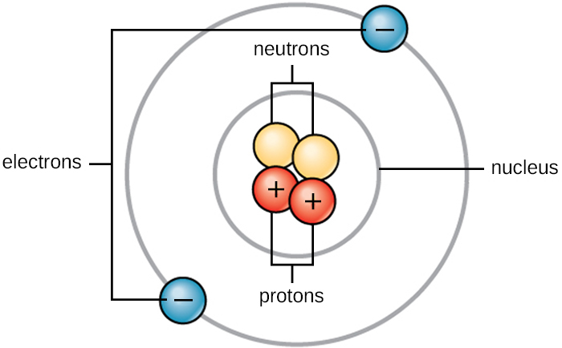
Basic Atomic Structure
Atoms – made of protons (+1), neutrons (0), & electrons (–1)
nucleus – center of atom
contains protons & neutrons (positive)
electrons move around outside the nucleus, creating an electron cloud
negative electrons attracted to positive nucleus
electrons can’t leave atom without input of energy
Notes:
Understand where electrons are located in comparison to protons, neutrons and the nucleus of an atom.
Hint: Do not confuse the nucleus of an atom with that of a cell.

Slide 21
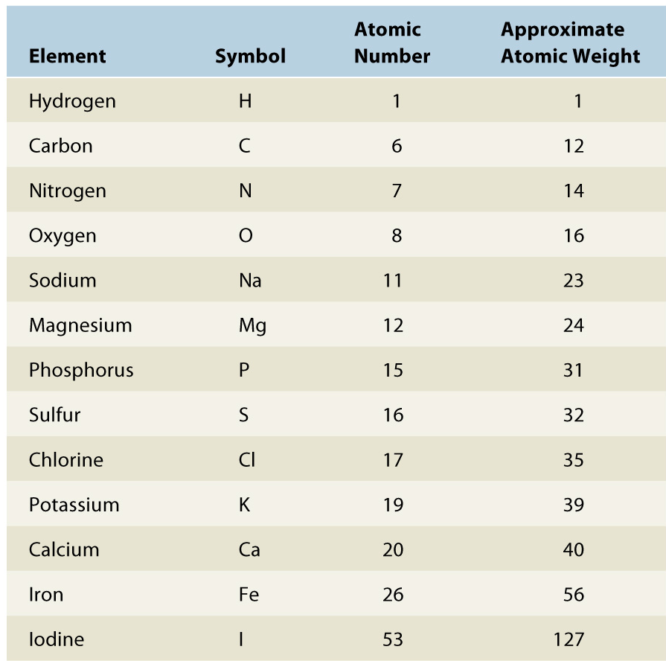
Elemental Properties
Atomic Number – number of protons
Defines an element
Mass Number (atomic weight) – number of protons and neutrons
Almost every element will have an isotope (a version of the element with more neutrons)

Slide 22
Practice Problems
Sodium has an atomic number of 11 and a mass number of 23. How many neutrons are in its nucleus?
Chlorine has an atomic number of 17 and a mass number 35. Assuming an overall neutral charge, how many electrons are present?
Element X has an atomic number of 30 and a mass number of 70. Assuming an overall neutral charge, how many protons are present?
Notes:
Please answer the following questions on a sheet of paper and then check your answers below:
12 neutrons (23-11 = # of neutrons).
17 electrons (assuming an overall neutral charge, then the number of protons (positive charge) must equal the number of negative charges (electrons).
30 protons (atomic number is the number of protons).

Slide 23
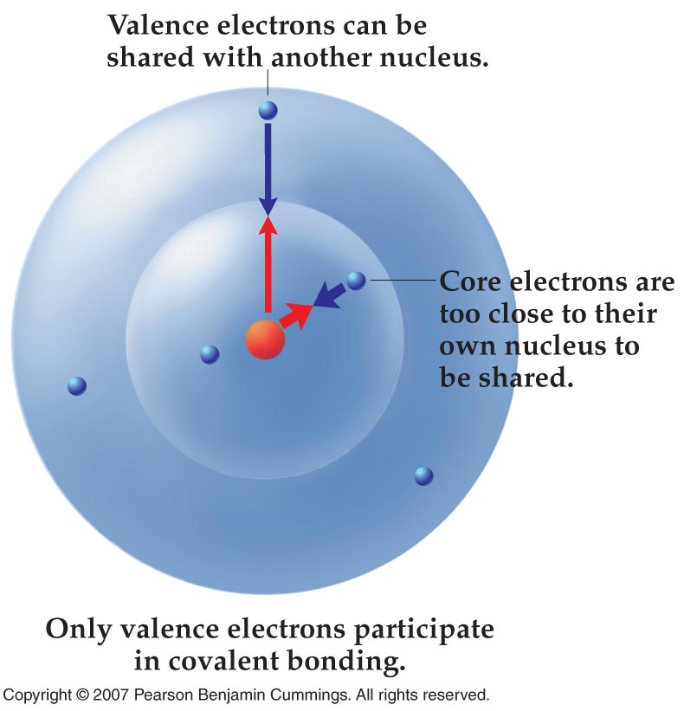
Covalent Bonds
When atoms come together to form molecules, it’s always the valence electrons that interact
valence electrons – in outer shell
Covalent bond –results from valence electrons being shared between two nuclei; bond holds molecules together
electrons are shared
very strong bond
generally between nonmetals
Notes:
Here, most atoms want to share a total of 8 electrons in the valence shell, this is known as the octet rule. An exception is Hydrogen, which only wants to share a total of 2 electrons.

Slide 24
Ionic Bonds – Transferring Electrons
Ionic bond – a bond between two ions, formed when atoms of one give up electrons and the atoms of the other accept electrons
electrons are transferred, NOT shared
electrons lost by metal, gained by nonmetal
oppositely charged ions attract each other
moderately strong bond
Notes:
Chlorine takes an electron from sodium, causing Na+ and Cl-, opposites attract so the two atoms bond together
In general, non-metals form covalent bonds and metals form ionic bonds with non-metals
Question: If Sodium lost an electron, why is it designated as being “+”? Hint: what charge does an electron have?

Slide 25
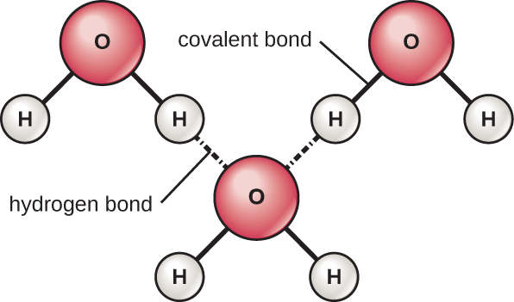
Hydrogen Bonds
Hydrogen bond – attraction between δ+ H covalently bonded to O, N, or F and δ– O, N, or F of another molecule
Hydrogen bonds:
individually fairly weak
collectively quite strong
responsible for unique
properties of water
Notes:
δ means partially, or weakly (negative or positive) in charge
Hydrogen bonding is what allows for the surface tension of water. For example, if you have two droplets of water near each other what happens as they touch? Do they remain as two drops? What happens when you jump into a pool? Does the water break into individual molecules or do droplets cause a splash? Which is less painful a cannonball into a pool or a belly flop? Why? (Hint: think surface area versus surface tension). These are all examples of Hydrogen bonding.

Slide 26
Dissociation of ions in water
When table salt (NaCl) is mixed in water, spheres of hydration form around the ions.

Slide 27
Acids, Bases, and Salts
Acids – H⁺ donor; dissociate into one or more H⁺
HCl → H⁺ + Cl⁻
Bases – H⁺ acceptor; dissociate into one or more OH⁻
NaOH → Na⁺ + OH⁻
Salts – dissociate into cations (positive ions) & anions (negative ions), but not H⁺ or OH⁻
NaCl → Na⁺ + Cl⁻
Notes:
Please know these definitions well.

Slide 28
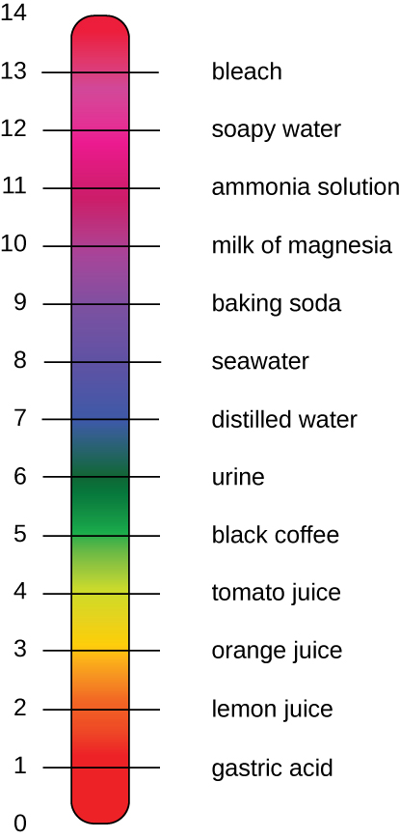
Acid-Base Balance
pH – concentration of H⁺ in solution: pH = −log[H⁺]
pH scale: logarithmic
from 0 (strong acid) to 14 (strong base); 7 is neutral
Buffers – prevent changes in pH
release & accept H⁺
Most organisms grow best at pH 6.5-8.5
enzymes require particular pHs to retain shape
biochemical reactions very sensitive to pH
Notes:
Please be familiar with the info on the left side of the slide. You do NOT need to know the pH of the liquids given, they are simply a reference for you.

Slide 29
Practice Problems
Which of the following solutions has the greater hydrogen ion concentration, a solution with a pH of 3 or a solution with a pH of 6?
Which of the following solutions is most acidic? Solutions of pH 7, 9, 11, 13?
Which of the following solutions has the greater hydrogen ion concentration, a solution with a pH of 9 or a solution with a pH of 11?
Notes:
Please answer the following questions on a separate sheet of paper and then check your answers below:
pH 3
pH 7 (by comparison, even though 7 itself is considered neutral).
pH 9

Slide 30
Chemical Reaction Formulas
A
+
B
AB
Reactants
Products
AB
A
+
B

Slide 31
Chemical reactions
Combines to form
Synthesis Reaction
Occur when atoms, ions, or molecules combine to form new, larger molecules
Anabolism is the synthesis of molecules in a cell
Decomposition Reaction
Occur when a molecule is split into smaller molecules, ions, or atoms
Catabolism is the decomposition reactions in a cell
A
+
B
AB
Breaks down into
AB
A
+
B

