Slide 1
Chapter 3
Functional Anatomy of Prokaryotic and Eukaryotic Cells
Notes:
1

Slide 2
The Debate over Spontaneous Generation
Spontaneous generation: the hypothesis that living organisms arise from nonliving matter; a “vital force” forms life
Vs
Biogenesis: the hypothesis that living organisms arise from preexisting life
Notes:
Think back to societies of the past. What did it mean to contradict what the majority believed to be true? Many believed that the theory of biogenesis denounced God’s existence. What implications might that have?

Slide 3
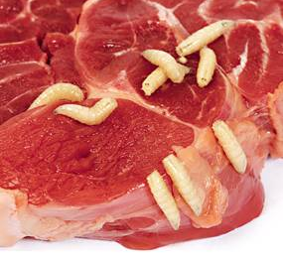
The Debate over Spontaneous Generation
Aristotle: 325 BC thought that life arose spontaneously
“vital force” forms life
common belief among scientists
examples:
moist soil → toads, snakes, mice
manure → flies
decaying corpses → maggots

Slide 4
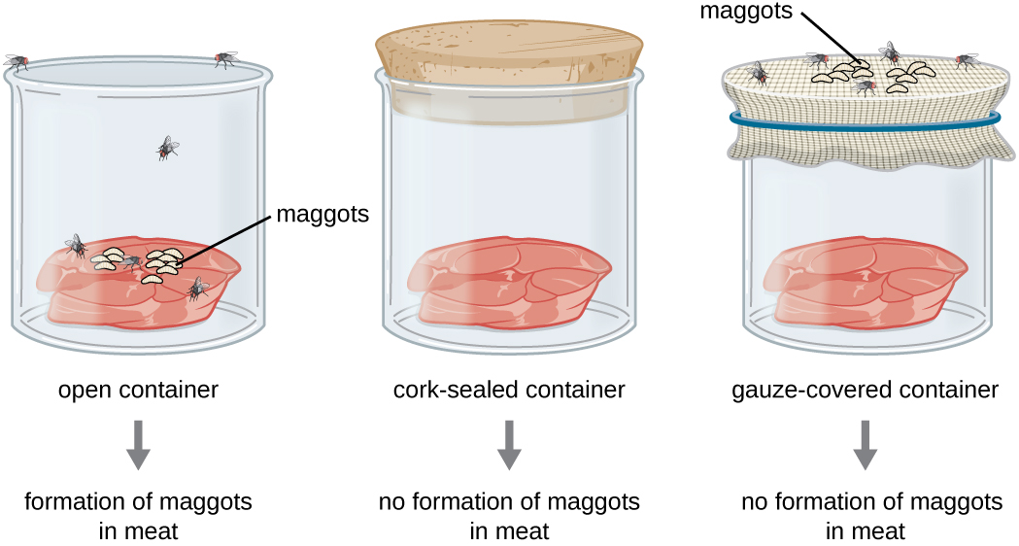
1668: Francesco Redi filled jars with decaying meat
Many scientists still believed in spontaneous
Generation, especially of the small “animalcules”

Slide 5
Louis Pasteur
French scientist Louis Pasteur, who definitively refuted the long-disputed theory of spontaneous generation.
The unique swan-neck feature of the flasks used in Pasteur’s experiment allowed air to enter the flask but prevented the entry of bacterial and fungal spores.
Pasteur’s experiment consisted of two parts. In the first part, the broth in the flask was boiled to sterilize it. When this broth was cooled, it remained free of contamination. In the second part of the experiment, the flask was boiled and then the neck was broken off. The broth in this flask became contaminated. (credit b: modification of work by “Wellcome Images”/Wikimedia Commons)
Notes:
Please be familiar with this experiment and how it was paramount in disproving the theory of spontaneous generation.

Slide 6
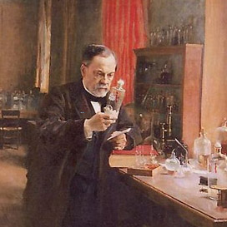
Louis Pasteur demonstrated:
spontaneous generation not possible
microorganisms present in non-living matter (solids, liquids, air)
microbial life destroyed by heat
Basis of aseptic technique
prevent contamination by unwanted microorganisms
standard laboratory and medical practices today
Notes:
Appreciate the significance of these discoveries.

Slide 7
The new belief
Biogenesis – hypothesis that living organisms arise from preexisting life
1858: Rudolph Virchow

Slide 8
The Germ Theory of Disease
Germ theory of disease – microorganisms cause disease
not demons or punishment from God
1835: Agostino Bassi showed that a silkworm disease was caused by a fungus
1865: Pasteur believed that another silkworm disease was caused by a protozoan
Notes:
Again, you must imagine being in the 1800s and hearing that disease was due to microscopic organisms and not deities.

Slide 9
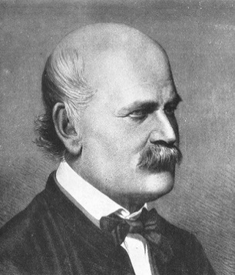
The Germ Theory of Disease
1840s: Ignaz Semmelweis
hand washing prevented puerperal fever in OB patients
1860s: Joseph Lister
chemical disinfectant prevented surgical wound infection
1876: Robert Koch
bacterium causes anthrax
V
Notes:
Please know these scientists are associated with these discoveries.

Slide 10
Prokaryotic Cells: Shapes
Average size: 0.2 – 2.0 µm × 2 – 8 µm
Shape determined by heredity
most bacteria monomorphic – maintain single shape
some pleomorphic – can have many shapes
Notes:
Please know these terms and shapes.

Slide 11
Figure 3.13
(credit “Coccus” micrograph: modification of work by Janice Haney Carr, Centers for Disease Control and Prevention; credit “Coccobacillus” micrograph: modification of work by Janice Carr, Centers for Disease Control and Prevention; credit “Spirochete” micrograph: modification of work by Centers for Disease Control and Prevention)
Notes:
Please know these shapes.

Slide 12
Common Arrangements
Notes:
Please know these arrangements.

Slide 13
Arrangements of Bacillus
Bacillus: name & shape
scientific name: Bacillus
shape: bacillus
Bacillus divide only along short axis (1 plane)
diplobacilli – pairs
streptobacilli – chains
coccobacillus – rounded but still rod shaped
Notes:
Scientific name is big B (Genus), shape name is little b (descriptive)
Please know these terms.
Please see previous slide for visual.

Slide 14
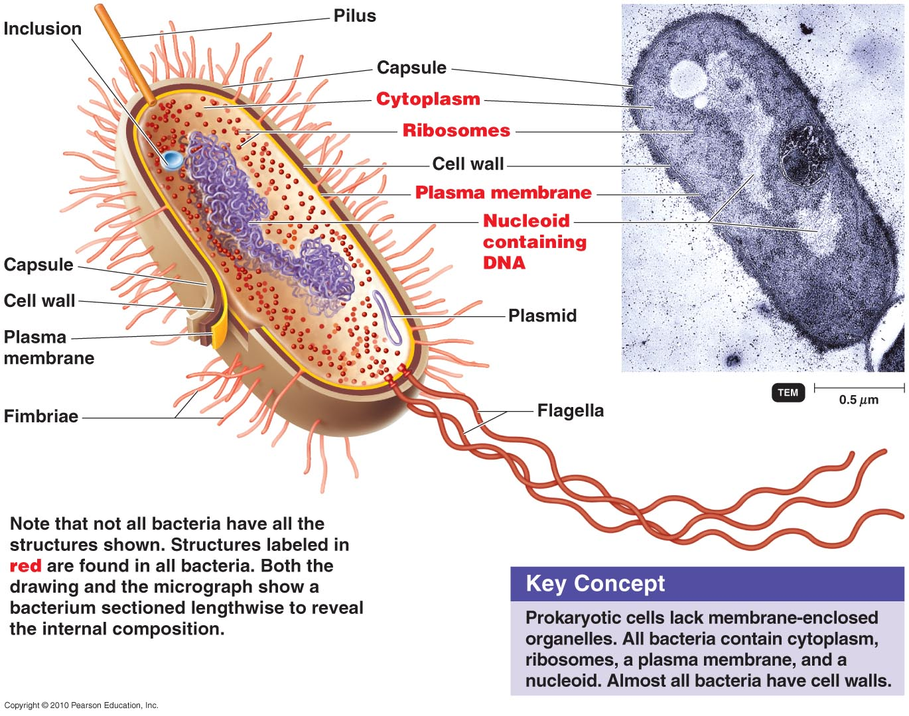
Structure of a Prokaryotic Cell
Notes:
Please be familiar with the structures in red as they are found in all bacteria. Photo credit to Tortora’s Introduction to Microbiology.

Slide 15
The Cell Wall
Cell wall – rigid; outside of the plasma membrane
responsible for cell shape
protects plasma membrane & cell from environment
Prevents osmotic lysis (rupture)
anchors flagella (tail)
contributes to pathogenicity
used to differentiate
bacterial types
Notes:
Please understand the importance and function of the cell wall in bacterial species.

Slide 16
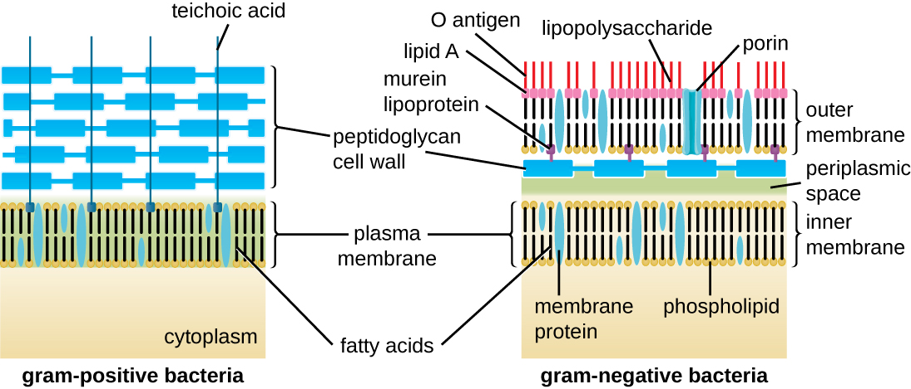
The Cell Wall
Bacterial cell wall made of peptidoglycan
Notes:
Adjacent rows are linked by polypeptides
Be familiar with this structure as it will be important to understand once we discuss antibiotics

Slide 17
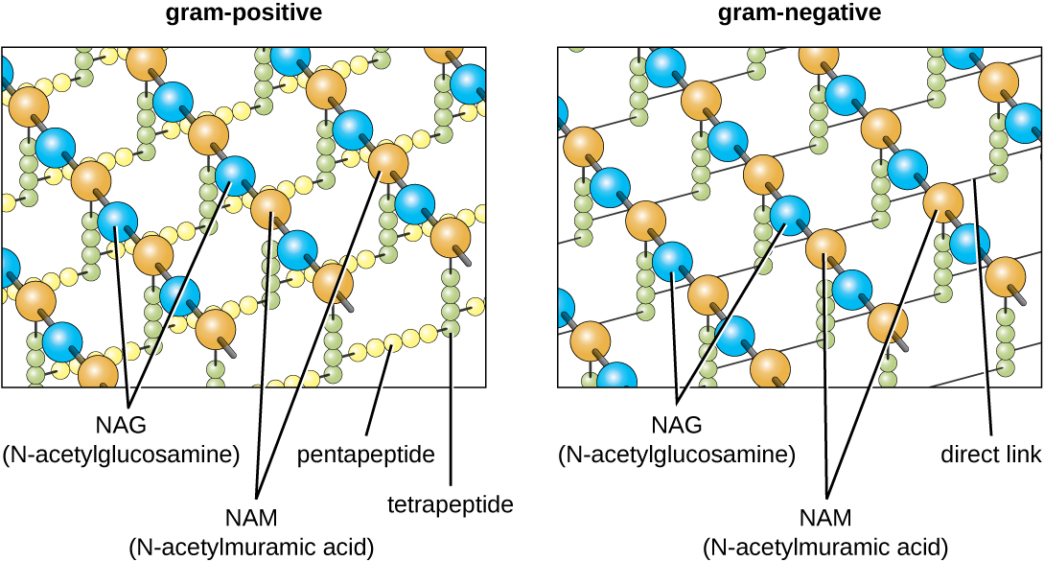
Gram-Positive Cell Walls
Gram-positive cell walls
many peptidoglycan layers
mechanically strong
Lipoteichoic acid links to plasma membrane
Wall teichoic acid links to peptidoglycan
Polysaccharides provide antigenic variation
prevent cell wall breakdown
Notes:
Phosphate groups cause the negative charge of the acid

Slide 18
Gram-Negative Cell Walls
Gram-negative cell walls
thin peptidoglycan layer bound to outer membrane lipoproteins
susceptible to mechanical breakage
no teichoic acids
Notes:
Understand some basic structural differences between Gram-positive and Gram-negative cell walls.

Slide 19
Gram-Negative Cell Walls
Gram-negative cell walls
outer membrane – lipopolysaccharides (LPS), lipoproteins, & phospholipids
strong negative charge: helps evade phagocytosis
barrier to antibiotics & digestive enzymes
3 components of LPS:
lipid A – in top layer of outer membrane
endotoxin: responsible for symptoms of infections
core polysaccharide – provides stability
O polysaccharide – surface antigen
Notes:
Please know this information especially in regards to how Gram-Negatives differ from Gram-Positives
When microbes die they release lipid A as an endotoxin – causes fever, dilation of blood vessels, shock, blood clotting

Slide 20
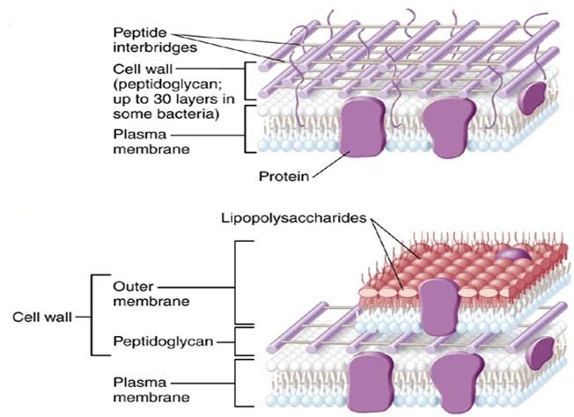
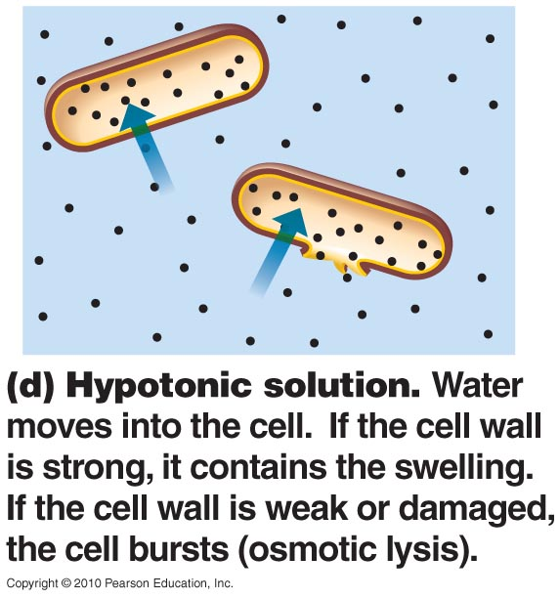
Damage to the Cell Wall
Cell wall synthesis: target for antimicrobial drugs
Lysozyme
digestive enzyme produced by many eukaryotic cells
digests peptidoglycan backbone
gram-positive cells become protoplasts – cells missing cell walls
gram-negative cells become spheroplasts – wall missing, outer membrane still intact
protoplasts & spheroplasts susceptible to osmotic lysis
burst in water
Notes:
Please know bolded terms.

Slide 21
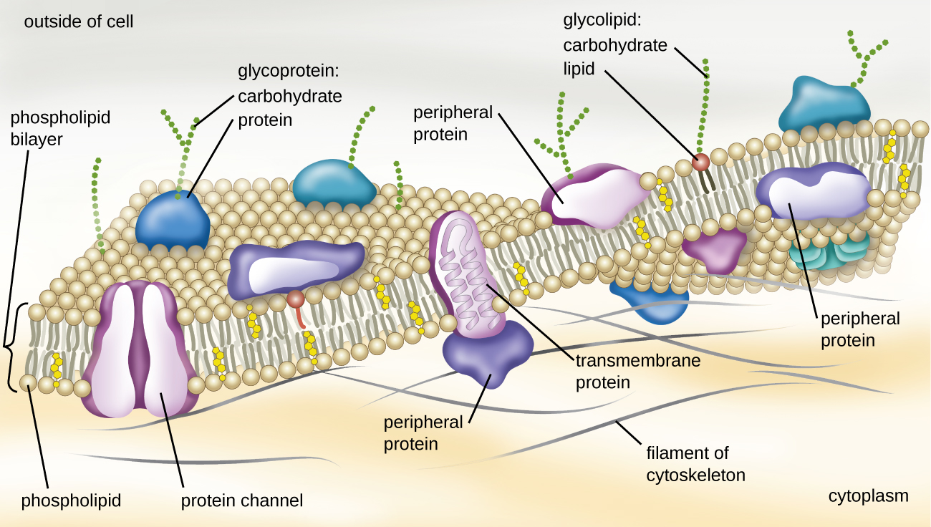
Plasma Membrane

Slide 22
The Plasma Membrane – Structure
Membrane proteins
peripheral proteins – on inner or outer surface
integral proteins (transmembrane proteins) – penetrate membrane
may have channel through center
Notes:
Please understand the different types of proteins that may exist in the plasma membrane.

Slide 23
The Plasma Membrane – Function
Selective permeability – allows passage of some molecules
large molecules & ions can’t pass
small uncharged & lipid-soluble particles can get in
transporter proteins let in specific molecules
Notes:
Please understand the importance of this concept.

Slide 24
Movement of Materials Across Membranes
Passive processes
substances move with concentration gradient
from areas of high concentration to low concentration
Ex. simple diffusion, facilitated diffusion, osmosis
Active processes
cell uses ATP (Energy) to move substances against concentration gradient
from areas of low concentration to high concentration
Ex. active transport, group translocation
Notes:
This is an important slide, please understand this information well.

Slide 25
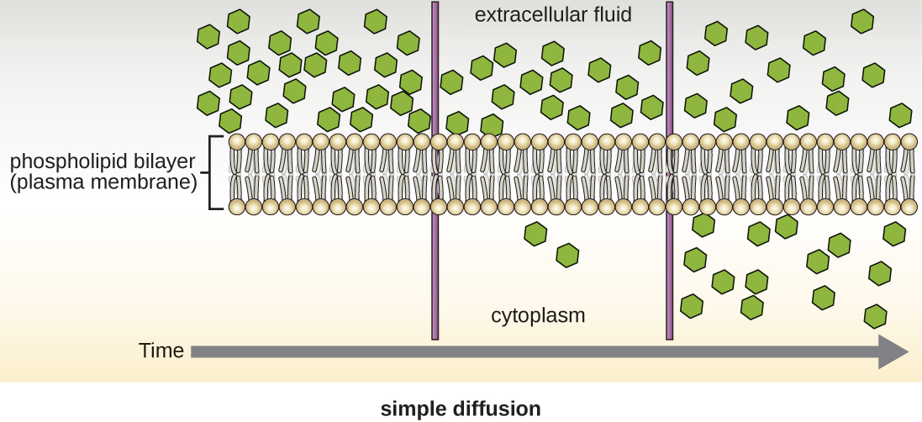
Movement of Materials Across Membranes
Simple diffusion
movement of solute from area of high concentration to area of low concentration
continues until equilibrium
Notes:
Know this definition. Please realize ATP is not required.

Slide 26
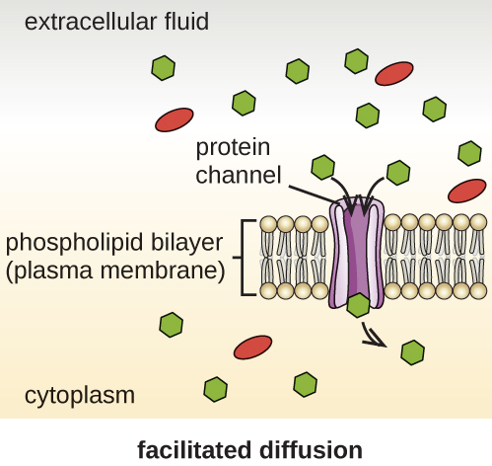
Movement of Materials Across Membranes
Facilitated diffusion
for ions, hydrophilic molecules, & large molecules
transporters or permeases (membrane proteins) form channels
solute binds to transporter; transporter changes shape & releases molecule on other side
Notes:
Know this definition. Please realize ATP is not required.

Slide 27
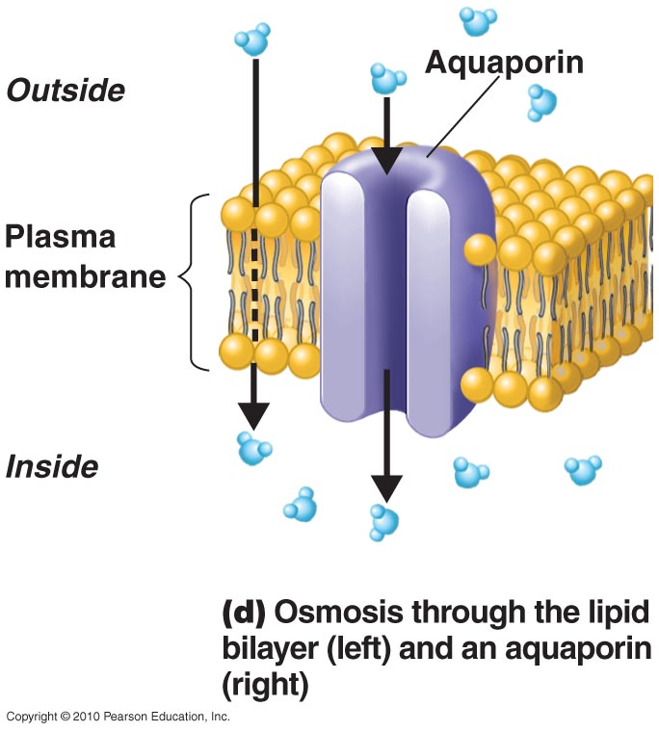
Movement of Materials Across Membranes
Osmosis
net movement of solvent across a selectively permeable membrane
from area of high solvent concentration to area of lower solvent concentration
solvent generally water
water moves into & out of cells through membrane & through aquaporins
Notes:
Please know this definition as well as purpose of aquaporins. Understand that this process discusses movement of solvent and not solute. Please realize it does not require ATP.

Slide 28
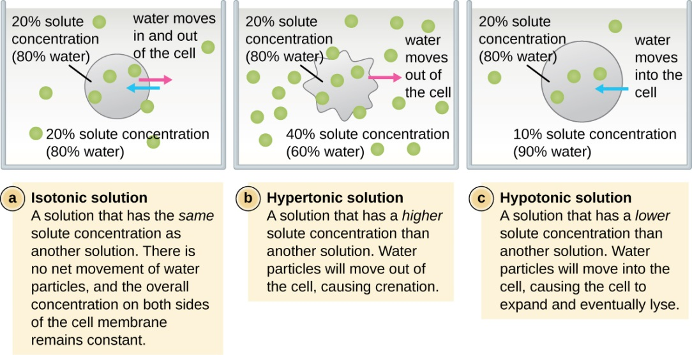
The Principle of Osmosis
Osmotic solutions: (relative to cell) “water follows salt”
isotonic – same concentration of solutes outside & inside
no net movement of water
hypotonic – concentration of solutes lower outside than inside
water enters cell; may swell or lyse (burst)
most bacteria live in hypotonic solutions; cell wall prevents lysis
hypertonic – concentration of solutes higher outside than inside
water leaves cell; causes cell to plasmolyze (shrink)
Notes:
This is a very important slide to understand. Please be comfortable with all of the concepts presented. Be able to determine what might happen to a cell in these three conditions. Understand the importance of the cell wall in a hypotonic solution for bacteria. Know the definitions lyse and plasmolyze.

Slide 29
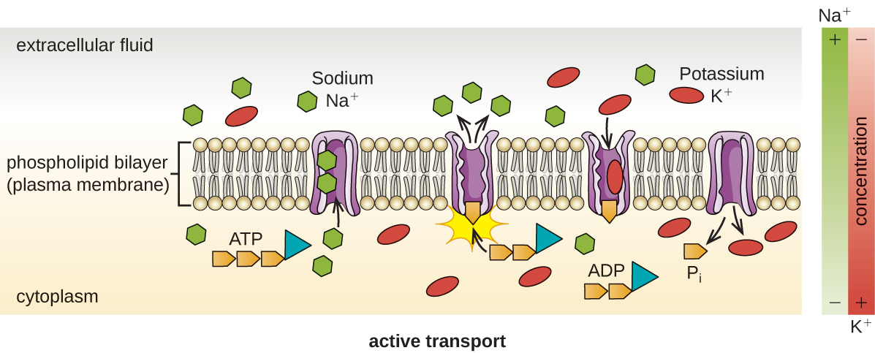
Movement of Materials across Membranes
Active transport
requires transporter protein & ATP
move substances across membrane against concentration gradients
substances not altered in transport
Ex. ions, amino acids, simple sugars
Notes:
Please understand that active transport requires energy in the form of ATP to complete movement across the membrane.

Slide 30
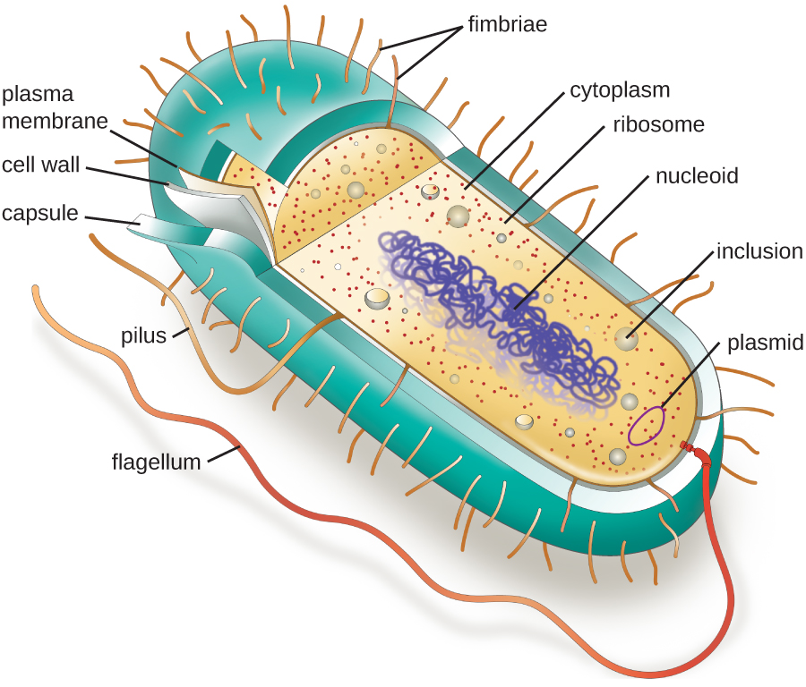
Cytoplasm
Cytoplasm – internal environment
inside plasma membrane
80% water: thick, semitransparent, elastic (gel-like)
protein filaments give cells shape
contains carbohydrates, enzymes, lipids, ions, etc.

Slide 31
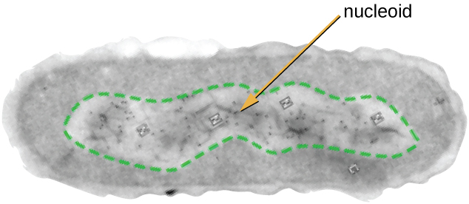
The Nucleoid Region
Nucleoid – location of DNA
spherical or elongated
region containing bacterial chromosome
double-stranded DNA circle,
attached to cell membrane
bacteria may also have plasmid
small double-stranded DNA circle
Notes:
This is important information to understand. Please remember that bacterial cells do have DNA, but not a nucleus. The region that houses the DNA is known as the nucleoid region, meaning “resembling a nucleus”.

Slide 32
Ribosomes
Ribosomes – sites of protein synthesis
smaller than eukaryotic ribosomes
2 subunits:
30S + 50S
Notes:
Please know that prokaryotes form a completed 70s ribosome (Hint: It is well known at 50 plus 30 is not 70, this is not a linear addition and is beyond this course to discuss why).

Slide 33
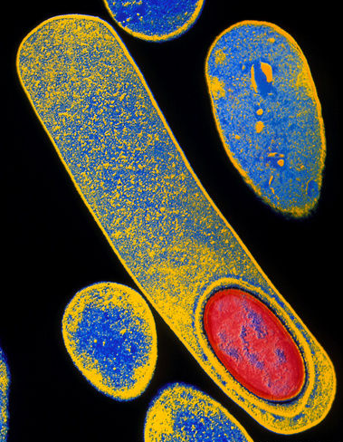
Endospores
Endospores – gram-positive resting cells
formed by Bacillus & Clostridium
formed when nutrients depleted
not for reproduction
thick, durable walls: resistant to desiccation, heat, chemicals, & radiation
problem for food industry
endospore in Clostridium difficile
Notes:
Upper image from Science Photo Library.
Clostridium difficile. Coloured Transmission electron micrograph of C. difficile bacterium forming an endospore (lower right, red oval). C. difficile, a Gram-positive anaerobic bacillus, exists in small numbers in the human gut. It can proliferate when intestinal resistance is low, producing a toxin that irritates the colon and causes diarrhea. In severe cases this leads to pseudomembranous colitis (PMC), where mucus and dead cells build up in plaques on the walls of the colon. PMC can be treated with an antibiotic but relapses are common because the bacteria forms such highly resistant spores. Magnification: x18,000 at 6x6.45cm size.

Slide 34
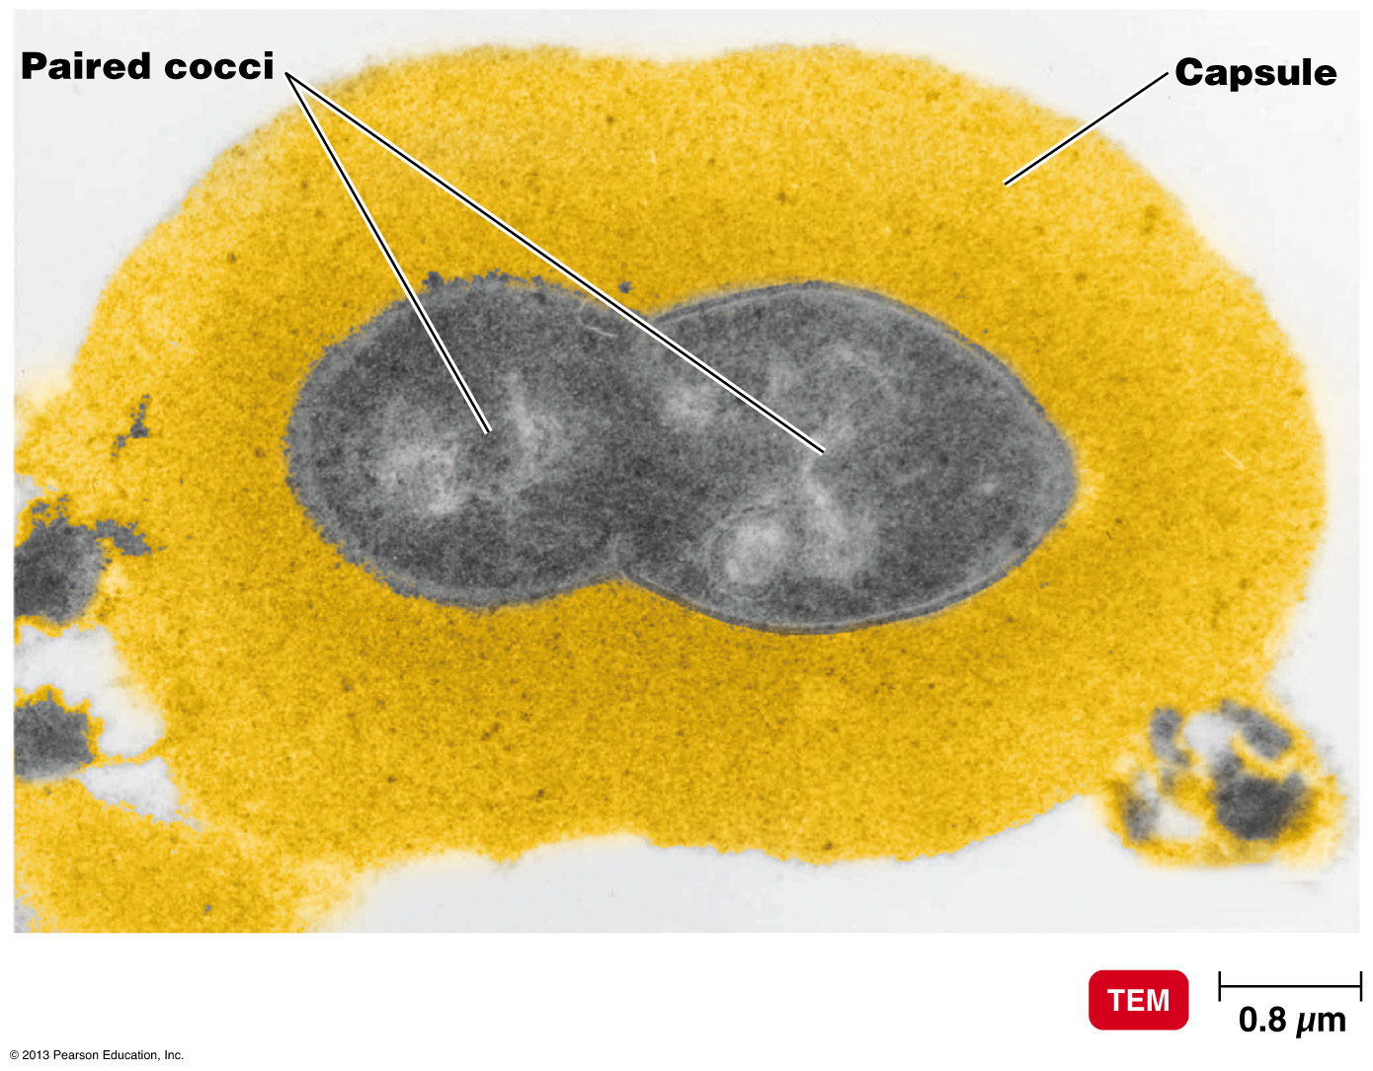
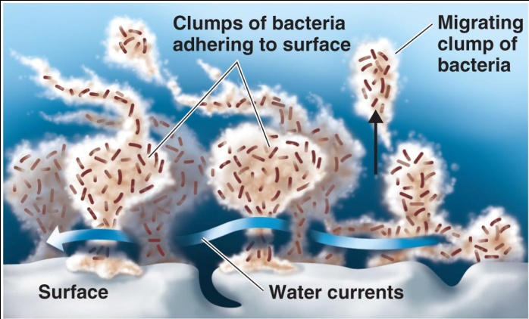
Outside the Cell Wall: Glycocalyx
Glycocalyx – sugar coat outside cell wall
usually sticky
polysaccharide, polypeptide, or both
Varies widely with species
capsule – if organized & firmly attached
protects pathogenic microbes from host
prevents phagocytosis (Being engulfed)
slime layer – if unorganized and loosely attached
for attachment to substrate & other cells
extracellular polymeric substance – glycocalyx produced by biofilm cells
helps attach to substrate
Notes:
Please understand these concepts. Please be able to compare a capsule to a slime layer.

Slide 35
Outside the Cell Wall: Flagella
Flagella – long & filamentous, propel bacteria
trichous – Greek for “hair”
atrichous – no flagella (no projections)
peritrichous – flagella distributed over entire cell
polar – flagella only at ends
monotrichous – 1 flagella
lophotrichous – tuft of flagella at 1 end
amphitrichous – flagella at both poles
Notes:
Please know these definitions. What is the purpose of flagella? Note: Prokaryotes spin clockwise or counterclockwise whereas eukaryotes use flagella in a wave motion

Slide 36
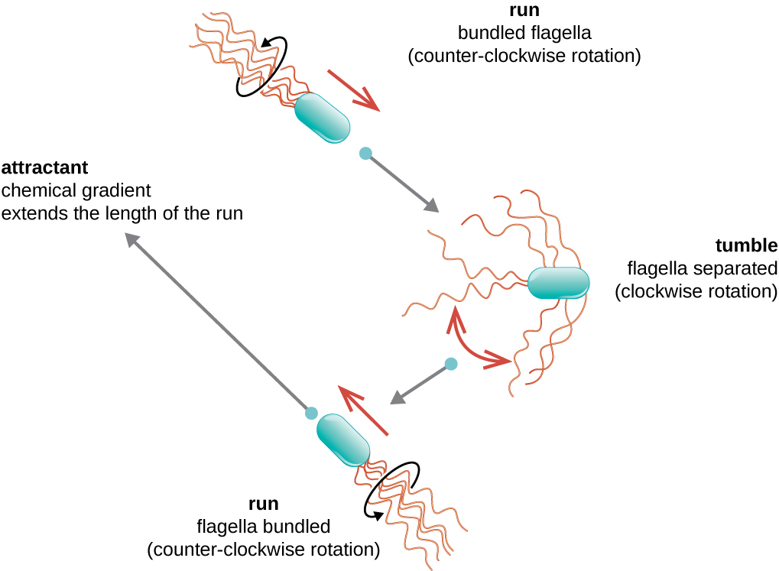
Motile Cells
Motility – alter speed & direction
run (“swim”) - move in one direction
tumble – change direction
reverse flagella spin
Moving requires energy
Taxis – move toward or away from stimuli
chemotaxis – response to chemicals
phototaxis – response to light
Notes:
Moving towards or away from Oxygen, toxins, food.

Slide 37
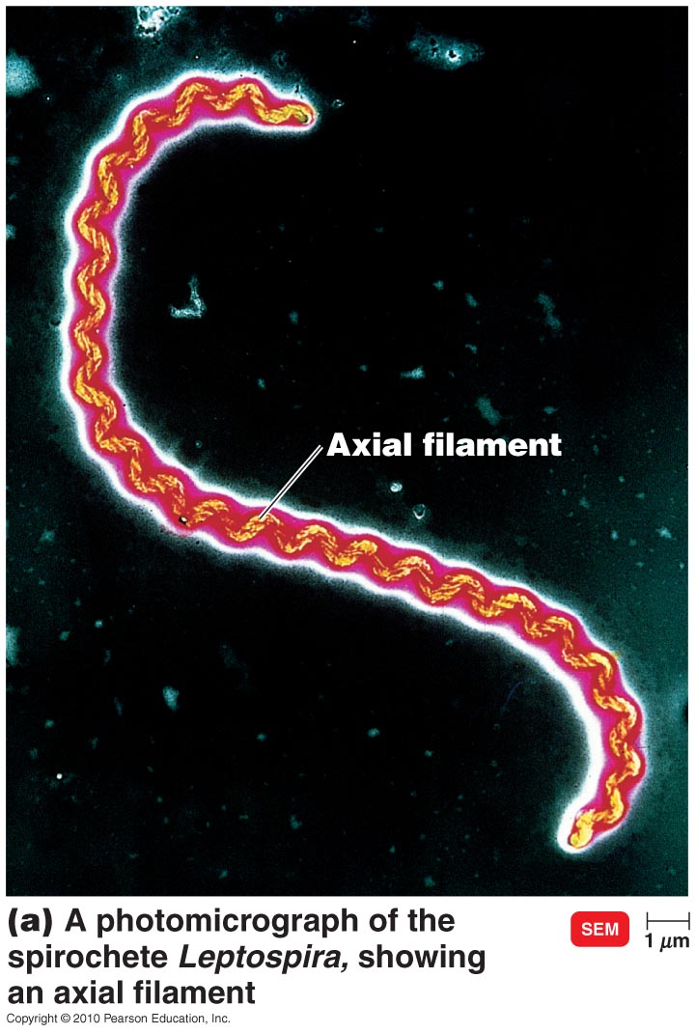
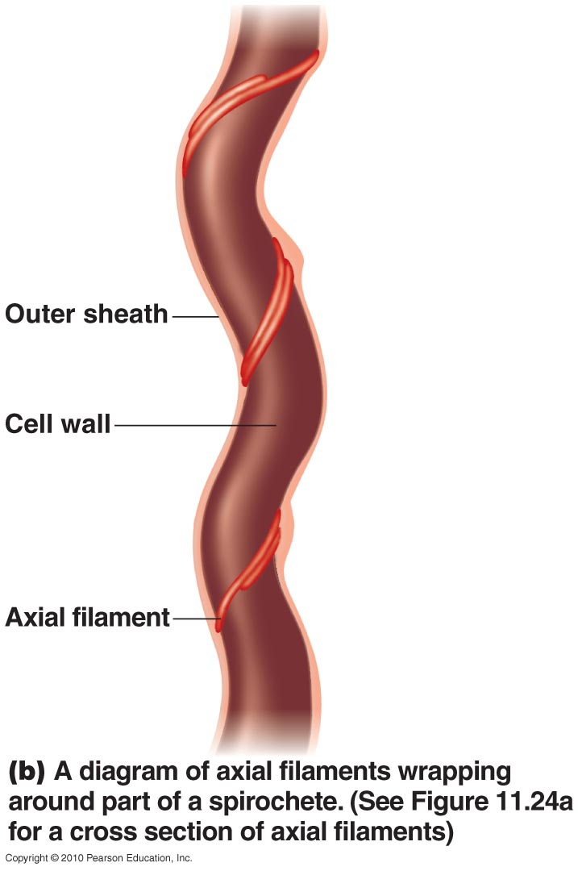
Outside the Cell Wall: Axial Filaments
Spirochetes move using axial filaments (endoflagella)
bundles of fibrils like flagella
anchored at one end, wrapped around cell
rotation causes corkscrew-like motion
Ex.Treponema pallidum
Ex. Borrellia burgdorferi
Notes:
Treponema pallidum - Causes Syphilis
Borrellia burgdorferi – Causes Lyme disease

Slide 38
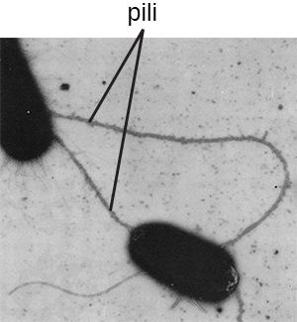
Outside the Cell Wall: Fimbriae and Pili
Fimbriae & pili
on gram-negative bacteria
shorter, straighter, & thinner than flagella
made of protein pilin
Fimbriae
adhere to each other & surfaces
for aggregations & biofilms

Slide 39
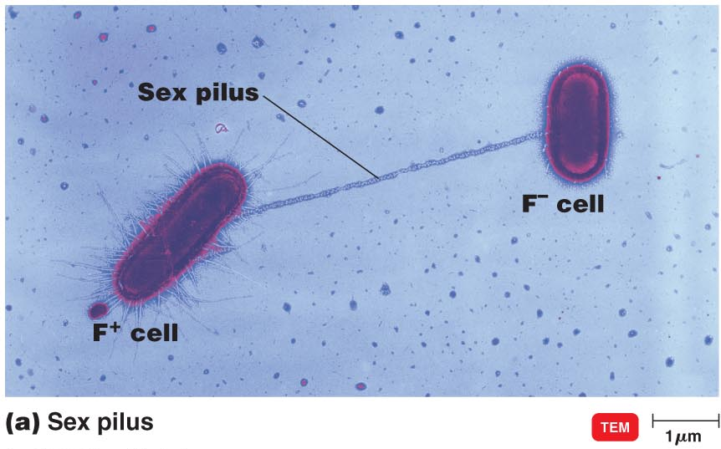
Outside the Cell Wall: Fimbriae and Pili
Pili
longer & fewer than fimbriae
for twitching & gliding motility
bring bacteria together
conjugation pilus connects 2 cells
Notes:
Please be able to compare and contrast pili and fimbriae.

Slide 40
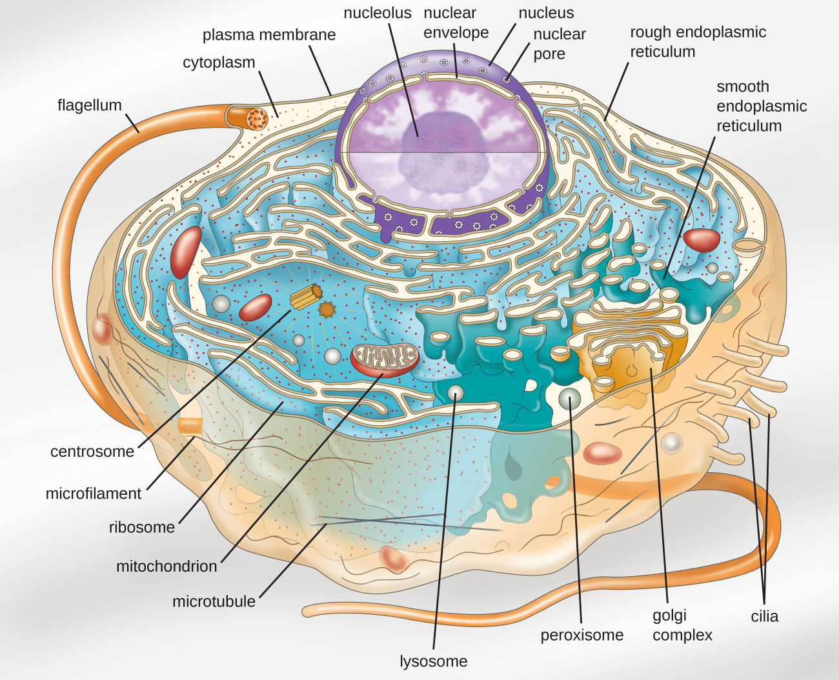
Structure of a Eukaryotic Cell

Slide 41
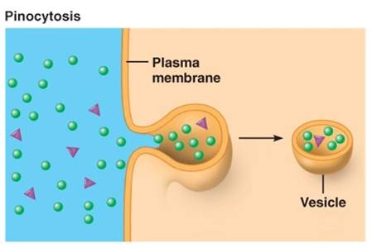
The Plasma Membrane
Eukaryotic plasma membranes:
generally similar to prokaryotic membrane
contain sterols – lipids; help cells resist lysis
Crossing the membrane:
endocytosis – membrane segment surrounds particle,
encloses it, brings it into cell
phagocytosis – pseudopods extend & engulf particles
pinocytosis – membrane folds inward, bringing in fluid
& dissolved substances
exocytosis – vesicles fuse with membrane & substances leave cell
Notes:
Please know the new, bolded terms.

Slide 42
Figure 3.52
Three variations of endocytosis are shown. (a) In phagocytosis, the cell membrane surrounds the particle and pinches off to form an intracellular vacuole. (b) In pinocytosis, the cell membrane surrounds a small volume of fluid and pinches off, forming a vesicle. (c) In receptor-mediated endocytosis, the uptake of substances is targeted to a specific substance (a ligand) that binds at the receptor on the external cell membrane. (credit: modification of work by Mariana Ruiz Villarreal)
Notes:
Please be familiar with these three types of endocytosis.

Slide 43
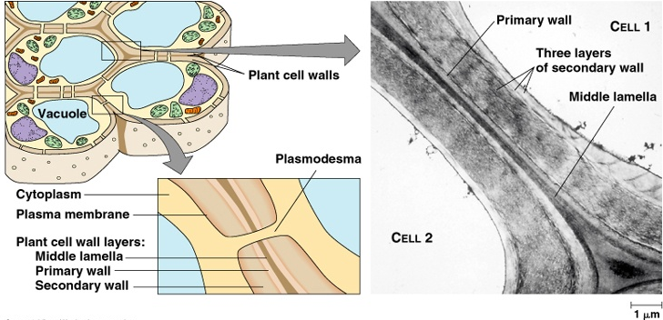
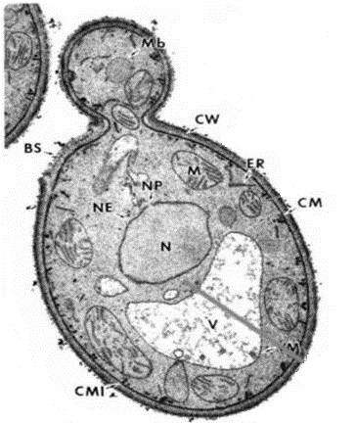
The Cell Wall
Cell walls
Most eukaryotes have them, but very simple
Not found in animal cells
no peptidoglycan
Antibiotics won’t target most eukaryote cells
made of carbohydrates:
cellulose: algae & plants
chitin: most fungi
glucan & mannan: yeasts
Notes:
Please know the components of cell walls in different organisms. Also, understand why it is important that the cell wall of animals does not contain peptidoglycan in regards to antibiotic usage.

Slide 44
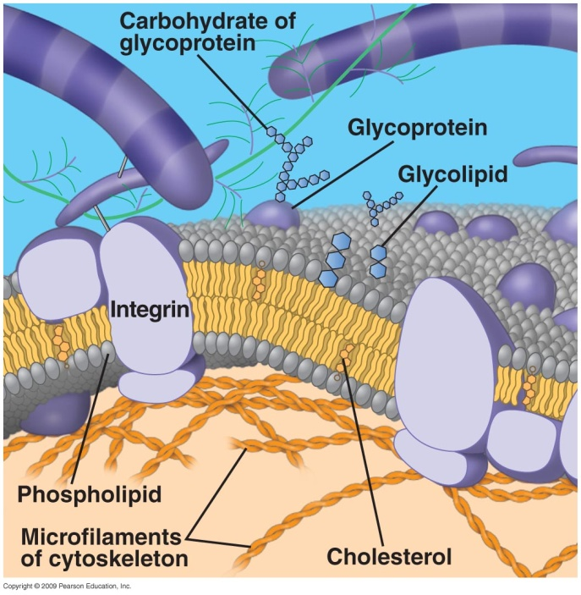
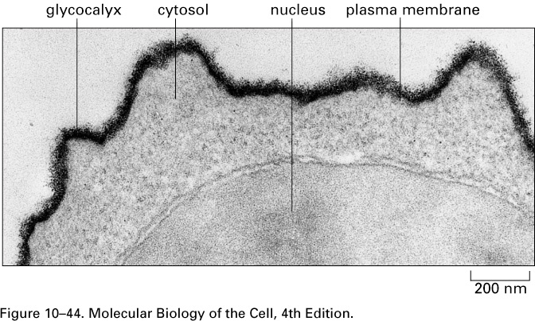
The Glycocalyx
Glycocalyx – substance found covering the cell membrane of some eukaryotes (animals too)
sticky carbohydrates extending from proteins in cell membrane
some attached to proteins (glycoproteins) & lipids (glycolipids)
Covalent bonds
strengthens cell surface
connects cells
works in cell-cell recognition

Slide 45
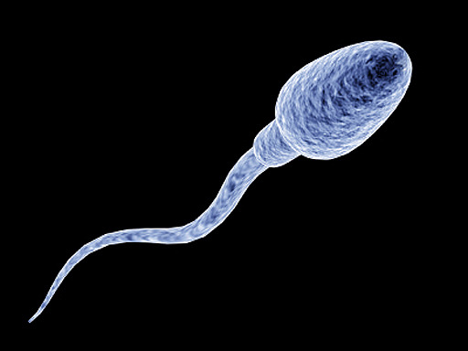
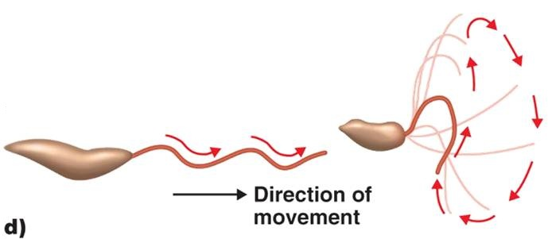
Flagella and Cilia
Cellular projections: for locomotion
flagella – few & long
cilia – many & short
move like a wave

Slide 46
Cytoplasm
Cytoplasm – inside membrane, outside nucleus
cytosol – fluid portion of cytoplasm
complex internal structure
cytoskeleton – microfilaments, intermediate filaments, & microtubules
support, shape, internal transport
cytoplasmic streaming – movement of cytoplasm in cells
distributes nutrients, moves cell
Notes:
Know these definitions.

Slide 47
Nucleus
Nucleus – contains DNA
Surrounded by nuclear envelope
double membrane
nuclear pores control movement in & out
Nucleolus
condensed region of chromosomes
where ribosomal RNA (rRNA) is made
Notes:
Know these definitions. Please be careful not to confuse the spelling of nucleus versus nucleolus on a quiz or exam. Also, please note that the plural of nucleus is nuclei and the plural of nucleolus is nucleoli.

Slide 48
DNA
Generally, DNA is uncoiled & stored in the nucleus
this is its “readable” form
uncoiled, humans have about 2 meters of DNA
chromatin – uncondensed DNA & associated proteins
DNA coils into chromosomes for cell division
chromosomes – condensed chromatin
Only seen during cell division

Slide 49
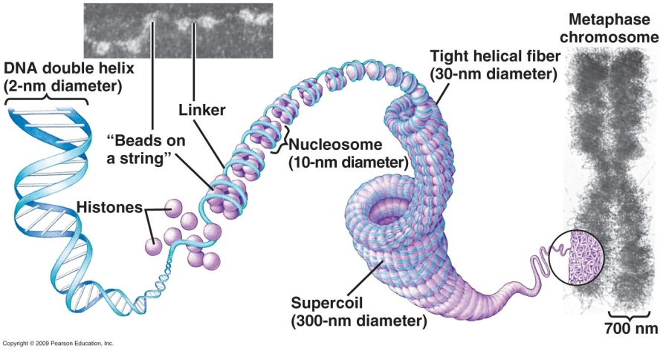
Chromosomes
DNA coils around histones & nonhistone proteins
into tightly wound chromosomes (like thread around spools)
simple organisms (prokaryotes) like bacteria have only 1 chromosome
complex organisms (eukaryotes) like plants & animals have multiple paired chromosomes
one set from mother (egg), one set from father (sperm)
Notes:
Understand the function of histones.

Slide 50
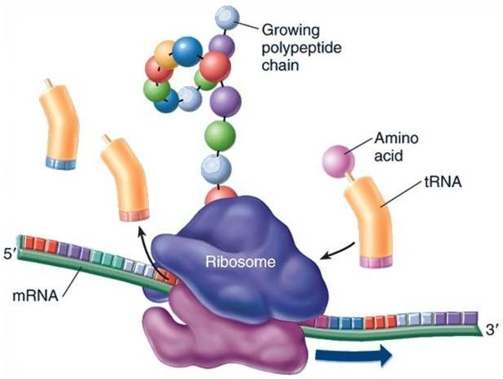
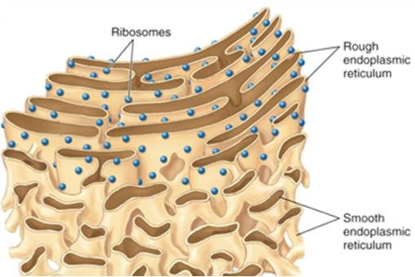
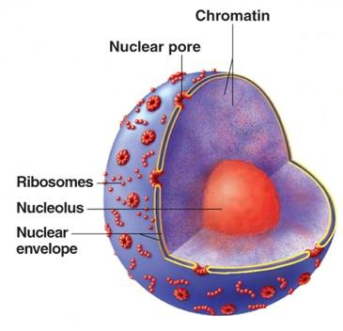
Ribosomes
Ribosomes – sites of protein synthesis
free in cytoplasm & attached to rough endoplasmic reticulum
free ribosomes: proteins used in cell
membrane-bound ribosomes: proteins for plasma membrane or export
larger & denser than prokaryotic ribosomes
subunits made in nucleolus of nucleus, join together in cytosol
Notes:
Know the difference between free and membrane-bound ribosomes. When you think ribosomes, think protein production.

Slide 51
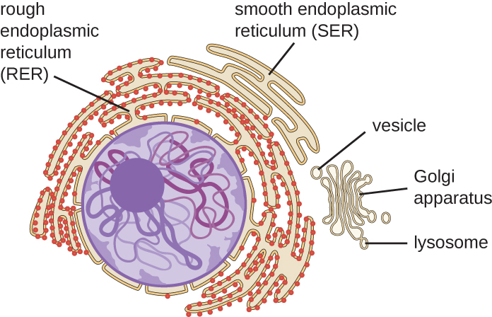
Endoplasmic Reticulum
Endoplasmic reticulum (ER)
membrane network of flattened sacs (cisterns)
continuous with nuclear envelope

Slide 52
Endoplasmic Reticulum
2 distinct but interrelated forms of ER that differ in structure and function
rough ER –studded with ribosomes
Connected to the nucleus and is vital to transporting proteins into and out of the nucleus
Provides surface area for ribosomes
Proteins enter cisterns for processing
More proteins needed by a cell, the more rough ER
smooth ER – network of membrane tubules
No ribosomes
storage site for proteins that will be transported to the plasma membrane or excreted
contains enzymes to make fats & steroids
Notes:
Please understand the difference in function between rough and smooth ER.

Slide 53
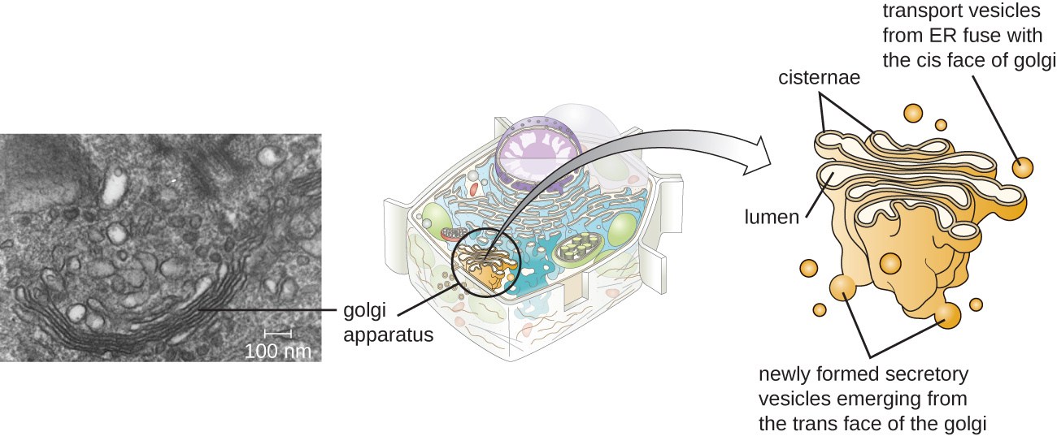
Golgi Complex
Flattened sacs on top of each other
Sorts, processes, modifies, packages and transports proteins and lipids around the cell
Notes:
I think of this as the “FedEx” of the cell.

Slide 54
Golgi Complex
Path of proteins made by ribosomes on rough ER:
bud off from ER in transport vesicles; fuse with Golgi cistern
proteins modified: form glycoproteins, glycolipids, & lipoproteins
leave cisterns in secretory vesicles
kept in storage vesicle, or delivered to plasma membrane & discharged by exocytosis or incorporated into membrane
Notes:
Please understand this process.

Slide 55
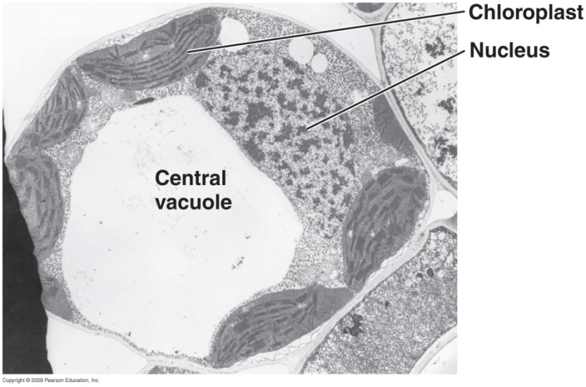
Vacuoles
Vacuole – space enclosed by tonoplast membrane
occupies 5-90% of plant cell volume
function: storage
proteins, sugars, organic acids, &
inorganic ions
metabolic wastes & poisons
water: lets cells grow bigger &
provides support

Slide 56
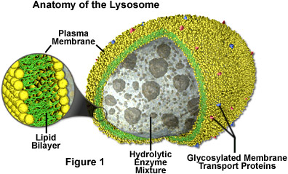
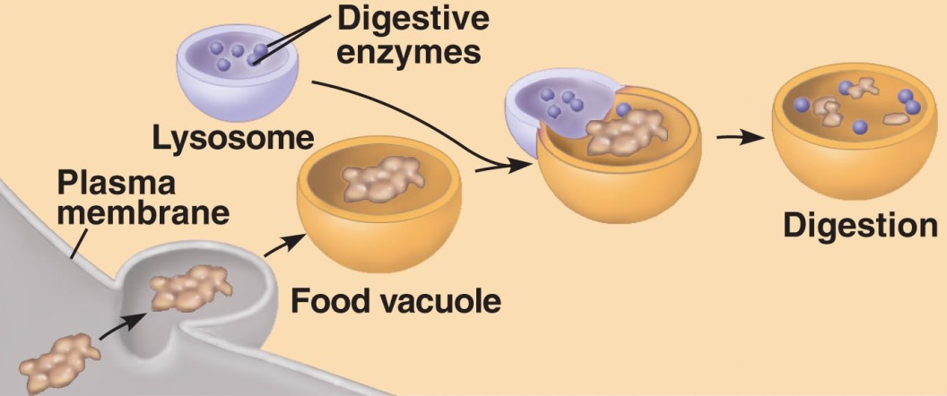
Lysosomes
Lysosome – membrane-enclosed sphere
no internal structure
contains powerful digestive enzymes
breaks down molecules
digests bacteria
breaks down damaged organelles by fusing with them
Notes:
Digests macromolecules by hydrolysis including proteins, polysaccharides, fats, and nucleic acids
the lysosome uses a series of proton pumps in it's membrane to maintain the optimal pH balance.
At the end of a cell's life the lysosomes serve an important function in destroying the dead cell. Certain chemical signals are sent to the lysosomes telling them to release all of their digestive enzymes, and therefore causing the cell to digest itself.

Slide 57
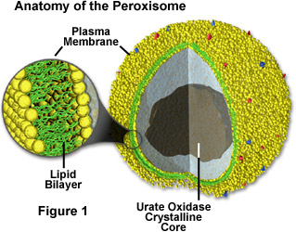
Peroxisomes
Peroxisome – small membrane-enclosed sphere
no internal structure
oxidizes amino acids, fatty acids, & toxic substances
protects cell from H₂O₂
When the peroxisome reaches a certain size it splits into two
Notes:
I think of this as the specialized HAZMAT clean up crew.

Slide 58
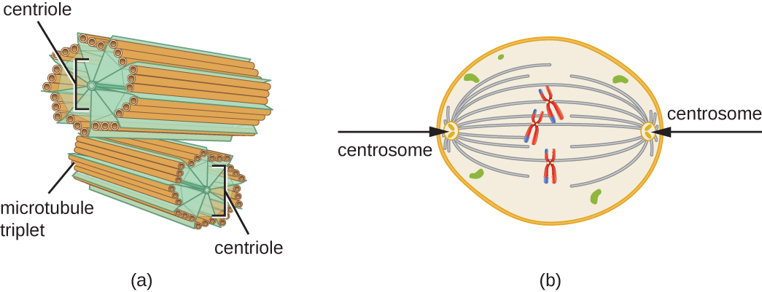
Centrosomes
Centrosomes – pericentriolar area & centrioles
located near nucleus
pericentriolar material – dense
network of protein fibers
organizes mitotic spindle, for
cell division & microtubule formation

Slide 59
Mitochondria
Present in all eukaryotic cells
1-100’s of mitochondria
Cells that require more energy will have more mitochondria (muscle, cardiac)
Structure:
outer membrane smooth
inner membrane folded into cristae
Notes:
Please understand these concepts, especially the concept that more mitochondria will be required in cells which require more energy.

Slide 60
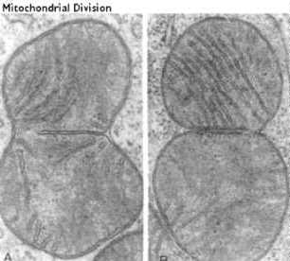
Mitochondria
Each mitochondria have their own ribosomes and DNA
DNA is circular and found in a nuceloid
Mitochondria grow and self replicate in each cell
Binary fission
Mitochondria are not inherited as our cells genetic material
Mitochondria DNA comes from the egg only (maternal inheritance)
Notes:
An individual's mitochondrial genes are not inherited by the same mechanism as nuclear genes. At fertilization of an egg cell by a sperm, the egg nucleus and sperm nucleus each contribute equally to the genetic makeup of the zygote nucleus. In contrast, the mitochondria, and therefore the mitochondrial DNA, comes from the egg only. The sperm's mitochondria enter the egg but do not contribute genetic information to the embryo. Instead, paternal mitochondria are marked with ubiquitin to select them for later destruction inside the embryo. The egg cell contains relatively few mitochondria, but it is these mitochondria that survive and divide to populate the cells of the adult organism. Mitochondria are inherited down the female line, known as maternal inheritance. This mode is seen in most organisms including all animals.

Slide 61
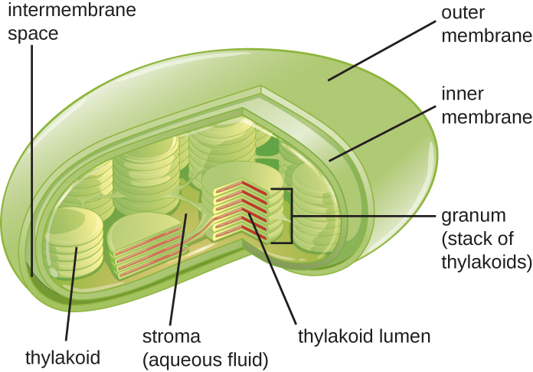
Chloroplasts
Chloroplasts – perform photosynthesis, make sugars
in algae & green plants
structure:
outer membrane
inner membrane
semifluid stroma within inner membrane
contains enzymes for sugar production
grana – stacks of thylakoids
flattened membrane sacs
contain chlorophyll pigments
capture light energy
Notes:
Please understand this structure and which organisms’ cells have them.

Slide 62
Evolution of Eukaryotes
Eukaryotic cells evolved from prokaryotic cells 2.5 billion years ago
Theory of endosymbiosis
larger bacteria cells lost cell walls & engulfed smaller aerobic (or photosynthetic) bacterial cells
host supplied nutrients, endosymbiont supplied energy or glucose
eukaryotic flagella & cilia may have been free-living spirochetes
Notes:
Please understand and be able to describe this theory and its support. Consult text for more information if needed.

Slide 63
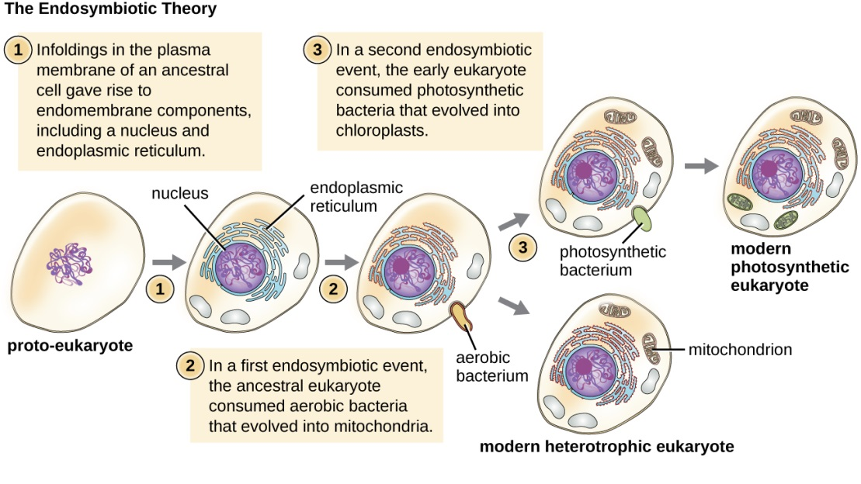
Evolution of Eukaryotes
Evidence for endosymbiosis: mitochondria & chloroplasts…
resemble bacteria in size & shape
reproduce independently of host cell, using binary fission
contain circular DNA
have ribosomes & do protein synthesis like bacteria
antibiotics that inhibit protein synthesis in bacteria do so also in mitochondria & chloroplasts
Notes:
There is evidence to indicate that the prokaryotic ancestors of mitochondria and chloroplasts probably gained entry to the host cell as undigested prey or internal parasites. With time, a mutually beneficial relationship resulted.
The evidence that mitochondria and chloroplasts evolved from free-living prokaryotes is further supported by the small size of these organelles, similar to the size of a prokaryote. Mitochondria and chloroplasts are therefore helpful in comparing the general size of eukaryotic and prokaryotic cells. You might think of these organelles as built-in comparisons.
Mitochondria and chloroplasts are not cellular structures that are synthesized in a cell like ribosomes and lysosomes. Instead, mitochondria only come from other mitochondria and chloroplasts only come from other chloroplasts. This is further evidence of the independent evolution of these organelles from free-living ancestral forms.

