Slide 1
Chapter 9
Microbial Growth
Notes:
1

Slide 2
Requirements for Growth - #s not size
Physical requirements
temperature
pH
osmotic pressure
Chemical requirements
carbon
nitrogen, sulfur, & phosphorous
trace elements
oxygen
organic growth factors
Notes:
Please understand that microbial growth: increase in cell number, not size

Slide 3
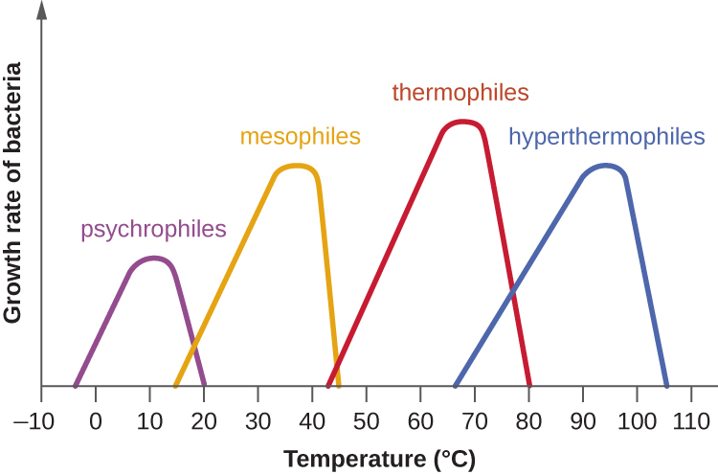
Temperature
Limited temperature range for each species
minimum, optimum, & maximum growth temperatures
Psychrophiles: cold-loving microbes
-10 to 15°C
Psychrotrophs: grow between 0°C and 20–30°C
can cause food spoilage, grow well at refrigerator temps
More common than psychrophiles
Mesophiles: moderate-temperature-loving
grow at our body temperature
commonly cause food spoilage
Most common type of microbe
Thermophiles: heat-loving
endospores survive very high heat
Hyperthermophiles: Archaea
optimum temperature is greater than 80°C
Associated with volcanic activity
Notes:
Please be comfortable with these definitions and relative temperature ranges.

Slide 4
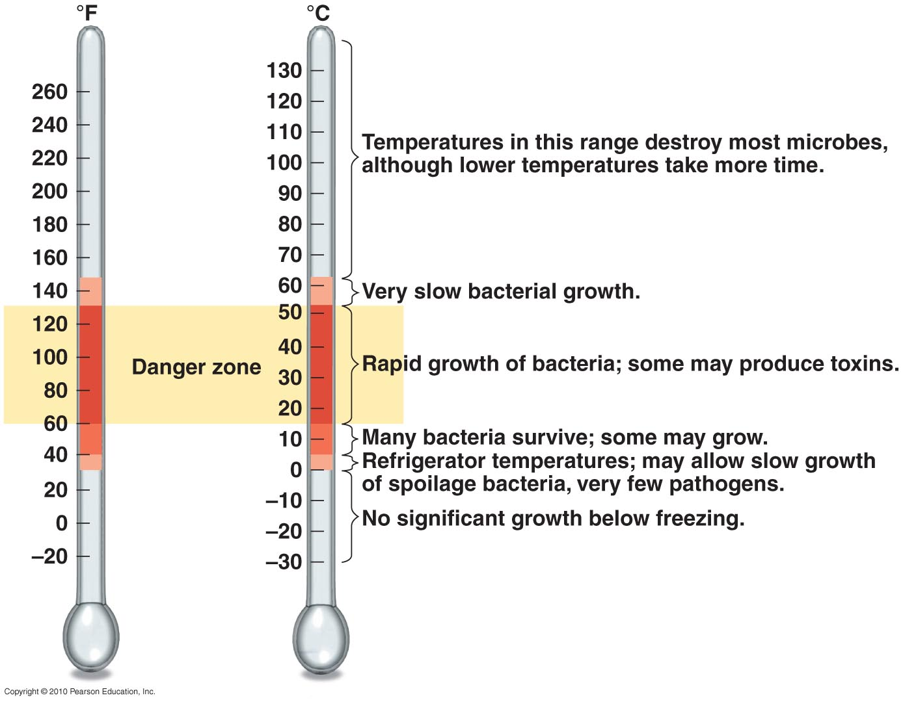
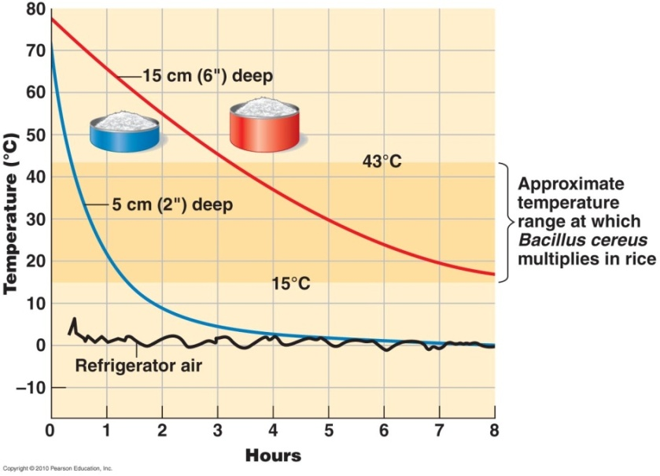
Temperature
Food Spoilage
Notes:
Please understand these facts as they relate to the concepts of refrigeration, freezing and cooking food. Also, be able to explain why someone should choose to store food in a shallow container in a refrigerator. Photo credit: Tortora Microbiology text.

Slide 5
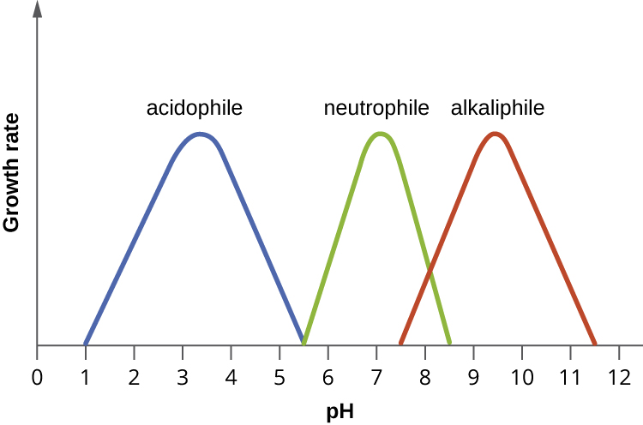
pH
pH = – log [H⁺]
Most bacteria grow between pH 6.5 & 7.5 (neutral)
Cultured bacteria produce acid as a waste product so buffers are included in growth medium
Peptone, amino acids, phosphate salts
Acidophiles grow in acidic environments
Rare, very few live below pH 4
Acidic foods generally spoil less
Molds & yeasts grow between pH 5 and 6

Slide 6
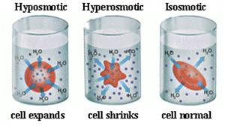
Osmotic Pressure
Osmotic pressure – amount of dissolved solute in solvent
isotonic – [solute] in & outside cell equal
hypertonic environments – high [solute]
Cause plasmolysis (water loss)
Shrinkage
high salt or sugar conditions protect foods
required by extreme or obligate halophiles (salt-loving)
tolerated by facultative halophiles
hypotonic environments – low [solute]
cause lysis (bursting) if cell walls are weak
Notes:
Understand these concepts. Do they sound familiar?

Slide 7
Chemical Requirements
Carbon
Needed for structure & energy source
Half the dry weight of bacteria is carbon
Nitrogen
in amino acids & proteins
some bacteria use gaseous N₂
Nitrogen fixation - (live in plant root nodules)
Phosphorus
in DNA, RNA, ATP, & membranes
Sulfur
in amino acids & some vitamins
Trace elements
usually enzyme cofactors
small amounts of elements (Fe, Cu, Mo, Zn)
Organic growth factors
vitamins (for coenzymes), amino acids, purines & pyrimidines
Most bacteria synthesize their own vitamins
Notes:
Please be able to give examples of what these requirements are needed for.

Slide 8
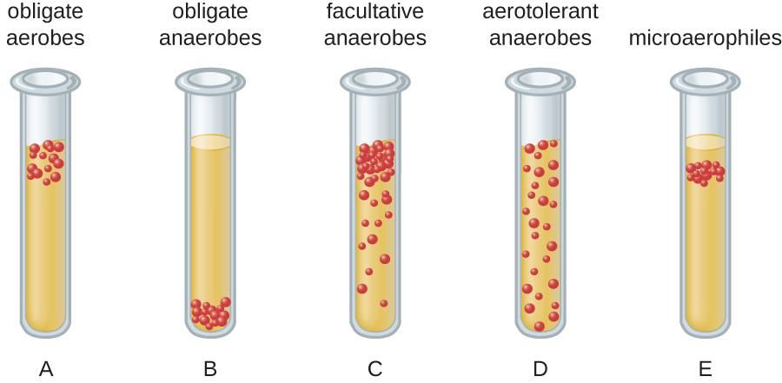
Oxygen
Aerobes – use O₂ to produce energy
obligate aerobes – require O₂
facultative anaerobes – can use O₂ but don’t require it
microaerophiles – require low concentrations of O₂
Anaerobes – don’t use O₂ to produce energy
aerotolerant anaerobes – can’t use O₂, but tolerate it
obligate anaerobes – don’t use O₂
harmed by superoxide radicals: no enzymes to break them down
Notes:
Please know these definitions and be able to identify the type of organism present based on the figures above.

Slide 9
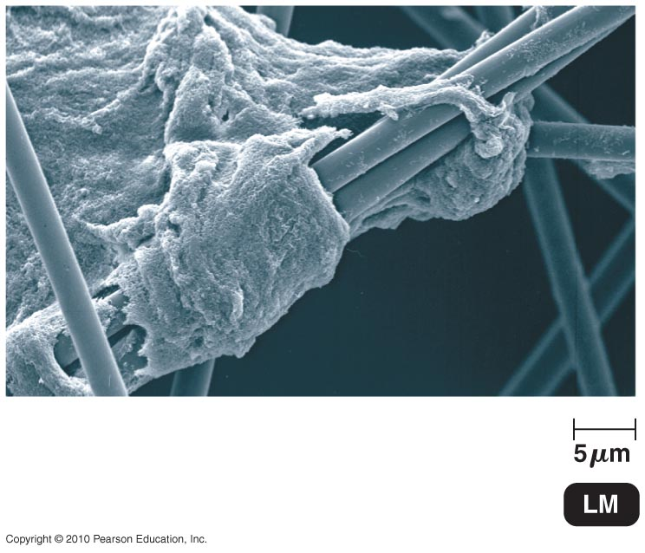
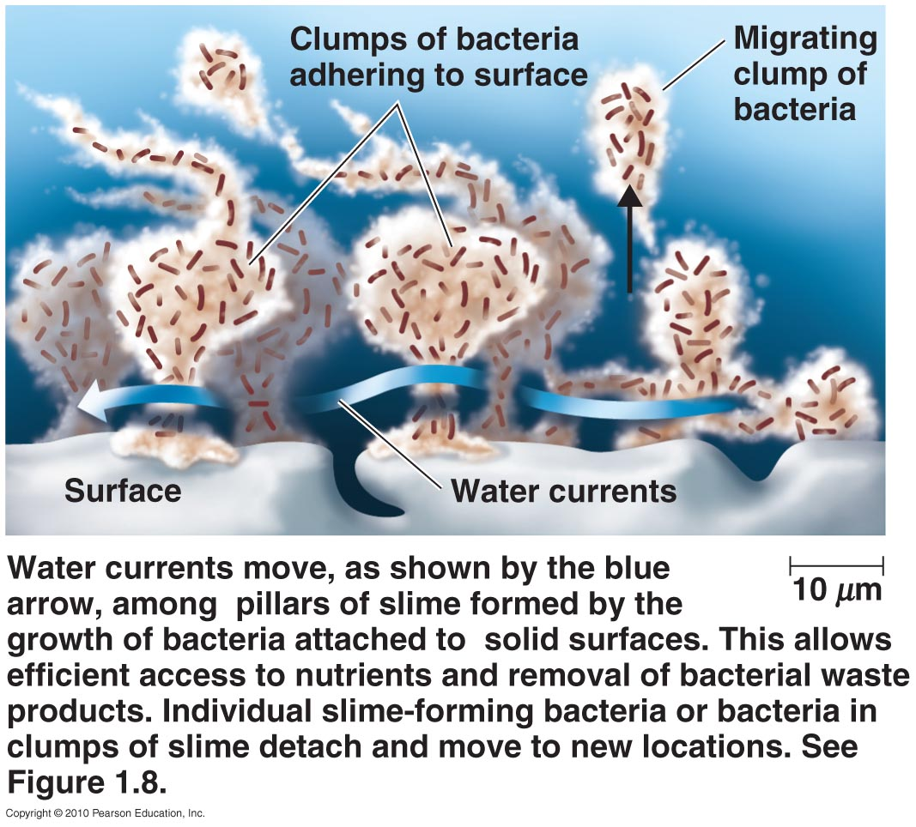
Biofilms
Microbial communities
≥1 species attached to surfaces
Form slime or hydrogel
polysaccharides, DNA, & proteins
cells attracted by chemicals via quorum sensing
cell-cell communication
form pillar-like structures
Advantages:
share nutrients
sheltered from harmful environmental factors
facilitates genetic transfer
Notes:
Be comfortable explaining the advantages of biofilms for bacteria and potential concerns for humans, etc.

Slide 10
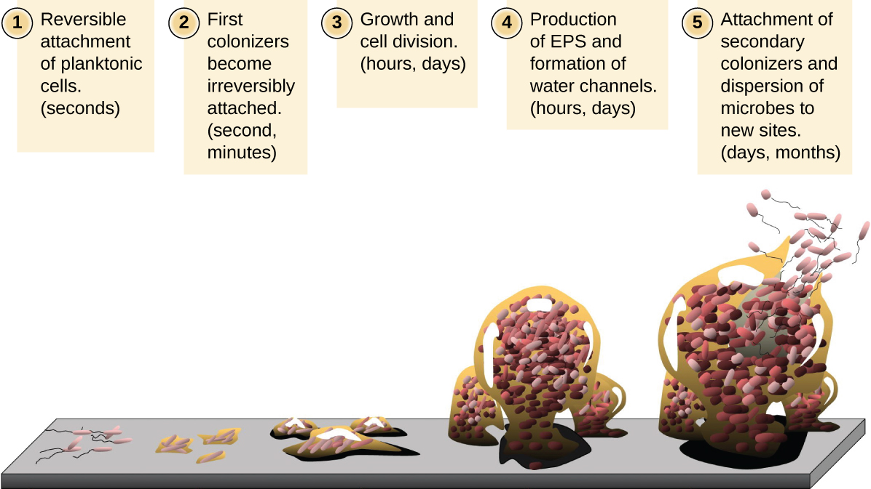
Dental Biofilm
Notes:
Just a visual.

Slide 11
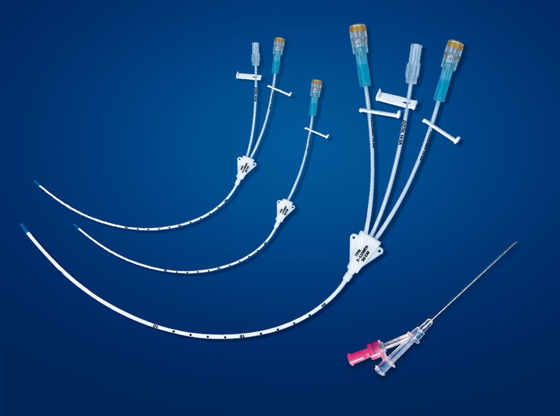
Biofilms
70% of infections involve biofilms
bacterial or fungal
common on medical devices: catheters, mechanical heart valves
hard to clean: biofilms 1000X more resistant to microbicides
Antimicrobials incorporated into surfaces to prevent biofilms

Slide 12
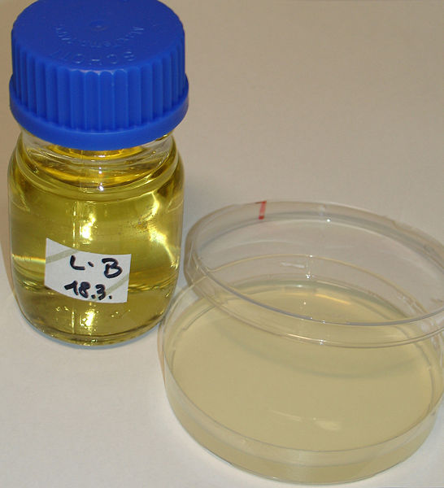
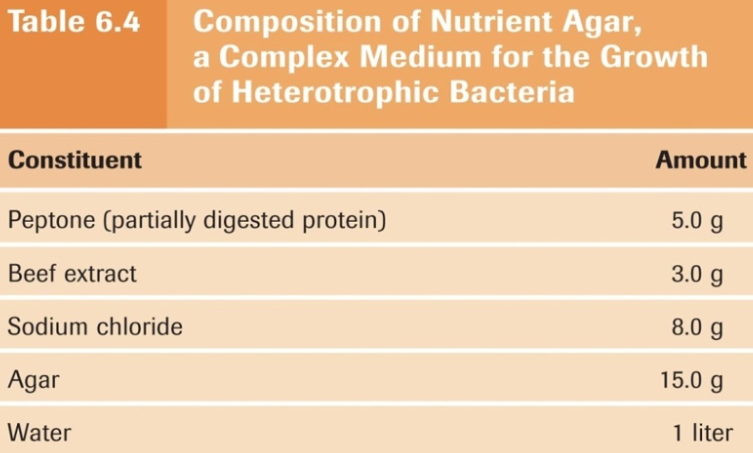
Culture Media
Culture medium – nutrient material prepared for microbial growth in lab
needs nutrients, moisture, O₂, proper pH & temperature
Agar – solidifying agent for culture medium
(plates, slants, & deeps)
generally not metabolized by microbes
liquefies at 100°C, solidifies at ~40°C
Sterile – contains no living microbes
Inoculum – microbes introduced
to culture medium
Culture – microbes growing
in/on culture medium
Notes:
Be comfortable with the components of culture medium and why they are needed. We will discuss these further in future labs. You do not need to know Table 6.4.

Slide 13
Culture Media
Complex media – extracts & digests of yeasts, meat, &/or plants; exact chemical composition unknown
most energy & nutrients from peptones (short amino acid chains)
vitamins & growth factors from meat extract
for most heterotrophic bacteria & fungi
nutrient broth – liquid (no agar)
nutrient agar – solid
Some microbes can’t be
grown on artificial media
grown in living organisms
or cell culture

Slide 14
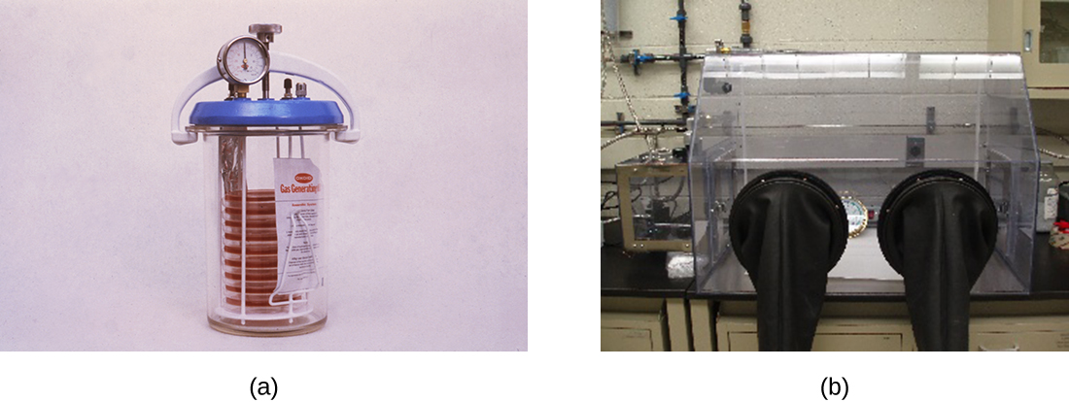
Anaerobic Culture Methods
Reducing media
to culture anaerobic bacteria
contain chemicals (thioglycolate or oxyrase) that combine with & deplete O₂
tubes heated before use to drive off O₂, then
kept tightly capped
Anaerobic jar
to grow anaerobes
on Petri plates
chemicals produce H₂ & CO₂
remove O₂ by 2H₂ + O₂ → 2H₂O
Anaerobic chamber
Notes:
Understand these basic concepts.

Slide 15
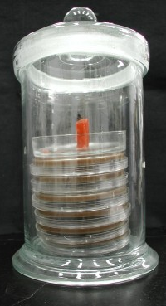
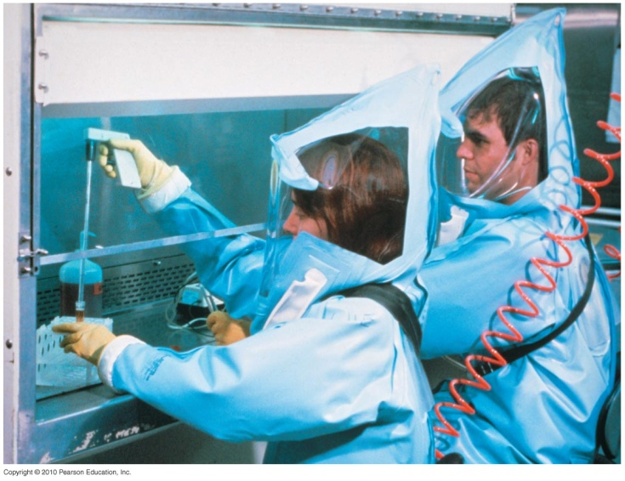
Special Culture & Safety Techniques
Capnophiles – require high CO₂ conditions; grown using:
chemical packets – provide precise CO₂ concentrations
carbon dioxide incubators
Biosafety levels (BSL)
1: no special precautions
2: lab coat, gloves, eye protection
3: biosafety cabinets, filtered room air
prevent airborne transmission
4: suits in sealed, negative pressure rooms
exhaust air filtered twice
Notes:
Know the definition of capnophiles and be able to identify the BSL based upon a description of a lab.

Slide 16
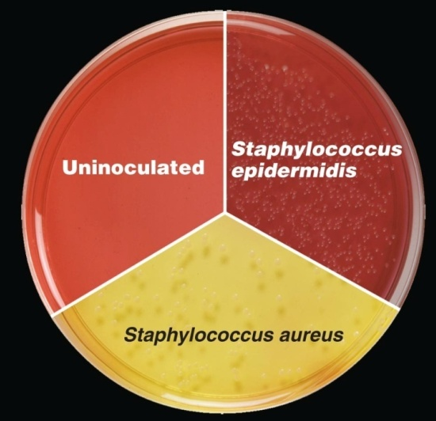
Selective and Differential Media
Selective media – suppress unwanted microbes, encourage desired microbes
bismuth sulfite agar, Sabouraud’s dextrose agar
Differential media – helps distinguish between microbes; identifiable reactions
blood agar: identifies microbes that destroy red blood cells
Media can be both selective & differential
mannitol salt agar: identify microbes that tolerate salt (grow) & ferment mannitol to acid (color change: pH indicator)
Notes:
Know the definitions; however, you do not need to known the examples.

Slide 17
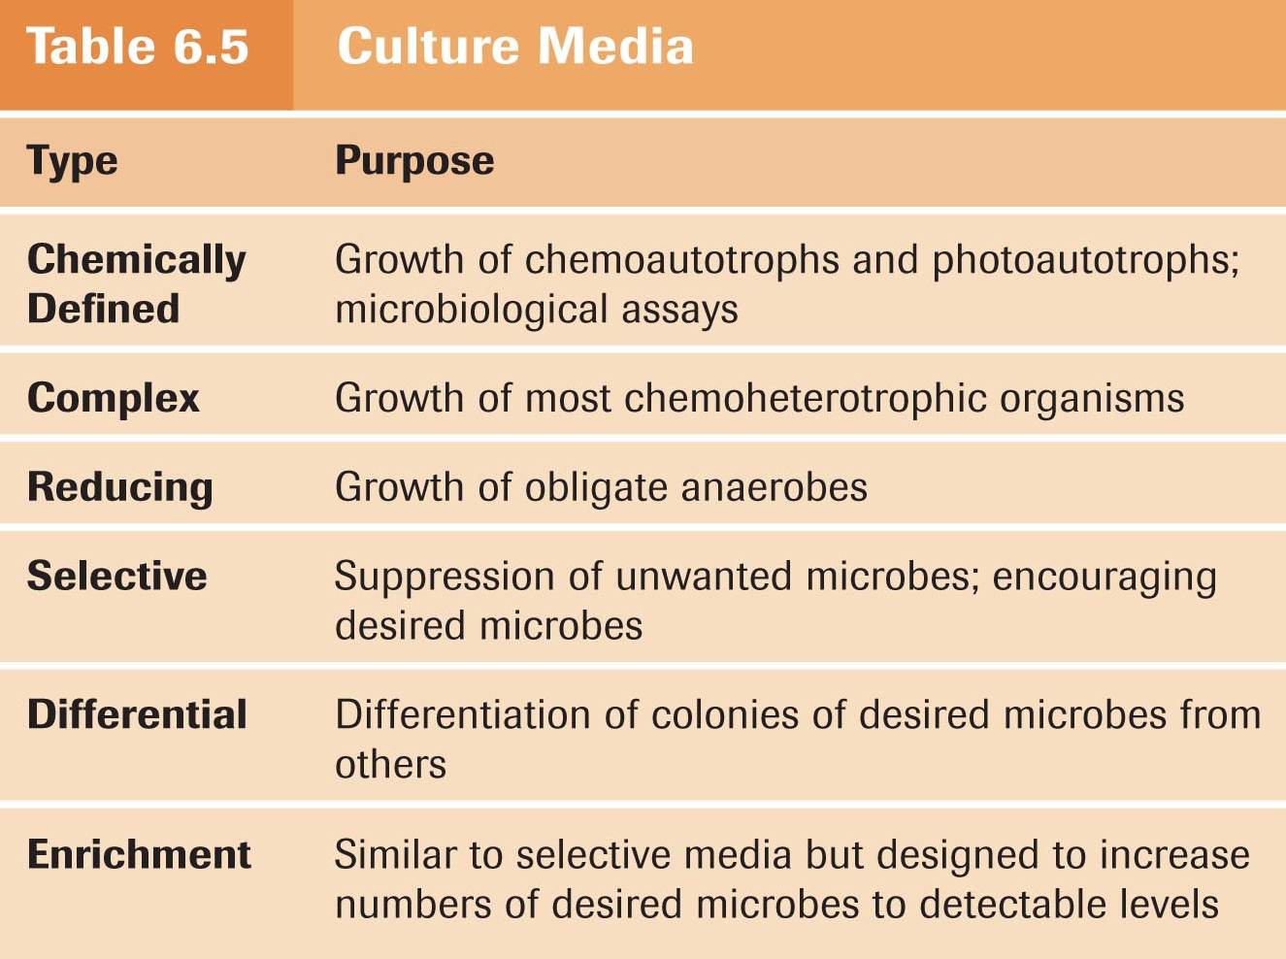
Enrichment Culture
Enrichment medium – encourages growth of desired microbe over others; usually liquid
when microbe of interest present in small numbers & other microbes numerous
soil & fecal samples

Slide 18
Obtaining Pure Cultures
Colony – population of cells arising from single cell, spore, or group of attached cells
distinctive appearance
often called colony-forming unit (CFU)
Pure culture – bacterial clone
Streak plate method – streak loop-full of mixed culture to isolate pure cultures
sterilize loop between streak series
get microbes far enough apart to grow into isolated colonies
pick & grow individual colonies
effective for microbes present in large numbers in mixed cultures
Notes:
Know the content of this slide well.

Slide 19
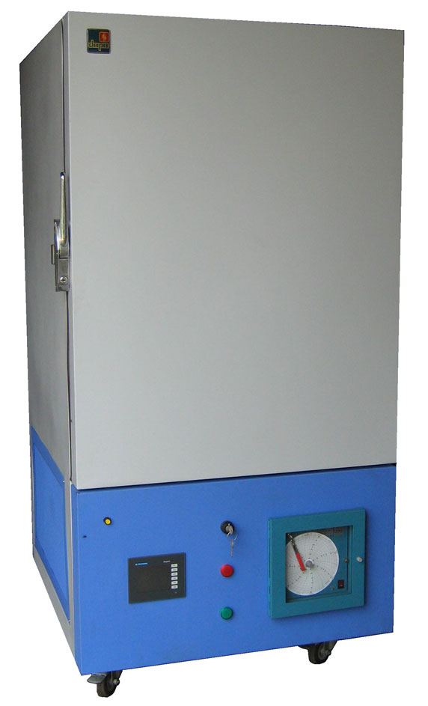
Preserving Bacterial Cultures
Short-term: refrigeration
Long-term:
deep-freezing: pure culture quick-frozen at –50° to –95°C in suspending liquid
can thaw & re-culture even years later
lyophilization (freeze-drying): microbe suspension frozen at –54° to –72°C, dehydrated in a vacuum, & sealed
powder remains; can store for years
revive by rehydration
Notes:
Know what lyophilization is.

Slide 20
Reproduction in Prokaryotes
Binary fission
Budding
Conidiospores (actinomycetes)
Fragmentation of filaments

Slide 21
Reproduction in Microbes
V
Most bacteria reproduce by binary fission
Notes:
Be comfortable with this concept.

Slide 22
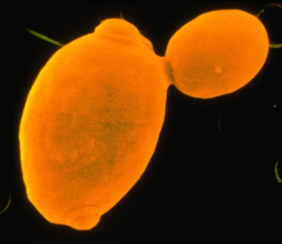
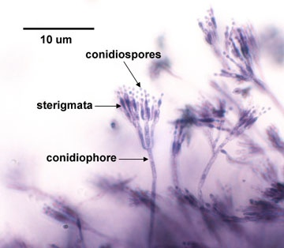
Reproduction in Microbes
Yeast & some bacteria reproduce by budding
Some filamentous bacteria produce chains of conidiospores; others fragment

Slide 23
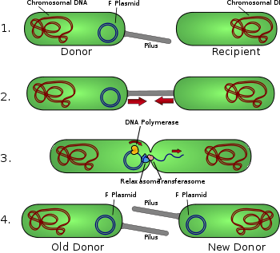
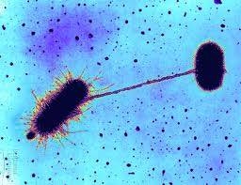
Conjugation
Sexual reproduction?
Conjugation – one bacteria transfers some genetic material into another bacteria through a protein bridge
does not increase the number of bacteria – creates genetically different bacteria
The cells then go through binary fission to produce two bacteria with new genetic material
Notes:
Please understand this concept and its contrast from binary fission.

Slide 24
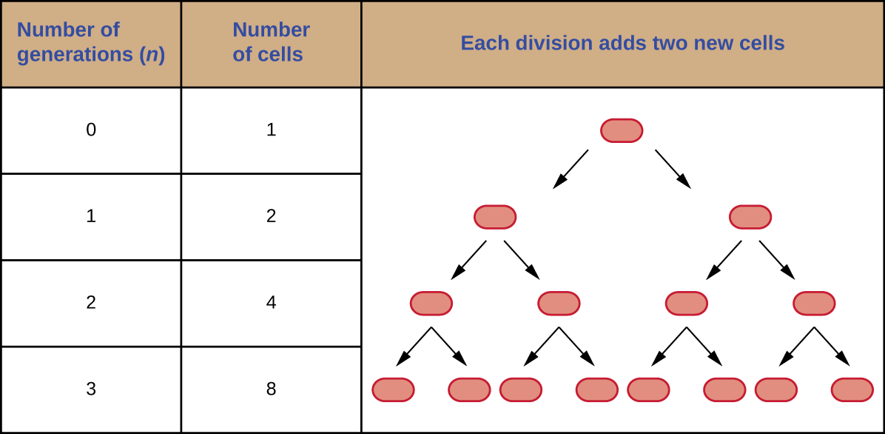
Generation Time
Bacterial reproduction: doubling
Generation time – time required for cell to divide (doubling)
highly variable: usually 1-3 hours, sometimes 20 minutes, sometimes >24 hours
Notes:
Understand the definition and concept of generation time.

Slide 25
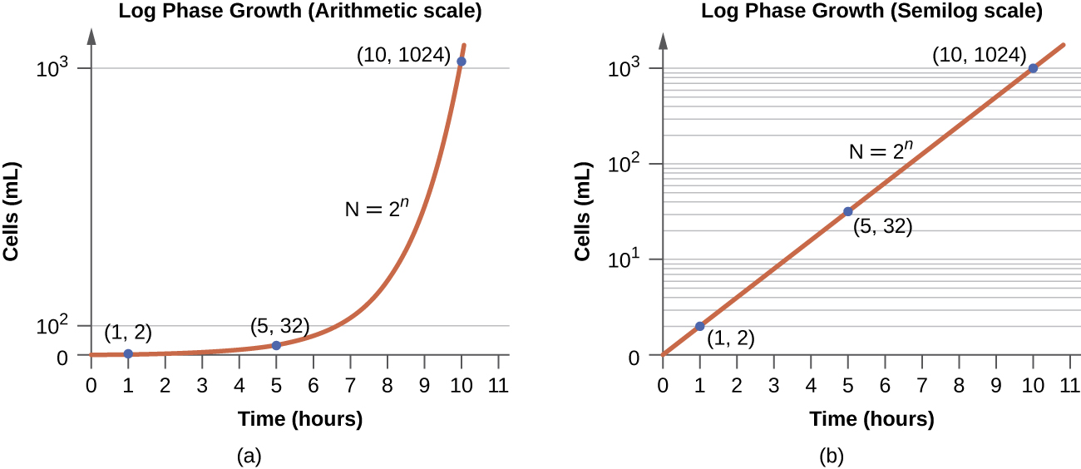
Generation Time
Population growth easier to see when plotted logarithmically, rather than arithmetically

Slide 26
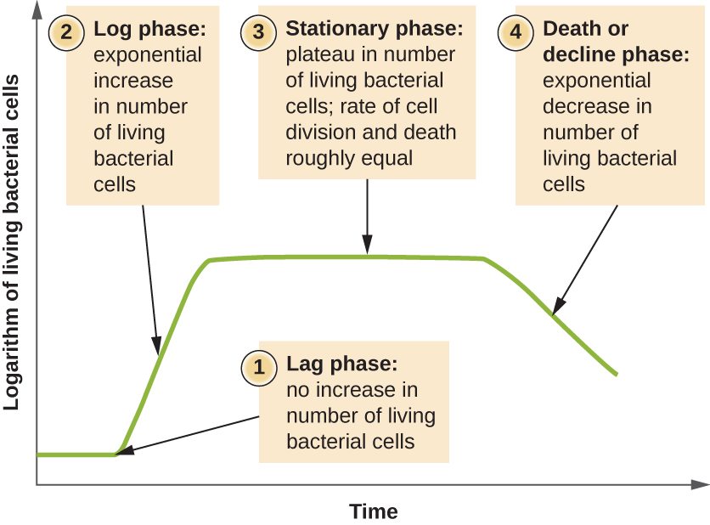
Phases of Growth
4 phases of bacterial population growth:
lag – preparation for growth
enzyme & biological molecule synthesis
log – exponential growth
active cell reproduction
generation time consistently at minimum
stationary – cell deaths balance new cells
due to exhaustion of nutrients, accumulation of wastes, &/or changes in pH
death – cell
deaths exceed
new cells
logarithmic
decline
Notes:
Know these stages and be able to identify them on a similar graph.

Slide 27
Direct Microscopic Count
Direct microscopic count – measured volume of bacterial suspension placed on slide, stained, observed under oil immersion
viewing field area
calculated,
all cells in several
squares counted
& averaged
doesn‘t require
incubation
cons: counts dead
cells, difficult for
motile cells,
requires high cell
concentrations
Notes:
Please be comfortable describing this process.

Slide 28
Figure 9.12
In the pour plate method of cell counting, the sample is mixed in liquid warm agar (45–50 ºC) poured into a sterile Petri dish and further mixed by swirling. This process is repeated for each serial dilution prepared. The resulting colonies are counted and provide an estimate of the number of cells in the original volume sampled.

Slide 29
Figure 9.13
In the spread plate method of cell counting, the sample is poured onto solid agar and then spread using a sterile spreader. This process is repeated for each serial dilution prepared. The resulting colonies are counted and provide an estimate of the number of cells in the original volume samples.

Slide 30
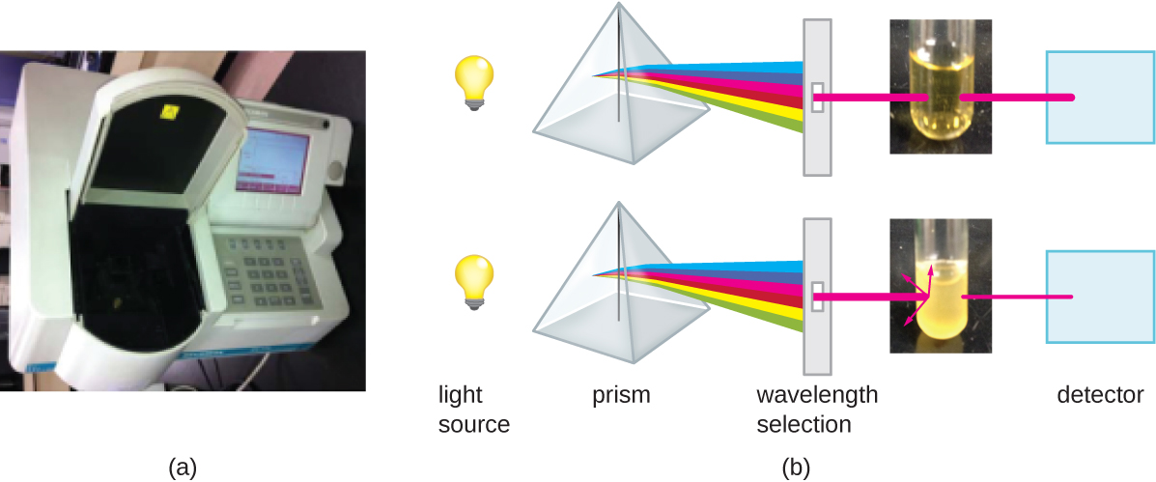
Indirect Measures
Indirect measures of bacterial growth:
metabolic activity – measures amount of metabolic product
acid or CO₂
dry weight – for filamentous bacteria & molds
turbidity – more bacteria in liquid medium, more turbidity
spectrophotometer
measures amount of
light transmitted
through sample &
sample optical density
requires >1,000,000
cells/mL
Notes:
Understand this concept.

