Slide 1
Chapter 4a
Classification
Notes:
Note: Not all of the material presented in this lecture series can be found in the text’s chapter 4, some of this material is located back in Chapter 1 as well.
1

Slide 2
Classifying Life
Taxonomy – science of classifying organisms
Why do biologists Classify Organisms?
Grouping organisms makes studying them easier
Classification – grouping of organisms based on similarities
Taxonomy (Taxis = "arrangement“) science of classification of organisms
Universal naming so everyone is talking about the same organism
shows relatedness
All Species Inventory (project dates: 2001–2025)
identify all species of life on Earth
1.7 million currently identified
10 to 100 million predicted
Notes:
Understand why classification of organisms is necessary.

Slide 3
Scientific Nomenclature
Common names
vary with languages & geography
often misleading
Spanish moss: neither Spanish nor moss
Scientific names
worldwide
Latin or Latinized
binomial nomenclature
genus & specific epithet (species)
Scientific Binomial | Source of Genus Name | Source of Specific Epithet
Klebsiella pneumoniae | honors Edwin Klebs | the disease
Pfiesteria piscicida | honors Lois Pfiester | disease in fish
Salmonella typhimurium | honors Daniel Salmon | stupor (typh-) in mice (muri-)
Streptococcus pyogenes | chains of cells (strepto-) | forms pus (pyo-)
Penicillium chrysogenum | tuftlike (penicill-) | produces a yellow (chryso-) pigment
Trypanosoma cruzi | corkscrew-like (trypano-, borer; soma-, body) | honors Oswaldo Cruz
Notes:
You do not need to memorize these sources of names; however, please look them over and be able to describe some examples of how names are created for organisms. For example, honoring the discoverer or descriptive.

Slide 4
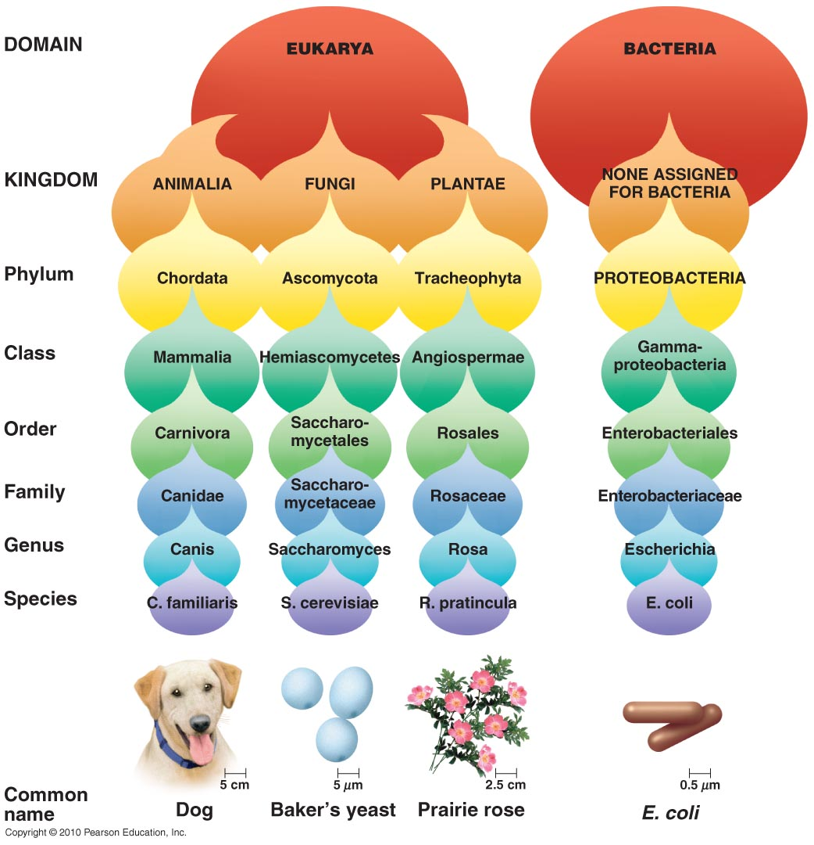
Taxonomic Hierarchy
Series of subdivisions
Domain
Kingdom
Phylum
Class
Order
Family
Genus
Species
group of closely related (eukaryotic) organisms that breed among themselves
Notes:
Please remind yourself the order of this classification system.

Slide 5
History of Classification
~340 BC, Aristotle: plants & animals
1735, Linnaeus: kingdoms plantae & animalia
Latinized names
1937, Chatton: prokaryote – cell without nucleus
1969, Whittaker: 5 kingdom system
1978, Wose: 6 kingdoms & 3 domains – 2 prokaryotic, 1 eukaryotic
domains have slightly different ribosomes, membrane lipids, & transfer RNA
Notes:
~340 BC, Aristotle: plants or animals
1735, Linnaeus: kingdoms plantae & animalia
Latinized names
1857, Nägeli: bacteria & fungi in kingdom plantae: flora
1866, Haeckel: kingdom protista for bacteria, protozoa, algae, & fungi
1937, Chatton: cell without nucleus – prokaryote
1961, Stanier: prokaryote – cell in which nuclear material is not surrounded by a nuclear membrane
1959: kingdom fungi
1968, Murray: kingdom prokaryotae (sometimes called Monera)
1969, Whittaker: 5 kingdom system
1978, Wose: 3 domains – 2 types of prokaryotic cells, 1 type of eukaryotic cell
each have slightly different ribosomes, membrane lipids, & transfer RNA

Slide 6
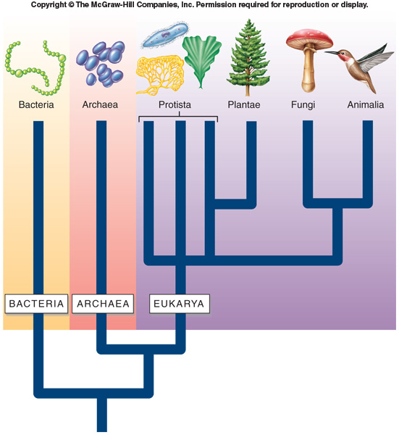
The Three Domains
3 domains of life:
Bacteria – prokaryotic cells
unicellular & microscopic
diverse & widespread
pathogenic & nonpathogenic
Archaea – prokaryotic cells
unicellular & microscopic
live in extreme environments
Eukarya – eukaryotic cells
contain nucleus & organelles
4 kingdoms:
Protista (includes algae)
Fungi
Plantae
Animalia
Notes:
Know the domains and kingdoms.

Slide 7
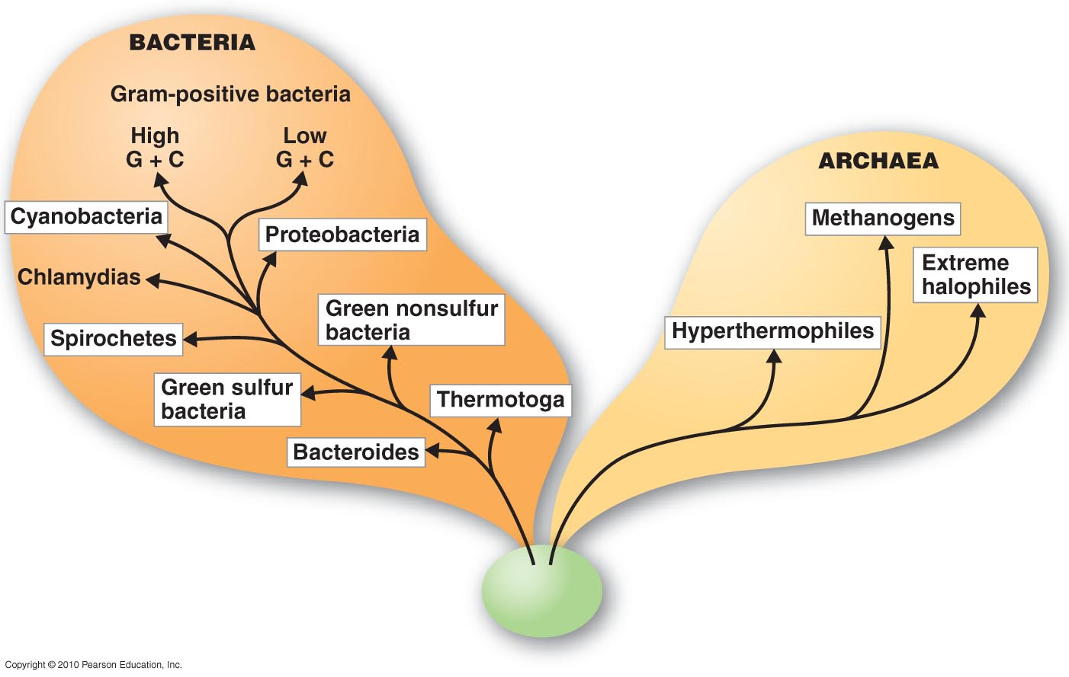
Classification of Prokaryotes
Prokaryotic species – a population of cells with similar characteristics
culture – grown in laboratory media
clone – population of cells derived from a single cell
strain – genetically different cells within a clone
see Bergey’s Manual
identification &
classification

Slide 8
Classification of Eukaryotes
Protista
catchall kingdom for eukaryotic organisms that don’t fit other kingdoms
nutritionally diverse (photosynthetic to parasitic)
grouped into clades based on rRNA
Fungi
unicellular yeast, multicellular molds, macroscopic mushrooms
decomposers; absorb dissolved organic matter
cells joined, form hyphae; cell walls of chitin
develop from spores or hyphal fragments
Plantae
multicellular, cellulose cell walls
usually photoautotrophic
Animalia
multicellular, no cell walls
chemoheterotrophic

Slide 9
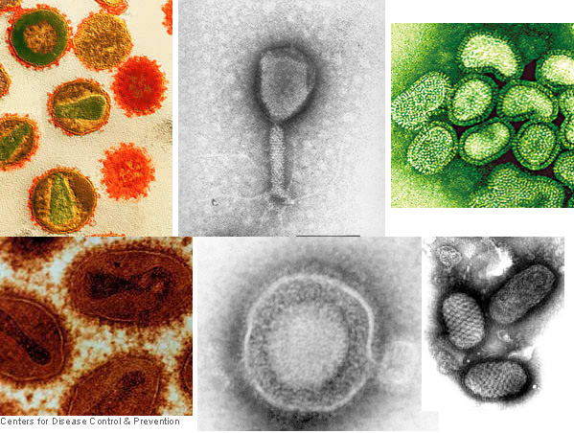
Classification of Viruses
Viruses: not made of cells, not classified in a domain
obligate intracellular parasites
arose from independently replicating DNA or degenerative cells
viral species – population of viruses with similar characteristics (morphology, genes, enzymes) that occupies a particular ecological niche
Notes:
Clockwise: Human immunodeficiency virus (HIV); Aeromonas virus 31, Influenza virus, Orf virus, Herpes simplex virus (HSV), Smallopx virus
Please understand that viruses are not classified in a domain as they are not made of cells.

Slide 10
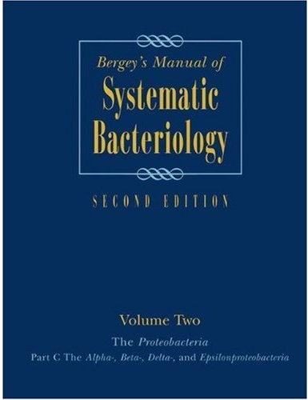
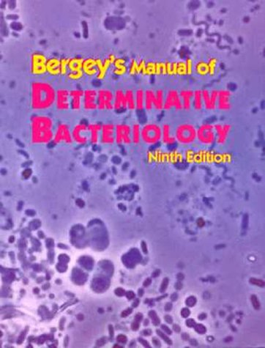
Classification and Identification of Microbes
Classification
characteristics of known organisms
placing organisms in groups of related species; inferring evolutionary history
Identification
matching characteristics of unknown organism to lists of known organisms
clinical lab identification
Bergey’s Manual of Systematic Bacteriology | Provides phylogenetic information on bacteria and archaea | Based on rRNA sequencing
Bergey’s Manual of Determinative Bacteriology | Provides identification schemes for identifying bacteria and archaea | Morphology, differential staining, biochemical tests
Notes:
Understand the difference between “Systematic” and “Determinative”. In particular, that systematic is based on rRNA sequencing whereas determinitive is based upon the results of multiple biochemical tests.

Slide 11
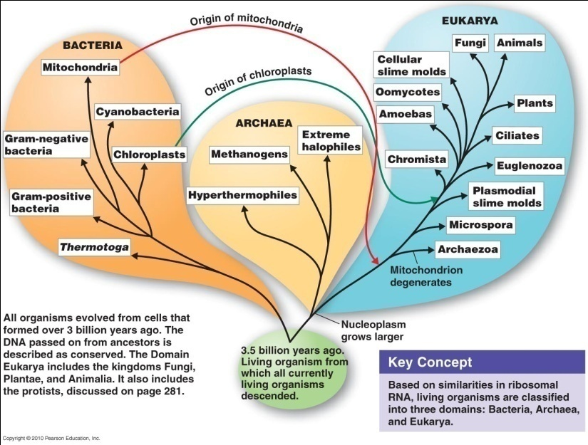
The Study of Phylogenetic Relationships
Systematics (phylogeny) – study of evolutionary history of organisms
all organisms descended from common ancestor
all have: DNA, ATP, cell membranes
Charles Darwin: descent with modification, by means of natural selection (survival of the fittest)

Slide 12
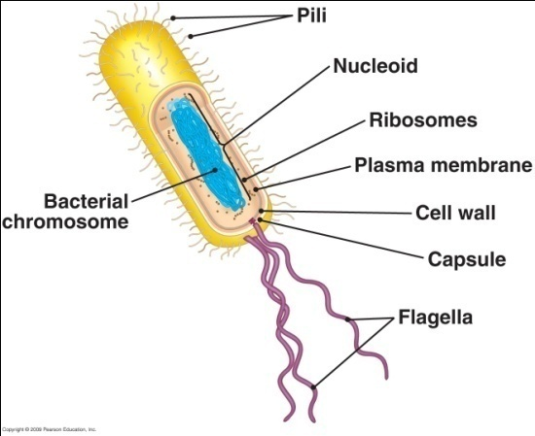
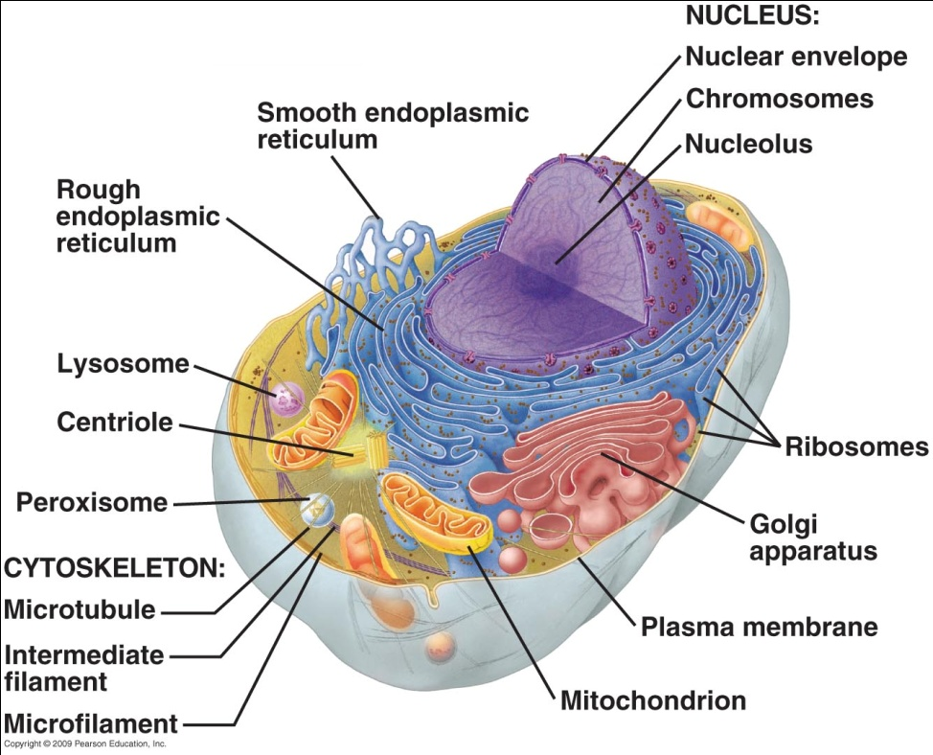
The Two Cell Types
2 cell types:
prokaryotic (evolved 3.5 billion years ago)
small, simple cells
small, circular chromosome
no internal membranes
eukaryotic (evolved 1.4 billion years ago)
larger, complex cells
large, linear chromosomes
internal membranes
evolved from infoldings of cell membrane
Notes:
A reminder for you.

Slide 13
Endosymbiosis
Notes:
Be comfortable with these comparisons. Photo credit Tortora Microbiology text.

Slide 14
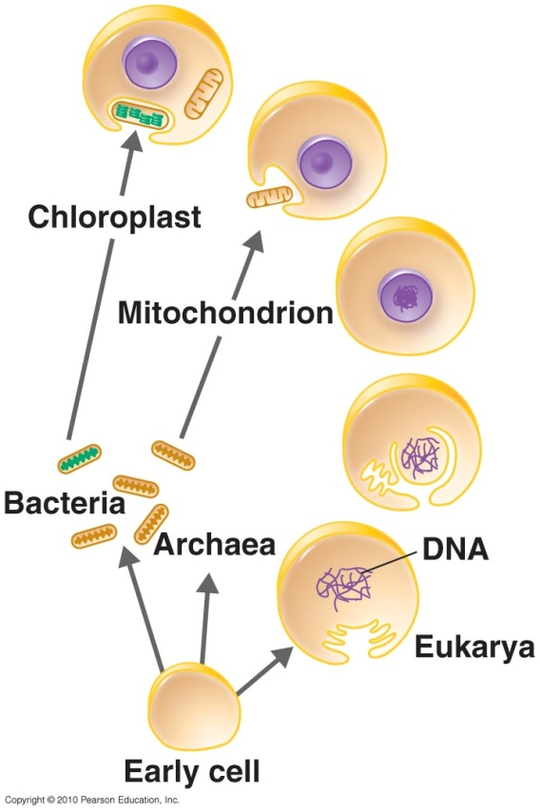
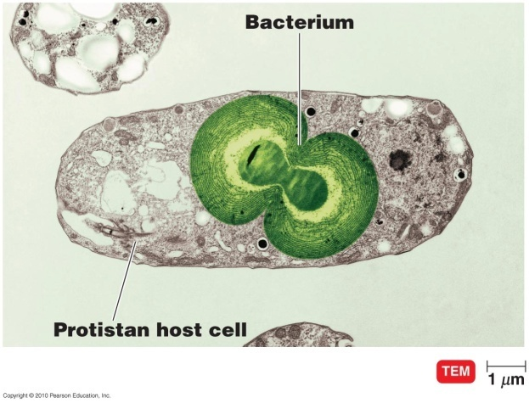
Endosymbiosis
Eukaryotic cells evolved via endosymbiosis
mitochondria & chloroplasts: small prokaryotes that began living in larger cells
originally undigested prey or internal parasites
many similarities between prokaryotic cells & eukaryotic organelles
Notes:
Be able to describe the theory of endosymbiosis and give support for it.

Slide 15
Phylogenetic Hierarchy
Group organisms according to common properties
groups evolved from common ancestor
each species retains some ancestral characteristics
Classify based on:
fossils
microbes usually don’t fossilize
exceptions:
protists: White Cliffs of Dover
stromatolites (filamentous bacteria)
cyanobacteria
anatomy
rRNA sequencing, DNA hybridization

Slide 16
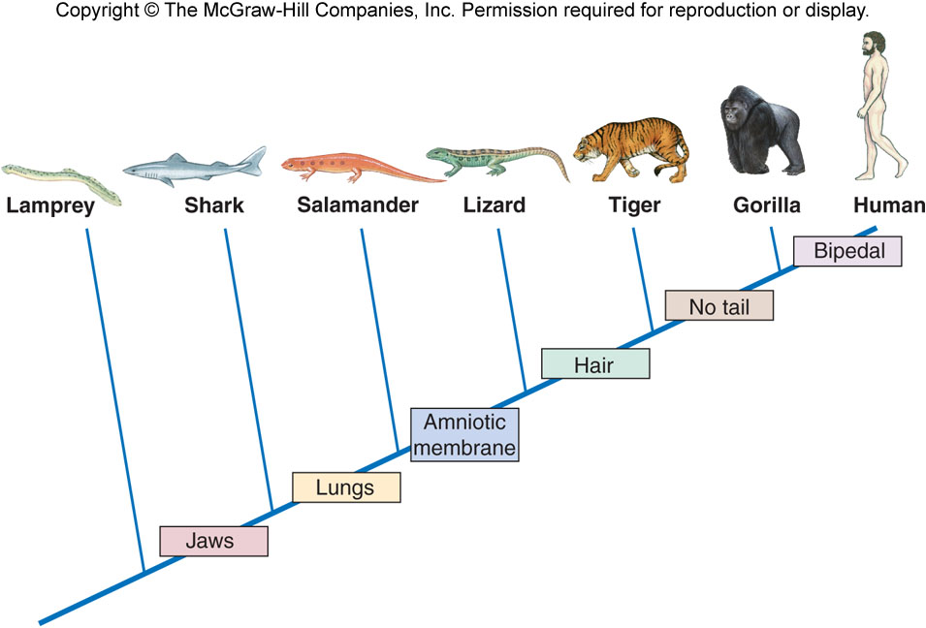
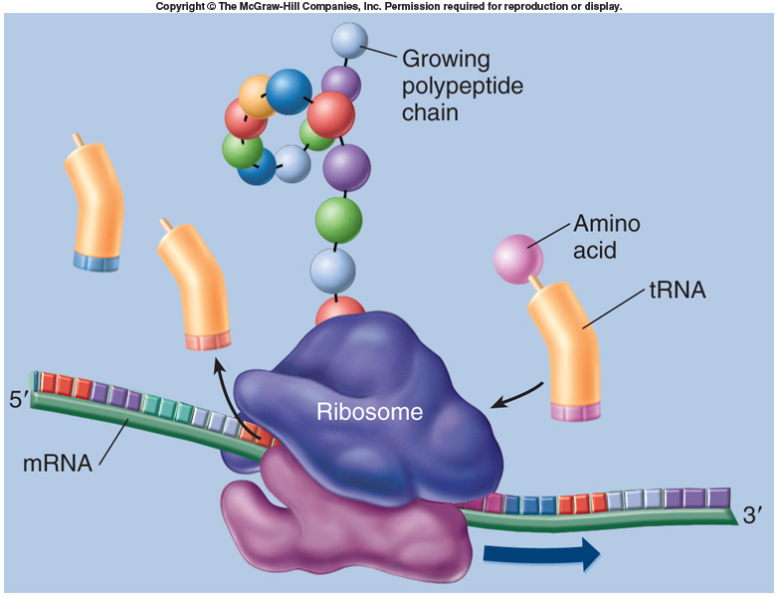
Cladograms
Cladogram – map showing evolutionary relationships among organisms
branch points defined by shared features
nodes represent common ancestors
data:
historically made using fossil evidence
now confirmed by rRNA sequences
rRNA also used for microbe cladograms
Notes:
Know this definition.

Slide 17
Building a Cladogram
Making cladograms
calculate similarity between rRNA sequences of organisms
draw branches proportional to calculated similarities
Notes:
Just a visual.

Slide 18
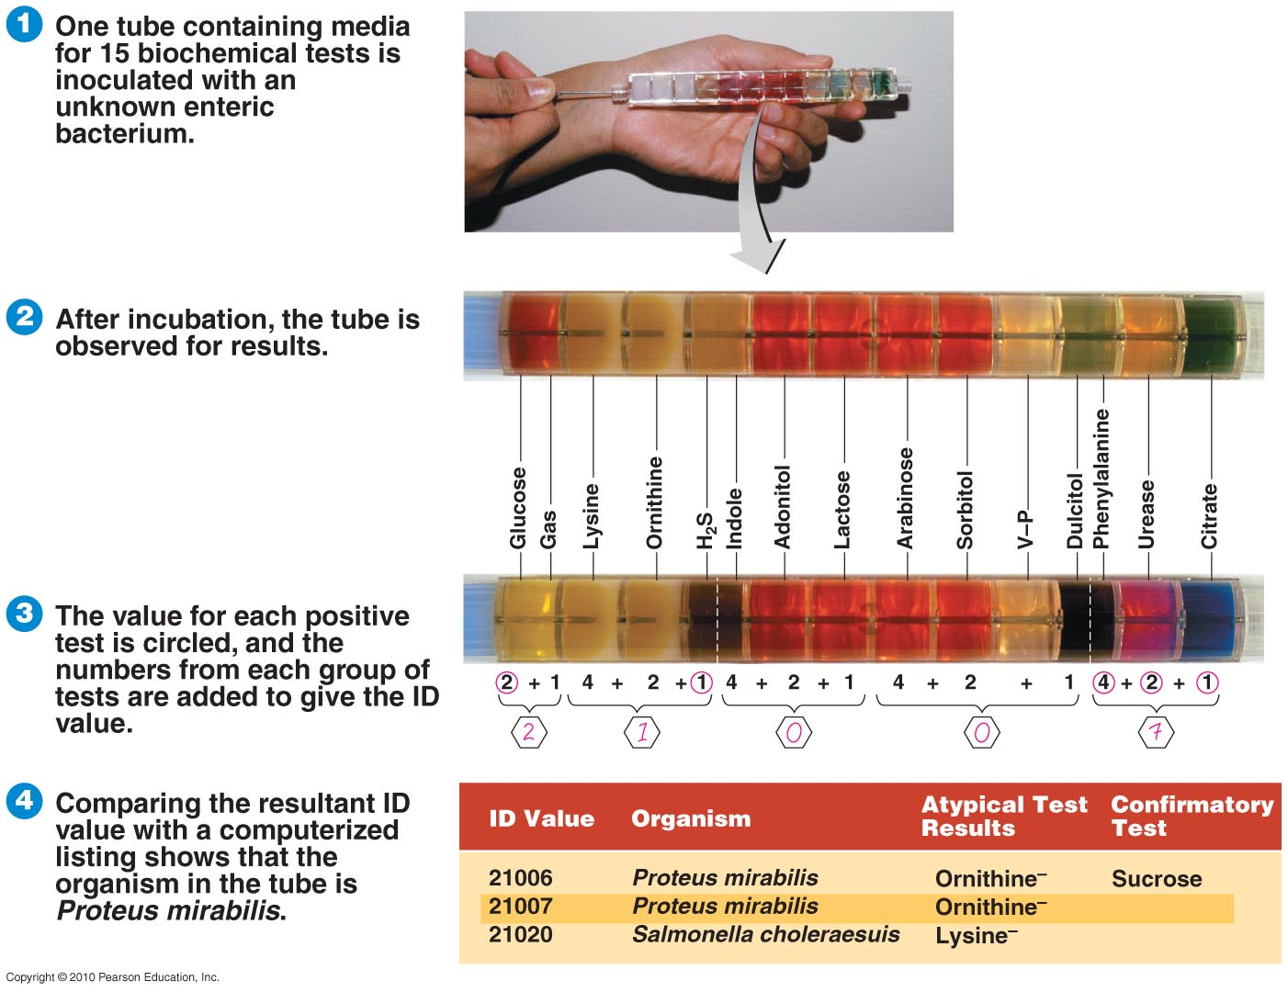
Identification Methods: Biochemical Tests
Biochemical tests
determine presence of bacterial enzymes
use of selective or differential media
rapid identification methods (numerical identification)
perform several tests at once
each test assigned value; score all tests to get ID value
limitation: mutations & plasmids may alter characteristics

Slide 19
Identification Methods
Agglutination test
Bacteria are treated with an anti-serum of known disease states
Antibodies will bind to the bacteria and clump
ELISA (Enzyme-linked immunosorbent assay)
Western blotting
Phage typing
Flow cytometery

Slide 20
Dichotomous Keys
Widely used for microbe identification
not related to phylogeny
Identification based on successive questions with 2 possible answers
Notes:
Understand this concept well as you will be constructing one for your final unknown identification in lab.

Slide 21
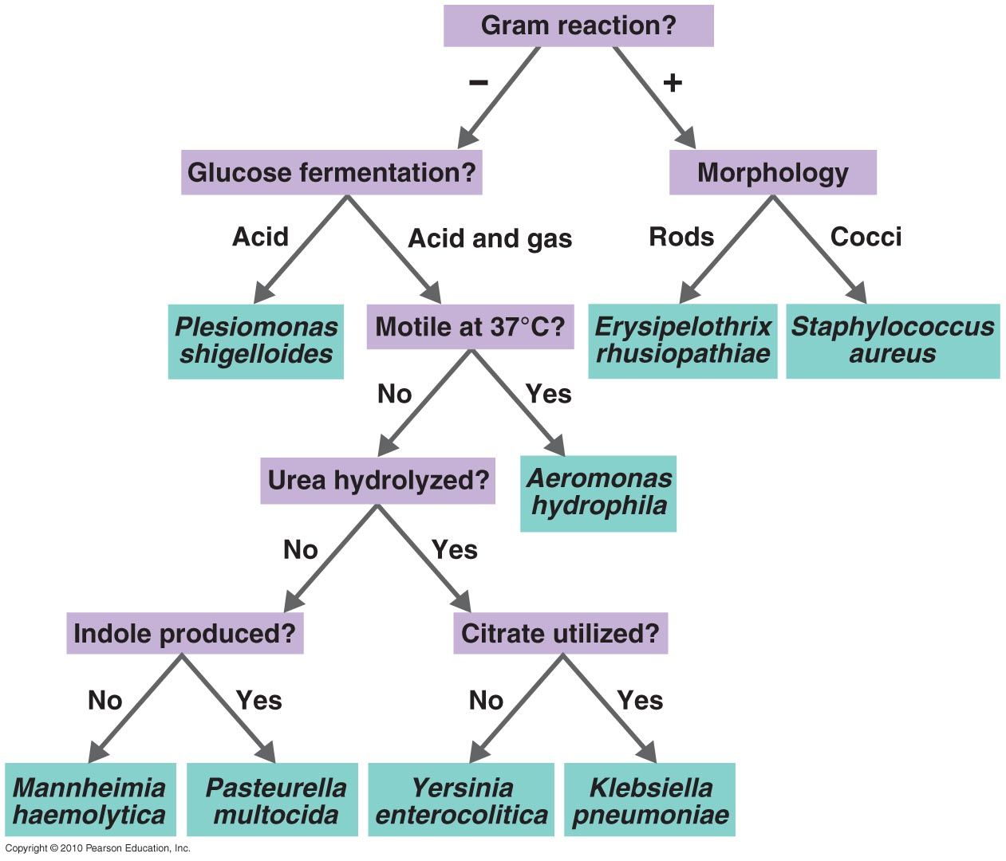
Dichotomous Keys

Slide 22
Building a Dichotomous Key
Identify defining characteristics for each microbe
shape, Gram stain, biochemical tests
yes or no, + or – questions
Make a dichotomous key for species in genus Summer:
science: works at a good job, works indoors
bored: not working, lots of free time but no fun
lifeguard: works at a good job, works outdoors
kids: not working but still no free time
fries: lousy job in fast food
beach: not working, lots of free time and fun

