Slide 1
How this course operates
Elements of Microbiology (Online)
CCV – Rutland
Dr. Joseph Dionne

Slide 2
Welcome to Elements of Microbiology
Welcome to the course!
This term, we will learn a great deal about the basics of the field of Microbiology. This course is designed for STEM majors, nursing students and all others. There is some discussion of clinical applications of microbiology; however, this is a basic science course and not a clinical course.
The slides that follow give some helpful information in regards to the format of this online course.

Slide 3
How Does This Course Work Online?
Online Lecture: Here is where you will read the required chapters from the text as well as additional journal articles as posted on the Canvas page. All quizzes, exams and assignments will be performed online on Canvas. The content (lecture) material will be online via Canvas.
Online Lab: You will choose the McGraw-Hill Connect link in the left hand column of the main Canvas page to enter the virtual lab. You will follow the instructions and enter your personal access code to register for the lab portion of the course.

Slide 4
Your Responsibilities
Please read the syllabus for further details.
Complete all online assignments and discussions by the due date
Read assigned chapters in text and any additionally posted journal articles. Videos may also be posted, please watch.
Read accompanying PowerPoints. Please note some slides have helpful hints written in the notes under the slide (cannot be on “view slide show”). Others have audio clips. Please use these to assist your learning.
Complete all lab activities/assignments on a weekly basis.

Slide 5
Lecture Notes
All the material located in lecture notes and the videos added to Canvas are fair game to be on quizzes and exams. I will NEVER ask you a question regarding material only found in the text.
Please reference all notes found below slides and listen to the audios that accompany some slides. These are present to better your understanding as well as alert you to key topics more likely to be found on quizzes and exams.
Notes:
Additional information is found here on many slides, please read!

Slide 6
How to Contact Instructor
The best way to contact me is via CCV e-mail. I check this several times per day and guarantee a response within 24 hours. Please do not rely on Canvas messenger as I have difficulty accessing this on my phone and do not check it as often as I do my e-mail.
Joseph.Dionne@ccv.edu

Slide 7
Important Notes
Attendance and active participation online is necessary for successful completion of this course.
Assignments and Lab Activities will not be accepted late. Quizzes and exams cannot be made up under any circumstances (see syllabus).
All assignments are to be submitted via Canvas.
Please submit only your original work. Please do not copy answers from the text, slides, online sources or other students.

Slide 8
The Text
The previous text I used now sells for nearly $300! Thus, I have chosen a new text from Rice University which is FREE to download online. Or, you may purchase a hard copy for about $25 on Amazon.
It can be found at: https://openstax.org/subjects. It is entitled, Microbiology.

Slide 9
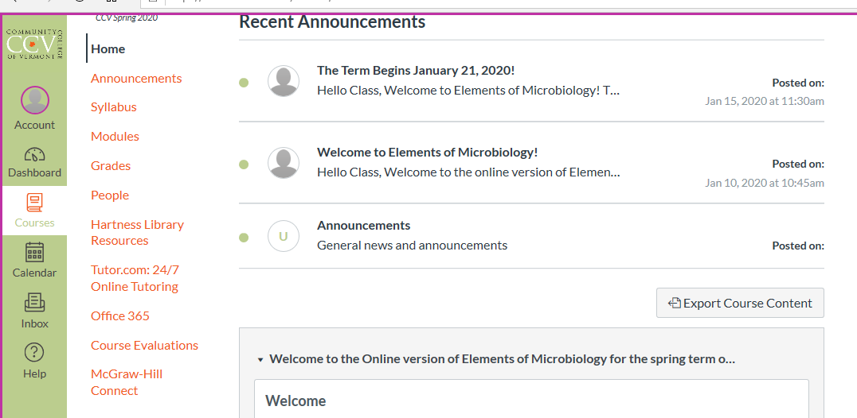
Virtual Lab
Access by selecting the McGraw-Hill Connect link on the Canvas course page and following the instructions. You will need your personal access code.

Slide 10
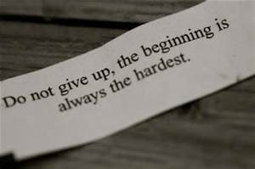
I look forward to meeting you all soon!
I look forward to meeting you all soon.

