Slide 1
Chapter 1
j
An Invisible World
Joseph Dionne
CCV - Rutland
Notes:
1

Slide 2
A question to you…..
What is microbiology?
What are microbes/microoragnisms?
Notes:
Hint: Look these up in the text and be able to differentiate between the two for quizzes/exams.

Slide 3
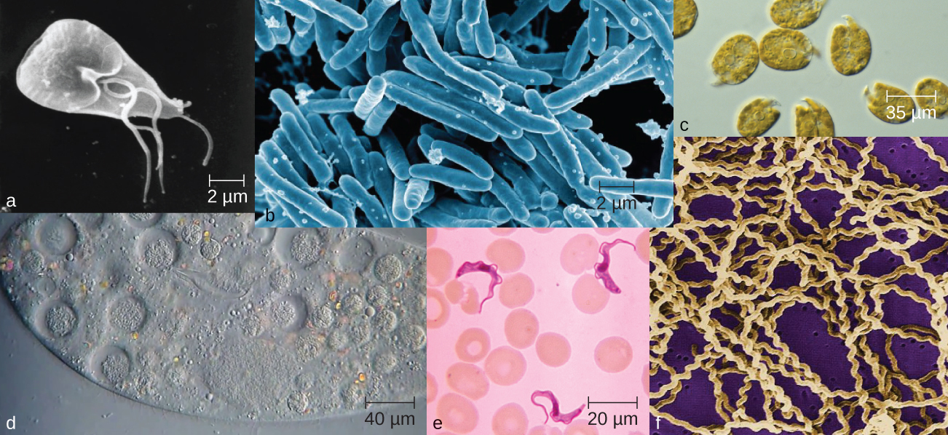
Microbes in Our Lives
Microorganisms: organisms that are too small to be seen by the unaided eye
bacteria
fungi (yeasts, molds)
protozoa
algae
viruses
Notes:
Be familiar with this definition and examples

Slide 4
Microbes in Our Lives: effects & uses
Infection and food spoilage
Are producers in the ecosystem by photosynthesis
Decompose organic waste
Produce industrial chemicals
Ethanol and acetone
Synthesize vitamins, acids, enzymes
Produce fermented foods such as vinegar, cheese, yogurt and bread
Produce products used in manufacturing (e.g., cellulase) and disease treatment (e.g., insulin, Drugs)
Notes:
Be familiar with these examples of ways in which microbes effect our world. We will go into more detail on these topics later in the term.

Slide 5
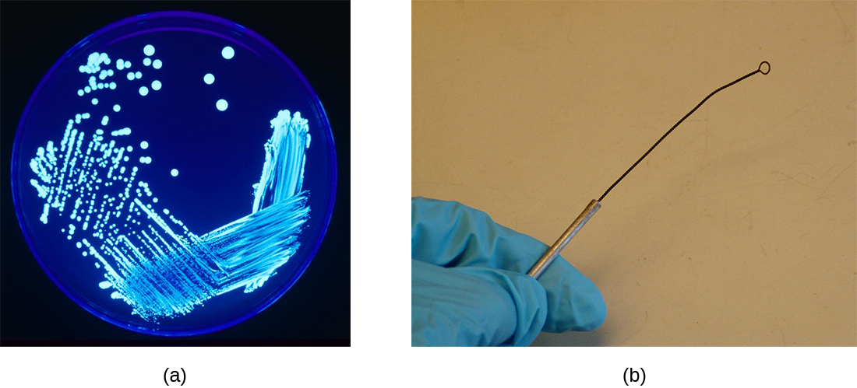
Microbes in Our Lives
Pathogenic microbes
disease-causing
knowledge essential for all health workers
Aseptic techniques
prevent contamination in medicine & laboratories
Notes:
Know these terms!

Slide 6
Classifying Life
Why do biologists Classify Organisms?
More than 1 million kinds of organisms on Earth
Grouping organisms makes studying them easier
Classification – grouping of organisms based on similarities
Taxonomy (Taxis = "arrangement“) science of classification of organisms
Notes:
Imagine if all one million+ species were given names such as, “Steve or Amanda”. This would very confusing and redundancies would exist, such as in humans. To avoid this, through time science has established a more standardized method of naming organisms. More to be discussed in later chapters.

Slide 7
Characteristics of Life
6 Characteristics of life:
Cellular Organization
Chemicals of life (carbohydrates, lipids, nucleic acids, proteins, water)
Energy Use
Response to surroundings
Reproduction
Growth and Development
Notes:
Know and understand these six characteristics that are required for life to exist.
Question to ponder: “Why is reproduction a necessary characteristic of life?”

Slide 8
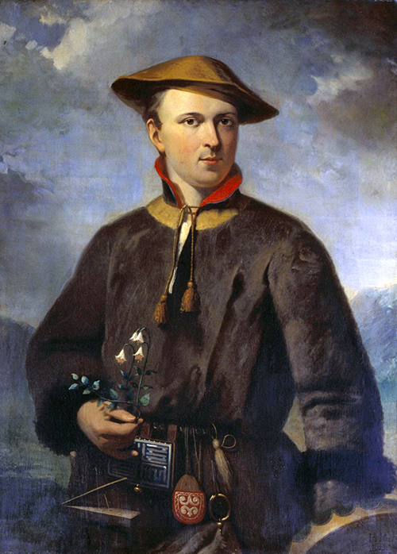
Naming and Classifying Microorganisms
Scientific names
Carolus Linnaeus, 1735
“Latinized” & used worldwide
Genus & species (specific epithet)
genus abbreviated after first use
Descriptive or honor scientist
Escherichia coli
discoverer: Theodor Escherich
habitat: large intestine (colon)
Staphylococcus aureus
clustered (staphylo) spherical (cocci) cells
gold-colored (aureus) colonies
Notes:
Binomial Nomenclature – unique two-part scientific name (Binomial = two names)
The important aspect of this slide is to understand that binomial nomenclature is still used today. That it is italicized (or underlined) and that the Genus is capitalized and the species is not. Also, please note that Genus can be abbreviated with a single capital letter after its first use in a written document. For example, Escherichia coli can be abbreviated as E. coli.
Additionally, please understand how some organisms were named after the scientist who discovered them while others are more descriptive about the organisms itself.
Why do you suppose Latin was primarily used then and now?

Slide 9
Scientific Names
Are italicized or underlined
The genus is capitalized; the specific epithet is lowercase
After the first use, scientific names may be abbreviated with the first letter of the genus and the specific epithet:
Homo sapiens = H. sapiens
Notes:
Just a reminder….hmmm…that must mean it is important to know!!!

Slide 10
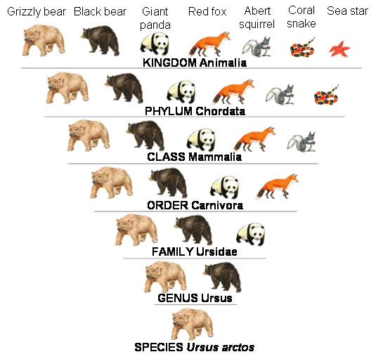
Classification
Domain
Kingdom
Phylum
Class
Order
Family
Genus
Species
Did King Phillip Come Over For Grape Soda?
Notes:
As you go down the list of classifications, the characteristics become more specific and the number of organisms becomes fewer
Please know these in order from broadest category to most specific category.

Slide 11
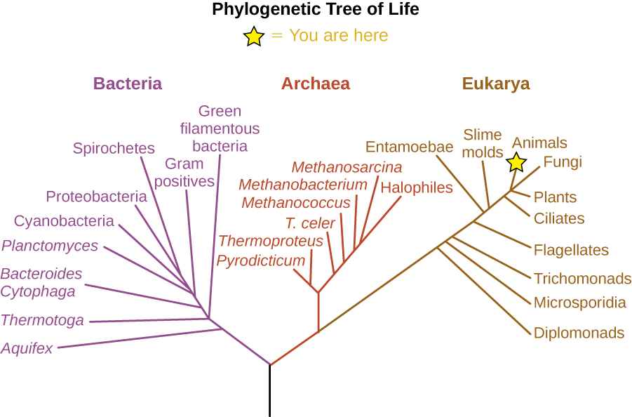
Classification of Microorganisms
2 cell types:
Prokaryotic (no nucleus)
Eukaryotic (nucleus)
3 domains:
Bacteria
Archaea
Eukarya
6 kingdoms:
Bacteria
Archaea
Protists
Fungi
Plants
Animals

Slide 12
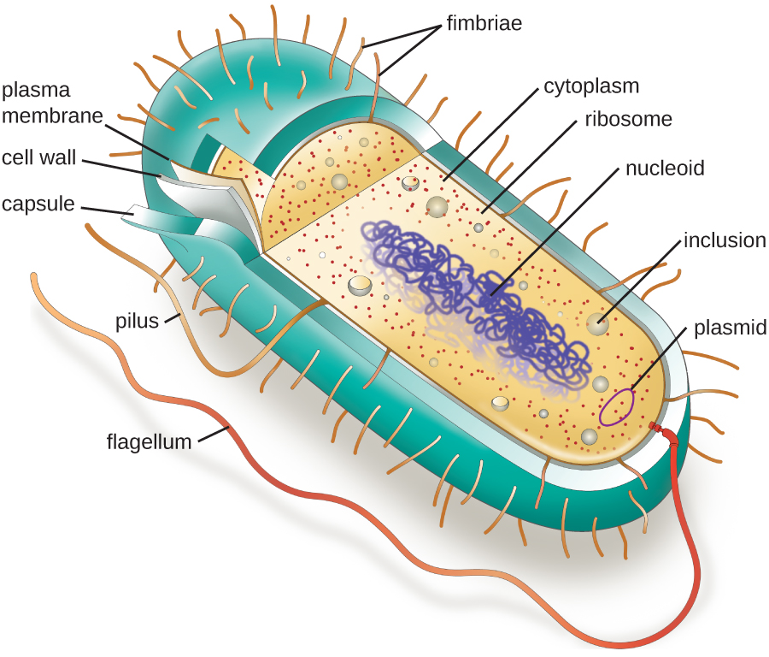
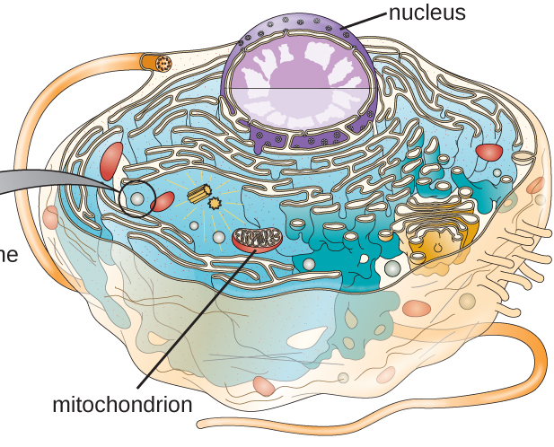
Prokaryotic vs Eukaryotic cell
Prokaryotic Cell
Eukaryotic Cell
Notes:
We will learn more later in this term. For now, understand that eukaryotic cells have a nucleus and prokaryotic cells do not.

Slide 13
Bacteria
Prokaryotes
Shapes:
bacillus – rod-like
coccus – spherical
spirillum – spiral
Cell walls: peptidoglycan
Division: binary fission
Movement: flagella
Notes:
Please be familiar with the shapes and the three bolded items.

Slide 14
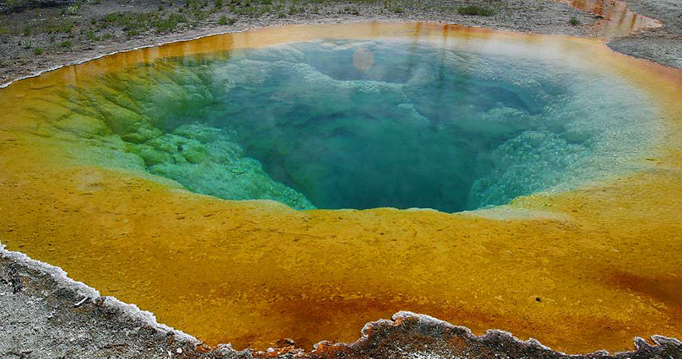
Archaea
Prokaryotes
Lack peptidoglycan
Extreme environments
3 main groups:
methanogens
produce methane
extreme halophiles
salt-loving
extreme thermophiles
hot-loving
Notes:
Especially understand that Archaea do NOT have peptidoglycan in the cell wall.
Halo = salt, phillic = loving – salt loving organisms: the Great Salt Lake
hot springs at Yellowstone National Park

Slide 15
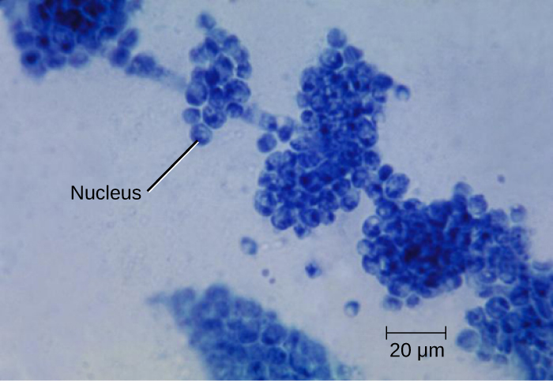
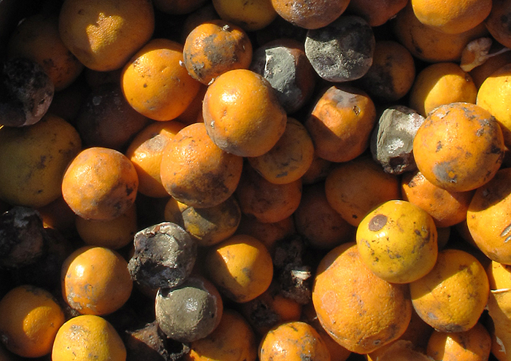
Fungi
Eukaryotes - nucleus
Cell walls: chitin
Nutrition:
Organic chemicals
Not photosynthetic
Molds and mushrooms
multicellular
Yeasts
unicellular
Notes:
Know that chitin composes the walls of fungi. Also, know examples of multicellular (more than one cell) versus unicellular (one cell) organisms.

Slide 16
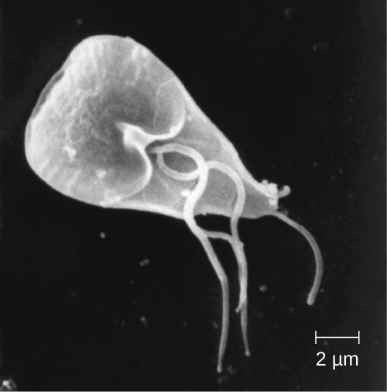
Protozoa
Eukaryotes – Kingdom protista
Free-living or parasitic single cells
Absorb or ingest organic chemicals
Movement:
pseudopods (false feet)
cilia
flagella
Notes:
Understand this is a single (one) celled eukaryote. Also, pseudopods look like a false foot that extends from the organism to consume extracellular (outside of the cell) material for use within the cell.

Slide 17
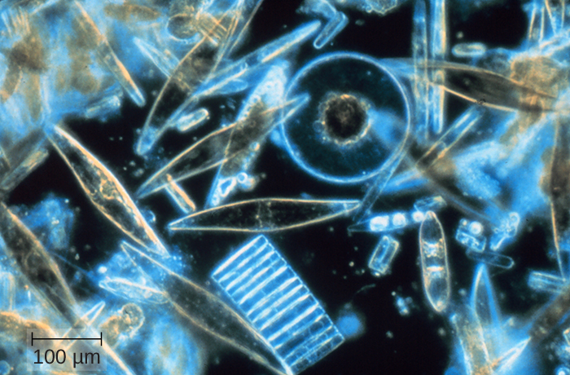
Algae
Eukaryotes – Kingdom protista
Single or multicellular
Cell walls: cellulose
Photosynthetic
use sunlight to make sugars
oxygen is a byproduct
Notes:
Understand Algae can be single or multicellular, cell walls composed of cellulose and that they can perform photosynthesis (more info to come in later chapters)

Slide 18
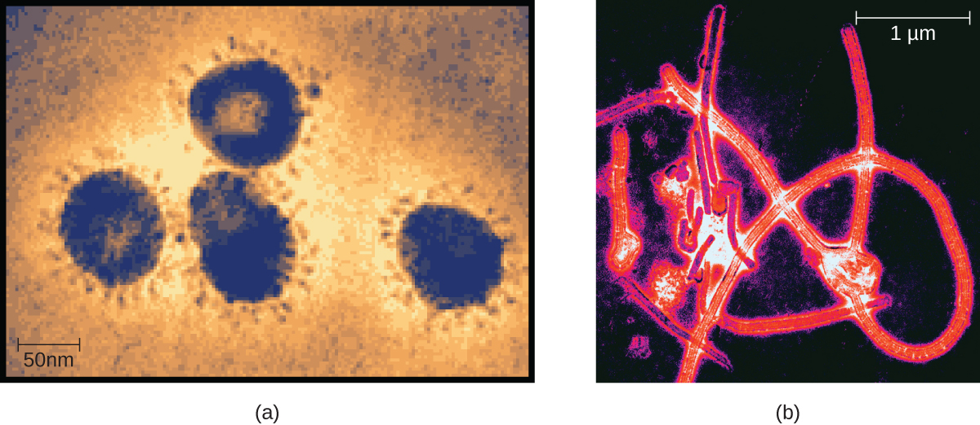
Viruses
Much smaller than bacteria
Acellular
Replicates only when in living host cell
inert outside of hosts
Notes:
Viruses are not living. They can only replicate within the cells of the host (infected organism).

Slide 19
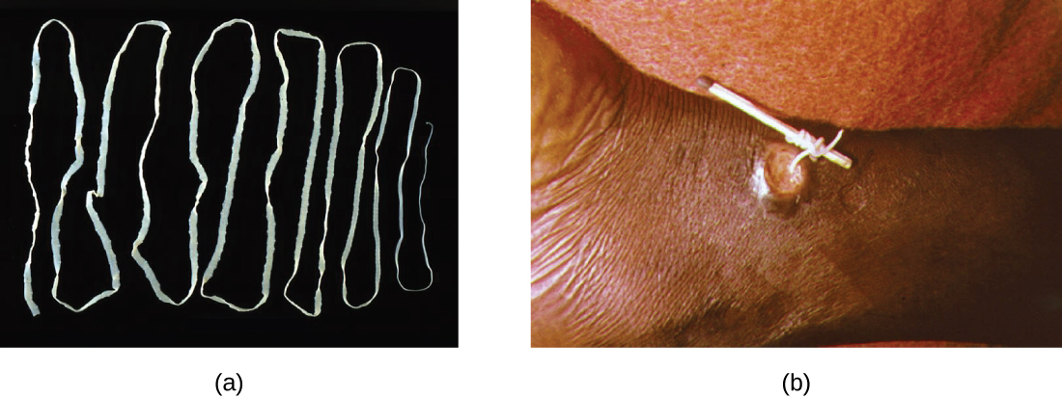
Multicellular Animal Parasites
Eukaryotes
Multicellular animals
Helminths
parasitic worms
Notes:
Understand that helminths are parasitic worms.

Slide 20
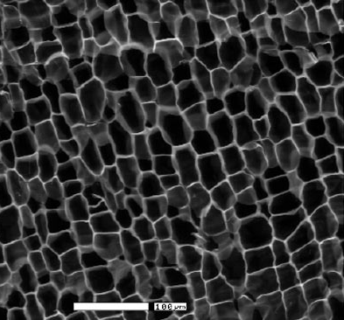
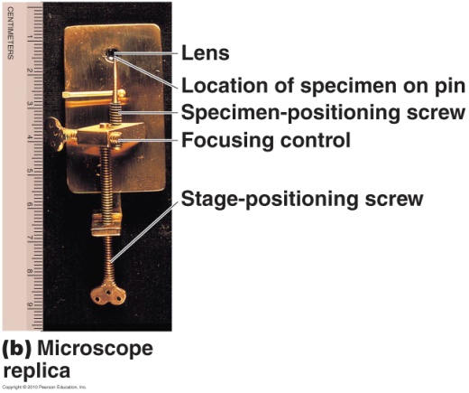
A Brief History of Microbiology: The First Observations
1665: Robert Hooke
cork under microscope
little boxes: cells
1858: Rudolf Virchow said cells arise from preexisting cells
Cell theory – all living things are composed of cells & come from preexisting cells
Notes:
All of the info on this slide is very important to understand.
(Note: look at how simplistic the original microscopes were…very different from the parfocal scopes we will be using in lab!)
Know definition of Cell Theory as well as these scientists’ contributions.

Slide 21
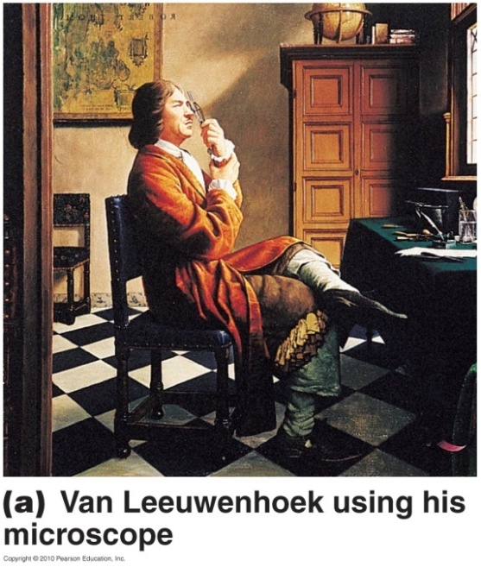
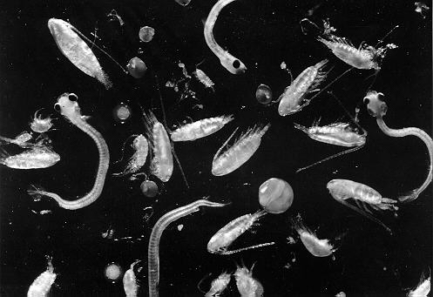
A Brief History of Microbiology: The First Observations
1673-1723: Anton van Leeuwenhoek
live microorganisms
“animalcules”
Looked at teeth scraping, feces, and rain water

Slide 22
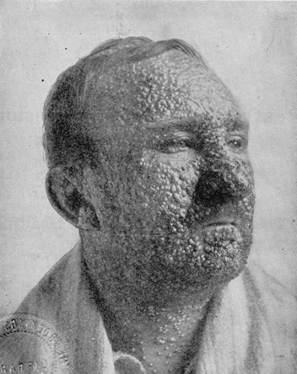
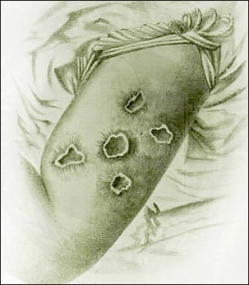
Vaccination
Smallpox: periodic epidemics killed 1000s (disfigured survivors)
1796: Edward Jenner – vaccination
collected scrapings from cowpox blisters
scratched healthy boy with cowpox contaminated needle
boy then immune to (protected from) cowpox & smallpox
Mechanism:
microorganisms with decreased virulence induce immunity against infections by closely related virulent microorganisms
Notes:
Understand the significance of this discovery. Also, what types of risks were involved in this type of human experimentation? Could this type of experiment be performed today?

Slide 23
The Birth of Modern Chemotherapy
Chemotherapy – treatment of disease using chemical substances
some chemicals more poisonous to microorganisms than hosts
antibiotics – produced by bacteria & fungi; inhibit or kill other microbes
synthetic drugs – made from chemicals in the lab
Notes:
Understand this is the general definition of the term “chemotherapy”, and need not be associated with cancer treatment.

Slide 24
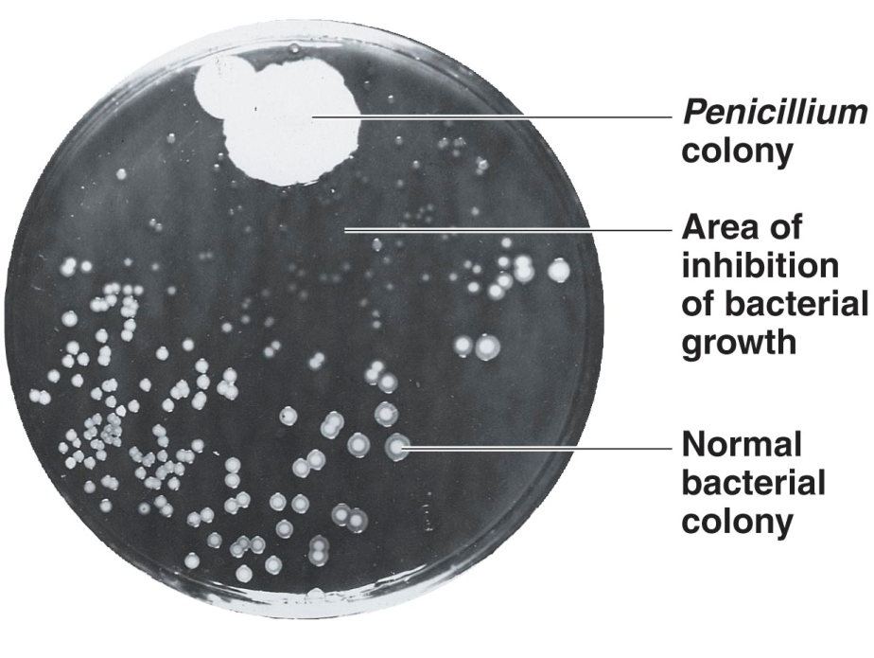
A Fortunate Accident: Antibiotics
1928: Alexander Fleming
discovered first antibiotic by accident
Penicillium fungus made antibiotic, penicillin; killed S. aureus bacteria
penicillin clinically tested & mass produced by 1940s
Problems with chemotherapeutic drugs:
too toxic: kill but also healthy cells
antibiotic resistance: evolve to tolerate or inactivate antibiotics
V
Notes:
What an important accidental discovery!

Slide 25
Modern Developments in Microbiology
Bacteriology – study of bacteria
in food & environment
Mycology – study of fungi
medical, agricultural, & ecological
Parasitology – study of protozoa & parasitic worms
1000s of years old
Virology – study of viruses
observed using electron microscopes
Genomics – study of genes
new tools for classifying microorganisms
Notes:
Please know these basic definitions.

Slide 26
Modern Developments in Microbiology
Immunology is the study of immunity
Vaccines and interferons are being investigated to prevent and cure viral diseases
The use of immunology to identify some bacteria according to serotypes was proposed by Rebecca Lancefield in 1933
Notes:
Please know the definition in bold.

Slide 27
Recombinant DNA Technology
Microbial genetics: the study of how microbes inherit traits
Recombinant DNA: DNA made from two different sources
Notes:
Please know these definitions.

Slide 28
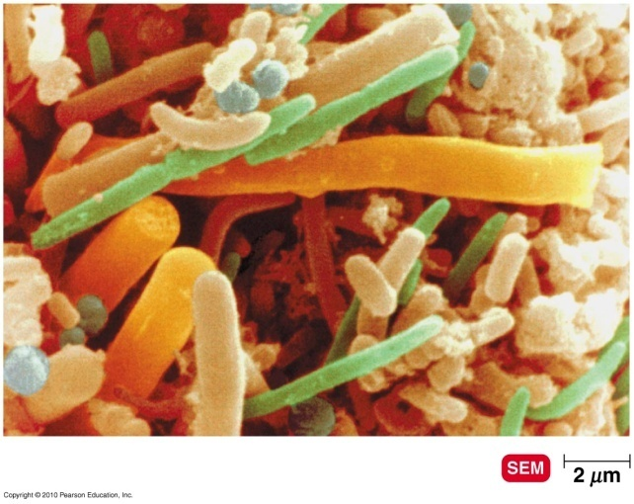
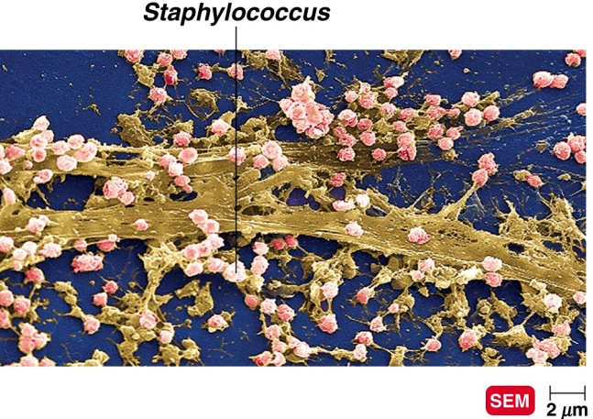
Normal Microbiota
Normal microbiota – microbes normally
present in & on human body
prevent growth of pathogens
produce K & B vitamins
Biofilms – microbes attach to each other
& solid surfaces, grow into masses
on rocks, pipes, teeth, medical implants
physically protected against antibiotics
Notes:
Not all bacteria are bad! Some are required for life. Also, having non-harmful bacteria covering our organs competes with harmful bacteria, yeast, etc. for the “real estate” and decreases the risk of infections.

Slide 29
Emerging Infectious Diseases
Disease – when a pathogen overcomes the host’s resistance
Emerging infectious diseases (EIDs) – new diseases & diseases increasing in incidence
EIDs due to:
evolutionary changes in existing organisms
spread of diseases by modern transportation
exposure to diseases from ecologically disturbed areas\
Notes:
Understand that even today, new diseases can still be discovered. Understand why this is possible.

