Slide 1
Chapter 18
Adaptive Specific Host Defenses

Slide 2
Immunity
Innate immunity: defenses against any pathogen
Adaptive immunity: induced resistance to a specific pathogen

Slide 3
Historical Development
Pasteur observed immunity in chickens injected with weakened pathogens
Von Behring received the Nobel prize for development of antitoxin
Ehrlich’s work led to the identification of antibodies in serum

Slide 4
Figure 17.20 The dual nature of the adaptive immune system.
Humoral (antibody-mediated) immune system
Cellular (cell-mediated) immune system
Control of freely circulating pathogens
Control of intracellular pathogens
Intracellular antigens are expressed on the surface of an APC, a cell infected by a virus, a bacterium, or a parasite.
Extracellular antigens
A B cell binds to the antigen for which it is specific. A T-dependent B cell requires cooperation with a T helper (T_{H}) cell.
T cell
A T cell binds to MHC–antigen complexes on the surface of the infected cell, activating the T cell (with its cytokine receptors).
Cytokines activate T helper (T_{H}) cell.
Cytokines activate macrophage.
Cytokines
Cytokines
B cell
Cytokines from the T_{H} cell transform B cells into antibody-producing plasma cells.
Activation of macrophage (enhanced phagocytic activity).
The B cell, often with stimulation by cytokines from a T_{H} cell, differentiates into a plasma cell. Some B cells become memory cells.
T_{H} cell
Plasma cell
Cytotoxic T lymphocyte
The CD8⁺T cell becomes a cytotoxic T lymphocyte (CTL) able to induce apoptosis of the target cell.
Plasma cells proliferate and produce antibodies against the antigen.
Memory cell
Some T and B cells differentiate into memory cells that respond rapidly to any secondary encounter with an antigen.
Lysed target cell
Notes:
Photo Credit Tortora Microbiology.

Slide 5
Dual Nature of Adaptive Immunity
T and B cells develop from stem cells in red bone marrow
B cells differentiate and mature in the bone marrow
T cells differentiate and mature in the thymus

Slide 6
Dual Nature of Adaptive Immunity
Humoral immunity
Due to antibodies
B cells mature in the bone marrow

Slide 7
Dual Nature of Adaptive Immunity
Cellular immunity
Due to T cells
T cells mature in the thymus

Slide 8
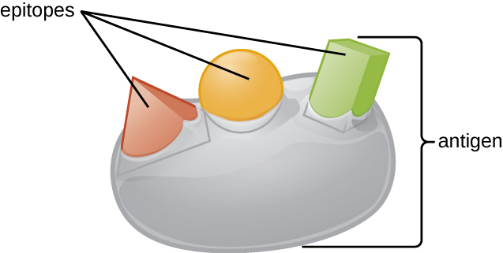
The Nature of Antigens
Antigen (Ag): a substance that causes the body to produce specific antibodies or sensitized T cells
Name is short for “Antibody Generator”
Antibodies (Ab) interact with epitopes, or antigenic determinants
Hapten: antigen is combined with carrier molecules
Notes:
Know this information well.

Slide 9
Antigen-Antibody Binding
A typical protein antigen has multiple epitopes, shown by the ability of three different antibodies to bind to different epitopes of the same antigen.

Slide 10
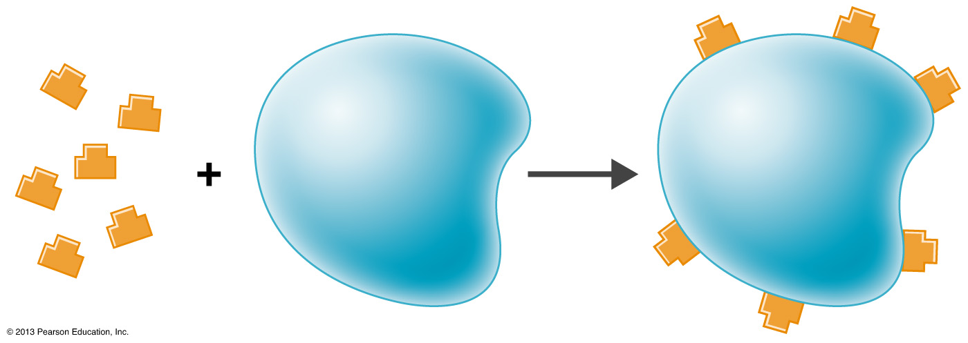
Figure 17.2 Haptens.
Hapten molecules
Carrier molecule
Hapten-carrier conjugate

Slide 11
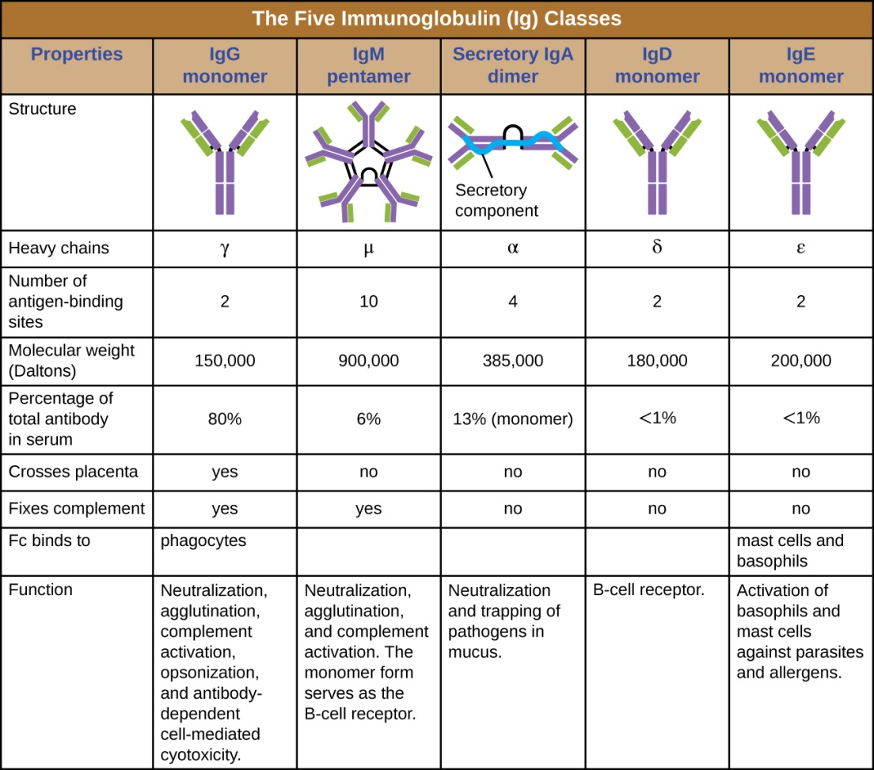
The Nature of Antibodies
Globular proteins called immunoglobulins
The number of antigen-binding sites determines valence

Slide 12
Typical Antibody Structure
The typical four-chain structure of a generic antibody monomer.
The corresponding three-dimensional structure of the antibody IgG. (credit b: modification of work by Tim Vickers)

Slide 13
IgG Antibodies
Monomer
80% of serum antibodies
Fix complement
In blood, lymph, and intestine
Cross placenta
Enhance phagocytosis; neutralize toxins and viruses; protect fetus and newborn
Half-life = 23 days

Slide 14
IgM Antibodies
Pentamer
5–10% of serum antibodies
Fix complement
In blood, in lymph, and on B cells
Agglutinate microbes; first Ab produced in response to infection
Half-life = 5 days

Slide 15
IgA Antibodies
Dimer
10–15% of serum antibodies
In secretions
Mucosal protection
Half-life = 6 days

Slide 16
IgD Antibodies
Monomer
0.2% of serum antibodies
In blood, in lymph, and on B cells
On B cells, initiate immune response
Half-life = 3 days

Slide 17
IgE Antibodies
Monomer
0.002% of serum antibodies
On mast cells, on basophils, and in blood
Allergic reactions; lysis of parasitic worms
Half-life = 2 days

Slide 18
Activation of B Cells
Major histocompatibility complex (MHC) expressed on mammalian cells
T-dependent antigens
Ag presented with (self) MHC to T_{H} cell
T_{H} cell produces cytokines that activate the B cell
T-independent antigens
Stimulate the B cell to make Abs

Slide 19
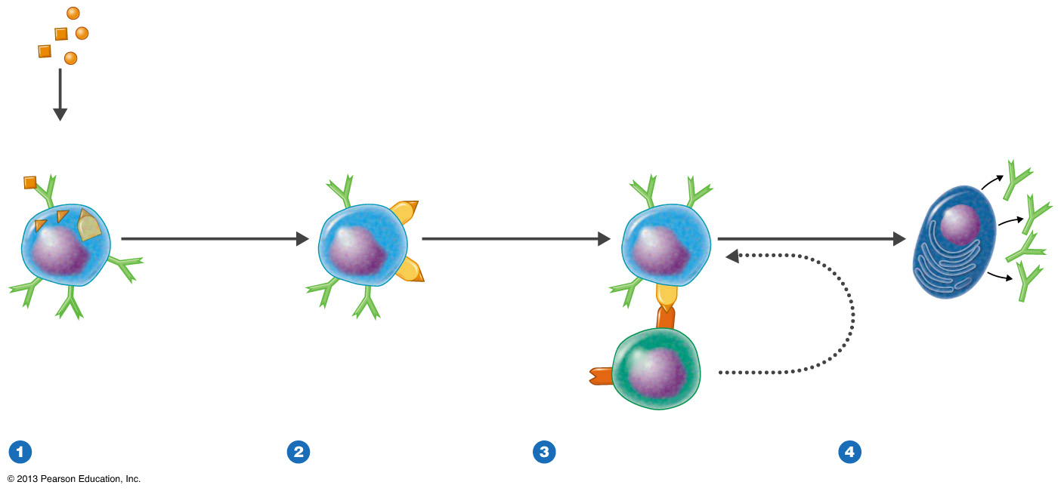
Figure 17.4 Activation of B cells to produce antibodies.
Extracellular antigens
MHC class II with Ag fragment displayed on surface
Ag fragment
MHC class II with
Ag fragment
Antibodies
B cell
B cell
Immunoglobulin receptors coating B cell surface
Plasma cell
T_{H} cell
B cell
Cytokines
Immunoglobulin receptors on B cell surface recognize and attach to antigen, which is then internalized and processed. Within the B cell a fragment of the antigen combines with MHC class II.
MHC class II–antigen-fragment complex is displayed on B cell surface.
Receptor on the T helper cell
(T_{H}) recognizes complex of
MHC class II and antigen
fragment and is activated—
producing cytokines, which
activate the B cell. The T_{H} cell
has been previously activated by
an antigen displayed on a
dendritic cell (see Figure 17.10).
B cell is activated by cytokines and begins clonal expansion. Some of the progeny become antibody-producing plasma cells.
Notes:
Photo Credit: Tortora Microbiology

Slide 20
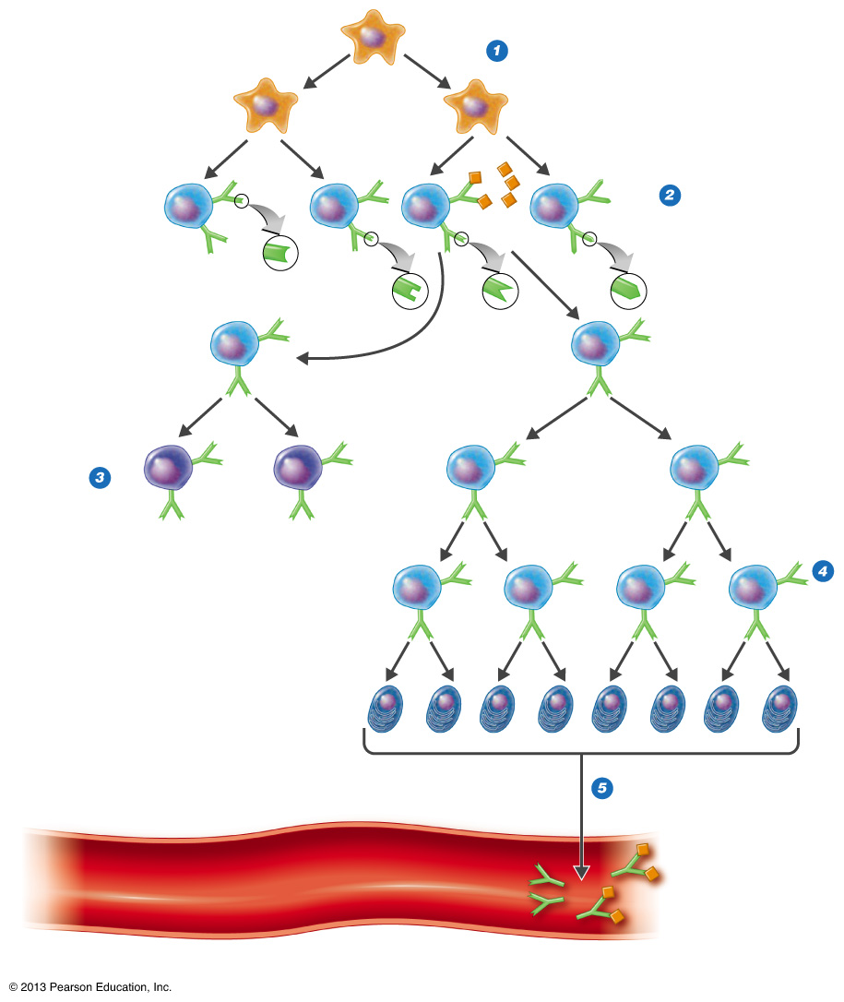
Figure 17.5 Clonal selection and differentiation of B cells.
Stem cell
Stem cells differentiate into mature B cells, each bearing surface immunoglobulins against a specific antigen.
Antigen
B cells
B cell III complexes with its specific antigen and proliferates.
I
II
III
IV
Memory cells
Some B cells proliferate into long-lived memory cells, which at a later date can be stimulated to become antibody-producing plasma cells. See Figure 17.17.
Other B cells proliferate into antibody-producing plasma cells.
Plasma cells
Plasma cells secrete antibodies into circulation.
Antigens in circulation now attached to circulating antibodies
Cardiovascular system
Notes:
Photo credit: Tortora Microbiology

Slide 21
Activation of B Cells
B cells differentiate into:
Antibody-producing plasma cells
Memory cells
Clonal deletion eliminates harmful B cells

Slide 22
Antigen–Antibody Binding
Agglutination
Opsonization
Activation of complement
Antibody-dependent cell-mediated cytotoxicity
Neutralization

Slide 23
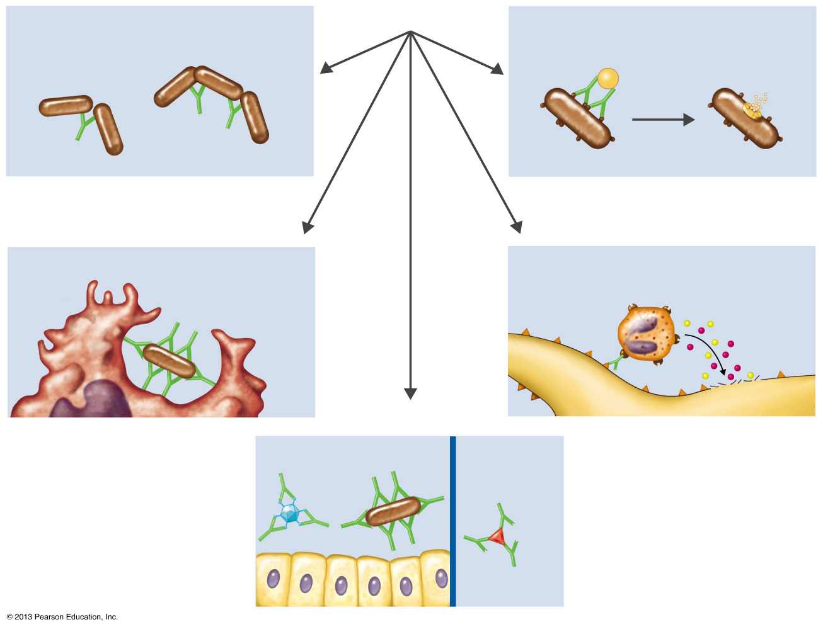
Figure 17.7 The results of antigen–antibody binding.
Agglutination
(see also Figure 18.5)
PROCTECTIVE MECHANISM OF BINDING ANTIBODIES TO ANTIGENS
Activation of complement
(see also Figure 16.9)
Reduces number of infectious units to be dealt with
Causes inflammation and
cell lysis
Complement
Bacteria
Bacterium
Lysis
Antibody-dependent
cell-mediated cytotoxicity
(see also Figure 17.16)
Opsonization
(see also Figure 16.9)
Coating antigen with antibody enhances phagocytosis
Antibodies attached to target cell cause destruction by macrophages, eosinophils, and NK cells
Phagocyte
Eosinophil
Epitopes
Neutralization
(see also Figure 18.9)
Large target cell (parasite)
Perforin and lytic enzymes
Blocks adhesion of bacteria and viruses to mucosa
Blocks attachment of toxin
Virus
Toxin
Bacterium
Notes:
Photo credit: Tortora Microbiology

Slide 24
Neutralization
Neutralization involves the binding of specific antibodies to antigens found on bacteria, viruses, and toxins, preventing them from attaching to target cells.

Slide 25
Opsonization
Antibodies serve as opsonins and inhibit infection by tagging pathogens for destruction by macrophages, dendritic cells, and neutrophils. These phagocytic cells use Fc receptors to bind to IgG-opsonized pathogens and initiate the first step of attachment before phagocytosis.

Slide 26
Agglutination
Antibodies, especially IgM antibodies, agglutinate bacteria by binding to epitopes on two or more bacteria simultaneously. When multiple pathogens and antibodies are present, aggregates form when the binding sites of antibodies bind with separate pathogens.

Slide 27
Antibody-dependent Cell-mediated Cytotoxicity
Antibodies serve as opsonins and inhibit infection by tagging pathogens for destruction by macrophages, dendritic cells, and neutrophils. These phagocytic cells use Fc receptors to bind to IgG-opsonized pathogens and initiate the first step of attachment before phagocytosis.

Slide 28
T Cells and Cellular Immunity
T cells mature in the thymus
Thymic selection eliminates many immature T cells

Slide 29
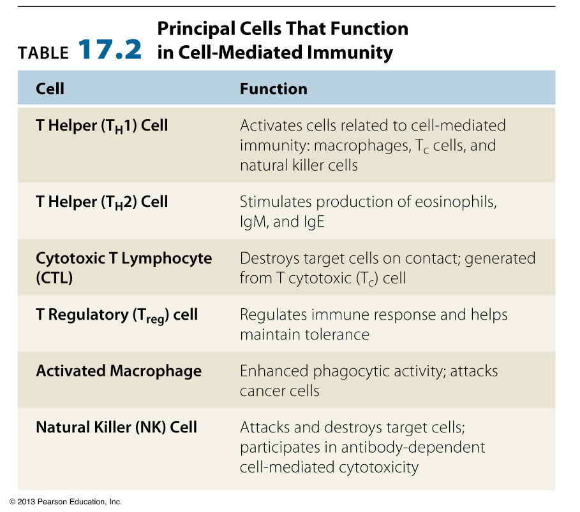
Table 17.2 Principal Cells That Function in Cell-Mediated Immunity
Notes:
Chart credit: Tortora Microbiology

Slide 30
T Cells and Cellular Immunity
T cells respond to Ag by T-cell receptors (TCRs)
T cells require antigen-presenting cells (APCs)
Pathogens entering the gastrointestinal or respiratory tracts pass through:
M (microfold) cells over
Peyer’s patches, which contain APCs

Slide 31
Figure 18.22
In T cell-dependent activation of B cells, the B cell recognizes and internalizes an antigen and presents it to a helper T cell that is specific to the same antigen. The helper T cell interacts with the antigen presented by the B cell, which activates the T cell and stimulates the release of cytokines that then activate the B cell. Activation of the B cell triggers proliferation and differentiation into B cells and plasma cells.

Slide 32
T Cytotoxic Cells
CD8⁺ or T_{C} cells
Target cells are self-cells carrying endogenous antigens
Activated into cytotoxic T lymphocytes (CTLs)
CTLs recognize Ag + MHC I
Induce apoptosis in target cell
CTL releases perforin and granzymes

Slide 33
Figure 17.12 Killing of virus-infected target cell by cytotoxic T lymphocyte.
Processed antigen presented with
MHC class I
T cell receptors
Infected target cell is lysed
Processed antigen
MHC class I
Virus-infected cell (example of endogenous antigen)
CTL
Virus-infected cell
Cytotoxic T lymphocyte (CTL)
A normal cell will not trigger a response by a cytotoxic T lymphocyte (CTL), but a virus-infected cell (shown here) or a cancer cell produces abnormal endogenous antigens.
The abnormal antigen is presented on the cell surface in association with MHC class I molecules. CD8⁺T cells with receptors for the antigen are transformed into CTLs.
The CTL induces destruction of the virus-infected cell by apoptosis.

Slide 34
T Regulatory Cells
T_{reg} cells
CD4 and CD25 on surface
Suppress T cells against self

Slide 35
Antigen-Presenting Cells
Digest antigen
Ag fragments on APC surface with MHC
B cells
Dendritic cells
Activated macrophages

Slide 36
Dendritic Cell
A dendritic cell phagocytoses a bacterial cell and brings it into a phagosome. Lysosomes fuse with the phagosome to create a phagolysosome, where antimicrobial chemicals and enzymes degrade the bacterial cell. Proteases process bacterial antigens, and the most antigenic epitopes are selected and presented on the cell’s surface in conjunction with MHC II molecules. T cells recognize the presented antigens and are thus activated.

Slide 37
Natural Killer (NK) Cells
Granular leukocytes destroy cells that don’t express MHC I
Kill virus-infected and tumor cells
Attack parasites

Slide 38
Cytokines
Chemical messengers
Overproduction leads to cytokine storm

Slide 39
Cells Communicate via Cytokines
Cytokine | Representative Activity
Interleukin-1 (IL-1) | Stimulates T_{H} cells in presence of antigens; attracts phagocytes
Interleukin-2 (IL-2) | Proliferation of antigen-stimulated CD4⁺ T helper cells, proliferation and differentiation of B cells; activation of CD8⁺ T cells and NK cells
Interleukin-12 (IL-12) | Inhibits humoral immunity; activates T_{H}1 cellular immunity

Slide 40
Cells Communicate via Cytokines
Cytokine | Representative Activity
Chemokines | Induce the migration of leukocytes
TNF-α | Promotes inflammation
Hematopoietic cytokines | Influence differentiation of blood stem cells
IFN-α and IFN-β | Response to viral infection; interfere with protein synthesis
IFN-γ | Stimulates macrophage activity

Slide 41
Immunological Memory
Antibody titer is the amount of Ab in serum
Primary response occurs after initial contact with Ag
Secondary (memory or anamnestic) response occurs after second exposure

Slide 42
Primary v. Secondary Response
Compared to the primary response, the secondary antibody response occurs more quickly and produces antibody levels that are higher and more sustained. The secondary response mostly involves IgG.

Slide 43
Types of Adaptive Immunity
Naturally acquired active immunity
Resulting from infection
Naturally acquired passive immunity
Transplacental or via colostrum
Artificially acquired active immunity
Injection of Ag (vaccination)
Artificially acquired passive immunity
Injection of Ab
Notes:
Please know these definitions and examples

Slide 44
Types of Adaptive Immunity
The four classifications of immunity. (credit top left photo: modification of work by USDA; credit top right photo: modification of work by “Michaelberry”/Wikimedia; credit bottom left photo: modification of work by Centers for Disease Control and Prevention; credit bottom right photo: modification of work by Friskila Silitonga, Indonesia, Centers for Disease Control and Prevention)
Notes:
Please know these definitions and examples.

Slide 45
Terminology of Adaptive Immunity
Serology: the study of reactions between antibodies and antigens
Antiserum: the generic term for serum because it contains Ab
Globulins: serum proteins
Immunoglobulins: antibodies
Gamma (γ) globulin: serum fraction containing Ab

