Slide 1
Chapter 2
How We See the Invisible World
Joseph Dionne
CCV - Rutland
Notes:
1

Slide 2
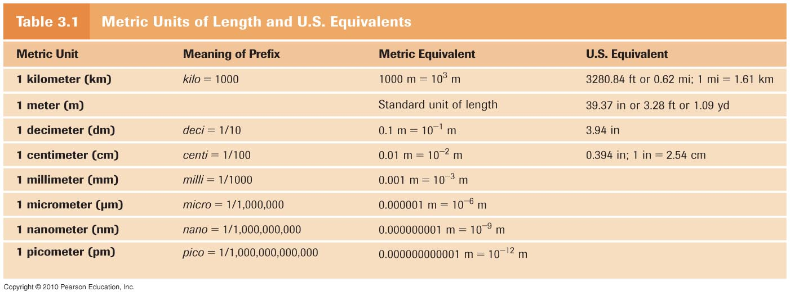
Units of Measurement
Metric system
meter: standard unit of length
units related by factor of 10
Notes:
You do not need to be able to convert from metric to U.S. equivalent; however, please know the meaning of the prefixes and how they are related to one another. Be able to convert within the metric system. For example, understand how many millimeters (mm) are in one meter (m), etc. You should be able to convert amongst meters, centimeters, millimeters, and micrometers. You should also be able to represent the measurements in scientific notation (for example: 1 mm = 0.001 m or 1 x 10⁻³ m).

Slide 3
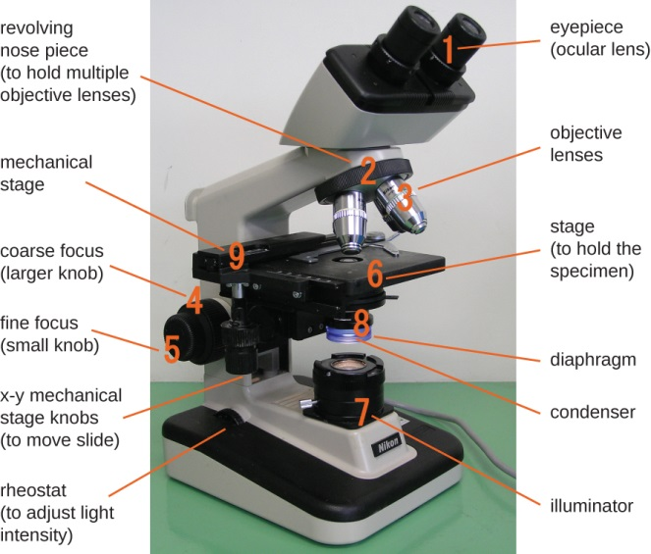
Microscopy: The Instruments
V
Simple microscope: only one lens
More like a magnifying glass
van Leeuwenhoek’s microscope: 300X magnification
Compound microscope: multiple lenses
More common today (will use these in lab)
Notes:
Appreciate how simplistic the original microscopes were back when the microbial world was first discovered.

Slide 4
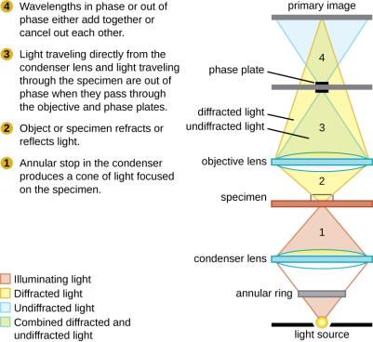
Light Microscopy
Light microscopy
any microscope that uses visible light
Compound light microscope:
series of lenses
light from illuminator, directed by condenser
magnification by objective & ocular lenses
total magnification = objective × ocular lens
Notes:
This is the type of microscope we will discuss the most as we will use this type in the lab. Please know the equation to solve for total magnification (to be discussed further in lab).

Slide 5
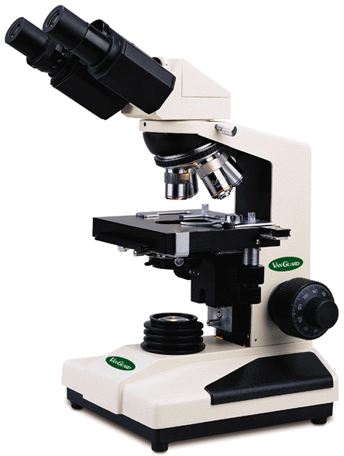
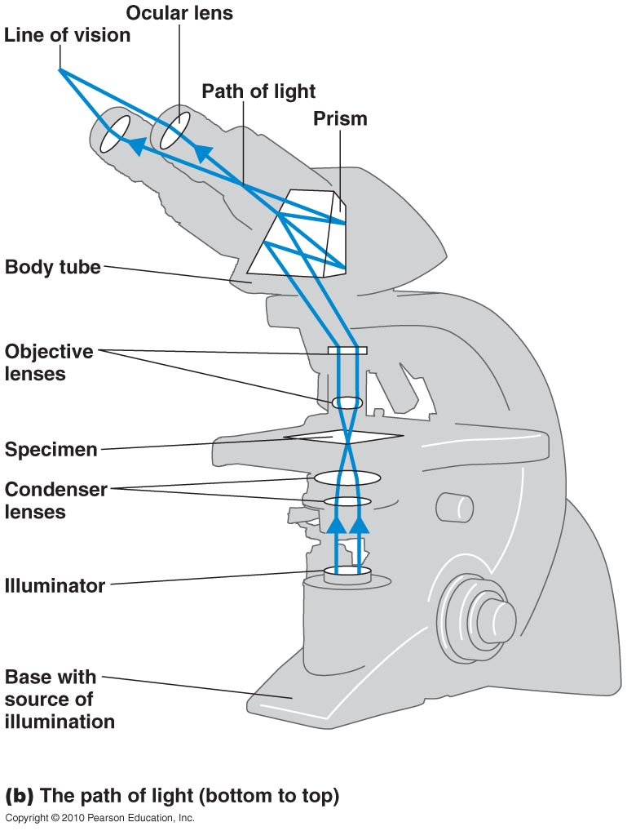
Light Microscope
Notes:
Please reference the photo in the text and be familiar with naming the parts of a light microscope, as this will be necessary for the lab practical. Also, please notice that the image inverts (flips) twice so that it appears to be upside down and opposite left to right from the specimen.

Slide 6
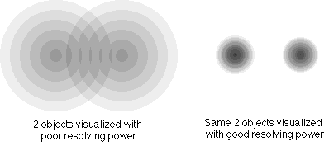
Compound Light Microscopy
Resolution (resolving power) – ability of lenses to distinguish 2 points
resolving power of 0.4 nm: can distinguish between 2 points ≥ 0.4 nm apart
4 nm
4 nm
Notes:
Please know this definition

Slide 7
Compound Light Microscopy
Shorter wavelengths provide greater resolution
white light
resolving power ~0.2 μm
best compound light microscope: 2000X
electrons
shorter wavelength, better resolving power
Notes:
Please understand this concept in relation to resolution.

Slide 8
Magnification
Total magnification = objective lens magnification x ocular lens magnification
Microscopes have 3 objective lenses: 10x (low power), 40x (high power) and 100x (oil immersion)
Ocular lens magnification = 10x
So if you were using the 40x objective the total magnification will be (40x10)= 400x
Notes:
This is important to know, we will discuss this heavily in the lab.

Slide 9
Compound Light Microscopy
Refractive index – measure of light-bending ability of a medium
light rays change direction at boundaries between materials
Staining cells takes advantage of this principle
Notes:
Refractive index is an important concept to understand, especially when we discuss the use of immersion oil with use of the 100x objective.

Slide 10
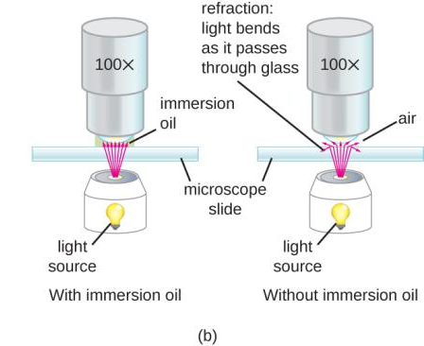
Compound Light Microscopy
100X objective lens is small
light refracted by air after passing though specimen; misses lens
Immersion oil keeps light from bending
same refractive index as glass
improves resolving power
Notes:
Please understand why immersion oil is used for the 100x objective lens. This will be very important when using the scope in the lab.

Slide 11
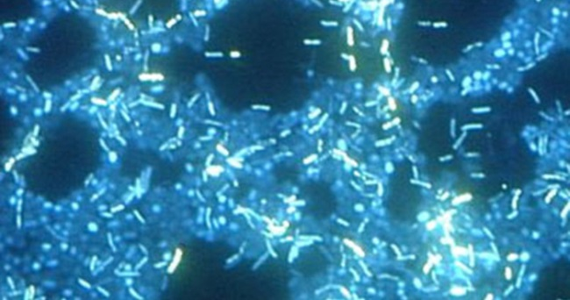
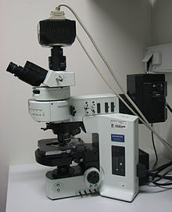
Fluorescence Microscopy
Fluorescence – ability of substances to absorb short wavelengths of light and give off light at a longer wavelength
Fluorochromes – fluorescent dye
Some dyes are attracted to specific organisms
Notes:
Understand the concept of fluorescent microscopy

Slide 12
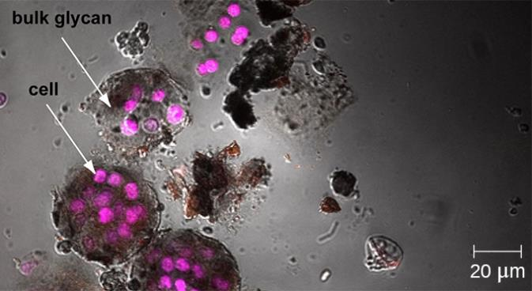
Confocal Microscopy
Light microscopy or fluorescent microscopy used to reconstruct a 3D image of a cell
Can take “splices” of a cell to determine where a specific molecule can be found

Slide 13
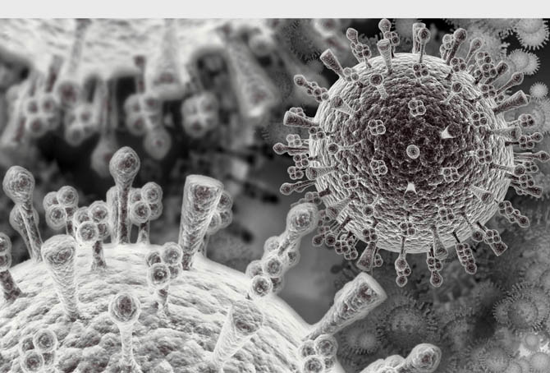
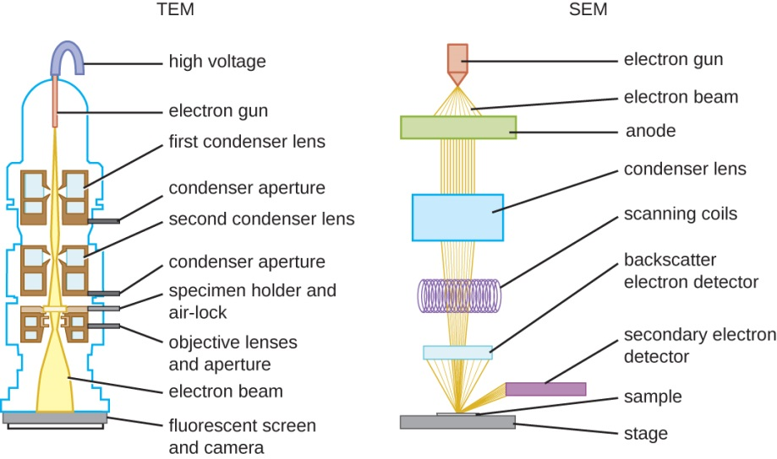
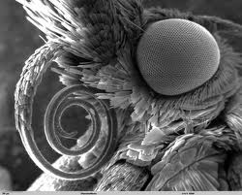
Electron Microscopy
Beam of electrons is used instead of a beam of light
Notes:
This microscope can view very small specimen. As its resolution is greater than light microscopes.

Slide 14
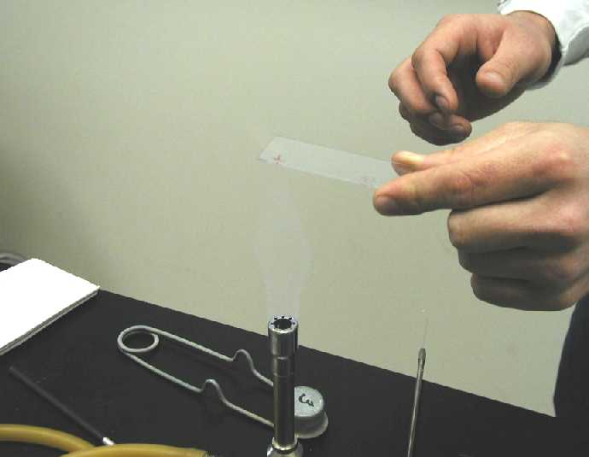
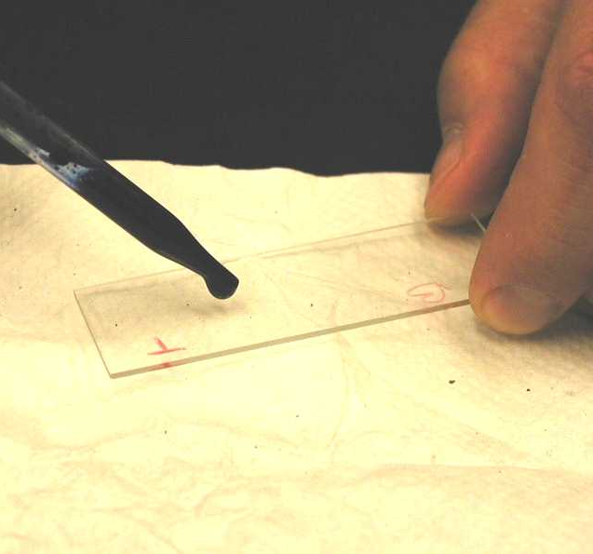
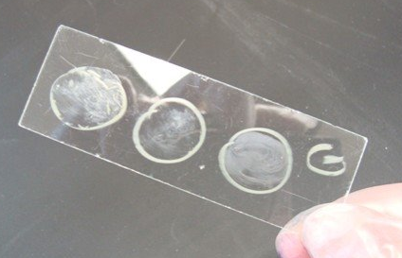
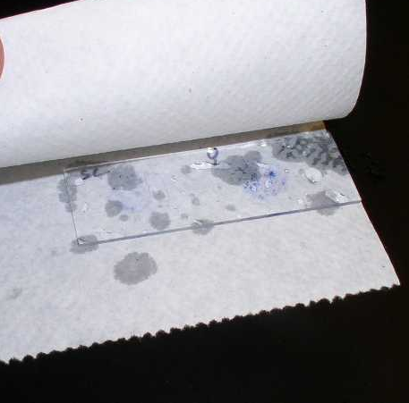
Preparing Smears for Staining
Smear – thin film of microbe solution spread on slide, air dried
Fixing – kills microbes, attaches them to slide, preserves structure
smear passed through flame or covered with methyl alcohol
Stained, rinsed, & blotted with paper
Notes:
We will see these processes in lab. Please know these definitions.

Slide 15
Preparing Slides
A specimen can be heat-fixed by using a slide warmer like this one.
Another method for heat-fixing a specimen is to hold a slide with a smear over a microincinerator.
This tissue sample is being fixed in a solution of formalin (also known as formaldehyde). Chemical fixation kills microorganisms in the specimen, stopping degradation of the tissues and preserving their structure so that they can be examined later under the microscope. (credit a: modification of work by Nina Parker; credit b: modification of work by Nina Parker; credit c: modification of work by “University of Bristol”/YouTube)
Notes:
We will be waving our slides briefly over an infrared heater in lab as depicted in “b” of the above photo.

Slide 16
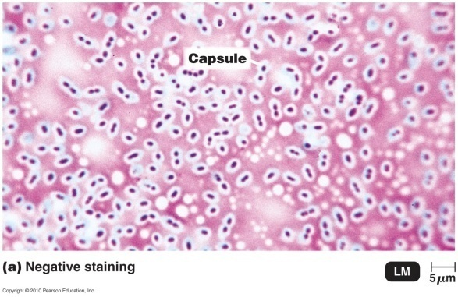
Stains
Staining – coloring microbes with dye that emphasizes certain structures; provides contrast
Notes:
Understand that staining allows us to visualize small organisms which would otherwise be clear and difficult to distinguish from the glass slide.

Slide 17
Stains
These Bacillus anthracis cells have absorbed crystal violet, a basic positive stain.
This specimen of Spinoloricus, a microscopic marine organism, has been stained with rose bengal, a positive acidic stain.
These B. megaterium appear to be white because they have not absorbed the negative red stain applied to the slide. (credit a: modification of work by Centers for Disease Control and Prevention; credit b: modification of work by Roberto Danovaro, Antonio Pusceddu, Cristina Gambi, Iben Heiner, Reinhardt Mobjerg Kristensen; credit c: modification of work by Anh-Hue Tu)
Notes:
Just some examples of what stains look like using the microscope.

Slide 18
Stains
3 types of stains:
Simple
Differential
Special

Slide 19
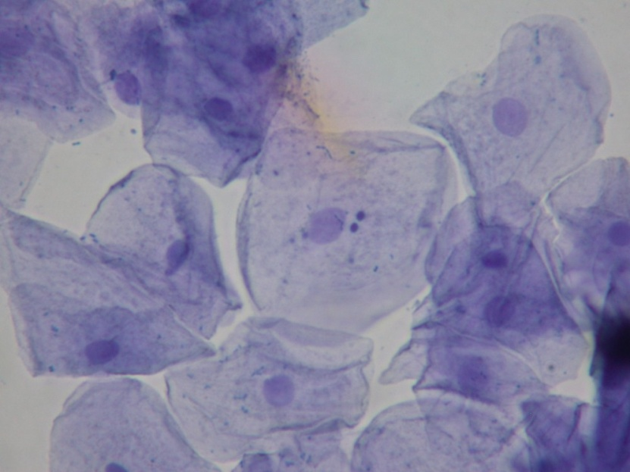
Simple Stains
Simple stain – use of single basic dye
highlights entire microbe
cell size, shape, & arrangement
methylene blue, carbolfuchsin, crystal violet, safranin are examples
mordant – chemical that may be added to intensify stain
increases affinity of stain for specimen, or coats specimen to thicken it
Notes:
This type of stain is used to observe a microorganism. Please know the term mordant.

Slide 20
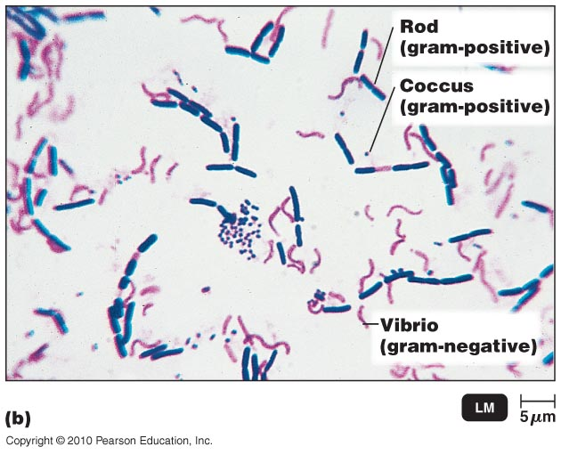
Differential Stain: Gram Stain
Differential stains – distinguish between bacteria; use >1 dye
Gram stain
acid-fast stain
Gram stain: separates bacteria
into gram-positive & gram-negative
Gram-positive bacteria: killed by
penicillin, cephalosporins, & detergents
Gram-negative bacteria: more resistant to antibiotics
can’t penetrate lipopolysaccharide layer
best on young, growing bacteria
Notes:
Differential staining is used when more than one bacteria is likely present and comparisons and identifications can be had. Be very familiar with the concept of Gram staining as this will be a significant portion of the lab.

Slide 21
Differential Stain: Gram Stain
Gram-staining is a differential staining technique that uses a primary stain and a secondary counterstain to distinguish between gram-positive and gram-negative bacteria.
Notes:
Please understand what is occurring in each step as you prepare for the Staining Lab.

Slide 22
Differential Stain: Gram Stain
Bacterial cell walls:
Gram positive: thick peptidoglycan layer
Gram negative: thin peptidoglycan layer and outer lipopolysaccharide layer
Notes:
Basic comparison between Gram positive and Gram negative bacteria. More information to follow.

Slide 23
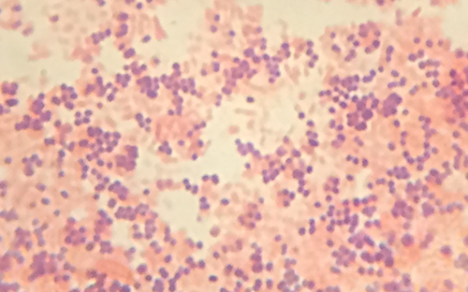
Gram Stain
Notes:
Just a visual.

Slide 24
Differential Stain: Gram Stain
Crystal violet & iodine enter, form CV-I complex
Gram-positive bacteria: retain CV-I; remain purple after decolorizing
thicker peptidoglycan cell walls
CV-I can’t be washed out of intact peptidoglycan layer
Gram-negative bacteria: don’t retain CV-I; lose purple color after decolorization
peptidoglycan layer very thin; can’t hold CV-I
alcohol disrupts lipopolysaccharide layer; allows CV-I out
Notes:
Be very comfortable with this concept.

Slide 25
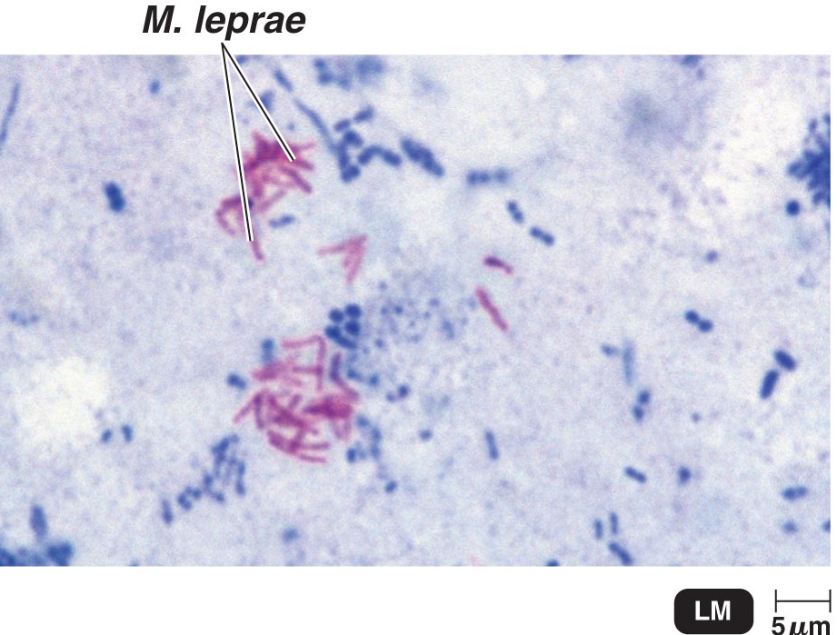
Differential Stain: Acid-Fast Stain
Binds strongly to bacteria with waxy material in cell walls
stained waxy cell wall not decolorized by acid-alcohol
Identifies:
Mycobacterium
tuberculosis & leprosy
Nocardia
 | Color of Acid-fast | Color of Non–Acid-fast
Primary stain: Carbolfuchsin | Red | Red
Decolorizing agent: Acid-alcohol | Red | Colorless
Counterstain: Methylene blue | Red | Blue
Notes:
Understand the idea that a waxy cell wall is required for this stain to bind.

Slide 26
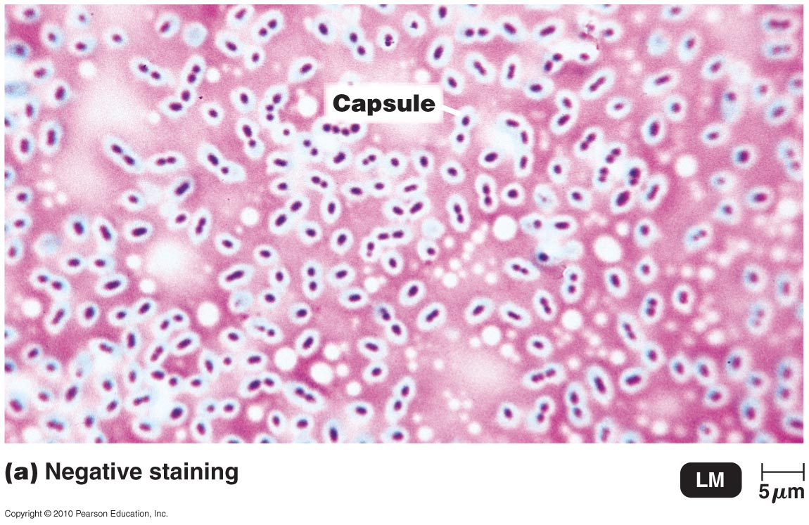
Special Stain: Negative Staining for Capsules
Special stains – distinguish parts of cells
Finding capsule helps determine virulence
Capsule staining difficult
capsules water-soluble & fragile
Negative stain background, simple stain bacteria
capsules repel dye; look like clear halos
Notes:
This is an important staining technique to be familiar with. We will see in later chapters why capsulated bacteria can be of great concern clinically.

Slide 27
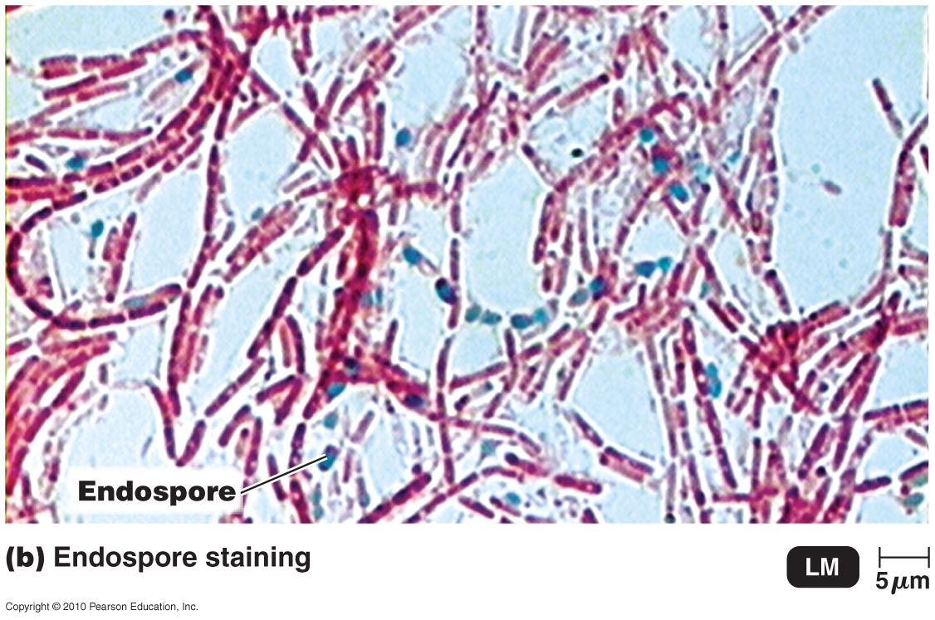
Special Stain: Endospore Staining
Endospore – resistant, dormant structure in bacteria cell
protects bacteria from adverse environment
most dyes don’t penetrate endospore wall
Schaeffer-Fulton endospore stain
primary stain: malachite green, heated
stains endospores
decolorize cells: water
counterstain: safranin
stains rest of cell
Notes:
Know that this stains looks for endospores. More information on endospores to come in future chapters.

Slide 28
Simple Stains
(credit “basic stains”: modification of work by Centers for Disease Control and Prevention; credit “Acidic stains”: modification of work by Roberto Danovaro, Antonio Dell’Anno, Antonio Pusceddu, Cristina Gambi, Iben Heiner, Reinhardt Mobjerg Kristensen; credit “Negative stains”: modification of work by Anh-Hue Tu)
Notes:
A Review.

Slide 29
Differential Stains
(credit “Gram stain”: modification of work by Nina Parker; credit “Acid-fast stain”: modification of work by American Society for Microbiology; credit “Endospore stain”: modification of work by American Society for Microbiology; credit “Capsule stain” : modification of work by American Society for Microbiology; credit “Flagella stain”: modification of work by Centers for Disease Control and Prevention)
Notes:
A Review.

