Slide 1
Chapter 12
Modern Application of Microbial Genetics
Notes:
1

Slide 2
Biotechnology and Recombinant DNA
Biotechnology: the use of microorganisms, cells, or cell components to make a product
Foods, antibiotics, vitamins, enzymes
Recombinant DNA (rDNA) technology: insertion or modification of genes to produce desired proteins

Slide 3
Biotechnology and Recombinant DNA
Vector: self-replicating DNA used to carry the desired gene to a new cell
Clone: population of cells arising from one cell; each carries the new gene

Slide 4
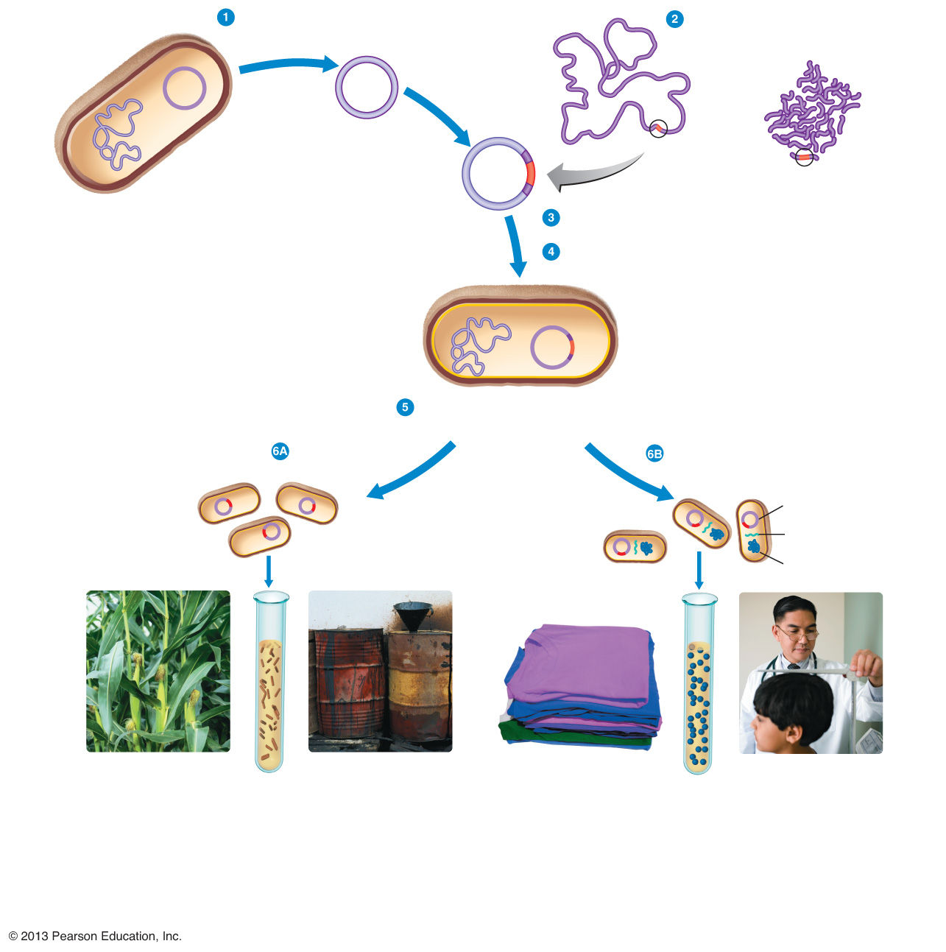
Figure 9.1 A Typical Genetic Modification Procedure.
Vector, such as a plasmid, is isolated.
DNA containing gene of interest from a different species is cleaved by an enzyme into fragments.
bacterium
Plasmid
DNA containing gene of interest
Bacterial cromosome
recombinant DNA
(plasmid)
Desired gene is selected and inserted into plasmid.
Plasmid is taken up by a cell, such as a bacterium.
transformed bacterium
Cells with gene of interest are cloned with either of two goals in mind.
Create and harvest copies of a gene.
or
Create and harvest protein products of a gene.
Plasmid
RNA
Protein product
Gene encoding protein for pest resistance is inserted into plant cells.
Gene encoding degradative enzyme to clean up toxic waste is inserted into bacterial cells.
Amylase, cellulase, and other enzymes prepare fabrics for clothing manufacture.
Human growth hormone treats stunted growth.

Slide 5
Selection and Mutation
Selection: culture a naturally occurring microbe that produces the desired product
Mutation: mutagens cause mutations that might result in a microbe with a desirable trait
Site-directed mutagenesis: change a specific DNA code to change a protein
Select and culture a microbe with the desired mutation

Slide 6
Restriction Enzymes
Cut specific sequences of DNA
Destroy bacteriophage DNA in bacterial cells
Cannot digest (host) DNA with methylated cytosines

Slide 7
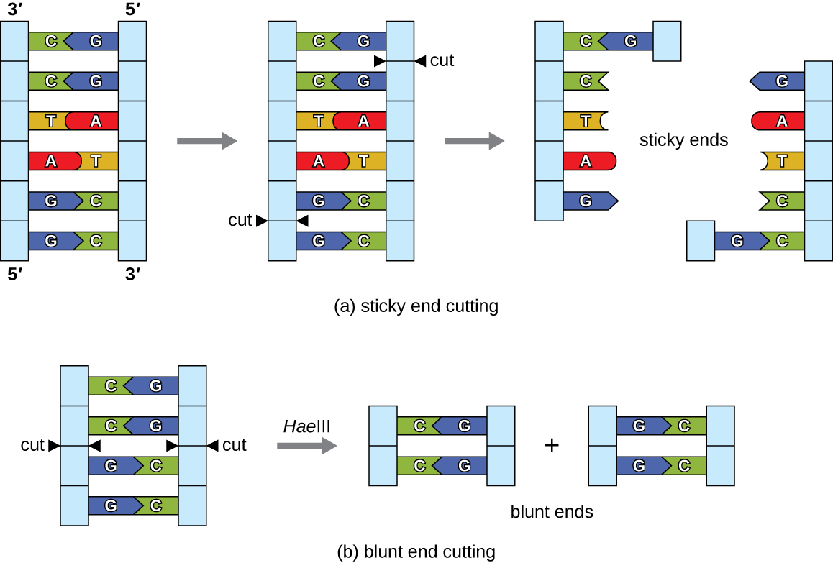
Table 9.1 Selected Restriction Enzymes Used in rDNA Technology

Slide 8
Recombinant DNA Process

Slide 9
Vectors
Carry new DNA to desired cell
Shuttle vectors can exist in several different species
Plasmids and viruses can be used as vectors
Notes:
Please understand the purpose of vectors.

Slide 10
Figure 12.12
The T_{i} plasmid of Agrobacterium tumefaciens is a useful shuttle vector for the uptake of genes of interest into plant cells. The gene of interest is cloned into the T_{i} plasmid, which is then introduced into plant cells. The gene of interest then recombines into the plant cell’s genome, allowing for the production of transgenic plants.

Slide 11
Polymerase Chain Reaction (PCR)
To make multiple copies of a piece of DNA enzymatically
Used to:
Clone DNA for recombination
Amplify DNA to detectable levels
Sequence DNA
Diagnose genetic disease
Detect pathogens

Slide 12
PCR
A thermal cycler (left) is used during a polymerase chain reaction (PCR). PCR amplifies the number of copies of DNA and can assist in diagnosis of infections caused by microbes that are difficult to culture, such as Chlamydia trachomatis (right). C. trachomatis causes chlamydia, the most common sexually transmitted disease in the United States, and trachoma, the world’s leading cause of preventable blindness. (credit right: modification of work by Centers for Disease Control and Prevention)

Slide 13
PCR
The polymerase chain reaction (PCR) is used to produce many copies of a specific sequence of DNA.
Notes:
Understand that the different temperatures allow for different enzymes to perform different functions.

Slide 14
Inserting Foreign DNA into Cells
DNA can be inserted into a cell by:
Gene gun
Microinjection

Slide 15
Figure 9.6 A gene gun, which can be used to insert DNA-coated “bullets” into a cell.

Slide 16
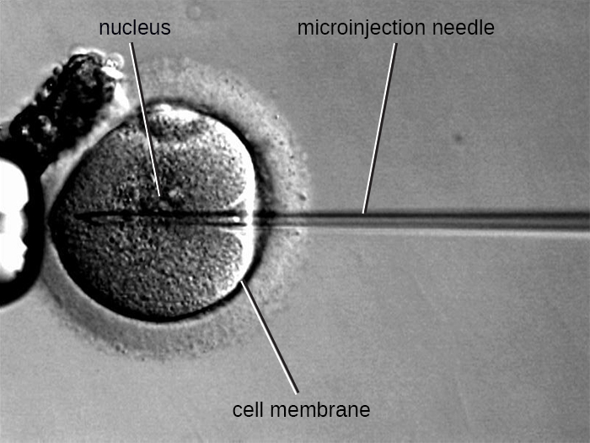
Figure 9.7 The microinjection of foreign DNA into an egg.
© 2013 Pearson Education, Inc.

Slide 17
Genomic Libraries
The generation of a genomic library facilitates the discovery of the genomic DNA fragment that contains a gene of interest. (credit “micrograph”: modification of work by National Institutes of Health)

Slide 18
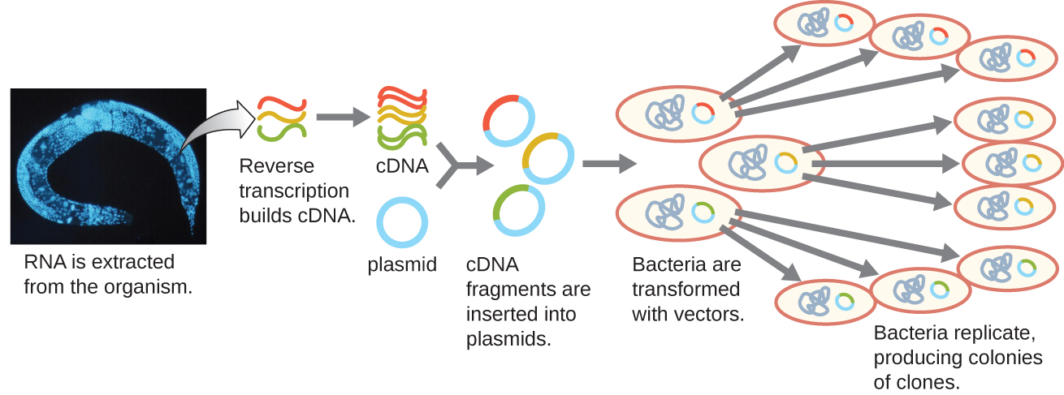
Obtaining DNA
Complementary DNA (cDNA) is made from mRNA by reverse transcriptase

Slide 19
Obtaining DNA
Synthetic DNA is made by a DNA synthesis machine

Slide 20
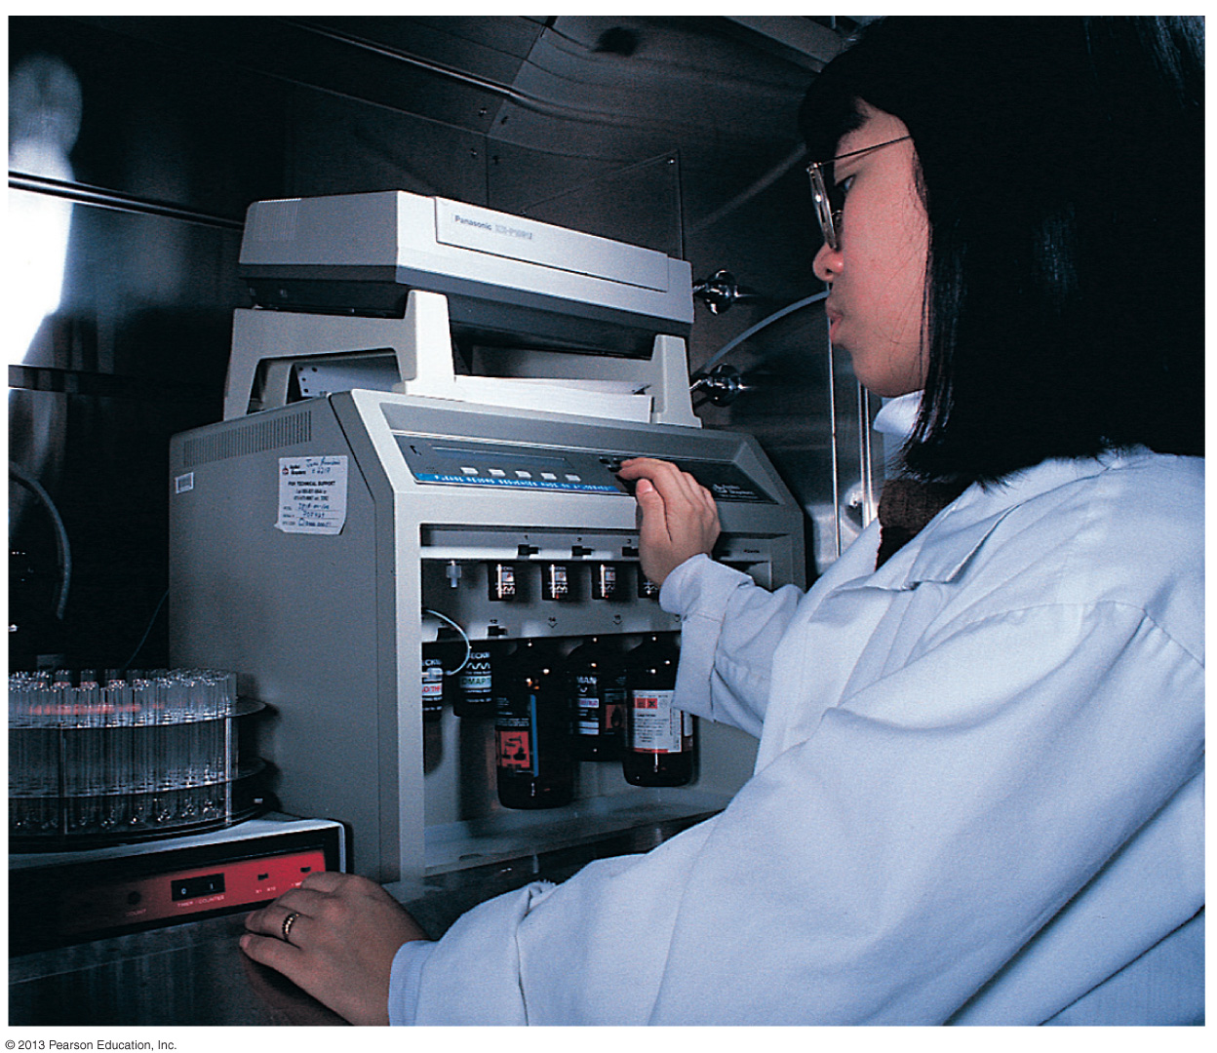
Figure 9.10 A DNA synthesis machine.

Slide 21
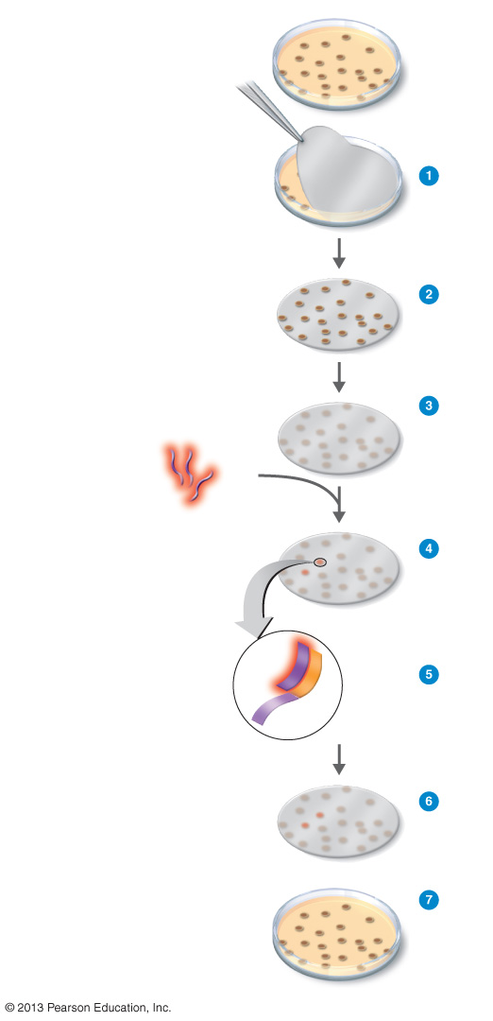
Figure 9.12 Colony hybridization: using a DNA probe to identify a cloned gene of interest.
Master plate with colonies of bacteria containing cloned segments of foreign genes.
Nitrocellulose filter
Make replica of master plate on nitrocellulose filter.
Treat filter with detergent (SDS) to lyse bacteria.
Strands of bacterial DNA
Treat filter with sodium hydroxide (NaOH) to separate DNA into single strands.
Fluorescence labeled probes
Add labeled probes.
Bound DNA probe
Gene of interest
Probe will hybridize with desired gene from bacterial cells.
Single-stranded DNA
Wash filter to remove unbound probe.
Colonies containing genes of interest
Compare filter with replica of master plate to identify colonies containing gene of interest.
Replica plate

Slide 22
Figure 12.13
DNA probes can be used to confirm the presence of a suspected pathogen in patient samples. This diagram illustrates how a DNA probe can be used to search for a gene of interest associated with the suspected pathogen.

Slide 23
Figure 12.14
The process of agarose gel electrophoresis.
A researcher loading samples into a gel.
This photograph shows a completed electrophoresis run on an agarose gel. The DNA ladder is located in lanes 1 and 9. Seven samples are located in lanes 2 through 8. The gel was stained with ethidium bromide and photographed under ultraviolet light. (credit a: modification of work by Magnus Manske; credit b: modification of work by U.S. Department of Agriculture; credit c: modification of work by James Jacob)
Notes:
Please be familiar with the process of agarose gel electrophoresis as we will perform this in lab.

Slide 24
Figure 12.16
In the Southern blot technique, DNA fragments are first separated by agarose gel electrophoresis, then transferred by capillary action to a nylon membrane, which is then soaked with a DNA probe tagged with a molecular beacon for easy visualization.

Slide 25
Figure 12.17
The steps in microarray analysis are illustrated. Here, gene expression patterns are compared between cancerous cells and healthy cells.
Microarray information can be expressed as a heat map. Genes are shown on the left side; different samples are shown across the bottom. Genes expressed only in cancer cells are shown in varying shades of red; genes expressed only in normal cells are shown in varying shades of green. Genes that are expressed in both cancerous and normal cells are shown in yellow.

Slide 26
Figure 12.18
SDS is a detergent that denatures proteins and masks their native charges, making them uniformly negatively charged.
The process of SDS-PAGE is illustrated in these steps.
A photograph of an SDS-PAGE gel shows Coomassie stained bands where proteins of different size have migrated along the gel in response to the applied voltage. A size standard lane is visible on the right side of the gel. (credit b: modification of work by “GeneEd”/YouTube)

Slide 27
Making a Product
E. coli
Used because it is easily grown and its genomics are known
Need to eliminate endotoxin from products
Cells must be lysed to get product

Slide 28
Making a Product
Saccharomyces cerevisiae
Used because it is easily grown and its genomics are known
May express eukaryotic genes easily
Plant cells and whole plants
May express eukaryotic genes easily
Plants are easily grown
Mammalian cells
May express eukaryotic genes easily
Harder to grow

Slide 29
Therapeutic Applications
Human enzymes and other proteins
Subunit vaccines
Nonpathogenic viruses carrying genes for pathogen’s antigens as DNA vaccines
Gene therapy to replace defective or missing genes

Slide 30
Gene Therapy
Gene therapy using an adenovirus vector can be used to treat or cure certain genetic diseases in which a patient has a defective gene. (credit: modification of work by National Institutes of Health)

Slide 31
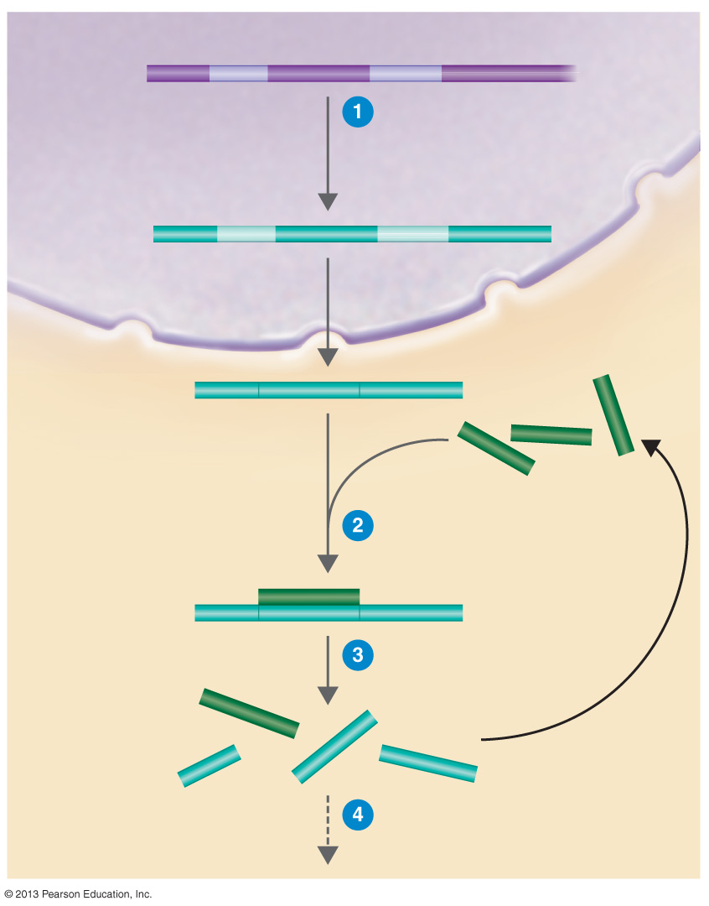
Figure 9.14 Gene silencing could provide treatments for a wide range of diseases.
Nucleus
DNA
An abnormal gene, cancer gene, or virus gene is transcribed in a host cell.
RNA transcript
mRNA
siRNA
siRNA binds mRNA.
RISC breaks down the RNA complex.
No protein expression occurs.
Cytoplasm

Slide 32
Gene Silencing
Cells like the eukaryotic cell shown in this diagram commonly make small antisense RNA molecules with sequences complementary to specific mRNA molecules. When an antisense RNA molecule is bound to an mRNA molecule, the mRNA can no longer be used to direct protein synthesis. (credit: modification of work by Robinson R)

Slide 33
Gene Silencing
This diagram illustrates the process of using siRNA or miRNA in a eukaryotic cell to silence genes involved in the pathogenesis of various diseases. (credit: modification of work by National Center for Biotechnology Information)

Slide 34
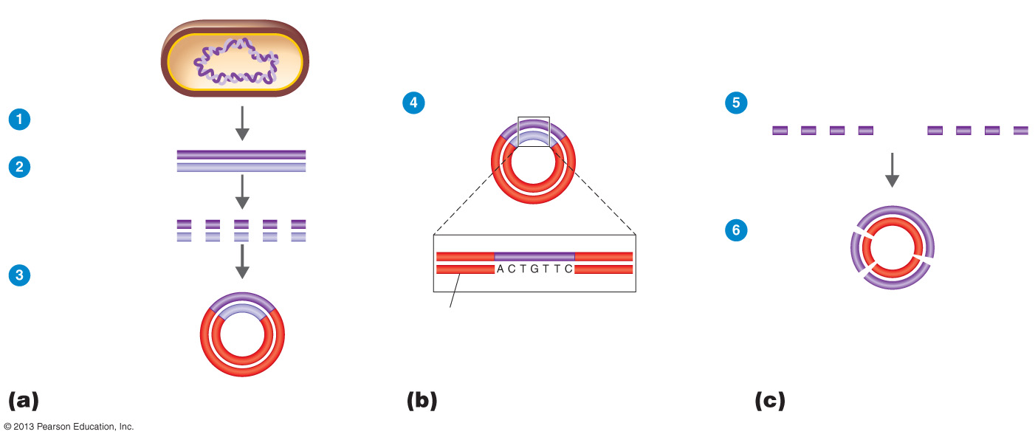
Figure 9.15 Shotgun sequencing.
Sequence DNA fragments.
Assemble sequences.
Isolate DNA.
Fragment DNA with restriction enzymes.
Edit sequences; fill in gaps.
Clone DNA in a bacterial artificial chromosome (BAC).
BAC
Constructing a gene library
Random sequencing
Closure phase

Slide 35
The Human Genome Project
Nucleotides have been sequenced
Human Proteome Project may provide diagnostics and treatments
Reverse genetics: block a gene to determine its function

Slide 36
Scientific Applications
Understanding DNA
Sequencing organisms’ genomes
DNA fingerprinting for identification

Slide 37
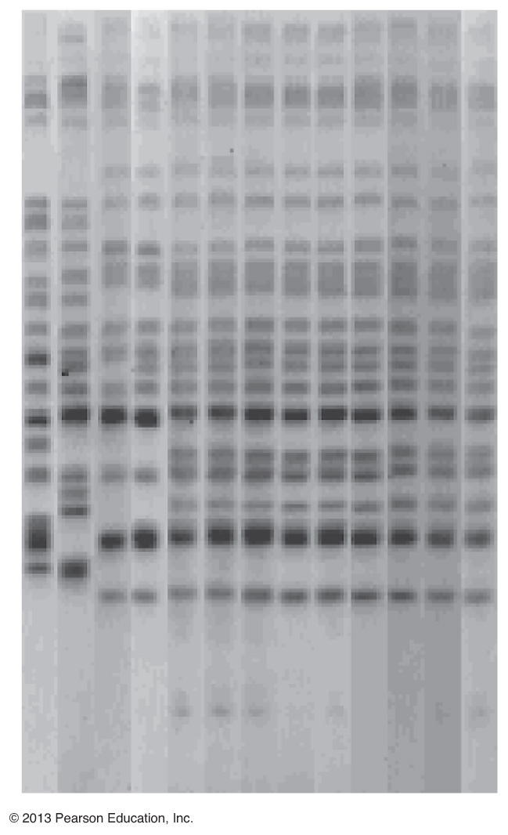
Figure 9.17 DNA fingerprints used to track an infectious disease.
E. coli isolates from patients whose infections were not juice related
E. coli isolates from patients who drank contaminated juice
Apple juice isolates

Slide 38
Figure 12.24
A gel showing PCR products of various Clostridium difficile strains. Javier’s sample is shown at the bottom; note that it matches ribotype 27 in the reference set. (credit: modification of work by American Society for Microbiology)

Slide 39
Forensic Microbiology
PCR
Primer for a specific organism will cause application if that organism is present
Real-time PCR: newly made DNA is tagged with a fluorescent dye; the levels of fluorescence can be measured after every PCR cycle
Reverse-transcription (RT-PCR): reverse transcriptase makes DNA from viral RNA or mRNA

Slide 40
Forensic Microbiology
Differs from medicine because it requires:
Proper evidence collection
Establishing chain of custody
Rape conviction
Tracing HIV to a physician who injected it
Anthrax in U.S. Mail

Slide 41
Nanotechnology
Bacteria can make molecule-sized particles

Slide 42
Safety Issues and Ethics of Using rDNA
Need to avoid accidental release
Genetically modified crops must be safe for consumption and for the environment
Who will have access to an individual’s genetic information?

