Slide 1
Chapter 5
The Eukaryotes: Fungi, Algae, Protozoa, and Helminths
Notes:
1

Slide 2
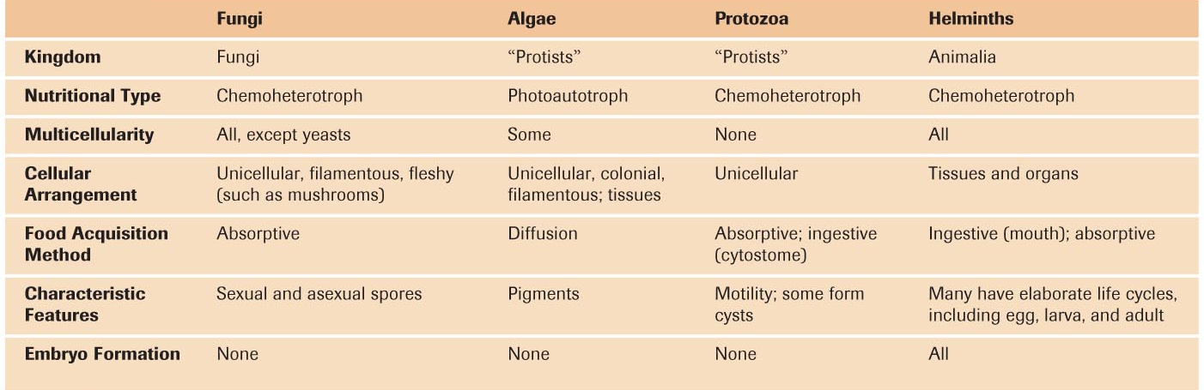
Microorganisms
Notes:
This would be a good table for you to be familiar with. Photo credit Tortora Microbiology.

Slide 3
Fungi
Kingdom | Fungi
Nutritional Type | Chemoheterotroph
Multicellularity | All, except yeasts
Cellular Arrangement | Unicellular, filamentous, fleshy
Food Acquisition Method | Absorptive
Characteristic Features | Sexual and asexual spores
Notes:
Be comfortable with this slide, especially the comparisons between fungi and what you already know regarding bacteria.

Slide 4
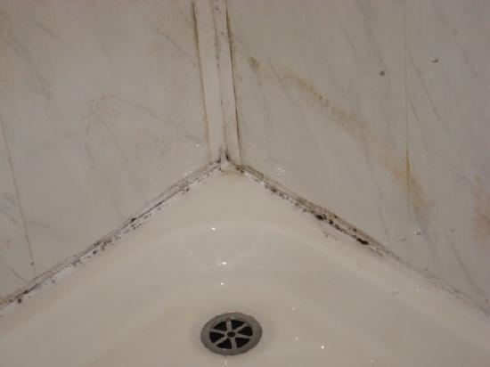
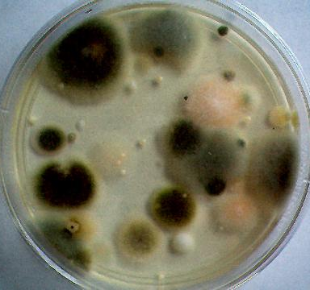
Fungi
Mycology – study of fungi
Fungi can be harmful – infections, diseases in animals and plants
Fungi are beneficial – food, drugs, decomposers, symbiotic with plants (minerals)
>100,000 species and ~200 pathogenic
Multicellular fungi are ID’d on the basis of physical appearance
Colony characteristics (color, size, shape…) and reproductive spores
Notes:
Be familiar with these concepts.

Slide 5
Fungi
Molds: aerobic
Yeasts: facultative anaerobic
Chemoheterotrophs (require organic compounds for energy and carbon)
some metabolize lignin in wood into glucose (ants take advantage of this)
Acidic environment
Grow with little moisture present
Resistant to osmotic pressure
grow with high sugar or salt
Notes:
Please know these characteristics of fungi.

Slide 6
Molds & Fleshy Fungi
Vegetative structures – fungal colonies
Composed of cells interacting
Thallus – body of mold or fleshy fungus
made of hyphae – long filaments of joined cells
cells generally divided by septum: septate hyphae
Creates a uninucleate unit
septum generally incomplete
All cells are interconnected
some hyphae have no septum: coenocytic hyphae
Long continuous cells with several nuceli throughout
Notes:
Please understand the concepts in bold.

Slide 7
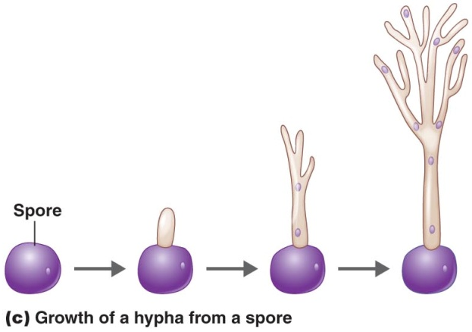
Hyphae
Hyphae grow by elongating at tips
Can create new hyphae
vegetative hypha – for growth (obtains nutrients)
aerial hypha – bear reproductive spores (projects from the surface)
mycelium – mass of hyphae (can be seen by eye)
Can grow miles
Notes:
Please be familiar with the concepts in bold.

Slide 8
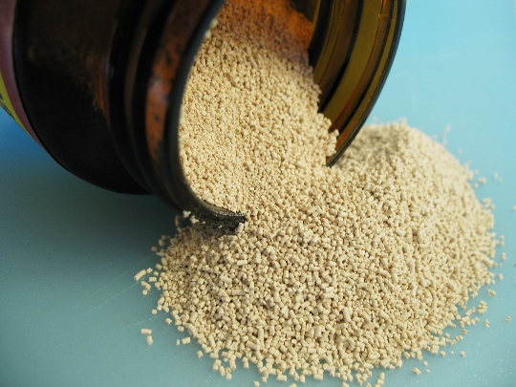
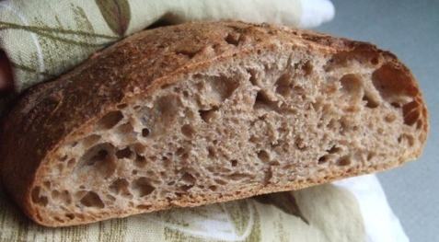
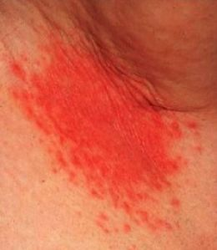
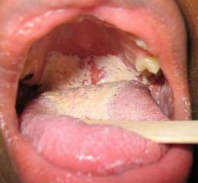
Yeasts
Yeasts – unicellular fungi
non-filamentous
spherical or oval cells
facultative anaerobes
O₂ or organic compound as final e– acceptor
aerobic when O₂ present
anaerobic or fermentative when O₂ absent; produce CO₂ & ethanol
Notes:
Please know this slide well. Pay particular attention to the items in bold.

Slide 9
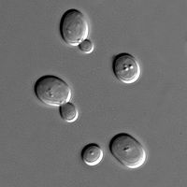
Yeasts
Fission yeasts – divide symmetrically
Budding yeasts – divide asymmetrically
Candida, Saccharomyces
parent cell nucleus divides, one nucleus migrates to bud, bud usually breaks away
pseudohypha – buds fail to detach; produce chains
1 yeast can bud ~ 24 daughter cells
Notes:
You do not need to know the examples; however, please understand the difference between fission and budding yeasts in regards to symmetry.

Slide 10
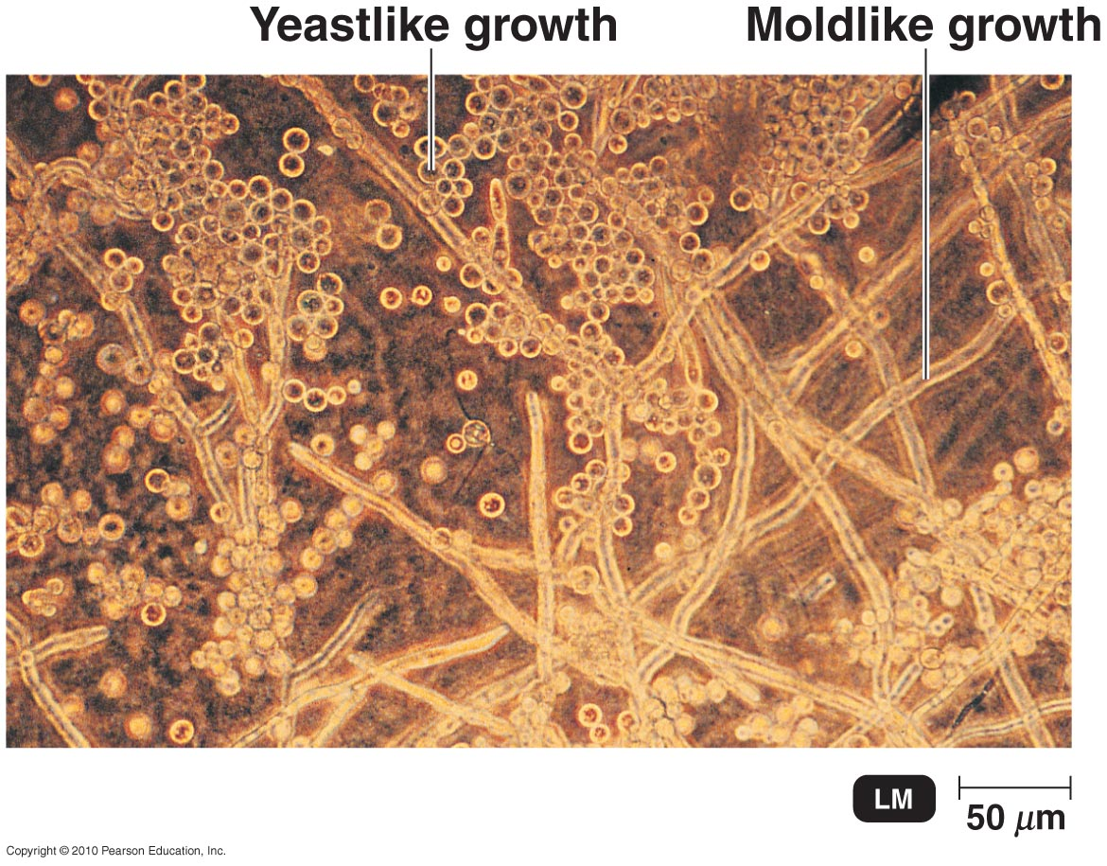
Fungal Dimorphism
Fungal dimorphism – 2 forms of growth: mold or yeast
generally in pathogens
molds: vegetative & aerial hyphae
yeasts: budding
temperature-dependent: yeast-like at 37°C, mold-like at 25°C
CO₂ dependent: yeast-like on agar surface, mold-like in interior
Notes:
Be familiar with this concept.

Slide 11
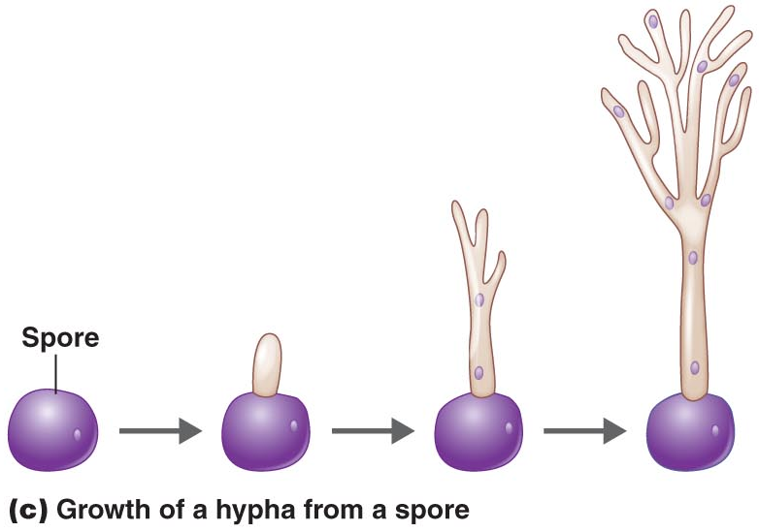
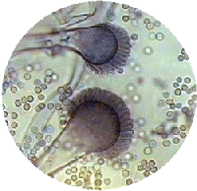
Reproduction
Fragmentation of hyphae
Sexual & asexual spores
spores formed by aerial hyphae
asexual – from hyphae of one organism; more common
sexual – from fusion of nuclei of opposite mating types
spore detaches from parent; forms new hypha
not as tolerant as endospores
Notes:
Understand that asexual reproduction is more common.

Slide 12
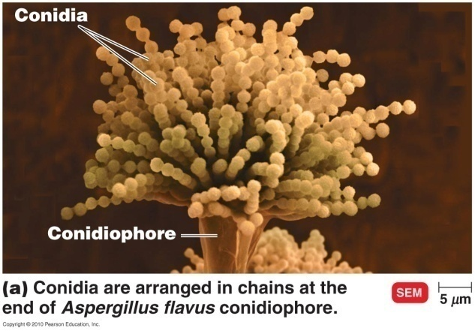
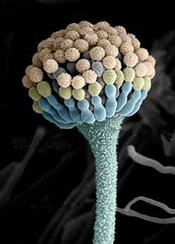
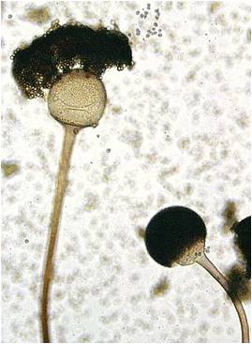
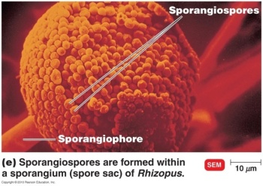
Asexual Spores
Produced by mitosis and subsequent cell division – no fusion of nuclei
Conidia or conidiospores
Produced in chains at ends of conidiophore hypha
Not enclosed in a sac
Sporangiospores
formed within sporangium (sac) at end of sporangiophore hypha
Notes:
Be familiar with this slide.

Slide 13
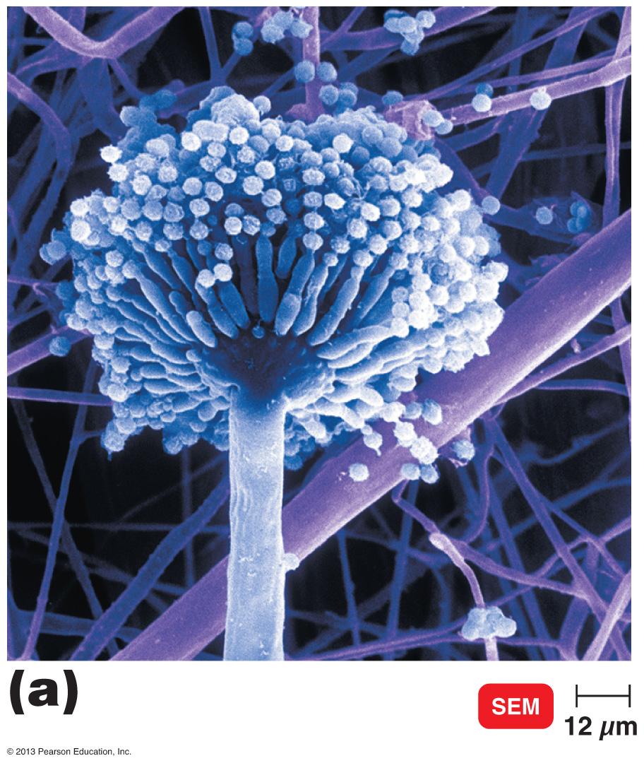
Figure 12.6a Representative asexual spores.
Conidiospores (conidia)
a unicellular or multicellular spore
not enclosed in a sac
produced in a chain at the end of aerial hyphae called conidiophores.
Example: Aspergillus
Conidia
Conidiophore
Notes:
Please know the concept(s) in bold as well as the example.

Slide 14
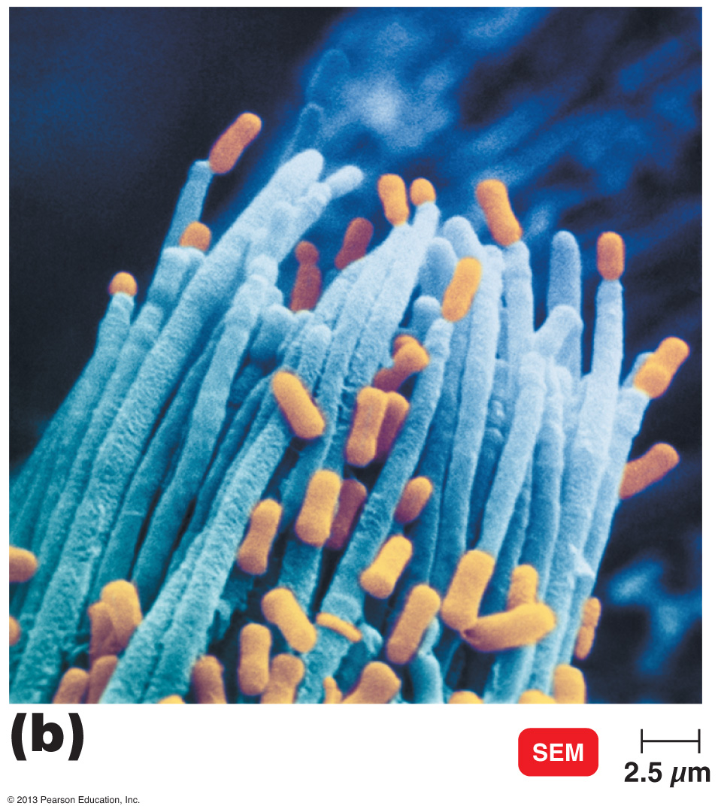
Figure 12.6b Representative asexual spores.
Arthrospores (arthroconidia)
Formed by fragmentation of septate hyphae into single cells
Example: Coccidioides immitis
Arthrospores
Notes:
Please know the concept(s) in bold as well as the example.

Slide 15
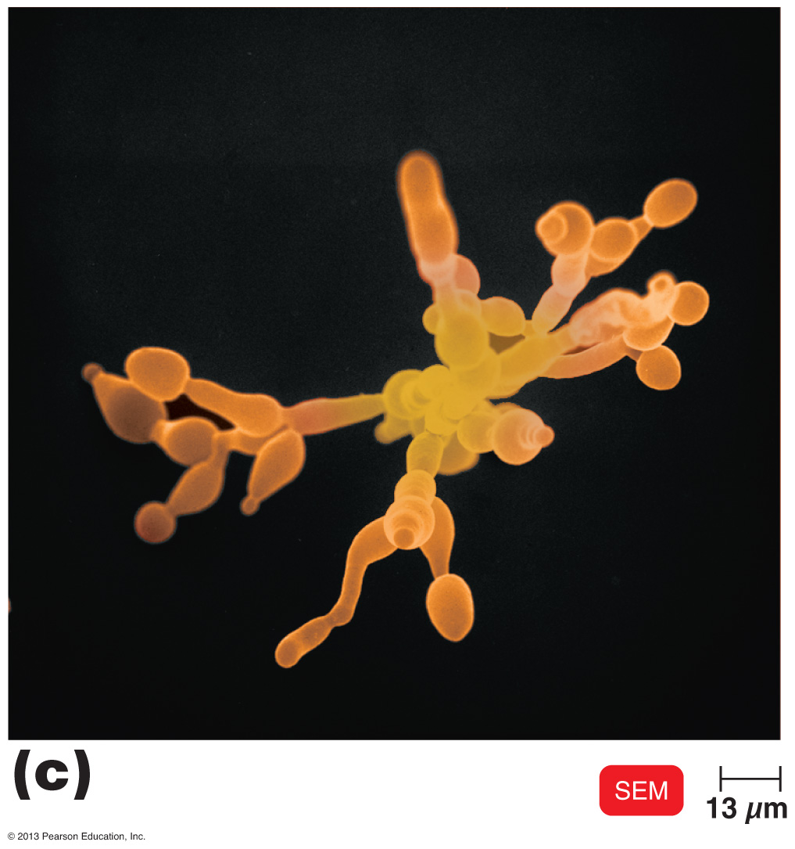
Figure 12.6c Representative asexual spores.
Blastospores (blastoconidia)
Buds from parent cell
Found in some yeasts
Example: Cryptococcus
Pseudohypha
Blastoconidia
Notes:
Please know the concept(s) in bold as well as the example.

Slide 16
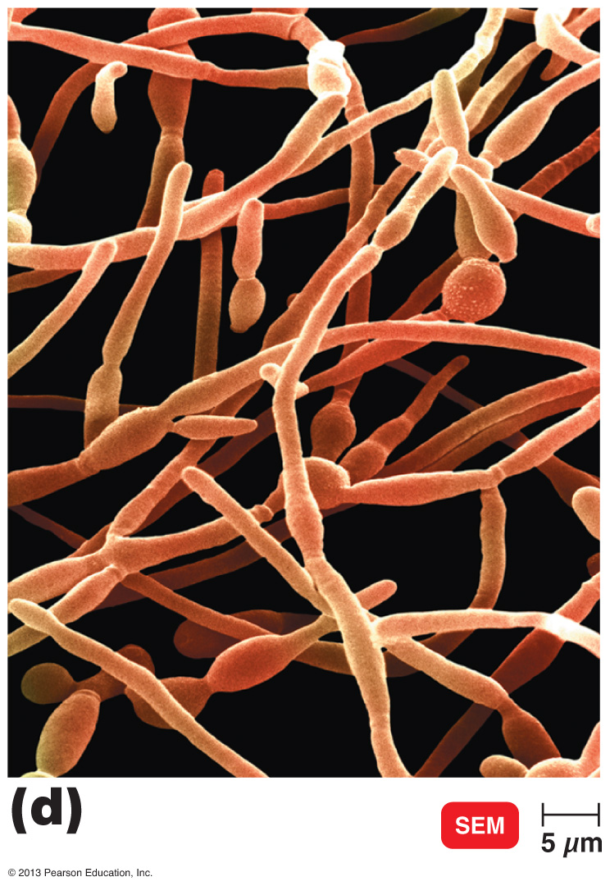
Figure 12.6d Representative asexual spores.
Chlamydospores (chlamydoconidia)
Thick-walled spore
Formed by rounding and enlargement within a hyphae segment
Example: Candida albicans
Chlamydoconidium
Notes:
Please know the concept(s) in bold as well as the example.

Slide 17
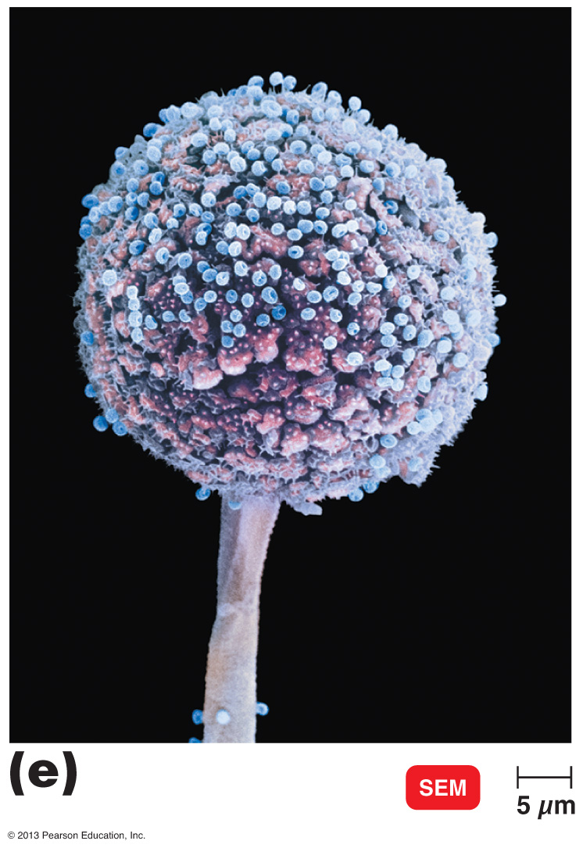
Figure 12.6e Representative asexual spores.
Sporangiospores
Sporangiospores
Formed within a sporangium (sac)
Sporangia are formed at the end of aerial hyphae called sporangiophores
Example: Rhizopus
Sporangiophore
Notes:
Please know the concept(s) in bold as well as the example.

Slide 18
Sexual Spores
Spores as a result of sexual reproduction
Three phases
Plasmogamy – a haploid nucleus of donor cell penetrates the cytoplasm of the recipient cell
Karyogamy – the nuclei fuse to form a diploid zygote nucleus
Meiosis – the diploid nucleus gets divided into two haploid nuclei spores
Notes:
Please be very familiar with this slide, especially at which stage the cells are haploid (half the total number of chromosomes) or diploid (complete number of chromosomes).

Slide 19
Overview
(credit “Ascomycota”: modification of work by Dr. Lucille Georg, Centers for Disease Control and Prevention; credit “Microsporidia”: modification of work by Centers for Disease Control and Prevention)
Notes:
Please be very comfortable with this slide. Please note that any organism classified as an Anamorph is not a true phylum
as they can’t reproduce sexually.

Slide 20
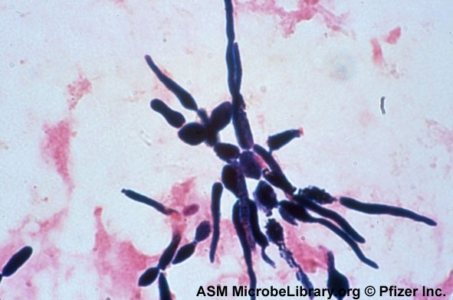
Anamorphs
Most fungi are teleomorphic
produce both sexual & asexual spores
Anamorphs produce asexual spores only
lost ability to reproduce sexually
also known as imperfect fungi
most are Ascomycota; some Basidiomycota
Notes:
Please know the two bolded terms.

Slide 21
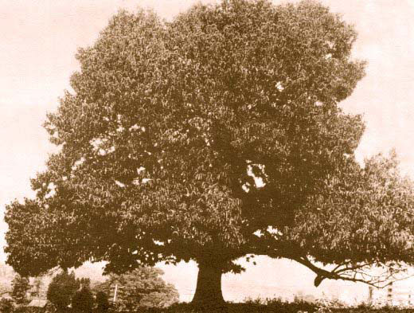
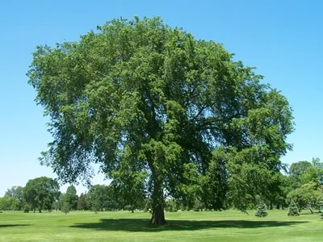
Economic Effects of Fungi
Positive:
Saccharomyces cerevisiae: bread, wine, proteins (i.e. hepatitis B vaccine)
Trichoderma (decomposer): cellulase
Taxomyces: taxol (anticancer drug)
Entomophaga: biocontrol of gypsy moths
mycorrhizae – symbiotic fungi in tree roots
increase surface area & nutrient absorption
Negative:
human diseases
mold: food spoilage (fruits, grains, vegetables)
Cryphonectria parasitica: chestnut blight
Ceratocystis ulmi: Dutch elm disease
Notes:
You do not need to know all of the examples; however, please be familiar with at least one example of a positive and one example of a negative effect of fungi.

Slide 22
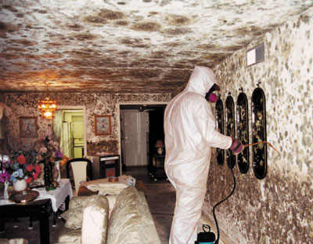
Fungal Diseases
Mycosis – fungal infection
long-lasting, slow growing
difficult to treat: fungi & animals closely related
5 groups of mycoses:
systemic – deep within body; from inhalation
subcutaneous – beneath the skin; from puncture wounds
cutaneous (dermatophytes) – affect hair, skin, and nails
superficial – localized in epidermal cells
opportunistic – caused by normal environmental fungi in debilitated host
Notes:
Please know the bolded terms. You do not need to know any further details from the table.

Slide 23
Lichens
Lichen – in kingdom Fungi
Colonize newly exposed soil & rock
algae & fungi couldn’t live there alone
very slow-growing
Grouped according to morphology:
crustose, foliose, fruticose
Mutualistic combination of alga (or cyanobacterium) & fungus
alga produces & secretes carbohydrates
fungus provides holdfast
Notes:
Please understand what a lichen is and of the mutualistic relationship that is present between alga and fungus. Know which produces carbohydrates for energy and which is the stabilizer.

Slide 24
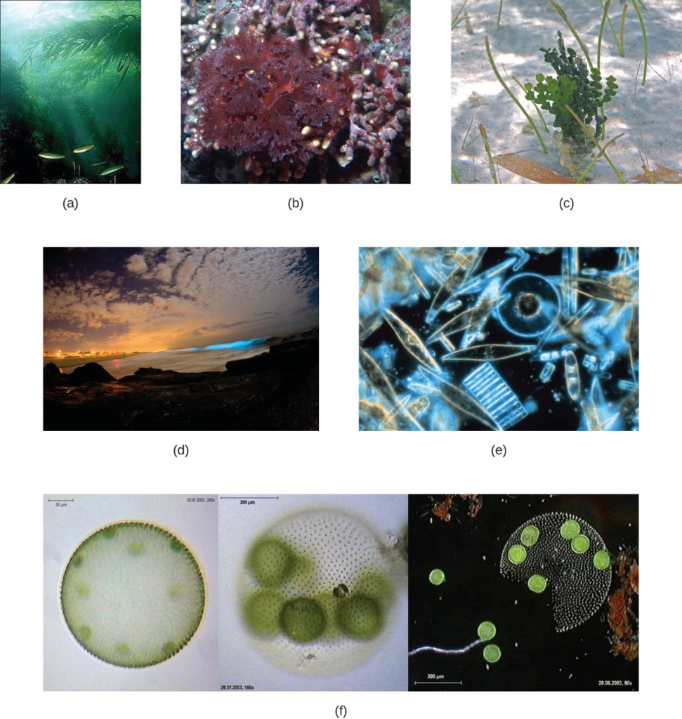
Algae
Not a taxonomic name – it’s a term for photoautotrophs that lack plant tissues
Mostly aquatic, some soil
require water for support, reproduction, & nutrients
Classified by rRNA sequences, structures and pigments

Slide 25
Algae
Kingdom | Protista
Nutritional Type | Photoautotroph
Multicellularity | Some
Cellular Arrangement | Unicellular, colonial, filamentous, tissues
Food Acquisition Method | Diffusion
Characteristic Features | Pigments
Notes:
Please be familiar with this table.

Slide 26
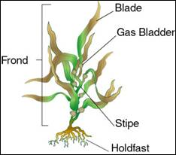
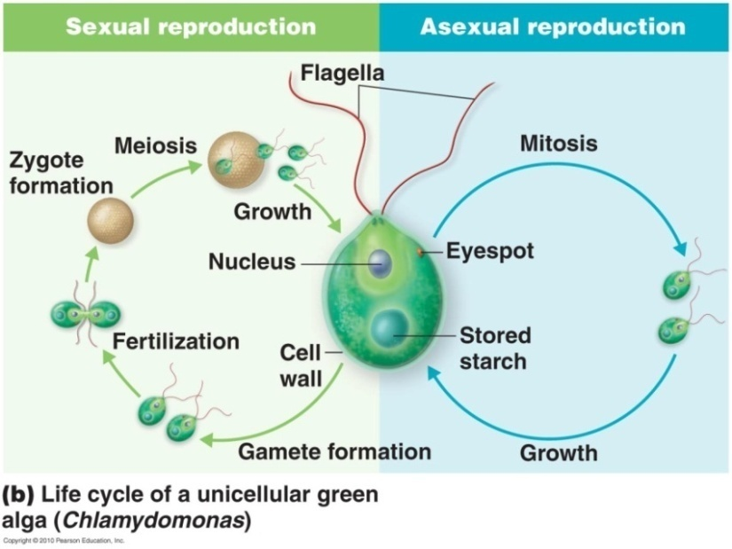
Algae
Unicellular, filamentous, or multicellular
lack vascular tissue
absorb water & nutrients directly into cells
Seaweeds – large multicellular algae
thallus – body
holdfast – anchorage
stipe – stem-like but not supportive
blade – leaf-like
some have pneumatocysts – gas bladders
Reproduction – either way
asexual reproduction by mitosis or fragmentation
sexual reproduction
sometimes, under particular conditions
Notes:
Please be comfortable with the concepts on this slide.

Slide 27
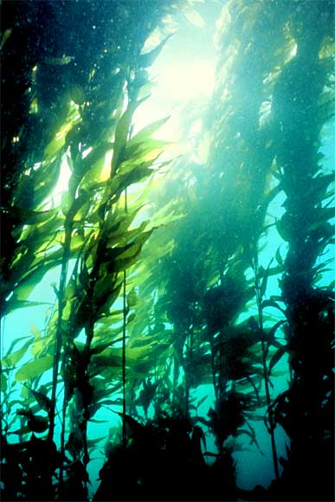
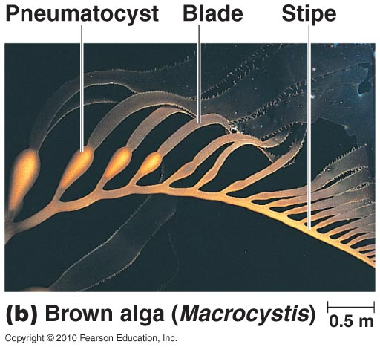
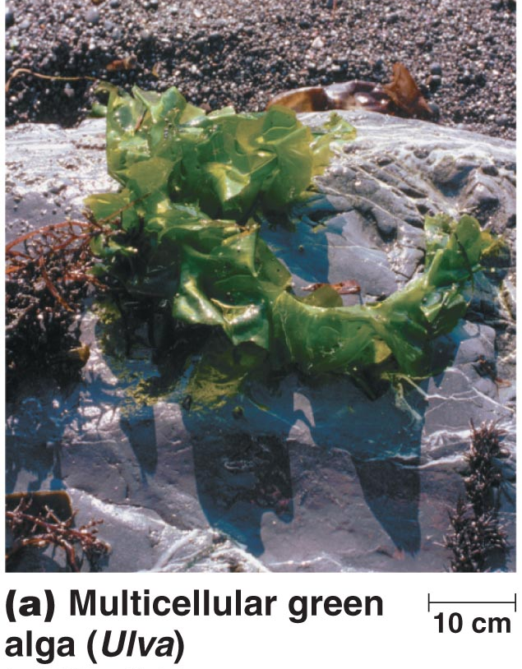
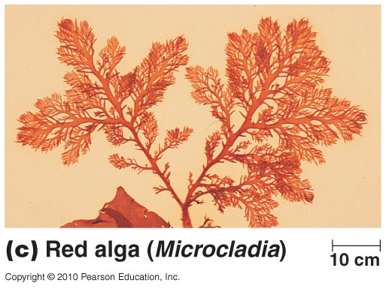
Algae – Seaweeds
Phaeophyta – brown algae (kelp)
up to 50 meters long; very fast growth
harvested for algin (food thickener)
Rhodophyta – red algae
branched, or crustose on rocks
harvested for agar & carrageenan: thickening agents
Chlorophyta – green algae
gave rise to plants
when algae from algal blooms die, O₂ depleted
most microscopic
unicellular, filamentous, or multicellular
Notes:
Just know the bolded associations.

Slide 28
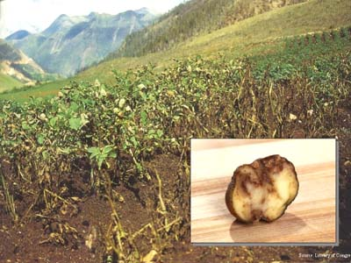
Algae
Oomycota – water molds
decomposers; cotton-like masses on dead algae & animals
Phytophthora infestans: Irish potato blight
Diatoms
store energy in oil
formed much petroleum & natural gas millions of years ago
complex cell walls: pectin & silica
fit together like glass boxes
Notes:
Please know these concepts.

Slide 29
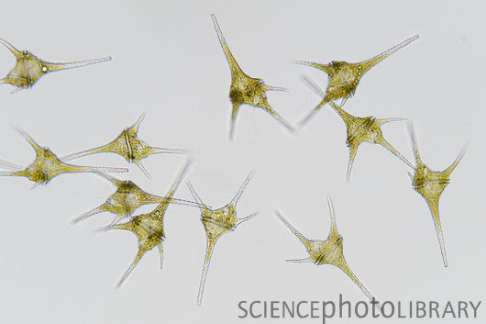
Algae
Dinoflagellates
unicellular; make up plankton, along with photosynthetic unicellular algae
some produce neurotoxins
cause red tide & paralytic shellfish poisoning
Stiff plates that a suit of armor
Variety of colors
2 flagella cause the algae to spin like a top through the water
Some glow in the dark when disrupted
Notes:
Please know these concepts well.

Slide 30
Protozoa
Kingdom | Various
Nutritional Type | Chemoheterotroph
Multicellularity | None
Cellular Arrangement | Unicellular
Food Acquisition Method | Absorptive; ingestive
Characteristic Features | Motility; some form cysts
Notes:
Please be familiar with this table.

Slide 31
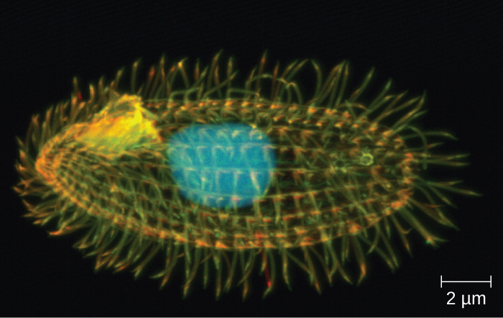
Protists
Protozoan means first animal
Very diverse group of organisms
Unicellular
Aerobic (some can live anerobically in the intestines)
chemoheterotrophs
digest food in vacuoles
Usually in water & soil
some are animal microbiota
some insect pathogens
relatively few cause human disease

Slide 32
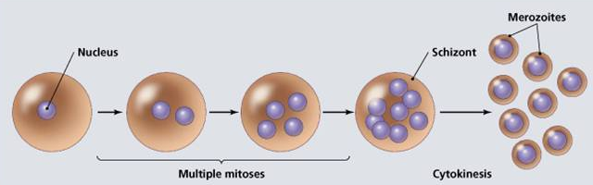
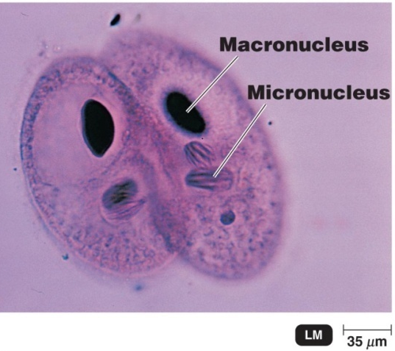
Protists
Trophozoite – vegetative (growing) form
asexual reproduction by:
Fission
Budding
Schizogony
multiple nuclear divisions before cell division
sexual reproduction by protozoan conjugation
cells fuse, share haploid (n) micronuclei which
fuse, produce diploid (2n) daughter cells
some produce cysts (protective capsules) under adverse conditions
Notes:
Please know the bolded terms.

Slide 33
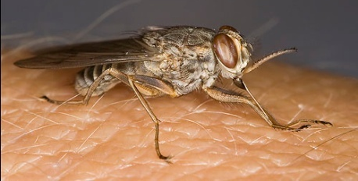
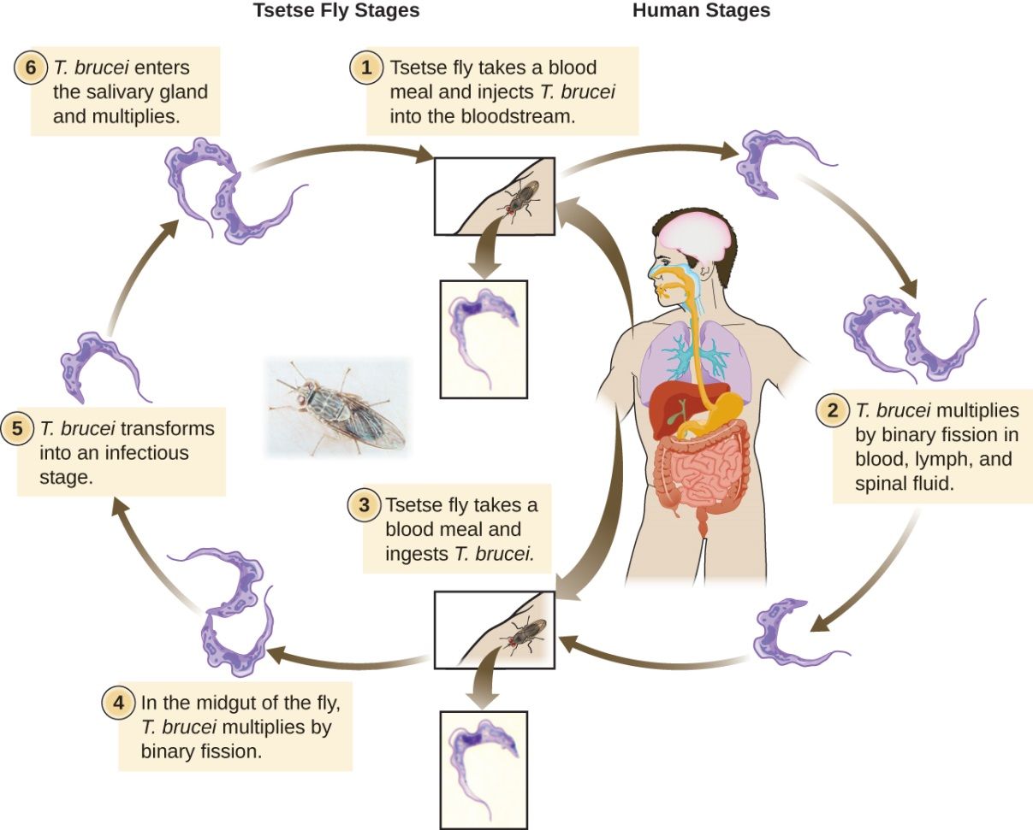
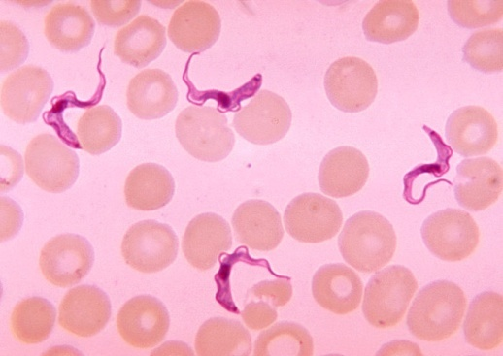
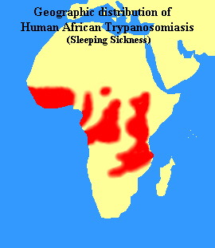
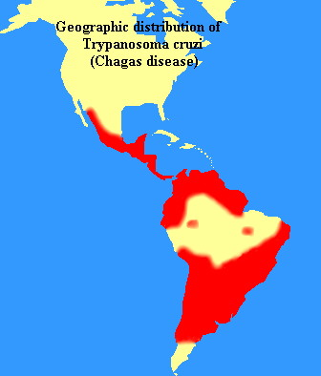
Trypanosoma – African Sleeping Sickness
tsetse fly
Notes:
Just a visual.

Slide 34
African Sleeping sickness
Symptoms:
Initial stages - headache, weakness, and joint pain
As disease progresses - anaemia, cardiovascular problems, and kidney disorders
Final stages - extreme exhaustion and fatigue during the day, insomnia at night, coma, and ultimately death
Left untreated - may cause dementia, megacolon, and megaesophagus, and damage to the heart muscle, and may result in death
Treatment is available
affects as many as 66 million people in sub-Saharan Africa
Notes:
Please be familiar with these concepts of this disease.

Slide 35
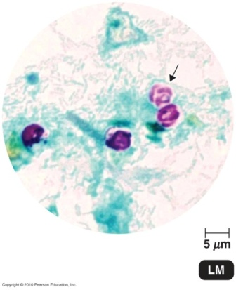
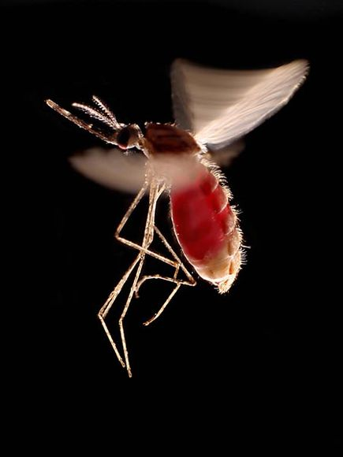
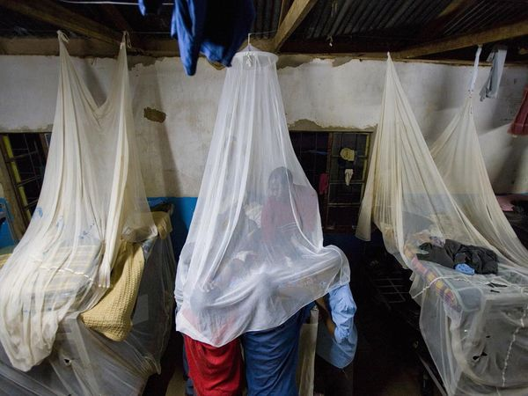
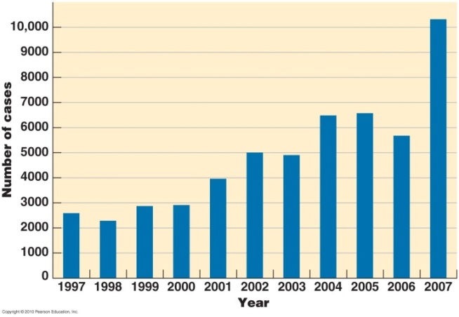
Phylum Apicomplexa
Non-motile intracellular parasites
organelles at cell tips to penetrate host tissues
Plasmodium vivax: malaria
grows in mosquito (definitive host)
sporozoite transmitted by bite to human
divide in liver, infect & rupture red blood cells
Notes:
Please know the bolded association.

Slide 36
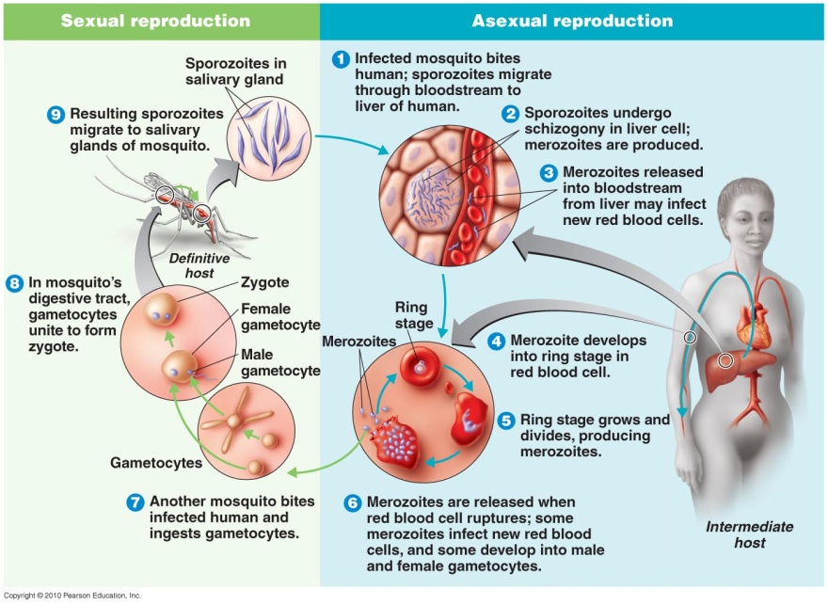
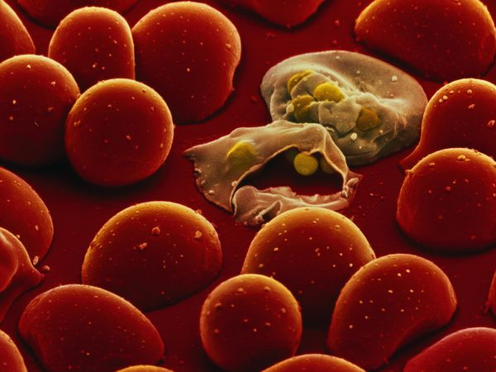
Plasmodium
Grow by sexual reproduction in the mosquito
Mosquito injects the infective protist (sporozoite)
Sporozoite undergoes schizogony in liver cells and produces 1000s of progeny called merozoites
Merozoites infect blood cells, blood cells eventually rupture
Notes:
Please know this concept.

Slide 37
Toxoplasma gondii
Toxoplasma gondii: congenital infections in utero
trophozoites (tachyzoites) reproduce in cats,oocysts excreted with feces
ingested by humans, trophozoites emerge & reproduce
usually minor and self-limiting
very few have symptoms because the immune system usually keeps the parasite from causing illness
serious or even fatal effects on a fetus whose mother first contracts the disease during pregnancy
Infections have the ability to change the behavior of rats and mice, making them drawn to, rather than fearful of, the scent of cats
Advantageous to the parasite so sexually reproduce if its host is eaten by a cat
Notes:
Please understand this disease and its relation to pregnant women and changing the litter boxes of cats during pregnancy. Also, please note how the infection can effect rats and mice.

Slide 38
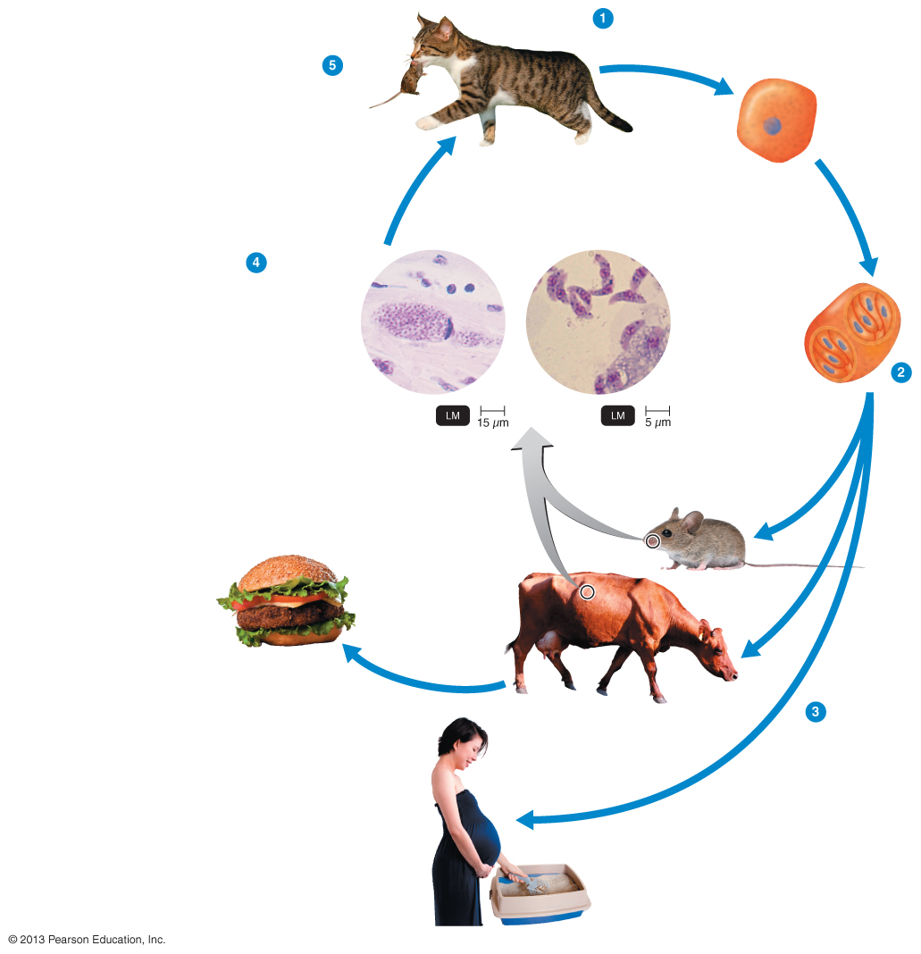
Figure 23.24 The life cycle of Toxoplasma gondii, the cause of toxoplasmosis.
5
Cat ingests bradyzoites in tissue cysts of animals, usually mice.
1
Immature oocyst is shed in cat feces.
Immature
cyst
Definitive host
Sporogony
4
Sporozoites from ingested oocysts invade animal tissue and develop into bradyzoites within tissue cysts or into tissue-invading tachyzoites.
Bradyzoites
in tissue cyst
Tachyzoites
Sporocysts
Mature oocyst
(10–13 μm x 9–11 μm)
Sporozoite
2
Mature oocysts develop by
sporogony and
contain two
sporocysts, each
with four infective
sporozoites.
Intermediate
hosts
If humans eat undercooked meat containing tissue cysts, they may become infected.
3
Oocysts can
infect many hosts,
including mice,
domestic animals,
and humans, via
ingestion.
If a pregnant woman accidentally ingests oocysts (contacted when changing a cat litter box), prenatal
infection of the fetus may occur.
Notes:
Just a visual. Photo credit to Tortora Microbiology.

Slide 39
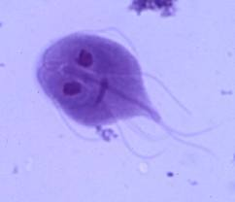
Giardia- Beaver Fever
Transmission: Drinking contaminated water (usually outdoor streams and other untreated water)
Symptoms: Severe diarrhea and vomiting
the protist takes up residence in the digestive tract
Notes:
Please be comfortable with the information on this slide.

Slide 40
Leishmania
Leishmania currently affects 12 million people in 88 countries
The parasite was named in 1903 after the Scottish pathologist William Boog Leishman
Leishmania cells have two forms:
promastigote (with an anterior flagellum in the insect host)
amastigote (without flagella) in the vertebrate host.
Cutaneous leishmaniasis - infections appear as obvious skin reactions
Visceral leishmaniasis - fever, swelling of the liver and spleen, and anemia
Mucocutaneous leishmaniasis - infections will start off as a reaction at the bite, and can go into the mucous membrane and become fatal
Notes:
Please be familiar with this slide.

Slide 41
Phylum Amoebozoa
Move & feed by extending pseudopods
surround food with pseudopods, engulf & phagocytose it
Entamoeba: in 10% of human population
E. dispar: nonpathogenic intestinal microbe; more common
E. histolytica: pathogenic intestinal microbe
Acanthamoeba: can cause blindness
Notes:
Please know this slide well.

Slide 42
Phylum Amoebozoa – Slime Molds
2 kinds of slime molds:
cellular slime mold
cells resemble amoebas; ingest fungi & bacteria
when conditions unfavorable, aggregates & releases spores
plasmodial slime mold
plasmodium (mass of multinucleated protoplasm) moves as giant amoeba; engulfs debris & bacteria
cytoplasmic streaming – protoplasm moves to distribute O₂ & nutrients
when conditions unfavorable, separates into groups & produces spores

Slide 43
Helminths
Kingdom | Animalia
Nutritional Type | Chemoheterotroph
Multicellularity | All
Cellular Arrangement | Tissues and organs
Food Acquisition Method | Ingestive; absorptive
Characteristic Features | Elaborate life cycles
Notes:
Please know these concepts well.

Slide 44
Worms - Helminths
Two phyla:
Platyhelminthes (flatworms)
Nematoda (roundworms)
Distinguish parasitic helminths vs free-living relatives
They may lack digestive system (can absorb nutrients from the host’s food, body fluids and tissues)
Their nervous system is reduced (they don’t need to search for food and don’t really respond to the environment it is constant)
Locomotion is limited or completely lacking
Reproductive system is often complex (produces large numbers of eggs)
Notes:
Please know this slide well, especially the characteristics which distinguish parasitic helminths from free living worms.

Slide 45
Helminths
Helminths – parasitic worms
multicellular eukaryotic animals
parasites specialized to hosts: provide food & habitat
degenerative evolution – loss of unnecessary functions
digestive system, nervous system, & locomotion reduced or lacking
complex life cycles – different intermediate hosts for different larval stages
complex reproductive system
Monoecious or dioecious
dioecious (“two houses”) – separate male & female
monoecious or hermaphroditic (“one house”) – male & female reproductive systems in one animal; may self-fertilize
free-living flatworm
Notes:
Please know the bolded terms.

Slide 46
Platyhelminths – Flatworms
Phylum: Platyhelminthes (flatworms)
trematodes – flukes
flat body, suckers
absorb food through cuticle
cestodes – tapeworms
intestinal parasites, grow ~6 meters
cysts ingested with muscle tissue
scolex (head) attaches to intestinal wall
absorb food through cuticle
no digestive system
body is reproductive proglottid segments; release eggs
Notes:
Please know the bolded terms.

Slide 47
Tapeworms
Life cycle of a tapeworm. (credit “illustration”: modification of work by Centers for Disease Control and Prevention; credit “step 3 micrographs”: modification of work by American Society for Microbiology)

Slide 48
Humans as Hosts
2 types of host:
definitive host – harbors adult parasite
intermediate host – harbors larval parasite
Humans definitive hosts
beef & pork tapeworms
Humans intermediate hosts
dog & coyote tapeworms
eggs ingested by humans or deer
hatch in small intestine
migrate to liver or lungs
develop into hydatid cyst
cysts eaten by wolf
attach & produce adults with proglottid segments
Notes:
Please know bolded terms.

Slide 49
Nematodes – Roundworms
Phylum: Nematoda (roundworms)
complete digestive system
dioecious (separate sexes)
free-living & parasitic species
2 categories of human roundworm parasites:
eggs infective
pinworms, Ascaris
larva infective
hookworms, heartworm

Slide 50
Parasitic Nematodes
Enterobius vermicularis: pinworm
adults in human large intestine
deposit eggs on perianal skin & ingested
Necator americanus: hookworms
adults in human small intestine
eggs excreted in feces, larvae penetrate skin (often feet)
enters blood or lymph, carried to lungs
Dirofilaria immitis: heartworm
adults often mature in mammal heart
larvae spread via mosquito bite
migrate to various organs
Notes:
Please know these organisms and which disease they are responsible for.

Slide 51
Arthropods as Vectors
Phylum: Arthropoda (exoskeleton, jointed legs)
class Insecta (6 legs): lice, fleas, mosquitoes
class Arachnida (8 legs): mites and ticks
Vectors
arthropods may transmit microbes when sucking blood
usually on animal only when feeding (except lice)
mechanical transport for pathogen (houseflies also land on feces)
parasites may multiply in vectors (Lyme disease & West Nile virus)
vector may also be definitive host (Plasmodium)
Notes:
Understand this concept.

