Slide 1
Chapter 10 and 11
Microbial Genetics
Notes:
1

Slide 2
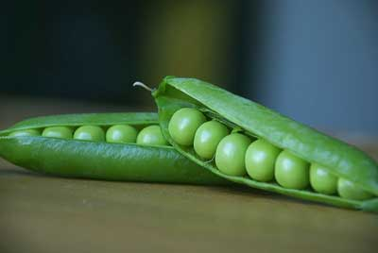
What is Heredity?
Passing of physical characteristic from parents to offspring
Notes:
Understand this definition.

Slide 3
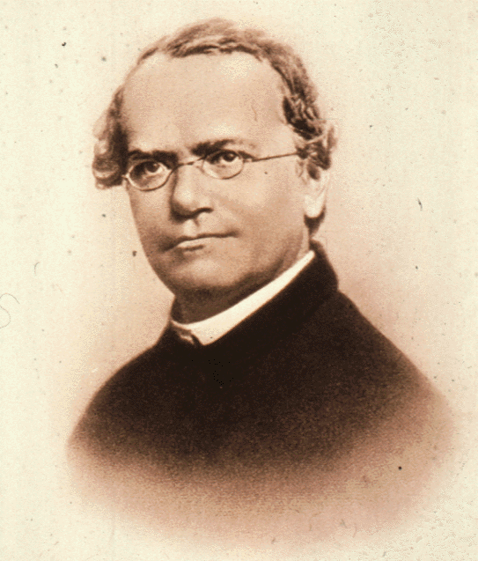
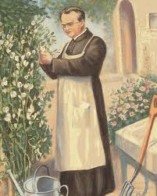
What is Heredity?
Gregor Mendel (1822-1884)
Worked in a garden at a European monastery
He noticed that pea plants had different characteristics
Tall vs Short
Green seeds vs Yellow seeds
The characteristics were similar to the parents BUT sometimes the traits differed

Slide 4
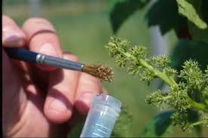
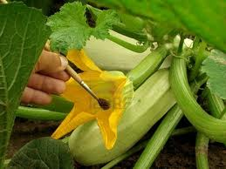
Mendel’s Experiment
Mendel cross pollinated pea plants
Started with a purebred – an organism with many offspring exhibiting the same traits
Used pollen from a plant with the opposite trait
Short plant pollen used to fertilize a tall plant
Notes:
Understand the method of his experiment.

Slide 5
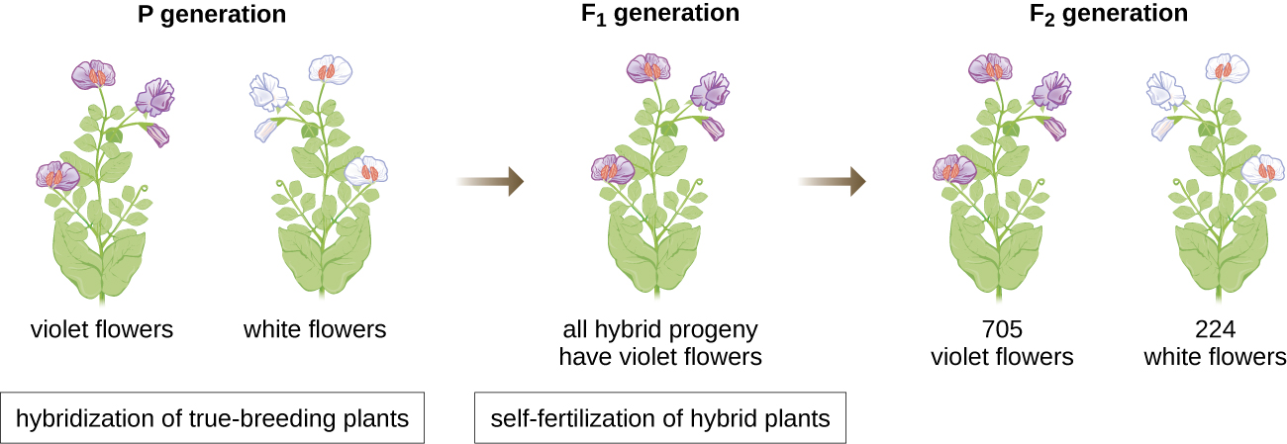
Mendel’s Experiment
After the 1st cross all plants were tall
After the 2nd cross most were tall but a few were short
Tall trait is dominant
Short trait was not lost but over powered
Notes:
Would you have come to the same conclusion if your experiment yielded these results?

Slide 6
Mendel’s Experiment
Individual factors (genes) must control the inheritance of traits in peas
The factors (genes) that control each trait appear in pairs
The female parent contributes one pair and the male parent contributes the other pair
One factor (gene) in a pair can mask (hide) the other factor
Tallness masked the shortness
Notes:
Understand what Mendel contributed to the field of genetics. Please understand that the male and female parent each contribute an allele to the offspring in most eukaryotic organisms.

Slide 7
Genes and Alleles
Gene – factor that controls a trait
Alleles – the different forms of a gene
The gene that controls pea height has two alleles (one for short and one for tall)
Each pea inherits two alleles – one from the egg and one from the sperm
Dominant allele – the trait will always show up in the organism if it is present
Always represented as a Capital letter
Recessive allele – the trait that is hidden whenever the dominant allele is present
Always represented as a Lower case letter
Notes:
Please understand the concept of dominant versus recessive alleles.
Homozygous: both alleles are dominant or recessive (purebreds)
Heterozygous: one allele is dominant and one is recessive (hybrids)

Slide 8
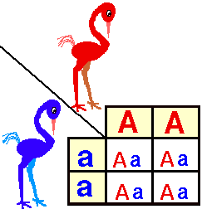
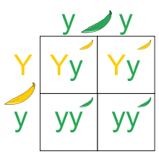
Probability and Genetics
Probability: Number that describes how likely it is that an event will occur
Probability that a coin toss will land on heads is 1:2 or 50%
Probability that you will roll a 6 on a dice is 1:6 or 16.6%
Laws of probability predict what is likely to occur NOT what will occur
Each event occurs independently
Punnett Square – chart that shows all of the possible ways the alleles can combine
2 Purebreds
Purebred x Hybrid
Notes:
Understand how to create and read a Punnett Square for the alleles of a particular trait.
For example, the top example of the 2 Purebreds (homozygous dominant (AA) crossed with homozygous recessive (aa) yields all heterozygous exhibiting the characteristics of the dominant trait.
The bottom example of a purebred crossed with a hybrid (heterozygous) yields 50% hybrid and 50% homozygous recessive.

Slide 9
Terminology
Genetics – study of heredity
what genes are, how they carry information, how information is expressed, how genes are replicated
Genomics – molecular study of genomes
Genome – all genetic information in a cell
chromosome – DNA structure; physically carries hereditary information
gene – segment of DNA; encodes a protein
Genetic code – rules that determine how genes are converted into proteins
genotype – genes of an organism
phenotype – expression of the genes (structural & functional proteins)
Notes:
Know these definitions.

Slide 10
Microbial Genetics
Inherited traits of microbes include:
Shape
Structure
Metabolism
Ability to move
Behavior
Ability to interact with other organisms (disease)
Resistance from antibiotics/chemicals

Slide 11
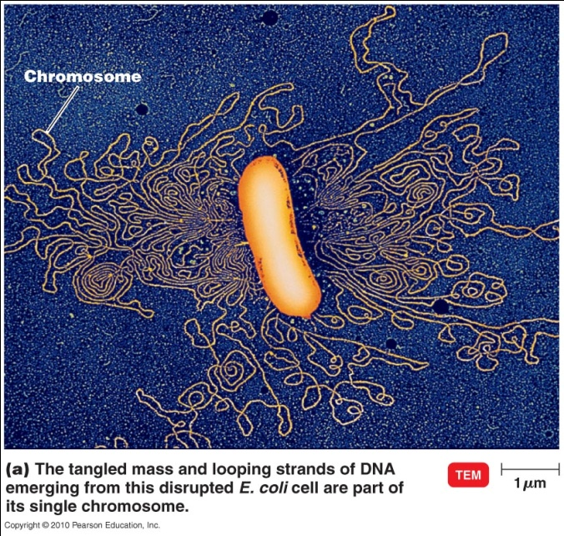
Bacterial Chromosome
Prokaryotic chromosome
single, circular
double helix, as in eukaryotes
Looped and folded and attached to one or several points to the plasma membrane
Short tandem repeats (STRs) – repeating sequences of two to five base sequences (used for DNA fingerprinting)
Open reading frame – regions of DNA that code for proteins
Notes:
Understand these concepts.
It is important to understand that there is only one prokaryotic chromosome, it is singular and that it is in the form of a double helix.

Slide 12
The Flow of Genetic Information
Gene expression: genetic information is used within a cell to produce proteins needed for the cell to function
DNA ^{_transcription_}> RNA ^{_translation_}> protein
DNA replication: copying DNA before cell division
Notes:
Please know this flow, also know as the Central Dogma of genetics.

Slide 13
DNA
Forms double helix
associated with proteins (histones) in eukaryotes
Polymer of nucleotides
adenine, thymine, cytosine, guanine
backbone: deoxyribose-phosphate
Hydrogen bonds between bases: A&T, G&C
strands are complementary
Notes:
A reminder of complementarity of base pairs.

Slide 14
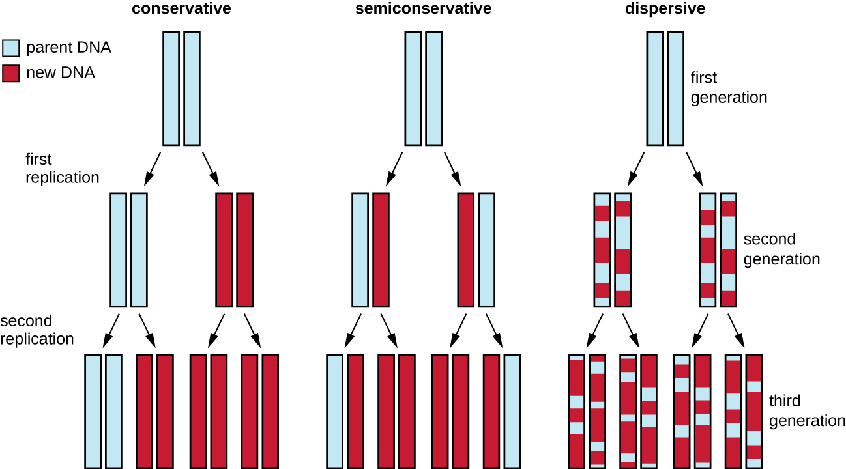
Semiconservative Replication
DNA replication semiconservative – each strand acts as template for new strand
Replication fork
parental strands unzip
daughter strands form using parent strands as templates
Notes:
Understand this concept.

Slide 15
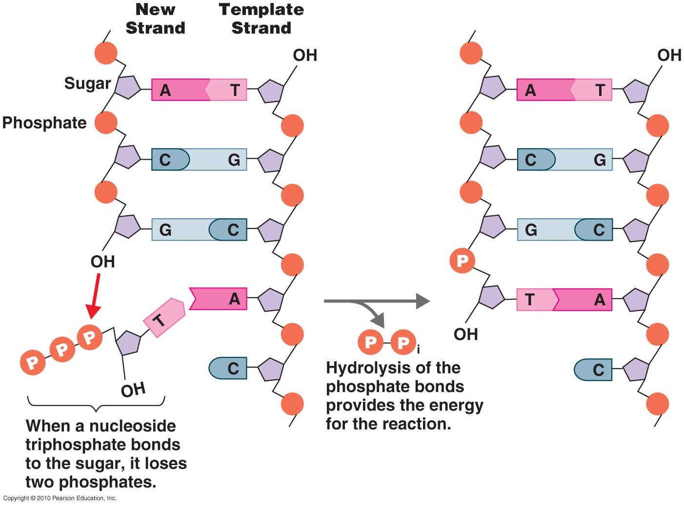
DNA Synthesis
Requires a great deal of energy
Energy for DNA synthesis from nucleotides
free nucleotides (nucleoside triphosphate)
2 phosphates hydrolyzed (removed); provide reaction energy
Same principle as ATP
DNA is copied by DNA polymerase
In the 5' → 3' direction
Initiated by an RNA primer

Slide 16
DNA
Watson and Crick proposed the double helix model for DNA.
The sugar-phosphate backbones are on the outside of the double helix and purines and pyrimidines form the “rungs” of the DNA helix ladder.
The two DNA strands are antiparallel to each other.
The direction of each strand is identified by numbering the carbons (1 through 5) in each sugar molecule. The 5ʹ end is the one where carbon #5 is not bound to another nucleotide; the 3ʹ end is the one where carbon #3 is not bound to another nucleotide.

Slide 17
Complementary Base Pairing
Hydrogen bonds form between complementary nitrogenous bases on the interior of DNA.
Notes:
Please understand why base pairing occurs. Due to the number of Hydrogen bonds each nucleotide can form.

Slide 18
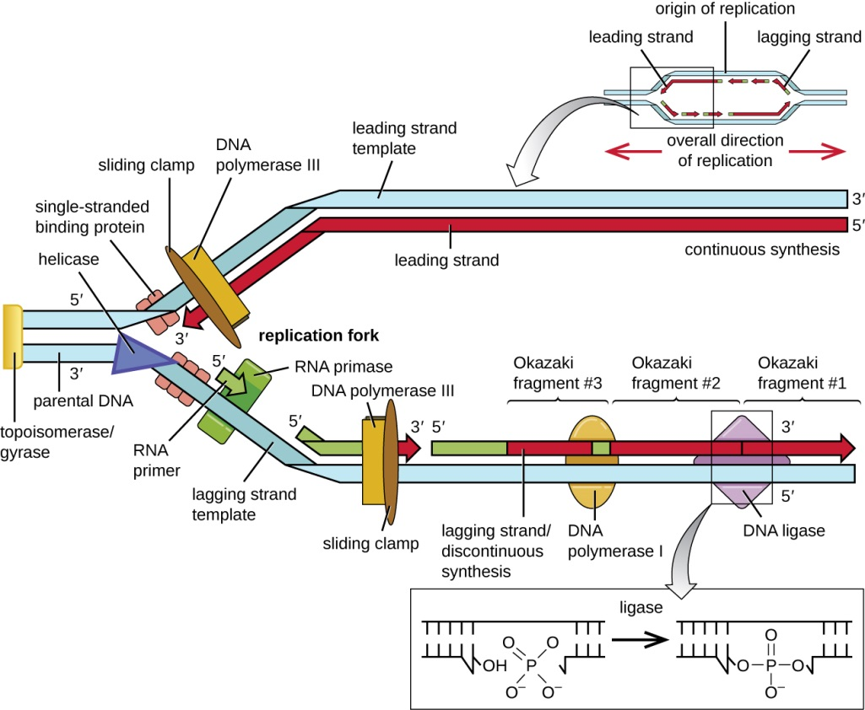
DNA Synthesis
DNA unwound by helicase at replication fork
DNA copied by DNA polymerase
enzyme moves from 5' to 3'; nucleotides added to 3' end
leading strand synthesized continuously
lagging strand synthesized discontinuously: Okazaki fragments
RNA primers removed & Okazaki fragments joined by DNA polymerase & DNA ligase
Notes:
Remember, those protein names ending with the suffix “-ase” are enzymes. What is the function of enzymes?
Please know the function of DNA helicase is to “unzip” the double stranded DNA.

Slide 19
Enzymes involved in DNA replication
Notes:
Please know the functions of DNA ligase, DNA polymerase, and Helicase.

Slide 20
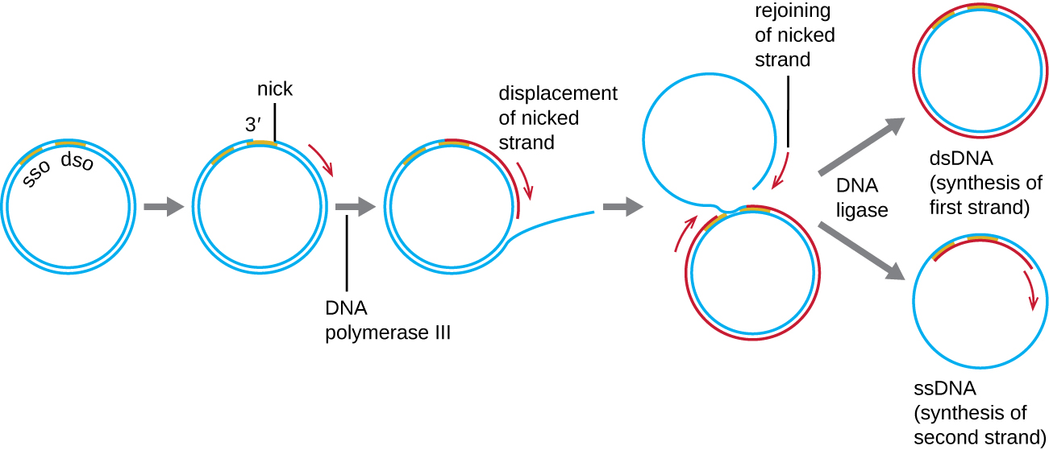
Replication of Bacterial DNA
Bacteria: circular DNA
Bacterial DNA replicated in 2 directions at once
from single origin of replication
copies attach to membrane at opposite ends

Slide 21
Transcription in Prokaryotes
DNA transcribed to make mRNA
RNA polymerase binds to promoter sequence
makes RNA copy of DNA, in 5' → 3' direction
uracil instead of thymine
stops when terminator sequence reached
Notes:
Remember there is no Thymine is RNA, but Uracil instead that binds with Adenine.

Slide 22
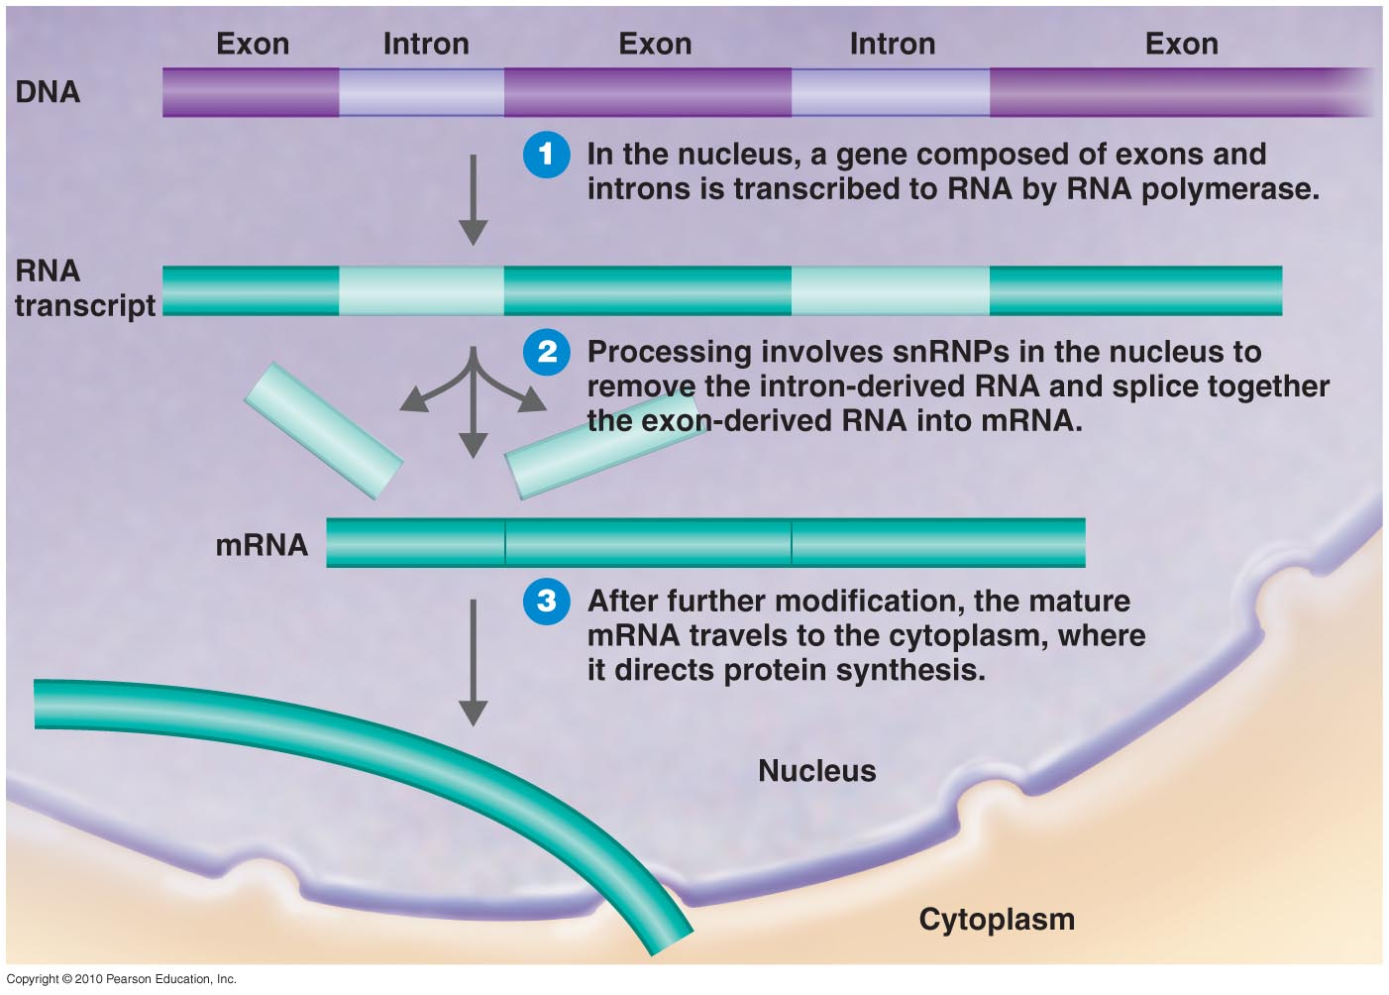
RNA Processing in Eukaryotes
Eukaryotic transcription occurs in nucleus
mRNA processed before leaving nucleus
introns (non-coding regions) removed from exons (expressed regions)
Notes:
Please note: The process of reverse transcription yields complementary DNA (cDNA) from a mRNA template. This means the resulting cDNA will not have the intron sequences as did the original DNA sequence.

Slide 23
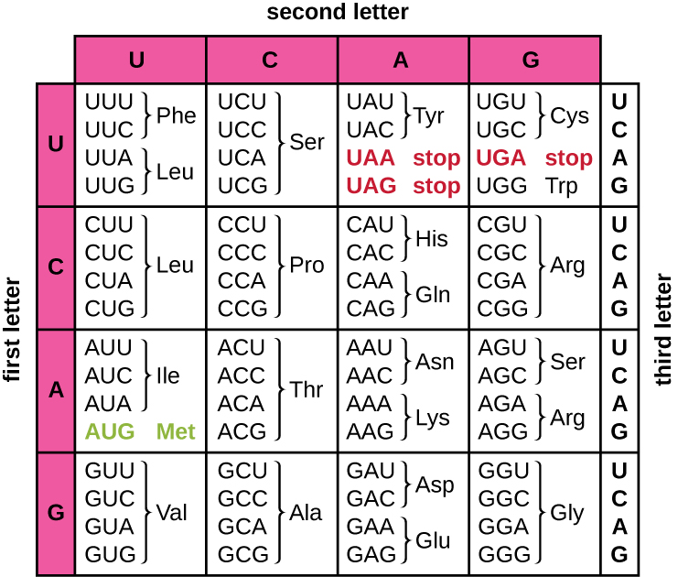
Translation
mRNA read in codons 3-nucleotide sequences
begins at start codon: AUG
ends at nonsense (stop) codons: UAA, UAG, UGA
61 mRNA sense codons encode the 20 amino acids
genetic code redundant – most amino acids coded by >1 codon
not all mutations change protein
Notes:
Please know sequence of start codons, all three stop codons and how to read mRNA to determine primary sequence of proteins.
Please be able to take a DNA sequence, transcribe it to mRNA and then determine which amino acids would be added in order for translation.
Here is an example question, please determine in order the amino acids corresponding to the DNA sequence 3’ – GGGGCATACGGAAATATTCGC.
First, we transcribe the mRNA from 5’ (phosphate end) to 3’ (hydroxyl end) as such: 5’ – CCCCGUAUGCCUUUAUAAGCG.
Next, we scan the mRNA in 5’ to 3’ direction to look for the start codon AUG. We then count in threes from there to determine the codons as follows until we reach a stop codon which will end translation of the protein:
5’ - AUG CCU UUA UAA
We then use the above chart to determine which amino acid the tRNA would bring as follows:
Methionine – Proline – Leucine are the amino acids of this protein.

Slide 24
Genetic Code
mRNA is “read” in codons, 3-nucleotide units
4 possible letters, 3 letters per codon; 64 combinations possible
each of the 20 amino acids is coded for by 1 or more codons
redundant (degenerate) – most amino acids coded for by >1 codon
not all genetic mutations change the protein produced
not ambiguous – only 1 amino acid for each codon
special codons:
1 start codon & 3 stop codons
stops don’t code for amino acids
Notes:
Please know the sequence of the “start” and “Stop” codons. You do NOT need to memorize the remainder of the sequences; however, please be able to use this chart to determine the amino acid sequence based upon the RNA sequence. Also, please understand the importance of redundancy and the codons not being ambiguous.

Slide 25
The Process of Translation
Components assemble
tRNA with first amino acid enters P site
Second tRNA enters A site; peptide bond between amino acids
Ribosome moves from 5' to 3'; second tRNA now in P site with polypeptide; next tRNA in A site
Notes:
Please understand this process and what is occurring at each of the three sites in the ribosome.

Slide 26
The Process of Translation
Second & third amino acids joined; first tRNA released from E site
Chain grows
Ribosome releases polypeptide when stop codon reached
Ribosome disassembles
Notes:
Consult your text and the link on the title slide of this presentation for more information.
I remember the order of the sites from left to right as “EPA”

Slide 27
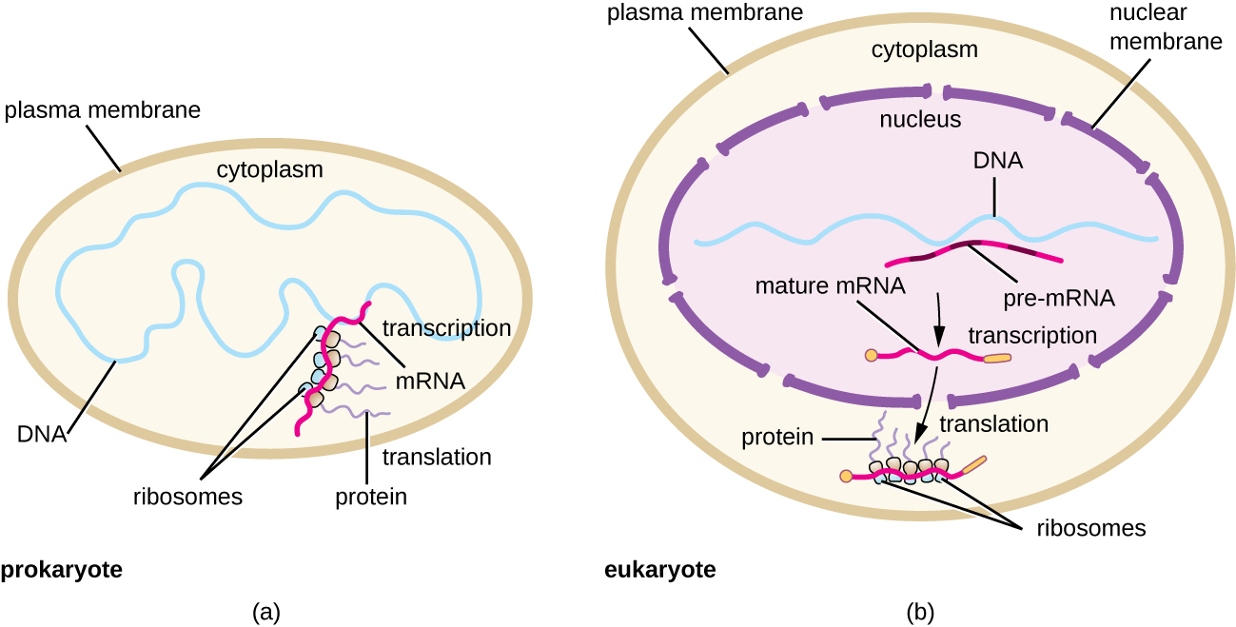
Simultaneous Transcription & Translation
Many ribosomes can attach to a single mRNA
In prokaryotes, translation can begin before transcription has ended
Notes:
Please know this fact.

Slide 28
Figure 11.17
Notes:
A review.

Slide 29
Regulation
Constitutive genes are expressed at a fixed rate
Other genes are expressed only as needed
Inducible genes
Repressible genes
Catabolite repression – glucose induced inhibition of catabolic processes
Epigenetic Control (no change in DNA sequence)
Methylating nucleotides
Methylated (off) genes are passed to offspring cells
Not permanent
Biofilm behavior
Notes:
Simply understand that several processes exist to regulate gene expression and why this is important. You do not need to know how each example works.

Slide 30
Mutation
Mutation – change in DNA sequence
can be neutral (silent), beneficial, or harmful
Causes of mutations:
mutagen – agent that causes mutations
chemicals, radiation (X rays, UV light)
Spontaneous mutations – occur in absence of a mutagen
mistakes in DNA replication are rare: 1 in 10¹⁰ bases
DNA polymerase proofreads
2 classes of mutations:
base substitutions
frameshift mutation

Slide 31
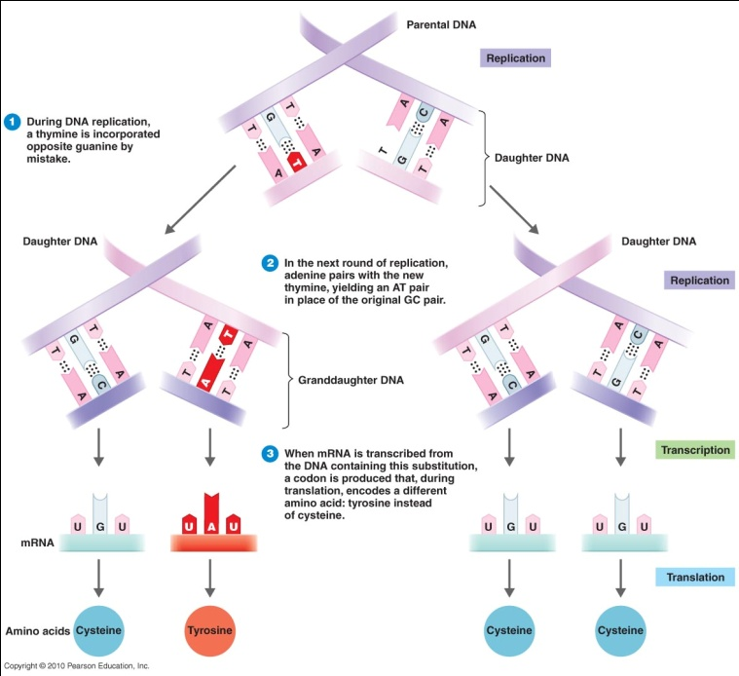
Mutations
Base substitution
missense mutation
results in amino acid change
nonsense mutation
results in nonsense (stop) codon
Notes:
Please understand these concepts.

Slide 32
Mutation
frameshift mutation:
insertion or deletion of one or more nucleotide pairs
shifts reading frame; all downstream amino acids changed
(1) The big red pig ate the red rag.
(2) The big res dpi gat eth ere dra g.
(3) The big rep iga tet her edr ag.
Notes:
Understand this concept and potential consequences.

Slide 33
Figure 11.18
Mutations can lead to changes in the protein sequence encoded by the DNA.
Notes:
A review. You may want to enlarge this up to view better.

Slide 34
Mutations
A heterozygous mutation is a mutation of only one allele.
A homozygous mutation is an identical mutation of both the paternal and maternal alleles
Notes:
Why is this an important concept to understand when calculating the likelihood that offspring will have a articular genetic disorder?

Slide 35
The Frequency of Mutation
Spontaneous mutation rate = 1 in 10⁹ replicated base pairs or 1 in 10⁶ replicated genes
Mutagens increase the rate
Ionizing radiation (X rays and gamma rays) causes the formation of ions that can react with nucleotides and the deoxyribose-phosphate backbone
UV radiation causes thymine dimers
Repair:
Photolyases separate thymine dimers
Nucleotide excision repair
Notes:
Understand and be able to compare these concepts. Understand that mutagens increase the likelihood that a mutation will occur beyond that of the spontaneous mutation rate.

Slide 36
Thymine Dimers
Ionizing radiation may lead to the formation of single-stranded and double-stranded breaks in the sugar-phosphate backbone of DNA, as well as to the modification of bases (not shown).
Nonionizing radiation like ultraviolet light can lead to the formation of thymine dimers, which can stall replication and transcription and introduce frameshift or point mutations.
Notes:
A reminder from previous chapters.

Slide 37
Figure 11.23
Bacteria have two mechanisms for repairing thymine dimers.
In nucleotide excision repair, an enzyme complex recognizes the distortion in the DNA complex around the thymine dimer and cuts and removes the damaged DNA strand. The correct nucleotides are replaced by DNA pol I and the nucleotide strand is sealed by DNA ligase.
In photoreactivation, the enzyme photolyase binds to the thymine dimer and, in the presence of visible light, breaks apart the dimer, restoring the base pairing of the thymines with complementary adenines on the opposite DNA strand.
Notes:
Understand that a process to correct thymine dimers in bacterial DNA exists and why this is important.

Slide 38
Conjugation - Horizontal gene transfer: the transfer of genes between cells of the same generation
Notes:
Consult video link on title slide for more information. Photo credit Tortora Microbiology.

Slide 39
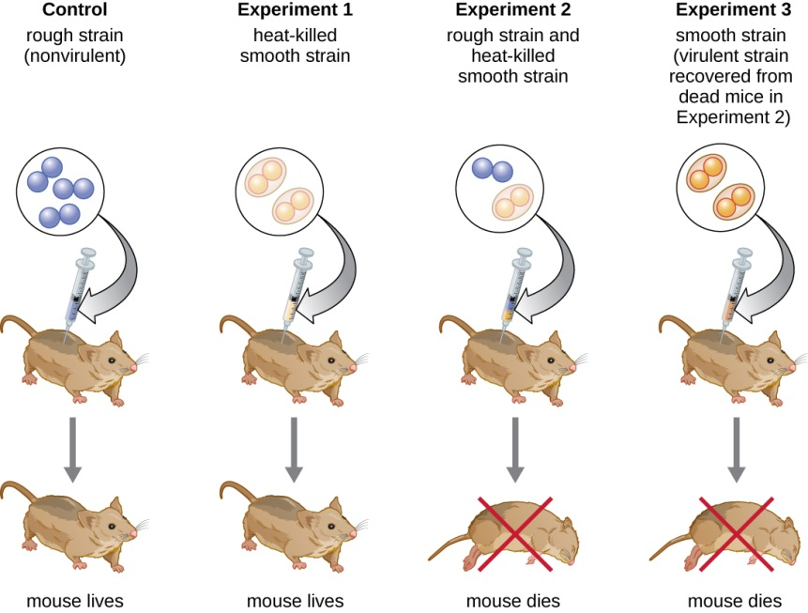
Conjugation
Griffith’s experiment – genetic transformation
Two strains of Streptococcus pneumoniae: pathogenic capsulated bacteria and avirulent bacteria without a capsule
Notes:
Understand and be able to explain this experiment and its contribution to genetics. You may need to consult text for a larger picture.

Slide 40
Genetic Recombination
Exchange of genes between two DNA molecules
Crossing over occurs when two chromosomes break and rejoin

Slide 41
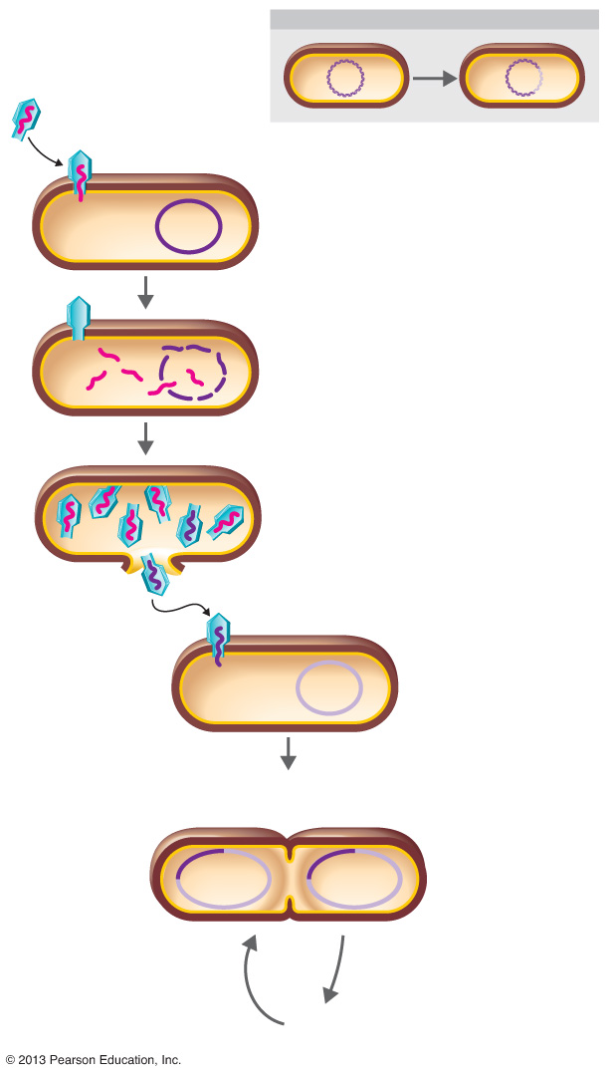
Figure 8.29 Transduction by a bacteriophage.
Phage protein coat
RECOMBINATION
Phage DNA
Bacterial
chromosome
A phage infects the donor bacterial cell.
Donor
cell
Phage DNA and proteins are made, and the bacterial chromosome is broken into pieces.
Occasionally during phage assembly, pieces of bacterial DNA are packaged in a phage capsid. Then the donor cell lyses and releases phage particles containing bacterial DNA.
Insert Fig 8.29
Phage
DNA
Bacterial
DNA
A phage carrying bacterial DNA infects a new host cell, the recipient cell.
Recipient
cell
Donor
bacterial
DNA
Recipient
bacterial
DNA
Recombinant
cell reproduces
normally
5
Recombination can occur, producing a recombinant cell with a genotype different from both the donor and recipient cells.
Many cell
divisions
© 2013 Pearson Education, Inc.
Notes:
Know this process and its potential benefit to bacteria. Photo credit Tortora Microbiology.

