Slide 1
Chapter 16
Principles of Disease and Epidemiology
Notes:
1

Slide 2
Pathology, Infection, and Disease
Pathology – study of disease
etiology – cause of disease
pathogens – disease-causing microbes
infection – colonization of body by pathogens
pathogenesis – development of disease
disease – infection results in change from state of health
Symbiosis – relationship between 2 organisms:
parasitism – one benefits at expense of other
commensalism – one benefits, other is unaffected
mutualism – both benefit
 | Symbioses
 | Parasitism | Commensalism | Mutualism
Organism 1 | + | + | +
Organism 2 | – | 0 | +
Notes:
Please know all of these definitions.

Slide 3
Normal Microbiota and the Host
Most microbes don’t cause disease
1x10¹³ (10,000,000,000,000) body cells
1x10¹⁴ (100,000,000,000,000) bacterial cells
Normal microbiota (flora) permanently colonize host
usually don’t cause disease
localized to particular body regions – not everywhere
require proper nutrients & growth conditions
transient microbiota – present for days, weeks, or months
Animals raised in sterile environments
survive: microbes not essential to life
but: undeveloped immune systems
Notes:
Please know these concepts well.

Slide 4
Normal Microbiota and the Host
Microbial antagonism (competitive exclusion) – competition between microbes
normal microbiota protect the host:
occupy niches & exclude pathogens
produce acids, inhibiting pathogenic bacteria & fungi
produce bacteriocins – inhibit growth of closely related bacteria
probiotics – live microbes applied to or ingested into the body to exert a beneficial effect
Yogurts with bacterial cultures
Opportunistic pathogens – cause disease when not in normal habitat in healthy person
E. coli fine in the intestines but can cause
problems in the bladder, lungs, or wounds
Notes:
Please understand these concepts well and how they benefit humans or microorganisms.

Slide 5
Koch’s Postulates
Infectious diseases – caused by microbes
Koch’s postulates – to prove cause of infectious disease
4 Criteria for Koch’s postulates:
Same pathogen present in every case
Pathogen isolated from diseased host & grown in pure culture
Pathogen from pure culture causes disease when inoculated into healthy animal
Pathogen isolated from inoculated animal is original pathogen
Notes:
You do not need to be able to state the four postulates; however, please understand that all four must be met in order to prove that a microorganism caused an infectious disease.

Slide 6
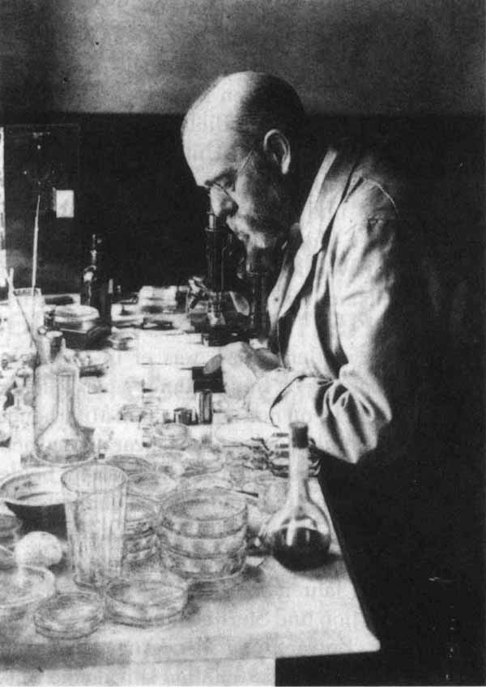
Exceptions to Koch’s Postulates
Koch’s postulates
useful in determining cause of bacterial diseases
not infallible:
some bacteria can’t be cultured
viruses multiply only in living cells
some diseases caused by many different microbes
some pathogens cause several diseases
some pathogens cause disease only in humans
Notes:
Please understand these exceptions to Koch’s postulates.

Slide 7
Koch’s Postulates
The steps for confirming that a pathogen is the cause of a particular disease using Koch’s postulates.

Slide 8
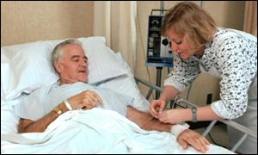
Patterns of Disease
Predisposing factors – make body more susceptible to disease
Gender (females have more UTI than males; males higher rates of pneumonia and meningitis)
genetic background
climate & weather (cold – more upper respiratory infections)
nutrition
fatigue
age
lifestyle
chemotherapy
etc.
Notes:
Know what a predisposing factor is and some examples.

Slide 9
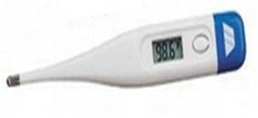
Classifying Infectious Diseases
Syndrome – specific group of signs & symptoms that accompany a disease
sign – measured or observed change in body, as a result of disease
symptom – change in body function, felt by patient, as a result of disease
Communicable disease – spread between hosts
contagious disease – easily spread from one host to another
Noncommunicable disease – not transmitted between hosts
Notes:
Please know these definitions.
Hint: a way of remembering the difference between sign and symptom is that a sign can be seen or measured by someone other than the patient. A symptom can only be felt or described by the patient.

Slide 10
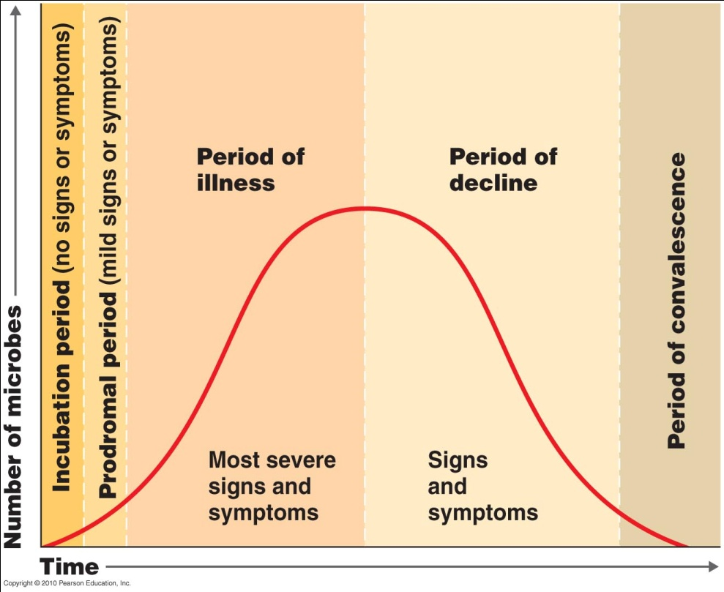
Development of Disease
Incubation period – between infection & appearance of signs or symptoms
Prodromal period – early, mild symptoms (very short)
Period of illness – severe illness, if infection not overcome, patient will die during this period
Period of decline – signs &
symptoms subside
Period of convalescence –
recovery
Notes:
Please know these definitions. You do not need to be able to label the graph.

Slide 11
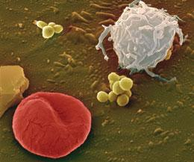
Extent of Host Involvement
Local infection – small area of body
Systemic infection – throughout body
focal infection – systemic infection that began as local infection
Sepsis – toxic inflammatory condition from spread of bacteria or their toxins from a focus of infection
bacteremia – bacteria in blood
septicemia – growth of bacteria in blood
(bld poisioning)
toxemia – toxins in the blood
viremia – viruses in the blood
Primary infection – acute infection; causes initial illness
secondary infection – opportunistic infection after primary (predisposing) infection
Subclinical (inapparent) infection – no noticeable illness
Notes:
Please know these definitions.

Slide 12
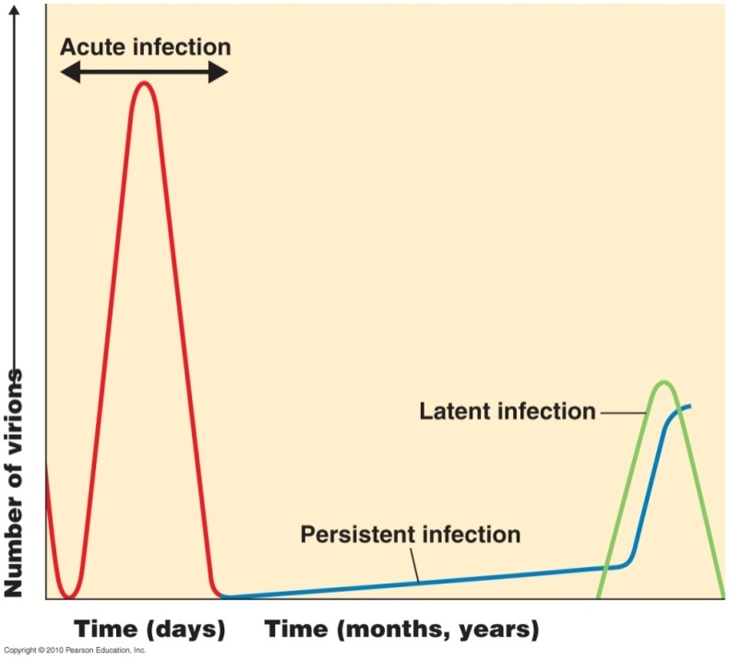
Severity or Duration of a Disease
Duration of disease:
acute – develops rapidly, lasts short time
chronic – develops slowly; continues or recurs for long periods (persistent)
subacute – between acute & chronic
latent – begins with period of
no symptoms

Slide 13
Vaccines
Vaccination – protects against disease
immune individuals prevent spread of disease
herd immunity – immunity in most of population
Shots or nasal sprays
The virus is isolated and weakened or killed by heat
A vaccine mixture is made from the weakened virus and a preservative
The vaccine is injected (or inhaled) into the person
The body creates antibodies (defense molecules) against the virus
stimulates the body's immune system to recognize the agent as foreign, destroy it, and "remember" it
The body now can resist and kill the virus if it gets infected
Notes:
Please understand how a vaccine is produced. It is important to understand that the vaccine is not giving antibodies to the patient, but that the patients’ immune systems must create the antibodies in response to the antigen.

Slide 14
Occurrence of a Disease
Frequency of disease occurrence in a population:
sporadic disease – occurs occasionally
endemic disease – constantly present
epidemic disease – acquired by many hosts in a short time
pandemic disease – worldwide epidemic
Notes:
Please know these bolded terms well.

Slide 15
Epidemic Vs Endemic
An outbreak or epidemic exists when there are more cases of a particular disease than expected in a given area, or among a specific group of people, over a particular period of time
Influenza
An endemic is when a population has a high level of the disease all the time
Malaria
Notes:
Please know the two definitions in red.

Slide 16
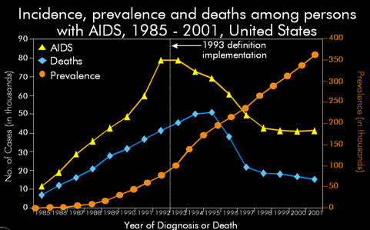
Occurrence of a Disease
How seriously & long does a disease affect a population?
incidence – fraction of population that contracts disease during specific time period
how many people are diagnosed each week, month, or year
prevalence – fraction of population with disease at a given time
how many people are sick each week, month, or year
incidence times duration
Notes:
Please know the two bolded definitions.

Slide 17
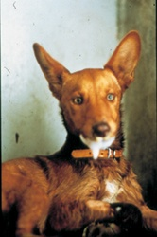
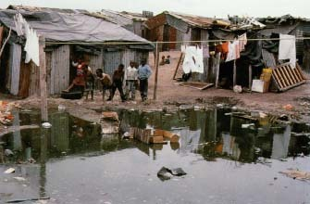
Reservoirs of Infection
Reservoirs of infection – continual sources of disease organisms
Human
Principal living reservoir of human disease is the human body itself
i.e. AIDS, gonorrhea
carriers – have inapparent infections or latent diseases
Animal
Both wild and domestic animalsare living reservoirs
i.e. rabies, Lyme disease
zoonoses (zoonotic)– animal diseases transmitted to humans (~150 known)
Nonliving
soil & water
i.e. botulism, tetanus, cholera
Notes:
Please know the bolded terms.

Slide 18
Transmission of Disease
Contact transmission
direct – close association between infected & susceptible hosts
“person-to-person transmission”
No intermediate object is involved
indirect – spread by fomites (nonliving objects)
Tissues, towels, diapers, bedding, utensils, toys….
droplet – airborne droplets
Coughing, sneezing, laughing or talking
1 sneeze can create 20,000 droplets
Travels less than 1m from the reservoir – not considered airborn transmission
Notes:
Know the term “fomite”.

Slide 19
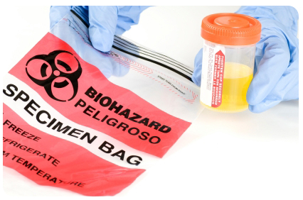
Transmission of Disease
Vehicle transmission – transmission of disease agents by a media (inanimate reservoir )
Water – contamination or poorly treated sewage
Food – incompletely cooked, poorly refrigerated, or prepared under unsanitary conditions
Air – droplets that travel > 1m from the reservoir to the host
But also includes blood and body fluids

Slide 20
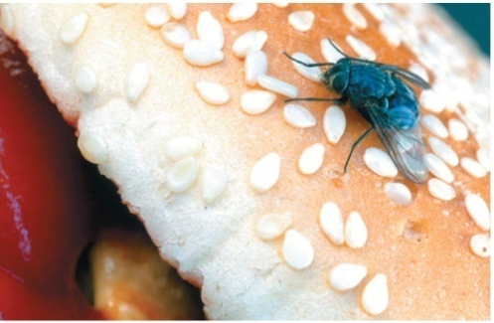
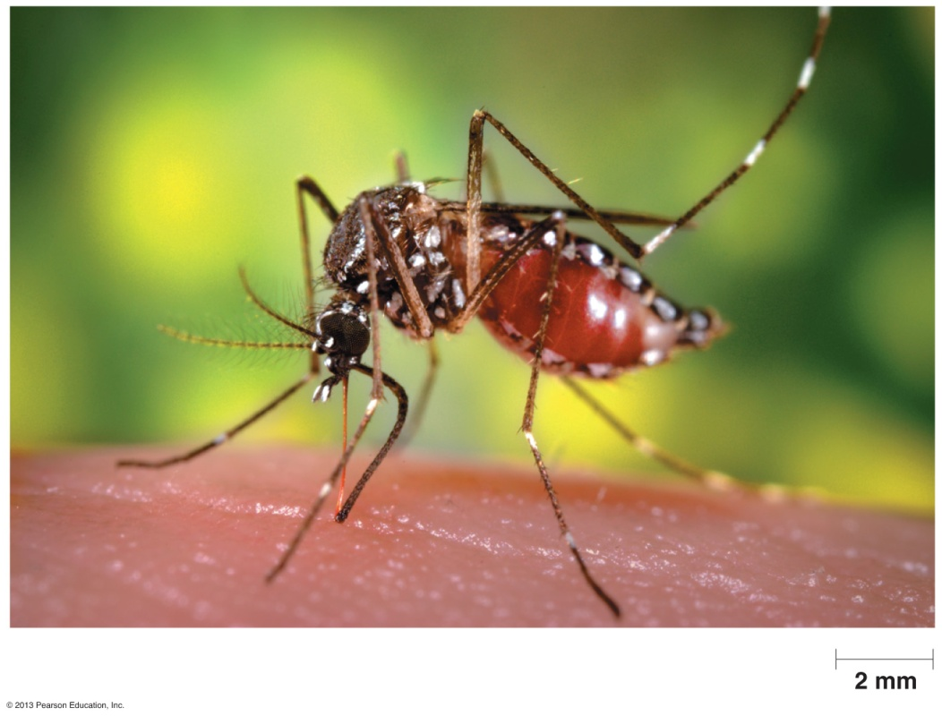
Transmission of Disease
Vector transmission – transmission of disease from one host to another
Arthropods (especially fleas, ticks, & mosquitoes)
mechanical transmission –carries pathogen on feet or other body parts
biological transmission – pathogen reproduces in vector
Notes:
Understand these concepts well.

Slide 21
Figure 16.12
A mechanical vector carries a pathogen on its body from one host to another, not as an infection.
A biological vector carries a pathogen from one host to another after becoming infected itself.

Slide 22
Figure 16.13
(credit “Black fly”, “Tick”, “Tsetse fly”: modification of work by USDA; credit: “Flea”: modification of work by Centers for Disease Control and Prevention; credit: “Louse”, “Mosquito”, “Sand fly”: modification of work by James Gathany, Centers for Disease Control and Prevention; credit “Kissing bug”: modification of work by Glenn Seplak; credit “Mite”: modification of work by Michael Wunderli)

Slide 23
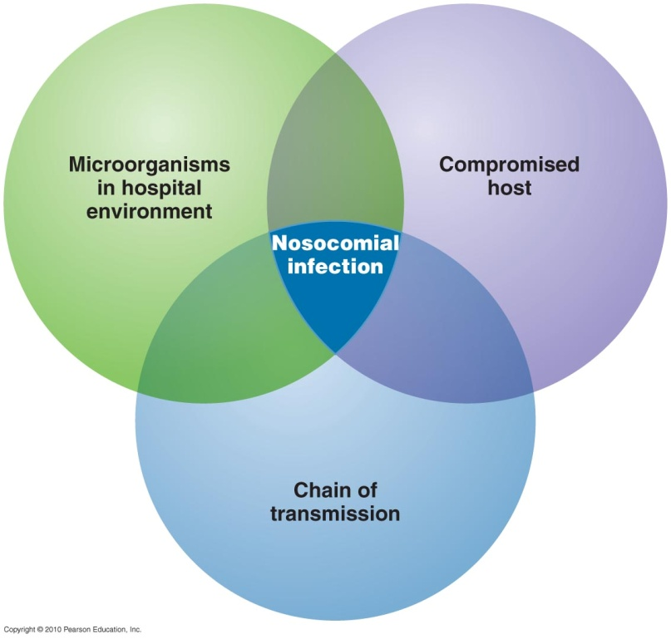
Nosocomial Infections
Acquired as a result of hospital stay
5–15% of all patients
become resistant to antimicrobial drugs
from microbes (often normal microbiota) transmitted between compromised hosts
compromised host – resistance impaired by disease, therapy, or burns producing broken skin or suppressed immune system
by direct transmission from staff, indirect transmission, or vehicle transmission
prevented by aseptic technique, hand washing, & isolation

Slide 24
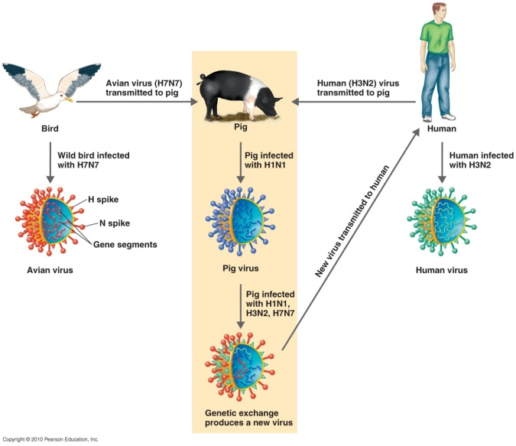
Emerging Infectious Diseases
Emerging infectious diseases – new, increasing in incidence, or showing potential to increase soon
Contributing factors:
new strains from genetic recombination
evolution of new strains
resistance from use of antibiotics & pesticides
changes in weather patterns (increased vectors)
modern transportation
ecological disaster, war, & expanding human settlement
animal control measures (killing predators of vectors)
public health failure (booster shots)
Notes:
Contributing factors
Genetic recombination
E. coli O157, avian influenza (H5N1)
Evolution of new strains
V. cholerae O139
Inappropriate use of antibiotics and pesticides
Antibiotic-resistant strains
Changes in weather patterns
Hantavirus
Modern transportation
West Nile virus
Ecological disaster, war, and expanding human settlement
Coccidioidomycosis
Animal control measures
Lyme disease
Public health failure
Diphtheria

Slide 25
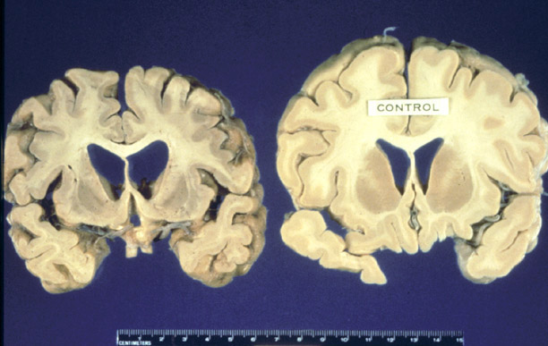
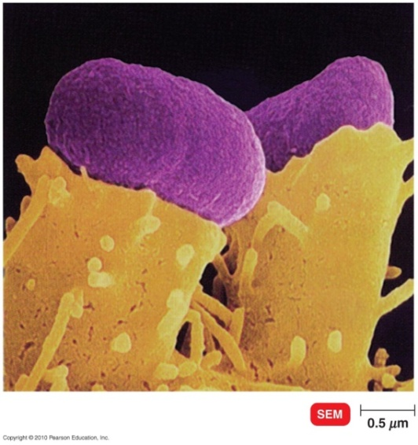
Infectious Diseases
West Nile encephalitis
caused by West Nile virus
carried by birds, transmitted to humans by mosquitoes
Bovine spongiform encephalopathy
mad cow disease
caused by a prion
causes spongy degeneration in brain & spinal cord
new variant Creutzfeldt-Jakob disease in humans related to cattle fed sheep offal (butchering waste)
Escherichia coli O157:H7
toxin-producing strain of E. coli
leading cause of diarrhea worldwide
Notes:
from chapter 1

Slide 26
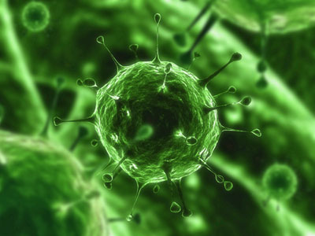
Infectious Diseases
AIDS caused by human immunodeficiency virus (HIV)
first identified in 1981
worldwide epidemic: ~30 million people
1.2 million in US infected with HIV
destroys white blood cells
T cells important for immune defenses
spread by:
sexual intercourse, contaminated needles, breast milk, blood transfusions
Notes:
from chapter 1

Slide 27
Epidemiology
Epi means “on, upon, befall”; Demo means “people”; -ology means “the study of”
“the study of that which befalls people”
study of health-event, health-characteristic, or health-determinant patterns in a society
First epidemiologists (before Koch’s work):
John Snow – cholera
mapped water sources
Florence Nightingale
Ignaz Semmelweis
encouraged hand washing
Notes:
Please understand the basic definition of epidemiology.

Slide 28
First epidemiologists
John Snow | 1848–1849 | Mapped the occurrence of cholera in London
Ignaz Semmelweis | 1846–1848 | Showed that handwashing decreased the incidence of puerperal fever (child birth fever)
Florence Nightingale | 1858 | Showed that improved sanitation decreased the incidence of epidemic typhus
Notes:
Please know these scientists/practitioners and their contributions to epidemiology. You do not need to know the dates.

Slide 29
Figure 16.5
John Snow (1813–1858), British physician and father of epidemiology.
Snow’s detailed mapping of cholera incidence led to the discovery of the contaminated water pump on Broad street (red square) responsible for the 1854 cholera epidemic. (credit a: modification of work by “Rsabbatini”/Wikimedia Commons)

Slide 30
Figure 16.7
Florence Nightingale reported on the data she collected as a nurse in the Crimean War.
Nightingale’s diagram shows the number of fatalities in soldiers by month of the conflict from various causes. The total number dead in a particular month is equal to the area of the wedge for that month. The colored sections of the wedge represent different causes of death: wounds (pink), preventable infectious diseases (gray), and all other causes (brown).

Slide 31
Epidemiology
Epidemiology – study of where & when diseases occur & their transmission
3 types of epidemiological investigations:
descriptive – collection & analysis of data (retrospective)
analytical – determine cause of disease
case control method – compare diseased & healthy groups
cohort method – compare group in contact with disease agent & group with no contact
experimental – controlled experiments (using placebos)
Notes:
Know the three types of epidemiology.

Slide 32
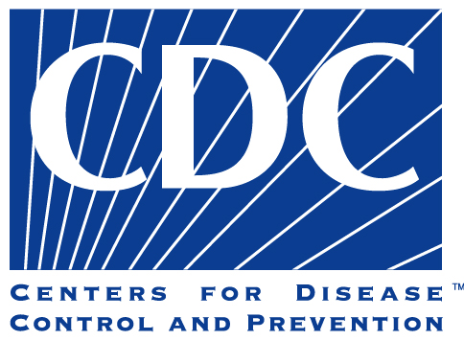
The CDC
Case reporting – health care workers report specified disease to local, state, & national offices
establishes chain of transmission
Centers for Disease Control and Prevention (CDC)
collects & analyzes US epidemiological information
nationally notifiable diseases – physicians required to report occurrence to US public health service
publishes Morbidity and Mortality Weekly Report
morbidity – incidence of disease
mortality – deaths from disease

