Slide 1
Chapters 13 and 14
Control of Microbial Growth
Notes:
1

Slide 2
Terminology of Microbial Control
Sterilization – removing all microbial life
commercial sterilization – limited heat, kills endospores of Clostridium botulinum
Excessive heat will destroy the food
Disinfection – removing harmful microbes from surfaces
Non-endospore producing pathogens
NOT sterile
chemicals, UV, boiling water, steam
Antisepsis – removing pathogens from living tissue
sepsis – (Greek for decay or putrid) microbial contamination
asepsis – absence of significant contamination
Notes:
Know these definitions.
Commercial sterilization does not kill all of the microorganisms… organisms that are capable of food spoilage are still alive but they will not grow at room temp, temps higher than 45 and they will grow so you must be careful to store canned goods at lower than 45… these microbes will not cause human disease

Slide 3
Terminology of Microbial Control
Sanitization – lowering microbial counts
Restaurant glassware and china
High temp washing or dip into a chemical disinfectant
Biocide & germicide – treatment that cause microbe death
Suffix –cide means kill
Fungicide, virucide
Bacteriostasis – inhibiting, not killing, microbes
Suffix –stat or –stasis means to stop
Once this chemical is removed the bacteria will grow again
Notes:
Know these definitions.

Slide 4
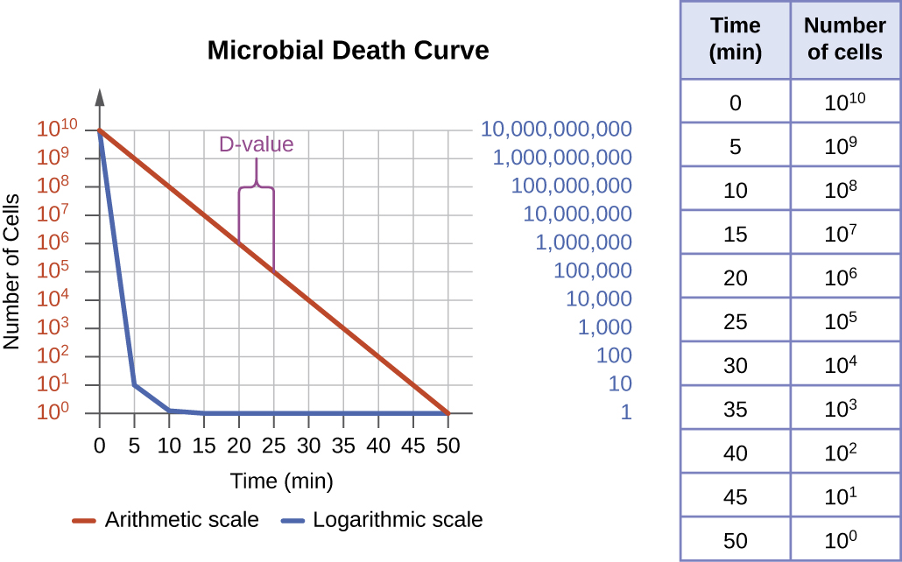
Rate of Microbial Death
When bacteria are heated or treated with antimicrobial chemicals – they usually die at a constant rate
regular percentage dies during each unit time
For example: if 1 million microbes are treated for 1 minute and 90% of the microbes die; then..... There are 100,000 microbes and if they are heated for 1 minute, 90% will die and there will be 10,000…….
Notes:
This is why some cleaners recommend allowing the product to set on a surface for a few minutes prior to wiping away.

Slide 5
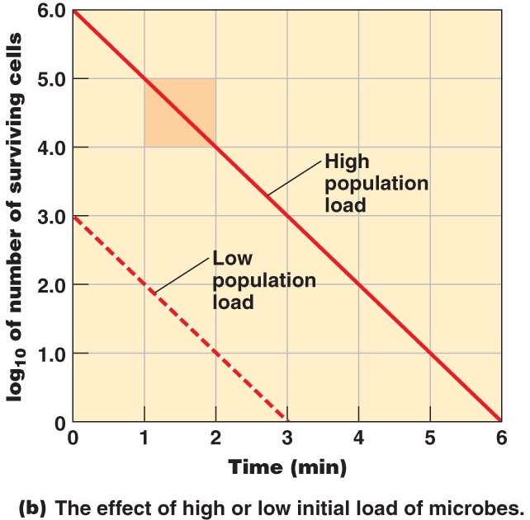
Rate of Microbial Death
Effectiveness of treatment depends on:
number of microbes – the more microbes the longer it takes to eliminate the entire population
Environmental influences
Organic matter inhibits the action of chemical antimicrobials
Temperature – more effective under acid conditions
Biofilms – more difficult to affect
pH
Time of exposure
chemical antimicrobials take longer
Microbial characteristics
It depends on the microbe
Notes:
Understand these concepts.

Slide 6
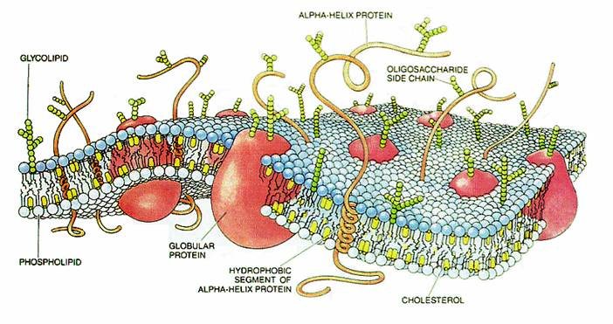
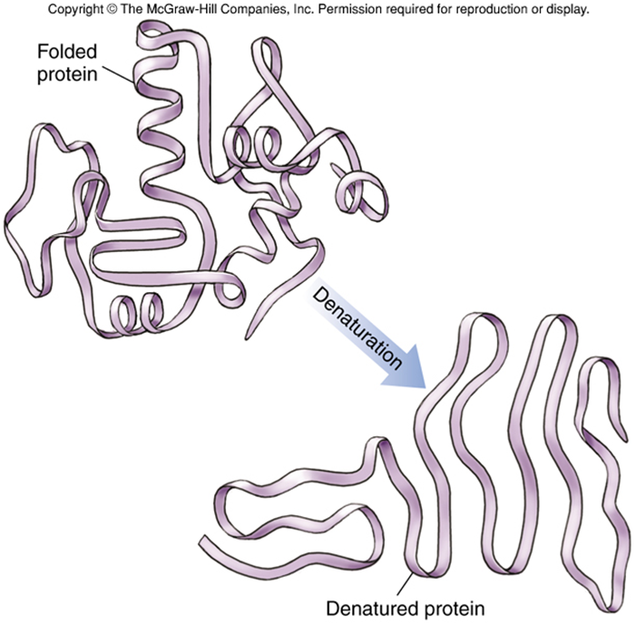
Actions of Microbial Control Agents
Alteration of membrane permeability
Chemicals alter the membrane proteins and lipids
Cell contents leak into surroundings, inhibits growth
Damage to proteins
Denature proteins – loss of function
Enzymes central to cell function, inhibit or destroy these and the cell shuts down
Damage to nucleic acids
Keeps cell from replicating or metabolizing (no mRNA)
Notes:
Understand how these actions would control microbial growth.

Slide 7
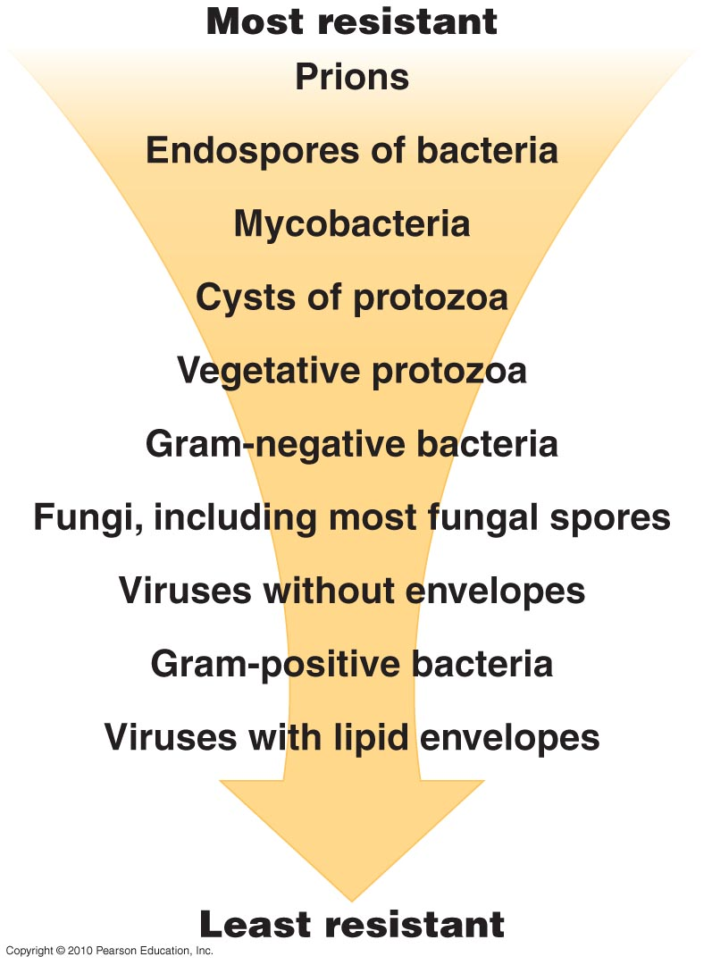
Microbial Characteristics
Gram-negative bacteria protected by lipopolysaccharide layer
Pseudomonas & Burkholderia especially resistant to biocides & antibiotics
Biocides more effective against gram-positive bacteria
Notes:
You do not need to know the list on the right in order; however, understand some reasons as to why some organisms are more difficult to kill than others. How is this helpful to the microorganism? How is the concept concerning to humans?

Slide 8
Microbial Characteristics
Mycobacteria
especially resistant due to waxy cell wall component
Mycobacterium tuberculosis
Endospores
resistant to harsh environments: heat, desiccation, radiation, chemicals, & acids
Notes:
These are two physical structures a microbe may utilize to protect itself and ensure survival.

Slide 9
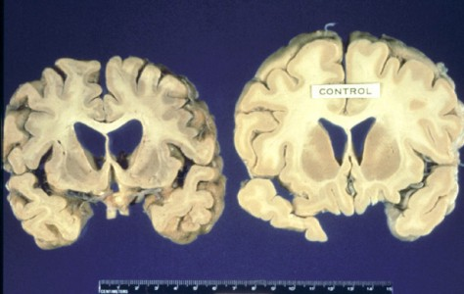
Microbial Characteristics
Prions
Infectious proteins (not living organisms)
Induce abnormal folding of specific proteins
Typically within the brain – result in significant brain damage and death
Resistant even to autoclaving
Notes:
The term "prions" refers to abnormal, pathogenic agents that are transmissible and are able to induce abnormal folding of specific normal cellular proteins called prion proteins that are found most abundantly in the brain. The functions of these normal prion proteins are still not completely understood. The abnormal folding of the prion proteins leads to brain damage and the characteristic signs and symptoms of the disease. Prion diseases are usually rapidly progressive and always fatal. Know these concepts well.

Slide 10
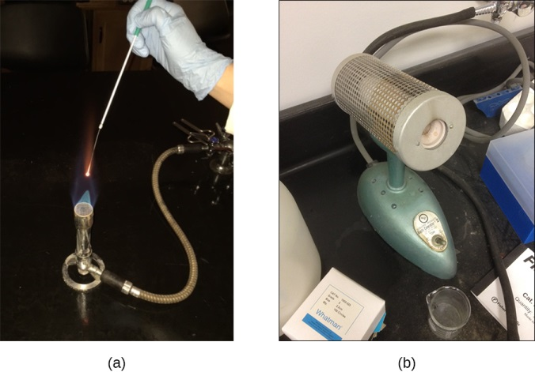
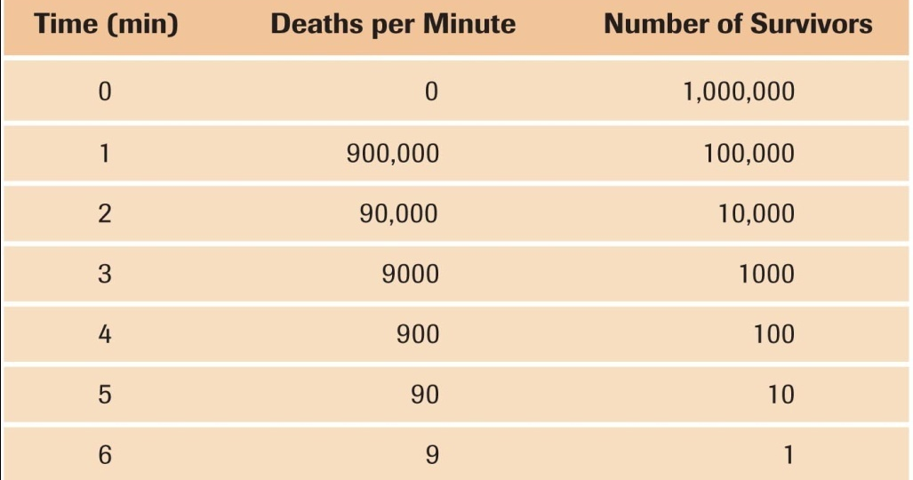
Physical Methods of Microbial Control: Heat
Thermal death point (TDP) – lowest temperature that kills all cells in culture in 10 minutes
Thermal death time (TDT) – minimal time to kill all cells in culture at given temperature
Decimal Reduction Time (DRT) – minutes to kill 90% of population at a given temperature
Notes:
Heat kills microorganisms by denaturing their enzymes. Know these three definitions.

Slide 11
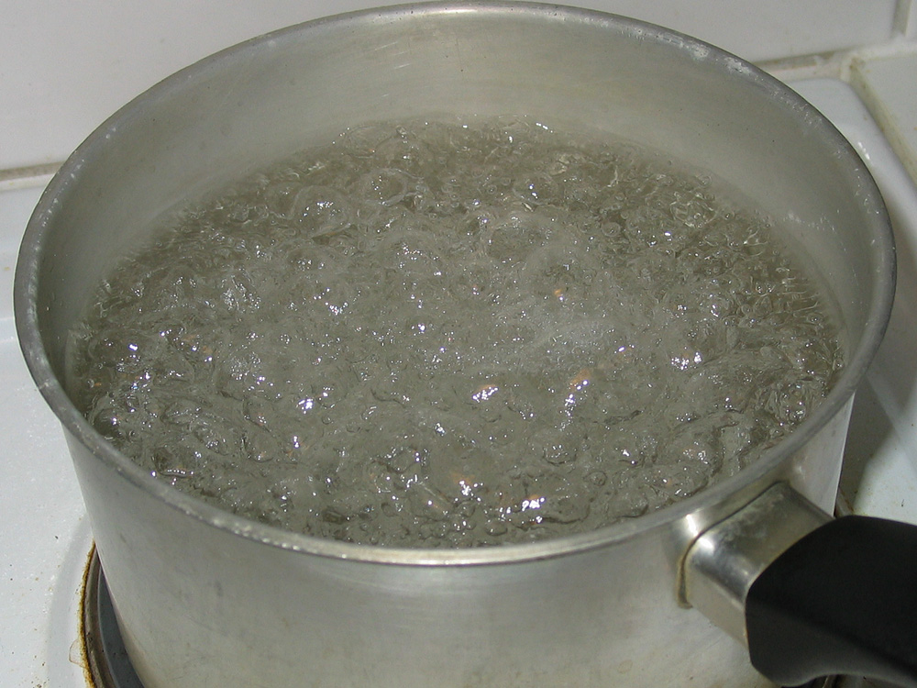
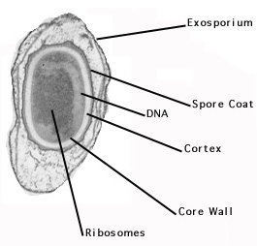
Moist Heat Sterilization
Moist heat – denatures proteins
boiling & autoclaving
Boiling – kills most pathogens in ~10 minutes
viruses & endospores survive extensive boiling: must be hotter
Notes:
Hepatitis Virus can last up to 30 mins in boiling water
Some endospores have been documented to last 20hrs in boiling water

Slide 12
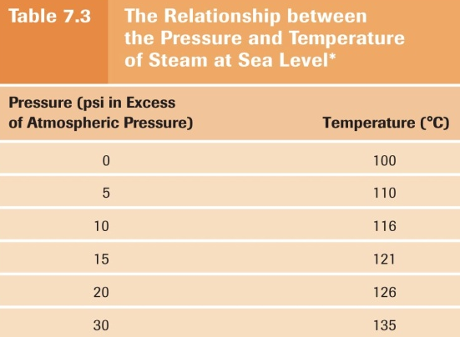
Moist Heat Sterilization
Autoclave – steam under pressure
preferred sterilization method for lab & medical supplies
pressure increases temperature
kills everything (but prions) in ~15 minutes at 121 °C

Slide 13
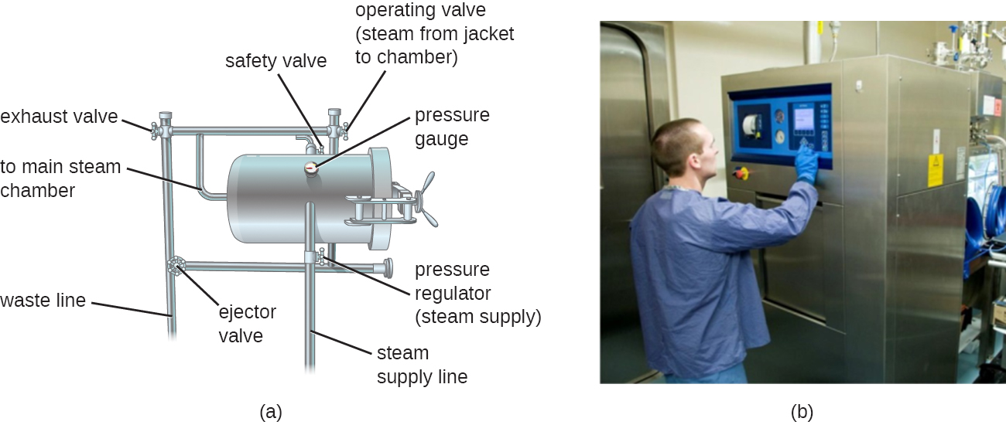
Moist Heat Sterilization
Notes:
Just a visual.

Slide 14
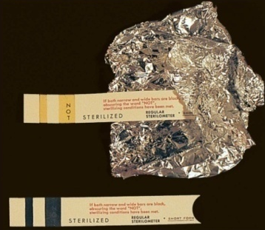
Moist Heat Sterilization
Most effective when surfaces are not in contact with metal. Allows for better contact with steam or water
wrap dry materials in paper, not foil
indicators:
autoclave tape: color change when sterilized
endospore preparations: look for growth later

Slide 15
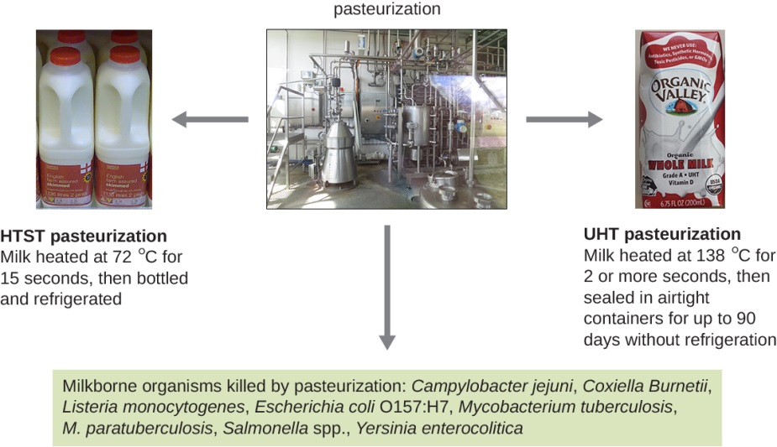
Pasteurization
Pasteurization – mild heating, eliminates pathogens, reduces spoilage microbes
thermoduric organisms survive
unlikely to cause disease or spoilage
phosphatase test – if enzyme denatured, product pasteurized
different products, different times & temperatures
usually 30 minutes at 63°C
Notes:
Pasteurization does break down some of the nutrients – folate, vitamins, calcium… some of these are added back. Understand that the overall goal of Pasteurization is to reduce number of pathogens without significantly altering the structure and taste of the food.
Phosphatase test – incubate the milk with a solution containing a chemical that when it interacts with active phosphatases, it changes color to green

Slide 16
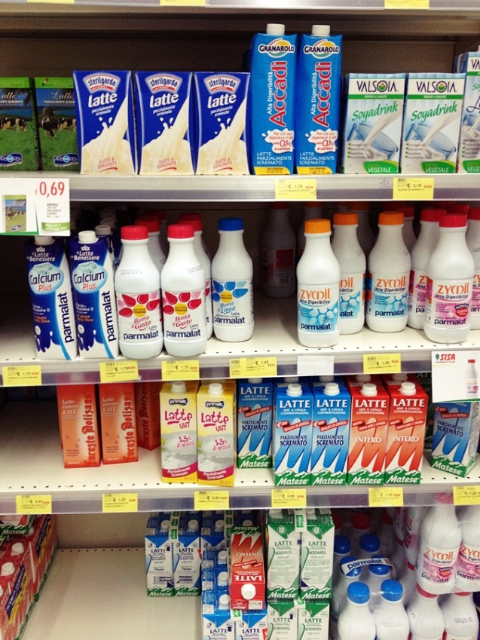
Pasteurization
Equivalent treatments: if temperature higher, time shorter
high-temperature short-time (HTST): 72°C 15 sec
Most common
ultra-high-temperature (UHT): 140°C 4 sec
sterilizes
for unrefrigerated milk (coffee creamers, developing world)

Slide 17
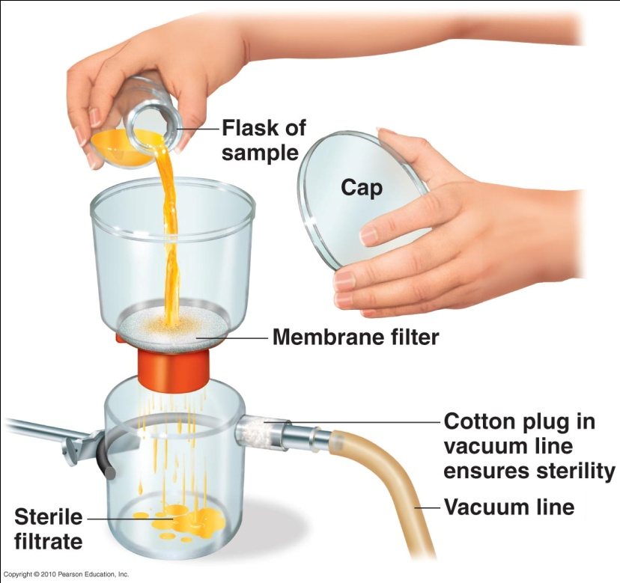
Dry Heat Sterilization and Filtration
Dry heat sterilization – kills by oxidation
flaming
incineration
hot-air sterilization
170°C for 2 hours in oven
equivalent to autoclave for
15 minutes at 121°C
Filtration – pressure forces
liquid through filter
sterilizes heat-sensitive materials
membrane filters
remove microbes >0.22 µm
like high-efficiency particulate air (HEPA) filters
remove microbes >0.3 µm from rooms
Notes:
High-Efficiency Particulate Arresting or HEPA is a type of air filter. Filters meeting the HEPA standard have many applications, including use in medical facilities, automobiles, aircraft, and homes. The filter must satisfy certain standards of efficiency such as those set by the United States Department of Energy (DOE). To qualify as HEPA by US government standards, an air filter must remove 99.97% of all particles greater than 0.3 micrometer from the air that passes through.

Slide 18
Physical Methods of Microbial Control
Low temperature inhibits microbial growth
refrigeration (0-7 °C): reduces metabolic rate; can’t reproduce
below-freezing temperatures: make microbes dormant, kills some
deep-freezing & lyophilization
High pressure denatures proteins & kills cells
alternating pressure cycles (high, low, high) kill endospores
preserves food flavor, nutrients, & color
Desiccation (drying) prevents metabolism
some microbes killed, some (viruses & endospores) remain dormant
freeze-drying
Osmotic pressure causes plasmolysis
salts & sugars create hypertonic environment, desiccating cells
less effective preventing molds & yeasts
Notes:
Please know these concepts well.

Slide 19
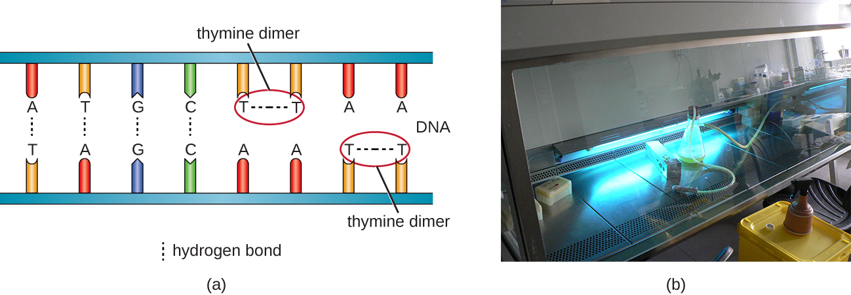
Radiation
Electromagnetic spectrum – frequency range of electromagnetic waves
shorter wavelengths have more energy
Radiation – depends on wavelength, intensity, & duration
microwaves kill by heat; not very antimicrobial
solid foods heat unevenly in microwaves

Slide 20
Radiation
2 types of radiation:
ionizing radiation (gamma rays, X rays, electron beams)
nonionizing radiation (UV, particularly ~260 nm)

Slide 21
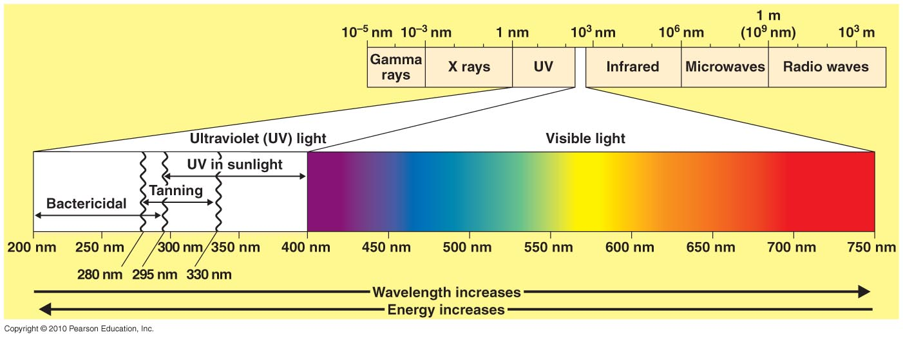
Radiation
Ionizing radiation (gamma rays, X rays, electron beams)
sterilize food, pharmaceuticals, & medical waste
ionizes water to release hydroxyl radicals, damaging DNA
mutations usually harmful enough to kill microbes
high-energy
gamma rays: slow & penetrating
electron beams: fast but not penetrating
Notes:
Know this slide well.

Slide 22
Radiation
Nonionizing radiation (UV, particularly ~260 nm)
kills airborne microbes, disinfects medical products
damages DNA: causes thymine dimers
can be repaired if not extensive
most bactericidal (UVC) UV radiation screened out by ozone
harmful to humans (cancer)
also UVB: sunburn & UVA: aging
not penetrating
Notes:
Know this concept well.

Slide 23
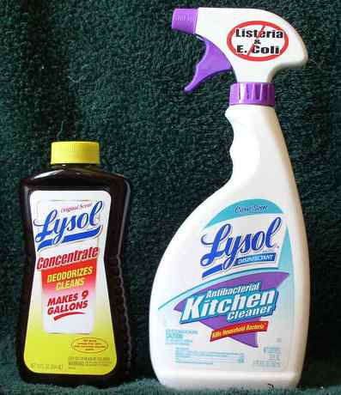
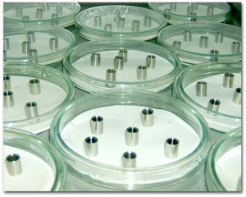
Principles of Effective Disinfection
Chemical disinfectants – few produce sterility
effectiveness based on:
target microbes
concentration of disinfectant
organic matter that can interfere
pH
contact with surface (might require scrubbing)
time
Evaluated by use-dilution test:
metal rings dipped in test bacteria, dried
placed in disinfectant for 10 minutes at 20°C
transferred to culture media
did bacteria survived treatment?

Slide 24
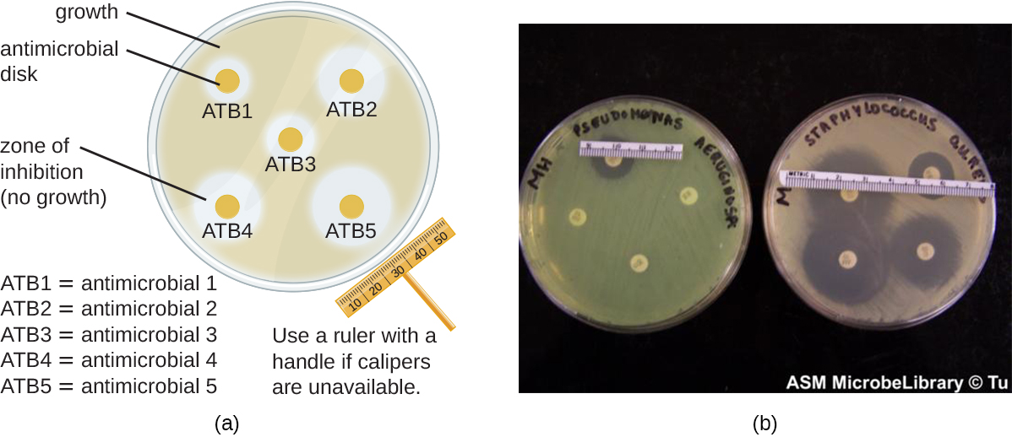
Disk-Diffusion Method
Chemicals also evaluated by disk-diffusion method:
filter paper soaked in chemical, placed on bacterial lawn
zone of inhibition (no bacteria) around disks with effective chemicals
also used to evaluate antibiotics
Notes:
Understand these concepts well. We will see this in lab.

Slide 25
Types of Disinfectants
Phenolics
disrupt plasma membranes, make cells leak
derivatives of phenol (carbolic acid)
active in presence of organic compounds
stable; persist after application
Bisphenols
affect plasma membrane integrity
hexacholorphene in hospital antimicrobials
triclosan in antibacterial soaps, toothpaste, cutting boards, etc.
triclosan-resistant bacteria reported
Biguanides
affect cell membranes
chlorhexidine in surgical hand scrubs
Notes:
Recognize triclosan. Understand that most of these disinfectants disrupt the plasma membrane as a method of killing off microbes. Why does this concept work well for most microbes?

Slide 26
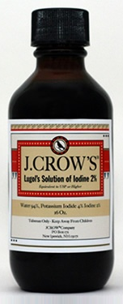
Types of Disinfectants
Halogens
iodine: I₂
old, effective antiseptic
impairs protein synthesis, disrupts membranes
tincture – in aqueous alcohol
iodophors – in organic molecules
povidone-iodine (Betadine)
chlorine: Cl₂
disinfects drinking water, pools, sewage
chlorine + water = hypochlorous acid (HOCl)
strong oxidizing agent, disrupts enzymes
chlorine solutions (bleach)
disinfect restaurant equipment, hospital dressings
Notes:
Understand these two well and be able to discuss them.

Slide 27
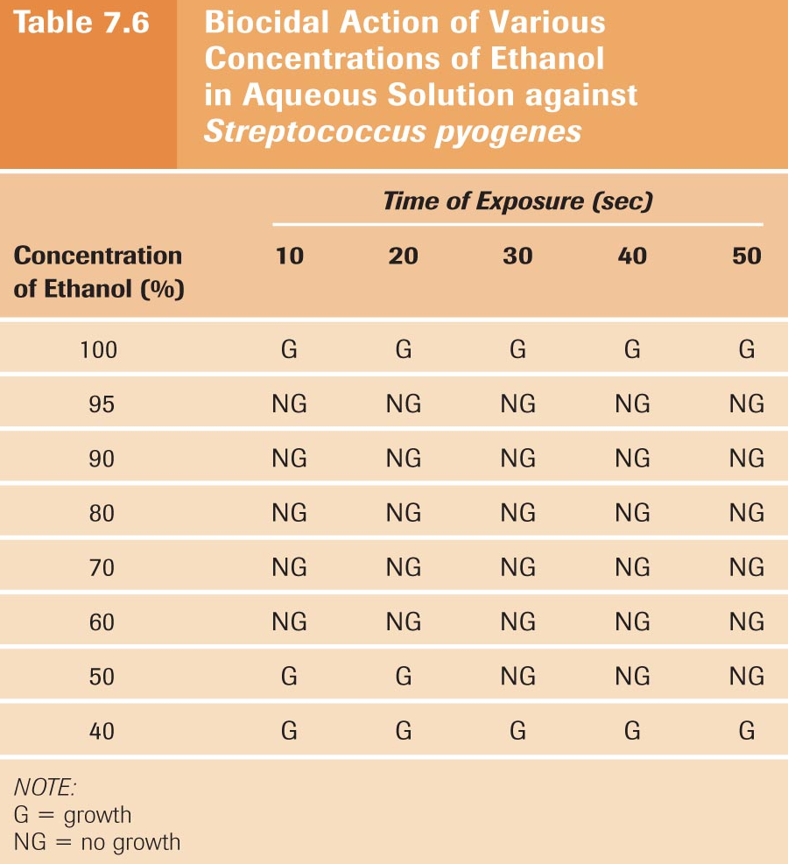
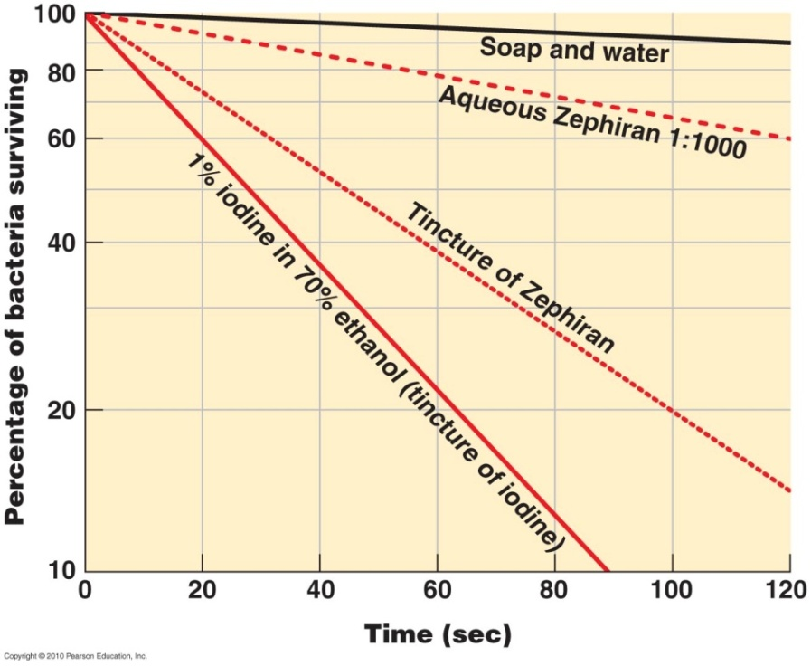
Types of Disinfectants
Alcohols
kill bacteria & fungi, but not endospores or viruses
denatures proteins, disrupts membranes
not very effective on wounds
bacteria grow under layer of denatured protein
ethanol, isopropanol (rubbing alcohol)
work better when combined with water ~70%
many antiseptics work better as tinctures with alcohol
Notes:
Understand why alcohol is often diluted to 70% for disinfectant purposes, as in our lab.

Slide 28
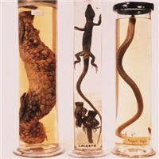
Types of Disinfectants
Aldehydes
effective antimicrobials; inactivate proteins
formaldehyde (formalin), glutaraldehyde
preservatives, medical equipment disinfectants
Peroxygens
oxidizing agents
hydrogen peroxide – not effective on open wounds (broken down by catalase), effective on inanimate objects
in aseptic food packaging & contact lens disinfectant
peracetic acid – effective on endospores & viruses
in food processing & medical equipment
no toxic residues
benzoyl peroxide
Notes:
Although hydrogen peroxide is commonly used as a disinfectant for minor cuts and scrapes, it is actually not very effective and may even delay the healing process by irritating a person's living cells. You can use hydrogen peroxide but apply it around the open wound, not directly to it. An antibiotic ointment such as Neosporin is a better alternative - it will keep the wound from getting infected and speed up the healing process.
Peracetic acid (C2H4O3) is a mixture of acetic acid (CH3COOH) and hydrogen peroxide (H2O2) Peracetic acid is used mainly in the food industry, where it is applied as a cleanser and as a disinfectant. Since the early 1950’s, acetic acid was applied for bacteria and fungi removal from fruits and vegetables. It was also used for the disinfection of recicled rinsing water for foodstuffs.
Nowadays peracetic acid is applied for the disinfection of medical supplies and to prevent bio film formation in pulp industries. It can be applied during water purification as a disinfectant and for plumming disinfection.

Slide 29
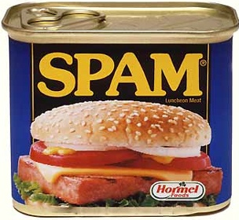
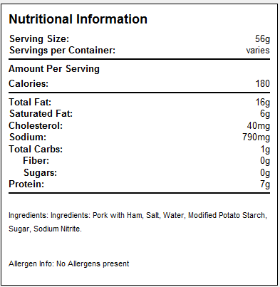
Types of Disinfectants
Chemical food preservatives
organic acids, safe in foods
sulfur dioxide
prevent spoilage during wine-making
sorbic acid, sodium benzoate, calcium propionate
prevent spoilage by mold
sodium nitrite
prevents endospore germination (botulism) in meat
Antibiotics
most used to treat disease
nisin & natamycin
prevent spoilage of cheese
Notes:
Understand the purpose of food preservatives

Slide 30
Antibiotic Resistance
Broad-spectrum antimicrobial use may lead to the development of a superinfection. (credit: modification of work by Centers for Disease Control and Prevention)

Slide 31
Figure 14.9
There are several classes of antibacterial compounds that are typically classified based on their bacterial target.

Slide 32
Figure 14.11
The major classes of protein synthesis inhibitors target the 30S or 50S subunits of cytoplasmic ribosomes.

Slide 33
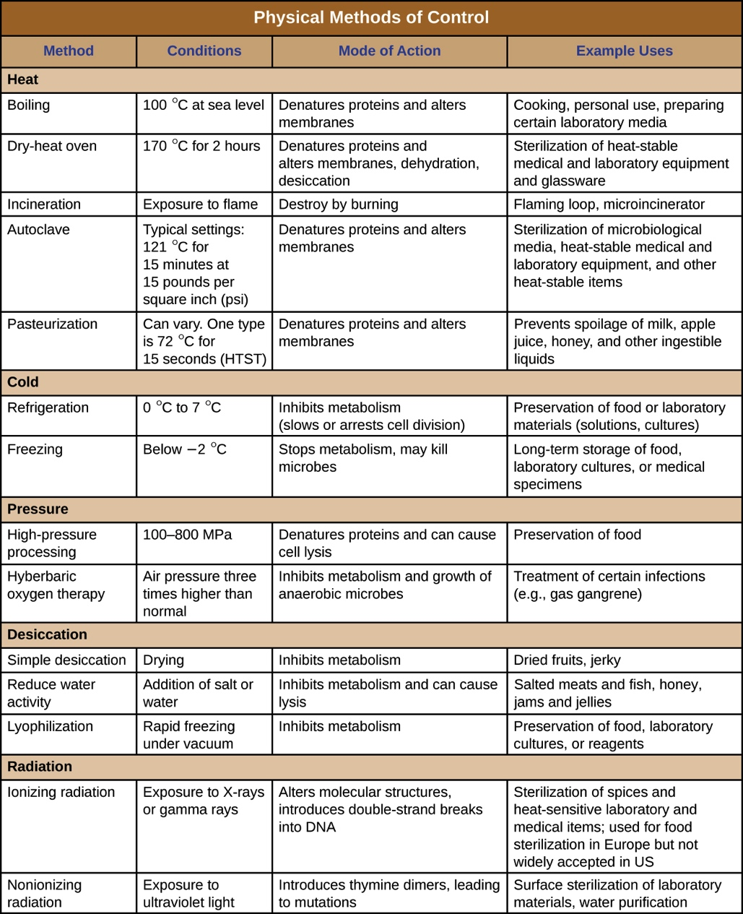
Notes:
A Review

Slide 34
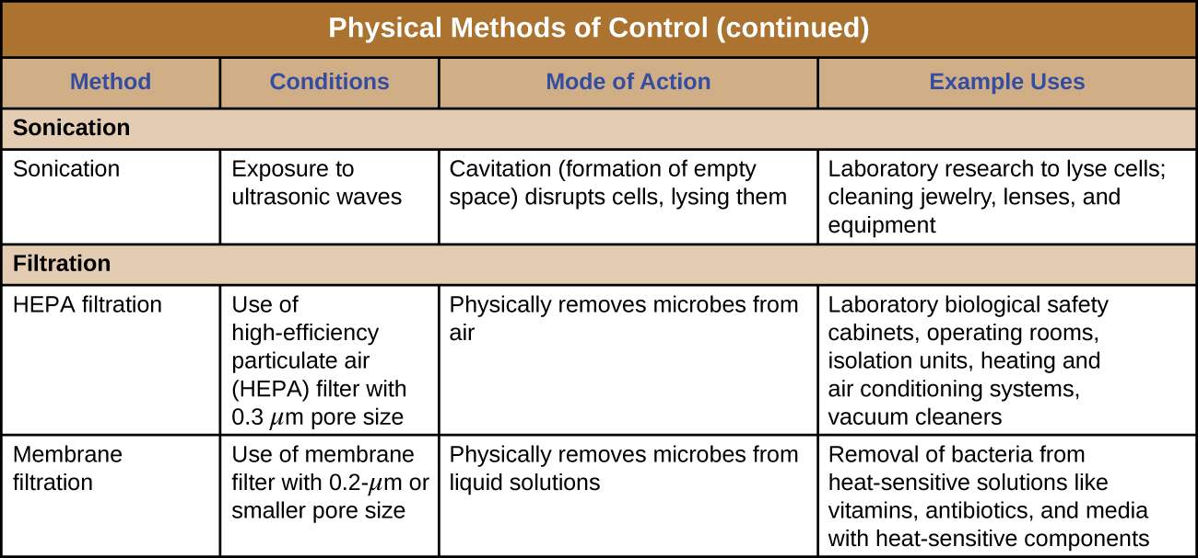
Notes:
A review

Slide 35
Antibacterial Mechanisms
Selective Toxicity
Drug kills or inhibits the growth of only the targeted microorganisms while causing no harm to the host.
Notes:
Appreciate the significance of this statement. Understand why it is easier to target death in prokaryotic infections as opposed to eukaryotic when the host is a human.

Slide 36
Antibacterial Mechanisms
Antibacterials, such as antibiotics, limit growth or kill bacterial cells via different mechanisms:
Inhibiting cell wall synthesis
Inhibiting protein biosynthesis
Inhibiting membrane function
Inhibiting nucleic acid synthesis
Inhibiting metabolic pathways
Inhibiting ATP synthase
Notes:
Please know this list and again understand the importance of distinguishing host cells from bacterial cells when providing treatment options.

Slide 37
Inhibiting/Attacking the Cell Wall
Helpful because humans do not produce Peptidoglycan
Often has better effect on Gram positive due to the thick peptidoglycan layer and its ability to easily absorb the chemical
Gram Negatives often can repel the chemical due to its outer membrane, often composed of lipopolysaccharide.
Notes:
Please understand that those antibiotics targeting the cell membrane may not work as well in treating Gram negative bacteria and a different antibacterial using a different mechanism may need to be chosen depending on what a culture determines the infectious agent to be. Please understand this concept well.

