Slide 1
Principles of Micro Economics, Ninth Edition N. Gregory Mankiw
Notes:
N. Gregory Mankiw Principles Of Micro Economics Ninth Edition

Slide 2
Chapter 22
Frontiers of Microeconomics

Slide 3
Asymmetric Information
Information asymmetry
“I know something you don’t know”
A difference in access to relevant knowledge
Hidden action: Moral hazard
The principal-agent problem
Hidden characteristic: Adverse selection
The lemons problem

Slide 4
Hidden Actions, Part 1
Moral hazard
Person who is imperfectly monitored
Tendency to engage in dishonest or otherwise undesirable behavior
Agent
Person who is performing an act for another person (the principal)

Slide 5
Hidden Actions, Part 2
Principal
Person for whom another person (the agent) is performing some act
Employment relationship
Moral hazard
Employer is the principal
Worker is the agent

Slide 6
Hidden Actions, Part 3
Moral-hazard problem (employer–employee)
The temptation of imperfectly monitored workers to shirk their responsibilities
Responses to moral-hazard problem
Better monitoring
High wages (efficiency-wage theories)
Delayed payment

Slide 7
Hidden Actions, Part 4
Moral-hazard problems
A homeowner with fire insurance buys too few fire extinguishers
Homeowner bears the cost of the extinguisher
Insurance company receives much of the benefit
Family lives near a river with a high risk of flooding
Family enjoys the scenic views
Government bears the cost of disaster relief

Slide 8
Hidden Actions, Part 5
Regulations aimed at addressing the problem
Insurance company – require homeowners to buy fire extinguishers
Government – prohibit building homes on land with high risk of flooding
The insurance company and the government
Don’t have perfect information
The problem of moral hazard persists

Slide 9
Hidden Characteristics, Part 1
Adverse selection
Mix of unobserved attributes
Tendency to become undesirable from the standpoint of an uninformed party
Market for used cars
Sellers know the defects of cars better than prospective buyers
Problem: Owners of good cars keep them rather than sell them at the low price

Slide 10
Hidden Characteristics, Part 2
Labor market
Workers – know their abilities better than firms
Problem: Wages – above equilibrium
Unemployment
Markets for insurance
People buying insurance – know more than insurance company
Problem: Buyers with low risk – uninsured

Slide 11
Signaling
Signaling
Action taken by an informed party to reveal private information to an uninformed party
Firms – advertising
Students – college degree
Effective signaling
Costly
More beneficial — higher-quality product

Slide 12
Gifts as Signals
Gift giving
Reflects asymmetric information and signaling
Choosing a good gift
Signal of love
Costly – it takes time
Cost depends on private information
Giving cash as gift
Signal: May offend
“Now we’ll see how much he loves me.”

Slide 13
Screening
Screening
Action taken by an uninformed party
To induce an informed party to reveal information
Seller of car insurance
Low premium policy (with deductible) to safe drivers
High premium policy (without a deductible) to risky drivers

Slide 14
Public Policy
Asymmetric information
Market may fail to put resources to their best use
May call for government action
Complications:
Private market – deal with information asymmetries (signaling and screening)
Government – rarely has more information than the private parties
Government – imperfect institution

Slide 15
Political Economy
Political economy
Study of government using the analytic methods of economics
Public choice
The Condorcet voting paradox
Failure of majority rule to produce transitive preferences for society

Slide 16
Table 1 The Condorcet Paradox
 | Voter Type | Voter Type | Voter Type
 | Type 1 | Type 2 | Type 3
Percent of electorate | 35 | 45 | 20
First choice | A | B | C
Second choice | B | C | A
Third choice | C | A | B
If voters have these preferences over outcomes A, B, and C, then in pairwise majority voting, A beats B, B beats C, and C beats A.

Slide 17
Arrow’s Impossibility Theorem, Part 1
Properties for voting system:
Unanimity
If everyone prefers A to B, then A should beat B
Independence of irrelevant alternatives
Ranking between any two outcomes A & B should not depend on whether outcome C is also available

Slide 18
Arrow’s Impossibility Theorem, Part 2
Properties for voting system:
Transitivity
If A beats B, and B beats C, then A should beat C
No dictators
There is no person who always gets his way regardless of everyone else’s preferences

Slide 19
Arrow’s Impossibility Theorem, Part 3
Arrow’s impossibility theorem
Mathematical result
Under certain assumed conditions
There is no scheme for aggregating individual preferences
Into a valid set of social preferences

Slide 20
The Median Voter Is King, Part 1
Median voter theorem
Mathematical result
If voters are choosing a point along a line
And each voter wants the point closest to his most preferred point
Then majority rule will pick the most preferred point of the median voter

Slide 21
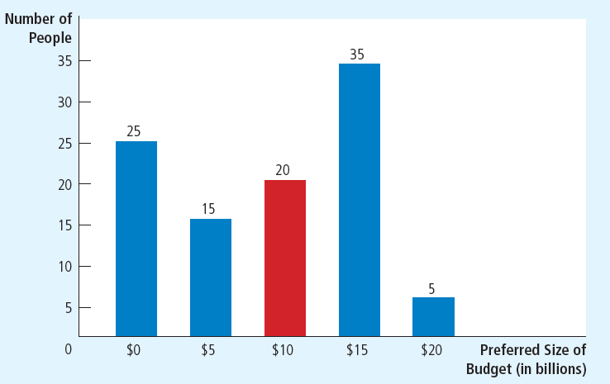
Figure 1 The Median Voter Theorem: An Example
This bar chart shows how 100 voters’ most preferred budgets are distributed over five options, ranging from zero to $20 billion. If society makes its choice by majority rule, the median voter, who here prefers $10 billion, determines the outcome.

Slide 22
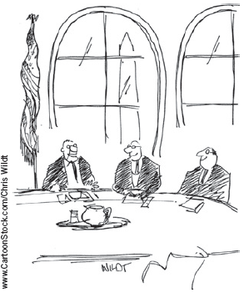
The Median Voter Is King, Part 2
Implications of the median voter theorem
Parties in a two-party system
Move toward the median voter
Minority views are not given much weight
Majority rule
Looks only to the person in the exact middle of the distribution
“Isn’t that the real genius of democracy? . . . The VOTERS are ultimately to blame.”

Slide 23
Politicians Are People Too
Politicians
Have objectives
Nice to assume (not realistic)
Looking out for the well-being of society as a whole
Aiming for an optimal combination of efficiency and equality
Self-interest – powerful motive
Desire for reelection
Greed

Slide 24
Behavioral Economics
Behavioral economics
Subfield of economics
Integrates the insights of psychology
Imperfections of human reasoning
Forgetful, impulsive, confused, emotional, and shortsighted

Slide 25
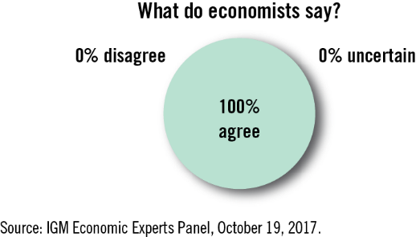
ASK THE EXPERTS
Behavioral Economics
“Insights from psychology about individual behavior—examples of which include limited rationality, low self-control, or a taste for fairness—predict several important types of observed market outcomes that fully-rational economic models do not.”

Slide 26
People Aren’t Always Rational, Part 1
People aren’t always rational
Not rational maximizers
Always choosing the best course of action
Satisfiers
Make decisions that are merely good enough
Near rational
Bounded rationality

Slide 27
People Aren’t Always Rational, Part 2
Systematic mistakes that people make
People are overconfident
People give too much weight to a small number of vivid observations
People are reluctant to change their minds
Confirmation bias: Two groups interpreting the same evidence in exactly opposite ways

Slide 28
People Aren’t Always Rational, Part 3
Economics – built on the rationality assumption
Yields reasonably accurate models of behavior
Economists are themselves not rational maximizers

Slide 29
People Care About Fairness
Ultimatum game: split $100 between two players
Only one player decides the shares
99–1: acceptable and rational
60–40: fair
Perceived fairness of what a firm pays its workers
Especially profitable year: workers may expect to be paid a fair share of the prize

Slide 30
People Are Inconsistent over Time
People are inconsistent over time
People make plans for themselves
But then they fail to follow through
People should try to find ways to commit their future selves to following through on their plans

