Slide 1
Principles of Micro Economics, Ninth Edition N. Gregory Mankiw
Notes:
N. Gregory Mankiw Principles Of Micro Economics Ninth Edition

Slide 2
Chapter 17
Oligopoly

Slide 3
Oligopoly
Oligopoly
Only a few sellers
Offer similar or identical products
Interdependent
Game theory
How people behave in strategic situations
Choose among alternative courses of action
Must consider how others might respond to the action he takes

Slide 4
Markets with Only a Few Sellers, Part 1
A small group of sellers, oligopolists
Tension between cooperation and self-interest
Best off cooperating, acting like a monopolist
Produce a small quantity of output
Charge P >MC
Each firm cares only about its own profit
Powerful incentives not to cooperate

Slide 5
Markets with Only a Few Sellers, Part 2
Duopoly
Oligopoly with only two members
Decide what quantity to sell
Price is determined on the market by the demand

Slide 6
Table 1 The Demand Schedule for Water
Quantity | Price | Total Revenue (and total profit)
0 gallons | $120 | $0
10 | 110 | 1,100
20 | 100 | 2,000
30 | 90 | 2,700
40 | 80 | 3,200
50 | 70 | 3,500
60 | 60 | 3,600
70 | 50 | 3,500
80 | 40 | 3,200
90 | 30 | 2,700
100 | 20 | 2,000
110 | 10 | 1,100
120 | 0 | 0

Slide 7
Markets with Only a Few Sellers, Part 3
For a perfectly competitive firm
Price = marginal cost
Quantity is efficient
For a monopoly
Price > marginal cost
Quantity is lower than the efficient quantity

Slide 8
Markets with Only a Few Sellers, Part 4
A duopoly can:
Collude and form a cartel, act as a monopoly and agree on:
Total level of production
Quantity produced by each member
Don’t collude, act in self-interest
Difficult to agree; Antitrust laws
Higher quantity; lower price; lower profit
Not competitive allocation
Nash equilibrium

Slide 9
Markets with Only a Few Sellers, Part 5
Collusion
Agreement among firms in a market
Quantities to produce or
Prices to charge
Cartel
Group of firms acting in unison

Slide 10
Equilibrium for an Oligopoly, Part 1
Nash equilibrium
Economic actors interacting with one another
Each choose their best strategy
Given the strategies that all the other actors have chosen

Slide 11
Equilibrium for an Oligopoly, Part 2
Oligopolists
Better off cooperating and reaching the monopoly outcome
They pursue their own self-interest
Do not end up reaching the monopoly outcome and maximizing their joint profit
Each is tempted to raise production and capture a larger share of the market
Total production rises and price falls

Slide 12
Equilibrium for an Oligopoly, Part 3
When firms in an oligopoly individually choose production to maximize profit
Produce a quantity of output
Greater than the level produced by monopoly
Less than the level produced by competition
The price is
Less than the monopoly price
Greater than the competitive price (MC)

Slide 13
Markets with Only a Few Sellers, Part 6
If oligopolists form a cartel
Maximize total profit
Produce monopoly quantity
Charge monopoly price
Difficult to reach and enforce an agreement as the size of the group increases

Slide 14
Markets with Only a Few Sellers, Part 7
If oligopolists do not form a cartel, each firm has to take into account:
The output effect
Because P > MC, selling one more unit increases profit
The price effect
Increasing production increases total amount sold
Decrease in price and lower the profit

Slide 15
Markets with Only a Few Sellers, Part 8
The size of an oligopoly affects the market outcome
As the number of sellers in an oligopoly grows larger
Oligopolistic market looks more like a competitive market
Price approaches marginal cost
Quantity produced approaches socially efficient level

Slide 16
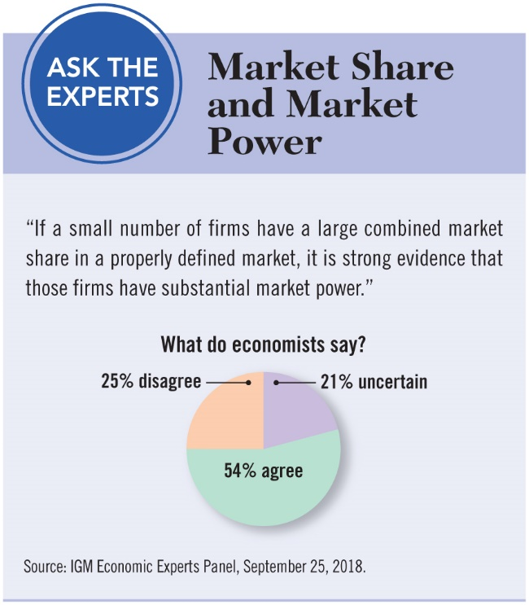
ASK THE EXPERTS
Nash Equilibrium

Slide 17
The Economics of Cooperation, Part 1
The prisoners’ dilemma
Particular “game” between two captured prisoners
Illustrates why cooperation is difficult to maintain even when it is mutually beneficial
Dominant strategy
Strategy that is best for a player in a game
Regardless of the strategies chosen by the other players

Slide 18
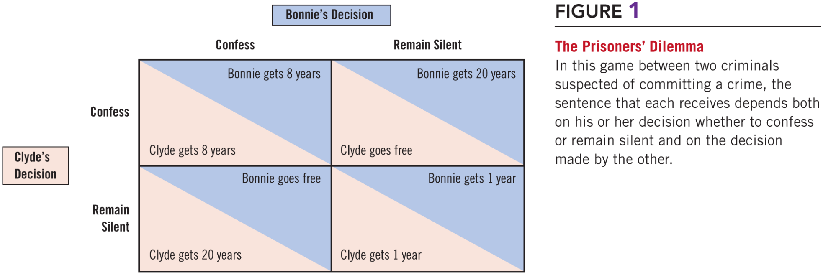
Figure 1 The Prisoners’ Dilemma

Slide 19
The Economics of Cooperation, Part 2
The prisoners’ dilemma
Because each pursues his or her own interests
The two prisoners together reach an outcome that is worse for each of them
Cooperation between the two prisoners is difficult to maintain
Because cooperation is individually irrational

Slide 20
The Economics of Cooperation, Part 3
Game oligopolists play
In trying to reach the monopoly outcome
Similar to the game that the two prisoners play in the prisoners’ dilemma
Firms are self-interested
And do not cooperate
Even though cooperation (cartel) would increase profits
Each firm has incentive to cheat

Slide 21
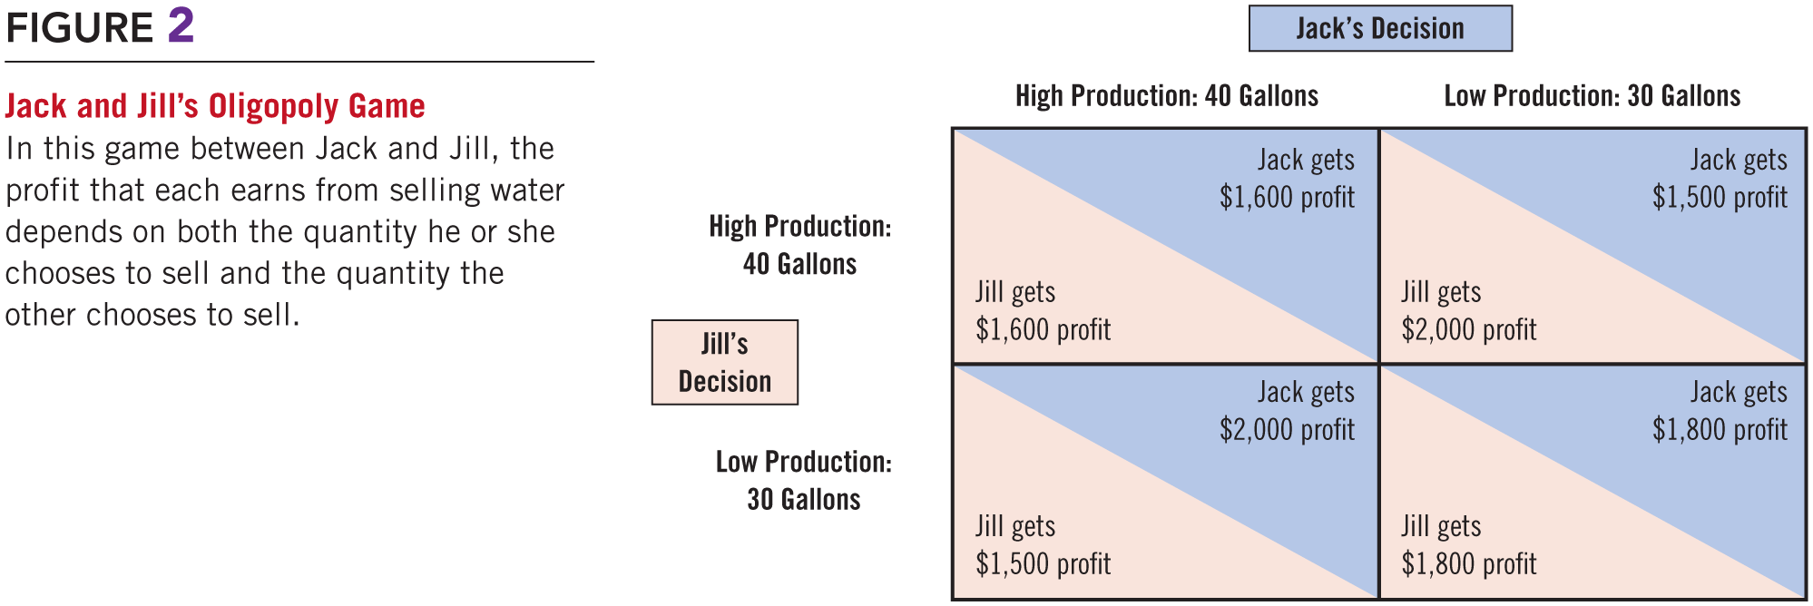
Figure 2 Jack and Jill’s Oligopoly Game

Slide 22
OPEC and the World Oil Market, Part 1
Organization of Petroleum Exporting Countries (OPEC) is a cartel
Formed in 1960: Iran, Iraq, Kuwait, Saudi Arabia, Venezuela
By 1973: Qatar, Indonesia, Libya, the United Arab Emirates, Algeria, Nigeria, Ecuador, Gabon
Control about 80 percent of the world’s oil reserves

Slide 23
OPEC and the World Oil Market, Part 2
OPEC
Tries to raise the price of its product
Coordinated reduction in quantity produced
Tries to set production levels for each of the member countries
Problem
The countries want to maintain a high price of oil

Slide 24
OPEC and the World Oil Market, Part 3
Problem
Each member of the cartel
Tempted to increase its production
Get a larger share of the total profit
Cheat on agreement
OPEC – successful at maintaining cooperation and high prices
From 1973 to 1985: increase in price

Slide 25
OPEC and the World Oil Market, Part 4
Mid-1980s — member countries began arguing about production levels
OPEC — ineffective at maintaining cooperation
Decrease in price
Recent years: less successful at reaching and enforcing agreements
Fluctuations in oil prices
Driven by supply and demand

Slide 26
The Economics of Cooperation, Part 4
Arms races
After World War II, United States and the Soviet Union
Engaged in a prolonged competition over military power
Strategies
Build new weapons
Disarm
Dominant strategy: Arm

Slide 27
Figure 3 An Arms-Race Game

Slide 28
The Economics of Cooperation, Part 5
Common resources
Two companies own a common pool of oil
Strategies
Each company drills one well
Each company drills a second well and get more oil
Dominant strategy
Each company drills two wells: lower profit

Slide 29
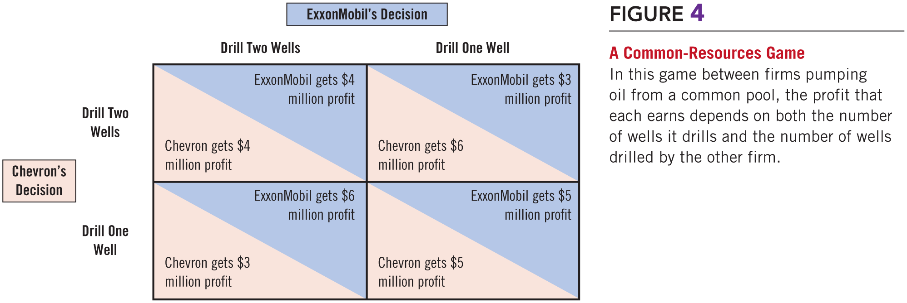
Figure 4 A Common-Resources Game

Slide 30
Welfare of Society
Dominant strategy
Noncooperative equilibrium may be bad for society and the players
Examples: Arms race game, Common resource game
Noncooperative equilibrium may be good for society
Oligopolists trying to obtain monopoly profits
Quantity and price – closer to optimal level

Slide 31
Why People Sometimes Cooperate
Game of repeated prisoners’ dilemma
Repeat the game
Agree on penalties if one cheats
Both have incentive to cooperate
As long as the players care enough about future profits, they will choose to forgo the one-time gain from defection

Slide 32
The Prisoners’ Dilemma Tournament, Part 1
Repeated prisoners’ dilemma
The score at the end of the game is the total number of years in jail
Encourage cooperation
Penalty for not cooperating
Better strategy
Return to cooperative outcome after a period of noncooperation

Slide 33
The Prisoners’ Dilemma Tournament, Part 2
Repeated prisoners’ dilemma
Best strategy: tit-for-tat
Player starts by cooperating, then do whatever the other player did last time
Starts out friendly
Penalizes unfriendly players
Forgives them if warranted

Slide 34
Public Policy Toward Oligopolies, Part 1
Governments
Can sometimes improve market outcomes
Policymakers
Try to induce firms in an oligopoly to compete rather than cooperate
Move the allocation of resources closer to the social optimum

Slide 35
Public Policy Toward Oligopolies, Part 2
Antitrust laws
The Sherman Antitrust Act, 1890
Elevated agreements among oligopolists from an unenforceable contract to a criminal conspiracy
The Clayton Act, 1914
Further strengthened the antitrust laws
Used to prevent mergers
Used to prevent oligopolists from colluding

Slide 36
An Illegal Phone Call, Part 1
Robert Crandall — president of American Airlines
Howard Putnam — president of Braniff Airways
Crandall: I think it’s dumb as hell . . . to sit here and pound the @#$% out of each other and neither one of us making a #$%& dime.
Putnam: Do you have a suggestion for me?
Crandall: Yes, I have a suggestion for you. Raise your $%*& fares 20 percent. I’ll raise mine the next morning.

Slide 37
An Illegal Phone Call, Part 2
Putnam: Robert, we . . .
Crandall: You’ll make more money, and I will, too.
Putnam: We can’t talk about pricing!
Crandall: Oh @#$%, Howard. We can talk about any &*#@ thing we want to talk about.
The Sherman Antitrust Act
Prohibits competing executives from even talking about fixing prices

Slide 38
Public Policy Toward Oligopolies, Part 3
Controversies over antitrust policies
Used to condemn some business practices whose effects are not obvious
Resale price maintenance
Predatory pricing
Tying

Slide 39
Public Policy Toward Oligopolies, Part 4
Resale price maintenance (fair trade)
Require retailers to charge customers a given price
Might seem anticompetitive
Prevents the retailers from competing on price
Defenders:
Not aimed at reducing competition
Legitimate goal: some retailers offer service

Slide 40
Public Policy Toward Oligopolies, Part 5
Predatory pricing
Charge prices that are too low
Anticompetitive
Price cuts may be intended to drive other firms out of the market
Skeptics
Predatory pricing — not a profitable strategy
Price war — to drive out a rival’ prices are driven below cost

Slide 41
Public Policy Toward Oligopolies, Part 6
Tying
Offer two goods together at a single price
Expand market power
Skeptics
Cannot increase market power by binding two goods together
Form of price discrimination
Tying may increase profit

Slide 42
The Microsoft Case, Part 1
U.S. government’s suit against the Microsoft Corporation, 1998
Central issue: tying
Should Microsoft be allowed to integrate its Internet browser into its Windows operating system
Bundling to expand market power into the market of Internet browsers
Would deter other software companies from entering the market and offering new products

Slide 43
The Microsoft Case, Part 2
Microsoft responded
New features into old products - natural part of technological progress
Cars — include CD players, air conditioners
Cameras — built-in flashes
Operating systems — added many features to Windows
Previously stand-alone products
Computers - more reliable and easier to use
Integration of Internet technology
The next natural next step

Slide 44
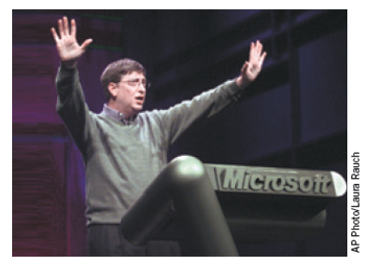
The Microsoft Case, Part 3
Disagreement
Extent of Microsoft’s market power
The government
More than 80% of new personal computers
Used a Microsoft operating system
Substantial monopoly power
“Me? A monopolist? Now just wait a minute . . .”

Slide 45
The Microsoft Case, Part 4
Microsoft
Software market is always changing
Competitors: Apple Mac & Linux operating systems
Low price – limited market power
November 1999 ruling
Microsoft — great monopoly power
Illegally abused that power

Slide 46
The Microsoft Case, Part 5
June 2000
Microsoft – to be broken up into two companies
Operating system & Applications software
2001, appeals court
Overturned the breakup order
September 2001
Justice Department — wanted to settle the case quickly

Slide 47
The Microsoft Case, Part 6
Settlement: November 2002
Microsoft – some restrictions
Government – browser would remain part of the Windows operating system
Private antitrust suits
Suits brought by the European Union
Alleging a variety of anticompetitive behaviors

