Slide 1
Viruses & Prions
CCV
Dr. Melanie Meyer

Slide 2
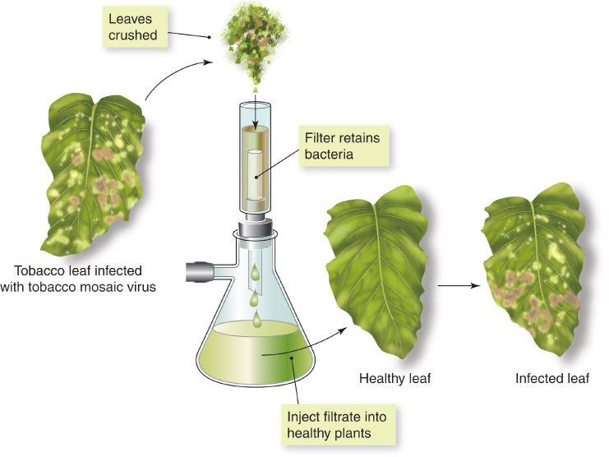
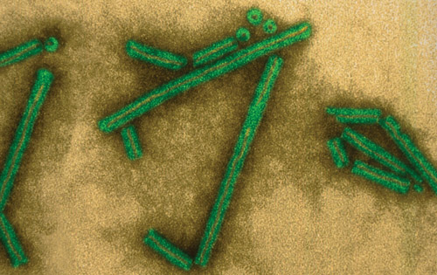
Viruses were first described in scientific terms as “filterable agents”
Russian Dmitri Ivanowski, 1892, passed diseased tobacco leaf extract through filters that removed bacteria, filtrate caused disease (tobacco mosaic virus)
In 1935 Wendell Stanley crystallized TMV
Figure 05.02A: Discovery of “filterable” viruses.
Figure 05.02B: TEM of TMV.

Slide 3
General Characteristics of Viruses
Obligatory intracellular parasites—require living host cells in order to multiply
Inert outside of living host cells
Enter host→viral nucleic acids become active and viral multiplication occurs
Especially small organisms—filterable

Slide 4
Distinctive Features of Viruses
Acellular (subcellular)
Contain a single type of nucleic acid—either DNA or RNA (never both)
Contain a protein coat that surrounds the nucleic acid
Multiply inside living cells by using the synthesizing machinery of the cell
Cause the synthesis of a specialized structure that can transfer the viral nucleic acid to other cells
Viruses have few or no enzymes for their own metabolism—cannot synthesize ATP
Most viruses are able to infect specific types of cells

Slide 5
Host Range
= the spectrum of host cells the virus can infect
Viruses can infect invertebrates, vertebrates, plants, protists, fungi and bacteria
Most infect specific cell types but some can cross the host-range barrier
Ex: bacteriophage (phages) = viruses that infect bacteria
Phage therapy –using bacteriophages to treat bacterial infections
Has been in use for 100 years
Study is still underway

Slide 6
Viral Size
Determined with the aid of an electron microscope
Considerable variability in virus size
Most are smaller than bacteria but with exceptions

Slide 7
Viral Structure
Virion= a complete, fully developed, infectious viral particle composed of nucleic acid and surrounded by a protein coat outside of a host cell
Extracelllular terminology
Viruses are classified by their nucleic acid and by differences in the structures of their coats

Slide 8
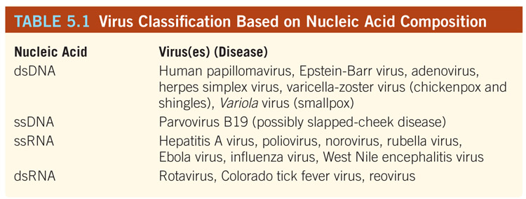
Viral Structure
Nucleic Acid:
In contrast to prokaryotic and eukaryotic cells, in which DNA is always the primary genetic material, a virus can have either DNA or RNA—never both
Nucleic acid of a virus can be single-stranded or double-stranded

Slide 9
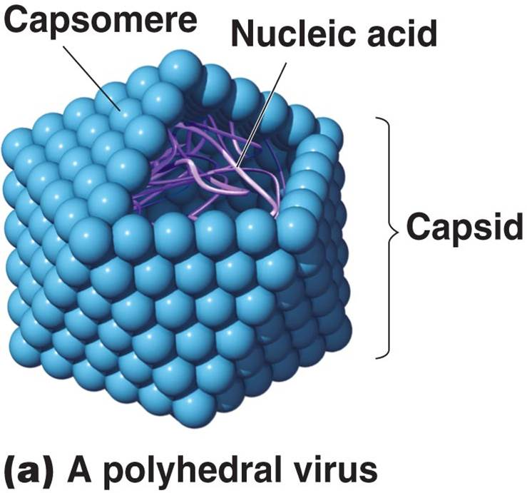
Viral Structure
Capsid—the protein coat which protects the nucleic acid of a virus
Each capsid is composed of protein subunits called capsomeres

Slide 10
Viral Structure
Envelope:
In some viruses, the capsid is covered by an envelope, which usually consists of some combination of lipids, proteins, and carbohydrates
Some animal viruses are released from the host cell by an extrusion process that coats the virus with a layer of the host’s plasma membrane—this layer becomes the viral envelope
Depending on the virus, envelopes may or may not be covered by spikes
Spikes = carbohydrate-protein complexes that project from the surface of the envelope
Some viruses attach to host cells by means of spikes

Slide 11
Viral Structure
Non-enveloped Viruses (naked viruses):
Viruses whose capsids are not covered by an envelope
The capsid of a non-enveloped virus protects the nucleic acid from nuclease enzymes in biological fluids and promotes the viruses’s attachment to susceptible host cells

Slide 12
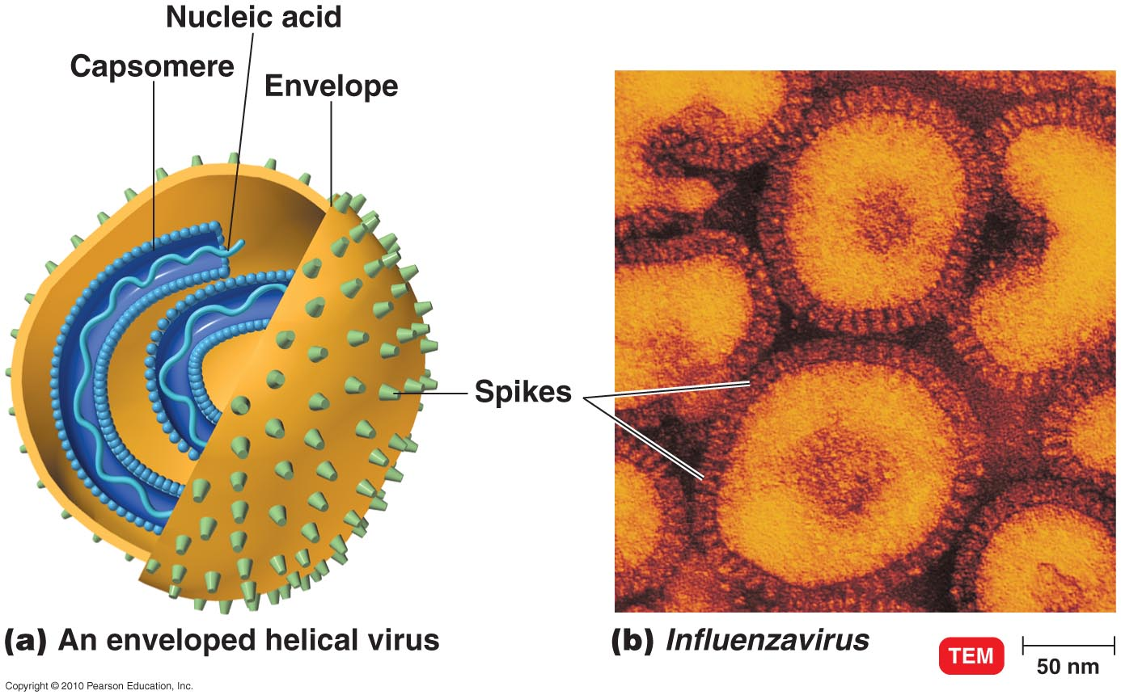
Morphology of an Enveloped Virus

Slide 13
General Morphology
1) Helical Viruses: consist of a series of rod-shapes capsomeres that form a continuous helical tube
2) Polyhedral: many-sided
Icosahedral—most polyhedral viruses are in this shape = 3-dimensional, 20-sided triangular stuctures that confer a geodesic shape to the virus
3) Complex: consist of a polyhedral head, a helical tail, and tail fibers that serve for attachment to the host cell (resemble a spacecraft)

Slide 14
General Morphology—classification by capsid architecture

Slide 15
Taxonomy of Viruses
Family names end in -viridae.
Genus names end in -virus.
Viral species: A group of viruses sharing the same genetic information and ecological niche (host). Common names are used for species.
Subspecies are designated by a number.

Slide 16
Taxonomy of Viruses
Herpesviridae
Herpesvirus
Human herpes virus HHV-1, HHV-2, HHV-3
Retroviridae
Lentivirus
Human immunodeficiency virus HIV-1, HIV-2

Slide 17
Viral Classification
Structure: by type of nucleic acid and shape
Host Cell: (microbe, plant, or animal)
Bacterial viruses termed bacteriophage or phage
Clinical: organ or organ system
Dermotropic (skin)
Viscerotropic (internal organs)
Pneumotropic (respiratory system)

Slide 18
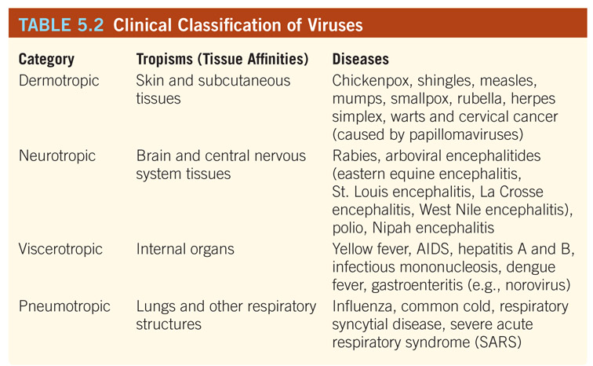

Slide 19
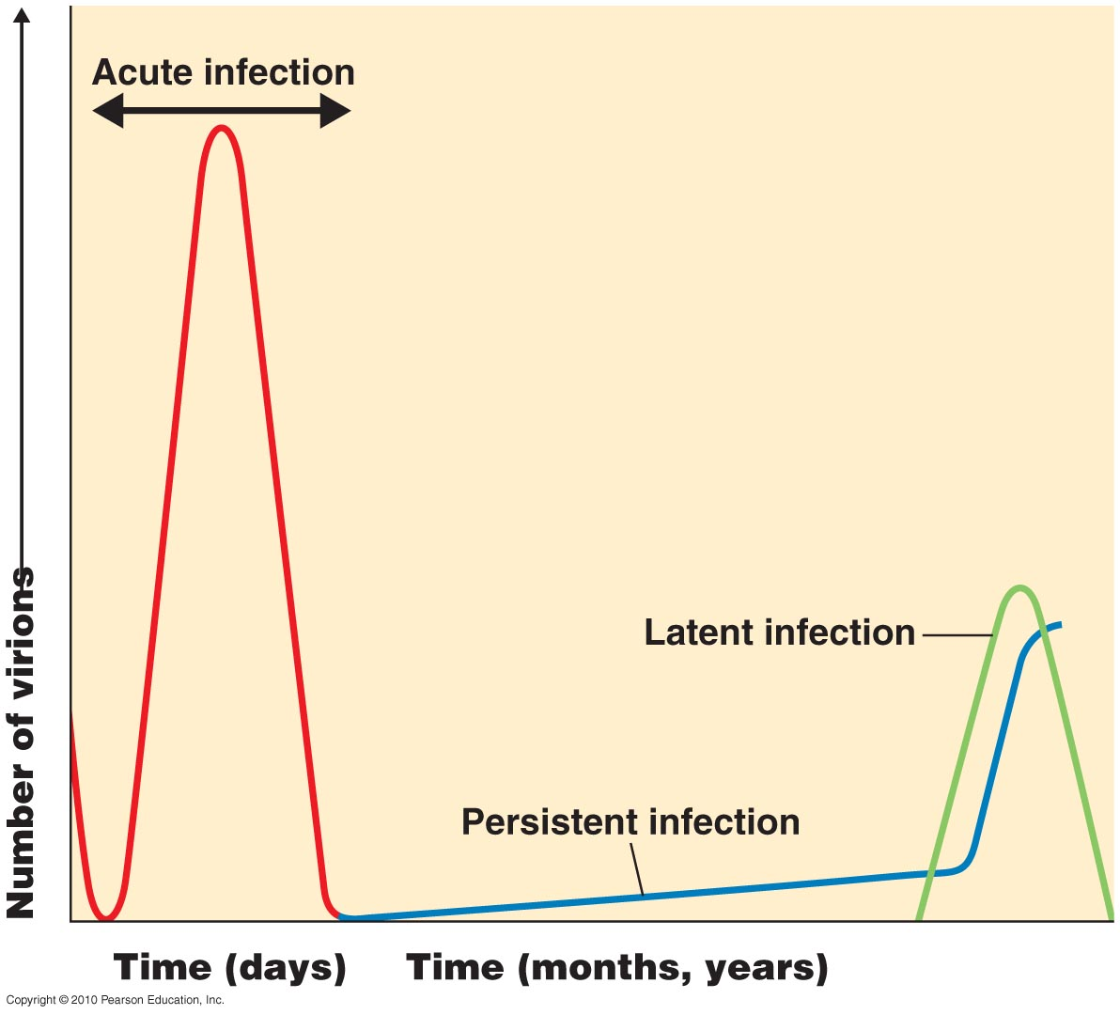
Latent Viral Infections
Virus remains in asymptomatic host cell for long periods
Cold sores, shingles
Figure 13.21

Slide 20
Persistent Viral Infections
Disease processes occurs over a long period; generally is fatal
Subacute sclerosing panencephalitis (measles virus)
Figure 13.21

Slide 21
Viral Replication—5 Stages

Slide 22
Viral Multiplication
For a virus to multiply, it must invade a host cell and take over the host’s metabolic machinery
A single virion can give rise to several or even thousands of similar viruses in a single host cell.
This process can drastically change the host cell and usually causes its death
In a few viral infections, cells survive and continue to produce viruses indefinitely

Slide 23
Viral One-Step Growth Curve

Slide 24
Bacteriophage Replication
Lytic cycle
Phage causes lysis and death of host cell
Lysogenic cycle
Prophage DNA incorporated in host DNA
Phage conversion
Specialized transduction

Slide 25
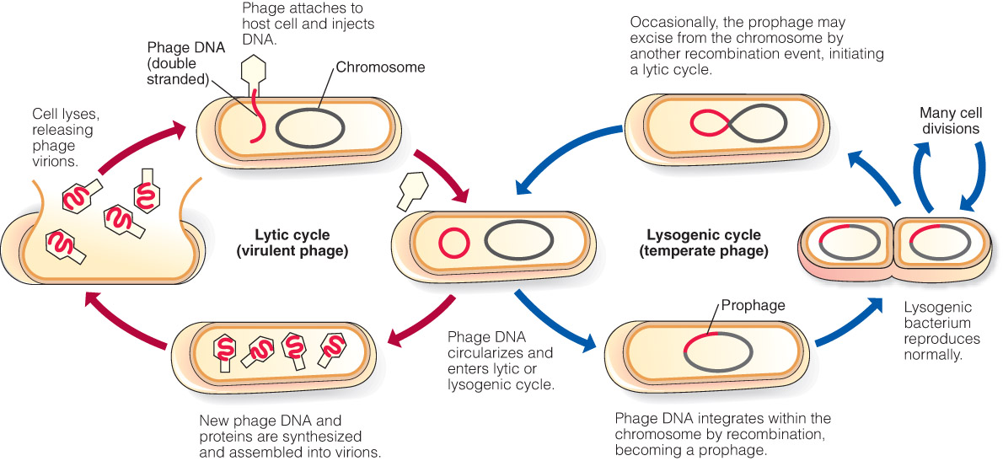
Two types of bacteriophage infection: lytic or lysogenic
Figure 05.05: Replication cycle of a bacterial virus.

Slide 26
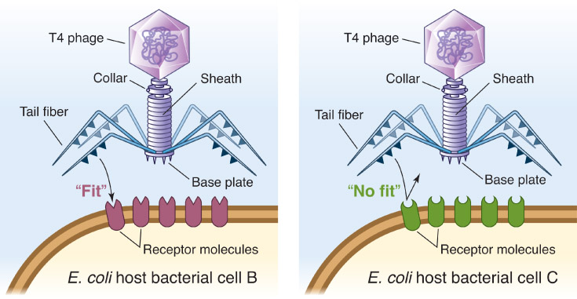
1) Adsorption (Attachment)
Virus docks with specific cell surface receptors
Recognition specificity establishes host range

Slide 27
2) Penetration
Viruses have evolved various strategies for delivering the genome to the cytoplasm
The nucleic acid alone enters the cell and the virion remains outside the cell (e.g., phage, polio).
For some enveloped viruses (e.g., measles, mumps) the viral and cell membranes fuse to release nucleocapsid.
For other enveloped viruses (e.g., poxviruses, influenza) the entire virion is endocytosed. The vesicle and viral membranes fuse to release the nucleocapsid.

Slide 28
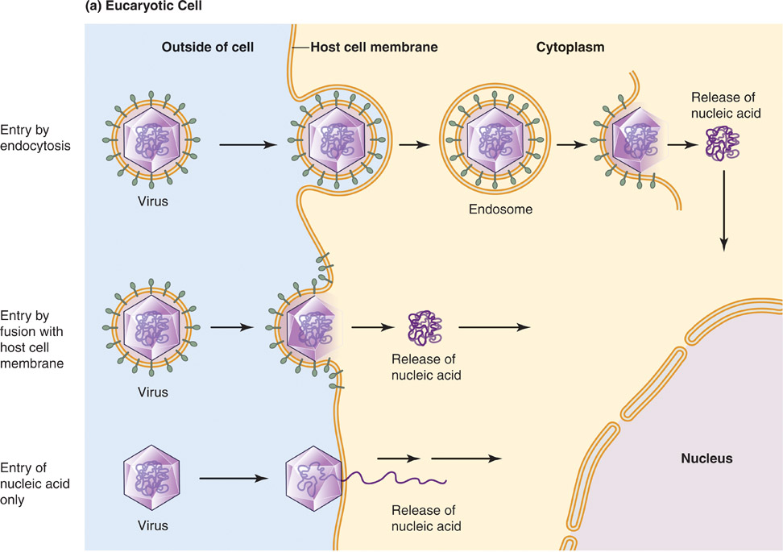
Figure 05.07: Strategies of viral penetration of cells.

Slide 29
3) Viral Replication
The replication process is dependent upon the genome type of the virus (DNA or RNA, ss or ds)
The genome contains the blueprints for making the parts of the virus
The various viral parts (protein and nucleic acid) are manufactured (usually) using machinery and building block molecules from the host

Slide 30
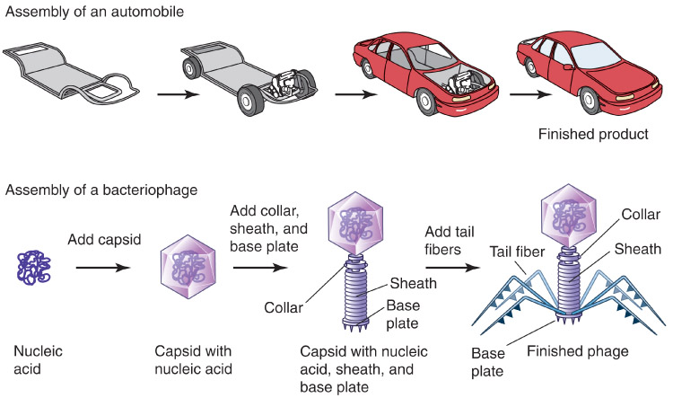
4) Assembly
Once the parts are made (proteins, genome, etc.), they “self-assemble,” in an assembly line fashion, to make new virions

Slide 31
5) Release
New virions exit the cell by one of several virus-specific mechanisms
Phage and some animal viruses rupture (lyse) the cell (the host cell dies).
Some enveloped viruses are released by budding, or “endocytosis in reverse.”
budding is gradual and does not necessarily kill the cell
Figure 05.09: Lysis of bacterial host cell by phage.

Slide 32
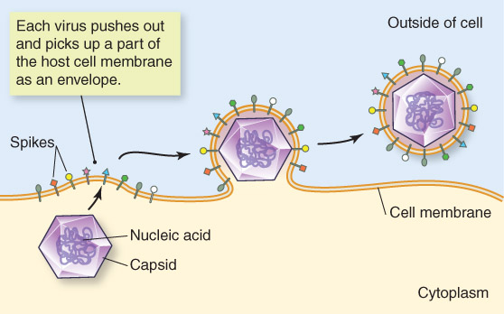
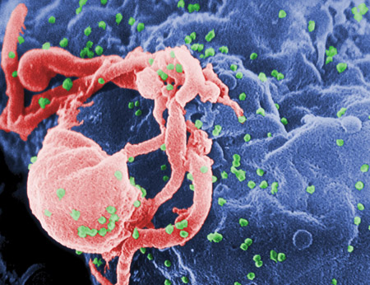
Budding of enveloped viruses
Figure 05.10B: SEM of HIV-budding from T lymphocyte.
Figure 05.10A: Release by budding.

Slide 33
Studying Viruses in the Lab
Hard to grow and study due to status as obligate intracellular parasites
Cultivation of viruses requires the presence of living cells
Bacteriophages are relatively easy to study due to the ease of using readily grown bacteria as the host
Bacteriophages have served a model for animal viruses
Mostly the T4 bacteriophase with E. coli

Slide 34
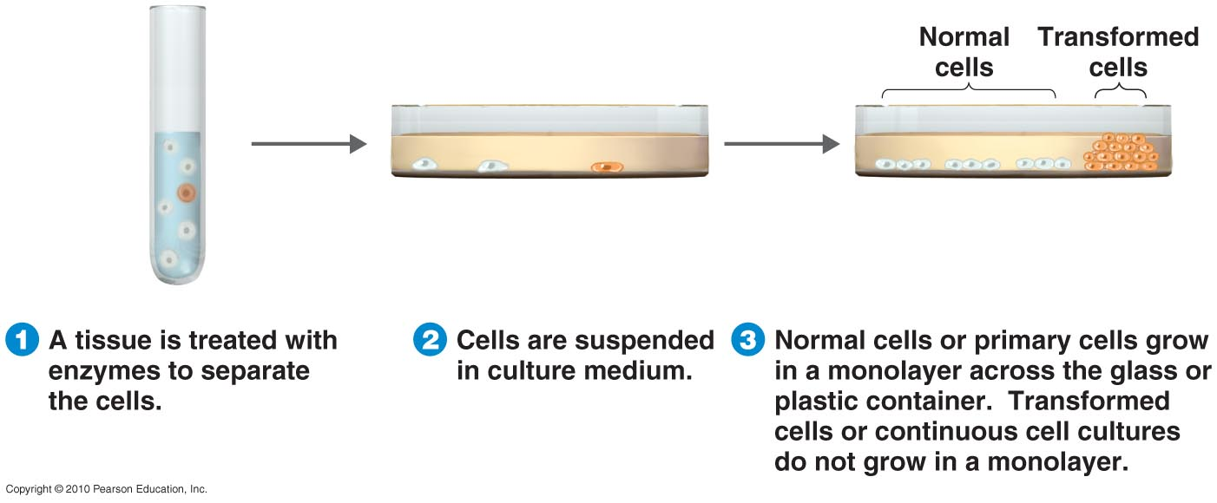
Growing Viruses
Animal and plant viruses may be grown in cell culture
Continuous cell lines may be maintained indefinitely
Figure 13.8

Slide 35
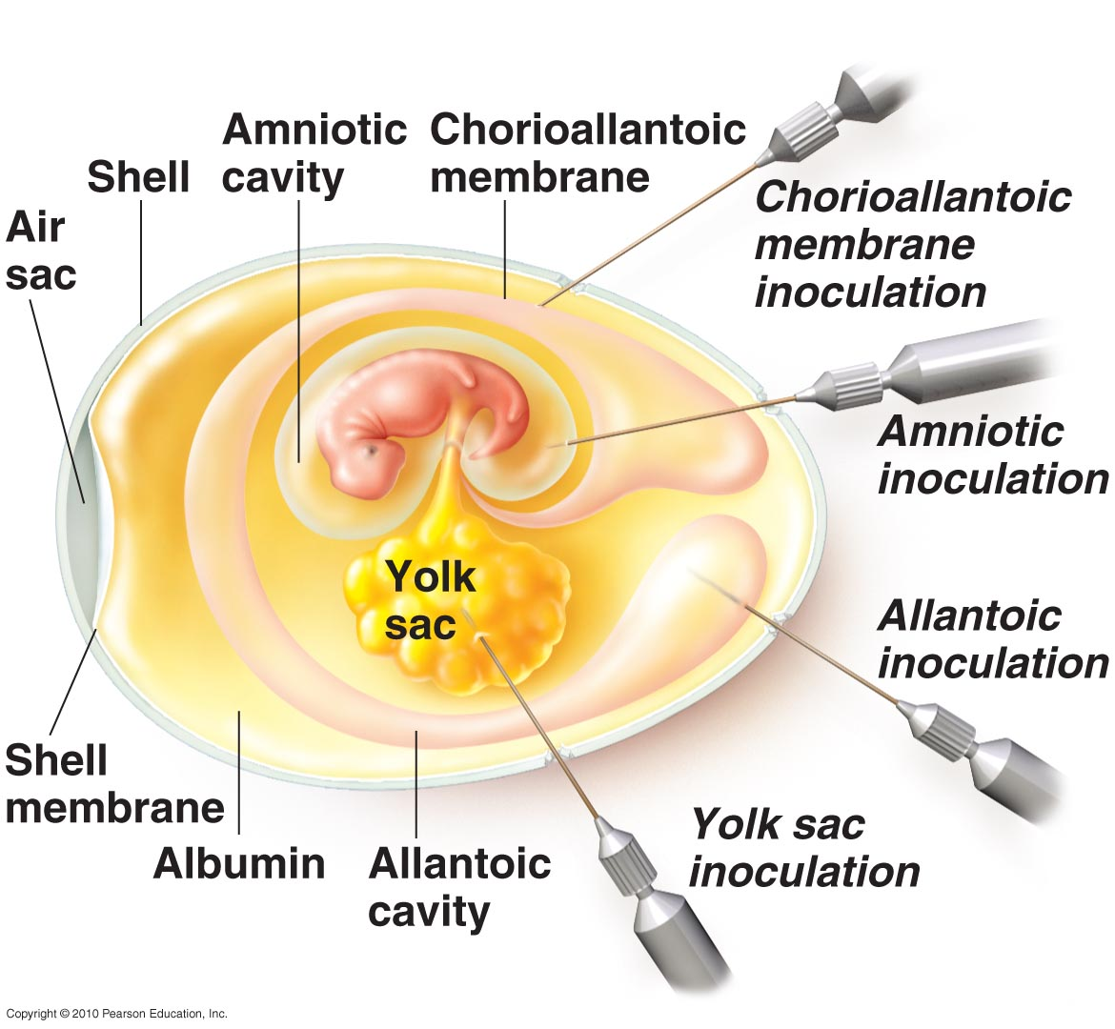
Growing Viruses
Animal viruses may be grown in living animals or in embryonated eggs
Figure 13.7

Slide 36
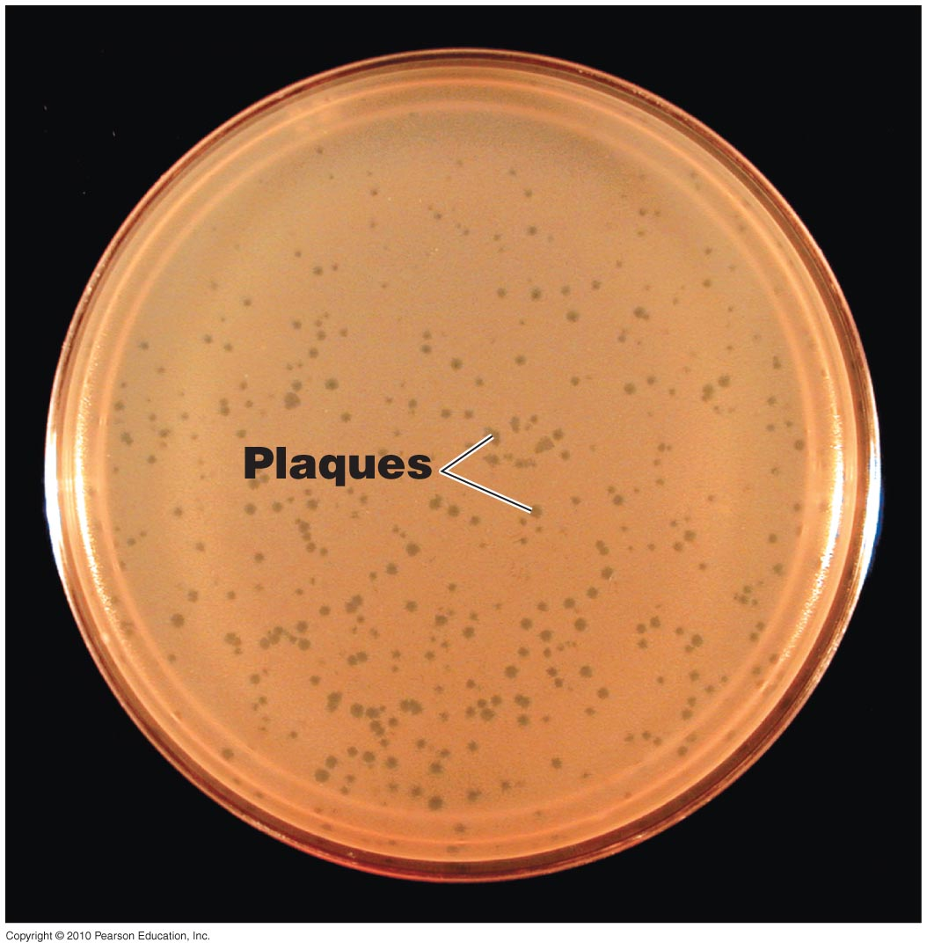
Growing Viruses
Bacteriophages form plaques on a lawn of bacteria
Figure 13.6

Slide 37
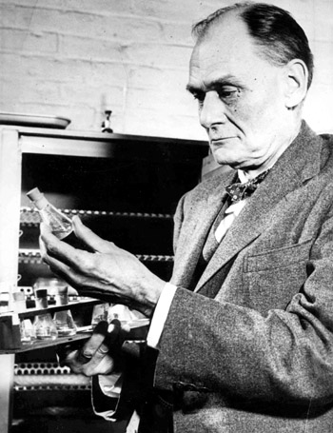
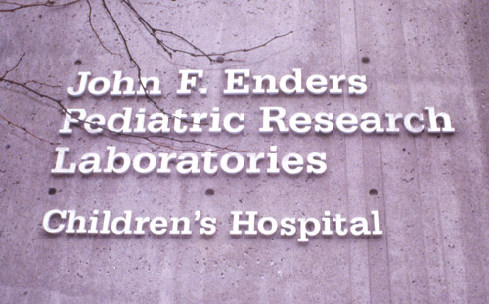
Enders, Weller and Robbins successfully cultivated poliovirus in monkey kidney cells in culture.
Courtesy of The Children's Hospital Boston Archives, Boston, MA.
Author's Photo (RIK)
Figure 05.14: John F. Enders Pediatric Research Laboratories.

Slide 38
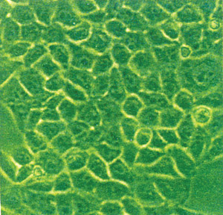
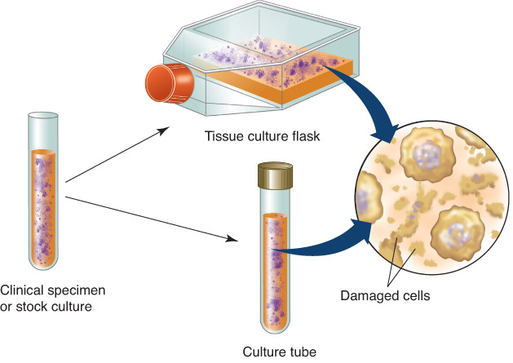
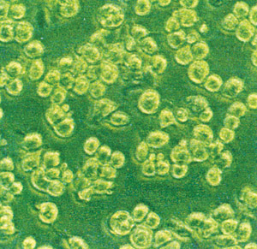
Cell culture in the ’40s and ’50s replaced use of live monkeys for growth of polio virus and led to Salk and Sabin vaccines
Figure 05.13B: Monkey kidney cells in culture.
Author's photo (TS)
Figure 05.13C: Monkey kidney cells in culture infected with vaccinia virus. CPEs include detachment and rounding of cells.
Figure 05.13A: Cultivation of viruses in cell culture.
Author's photo (TS)

Slide 39
Diagnosis of Viral Infection
Unlike bacteria, viruses are usually not cultured for diagnosing illness
Too difficult, expensive, and time-consuming
Diagnosis based on signs and symptoms/clinical presentation in the majority of viral infections
Telltale rashes are particularly useful (chickenpox, etc.)

Slide 40
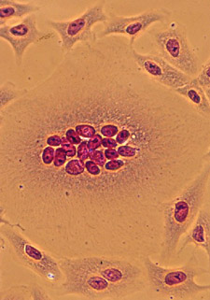
Host Cell Damage
Most viruses damage or even kill their host
Can be helpful to examine host tissue for pathological changes associated with viral infection
Cytopathic effect (CPE) is characteristic of the damage caused
Viewed microscopically, the CPE may be helpful in viral identification
Observation of syncytia formation
Negri bodies are visualized 50% of the time in brain tissues from rabid animals
Figure 05.11: Syncytia formation (cells in culture infected with measles virus).

Slide 41
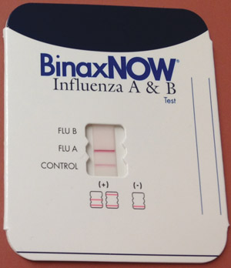
Diagnosis of Viral Infection
Molecular technology is available in specialized viral diagnostic labs.
1) Enzyme-linked immunosorbent assays (ELISAs)—look for antibodies to the virus in the host’s body fluid
Some designed as rapid tests
Rapid influenza A & B test
2) Nucleic acid-based diagnostics
Uses some form of polymerase chain reaction (PCR)
Amplifies the genetic material to identify the virus
Figure 05.15: Rapid influenza A & B test.

Slide 42
Diagnosis of Viral Infection
Table 05.04: Most useful diagnostic tests used for viral infections.

Slide 43
Viruses & Cancer
Viruses have been implicated in the development of a number of cancers
Some background to better understand the relationship:
Under normal conditions, the division of cells in a mature multicellular animal is under strict genetic control
If something upsets genetic control, cells begin to divide uncontrollably
Neoplasia = phenomenon of uncontrolled cell division
Tumor = mass of neoplastic cells
Benign or malignant
Cancers rob normal cells of space and nutrients and cause pain→affect tissue function

Slide 44
Virus and Cancer Theories
Several theories have been proposed to explain the role viruses play in the development of cancers
These theories revolve around the presence if protooncogenes.
Protooncogenes play a role in cell division. As long as they are repressed, no cancer results.
If they become active as oncogenes or if oncogene repressors are inactivated, cancer can develop.
In most cases, several genetic changes must occur before cancer develops→ “multiple hits” to the genome
Environmental factors contributing to the inhibition of oncogene repressors include: UV light, radiation, certain chemicals called carcinogens, and viruses

Slide 45
Viruses & Cancer
Viruses cause 20-25% of human cancers in several ways:
Some viruses carry copies of oncogenes as part of their genomes.
Some viruses promote oncogenes already present in the host
Some viruses interfere with normal tumor repression when they insert, as proviruses, into repressor genes
Documented virally-induce cancers in humans include:
Burkitt’s Lymphoma
Hodgkin’s disease
Kaposi’s sarcoma
Cervical cancer

Slide 46
Oncogenic Viruses
Oncogenic DNA viruses
Adenoviridae
Herpesviridae
Poxviridae
Papovaviridae
Hepadnaviridae
Oncogenic RNA viruses
Retroviridae
Viral RNA is transcribed to DNA, which can integrate into host DNA
HTLV-1
HTLV-2

Slide 47
In better news…
Viruses are also being studied for their potential in treating cancer.
Oncolytic virotherapy = an emerging technology that uses engineered viruses to treat malignancies
Viruses can be designed with biological specificity to infect cancerous cells preferentially, and to replicate in these cells exclusively.
Malignant cells may be killed directly by overwhelming viral infection and lysis, which releases additional viral particles to infect neighboring cells and distant metastasis.
Viral infections may also activate the immune system, unmask stealthy tumor antigens, and aid the immune system to recognize and attack neoplasms.

Slide 48
Oncolytic Virotherapy

Slide 49
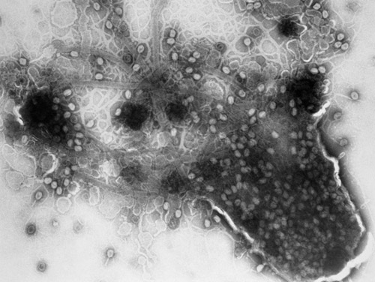
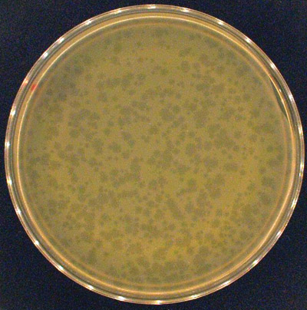
Phage Therapy
The problem of antibiotic resistance in bacteria has rejuvenated interest in using phage to fight bacterial infection
Phage target specific bacteria, leaving beneficial ones alone
Phage are inexpensive, easily grown and purified
Courtesy of Giles Scientific Inc., www.biomic.com
© Biozentrum, University of Basel/Science Photo Library/Photo Researchers, Inc.
Figure 05.16A: The lytic activity of phage.
Figure 05.16B: A lawn of E. coli with plaques.

Slide 50
Prions
=Proteinaceous Infectious particle
Subcellular/acellular
Smaller than a virus
Lacks both DNA and RNA
Cause: bovine spongiform encephalopathy (mad cow disease) in animals and variant Creutzfeldt-Jakob disease (vCJD) in humans
Once thought to be “slow viruses”
Inherited and transmissible by ingestion, transplant, and surgical instruments
Spongiform encephalopathies: Sheep scrapie, Creutzfeldt-Jakob disease, Gerstmann-Sträussler-Scheinker syndrome, fatal familial insomnia, mad cow disease
Normal cooking or sterilization procedures do not deactivate prions
No treatment for prion disease
Different prions may lie behind other neuronal diseases such as Alzheimer’s Dz, Parkinson’s Dz, and ALS.

Slide 51
Prions
Normal Prion
Misfolded Prion

Slide 52
Conversion of Normal Prion to Infectious Prion

