Slide 1
Characterizing & Classifying Eukaryotes
Chapter 12 Abbreviated
CCV
Microbiology

Slide 2
General Characteristics of Eukaryotic Organisms
Eukaryotic microorganisms
Protozoa
Fungi
Algae
Water molds
Slime molds
Include both human pathogens and organisms vital for human life

Slide 3
General Characteristics of Eukaryotic Organisms
Reproduction of Eukaryotes
More complicated than that in prokaryotes
Eukaryotic DNA is packaged as chromosomes in the nucleus
Have variety of methods of asexual reproduction
Many reproduce sexually by forming gametes and zygotes
Algae, fungi, and some protozoa reproduce both sexually and asexually

Slide 4
General Characteristics of Eukaryotic Organisms
Reproduction of Eukaryotes
Nuclear division
Nucleus has one or two complete copies of genome
Single copy (haploid)
Most fungi, many algae, some protozoa
Two copies (diploid)
Other fungi, algae, and protozoa
Two types
Mitosis
Meiosis

Slide 5
General Characteristics of Eukaryotic Organisms
Reproduction of Eukaryotes
Nuclear division
Mitosis
Cell partitions that replicate DNA equally between two nuclei
Maintains ploidy of parent nucleus
Four phases
Prophase
Metaphase
Anaphase
Telophase

Slide 6
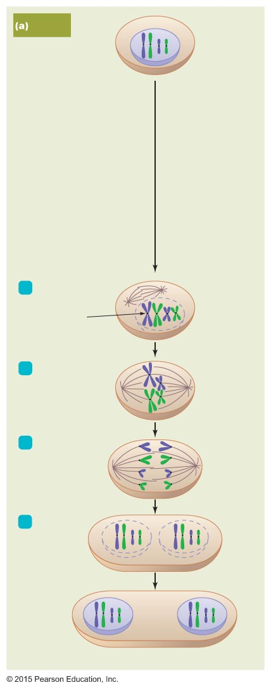
Figure 12.1a The two kinds of nuclear division: mitosis and meiosis.
Mitosis
Diploid nucleus
(2n)
DNA replication
Prophase
1
Chromosome
(two
chromatids)
Centromere
2
Metaphase
Spindle
3
Anaphase
4
Telophase
Nuclear
envelope
Two diploid nuclei (2n)

Slide 7
General Characteristics of Eukaryotic Organisms
Reproduction of Eukaryotes
Nuclear division
Meiosis
Nuclear division that partitions chromatids into four nuclei
Diploid nuclei produce haploid daughter nuclei
Two stages – meiosis I and meiosis II
Each stage has four phases
Prophase
Metaphase
Anaphase
Telophase

Slide 8
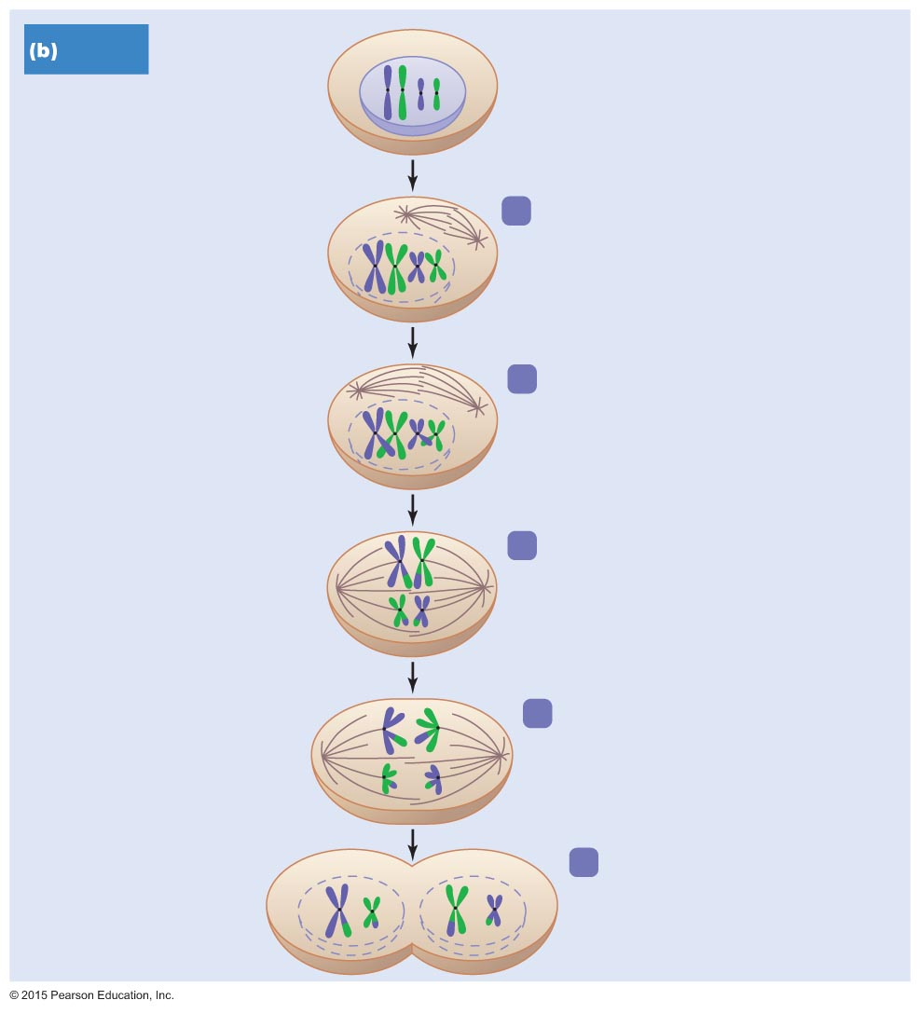
Figure 12.1b The two kinds of nuclear division: mitosis and meiosis (1 of 2).
Meiosis
Diploid nucleus
(2n)
DNA replication
Centromere
1
Prophase I
Tetrad
(two homologous
chromosomes,
four chromatids)
2
Late prophase I
Crossing over
MEIOSIS I
3
Metaphase I
Spindle
4
Anaphase I
Chromosome
(two chromatids)
5
Telophase I

Slide 9
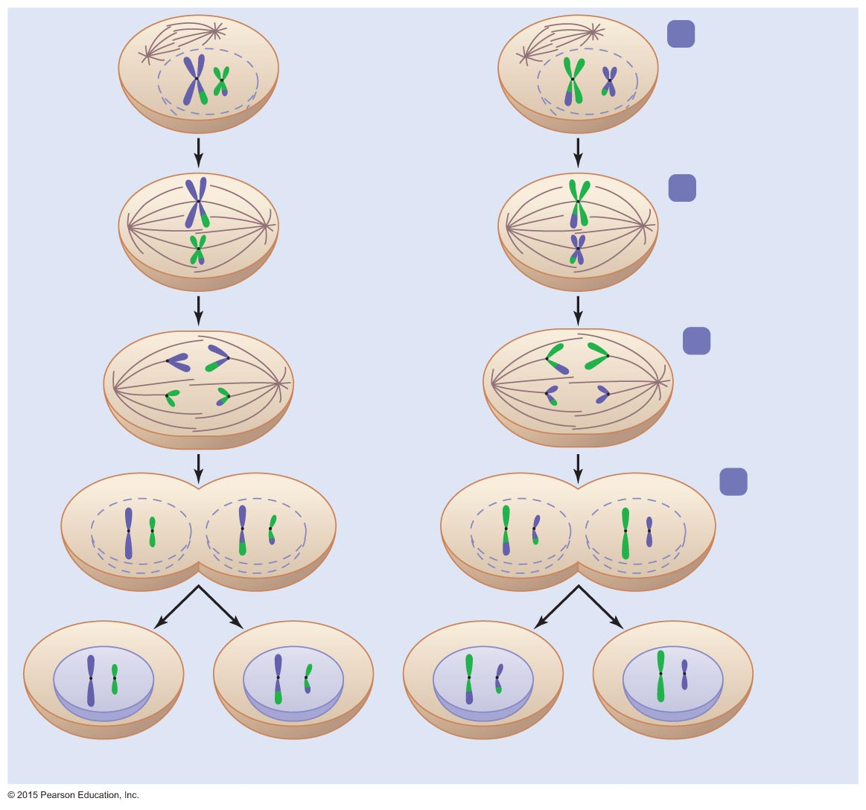
Figure 12.1b The two kinds of nuclear division: mitosis and meiosis (2 of 2).
6
Prophase II
7
Metaphase II
8
Anaphase II
MEIOSIS II
9
Telophase II
Nuclear
envelope
Four haploid nuclei (1n)

Slide 10
Notes:
10

Slide 11
Mitosis

Slide 12
Meiosis

Slide 13
General Characteristics of Eukaryotic Organisms
Reproduction of Eukaryotes
Cytokinesis (cytoplasmic division)
Typically occurs simultaneously with telophase of mitosis
In some algae and fungi, is postponed or does not occur at all
Results in multinucleated cells called coenocytes

Slide 14
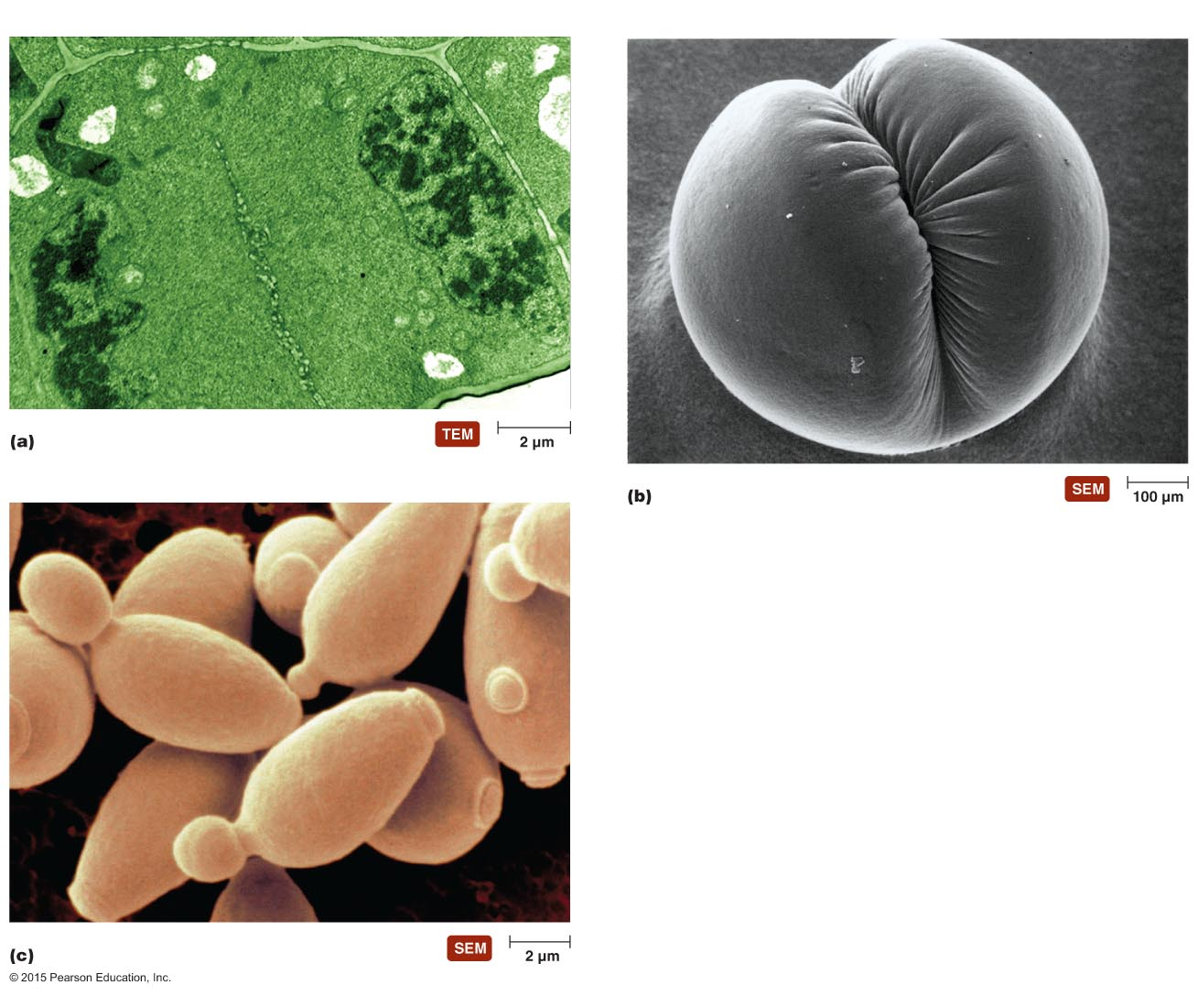
Figure 12.2 Different types of cytoplasmic division.
Wall of parent cell
Nuclei of daughter cells
Vesicles forming cell plate
Cleavage furrow
Bud

Slide 15
Schizogony—as occurs in Plasmodium
Merozoites
Nucleus
Schizont
Multiple mitoses
Cytokinesis

Slide 16
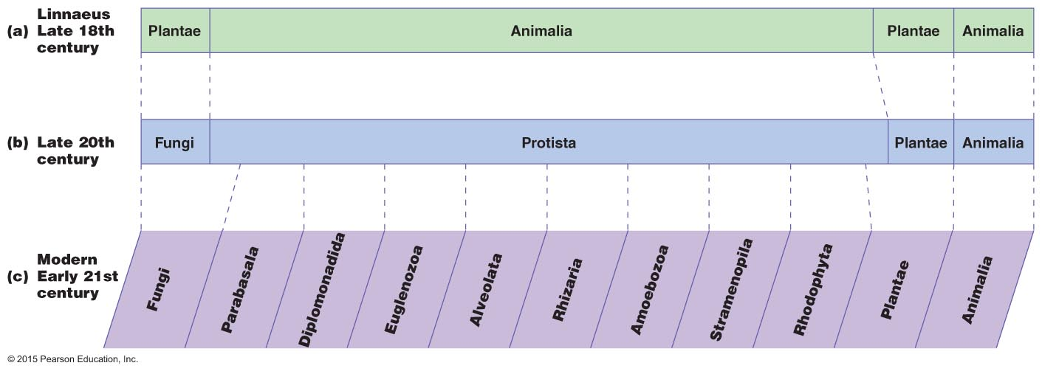
The changing classification of eukaryotes over the centuries

Slide 17
Protozoa
Defined: single-celled eukaryotes that lack a cell wall and are similar to animals in their nutritional needs & structure
Diverse group defined by three characteristics
Eukaryotic
Unicellular
Lack a cell wall
Motile by means of cilia, flagella, and/or pseudopods
Except a subgroup: apicomplexans

Slide 18
Protozoa
Distribution of Protozoa
Require moist environments
Most live in ponds, streams, lakes, and oceans
Critical members of plankton
Others live in moist soil, beach sand, and decaying organic matter
Very few are pathogens

Slide 19
Protozoa
Morphology of Protozoa
Great morphological diversity
Some have two nuclei
Macronucleus
Contains many copies of the genome
Controls metabolism, growth, & sexual reproduction
Micronucleus
Involved in genetic recombination, sexual reproduction & regeneration of macronucleus
Variety in number and kinds of mitochondria
Some have contractile vacuoles that pump water out of cells
Different stages in life cycle
Motile feeding stage called a trophozoite
Resting stage called a cyst

Slide 20
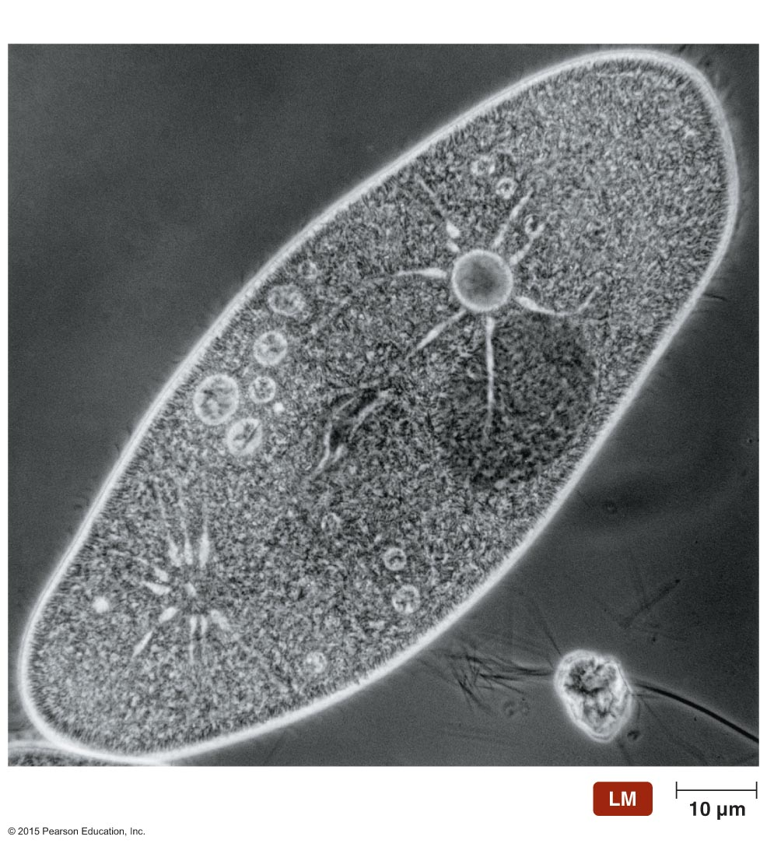
Figure 12.5 Contractile vacuoles.
Closed vacuole
Open vacuole

Slide 21
Protozoa
Nutrition of Protozoa
Most are chemoheterotrophic
Obtain nutrients by phagocytizing bacteria, decaying organic matter, other protozoa, or the tissues of host
Few absorb nutrients from surrounding water
Dinoflagellates and euglenoids are photoautotrophic

Slide 22
Protozoa
Reproduction of Protozoa
Most reproduce only asexually
Binary fission or schizogony
Few also have sexual reproduction
Some become gametocytes that fuse to form diploid zygotes
Some utilize a process called conjugation

Slide 23
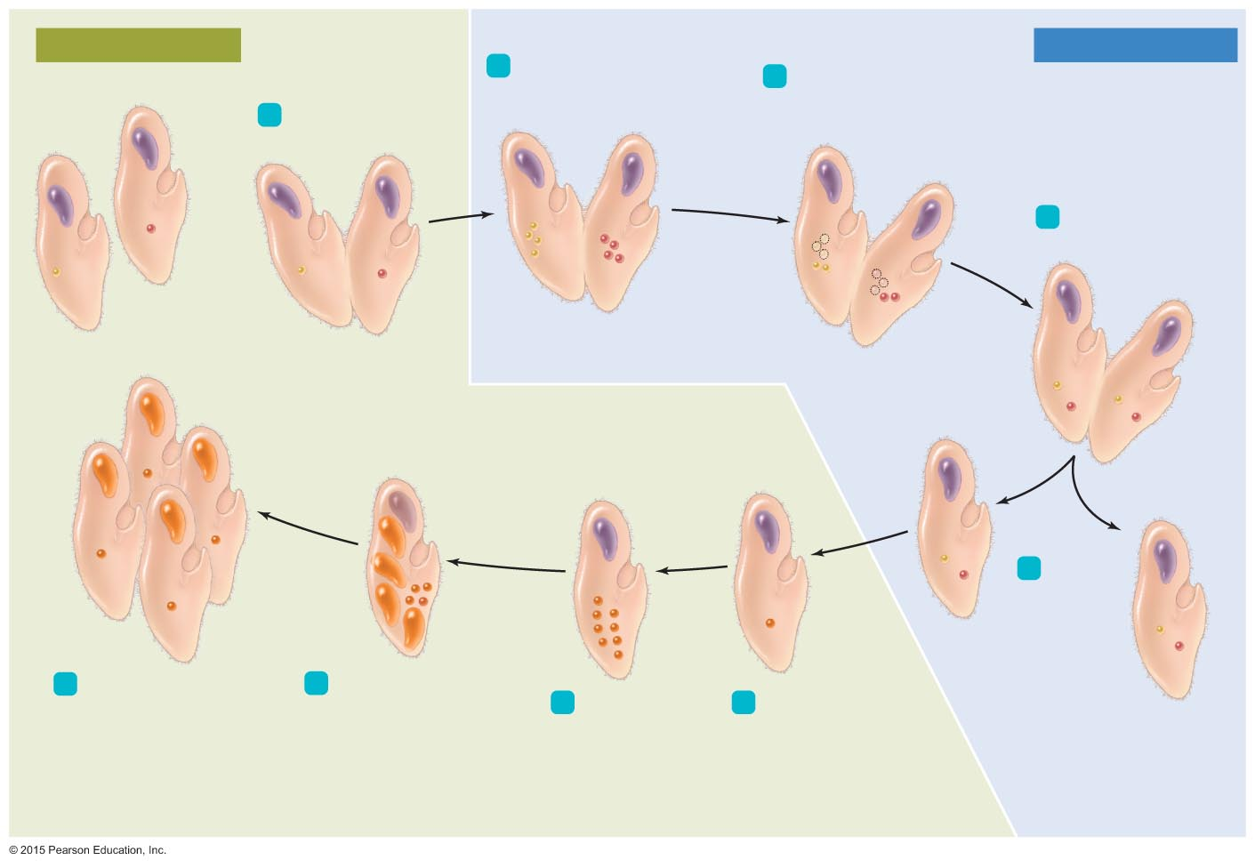
Figure 12.6 Sexual reproduction via conjugation in ciliates.
Diploid micronuclei
Haploid micronuclei
2
Meiosis of micronuclei
produces four haploid
micronuclei in each.
3
Three micronuclei in each
disintegrate; the remaining
two replicate by mitosis.
Compatible
mates
1
Mates couple.
4
Mates each swap
one micronucleus.
Haploid
micronucleus
(1n)
Macronucleus
(50n)
Diploid
micronucleus
(2n)
5
Partners
separate.
9
8
Original macronucleus
disintegrates. Four
micronuclei become
macronuclei by replicating
chromosomes numerous
times; four micronuclei
remain micronuclei.
Three cytokineses
partition a macronucleus
and a micronucleus into
each of four daughter cells.
7
Three mitoses
without
cytokinesis
produce eight
micronuclei.
6
The two different
micronuclei fuse
to form diploid
micronucleus.

Slide 24
Protozoa
Classification of Protozoa
Classification of protozoa has shifted over the years
Revised and updated based on 18S rRNA sequences (on small 40S ribosomal subunit)
One current scheme groups protozoa into six groups
Parabasala
Diplomonadida
Euglenozoa
Alveolates
Rhizaria
Amoebozoa

Slide 25
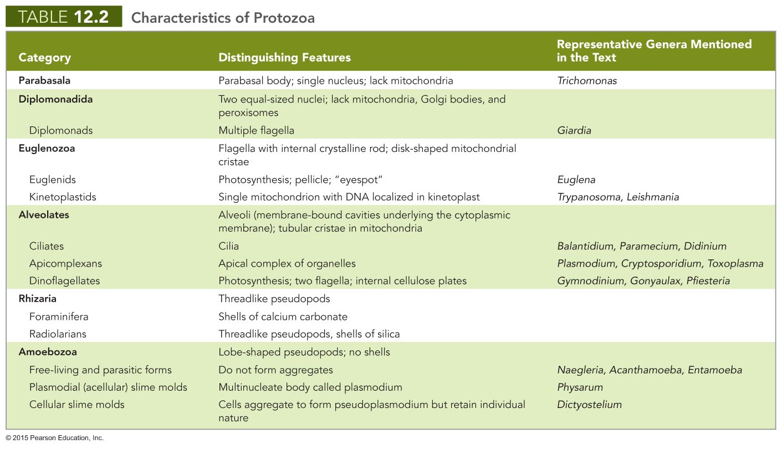
Notes:
25

Slide 26
Fungi
Chemoheterotrophic
Have cell walls typically composed of chitin
Do not perform photosynthesis
Lack chlorophyll
Related to animals

Slide 27
Fungi
The Significance of Fungi
Decompose dead organisms and recycle their nutrients
Help plants absorb water and minerals
Used for food, in religious ceremonies, and in manufacture of foods and beverages
Produce antibiotics and other drugs
Serve as important research tools
30% cause diseases of plants, animals, and humans
Can spoil fruit, pickles, jams, and jellies

Slide 28
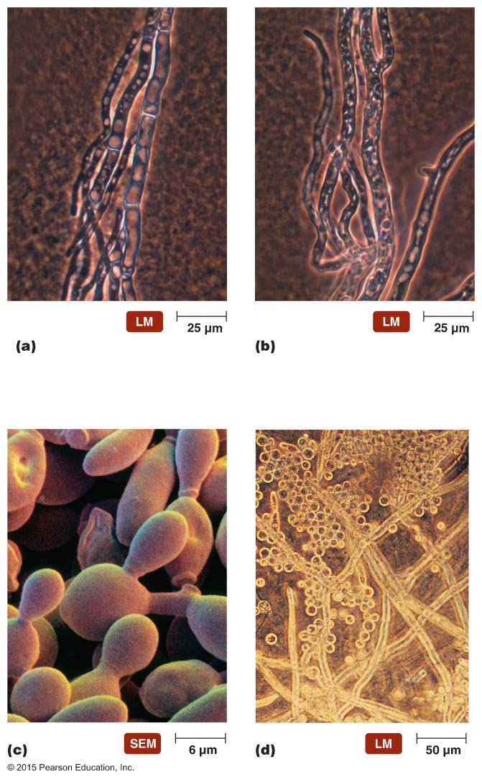
Figure 12.15 Fungal morphology.
Septate hypha
Aseptate hypha
Yeastlike
form
Moldlike
(filamentous)
form
Bud

Slide 29
Fungi
Nutrition of Fungi
Acquire nutrients by absorption
Most are saprobes
Some trap and kill microscopic soil-dwelling nematodes
Haustoria allow some fungi to derive nutrients from living plants and animals
Most fungi are aerobic
Many yeasts are facultative anaerobes

Slide 30
Fungi
Reproduction of Fungi
All have some means of asexual reproduction involving mitosis and cytokinesis
Most also reproduce sexually

Slide 31
Fungi
Reproduction of Fungi
Budding and asexual spore formation
Yeasts bud in manner similar to prokaryotic budding
Some yeasts produce long filament called a pseudohypha
Filamentous fungi produce lightweight spores that disperse over large distances
Sexual spore formation
Fungal mating types designated as "+" and "–"
Four basic steps

Slide 32
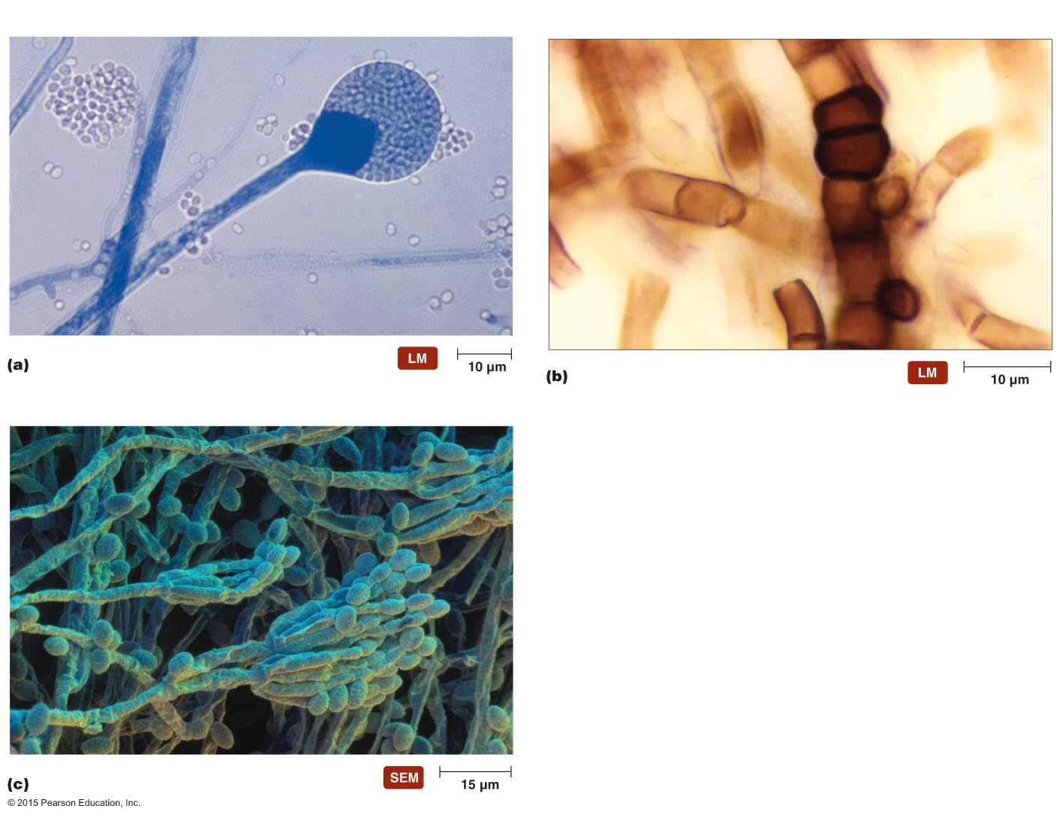
Figure 12.18 Representative asexual spores of molds.
Sporangiophore
Sporangium
Sporangiospore
Chlamydospore
Conidiophore
Conidia

Slide 33
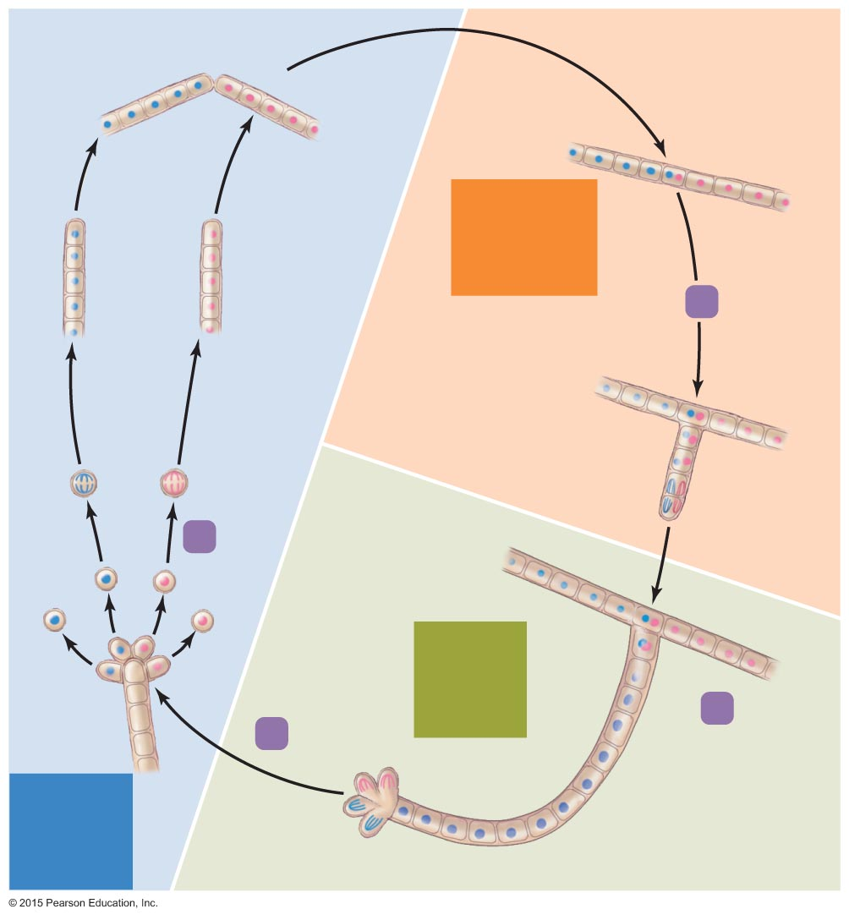
Figure 12.19 The process of sexual reproduction in fungi.
Tips fuse
+
–
Dikaryotic
stage
(n+n)
+
–
1
Dikaryon
Mitoses
and cell
divisions
Two nuclei
per cell
+
–
4
+
–
+
–
+
–
Diploid
stage
(2n)
+
–
2
Nuclei
fuse
3
Meiosis
Haploid
stage
(n)

Slide 34
Fungi
Classification of Fungi
Division Zygomycota
Division Ascomycota
Division Basidiomycota
Deuteromycetes

Slide 35
Fungi
Lichens
Partnerships between fungi and photosynthetic microbes
Fungus provides nutrients, water, and protection
Photosynthetic microbe provides carbohydrates and oxygen
Abundant throughout the world
Grow in almost every habitat
Occur in three basic shapes
Foliose, crustose, fruticose
Create soil from weathered rocks
Some lichens provide nitrogen in nutrient-poor environments
Eaten by many animals

Slide 36
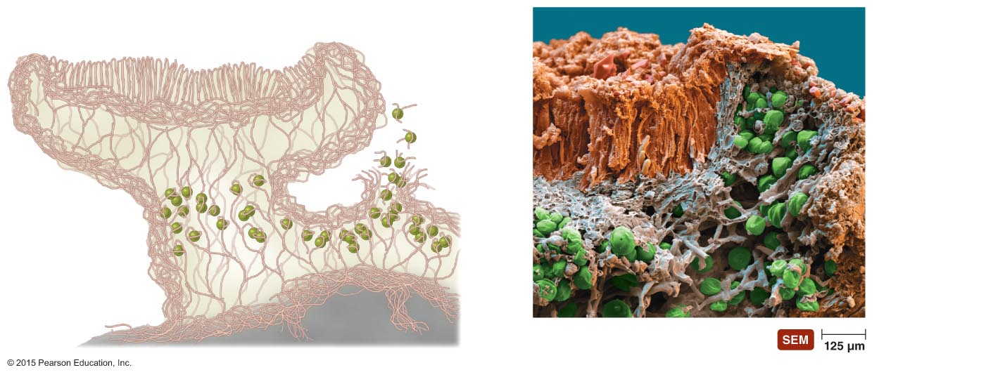
Figure 12.25 Makeup of a lichen.
Ascocarp of fungus
Soredium
Algal cell
Fungal hyphae
Phototrophic layer
Fungal hyphae
Substrate

Slide 37
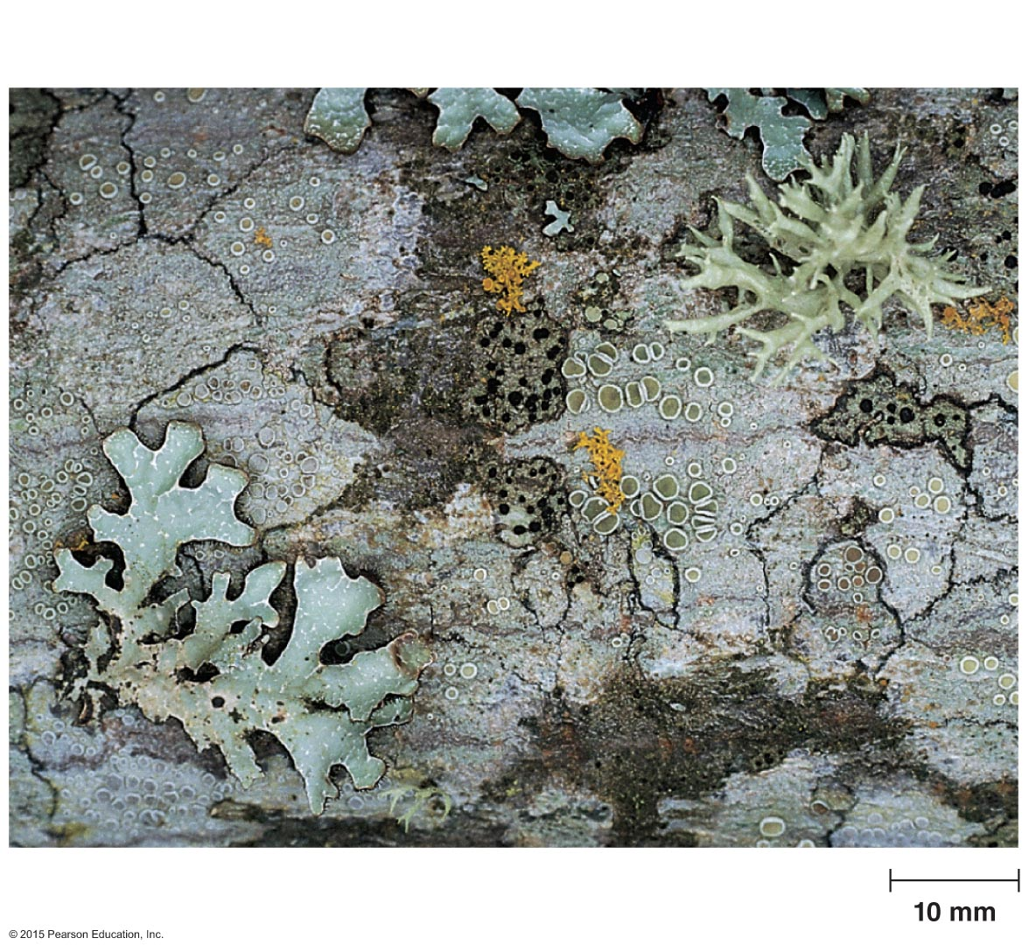
Figure 12.26 Gross morphology of lichens.
Foliose
Crustose
Fruticose

Slide 38
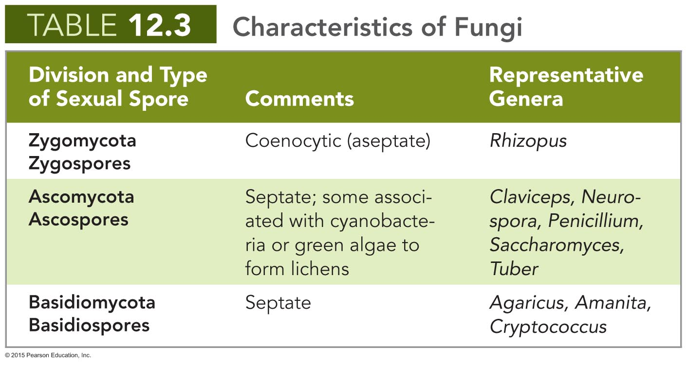
Notes:
38

Slide 39
Algae
Simple, eukaryotic phototrophs
Carry out oxygenic photosynthesis using chlorophyll a
Have sexual reproductive structures in which every cell becomes a gamete
Differ widely in distribution, morphology, reproduction, and biochemical traits

Slide 40
Algae
Distribution of Algae
Most are aquatic
Live in the photic zone of freshwater, brackish water, and saltwater
Have accessory photosynthetic pigments that trap energy of short-wavelength light
Allows algae to inhabit deep parts of the photic zone

Slide 41
Algae
Morphology of Algae
Can have different morphologies
Unicellular
Colonial
Simple multicellular bodies called thalli

Slide 42
Algae
Reproduction of Algae
Reproduction in unicellular algae
Asexual reproduction involves mitosis followed by cytokinesis
In sexual reproduction, individual gametes form zygotes that undergo meiosis
Reproduction in multicellular algae
Reproduce asexually by fragmentation
Reproduce sexually with alternation of generations

Slide 43
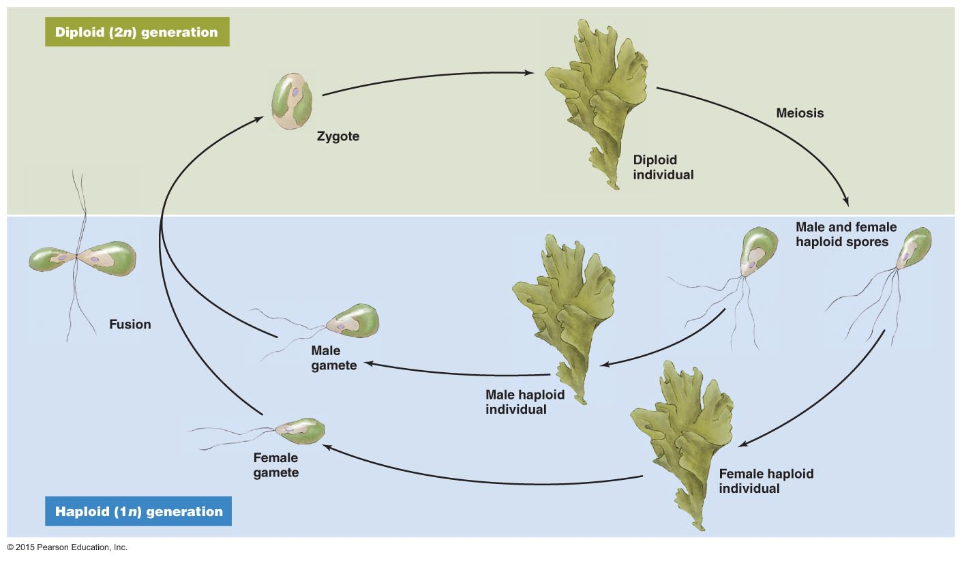
Figure 12.27 Alternation of generations in algae, as occurs in the green alga Ulva.

Slide 44
Algae
Classification of Algae
Classification is not settled
Classification schemes are based on different features
Differences in photosynthetic pigments
Storage products
Cell wall composition
Various groups
Division Chlorophyta
Kingdom Rhodophyta
Phaeophyta
Chrysophyta

Slide 45
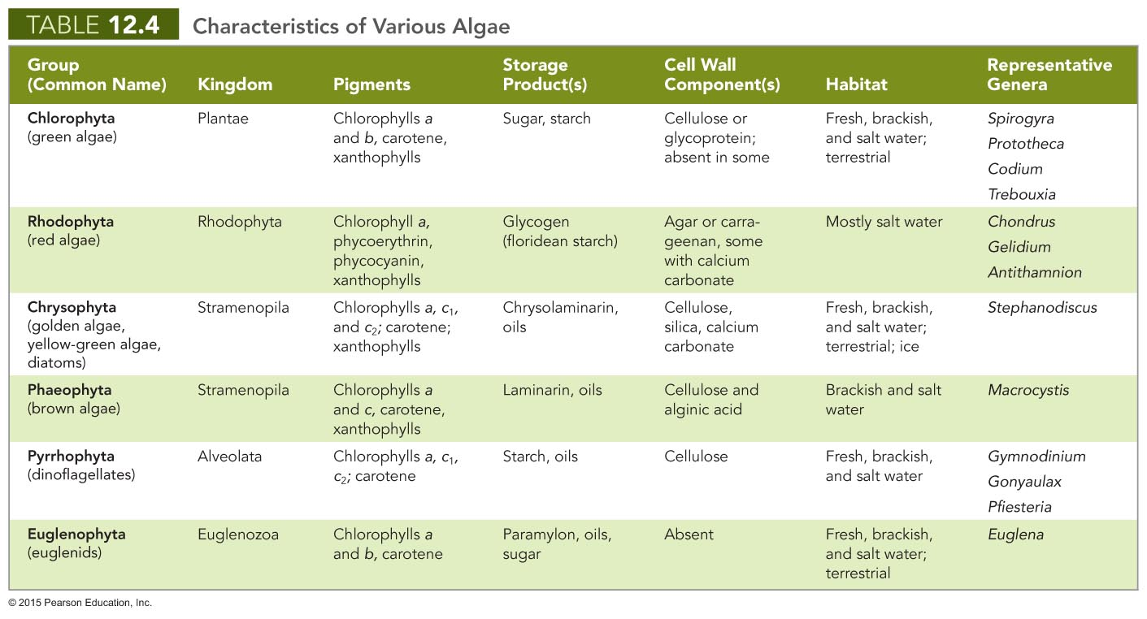
Notes:
45

Slide 46
Water Molds
Differ from fungi in several ways
Have tubular cristae in their mitochondria
Cell walls are of cellulose instead of chitin
Spores have two flagella
Have true diploid bodies
Decompose dead animals and return nutrients to the environment
Some species are pathogens of crops
Phytophthora infestans caused the Irish potato famine

Slide 47
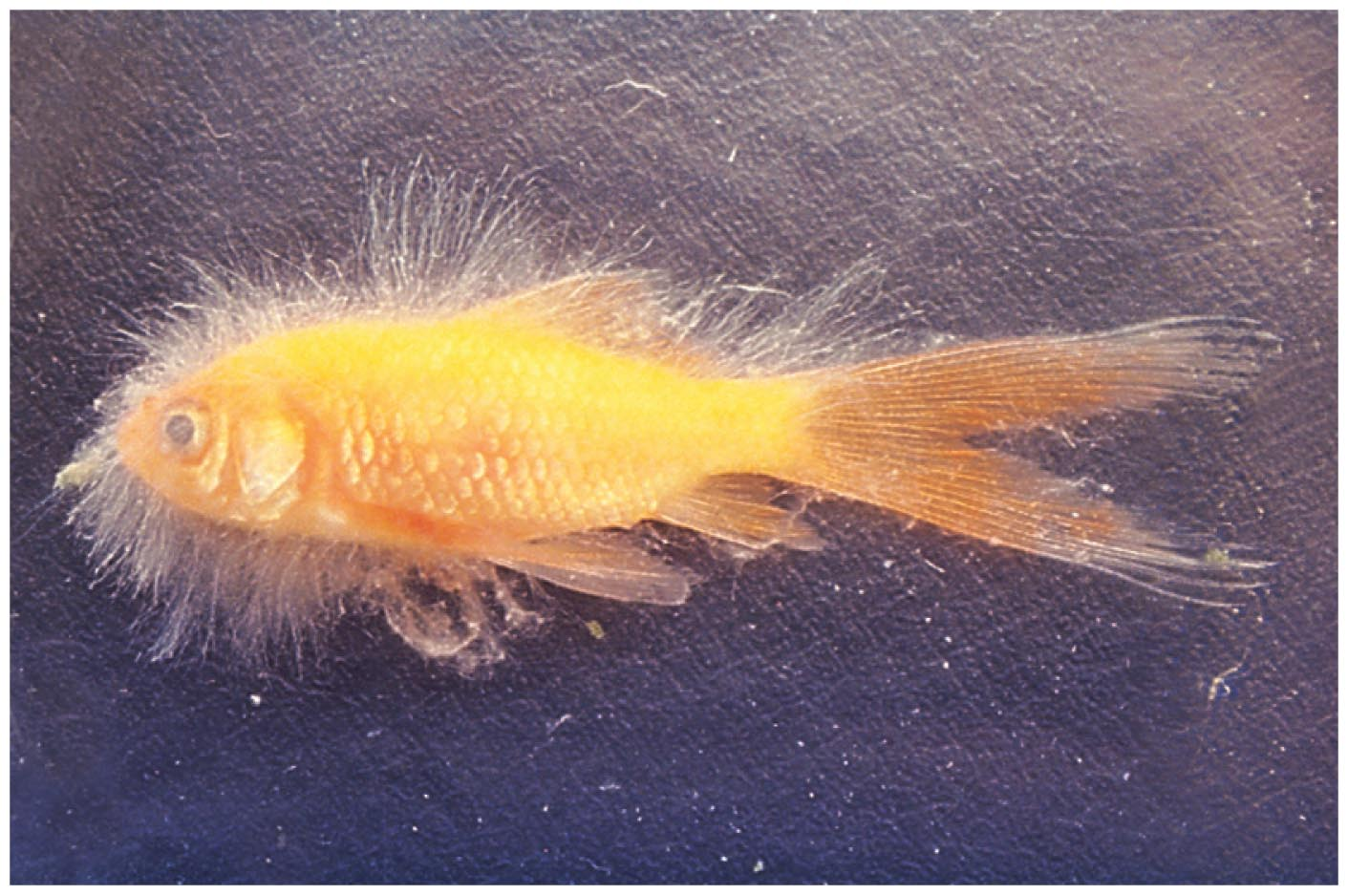
Figure 12.32 An example of the important role of water molds in recycling organic nutrients in aquatic habitats.

Slide 48
Other Eukaryotes of Microbiological Interest: Parasitic Helminths and Vectors
Parasitic worms have microscopic infective and diagnostic stages
Arthropod vectors are animals that carry pathogens
Mechanical vectors
Biological vectors
Disease vectors belong to two classes of arthropod
Arachnida
Insecta

Slide 49
Other Eukaryotes of Microbiological Interest: Parasitic Helminths and Vectors
Arachnids
Adult arachnids have four pairs of legs
Ticks are the most important arachnid vectors
Hard ticks are most prominent tick vectors
A few mite species transmit rickettsial diseases

Slide 50
Other Eukaryotes of Microbiological Interest: Parasitic Helminths and Vectors
Insects
Adult insects have three pairs of legs and three body regions
Include
Fleas
Lice
Flies
Mosquitoes
Most important arthropod vectors of disease
Kissing bugs

Slide 51
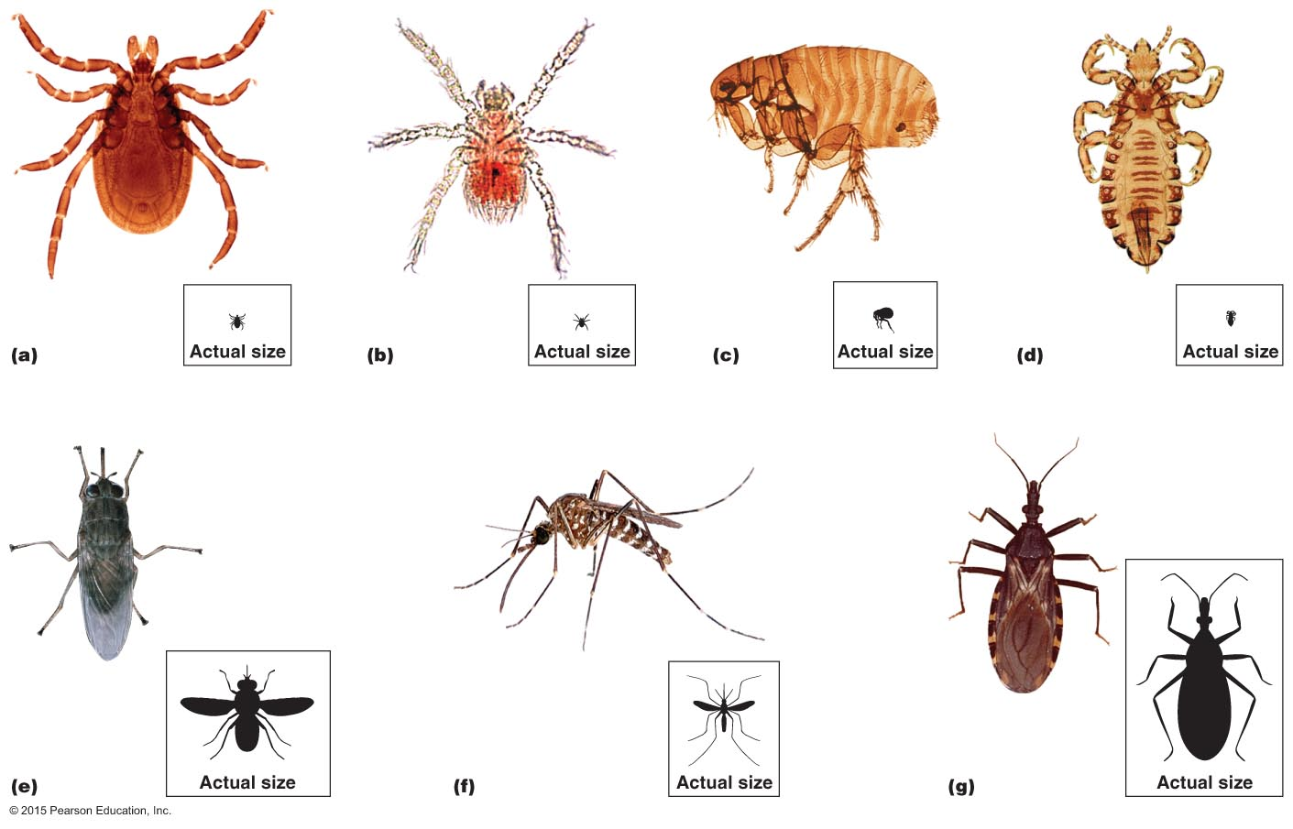
Figure 12.33 Representative arthropod vectors.

