Slide 1
Infection, Infectious Disease, & Epidemiology
Dr. Melanie Meyer
Microbiology
CCV

Slide 2
Biological Associations
Symbiosis or “living together,” is an association between two or more species
1) Mutualism— a condition in which both species benefit (E. coli in colon—Vitamin K synthesis!)
2) Commensalism—one species beneﬁts but the other neither beneﬁts nor is harmed (most normal flora)
3) Parasitism—an association in which the parasite lives at the expense of the other species, the host (all microbial pathogens)

Slide 3
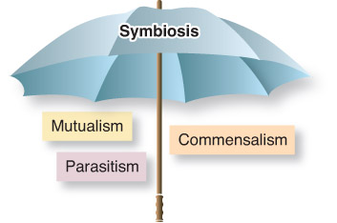
Figure 07.01: The symbiosis umbrella.

Slide 4
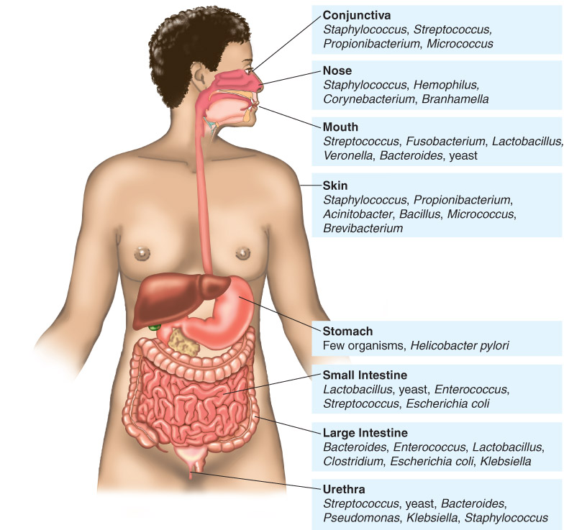
The human normal flora is composed mainly of commensal bacteria
Figure 07.04: The normal flora: mostly commensal organisms.

Slide 5
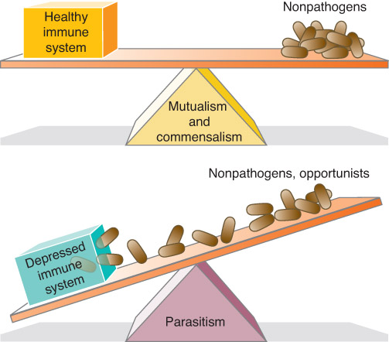
There is a see-saw relationship between mutualism, commensalism, and parasitism
Figure 07.05: The slippery see-saw of symbiosis—from mutualism to parasitism.

Slide 6
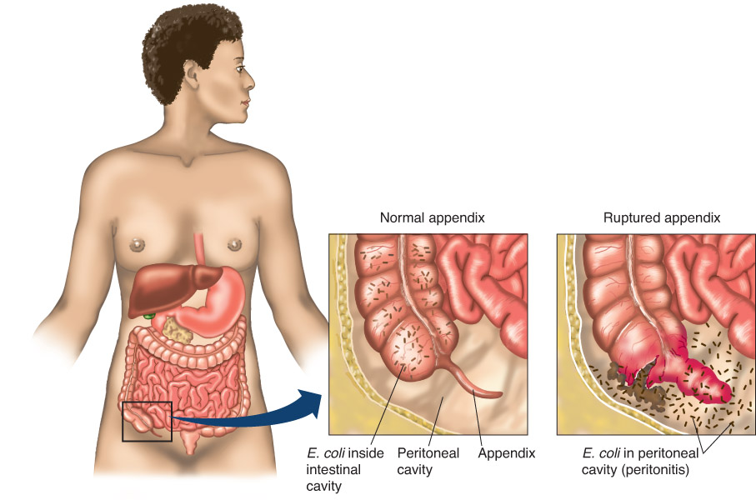
The normal flora can be opportunistic pathogens.
Figure 07.06: Peritonitis: microbes in the “wrong” place.

Slide 7
Parasitism: A Way of Life
Parasites are the cause of infectious disease
live at the expense of the host
cause damage or death to the host
Parasitism results in a constant negotiation between the parasite and the host, as each evolves in response to the other
Encompasses all microbes, including viruses, and worms that produce disease in the host

Slide 8
Koch’s Postulates
Association: The causative agent must be present in every case of a specific disease.
Isolation: The causative agent must be isolated in every case of the disease and grown in pure culture.
Causation: The causative agent in the pure culture must cause the disease when inoculated into a healthy and susceptible laboratory animal.
Re-isolation: The causative agent must be re-isolated from the laboratory animal and be identical to the original causative agent.

Slide 9
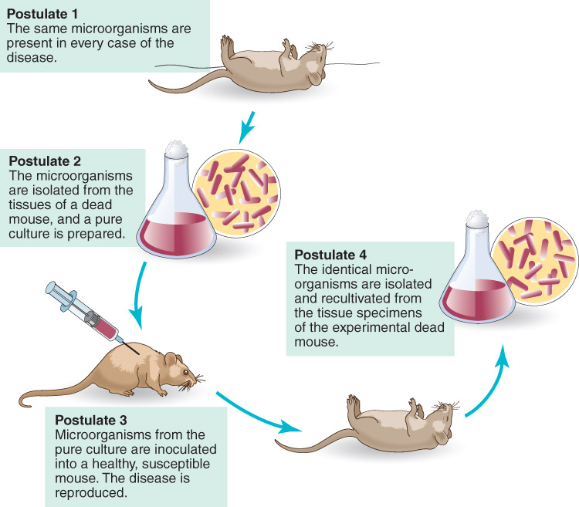
Koch’s postulates: association, isolation, causation, and reisolation, are still used to establish the cause of infection.

Slide 10
Microbial Mechanisms of Disease
The chance of acquiring an infection depends upon three major factors:
(n) dose, the number of microbes encountered
(V) virulence, virulence factors
(R) resistance, host immunity
Severity of infection = D = nV/R

Slide 11
Exceptions to Koch’s Postulates
Some pathogens cannot be cultured in the lab
Some diseases are caused by a combo of pathogens or by a combination of pathogens and physical, environmental or genetic cofactors.
Ethical violations prevent application of Koch’s postulates in humans in many cases.
Some diseases can be caused by more than one pathogen (ie meningitis, hepatitis, pneumonia)
Some pathogens have been historically overlooked (ie H. pylori)

Slide 12
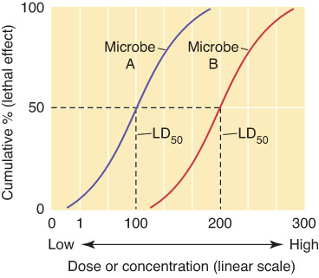
Pathogenicity and Virulence
Infective dose (ID), minimal number of microbes necessary for infection
More virulent organisms have smaller IDs than less virulent organisms
Vibrio cholerae (causes cholera) ID = one million
Mycobacterium tuberculosis (causes TB) ID = 10
LD₅₀ is the number
of microbes necessary
to kill 50% of the animals
infected

Slide 13
Pathogenicity and Virulence
Pathogenicity is the ability to cause disease
Virulence is a measure of pathogenicity, it encompasses two types of virulence factors:
Defensive strategies that allow microbes to escape destruction by the host immune system
2) Offensive strategies that result in damage to the host

Slide 14
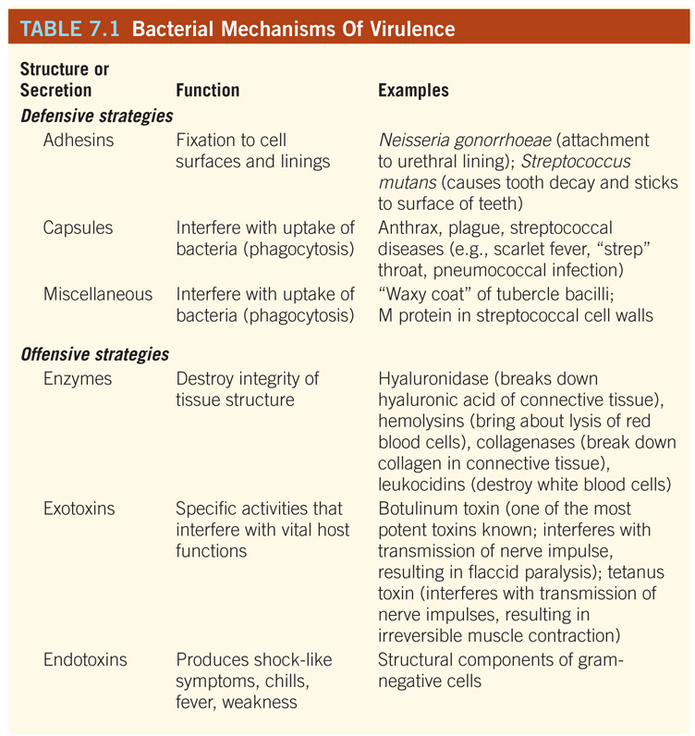

Slide 15
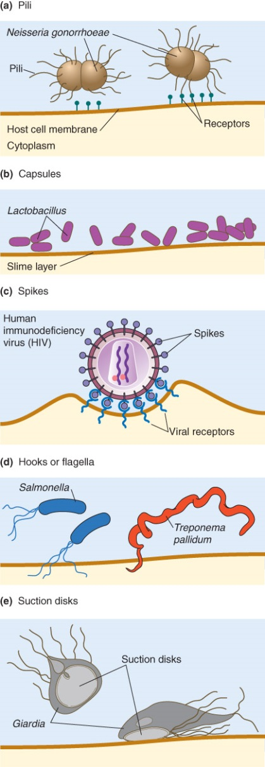
Adhesion Factors

Slide 16
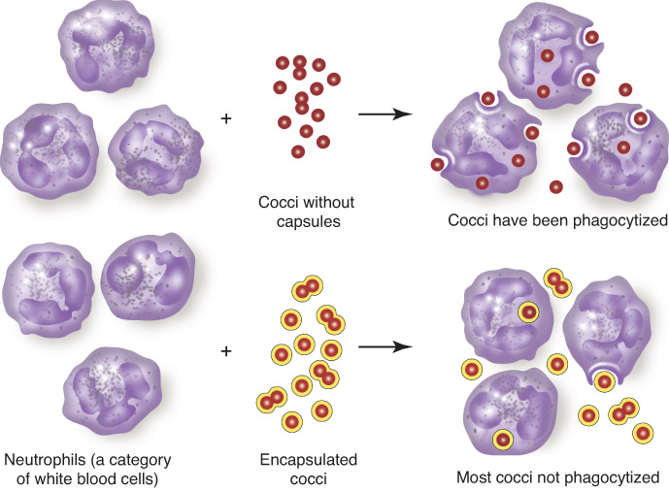
Defensive Strategy—Capsules Evasion of phagocytosis by host immune cells

Slide 17
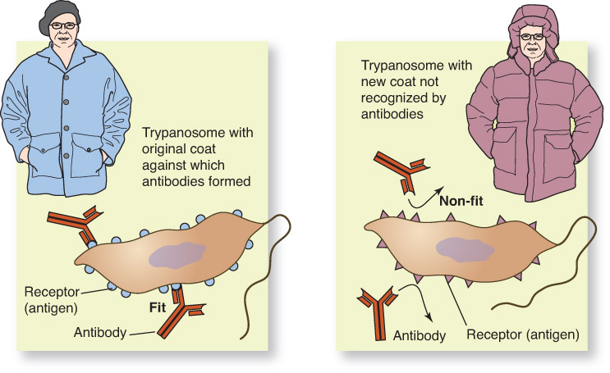
Defensive Strategy—antigenic variation change in surface antigens to evade host antibodies.

Slide 18
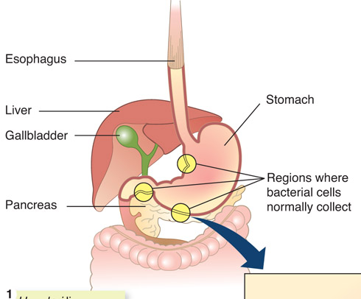
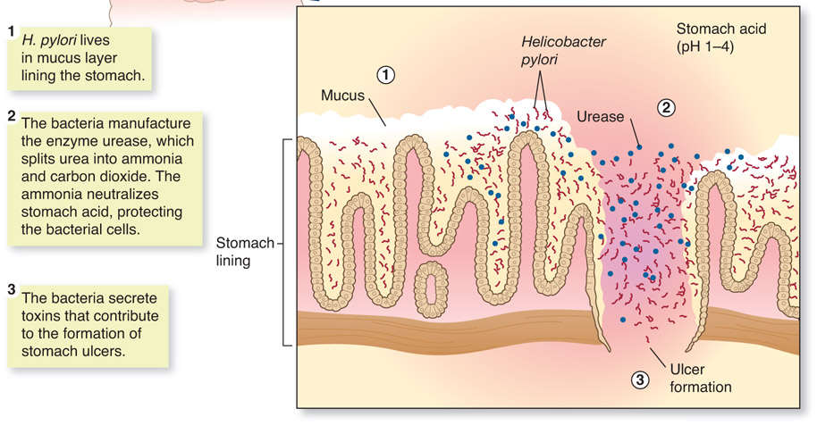
Defensive Strategy—Enzyme secretion Helicobacter pylori, the bacterium that causes peptic ulcers, secretes the enzyme urease, which enables it to survive in the highly acidic environment of the stomach

Slide 19
Offensive Strategys: Exoenzymes
Enzymes are proteins with activities that allow the invading bacteria to spread throughout host tissues, causing damage in the process.
These enzymes are useful to the pathogen in breaking down tissue barriers in the host
Examples:
Hyaluronidase breaks down hyaluronic acid content of connective tissues
Collagenase breaks down collagen which can result in necrotic (dead) tissue that requires debridement
Hemolysins destroy red blood cells
Kinases break down clots
Leukocidins destroy white blood cells

Slide 20
Offensive Strategy: Exotoxins
Exotoxins = proteins synthesized by the microbe and released into host tissue.
Associated primarily with gram + organisms
Toxigenicity = ability to produce toxins
3 Principal Types:
1) Cytotoxins—kill or damage cells
2) Neurotoxins—block nerve impulse transmission
3) Enterotoxins— affect cells lining gastrointestinal tract
Toxoids = detoxiﬁed toxins, retain antigenicity; used in immunizations against diseases that are primarily the result of exotoxin activity

Slide 21
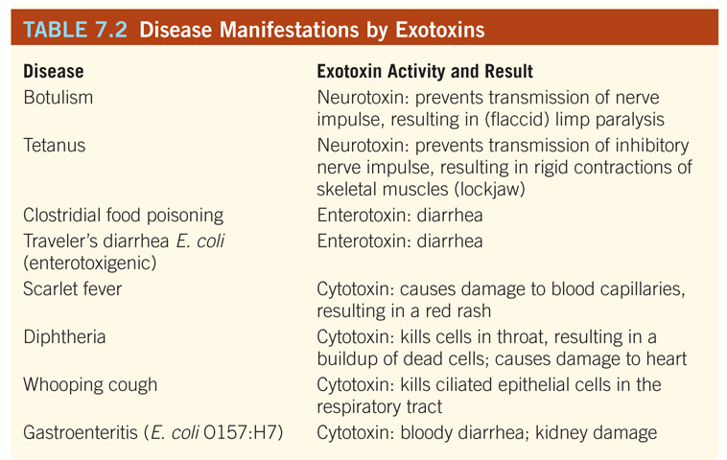
Table 07.02: Diseases Manifested by Exotoxins.

Slide 22
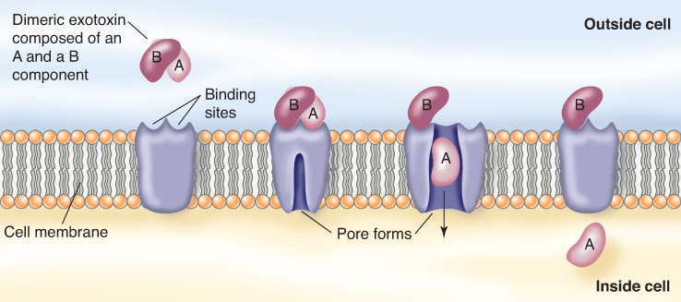
Many exotoxins have two subunits, the A (active subunit) and the B (binding subunit)
The AB model of exotoxin activity

Slide 23
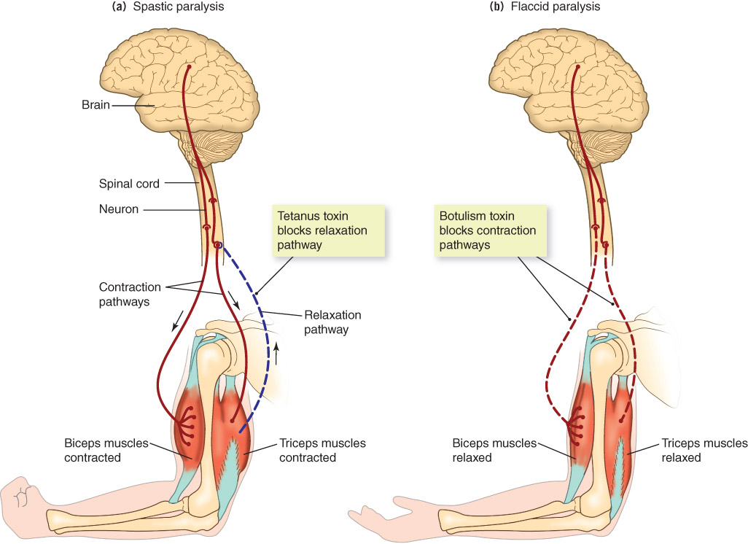
Botulinum toxin causes a flaccid muscle paralysis, while tetanus toxin works in the reverse.
Activity of botulinum and tetanus toxins

Slide 24
Offensive Strategy: Phage Conversion Confers Ability to produce toxins for some organisms
When bacteria become infected by bacteriophages, phage DNA may become incorporated into bacterial chromosome in a dormant state (prophage—lysogenization)
With replication, new daughter cells have new properties, including toxin production
Ex: Corynebacterium diptheriae with tox gene

Slide 25
Offensive Strategy: Endotoxins
Gram-negative bacteria have an outer membrane composed mainly of lipopolysaccharide (LPS)
Endotoxin (aka lipid A) is the lipid portion of the menbrane’s LPS.
Many endotoxins stimulate the body to release chemicals that cause fever, inflammation, diarrhea, hemorrhaging, shock, and blood coagulation.
Although exotoxin producing bacteria can produce more serious disease states, endotoxin-producing (gram-negatives) can produce life-threatening
Endotoxin can be released when gram-negative bacteria:
Dividing
Disintegrating or dying naturally
Being digested by phagocytic cells

Slide 26
Host response to endotoxins
Regardless of their source, endotoxins produce the same host response characterized by:
Shock-like symptoms
Chills
Fever
Weakness
Formation of small blood clots
Possible death
*Individuals with gram-negative infections may experience exaggerated symptoms during antibiotic treatment because of the release of endotoxins from dead cells.

Slide 27
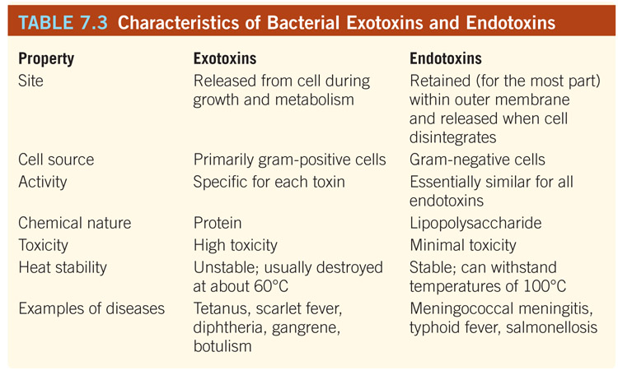
Table 07.03: Characteristics of Bacterial Exotoxins and Endotoxins.

Slide 28
Virulence Mechanisms of Non-bacterial Pathogens
Viruses
Defensive: antigenic variation (influenza), etc.
Offensive: death (lysis) of host cell from
Production of large numbers of replicating viruses
Inhibiting host protein synthesis
Damage to plasma membrane
Inhibiting host cell metabolism
Eukaryotic Microbes (including helminths)
Combination of offensive and defensive strategies described for bacteria (adhesins, toxins, antigenic variation, etc.)

Slide 29
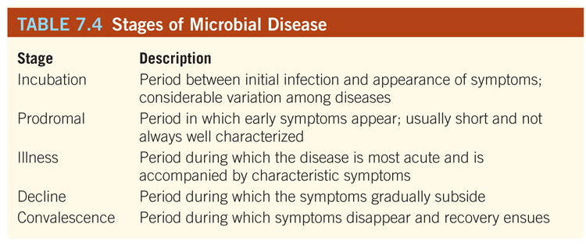
Table 07.04: Stages of Microbial Disease.

Slide 30
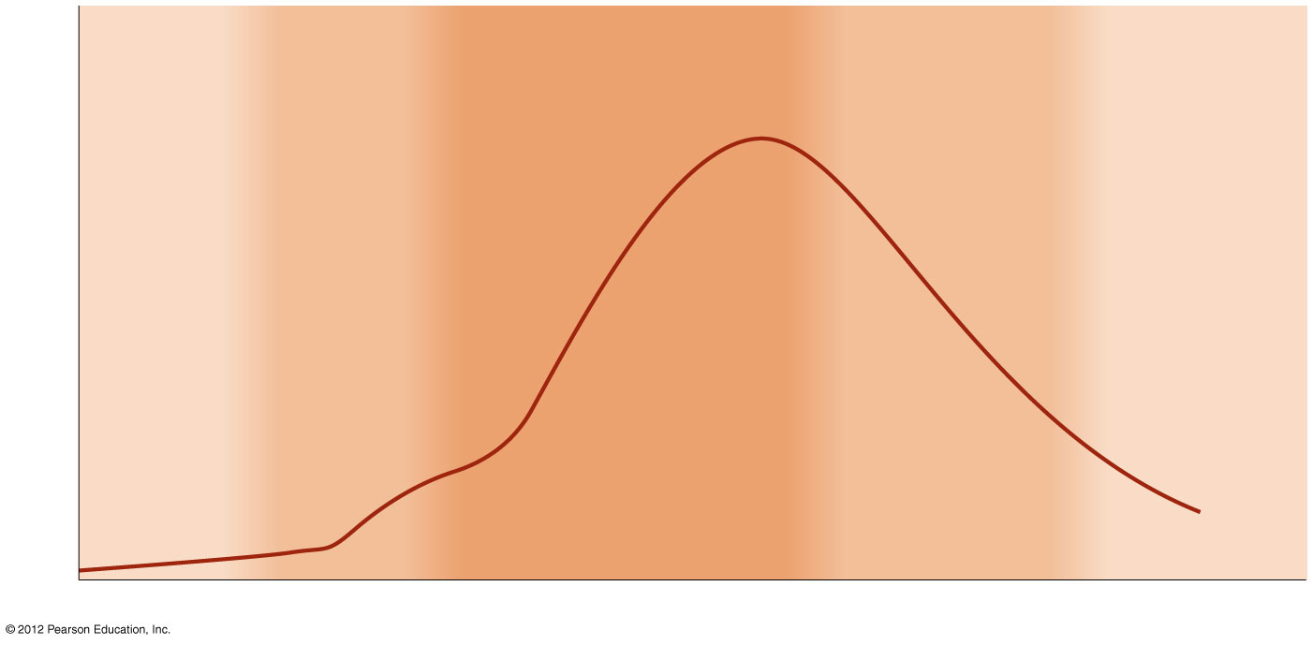
The Stages of Infectious Disease
Incubation period (no signs or symptoms)
Prodromal period (vague, general symptoms)
Illness (most severe signs and symptoms)
Decline (declining signs and symptoms)
Convalescence (no signs or symptoms)
Number of microorganisms or intensity of signs or symptoms
Time

Slide 31
Epidemiology and Cycle of Microbial Disease
Epidemiology = an investigative branch of medicine that deals with the source, cause, and possible control of infectious disease and other public health problems
Epidemiologists attempt to determine why an outbreak of disease occurs at a particular time and/or particular place
Dispatched by the CDC when the threat of an outbreak occurs anywhere in the world

Slide 32
Epidemiology has a long and interesting history
Hippocrates (460–377 B.C.) linked malaria, yellow fever, and swamps
Edward Jenner’s late 1700s observations regarding cowpox led to smallpox vaccine
Ignaz Semmelweis (mid 1800s) proved that childbed fever resulted from physicians not washing their hands after dissections (remember how sad the outcome was for Semmelweis!)
John Snow’s 1849 detective work in London showed that most with cholera got water from the Broad Street pump, thus ending the epidemic

Slide 33
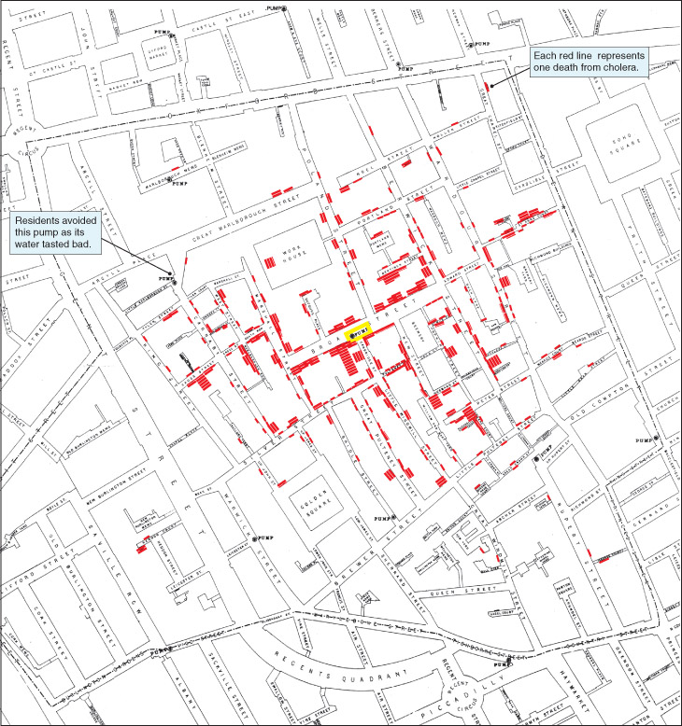
Figure 08.01A: portion of the map created by Dr. John Snow of the Broad Street area.
Courtesy of Frerichs, R. R. John Snow website: http://www.ph.ucla.edu/epi/snow.html, 2006

Slide 34
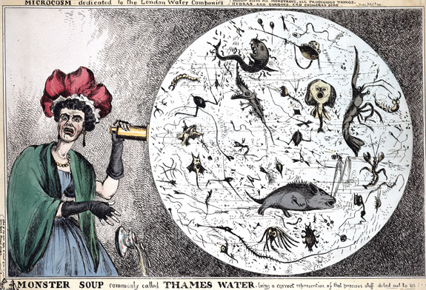
1849 Cholera Outbreak, London
Figure 08.02: “Monster Soup,” commonly called the Thames water.
Figure 08.01B: The John Snow Pub and the famous “ghost” replica of the Broadstreet Pump.
© Wellcome Library, London
© Wellcome Library, London

Slide 35
Terms for classification of diseases
Sporadic—occur only occasionally and in an unpredictable fashion (tetanus, etc.)
Endemic—regularly found at a steady level in a particular location (common cold, etc.)
Epidemic—sudden increase in morbidity (illness rate) and mortality (death rate) above the norm (plague, etc.)
Pandemic—epidemics that spread across continents (1918 influenza, HIV/AIDS)

Slide 36
Tracking Disease--terminology
Two measures to track occurrence of disease by epidemiologists:
Incidence = the number of new cases of a disease in a given area or population during a given period of time
Prevalence = total number of cases, both new and already existing, in a given area or population during a given period of time (a cumulative number)

Slide 37
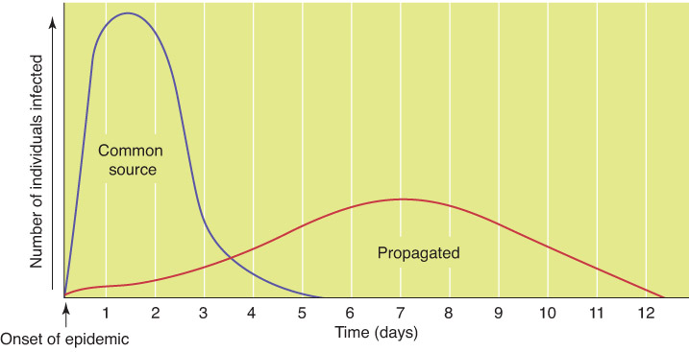
2 Epidemic Types:
1) Common-source epidemics involve contact with a single contamination source (contaminated water)
2) Propagated epidemics result from person-to-person contact (mumps and chicken pox)
Figure 08.03: A comparison of the courses of common-source and propagated epidemics.

Slide 38
Herd Immunity (Group Immunity)
Refers to the proportion of immunized individuals in a population
The smaller the number of susceptible individuals, the less opportunity for contact between them and infected individuals.
Public health officials strive to maintain high levels of herd immunity
Basis for mass vaccination/immunization programs

Slide 39
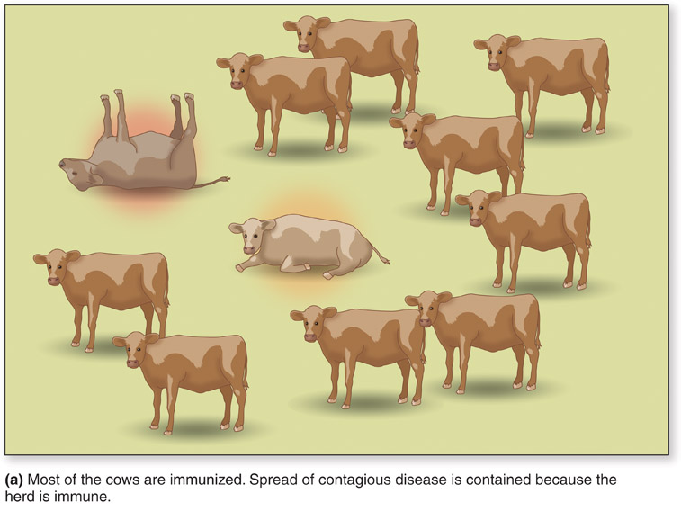
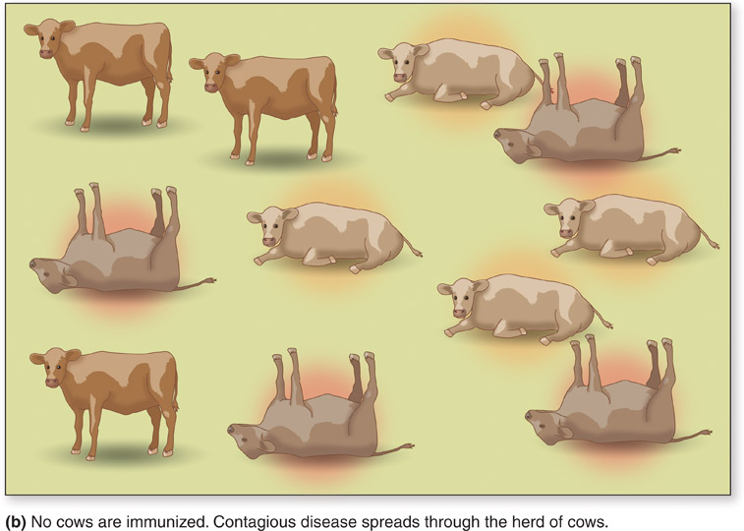
Herd Immunity
Figure 08.04: (a) Cows immunized and herd is protected. (b) Cows not immunized become infected and sick (lack of herd immunity).

Slide 40
Reproduction rate (R₀ or R-nought)
Measure of the potential for transmission of a particular disease
Mathematical equation
Mean number of secondary cases, occurring in a susceptible population in the wake of a particular infection.
Population density, duration of contagiousness, other factors considered
R₀ must be greater than 1 to spread; if less, it will die out.

Slide 41
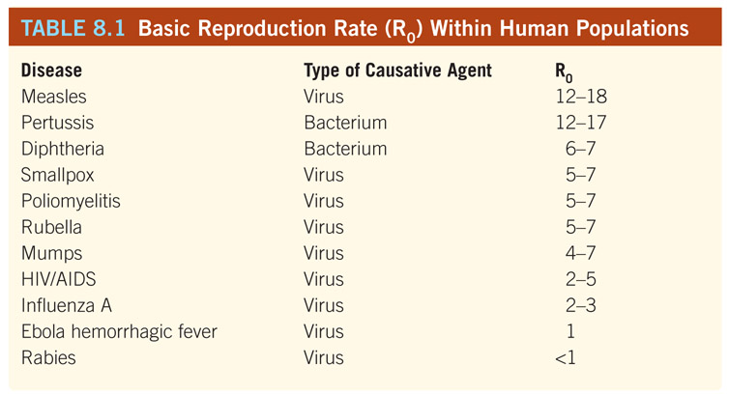
Table 08.01: Basic Reproduction Rate (R0) Within Human Populations.

Slide 42
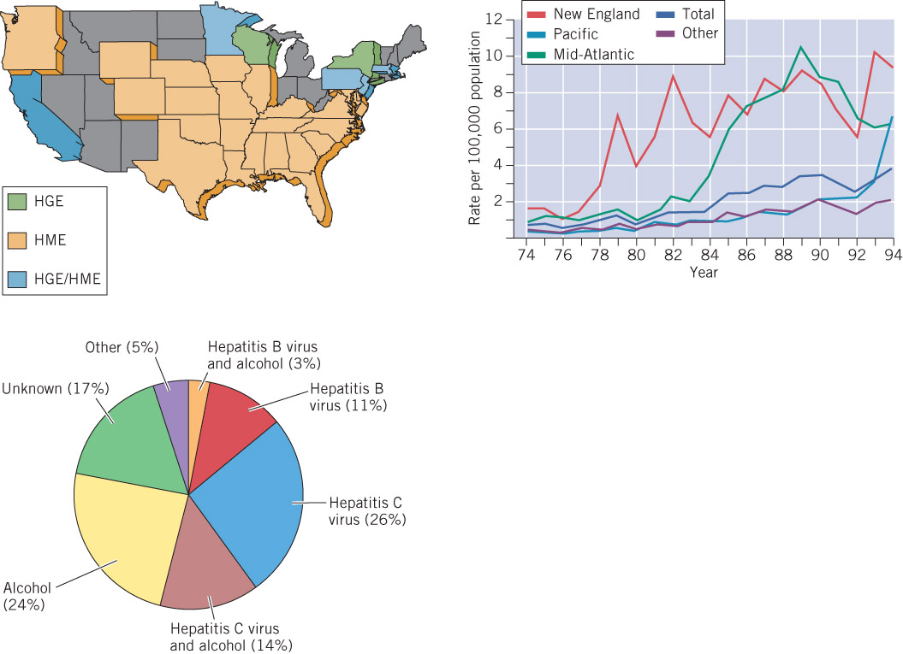
Graphs, charts, and maps are used by epidemiologists to illustrate the frequency and distribution of diseases
Figure 08.05: Graphs, charts, and maps used by epidemiologists to illustrate disease frequency and distribution. (Adapted from the CDC)
Adapted from CDC

Slide 43
Tracking Disease Incidence & Prevalence
Frequency and distribution of disease includes monitoring of the following re: a disease-afflicted population:
Age
Gender
Diet
Lifestyle
The above are used as starting points to establish a strategy for halting an outbreak
Center for Disease Control (CDC),The World Health Organization (WHO), and local and state agencies are responsible for ongoing surveillance of disease (See Table 8.2 for list of Nationally Notifiable Diseases, 2011)

Slide 44
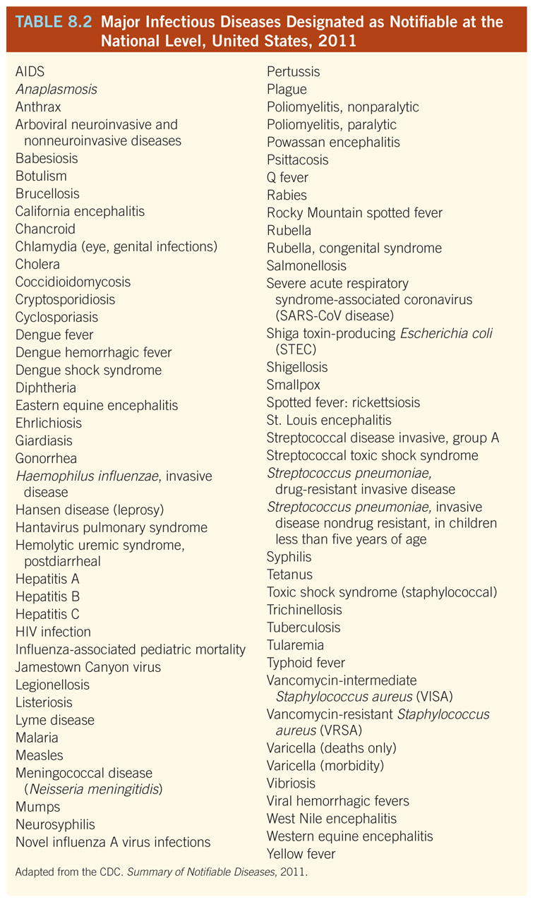
To keep track of infectious diseases in the United States, physicians are required to report cases of certain notifiable diseases
Table 08.02: Major Infectious Diseases Designated as Notifiable at the National Level, United States, 2011.
Reproduced from the CDC. Summary of Notifiable Disease, 2011.

Slide 45
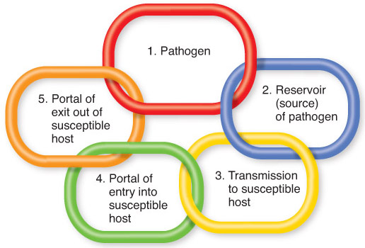
Cycle of Microbial Disease
For infectious dz to exist at the community level, a chain of linked factors (reservoirs, modes of transmission, portals of entry and exit) contributes to the cycle of microbial disease

Slide 46
Reservoirs of Infection
Reservoir is a site in nature in which microbes survive (and possibly multiply) and from which they may be transmitted
All pathogens, to exist, must have one or more reservoirs
Reservoirs are prime targets for preventing, minimizing, and eliminating existing and potential epidemics
Humans are the only known reservoir for pathogens that cause smallpox, gonorrhea, measles, polio, among others.

Slide 47
Reservoirs of Infection
Active carriers are individuals who have a microbial disease
Chronic carriers harbor the pathogen for long periods of time after recovery, without ever becoming ill again
Healthy carriers have no symptoms and may unwittingly pass the disease on to others
Chronic carriers continue to harbor the microbe after recovery, this state can continue indefinitely without illness (Typhoid Mary)
Carriers play a significant role in spread of TB.
Zoonoses are diseases in which animals serve as reservoirs

Slide 48
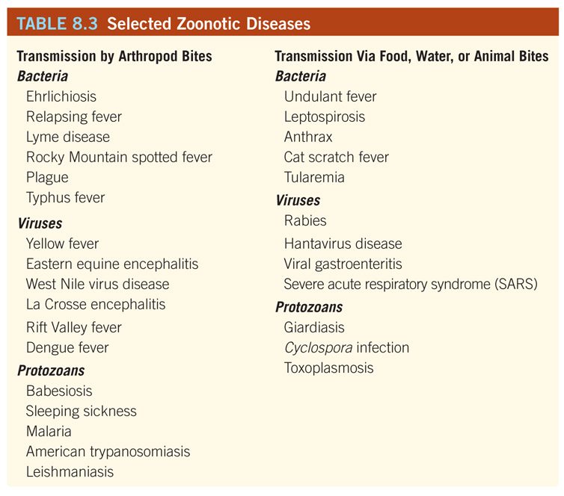
Zoonoses are diseases of animals that can affect humans. Animals act as reservoirs of pathogen.

Slide 49
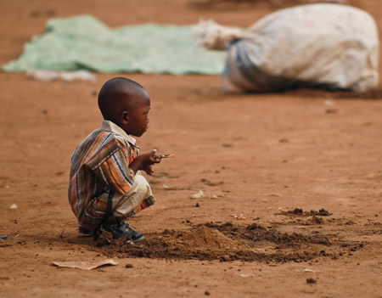
Nonliving Reservoirs
Some organisms are able to survive and multiply in nonliving environments, such as soil and water
Spore formers, like the group of Clostridium bacteria (cause of tetanus and botulism) can survive for many years in soil
Figure 08.07: Soil can be a nonliving reservoir for microbes and helminth eggs.
© Bernardo Erti/Dreamstime.com

Slide 50
Table 08.04: Water and Food as Reservoirs of Infection.

Slide 51
Transmission
Transmission = the mechanism by which an infectious agent is spread to a susceptible person
Table 08.05: Modes of Transmission.

Slide 52
Direct transmission—infectious agent is directly and immediately transferred from a port of exit into a port of entry
Horizontal: person-to-person, touch (including sex), droplets, etc.
Vertical: mother-to-child (transplacental, breast milk, birth canal)
Means of transmission:
Contact (kissing, sneezing, sex, etc.) <horizontal>
Animal Bites <horizontal>
Transplacental <vertical>

Slide 53
Indirect transmission = microbes pass from reservoir (or source) to an intermediate agent and then to a host
1) Vehicle-borne: via food, water, biological products (organs, blood, blood products), and fomites (inanimate objects)
2) Airborne: aerosols of water or dust particles (less than 4 µm) in the air; unlike droplets (10 µm or larger) aerosols remain airborne for extended periods
3) Vector-borne: Arthropods (i.e., ticks, ﬂies, mosquitoes, lice, and ﬂeas) or insects (Chagas’ kissing bug, etc.)
Mechanical passive transmission on feet, etc.; microbes do not invade, multiply, or develop in the vector
Biological vectors are a necessary part of the life cycle of a pathogen, transmission is an active process

Slide 54
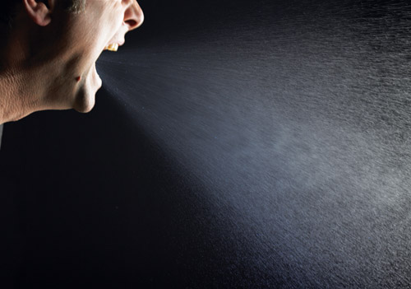
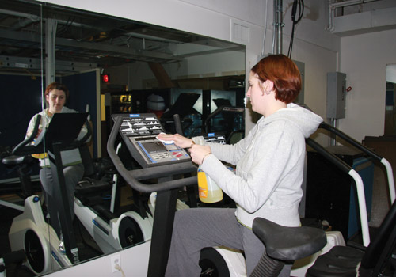
Transmission
Figure 08.08: Droplet transmission (sneezing)--DIRECT
Figure 08.09: Exercise machines can be reservoirs for microbes--FOMITES
© James Klotz/ShutterStock, Inc.
© Jones and Bartlett Learning

Slide 55
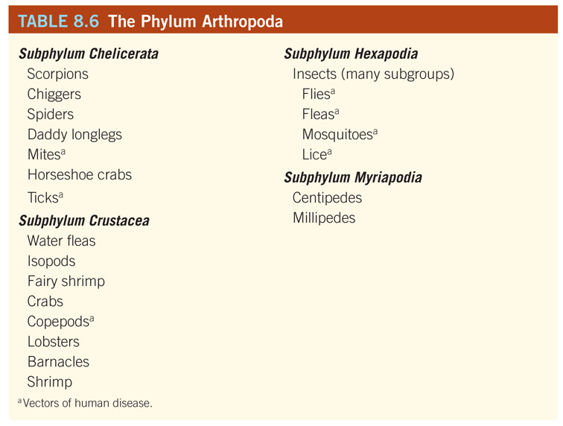
Arthropods—indirect, vector transmission
Table 08.06: The Phylum Arthropoda.

Slide 56
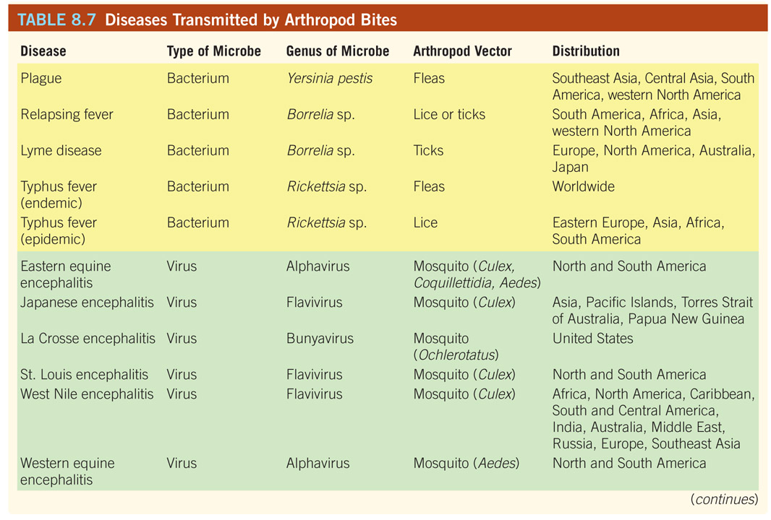

Slide 57
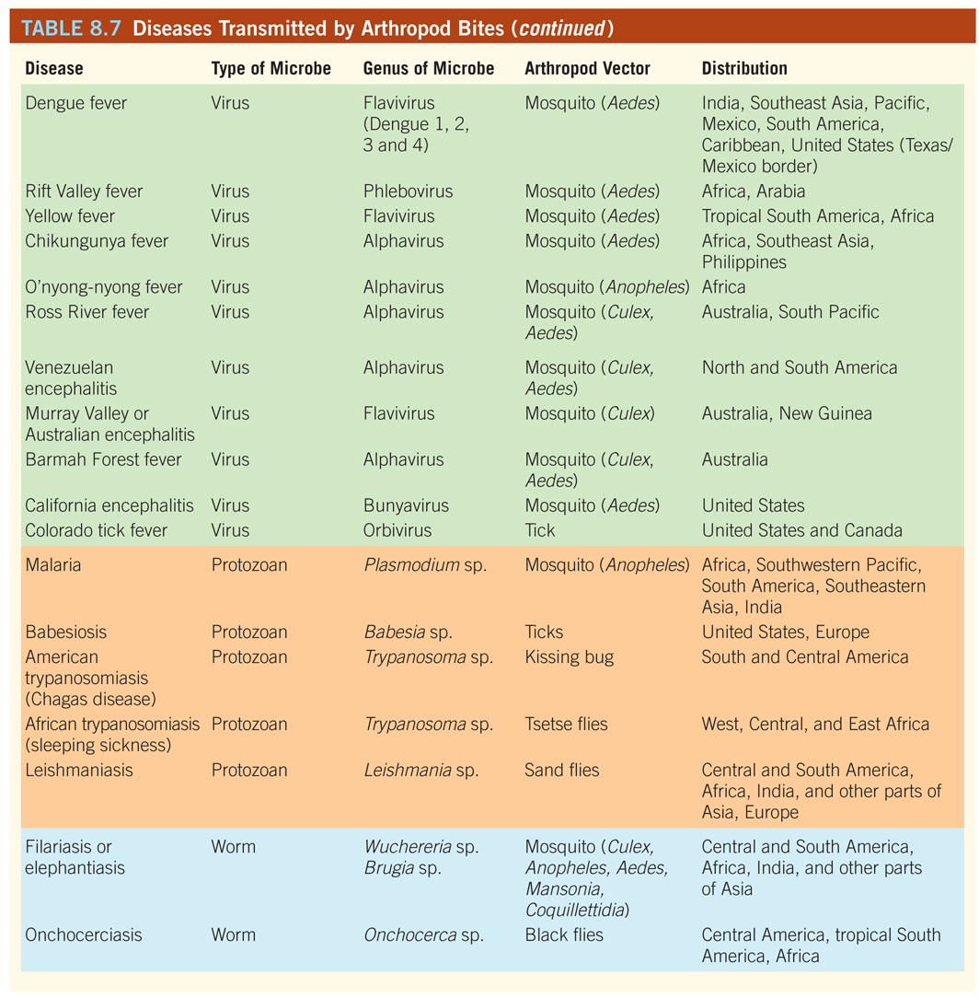

Slide 58
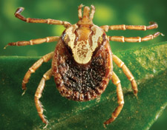
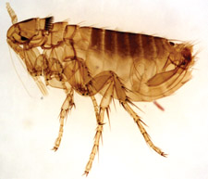
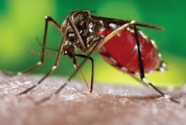
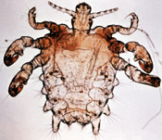
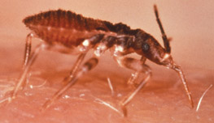
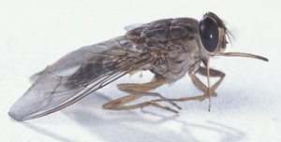
Vectors of infectious diseases are numerous and varied
Courtesy of James Gathany/CDC
Courtesy of John Montenieri/CDC
Courtesy of James Gathany/CDC
Tick
Mosquito
Flea
Courtesy of WHO/CDC
Courtesy of WHO/CDC
Courtesy of Peggy Greb/USDA ARS
Louse
Kissing bug
Tsetse fly
Figure 08.11: A “bug” parade”.

Slide 59
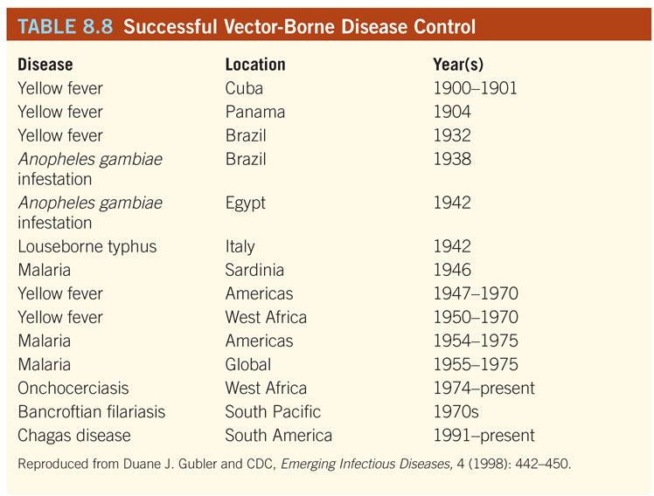
Table 08.08: Successful Vectorborne Disease Control or Elimination Programs.
Reproduced from Duane J. Gubler and CDC, Emerging Infectious Diseases, 4 (1998): 442-450

Slide 60
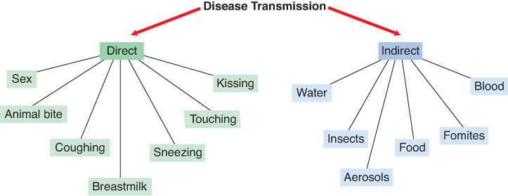
Summary Figure: Direct vs. Indirect Transmission
Figure 08.10: Direct vs. indirect transmission of microbial diseases.

Slide 61
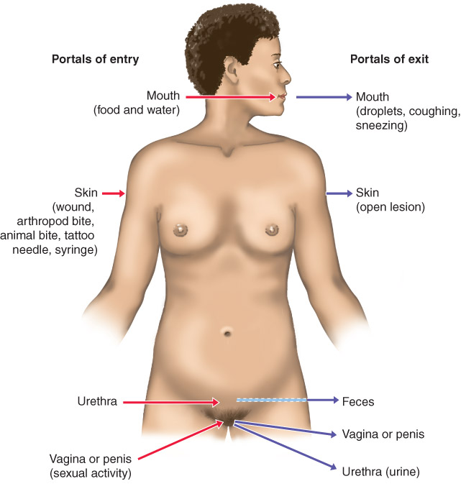
The portal of entry can be important in the outcome of infection; a portal of exit is required for transmission to a new host

Slide 62
Portals of exit
Eyes (tears)
Ear (earwax)
Nose (secretions)
Broken skin (blood)
Mouth (saliva, sputum)
Skin (flakes)
In females: Mammary glands (milk, secretions)
Vagina (secretions, blood)
Anus (feces)
Seminal vesicles (semen and lubricating secretions)
Urethra (urine)

Slide 63
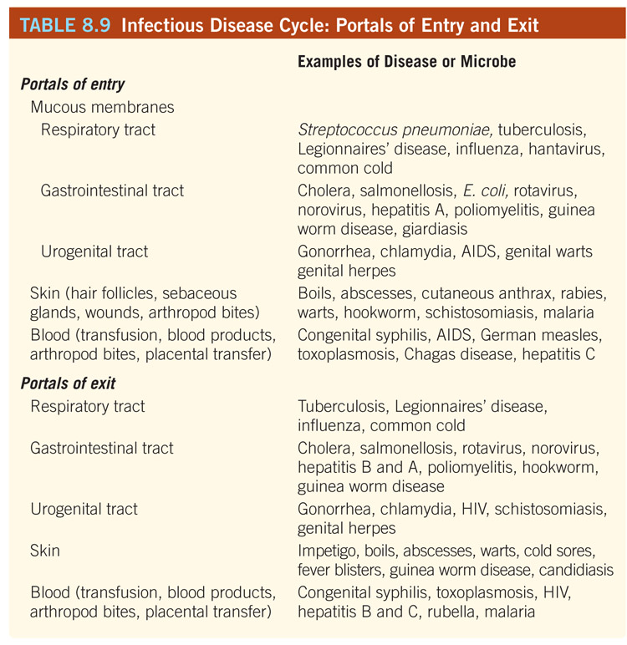

Slide 64
Nosocomial Infections
= infections acquired by patients or health care workers while they are in a health care facility (including hospitals, dental offices, nursing homes, and waiting rooms in doctor’s offices)
CDC estimate: 10% of American patients acquire a nosocomial infection each year
Result in 90,000 deaths annually.
2 types of nosocomial infections:
Exogenous nosocomial infection
Endogenous nosocomial infection

Slide 65
Exogenous vs. Endogenous Nosocomial Infections
Exogenous= caused by pathogens acquired from the health care environment
Endogenous= situation in which the normal flora becomes a pathogen as a result of medical treatments or hospitalization (i.e. chemotherapy)
Iatrogenic Infections = subset of nosocomial infections that are the direct result of modern medical proceduressuch as use of catheters, invasive diagnostic procedures and surgery (“doctor-induced”)

Slide 66
Figure 14.20 The interplay of factors that result in nosocomial infections
Presence of microorganisms in hospital environment
Immunocompromised patients
Nosocomial infection
Transmission of pathogens between staff and patients and among patients

Slide 67
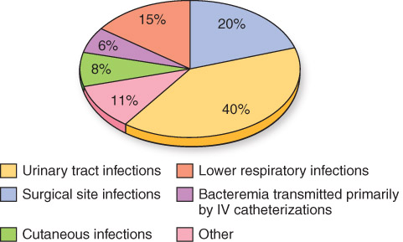
Figure 08.13: Body Site Distribution of Nosocomial Infections.
Data from: CDC, National Nosocomial iInfection Surveillance

Slide 68
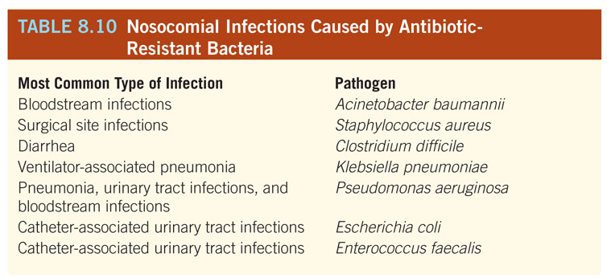
Nosocomial (Hospital-Acquired) Infections
Control Measures
All hospitals are required to have an infection-control officer and an infection control committee to maintain accreditation.

