Slide 1
Microbial Genetics— an overview
Microbiology
Dr. Melanie Meyer
CCV

Slide 2
Microbial Genetics
Virtually all microbial traits are influenced by heredity.
Inherited traits of microbes include—shape, structure features, metabolism, ability to move or behave in various ways, and ability to interact with other organisms (ex: causing disease)
Individual organisms transmit these characteristics to offspring through genes
Development of antibiotic resistance in microorganisms depends on genetics (ex: role of plasmids)
Emerging diseases necessitate an understanding of bacterial genetics (ex: E. coli O157:H7)
Studying bacterial genetics allows microbiologists to better understand relatedness among organisms and to better understand origins of potentially threatening organisms.

Slide 3
Structure & Function of Genetic Material
Key terms:
Genetics = the science of heredity
Genome = the genetic information as organized within a cell (both chromosomal DNA and non-chromosomal)
Chromosomes = structures containing DNA that physically carry hereditary information; the chromosomes create the genes
Genes = segments of DNA that code for functional products

Slide 4
Notes:
4

Slide 5
DNA Structure
DNA = deoxyribonucleic acid
Consists of 2 chains of nucleotides
Nucleotides consist of a base, a phosphate group, and a pentose sugar (deoxyribose)—next slide details this
DNA within a cell exists as long strands of nucleotides twisted together in pairs to form a double helix

Slide 6
Nucleotide Structure
The Nucleotide
Nitrogenous Bases

Slide 7
Bacterial Cell Division—via Binary Fission
Bacteria multiply via binary fission
Binary fission = an asexual mode of reproduction in which a cell splits into two new cells
Before this process can occur, DNA replication must occur

Slide 8
DNA Replication
In DNA replication, one “parental” double stranded DNA molecule is converted to two identical “daughter” molecules.
Because the bases along the two strands of double-helical DNA are complementary, one strand can act as a template for the production of the other strand
Semiconservative replication = the process of DNA replication in which each double-stranded DNA molecule contains one original strand and one new strand
This allows for identical DNA material to be utilized in the process of binary fission.

Slide 9
DNA Replication: Overview

Slide 10
DNA Replication
Notes:
10

Slide 11
DNA replication
Hydrogen Bonds are enzymatically cleaved (DNA polymerase enzyme)
Chagraff’s Rule of Complementary Base Pairs
As the two strands unzip at specific sites, exposed bases on each strand are free to attach to free nucleotides
Complementary base pairing occurs—A-T and G-C
As unzipping proceeds, each original strand serves as a template for a new strand
This process is typical of eukaryotic cells in which there are multiple linear pairs of chromosomes
Let’s look at the unique qualities of DNA replication for most prokaryotes (bacteria)

Slide 12
Loop Chromosome Structure in Bacterial Cells: chromosome is enzymatically nicked creating “replication fork”

Slide 13
Binary Fission

Slide 14
DNA—blueprint for the cell
DNA carries the information (genes) needed to build proteins.
Proteins are:
The most abundant compounds in the cell
Versatile
Key to genetic regulation for the cell
Major participants in cell’s chemical reactions
Composed of amino acids linked together by peptide bonds (= polypeptides )

Slide 15
Gene Function
The Transfer of Genetic Information
Transcription
Information in DNA is copied as RNA
Translation
Polypeptides are synthesized from RNA
Central dogma of genetics
DNA is transcribed to RNA
RNA is translated to form polypeptides (essentially, proteins)

Slide 16
Protein Synthesis
Involves 2 Sequential Processes:
Transcription
Translation
Both steps involve DNA and RNA

Slide 17
DNA vs. RNA
RNA is similar to DNA except:
RNA is single-stranded
Nucleotide uracil is substituted for thymine as the pair for adenine
Ribose (pentose sugar) has one more oxygen in its structure than does deoxyribose

Slide 18
RNA—Functional Classes
Messenger RNA: the type of RNA molecule that directs the incorporation of amino acids into proteins
Transfer RNA: the type of RNA molecule that brings amino acids to the ribosomal site where they are incorporated into proteins
Ribosomal RNA: they type of RNA molecule that is associated with ribosomes

Slide 19
Stage 1: Transcription
Genetic information is transferred from DNA to mRNA during this stage
One strand of DNA serves as a template to make mRNA
DNA is unzipped and the enzyme RNA polymerase is involved in making a complementary strand of mRNA
Only a short segment of single-stranded DNA is transcribed at one time
Transcription begins at a promoter site on the strand and ends at a terminator sequence
Result: strand of mRNA complementary to original DNA blueprint has been formed
Transcription takes place in the nucleus of the cell

Slide 20
Transcription

Slide 21
Stage 2: Translation
The final stage of protein synthesis
Takes place on ribosomes (protein synthesis organelles) in the cytoplasm of the cell
mRNA moves from nucleus to cytoplasm
Translation = conversion of genetic info from mRNA into the language of proteins

Slide 22
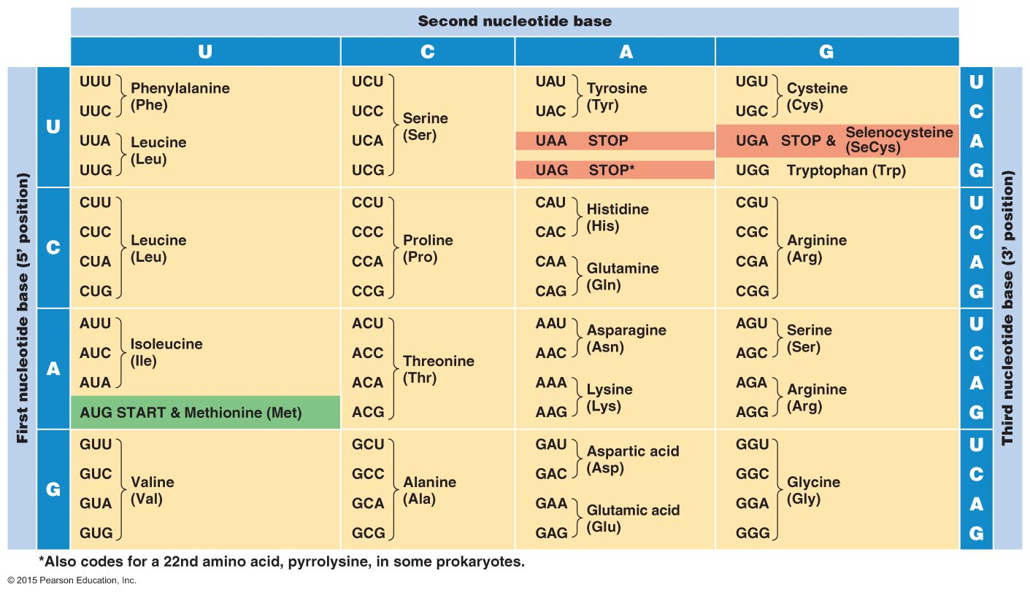
Figure 7.12 The genetic code.

Slide 23
Amino Acids
= building blocks of protein
Consist of:
Central carbon core
Amino group—NH₂
Carboxyl group—COOH
Side chain (this is the portion of the amino acid that is unique and the interactions of these with other AA’s give proteins their structure)—R group
Amino acids are joined by peptide bonds to make proteins (polypeptide molecules)

Slide 24
Side Chains—define the amino acid type

Slide 25
Peptide bonds—AA’s build proteins

Slide 26
Transfer RNA (tRNA)
Completion of translation process requires tRNA (transfer RNA)
tRNA = molecules responsible for transferring a specific AA to the ribosome to build a polypeptide
tRNA reads the mRNA nucleotides on the ribosome in groups of 3= codons
Each codon related to a complementary anticodon on tRNA
Each tRNA has a specific anticodon site to which an amino acid is chemically bonded

Slide 27
2 “business sites” on tRNA molecule
Each tRNA molecule has an anticodon site which is chemically bonded to a specific amino acid.
There are 2 business sites on each tRNA molecule.
Anticodon region (3 nucleotides which bind to mRNA codon)
Amino Acid binding site
tRNA’s carry the language and translate nucleic acid (mRNA) info into amino acid sequences (which make up the protein)=TRANSLATION

Slide 28
Translation

Slide 29
Gene Expression
Both prokaryotes and eukaryotes have mechanisms for turning off or turning on gene expression
Enzymes are major products of protein synthesis and are “biological catalysts”
For the purpose of energy conservation, not all genes are turned on at all times
Constitutive enzymes: produced constantly as they are always in the “on” position for expression
Inducible enzymes: production is the result of genes that can be turned on or off depending on the circumstances
Operons: a group of functionally related genes that act as “on and off” switches

Slide 30
Chromosomes—clarification
Chromosome—consists of long strands of DNA found or more succinctly, the structure into which DNA is organized
Chromosome number is constant for each species, no pattern or logic for chromosome numbers
Gene—piece or segment of that DNA

Slide 31
Gene Function
The Relationship Between Genotype and Phenotype
Genotype
Set of genes in the genome
Phenotype
Physical features and functional traits of the organism
Genotype determines phenotype
Not all genes are active at all times

Slide 32
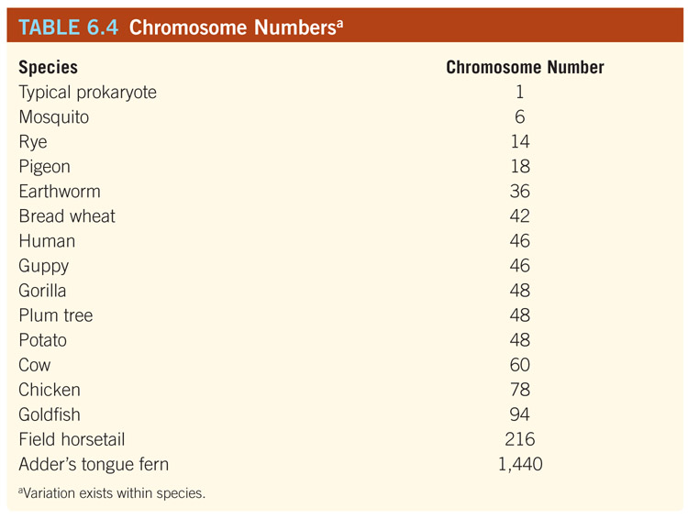
Table 06.T04: Chromsome Numbers

Slide 33
Bacterial Genetics
Mechanisms accounting for diversity in prokaryotic cells:
Mutation—a permanent change in the nucleotide base sequence of a genome
random and haphazard; may produce genes adverse to survival
2) Recombination--more efficient; deals with existing genes
Transformation
Transduction
Conjugation

Slide 34
Mutations
As previously discussed, the sequence of amino acids in a polypeptide determines the protein that results
Even small mutations can lead to major functional changes for the cell
Point mutation= one nucleotide is replaced with another nucleotide; insertion or deletion is taking place
Can occur spontaneously OR can be the result of mutagens or transposons
Mutagens= chemical or physical agents which can induce mutations
Transposons= aka “jumping genes,” genetic elements that move from one site on a chromosome to another or from a chromosome to a plasmid (or vice versa)

Slide 35
Point Mutation—Sickle Cell Example

Slide 36
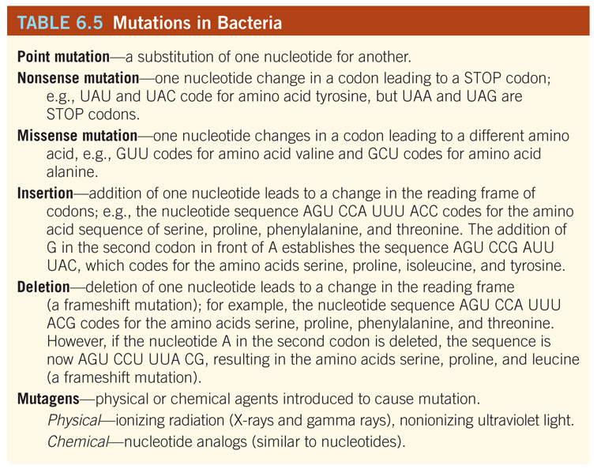
Table 06.T05: Mutations in Bacteria

Slide 37
Recombination
3 processes for recombination of bacterial genes: transformation, transduction, and conjugation
All are examples of horizontal transfer (vs. vertical)
All occur in nature, although described as laboratory phenomena
All require integration of foreign donor DNA into host DNA
All result in new gene combinations
Horizontal (lateral) gene transfer: process in which a donor cell contributes part of its genome to a recipient cell, which may be a different species or genus from the donor

Slide 38
Recombination—in Eukaryotes
Eukaryotes:
Recombination in sexually reproducing organisms is vertical
Vertical recombination—involves the fusion of male & female gametes
Gametes= haploid—carrying ½ of the genetic info
Process is meiosis
“genetic gamble” = new combination; reproduction

Slide 39
Recombination—in Prokaryotes
Strategy for recombination in prokaryotes is separate and distinct from reproduction
Remember—bacteria reproduce by binary fission in which two identical daughter cells are produced asexually →

Slide 40
Recombination Types

Slide 41
Transformation
= the process in which genes are transferred from one bacterium to another as “naked” fragments of DNA into competent cells
Process requires competence and homology for transfer to occur; mediated by enzymes
Naked DNA is integrated into the host DNA
Competence: cells have the ability to take up DNA from the environment resulting in gene transformation; most cells are not naturally competent—can be altered in lab settings
→ Competence results from alterations in the cell wall that make it permeable to large DNA molecules
Homology: refers to stretches of DNA with identical or closely related sequences

Slide 42
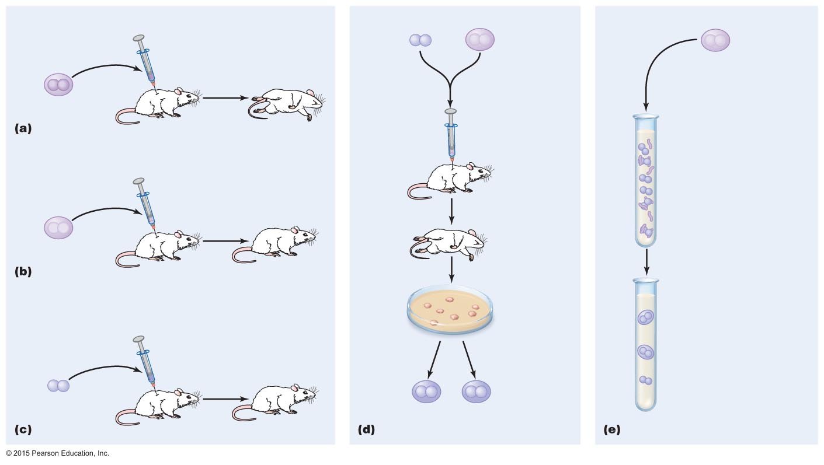
Figure 7.33 Transformation of Streptococcus pneumoniae.
Observations of Streptococcus pneumoniae
Griffith's experiment:
In vitro transformation
Living
strain R
X
Heat-treated
dead cells
of strain S
Heat-treated
dead cells of
strain S
X
X
X
X
X
X
Live cells
+
X
Injection
DNA broken
into pieces
Capsule
Mouse dies
Injection
DNA fragment
from strain S
Living strain R
Heat-treated
dead cells of
strain S
Some cells take
up DNA from the
environment and
incorporate it into
their chromosomes
Injection
X
X
X
X
Mouse dies
Mouse lives
Culture of
Streptococcus
from dead
mouse
Strain R live cells
(no capsule)
Transformed cells
acquire ability to
synthesize capsules
Injection
Living cells
with capsule
(strain S)
Mouse lives

Slide 43
Transduction—2 types
= the transfer of DNA from one cell to another by a bacteriophage
Bacteriophage= virus that infects and usually destroys bacterial cells
1) Generalized transduction = the transfer of bacterial chromosome fragments (random fragments) from one cell to another by a bacteriophage
2) Specialized transduction = process of transferring a sequence of host cell DNA adjacent to a prophage to another cell

Slide 44
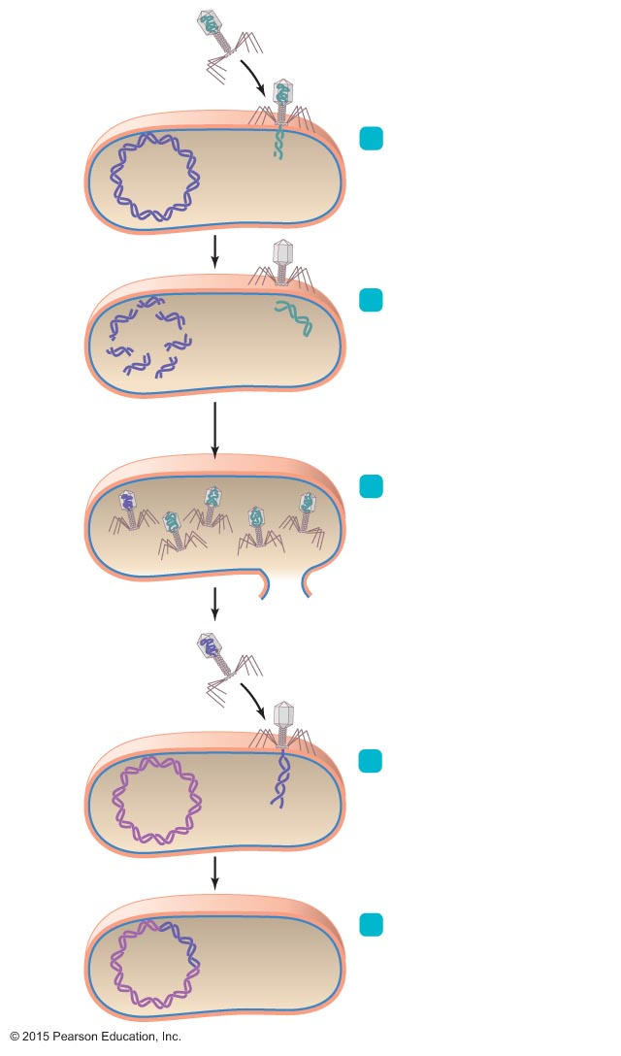
Figure 7.34 Transduction.
Bacteriophage
Host bacterial cell
(donor cell)
Bacterial chromosome
1
Phage injects its DNA.
2
Phage enzymes
degrade host DNA.
Phage
DNA
Phage with donor DNA
(transducing phage)
3
Cell synthesizes new
phages that incorporate
phage DNA and, mistakenly,
some host DNA.
Transducing phage
Recipient host cell
4
Transducing phage
injects donor DNA.
Transduced cell
5
Inserted
DNA
Donor DNA is incorporated
into recipient's chromosome
by recombination.

Slide 45
Conjugation
= the transfer of genetic material from one cell to another involving cell-to-cell contact
Looks similar to mating, but doesn’t meet the criteria for sexual reproduction (no gametes)
Conjugation is mediated by plasmids.
Plasmids differ from bacterial chromosomes in that the genes they carry are usually not essential for the growth of the cell under normal conditions.
The plasmids responsible for conjugation are transmissible between cells during conjugation
Requires that cells involved are of opposite mating type (ex: donor cells must carry plasmid while recipient cell does not)

Slide 46
Conjugation
Plasmid—referred to in conjugating cells as “F Factor” = fertility factor
Donor cell is F+ = has the F factor plasmid
Recipient cell is F- = no plasmid with fertility factor
Some F plasmids produce F pili (sex pili or conjugation pili) which act as a bridge between donor and recipient cells

Slide 47
Transfer of Genetic Info without Plasmids
Transfer of genetic material is not limited to plasmid containing cells.
F factor may be integrated into the chromosome of some cells.
HFr (high frequency recombination) = cell type in which frequent recombination occurs
The integration of the plasmid into the chromosome is reversible, which leads to a mixed population of Hfr and F+ cells

Slide 48
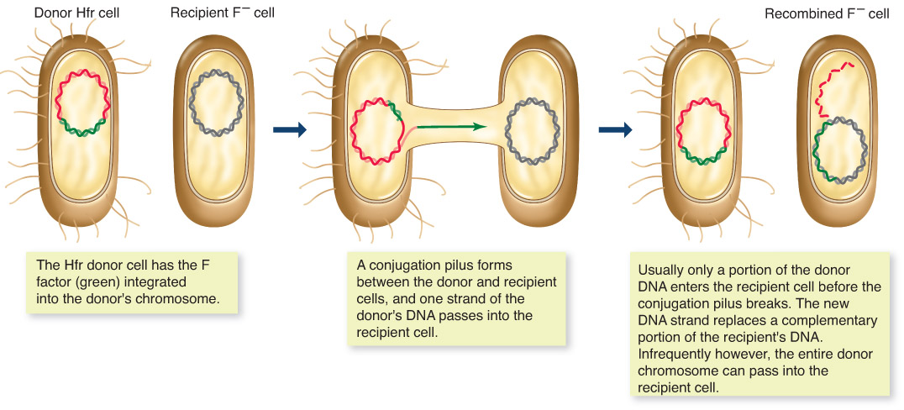
Figure 06.F17: Bacterial conjugation: Hfr to F –. (The pilus may not act as a channel as shown.)

Slide 49
Why We Care About Bacterial Genetics…
All mechanisms of genetic exchange in bacteria—transformation, transduction, conjugation, and mutation—are responsible for bacterial diversity
Diversity leads to the ability of bacteria to adapt to new environments—survival of the fittest at the genetic and molecular levels
The “fittest” are those bacteria in a diverse population with genes that allow them to adapt, survive and reproduce under hostile circumstances
Much of the antibiotic resistance that we are currently encountering is the result of genetic exchange/diversity of these organisms.

