Slide 1
Cell Structure & Function
Chapter 3—Week 1

Slide 2
Processes of life
1) Growth—increase in size
2) Reproduction—increase in number
3) Responsiveness—react to environmental stimuli
4) Metabolism—take in nutrients, perform chemical reactions

Slide 3
Microbes contrasted

Slide 4
Cells: PrOkaryotes or Eukaryotes
Prokaryotes:
Include both bacterial and archaea
Lack nucleus
Lack membrane-bound organelles
Typically smaller in size, simple in structure
Eukaryotes:
Include algae, protozoa, fungi, animals, and plants
Have a nucleus (membrane bound, contains the cell’s DNA)
“true nucleus”
Have membrane-bound organelles
Typically larger in size, more complex in structure

Slide 5
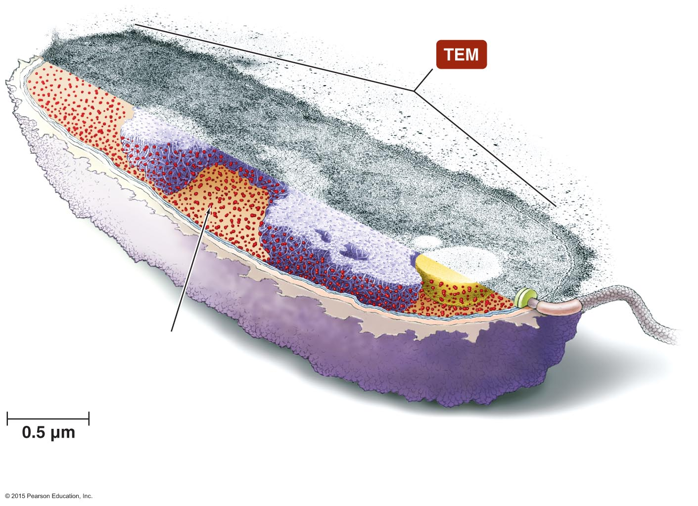
Figure 3.2 Typical prokaryotic cell.
Inclusions
Ribosome
Cytoplasm
Nucleoid
Flagellum
Glycocalyx
Cell wall
Cytoplasmic membrane
Notes:
5

Slide 6
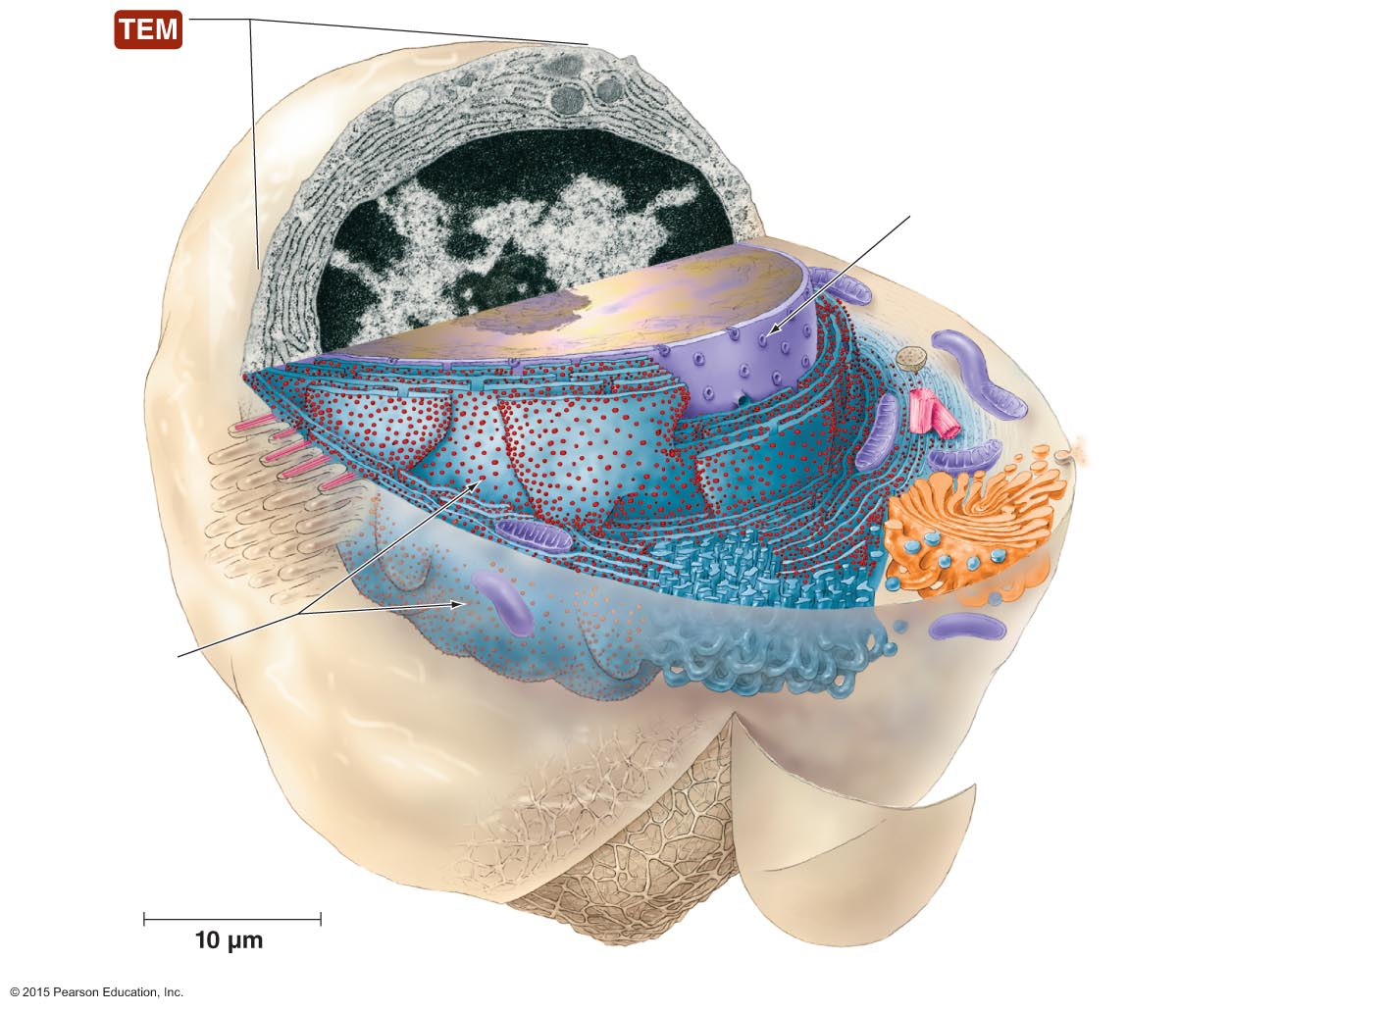
Figure 3.3 Typical eukaryotic cell.
Nuclear envelope
Nuclear pore
Nucleolus
Lysosome
Mitochondrion
Centriole
Secretory vesicle
Cilium
Golgi body
Transport vesicles
Ribosomes
Rough endoplasmic
reticulum
Smooth endoplasmic
reticulum
Cytoplasmic
membrane
Cytoskeleton
Notes:
6

Slide 7
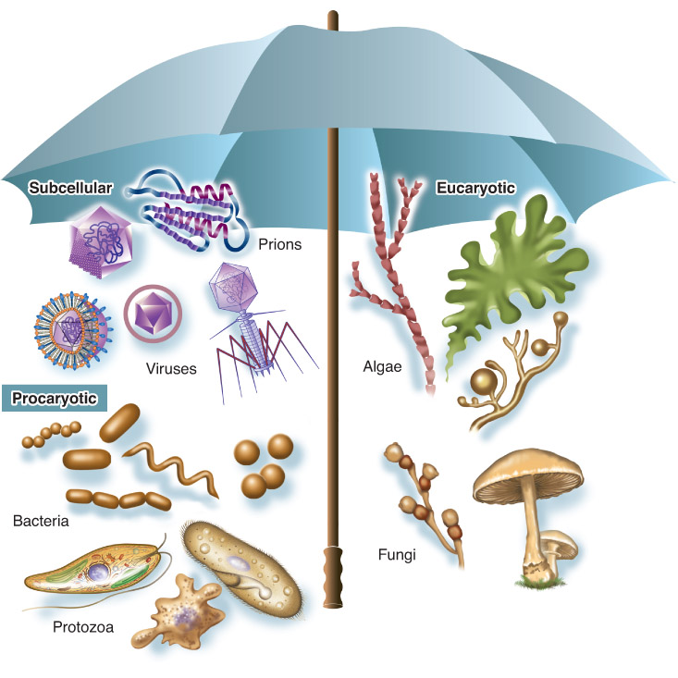
Introducing the Microbes
Measured in very small units of the metric system called micrometers (µm) and nanometers (nm)
.

Slide 8
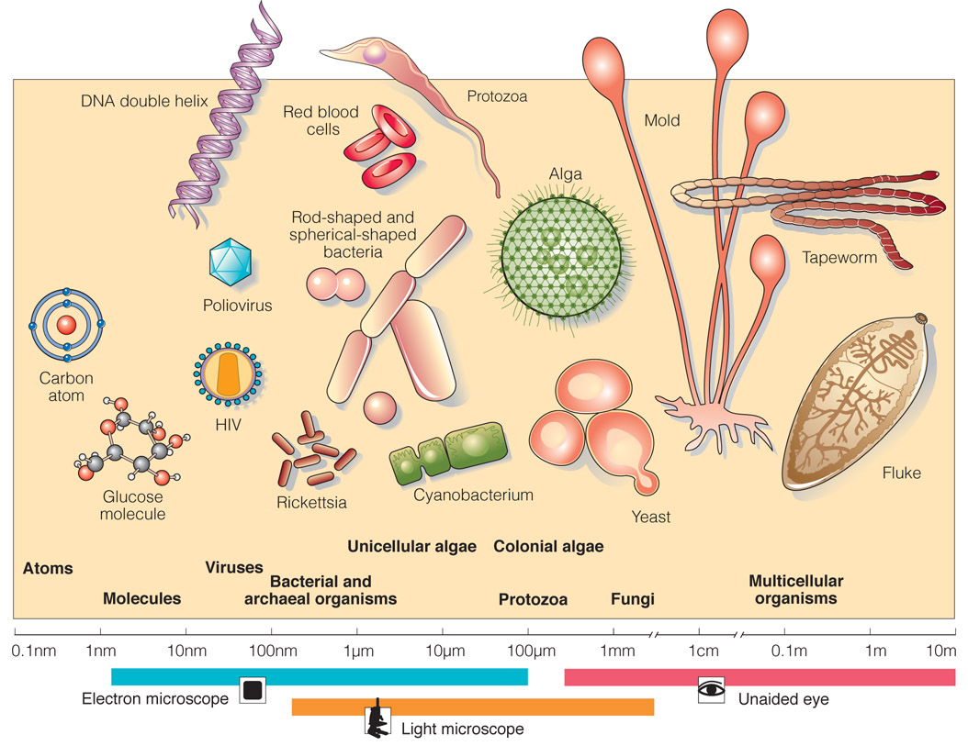
Microorganism size range

Slide 9
External structures of Bacterial cells

Slide 10
Glycocalyx: Bacterial Capsule or Slime Layer
Not always present
Not always integral to the life of the cell
Easily removed by treating a culture with enzymes or manipulating the culture nutrients available
VIRULENCE FACTOR when present—enhances the organism’s ability to produce disease
Special notes:
Glycocalyx = gelatinous, sticky substance that surrounds the outside of the cell (may be made of polysaccharides, polypeptides, or both. These are produced inside the cell and are extruded onto the cell’s surface
Classification of this layer is dependent on composition of the layer:
Capsule—when the glycocalyx is made of repeating organic chemical units firmly attached to the cell surface
OR
Slime Layer—a loose, water-soluble glycocalyx

Slide 11
Function of the Glycocalyx or Capsule
Prevent phagocytosis of the cell by our immune cells
Prevent bacterial cells from drying out
Slime layers are often sticky and provide the means for bacteria to attach to surfaces as biofilms, which are aggregates of bacteria living together on a surface

Slide 12
Flagella
= long structures that extend beyond the surface of a cell and its glycocalyx and propel the cell through its environment
Not all bacteria have flagella but for those that do, it assists with mobility and survival of the cell
Movement is similar to a boat propeller

Slide 13
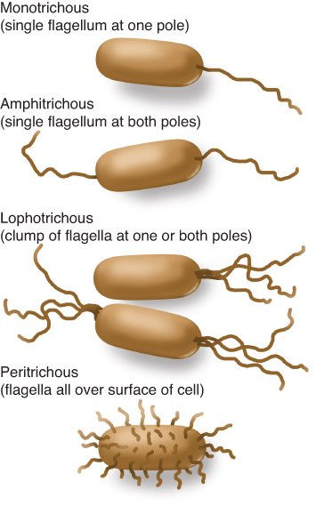
Flagella
Used for motility
Rotates like propeller
Responsible for Chemotaxis
Move toward attractant
Move away from repellant
Long, hollow, filament
made of subunits of flagellin
Many arrangements (single,
polar, bipolar, dispersed, etc.)
Cells with flagella are motile
Figure 04.09: Structure and arrangement of flagella.

Slide 14
Fimbriae and Pili
Fimbriae—rodlike, proteinaceous extensions
Sticky projections adhere to one another and to substances in the environment
Crucial to the pathogenicity of gonorrhea—non-fimbriated cells of this type don’t cause disease
Pili—longer versions of fimbriae but shorter than flagella
Cells use pili to transfer DNA from one cell to another = conjugation

Slide 15
Bacterial Cell Walls
Provide structure and shape and protect cell from osmotic forces
Assist some cells in attaching to other cells or in resisting antimicrobial drugs
Can target cell wall of bacteria with antibiotics
Give bacterial cells characteristic shapes
Composed of peptidoglycan
Scientists describe two basic types of bacterial cell walls
Gram-positive and Gram-negative

Slide 16
Bacterial cell Walls
Composed of peptidoglycan, a meshlike complex polysaccharide (sugar)
Made of either NAG or NAM, which are structurally similar to glucose
Cell walls gives bacterial cells their characteristic shapes

Slide 17
Gram Positive vs. Gram Negative
Cell wall
G+: thick layer of rigid polymer, peptidoglycan ( lab note: holds crystal violet stain in gram stain procedure)
G−: thin layer of peptidoglycan
Prevents osmotic rupture of cell membrane
Outer membrane (in gram negatives only)
Contains fever inducing endotoxin

Slide 18
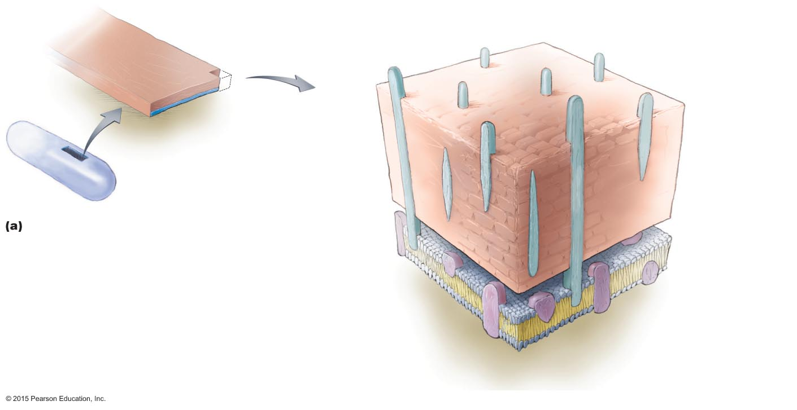
Figure 3.15a Comparison of cell walls of Gram-positive and Gram-negative bacteria.
Peptidoglycan layer
(cell wall)
Cytoplasmic
membrane
Gram-positive cell wall
Lipoteichoic acid
Teichoic acid
Integral
protein
Notes:
18

Slide 19
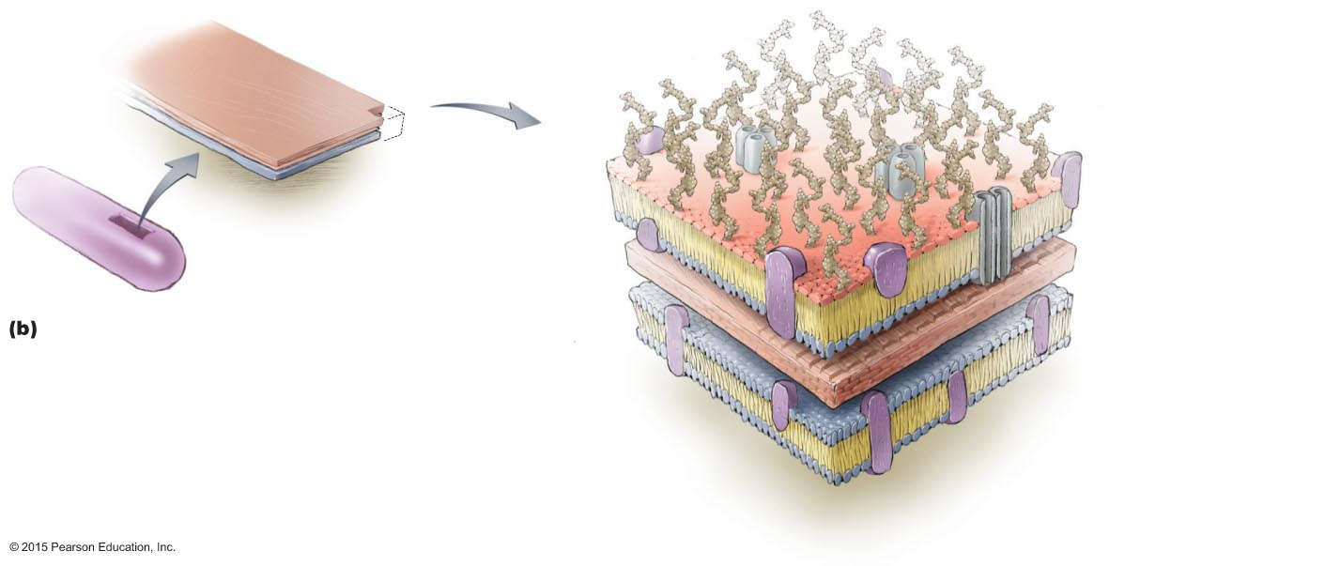
Figure 3.15b Comparison of cell walls of Gram-positive and Gram-negative bacteria.
Porin
Outer
membrane
of cell wall
Porin
(sectioned)
Peptidoglycan
layer of cell wall
Periplasmic space
Cytoplasmic
membrane
Gram-negative cell wall
Phospholipid layers
Lipopolysaccharide
(LPS) layer, containing
lipid A
Integral
proteins
Notes:
19

Slide 20
Cell Shapes and Patterns
Morphology: bacteria are found in several common shapes (and arrangements), which are useful in species identification
Bacillus, (bacilli, pl.) rod shaped
Coccus, (cocci, pl.) spherical
Curved or spiral, (vibrio= curved or comma-shaped; spirilla= rigid or stiff helix; & spirochete= loose or flexible helix)
Other unique shapes (pleomorphic = vary in size and shape)

Slide 21
Bacteria without cell walls
Mycoplasma pneumoniae is one of a few bacteria lacking in a cell wall
The Mycoplasma bacteria are considered “atypical” bacteria as they lack cells walls and are extremely small in size, which initially led to their mistaken classification as “viruses”

Slide 22
Bacterial Cytoplasmic membrane
Structure
Referred to as phospholipid bilayer
Composed of lipids and associated proteins
Integral proteins
Peripheral proteins
Fluid mosaic model describes current understanding of membrane structure

Slide 23
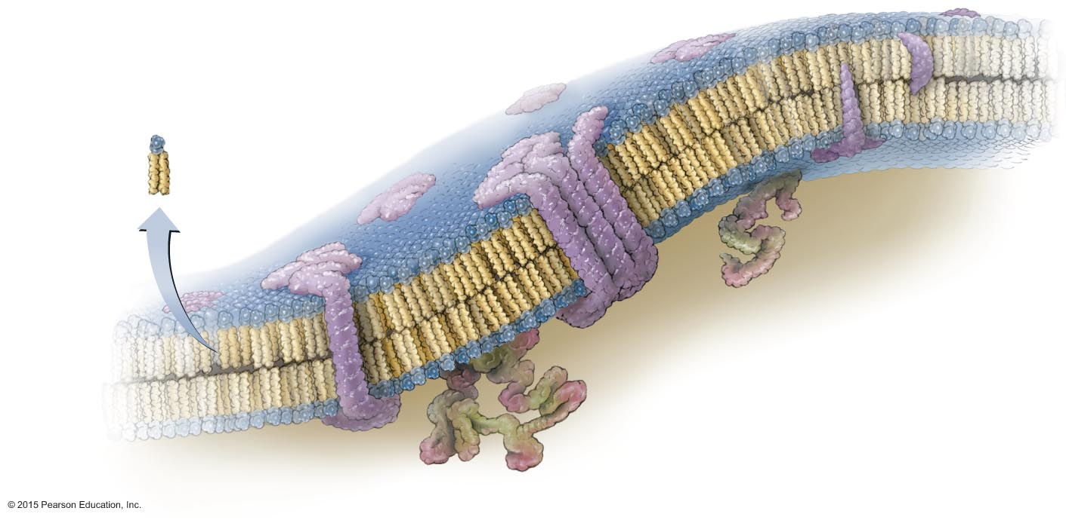
Figure 3.16 The structure of a prokaryotic cytoplasmic membrane: a phospholipid bilayer.
Head, which
contains phosphate
(hydrophilic)
Phospholipid
Tail
(hydrophobic)
Integral
proteins
Cytoplasm
Integral
protein
Phospholipid
bilayer
Peripheral protein
Integral protein
Notes:
23

Slide 24
Bacterial Cytoplasmic Membranes
Function
Control passage of substances into and out of the cell
Energy storage
Harvest light energy in photosynthetic bacteria
Selectively permeable
Naturally impermeable to most substances
Proteins allow substances to cross membrane
Maintain concentration and electrical gradient

Slide 25
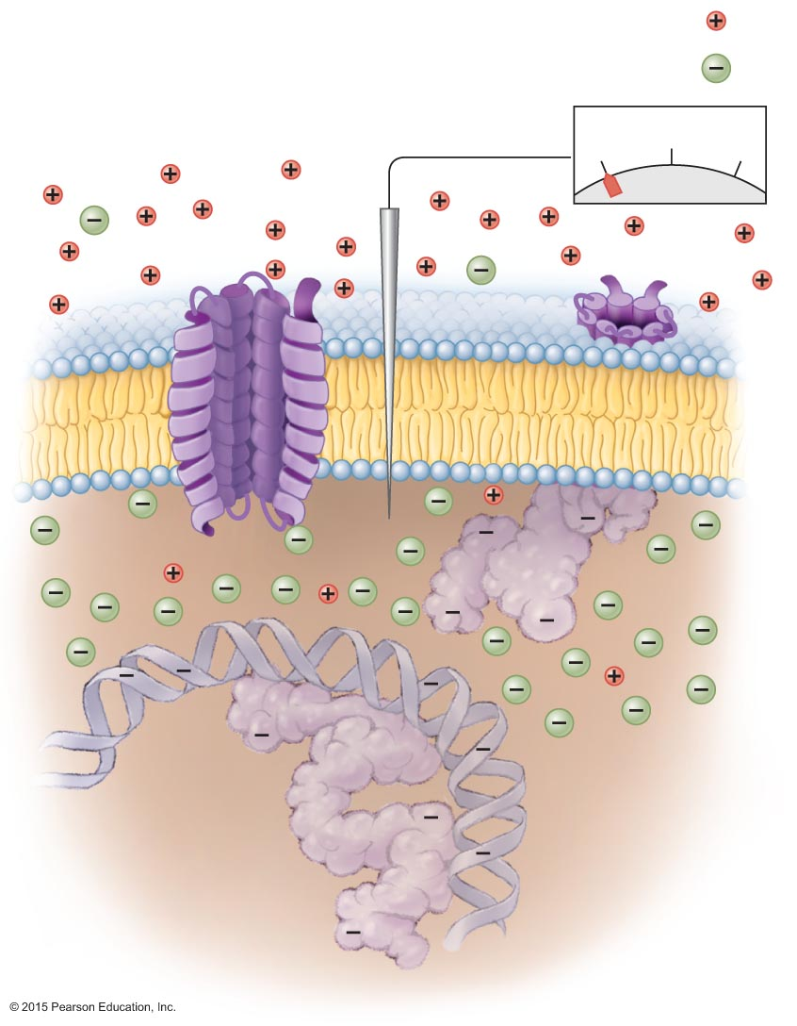
Figure 3.17 Electrical potential of a cytoplasmic membrane.
Na+
Cl–
Cell exterior (extracellular fluid)
–70
–30
0
mV
Cytoplasmic membrane
Integral
protein
Protein
DNA
Protein
Cell interior (cytoplasm)
Notes:
25

Slide 26
Bacterial cell Membrane Function—Passive
Function
Passive processes
Diffusion
Facilitated diffusion
Osmosis
DON’T REQUIRE ATP

Slide 27
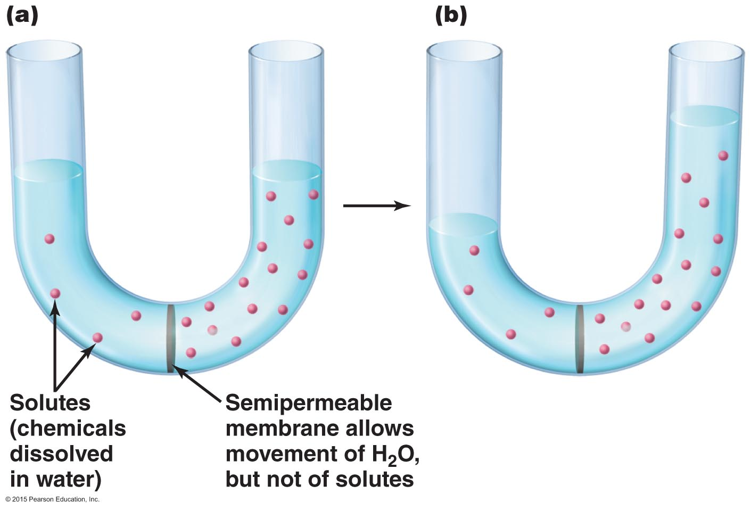
Figure 3.19 Osmosis, the diffusion of water across a semipermeable membrane.
Notes:
27

Slide 28
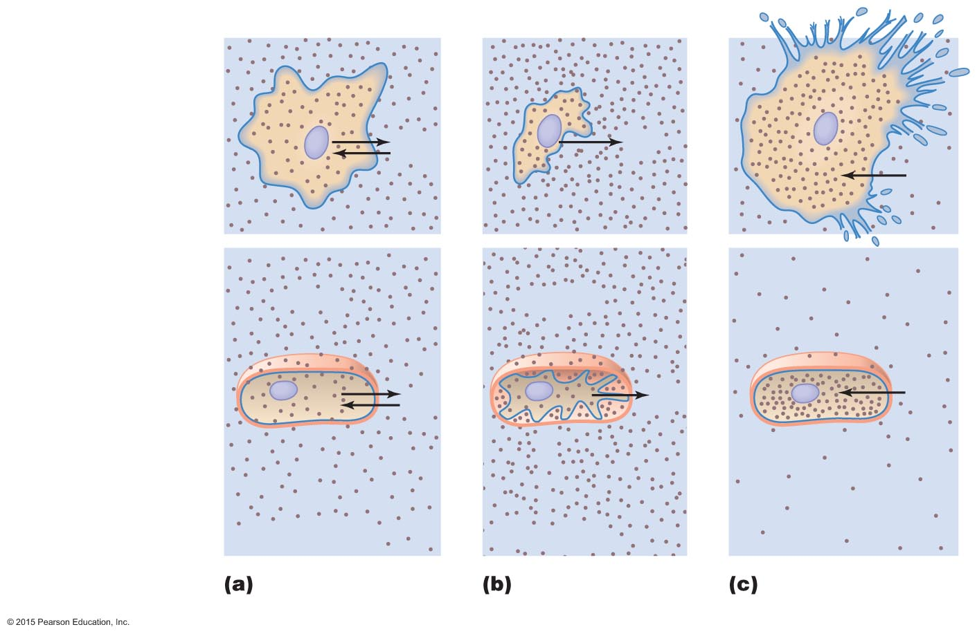
Figure 3.20 Effects of isotonic, hypertonic, and hypotonic solutions on cells.
Cells without a wall
(e.g., mycoplasmas,
animal cells)
H₂O
H₂O
H₂O
Cell wall
Cell wall
Cells with a wall
(e.g., plants, fungal
and bacterial cells)
H₂O
H₂O
H₂O
Cell membrane
Cell membrane
Isotonic
solution
Hypertonic
solution
Hypotonic
solution
Notes:
28

Slide 29
Bacterial Cell Membrane Function—Active
Function
Active processes
Active transport
Group translocation
Substance is chemically modified during transport
REQUIRE ATP

Slide 30
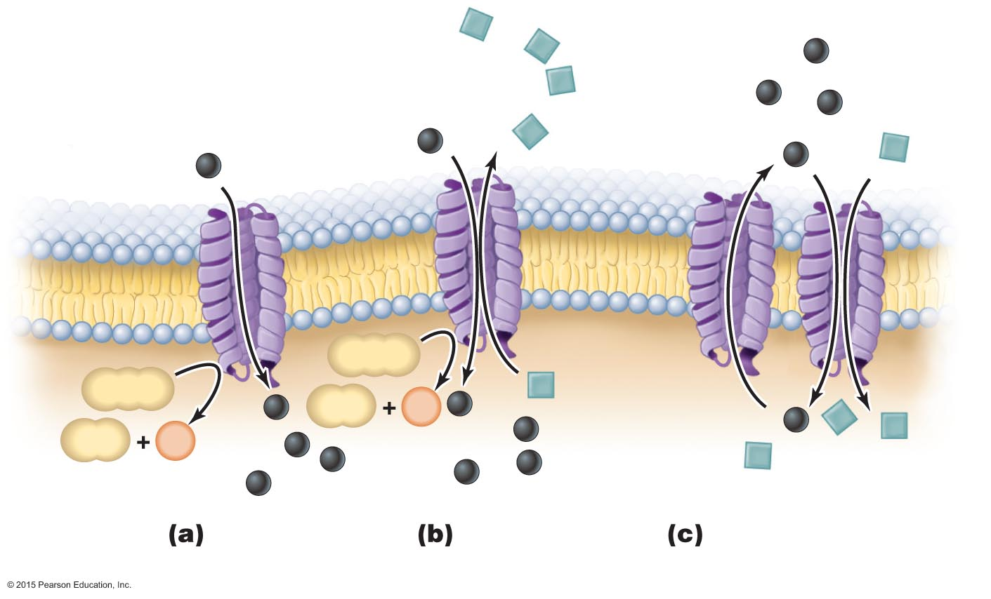
Figure 3.21 Mechanisms of active transport.
Extracellular fluid
Uniport
Cytoplasmic
membrane
ATP
ATP
ADP
P
ADP
P
Symport
Cytoplasm
Uniport
Antiport
Coupled transport:
uniport and symport
Notes:
30

Slide 31
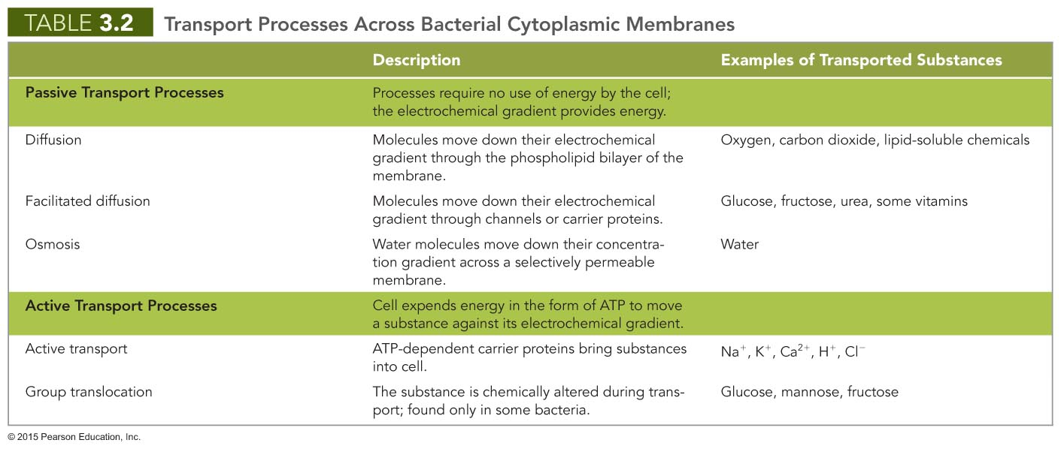
Notes:
31

Slide 32
Cytoplasm
= the area of the cell enclosed by the cell membrane containing organelles that function in cell metabolism and multiplication

Slide 33
Cytoplasm of Bacteria
Cytosol
Liquid portion of cytoplasm
Mostly water
Contains cell's DNA in region called the nucleoid
Inclusions
May include reserve deposits of chemicals

Slide 34
Cytoplasm of Bacteria
Endospores
Unique structures produced by some bacteria
Defensive strategy against unfavorable conditions
Vegetative cells transform into endospores when nutrients are limited
Resistant to extreme conditions such as heat, radiation, chemicals

Slide 35
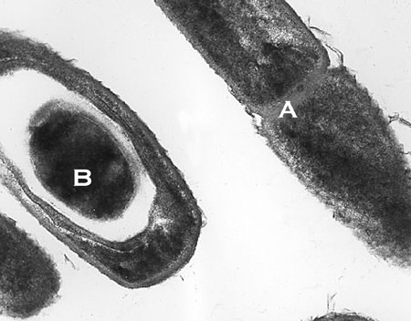
Spores (endospores) and Sporulation
=endospores, formed within the cell during “hard times”
Transformation from vegetative cell to endospore only when nutrients are in limited supply
viable for long periods (perhaps centuries or longer)
resistant to:
Heat
Boiling
Dehydration
Radiation
Various chemical compounds (ie alcohol)

Slide 36
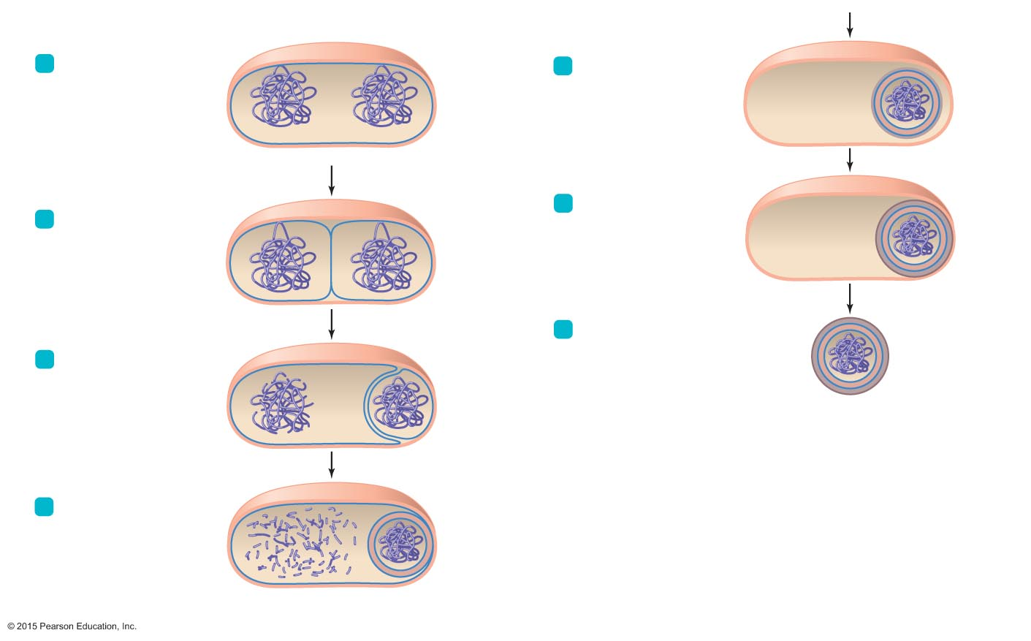
Figure 3.24 The formation of an endospore.
Cell wall
Cytoplasmic
membrane
Steps in Endospore Formation
1
DNA is replicated.
5
Spore coat forms
around endospore.
Spore coat
DNA
Vegetative cell
6
Endospore matures:
Completion of spore coat.
Increase in resistance
to heat and chemicals by
unknown process.
Outer
spore coat
2
Cytoplasmic membrane
invaginates to form
forespore.
Forespore
Endospore
7
Endospore is released from
original cell.
3
Cytoplasmic membrane
grows and engulfs
forespore within a
second membrane.
Vegetative cell's DNA
disintegrates.
First
membrane
Second
membrane
8
4
A cortex of pepti-
doglycan is deposited
between the membranes;
meanwhile, dipicolinic
acid and calcium ions
accumulate within the
center of the endospore.
Cortex

Slide 37
Sporulation
Important spore forming pathogens:
Bacillus anthracis, anthrax,
Clostridium spp., tetanus, botulism, gas gangrene
Sporulation is essential to the survival for these organisms in adverse conditions
On a practical level, sporulation in a major concern re: microbe safety
Video: https://www.youtube.com/watch?v=NAcowliknPs

Slide 38
Cytoplasm of Prokaryotes
Nonmembranous Organelles
Ribosomes
Sites of protein synthesis
Composed of polypeptides and ribosomal RNA
70S ribosome composed of smaller 30S and 50S subunits
Many antibacterial drugs act on bacterial ribosomes without affecting larger eukaryotic ribosomes

Slide 39
Cytoplasm of Prokaryotes
Nonmembranous Organelles
Cytoskeleton
Composed of three or four types of protein fibers
Can play different roles in the cell
Cell division
Cell shape
Segregation of DNA molecules
Movement through the environment

Slide 40
External Structure of Eukaryotic Cells
Glycocalyces
Not as organized as prokaryotic capsules
Help anchor animal cells to each other
Strengthen cell surface
Provide protection against dehydration
Function in cell-to-cell recognition and communication

Slide 41
Eukaryotic Cell Walls and Cytoplasmic Membranes
Fungi, algae, plants, and some protozoa have cell walls
Composed of various polysaccharides
Cellulose is found in plant cell walls
Fungal cell walls are composed of cellulose, chitin, and/or glucomannan
Algal cell walls are composed of a variety of polysaccharides

Slide 42
Eukaryotic Cell Walls and Cytoplasmic Membranes
All eukaryotic cells have cytoplasmic membrane
Are a fluid mosaic of phospholipids and proteins
Contain steroid lipids to help maintain fluidity
Localize signaling, protein sorting, and movement
Control movement into and out of cell

Slide 43
Notes:
43

Slide 44
Cytoplasm of Eukaryotes
Flagella
Structure and arrangement
Differ structurally and functionally from prokaryotic flagella
Within the cytoplasmic membrane
Shaft composed of tubulin arranged to form microtubules
Filaments anchored to cell by basal body; no hook
May be single or multiple; generally found at one pole of cell
Function
Do not rotate but undulate rhythmically

Slide 45
Figure 3.31a-b Eukaryotic flagella and cilia.
Flagellum
Cilia
Notes:
45

Slide 46
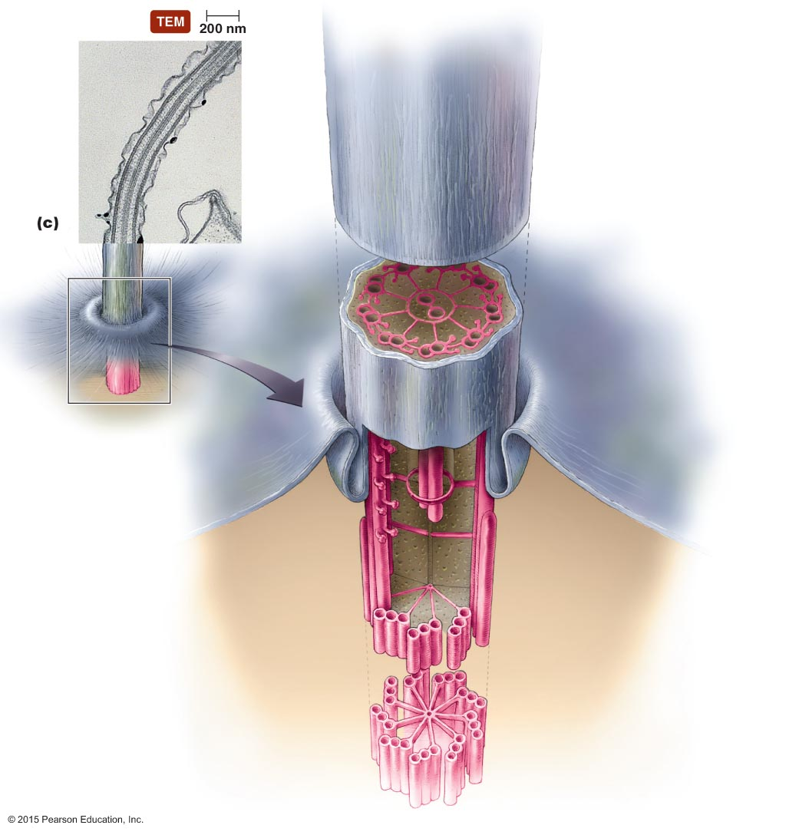
Figure 3.31c Eukaryotic flagella and cilia.
Cytoplasmic membrane
Cytosol
Central pair
microtubules
"9 + 2"
arrangement
Microtubules
(doublet)
Cytoplasmic
membrane
Portion
cut away to show
transition area
from doublets
to triplets and
the end of
central
microtubules
Basal body
Microtubules
(triplet)
"9 + 0"
arrangement
Notes:
46

Slide 47
Cytoplasm of Eukaryotes
Cilia
Shorter and more numerous than flagella
Coordinated beating propels cells through their environment
Also used to move substances past the surface of the cell

Slide 48
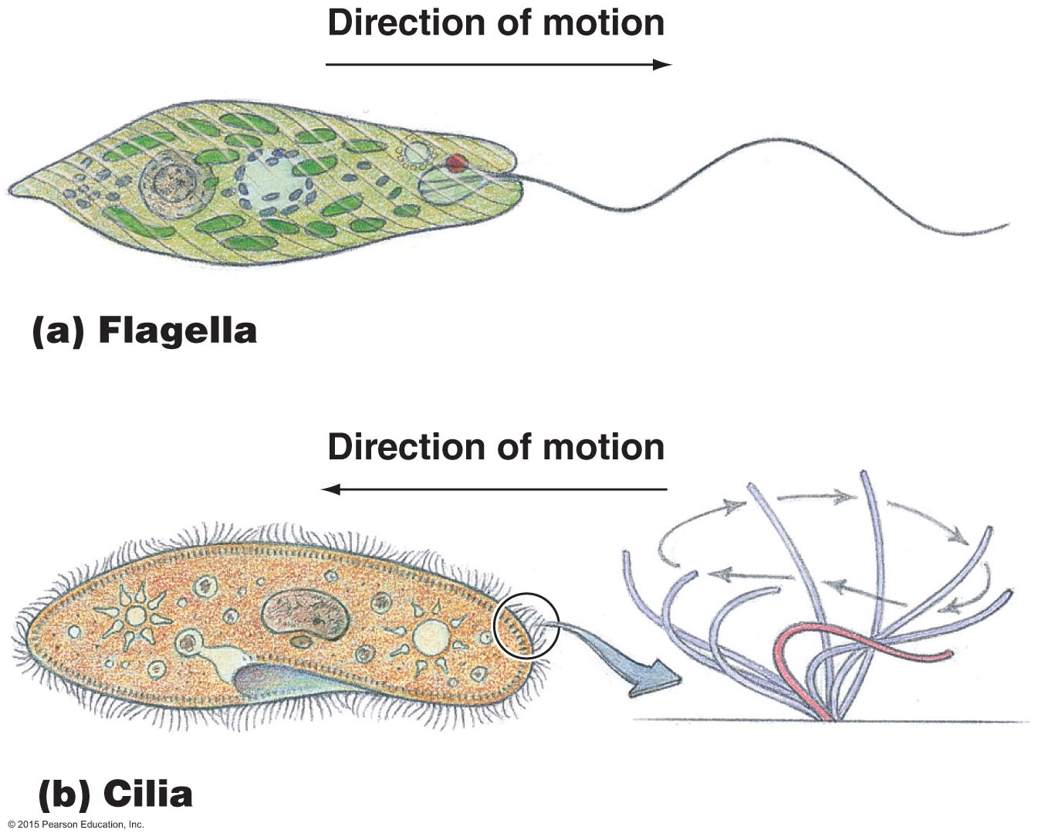
Figure 3.32 Movement of eukaryotic flagella and cilia.
Notes:
48

Slide 49
Cytoplasm of Eukaryotes
Other Nonmembranous Organelles
Ribosomes
Larger than prokaryotic ribosomes (80S versus 70S)
Composed of 60S and 40S subunits
Cytoskeleton
Extensive network of fibers and tubules
Anchors organelles
Produces basic shape of the cell
Made up of tubulin microtubules, actin microfilaments, and intermediate filaments

Slide 50
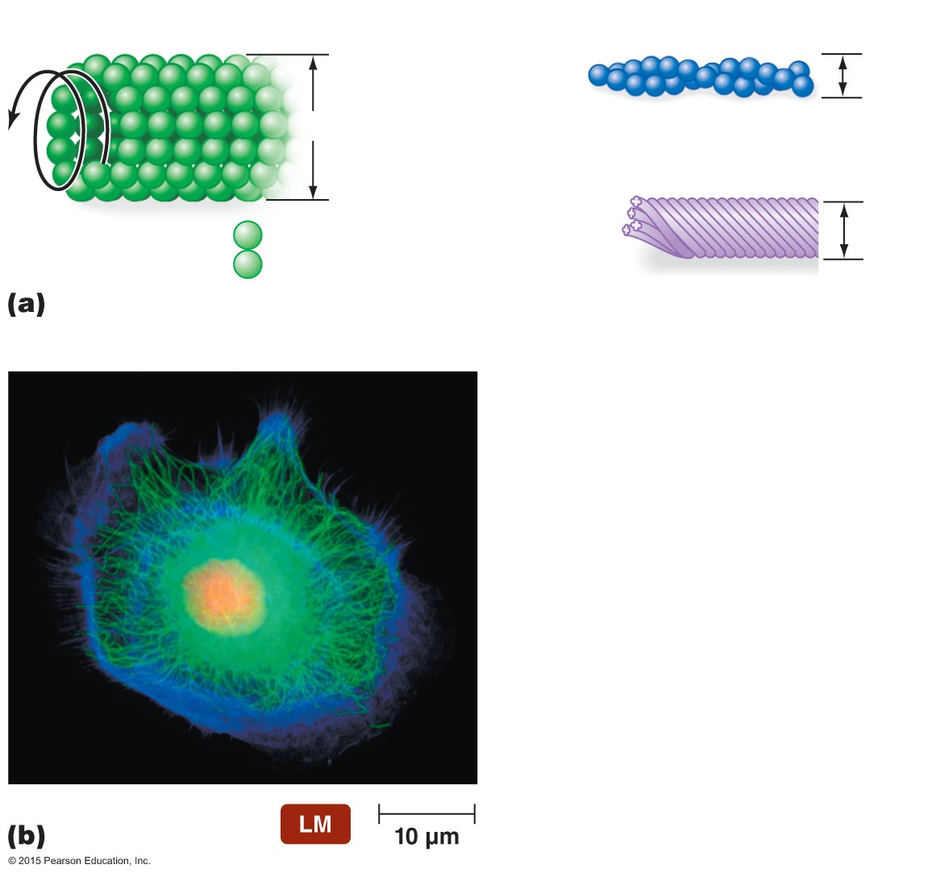
Figure 3.33 Eukaryotic cytoskeleton.
Microtubule
Microfilament
Actin
subunit
7 nm
25 nm
Intermediate filament
Protein
subunits
10 nm
Tubulin
Notes:
50

Slide 51
Cytoplasm of Eukaryotes
Other Nonmembranous Organelles
Centrioles and centrosome
Centrioles are composed of nine triplets of microtubules
Located in region of cytoplasm called centrosome
Not found in all eukaryotic cells
Centrosomes play a role in mitosis, cytokinesis, and formation of flagella and cilia

Slide 52
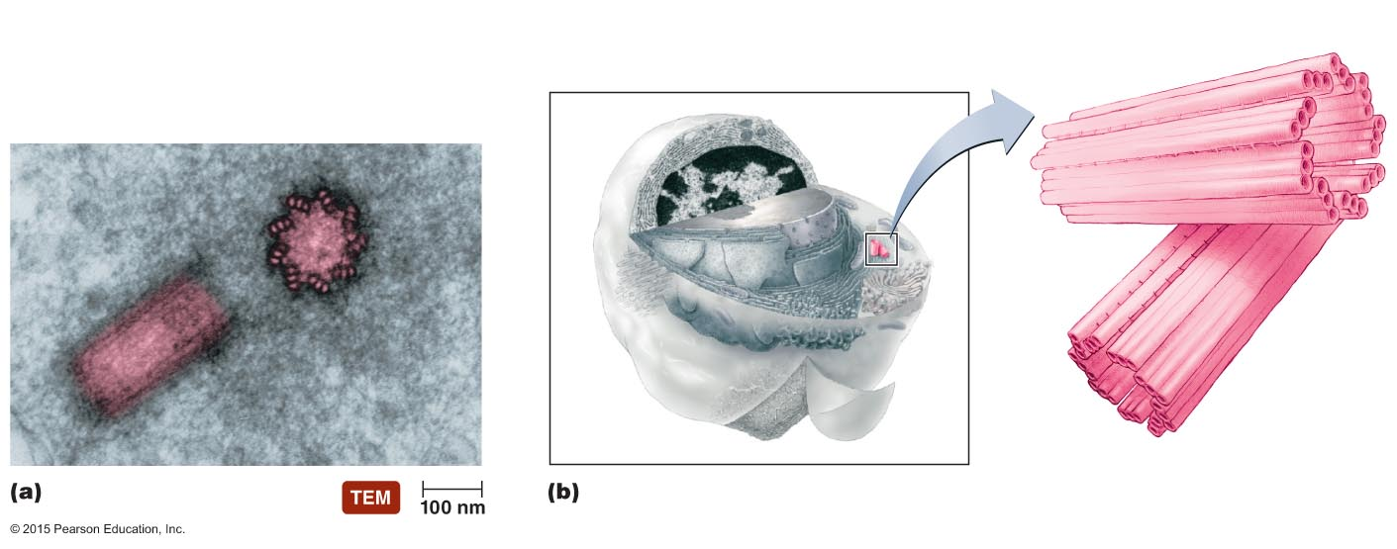
Figure 3.34 Centrosome.
Microtubules
Centrosome (made up of two centrioles)
Triplet
Notes:
52

Slide 53
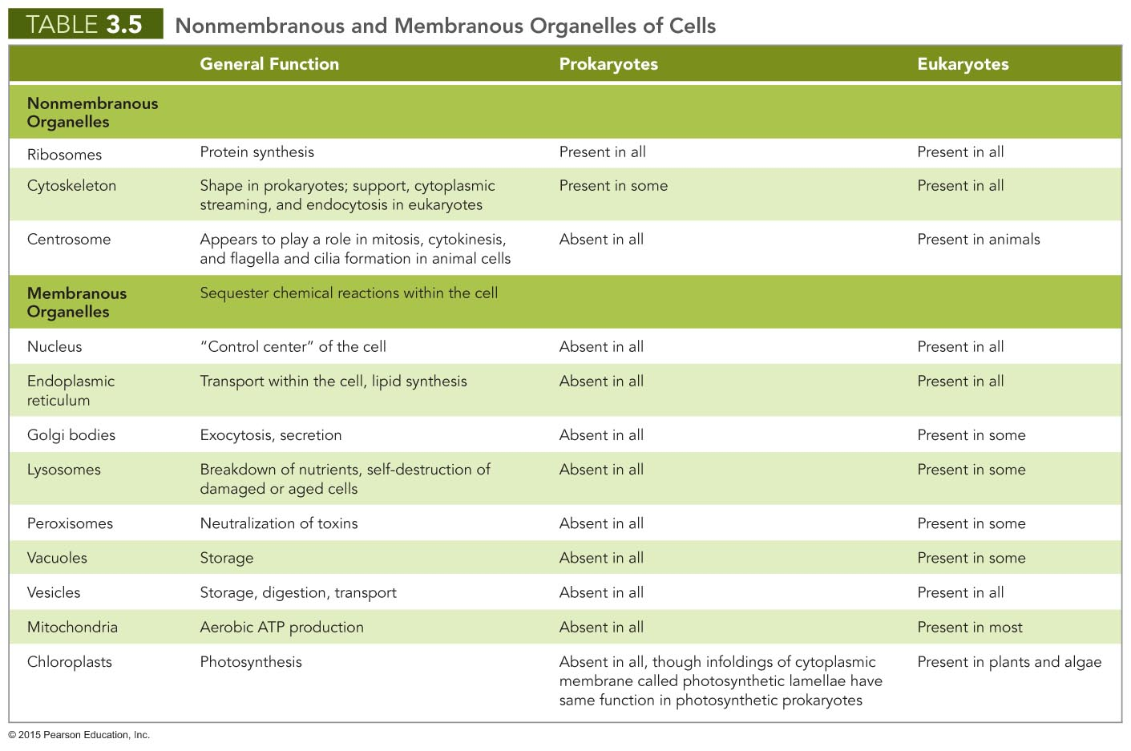
Notes:
53

Slide 54
Cytoplasm of Eukaryotes
Membranous Organelles
Nucleus
Often largest organelle in cell
Contains most of the cell's DNA
Semiliquid portion is called nucleoplasm
Contains chromatin
RNA synthesized in nucleoli present in nucleoplasm
Surrounded by nuclear envelope
Contains nuclear pores

Slide 55
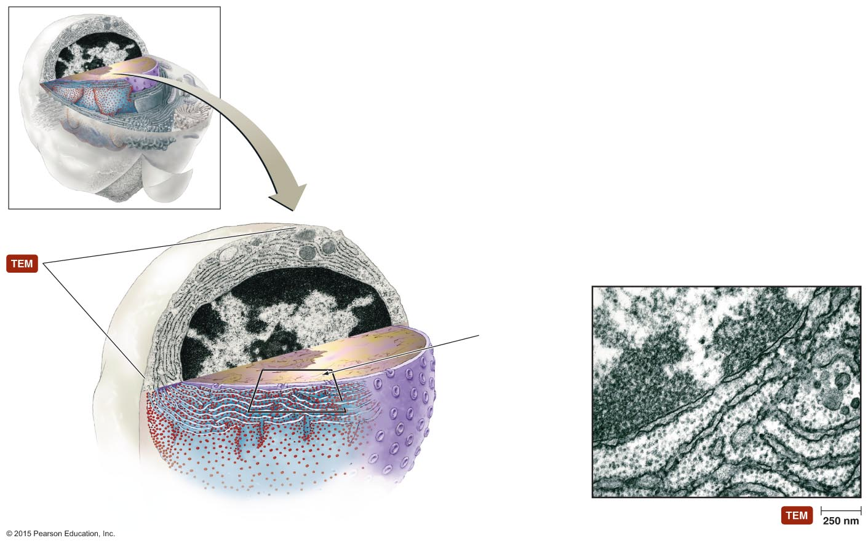
Figure 3.35 Eukaryotic nucleus.
Nucleolus
Nucleoplasm
Chromatin
Nuclear envelope
Two phospholipid
bilayers
Nuclear pores
Rough ER
Notes:
55

Slide 56
Cytoplasm of Eukaryotes
Membranous Organelles
Endoplasmic reticulum
Netlike arrangement of flattened, hollow tubules continuous with nuclear envelope
Functions as transport system
Two forms
Smooth endoplasmic reticulum (SER)
Rough endoplasmic reticulum (RER)

Slide 57
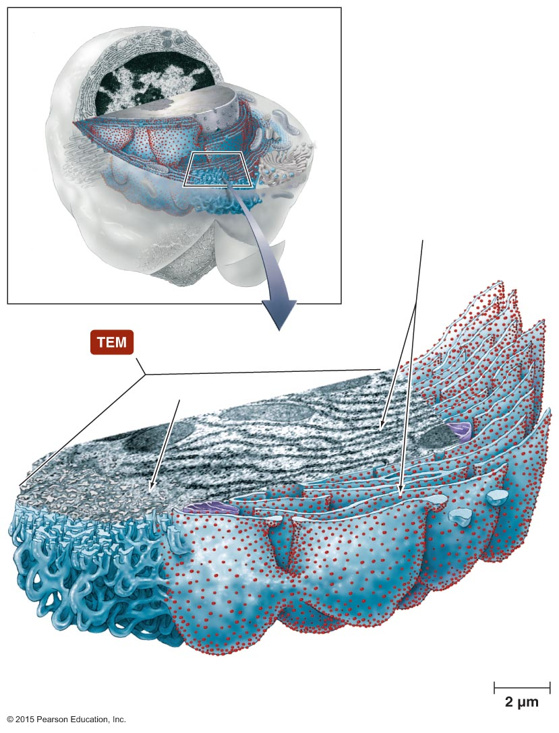
Figure 3.36 Endoplasmic reticulum.
Membrane-bound
ribosomes
Mitochondrion
Free ribosome
Rough endoplasmic
reticulum (RER)
Smooth endoplasmic
reticulum (SER)
Notes:
57

Slide 58
Cytoplasm of Eukaryotes
Membranous Organelles
Golgi body
Receives, processes, and packages large molecules for export from cell
Packages molecules in secretory vesicles that fuse with cytoplasmic membrane
Composed of flattened hollow sacs surrounded by phospholipid bilayer
Not in all eukaryotic cells

Slide 59
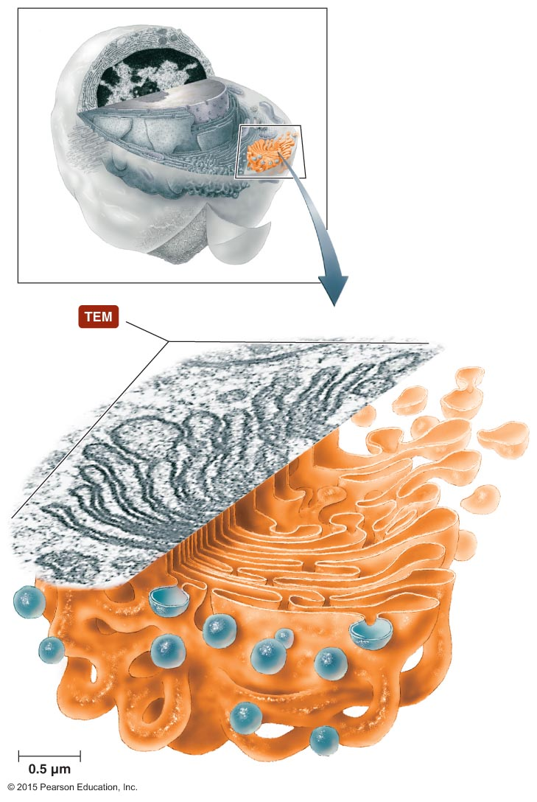
Figure 3.37 Golgi body.
Secretory vesicles
Vesicles
arriving
from ER
Notes:
59

Slide 60
Cytoplasm of Eukaryotes
Membranous Organelles
Lysosomes, peroxisomes, vacuoles, and vesicles
Store and transfer chemicals within cells
May store nutrients in cell
Lysosomes contain catabolic enzymes
Peroxisomes contain enzymes that degrade poisonous wastes

Slide 61
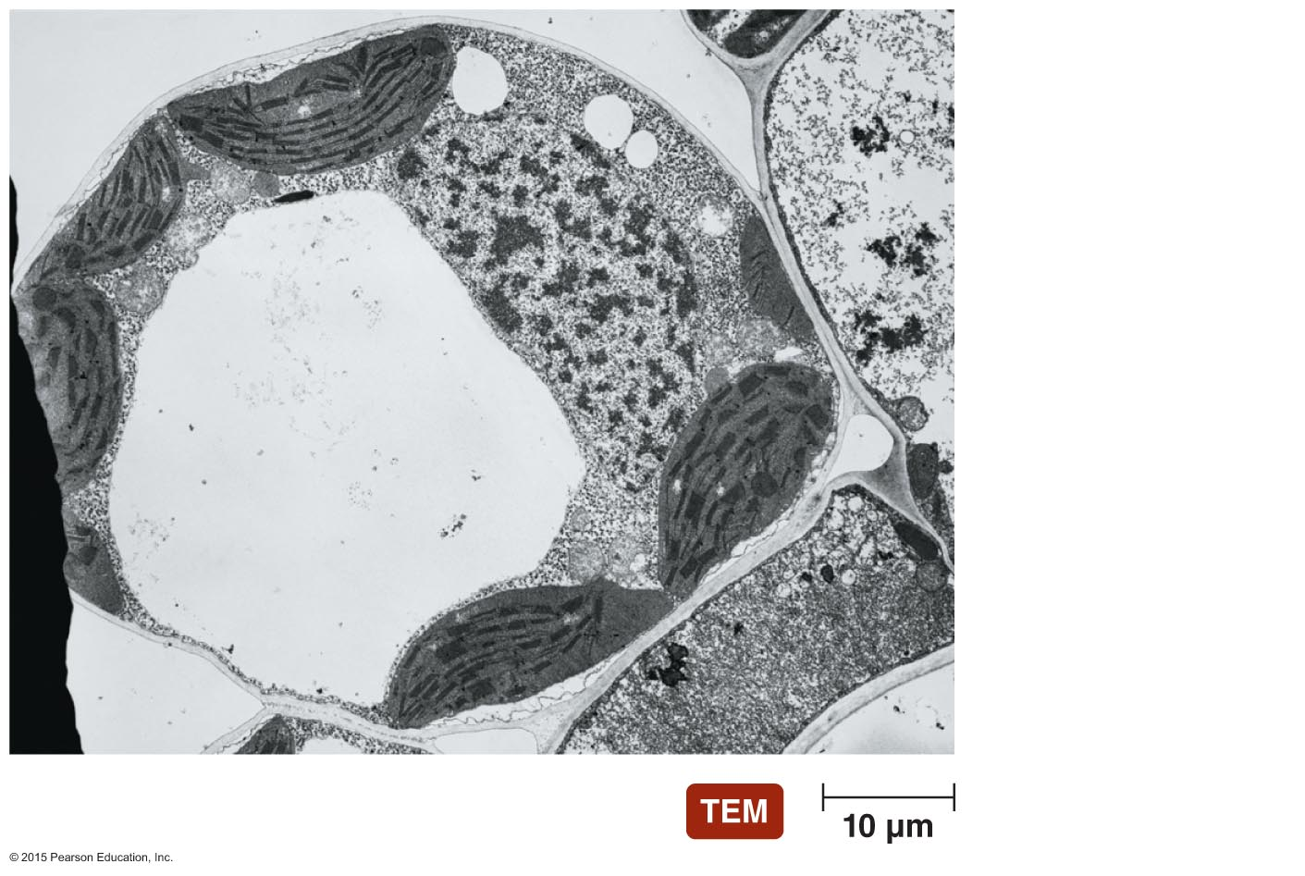
Figure 3.38 Vacuole.
Cell wall
Nucleus
Central vacuole
Cytoplasm
Notes:
61

Slide 62
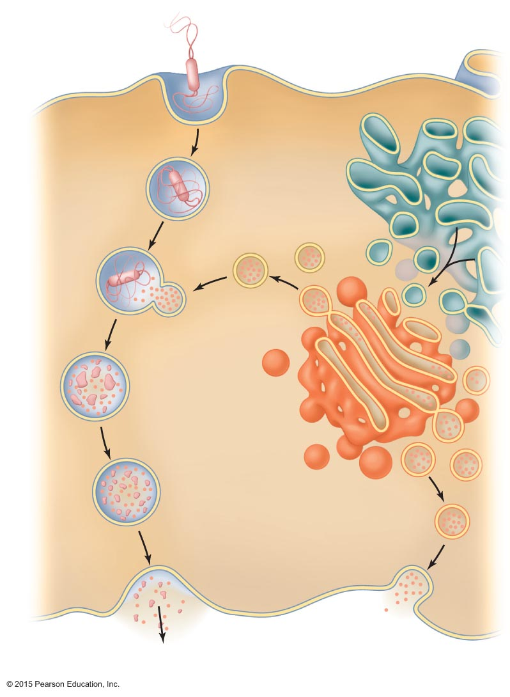
Figure 3.39 The roles of vesicles in endocytosis and exocytosis.
Endocytosis
(phagocytosis)
Bacterium
Smooth
endoplasmic
reticulum
(SER)
Phagosome
(food vesicle)
Vesicle
fuses with a
lysosome
Transport
vesicle
Lysosome
Phagolysosome
Golgi body
Secretory
vesicle
Exocytosis
(elimination, secretion)
Notes:
62

Slide 63
Cytoplasm of Eukaryotes
Membranous Organelles
Mitochondria
Have two membranes composed of phospholipid bilayer
Produce most of cell's ATP
Interior matrix contains 70S ribosomes and circular molecule of DNA

Slide 64
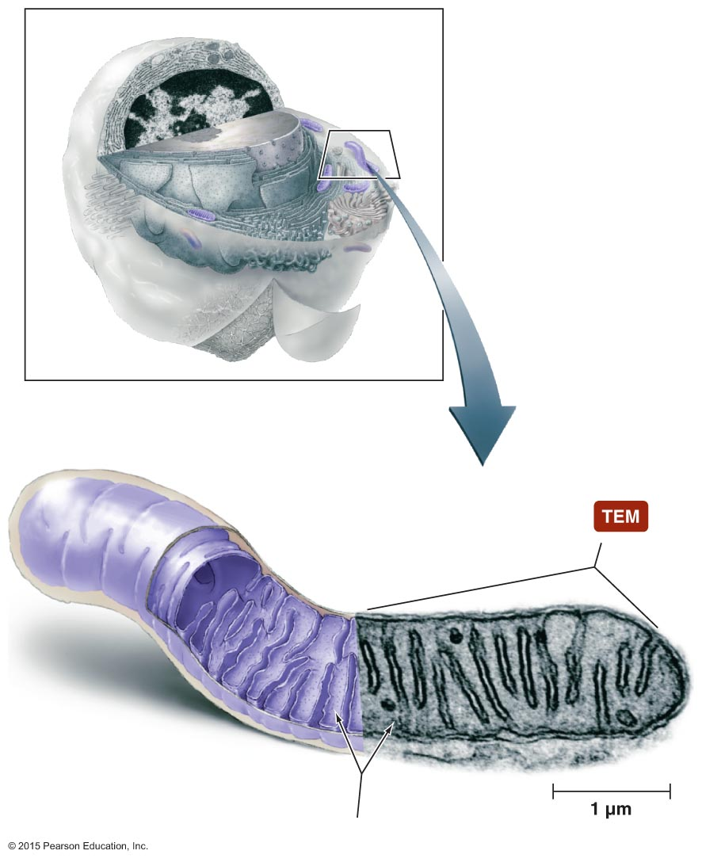
Figure 3.40 Mitochondrion.
Outer membrane
Inner membrane
Crista
Matrix
Ribosomes
Notes:
64

