Slide 1
Microbial nutrition & growth
Chapter 6
Microbiology – CCV

Slide 2
Growth Requirements
Microbial Growth
Increase in a population of microbes
Due to reproduction of individual microbes
Results in discrete colony or biofilm
Colony — aggregation of cells arising from single parent cell
Biofilm — collection of microbes living on a surface in a complex community

Slide 3
Growth Requirements
Organisms use a variety of nutrients for their energy needs and to build organic molecules and cellular structures
Most common nutrients contain necessary elements such as carbon, oxygen, nitrogen, and hydrogen
Microbes obtain nutrients from variety of sources

Slide 4
Growth Requirements
Nutrients: Chemical and Energy Requirements
Sources of carbon, energy, and electrons
Organisms classified into two groups based on source of carbon
Autotrophs—use inorganic carbon (ie carbon dioxide)
Heterotrophs—use catabolic process to obtain carbon from outside source
Organisms classified into two groups based on source of energy
Chemotrophs—acquire energy from redox reactions
Phototrophs—acquire energy from light

Slide 5
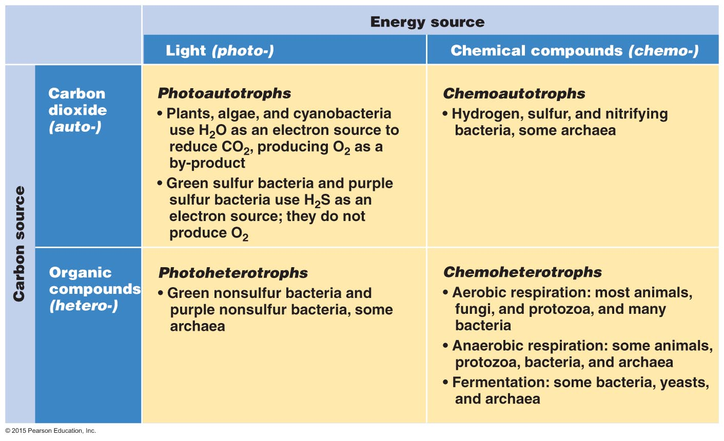
Figure 6.1 Four basic groups of organisms based on their carbon and energy sources.

Slide 6
Growth Requirements
Nutrients: Chemical and Energy Requirements
Sources of carbon, energy, and electrons
Organisms classified into two groups based on source of electrons
Organotrophs — heterotrophs acquire electrons from same organic molecules that provide them carbon
Lithotrophs — autrotrophs acquire electrons from inorganic molecules

Slide 7
Growth Requirements
Nutrients: Chemical and Energy Requirements
Oxygen requirements
Oxygen is essential for obligate aerobes
Oxygen is deadly for obligate anaerobes
How can this be true?
Toxic forms of oxygen are highly reactive and excellent oxidizing agents
Resulting oxidation causes irreparable damage to cells

Slide 8
Growth Requirements
Nutrients: Chemical and Energy Requirements
Oxygen requirements
Aerobes—oxygen is necessary
Anaerobes—oxygen is toxic
Facultative anaerobes—organisms can live with or without oxygen
Aerotolerant anaerobes--organisms which prefer anaerobic conditions but can tolerate exposure to low levels of oxygen
Microaerophiles—organisms that require low levels of oxygen

Slide 9
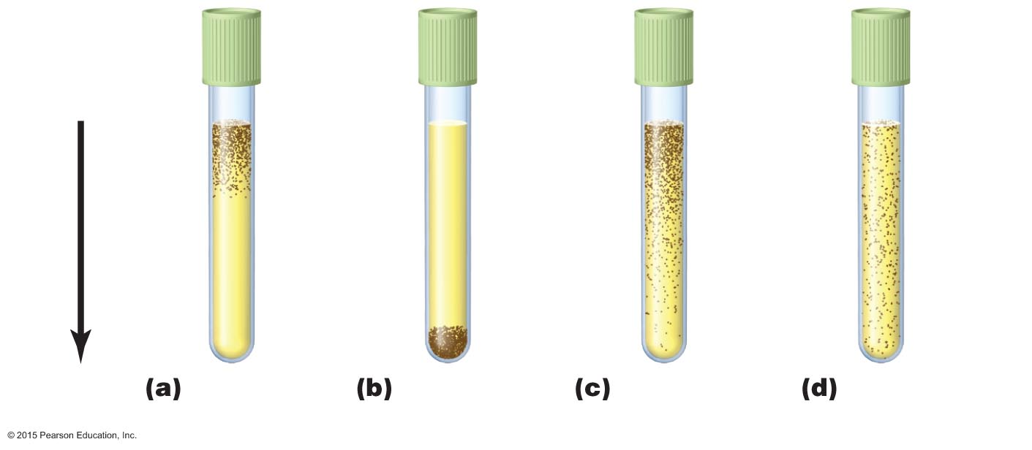
Figure 6.3 Using a liquid thioglycollate growth medium to identify the oxygen requirements of organisms.
Oxygen
concentration
Loose-
fitting
cap
High
Low
Obligate
aerobes
Obligate
anaerobes
Facultative
anaerobes
Aerotolerant
anaerobes

Slide 10
Growth Requirements
Nutrients: Chemical and Energy Requirements
Nitrogen requirements
Anabolism often ceases because of insufficient nitrogen (rate-limiting)
Nitrogen acquired from organic and inorganic nutrients
All cells recycle nitrogen from amino acids and nucleotides
Nitrogen fixation by certain bacteria is essential to life on Earth

Slide 11
Growth Requirements
Nutrients: Chemical and Energy Requirements
Other chemical requirements
Phosphorus
Sulfur
Trace elements
Required only in small amounts
Growth factors
Necessary organic chemicals that cannot be synthesized by certain organisms

Slide 12
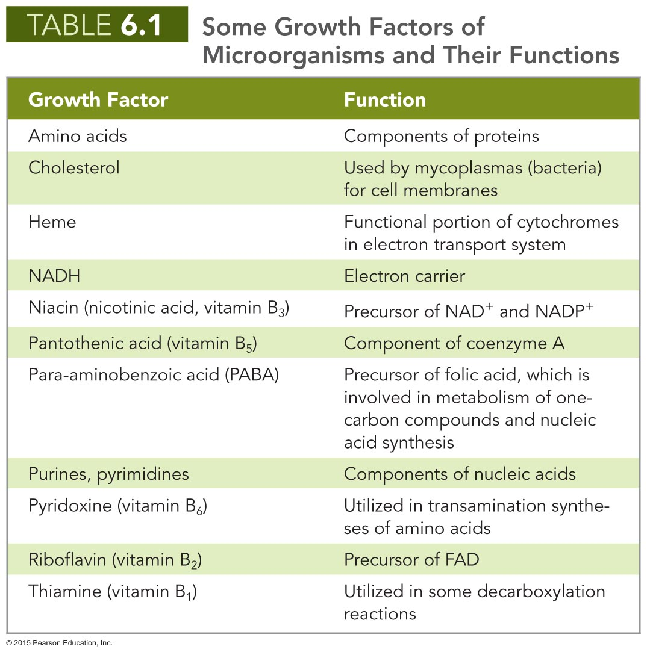

Slide 13
Growth Requirements
Physical Requirements
Temperature
Temperature affects three-dimensional structure of proteins
Lipid-containing membranes of cells and organelles are temperature sensitive
If too low, membranes become rigid and fragile
If too high, membranes become too fluid

Slide 14
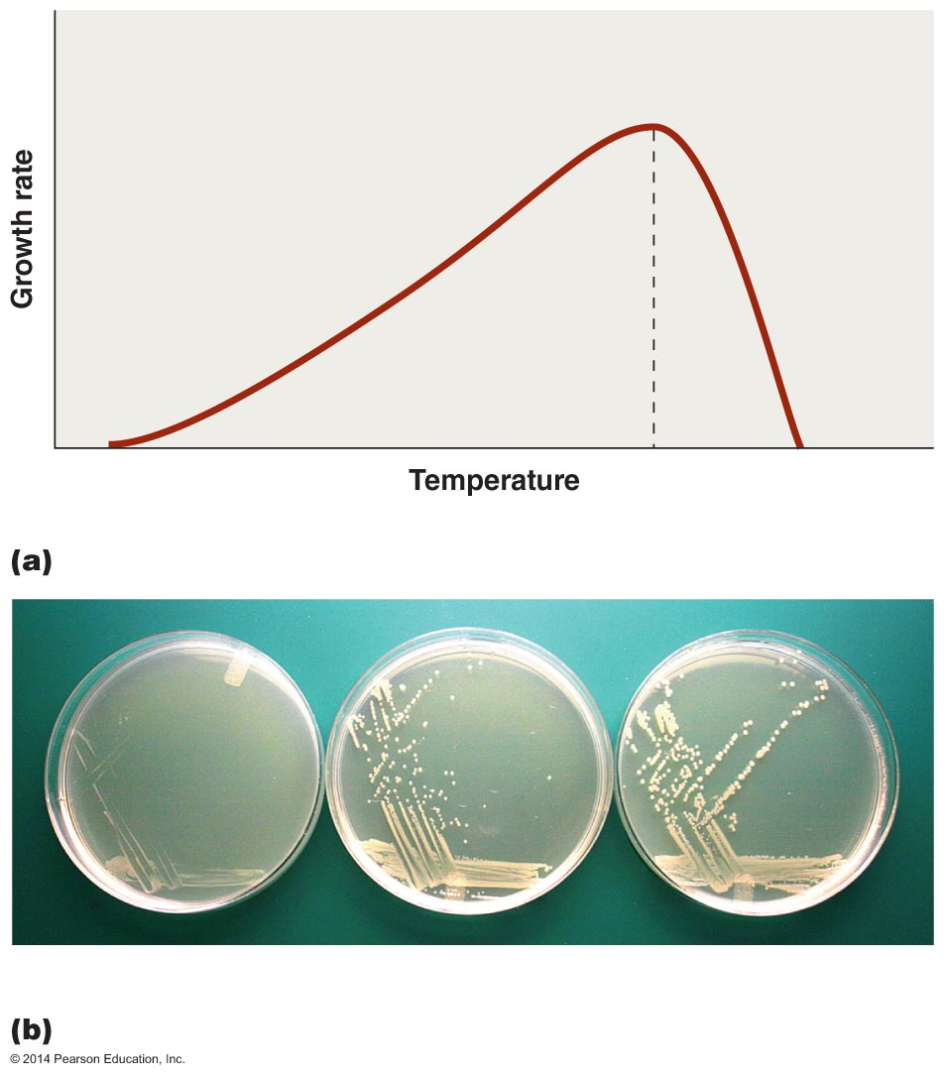
Figure 6.4 The effects of temperature on microbial growth.
Minimum
Maximum
Optimum
22ºC
30ºC
37ºC

Slide 15
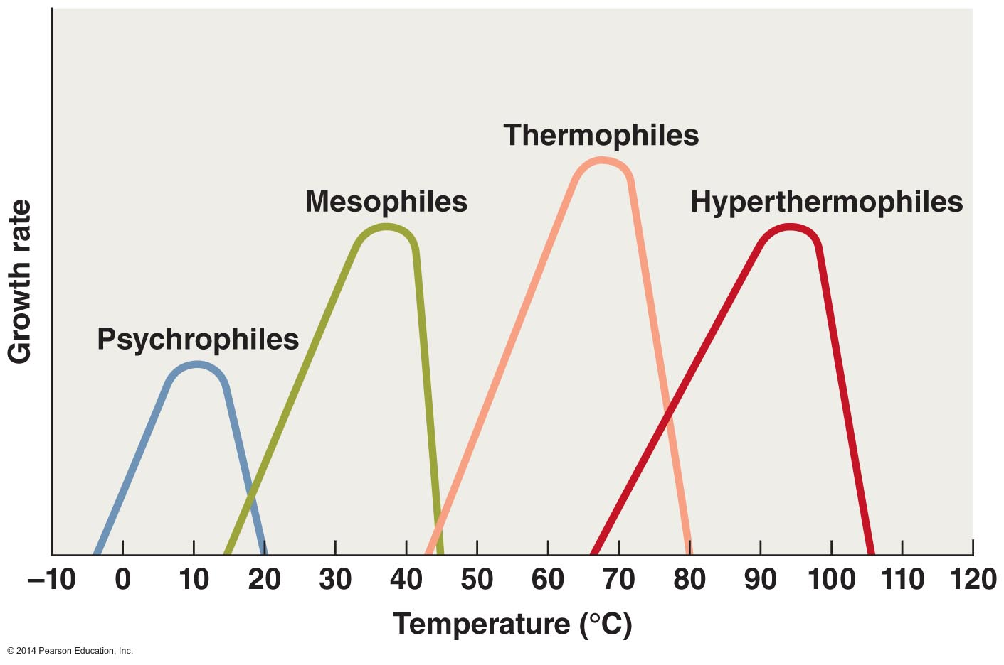
Figure 6.5 Four categories of microbes based on temperature ranges for growth.

Slide 16
Growth Requirements
Physical Requirements
pH
Organisms are sensitive to changes in acidity
Neutrophiles grow best in a narrow range around neutral pH
Acidophiles grow best in acidic habitats
Many microbes produce acidic waste products that can accumulate and inhibit their growth
Alkalinophiles live in alkaline soils and water

Slide 17
Growth Requirements
Physical Requirements
Physical effects of water
Microbes require water to dissolve enzymes and nutrients
Water is important reactant in many metabolic reactions
Most cells die in absence of water
Some have cell walls that retain water
Endospores and cysts cease most metabolic activity
Two physical effects of water
Osmotic pressure
Hydrostatic pressure

Slide 18
Growth Requirements
Physical Requirements
Physical effects of water
Osmotic pressure
Pressure exerted on a semipermeable membrane by a solution containing solutes that cannot freely cross membrane
Hypotonic solutions have lower solute concentrations
Cell placed in hypotonic solution swells
Hypertonic solutions have greater solute concentrations
Cell placed in hypertonic solution shrivels
Restricts organisms to certain environments
Obligate and facultative halophiles

Slide 19
Growth Requirements
Physical Requirements
Physical effects of water
Hydrostatic pressure
Water exerts pressure in proportion to its depth
Barophiles live under extreme pressure
Their membranes and enzymes depend on pressure to maintain their three-dimensional, functional shape

Slide 20
Growth Requirements
Associations and Biofilms
Organisms live in association with different species
Antagonistic relationships — a microbe harms another organism
Synergistic relationships — members of an association receive benefits that exceed those that would result if each lived by itself
Symbiotic relationships — organisms become interdependent and rarely live outside the relationship

Slide 21
Growth Requirements
Associations and Biofilms
Biofilms
Complex relationships among numerous microorganisms
Form on surfaces, medical devices, mucous membranes of digestive system
Form as a result of quorum sensing
Many microorganisms more harmful as part of a biofilm
Dental plaque is a biofilm that can lead to cavities
Scientists seeking ways to prevent biofilm formation

Slide 22
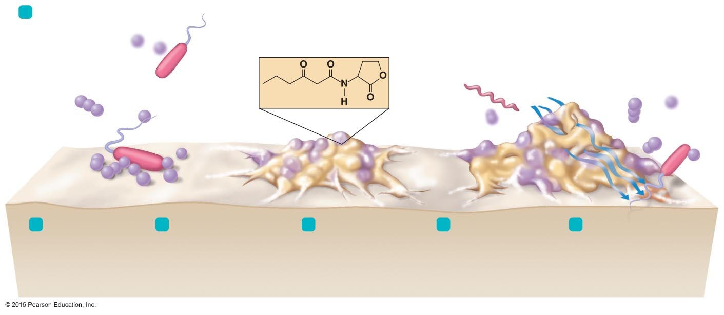
Figure 6.7 Biofilm development.
1
Free-swimming microbes are vulnerable to environmental
stresses.
Water flow
Chemical structure of one type of
quorum-sensing molecule
Water channel
Bacteria
Escaping
microbes
Matrix
2
Some microbes land on a surface, such as a tooth, and attach.
3
The cells begin producing an intracellular matrix and secrete quorum-sensing molecules.
Quorum sensing triggers cells to change their biochemistry and shape.
New cells arrive, possibly including new species, and water channels form in the biofilm.
Some microbes escape from the biofilm to resume a free-living existence
and, perhaps, to form a
new biofilm on another surface.
4
5
6

Slide 23
Culturing Microorganisms
Inoculum introduced into nutrients called media
Inocula obtained from various sources
1) Environmental specimens
2) Clinical specimens
3) Stored specimens
Culture
Act of cultivating microorganisms or the microorganisms that are cultivated

Slide 24
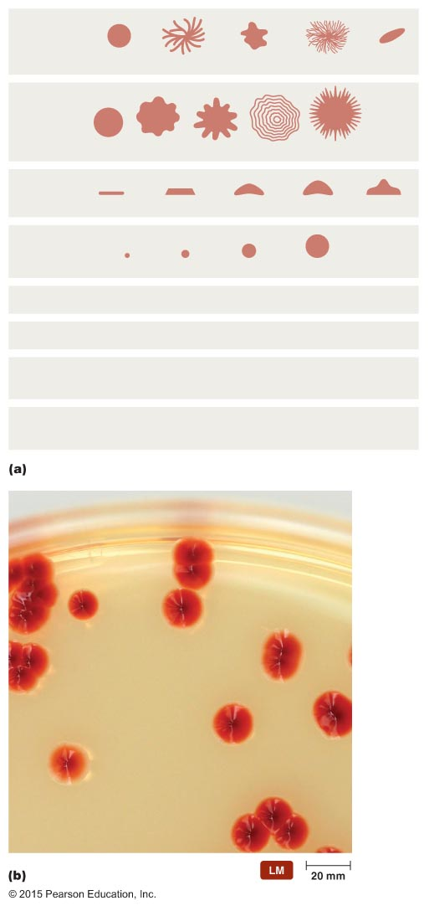
Figure 6.8 Characteristics of bacterial colonies.
Shape
Circular
Rhizoid
Irregular
Filamentous
Spindle
Margin
Entire
Undulate
Lobate
Curled
Filiform
Elevation
Flat
Raised
Convex
Pulvinate
Umbonate
Size
Punctiform
Small
Moderate
Large
Texture
Smooth or rough
Appearance
Glistening (shiny) or dull
Pigmenta-
tion
Nonpigmented (e.g., cream, tan, white)
Pigmented (e.g., purple, red, yellow)
Optical
property
Opaque, translucent, transparent
Colony

Slide 25
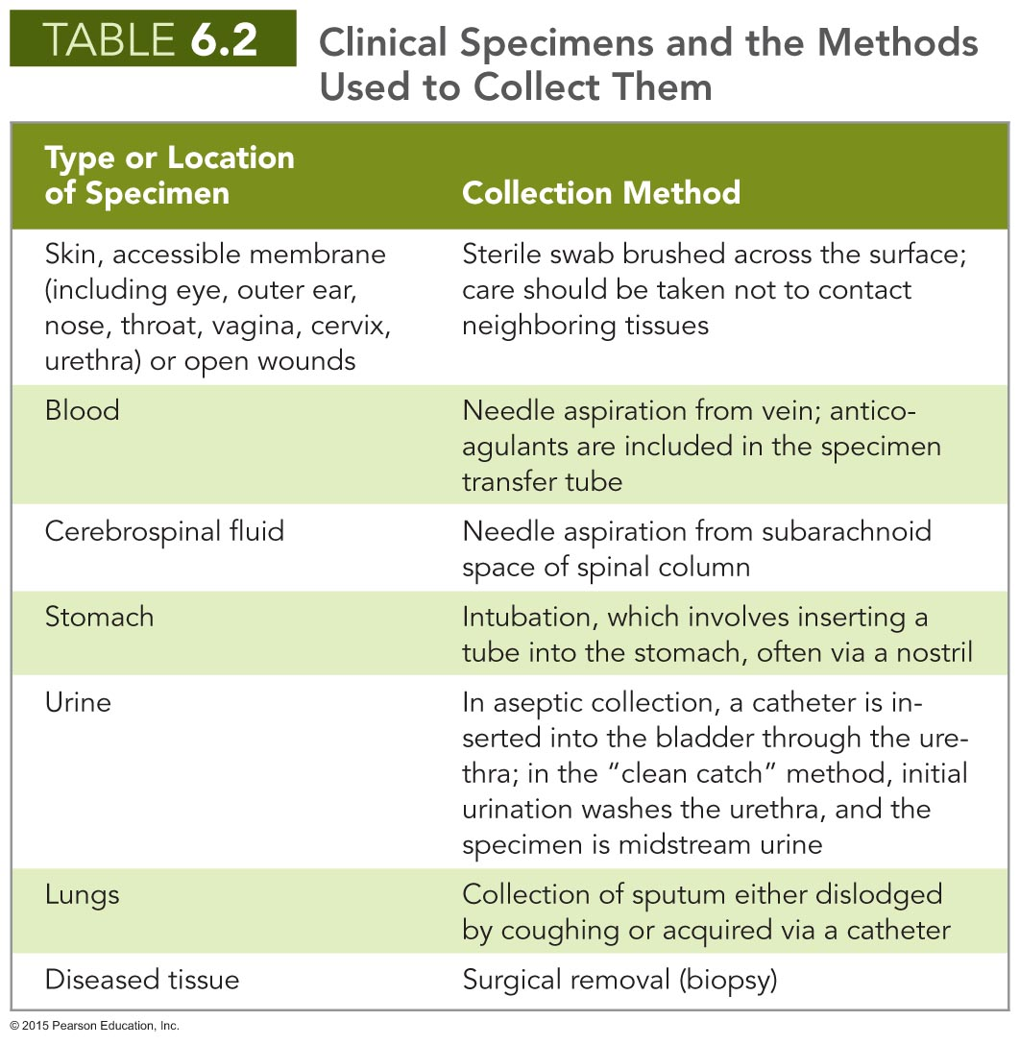

Slide 26
Culturing Microorganisms
Obtaining Pure Cultures
Pure cultures are composed of cells arising from a single progenitor
Progenitor is termed a colony-forming unit (CFU)
Aseptic technique prevents contamination of sterile substances or objects
Two common isolation techniques
1) Streak plates
2) Pour plates

Slide 27
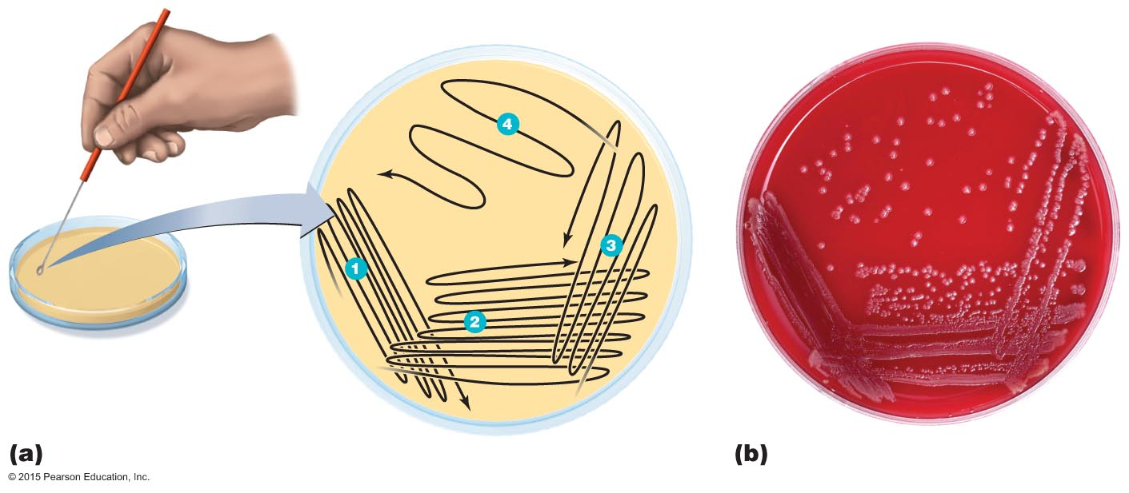
Figure 6.9 The streak-plate method of isolation.

Slide 28
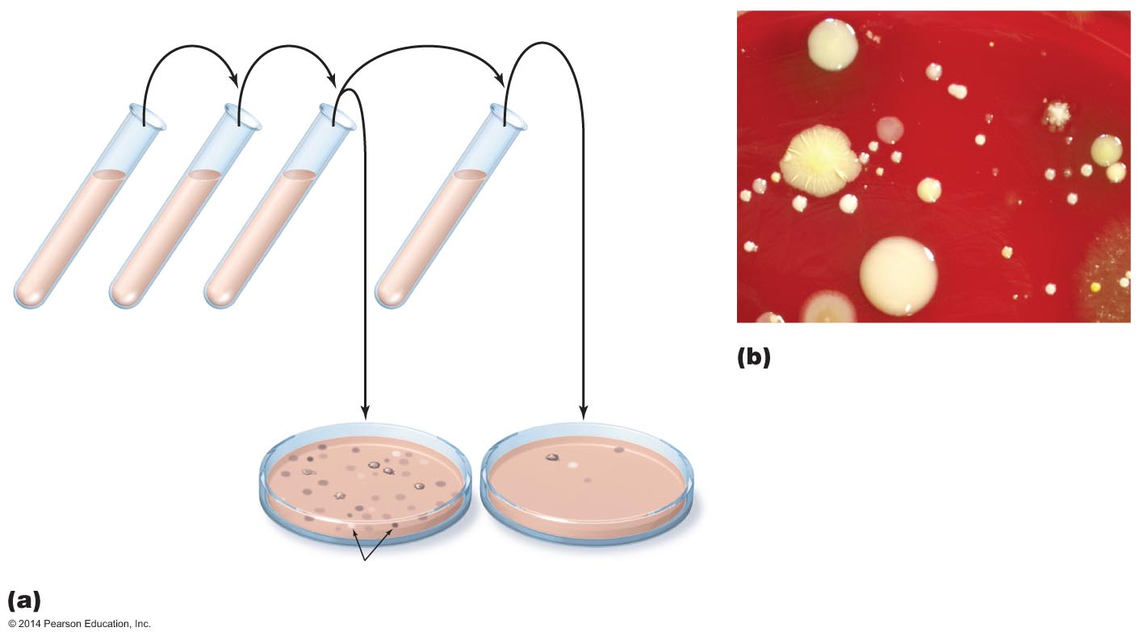
Figure 6.10 The pour-plate method of isolation.
Sequential inoculations
1.0 ml
1.0 ml
1.0 ml
9 ml
broth
9 ml
broth
9 ml
broth
Initial
sample
1.0 ml to each
Petri dish, add
9 ml warm agar,
swirl gently to mix
Colonies
Fewer colonies

Slide 29
Culturing Microorganisms
Obtaining Pure Cultures
Other isolation techniques
Some fungi are isolated with streak and pour plates
Protozoa and motile unicellular algae are isolated through dilution of broth cultures
Can individually pick single cell of some large microorganisms and use to establish a culture

Slide 30
Culturing Microorganisms
Culture Media
Nutrient broth is common medium
Agar is a common addition to many media
Complex polysaccharide derived from certain red algae
Produces a solid surface for colonial growth
Most microbes cannot digest agar

Slide 31
Culturing Microorganisms
Culture Media
Six types of general culture media
Defined media
Complex media
Selective media
Differential media
Anaerobic media
Transport media

Slide 32
Culturing Microorganisms
Culture Media
Defined media
Medium in which the exact chemical composition is known
Fastidious organisms require the addition of a large number of growth factors

Slide 33
Culturing Microorganisms
Culture Media
Complex media
Exact chemical composition is unknown
Contain nutrients released by partial digestion of yeast, beef, soy, or proteins
Support growth of wide variety of microorganisms
Used to culture organisms with unknown nutritional needs

Slide 34
Culturing Microorganisms
Culture Media
Selective Medium (@ right) favoring fungal growth but inhibiting bacterial growth
Selective media
Contain substances that either favor the growth of particular microorganisms or inhibit the growth of unwanted ones
A medium can become a selective medium when a single crucial nutrient is left out of it
Used to culture organisms with known nutritional needs

Slide 35
Culturing microorganisms
Differential Media
(L.= beta-hemolysis, middle = alpha-hemolysis, R = gamma-hemolysis)
Formulated to differentiate different types of bacteria in a sample based on key characteristics of behavior in the medium
Ex: Streptococcus pyogenes, Streptococcus pneumoniae, and Enterococcus faecalis in sample at right

Slide 36
Culturing Microorganisms
Culture Media
Enrichment media
Use of a selective medium to increase the numbers of a chosen microbe to observable levels
May require a series of cultures to enrich for the desired microbe
Cold enrichment used to enrich a culture with cold-tolerant species

Slide 37
Culturing Microorganisms
Culture Media
Anaerobic media
Obligate anaerobes must be cultured in the absence of free oxygen
Reducing media contain compounds that combine with free oxygen and remove it from the medium
Petri plates are incubated in anaerobic culture vessels
Sealable containers that contain reducing chemicals

Slide 38
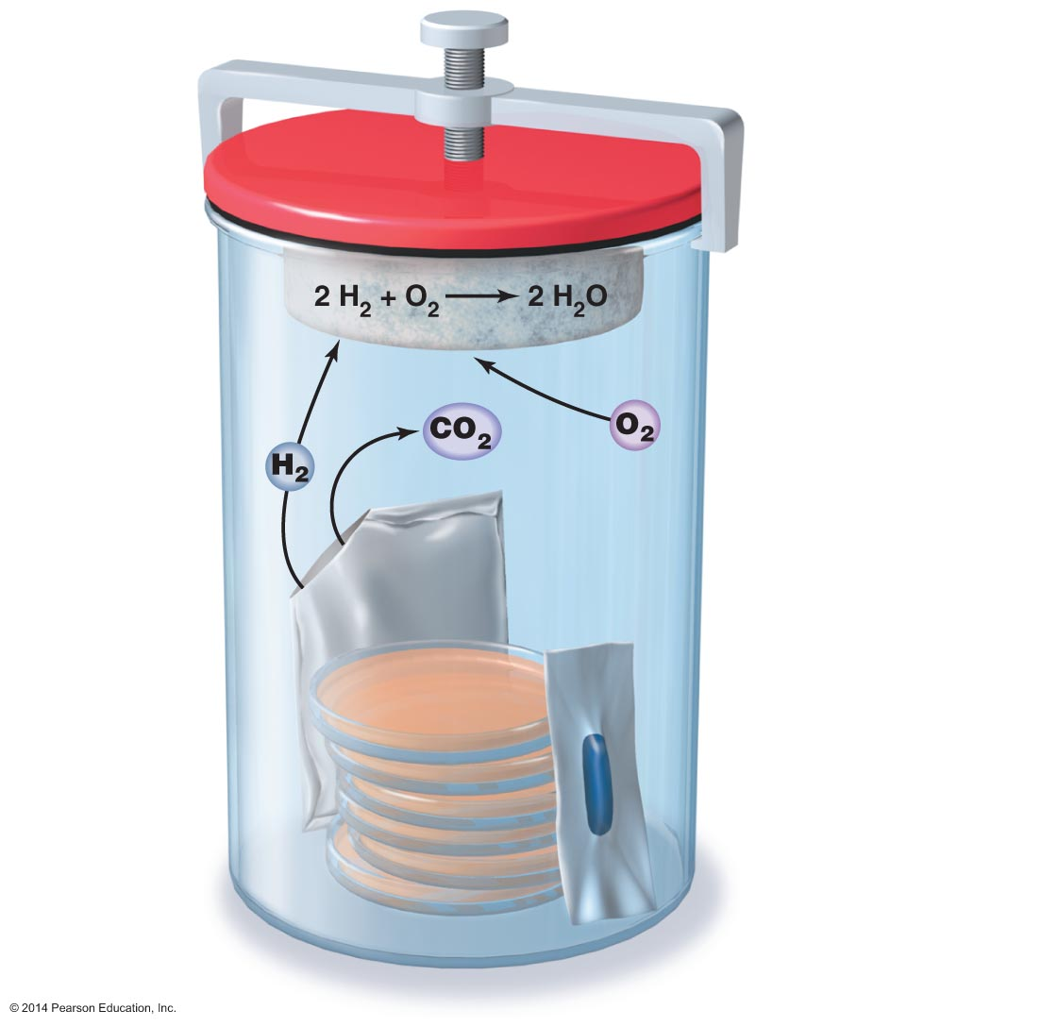
Figure 6.16 An anaerobic culture system.
Clamp
Airtight lid
Chamber
Palladium pellets
to catalyze reaction
removing O₂
Envelope
containing
chemicals to
release CO₂
and H₂
Methylene blue
(anaerobic
indicator)
Petri plates

Slide 39
Culturing Microorganisms
Culture Media
Transport media
Used by clinical personnel to ensure clinical specimens are not contaminated and to protect people from infection
Rapid transport of samples is important

Slide 40
Culturing Microorganisms
Special Culture Techniques
Techniques developed for culturing microorganisms
Animal and cell culture
Used when artificial media are inadequate
Required for growth of viruses and other obligate intracellular parasites

Slide 41
Bacterial growth
View the Study Area Video in Mastering Microbiology:
Study Area→Micro Animations→Microbial Nutrition & Growth→Bacterial Growth Overview

Slide 42
Binary Fisson
View the Study Area Video in Mastering Microbiology:
Study Area→Micro Animations→Microbial Nutrition & Growth→Binary Fission

Slide 43
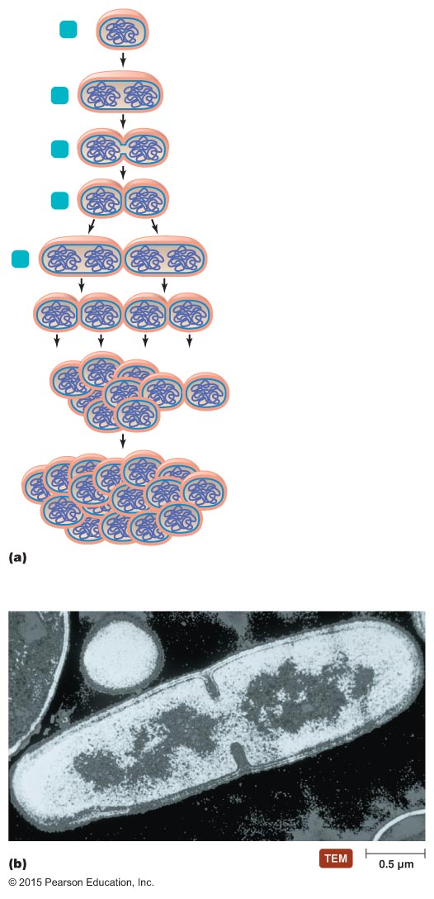
Figure 6.17 Binary fission.
1
Cytoplasmic membrane
Chromosome
Cell wall
2
Replicated
chromosome
30 minutes
3
Septum
4
Completed
septum
5
60 minutes
90 minutes
120 minutes
Septum

Slide 44
Growth of Microbial Populations
Generation Time
Time required for a bacterial cell to grow and divide
Dependent on chemical and physical conditions

Slide 45
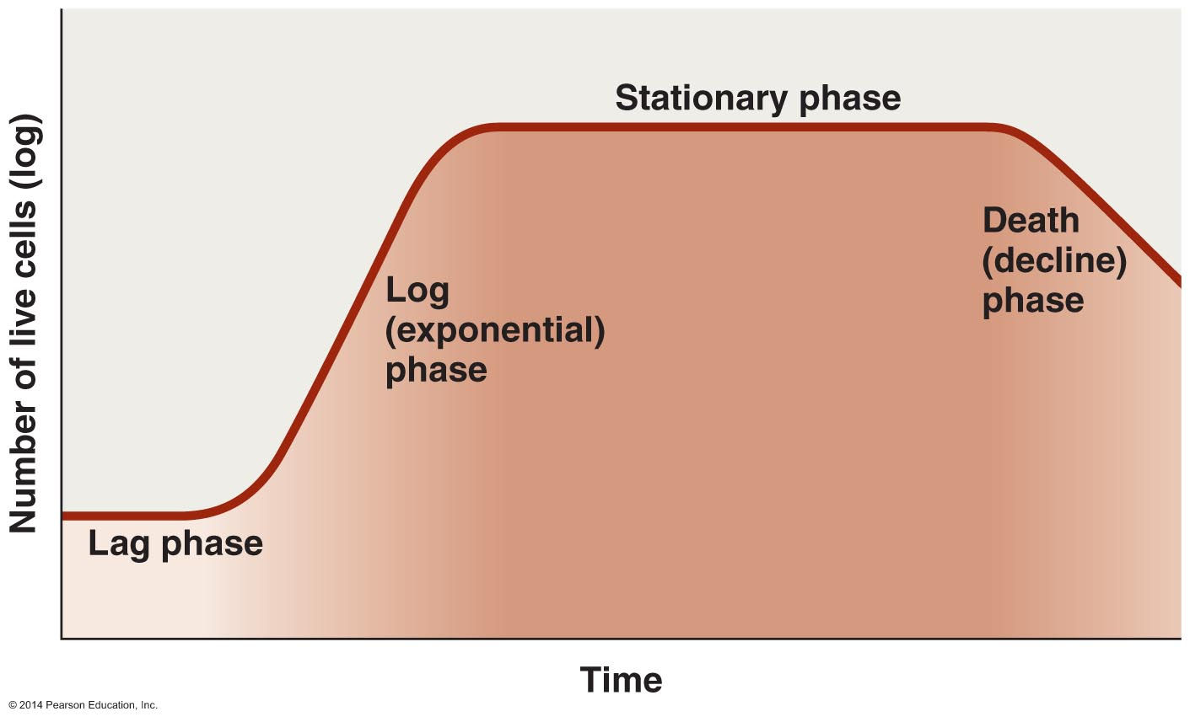
Figure 6.20 A typical microbial growth curve.

Slide 46
Bacterial growth curve
View the Study Area Video in Mastering Microbiology:
Study Area→Micro Animations→Microbial Nutrition & Growth→Bacterial Growth Curve

