Slide 1
Microbial Diseases of the Digestive System
Microbiology
CCV
Dr. Melanie Meyer

Slide 2
Structures of the Digestive System
Digestive System Structures Are Divided into Two Groups
Gastrointestinal tract (GI tract)
The pathway from the mouth to the anus
Most organs of the GI tract are protected by the peritoneum
Accessory digestive organs
Organs involved in grinding food or providing digestive secretions

Slide 3
Structures of the Digestive System
The Gastrointestinal Tract
Digests food, absorbs nutrients and water into the blood, and eliminates waste
Components of the gastrointestinal tract
Mouth
Esophagus
Stomach
Small intestine
Large intestine (colon)
Rectum and anus

Slide 4
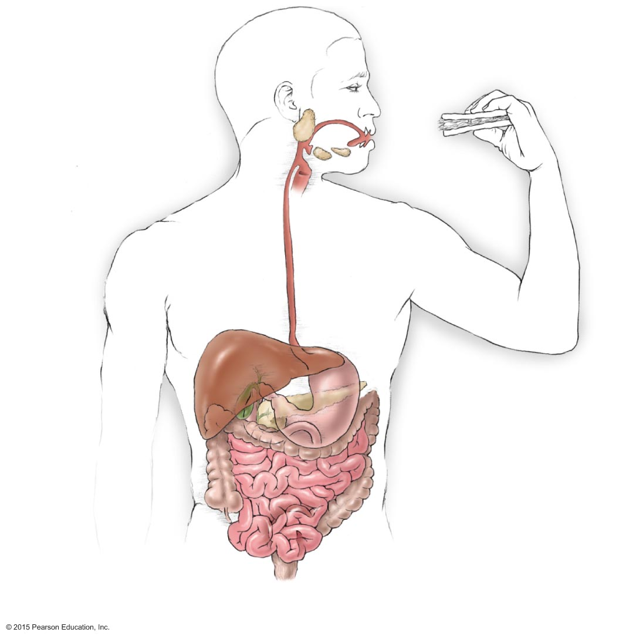
Figure 23.1 Major structures of the digestive system.
Uvula
Tongue
Salivary glands
Teeth
Pharynx
Mouth
Esophagus
Liver
Stomach
Pancreas
Gallbladder
Descending
colon
Duodenum
Transverse
colon
Small
intestine
Jejunum
Large
intestine
Ascending
colon
Ileum
Sigmoid colon
Rectum
Anus

Slide 5
Structures of the Digestive System
The Accessory Digestive Organs
Tongue and teeth
Salivary glands
Liver
Gallbladder
Pancreas

Slide 6
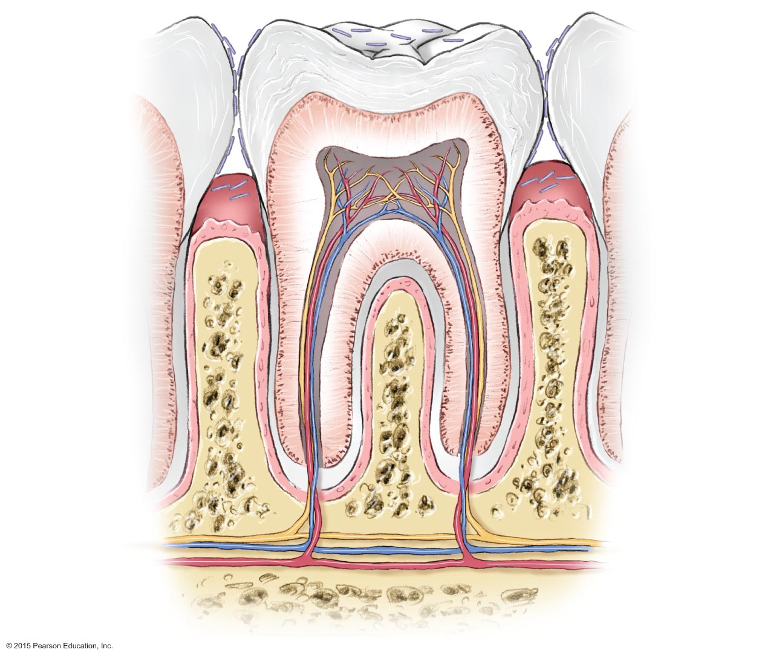
Figure 23.2 Detailed structure of teeth and socket.
Bacteria
Enamel
Dentin
Pulp
Gingiva
(gum)
Bone
Branches of
blood vessels
and nerve
in root canal

Slide 7
Normal Microbiota of the Digestive System
Esophagus, stomach, duodenum
These regions are almost free of microbes
Peristalsis and rapid transport of food helps prevent microbial colonization
Tongue, teeth, jejunum, ileum, colon, rectum
Viridans streptococci are most prevalent in this region
Lower small intestine and colon
Microbiota here are microbial antagonists
Mucous membrane prevents entry of microbes into the bloodstream

Slide 8
Bacterial Diseases of the Digestive System
Dental Caries, Gingivitis, and Periodontal Disease
Signs and symptoms
Caries
Appears as holes or pits in the teeth
Periodontal disease
Gums that are swollen, tender, bright red, or bleeding
Pathogen, virulence factors, and pathogenesis
Streptococcus mutans is a frequent cause of caries
Dextran and pili allow biofilm formation on the tooth
Porphyromonas gingivalis causes periodontal disease
Proteases break down gingival tissue

Slide 9
Figure 23.3 The process of tooth decay.

Slide 10
Bacterial Diseases of the Digestive System
Dental Caries, Gingivitis, and Periodontal Disease
Epidemiology
Most adults have experienced dental caries
Diets high in sucrose increase the risk of decay
Diagnosis, treatment, and prevention
Caries
Diagnosed by visual inspection
Treated by filling cavities if caught early
Gingivitis
Diagnosed by inspection of gums
Treated by scaling and use of antibacterial rinses
Prevention involves good oral hygiene

Slide 11
Bacterial Diseases of the Digestive System
Peptic Ulcers
Signs and symptoms
Abdominal pain is main symptom
Pathogen and virulence factors
Caused by Helicobacter pylori
Numerous virulence factors
Flagella enable burrowing through stomach lining
Adhesins facilitate attachment to gastric cells
Urease neutralizes stomach acid

Slide 12
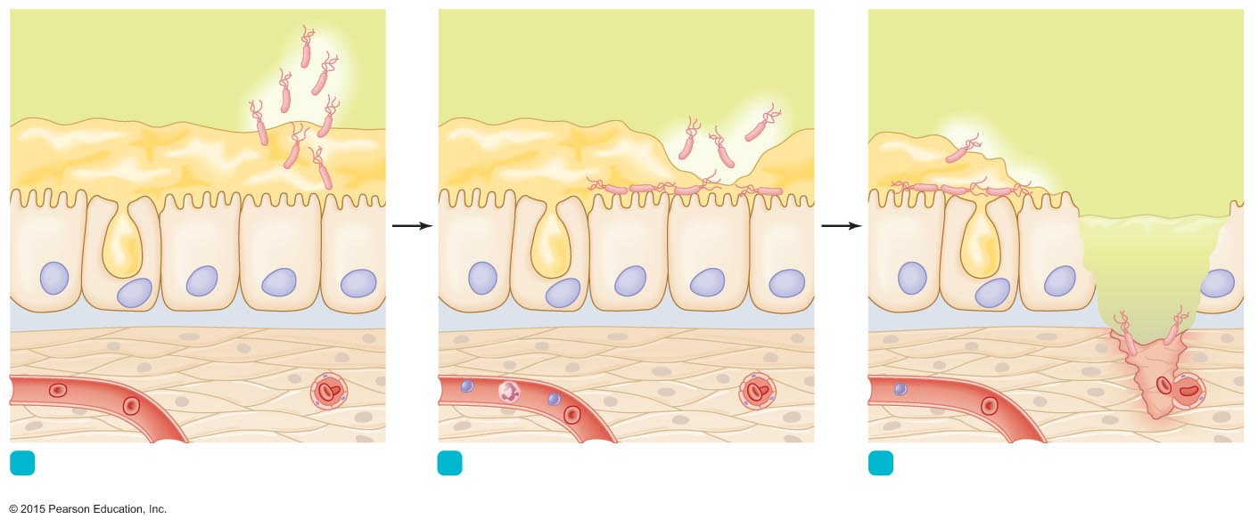
Figure 23.4 The role of Helicobacter pylori in the formation of ulcers.
Helicobacter pylori (neutralizes stomach acid)
Layer of mucus
Acidic gastric juice
Nucleus
Epithelial cell
in stomach lining
Mucus-
secreting cell
Neutrophil
Lymphocyte
Ulcer
Red blood
cells in capillaries
1
Bacteria invade mucus and attach to
gastric epithelial cells.
2
Helicobacter, its toxins, and inflammation
cause the layer of mucus to become thin.
3
Gastric acid destroys epithelial cells and
underlying tissue.

Slide 13
Bacterial Diseases of the Digestive System
Peptic Ulcers
Epidemiology
Fecal-oral transmission is likely
Stress may worsen ulcer symptoms
Diagnosis, treatment, and prevention
Diagnosis based on X-ray exam to identify ulcers and presence of H. pylori in clinical specimens
Treated with antimicrobials and drugs that inhibit stomach acid
Prevented by avoiding fecal-oral transmission

Slide 14
Bacterial Diseases of the Digestive System
Bacterial Gastroenteritis
Inflammation of stomach or intestines caused by bacteria
Associated with contaminated food or water and poor living conditions
General features
Similar manifestations despite different causative agents
Nausea, vomiting, diarrhea, abdominal pain, and cramps
Dysentery produces loose, frequent stool containing mucus and blood

Slide 15
Bacterial Diseases of the Digestive System
Bacterial Gastroenteritis: Shigellosis
Pathogen and virulence factors
Caused by four species of Shigella
Virulence factors include type III secretion systems and enterotoxins
Pathogenesis and epidemiology
Pathogen colonizes cells of the small, then large intestine
Diagnosis, treatment, and prevention
Diagnosed by symptoms and presence of Shigella in stool
Supportive treatment and administration of antimicrobials

Slide 16
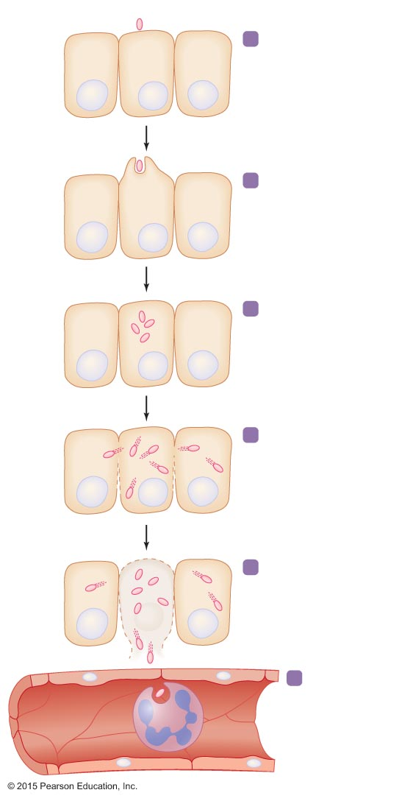
Figure 23.5 The events in shigellosis.
Shigella
1
Shigella attaches to epithelial cell of colon.
Epithelial cell
Nucleus
2
Shigella triggers
endocytosis.
Shigella multiplies
in cytosol.
3
Actin fibers
4
Shigella invades neighboring epithelial cells, thus avoiding
immune defenses.
Mucosal abscess
An abscess forms as
epithelial cells are killed
by the infection.
5
Blood vessel
Phagocyte
6
Shigella that enters the blood is quickly
phagocytized
and destroyed.
No bacteremia.

Slide 17
Bacterial Diseases of the Digestive System
Bacterial Gastroenteritis: Traveler's Diarrhea
Pathogen and virulence factors
Caused by Escherichia coli
Virulence factors: adhesins, fimbriae, and toxins
Pathogenesis and epidemiology
Diarrhea mediated by enterotoxins
Common in developing countries
Diagnosis, treatment, and prevention
Diagnosis is based on signs and symptoms
Treatment is based on fluid and electrolyte replacement
Antidiarrheal drugs prolong the symptoms

Slide 18
Bacterial Diseases of the Digestive System
Bacterial Gastroenteritis: Campylobacter Diarrhea
Pathogen and virulence factors
Caused by Campylobacter jejuni
Virulence factors: adhesins, cytotoxins, endotoxin
Pathogenesis and epidemiology
Virulence factors cause bleeding lesions and inflammation
Chickens are the main source of human infections
Diagnosis, treatment, and prevention
Diagnosis is based on signs and symptoms
Most cases resolve without treatment
Prevented with proper hygiene after handling raw poultry

Slide 19
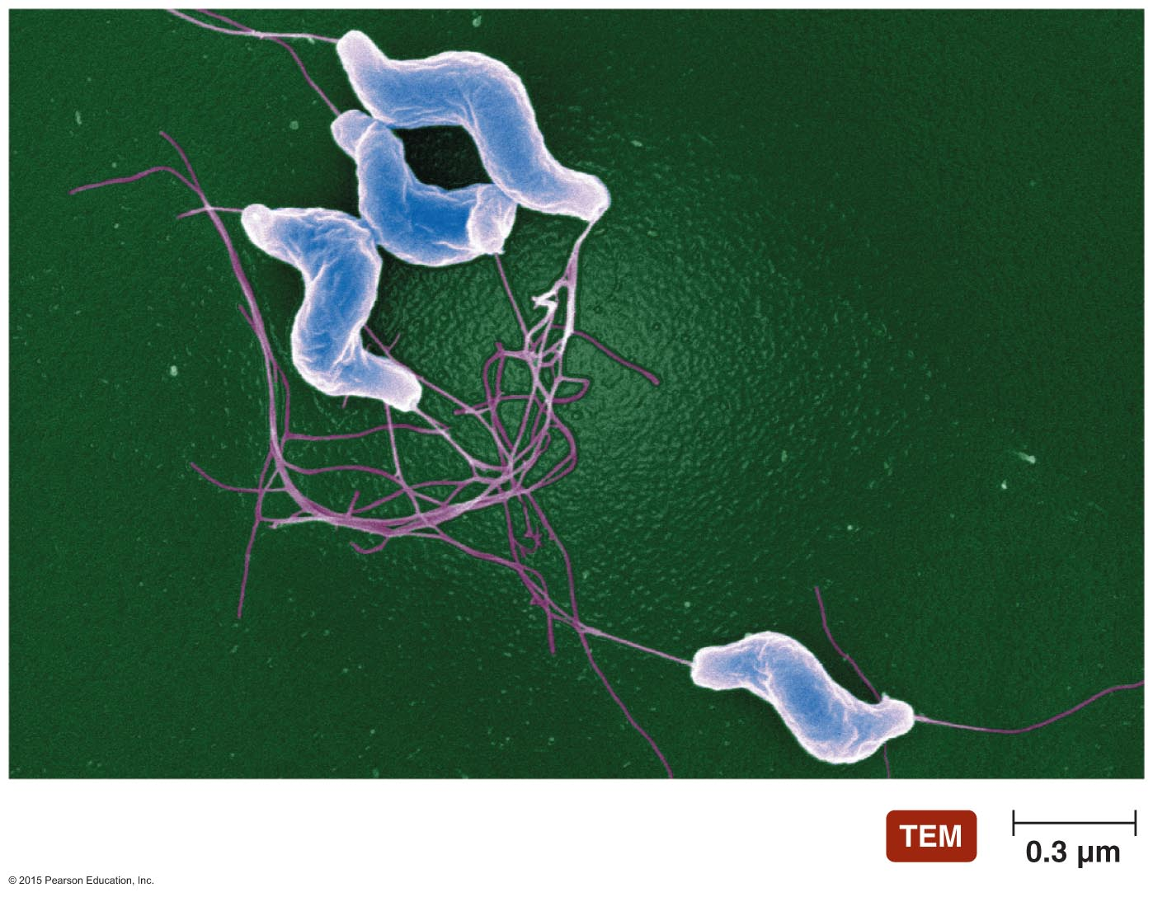
Figure 23.6 Campylobacter jejuni, the most common cause of bacterial gastroenteritis in the United States.

Slide 20
Bacterial Diseases of the Digestive System
Bacterial Gastroenteritis: C. diff. (Antimicrobial-Associated) Diarrhea
Signs and symptoms
Pseudomembranous colitis occurs in severe cases
Pathogen and virulence factors
Caused by Clostridium difficile
Antimicrobial use facilitates overgrowth of C. difficile
C. difficile produces two toxins
Pathogenesis
Toxins mediate inflammation and pseudomembrane formation

Slide 21
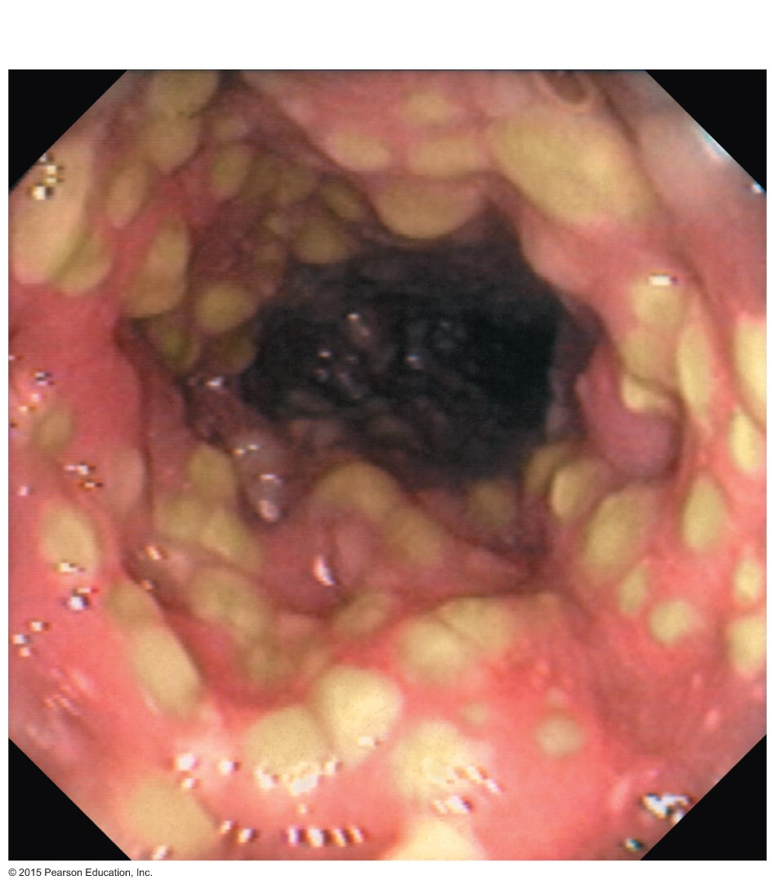
Figure 23.7 Pseudomembranous colitis.
Lesions

Slide 22
Bacterial Diseases of the Digestive System
Bacterial Gastroenteritis: C. diff. (Antimicrobial-Associated) Diarrhea
Epidemiology
By-product of modern medicine
Any antimicrobial can trigger the disease
Diagnosis, treatment, and prevention
Diagnosis is based on presence of bacterial toxin in stool
Treated with antimicrobials
Avoid unnecessary use of antimicrobials

Slide 23
Bacterial Diseases of the Digestive System
Bacterial Gastroenteritis: Salmonellosis and Typhoid Fever
Pathogen and virulence factors
Caused by Salmonella enterica serotypes
Serotypes Typhi and Paratyphi cause typhoid fever
Serotypes Enteritidis and Typhimurium cause salmonellosis
Bacteria tolerate acidity of stomach and pass to the intestine
Toxins disrupt numerous cellular activities
Pathogenesis and epidemiology
Typhoid fever is acquired by contaminated food or water
Salmonellosis is often acquired by consuming contaminated eggs

Slide 24
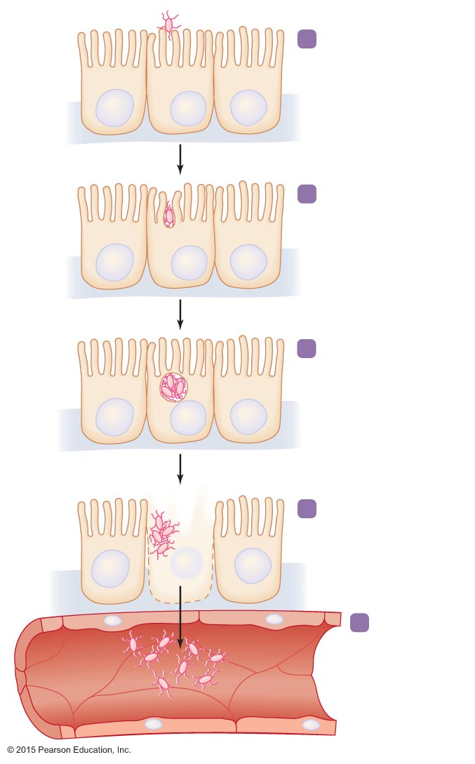
Figure 23.8 The events in salmonellosis.
Salmonella
1
Salmonella attaches to
epithelial cells lining
the small intestine.
Epithelial
cell
Nucleus
2
Salmonella triggers
endocytosis.
3
Salmonella multiplies
within food vesicle.
4
Salmonella kills host
cell, inducing fever, cramps, and diarrhea.
Capillary (blood vessel)
5
Bacteremia:
Salmonella
moves into
bloodstream.

Slide 25
Bacterial Diseases of the Digestive System
Bacterial Gastroenteritis: Salmonellosis and Typhoid Fever
Diagnosis, treatment, and prevention
Diagnosis is made by finding Salmonella in stool
Salmonellosis is usually self-limiting
Typhoid fever can be treated with antimicrobial drugs
Prevented with proper hygiene

Slide 26
Bacterial Diseases of the Digestive System
Bacterial Gastroenteritis: Cholera
Pathogen and virulence factors
Caused by Vibrio cholerae
Occurs in salt- and freshwater
Environment within the human body activates some Vibrio genes
Most important virulence factor is production of cholera toxin
Pathogenesis and epidemiology
Pandemics have occurred throughout history

Slide 27
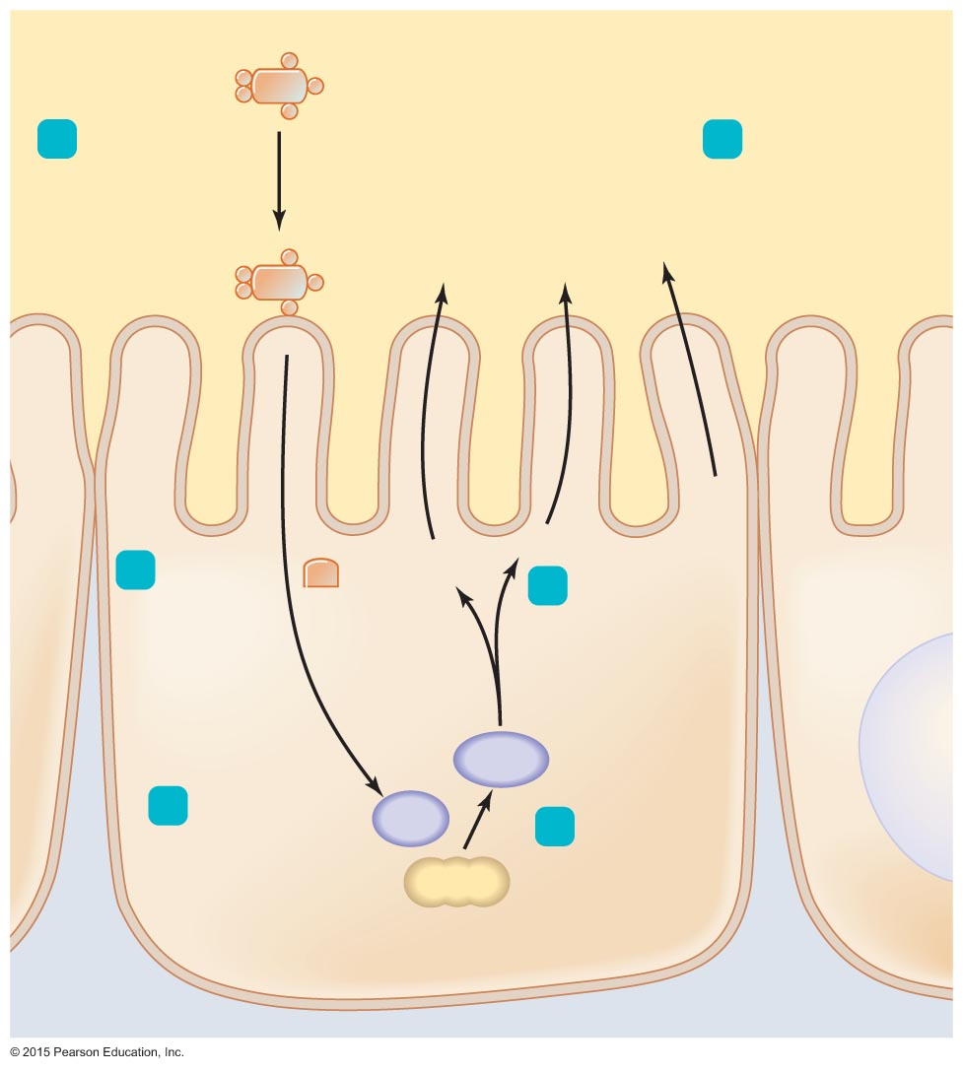
Figure 23.9 The action of cholera toxin in intestinal epithelial cells.
Intestinal lumen
Cholera toxin
binds to
membrane
of epithelial
cell.
A
Water follows
electrolytes into
lumen.
1
B
6
H₂O
Cl–
Na⁺
Cl–
Na⁺
Epithelial cell
2
Portion
of toxin
(part of A)
enters cell.
5
Cyclic AMP
stimulates
cell to secrete
Cl–, Na⁺,
and other
electrolytes.
A1
cAMP
3
A1 activates
adenylate
cyclase (AC).
AC
Cyclic AMP
(cAMP) is
synthesized.
4
ATP

Slide 28
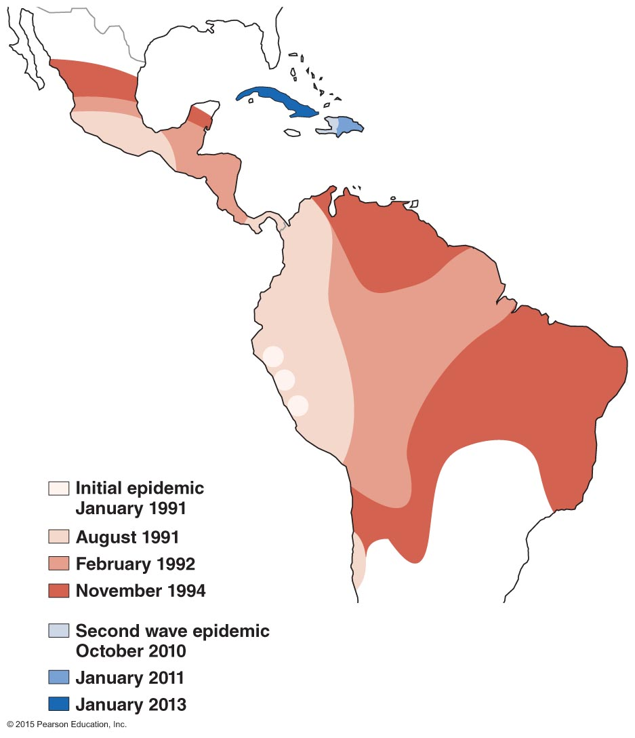
Figure 23.10 Cholera pandemic.

Slide 29
Bacterial Diseases of the Digestive System
Bacterial Gastroenteritis: Cholera
Diagnosis, treatment, and prevention
Diagnosis is based on presence of "rice-water" stool
Treated with supportive care and administration of doxycycline
Available vaccine provides only short-lived immunity
Proper hygiene is an important preventive measure

Slide 30
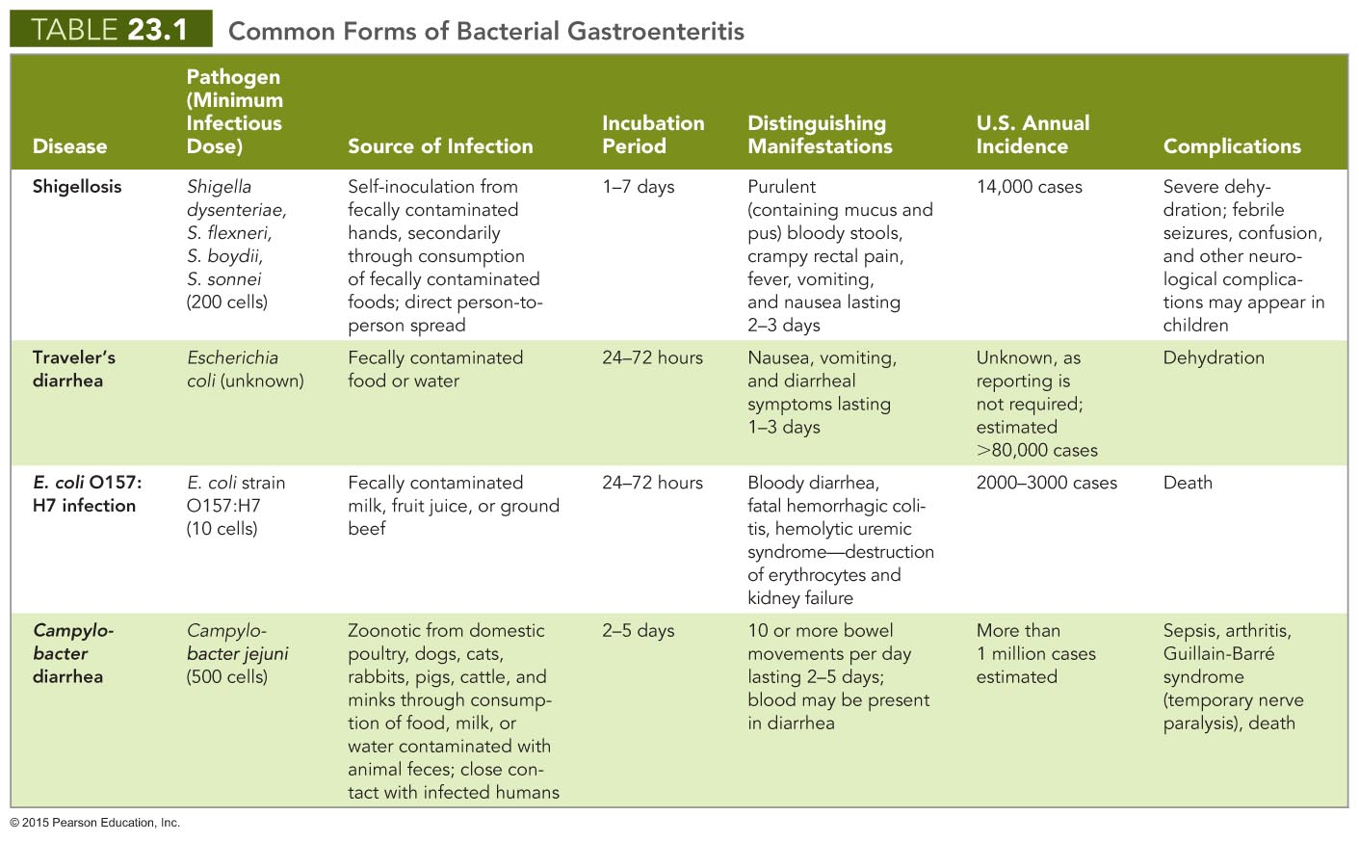

Slide 31
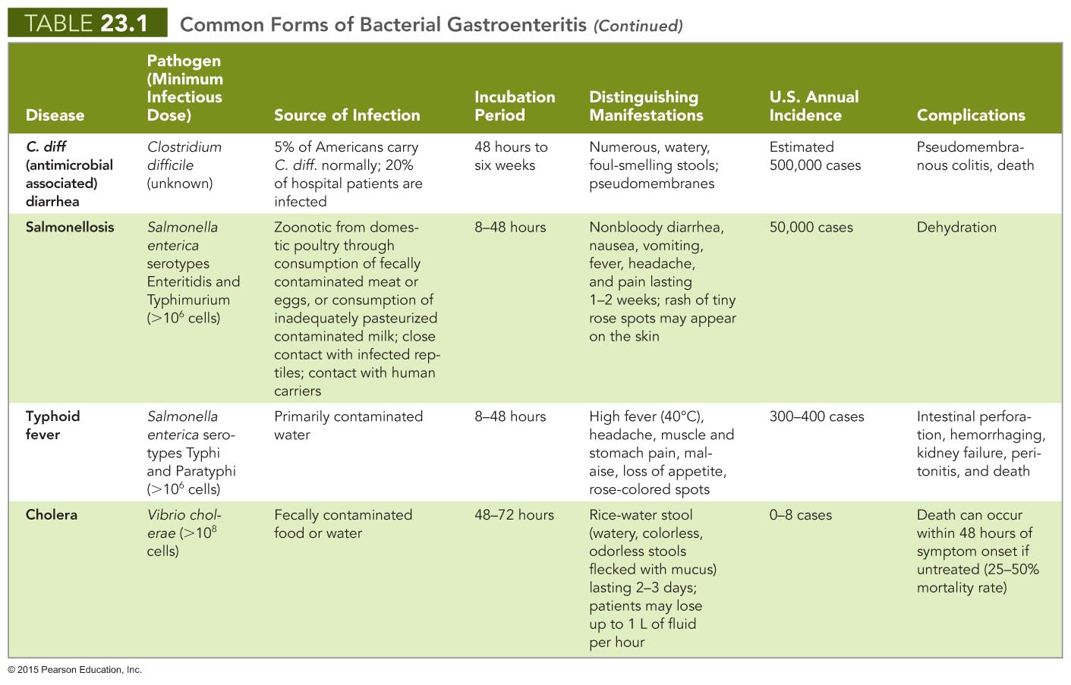

Slide 32
Bacterial Diseases of the Digestive System
Bacterial Food Poisoning (Intoxication)
Signs and symptoms
Nausea, vomiting, diarrhea, cramping
Pathogen and virulence factors
Caused by Staphylococcus aureus
Virulence factors include five enterotoxins
Pathogenesis and epidemiology
Outbreaks are associated with social functions
Diagnosis, treatment, and prevention
Diagnosis is based on signs and symptoms
Treated with fluid and electrolyte replacement
Proper hygiene can reduce incidence

Slide 33
Viral Diseases of the Digestive System
Oral Herpes
Signs and symptoms
Presence of cold sores
Infections may extend beyond the oral cavity
Herpetic gingivostomatitis
Herpetic pharyngitis
Herpes esophagitis
Pathogen and pathogenesis
Caused by human herpesvirus 1 (HHV-1)
Virions form syncytia to avoid host's immune system
Latency established in the trigeminal nerve ganglion

Slide 34
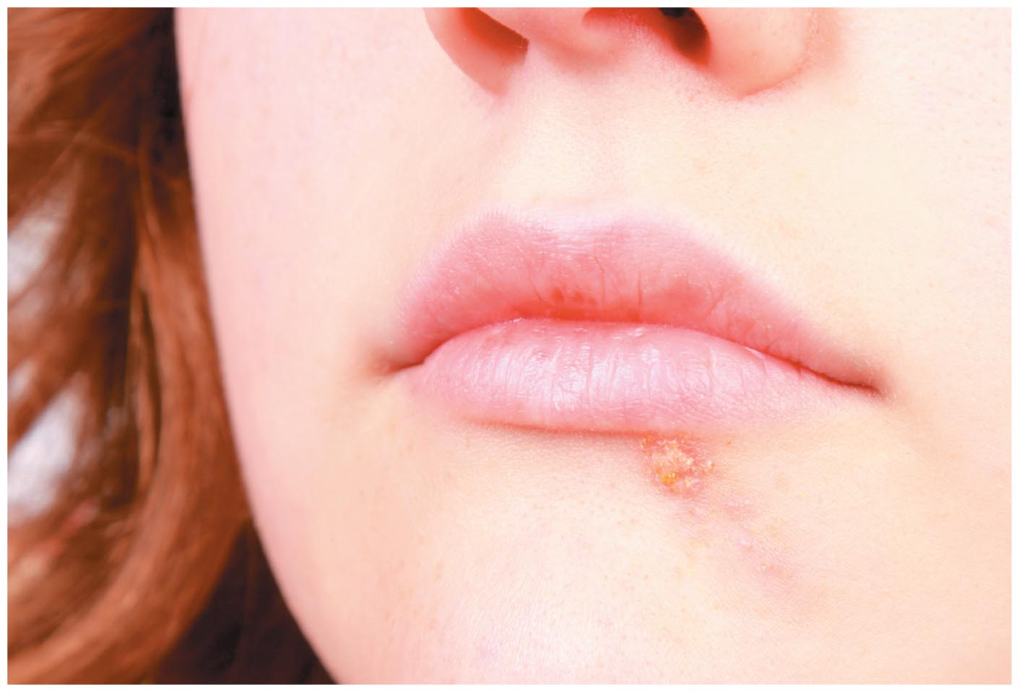
Figure 23.11 Oral herpes lesion.

Slide 35
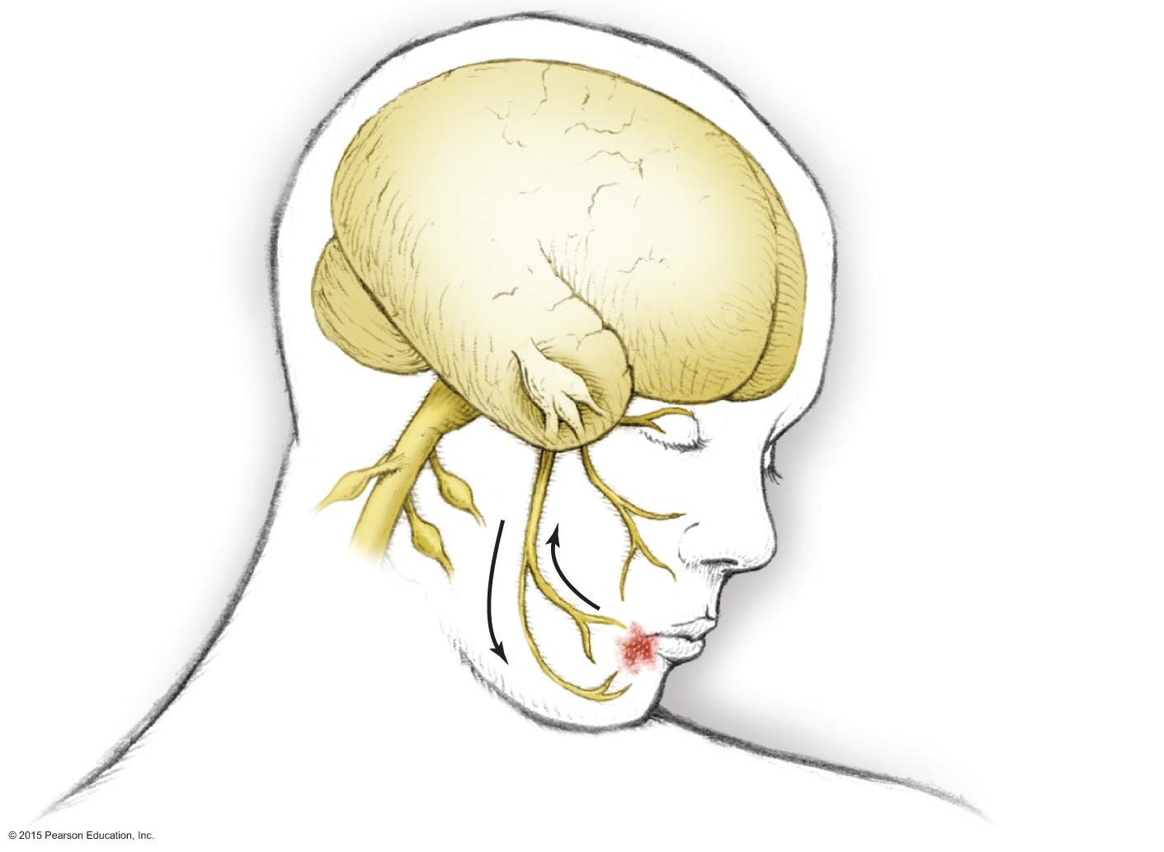
Figure 23.12 Latency and reactivation of oral herpesviruses.
Trigeminal nerve
Trigeminal (V) nerve ganglion, site of viral latency
• Ophthalmic branch
• Maxillary branch
• Mandibular branch
Fever blister

Slide 36
Viral Diseases of the Digestive System
Oral Herpes
Epidemiology
Infections occur by casual contact in childhood
Primary infections are usually asymptomatic
Diagnosis, treatment, and prevention
Diagnosis is based on characteristic lesions
Topical penciclovir or acyclovir limits duration of lesions
Avoid direct contact with infected individuals

Slide 37
Viral Diseases of the Digestive System
Mumps
Caused by the mumps virus
Humans are the only natural host
Once a very common childhood disease
Nearly nonexistent in developed countries because of immunization
No specific treatment for mumps
Infected individuals develop lifelong immunity

Slide 38
Viral Diseases of the Digestive System
Viral Gastroenteritis
Signs and symptoms
Similar to those of bacterial gastroenteritis
Dehydration is common complication
Pathogens and pathogenesis
Caused by caliciviruses, astroviruses, and rotaviruses
These viruses infect cells lining the intestinal tract
Epidemiology
More cases occur in winter
Rotaviruses are important cause of childhood deaths in developing countries

Slide 39
Figure 23.13 Some viruses causing gastroenteritis.

Slide 40
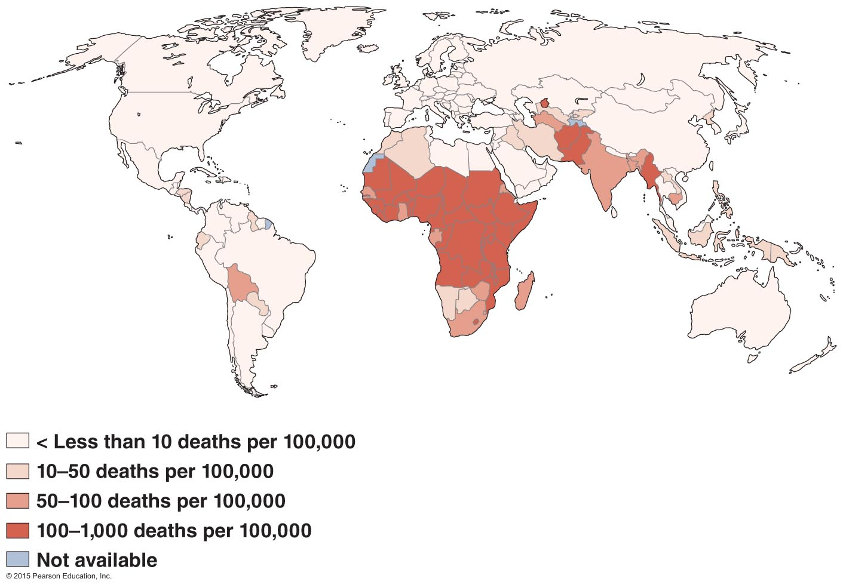
Figure 23.14 Deaths from rotaviral diarrhea are most common in developing countries.

Slide 41
Viral Diseases of the Digestive System
Viral Gastroenteritis
Diagnosis, treatment, and prevention
Serological test distinguishes among viruses
Treatment is based on fluid and electrolyte replacement
Prevention involves proper treatment of water and sewage and good hygiene practices
Vaccine for rotavirus exists

Slide 42
Viral Diseases of the Digestive System
Viral Hepatitis
Signs and symptoms
Jaundice, abdominal pain, fatigue, vomiting, weight loss
Symptoms may occur years after initial infection
Pathogen and pathogenesis
Liver damage due mostly to host immune response
Pathogens
Hepatitis A virus (HAV)
Hepatitis B virus (HBV)
Hepatitis C virus (HCV)
Hepatitis delta virus (HDV)
Hepatitis E virus (HEV)

Slide 43
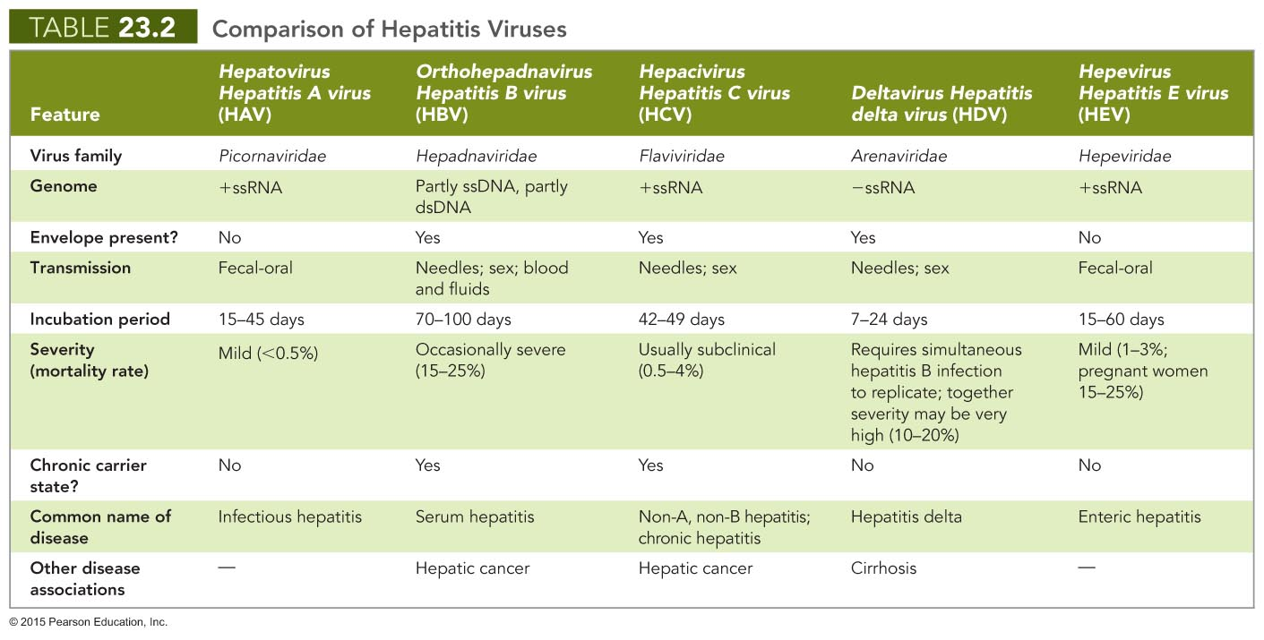

Slide 44
Viral Diseases of the Digestive System
Viral Hepatitis
Diagnosis, treatment, and prevention
Initial diagnosis made by observation of jaundice, enlarged liver, or fluid in the abdomen
Serological testing can identify viral antigens
HBV diagnosed by viral proteins in body fluids
Supportive care for symptoms
Alpha interferon and nucleotide analogs help reduce levels of virus
Prevented with good hygiene and protected sex or abstinence
Vaccines are available against HAV and HBV

Slide 45
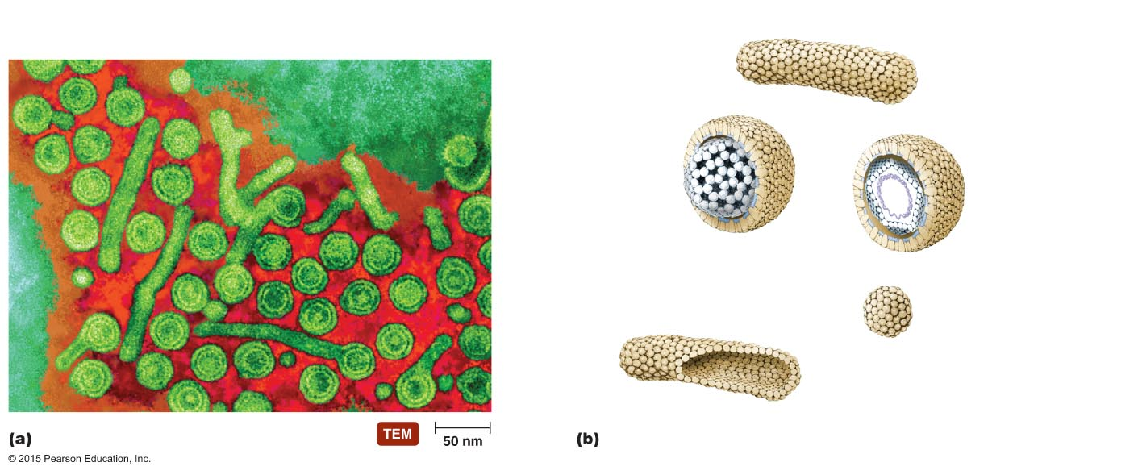
Figure 23.15 Three types of viral protein particles produced by hepatitis B viruses.
Dane particle
Spherical
particle
Filamentous
particle
Filamentous particle
Lipid bilayer
(from host cell)
Hepatitis B
surface
antigen
Genome
(partly single-stranded
DNA)
Hepatitis B
core antigen
Dane particle
(complete, infectious
virion; outer coat
and core in
cross section)
Dane particle
(complete, infectious
virion; outer coat of
surface antigens in
cross section)
Spherical particle
(viral surface
antigens only)
Viral surface antigens only
Filamentous particle
(angled section)

Slide 46
Protozoan Diseases of the Intestinal Tract
Giardiasis
Signs and symptoms
Often asymptomatic
Diarrhea and associated symptoms can last up to four weeks
Pathogen
Caused by Giardia intestinalis
G. intestinalis cysts are resistant to chlorine, heat, drying, and stomach acid

Slide 47
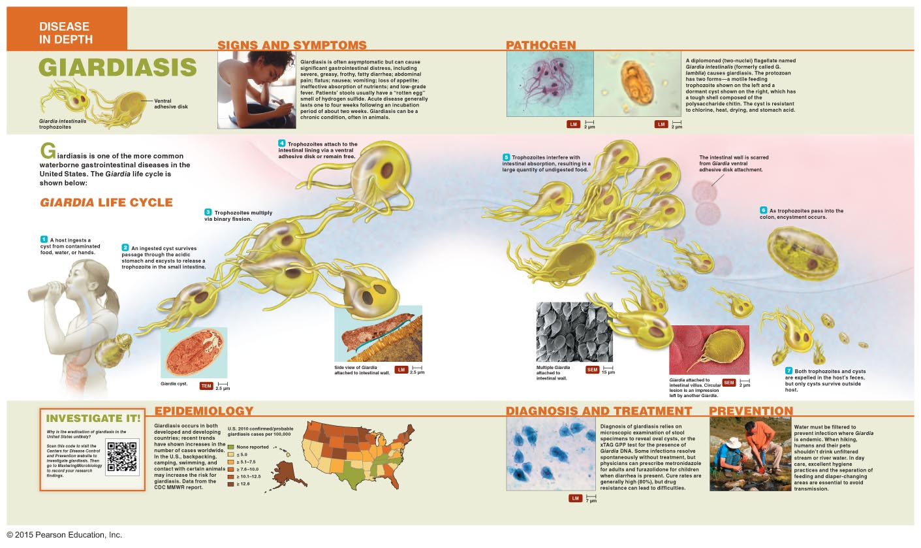
Disease in Depth: Giardiasis: Multiple Giardia attached to the intestinal wall

Slide 48
Protozoan Diseases of the Intestinal Tract
Giardiasis
Epidemiology
Occurs in developed and developing countries
Individuals ingest cysts from contaminated water, food, or hands
Hikers, campers, and swimmers are at particular risk
Diagnosis, treatment, and prevention
Diagnosed by microscopic observation of Giardia in stool
Treated with metronidazole (adults) or furazolidone (children)
Prevention relies on good hygiene and filtering water in endemic areas

Slide 49
Protozoan Diseases of the Intestinal Tract
Cryptosporidiosis
Signs and symptoms
Severe watery diarrhea with potentially serious complications
Pathogen and pathogenesis
Caused by Cryptosporidium parvum
Pathogenicity of C. parvum is unclear
Epidemiology
Infection results from drinking contaminated water
Diagnosis, treatment, and prevention
Presence of oocysts in feces is diagnostic
Treated with fluid and electrolyte replacement
Prevented with proper hygiene

Slide 50
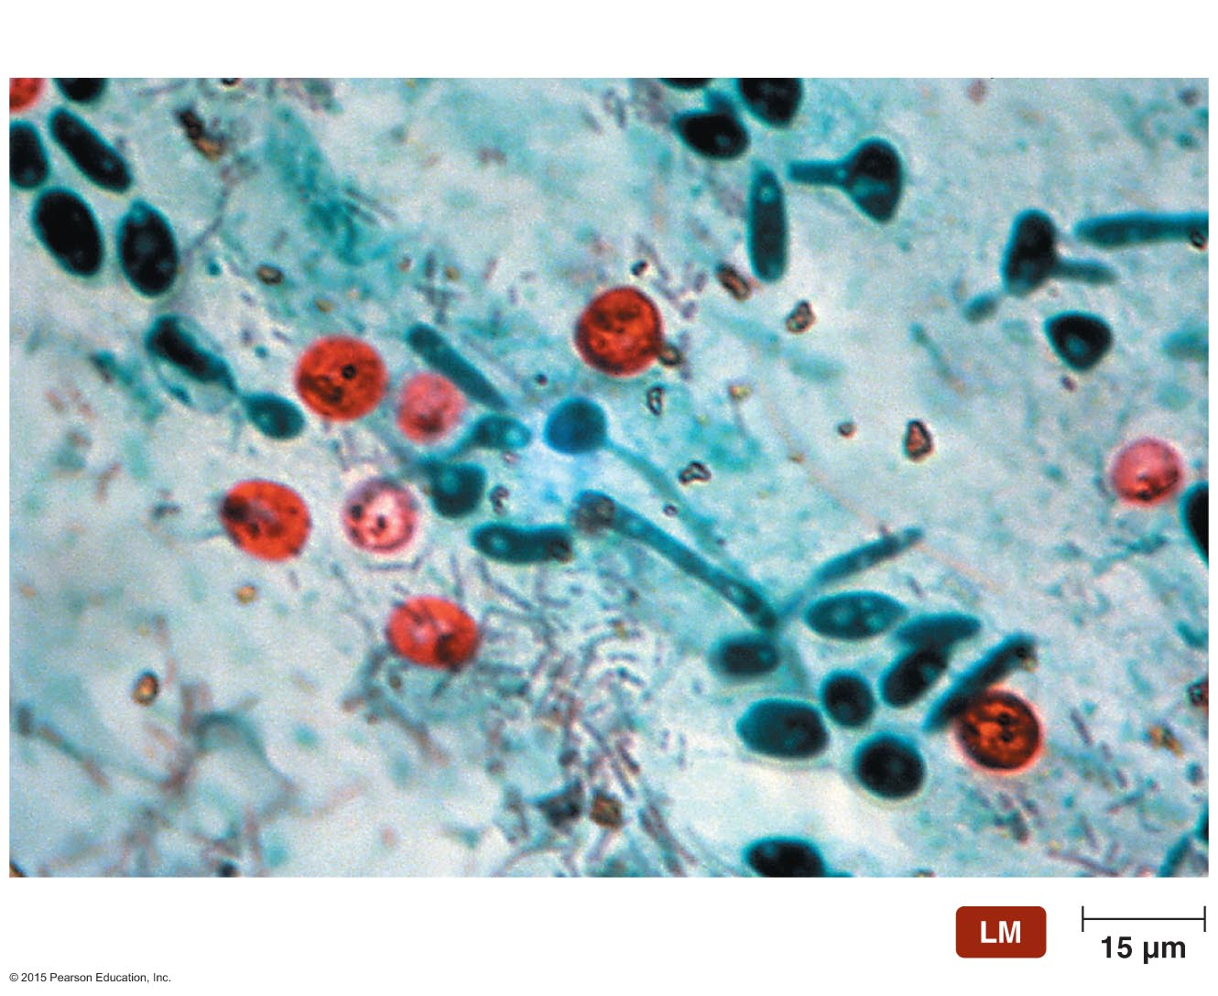
Figure 23.16 Oocysts of Cryptosporidium parvum in feces.
Oocysts

Slide 51
Protozoan Diseases of the Intestinal Tract
Amebiasis
Signs and symptoms
Luminal amebiasis is asymptomatic
Invasive amebic dysentery causes severe diarrhea, colitis, appendicitis
Invasive extraintestinal amebiasis causes necrotic lesions in various organs
Pathogen, virulence factors, and pathogenesis
Caused by Entamoeba histolytica
Virulent strains produce numerous proteins that are toxic to cells and facilitate invasion
Trophozoites in the peritoneal cavity or blood cause symptoms

Slide 52
Protozoan Diseases of the Intestinal Tract
Amebiasis
Epidemiology
Transmitted by consumption of contaminated food or water, from contaminated hands, or oral-anal intercourse
Majority of individuals develop luminal amebiasis
Human carriers help maintain transmission
Diagnosis, treatment, and prevention
Diagnosed by microscopic observation of Entamoeba in stool or intestinal biopsy
Treated with oral rehydration therapy and antiamebic drugs
Prevent with proper hygiene, safe sex practices
Individuals in endemic areas should drink bottled water and avoid uncooked vegetables or unpeeled fruits

Slide 53
Helminthic Infestations of the Intestinal Tract
Helminths are macroscopic, multicellular worms
Helminths can infest the GI tract as non-disease-causing parasites

Slide 54
Helminthic Infestations of the Intestinal Tract
Tapeworm Infestations
Tapeworm is the common name for a cestode
Flat, segmented, parasitic helminth
Intestinal parasites that lack own digestive system
Signs and symptoms
Usually asymptomatic
Nausea, abdominal pain, weight loss, and diarrhea may occur
Pathogens
Taenia saginata: beef tapeworm
Taenia solium: pork tapeworm
Life cycle split between primary and intermediate host

Slide 55
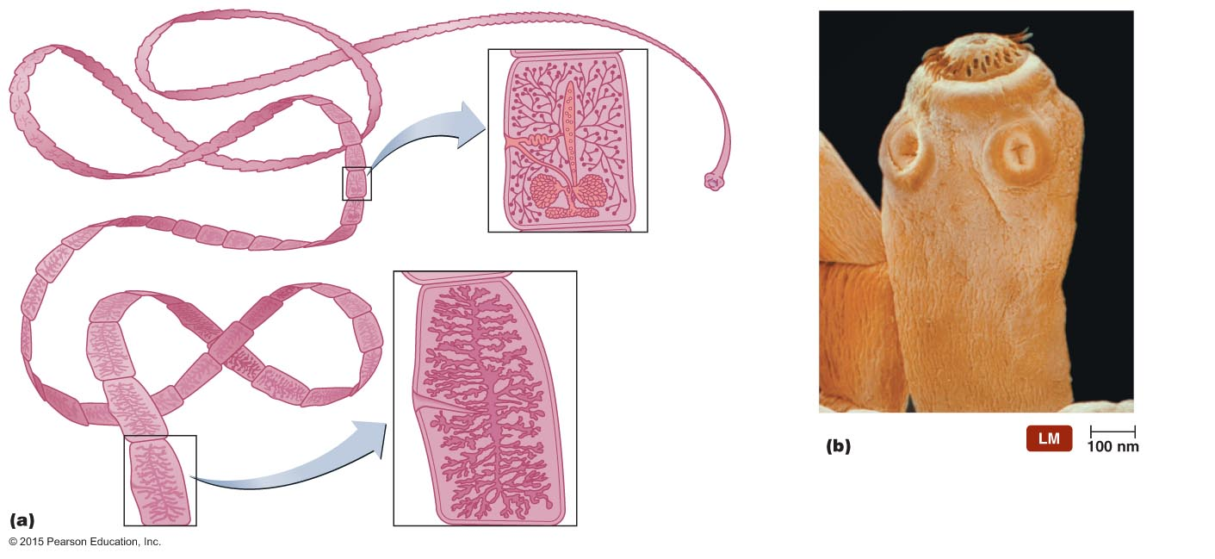
Figure 23.17 Features of tapeworm morphology.
Testes
Hooks
Uterus
Scolex
Ovary
Sucker
Strobila
Mature proglottid
Neck
Gravid proglottid with eggs (individual eggs not visible)
Cuticle

Slide 56
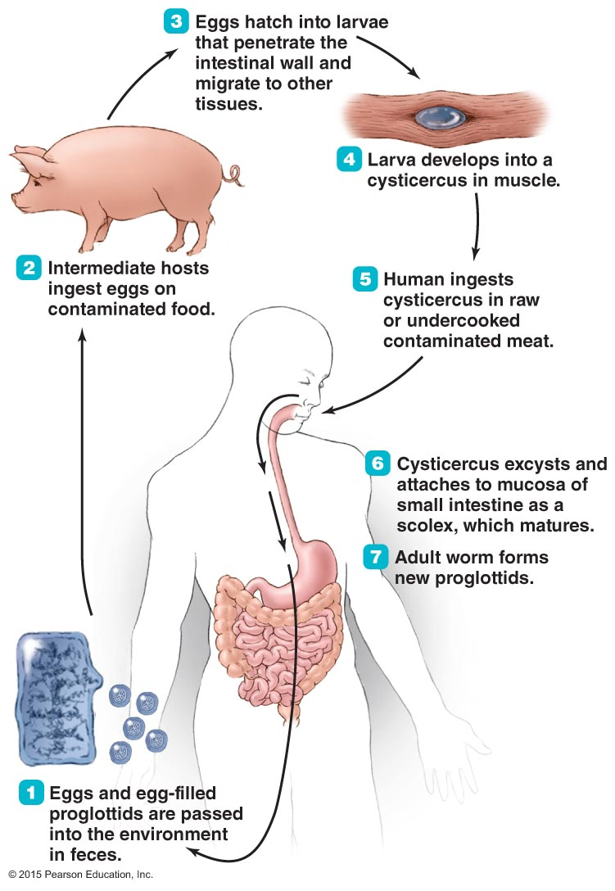
Figure 23.18 Life cycle of Taenia solium.

Slide 57
Helminthic Infestations of the Intestinal Tract
Tapeworm Infestations
Epidemiology
Taenia species live worldwide where beef and pork are food
High incidence
Regions of inadequate sewage treatment
Regions where humans live in close contact with livestock
Diagnosis, treatment, and prevention
Diagnosed by presence of proglottids in fecal sample
Treated with niclosamide or praziquantel
Prevention relies on thorough cooking of meats

Slide 58
Helminthic Infestations of the Intestinal Tract
Pinworm Infestations
Pinworms are nematodes
Long, thin, unsegmented, cylindrical helminth
Signs and symptoms
Perianal itching, irritability, decreased appetite
One-third of cases are asymptomatic
Pathogen and infestation
Caused by Enterobius vermicularis
Females deposit eggs in the perianal region at night
Eggs can be dislodged and spread the disease

Slide 59
Helminthic Infestations of the Intestinal Tract
Pinworm Infestations
Epidemiology
Infections commonly occur in children
Enterobius is the most common parasitic worm in the U.S.
Diagnosis, treatment, and prevention
Diagnosis is based on identification of eggs or adult pinworms
Treated with pyrantel pamoate or mebendazole
Prevention requires strict personal hygiene

Slide 60
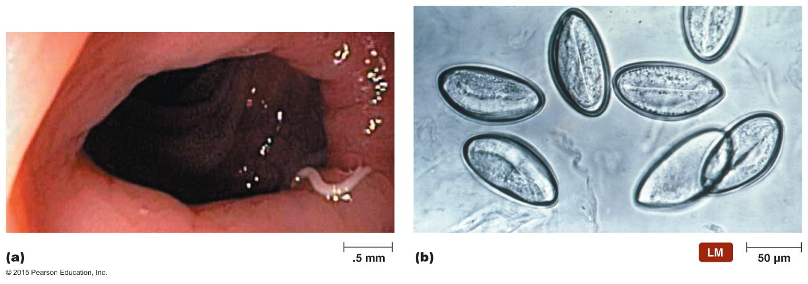
Figure 23.19 Nematodes.

Slide 61
Helminthic Infestations of the Intestinal Tract
Anisakiasis
Anisakiasis results from infestation by several parasitic nematodes
Signs and symptoms
Typically asymptomatic
Abdominal pain, nausea, vomiting, and fever may occur
Some individuals develop an allergic rash
Pathogen and infestation
Most commonly caused by Anisakis simplex
Complex life cycle with several larval stages

Slide 62
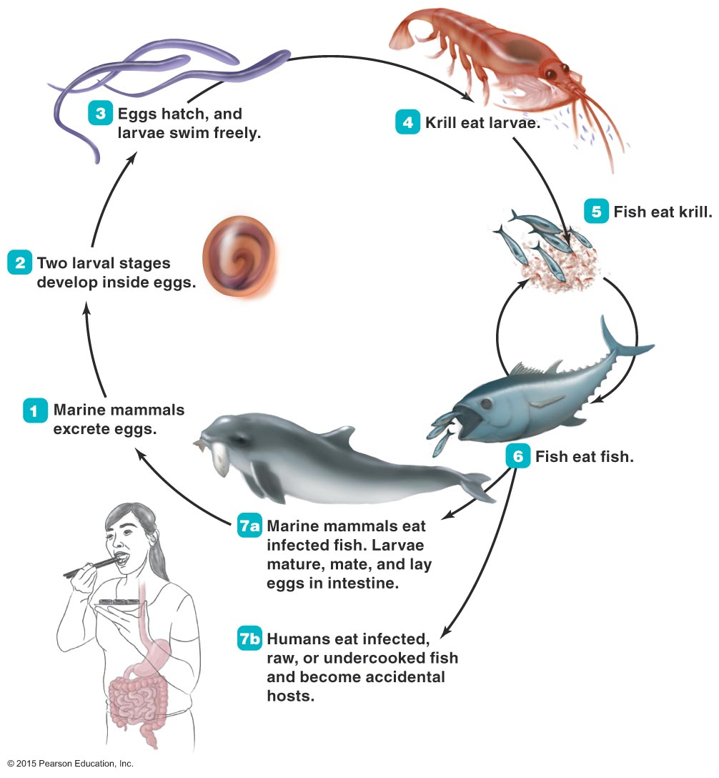
Figure 23.20 Life cycle of Anisakis.

Slide 63
Helminthic Infestations of the Intestinal Tract
Anisakiasis
Epidemiology
About 20,000 cases occur worldwide
Diagnosis, treatment, and prevention
Diagnosis is generally made using endoscopy to visualize worms
Treatment involves removing worms from the intestine
Prevented by avoiding raw and undercooked marine fish

