Slide 1
Microbial Diseases of the Respiratory System
Microbiology
CCV

Slide 2
Structures of the Respiratory System
Respiratory system exchanges gases between the atmosphere and the blood
Divided into two main parts
Upper respiratory system
Lower respiratory system

Slide 3
Structures of the Respiratory System
Structures of the Upper Respiratory System, Sinuses, and Ears
Components of the upper respiratory system
Nose
Nasal cavity
Pharynx
Tonsils
Mucus

Slide 4
Structures of the Respiratory System
Structures of the Lower Respiratory System
Components of the lower respiratory system
Larynx
Trachea
Bronchi
Alveoli
Diaphragm
Various protective components
Ciliated mucous membrane, alveolar macrophages, and secretory antibodies

Slide 5
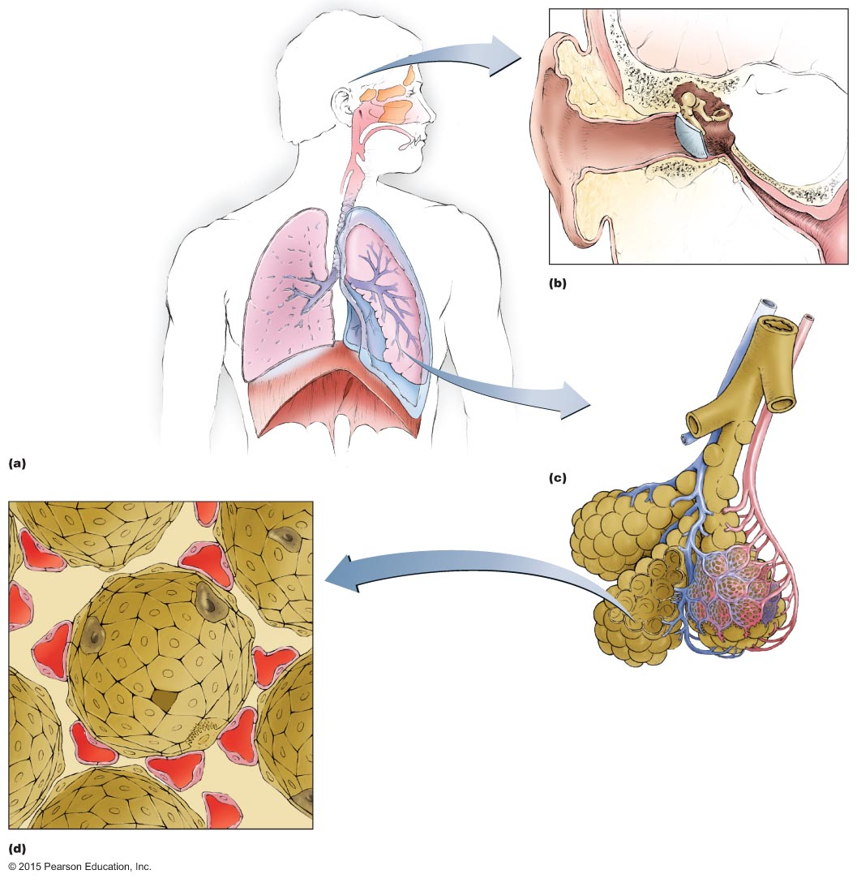
Figure 22.1 Structures of the respiratory system.
Nasal cavity
Upper
respiratory
system
Auditory tube
opening
Pharynx
Sinuses
Uvula
Middle ear
Epiglottis
External
ear canal
Auditory(eustachian)
tube
Larynx
Lower
respiratory
system
Trachea
Tympanic
membrane
(eardrum)
Pleurae
Pharynx
Bronchus
Bronchiole
Bronchiole
Diaphragm
Right lung
(sectioned)
Left lung
Alveoli
Alveolar
macrophage
Capillary
Alveolar sac

Slide 6
Structure of the Respiratory System
Normal Microbiota of the Respiratory System
Lower respiratory system
Typically microorganisms are not present
Upper respiratory system
Colonized by many microorganisms
Normal microbiota limit growth of pathogens
Normal microbiota may be opportunistic pathogens

Slide 7
Bacterial Diseases of the Upper Respiratory System, Sinuses, and Ears
Streptococcal Respiratory Diseases
Signs and symptoms
Pharyngitis
Sore throat and difficulty swallowing
Often accompanied by fever, malaise, and headache
Laryngitis and bronchitis can occur if infection spreads to lower respiratory tract
May progress to scarlet or rheumatic fever
Acute glomerulonephritis occurs in some untreated cases

Slide 8
Bacterial Diseases of the Upper Respiratory System, Sinuses, and Ears
Streptococcal Respiratory Diseases
Signs and symptoms
Pathogen and virulence factors
Caused by group A streptococci (S. pyogenes)
Variety of virulence factors
M proteins
Hyaluronic acid capsule
Streptokinases
C5a peptidase
Pyrogenic toxins
Streptolysins

Slide 9
Bacterial Diseases of the Upper Respiratory System, Sinuses, and Ears
Streptococcal Respiratory Diseases
Pathogenesis
Occurs when normal microbiota are depleted, large inoculum is introduced, or adaptive immunity is impaired
Epidemiology
Spread via respiratory droplets
Occurs most often in winter and spring
Diagnosis, treatment, and prevention
Often confused with viral pharyngitis
Oral penicillin is an effective treatment

Slide 10
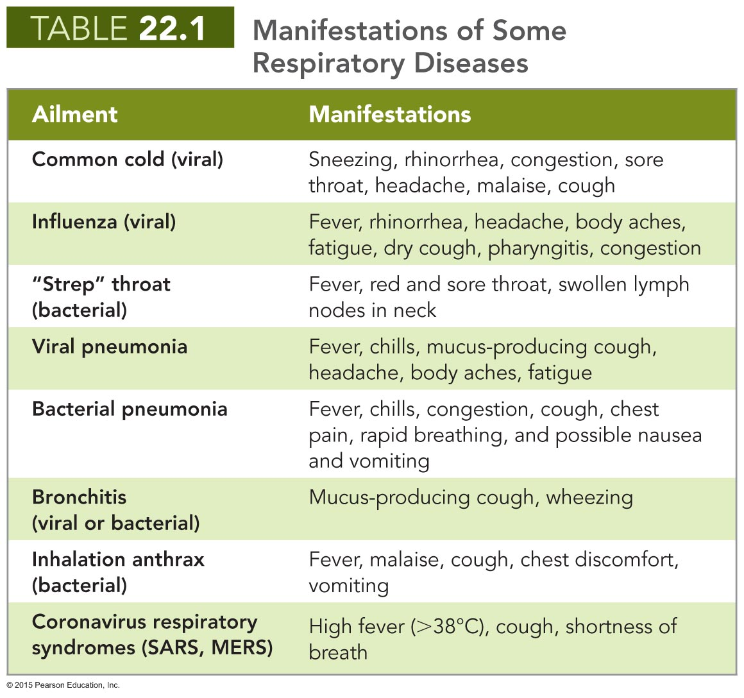

Slide 11
Bacterial Diseases of the Upper Respiratory System, Sinuses, and Ears
Diphtheria
Signs and symptoms
Sore throat, localized pain, fever
Presence of a pseudomembrane that can obstruct airways
Pathogen and virulence factors
Caused by Corynebacterium diphtheriae
Ubiquitous in animals and humans
Virulence factors
C. diptheriae produces diphtheria toxin
Prevents polypeptide synthesis and causes cell death

Slide 12
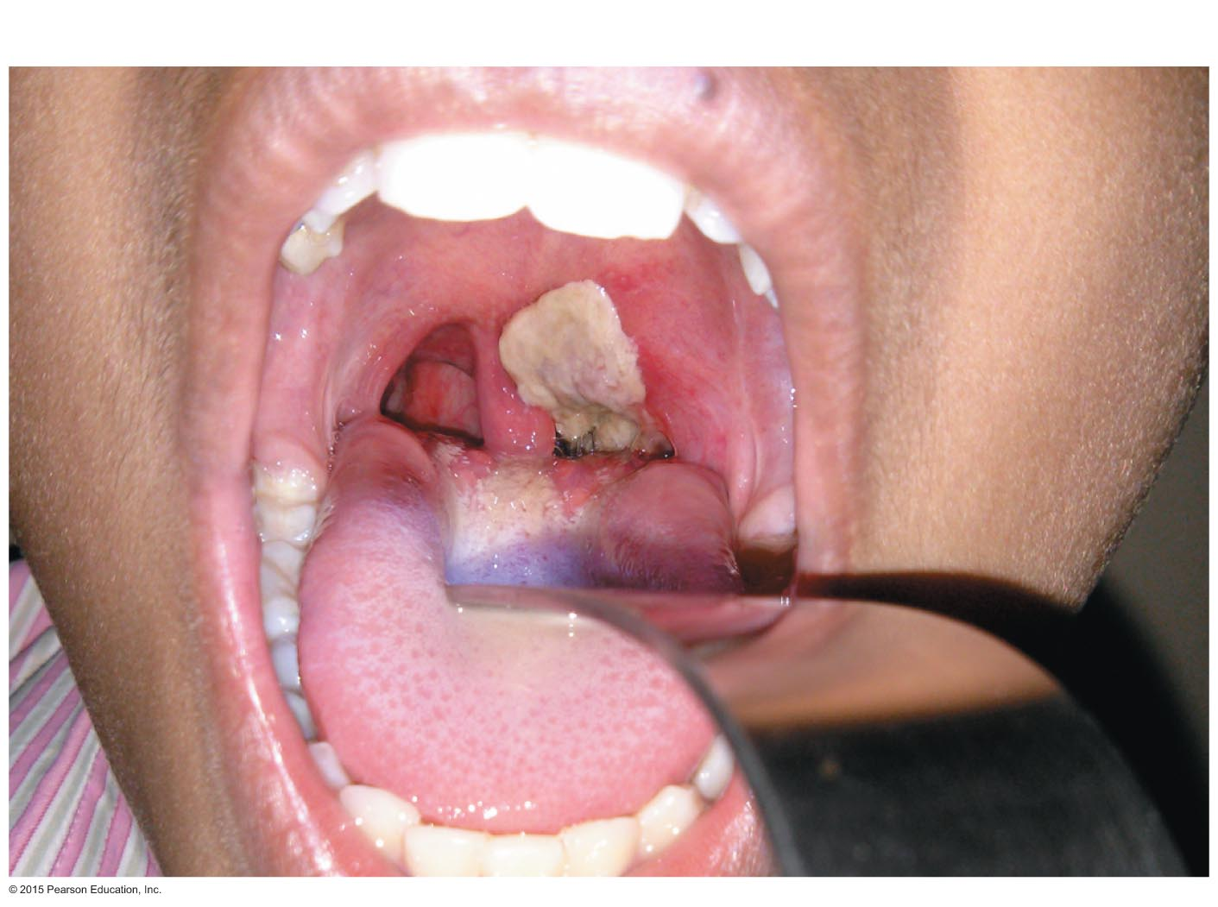
Figure 22.2 A pseudomembrane, characteristic of diphtheria.
Pseudomembrane

Slide 13
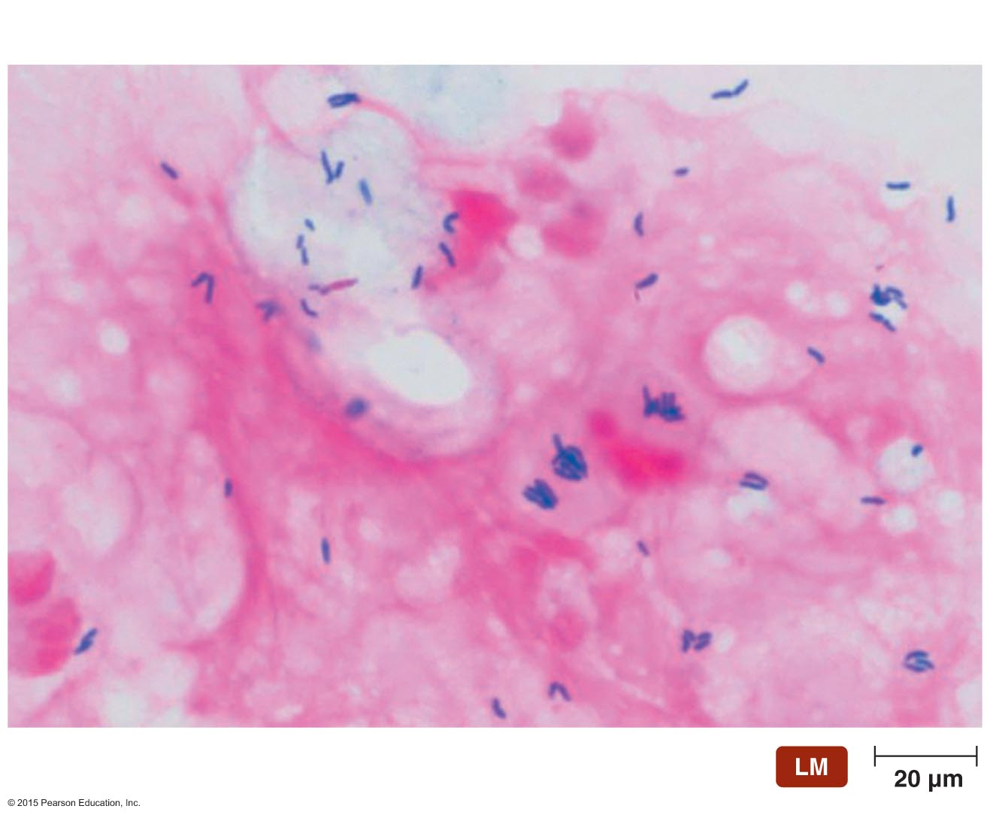
Figure 22.3 Characteristic arrangements of Gram-stained cells of Corynebacterium diphtheriae.
V-shapes
Palisade

Slide 14
Bacterial Diseases of the Upper Respiratory System, Sinuses, and Ears
Diphtheria
Pathogenesis and epidemiology
Spread via respiratory droplets or skin contact
Symptomatic in immunocompromised or nonimmune individuals
Leading cause of death among unimmunized children
Diagnosis, treatment, and prevention
Diagnosis is based on presence of a pseudomembrane
Treated with antitoxin and antibiotics
Immunization is an effective prevention

Slide 15
Bacterial Diseases of the Upper Respiratory System, Sinuses, and Ears
Rhinosinusitis and Otitis Media
Signs and symptoms
Malaise accompanied by headache and inflamed nasal passages
Otitis media results in severe pain in the ears
Pathogen and virulence factors
Caused by various respiratory microbiota
May be due to damage to upper respiratory system and auditory tube

Slide 16
Bacterial Diseases of the Upper Respiratory System, Sinuses, and Ears
Sinusitis and Otitis Media
Pathogenesis and epidemiology
Bacteria in the pharynx spread to the sinuses via the throat
Rhinosinusitis is more common in adults
Otitis media is more common in children
Diagnosis, treatment, and prevention
Symptoms are often diagnostic
No known way to prevent rhinosinusitis
Flushing nasal and sinus cavities with saline solution can reduce duration of symptoms

Slide 17
Figure 22.4 Neti pot.

Slide 18
Viral Diseases of the Upper Respiratory System
Common Cold
Signs and symptoms
Sneezing, runny nose, congestion, sore throat, malaise, and cough
Pathogens and virulence factors
Enteroviruses (rhinoviruses) are the most common cause
Numerous other viruses cause colds
Cold viruses replicate at the lower temperature of the nasal cavity
Pathogenesis
Cold viruses replicate in and kill infected cells

Slide 19
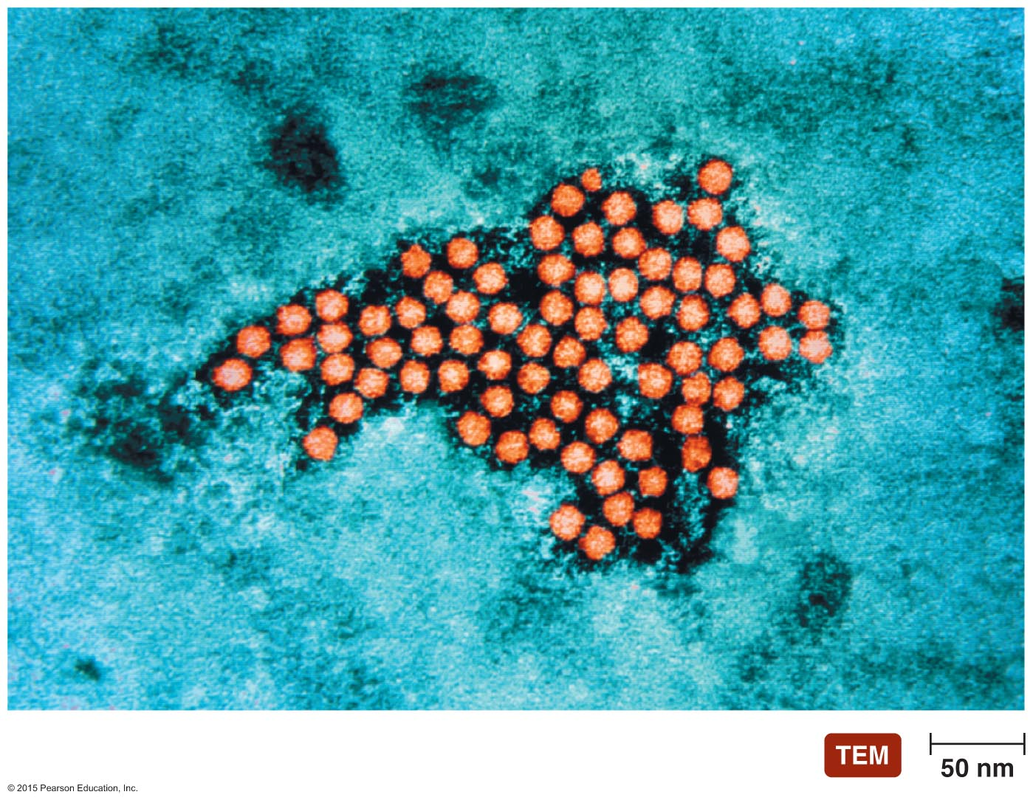
Figure 22.5 Rhinoviruses, the most common cause of colds.

Slide 20
Viral Diseases of the Upper Respiratory System
Common Cold
Epidemiology
Rhinoviruses are highly infective
Spread by coughing/sneezing, fomites, or person-to-person contact
Develop some immunity to serotypes over time
Diagnosis, treatment, and prevention
Signs and symptoms are usually diagnostic
Pleconaril can reduce duration of symptoms
Hand antisepsis is important preventive measure

Slide 21
Bacterial Diseases of the Lower Respiratory System
Lower respiratory organs are usually axenic
Bacterial infection of the lower respiratory system can cause life-threatening illness

Slide 22
Bacterial Diseases of the Lower Respiratory System
Bacterial Pneumonias
Lung inflammation accompanied by fluid-filled alveoli and bronchioles
Described by affected region or organism causing the disease
Lobar pneumonia
Mycoplasmal pneumonia
Healthcare associated pneumonia
Bacterial pneumonias are the most serious and the most frequent in adults

Slide 23
Bacterial Diseases of the Lower Respiratory System
Bacterial Pneumonias
Pneumoccocal Pneumonia
Signs and symptoms
Fever, chills, congestion, cough, chest pain
Results in short, rapid breathing
Blood enters the lungs, causing rust-colored sputum
Pathogen and virulence factors
Caused by Streptococcus pneumoniae
Virulence factors
Adhesins
Capsule
Pneumolysin

Slide 24
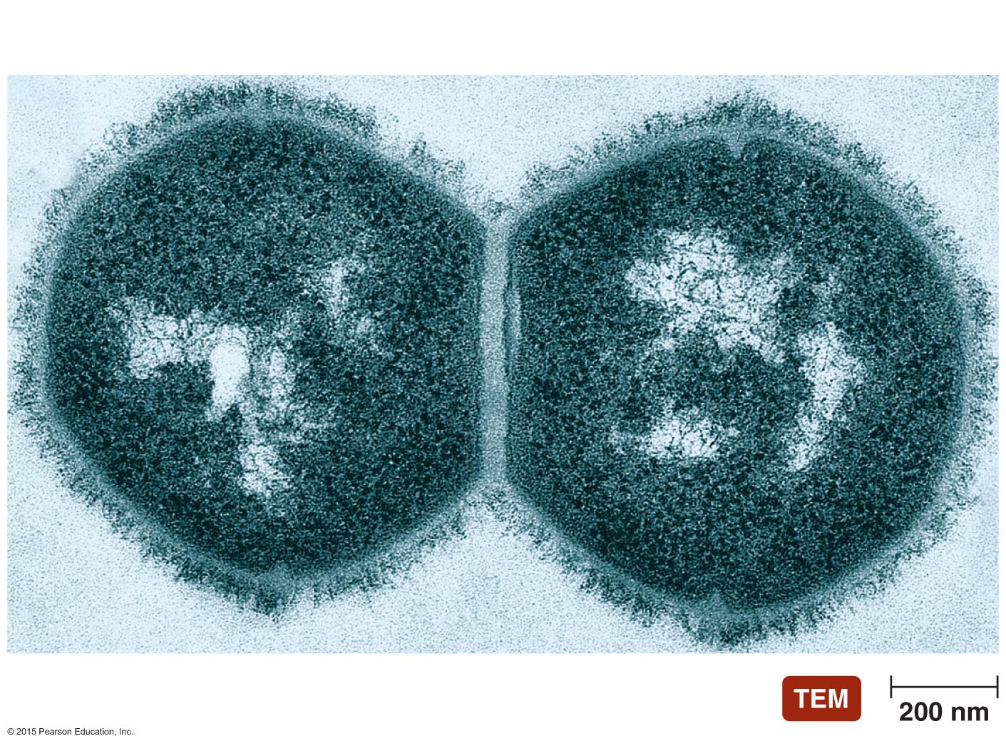
Figure 22.6 Streptococcus pneumoniae, the most common cause of bacterial pneumonia.
Capsule

Slide 25
Bacterial Diseases of the Lower Respiratory System
Bacterial Pneumonias
Pneumoccocal Pneumonia
Pathogenesis and epidemiology
Infection occurs by inhalation of bacteria
Bacterial replication causes damage to the lungs
Host secretory IgA destroyed by secretion of pneumococcal IgA protease
Pneumococcal pneumonia account for most cases of bacterial pneumonia
Diagnosis, treatment, and prevention
Diagnosed by identifying diplococci in sputum smears
Penicillin is drug of choice for treatment
Some strains are now penicillin resistant
Vaccination is method of prevention

Slide 26
Bacterial Diseases of the Lower Respiratory System
Primary Atypical (Mycoplasmal) Pneumonia
Signs and symptoms
Include fever, malaise, sore throat, excessive sweating
Symptoms may last for weeks
Pathogen and virulence factors
Caused by Mycoplasma pneumoniae
Virulence factors include an adhesion protein
Pathogenesis
Bacteria colonize and kill epithelial cells
Causes mucus buildup and colonization by other bacteria

Slide 27
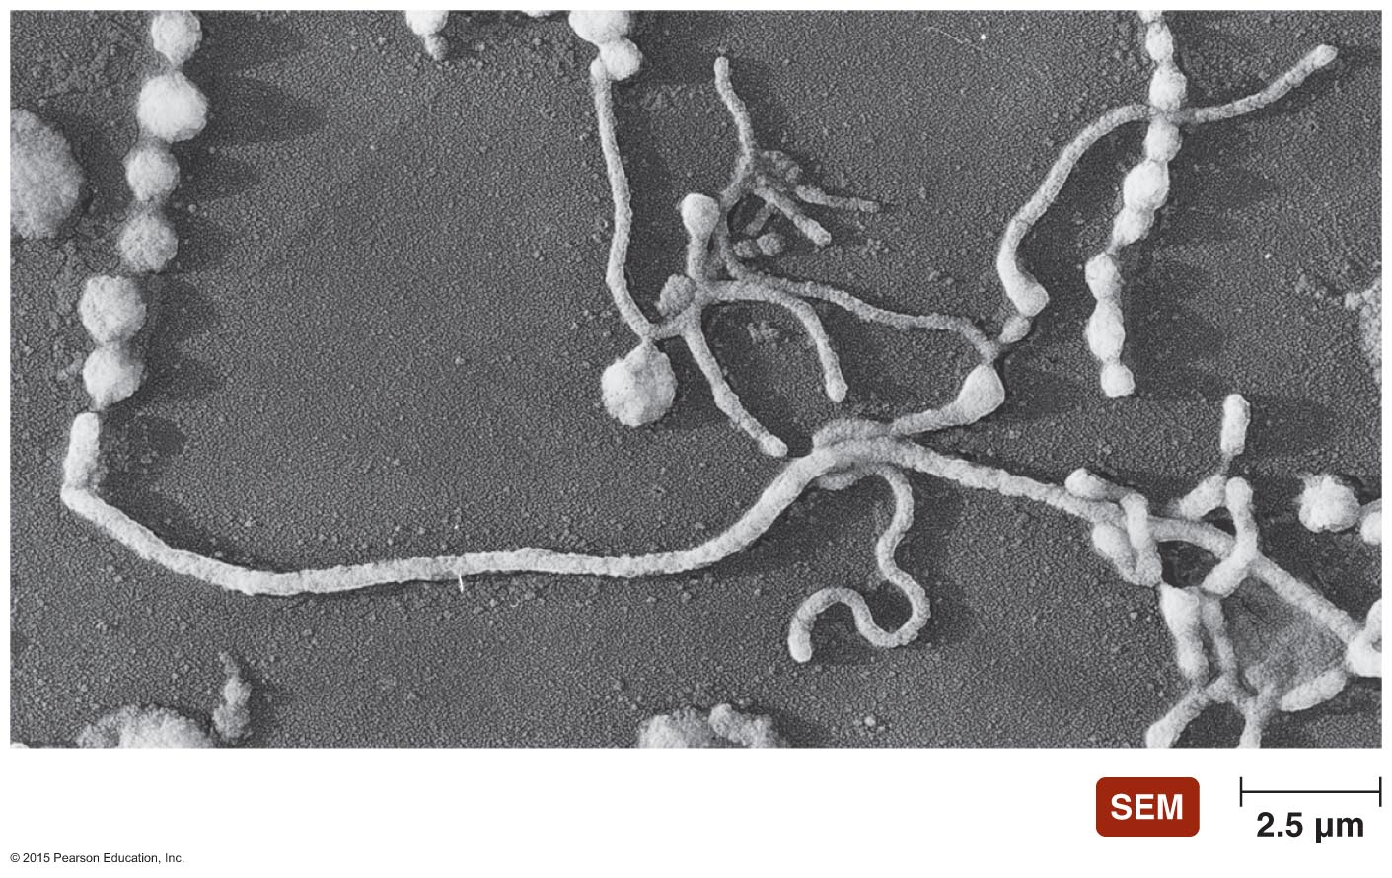
Figure 22.7 Pleomorphic forms of Mycoplasma.

Slide 28
Bacterial Diseases of the Lower Respiratory System
Primary Atypical (Mycoplasmal) Pneumonia
Epidemiology
Bacteria spread by nasal secretions
Most common form of pneumonia in teenagers and young adults
Diagnosis, treatment, and prevention
Difficult to diagnose
Treated with erythromycin or doxycycline
Prevention difficult since infected individuals may be asymptomatic

Slide 29
Bacterial Diseases of the Lower Respiratory System
Klebsiella Pneumonia
Signs and symptoms
Pneumonia symptoms with a thick, bloody sputum
Pathogen and virulence factors
Caused by Klebsiella pneumoniae
Virulence factors include a capsule
Pathogenesis and epidemiology
Immunocompromised individuals at greatest risk for infection
Diagnosis, treatment, and prevention
Diagnosed by identifying Klebsiella in sputum samples
Treated with antimicrobials
Prevention involves good aseptic technique by health care workers

Slide 30
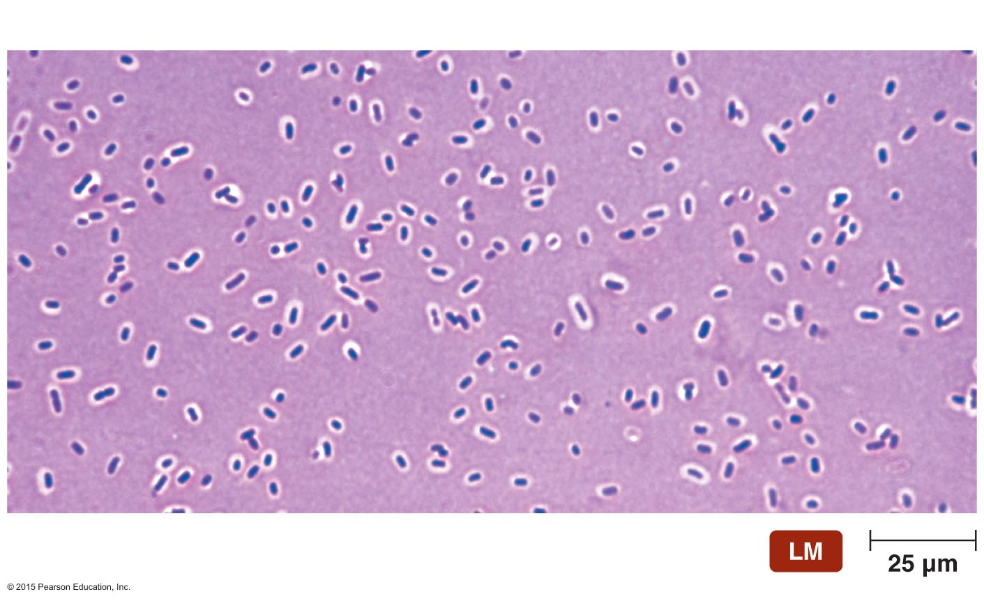
Figure 22.8 The prominent capsule of Klebsiella pneumoniae.
Capsules

Slide 31
Bacterial Diseases of the Lower Respiratory System
Other Bacterial Pneumonias
Haemophilus influenzae and Staphylococcus aureus
Disease similar to pneumococcal pneumonia
Yersinia pestis
Causes pneumonia, called pneumonic plague
Chlamydophila psittaci
Causative agent of ornithosis
Disease of birds that can be transmitted to humans
Chlamydophila pneumoniae
Causes pneumonia, bronchitis, and rhinosinusitis

Slide 32
Bacterial Diseases of the Lower Respiratory System
Legionnaires' Disease
Signs and symptoms
Typical pneumonia symptoms
Pulmonary function can rapidly decrease
Pathogen and virulence factors
Most cases caused by Legionella pneumophila
Pathogenesis
L. pneumophila kills human cells
Causes tissue damage and inflammation

Slide 33
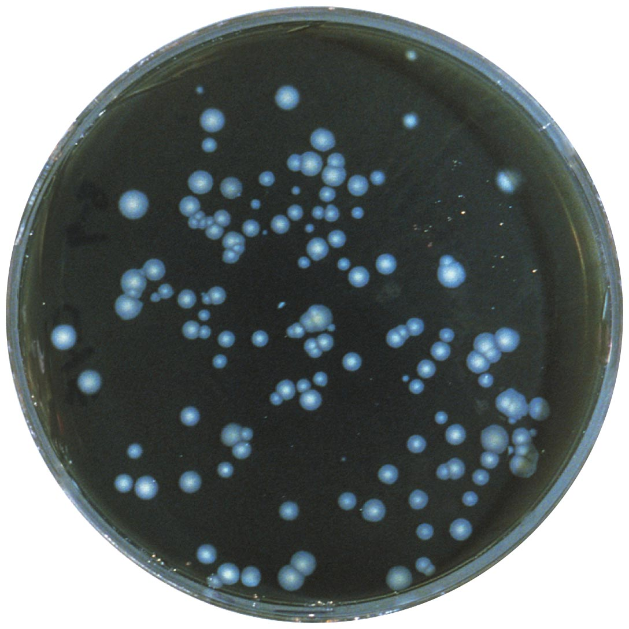
Figure 22.9 Legionella pneumophila growing on buffered charcoal yeast extract agar.

Slide 34
Bacterial Diseases of the Lower Respiratory System
Legionnaires' Disease
Epidemiology
Legionella survives in domestic water sources
The elderly, smokers, and immunocompromised individuals are at increased risk for infection
Diagnosis, treatment, and prevention
Diagnosed with fluorescent antibody staining or serology
Quinolones or macrolides are the preferred treatment
Controlled by reducing bacterial presence in water

Slide 35
Bacterial Diseases of the Lower Respiratory System
Tuberculosis
The leading disease killer in the world
Incidence has declined in the industrialized world
Signs and symptoms
Initially limited to minor cough and mild fever
Symptoms are not always apparent
Pathogen and virulence factors
Caused by Mycobacterium tuberculosis
Presence of mycolic acid gives bacteria unique features
Slow growth
Protection form phagocytic lysis
Intracellular growth
Resistance to many antimicrobial drugs

Slide 36
Bacterial Diseases of the Lower Respiratory System
Tuberculosis
Pathogenesis
Spread via inhalation of respiratory drops
Three types of tuberculosis
Primary tuberculosis
Secondary tuberculosis
Disseminated tuberculosis

Slide 37
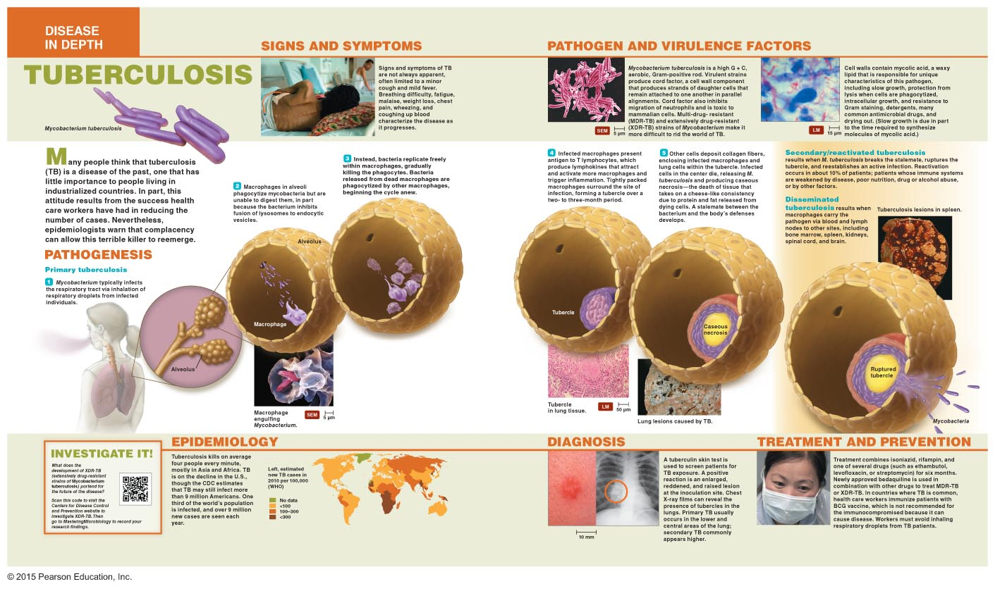
Disease in Depth: Tuberculosis, Pathogenesis

Slide 38
Bacterial Diseases of the Lower Respiratory System
Tuberculosis
Epidemiology
One-third of the world's population is infected
Most deaths occur in Asia and Africa
Diagnosis, treatment, and prevention
Tuberculin skin test identifies exposure to tuberculosis
Chest X-ray images can identify tubercles in the lungs
Treatment requires combination of drugs
Drug-resistant strains of M. tuberculosis have emerged
BCG vaccine is available where tuberculosis is common

Slide 39
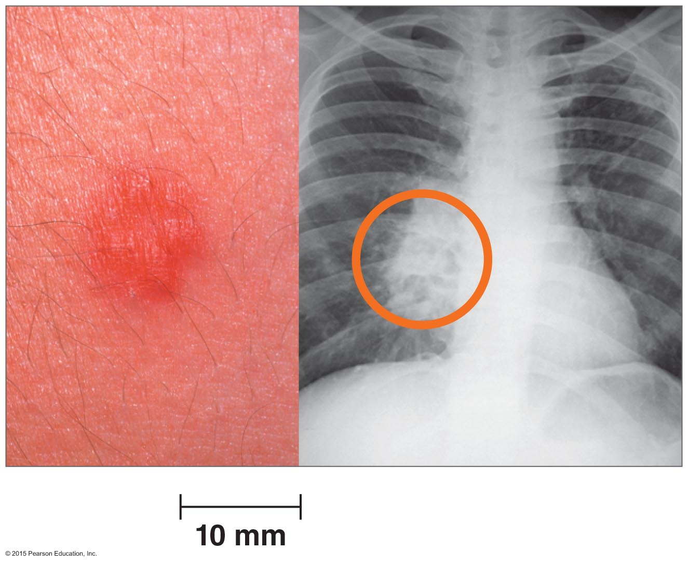
Figure Disease at a Glance: Diagnosis of tuberculosis—overview.

Slide 40
Bacterial Diseases of the Lower Respiratory System
Pertussis (Whooping Cough)
Signs and symptoms
Initially coldlike, then characteristic cough develops
Pathogen and virulence factors
Bordetella pertussis is the causative agent
Produces numerous virulence factors
Includes adhesins and several toxins
Pathogenesis
Pertussis progresses through four phases
Incubation, catarrhal, paroxysmal, and convalescent

Slide 41
Bacterial Diseases of the Lower Respiratory System
Pertussis (Whooping Cough)
Epidemiology
Highly contagious
Bacteria spread through airborne droplets in air
Bacteria does not survive long outside the body
Diagnosis, treatment, and prevention
Symptoms are usually diagnostic
Treatment is primarily supportive
Prevention is with the DTaP vaccine

Slide 42
Bacterial Diseases of the Lower Respiratory System
Inhalational Anthrax
Signs and symptoms
Initially resembles a cold or flu
Progresses to severe coughing, lethargy, shock, and death
Pathogen and virulence factors
Bacillus anthracis is the causative agent
Virulence factors include a capsule and anthrax toxin
Pathogenesis and epidemiology
Anthrax not spread from person to person
Acquired by contact or inhalation of endospores

Slide 43
Bacterial Diseases of the Lower Respiratory System
Inhalation Anthrax
Diagnosis, treatment, and prevention
Diagnosis based on identification of bacteria in sputum
Early and aggressive antimicrobial treatment is necessary
Anthrax vaccine is available to select individuals

Slide 44
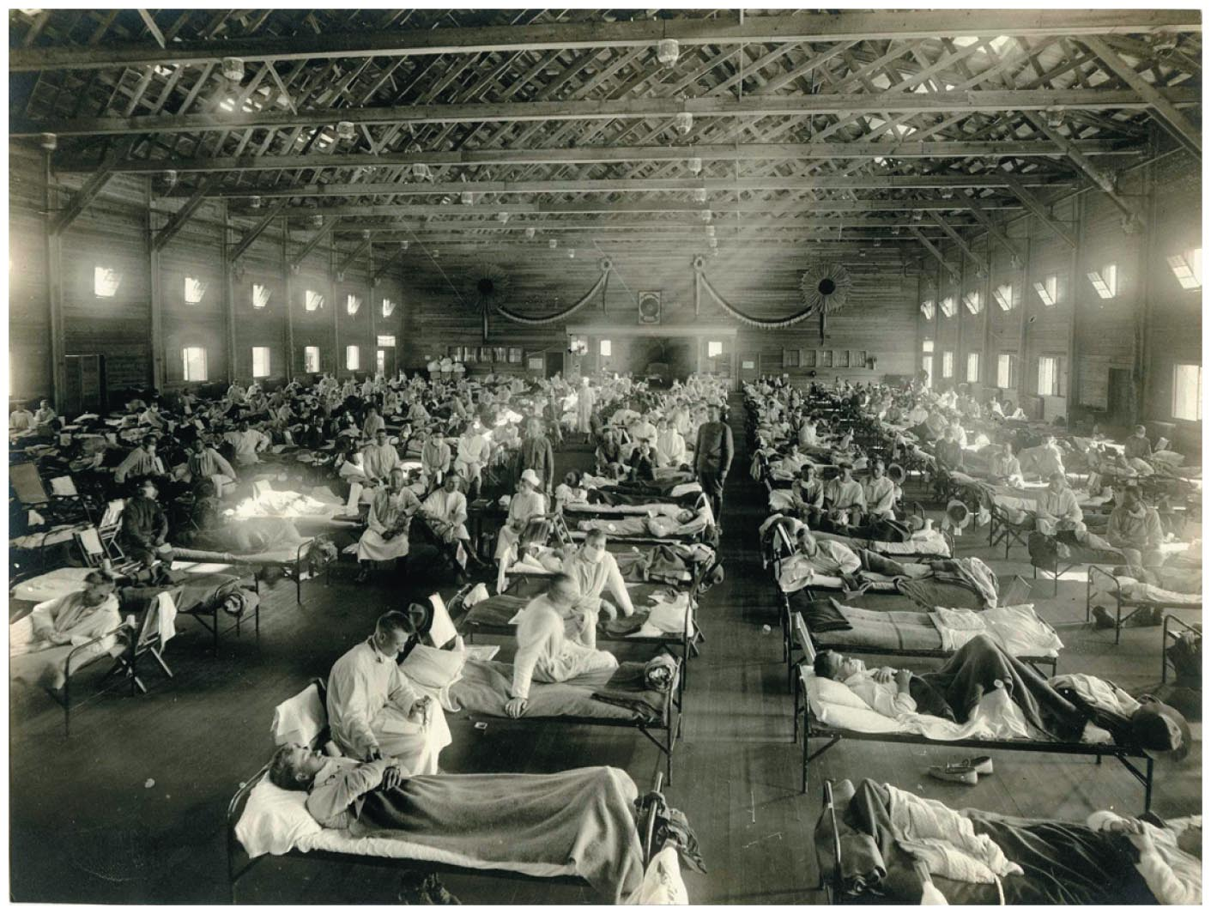
Figure 22.10 A scene from the flu pandemic of 1918–19.

Slide 45
Viral Diseases of the Lower Respiratory System
Influenza
Signs and symptoms
Pharyngitis, congestion, cough, myalgia
Sudden fever distinguishes flu from a common cold
Pathogens and virulence factors
Influenza virus types A and B are the causative agents
Mutations in hemagglutinin and neuraminidase produce new strains
Occurs via antigenic drift and antigenic shift
Concern about the fatality associated with strains similar to those of past pandemics

Slide 46
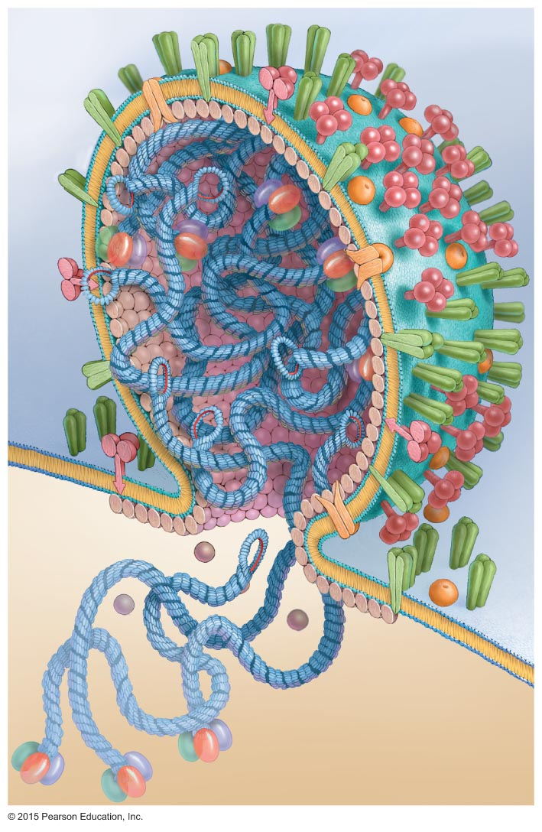
Figure 22.11 Artist's rendition of a cross-sectioned influenzavirus budding from a cell.
Neuraminidase
Envelope
Hemagglutinin
ssRNA
molecule
in helical
capsid

Slide 47
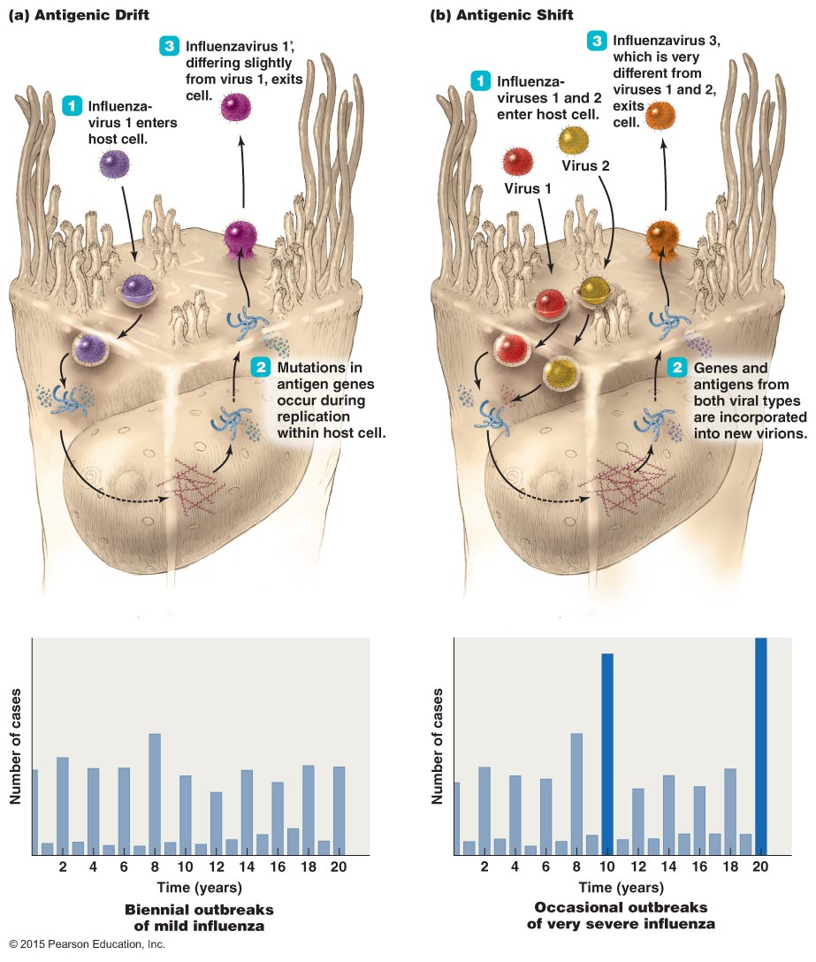
Figure 22.12 The development of new strains of flu viruses.

Slide 48
Viral Diseases of the Lower Respiratory System
Influenza
Pathogenesis
Symptoms produced by the immune response to the virus
Flu patients are susceptible to secondary bacterial infections
Virus causes damage to the lung epithelium
Epidemiology
Transmitted via inhalation of viruses or by self-inoculation
Complications occur most often in the elderly, children, and individuals with chronic diseases

Slide 49
Viral Diseases of the Lower Respiratory System
Influenza
Diagnosis, treatment, and prevention
Signs and symptoms during a community-wide outbreak are often diagnostic
Treatment involves supportive care to relieve symptoms
Oseltamivir and zanamivir can be administered early in infection
Prevented by immunization with a multivalent vaccine

Slide 50
Viral Diseases of the Lower Respiratory System
Coronavirus Respiratory Syndromes
Two recently emerging diseases
Severe acute respiratory syndrome (SARS)
Middle East respiratory syndrome (MERS)
Signs and symptoms
High fever, shortness of breath, difficulty breathing
Later, patients develop dry cough and pneumonia
Pathogen and virulence factors
Coronaviruses are the causative agent
Most diseases are usually mild
SARS and MERS have higher fatalities

Slide 51
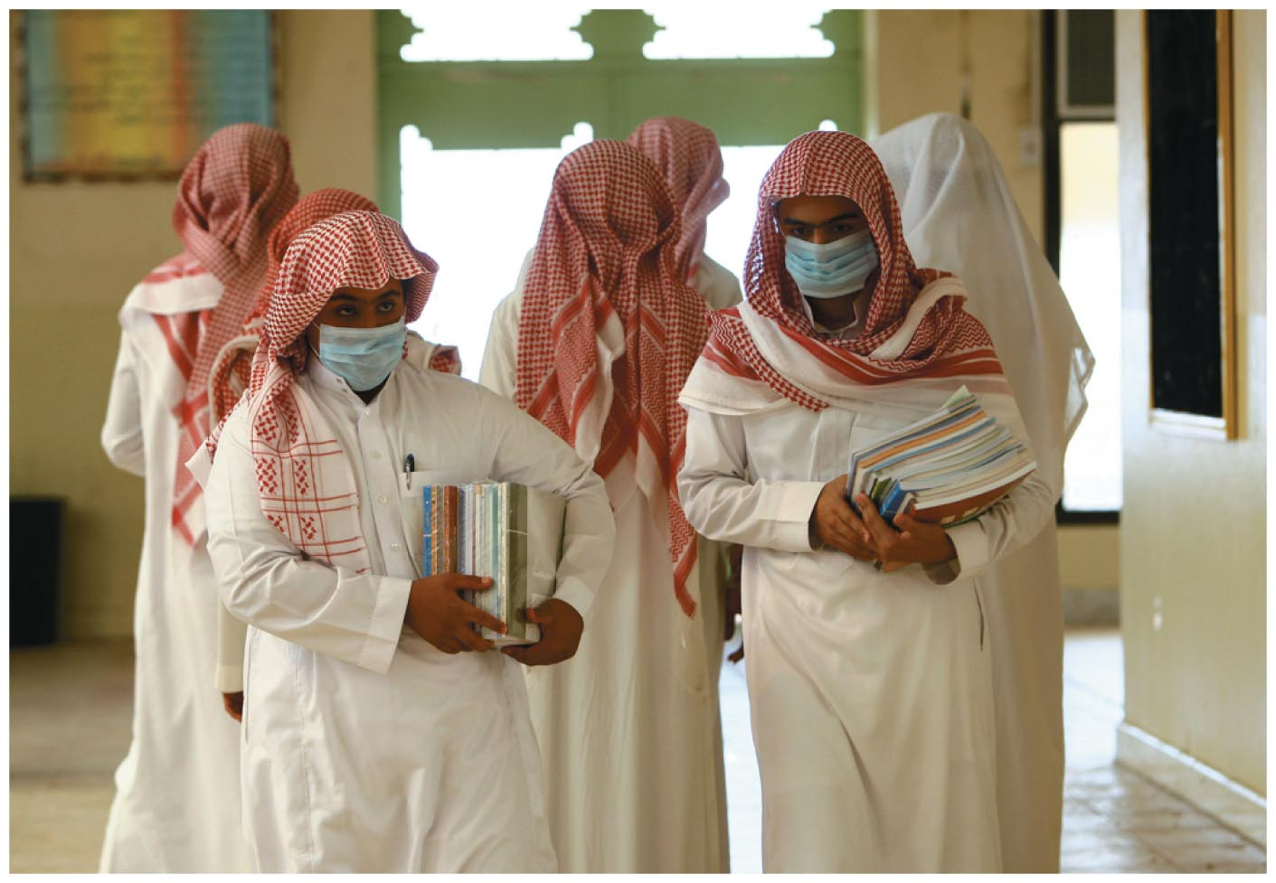
Figure 22.13 The face of coronavirus respiratory syndromes.

Slide 52
Viral Diseases of the Lower Respiratory System
Coronavirus Respiratory Syndromes
Pathogenesis and epidemiology
Coronaviruses spread via respiratory droplets
Virus spreads from the lungs to the heart and kidneys
Diagnosis, treatment, and prevention
Diagnosis is based on signs and symptoms
Confirmed by isolating the virus or antibodies against the virus
Treatment is supportive

Slide 53
Viral Diseases of the Lower Respiratory System
Respiratory Syncytial Virus Infection
Most common childhood respiratory disease
Signs and symptoms
Fever, runny nose, and coughing in babies or immunocompromised individuals
Mild coldlike symptoms in older children and adults
Pathogen
Respiratory syncytial virus (RSV)
Pathogenesis
Virus causes syncytia to form in the lungs
Immune response to RSV further damages the lungs

Slide 54
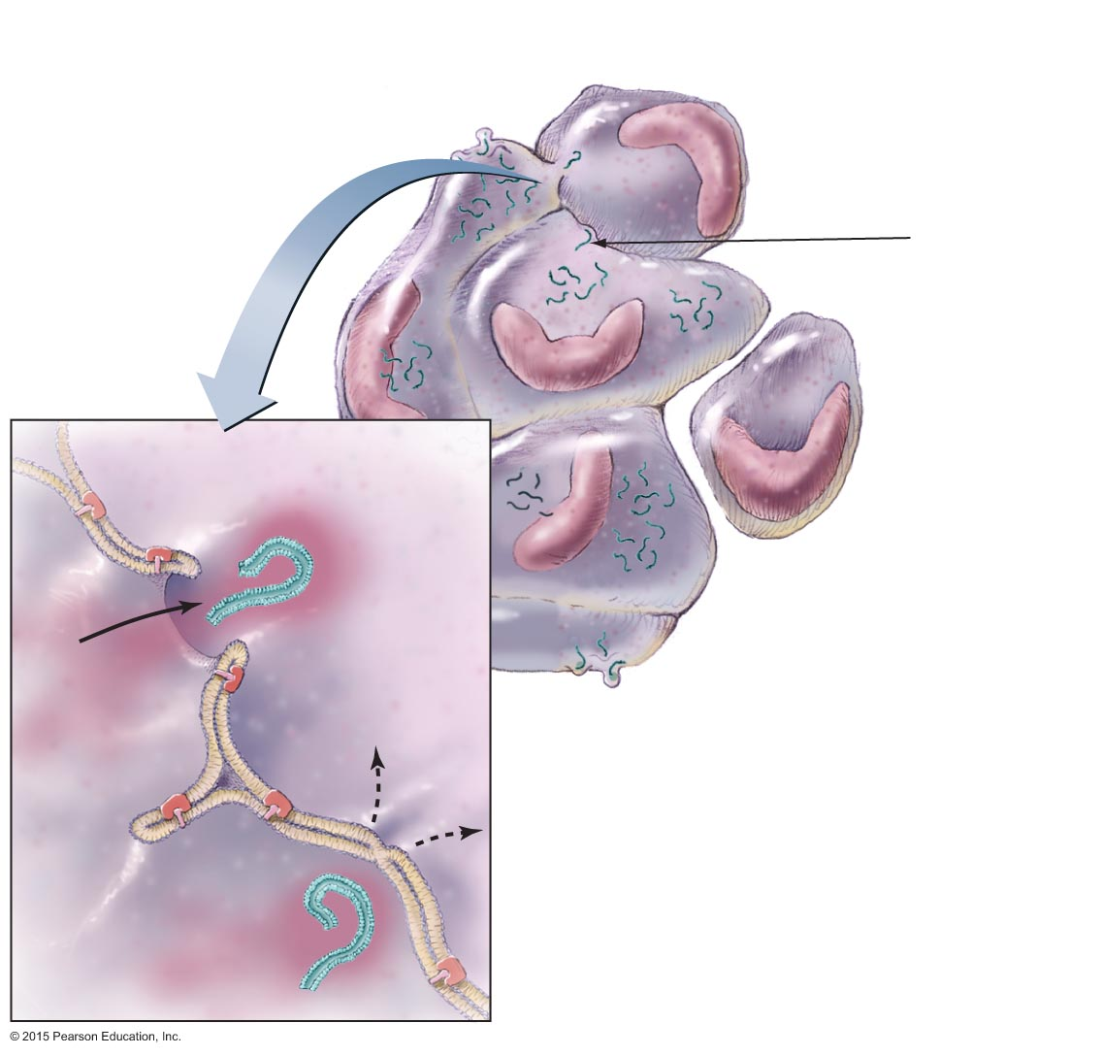
Figure 22.14 A syncytium forms when RSV triggers infected cells to fuse with uninfected cells.
Multinucleated
syncytium
Newly
infected cell
Nucleus
RSV
Infected
host cell
Uninfected
cell
Newly
infected cell
Infected
host cell
RSV
Multinucleated
syncytium

Slide 55
Viral Diseases of the Lower Respiratory System
Respiratory Syncytial Virus Infection
Epidemiology
Transmission occurs via close contact with infected persons
Diagnosis, treatment, and prevention
Diagnosis is made by immunoassay
Supportive treatment for young children
Prevention includes aseptic technique of health care and day care employees

Slide 56
Viral Diseases of the Lower Respiratory System
Hantavirus Pulmonary Syndrome (HPS)
Signs and symptoms
Symptoms progress to cough, shock, and labored breathing
Pathogen
Caused by Hantavirus
Transmitted from mice via inhalation
Pathogenesis
Hantavirus travels throughout body via the blood
Infection causes widespread inflammation leading to shock

Slide 57
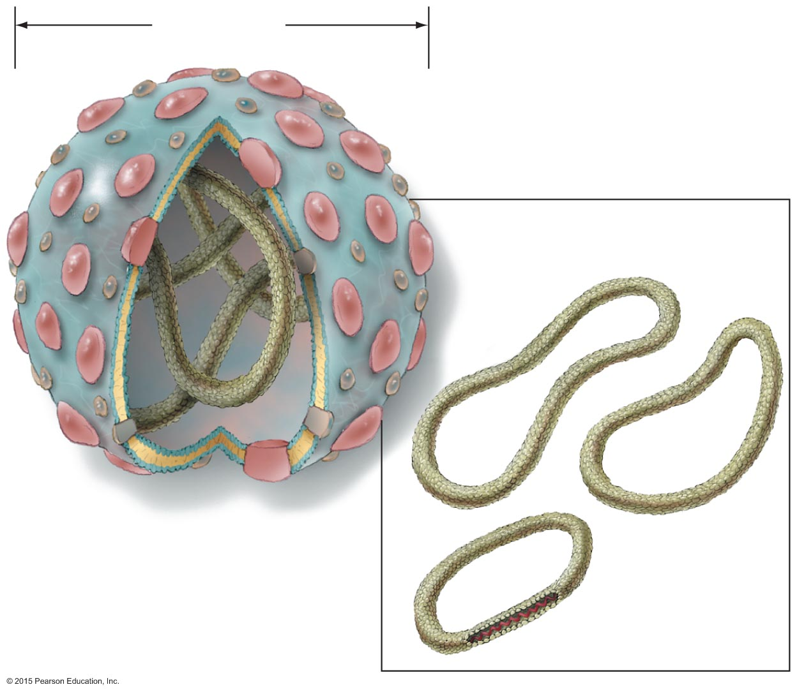
Figure 22.15 Hantavirus is an enveloped, segmented, −ssRNA bunyavirus.
90–100 nm
Three negative ssRNA
molecules within capsids
Membrane
glycoproteins
Lipid
envelope
Outer capsid
Negative ssRNA

Slide 58
Viral Diseases of the Lower Respiratory System
Hantavirus Pulmonary Syndrome (HPS)
Epidemiology
Human disease more likely as mouse population increases
Person-to-person contact does not occur
Diagnosis, treatment, and prevention
Diagnosis is based on characteristic symptoms
No pharmacological treatment is available
Prevention requires control of rodents

Slide 59
Viral Diseases of the Lower Respiratory System
Other Viral Respiratory Diseases
Other viruses cause respiratory disease in children, the elderly, or immunocompromised individuals
Cytomegalovirus
Metapneumovirus
Estimated to be the second most common cause of viral respiratory disease
Parainfluenza viruses
Three strains cause croup and viral pneumonia
Occur primarily in young children

Slide 60
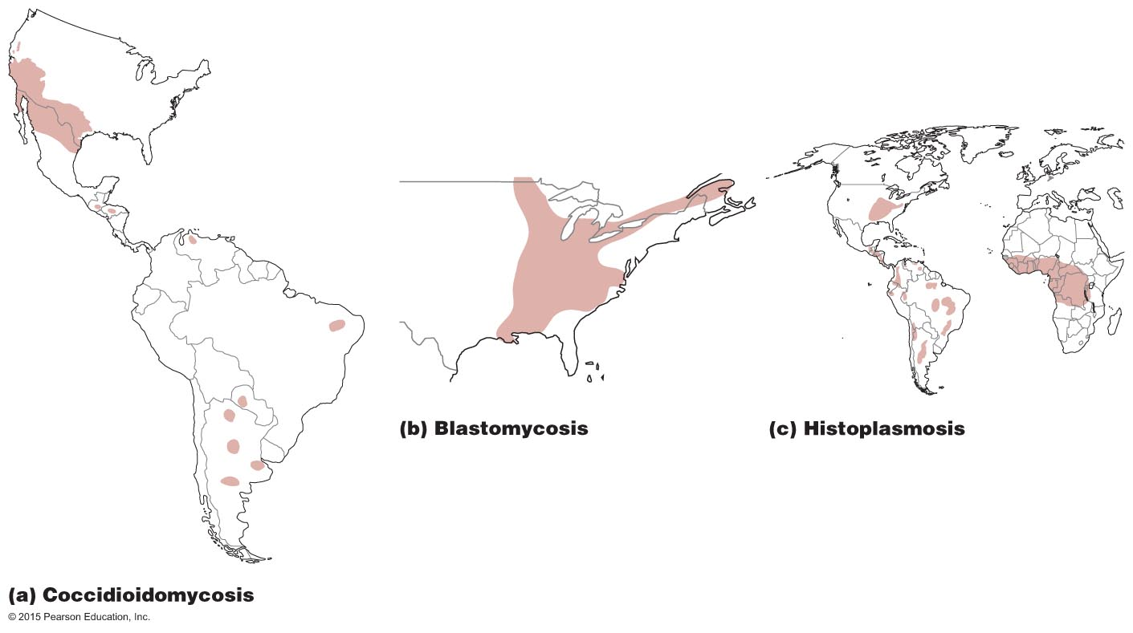
Figure 22.16 The geographic distributions of three systemic fungal diseases endemic to North America.

Slide 61
Mycoses of the Lower Respiratory System
Coccidioidomycosis
Signs and symptoms
Resembles pneumonia or tuberculosis
Can become systemic in immunocompromised persons
Pathogen and virulence factors
Caused by Coccidioides immitis
Pathogen assumes yeast form at human body temperature
Pathogenesis
Arthroconidia from the soil enter the body through inhalation

Slide 62
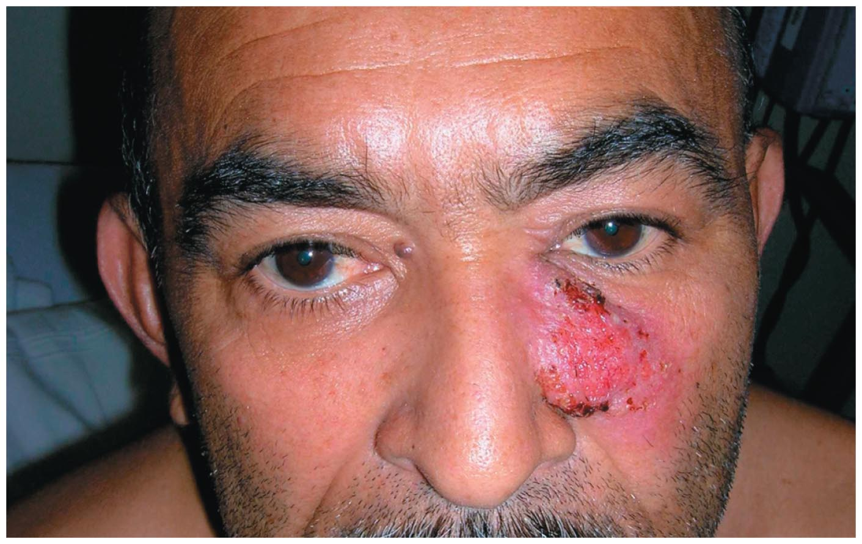
Figure 22.17 Coccidioidomycosis lesions in subcutaneous tissue.

Slide 63
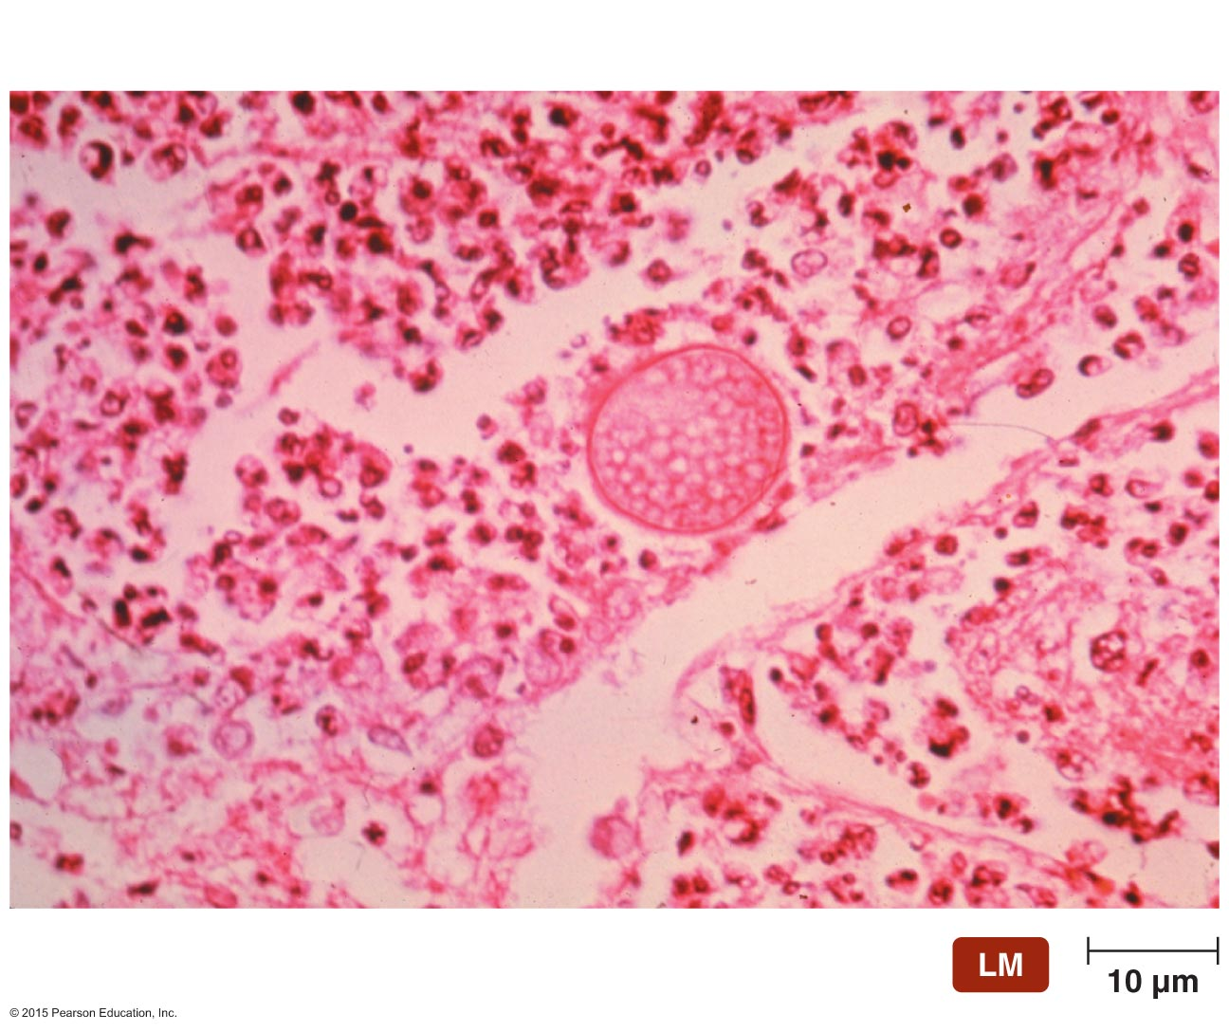
Figure 22.18 Spherules of Coccidioides immitis.
Spherule
Spores

Slide 64
Mycoses of the Lower Respiratory System
Coccidioidomycosis
Epidemiology
Almost exclusively in southwestern U.S. and northern Mexico
Diagnosis, treatment, and prevention
Diagnosed by presence of spherules in clinical specimens
Treated with amphotericin B
Protective masks can prevent exposure to arthroconidia

Slide 65
Mycoses of the Lower Respiratory System
Blastomycosis
Signs and symptoms
Flulike symptoms
Systemic infections can produce lesions on the face and upper body or purulent lesions on various organs
Pathogen
Caused by Blastomyces dermatitidis
Pathogenic yeast form at human body temperature

Slide 66
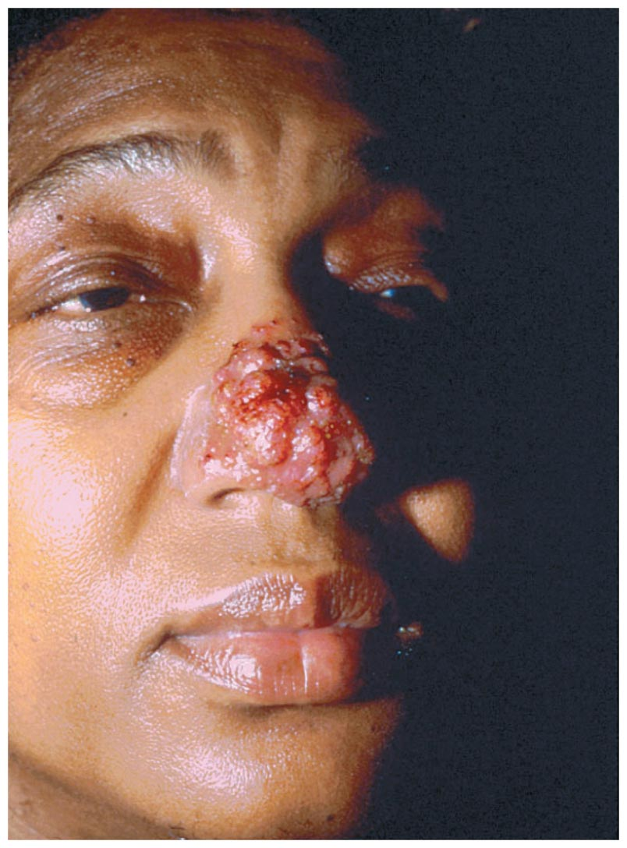
Figure 22.19 Cutaneous blastomycosis in an American woman.

Slide 67
Mycoses of the Lower Respiratory System
Blastomycosis
Pathogenesis and epidemiology
Enters body through inhalation of dust carrying fungal spores
Incidence of human infection is increasing
Diagnosis, treatment, and prevention
Diagnosis is based on identifying fungus in clinical samples
Treated with amphotericin B
Relapse common in AIDS patients

Slide 68
Mycoses of the Lower Respiratory System
Histoplasmosis
Signs and symptoms
Asymptomatic in most cases
Symptomatic infection causes coughing with bloody sputum or skin lesions
Pathogen
Caused by Histoplasma capsulatum
Pathogenic yeast form at human body temperature
Histoplasma produces several proteins that inhibit macrophage activation and other host defenses

Slide 69
Mycoses of the Lower Respiratory System
Histoplasmosis
Pathogenesis and epidemiology
Humans inhale airborne spores from the soil
Prevalent in the eastern U.S.
Diagnosis, treatment, and prevention
Diagnosis is based on identifying fungus in clinical samples
Infections in immunocompetent individuals typically resolve without treatment

Slide 70
Mycoses of the Lower Respiratory System
Pneumocystis Pneumonia (PCP)
Signs and symptoms
Difficulty breathing, anemia, hypoxia, and fever
Pathogen
Caused by Pneumocystis jirovecii
Pathogenesis and epidemiology
Transmitted by inhalation of droplets containing the fungus
Common disease in AIDS patients
Diagnosis, treatment, and prevention
Diagnosis is based on clinical and microscopic findings
Treated with trimethoprim and sulfamethoxazole
Impossible to prevent infection with P. jirovecii

Slide 71
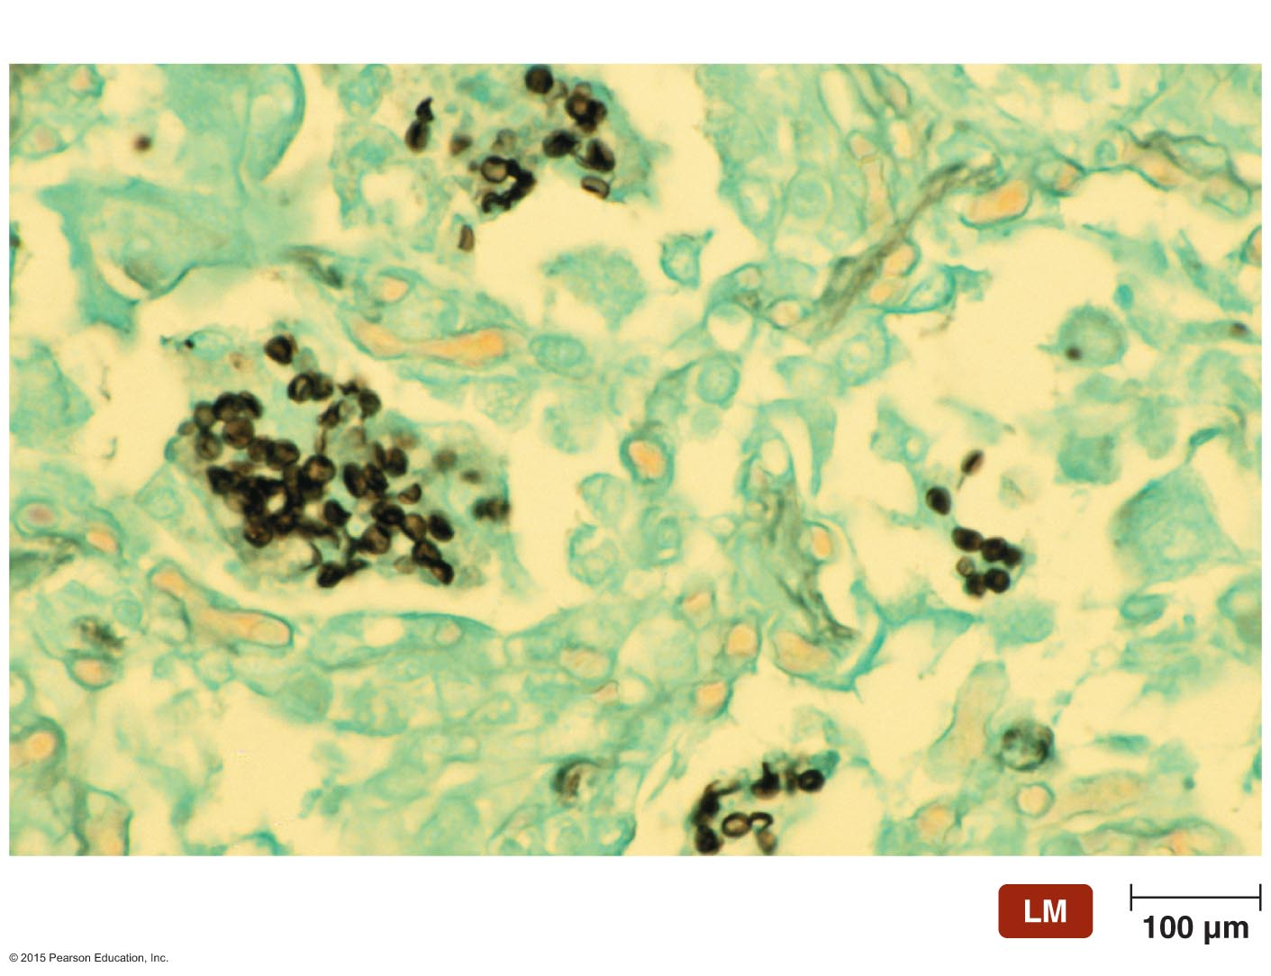
Figure 22.20 Cysts of Pneumocystis jirovecii in lung tissue.
Cyst

