Slide 1
Controlling Microbial growth in the environment
Chapter 9
CCV
Microbiology

Slide 2
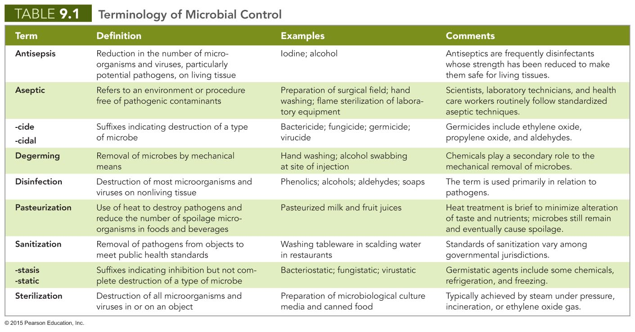

Slide 3
Action of Antimicrobial Agents
1) Alteration of cell walls and membranes
Cell wall maintains integrity of cell
When damaged, effects of osmosis cause cells to burst
Cytoplasmic membrane contains cytoplasm and controls passage of chemicals into and out of cell
When damaged, cellular contents leak out
Nonenveloped viruses can better tolerate harsh conditions

Slide 4
Action of Antimicrobial Agents
2) Damage to proteins and nucleic acids
Protein function depends on 3-D shape
Extreme heat or certain chemicals denature proteins
Chemicals, radiation, and heat can alter or destroy nucleic acids
Produce fatal mutants
Halt protein synthesis through action on RNA

Slide 5
The Selection of Microbial Control Methods
Ideally, agents should be:
Inexpensive
Fast-acting
Stable during storage
Capable of controlling microbial growth while being harmless to humans, animals, and objects

Slide 6
Factors Affecting the Efficacy of Antimicrobial Methods
1) Site to be treated
Harsh chemicals and extreme heat cannot be used on humans, animals, and fragile objects
Method of microbial control based on site of medical procedure

Slide 7
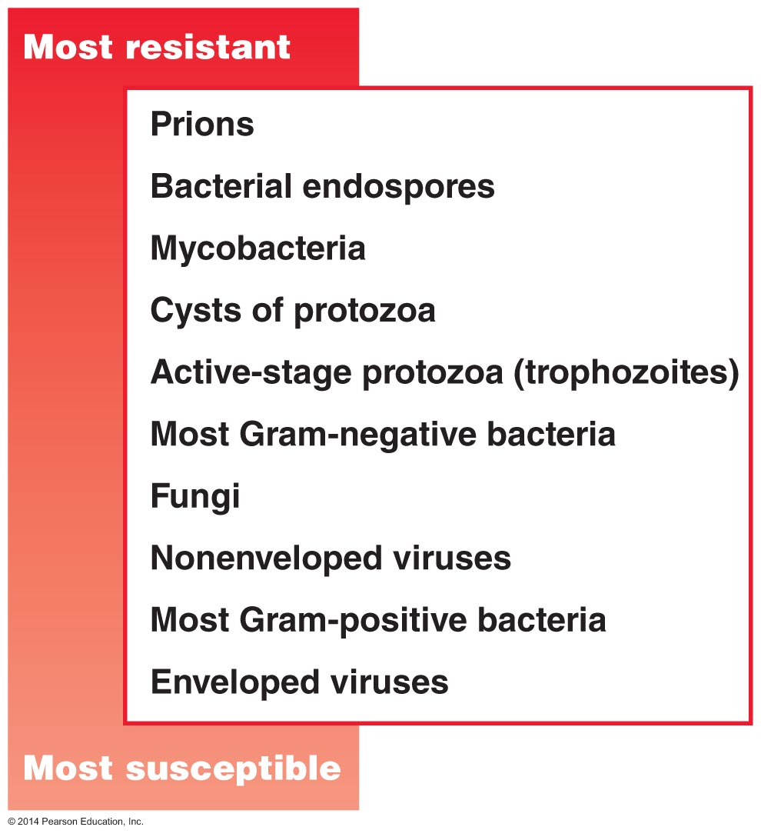
Figure 9.2 Relative susceptibilities of microbes to antimicrobial agents.

Slide 8
Factors Affecting the Efficacy of Antimicrobial Methods
1) Relative susceptibility of microorganisms
Germicide classification
High-level germicides
Kill all pathogens, including endospores
Intermediate-level germicides
Kill fungal spores, protozoan cysts, viruses, and pathogenic bacteria
Low-level germicides
Kill vegetative bacteria, fungi, protozoa, and some viruseS

Slide 9
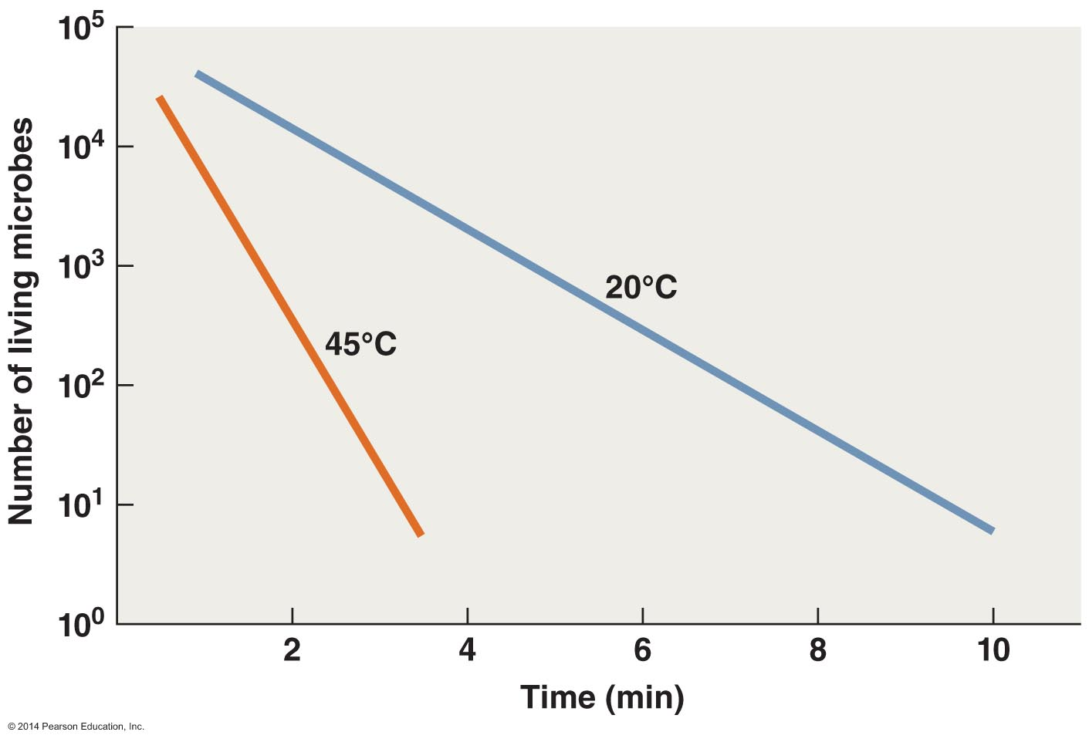
2) TEMPERATURE EFFECTS ON EFFICACY OF ANTIMICROBIAL AGENTS

Slide 10
The Selection of Microbial Control Methods
Biosafety Levels
Four levels of safety in labs dealing with pathogens
Biosafety Level 1 (BSL-1)
Handling microbes that do not cause disease in humans
Biosafety Level 2 (BSL-2)
Handling moderately hazardous agents
Biosafety Level 3 (BSL-3)
All manipulations of microbes done in safety cabinets
Biosafety Level 4 (BSL-4)
Handling microbes that cause severe or fatal disease
Lab space is isolated, and personnel wear protective suits

Slide 11
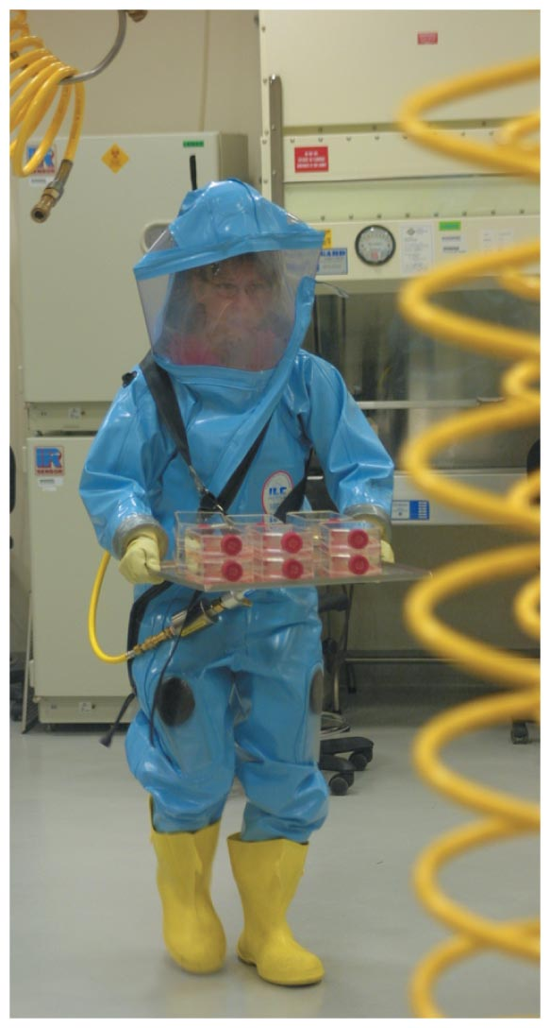
Figure 9.4 A BSL-4 worker carrying Ebola virus cultures.

Slide 12
Physical Methods of Microbial Control
Heat-Related Methods
Effects of high temperatures
Denature proteins
Interfere with integrity of cytoplasmic membrane and cell wall
Disrupt structure and function of nucleic acids
Thermal death point
Lowest temperature that kills all cells in broth in 10 min
Thermal death time
Time to sterilize volume of liquid at set temperature

Slide 13
Physical Methods of Microbial Control
Heat-Related Methods
Moist heat
Used to disinfect, sanitize, sterilize, and pasteurize
Denatures proteins and destroys cytoplasmic membranes
More effective than dry heat
Methods of microbial control using moist heat
Boiling
Autoclaving
Pasteurization
Ultrahigh-temperature sterilization

Slide 14
Physical Methods of Microbial Control
Heat-Related Methods
Moist heat
Boiling
Kills vegetative cells of bacteria and fungi, protozoan trophozoites, and most viruses
Boiling time is critical
Different elevations require different boiling times
Endospores, protozoan cysts, and some viruses can survive boiling

Slide 15
Physical Methods of Microbial Control
Heat-Related Methods
Moist heat
Autoclaving
Pressure applied to boiling water prevents steam from escaping
Boiling temperature increases as pressure increases
Autoclave conditions: 121ºC, 15 psi, 15 minutes

Slide 16
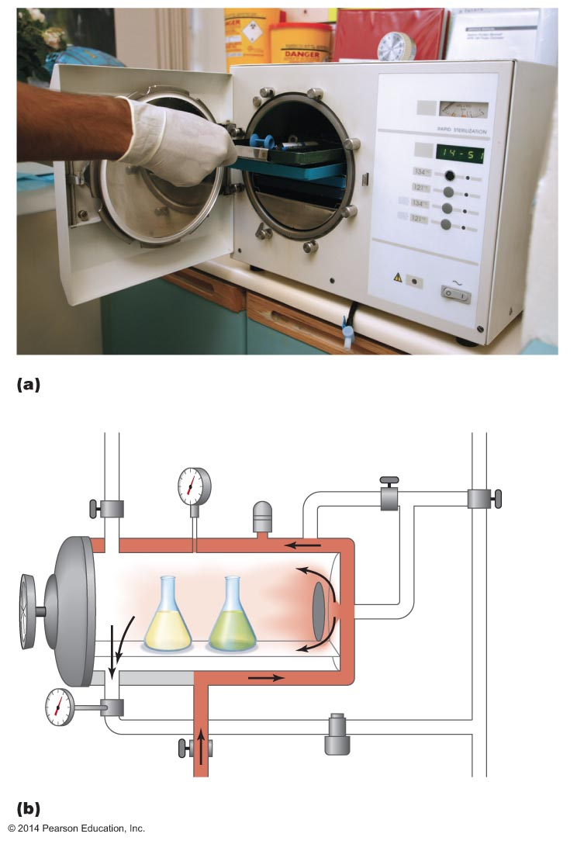
Figure 9.7 An autoclave.
Manual
exhaust to
atmosphere
Pressure
gauge
Valve for steam
to chamber
Safety
valve
Exhaust
valve
Steam
Air
Steam
jacket
Door
Material to
be sterilized
Trap
Thermometer
Steam supply

Slide 17
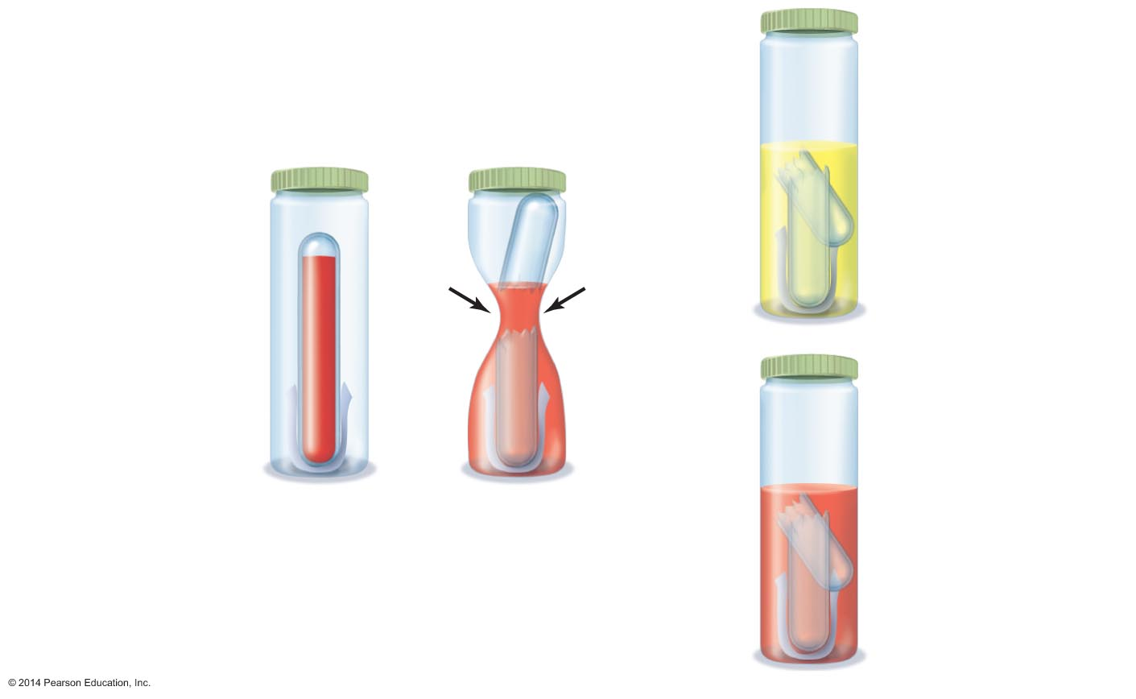
Figure 9.8 Sterility indicators.
Yellow medium
means spores are
viable; autoclaved
objects are not
sterile.
Cap that allows
steam to penetrate
Flexible plastic
vial
Crushable glass
ampule
Incubation
Nutrient medium
containing pH
color indicator
Red medium
means spores were
killed; autoclaved
objects are
sterile.
Endospore strip
After autoclaving, flexible
vial is squeezed to break
ampule and release
medium onto spore strip.

Slide 18
Physical Methods of Microbial Control
Heat-Related Methods
Moist heat
Pasteurization
Used for milk, ice cream, yogurt, and fruit juices
Not sterilization
Heat-tolerant microbes survive
Pasteurization of milk
Batch method
Flash pasteurization
Ultrahigh-temperature pasteurization

Slide 19
Physical Methods of Microbial Control
Heat-Related Methods
Moist heat
Ultrahigh-temperature sterilization
140ºC for 1 to 3 seconds, then rapid cooling
Treated liquids can be stored at room temperature

Slide 20
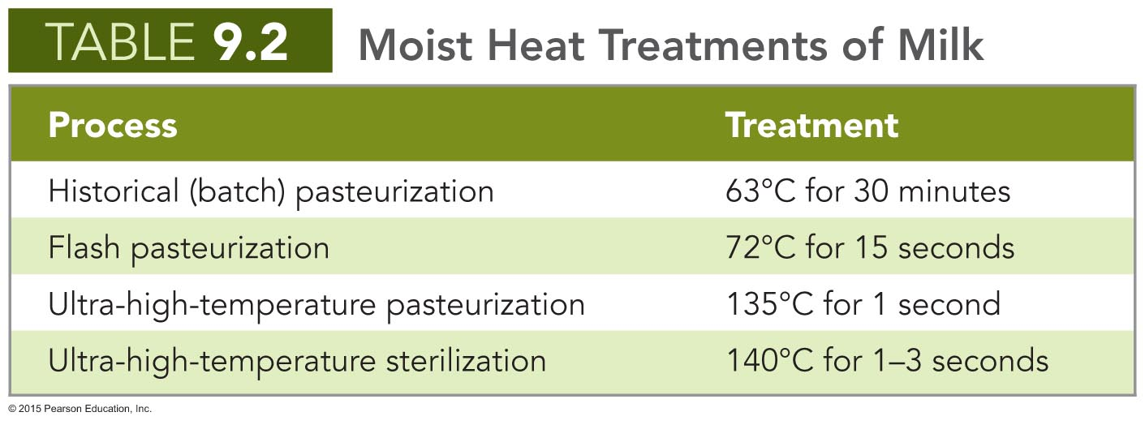

Slide 21
Physical Methods of Microbial Control
Heat-Related Methods
Dry heat
Used for materials that cannot be sterilized with moist heat
Denatures proteins and oxidizes metabolic and structural chemicals
Requires higher temperatures for longer time than moist heat
Incineration is ultimate means of sterilization

Slide 22
Physical Methods of Microbial Control
Refrigeration and Freezing
Decrease microbial metabolism, growth, and reproduction
Chemical reactions occur more slowly at low temperatures
Liquid water not available
Refrigeration halts growth of most pathogens
Some microbes can multiply in refrigerated foods
Slow freezing is more effective than quick freezing
Organisms vary in susceptibility to freezing

Slide 23
Physical Methods of Microbial Control
Desiccation and Lyophilization
Desiccation (drying) inhibits growth as a result of removal of water
Lyophilization (freeze-drying) is used for long-term preservation of microbial cultures
Prevents formation of damaging ice crystals

Slide 24
Figure 9.9 The use of desiccation as a means of preserving apricots in Pakistan.

Slide 25
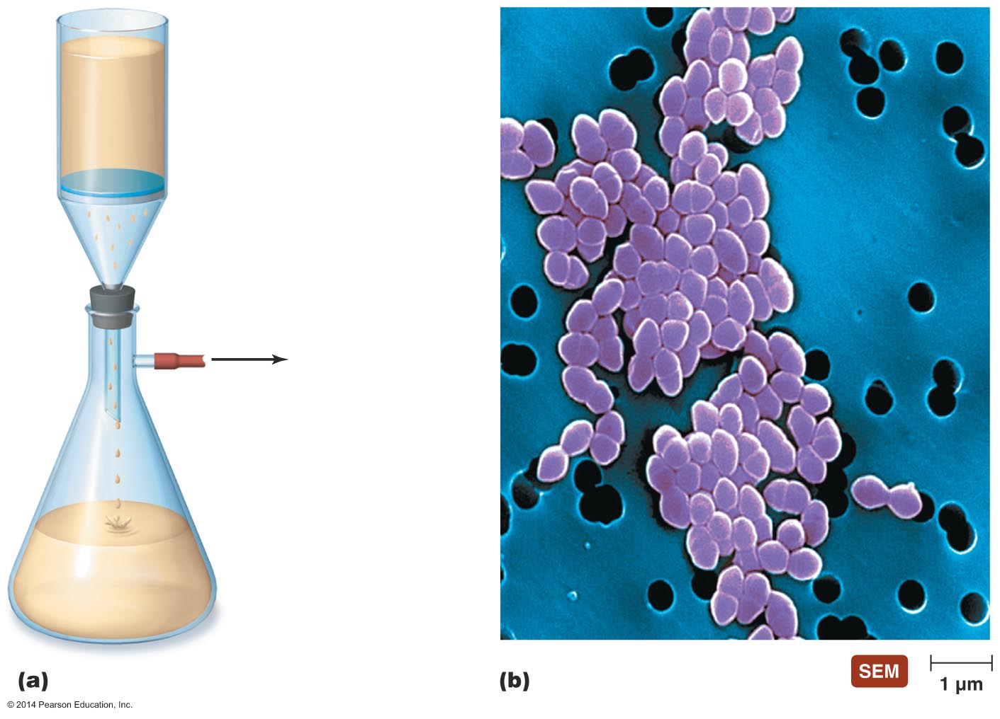
Figure 9.10 Filtration equipment used for microbial control.
Nonsterile medium
Membrane filter
To vacuum pump
Sterile medium

Slide 26
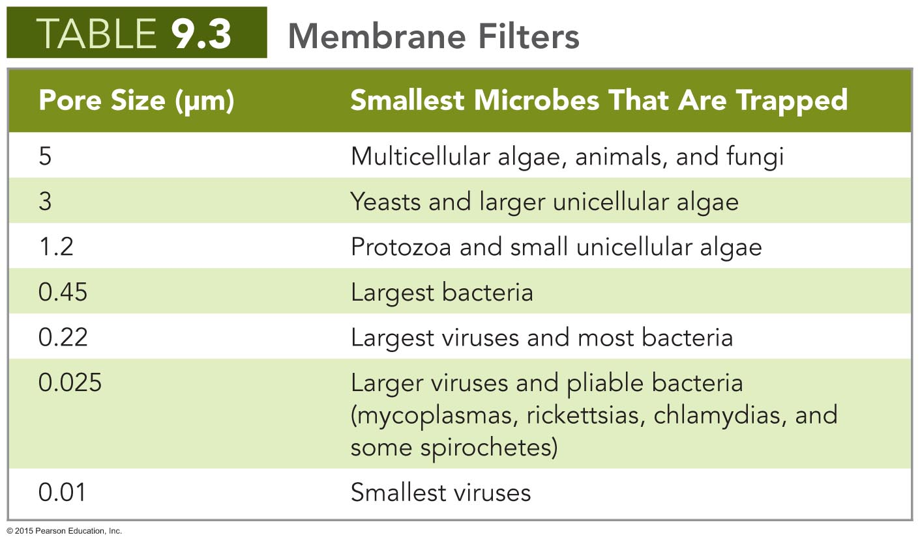

Slide 27
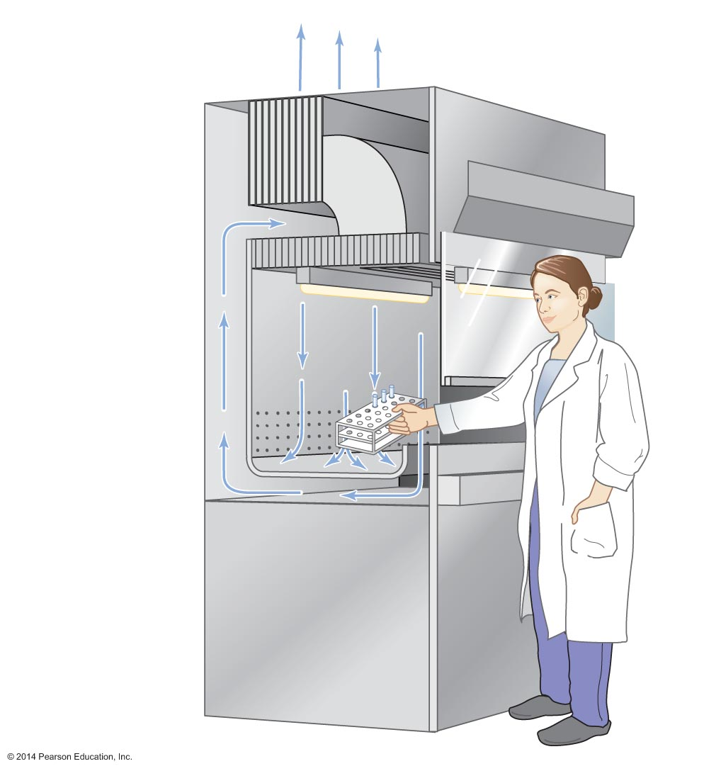
Figure 9.11 The roles of high-efficiency particulate air (HEPA) filters in biological safety cabinets.
Outside
Safety glass
viewscreen
Exhaust HEPA
filter
Blower
Supply HEPA
filter
Light
High-velocity
air barrier

Slide 28
Physical Methods of Microbial Control
Osmotic Pressure
High concentrations of salt or sugar in foods to inhibit growth
Cells in hypertonic solution of salt or sugar lose water
Fungi have greater ability than bacteria to survive hypertonic environments

Slide 29
Physical Methods of Microbial Control
Radiation
Two types of radiation
Particulate radiation
High-speed subatomic particles freed from their atoms
Electromagnetic radiation
Energy without mass traveling in waves at the speed of light
The shorter the wavelength, the more energy the wave carries
All types of radiation are described as either ionizing or nonionizing
Based on the effects to chemicals within cells

Slide 30
Physical Methods of Microbial Control
Radiation
Ionizing radiation
Wavelengths shorter than 1 nm
Electron beams, gamma ray, some X rays
Ejects electrons from atoms to create ions
Ions disrupt hydrogen bonding, oxidize double covalent bonds, and create hydroxyl radicals
Ions denature other molecules (DNA)
Electron beams effective at killing microbes but do not penetrate well
Gamma rays penetrate well but require hours to kill microbes
X rays require long time to kill microbes
Not practical for microbial control

Slide 31
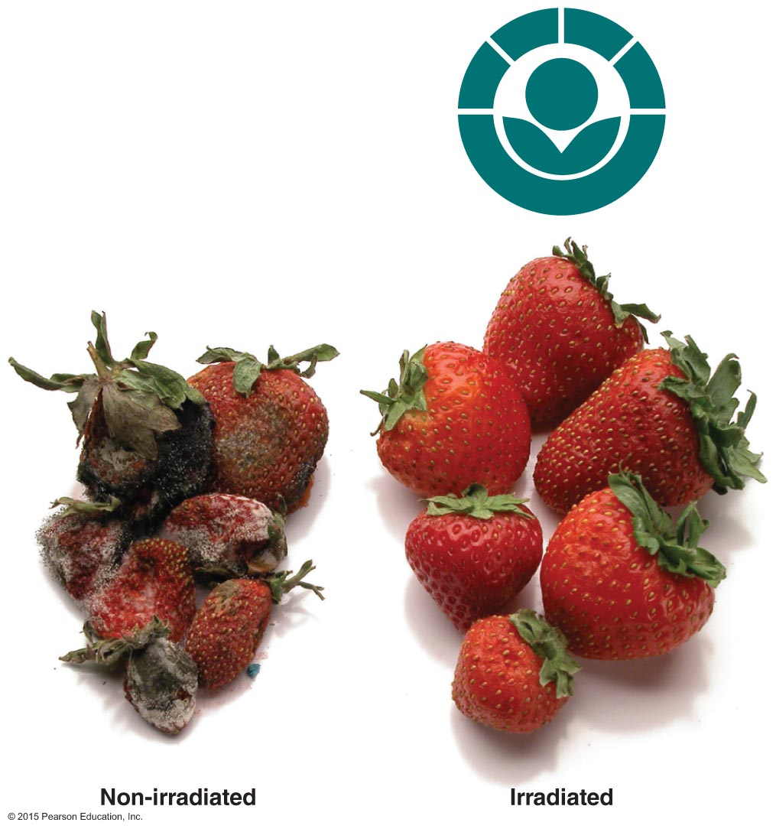
Figure 9.12 A demonstration of the increased shelf life of food achieved by ionizing radiation.

Slide 32
Physical Methods of Microbial Control
Radiation
Nonionizing radiation
Wavelengths greater than 1 nm
Excites electrons, causing them to make new covalent bonds
Affects 3-D structure of proteins and nucleic acids
UV light causes pyrimidine dimers in DNA
UV light does not penetrate well
Suitable for disinfecting air, transparent fluids, and surfaces of objects

Slide 33
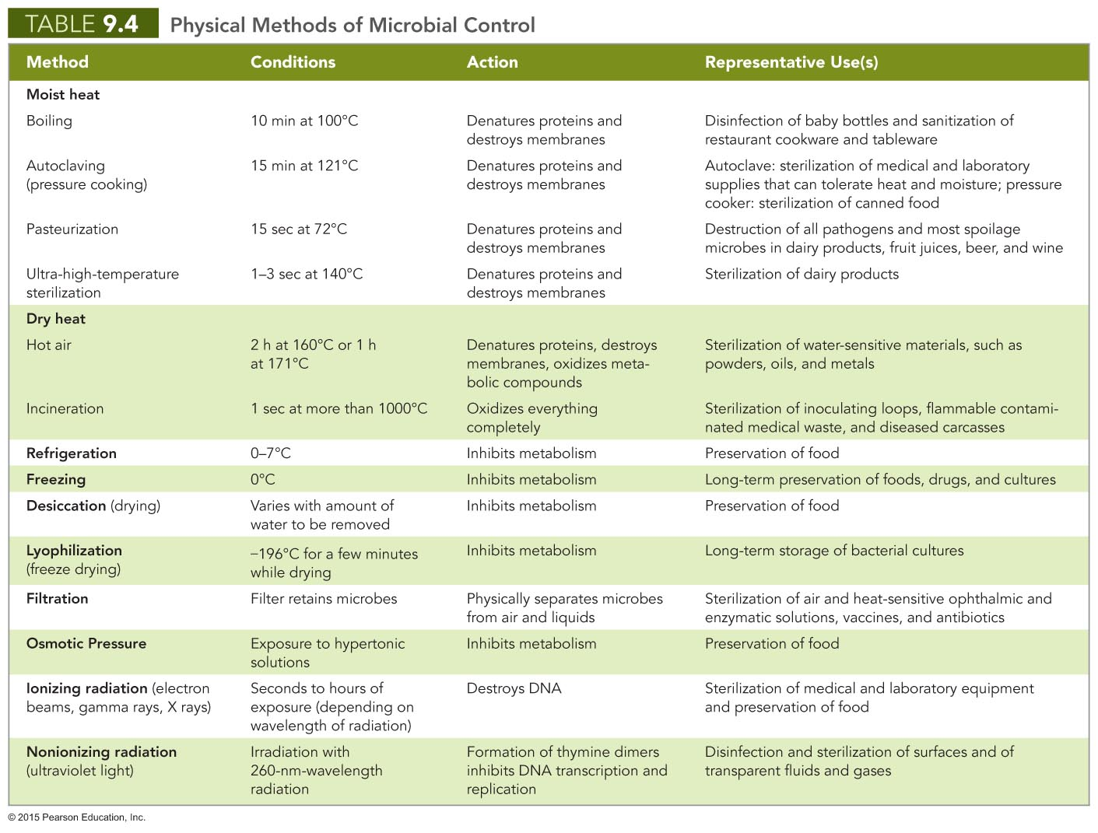

Slide 34
Chemical Methods of Microbial Control
Affect microbes' cell walls, cytoplasmic membranes, proteins, or DNA
Effect varies with differing environmental conditions
Often more effective against enveloped viruses and vegetative cells of bacteria, fungi, and protozoa

Slide 35
Chemical Methods of Microbial Control
Phenol and Phenolics
Denature proteins and disrupt cell membranes
Effective in presence of organic matter
Remain active for prolonged time
Commonly used in health care settings, labs, and homes
Have disagreeable odor and possible side effects

Slide 36
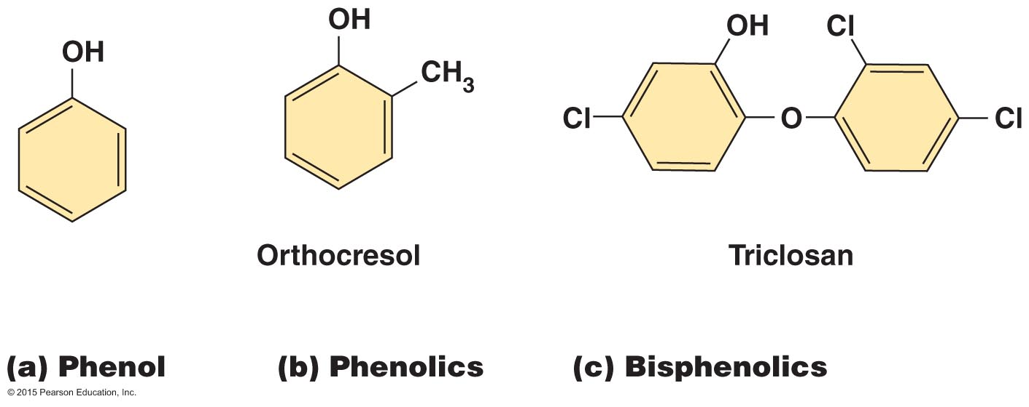
Figure 9.13 Phenol and phenolics.

Slide 37
Chemical Methods of Microbial Control
Alcohols
Intermediate-level disinfectants
Denature proteins and disrupt cytoplasmic membranes
More effective than soap in removing bacteria from hands
Swabbing skin with alcohol prior to injection removes most microbes

Slide 38
Chemical Methods of Microbial Control
Halogens
Include iodine, chlorine, bromine, and fluorine
Intermediate-level antimicrobial chemicals
Damage proteins by denaturation
Widely used in numerous applications
Iodine tablets, iodophores, chlorine treatment, bleach, chloramines, bromine disinfection, and the addition of fluoride to water and toothpastes

Slide 39
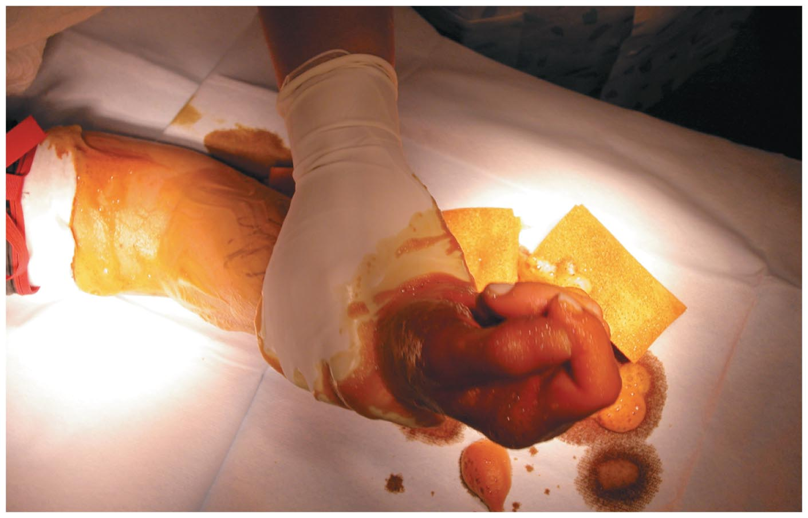
Figure 9.14 Degerming in preparation for surgery on a hand.

Slide 40
Chemical Methods of Microbial Control
Oxidizing Agents
Peroxides, ozone, and peracetic acid
Kill by oxidation of microbial enzymes
High-level disinfectants and antiseptics
Hydrogen peroxide can disinfect and sterilize surfaces
Not useful for treating open wounds because of catalase activity
Ozone treatment of drinking water
Peracetic acid is effective sporicide used to sterilize equipment

Slide 41
Chemical Methods of Microbial Control
Surfactants
"Surface active" chemicals
Reduce surface tension of solvents
Soaps and detergents
Soaps have hydrophilic and hydrophobic ends
Good degerming agents but not antimicrobial
Detergents are positively charged organic surfactants
Quaternary ammonium compounds (quats)
Low-level disinfectants
Disrupt cellular membranes
Ideal for many medical and industrial applications

Slide 42
Figure 9.15 Quaternary ammonium compounds (quats).
Ammonium ion
Cetylpyridinium
Hydrophobic tail
Benzalkonium
Quaternary ammonium ions (quats)

Slide 43
Chemical Methods of Microbial Control
Heavy Metals
Heavy-metal ions denature proteins
Low-level bacteriostatic and fungistatic agents
1% silver nitrate once commonly used to prevent blindness caused by N. gonorrhoeae
Thimerosal used to preserve vaccines
Copper controls algal growth

Slide 44
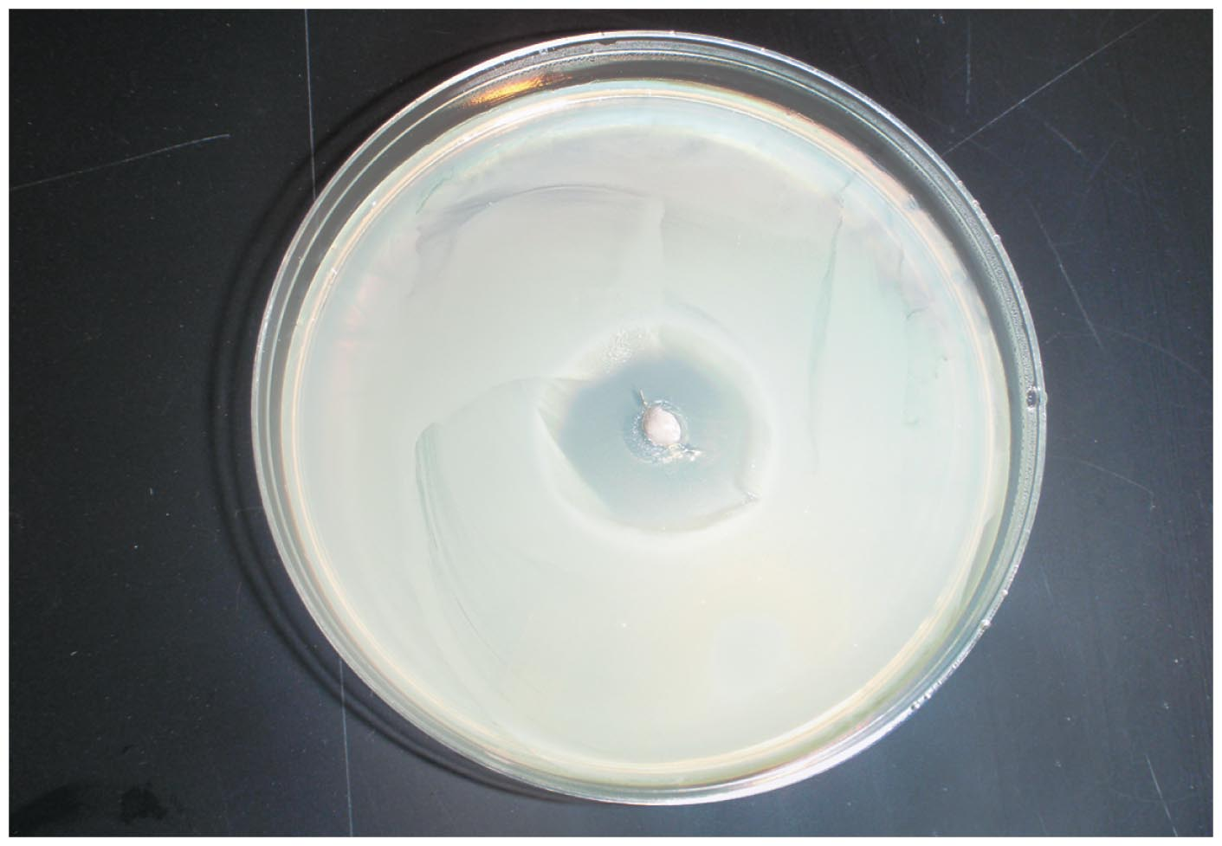
Figure 9.16 The effect of heavy-metal ions on bacterial growth.

Slide 45
Chemical Methods of Microbial Control
Aldehydes
Compounds containing terminal –CHO groups
Cross-link functional groups to denature proteins and inactivate nucleic acids
Glutaraldehyde disinfects and sterilizes
Formalin used in embalming and in disinfection of rooms and instruments

Slide 46
Chemical Methods of Microbial Control
Gaseous Agents
Microbicidal and sporicidal gases used in closed chambers to sterilize items
Denature proteins and DNA by cross-linking functional groups
Used in hospitals and dental offices
Disadvantages
Can be hazardous to people
Often highly explosive
Extremely poisonous
Potentially carcinogenic

Slide 47
Chemical Methods of Microbial Control
Enzymes
Antimicrobial enzymes act against microorganisms
Human tears contain lysozyme
Digests peptidoglycan cell wall of bacteria
Uses of enzymes to control microbes in the environment
Lysozyme is used to reduce the number of bacteria in cheese
Prionzyme can remove prions on medical instruments

Slide 48
Chemical Methods of Microbial Control
Antimicrobials
Antibiotics and semisynthetic and synthetic chemicals
Typically are used to treat disease
Some are used for antimicrobial control outside the body

Slide 49
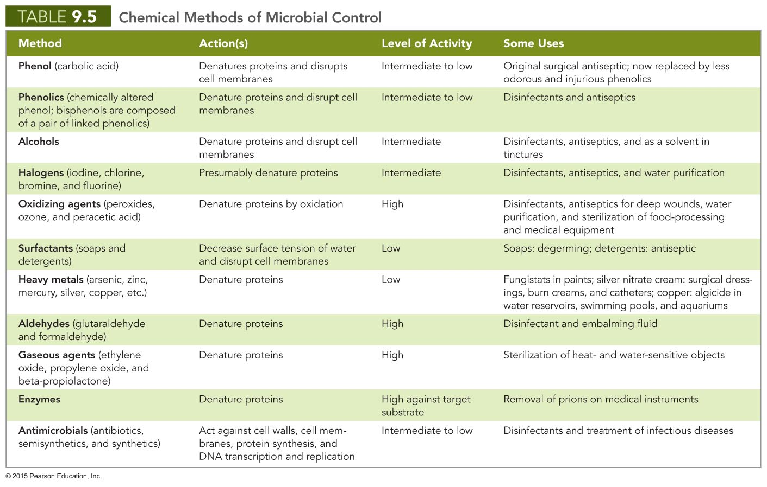

Slide 50
Chemical Methods of Microbial Control
Methods for Evaluating Disinfectants and Antiseptics
Phenol coefficient
Evaluates efficacy of disinfectants and antiseptics
Compares to phenol an agent's ability to control microbes
Greater than 1.0 indicates agent is more effective than phenol
Has been replaced by newer methods

Slide 51
Chemical Methods of Microbial Control
Methods for Evaluating Disinfectants and Antiseptics
Use-dilution test
Metal cylinders dipped into broth cultures of bacteria
Contaminated cylinder immersed into dilution of disinfectant
Cylinders removed, washed, and placed into tube of medium
Most effective agents entirely prevent growth at highest dilution
Current standard test in the U.S.
New standard procedure being developed

Slide 52
Chemical Methods of Microbial Control
Methods for Evaluating Disinfectants and Antiseptics
In-use test
Swabs taken from objects before and after application of disinfectant or antiseptic
Swabs inoculated into growth medium and incubated
Medium monitored for growth
Accurate determination of proper strength and application procedure for each specific situation

Slide 53
Chemical Methods of Microbial Control
Development of Resistant Microbes
Little evidence that products containing antiseptic and disinfecting chemicals add to human or animal health
Use of such products promotes development of resistant microbes

